Slide 1
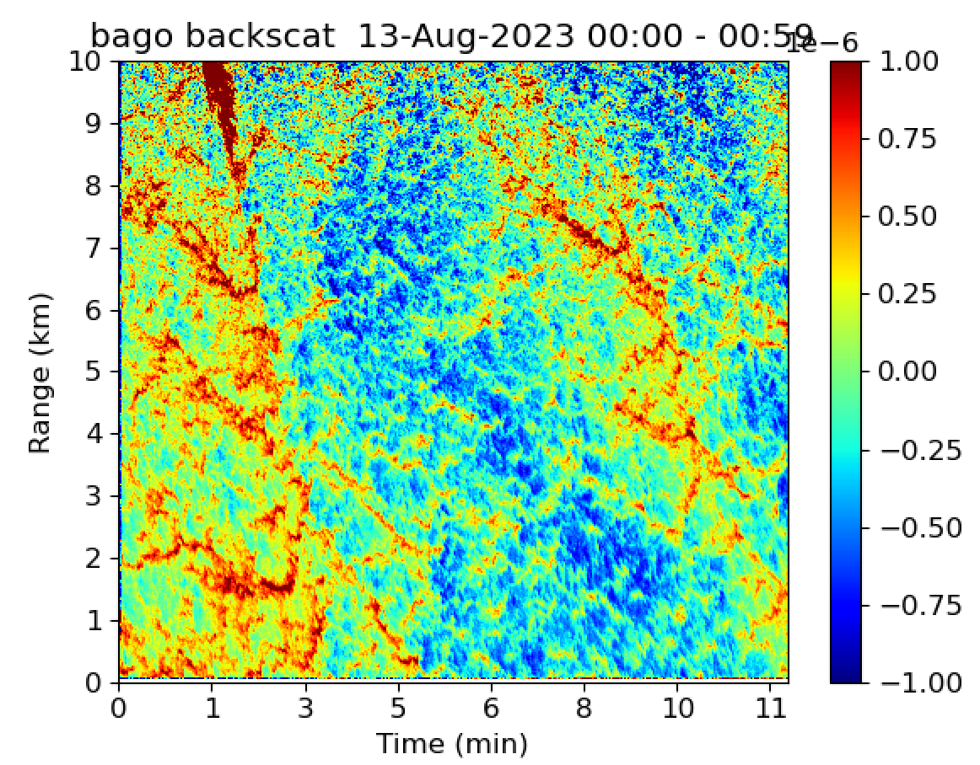
HSRL
HSRL Viewing Geometry
7.5 km
Ragged point
30 m
Lidar beam
Ocean

Slide 2
cloud
~ 1km
How is circulation organized to transfer thin
surface layer to cloud scale?
Conduction layer where heat and moisture are transferred to the air
Thickness ~ cm

Slide 3
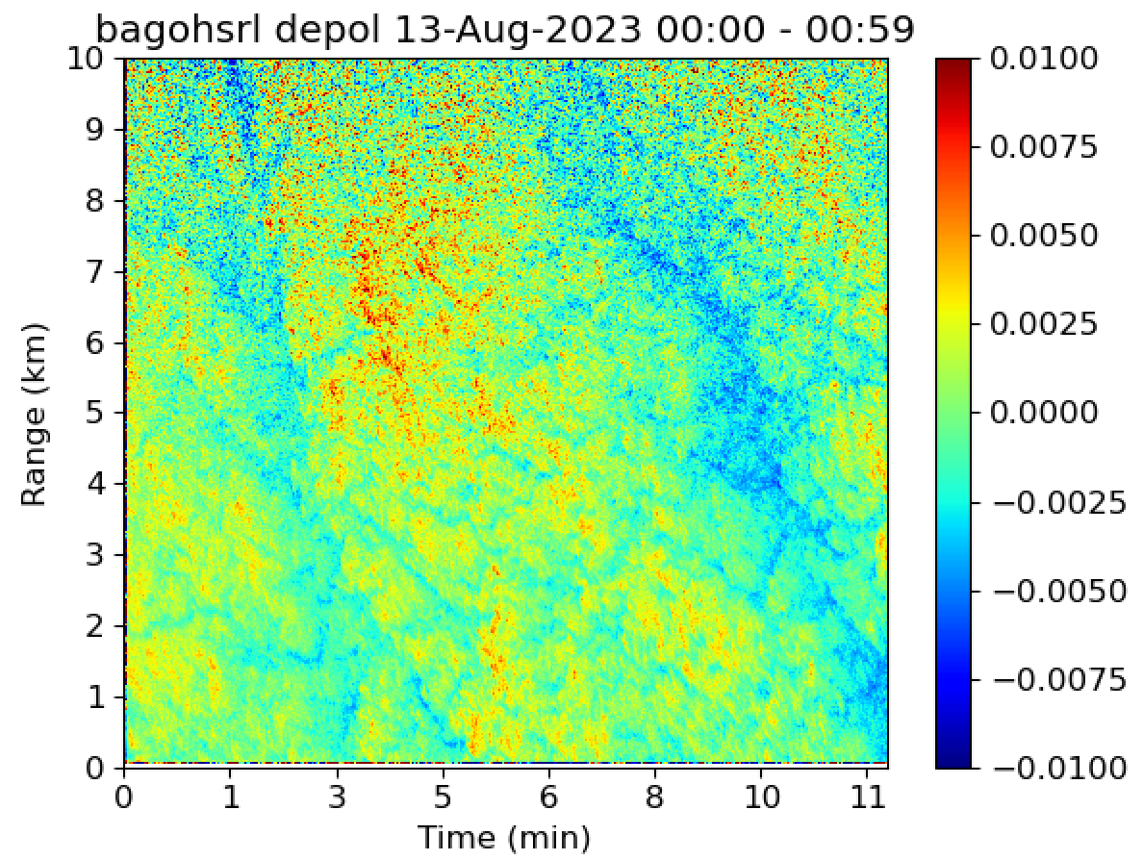

Slide 4
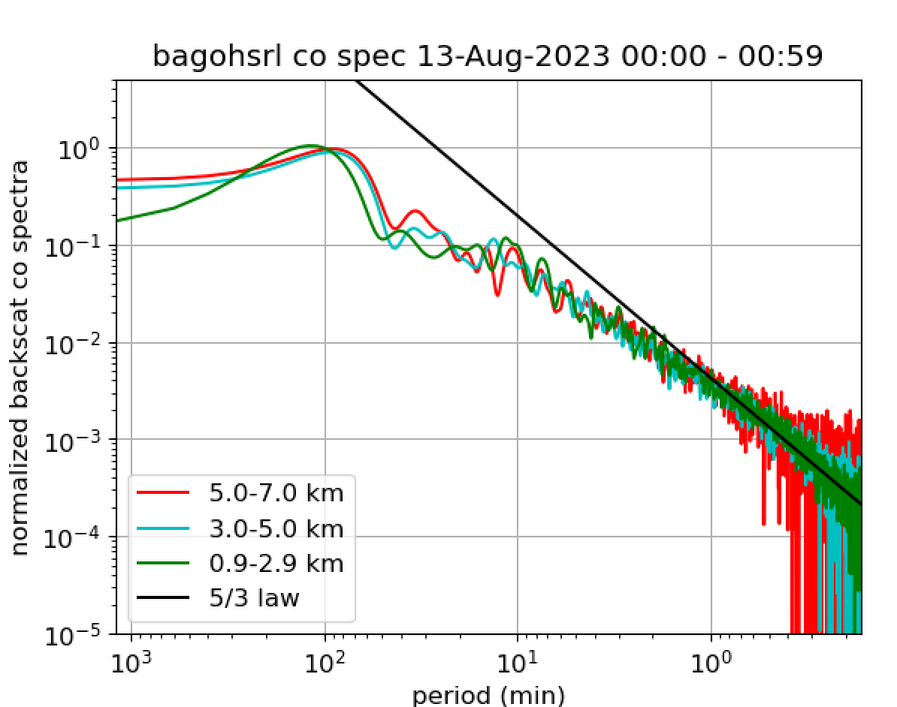

Slide 5
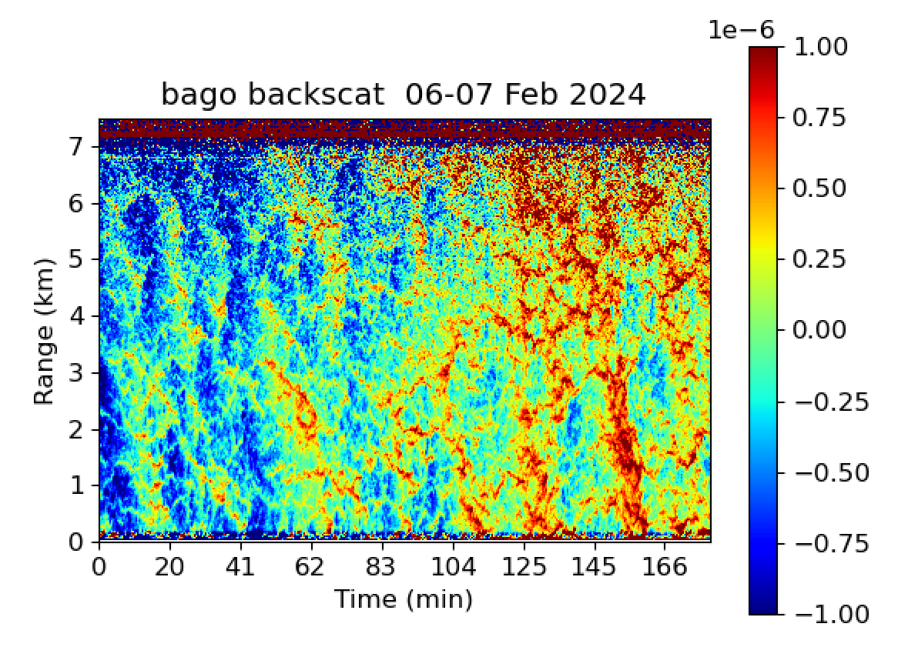
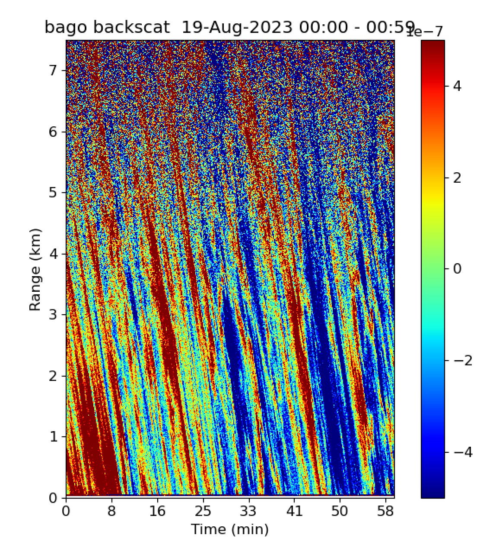
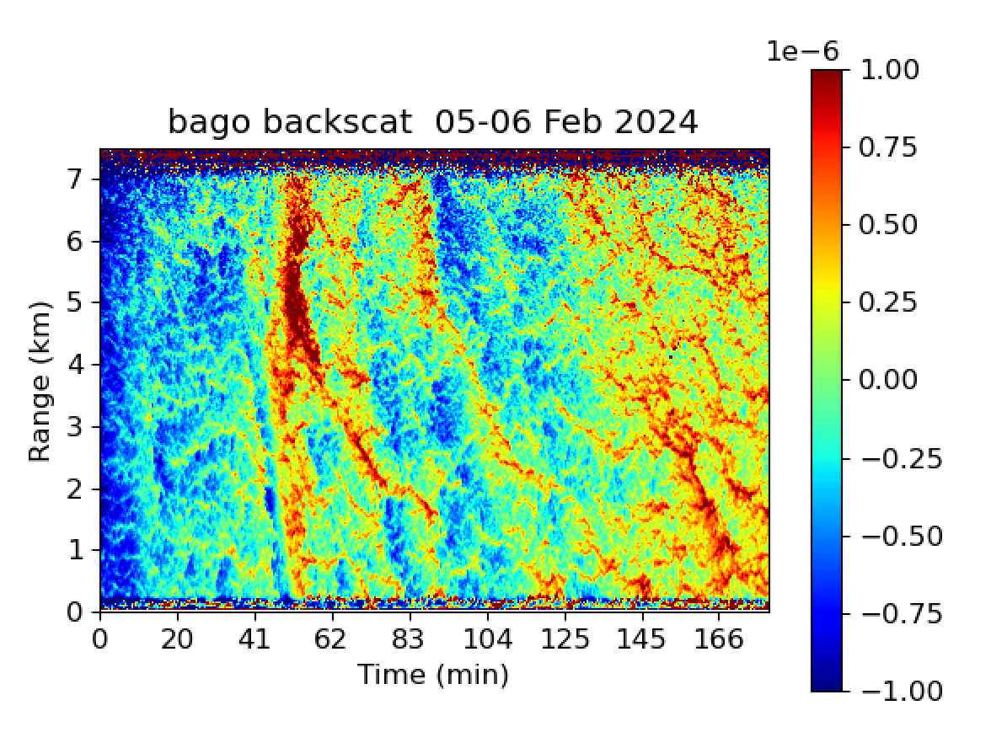
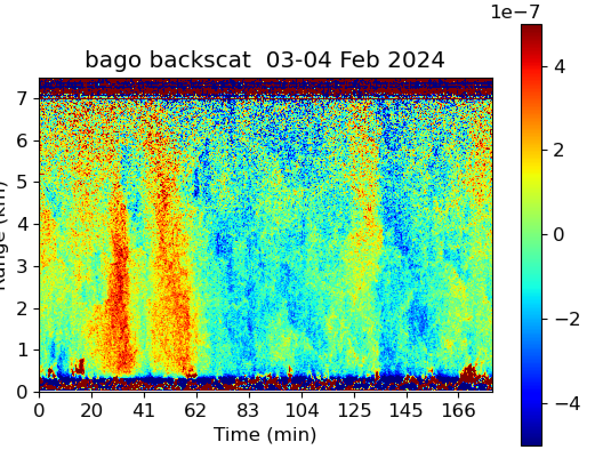
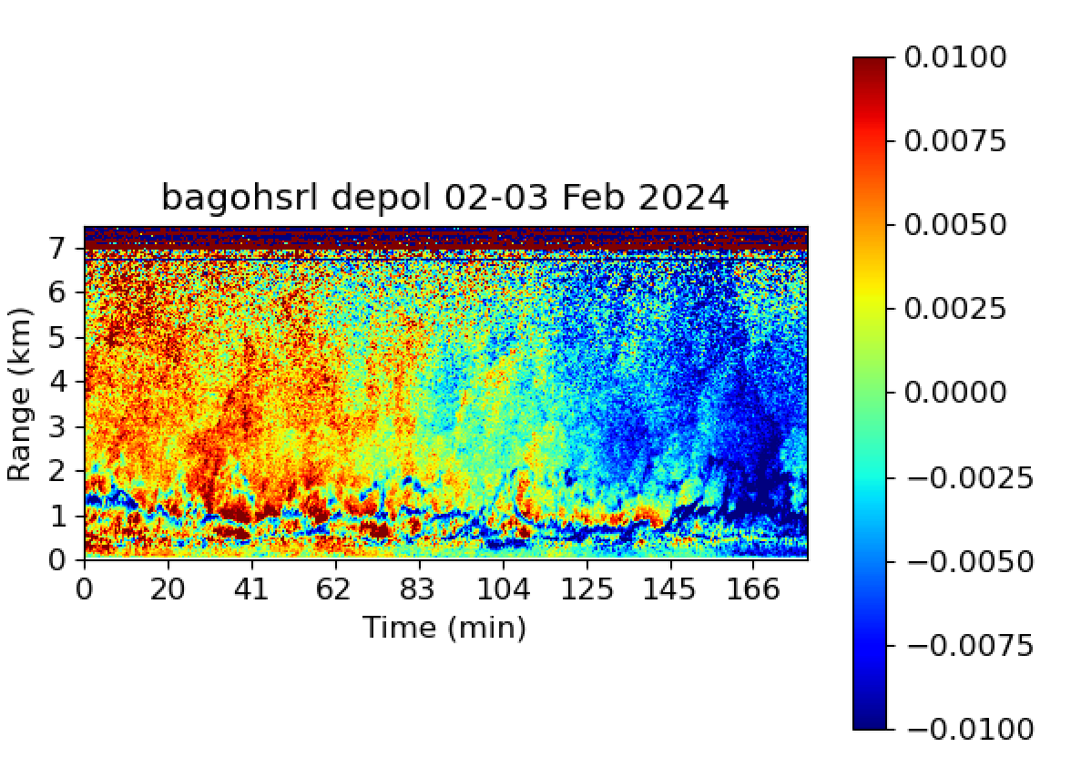
Wind 10 m/s 80 deg
Wind 9.5 m/s 59 deg
Wind 9 m/s 120 deg
Wind 8 m/s 115 deg
Wind 5.5 m/s 118 deg
Wind 3.1 m/s 143 deg

Slide 6
13-Aug 2023
Constant angle impacting ocean at 10 km

Slide 7
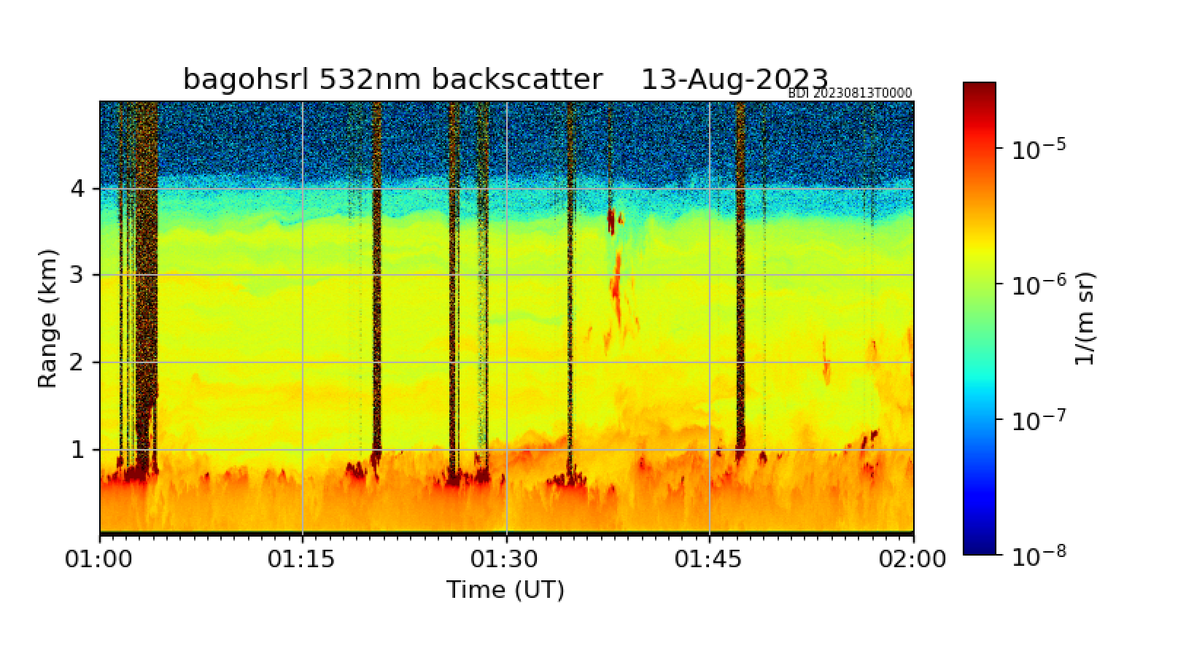

Slide 8
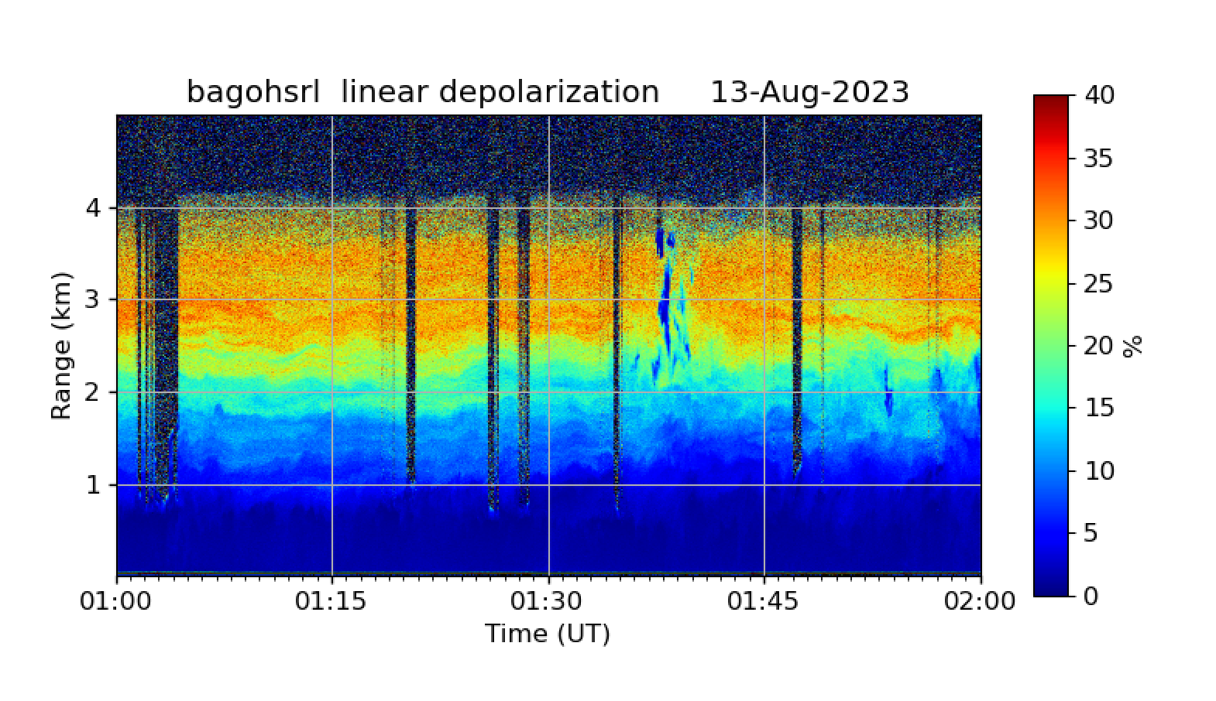

Slide 9
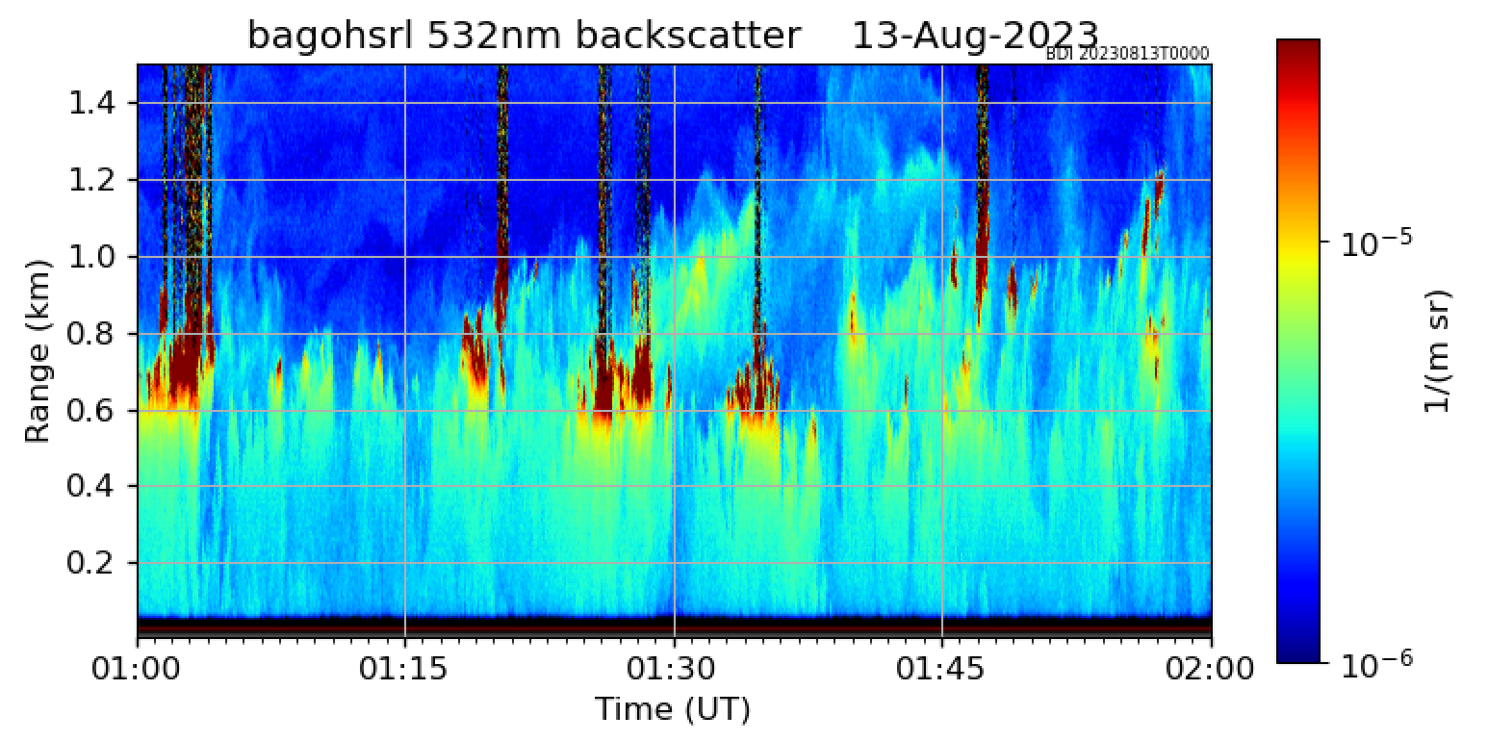
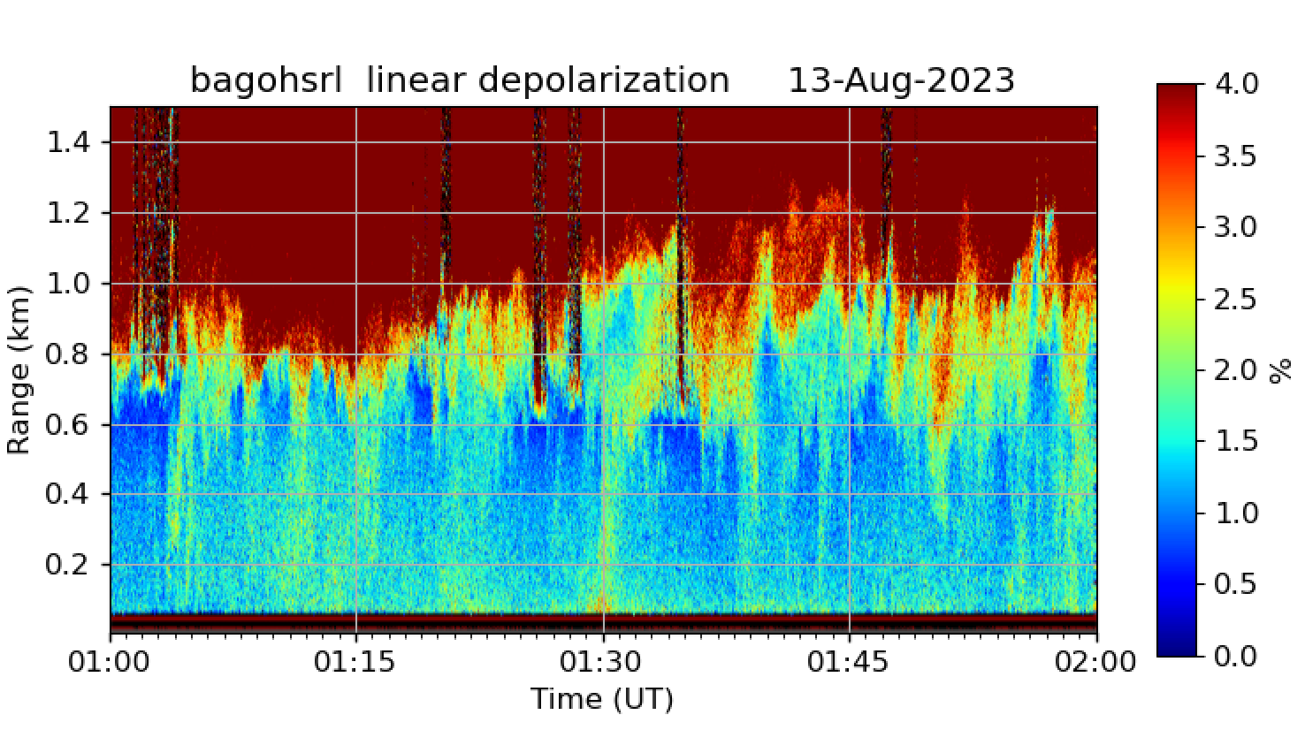

Slide 11
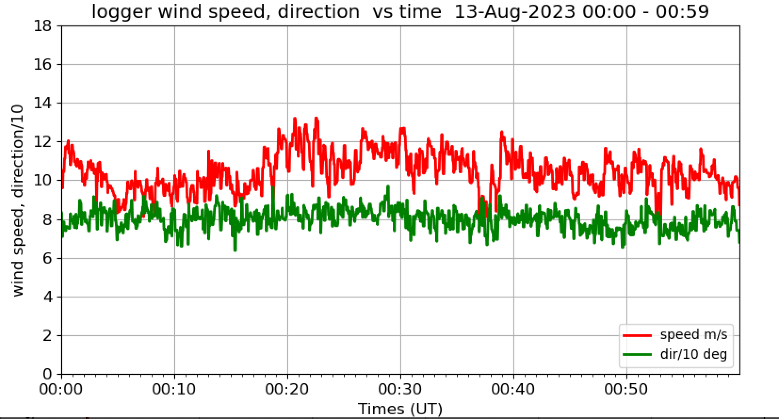

Slide 13
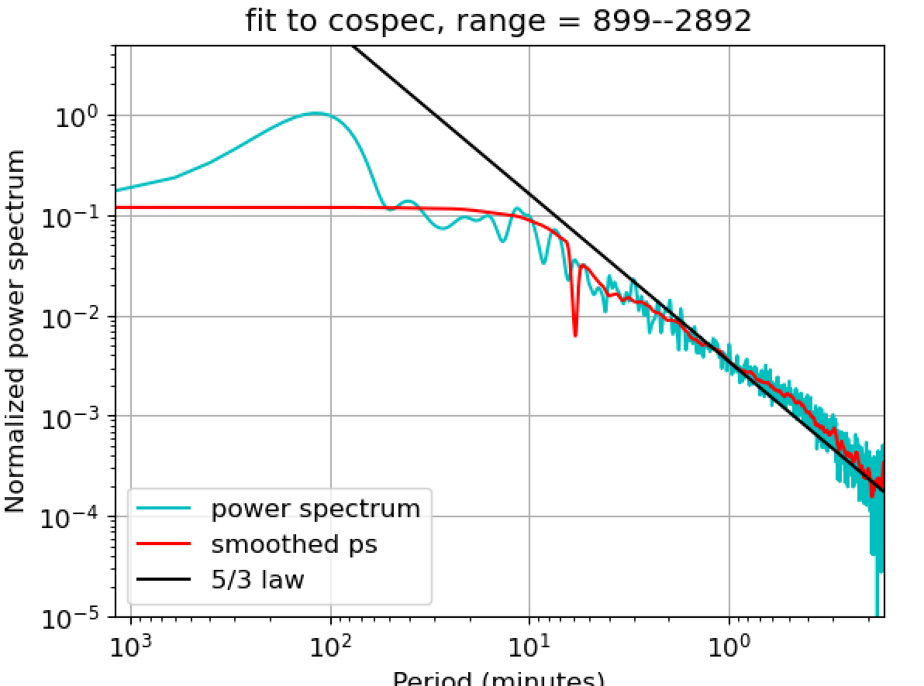

Slide 15
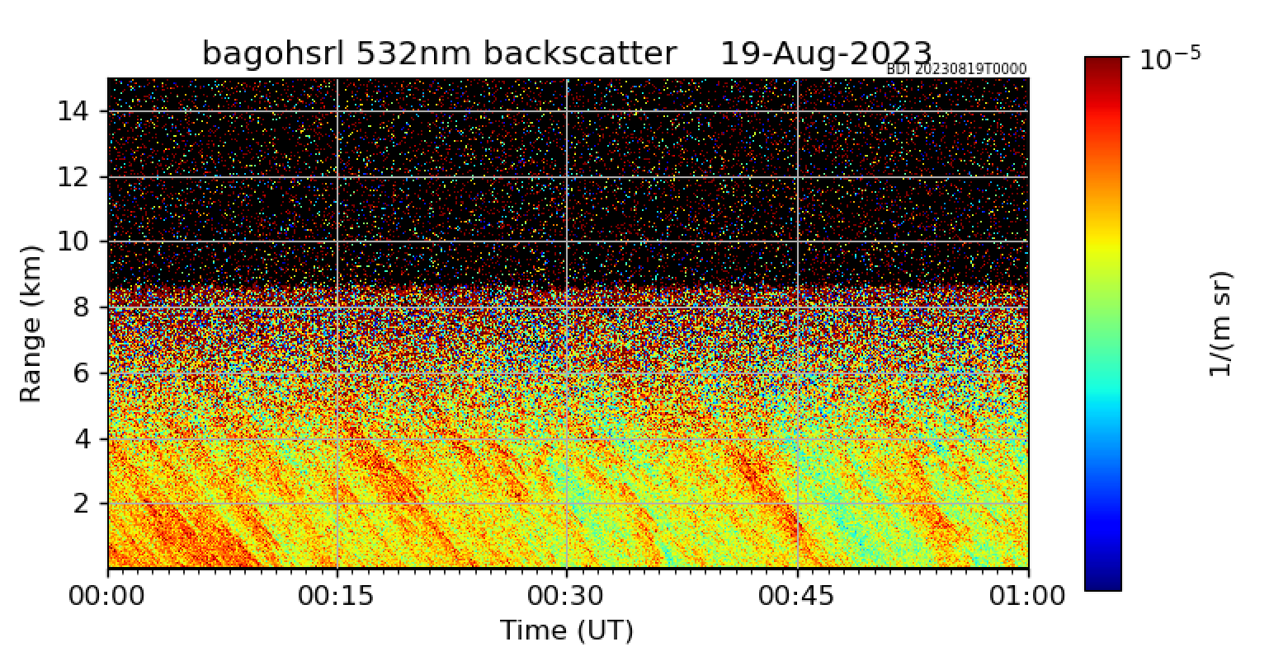

Slide 16
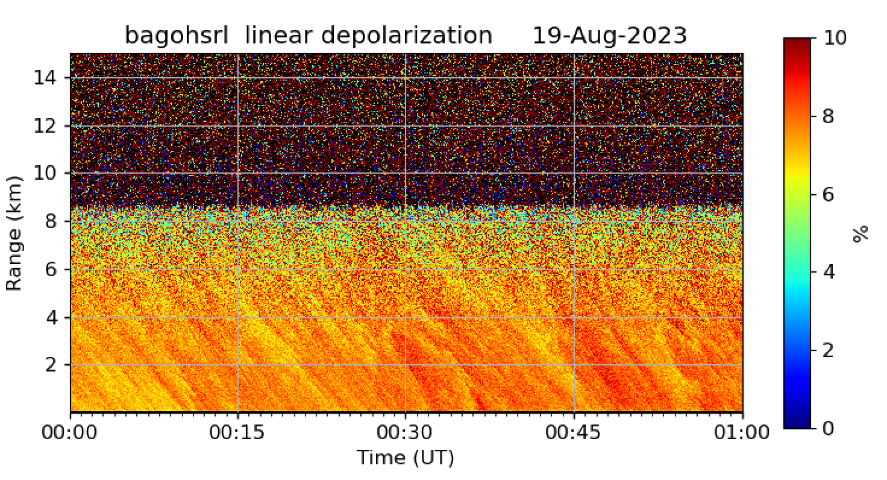

Slide 17
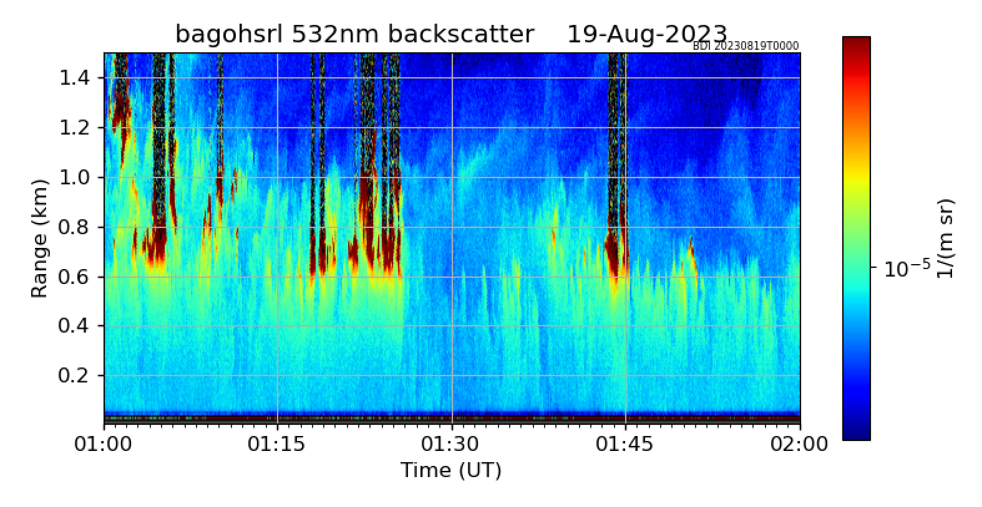

Slide 18
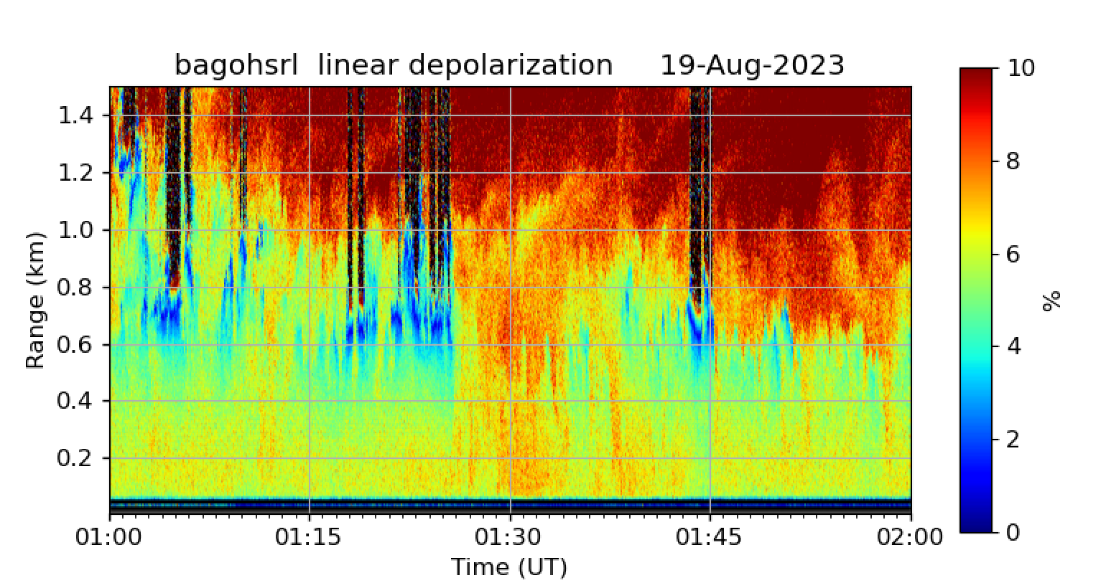

Slide 20
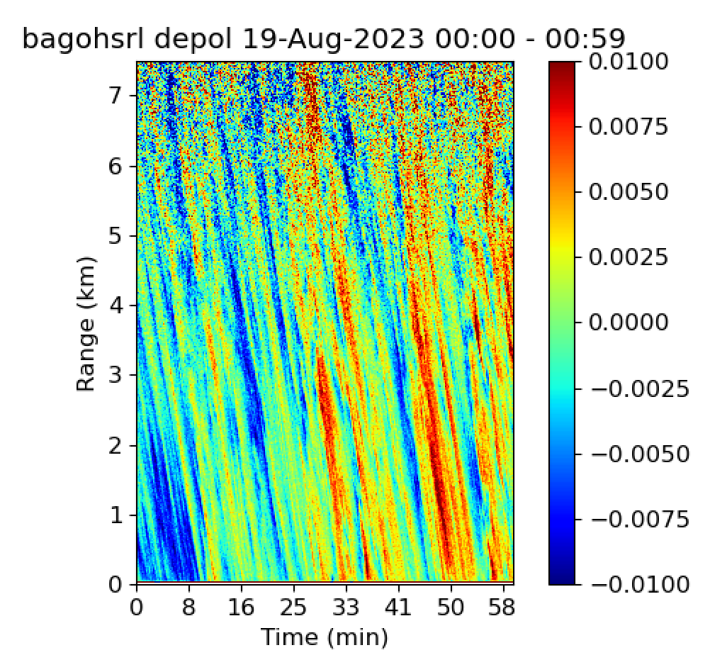

Slide 21
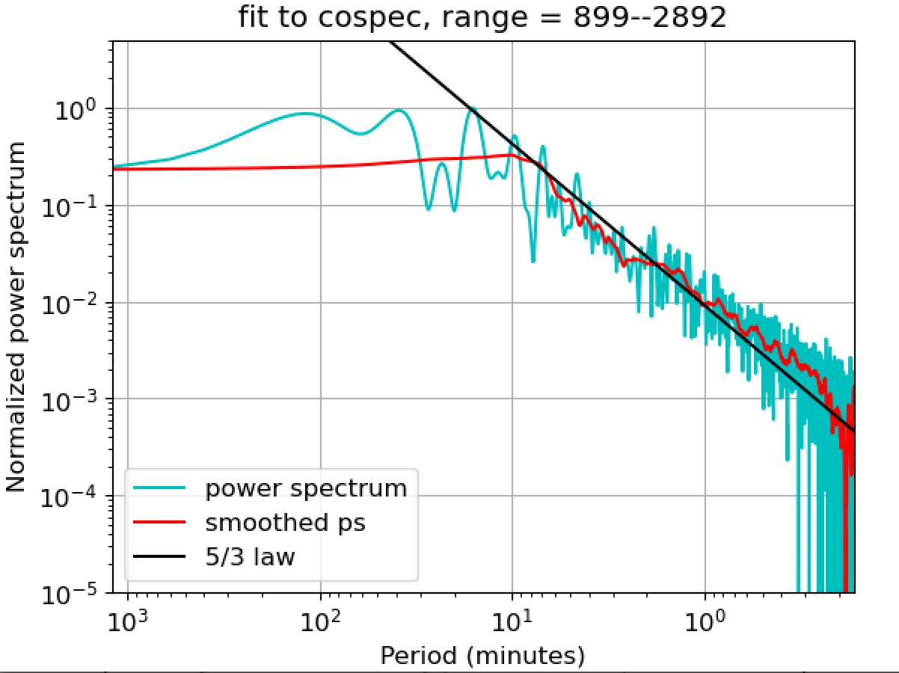

Slide 22
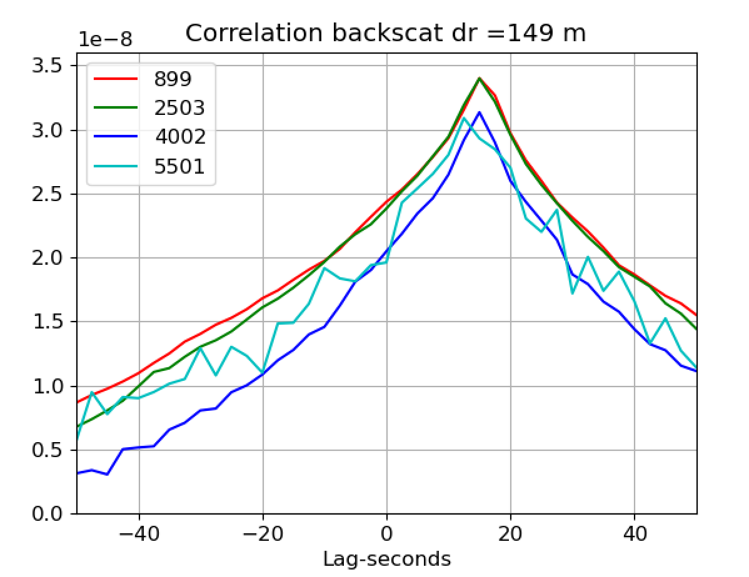

Slide 23
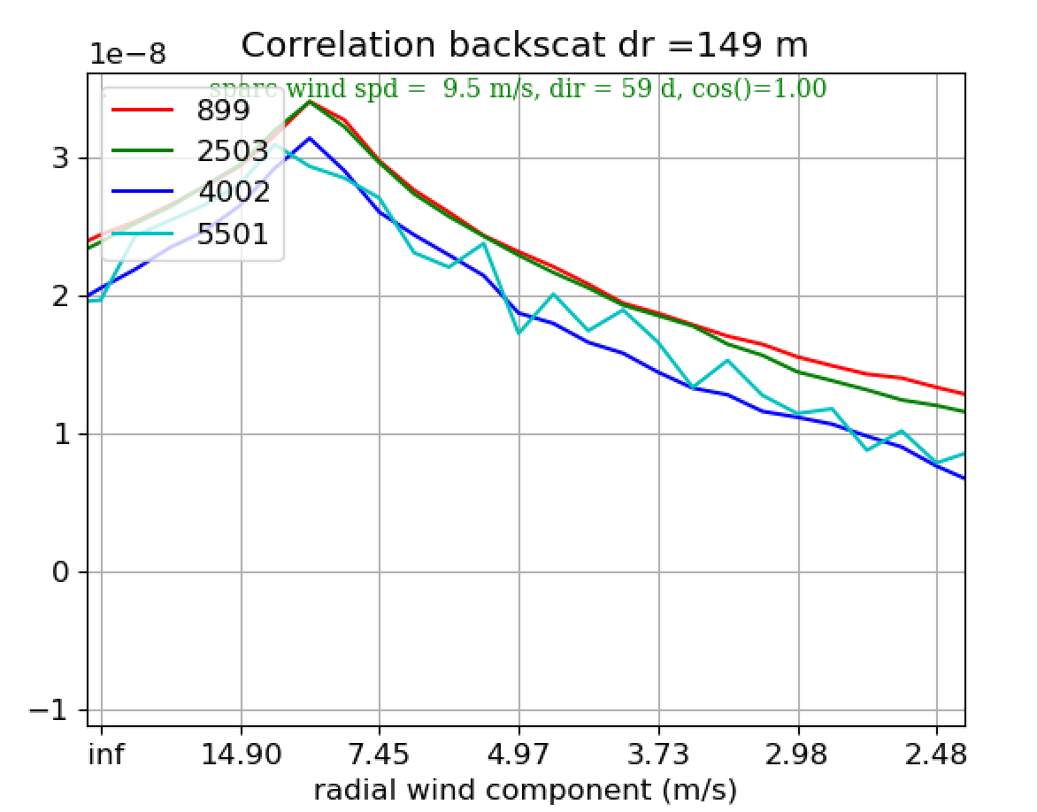

Slide 24
Feb 6-7 2024 wind 9 m/s 120 deg

Slide 26
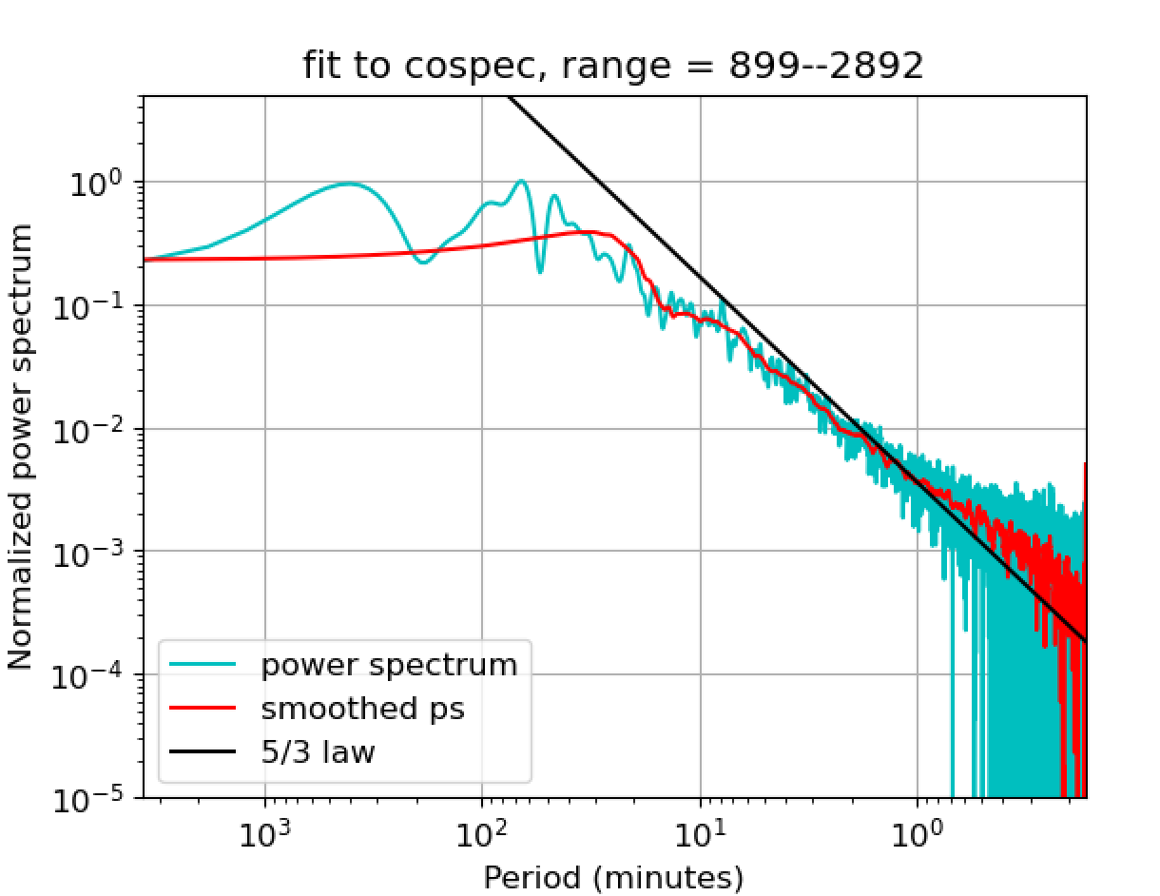

Slide 27
5-6 feb wind 8 m/s 116 deg cos(dtheta)= 0.56

Slide 28
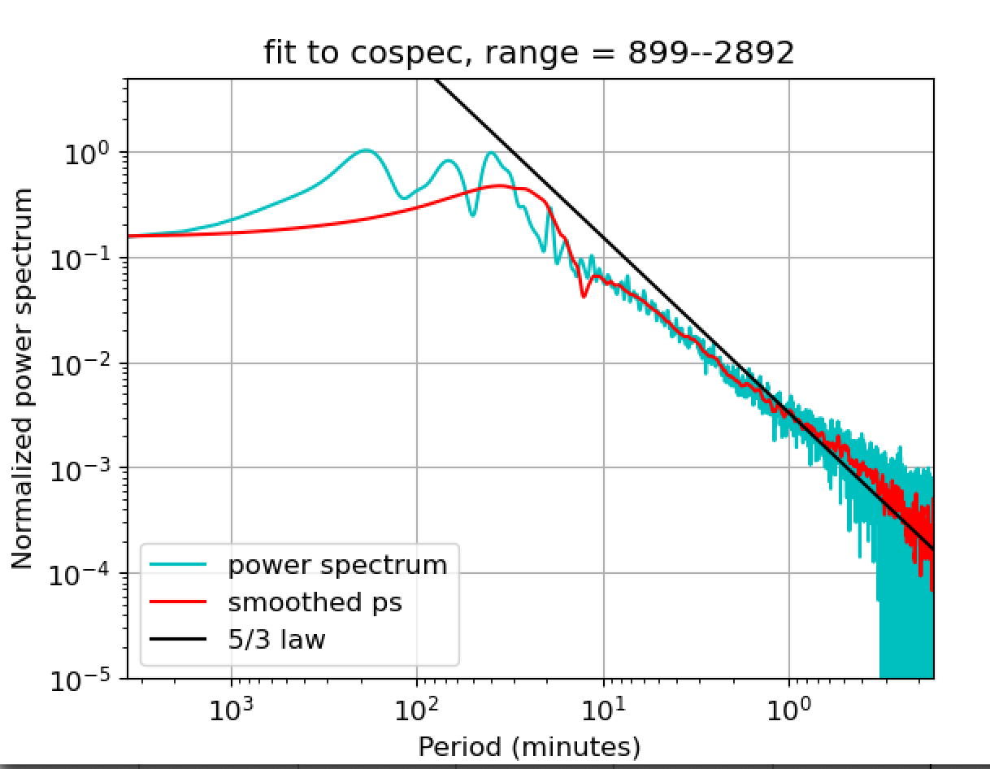

Slide 30
4-5 feb 2024, wind 5.5 m/s 118 deg

Slide 31
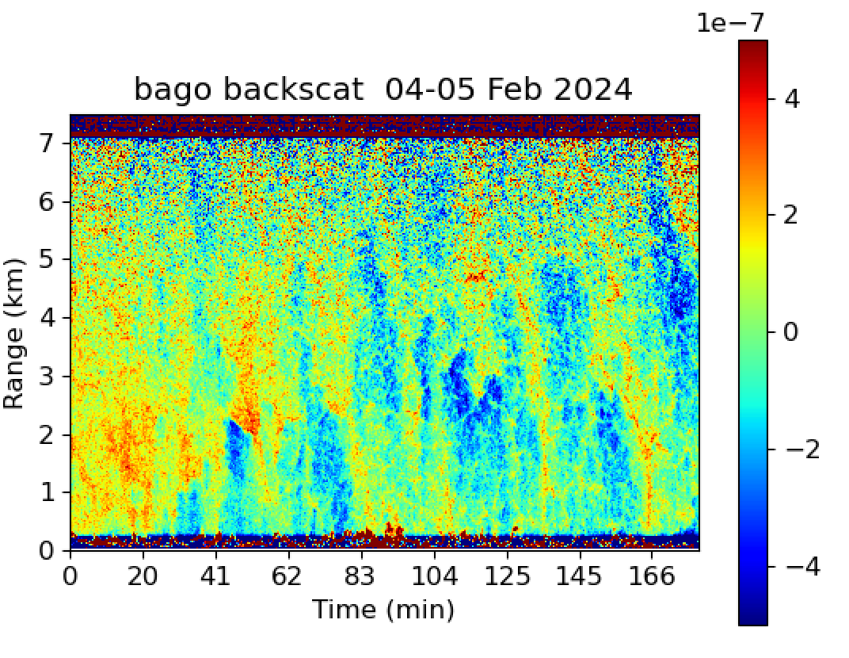

Slide 32
3-4 feb 2024, wind 4.2 m/s 127 deg cos(theta)=0.37

Slide 34
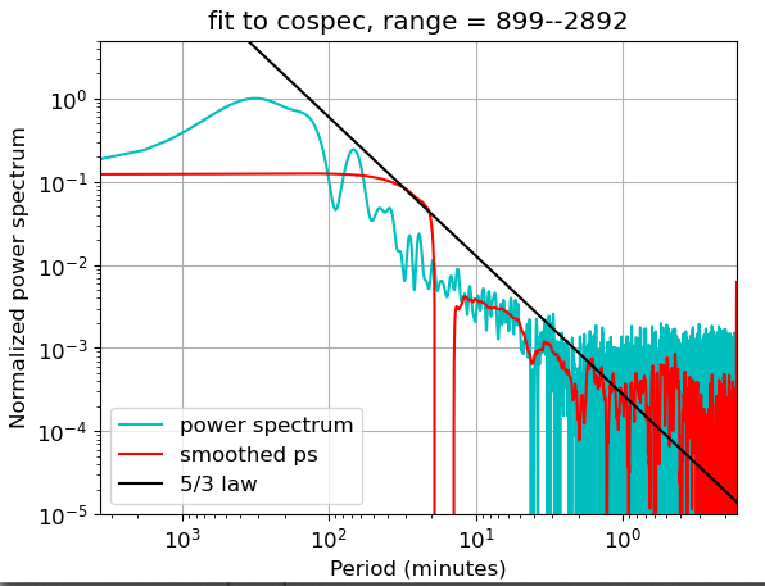

Slide 35
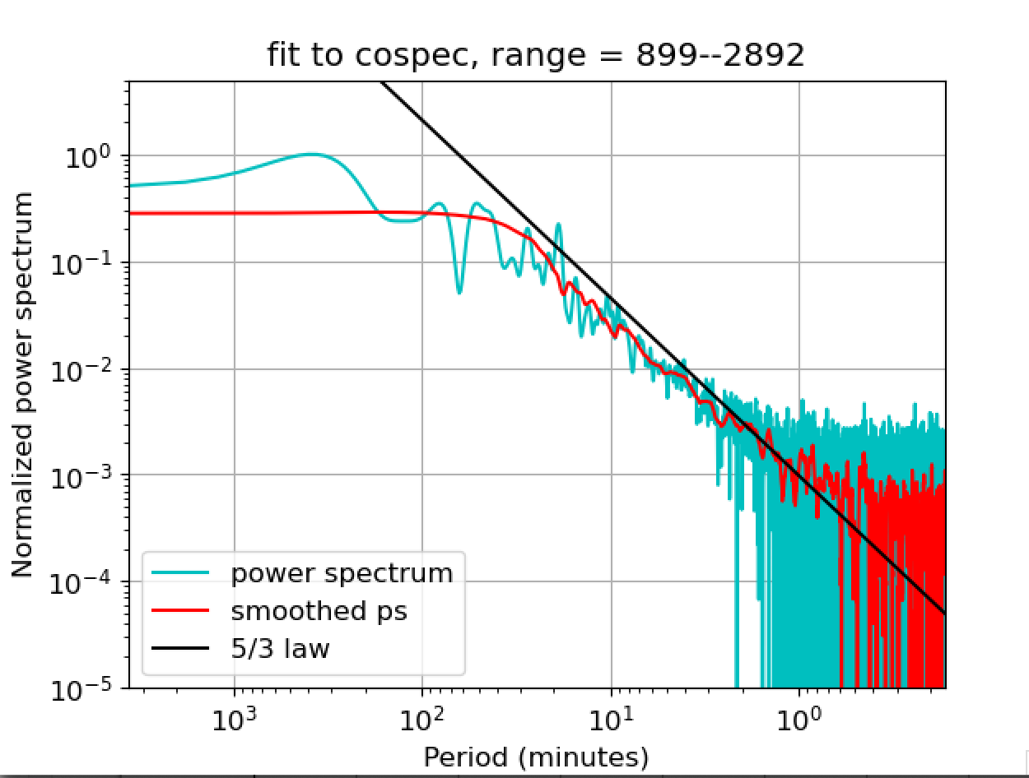

Slide 36
2-3 Feb 2024, Winds 3.1 m/s 143 deg, cos(phi)=0.11

Slide 37
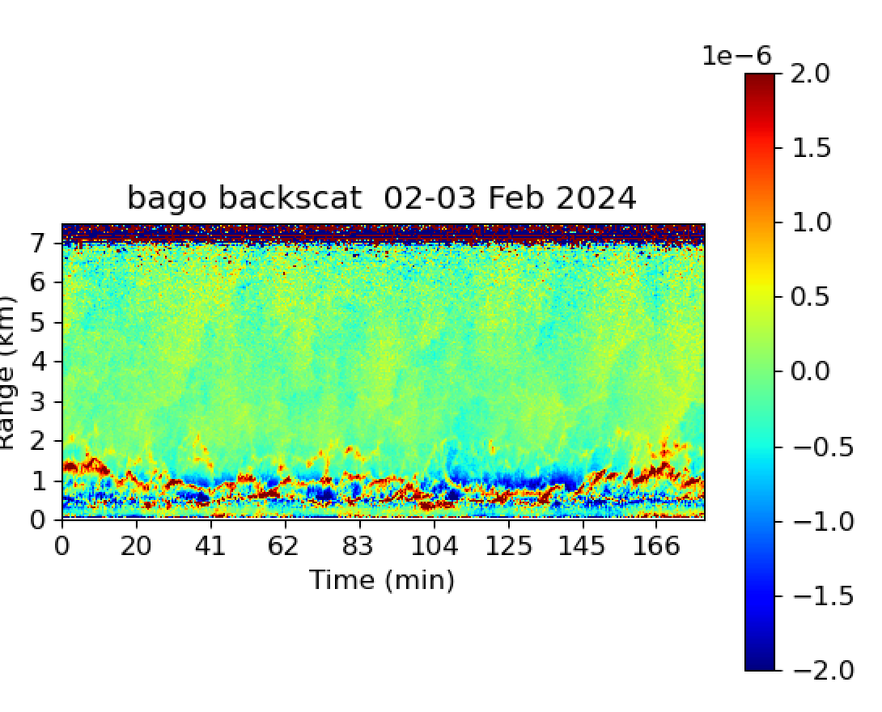

Slide 38
1e-6 1/(m sr)
%

Slide 39
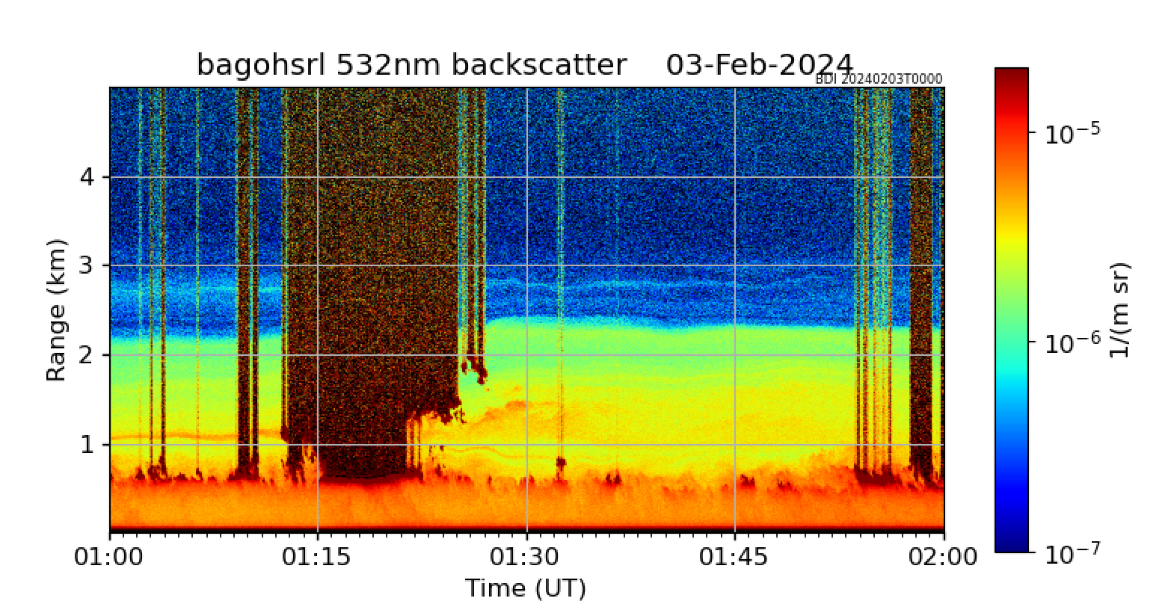
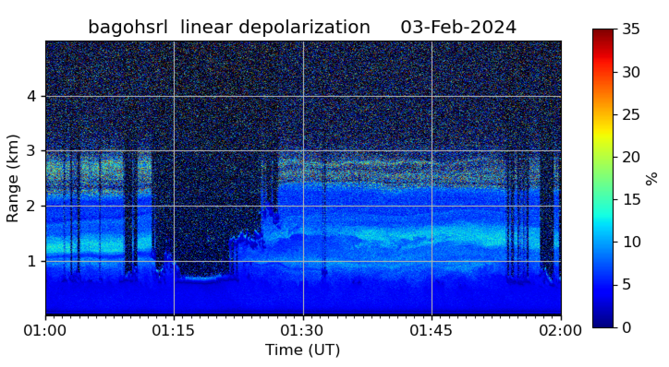

Slide 40
25 Aug 2023, Winds 1.7 m/s, 243 deg cos()= -1

Slide 41
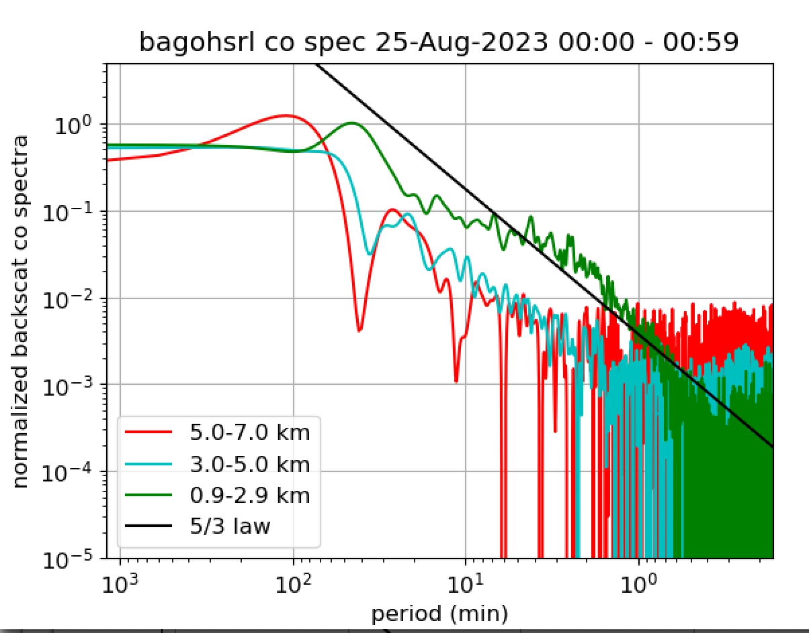

Slide 42
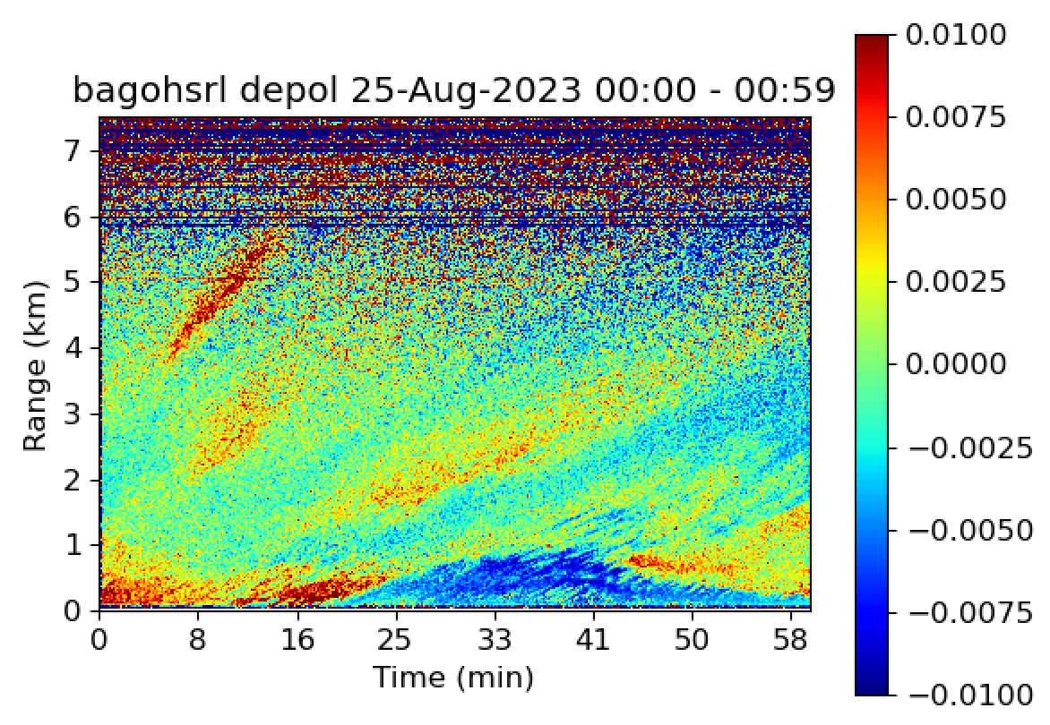

Slide 43
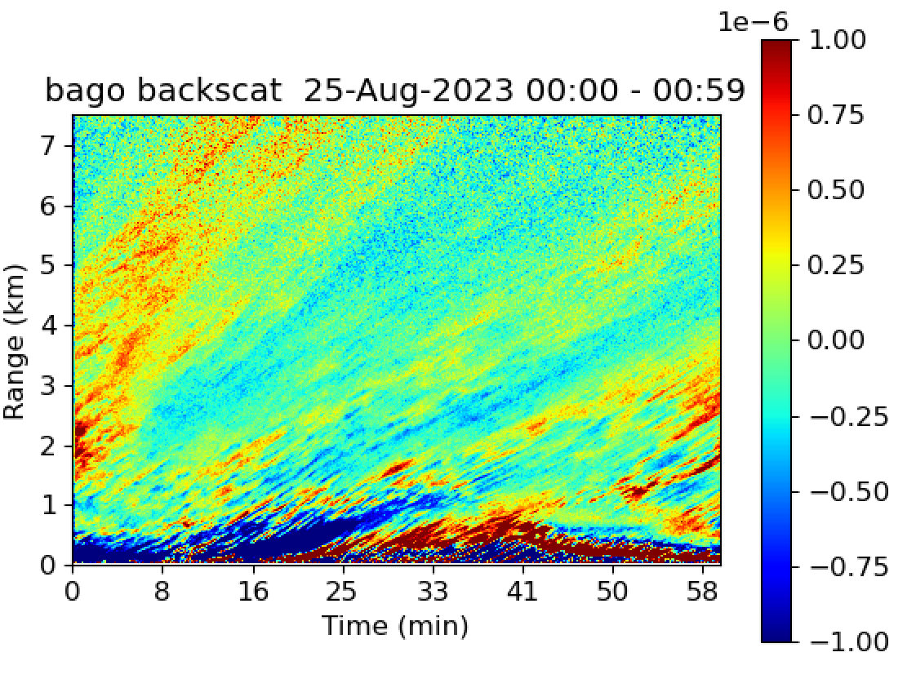

Slide 44
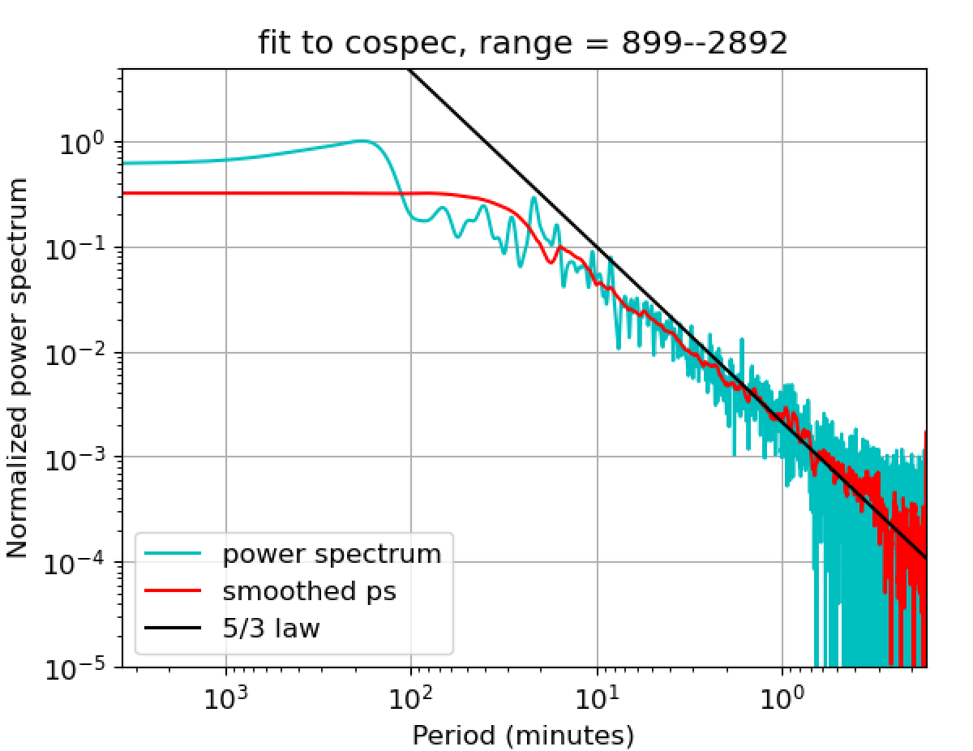

Slide 45
30-Aug-2023, Winds 8 m/s, 84 deg, cos()=0.91

Slide 46
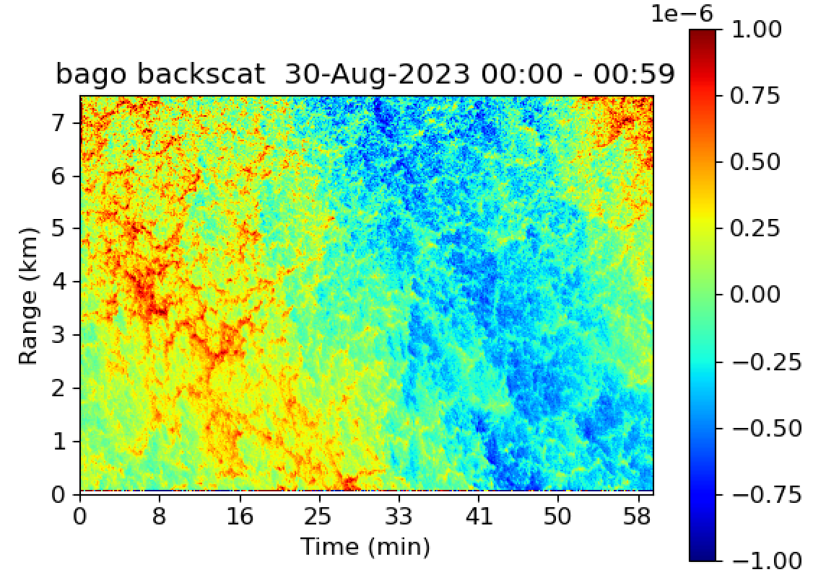

Slide 47
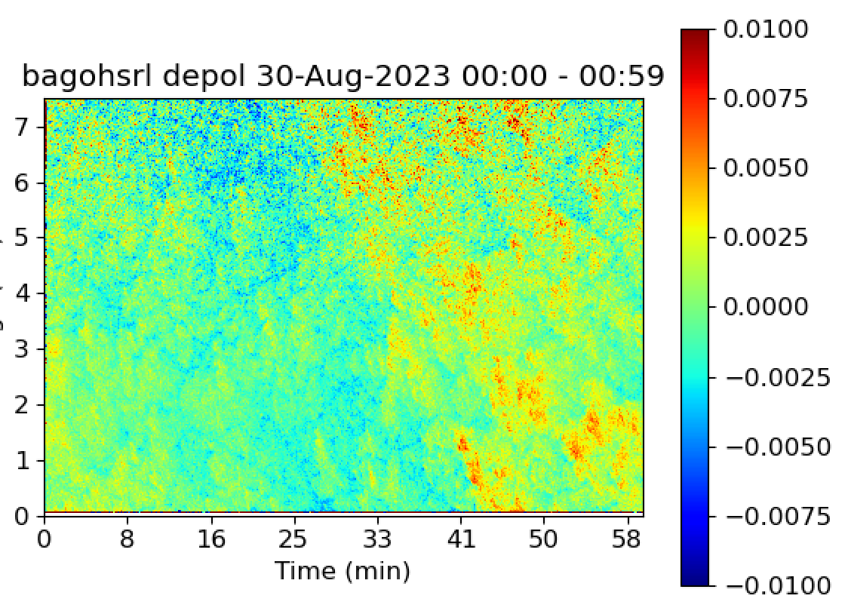

Slide 48
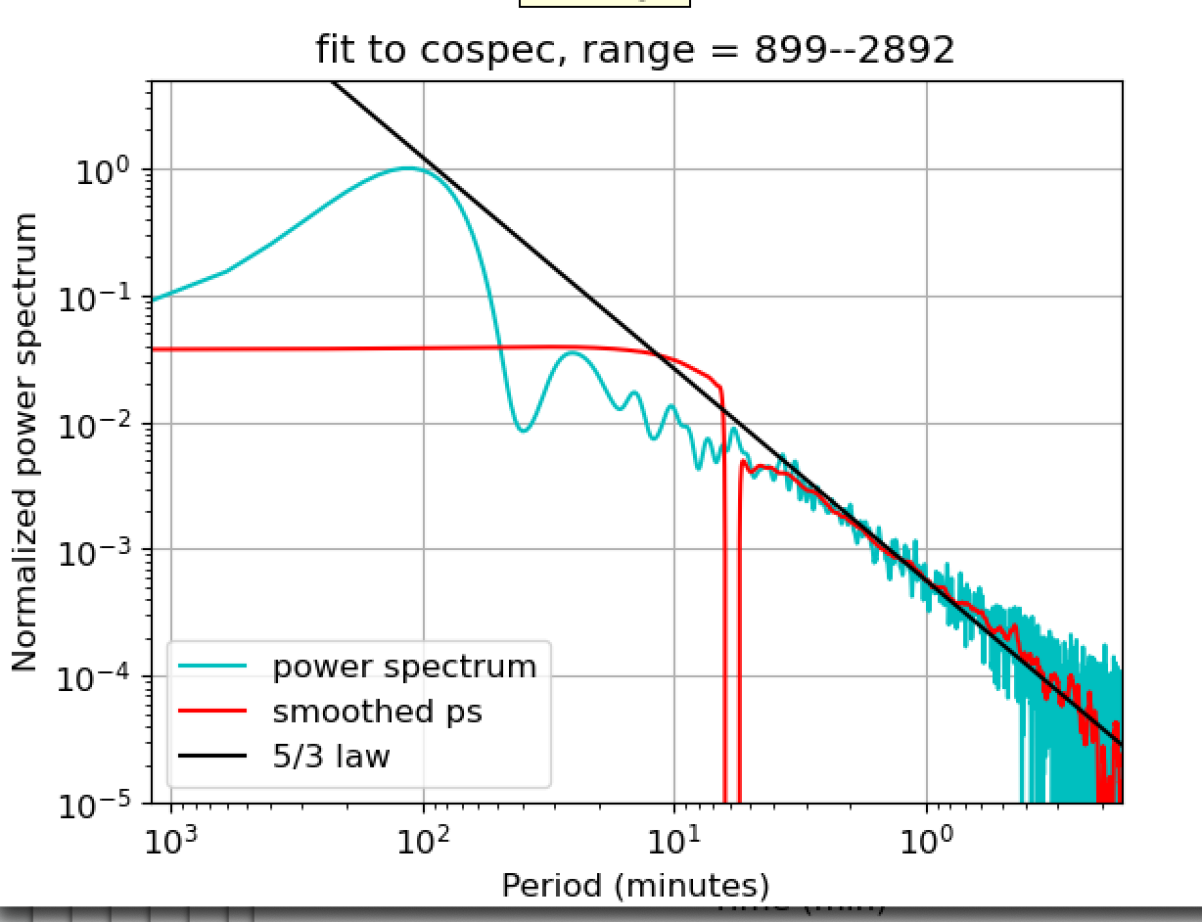

Slide 49
31-Aug_2023, Winds 7.9 m/s, 75 deg, cos()=.96

Slide 50
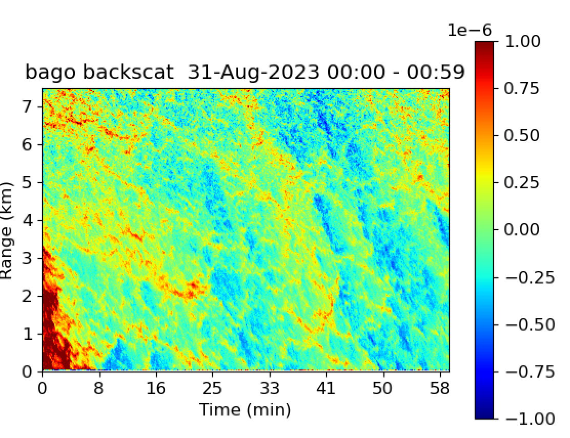

Slide 51
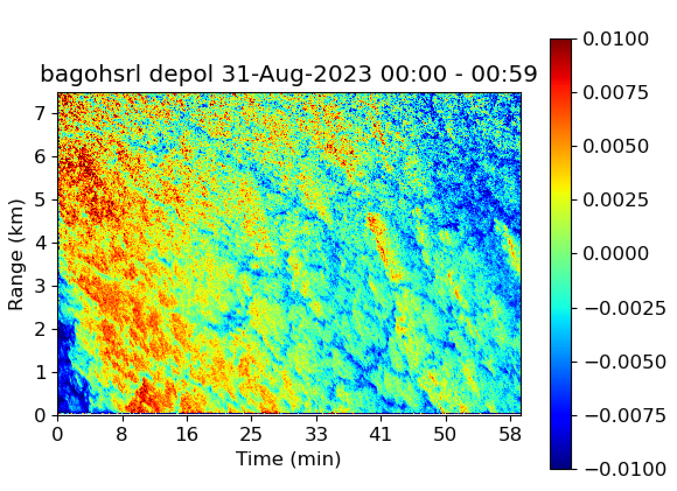

Slide 52
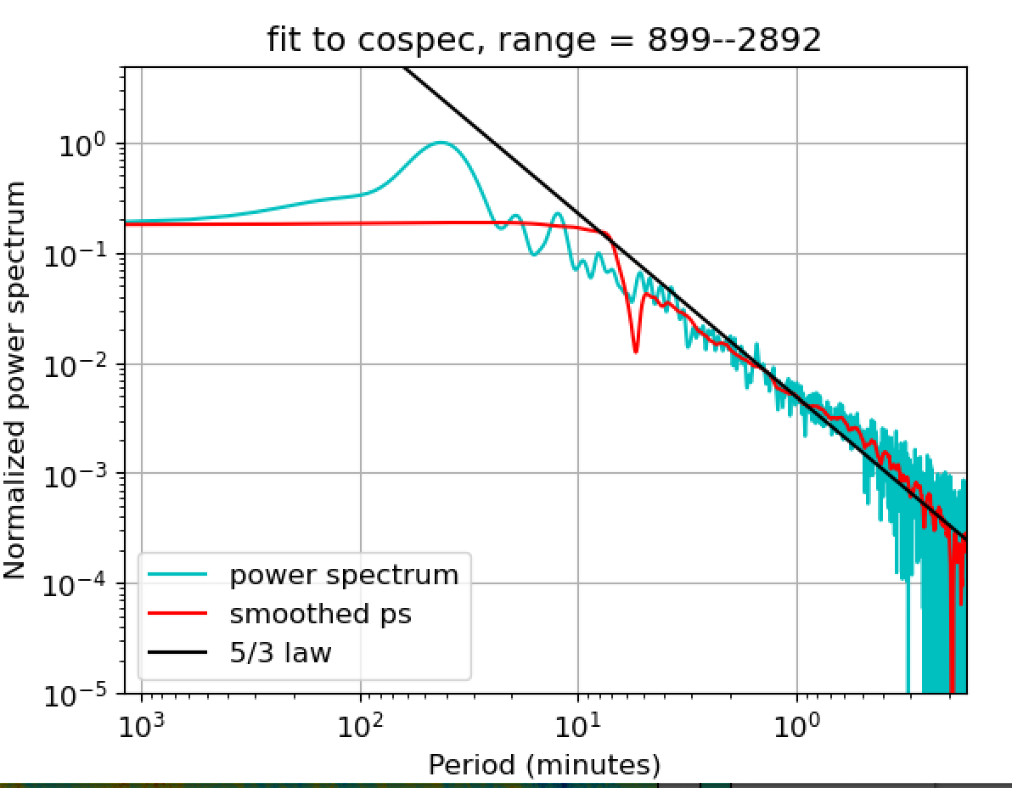

Slide 53
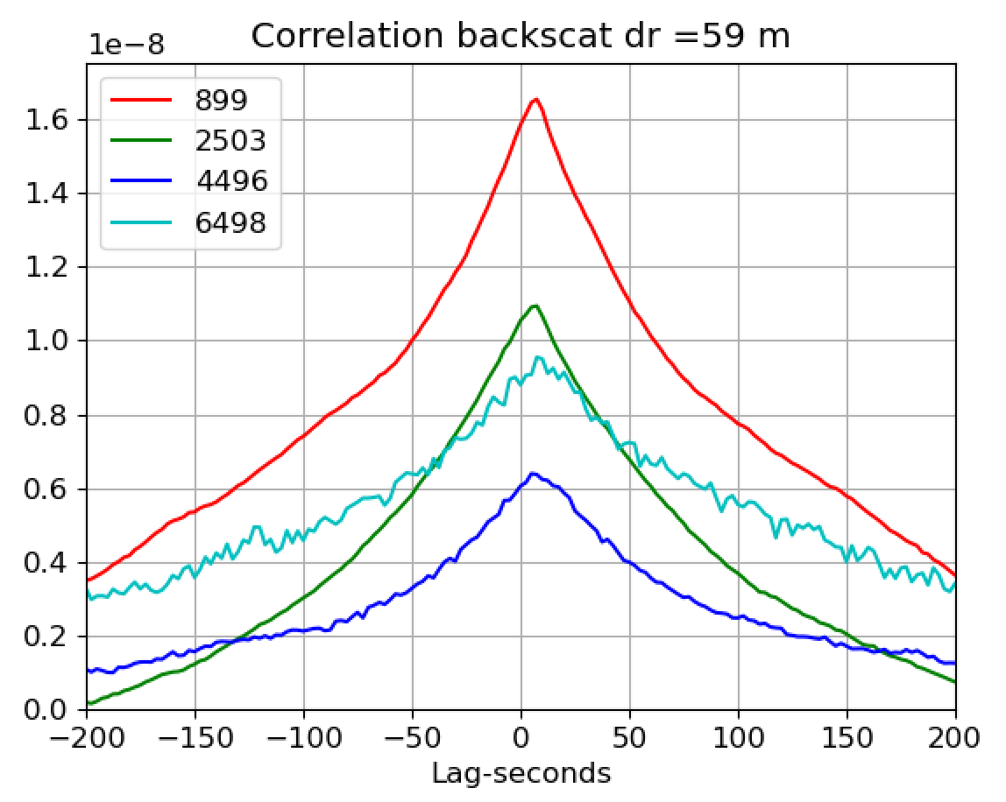
59 m / 7.2 s = 8.1 m/s

Slide 54
1-Sep-2023, Wind 8.0 m/s , 80 deg, cos() = 0.94

Slide 55
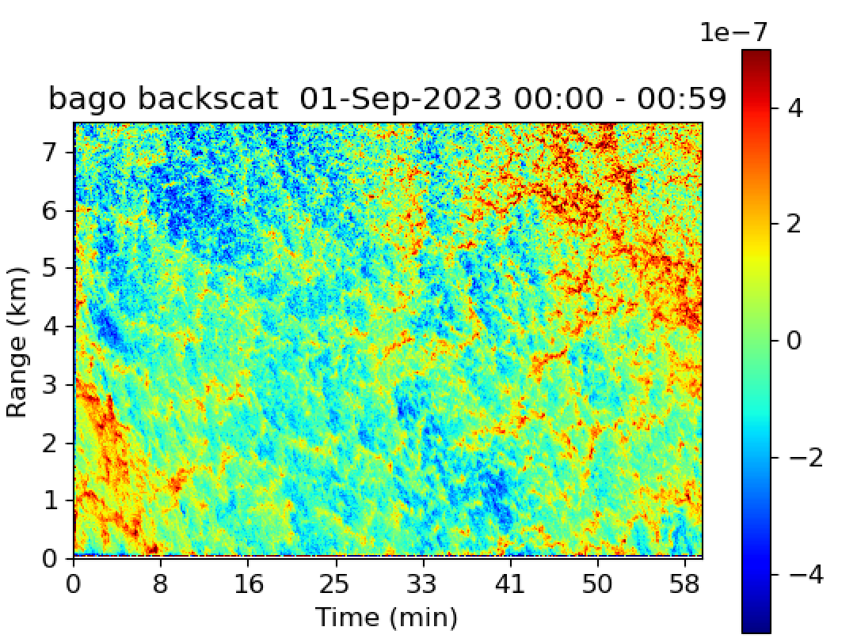

Slide 56
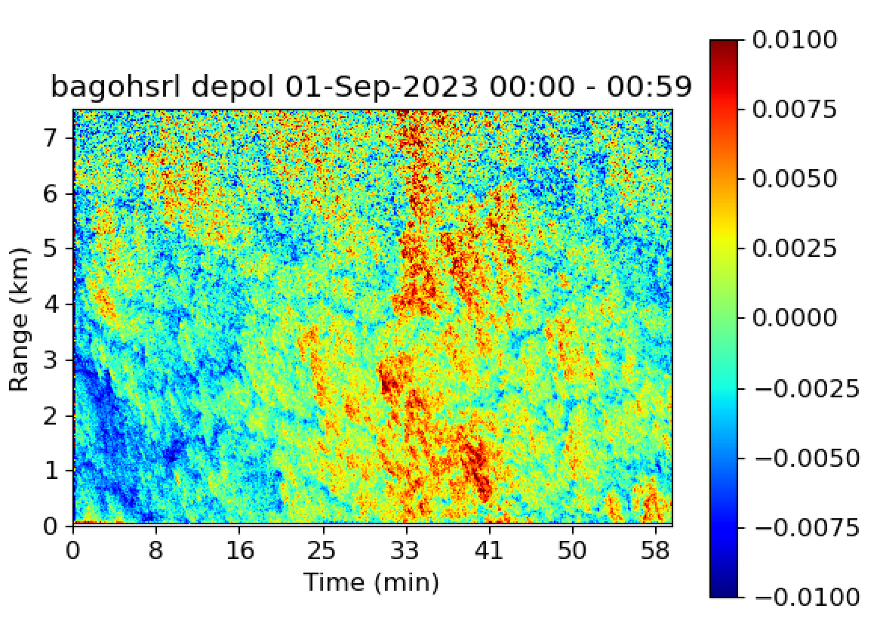

Slide 57
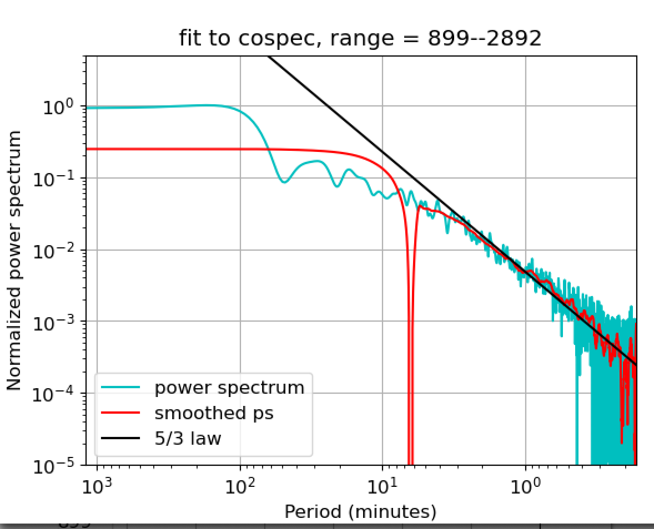

Slide 58
2-Sep-2024, Winds 6.9 m/s, 92 deg, cos() = 0.85

Slide 59
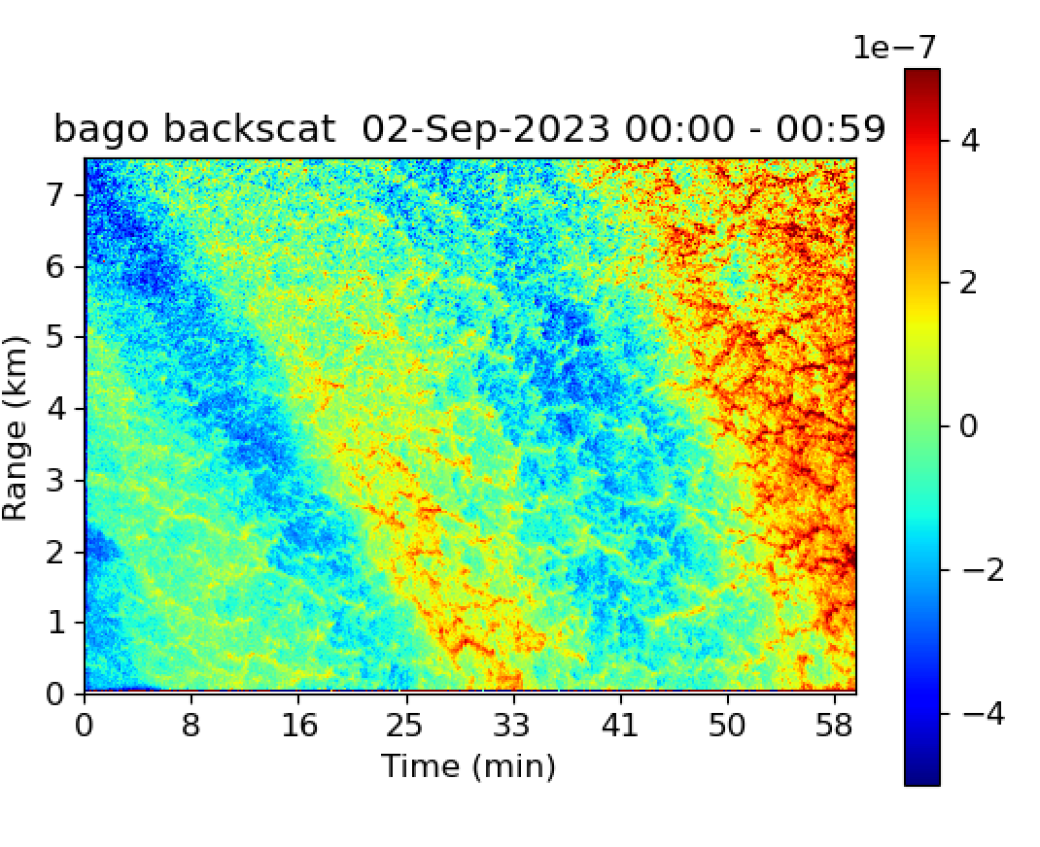

Slide 60
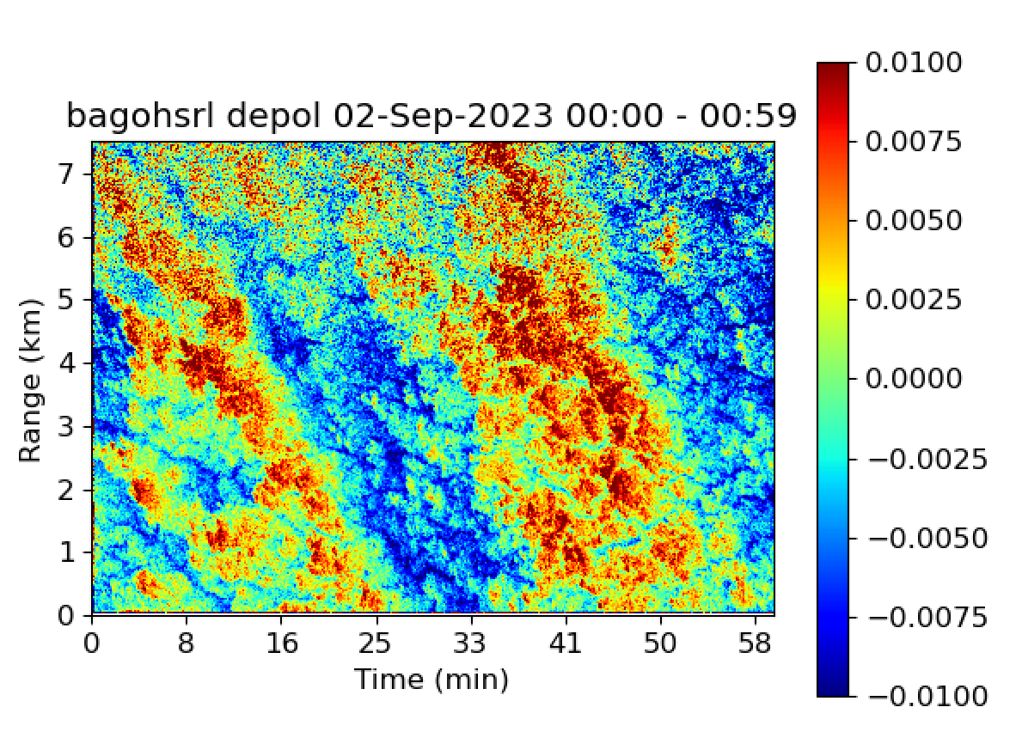

Slide 62
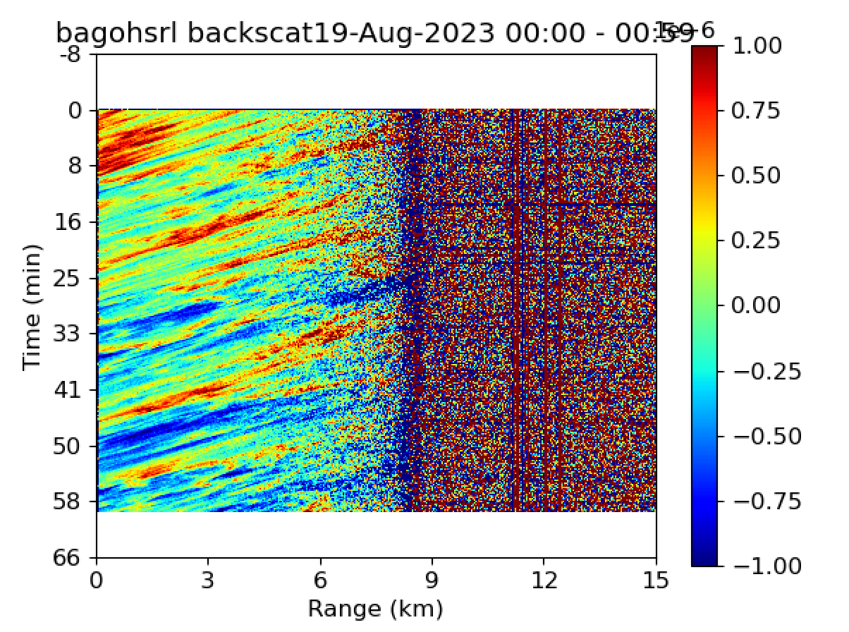

Slide 63
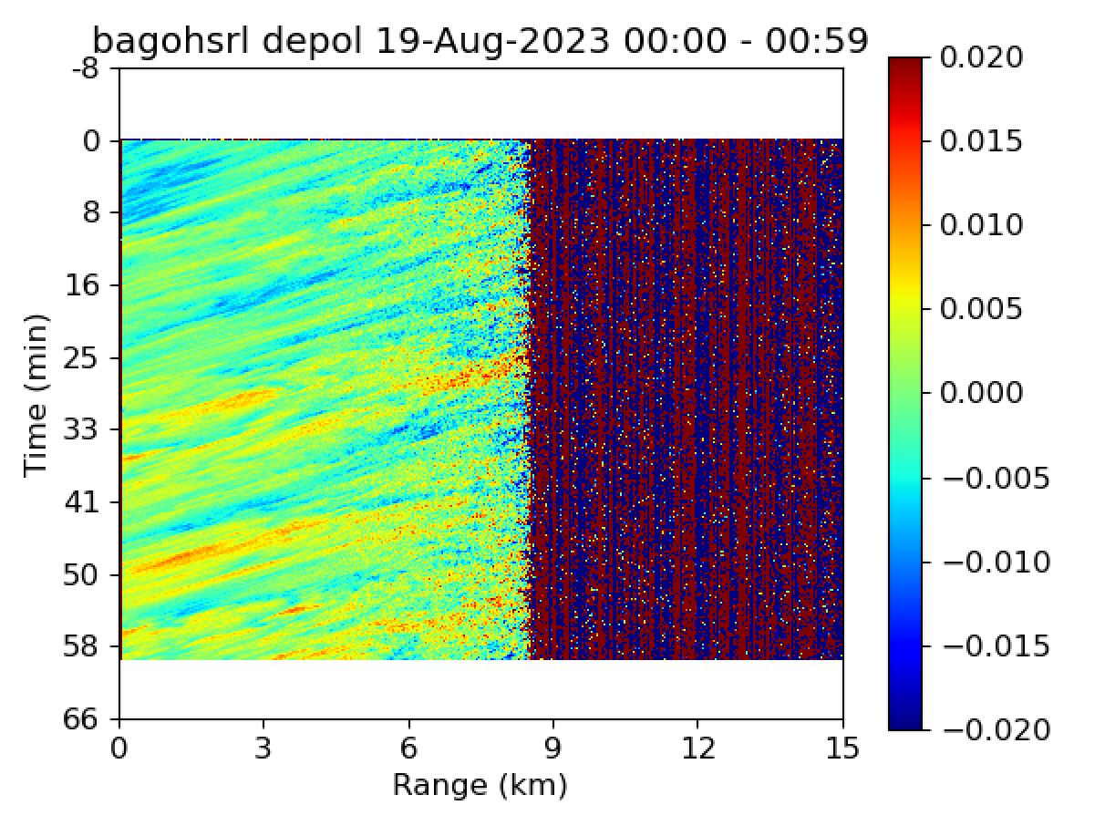

Slide 64
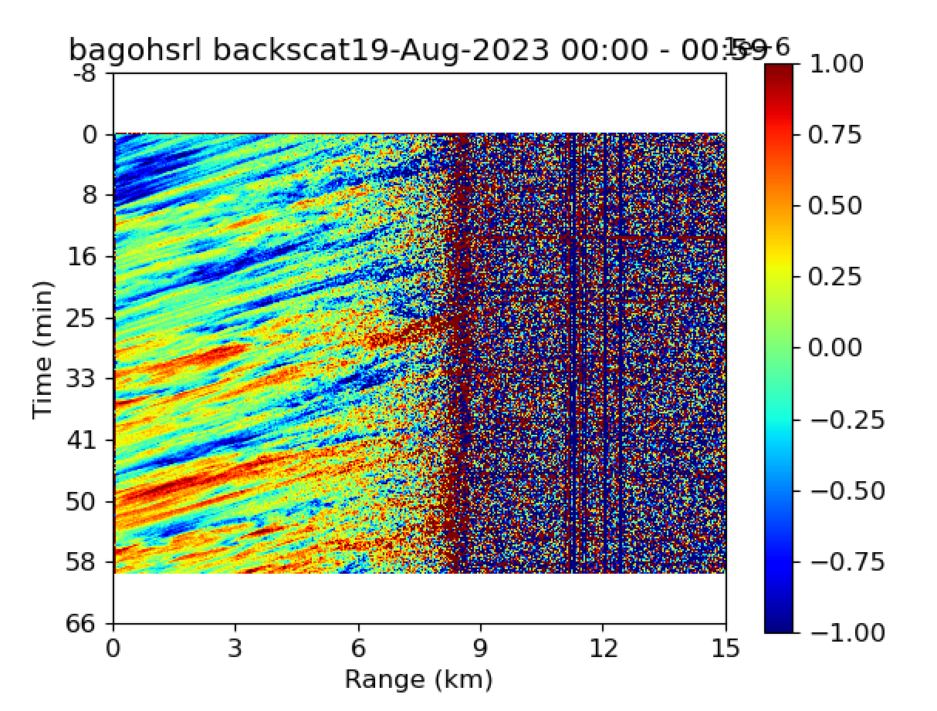
Deviation from the mean
Low backscatter--high depol downward moving parcel
Inverse of backscatter deviation
High backscatter low depol upward moving parcel

Slide 65
