Slide 1
Space-based lidar denoising methods and validation with focus on CALIOP
Willem J. Marais, Robert E. Holz, Danica F. Ehmer, Robert D. Nowak, Mark A. Vaughan, Charles R. Trepte, John W. Hair, Chris A. Hostetler
02/20/2025

Slide 2
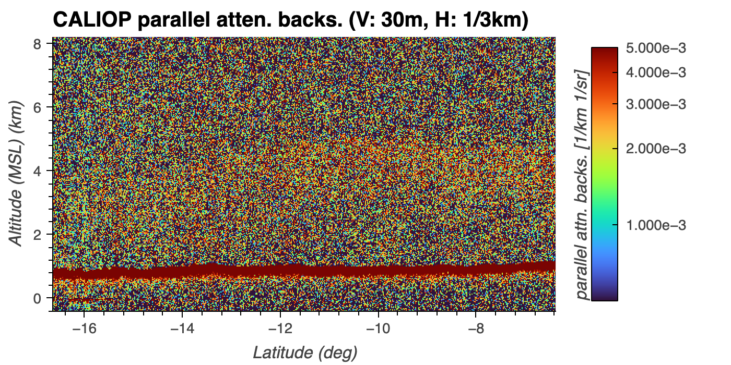

Slide 4
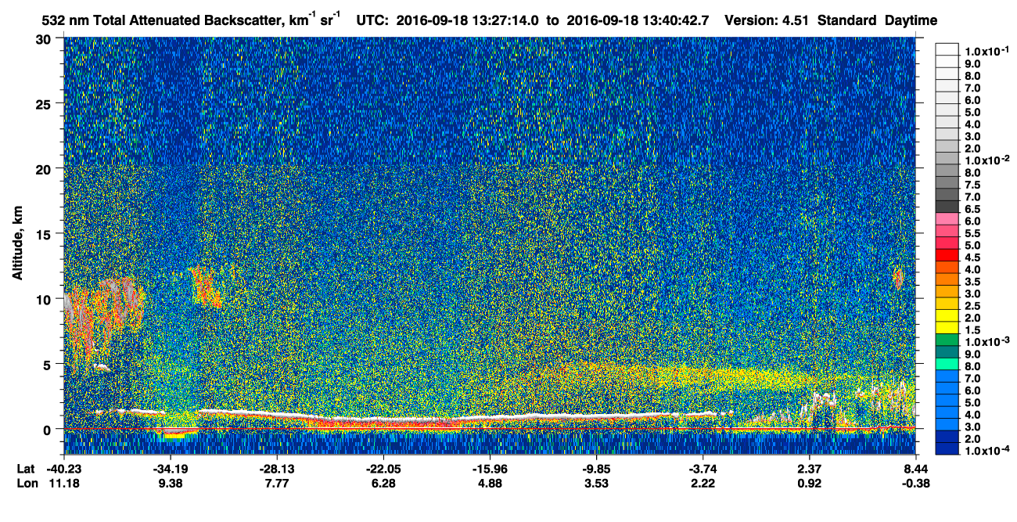

Slide 5
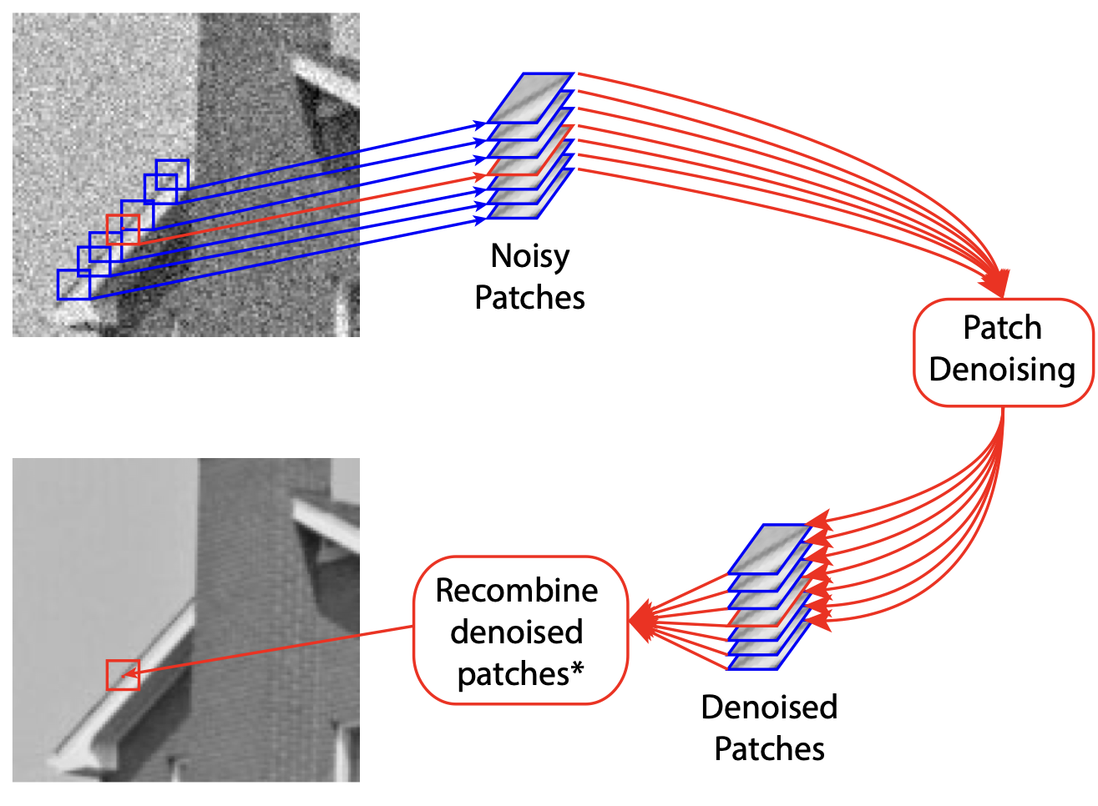
Denoising methodology
Core concept: Patch based denoising methods use redundancy to reconstruct noisy image.
This concept has been applied to medical imaging with similar physics and photon counting noise.

Slide 6
Space-based lidar denoising end goals
With the objective of reducing lidar hardware costs, how can denoising accommodate for lower signal to noise ratio measurements?
Involve academia by collaborating with experts that develop theory behind denoising and machine learning methods.
In our previous attempts we tried to denoise CALIOP at the maximum vertical and horizontal resolutions.
We took one step back and instead focus now on performing denoising on lower resolutions.

Slide 7
Space-based lidar denoising end goals
With the objective of reducing lidar hardware costs, how can denoising accommodate for lower signal to noise ratio measurements?
Involve academia by collaborating with experts that develop theory behind denoising and machine learning methods.
In our previous attempts we tried to denoise CALIOP at the maximum vertical and horizontal resolutions.
We took one step back and instead focus now on performing denoising on lower resolutions.

Slide 8
Space-based lidar denoising end goals
With the objective of reducing lidar hardware costs, how can denoising accommodate for lower signal to noise ratio measurements?
Involve academia by collaborating with experts that develop theory behind denoising and machine learning methods.
In our previous attempts we tried to denoise CALIOP at the maximum vertical and horizontal resolutions.
We took one step back and instead focus now on performing denoising on lower resolutions.

Slide 9
Space-based lidar denoising end goals
With the objective of reducing lidar hardware costs, how can denoising accommodate for lower signal to noise ratio measurements?
Involve academia by collaborating with experts that develop theory behind denoising and machine learning methods.
In our previous attempts we tried to denoise CALIOP at the maximum vertical and horizontal resolutions.
We took one step back and instead focus now on performing denoising on lower resolutions.

Slide 11
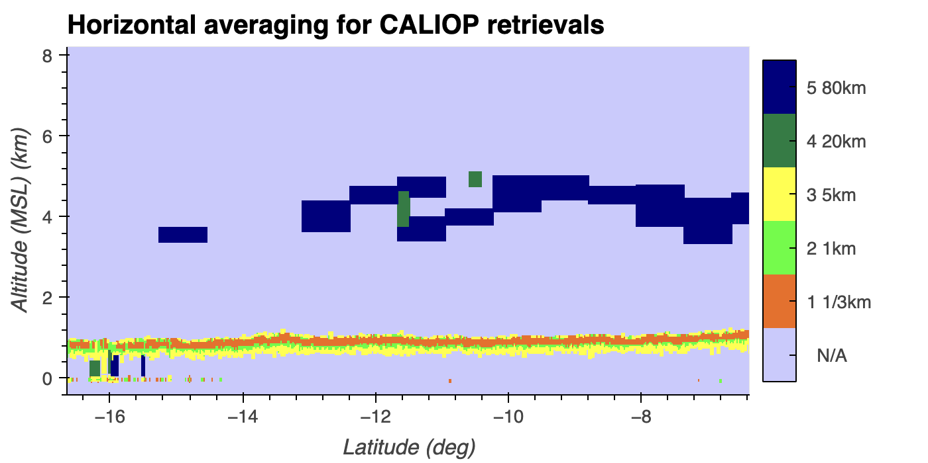

Slide 12
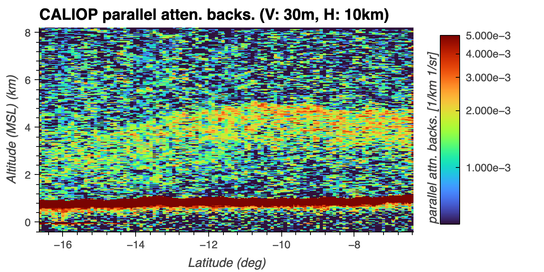

Slide 14
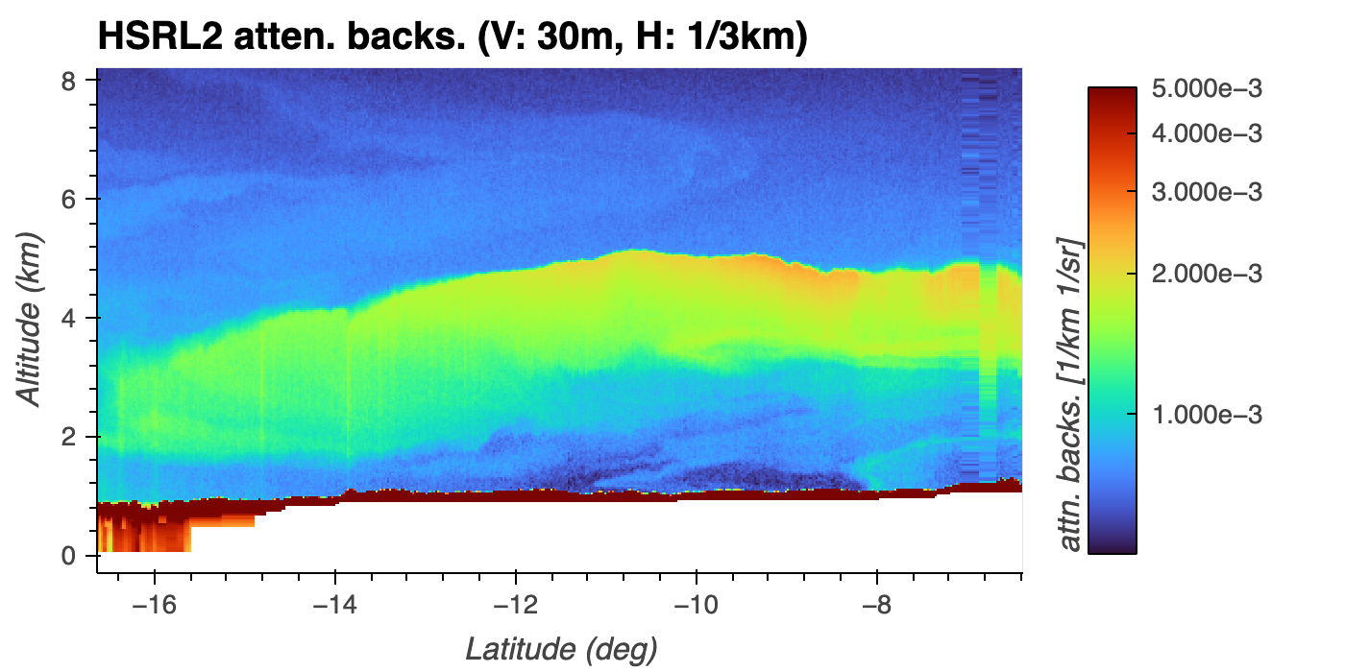

Slide 16
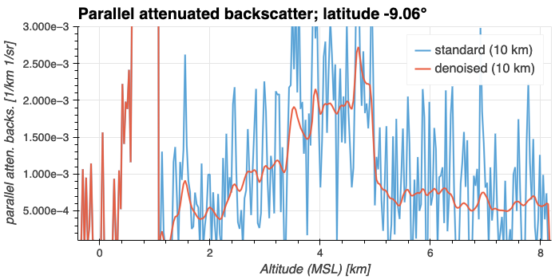

Slide 17
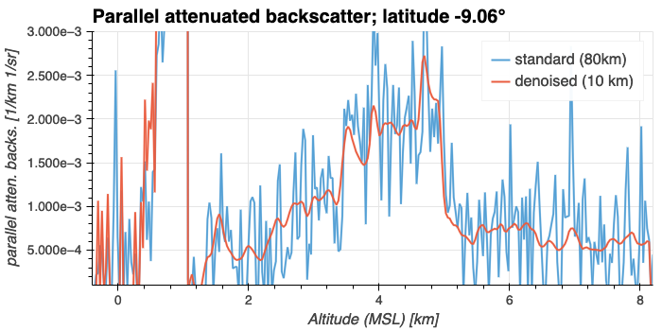

Slide 18
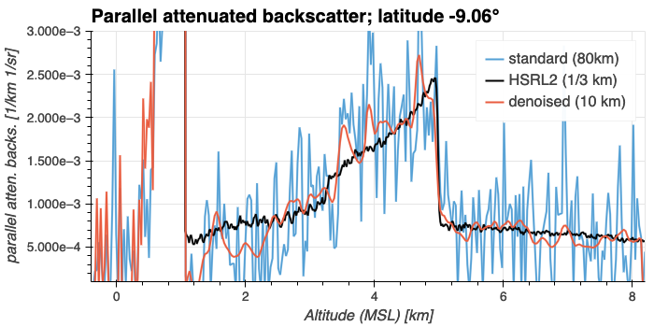

Slide 19
Ripple effects probably
residual noise

Slide 20
Future work and comments
Create baseline results to show advantage of denoising space-based lidar data:
  Check how CALIOP retrieval algorithms perform on denoised L1Bs.
  Denoise all CALIOP data that has Langley NASA HSRL under flights and compare attenuated backscatter coefficient retrievals.
Next, improve up baseline denoising results:
  Work with academia (Dr. Robert Nowak and Danica Fliss Ehmer)
  Do fundamental research to develop novel denoising methods
Can you do straight up denoising on ATLID data and get better extinction measurements? Not necessarily.
  You will mostly likely need to do an inversion similar to optimal estimation.

Slide 21
Future work and comments
Create baseline results to show advantage of denoising space-based lidar data:
  Check how CALIOP retrieval algorithms perform on denoised L1Bs.
  Denoise all CALIOP data that has Langley NASA HSRL under flights and compare attenuated backscatter coefficient retrievals.
Next, improve up baseline denoising results:
  Work with academia (Dr. Robert Nowak and Danica Fliss Ehmer).
  Do fundamental research to develop novel denoising methods.
Can you do straight up denoising on ATLID data and get better extinction measurements? Not necessarily.
  You will mostly likely need to do an inversion similar to optimal estimation.

Slide 22
Future work and comments
Create baseline results to show advantage of denoising space-based lidar data:
  Check how CALIOP retrieval algorithms perform on denoised L1Bs.
  Denoise all CALIOP data that has Langley NASA HSRL under flights and compare attenuated backscatter coefficient retrievals.
Next, improve up baseline denoising results:
  Work with academia (Dr. Robert Nowak and Danica Fliss Ehmer).
  Do fundamental research to develop novel denoising methods.
Can you do straight up denoising on ATLID data and get better extinction measurements? Not necessarily.
  You will mostly likely need to do an inversion similar to optimal estimation.

Slide 24
Extra slides

Slide 25
Striping artifacts probably due to solar
background radiation variation

Slide 26
Striping artifacts probably due to solar
background radiation variation

Slide 28
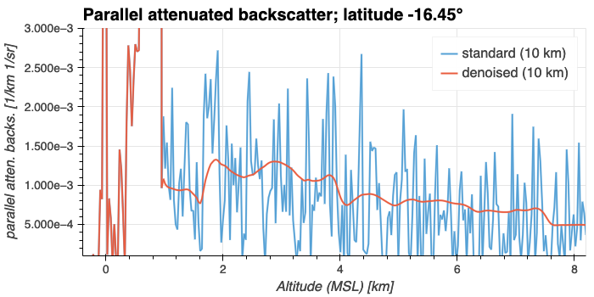

Slide 29
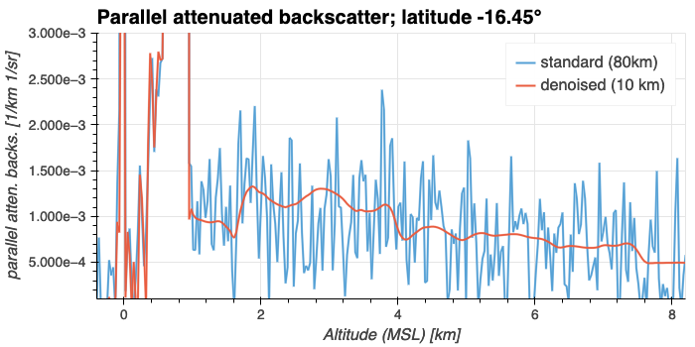

Slide 30
