Slide 1






Overview of the American Meteorological Society
Committee on Radio Frequency Allocations
Jordan Gerth, AMS Committee Chair
With contributions from the committee and colleagues
NAS CORF Meeting, Washington, DC, 9 May 2025
@AMSspectrum
@jjgerth

Slide 2
AMS Committee on RF Allocations
Organizes members to review and coordinate on all matters of radio frequency spectrum management pertinent to the enterprise
  2025 Membership: 19 members + 1 ex officio member
  Chandra Venkatachalam, Colorado State University, incoming vice chair
Contains academic, government, and private sector professionals with expertise in remote sensing, radar meteorology, satellite meteorology, systems engineering, telecommunications, and policy
Reviews and revises the policy statement on radio
frequency allocations for the Society
ametsoc.org/radio

Slide 3
Committee Goals
Increase membership awareness of spectrum management matters and their potential impacts on the weather, water, and climate enterprise,
Develop coalitions with other entities to inform the public and policymakers on radio frequency interference and its consequences, and
Provide subject-matter expertise on how changes in spectrum policy and allocations could affect the collection or delivery of meteorological, hydrological, and oceanographical data
ametsoc.org/radio

Slide 4
Committee Activities
Encouraging ex parte briefings at FCC
Filings in FCC dockets
Informational meetings with legislative staff
Op-eds and media interviews
Outreach to interested groups
Planning scientific sessions at AMS meetings
ametsoc.org/radio

Slide 5
Observations
Collection: High-power terrestrial wireless emissions in or near spectrum allocated for earth sensing will reduce consistent and reliable global weather observations
Transmissions
Delivery: Sharing of radio frequencies could threaten the timely and routine transmissions of space-to-Earth weather satellite imagery and other Earth-to-space observations (DCS)
Inconsistency
Impact: The risk of spectrum sharing is not a sudden decrease in forecast skill or a complete loss of observations, but an inability to deliver consistent weather services
The scientific results and conclusions, as well as any views or opinions expressed herein, are those of the author and do not necessarily reflect the views of NOAA or the Department of Commerce.

Slide 6
Committee Priorities
1675-1680 MHz (L band) and related Ligado proceedings
  GOES-R data relay and image rebroadcast (Delivery)
3.1-3.45 GHz (C), 7.125-8.4 GHz (X), 23.8/24 GHz (K band)
  Passive rain rate and sea surface temperature sensing (Collection)
  Direct broadcast of LEO weather satellite imagery (Delivery)
  Passive microwave water vapor sensing (Collection)
More passive sensing: 50+ GHz (U) and 86 – 92 GHz (W band)
Identifying technical solutions to reduce future sharing complications in the microwave
ametsoc.org/radio

Slide 7
NOAA Satellite L-Band Data Downlinks
GOES Data Collection System
· Flood and tsunami warning
· River and coastal gages
· Fire weather sensors
· Inland river navigation
· Drought management
Emergency Management
and Reduced Data
 | 1675 |  |  |  |  | 1680 |  |  |  |  | 1685 |  |  |  |  | 1690 |  |  |  |  | 1695 |  |  |  |  | 1700
Broadband/Proposed Share
GOES Rebroadcast
(Science and Imagery)
Broadband/AWS-3
1675-1680 MHz
Proposed Auction
MHz
1695-1710 MHz
NOAA Polar Satellites

Slide 8
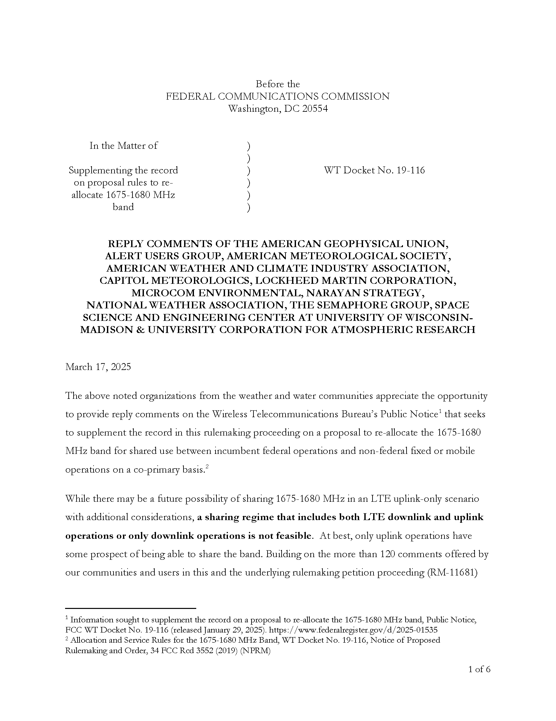
AMS, AGU, NWA, UCAR, and others filed in WT Docket No. 19-116 (March 2025):
“…a sharing regime that includes both LTE downlink and uplink operations or only downlink operations is not feasible.”

Slide 9

National Spectrum Strategy: 7125-8400 MHz
Real-time High Rate Data (NOAA JPSS)
7.812 GHz (50 MHz Bandwidth)
Passive Sensing (JAXA GCOM-W/GW)
Rainfall Rate
Sea Surface Temperature
6.925 GHz (350 MHz Bandwidth)
7.3 GHz (350 MHz Bandwidth)
Existing RFI evident in 6.925 GHz
No allocation except footnote (RR FN 5.458)
Notes:
From Bill Emery: The Navy wanted a passive microwave sensor for wind direction as well which drove the creation of Windsat. It demonstrated that using the 4th Stokes parameter wind direction could be retrieved from passive microwave data but only for winds greater than 7 m/s. The scatterometer (an active radar system) is capable of direction down to wind speeds of 3 m/s. This wind data is particularly important for hurricane detection and forecasting.

Slide 10
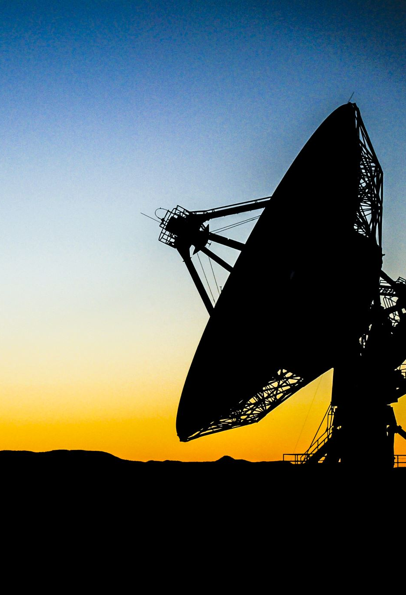
Low-Latency Reception
X-band is the single most significant spectrum portion for downlinking Earth observation data acquired by satellites.
No current alternative to X-band downlink exists at scale, especially for existing LEO satellites with a geographically-dependent direct broadcast downlink.
Short-term challenges from a change to 7/8 GHz allocations could not be overcome without some protection.

Slide 11
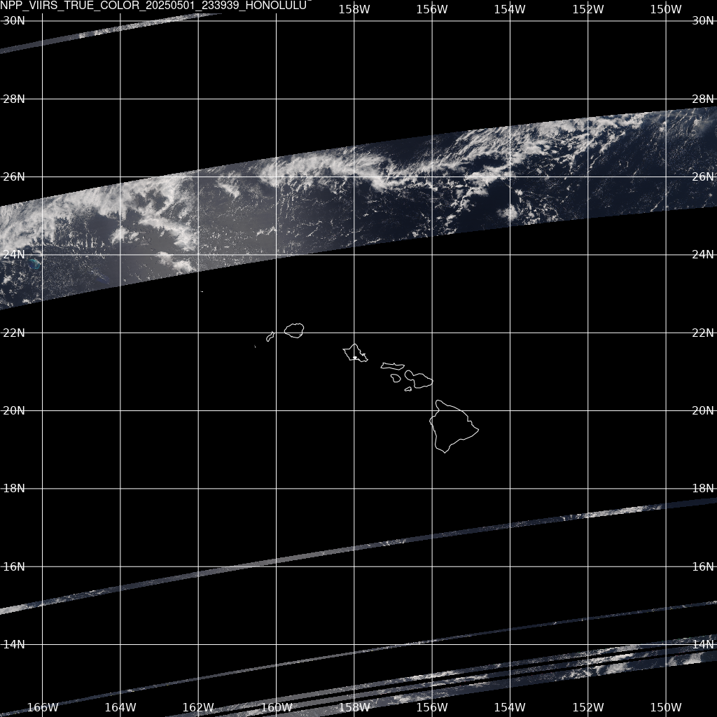
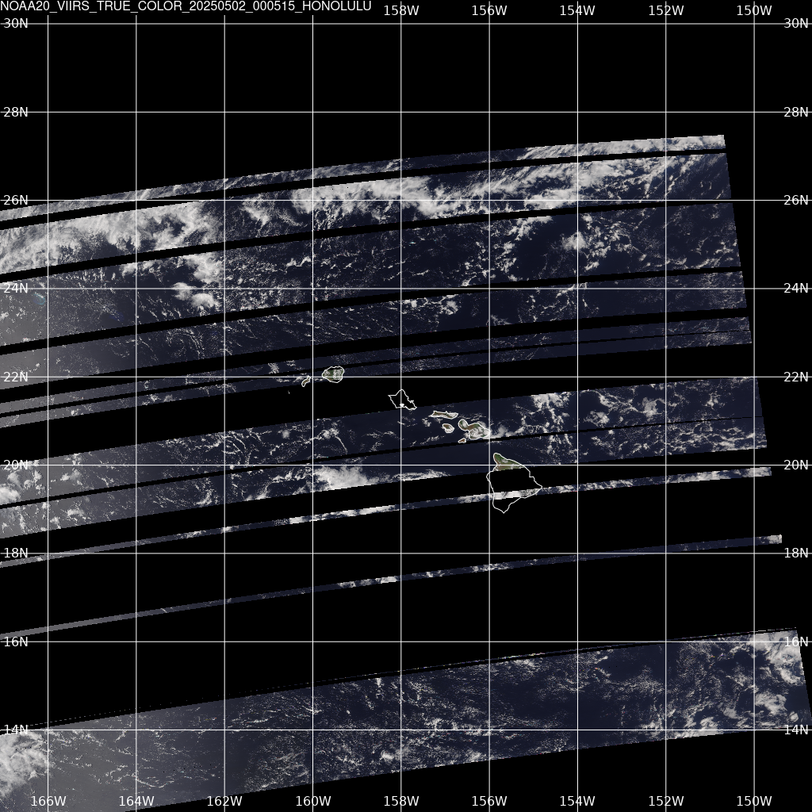
Intermittent RFI
NOAA (NPP/JPSS) Direct Broadcast
Site: Honolulu Community College (Operated by University of Wisconsin-Madison)

Slide 12
7 GHz Passive Sensing
WMO Position:
  “Preliminary results of studies ongoing in ITU-R WP 7C show that interference will occur on current and planned SST measurements especially in coastal areas if IMT is deployed in any portion of the 6425-7125 MHz band.”
  “A similar conclusion can be drawn for the 7125-7250 MHz band if an IMT identification is made in that frequency band.”
Reality:
  This is already interference in this band.
  Extent depends on geographic region.
Challenge:
  We have not been able to study the role of 7 GHz on microwave (passive) SST.

Slide 13
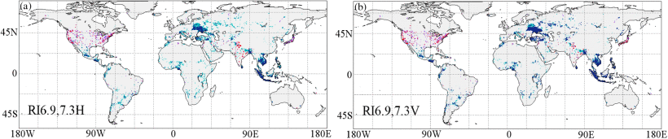
6.9/7.3 GHz RFI (9/2012-8/2013)
A. H. A. de Nijs, R. M. Parinussa, R. A. M. de Jeu, J. Schellekens and T. R. H. Holmes, "A Methodology to Determine Radio-Frequency Interference in AMSR2 Observations," in IEEE Transactions on Geoscience and Remote Sensing, vol. 53, no. 9, pp. 5148-5159, Sept. 2015, doi: 10.1109/TGRS.2015.2417653.

Slide 14
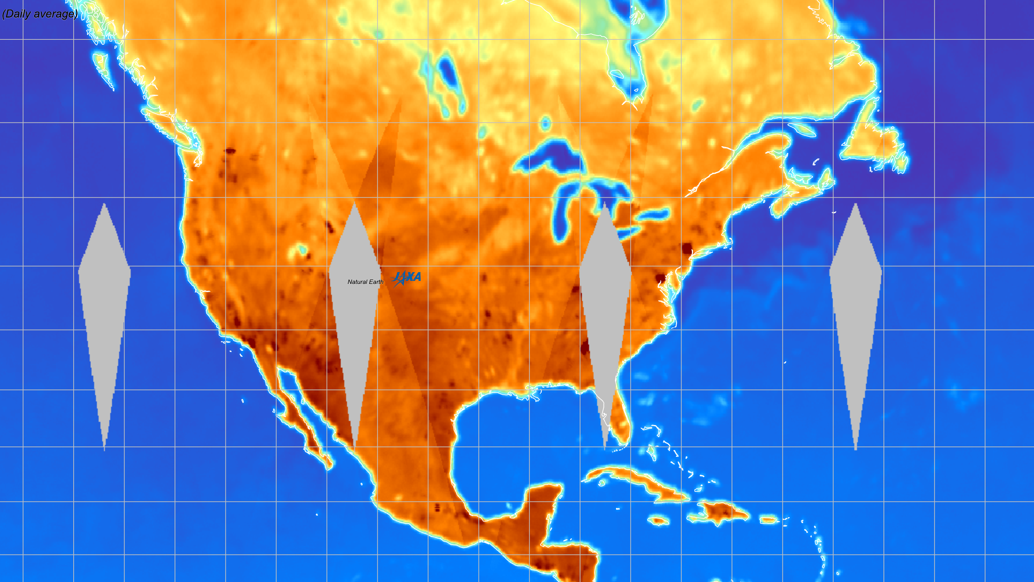

JAXA GCOM-W AMSR-2
6.925 GHz on 20 May 2024
VPol (Ascending/Descending)
Notes:
Image Source: https://www.eorc.jaxa.jp/AMSR/viewer/index.html

Slide 15
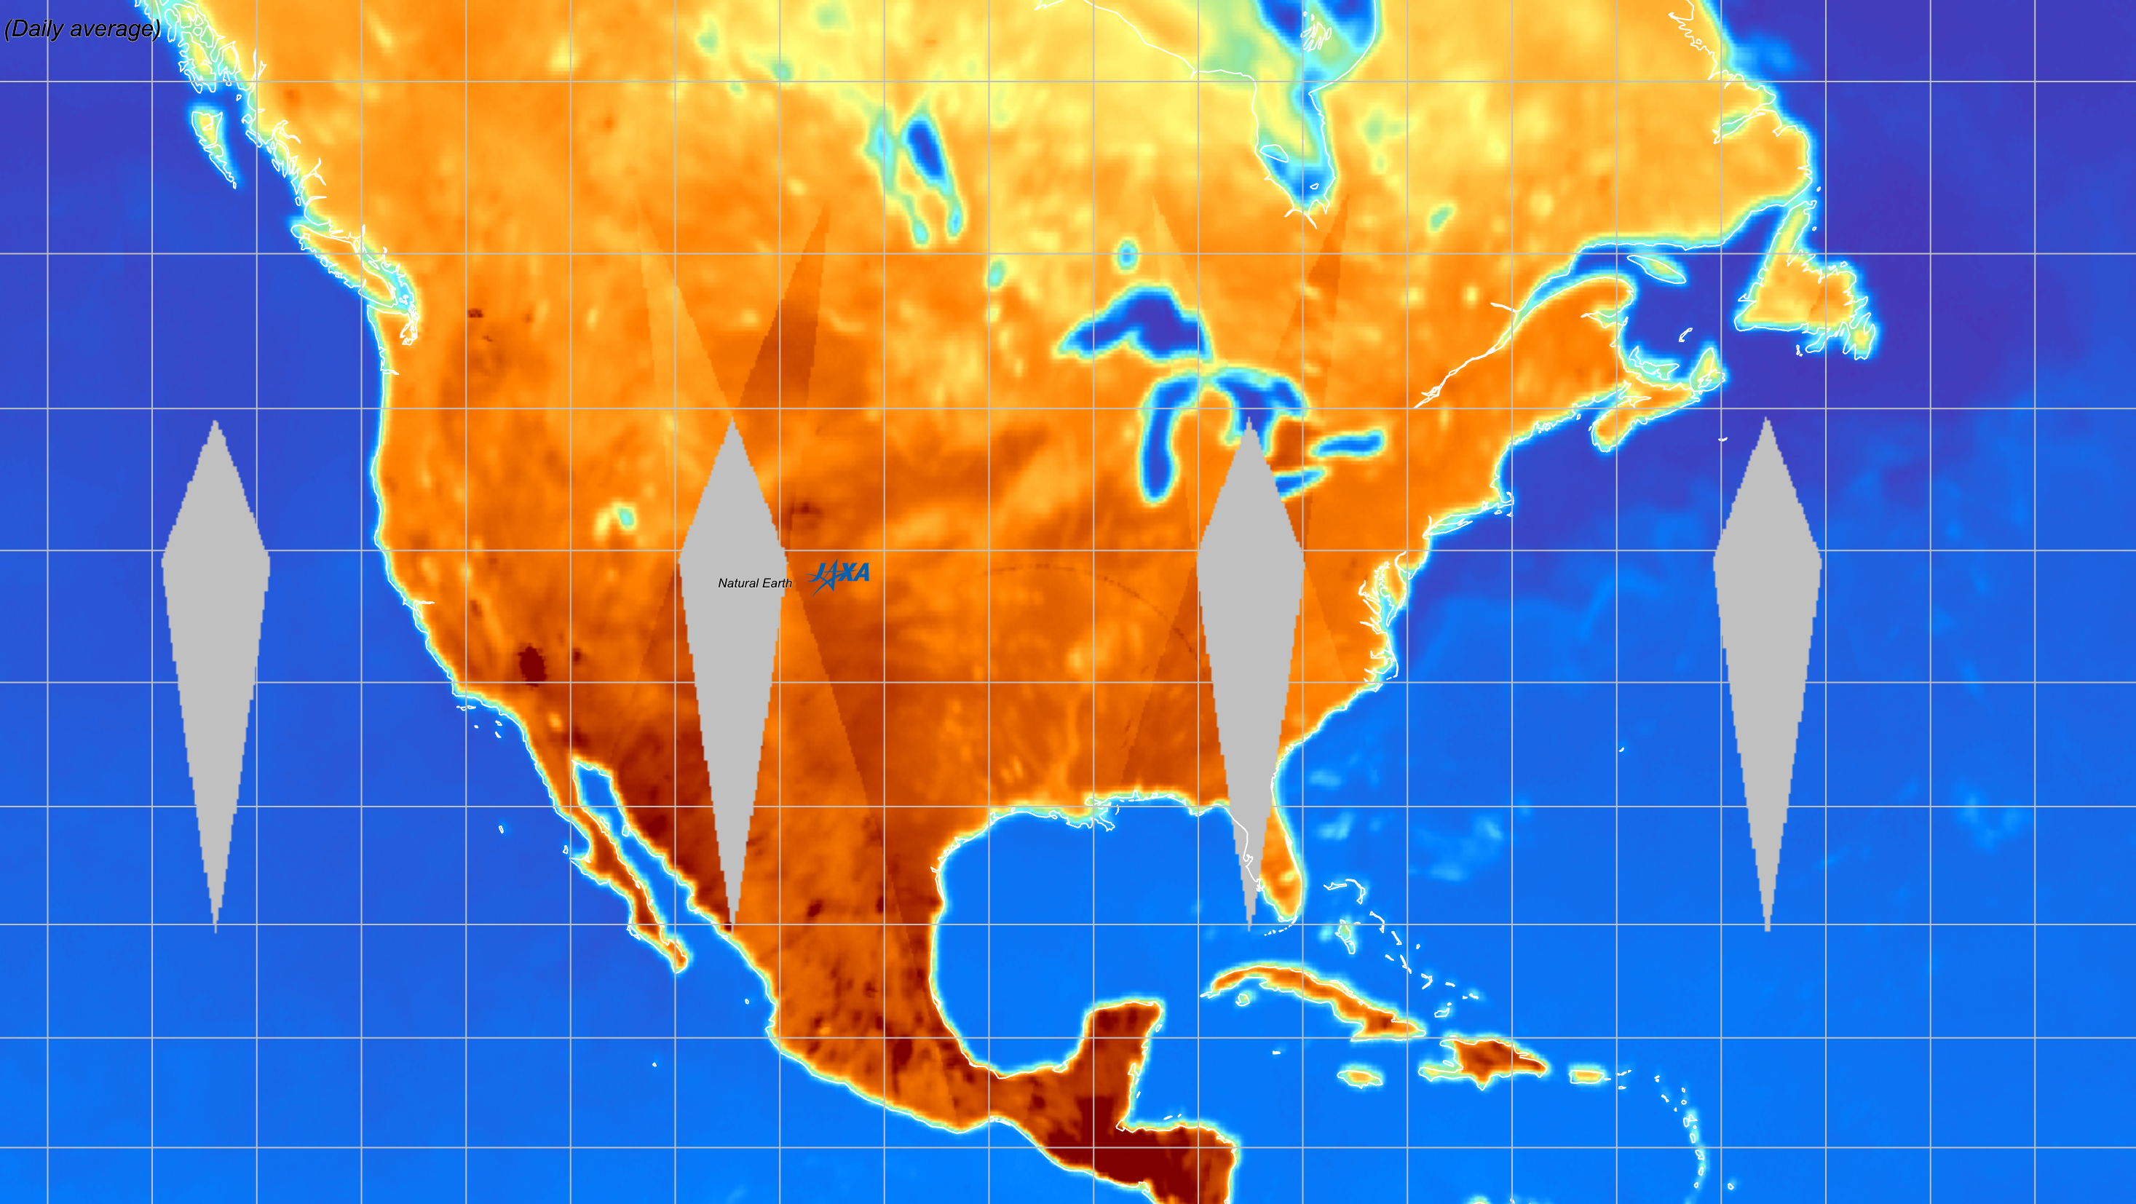
JAXA GCOM-W AMSR-2
7.3 GHz on 20 May 2024
VPol (Ascending/Descending)
Notes:
Image Source: https://www.eorc.jaxa.jp/AMSR/viewer/index.html

Slide 16
7 GHz Band Overlapping Spectrum: 5G/6G & EOS Measurements
7.125 – 8.4 GHz: largest contiguous block of mid-band spectrum.
  Rapid deployment: Use the existing 3.5 GHz wireless network footprint¹.
  US National Spectrum Strategy & ITU WRC-27: Recommendations to make the 7GHz band available for wireless communications⁴.
Earth Observation Satellite sea surface temperatures at 6.925 & 7.3 GHz (Δf = 0.175 GHz) used for hurricane tracking, weather forecasting, and climate models.
Sea Surface Temperatures: passive microwave measurements³ (AMRS2, AMSR3 in 2025)
Neither band protected. 6.9GHz data already corrupted in some places.
¹ Increased propagation loss @7GHz balanced by increased antenna gain - reduction in Tx/Rx MIMO size.
^{2 I}ITU footnote RR No 5.458 suggests regulators should consider EESS passive services in planning the use of
6425–7075 MHz and 7075–7250 to accommodate sea-surface temperature (SST) measurements.
³ part of the NASA/JAXA et.al. Global Precipitation Mission.
⁴ Most of the world focused on 7GHz, China is planning to use the upper 6GHz

Slide 17
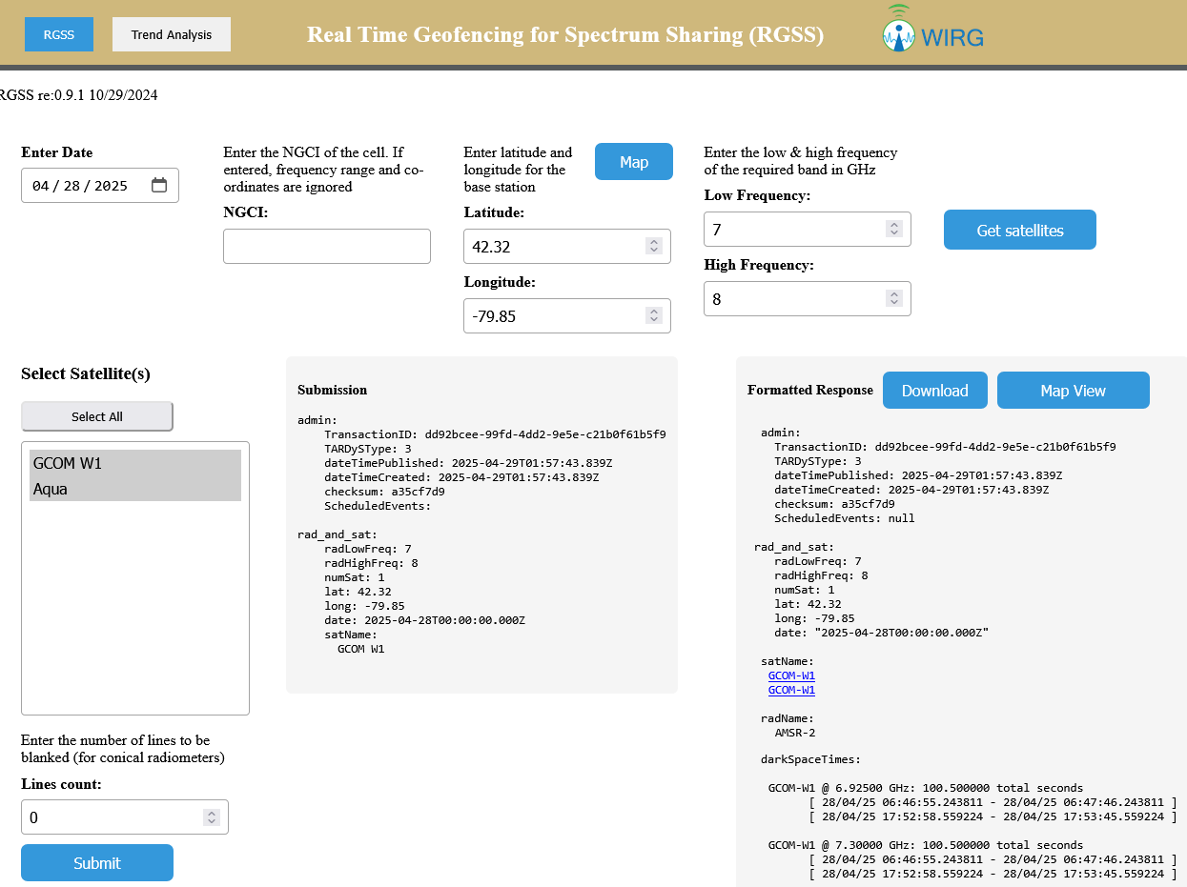
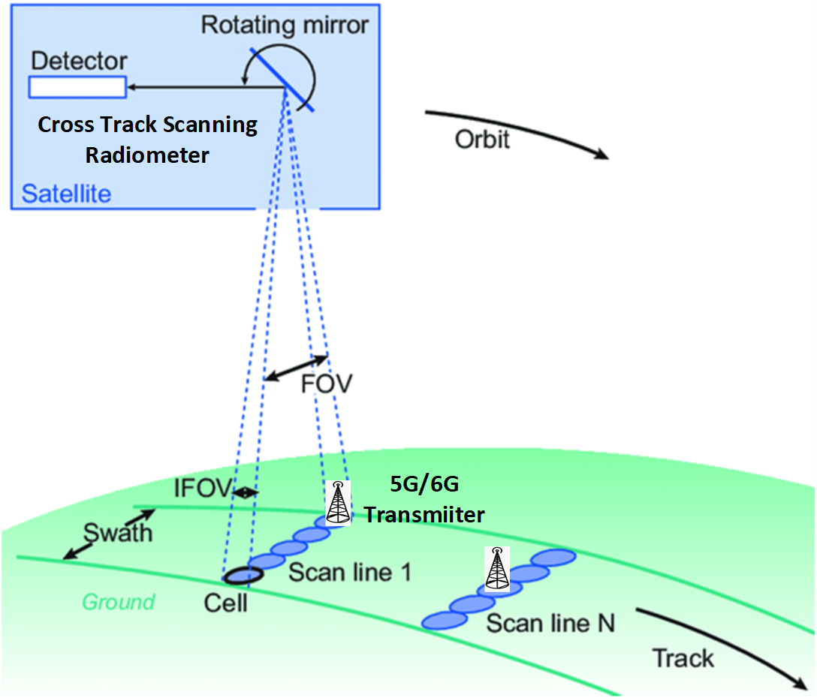
RGSS Prototype:
UTC Time
GCOM-W1 @ 7.30000 GHz: 100.500000 total seconds
[ 28/04/25 06:46:55.243811 - 28/04/25 06:47:46.243811 ]
[ 28/04/25 17:52:58.559224 - 28/04/25 17:53:45.559224 ]
Currently supports ATMS (SUOMI, JPSS-1, JPSS-2), AMSU (METOP B&C), AMSR2 (GCOM). Web and programmatic (JSON) interfaces available to researchers in academia, government, & industry.
Accurate prediction of location, size, and timing of pixels verified by comparing predicted vs actual data from satellite downloads (for ATMS, accuracy is ± a few kms and ≤ ∼10 μsec)
Enables protection of EOS measurements while allowing Wireless Service Providers access with high (>99%) network availability. In Local Time, traversals are 1-3AM and 1-3PM.

Slide 18
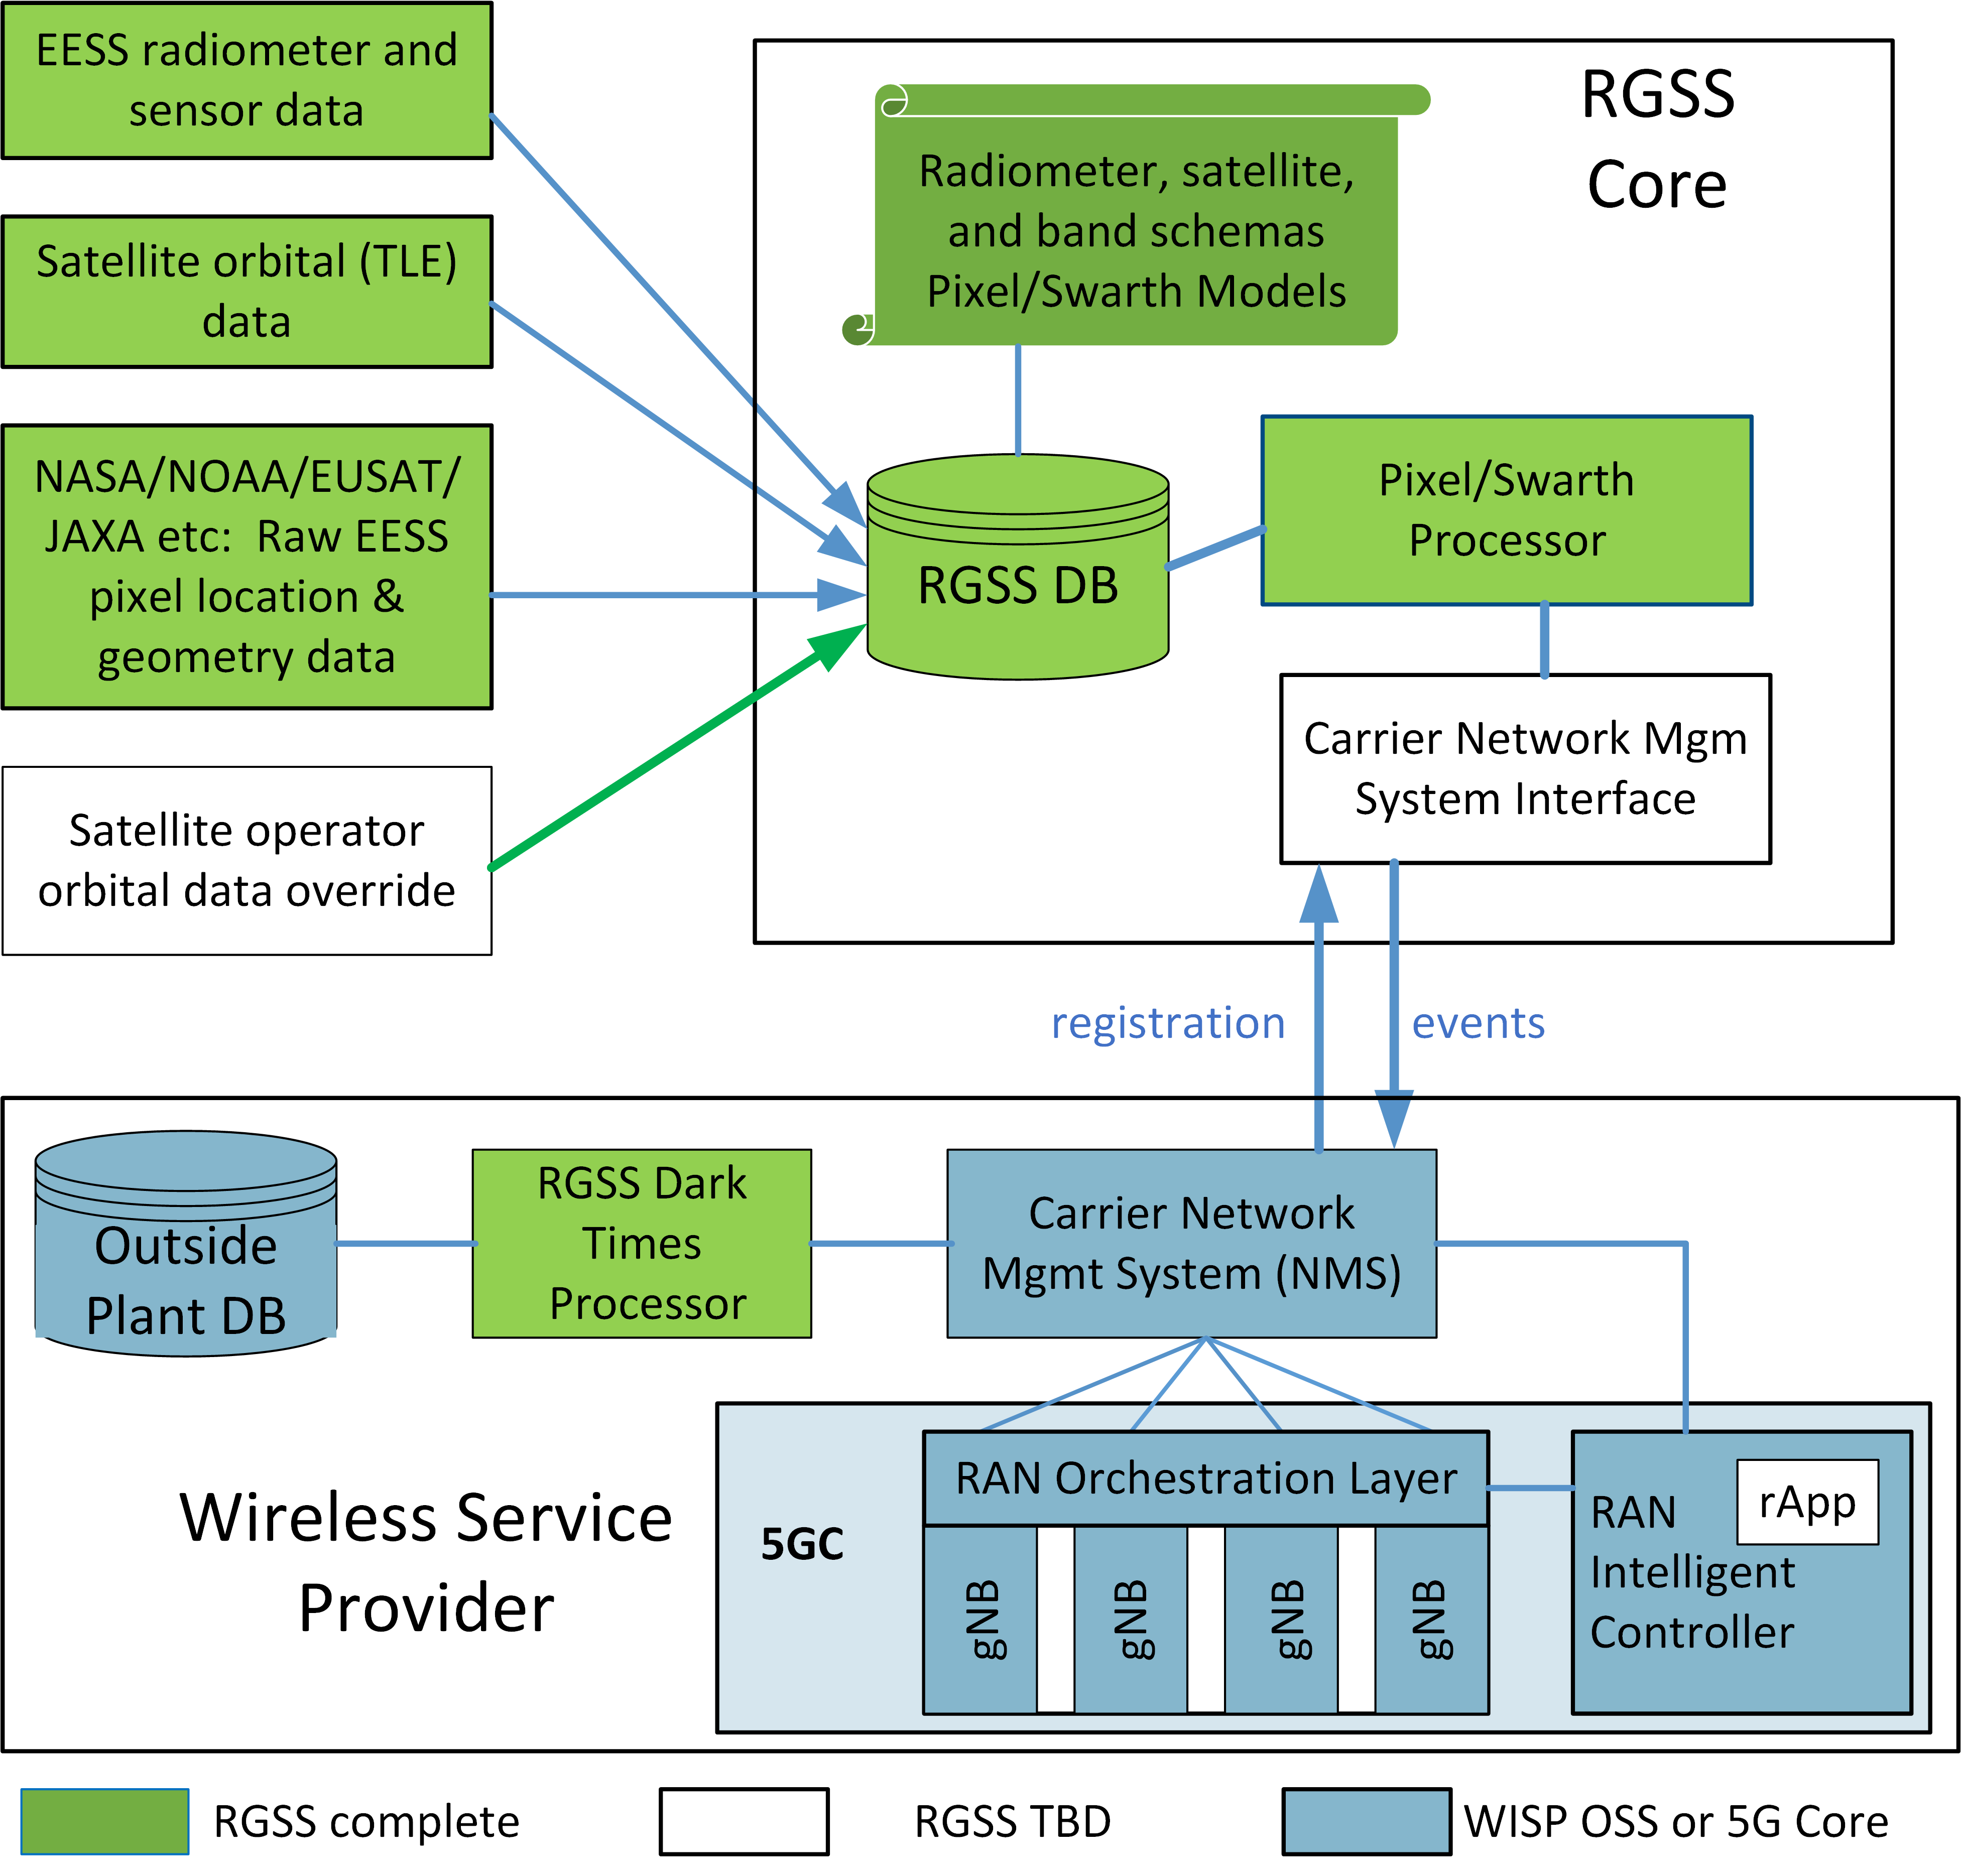
System Architecture + Feedback from the wireless community
Minimize effort to integrate with Network Management Systems
Maintain confidentiality of Outside Plant data (DB)
Utilize 3GPP inter-cell band movement based on CoS as needed (DAPS and L1/L2 Triggering) => no impact to low-latency / high reliability services.
One remaining piece: rApp for the RIC

Slide 19
Summary and Engagement:
Real-time Geofencing for Spectrum Sharing (RFSS) enables radiometers on Earth Observation Satellites and wireless 5G/6G to share overlapping spectrum in the 7 GHz band (6.925 and 7.3 ± 0.175 GHz) without interference. The 7GHz band is an ideal place to test and operationalize RGSS¹ (which can be applied to all GHz & THz bands).
Positive Feedback from Government Stakeholders:
  Satellite/Sounder Operators: NOAA and NASA
  Regulatory Community: FCC
  Congress: Senate Commerce Committee (Majority & Ranking), House Science & Technology (Ranking), House Commerce (Majority)
Positive Feedback from Industry:
  CTIA (wireless communities lobbying group)
  US Carrier & 5G RAN Equipment Vendors
Positive Feedback from the Research Community
  SpectrumX, NSF-NRDZCOM, & AMS Spectrum Committee participants
¹material based upon work supported by the National Science Foundation under Grant No. 2232368

Slide 20
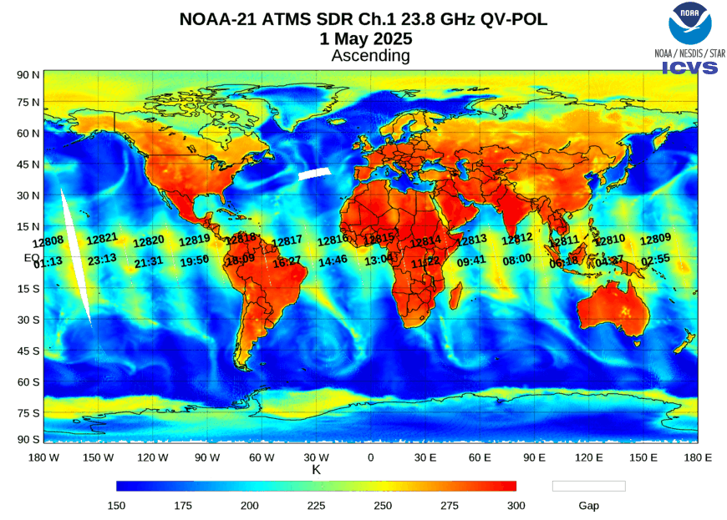
24 GHz
20
AMSU-A | ATMS | Central Frequency (GHz) | Bandwidth (MHz) | NWP Centers
1 | 1 | 23.800 | 270 | Few
2 | 2 | 31.400 | 180 | Few
3 | 3 | 50.300 | 180 | Few
 | 4 | 51.760 | 400 | Few
4 | 5 | 52.800 | 400 | Some
5 | 6 | 53.596 ± 0.115 | 170 | Most
6 | 7 | 54.400 | 400 | All
7 | 8 | 54.940 | 400 | All
8 | 9 | 55.500 | 330 | All
9 | 10 | f0 = 57.290344 | 330 | All
10 | 11 | f0 ± 0.217 | 78 | Most
11 | 12 | f0 ± 0.3222 ± 0.048 | 36 | Most
12 | 13 | f0 ± 0.3222 ± 0.022 | 16 | Most
13 | 14 | f0 ± 0.3222 ± 0.010 | 8 | Most
14 | 15 | f0 ± 0.3222 ± 0.0045 | 3 | Most
Primary application:
Total column water vapor

Slide 21
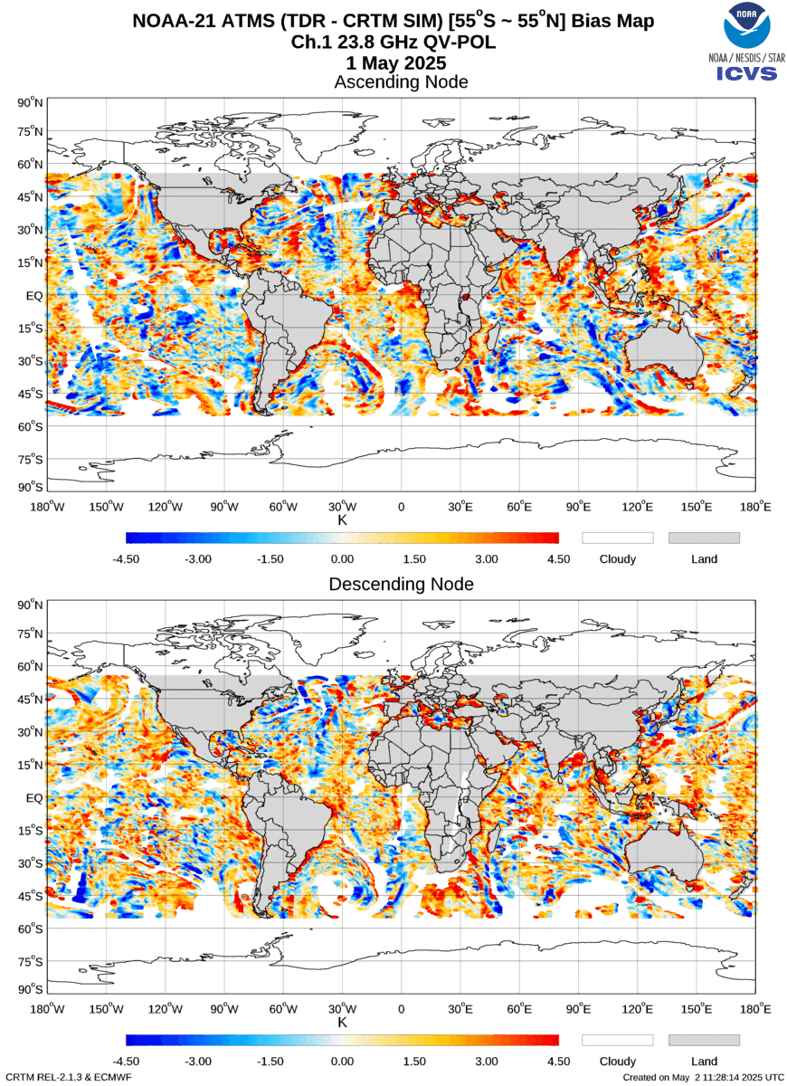
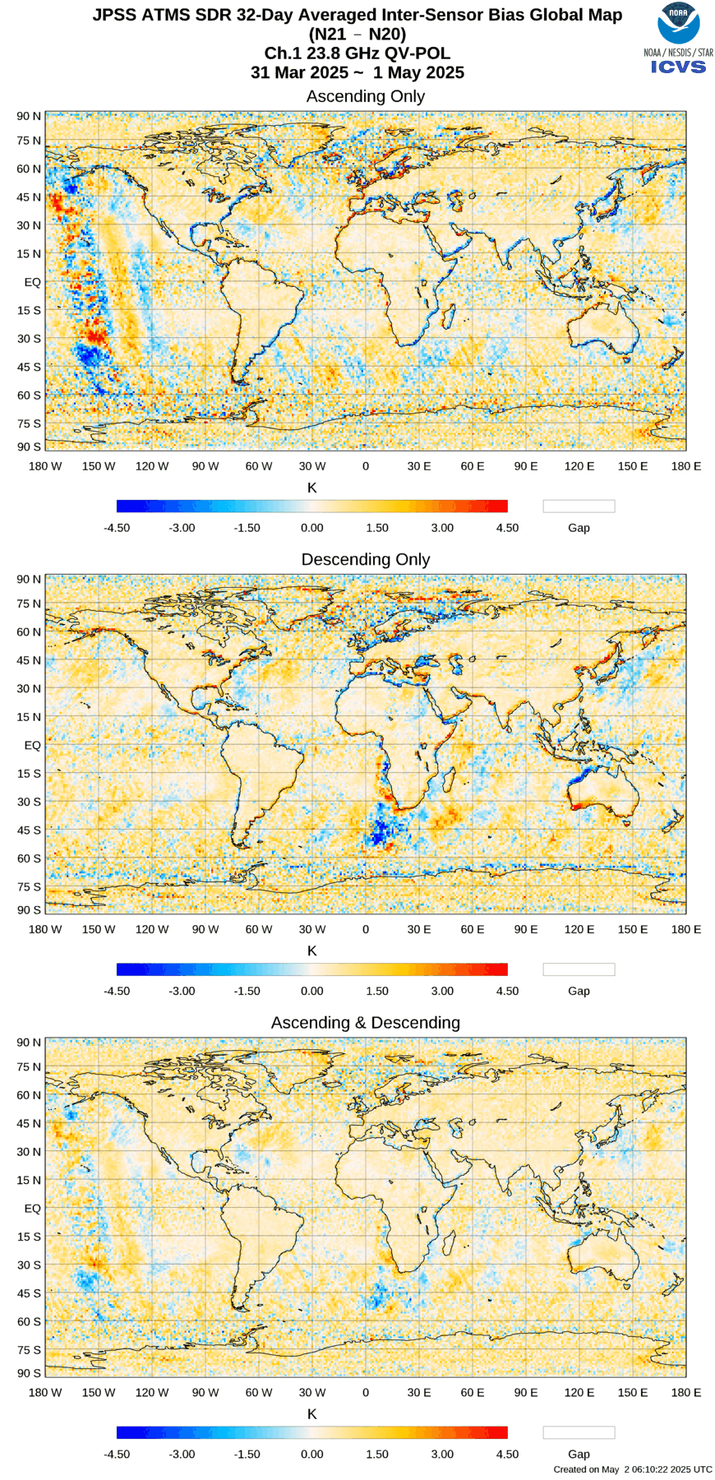
Notes:
Source: https://www.star.nesdis.noaa.gov/icvs/comparison_ATMS.php
Left: N21 vs CRTM ECMWF Channel 01 -- 1 May 2025 -- Direct Difference
Right: N21 vs N20 ATMS Channel 01 -- 1 May 2025 -- Direct Difference

Slide 22
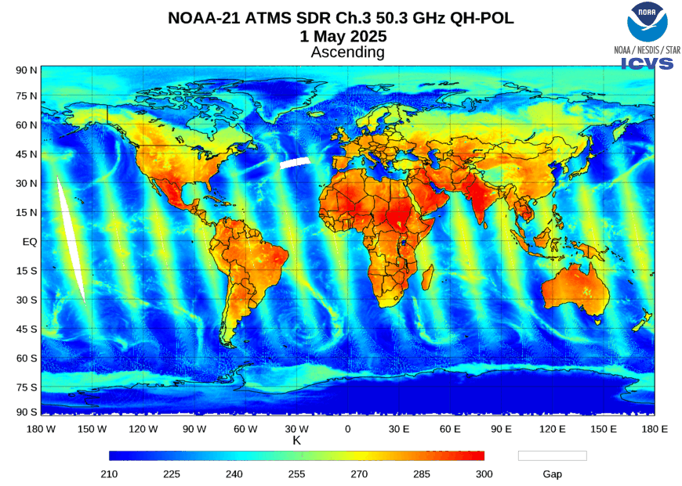
36-54 GHz
22
AMSU-A | ATMS | Central Frequency (GHz) | Bandwidth (MHz) | NWP Centers
1 | 1 | 23.800 | 270 | Few
2 | 2 | 31.400 | 180 | Few
3 | 3 | 50.300 | 180 | Few
 | 4 | 51.760 | 400 | Few
4 | 5 | 52.800 | 400 | Some
5 | 6 | 53.596 ± 0.115 | 170 | Most
6 | 7 | 54.400 | 400 | All
7 | 8 | 54.940 | 400 | All
8 | 9 | 55.500 | 330 | All
9 | 10 | f0 = 57.290344 | 330 | All
10 | 11 | f0 ± 0.217 | 78 | Most
11 | 12 | f0 ± 0.3222 ± 0.048 | 36 | Most
12 | 13 | f0 ± 0.3222 ± 0.022 | 16 | Most
13 | 14 | f0 ± 0.3222 ± 0.010 | 8 | Most
14 | 15 | f0 ± 0.3222 ± 0.0045 | 3 | Most
Primary application:
Low-level rain water, temperature

Slide 23
AMS (AGU/NWA/UCAR) Comments to FCC NSS on 37 GHz
(Docket no. 24-243)
[I]t is important for the Commission to implement additional measures to protect spaceborne remote passive sensors in the 36-37 GHz band.
To safeguard U.S. weather forecasting and climate monitoring abilities, the use of passive bands near 37 GHz must not cause harmful interference.
Harmful interference is a growing threat to U.S. weather forecasting and climate monitoring.
We support the CORF filing.

Slide 24
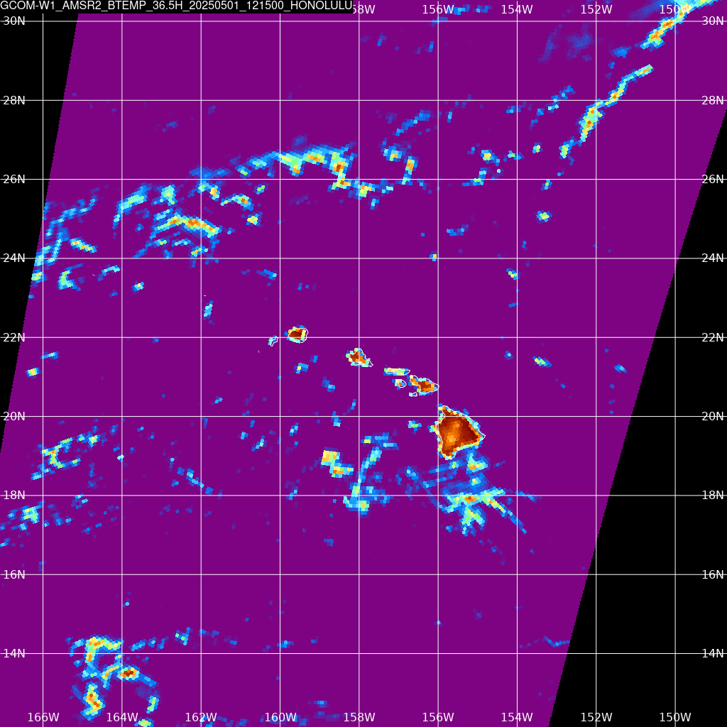
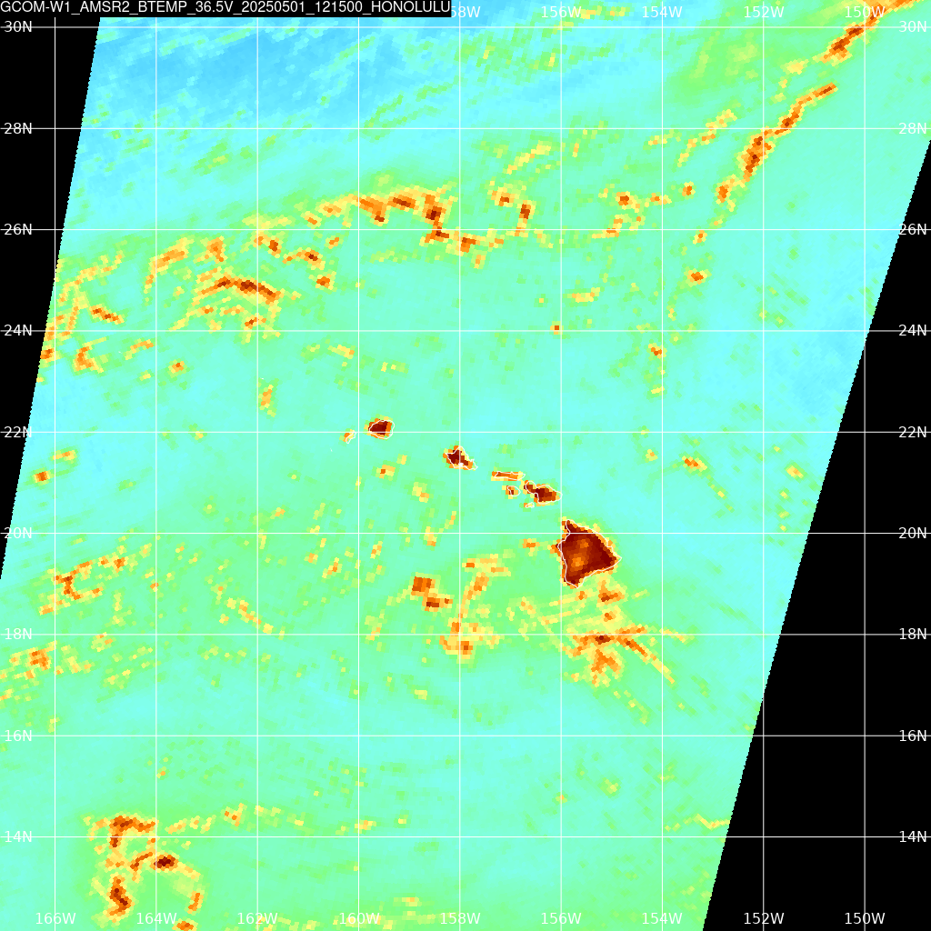
Challenges for Discerning RFI

Slide 25
Community Engagement
Impact studies of bands in 50-54 GHz range, individually and in aggregate, for both “traditional/physical” NWP models and AI-based models are in demand.
  Land+sea vs. only sea
The risk of significant impacts from 50-54 GHz interference is believed to be high, especially considering the potential sources (Earth-to-space).
Increased use and impact studies of bands at 88+ GHz would also be valuable, especially considering potential for RFI in lower MW bands and the addition of new missions.

Slide 26
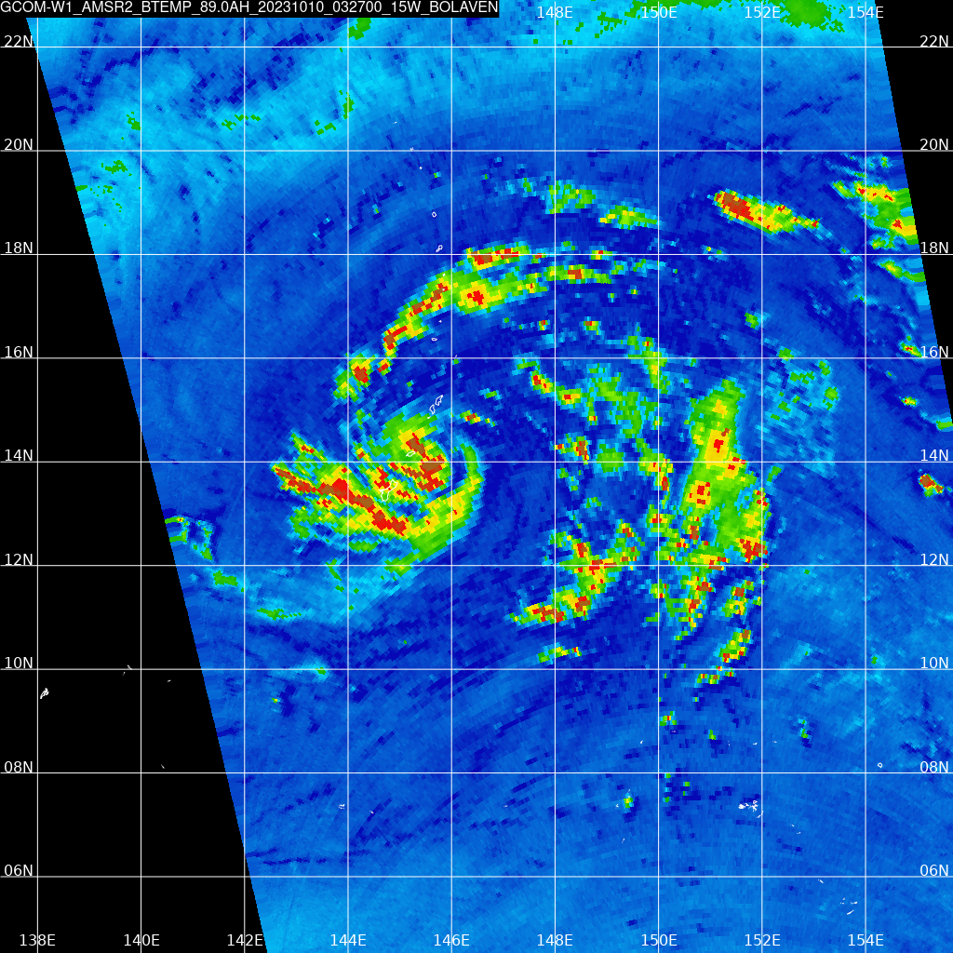
88+ GHz
ATMS | GMI | Central Frequency (GHz) | Bandwidth (MHz) | NWP Centers
16 |  | 88.2 | 2000 | Few
 | 8 / 9 | 89.0 (V / H) | 6000 | Few
17 |  | 165.5 | 3000 | Few
 | 10 / 11 | 166.5 (V / H) | 4000 | Few
18 | 13 | 183.31 ± 7.0 | 2000 | Most (Sounder), Few (Imager)
19 |  | 183.31 ± 4.5 | 2000 | Most
20 | 12 | 183.31 ± 3.0 | 1000 / 2000 | All (Sounder), Few (Imager)
21 |  | 183.31 ± 1.8 | 1000 | Most
22 |  | 183.31 ± 1.0 | 500 | All
Notes:
Source: https://cimss.ssec.wisc.edu/satellite-blog/archives/55019

Slide 27
EESS Application vs.
Adjacent Active Service
EESS Passive Band | Application | Active Service Band | Active Service
86-92 GHz | Precipitation, Sea ice | 81-86 GHz | Fixed satellite (E-S), mobile
 |  | 92-04 GHz | Mobile, radiolocation
114.25-116 GHz | Temperature profiling | 111.8-114.25 GHz | Fixed, mobile
164-167 GHz | Water vapor profiling | 158.5-164 GHz | Fixed, fixed satellite (S-E), mobile, mobile satellite
 |  | 167-174.5 GHz | Fixed, fixed satellite (S-E), inter-satellite, mobile
200-209 GHz | Water vapor | 191.8-200 GHz | Fixed, inter-satellite, mobile, mobile satellite, radionavigation and RNSS
 |  | 209-217 GHz | Fixed, fixed satellite (E-S), mobile

Slide 28
229-244 GHz
Primary application:
Ozone, cirrus clouds
Satellite | Agency | Launch | End of Life | Inst. | Frequency (GHz) | Bandwidth (MHz) | Application
Metop-SG-A1-3 | EUMETSAT | ≥2025 | ≥2037 | MWS | 229 | 2000 | Window/Cirrus Clouds
Aura | NASA | 2004 | ≥2025 | MLS | 230.5432 | 10 | CO/Ozone
 |  |  |  |  | 230.5432 | 1250 | CO/Ozone
 |  |  |  |  | 233.9515 | 1250 | Ozone
 |  |  |  |  | 235.7151 | 10 | Ozone
 |  |  |  |  | 235.7151 | 1250 | Ozone
 |  |  |  |  | 239.66 | 15600 | Ozone
Metop-SG-B1-3 | EUMETSAT | ≥2026 | ≥2048 | ICI | 243.2 | 8000 | Window/Cirrus Clouds

Slide 29

Weather Satellite Interference Impacts Summary
The delivery of satellite weather data must always be timely, consistent, and reliable.
Microwave observations are unique, valuable, and global.
Continuing observing capabilities and open data sharing policies maintains the value of our satellite constellations and quality of local and global weather forecasts.
We are in search of engineering solutions to apply to ground networks to adapt to the ever-changing spectrum landscape.

Slide 30
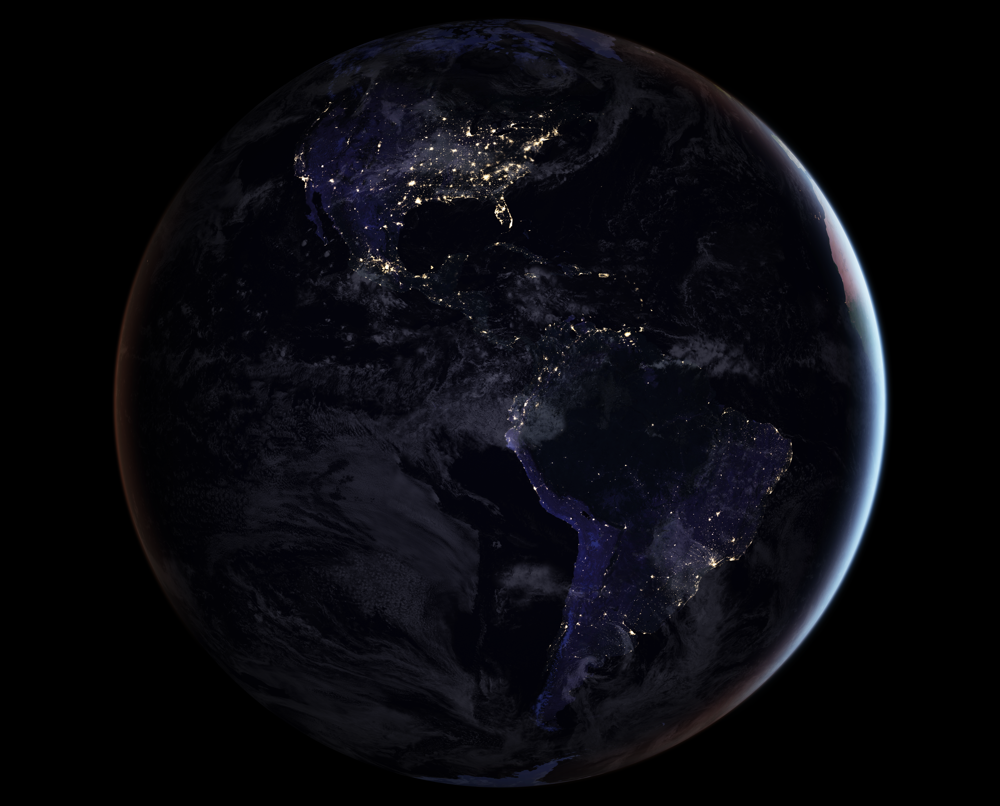

Questions?
Jordan Gerth
jordan.gerth@ssec.wisc.edu
ametsoc.org/radio
Special thanks to…
Elliot Eichen
Renee Leduc
Chandra Venkatachalam
@AMSspectrum
@jjgerth
Notes:
Image Source: https://www.nasa.gov/sites/default/files/thumbnails/image/blackmarble_2016_americas_composite.png

