Slide 1
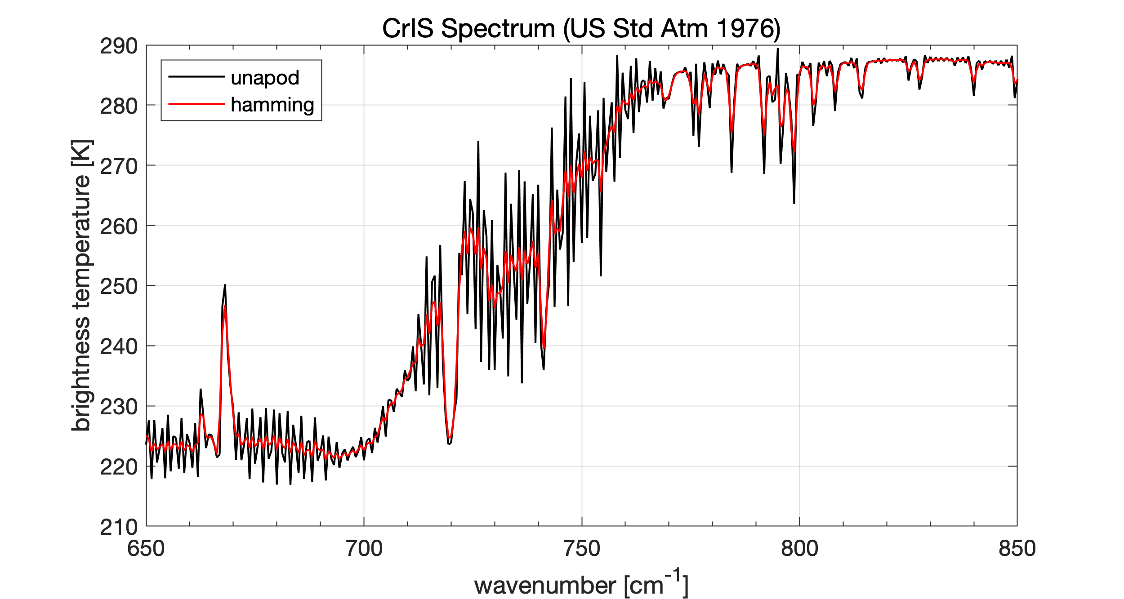
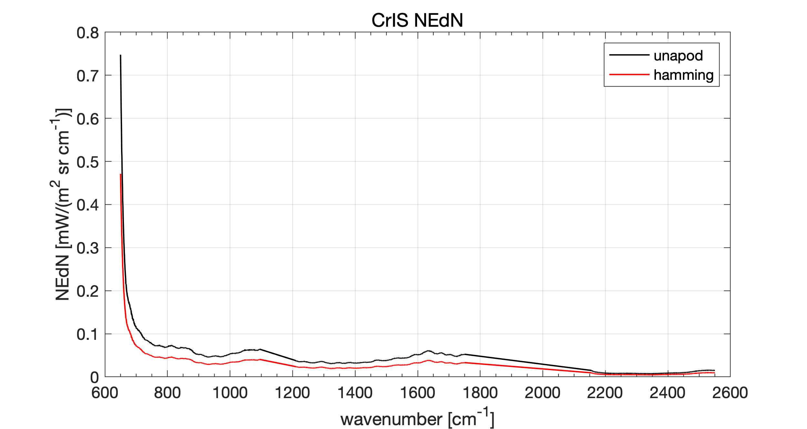
GeoXO Imager and Sounder Studies to Enhance PBL Moisture Information in the Pre-Convective Environment
CrIS Apodization Study
D. Tobin, 2023
NCEP and ECMWF channels and NEDR from ‘cris_list_DCT_20230124.txt’

Slide 2
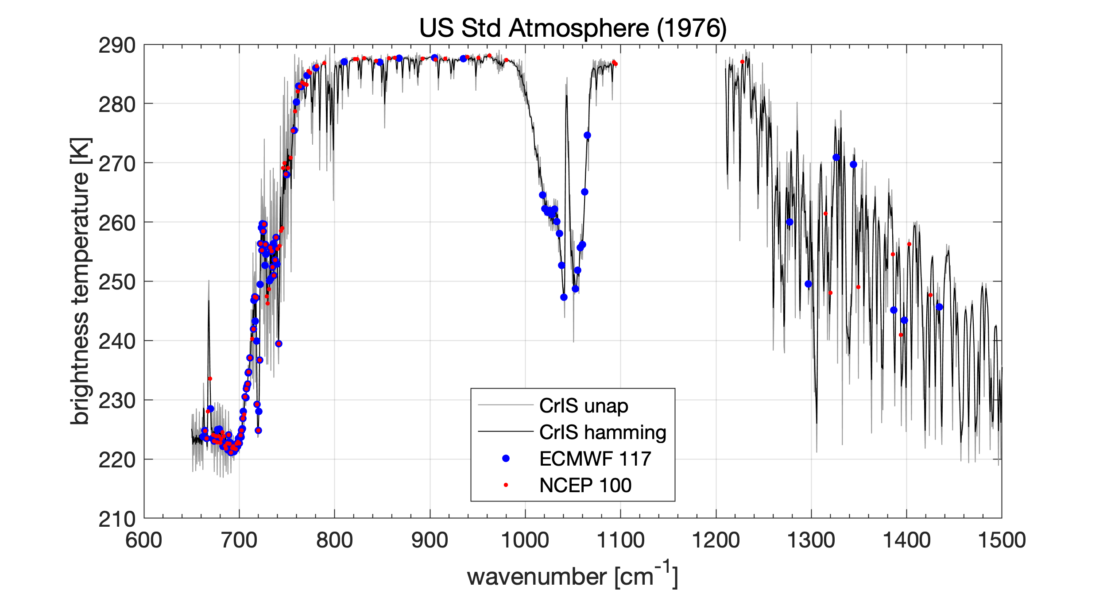
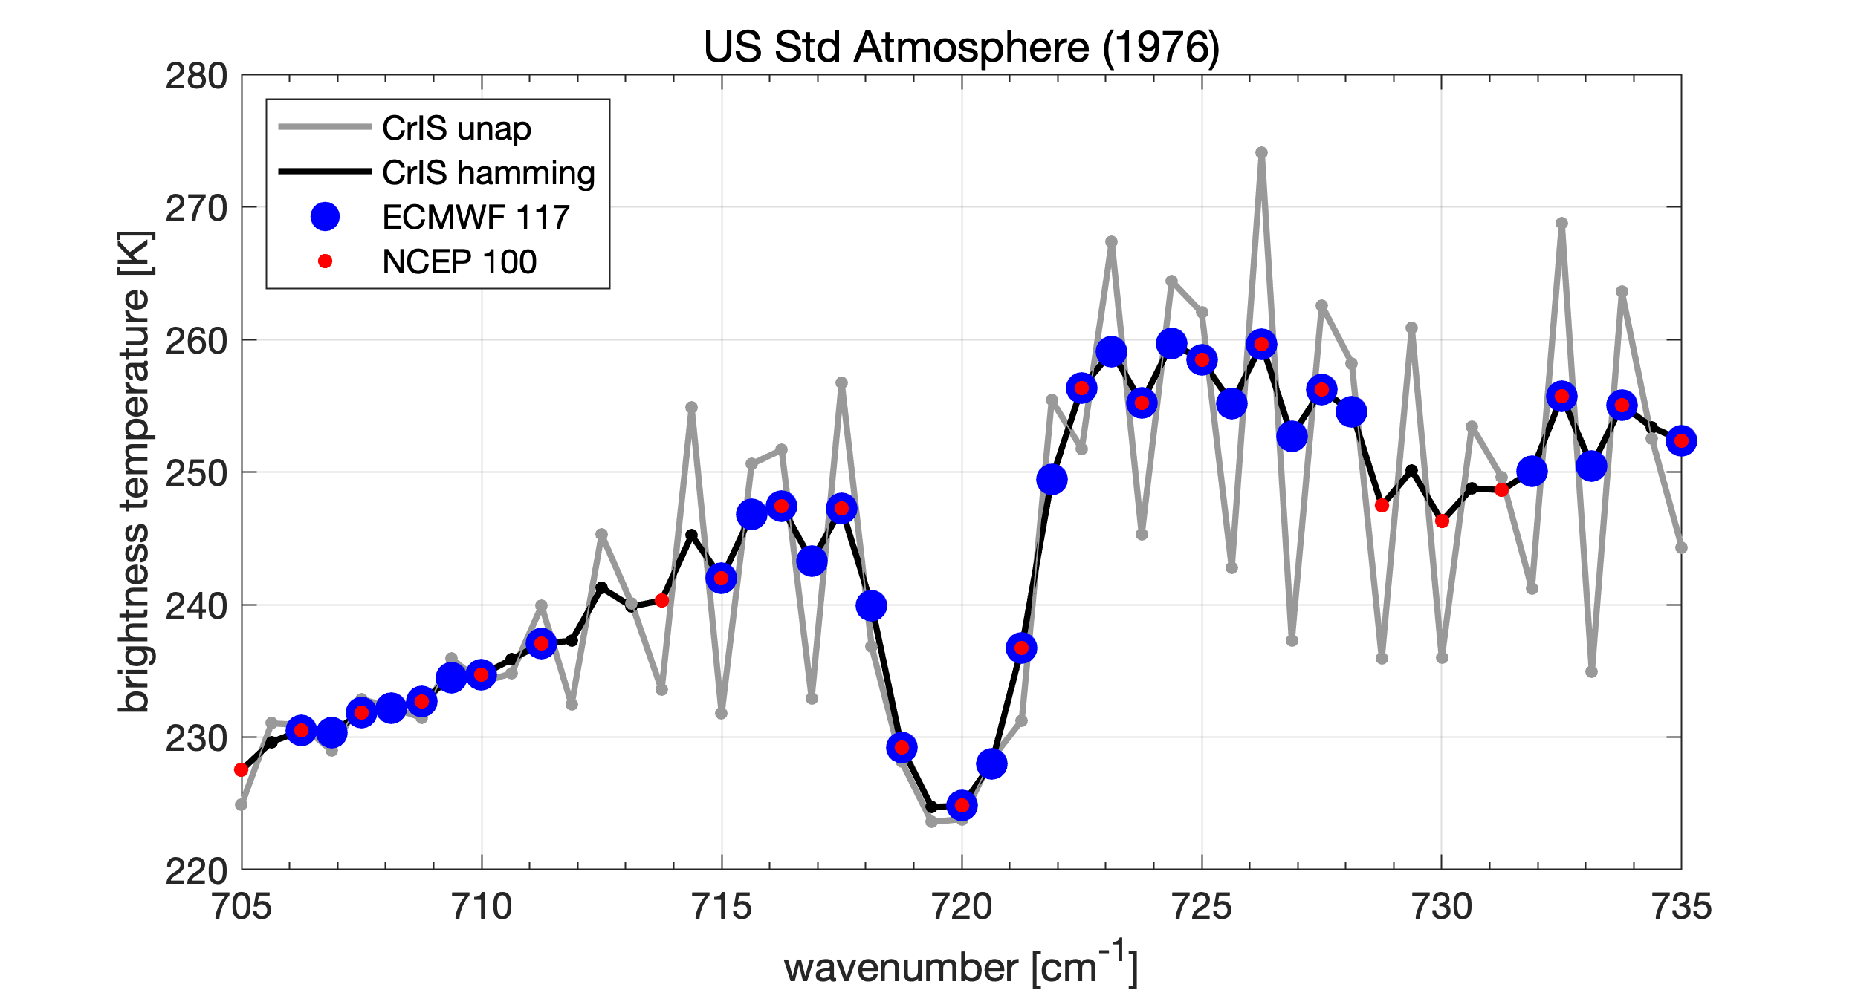
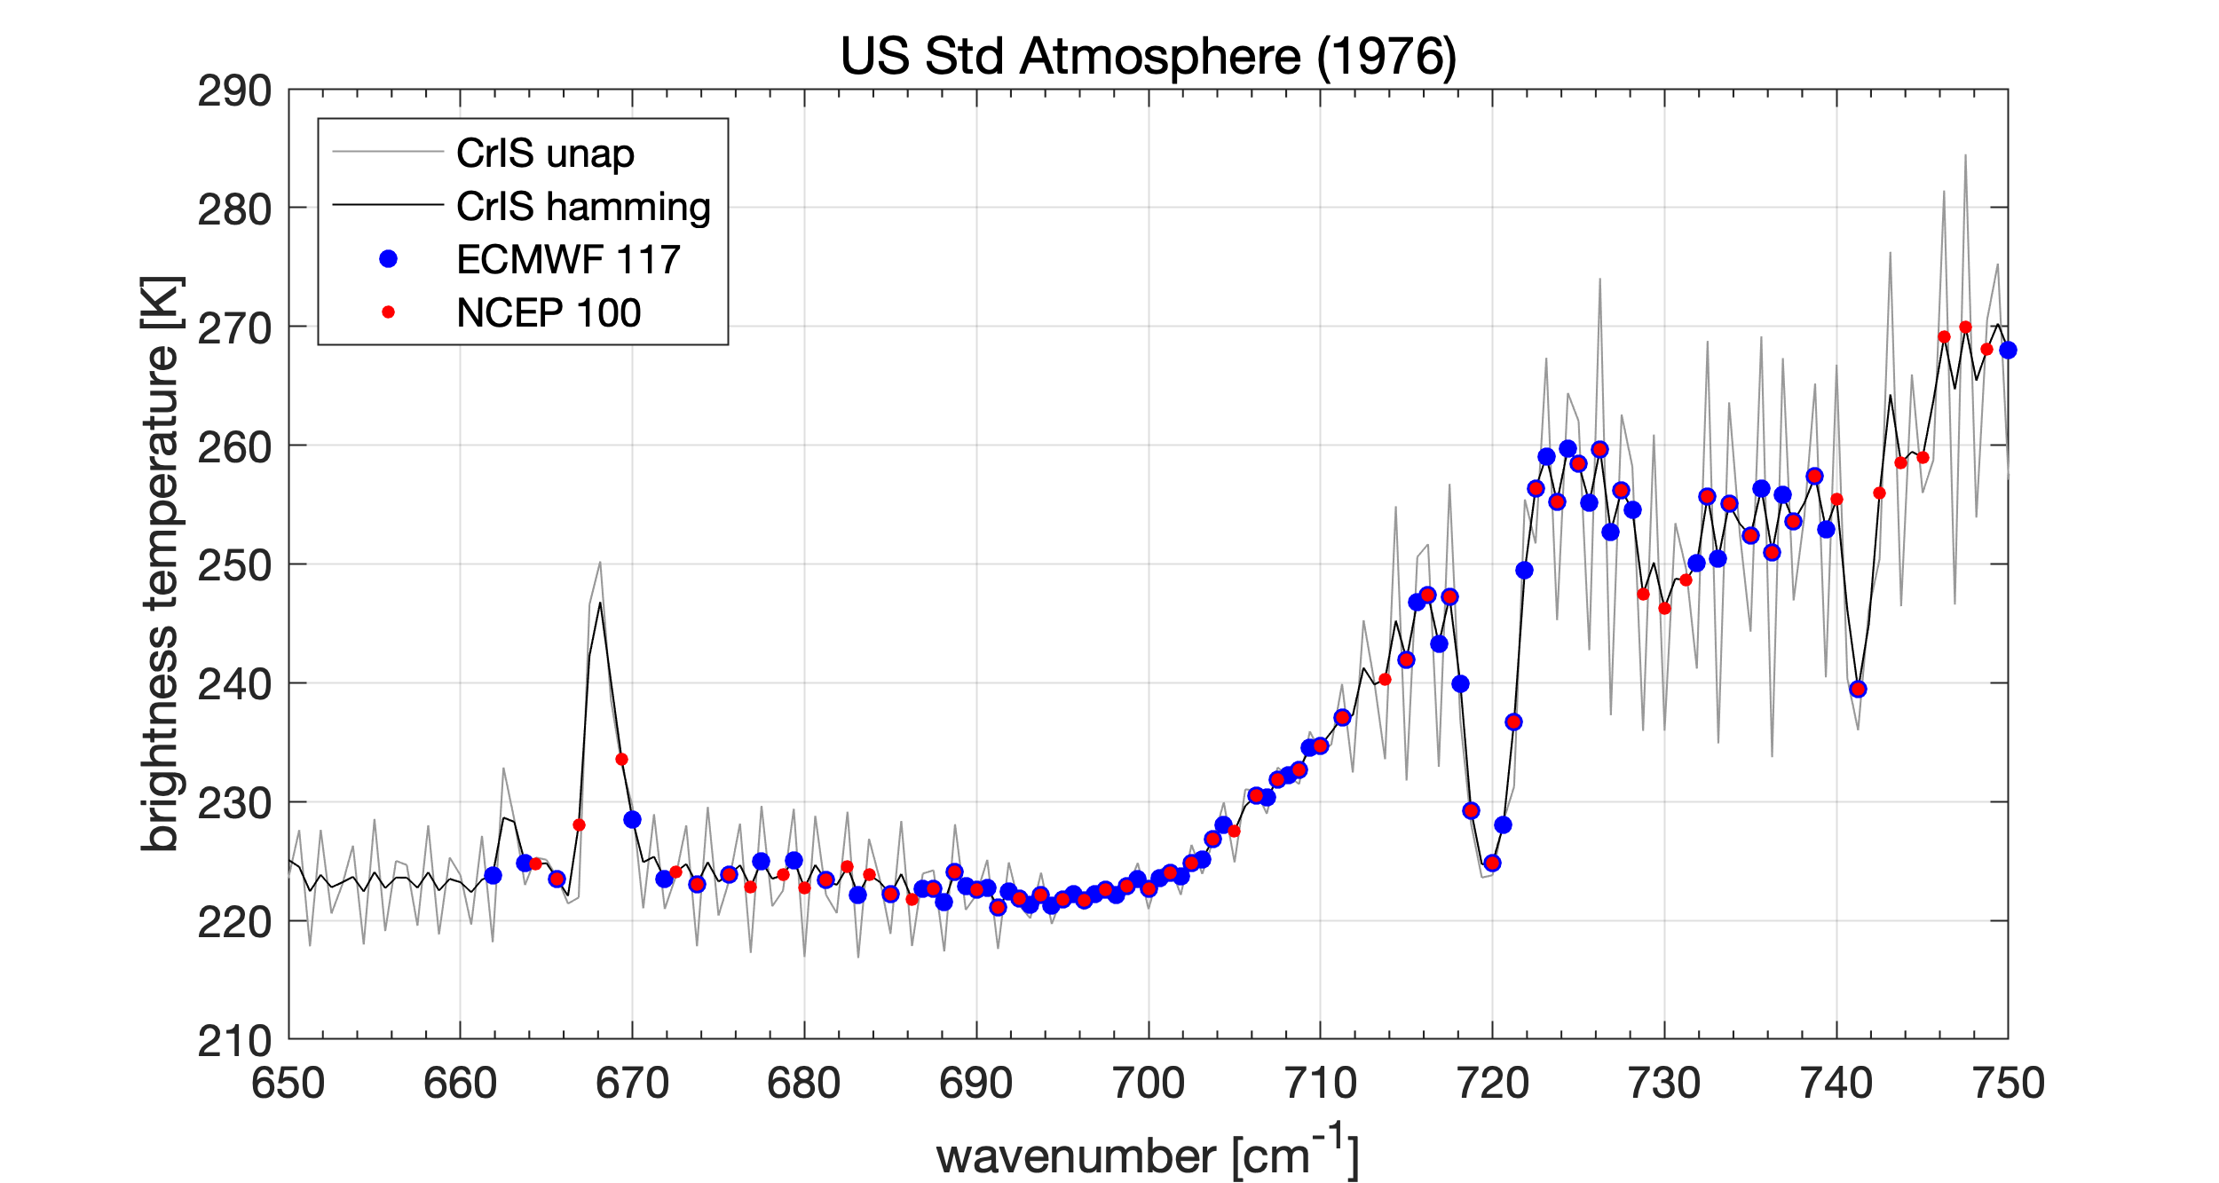
ECMWF (nchan=117) and NCEP (nchan=100) Channel Sets
From: CrIS_Spectral_Analysis_10May23. pptx
See Appendix (or CrIS_Spectral_Analysis_27Jul23. pptx)
for IC, DoF, RTVl comparisons

Slide 3
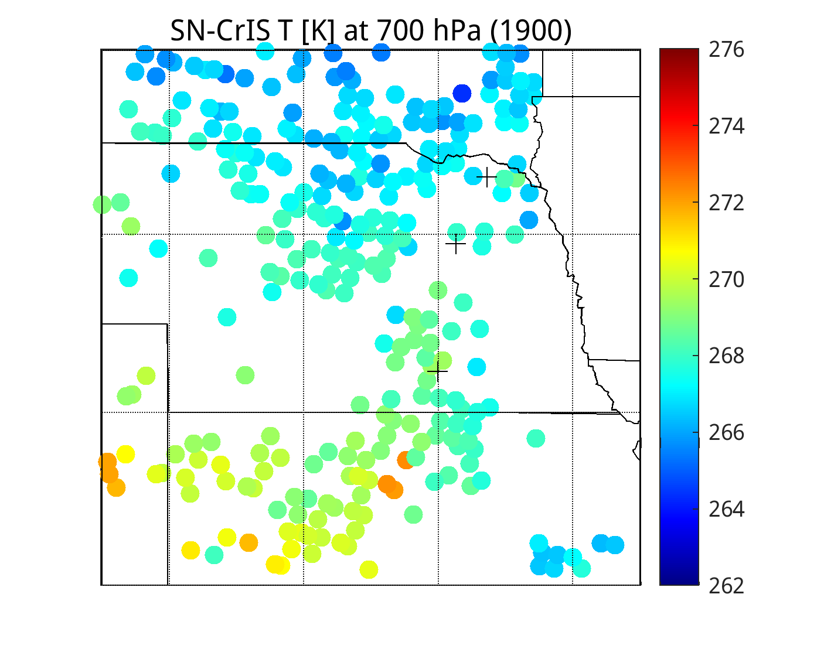
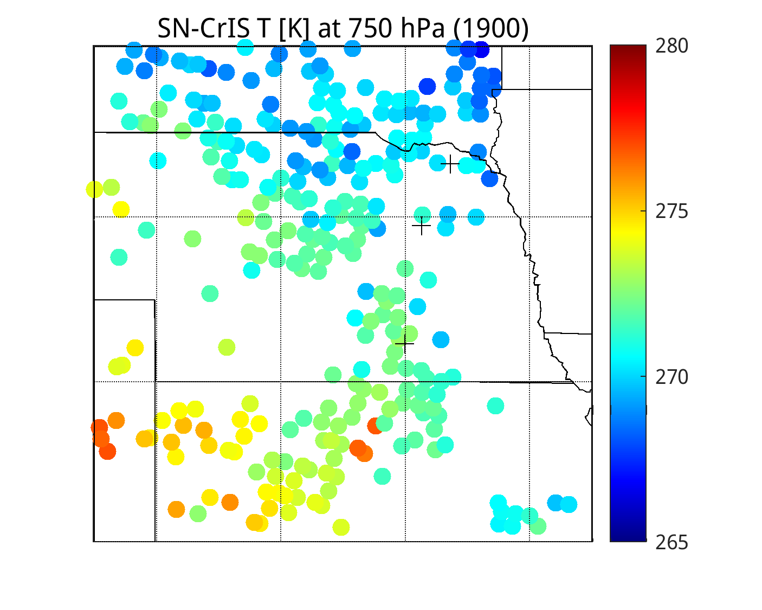
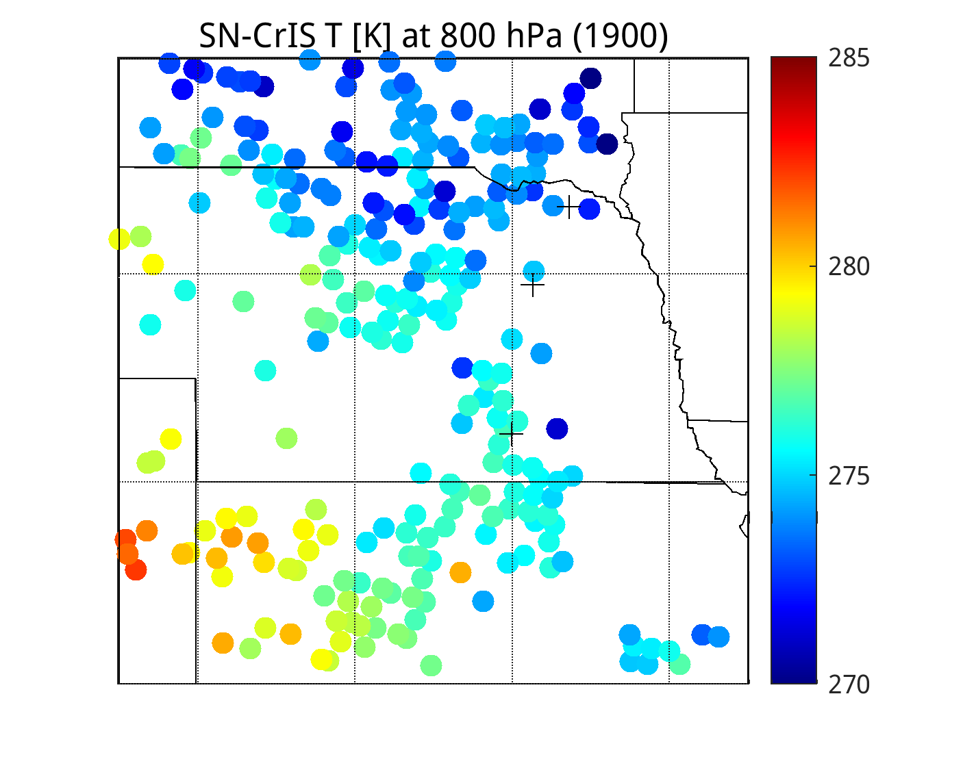
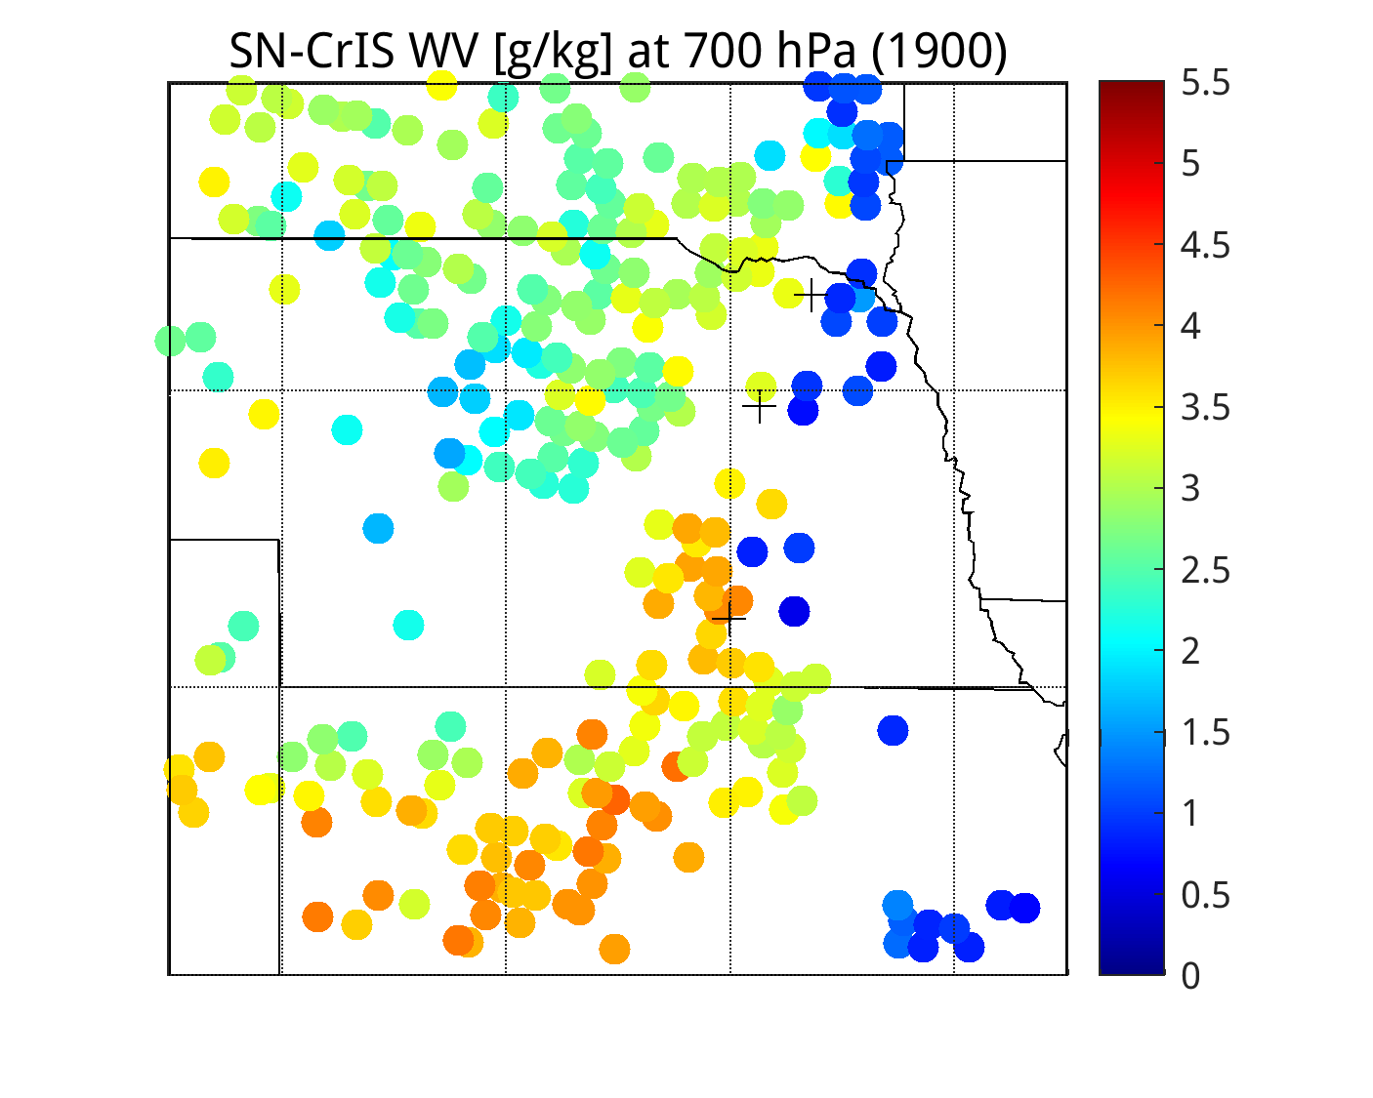
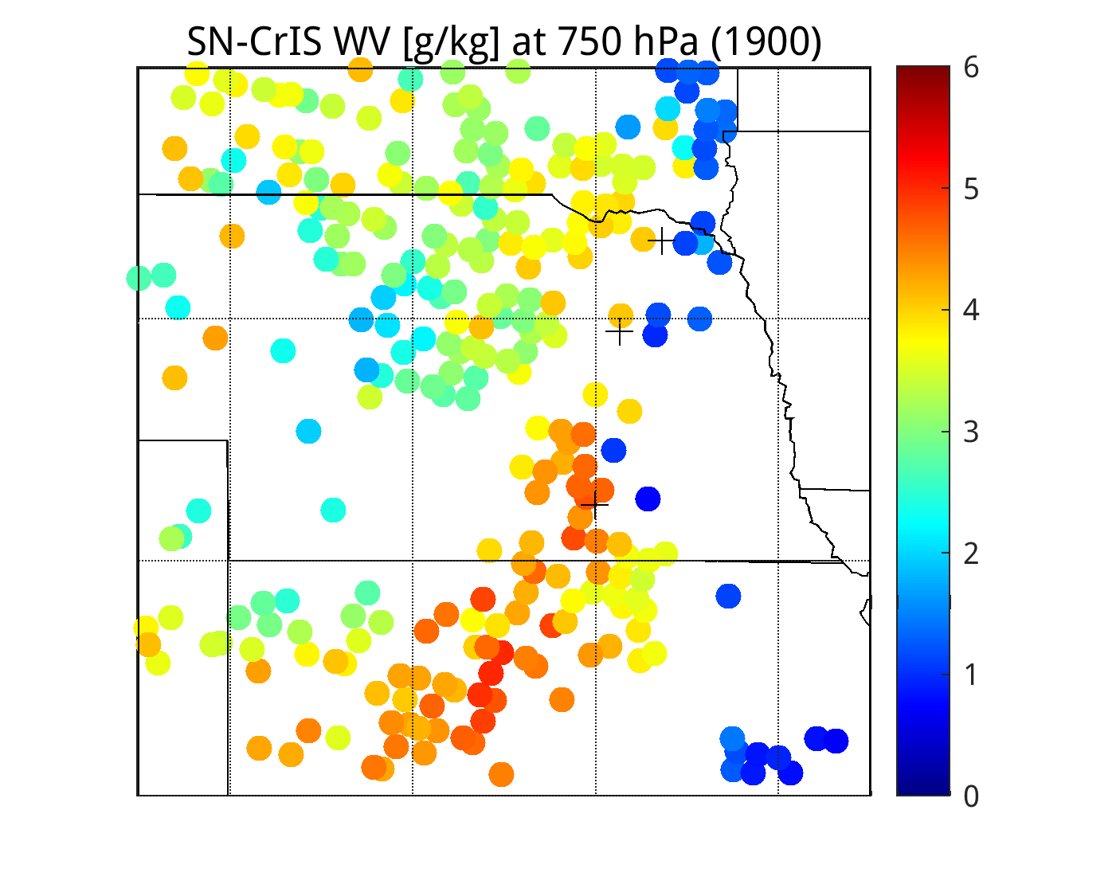
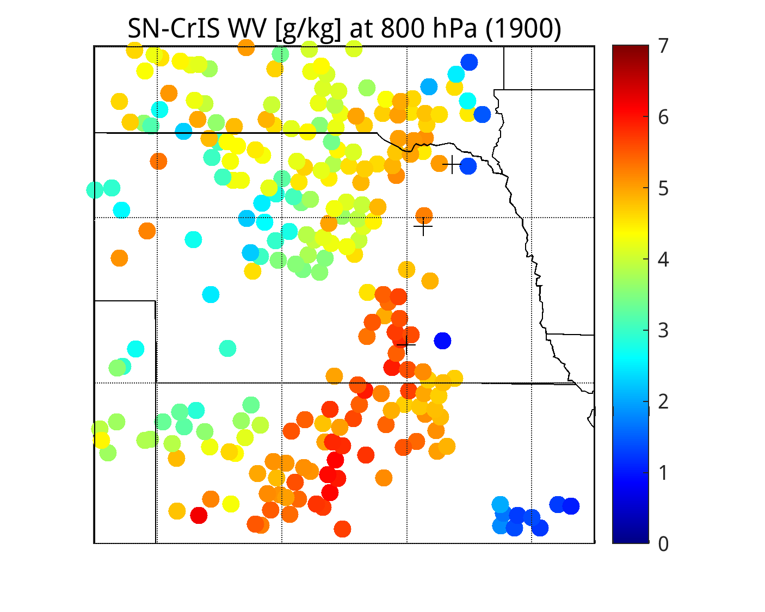
Full Spectrum CrIS Dual-Regression Retrievals

Slide 4
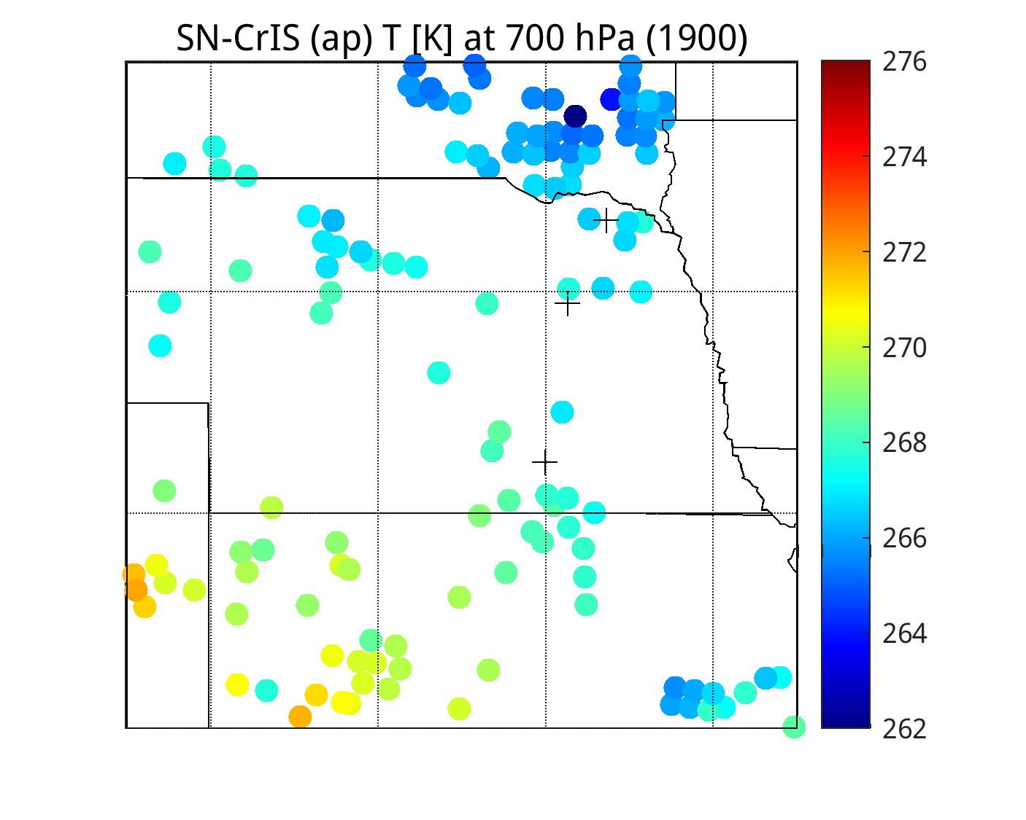
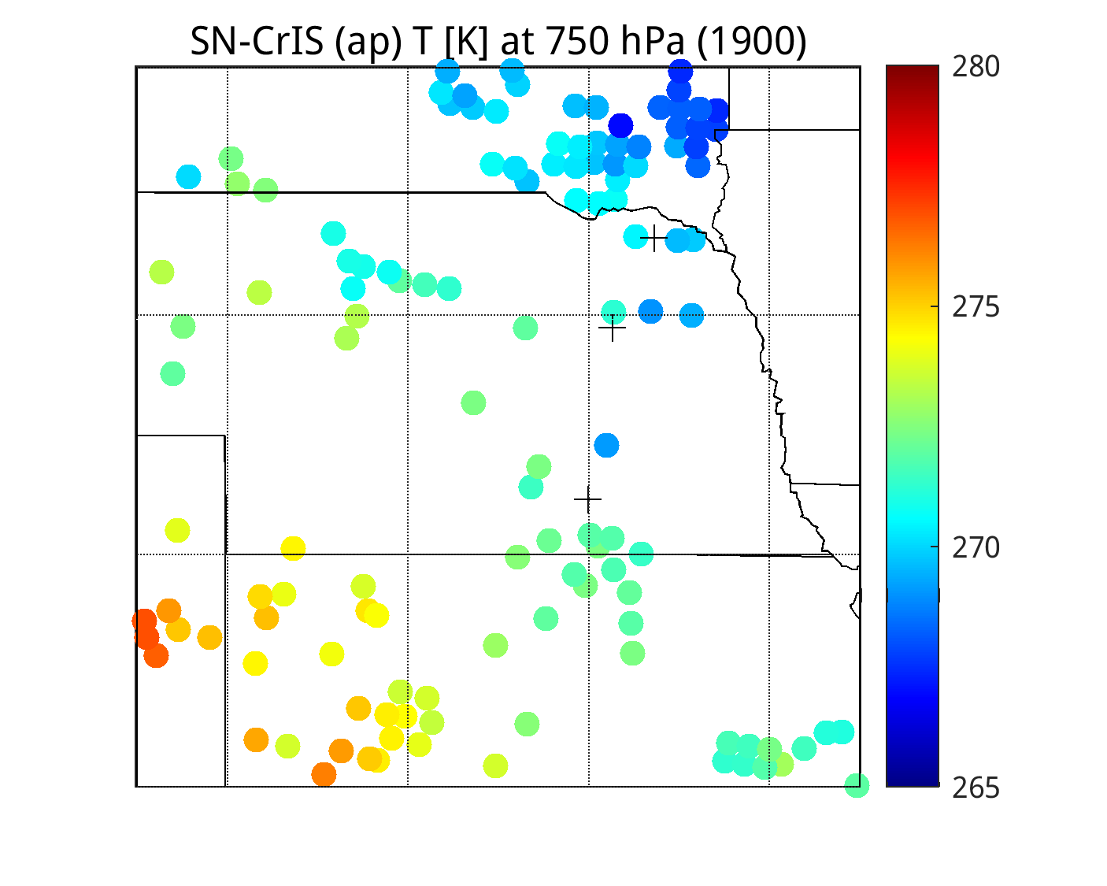
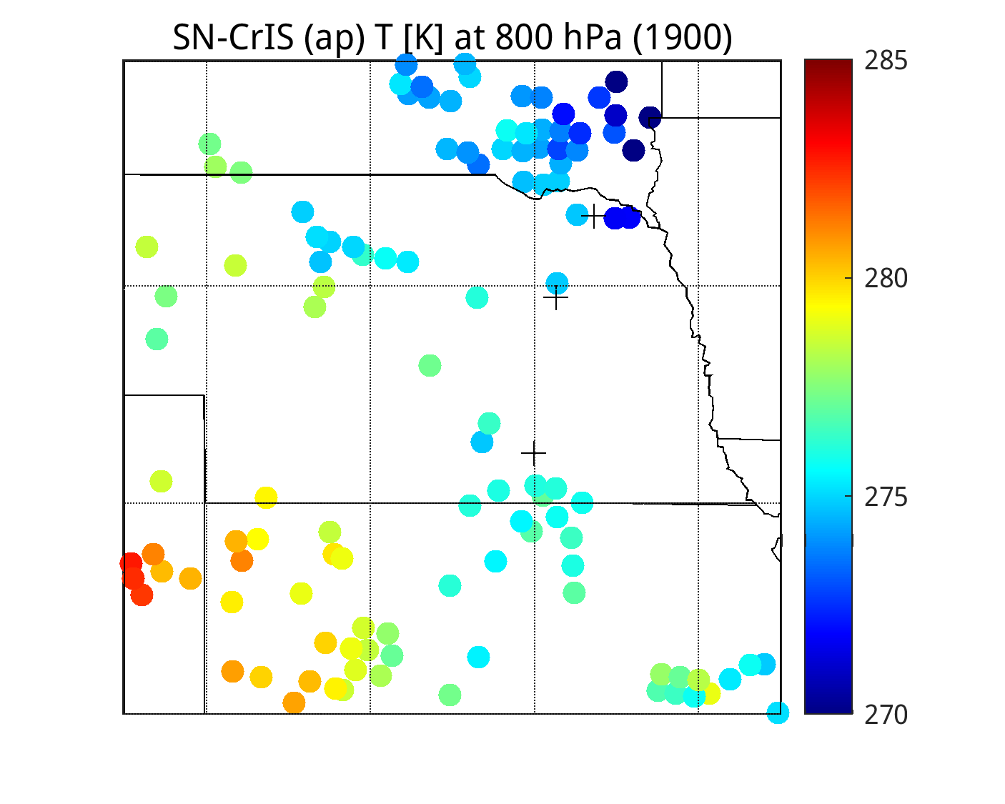
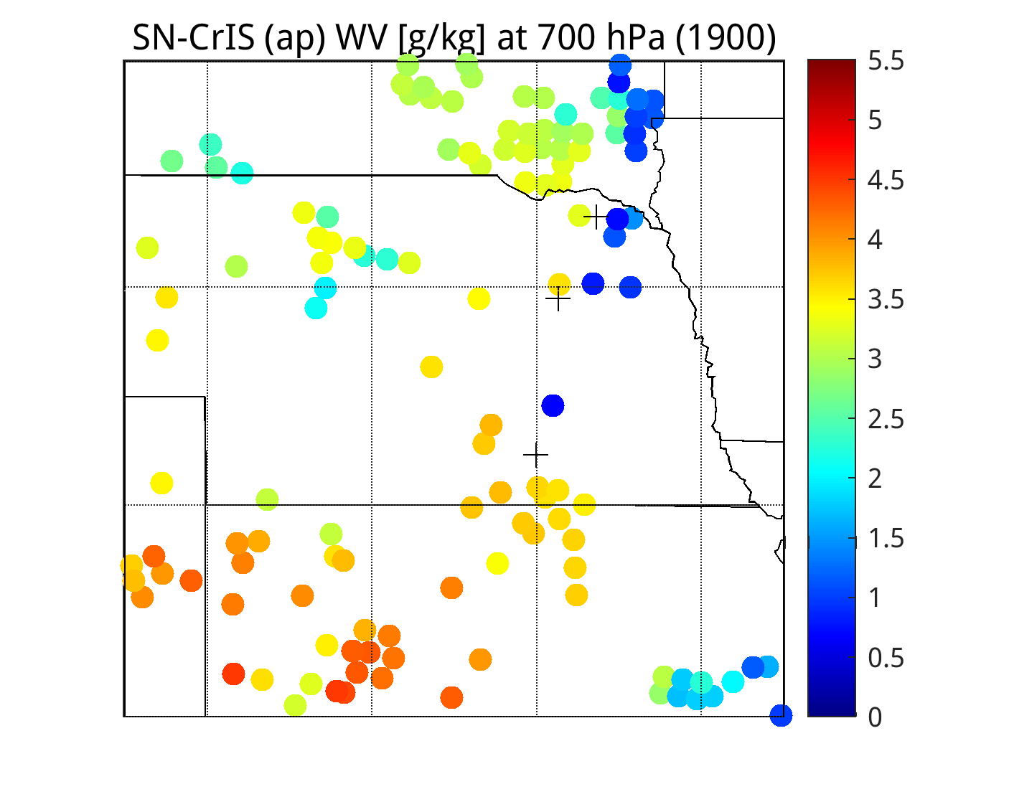
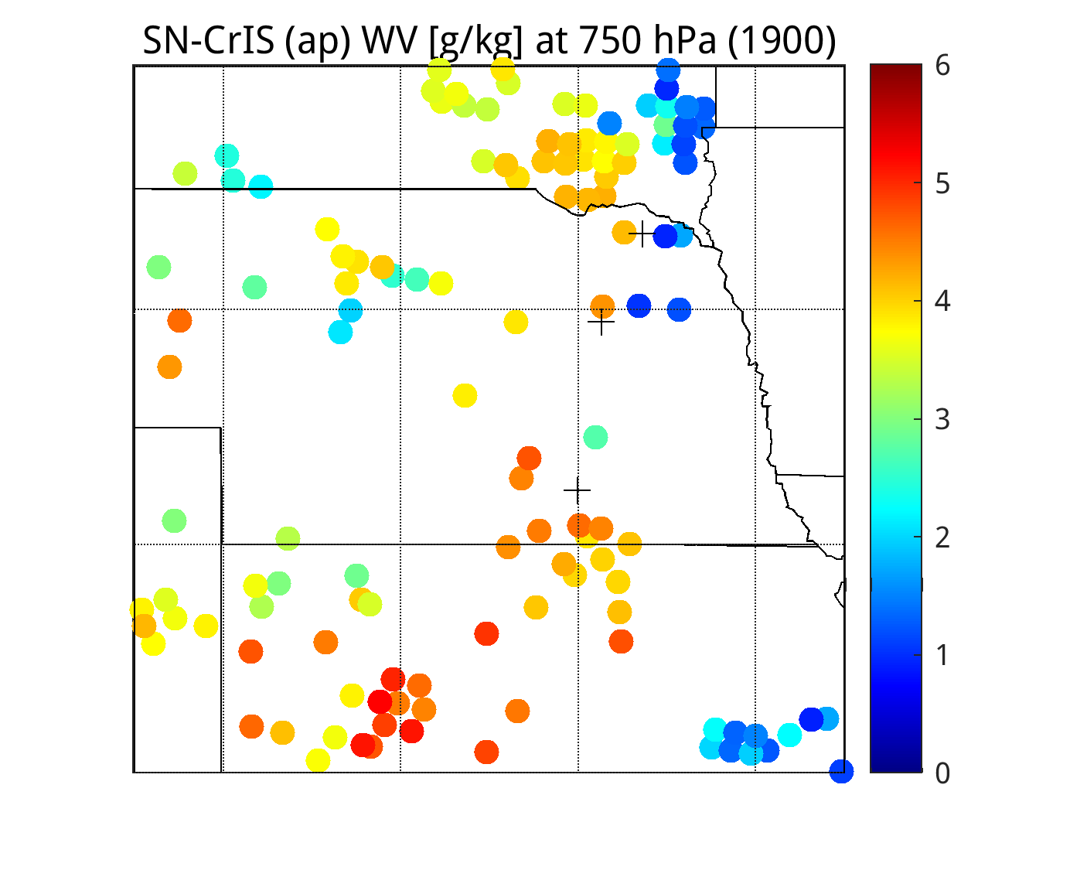
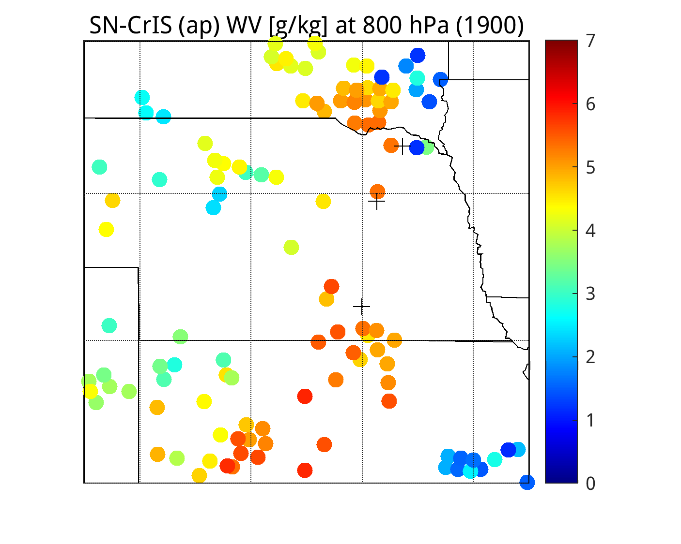
Full Spectrum Apodized CrIS Dual-Regression Retrievals

Slide 5
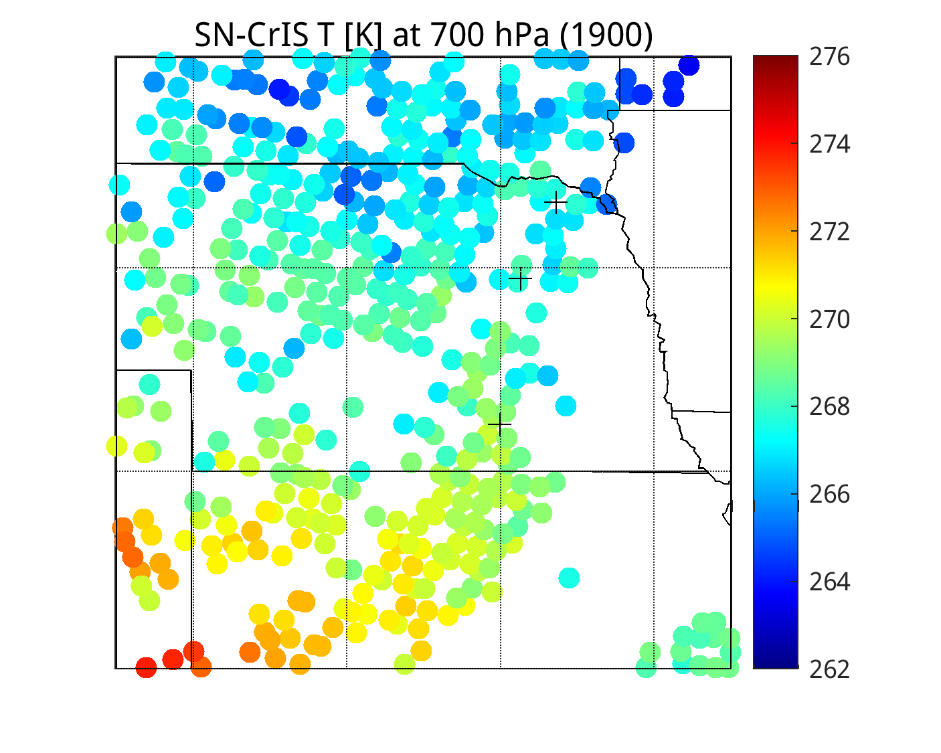
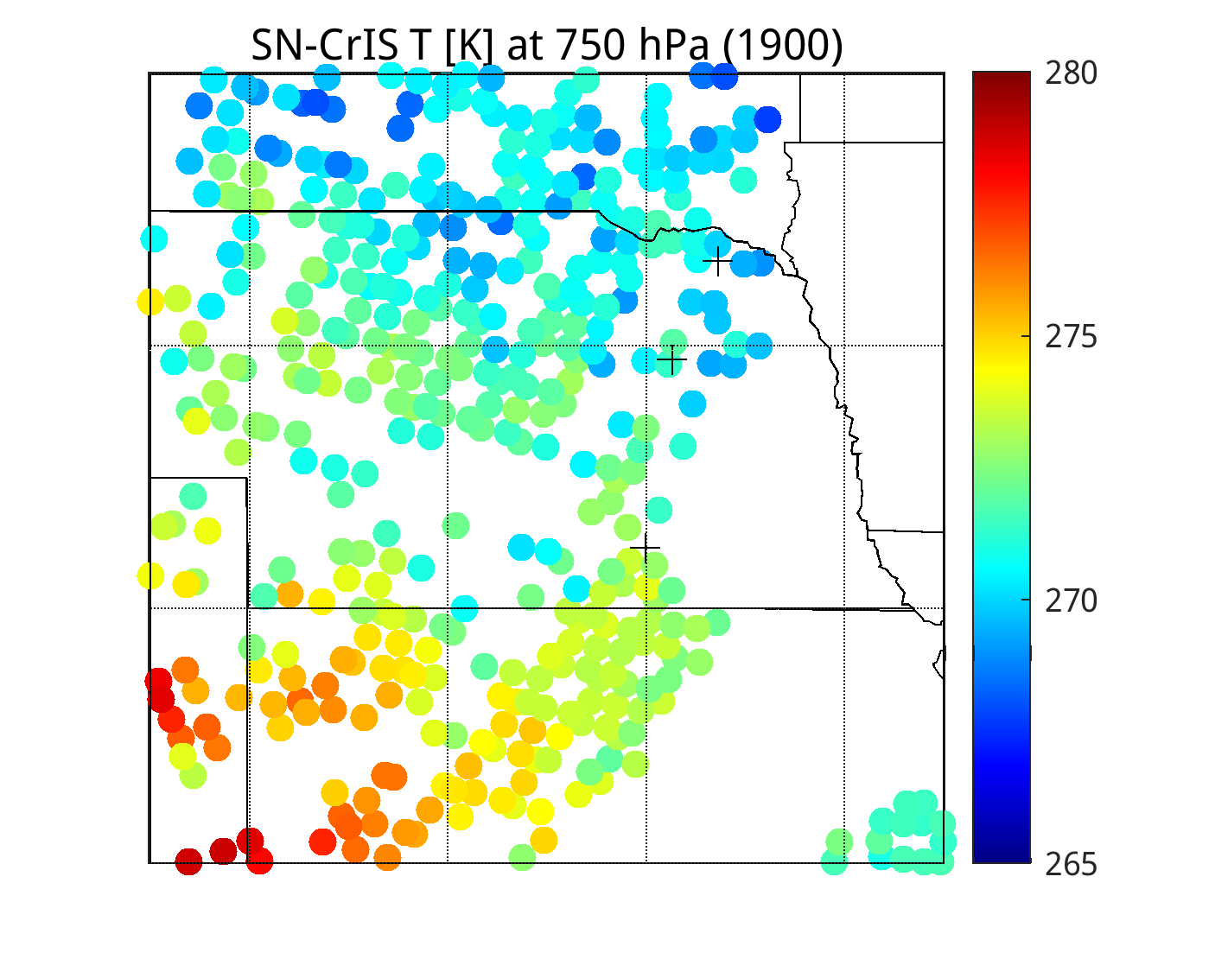
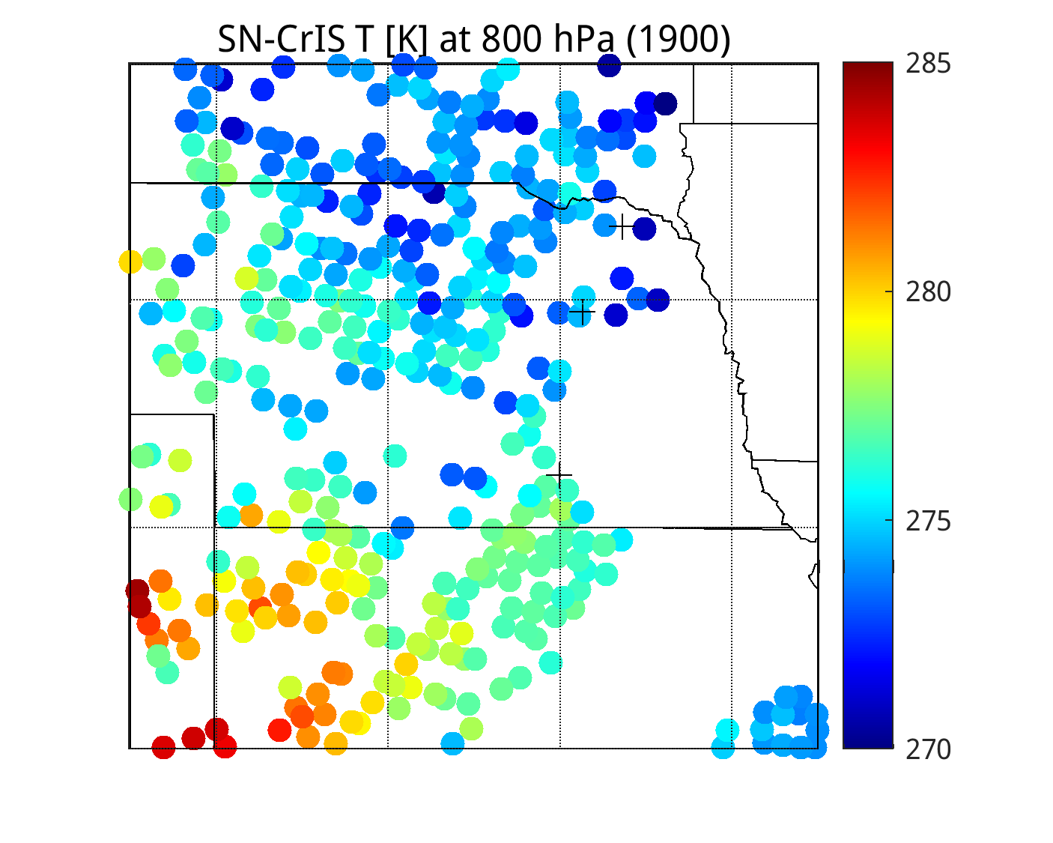
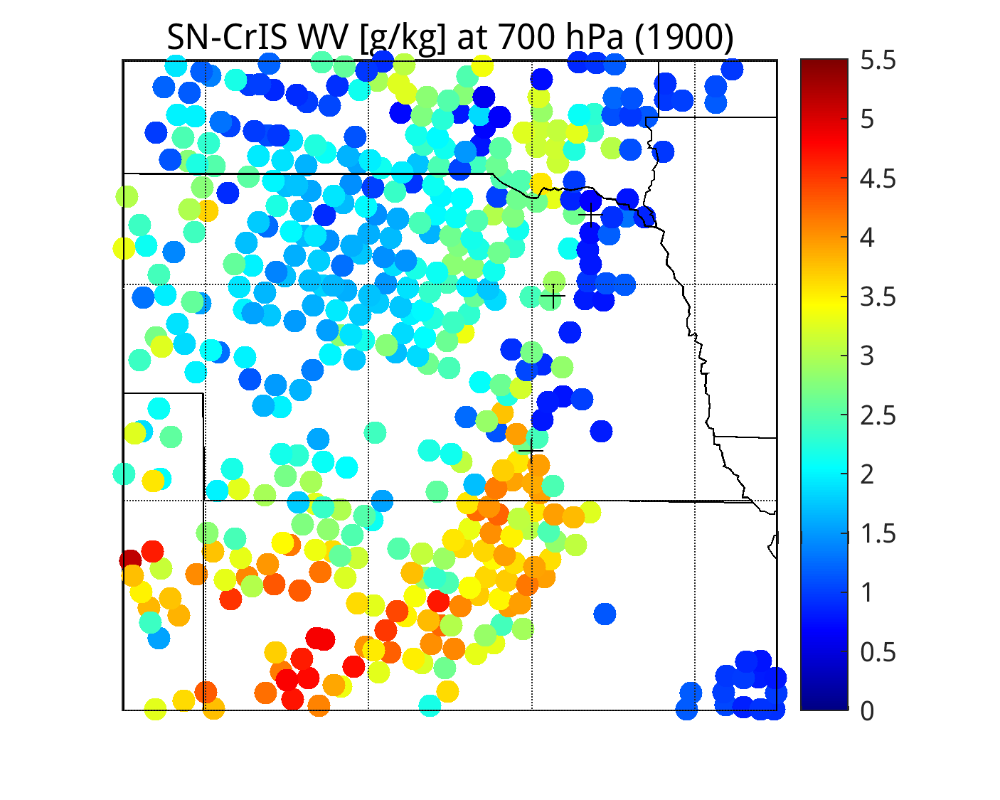
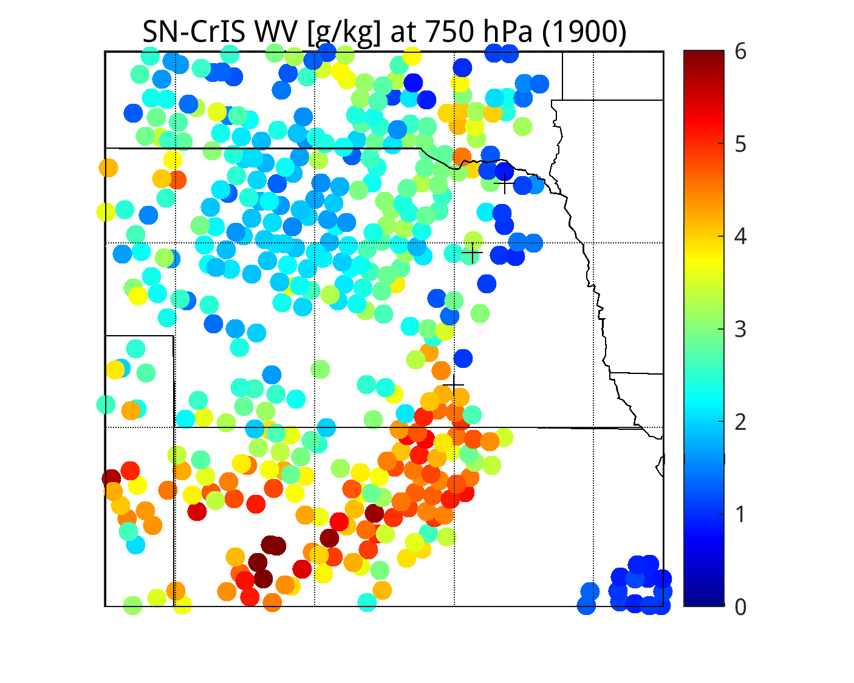
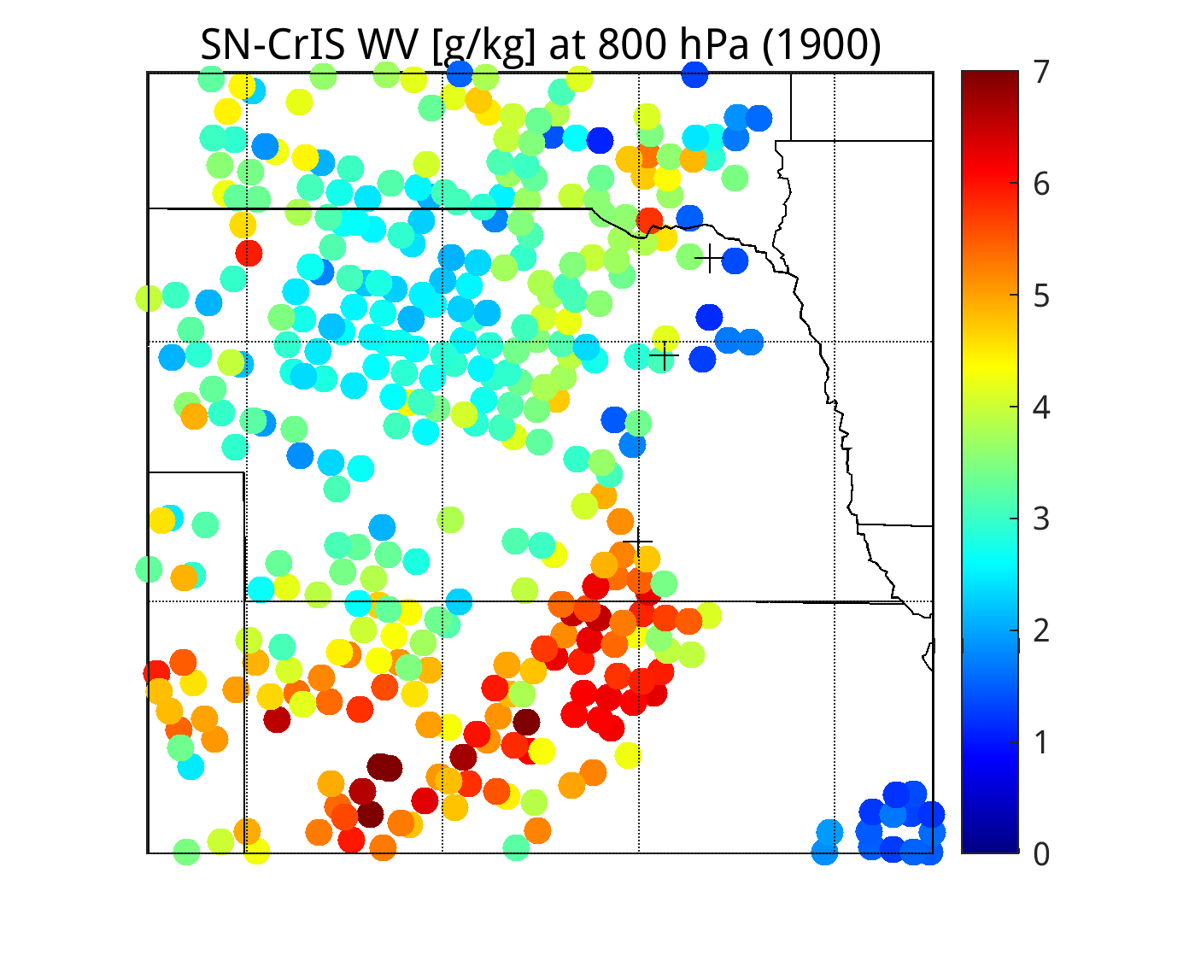
ECMWF (nchan=117) CrIS Dual-Regression Retrievals

Slide 6
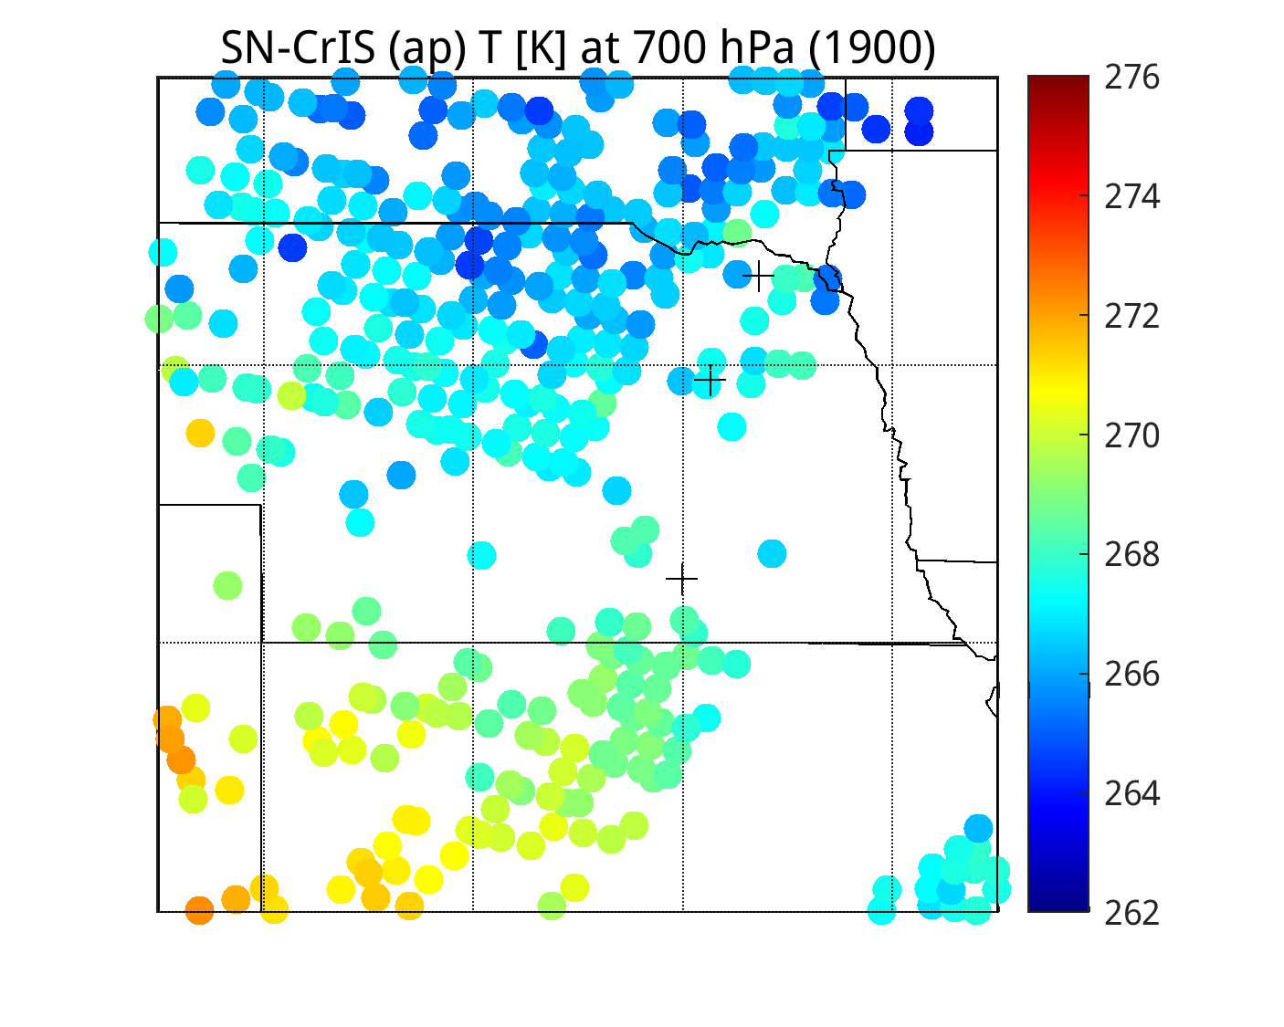
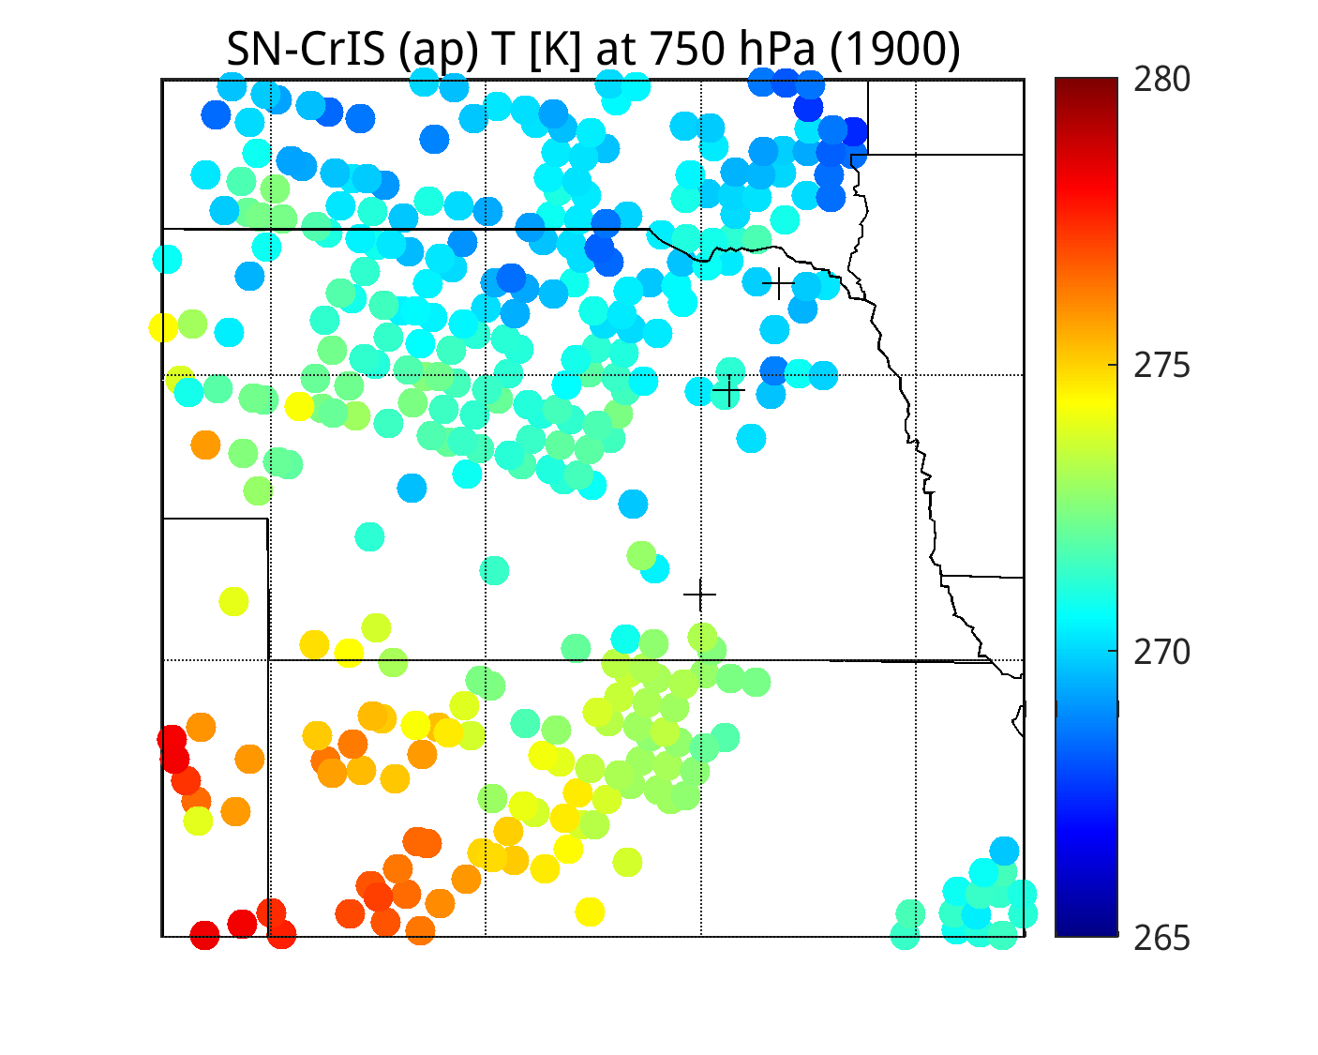
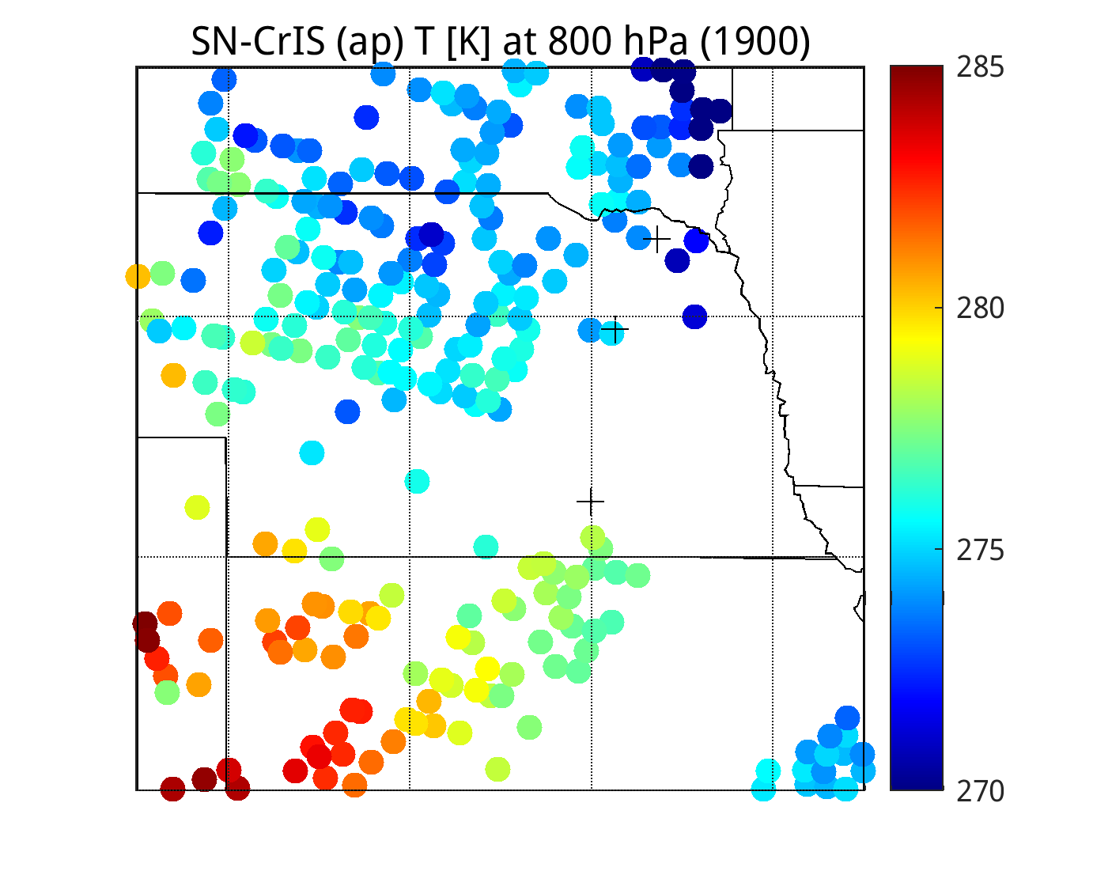
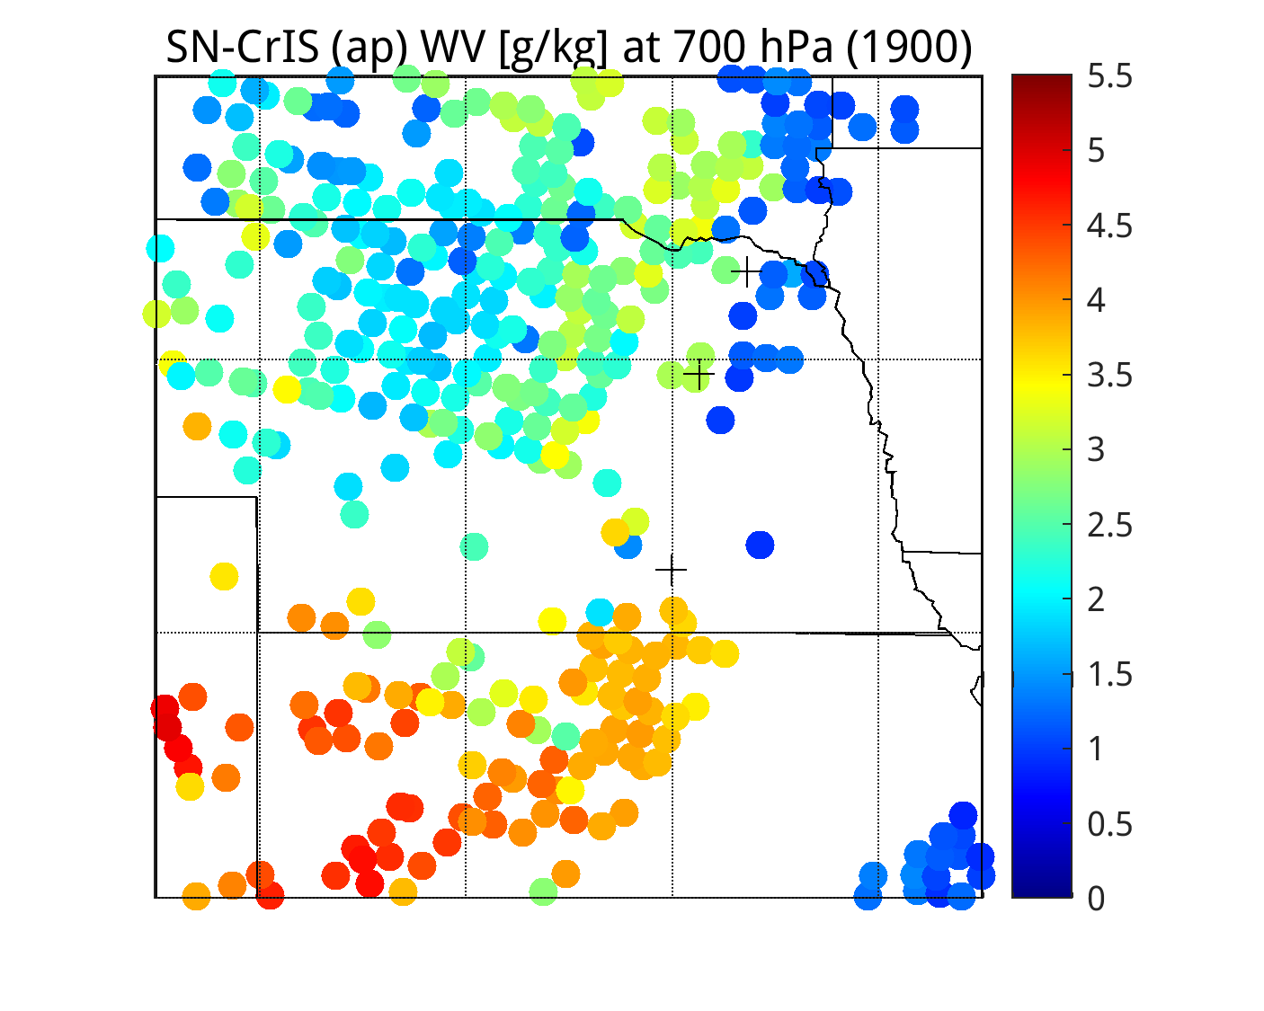
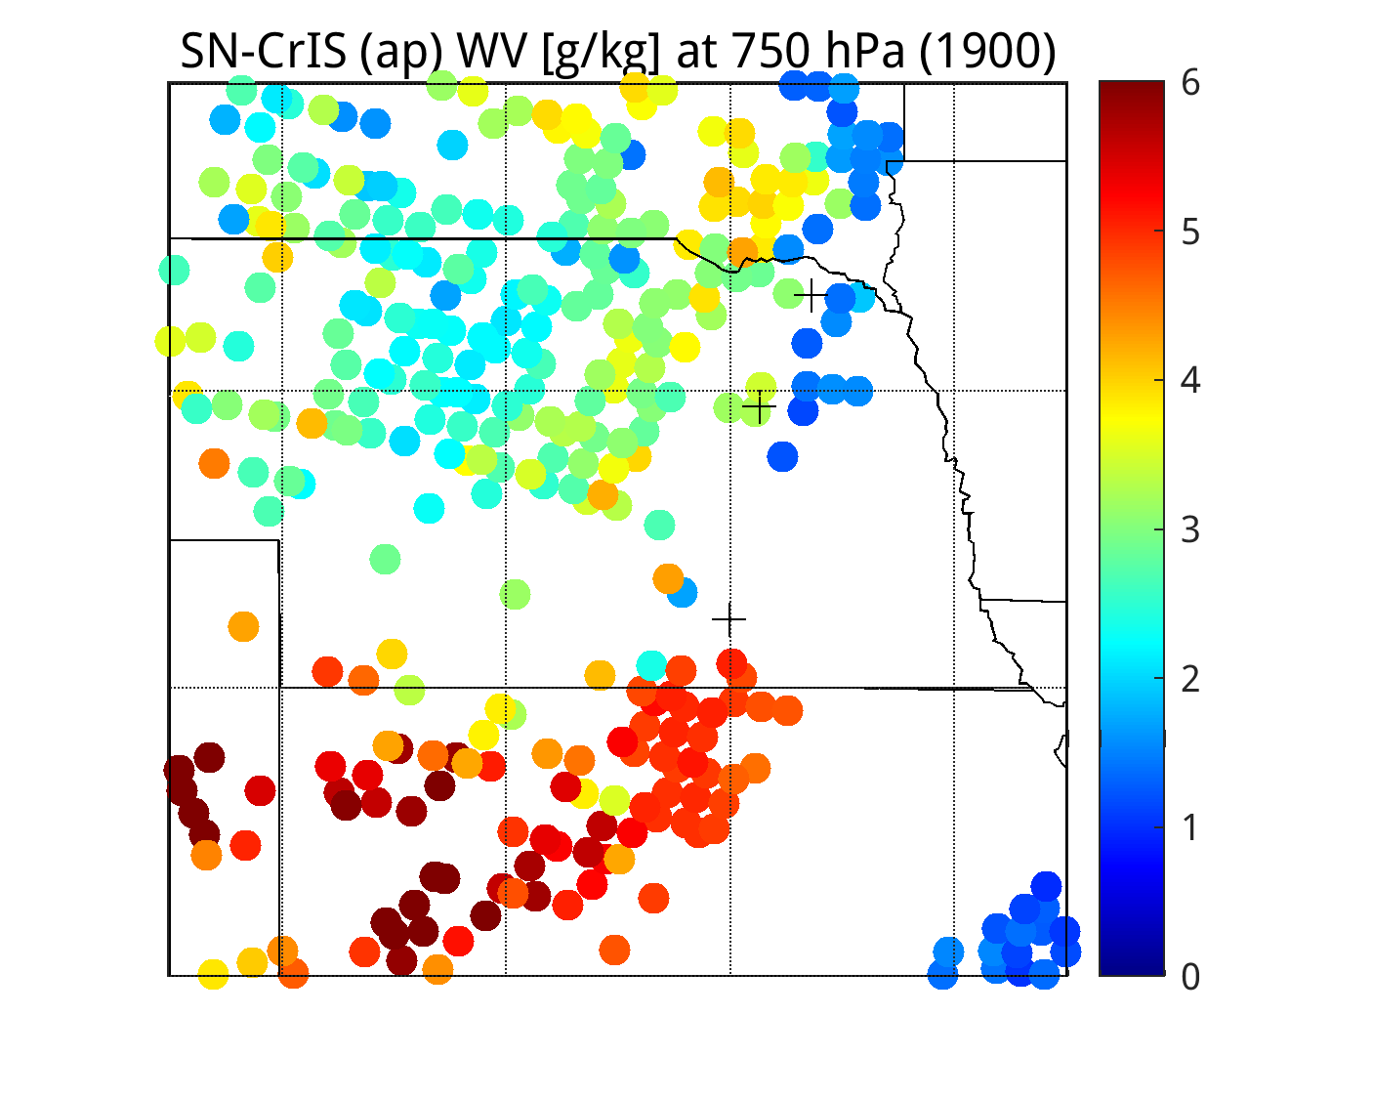
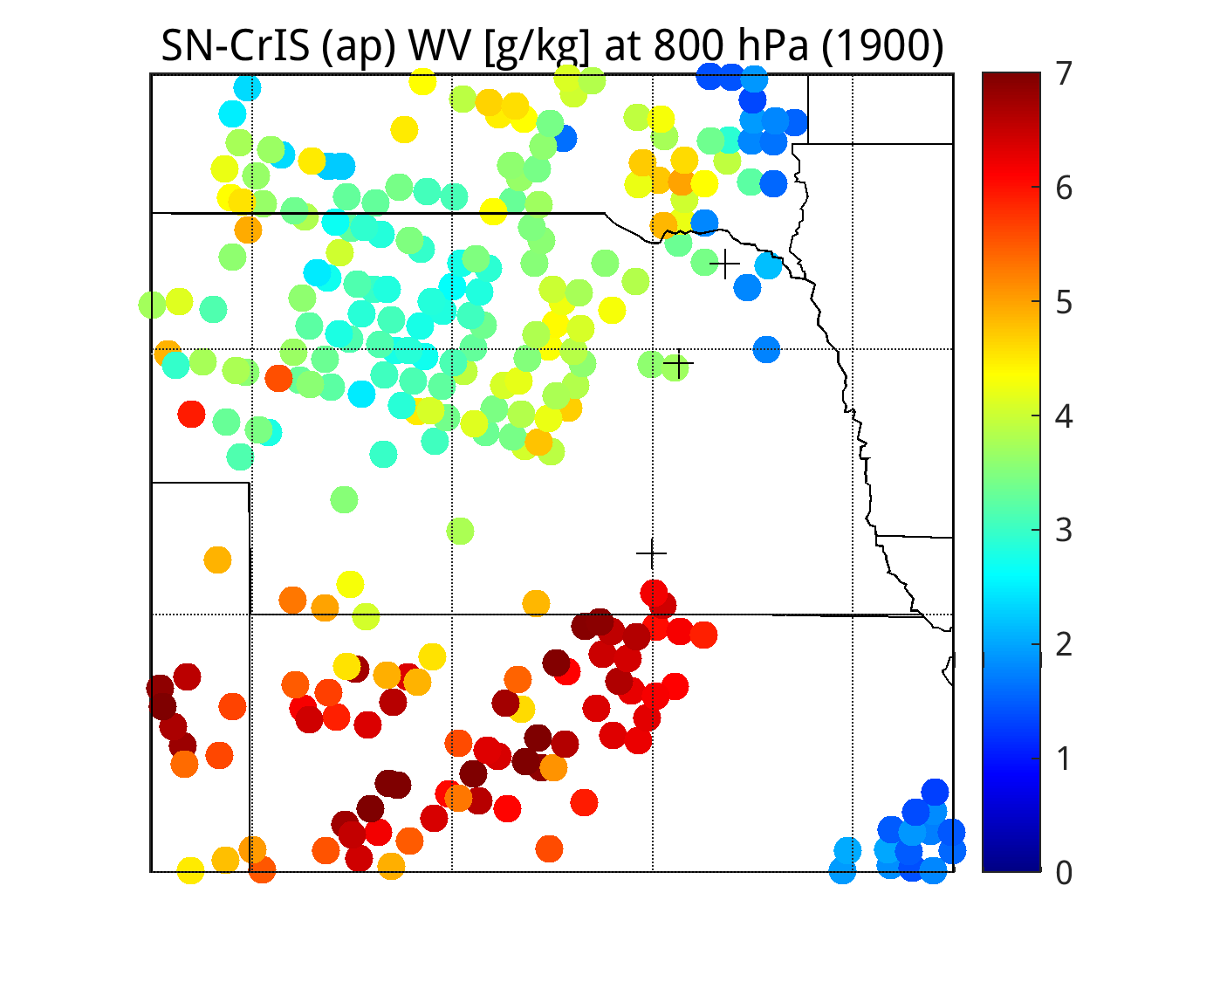
ECMWF (nchan=117) Apodized CrIS Dual-Regression Retrievals

Slide 7
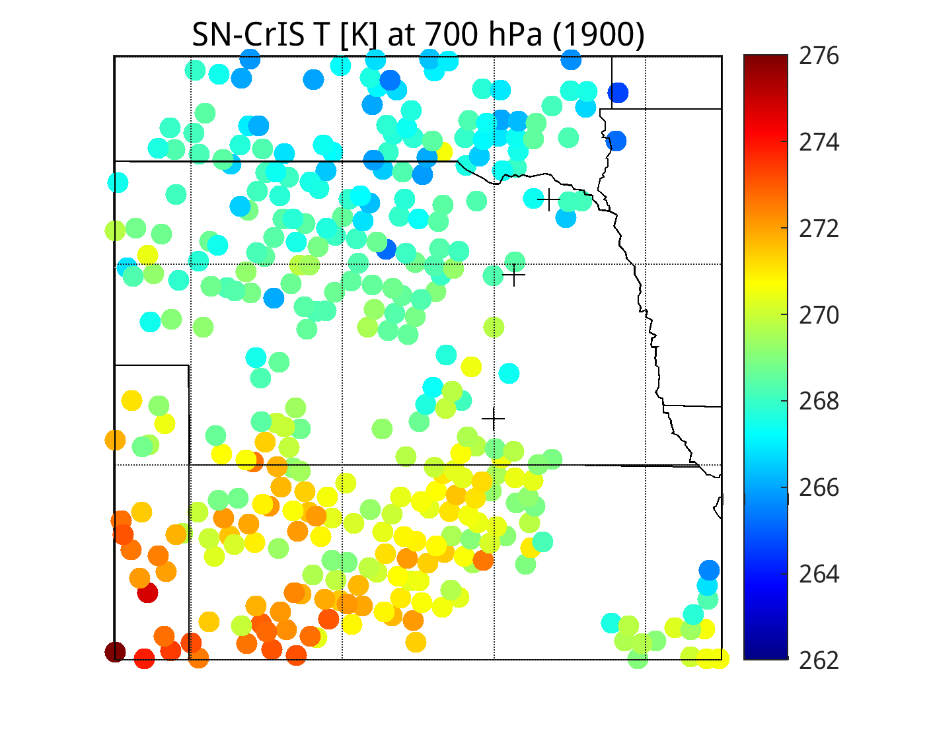
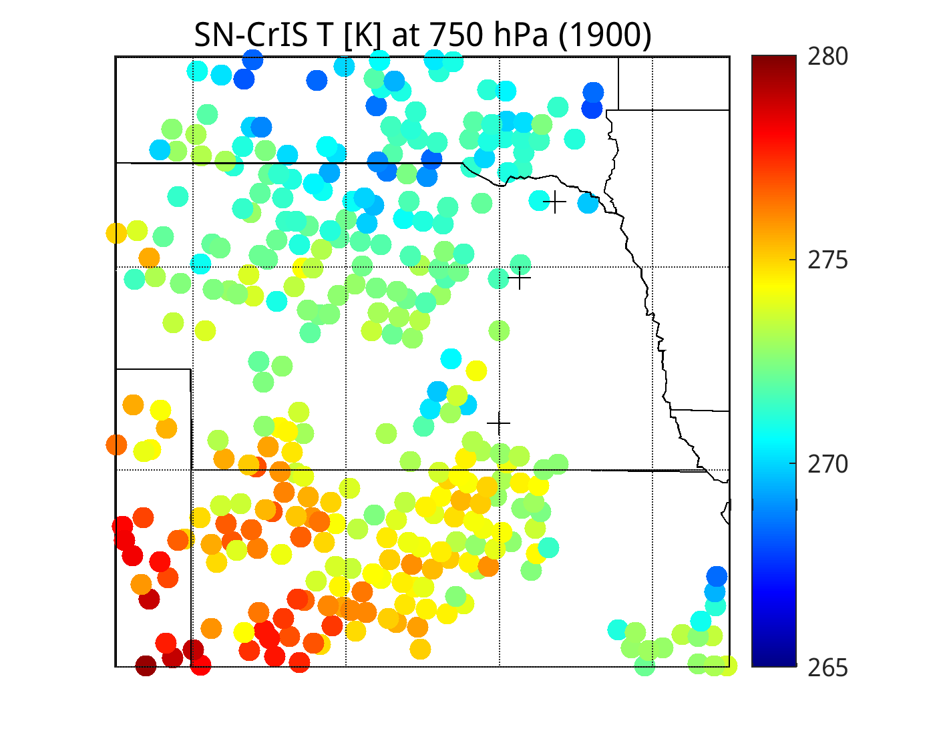
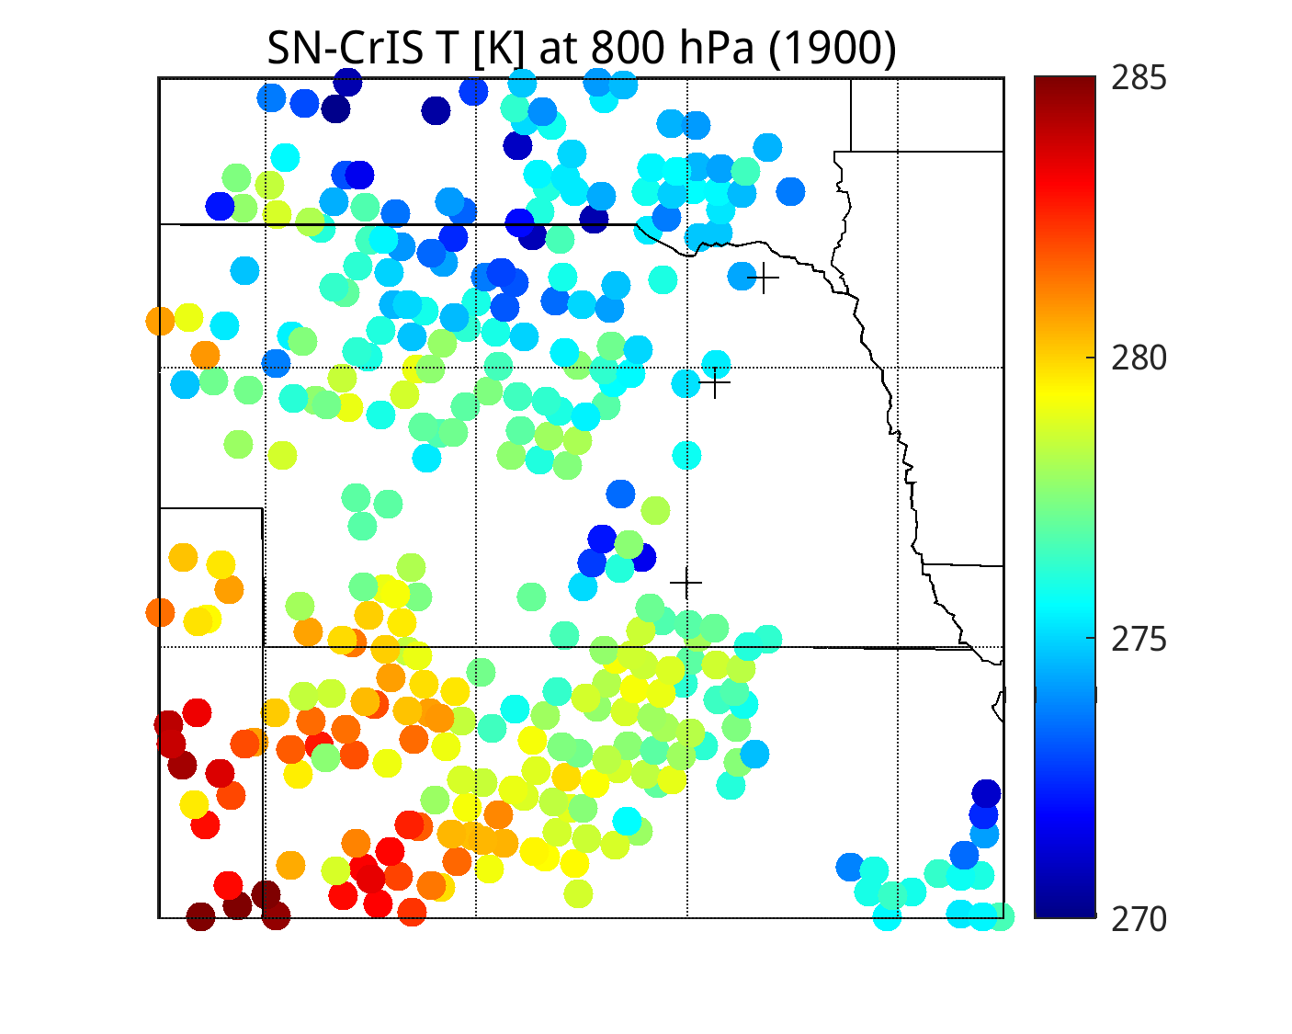
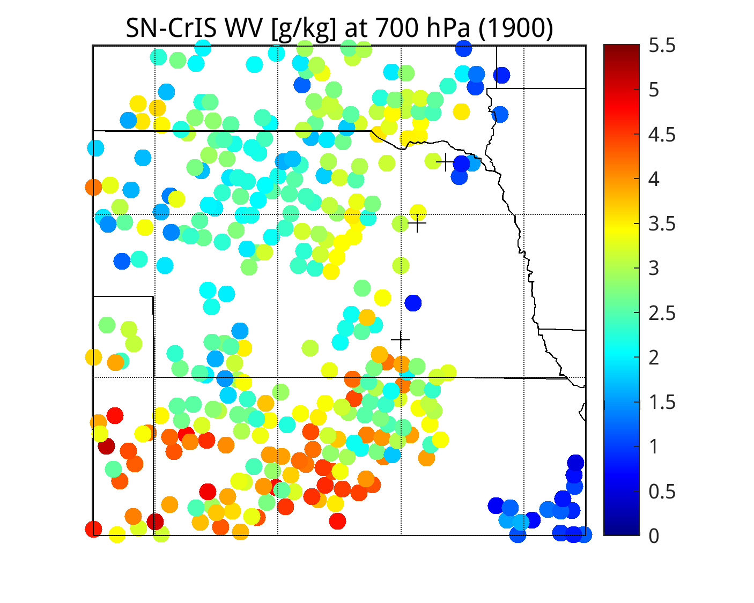
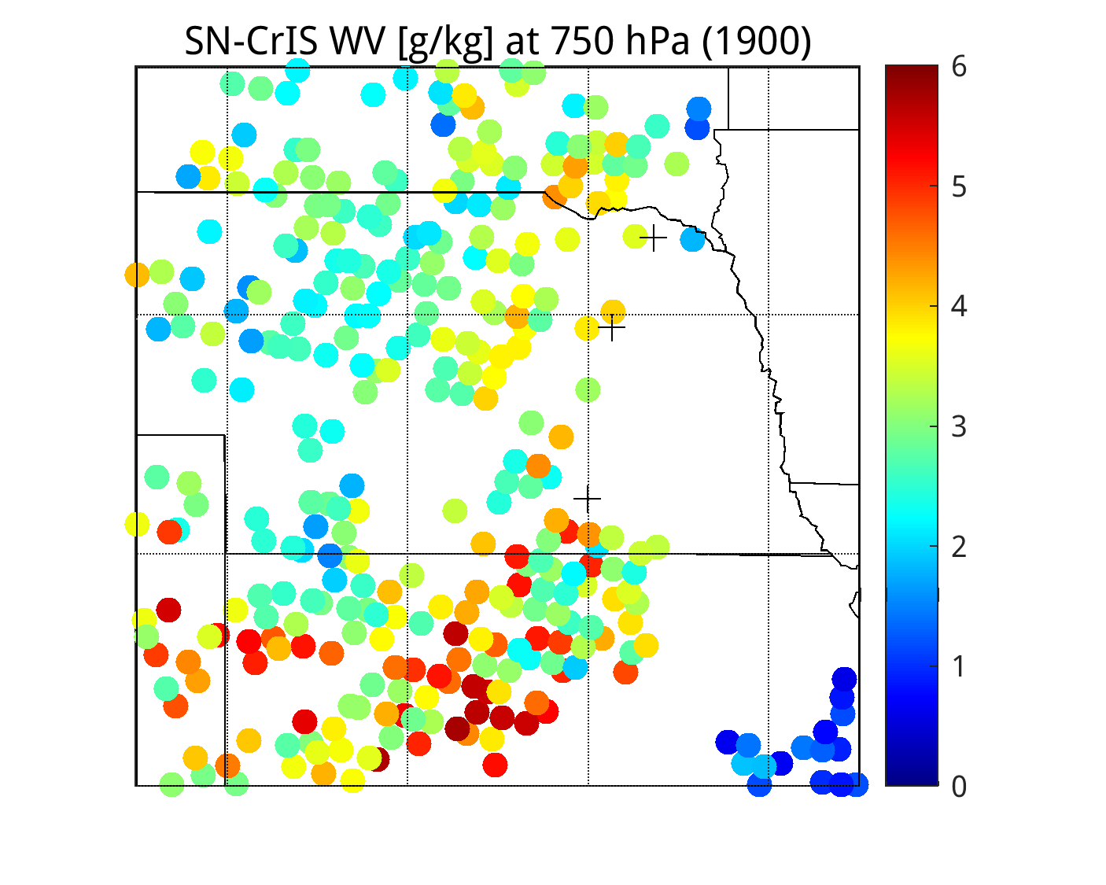
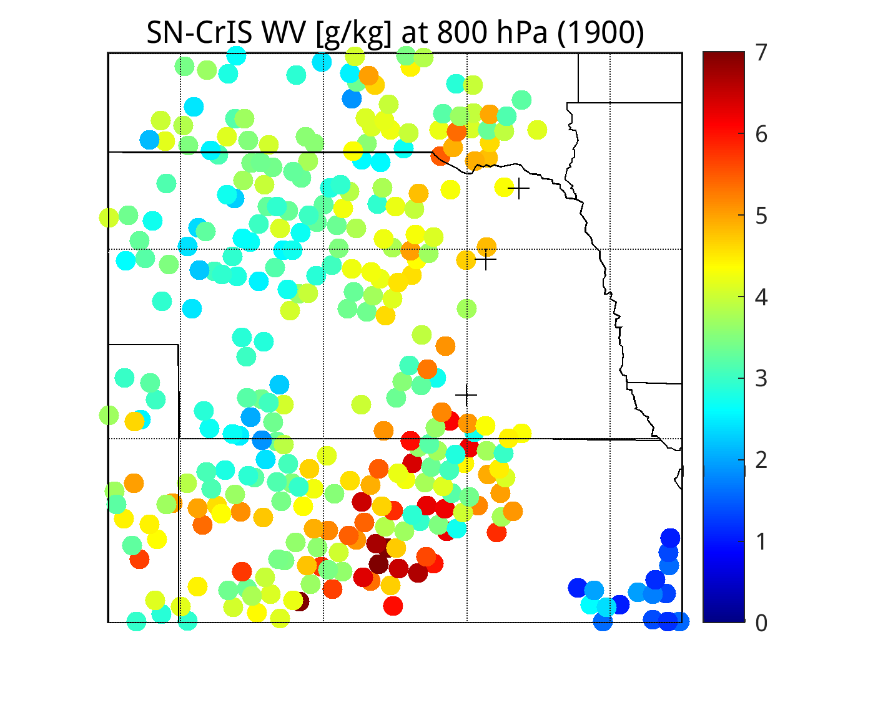
NCEP (nchan=100) CrIS Dual-Regression Retrievals

Slide 8
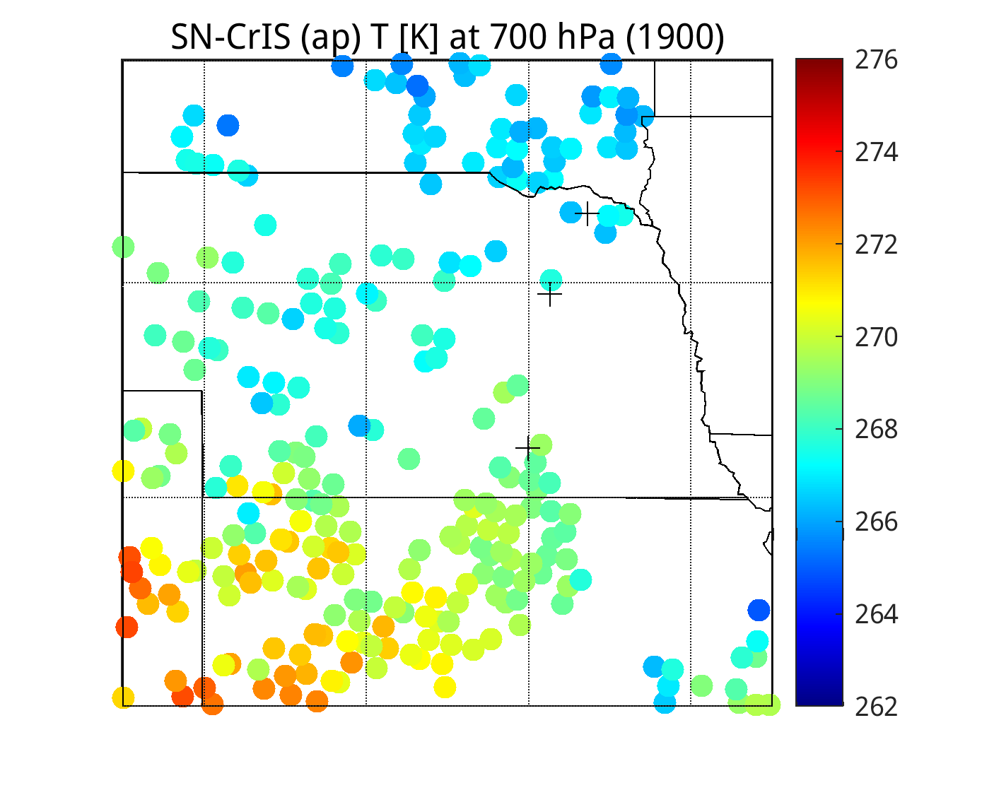
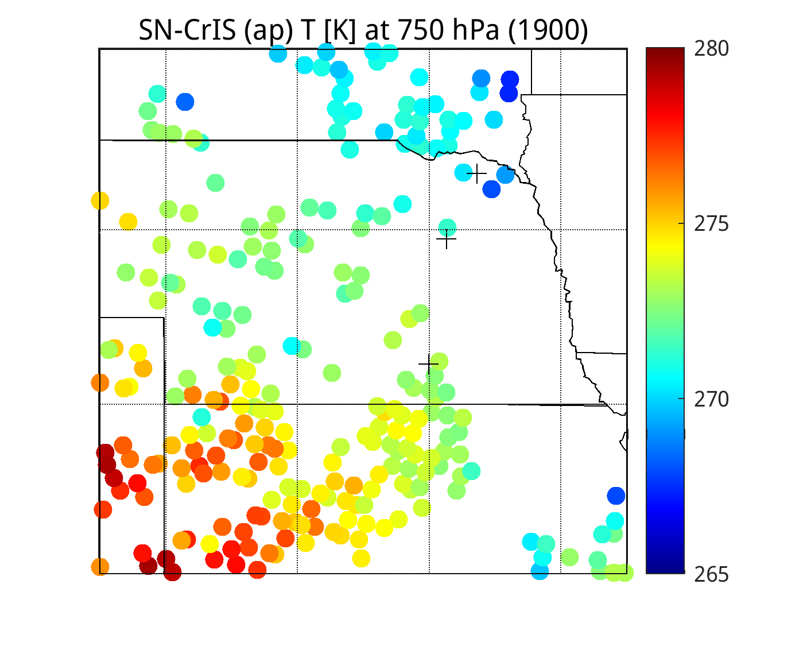
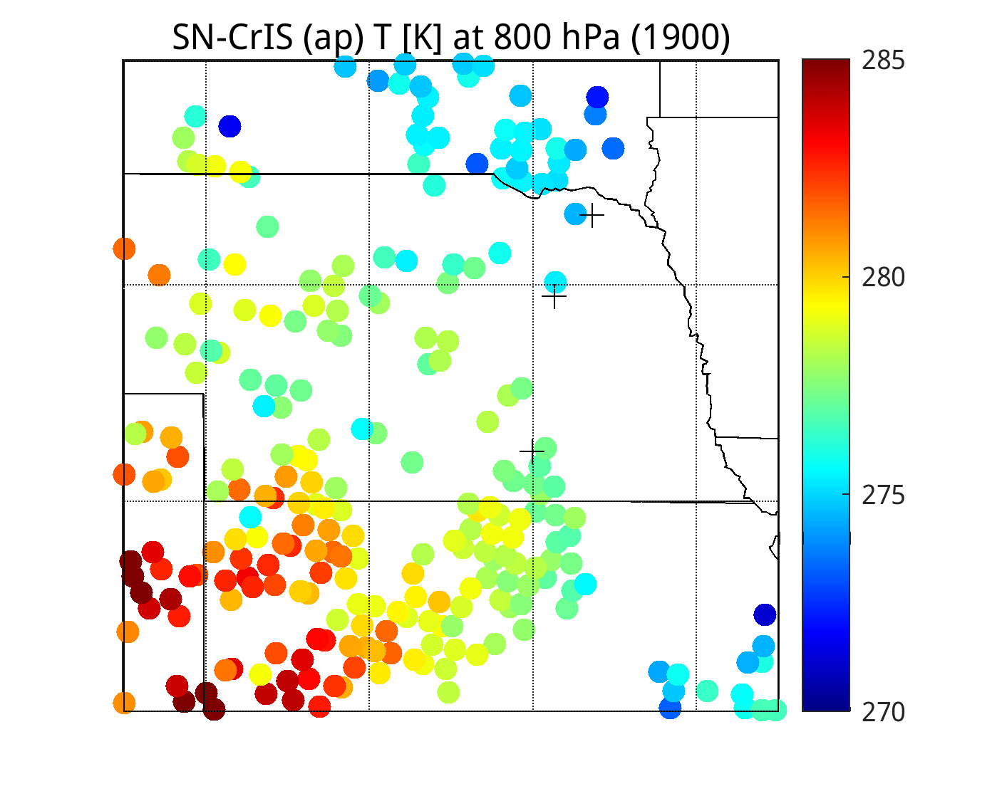
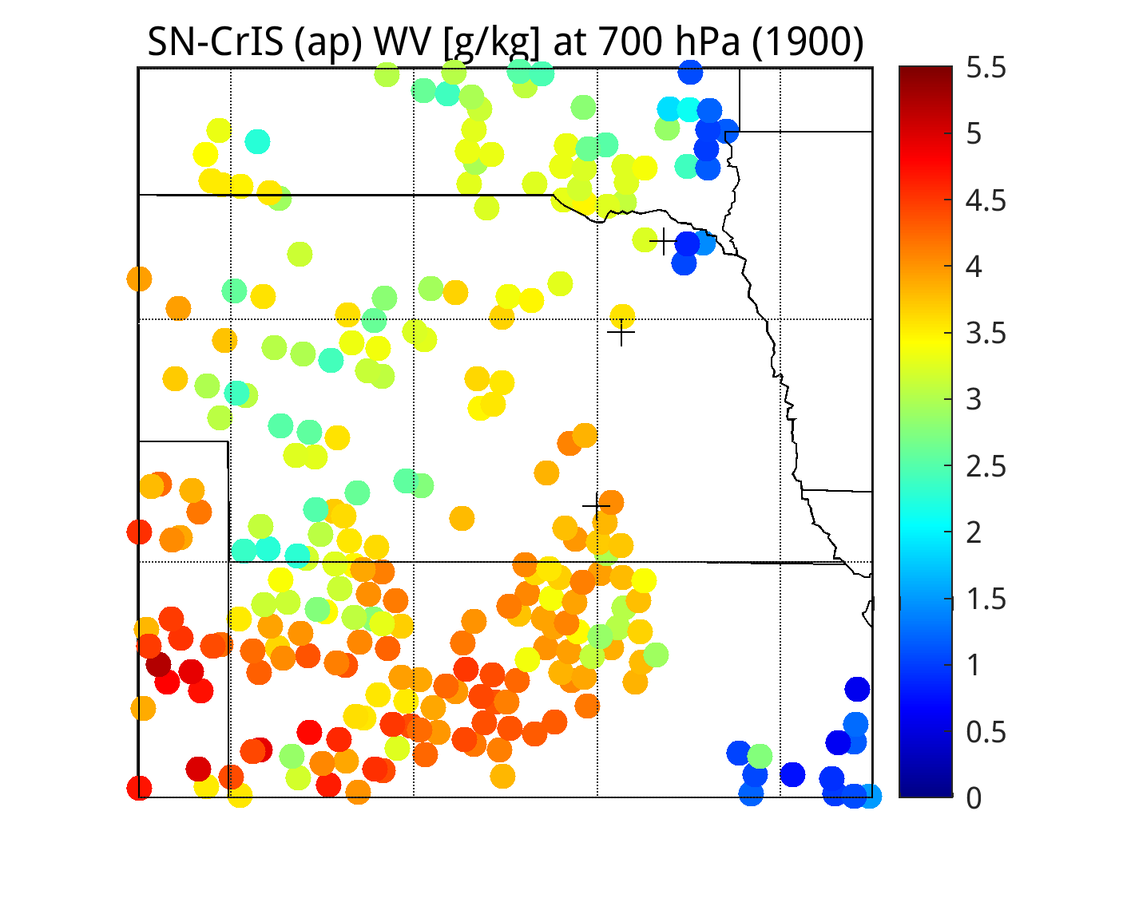
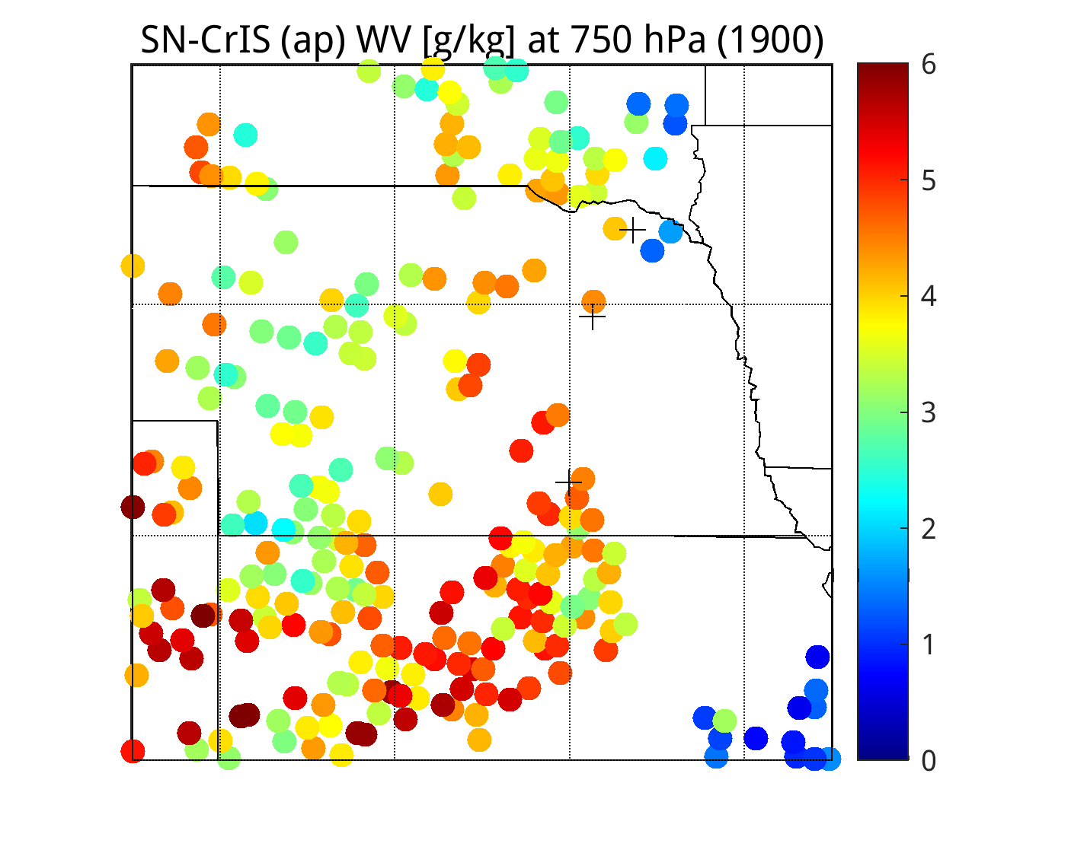
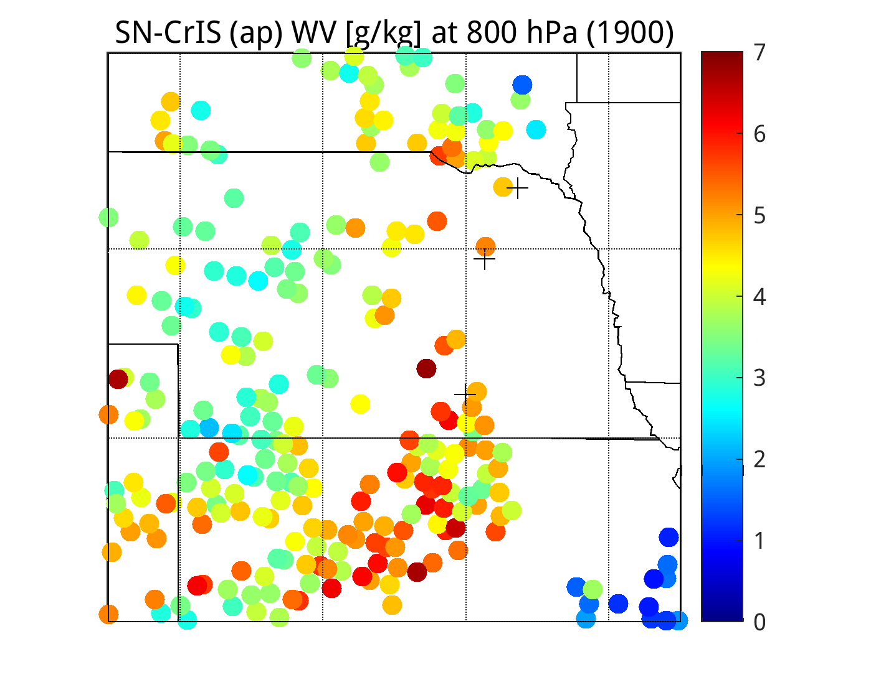
NCEP (nchan=100) Apodized CrIS Dual-Regression Retrievals

Slide 9
APPENDIX

Slide 10
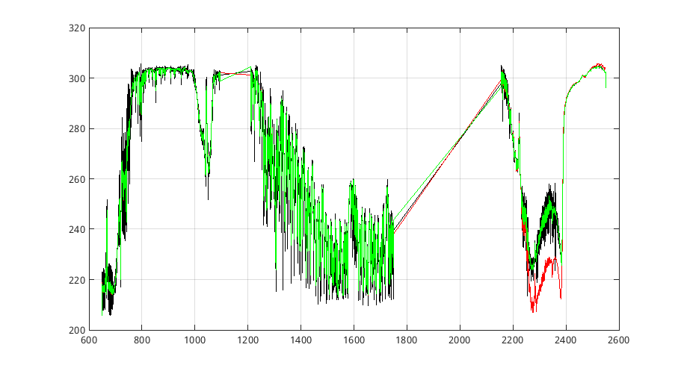
Issue with PCRTM apodized CrIS rads during daytime (low solzen)
Black … unapodized CrIS
Red … Hamming apodized CrIS
Green … Hamming added manually to unapodized (black)
Because of this, Hamming apodization was manually applied (using ‘hamming.m’) to the original (unapodized)
PCRTM original radiances

Slide 11
From 2023 CrIS Spectral Analysis Study
(e.g., CrIS_Spectral_Analysis_27Jul23. pptx)

Slide 12
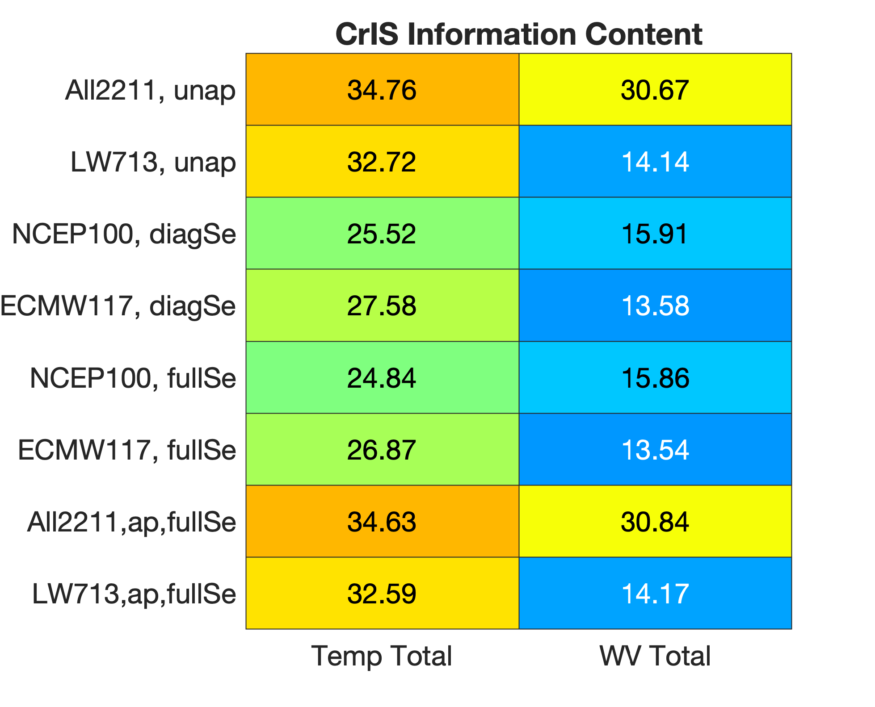
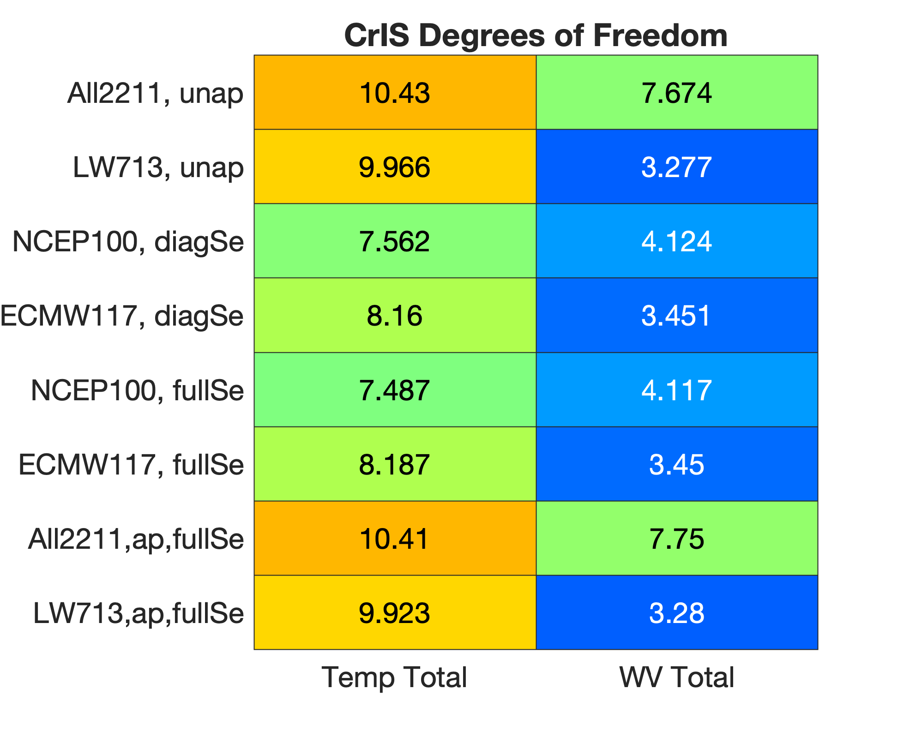
CrIS Information Content (IC) and Degrees of Freedom (DoF)
(from CrIS spectrum computed for US Std 1976 profile)

Slide 13
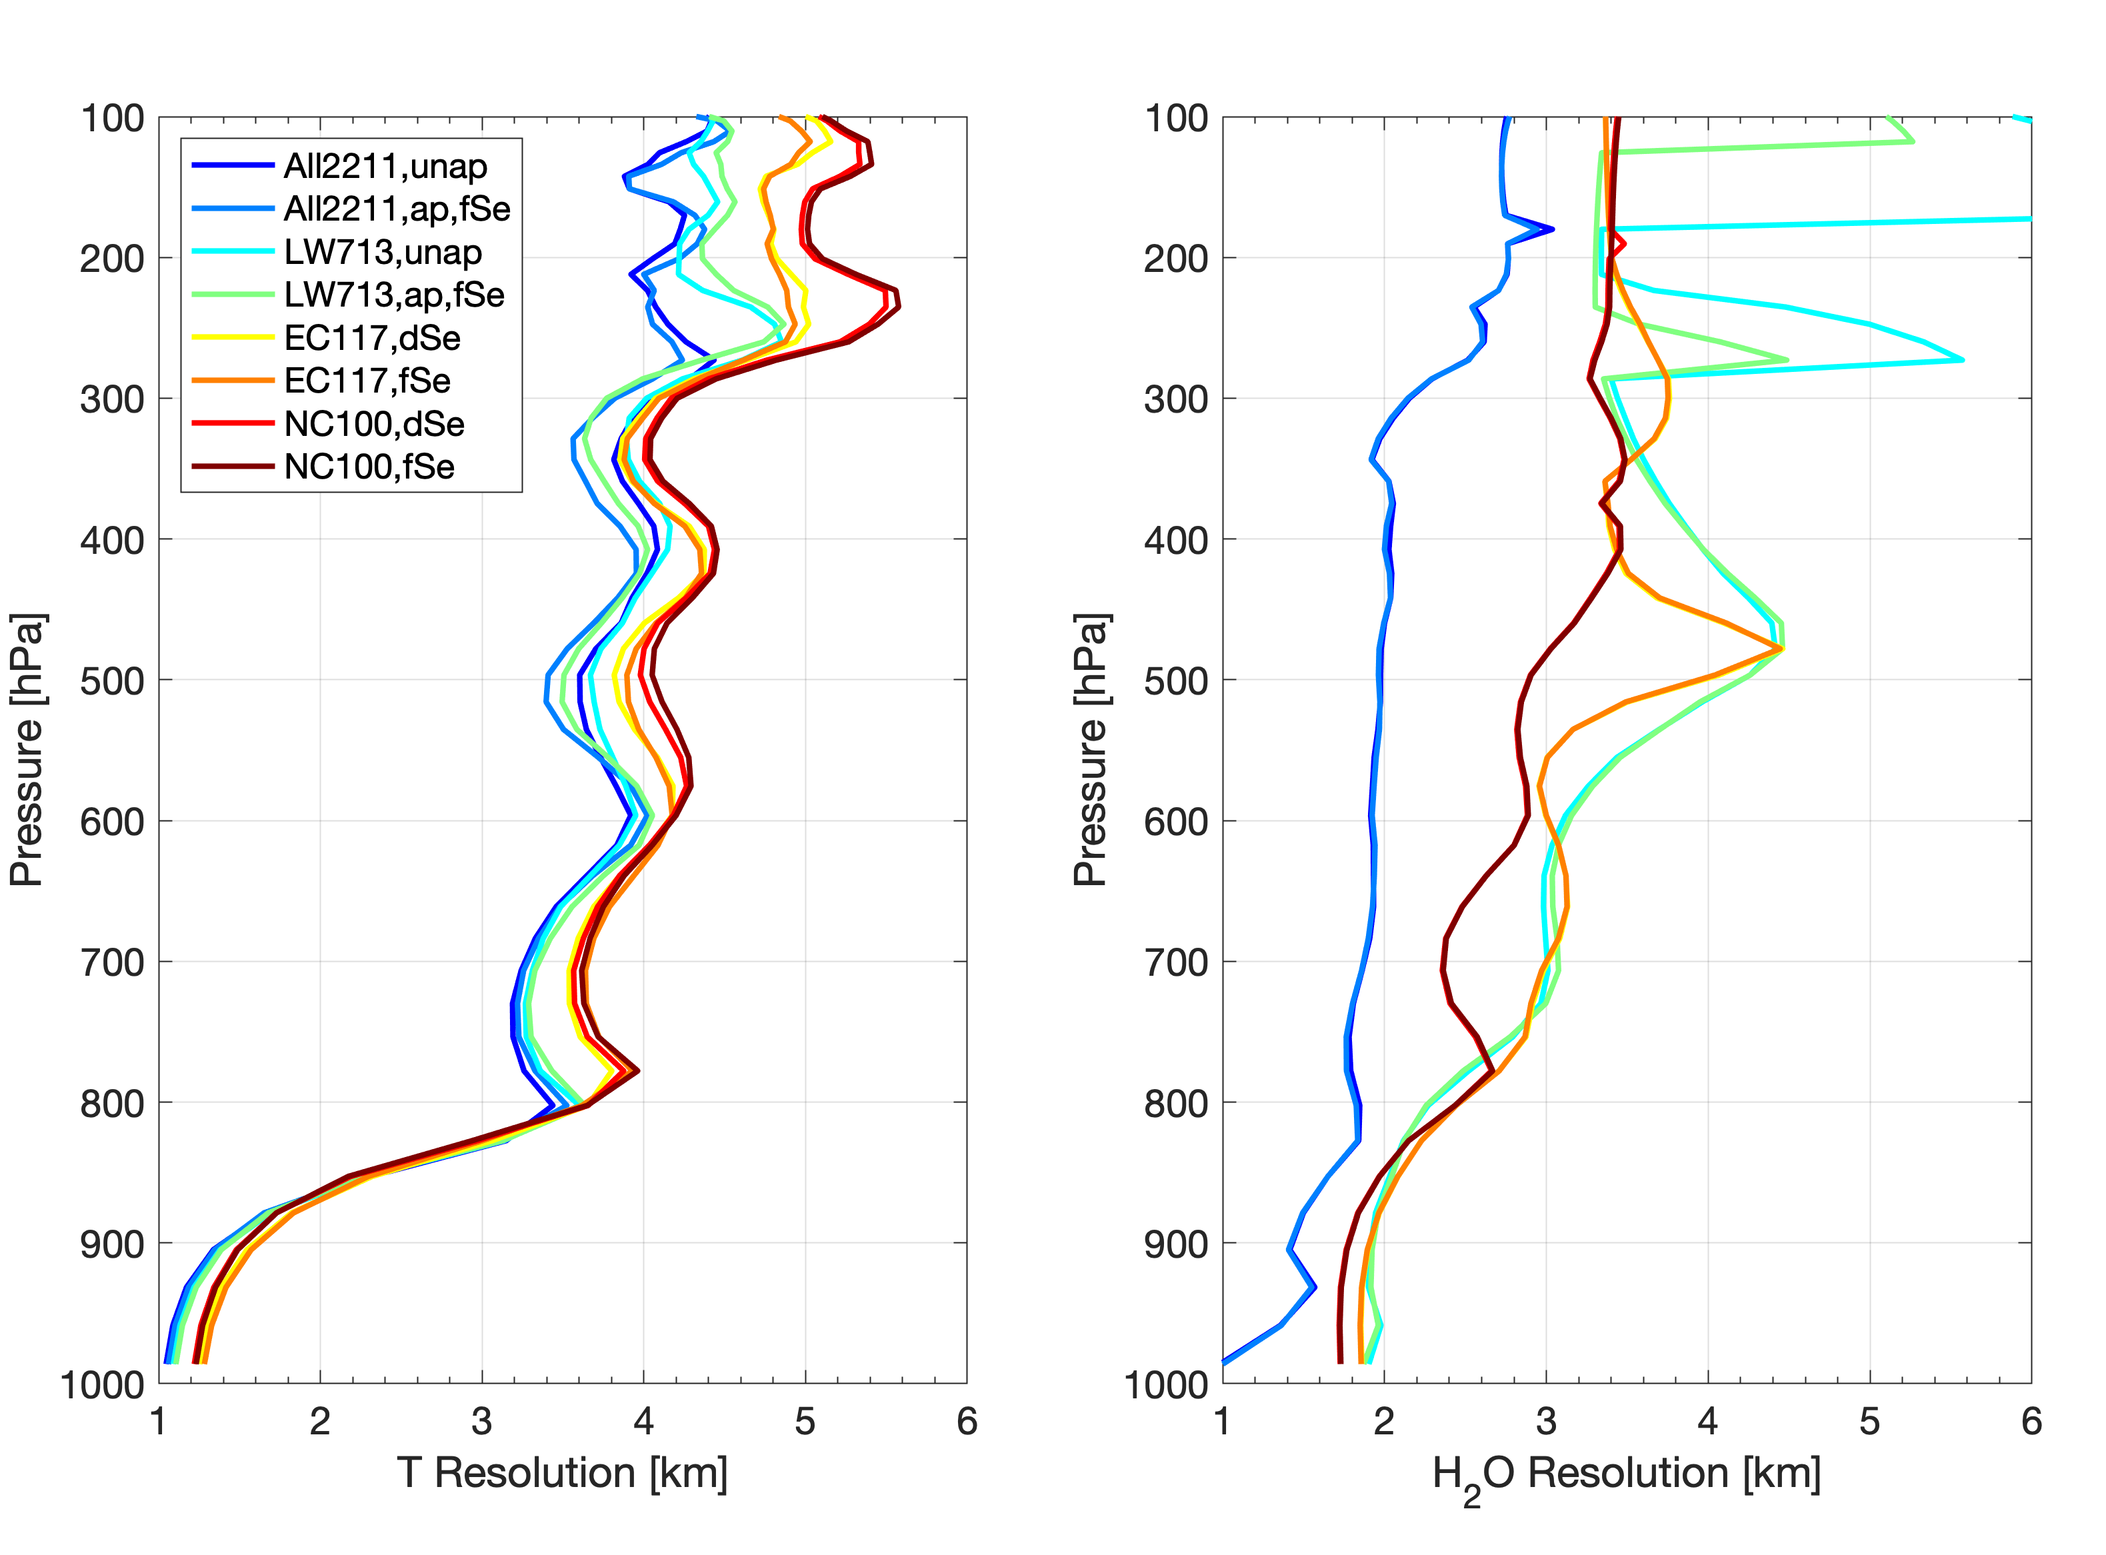
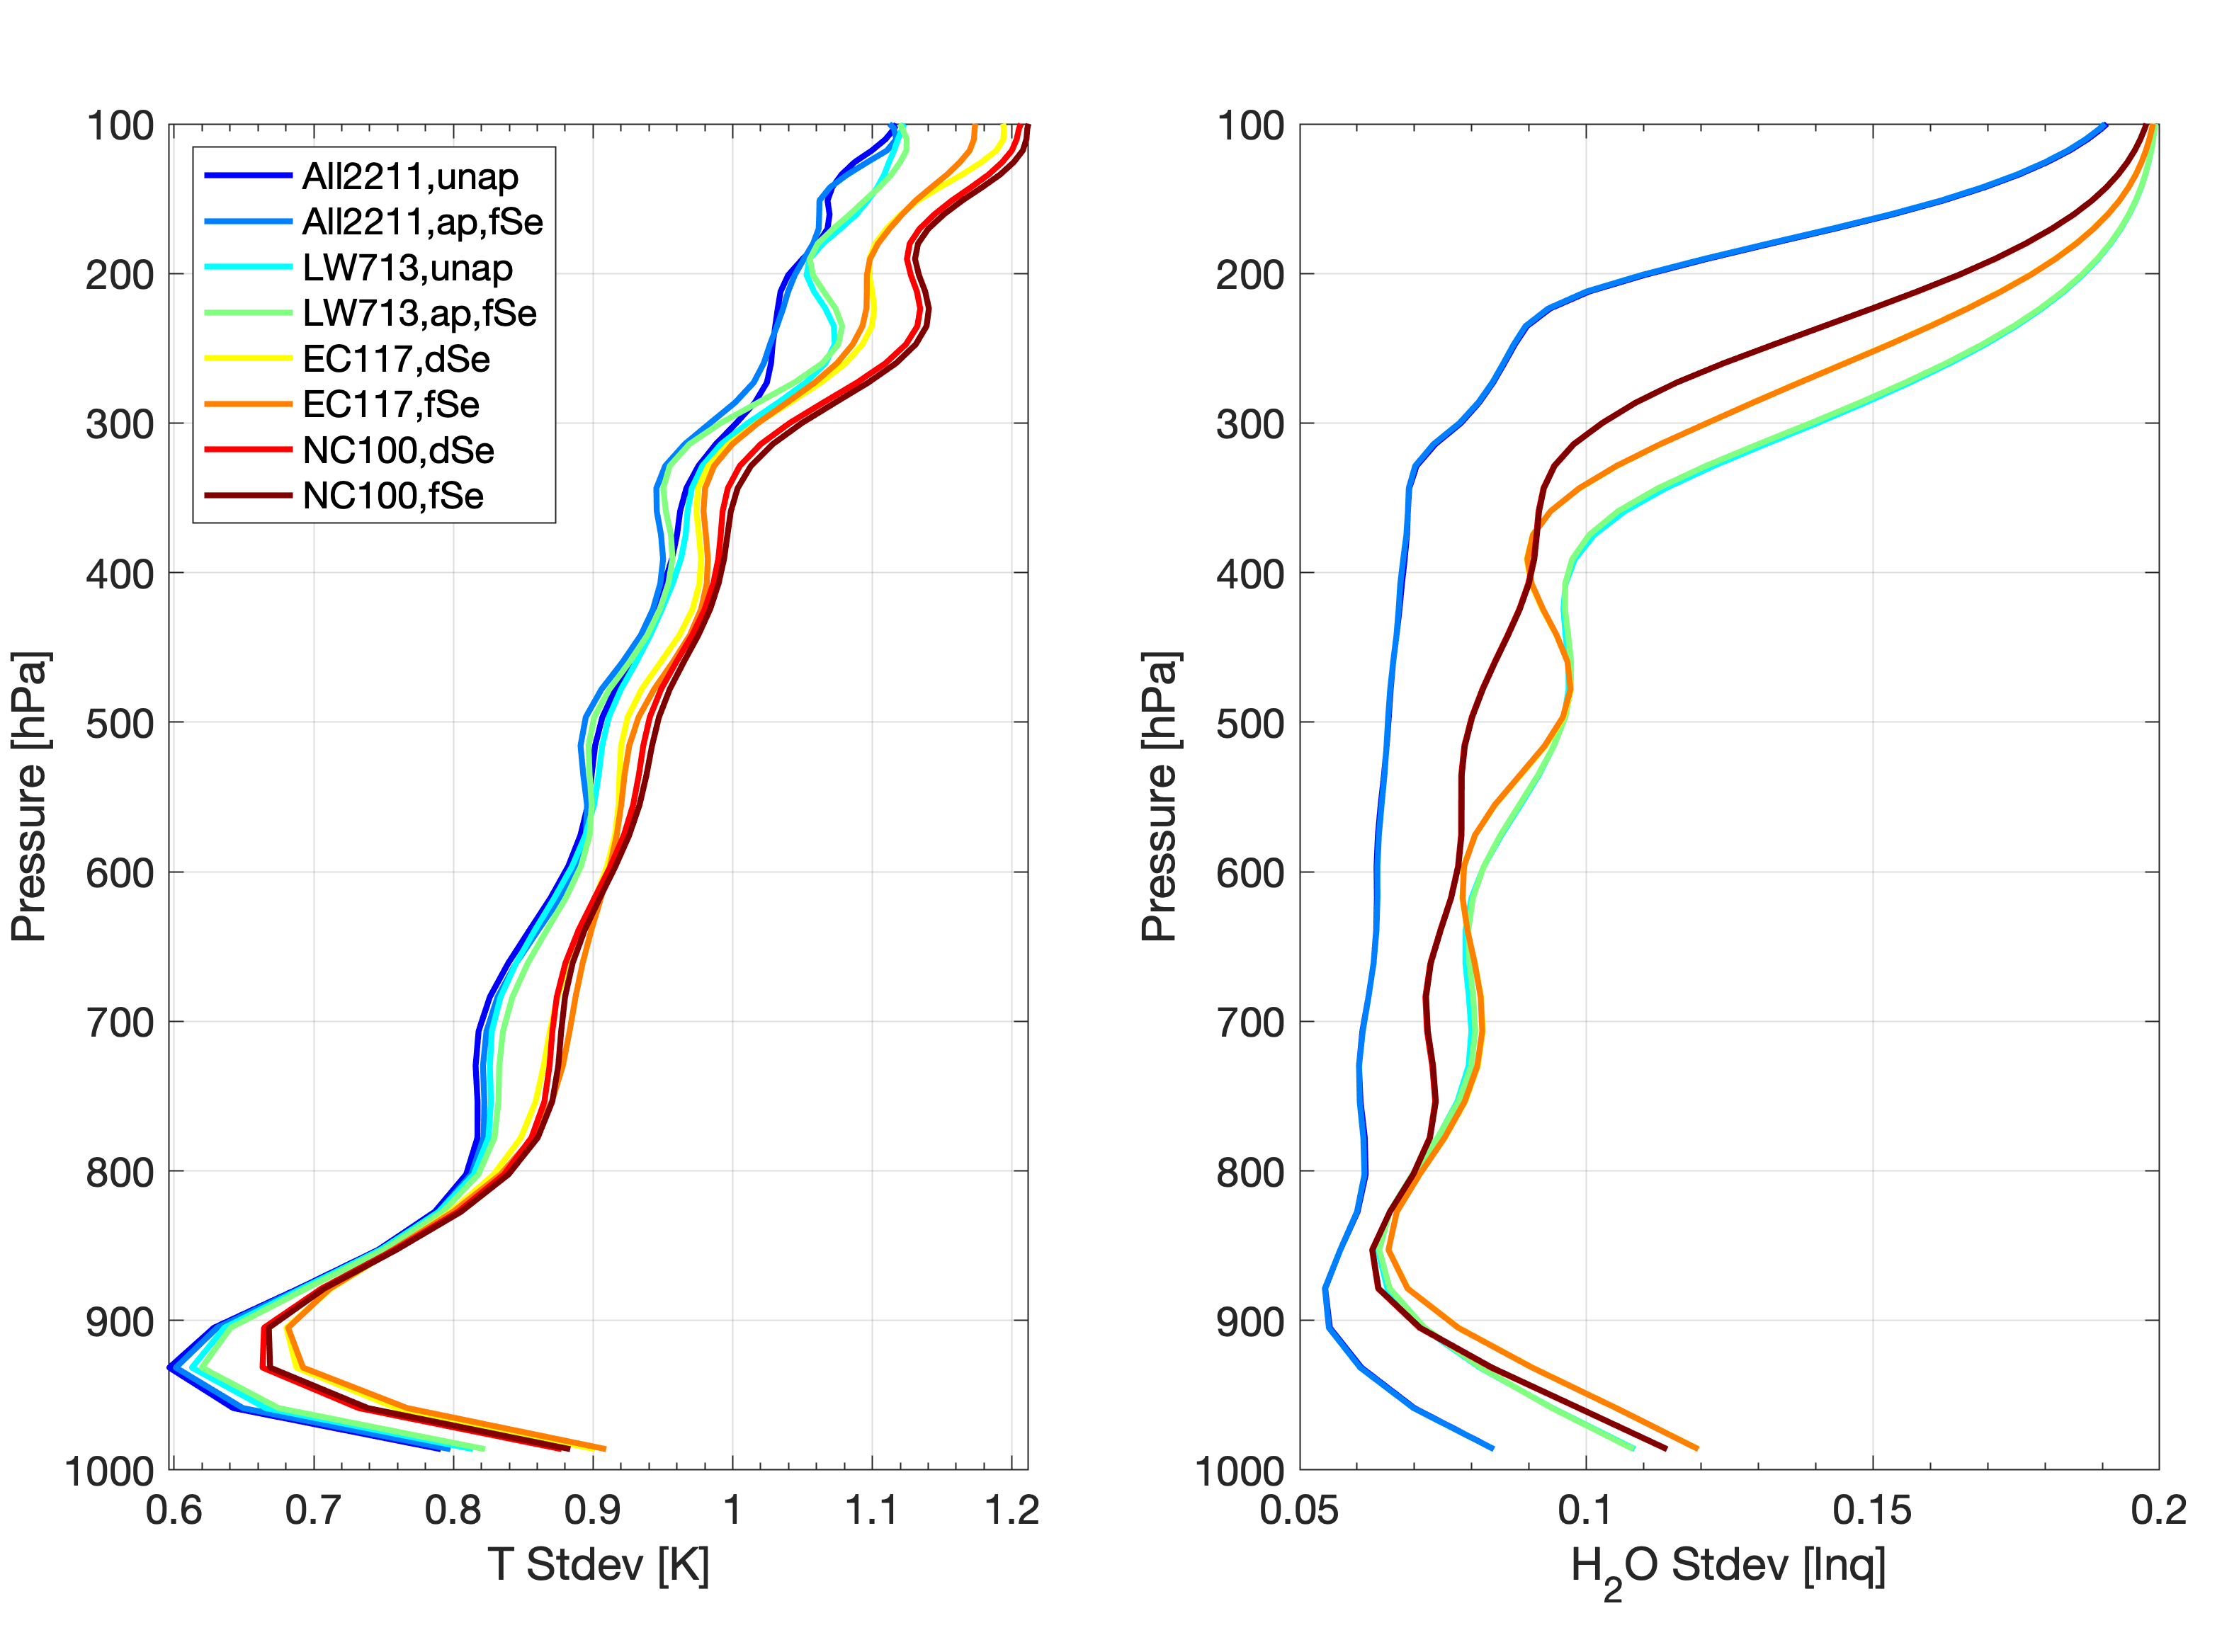
Vertical Resolution (left) and Retrieval Error (right)
NOTE: Vertical resolution has been computed via FWHM of the Averaging Kernels,
and the retrieval errors are the square roots of the diagonal elements of the retrieval error covariance matrix

Slide 14
RH RTV comparison with RAOB (left) and ‘RAP minus RTV’ error statistics (right)
DR RTV vs one co-located Cart SGP RAOB
(2018-04-28)
2-hr FCST RAP minus DR RTV
(nsamps=12159)

