Slide 1
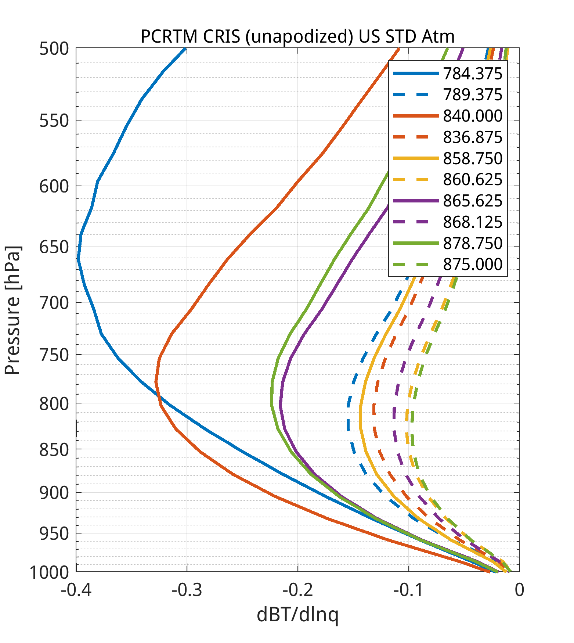
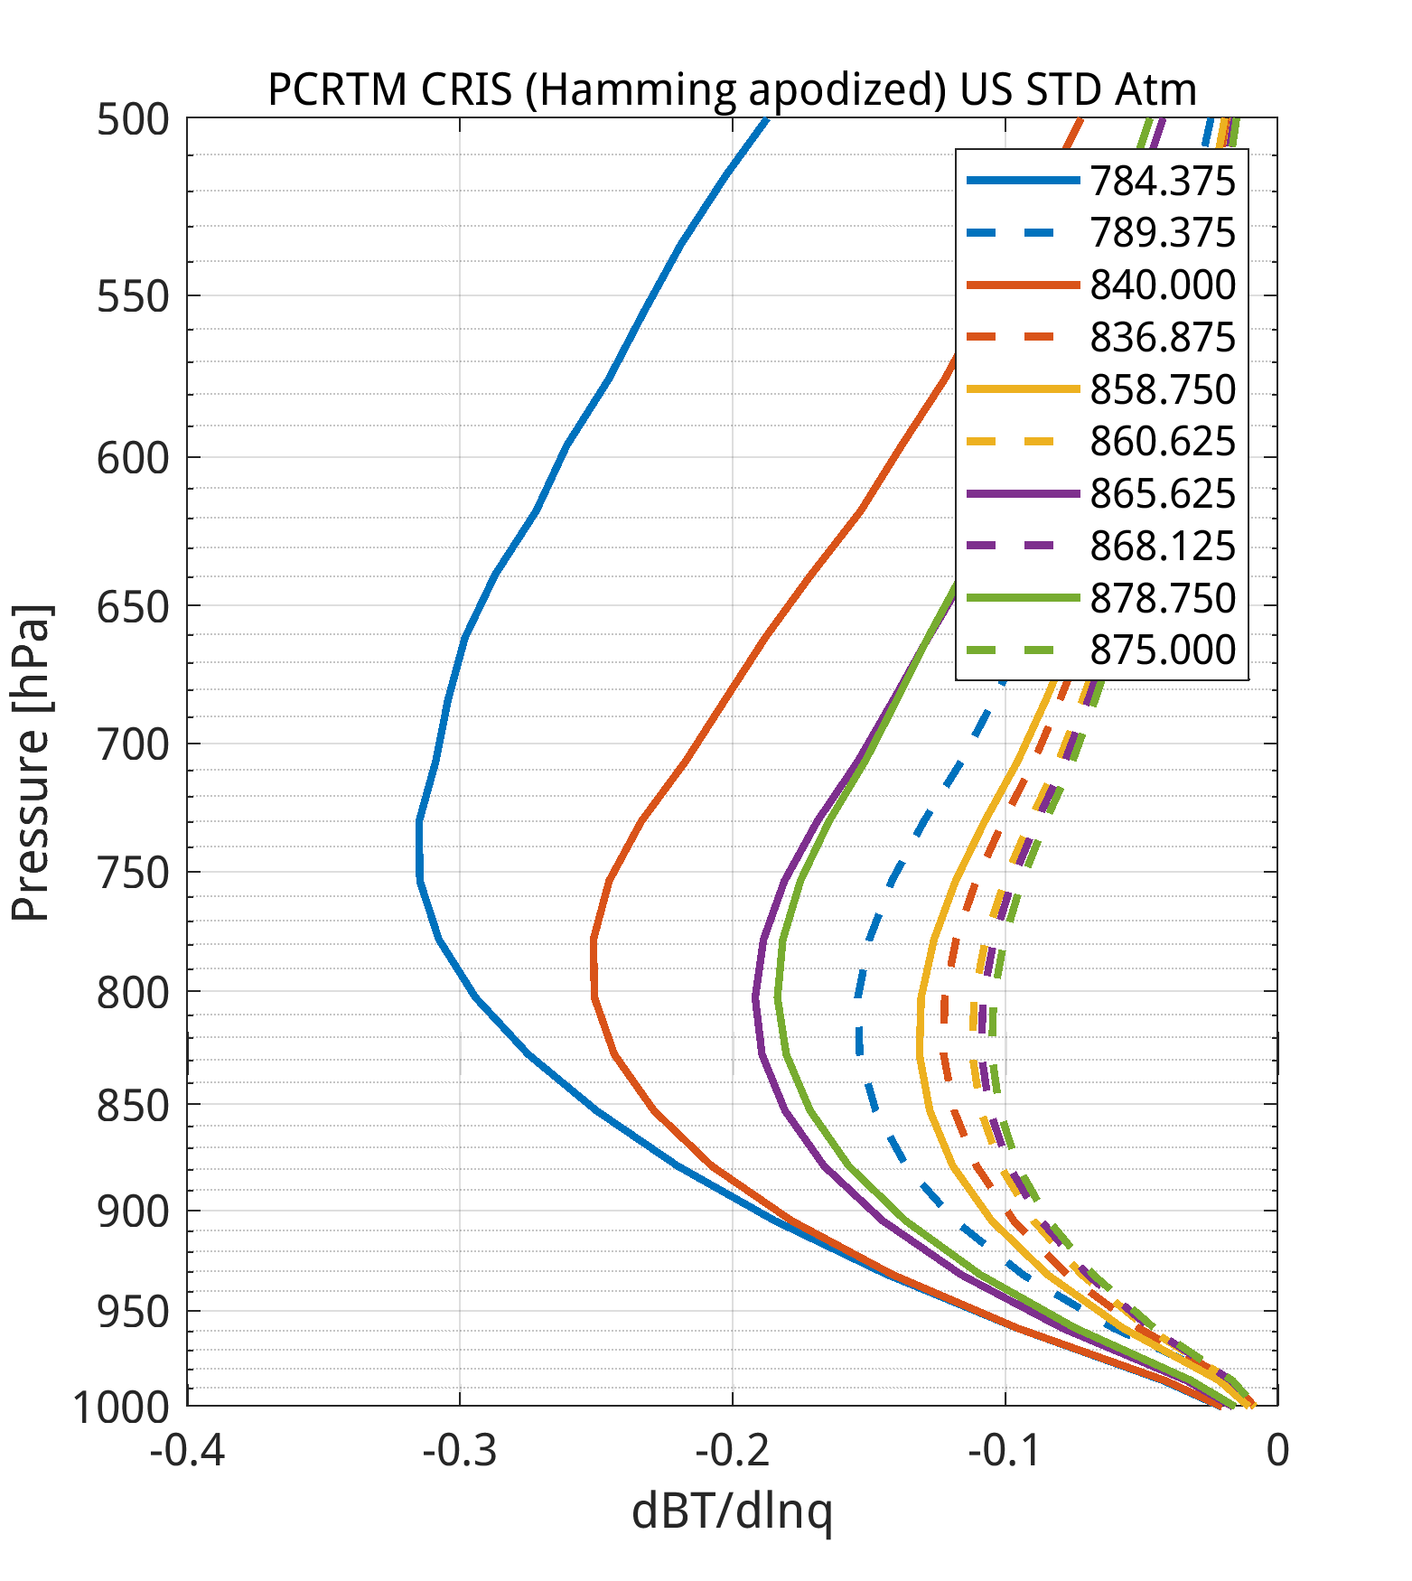
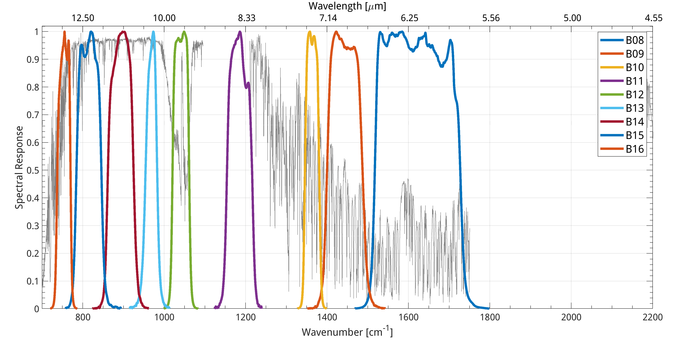
GeoXO Imager and Sounder Studies to Enhance PBL Moisture Information in the Pre-Convective Environment
Task 2 CrIS Summary
Investigate if ‘CrIS to ABI’ low-level retrievals can be improved by adding selected CrIS online/offline IR WV rotational
Channels, and how apodization affects the retrieval outcome.

Slide 2
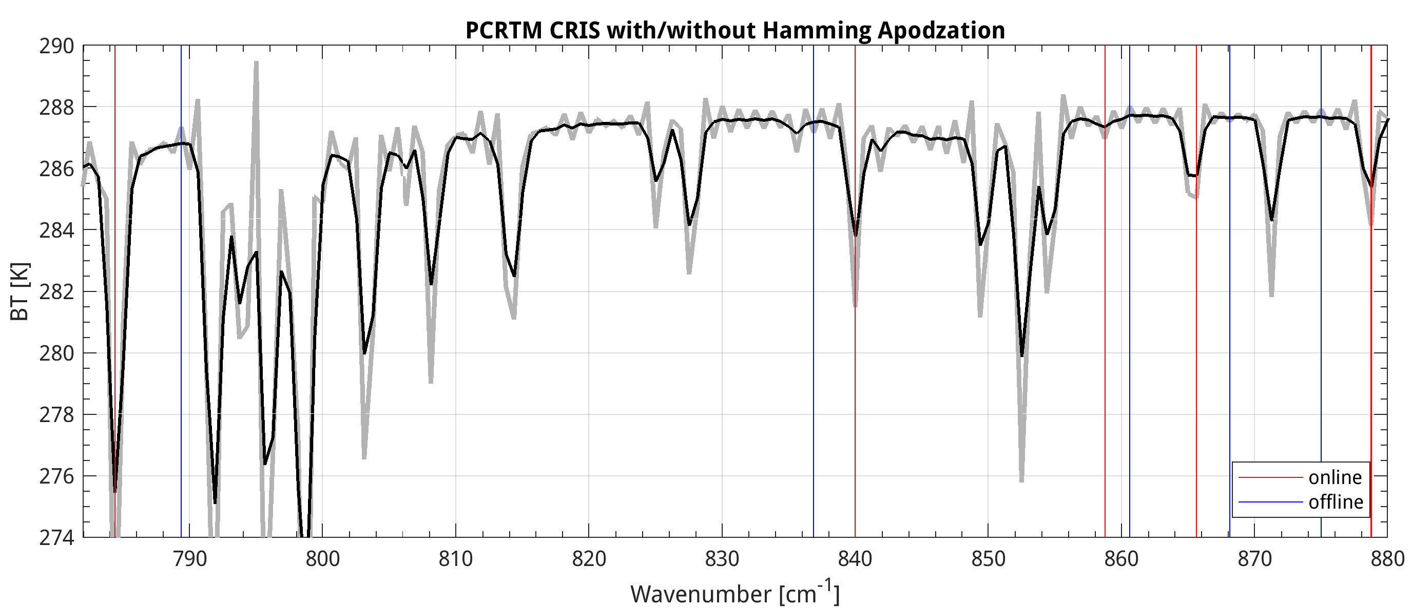
CrIS BT Spectrum with selected ONL/OFL channels
D. Tobin, 2023

Slide 3
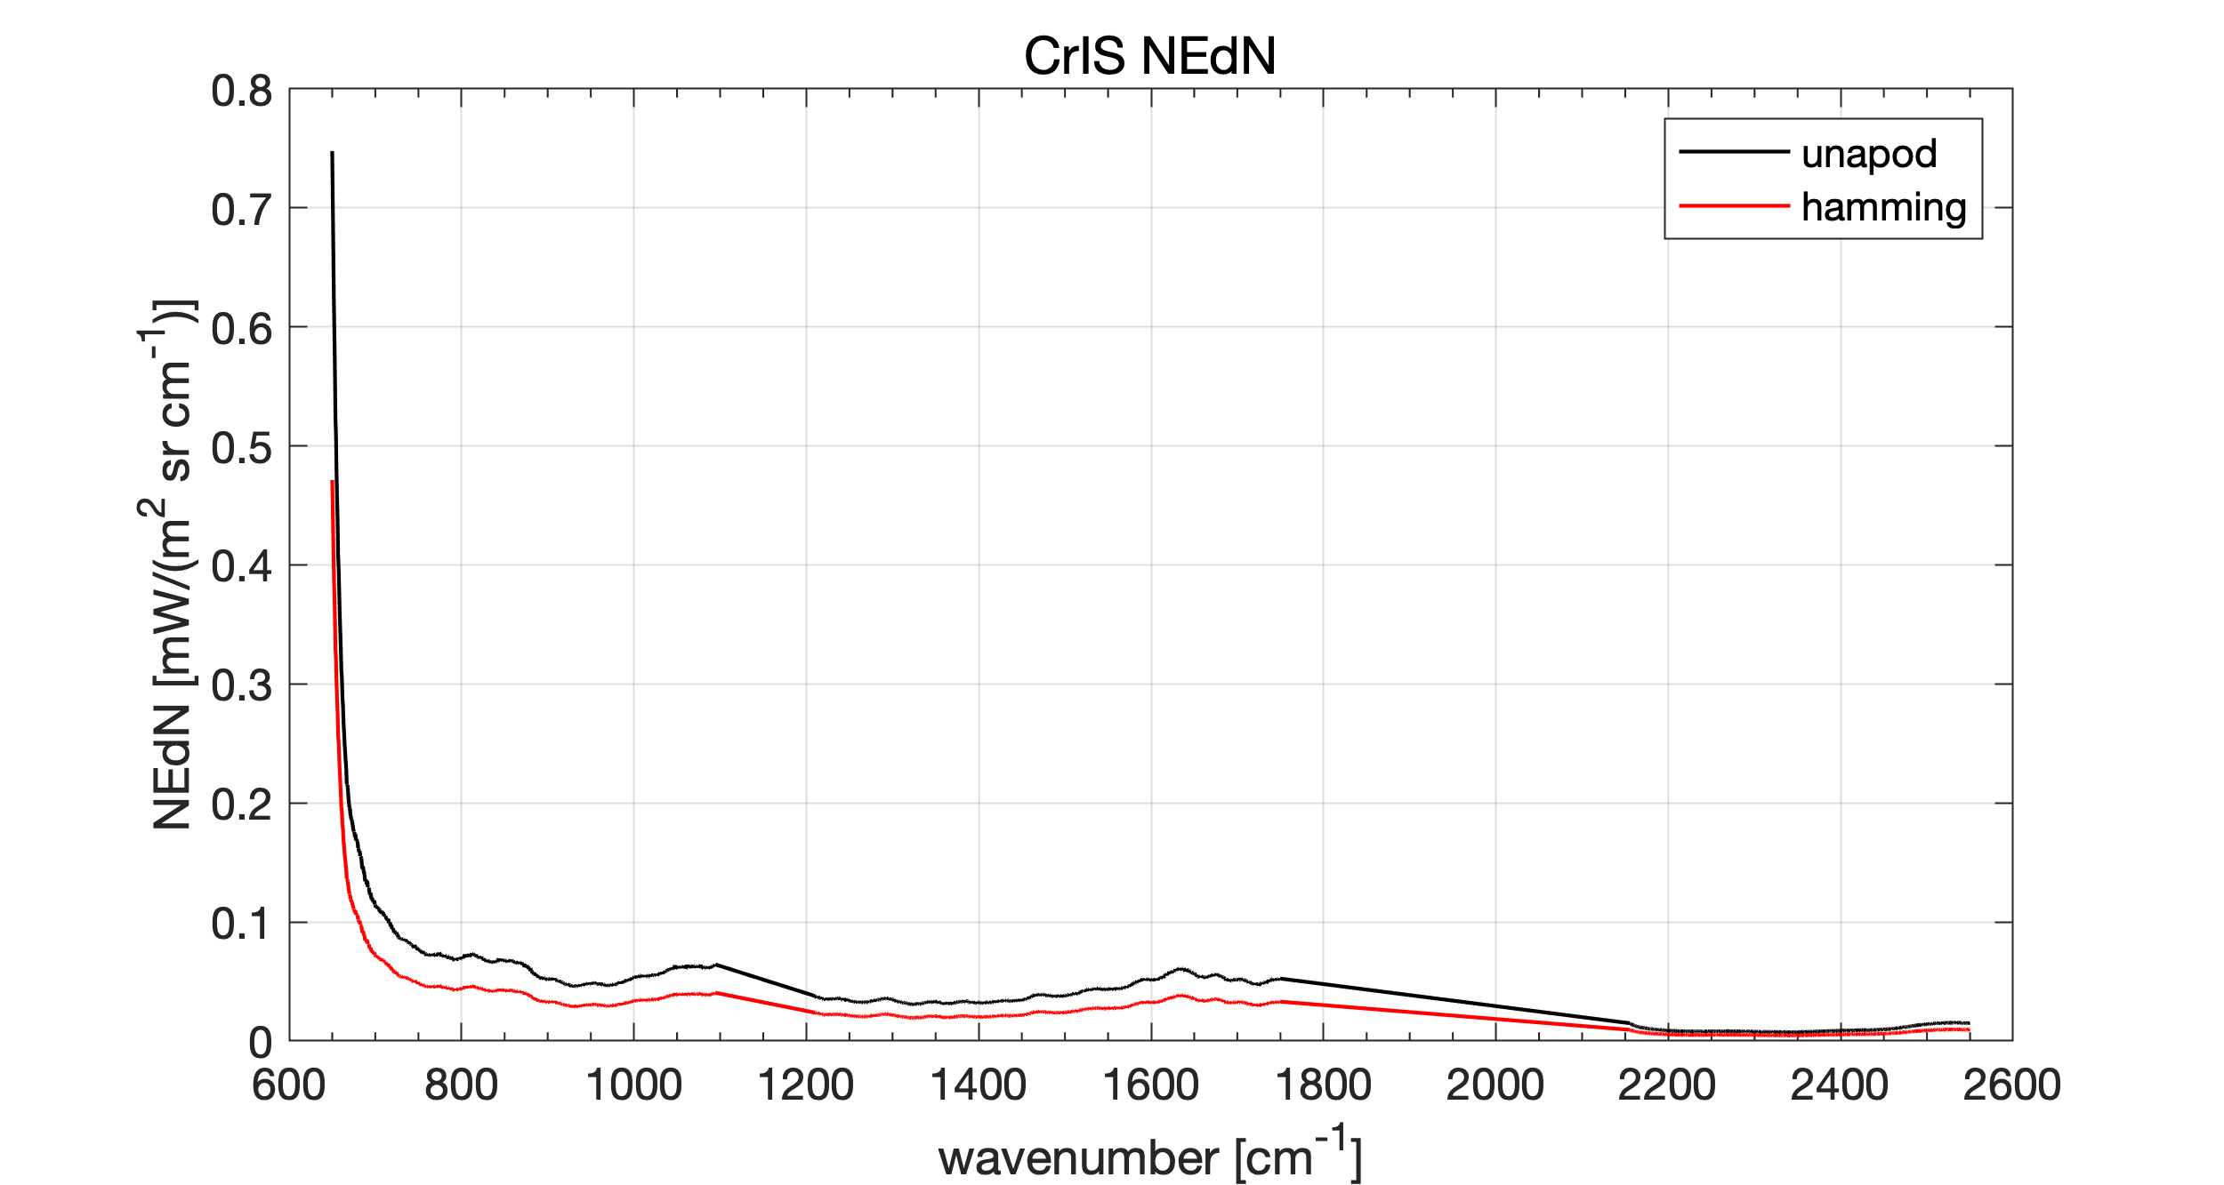
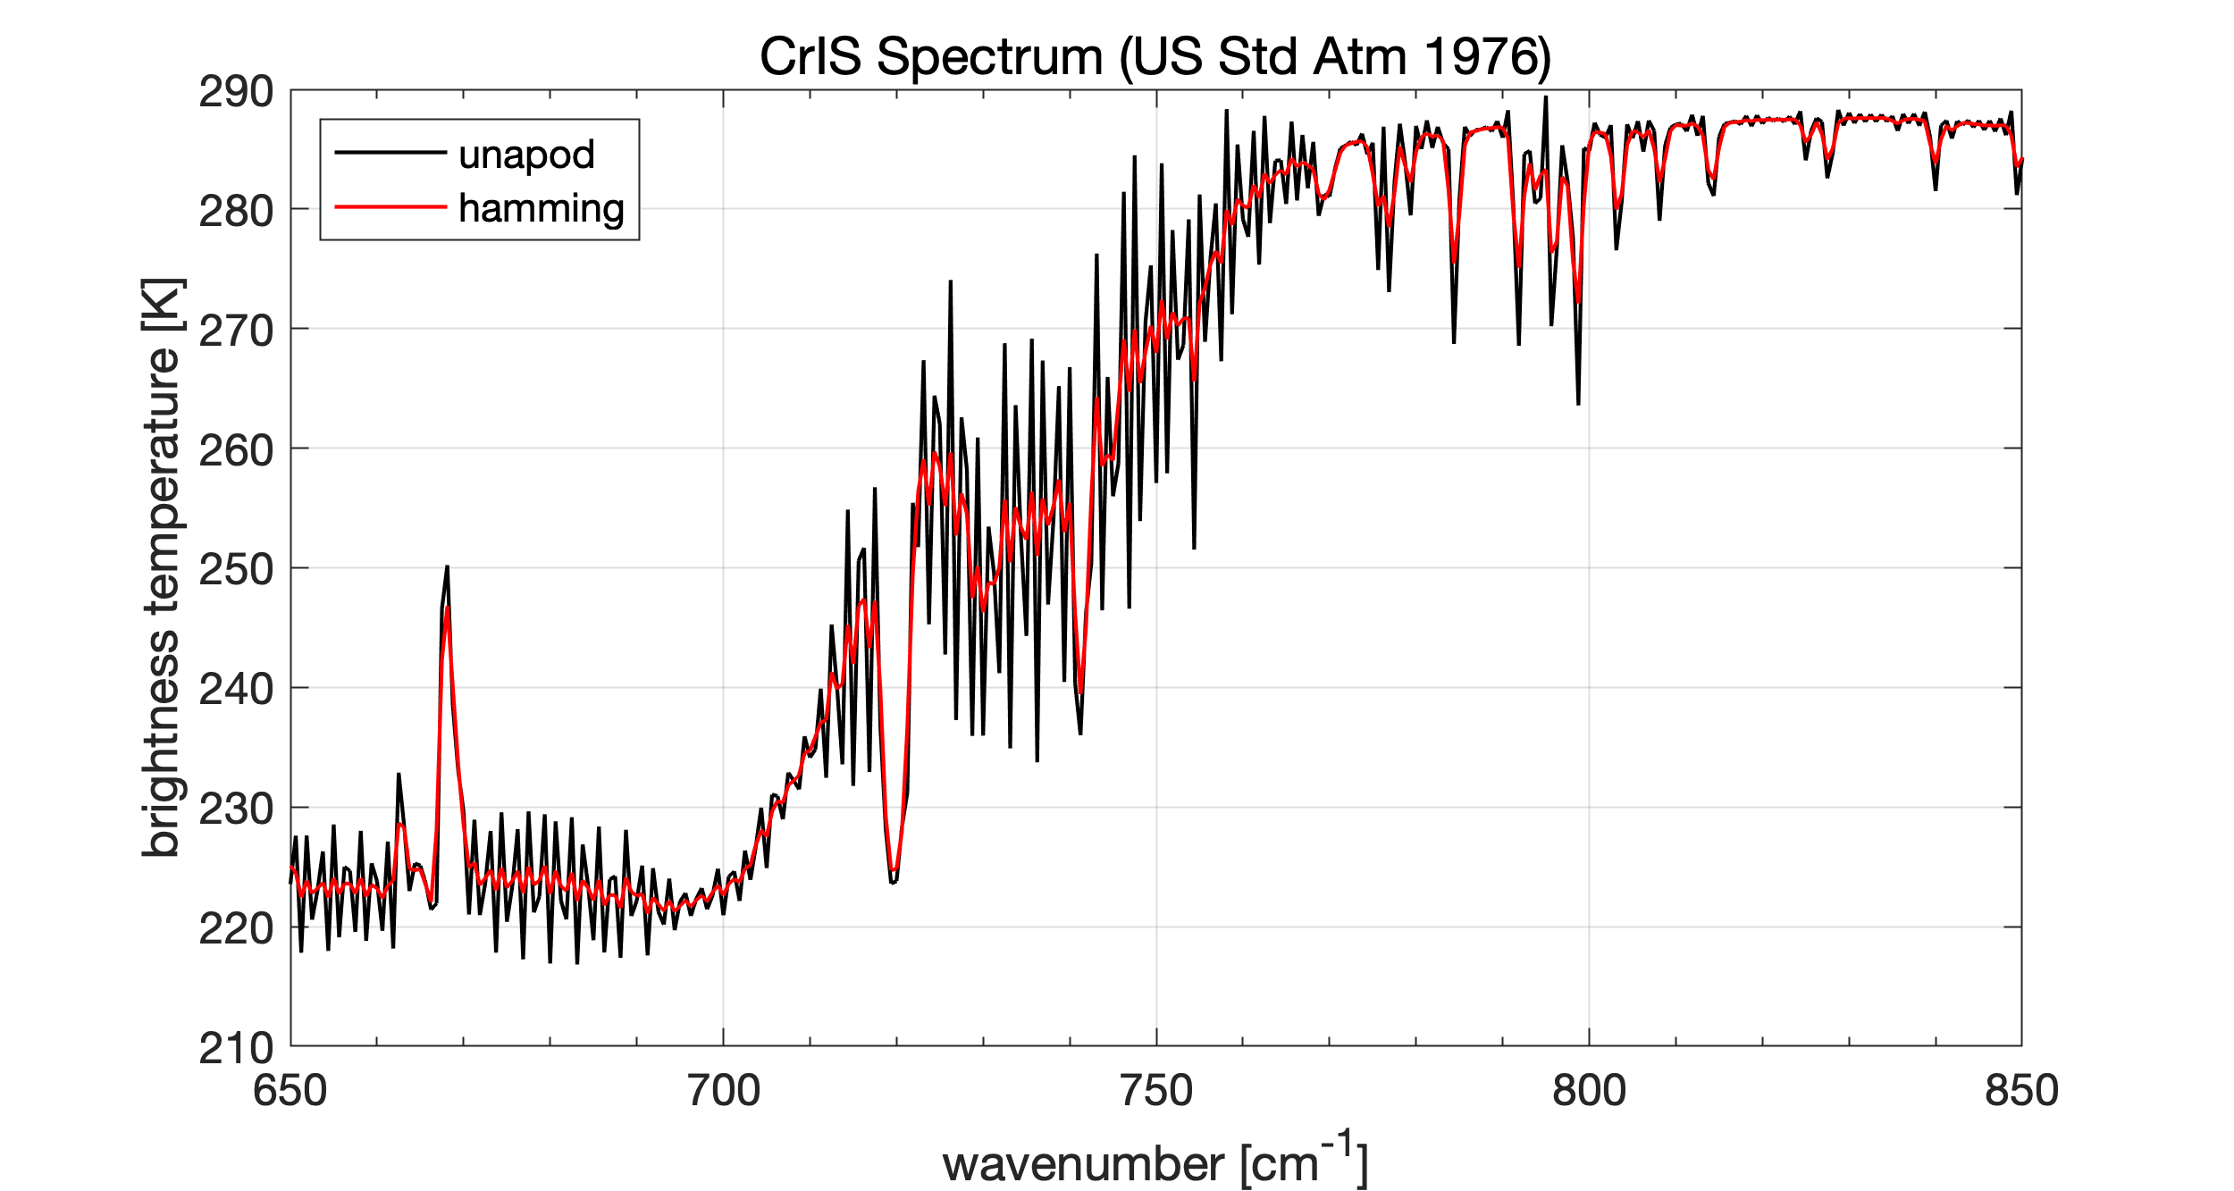
From 2023 CrIS Spectral Analysis Studies
NCEP and ECMWF channels and NEDR from ‘cris_list_DCT_20230124.txt’

Slide 4
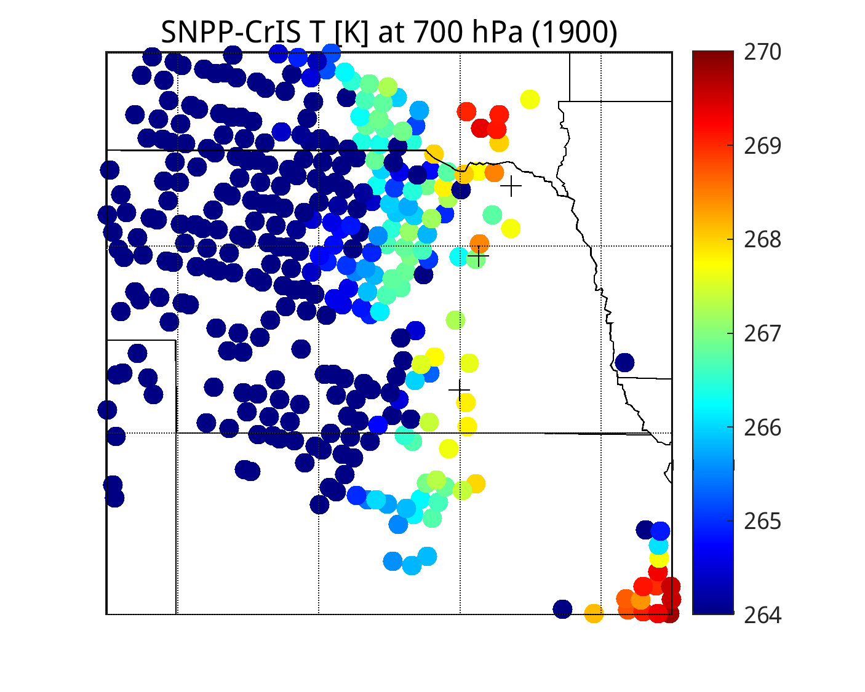
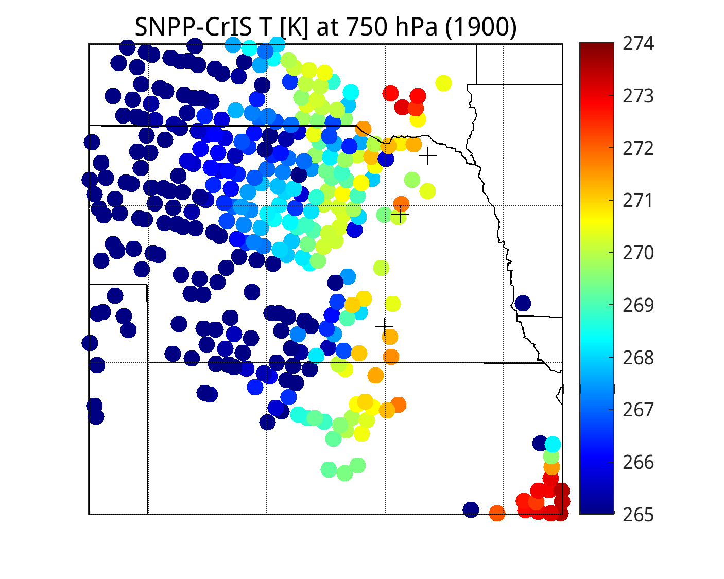
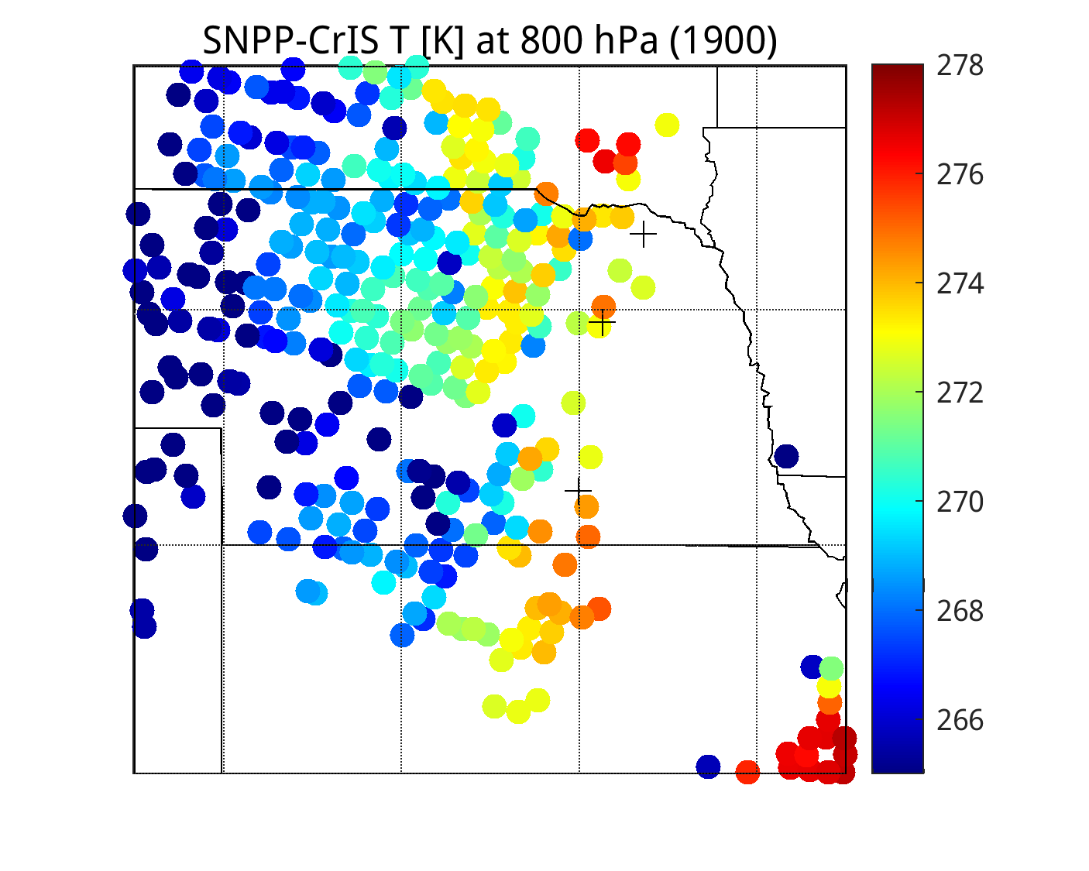
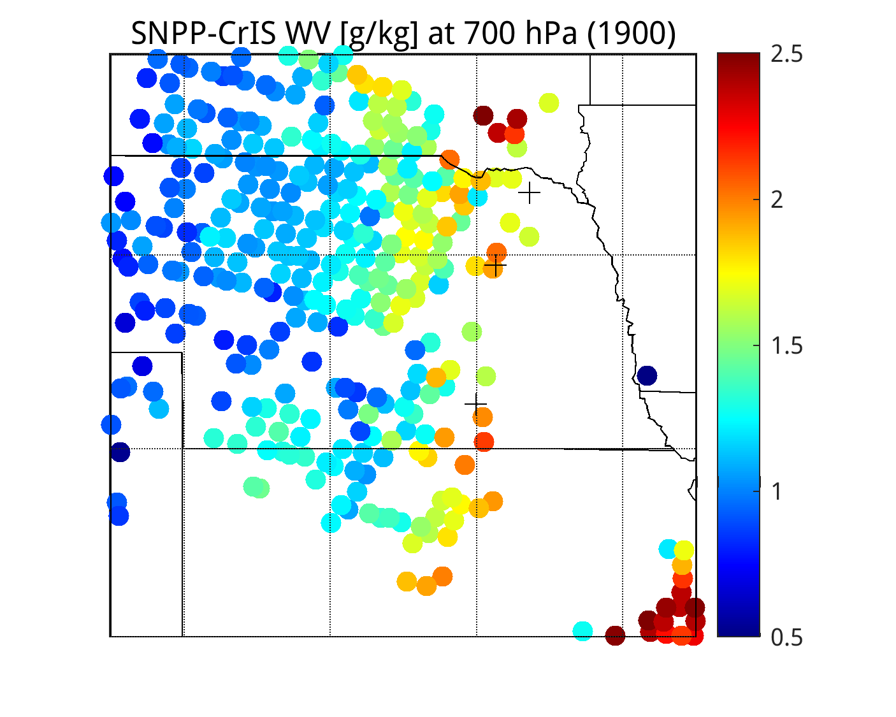
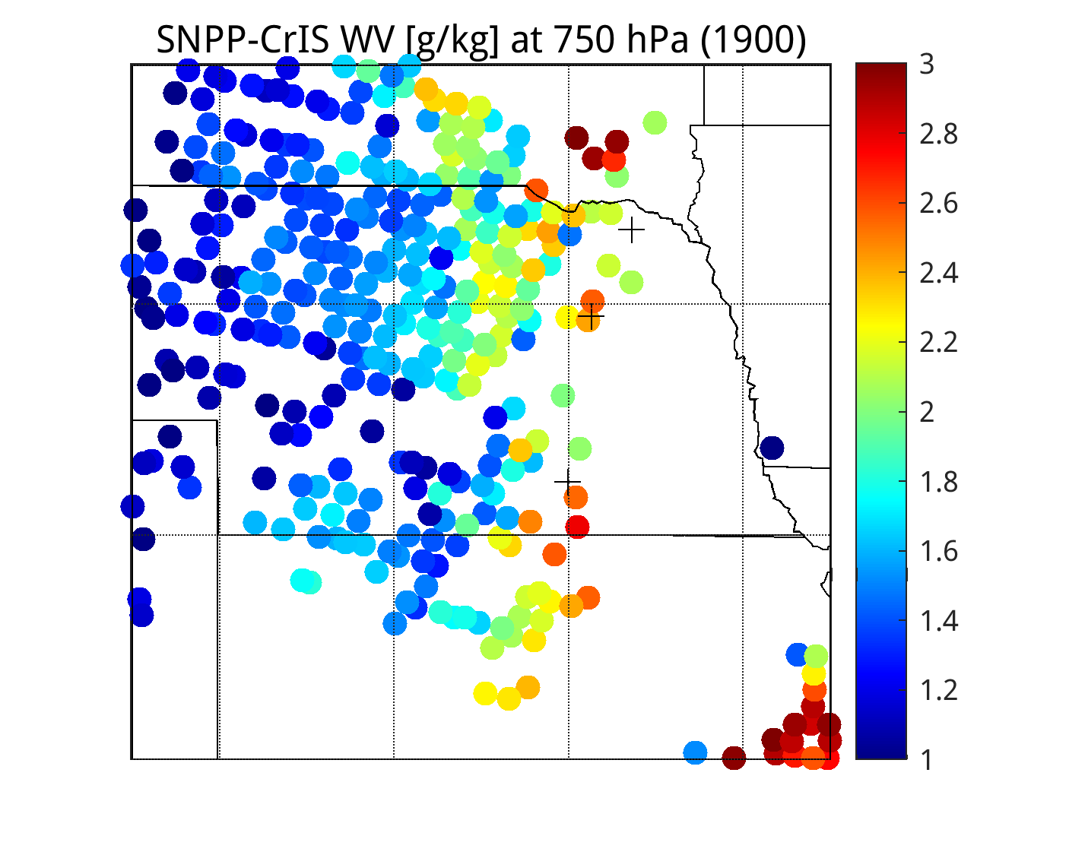
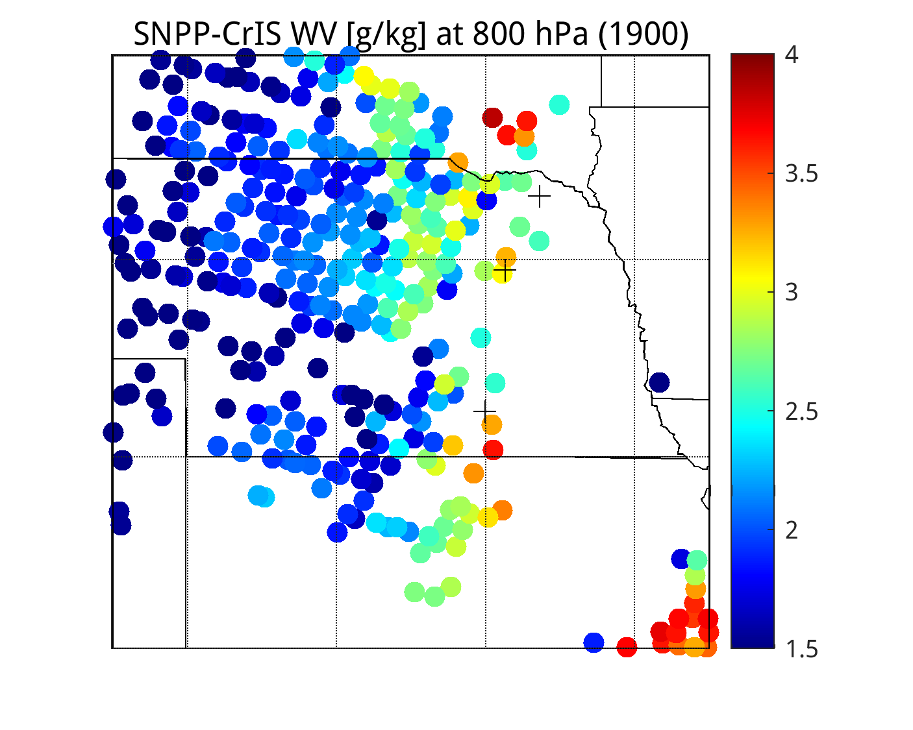
8 Band Retrieval of SN-CRIS convolved to ABI radiances at 1900 UTC
700 hPa
750 hPa
800 hPa
Hartington
Meadow Grove
Temperature [K]
Clay Center
Hartington
Meadow Grove
Humidity [g/kg]
Cay Center

Slide 5
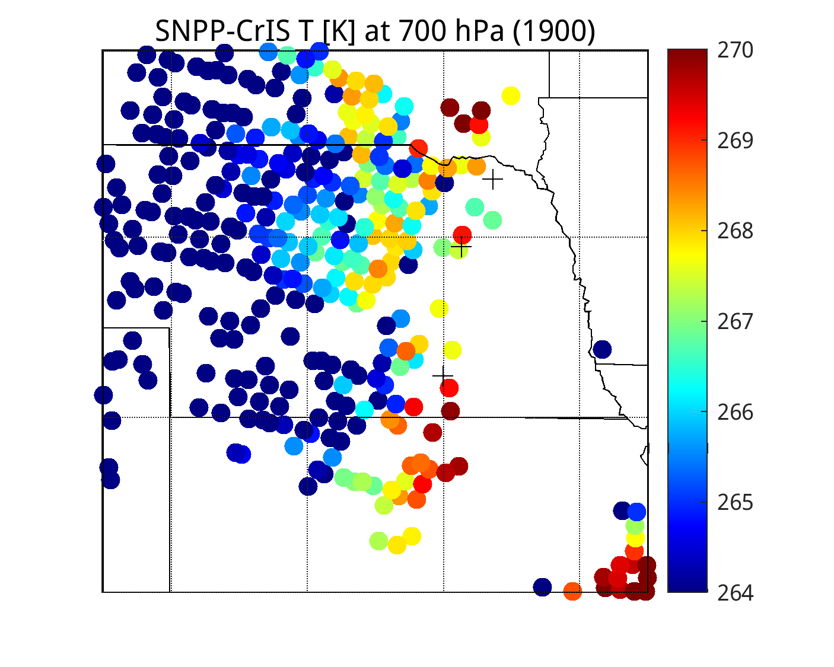
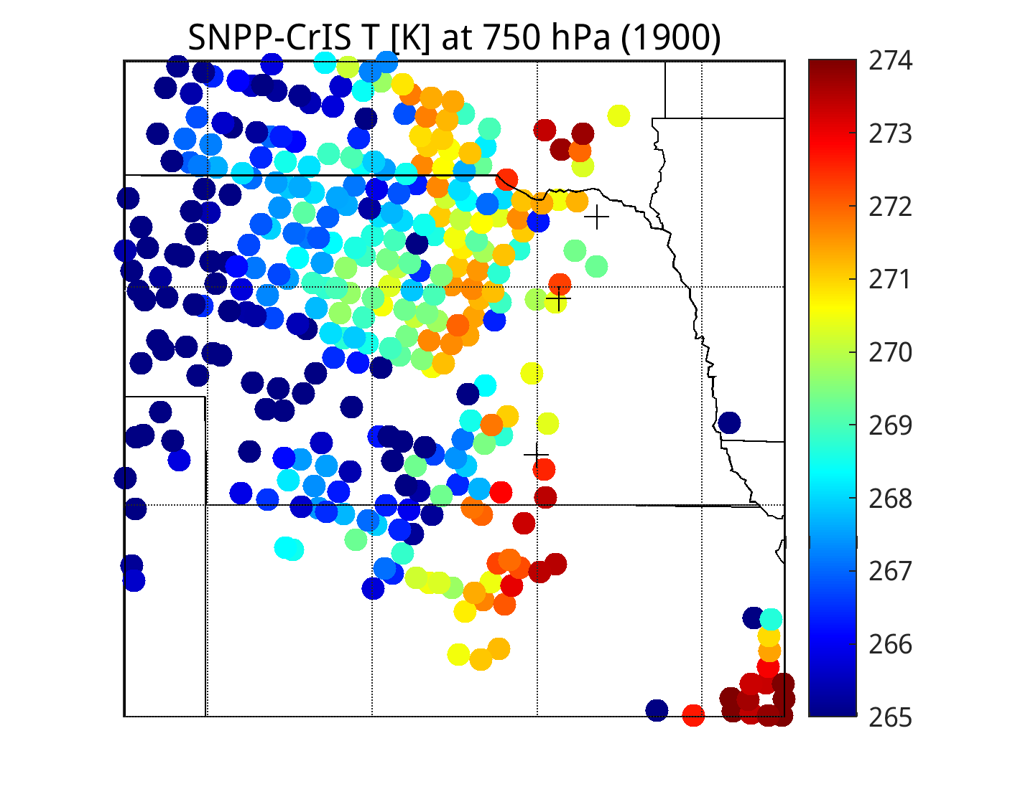
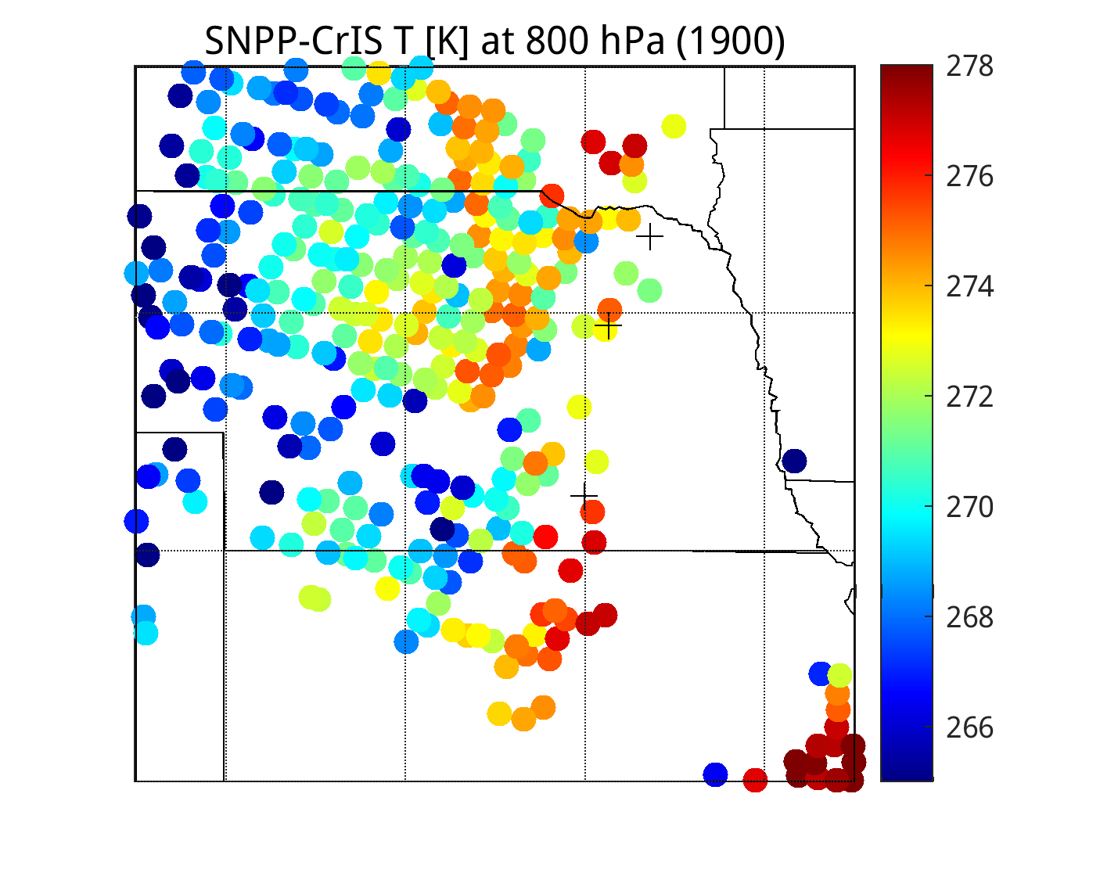
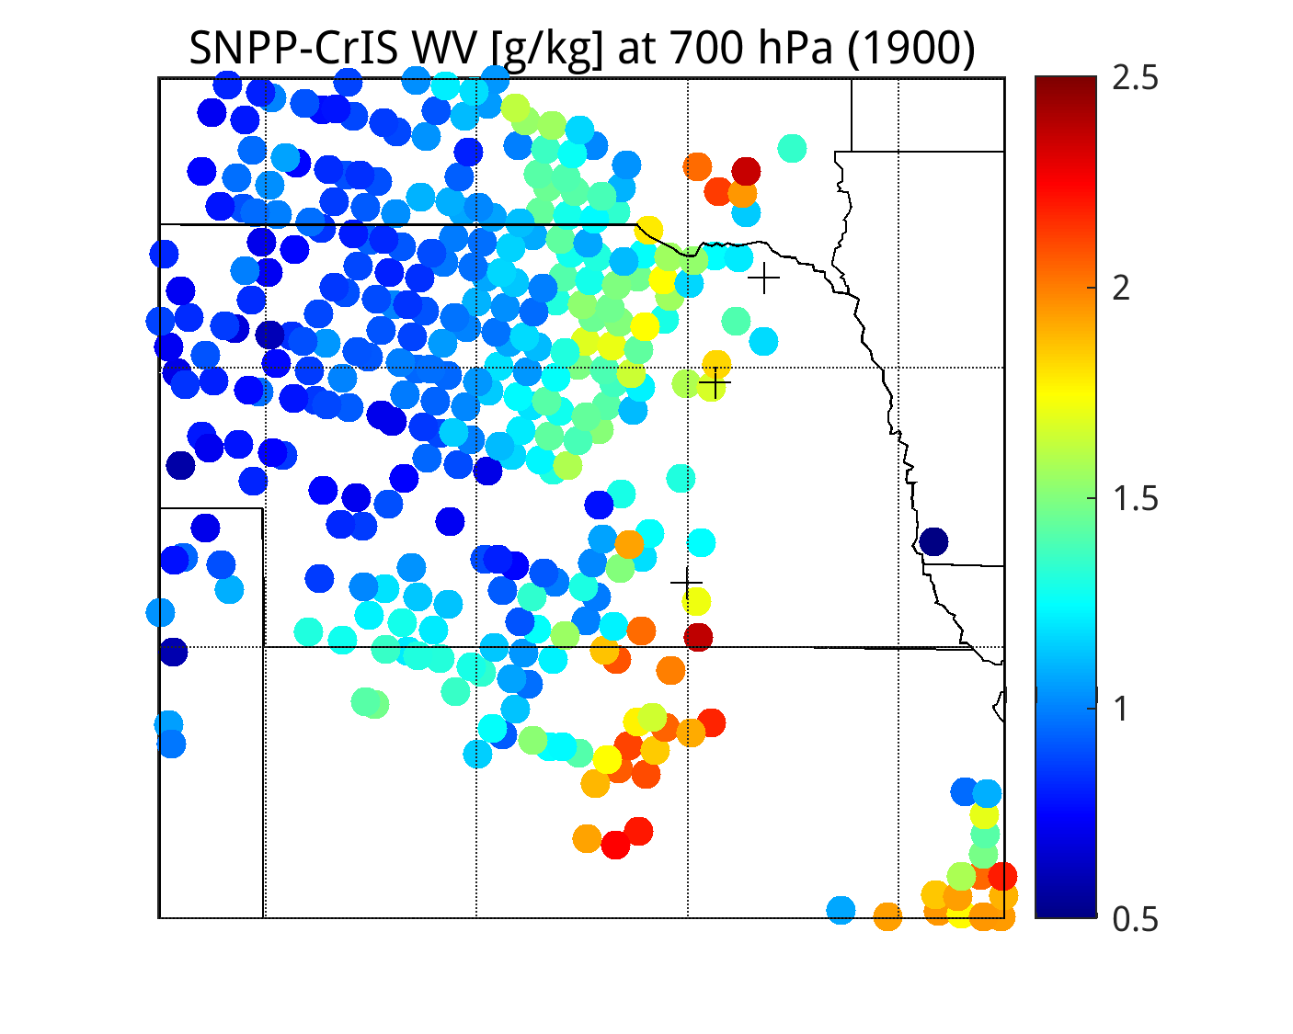
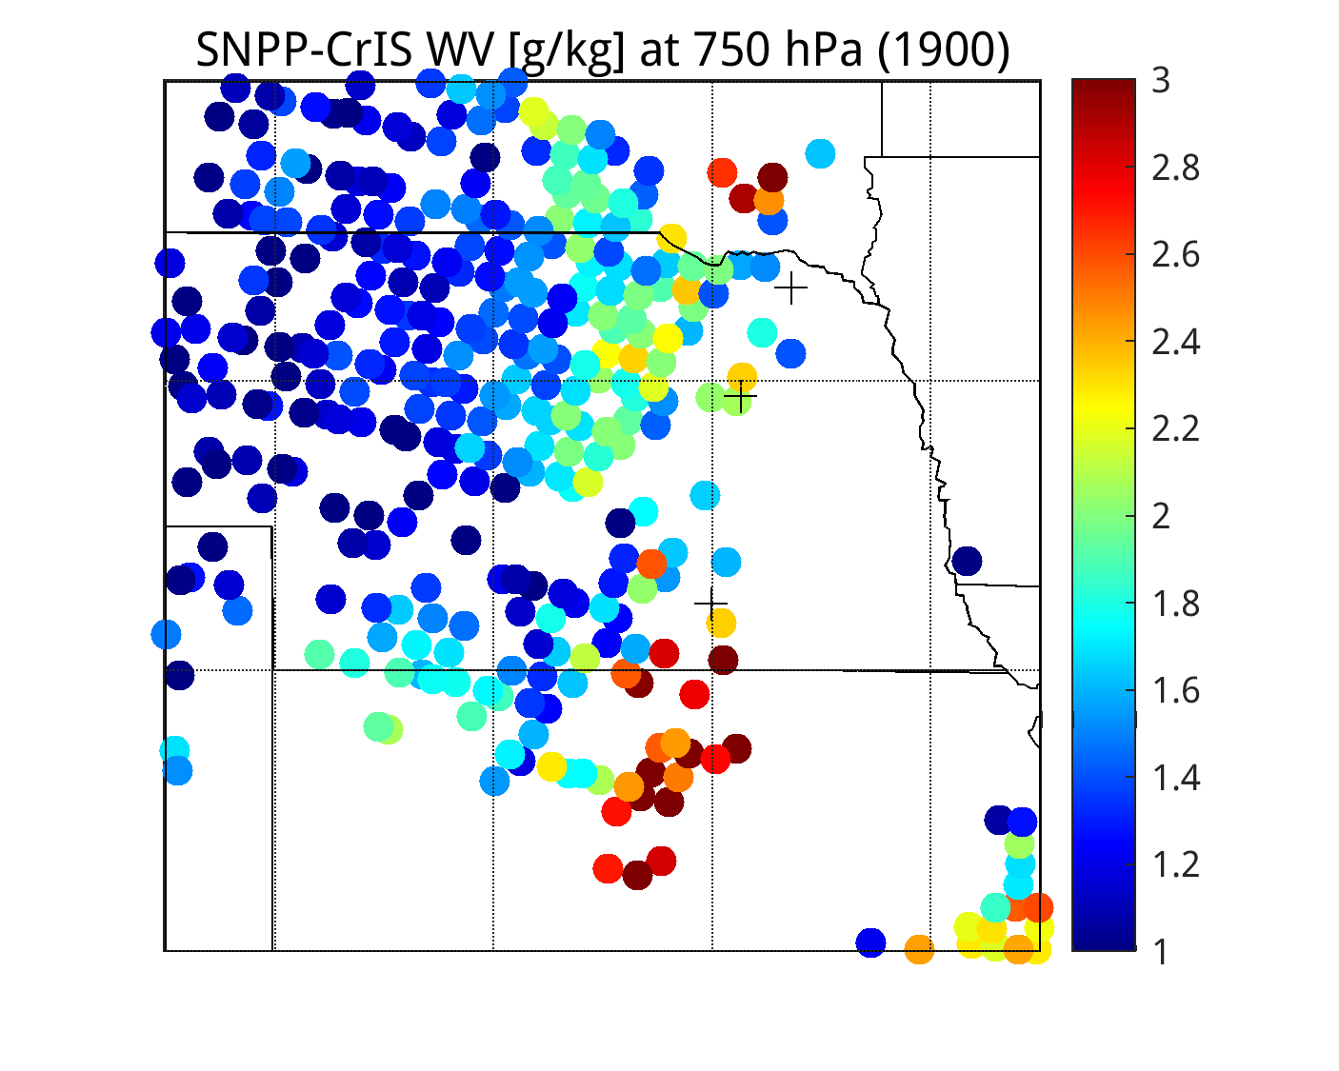
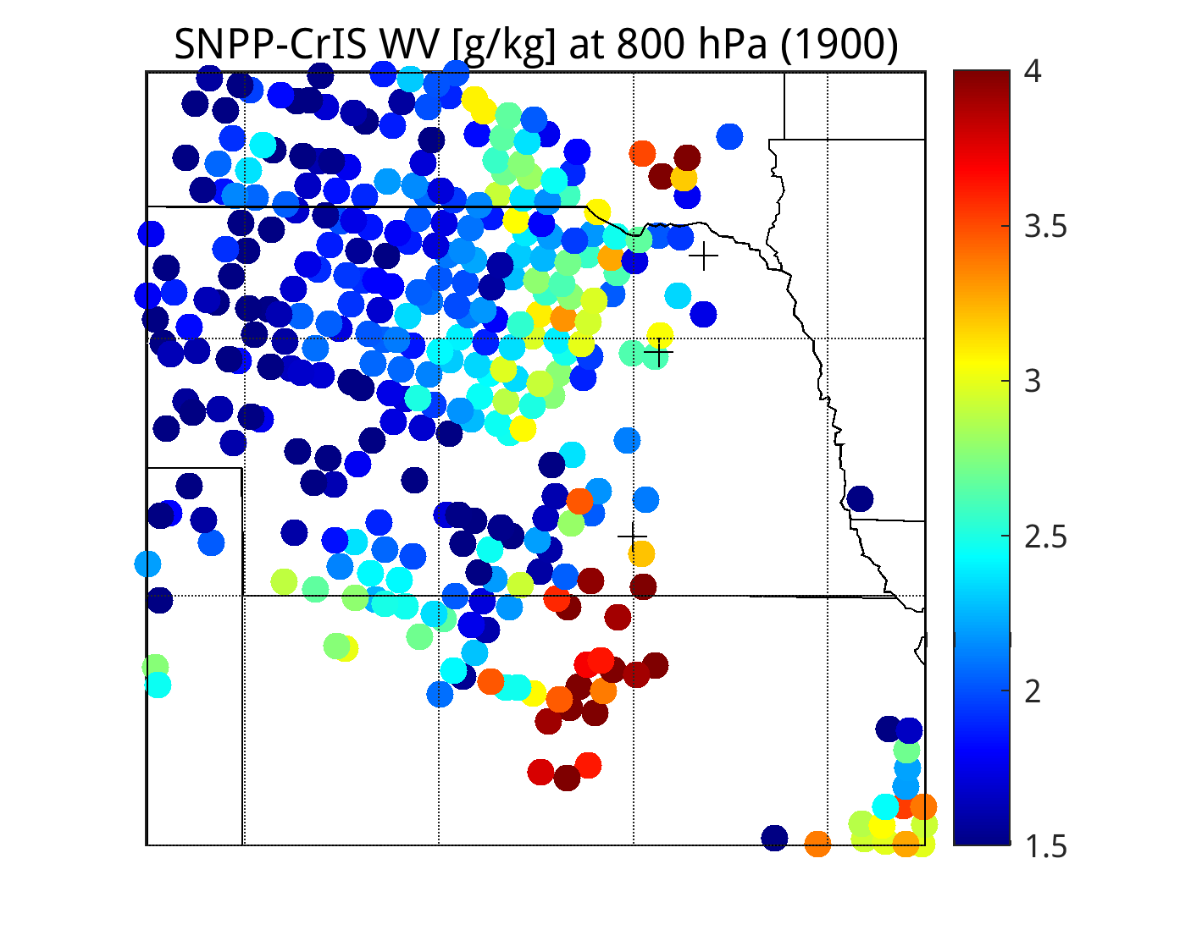
18 Channel Retrieval of SN-CrIS at 1900 UTC
(8 convolved bands + 10 CrIS ONL/OFL channels)
700 hPa
750 hPa
800 hPa
Temperature [K]
Humidity [g/kg]

Slide 6
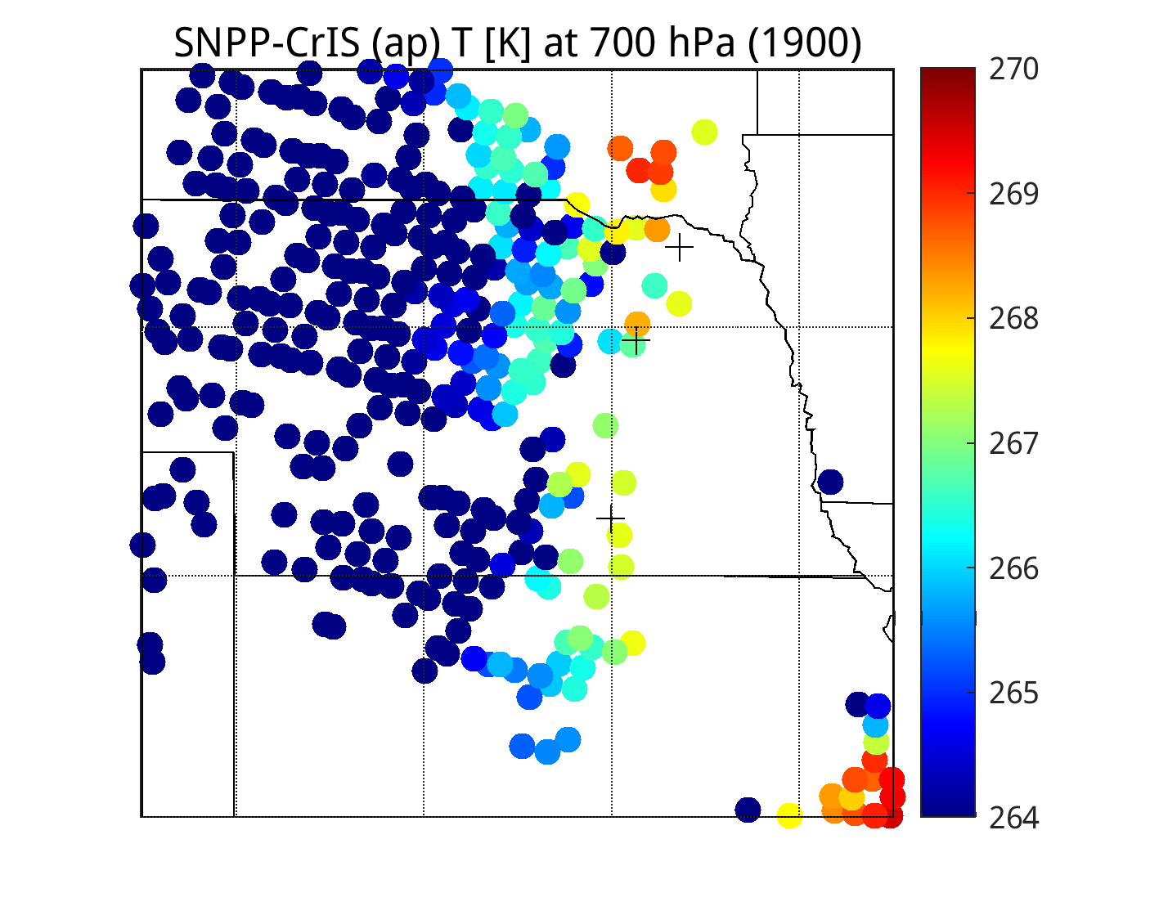
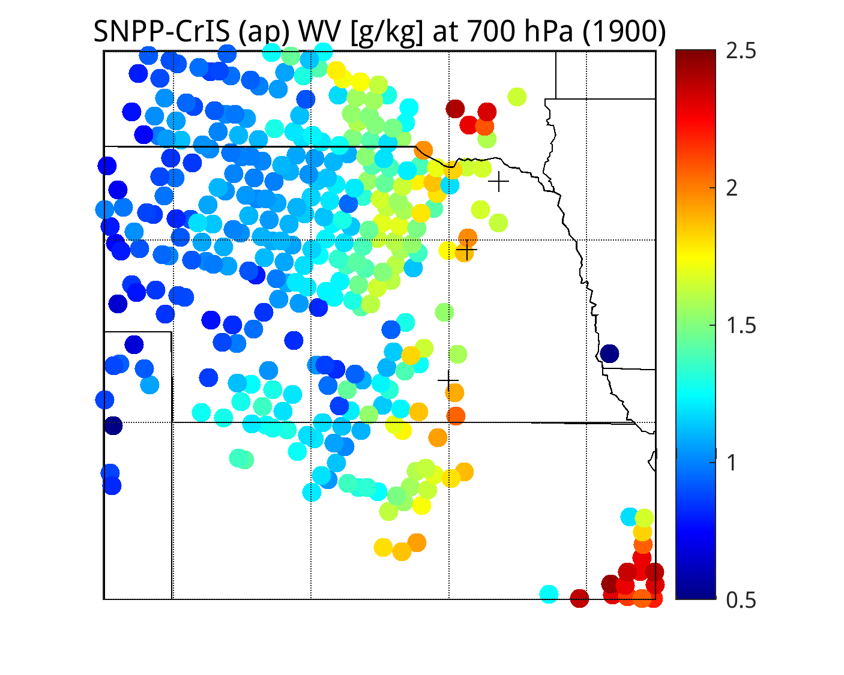
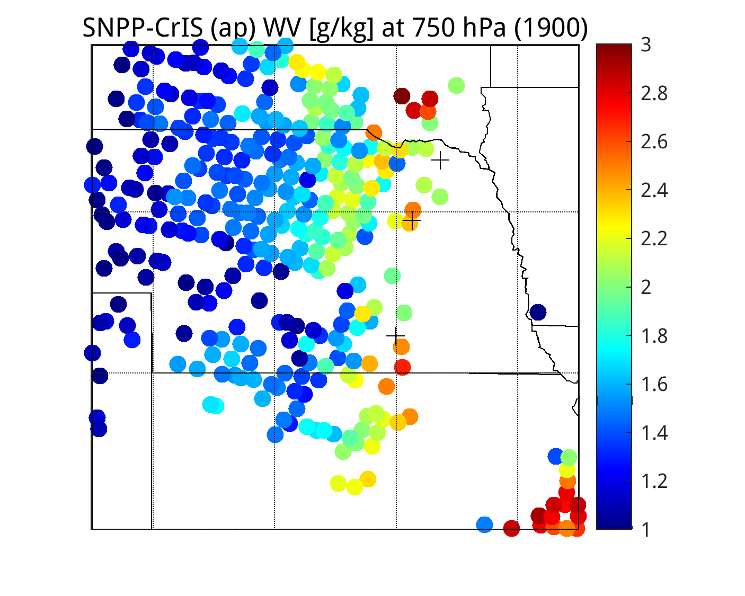
8 Band Retrieval of apodized SN-CRIS convolved to ABI radiances at 1900 UTC
700 hPa
750 hPa
800 hPa
Temperature [K]
Humidity [g/kg]

Slide 7
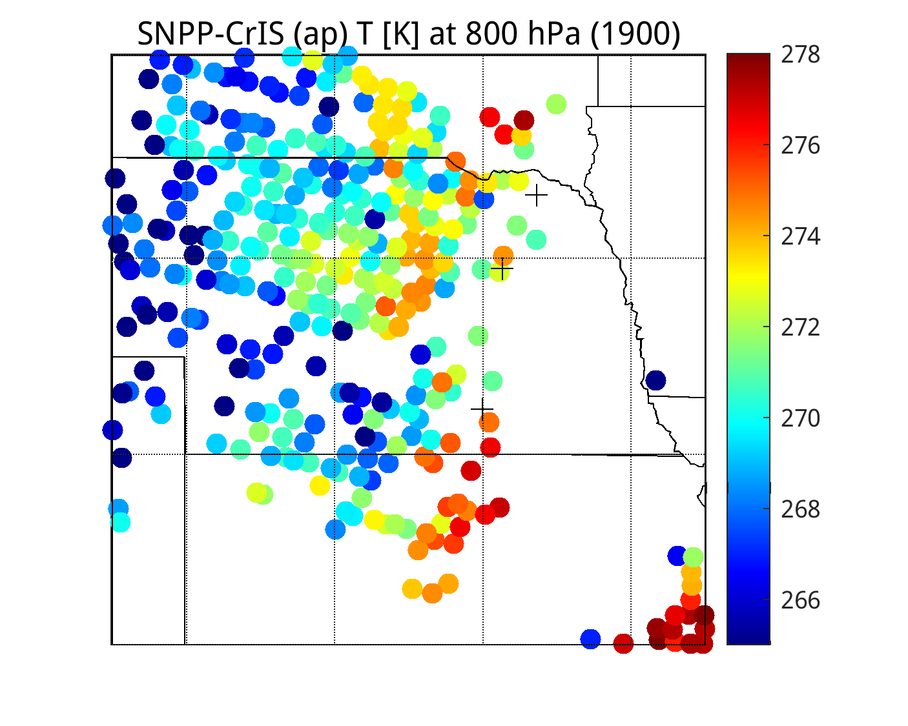
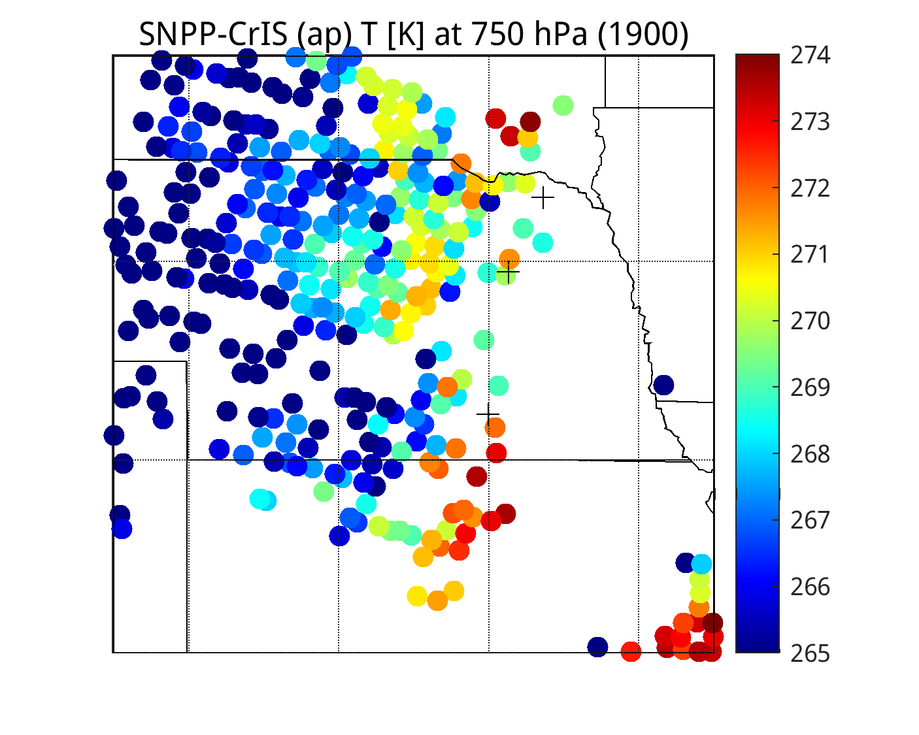
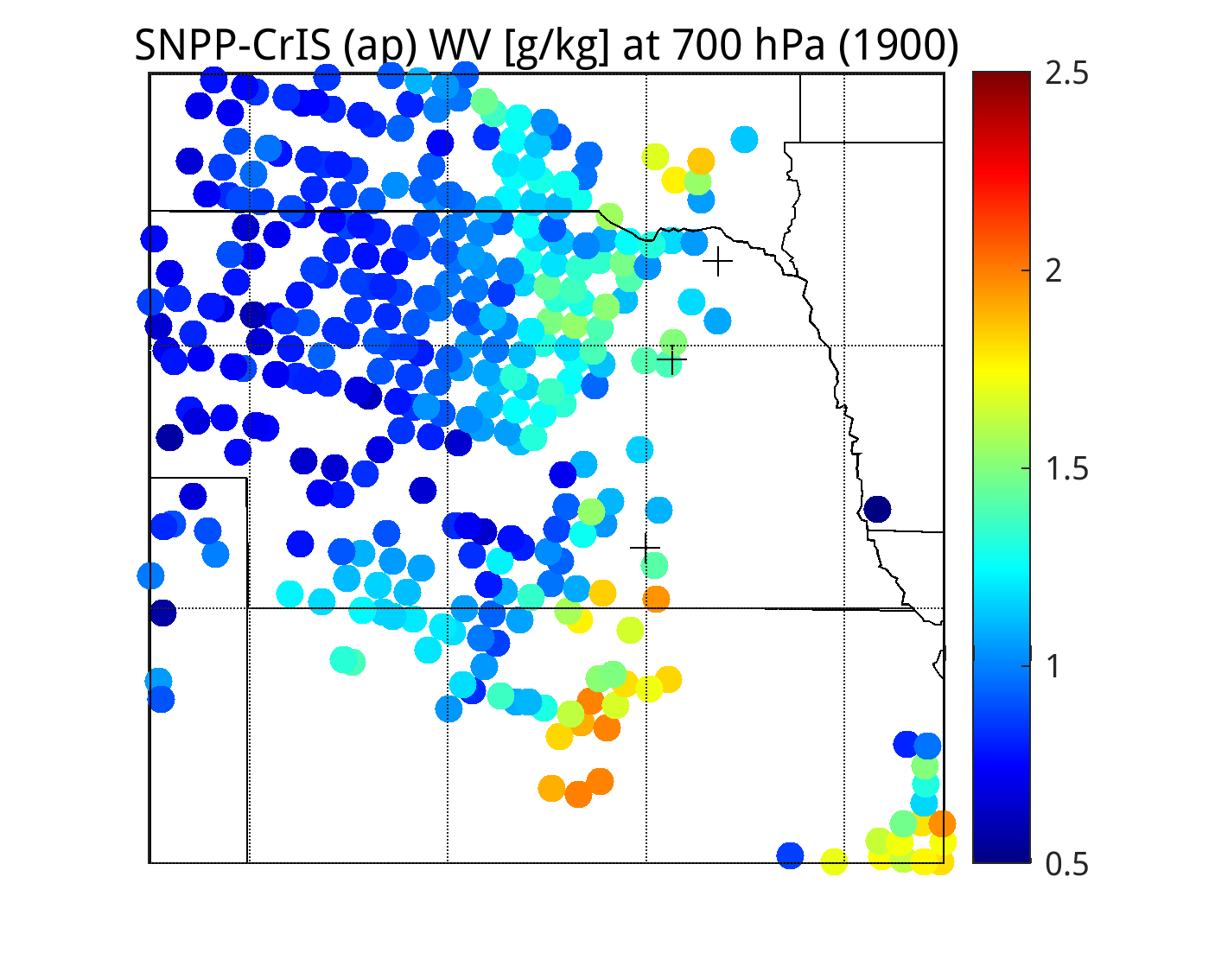
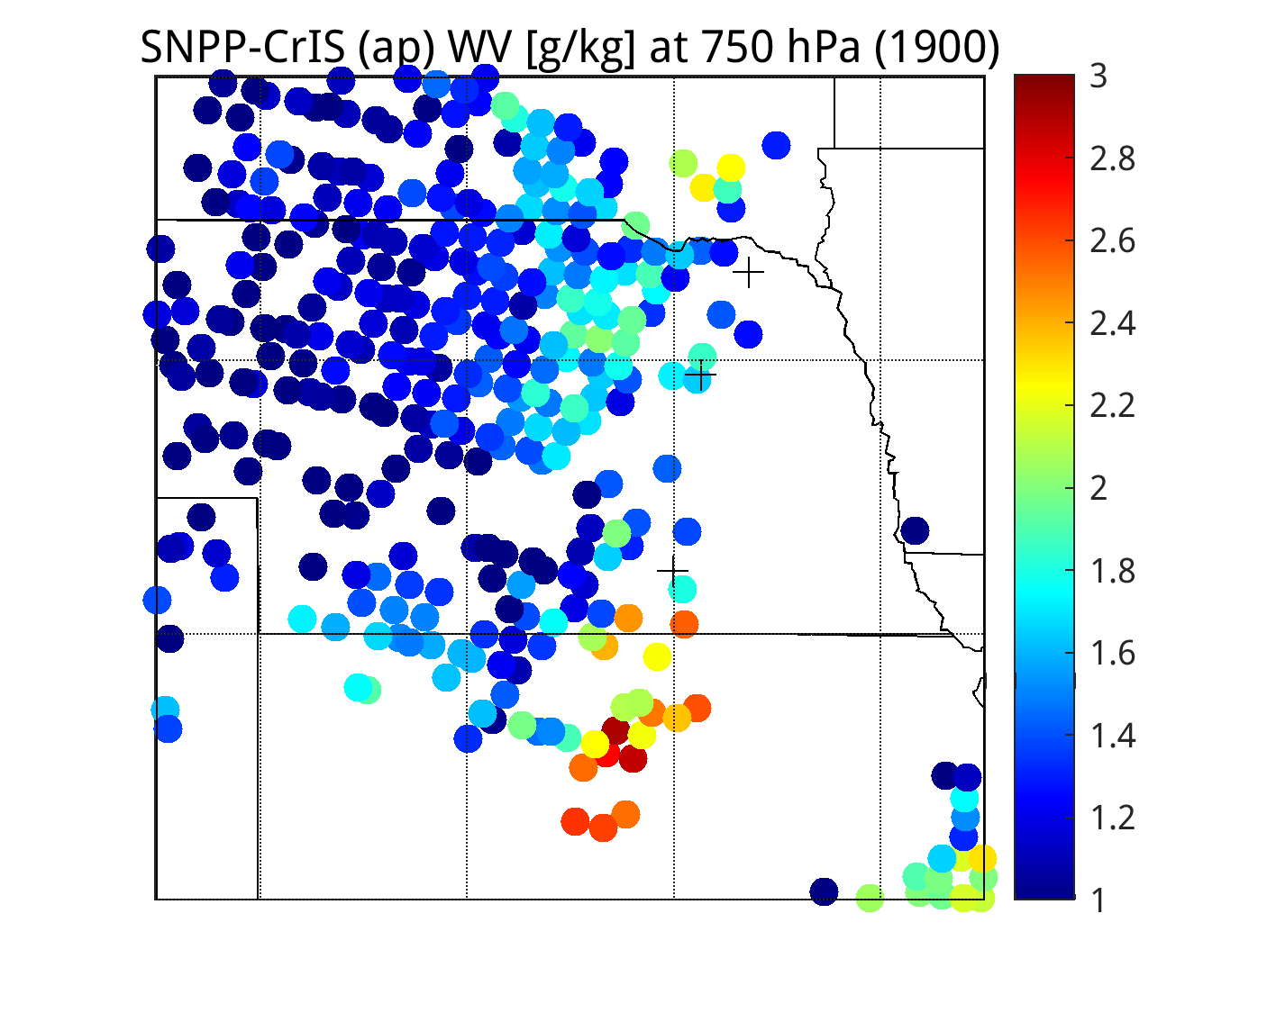
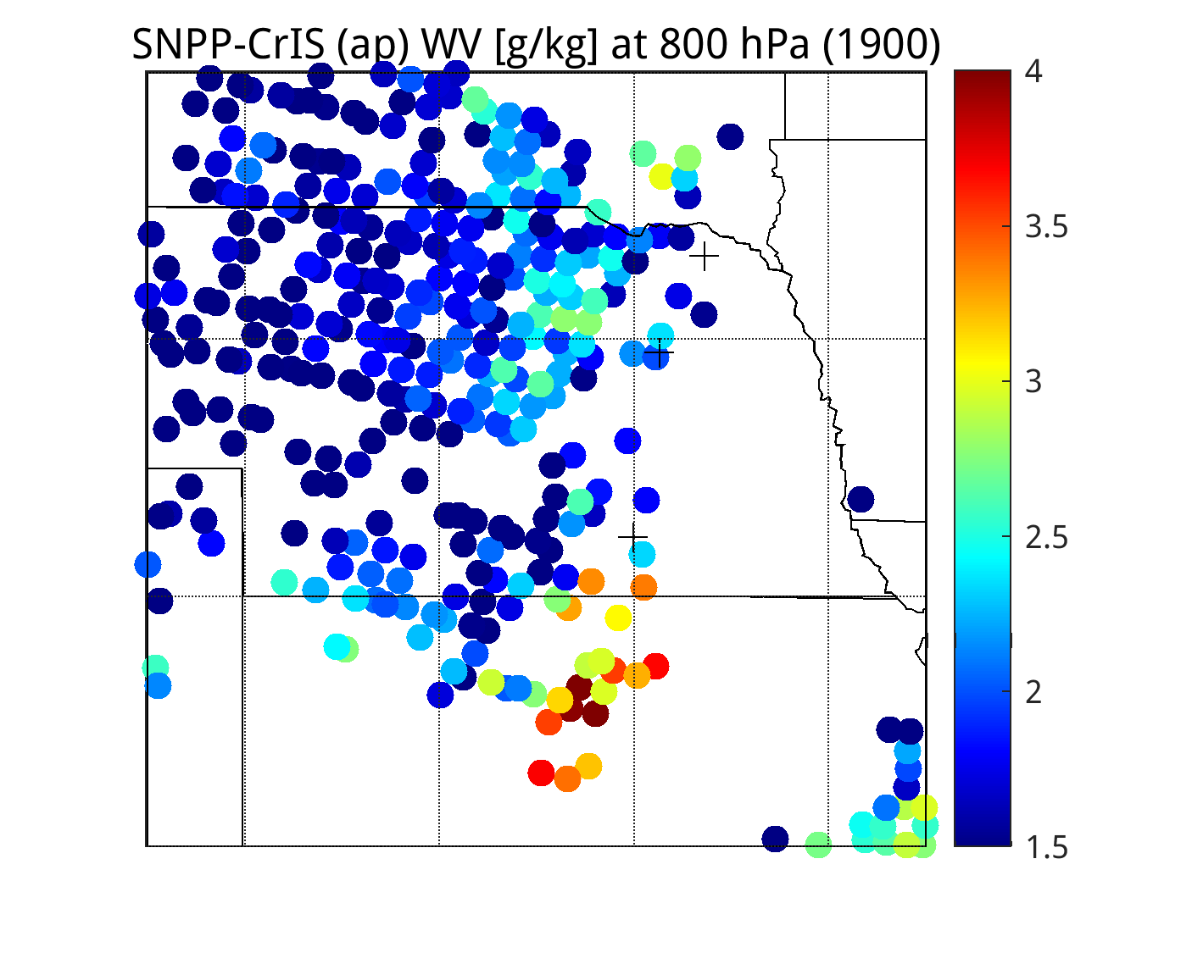
18 Channel Retrieval of apodized SN-CrIS at 1900 UTC
(8 convolved bands + 10 CrIS ONL/OFL channels)
700 hPa
750 hPa
800 hPa
Temperature [K]
Humidity [g/kg]

Slide 8
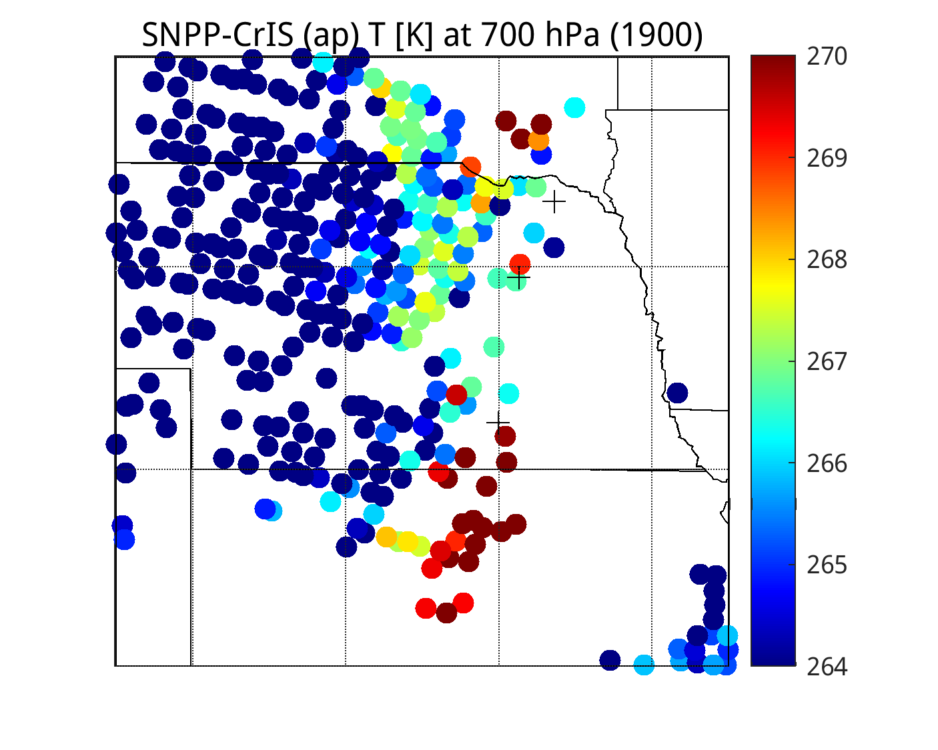
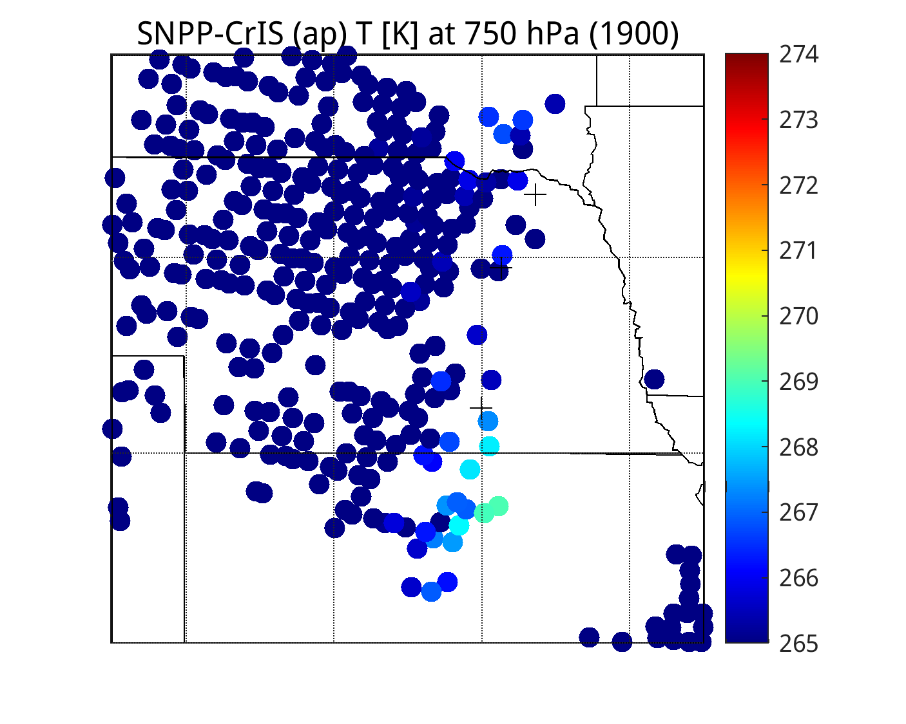
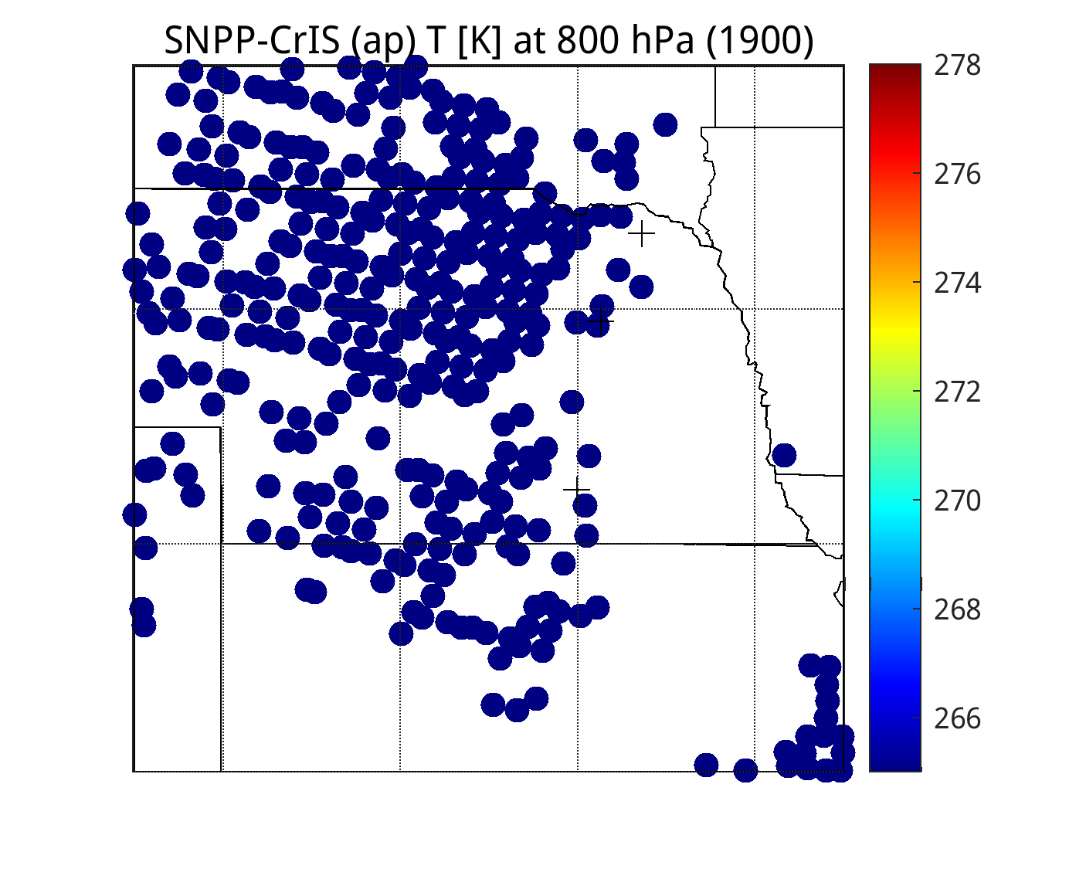
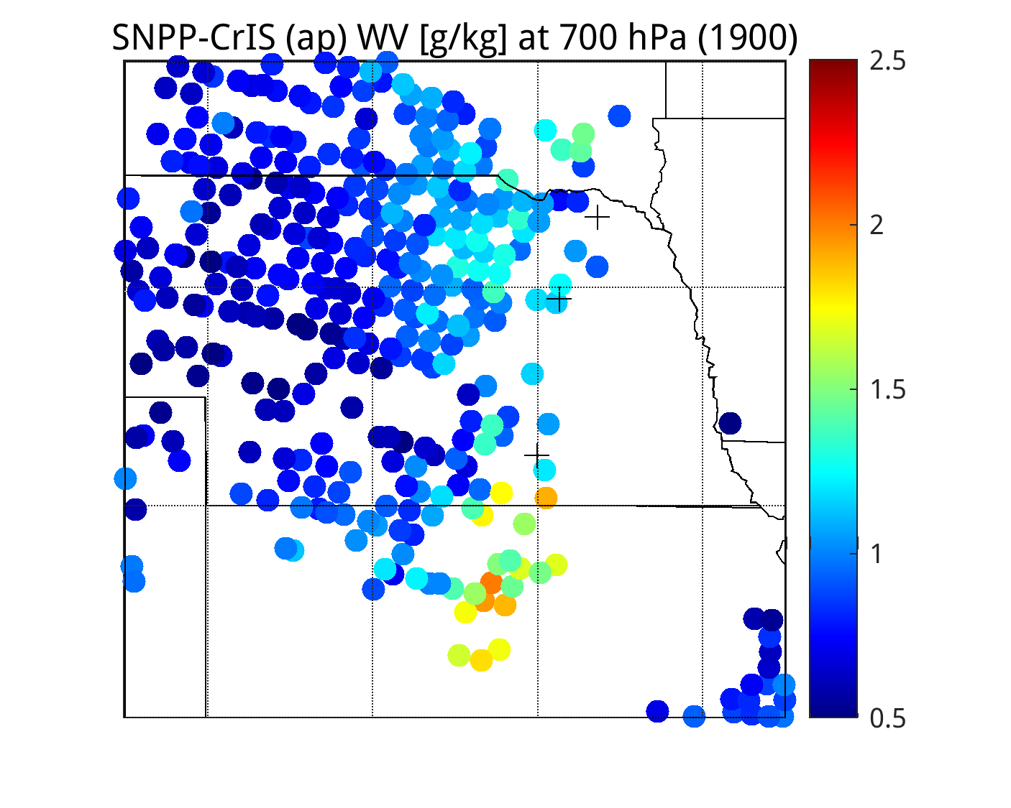
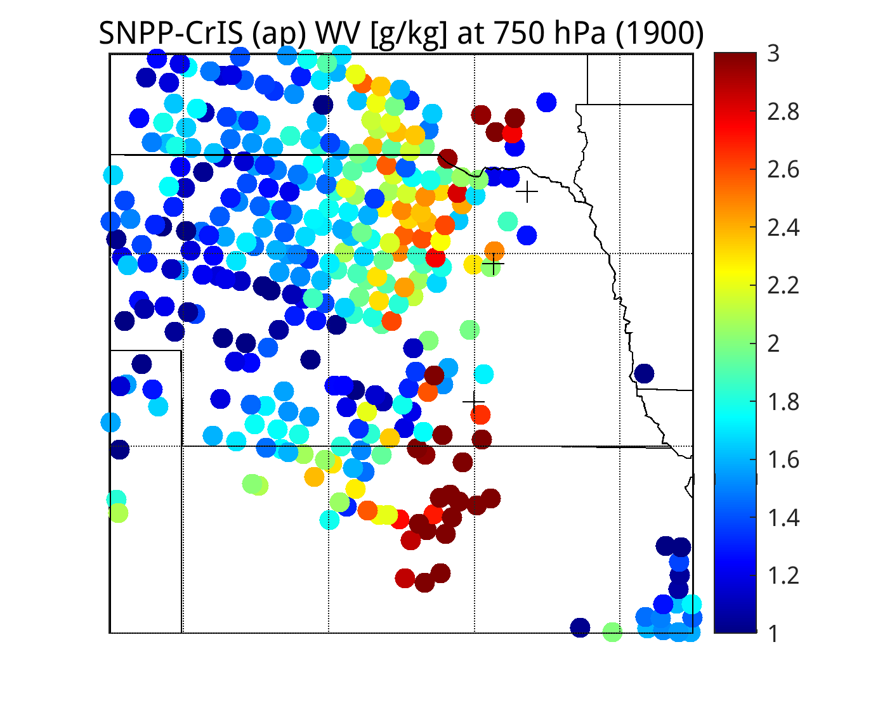
18 Channel Retrieval of apodized SN-CrIS at 1900 UTC
(8 convolved bands + 10 CrIS ONL/OFL channels)
700 hPa
750 hPa
800 hPa
Temperature [K]
OLD - WRONG
Humidity [g/kg]

Slide 9
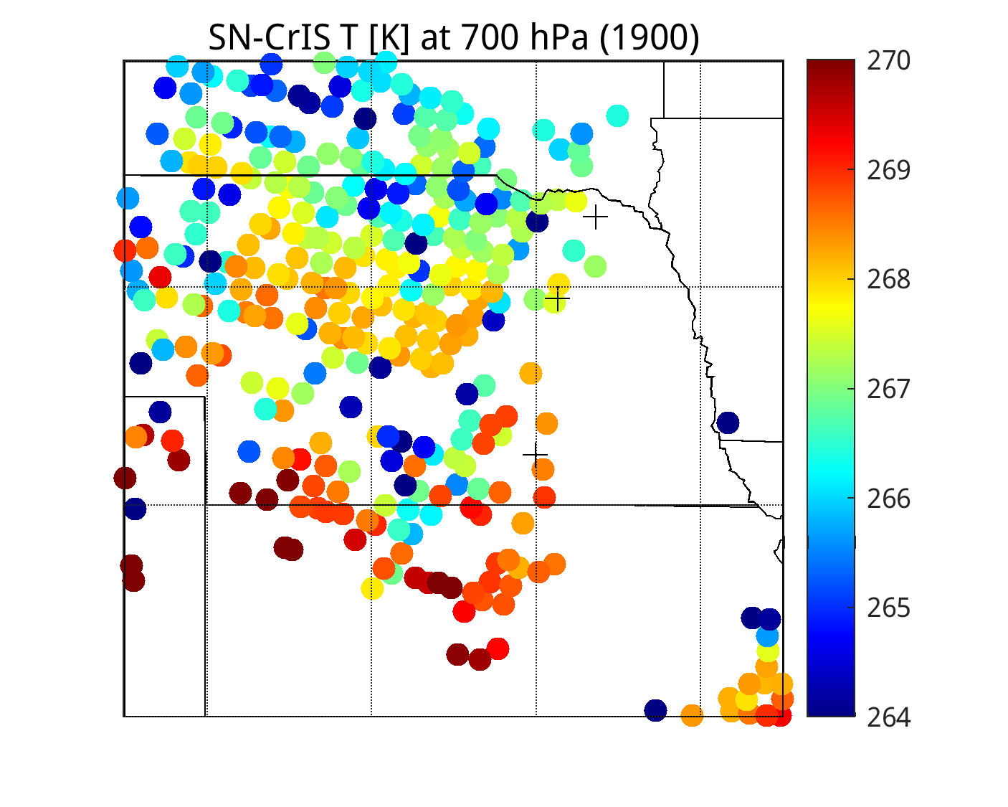
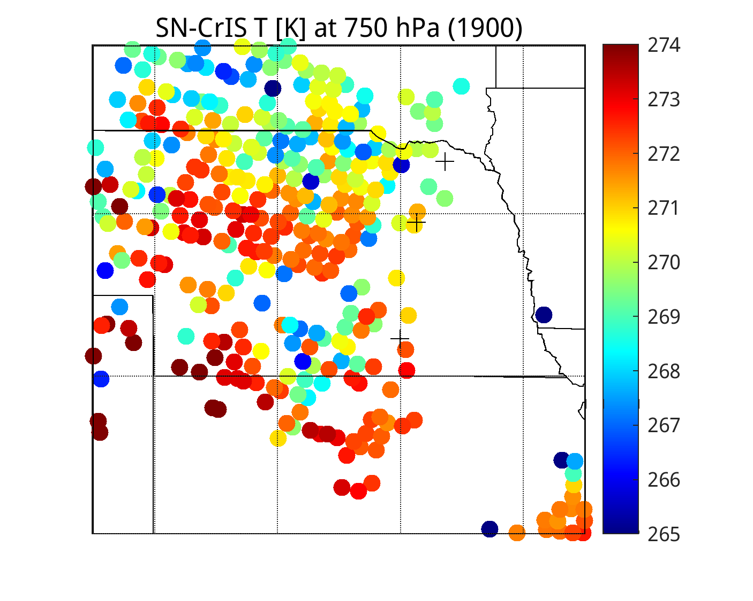
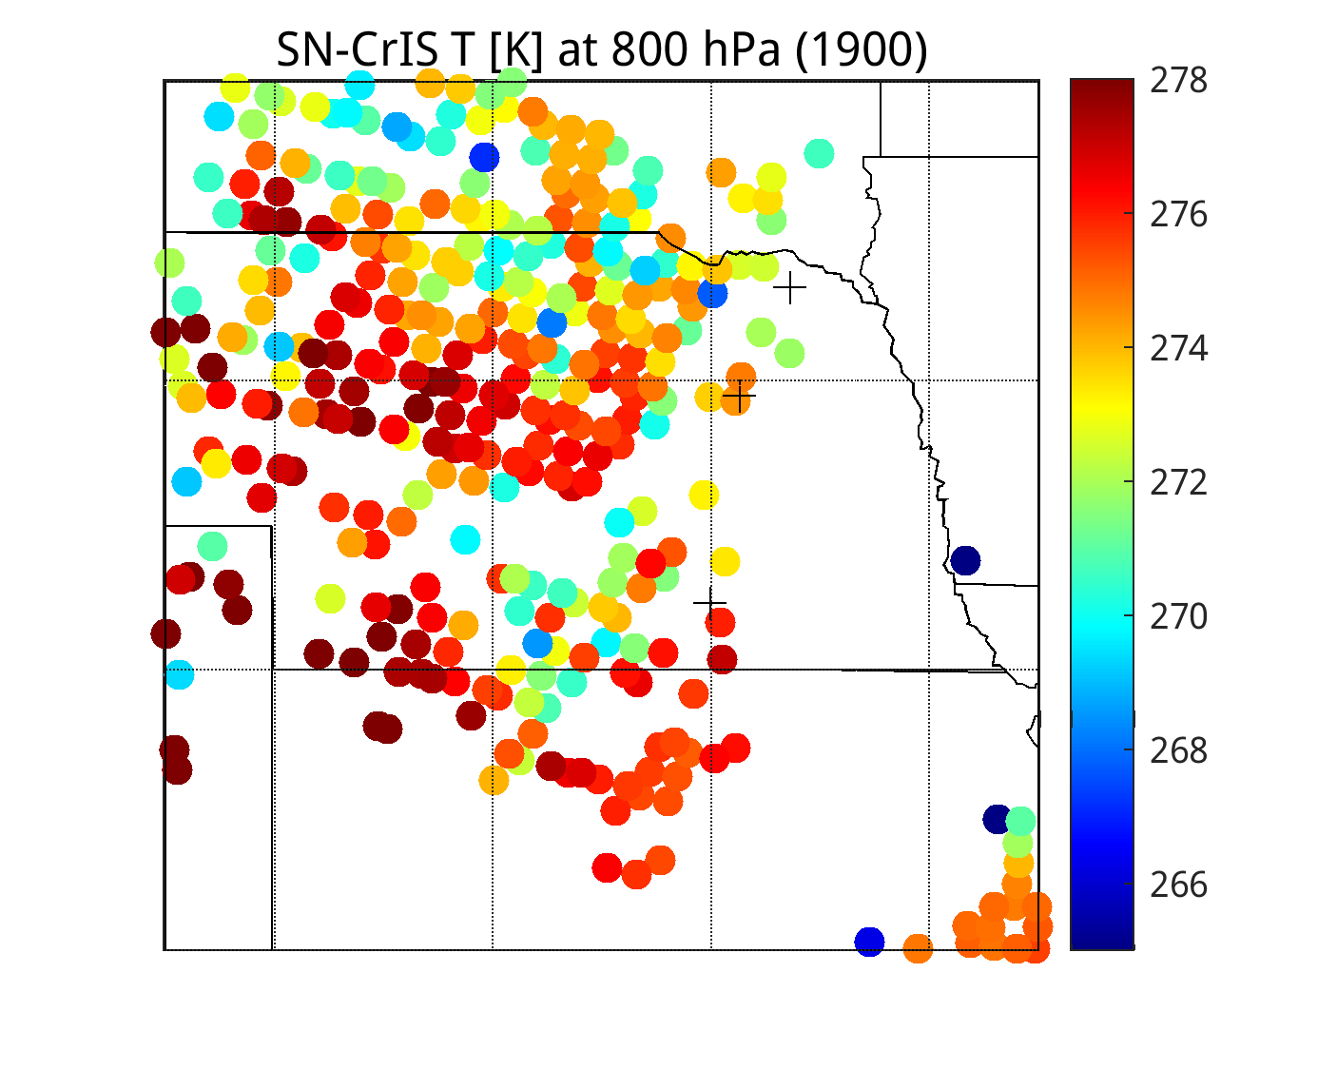
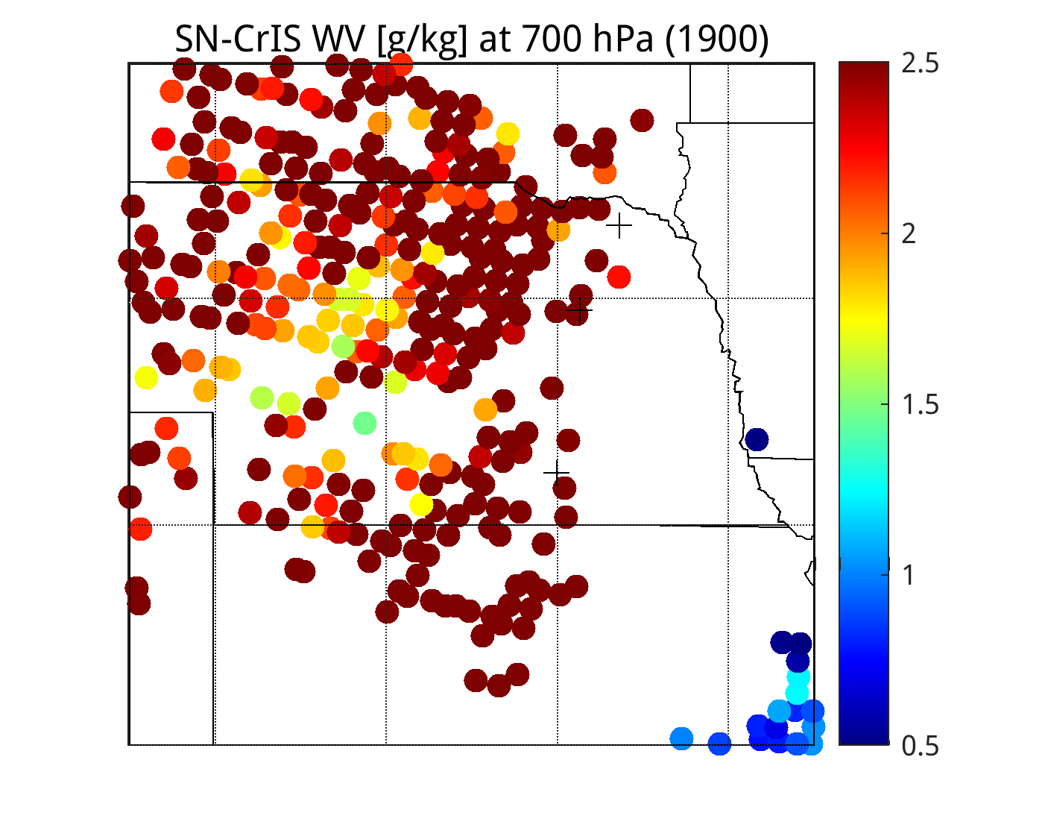
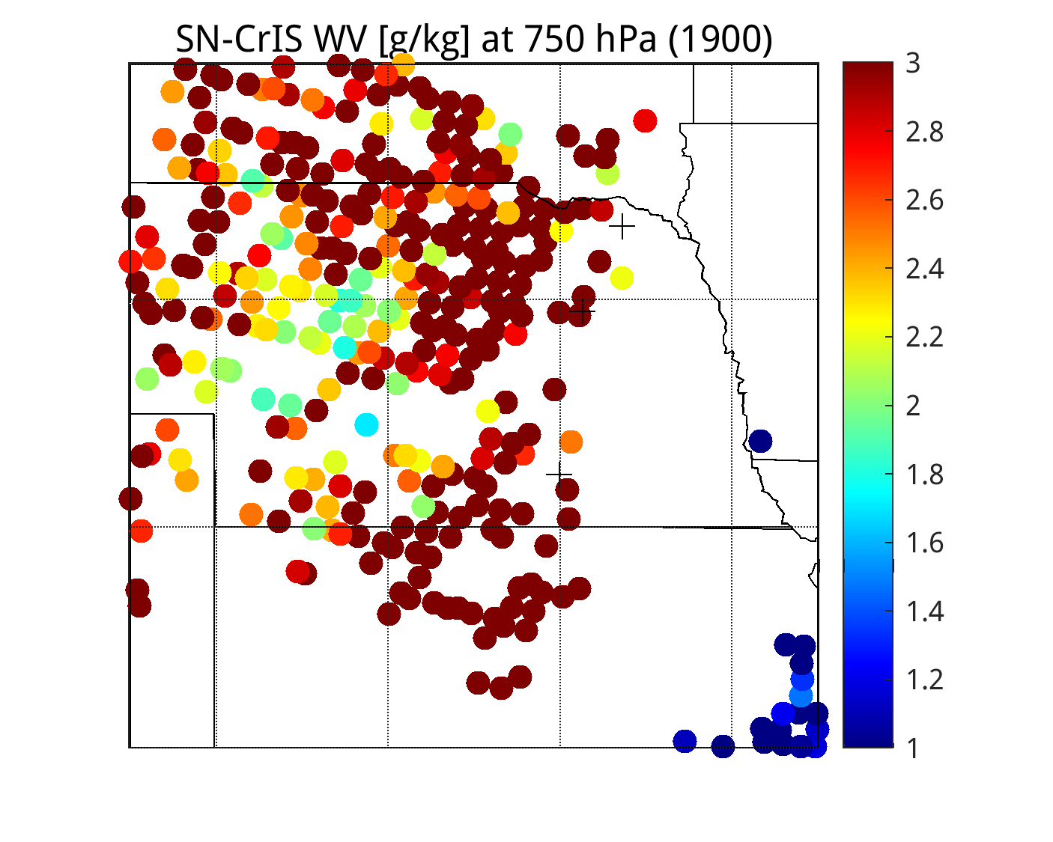
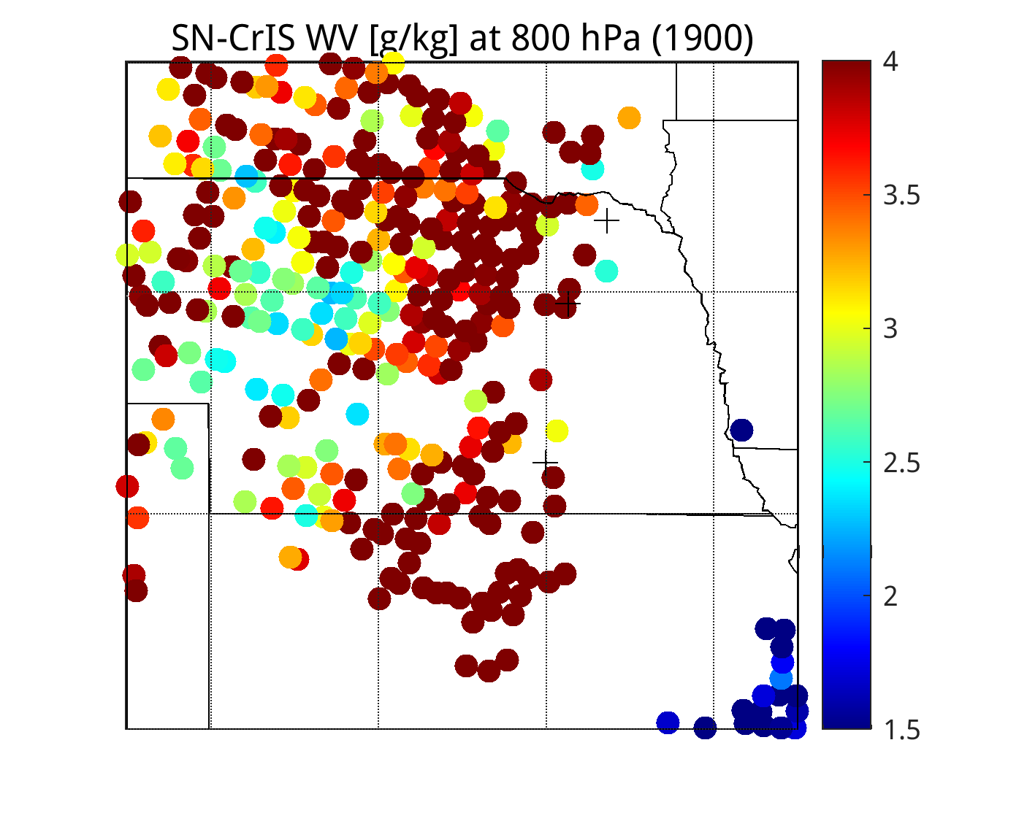
Original (full spectrum) SN-CRIS clear-sky regression Retrieval at 1900 UTC
700 hPa
750 hPa
800 hPa
Temperature [K]
Humidity [g/kg]

Slide 10
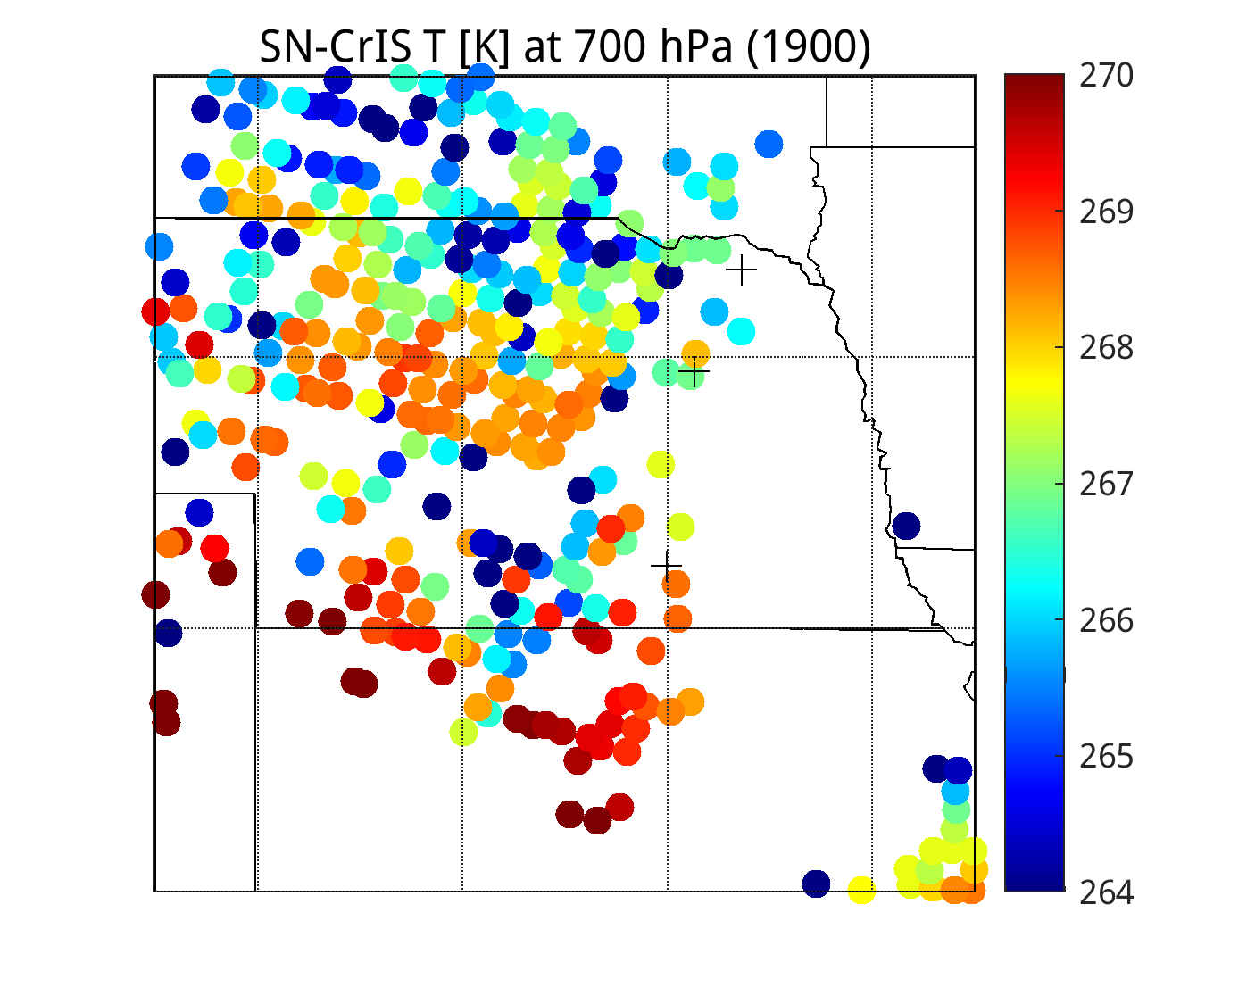
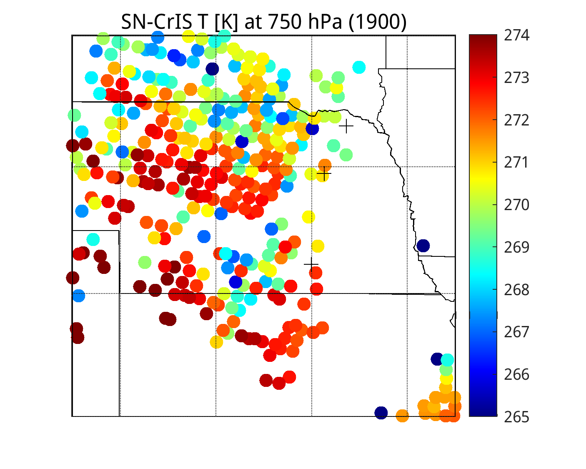
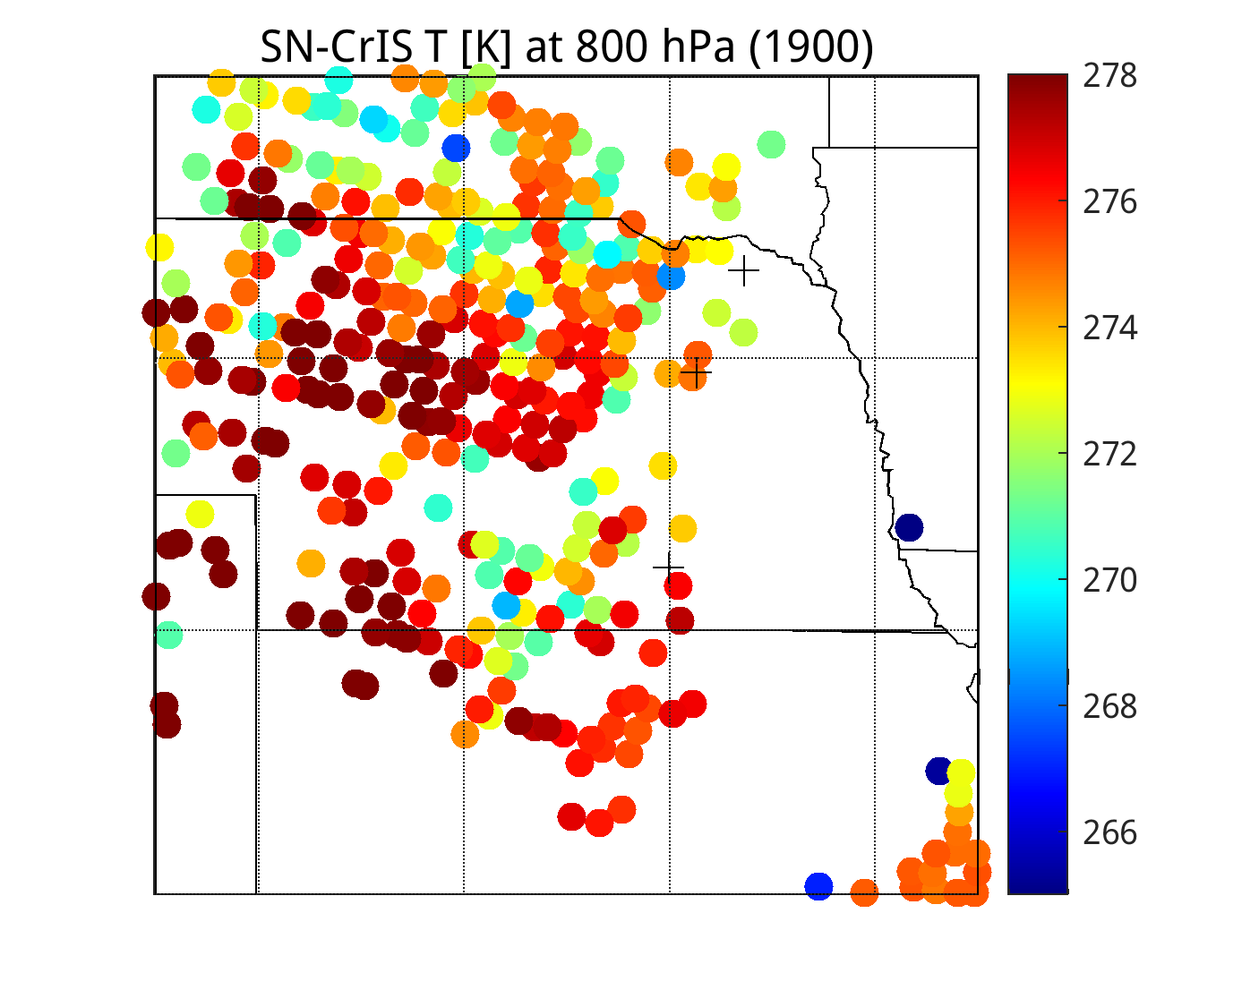
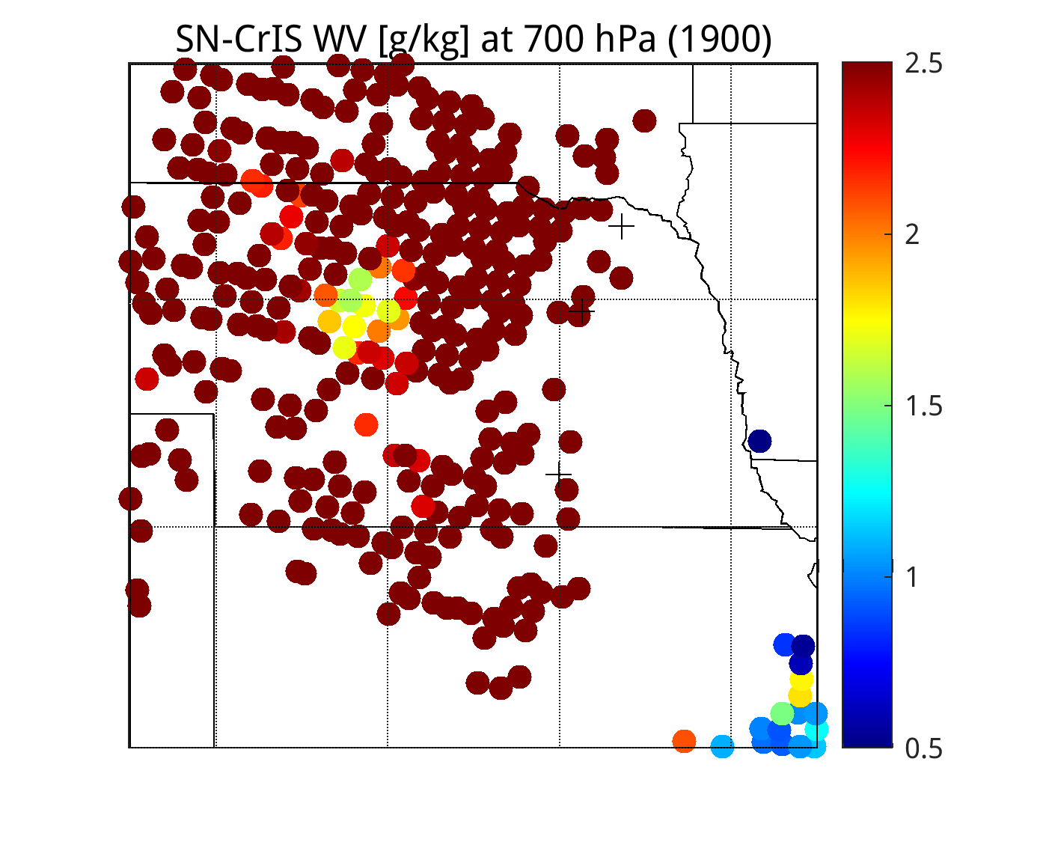
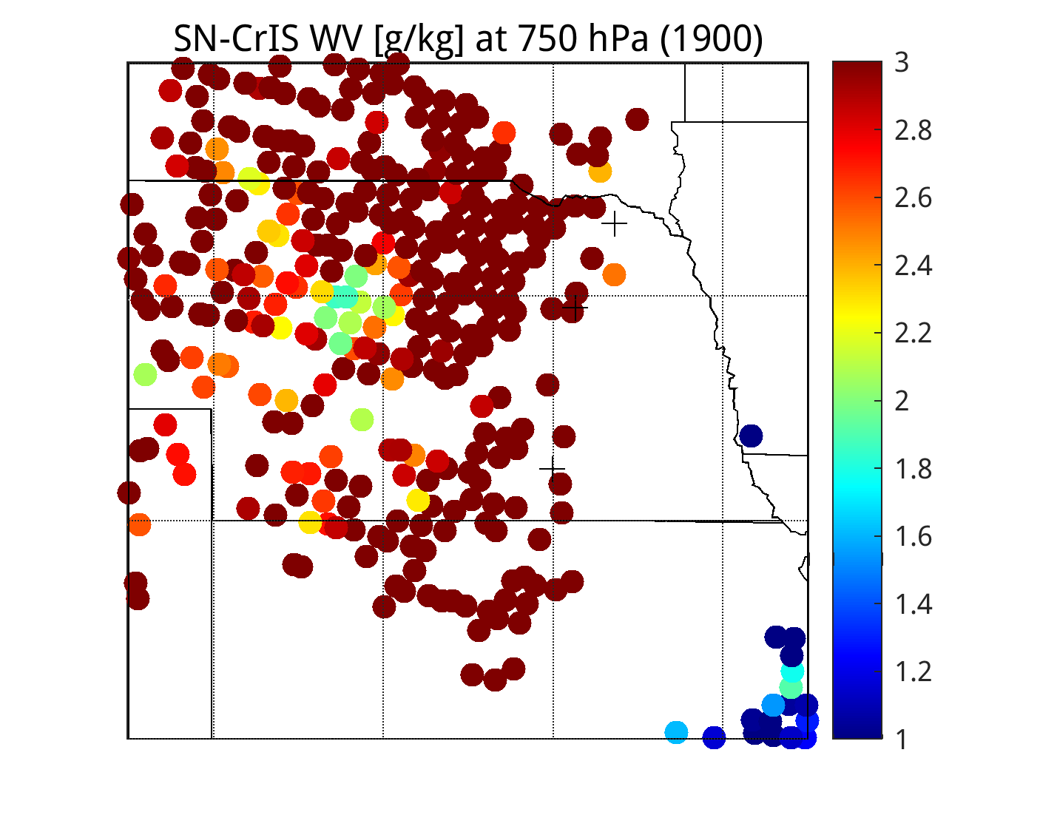
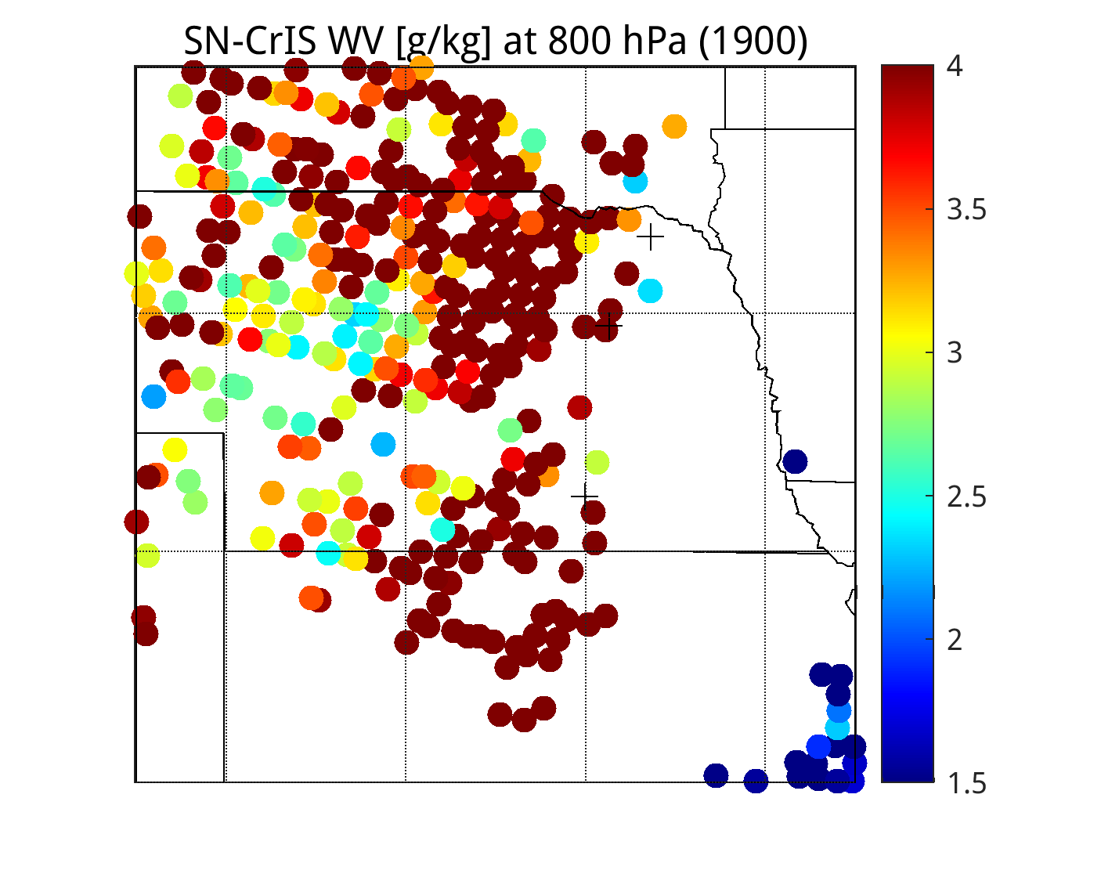
Original (apodized full spectrum) SN-CRIS clear-sky regression Retrieval at 1900 UTC
700 hPa
750 hPa
800 hPa
Temperature [K]
Humidity [g/kg]

Slide 11
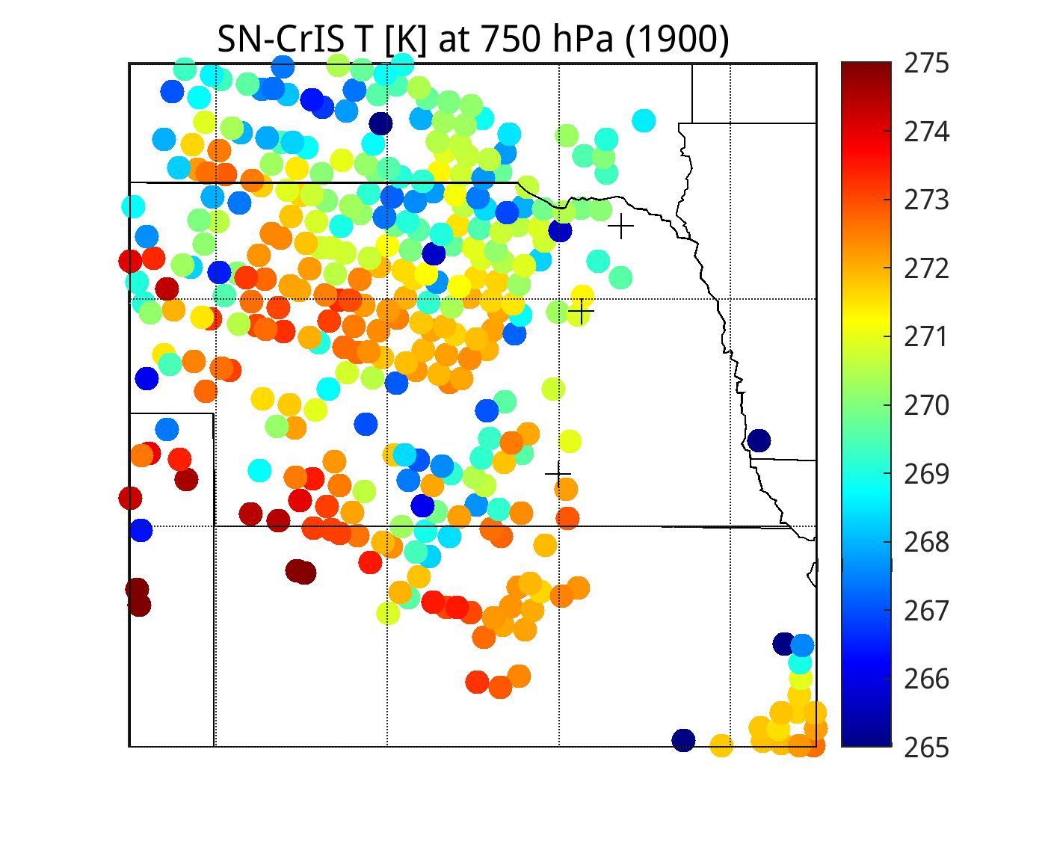
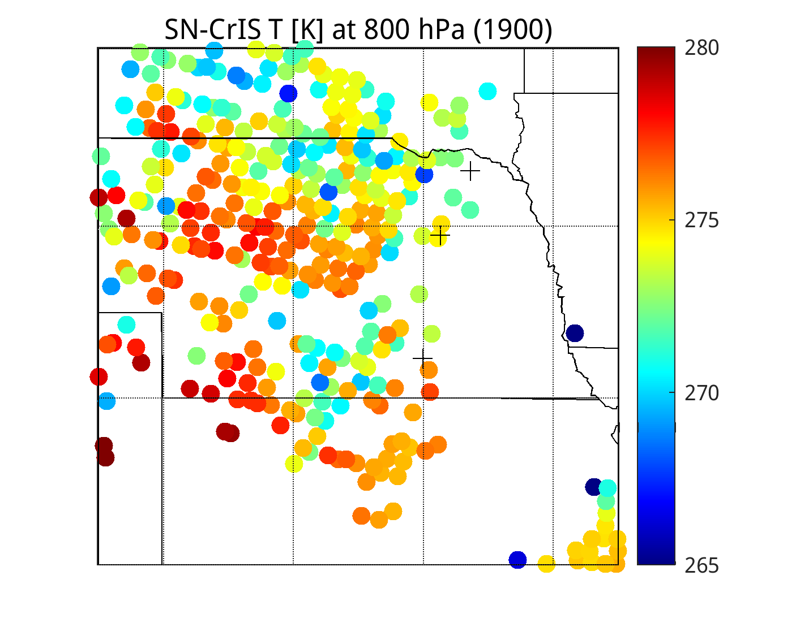
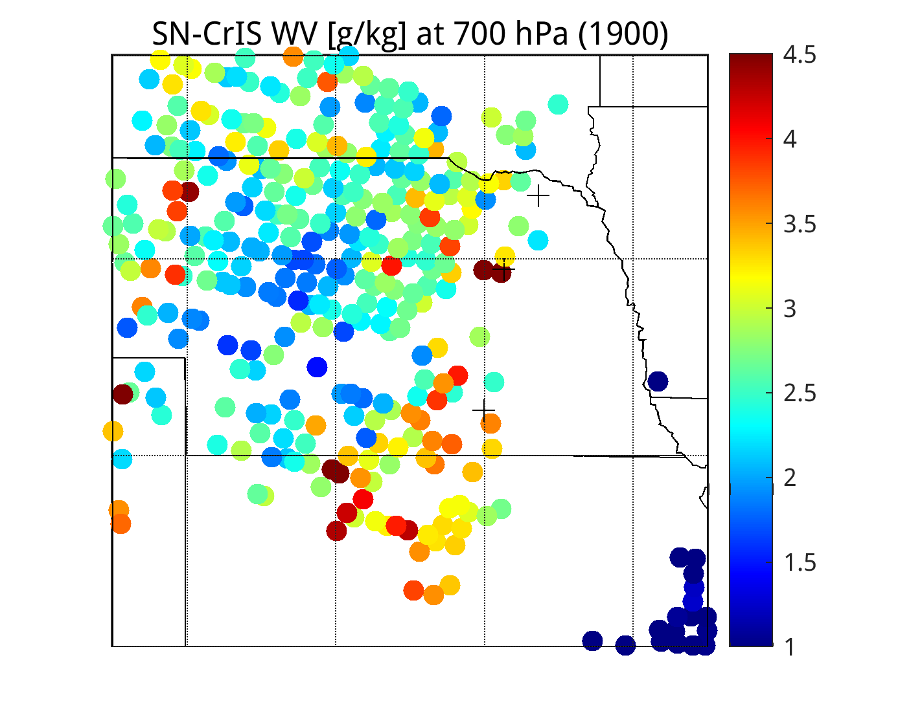
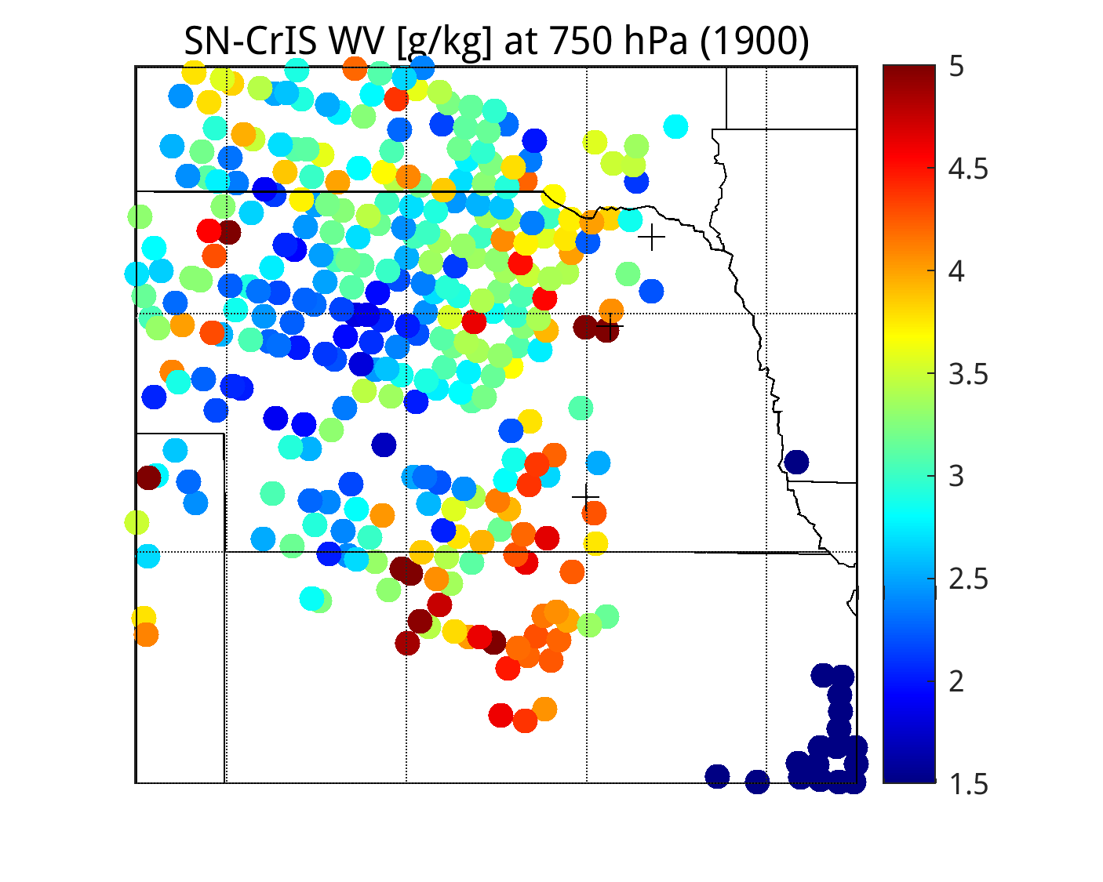
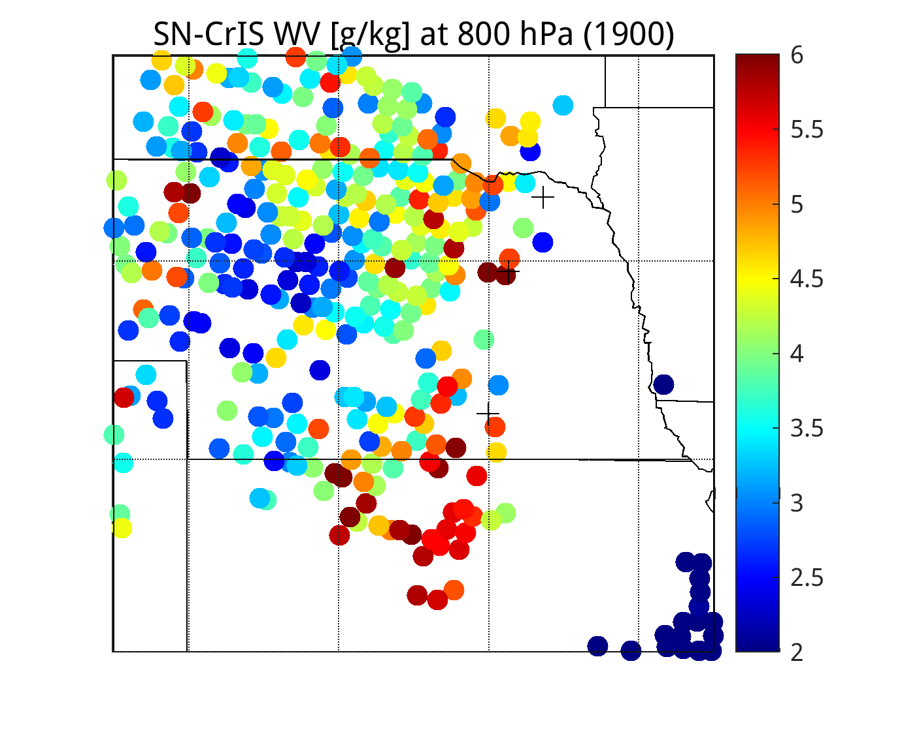
Original (full spectrum) SN-CRIS clear-sky regression Retrieval at 1900 UTC
700 hPa
750 hPa
800 hPa
Temperature [K]
Humidity [g/kg]
Same as before except different colorbar

Slide 12
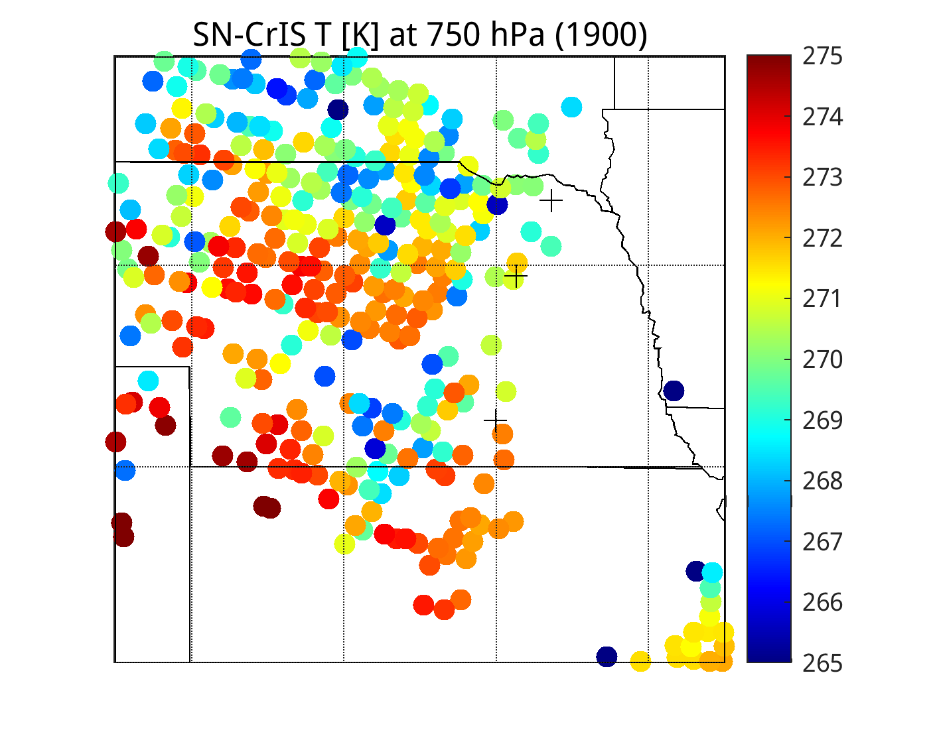
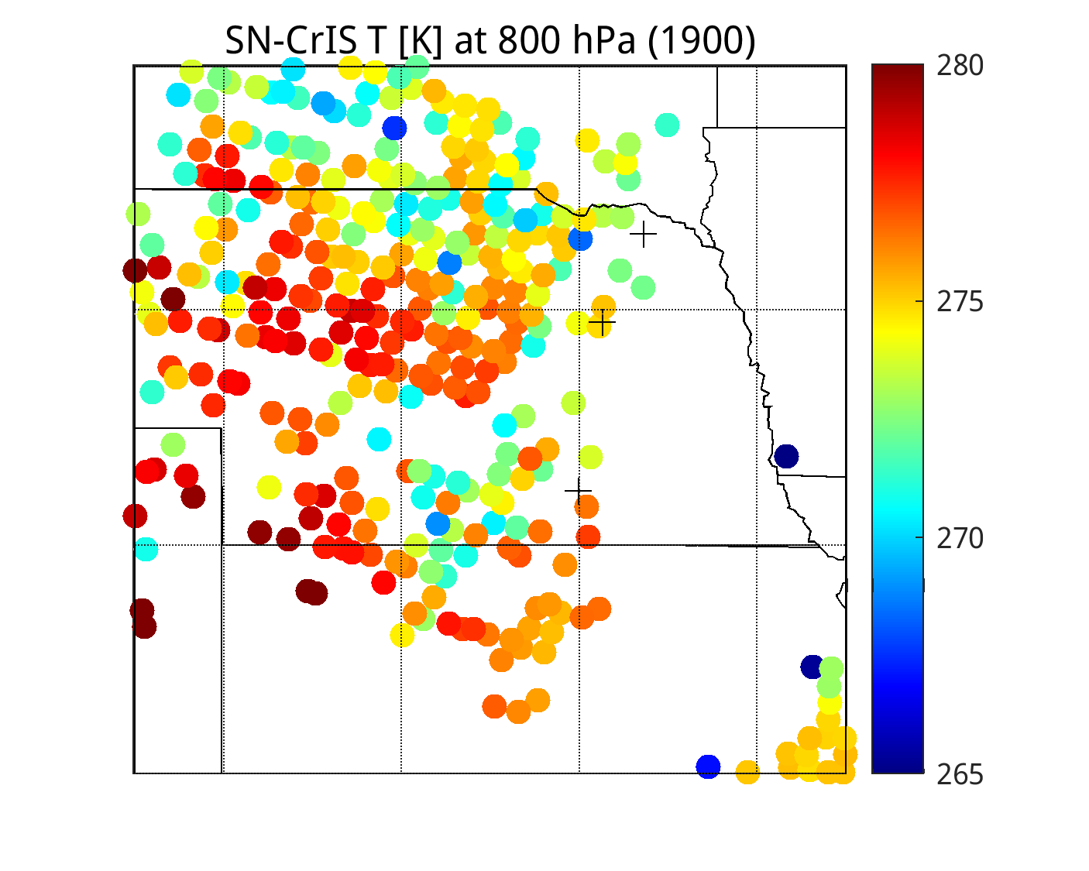
Original (apodized full spectrum) SN-CRIS clear-sky regression Retrieval at 1900 UTC
700 hPa
750 hPa
800 hPa
Temperature [K]
Humidity [g/kg]

Slide 13
Conclusions
Adding unapodized CrIS ONL/OFFL channels from the rotational WV lines in the IR window region to the ABI bands improves low-level T and Q products significantly (like IASI results)
When using apodized radiances this is less obvious.
However, using the full-spectrum or convolved apodized radiances seems to be okay
Next, use ECMWF and NCEP channel subsets and compare unapodized vs apodized CrIS retrieval results.

Slide 14
Issue with PCRTM apodized CrIS rads during daytime (low solzen)
Black … unapodized CrIS
Red … Hamming apodized CrIS
Green … Hamming added manually to unapodized (black)

