Slide 1
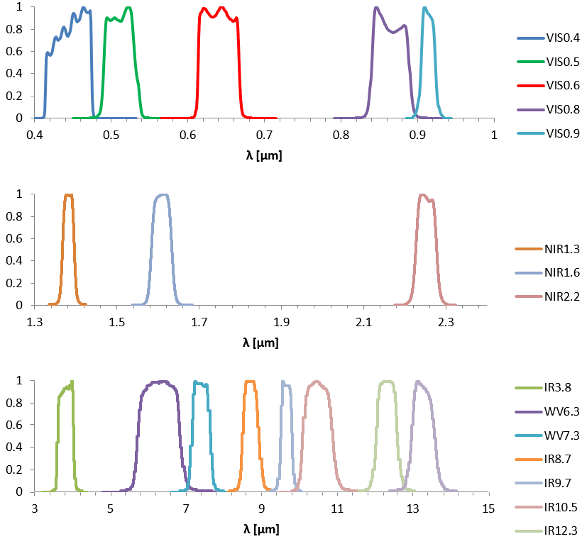
Preview of MTG FCI + IASI T and Q Product Fusion
FY25 Project: Studies of the Anticipated GeoXO Sounder Capabilities for
Depicting Low Level Atmospheric Moisture
# | Spectral channel | Central wavelength, lambda_0 | Spectral width, delta lambda_0 | Spatial Sampling Distance (SSD)
1 | VIS 0.4 | 0.444µm | 0.060µm | 1.0km
2 | VIS 0.5 | 0.510µm | 0.040µm | 1.0km
3 | VIS 0.6 | 0.640µm | 0.050µm | 1.0km 0.5km (HR)
4 | VIS 0.8 | 0.865µm | 0.050µm | 1.0km
5 | VIS 0.9 | 0.914µm | 0.020µm | 1.0km
6 | NIR 1.3 | 1.380µm | 0.030µm | 1.0km
7 | NIR 1.6 | 1.610µm | 0.050µm | 1.0km
8 | NIR 2.2 | 2.250µm | 0.050µm | 1.0km 0.5km (HR)
9 | IR 3.8 | 3.800µm | 0.400µm | 2.0km 1.0km (HR)
10 | WV 6.3 | 6.300µm | 1.000µm | 2.0km
11 | WV 7.3 | 7.350µm | 0.500µm | 2.0km
12 | IR 8.7 | 8.700µm | 0.400µm | 2.0km
13 | IR 9.7 | 9.660µm | 0.300µm | 2.0km
14 | IR 10.5 | 10.500µm | 0.700µm | 2.0km 1.0km (HR)
15 | IR 12.3 | 12.300µm | 0.500µm | 2.0km
16 | IR 13.3 | 13.300µm | 0.600µm | 2.0km
wv_63
wv_73
ir_87
ir_105
ir_123
ir_133
FCI bands used in kdtree search
From https://user.eumetsat.int/resources/user-guides/mtg-fci-level-1c-data-guide

Slide 2
FCI and IASI Spatial/Temporal Product Fusion
Download IASI L1c data from NOAA CLASS and FCI L1 Normal Resolution Data from https://user.eumetsat.int/catalogue/EO:EUM:DAT:0662
2. Current Case study: IASI Metop-B (M01) granules 0944+0947 UTC over Europe on 5/12/25 with FCI L1 data at 9:40, 9:50, …10:40 UTC
Perform DR retrievals on IASI granules
Perform FCI+IASI spatial and temporal fusion on DR temperature and humidity (selected levels) retrievals.
A geographical kdtree is used for collocation, needed for spatial fusion
Input data to kd-tree search are FCI radiances of
Six FCI IR bands (bands 10-12,14-16) for T and q fusion
Two WV bands (bands 10,11) for q fusion
Then DR IASI retrievals are averaged over the 5 best matches in spatial fusion, followed by multiple temporal fusion steps (9:50, 10:00 … 10:40 UTC)
Create simple FCI cloudmask to be applied when plotting the fusion results

Slide 3
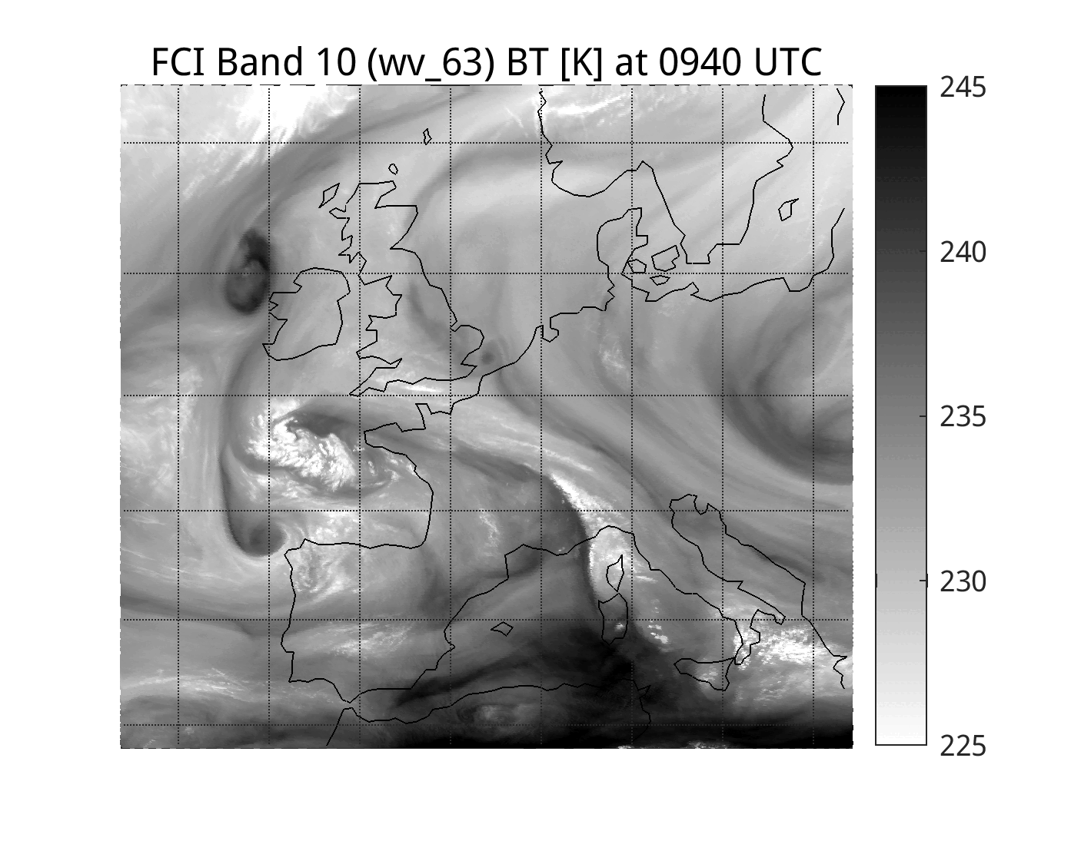
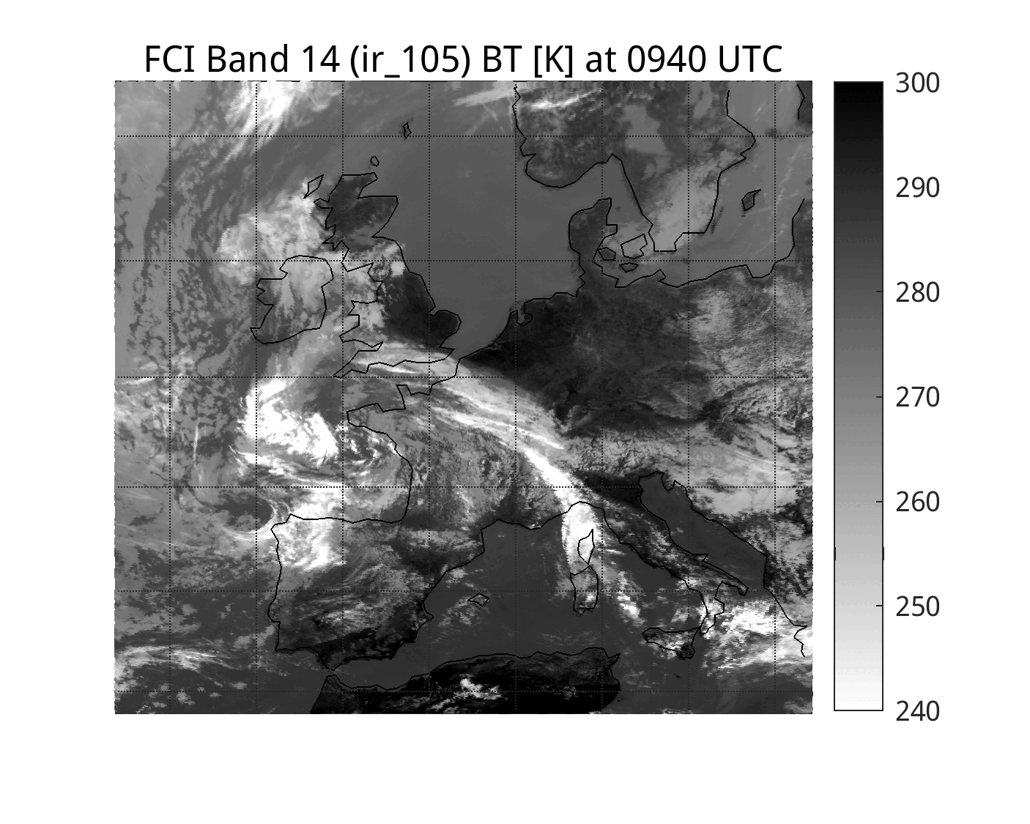
FCI Band 10 (6.3 μm) and 14 (10.5 μm) Animations from 9:40 to 10:40 UTC on 5/12/25

Slide 4
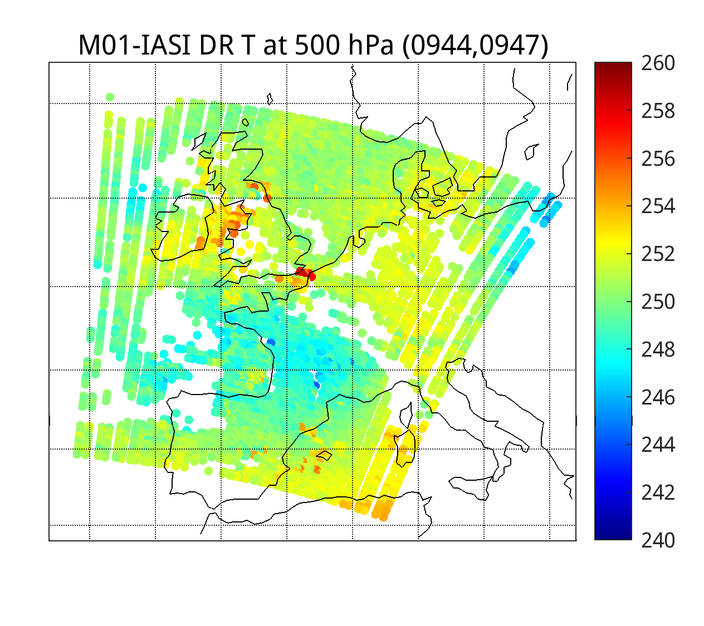
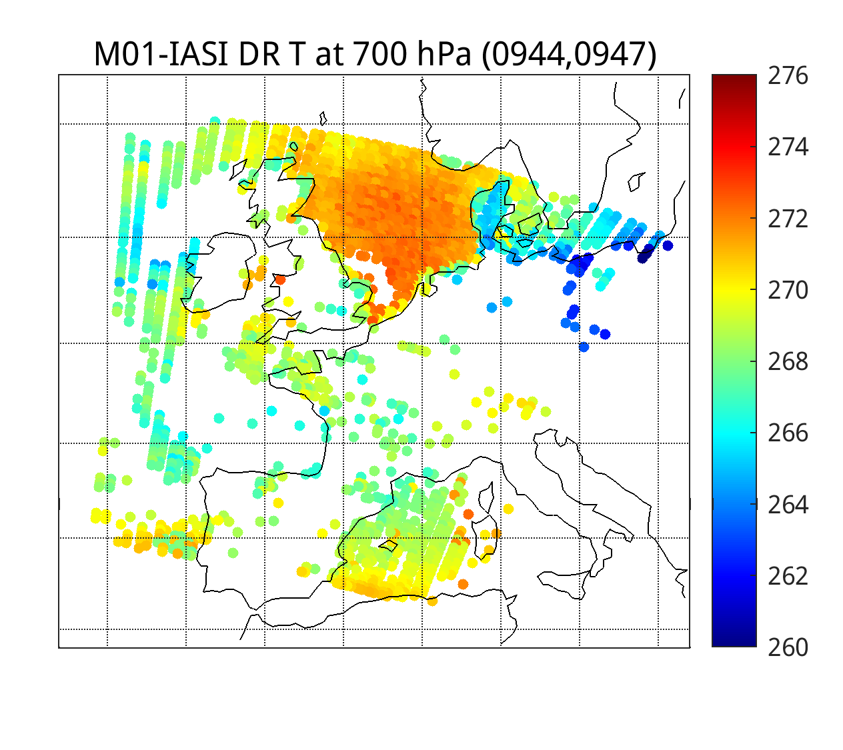
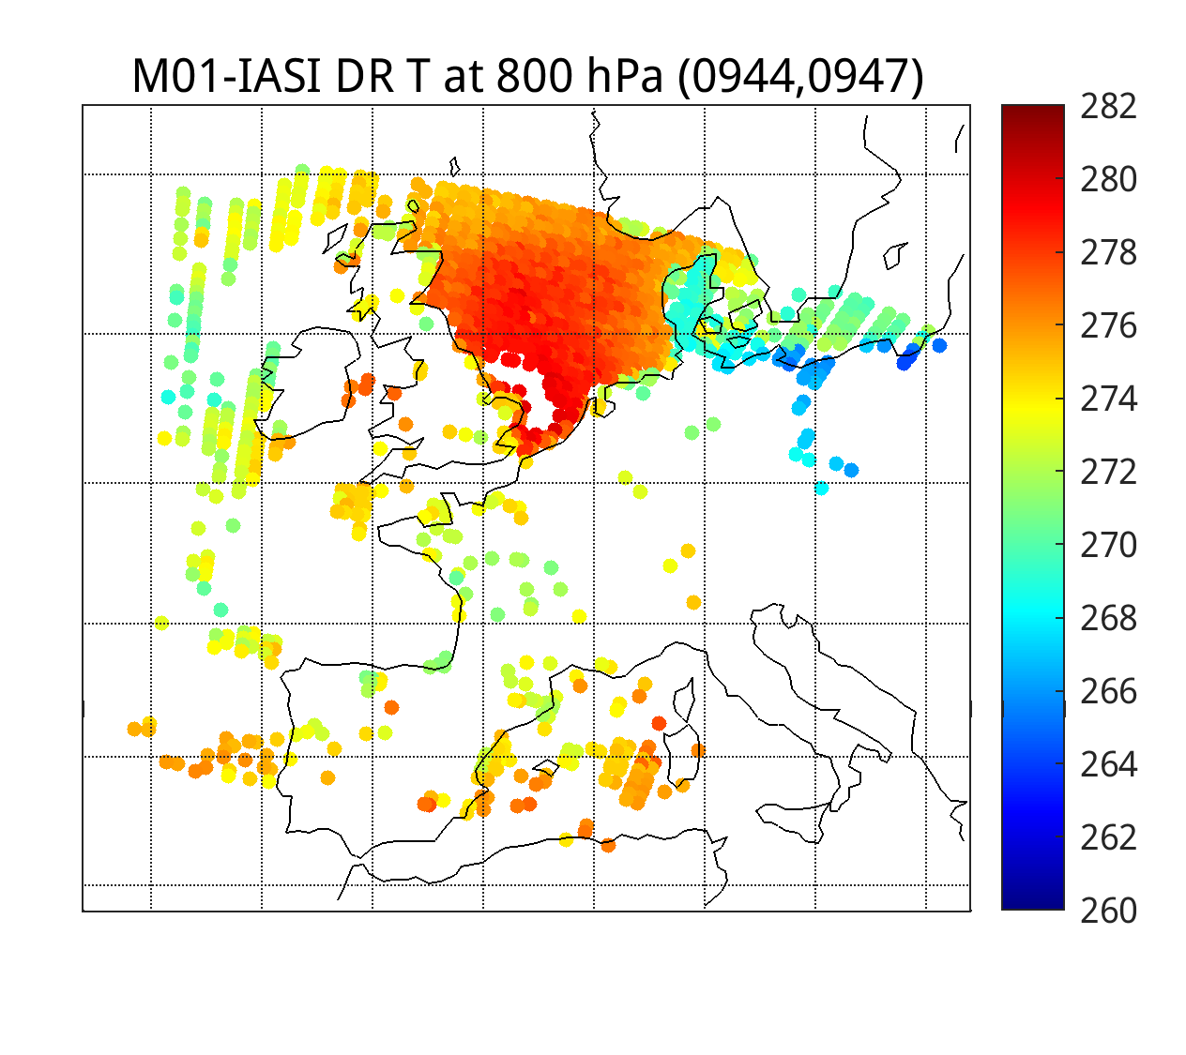
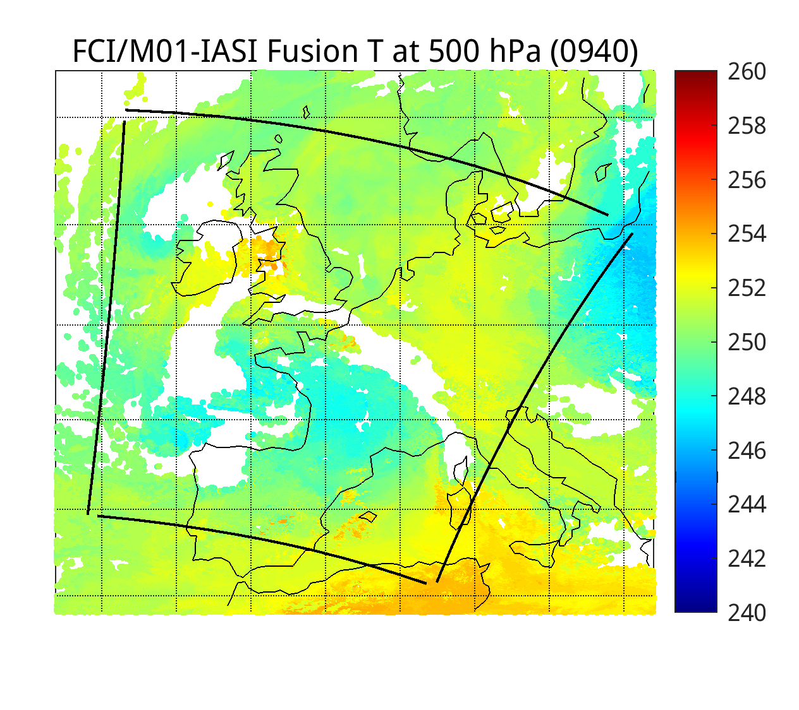
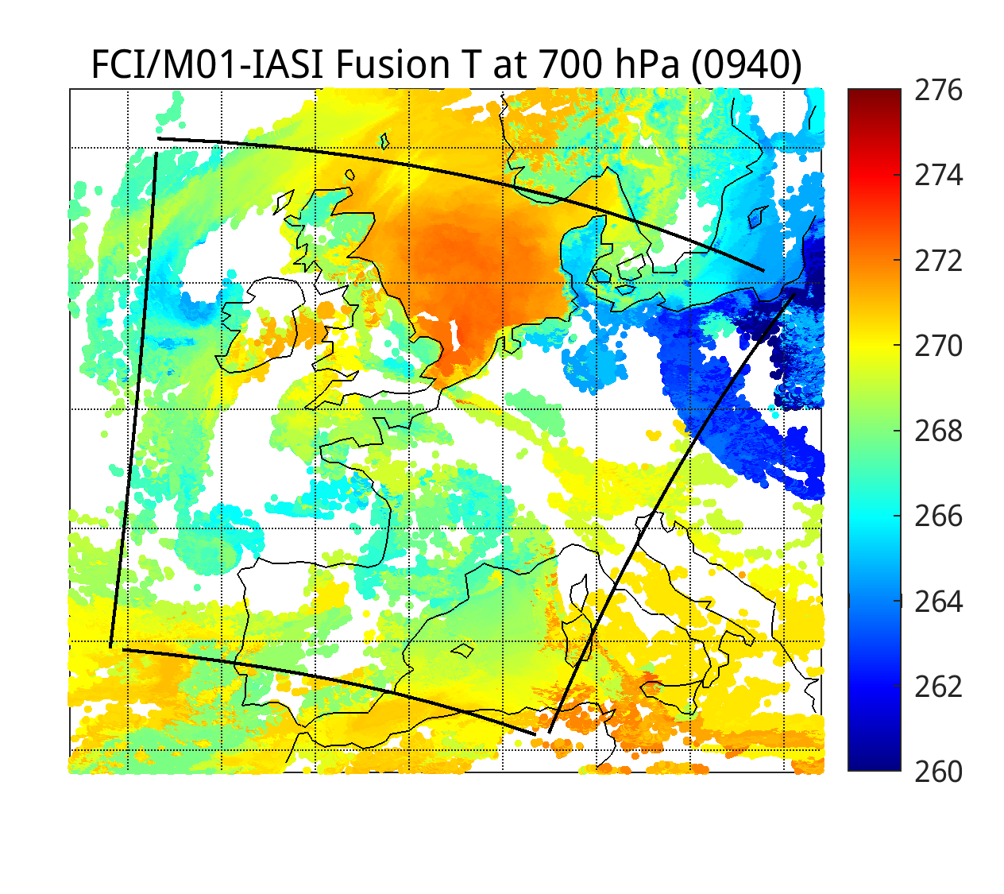
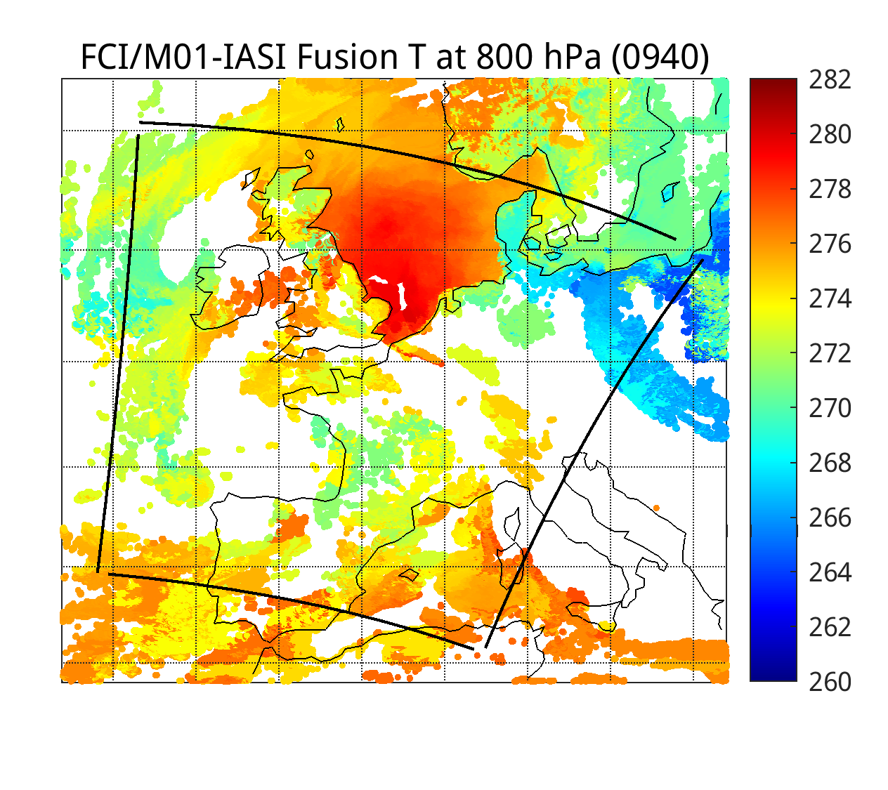
IASI DR Temperature RTVL (top) and FCI/IASI Fusion Temperature (bottom) at 500,600,800 hPa (0940 UTC)
(IASI-B 0944 and 0947 granules on 5/12/25)

Slide 5
FCI/IASI Fusion Temperature Animations from 9:40 to 10:40 UTC on 5/12/25

Slide 6
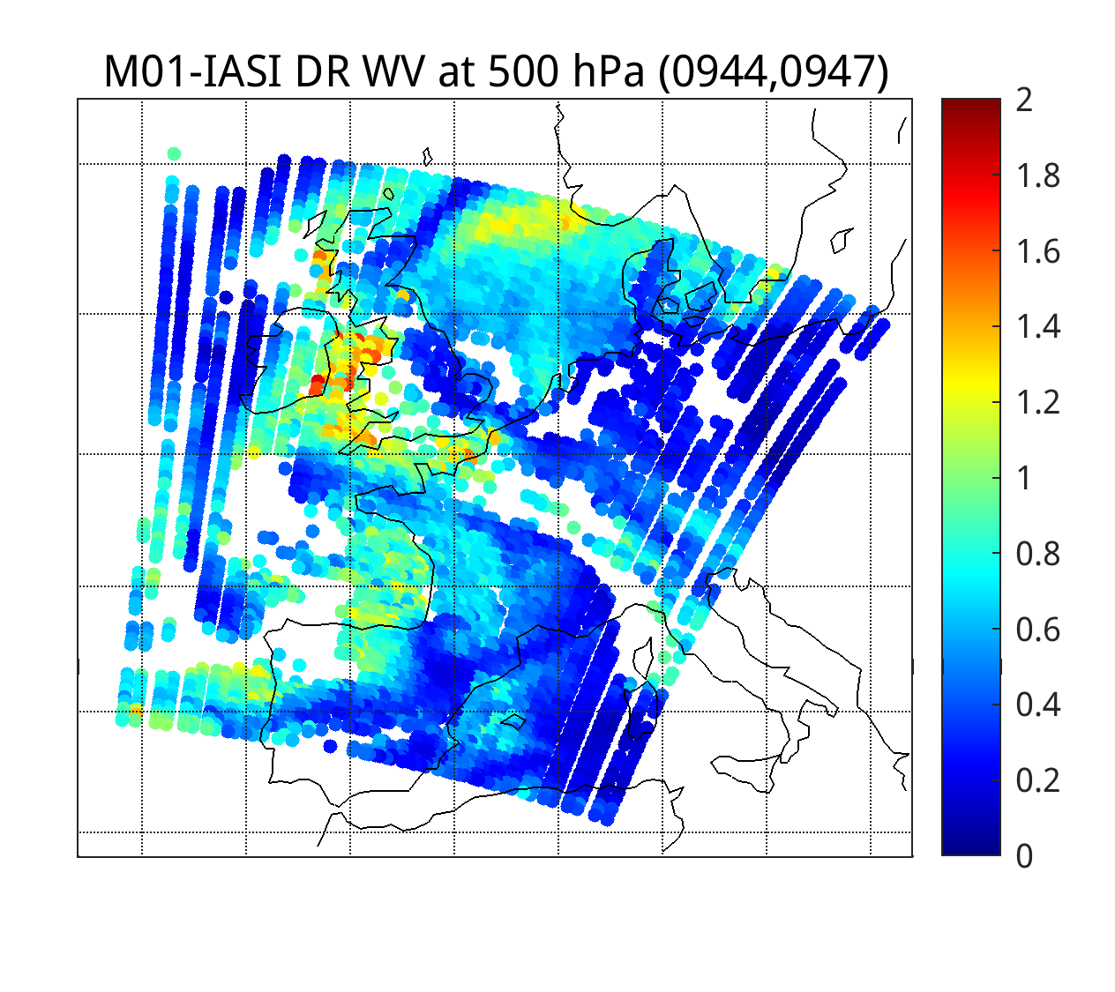
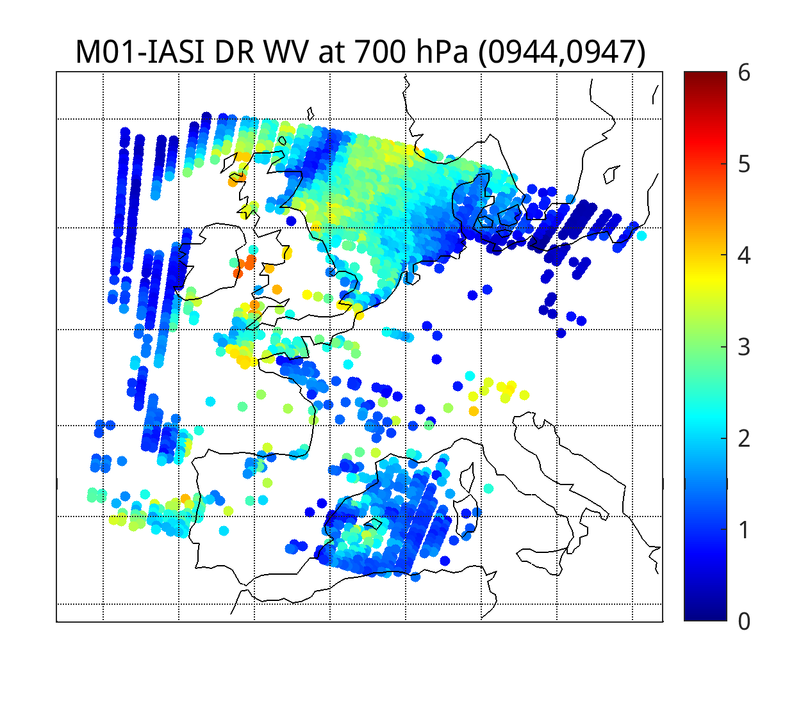
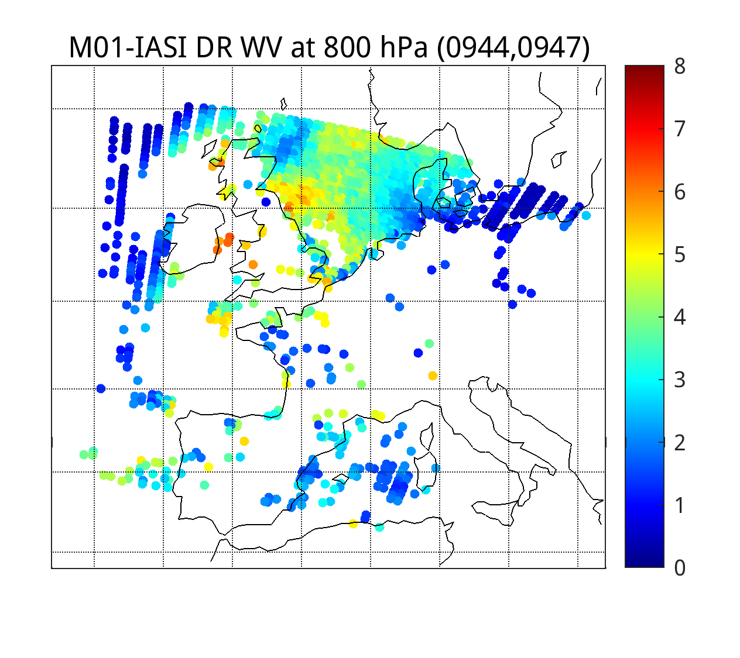
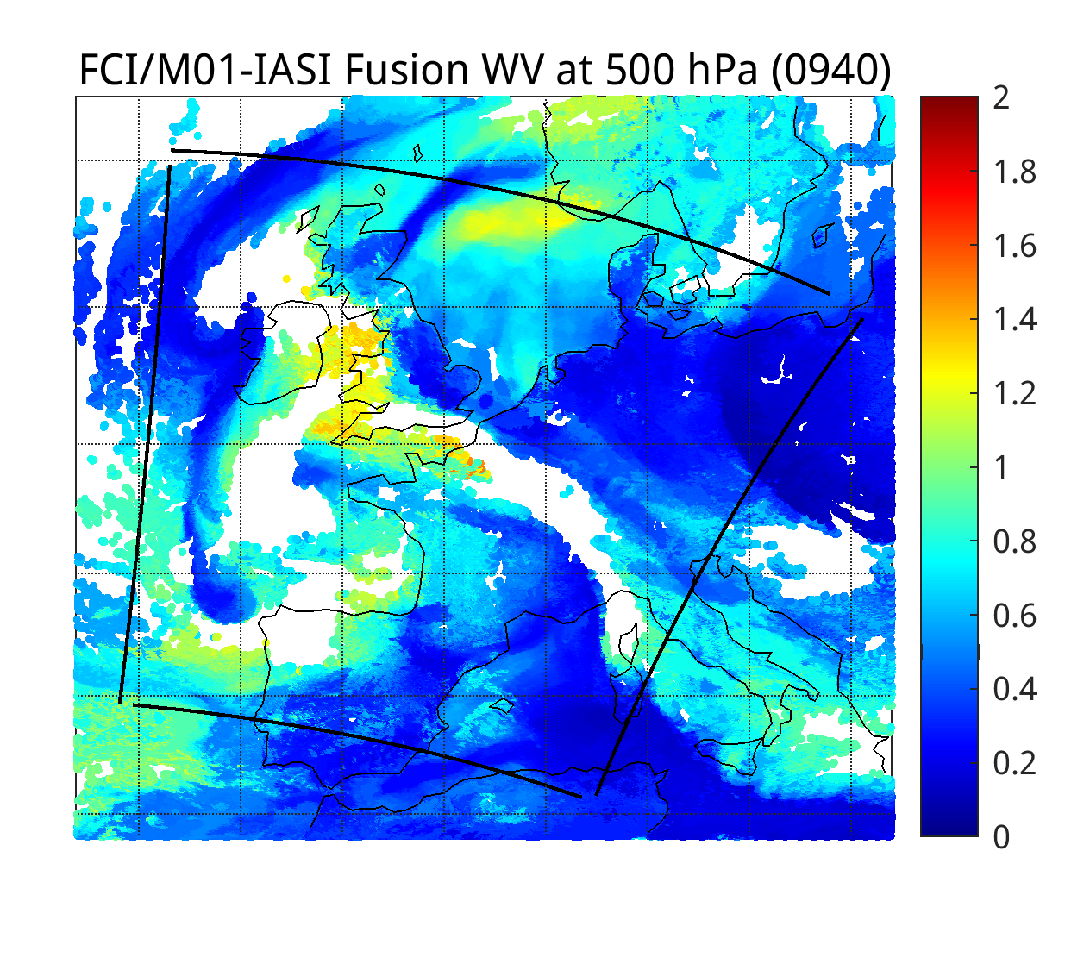
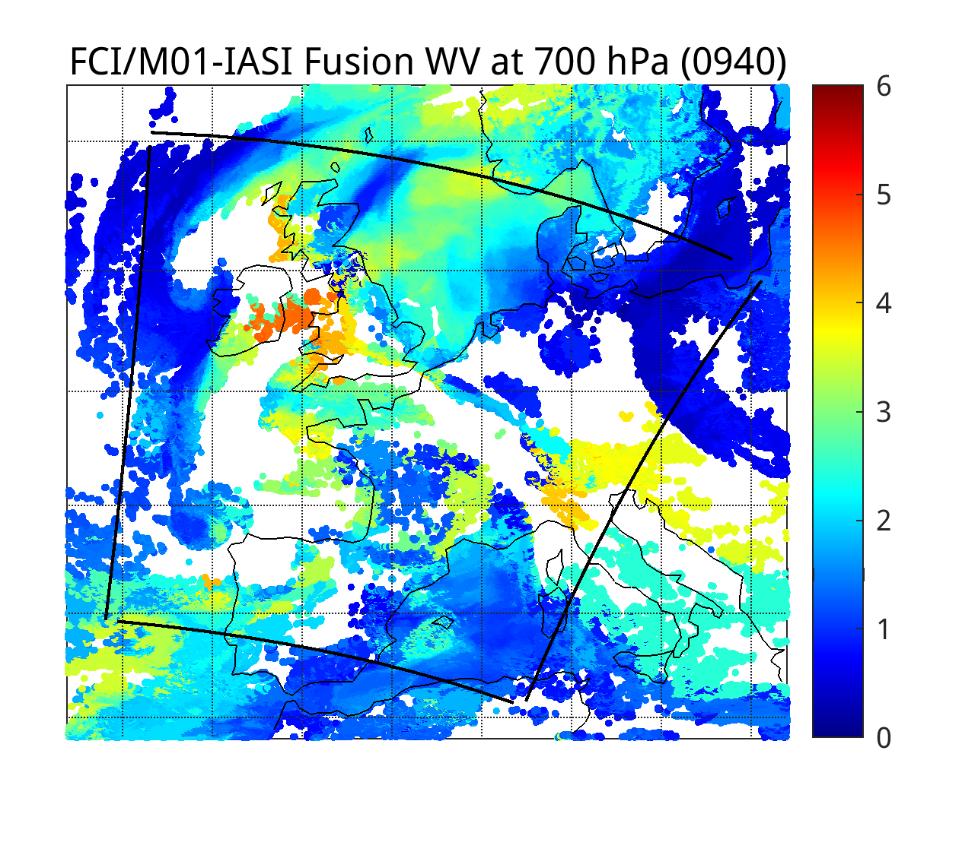
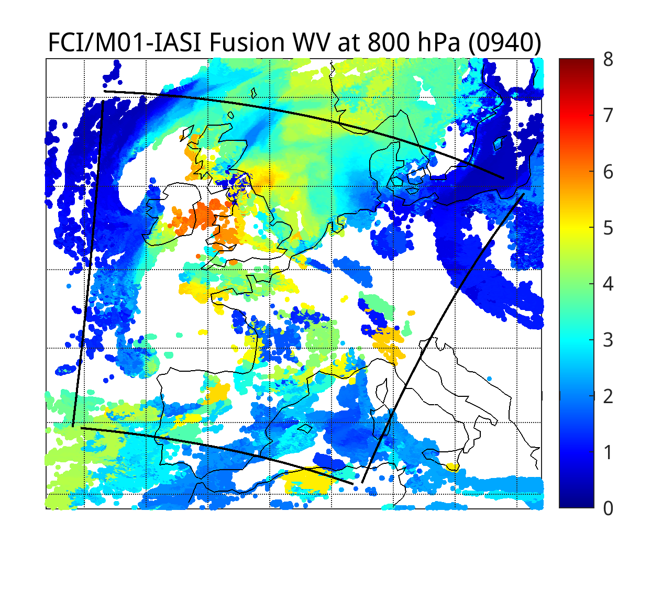
IASI DR Humidity RTVL (top) and FCI/IASI Fusion Humidity (bottom) at 500,600,800 hPa (0940 UTC)
(IASI-B 0944 and 0947 granules on 5/12/25)
FCI Bands in kdtree search: 6 IR bands (10,11,12, 14, 15, 16)

Slide 7
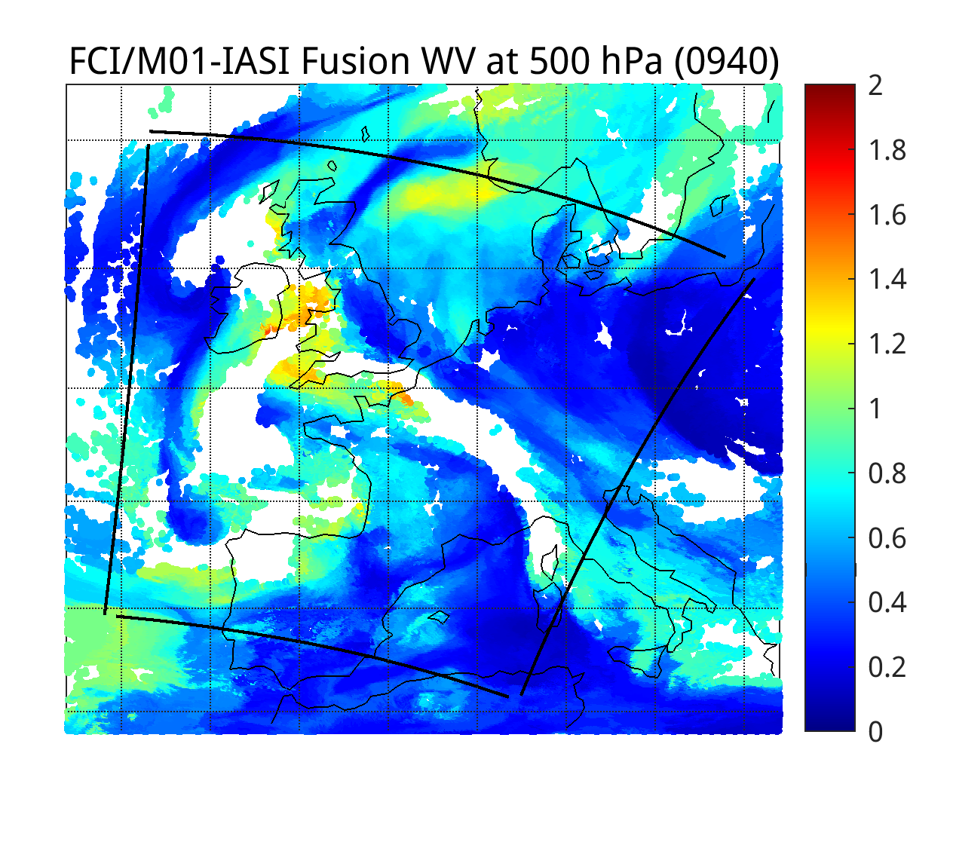
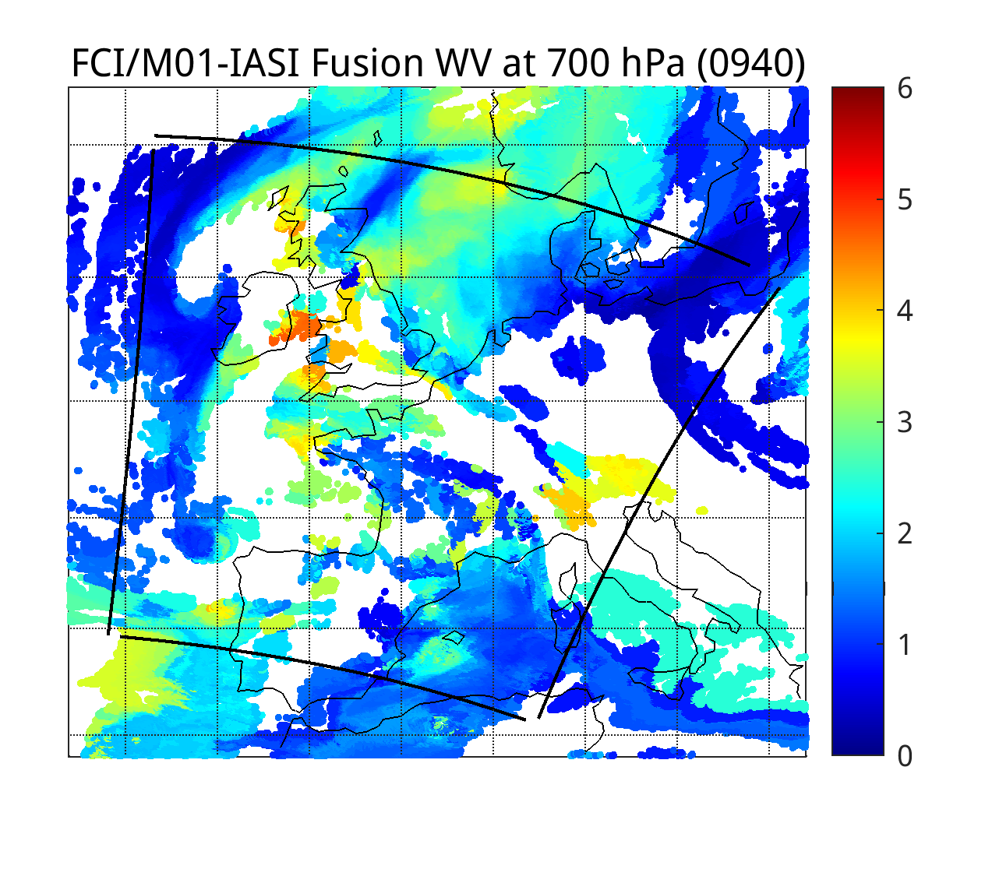
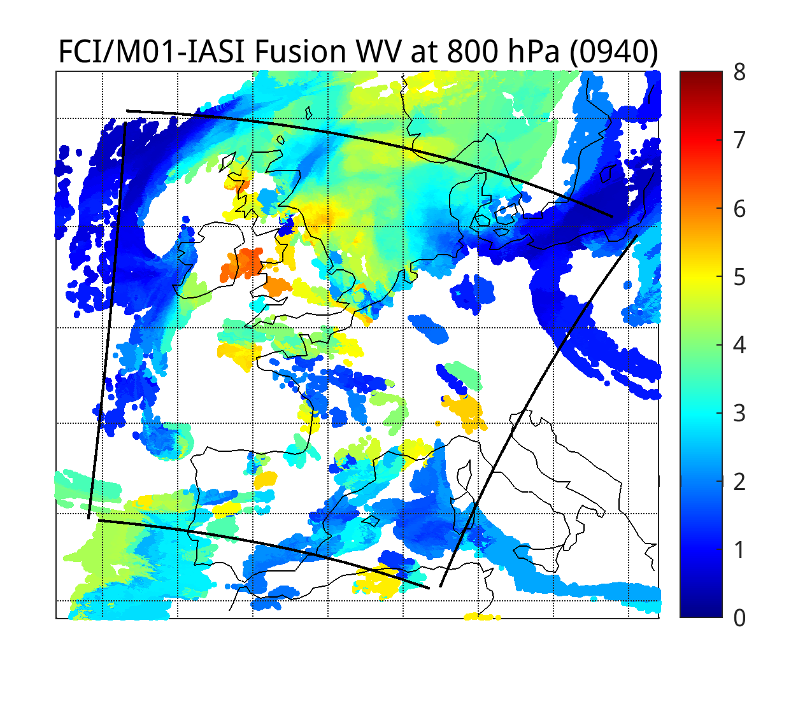
IASI DR Humidity RTVL (top) and FCI/IASI Fusion Humidity (bottom) at 500,600,800 hPa (0940 UTC)
(IASI-B 0944 and 0947 granules on 5/12/25)
FCI Bands in kdtree search: WV bands (10+11)

Slide 8
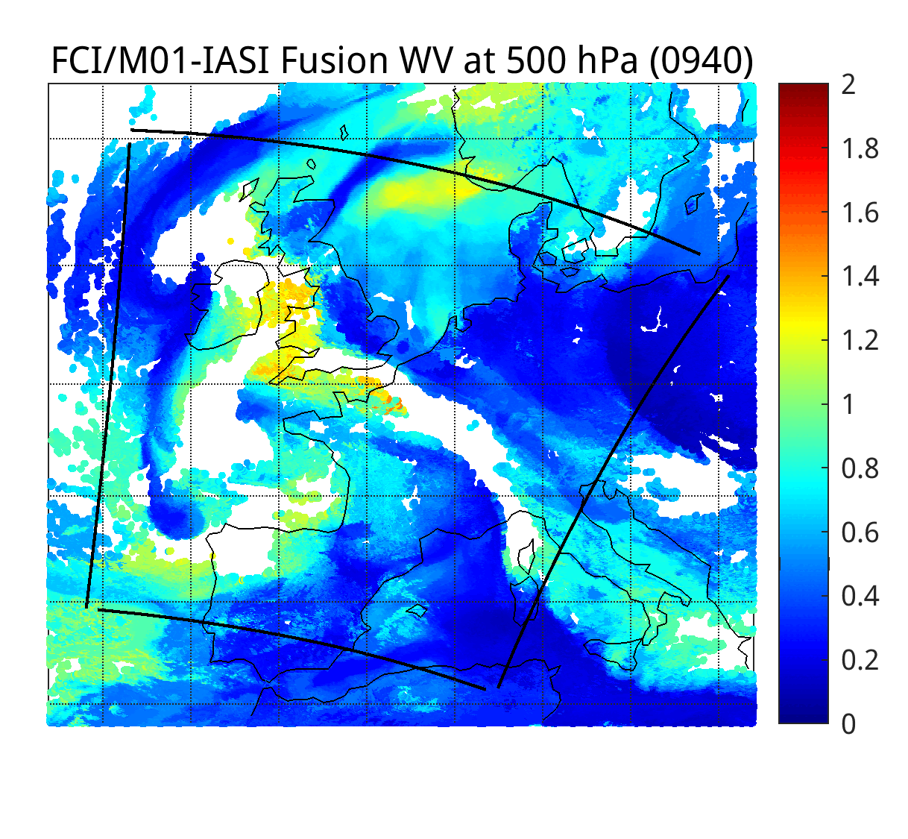
FCI/IASI Fusion Humidity [g/kg] Animations from 9:40 to 10:40 UTC on 5/12/25
FCI Bands in kdtree search: 6 IR bands (10,11,12, 14, 15, 16)

Slide 9
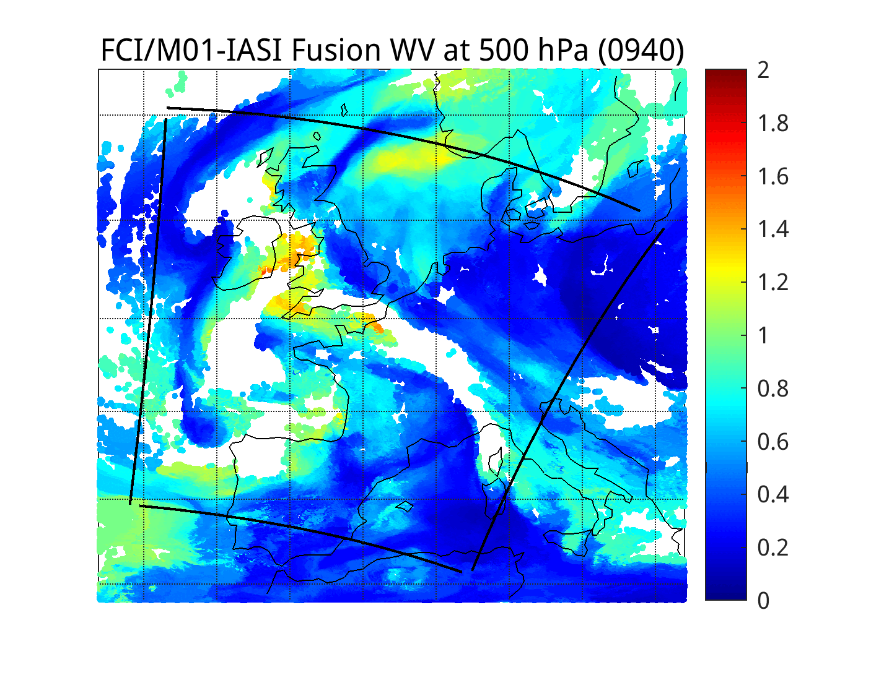
FCI/IASI Fusion Humidity [g/kg] Animations from 9:40 to 10:40 UTC on 5/12/25
FCI Bands in kdtree search: WV bands (10+11)

Slide 10
FCI BT (top) and Humidity Fusion (bottom) Animations from 9:40 to 10:40 UTC on 5/12/25

