Slide 1
Extending CAMEL emissivity database to far-IR for RTTOV
Kick-off Meeting
May 19, 2025
UW-Madison/SSEC: Michelle Loveless, Robert Knuteson and Eva Borbas
Met Office: Fabien Carminati, James Hocking
Meteo France: Jerome Vidot, Jean-Marie Lalande

Slide 2
Outline
Proposal
ARI FIR measurements
Initial results
Discussions/feedbacks

Slide 3
PROPOSAL

Slide 4
Proposal Objective:
To extend CAMEL emissivity atlas into the far IR for RTTOV with the following objectives:
  1. To provide an extension to CAMEL V3 and CAMEL CLIM V3,
  2. To add uncertainties,
  3. To update the error covariance matrices.
lt would be a potential enhancement for RTTOV v13 and v14 especially regarding recent (PREFIRE) and upcoming (FORUM, ESA EE 9th) far-infrared mission.

Slide 5
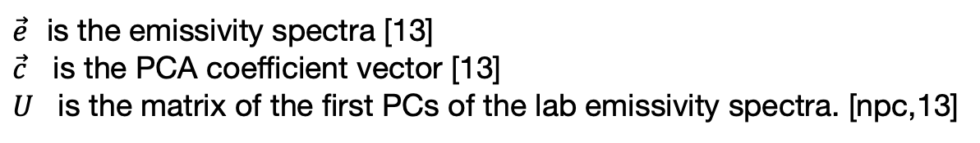
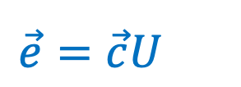
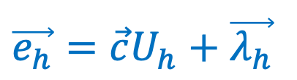
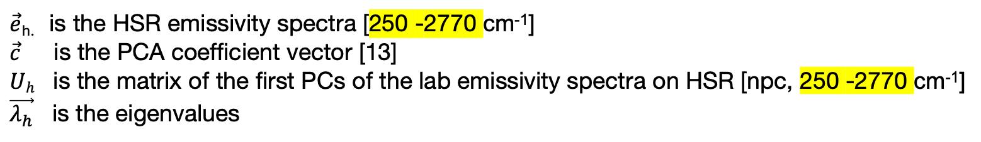
Method
$\vec{e}=\vec{c}U$
$\vec{e}$ is the emissivity spectra [13]
$\vec{c}$ is the PCA coefficient vector [13]
$U$ is the matrix of the first PCs of the lab emissivity spectra. [npc,13]
$\vec{e_{h}}=\vec{c}U_{h}+\vec{λ_{h}}$
$\vec{e}$_{h.} is the HSR emissivity spectra [250 -2770 cm⁻¹]
$\vec{c}$ is the PCA coefficient vector [13]
$Uh$ is the matrix of the first PCs of the lab emissivity spectra on HSR [npc, 250 -2770 cm⁻¹]
$\vec{λ_{h}}$ is the eigenvalues
To extend CAMEL to the FIR, a set of HSR land surface emissivity spectra in the combined FIR-Thermal IR (TIR) spectral range (250-1200 cm⁻¹), representing all of Earth's possible surface types, is needed. While the emissivity laboratory dataset that the CAMEL HSR algorithm uses (the ASTER v2.0) is good at representing all of Earth's surfaces, it does not extend to wavenumbers lower than 650 cm⁻¹ for most surface types. For this proposed activity, not only emissivity in the FIR but the entire FIR and TIR range between at least 1200 and 250 cm⁻¹ are needed to ensure spectral consistency: emissivity in the TIR will be used to fit the CAMEL 13 hinge points, and the FIR part will enable extrapolation into the FIR range. CAMEL has 13 hinge points between 700 and 2760 cm^{-1,} but the 700-1500 range with ten hinge points would be sufficient since that range carries most of the spectral features of the main surface types, like the double quartz duplets or the peak for snow and ice between 900-1000 cm⁻¹. The proposed measurements covering all the primary surface types with the 250-1200 cm⁻¹ spectral range will fit these requirements.

Slide 6
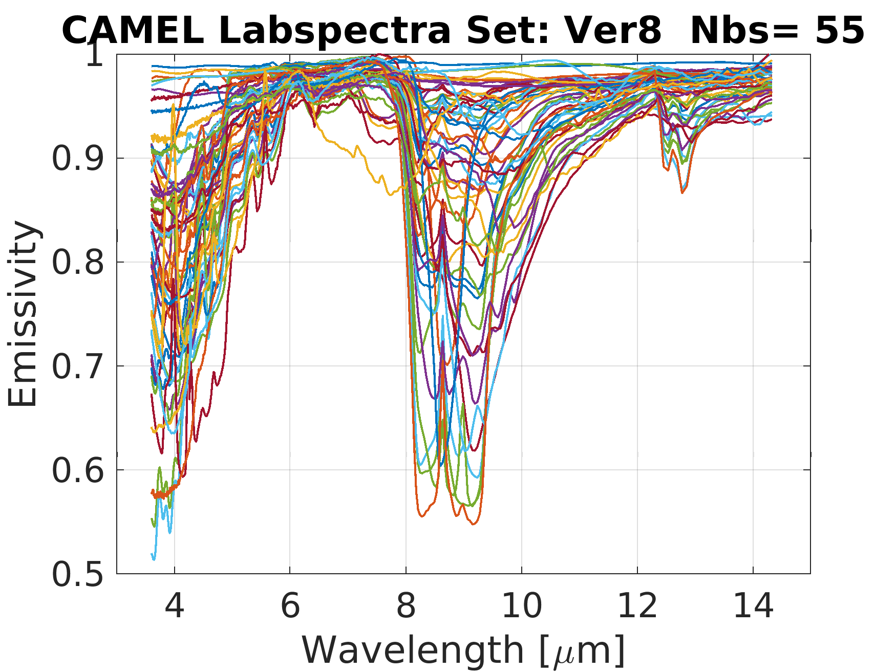
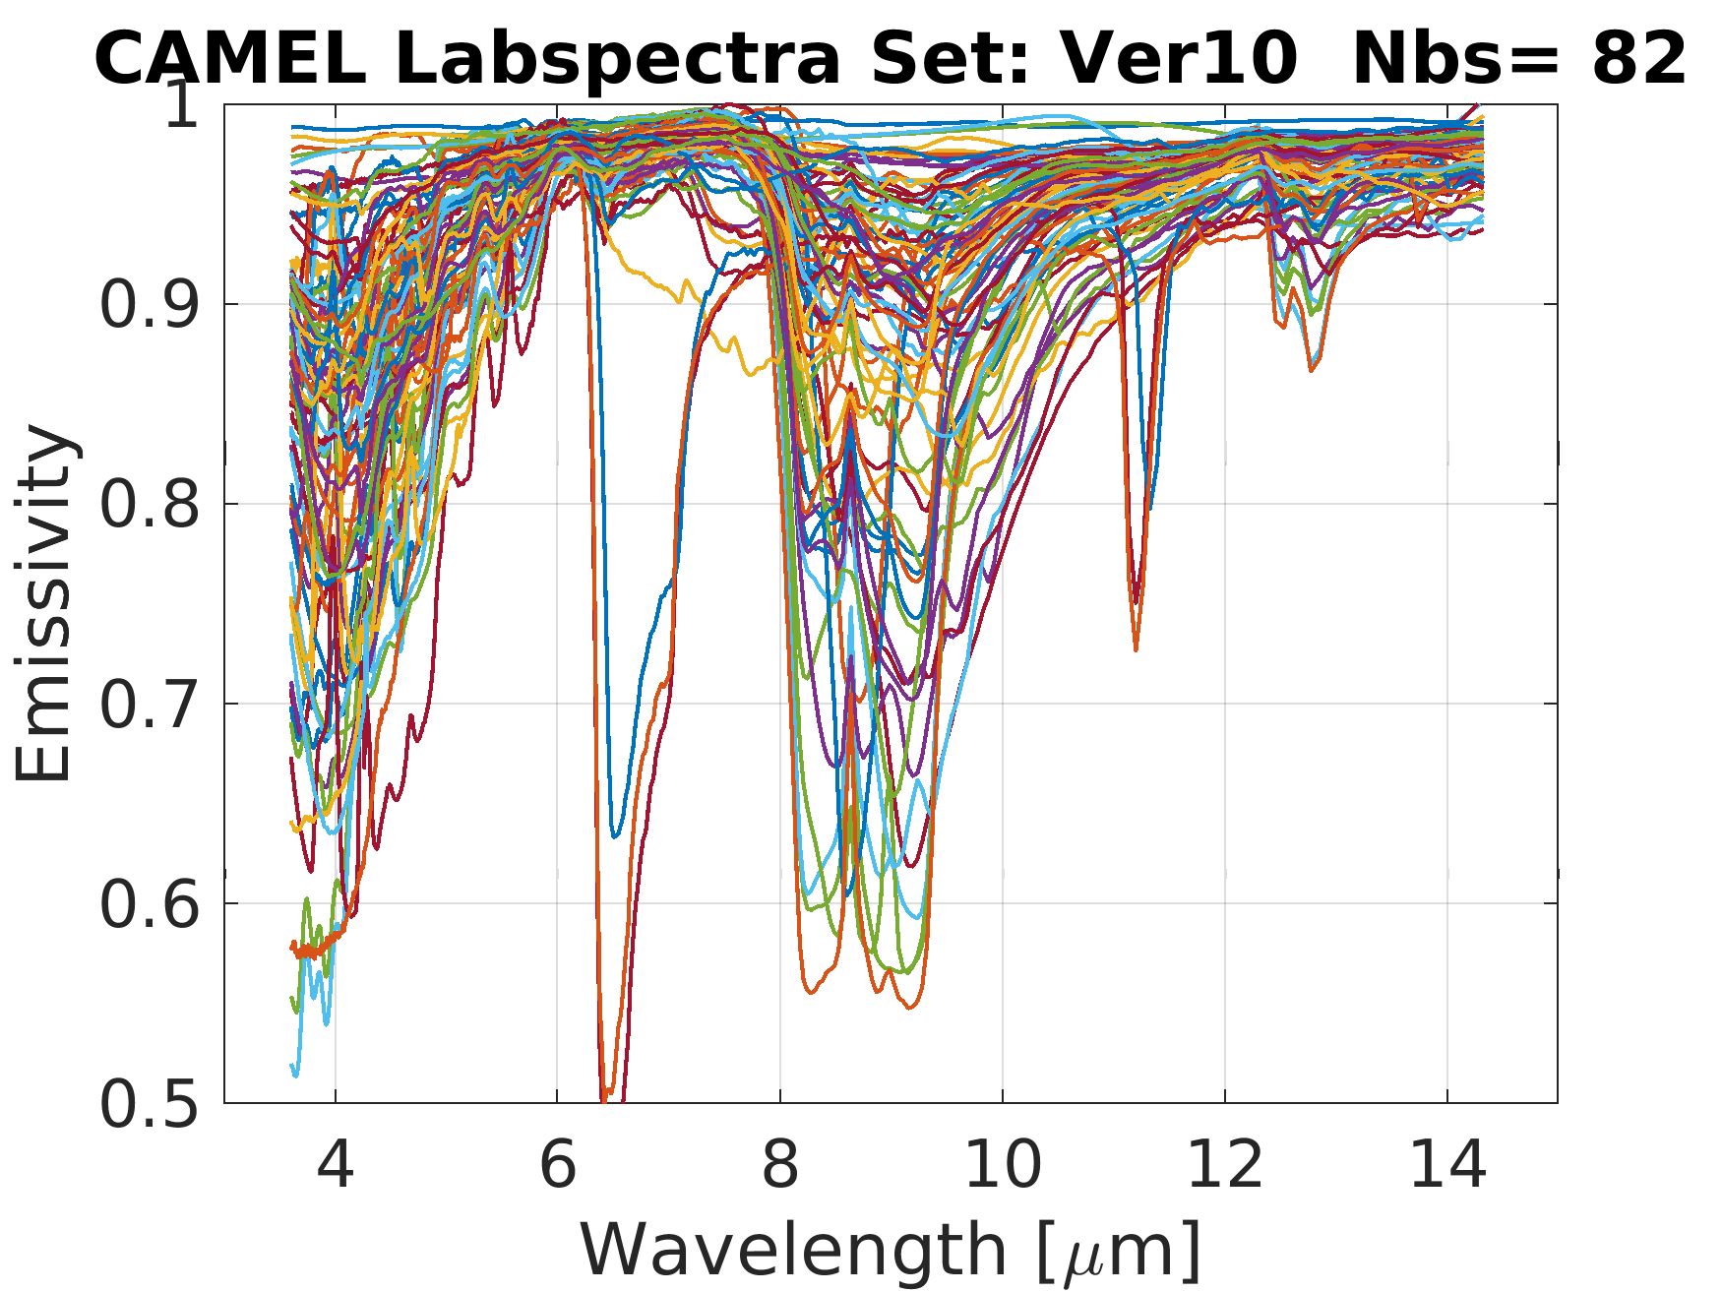
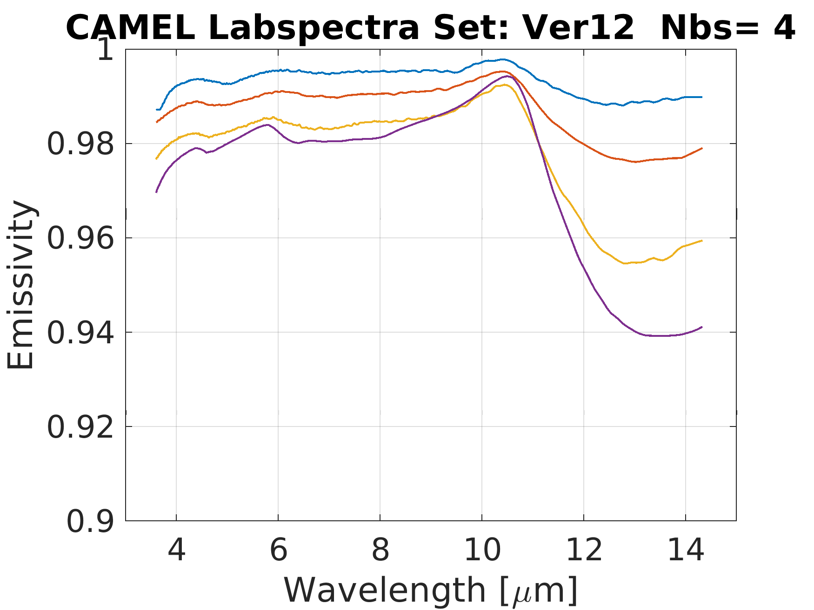
CAMEL Laboratory Datasets
MEASUREs selected Laboratory spectra
UW BF selected Laboratory spectra
Rock, soils, sands, veg, ice, water
Rock, soils, sands, veg, ice, water
Carbonates
Fine snow, Med snow, Coarse snow, Ice
Ver9 = Ver8 + Ver12
Two additional sets for FIR + IR:
Snow/Ice
Snow/Ice/EverGreen/Sand/DryGrass
Ver11= Ver10+ Ver12

Slide 7
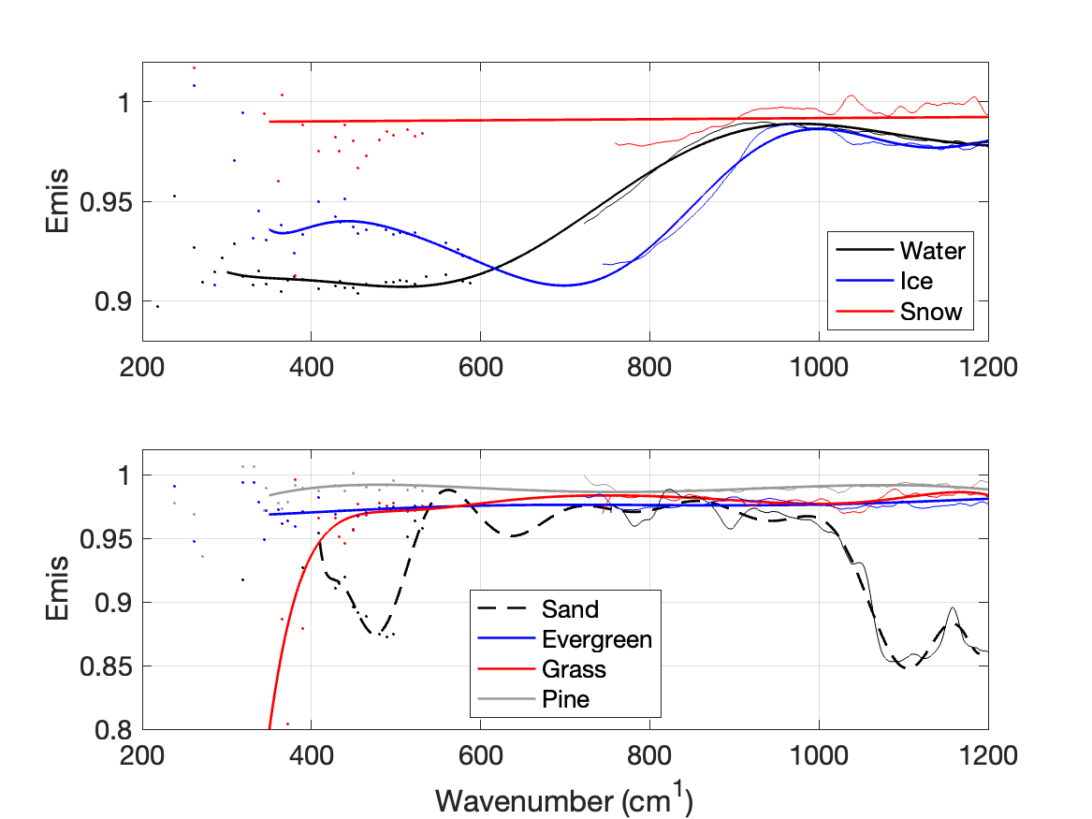
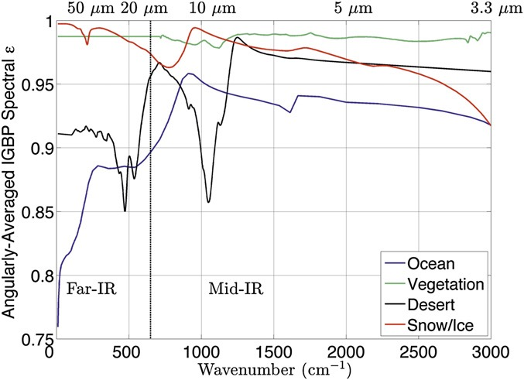
Source of “Laboratory” data
Figure 3: Reflectance of Quartz from the USGS Spectral Library V7 (Kokaly et al., 2017)
Figure 2: Angularly averaged, spectrally resolved far-IR surface emissivity for four IGBP land types (ocean, vegetation, desert, and snow) based on 3D radiative transfer calculations and published indices of refraction. (Feldman et al. 2014): "At high latitudes and altitudes, a 0.05 change in emissivity due to mineralogy and snow grain size can cause a 1.8-2 Wm-2 difference in instantaneous clear sky OLR."
Figure 1. Summary of the ARI retrieved emissivity for the seven measured sample types: (top panel) water, ice, and snow, (bottom panel) sand, evergreen, grass, and pine needle. Retrieved emissivities for each sample type are averaged together and 1) spectrally smoothed using a moving boxar (thin lines shown in the TIR region) and 2) modeled using a best-fit line across the TIR and FIR (thick lines). The FIR micro window results are shown for reference as dots.
Huang et al. (2016)

Slide 8
Evaluation
RTTOV CAMEL-FIR module will be tested on case studies directly and compared to air-based measurements:
  TAFTS instrument over Greenland ice sheet on March 19, 2015 (Bellisario et al., 2017, Murray et al., 2020 )
  PREFIRE mission over NSA Cart Site, Tibet, ???:
    https://prefire.ssec.wisc.edu:
    https://search.earthdata.nasa.gov/search?fpj=PREFIRE
      ext.: PREFIRE_SAT1_1B-RAD_P00_R00_20250417012449_04782.nc
Ground-based measurements:
  Radiation Explorer in the FIR – Prototype for Applications and Development (REFIR-PAD) (e.g., Bianchini et al., 2019)
  Far-Infrared Spectroscopy of the Troposphere (FIRST) instrument (e.g., Mlynczak et al., 2016)
  Extended-range Atmospheric Emitted Radiance Interferometer (E-AERI) (e.g., Mariani et al., 2012)
  Far-Infrared Radiation Mobile Observation System (FIRMOS) (Belotti et al., 2023)
???

Slide 9
ARI Measurements at UW-Madison/SSEC

Slide 10
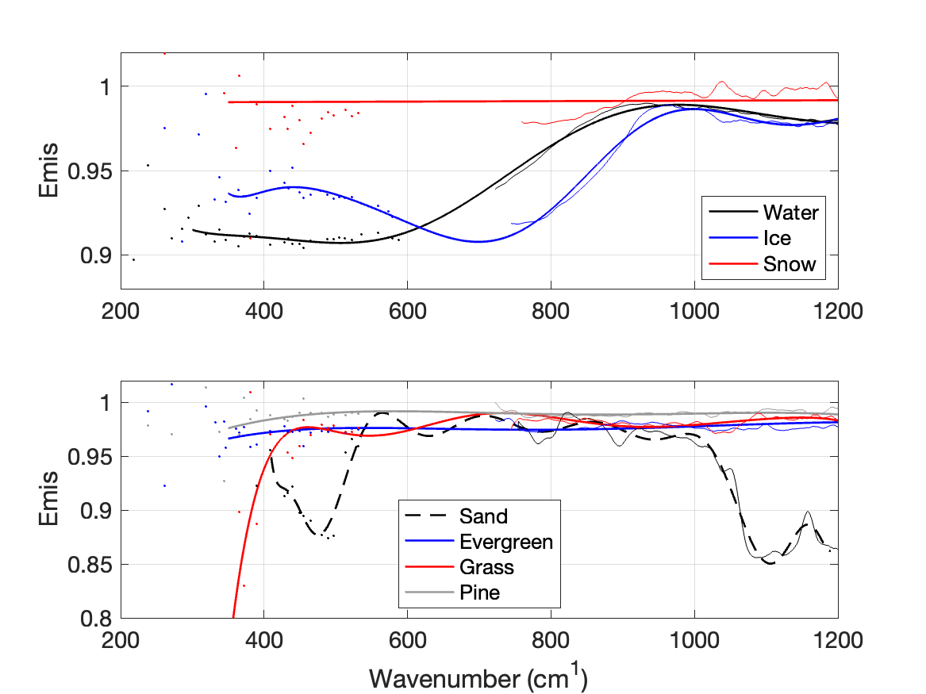
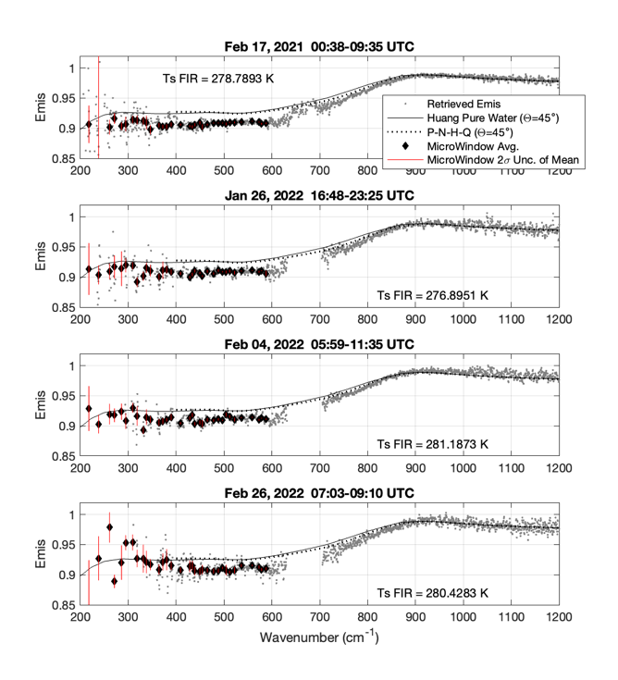
Ground-Based Far Infrared Emissivity Measurements Using the Absolute Radiance Interferometer
M. Loveless¹, D. Adler¹, F. Best¹, E. Borbas¹, X. Huang², R. Knuteson¹, T. L’Ecuyer³, N. R. Nalli⁴, E. Olsen¹, H. Revercomb¹, and J. K. Taylor¹
¹ Space Science and Engineering Center, University of Wisconsin-Madison,
² University of Michigan, Dept. of Climate and Space Sciences and Engineering,
³ Cooperative Institute for Meteorological Satellite Studies, University of Wisconsin-Madison,
⁴ IMSG, Inc. at NOAA/NESDIS Center for Satellite Applications and Research (STAR)
Accepted to Earth and Space Science, 2024.
This work was funded by the SSEC2022 project at the University of Wisconsin – Madison, Space Science and Engineering Center (SSEC).
Publication cost was covered by NASA’s PREFIRE grant # 80NSSC18K1485.
Figure 4 (taken from paper) Example ARI target samples measured during the January and February 2022 data collection. Photo Credits: Doug Adler.
Key Points:
SSEC’s Absolute Radiance Interferometer (ARI) was used to obtain high spectral resolution far infrared radiation measurements in semi-controlled environments
Measurements of the sky and samples, including snow, water, ice, sand, and vegetation, allowed for retrieval of sample emissivity within the thermal IR and into the far IR
The retrieved far infrared emissivity spectra are publicly available for model intercomparisons and other uses at the University of Wisconsin MINDS@UW database: http://digital.library.wisc.edu/1793/84945
Figure 22 (taken from paper). Summary of the ARI retrieved emissivity for the seven measured sample types: (top panel) water, ice, and snow, (bottom panel) sand, evergreen, grass, and pine needle. Retrieved emissivities for each sample type are averaged together and 1) spectrally smoothed using a moving boxar (thin lines shown in the TIR region) and 2) modeled using a best fit line across the TIR and FIR (thick lines). The FIR microwindow results are shown for reference as dots.
Figure S2 (taken from paper, modified): Retrieved water emissivity. Single channel (grey dots) and microwindow results (black diamonds with red vertical bars denoting the 2-sigma unc. of the mean value) are shown with reference emissivities from Huang et al. (2016) (black lines) and Nalli et al. (2022a, 2022b) (dotted line).

Slide 11
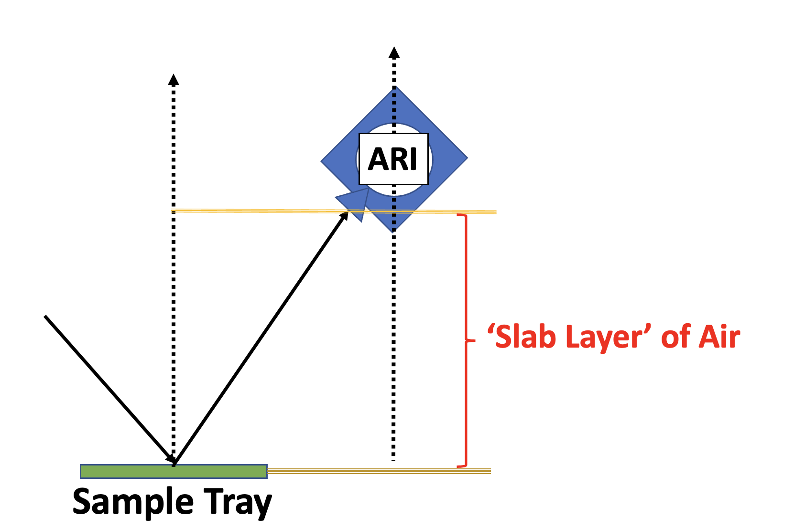
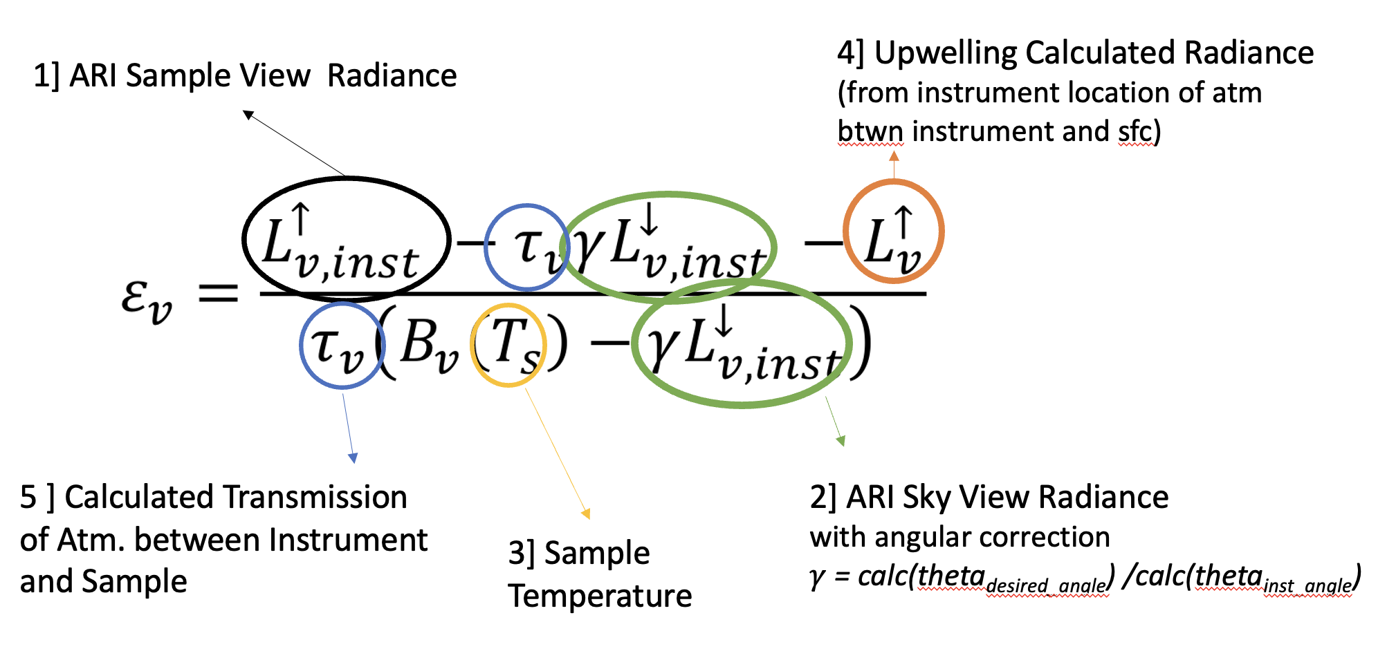
Methods
Equation used to derive emissivity taken from Smith et al. (BAMS, 1996), Bower et al. (Conf. Atm. Rad., 1999), and Knuteson et al. (Adv. Space Reas., 2004)
Sample T retrieved using online/offline method (assumes emissivity is spectrally smooth), use spectrally averaged, weighted estimate
Calculations of sky-view radiances used to angularly correct sky-view measurements
Emission of slab layer of air between instrument and sample surface taken into account using calculations (terms 4], 5] from right)
PC noise-filtering applied to measurements

Slide 12
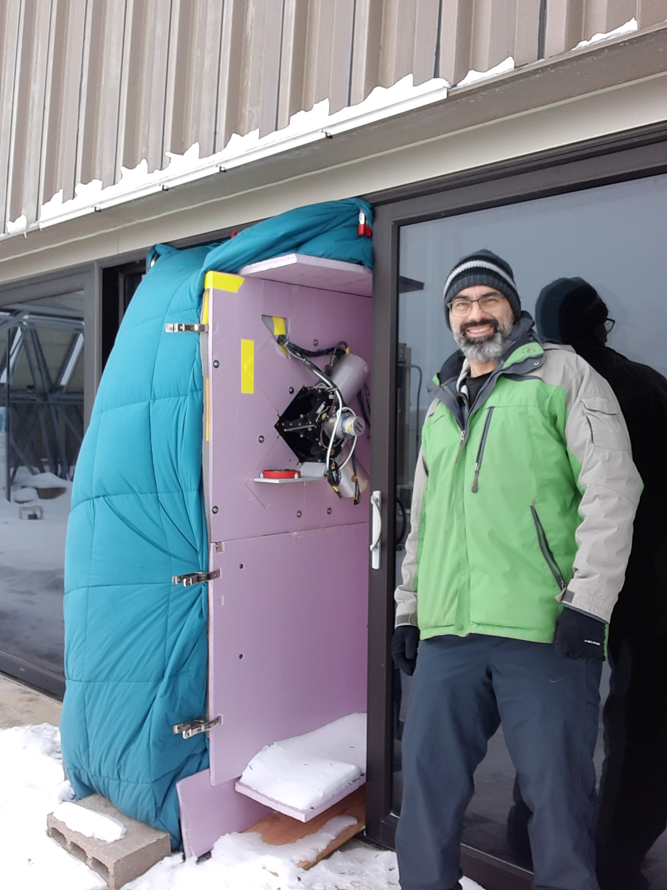
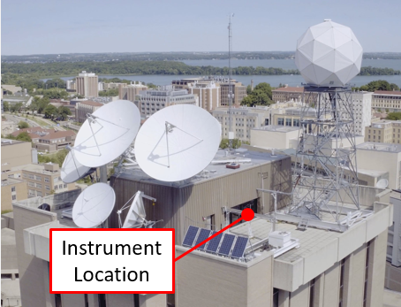
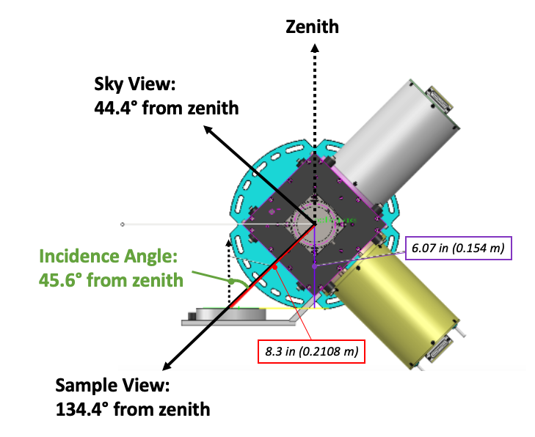
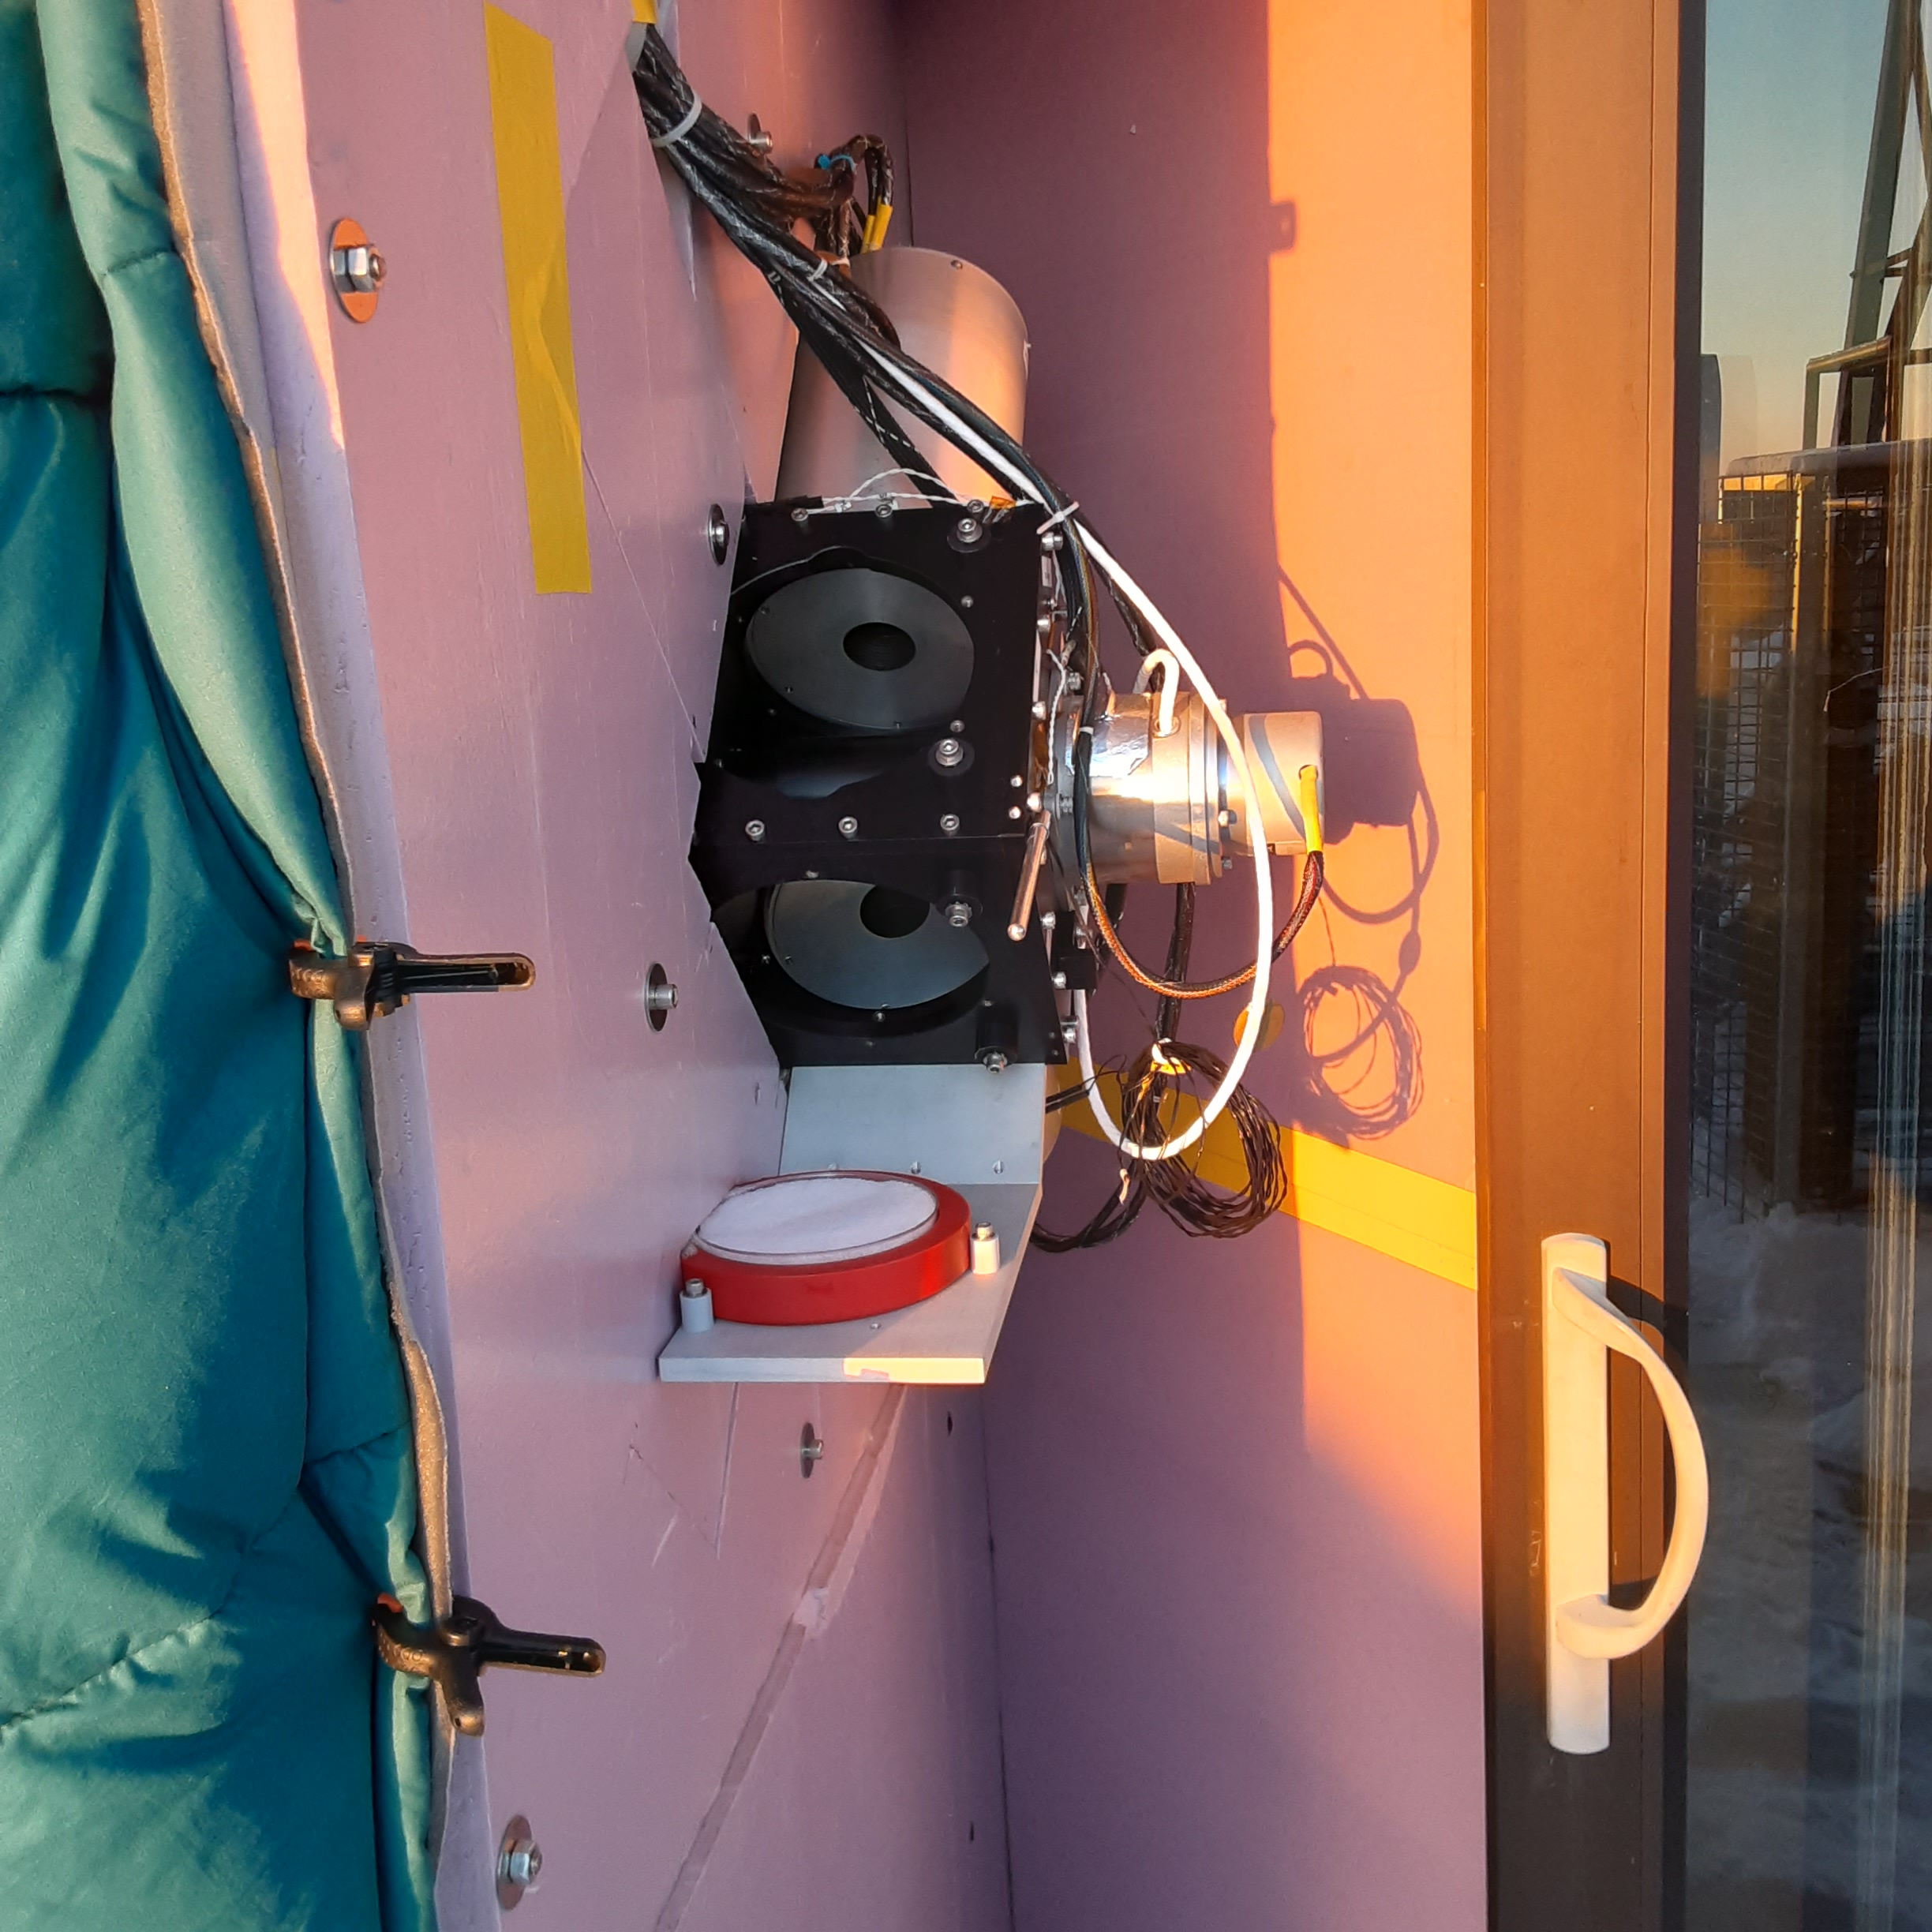
Campaign Year 1 Details
ARI deployed on UW-Madison AOSS rooftop
  Instrument kept inside, with “front end” optical components outside at ambient air temperature
Sample tray attached to instrument frame for easy sample swapping
Not ideal for diffuse samples (surrounding structures emit/reflect radiation)
235+ hrs science data, supplemented with radiosondes, met. tower, & in-situ T sensors
Fixed sample view angle of ~135° from zenith
Photo Credits: Doug Adler

Slide 13
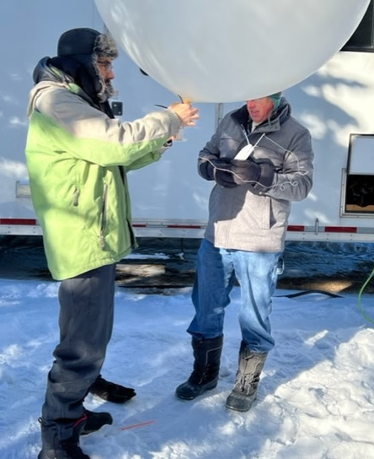
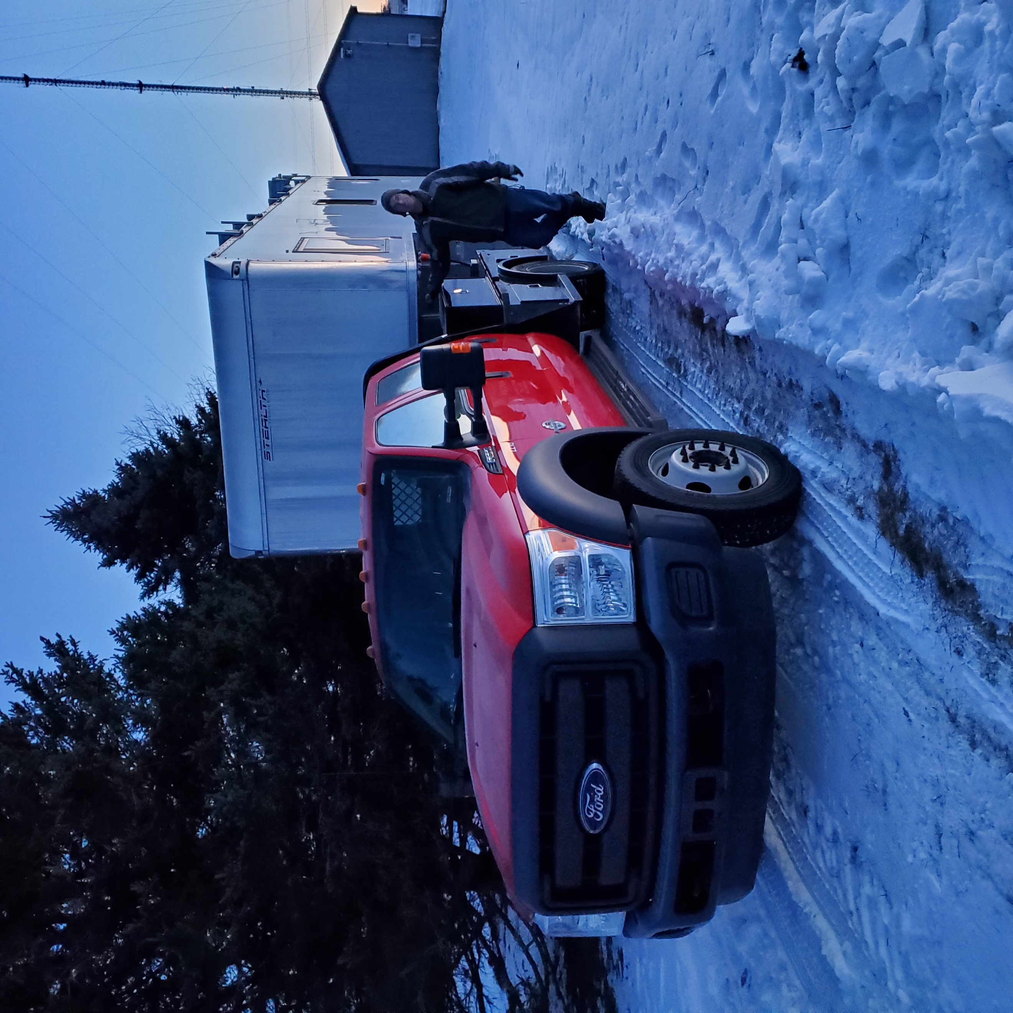
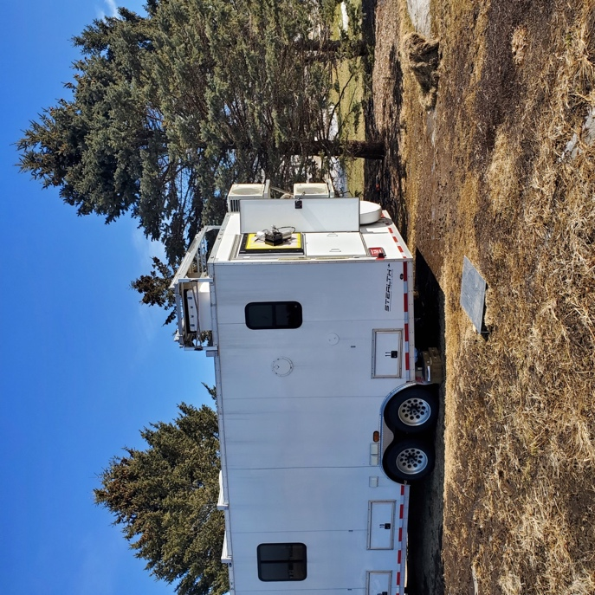
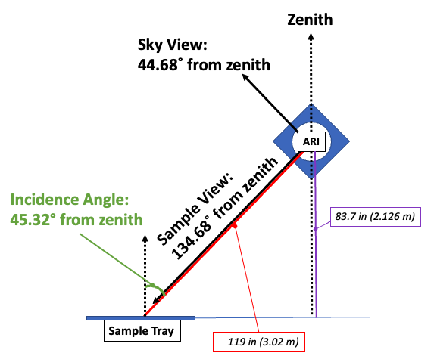
Campaign Year 2 Details
ARI deployed in SSEC’s mobile SPARC trailer (UW-Madison Agricultural Research Station, open field)
Sample trays placed on ground & location verified by instrument field of view (FOV) testing
Numerous diffuse sample types, water/ice measured
112+ hrs of science data, again supplemented with radiosondes, met. tower, & in-situ T sensors
Fixed sample view angle of ~135° from zenith
Photo Credits: Doug Adler

Slide 14
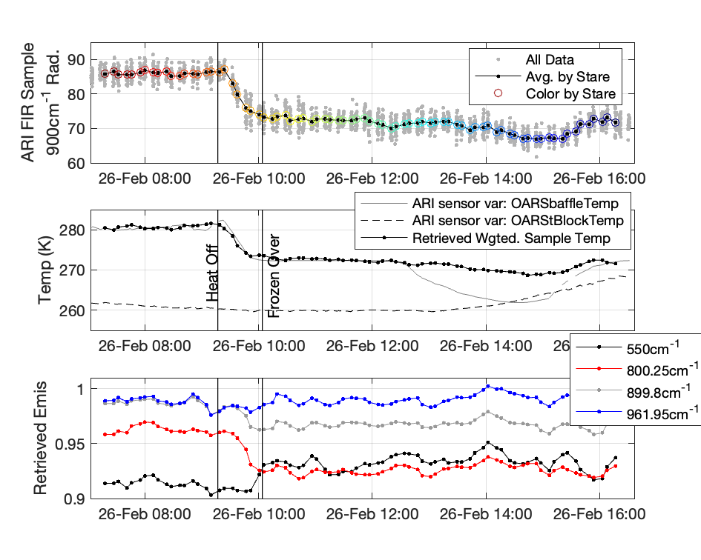
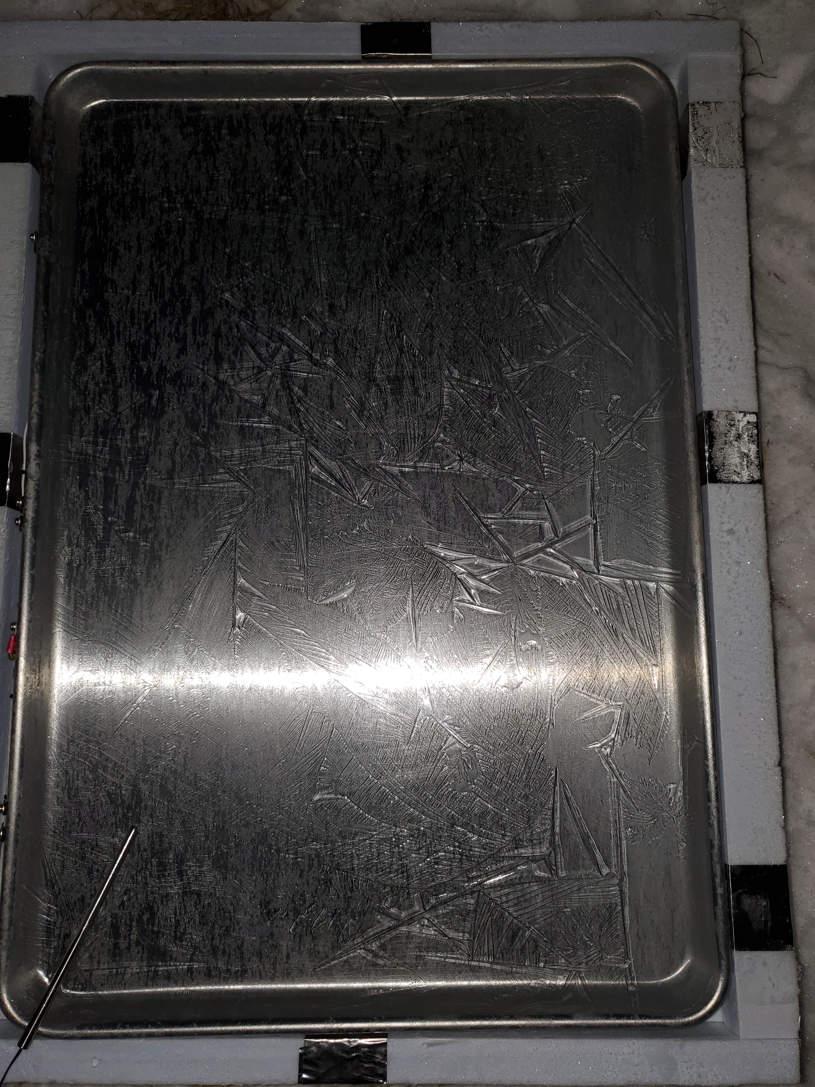
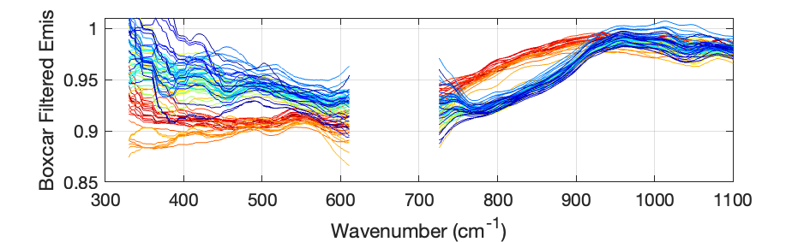
Methods Example: Water-to-Ice Transition
Timeseries computed by averaging over 36 spectra at a time measured over a 5 min time span
  Right shows timeseries of (top) ARI sample view radiance, (middle) retrieved sample temperature and (bottom) emissivity
Changes in sample T and emissivity resolvable over the phase change
Below left figure shows emissivity spectra colored by time (red-liquid water, blue-ice)
Noise is addressed in subsequent results by using longer time averages
Water Emissivity Colored by Time
(Red ~during liquid phase, Blue ~during solid phase)
Example illustrates ability of online/offline method to separate temperature changes from emissivity changes in the transition from liquid water to frozen ice

Slide 15
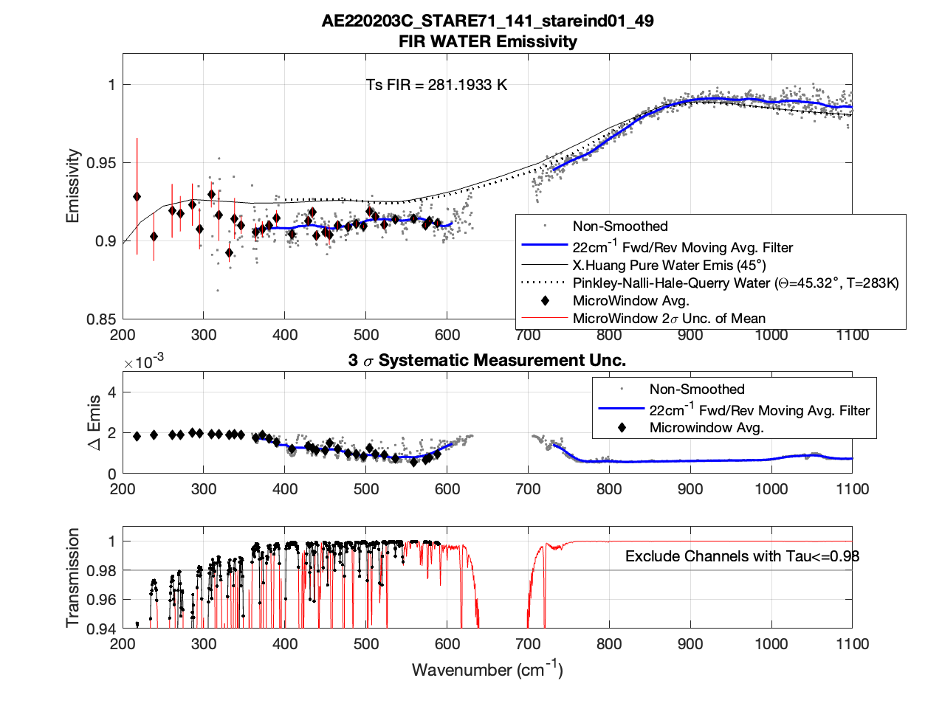
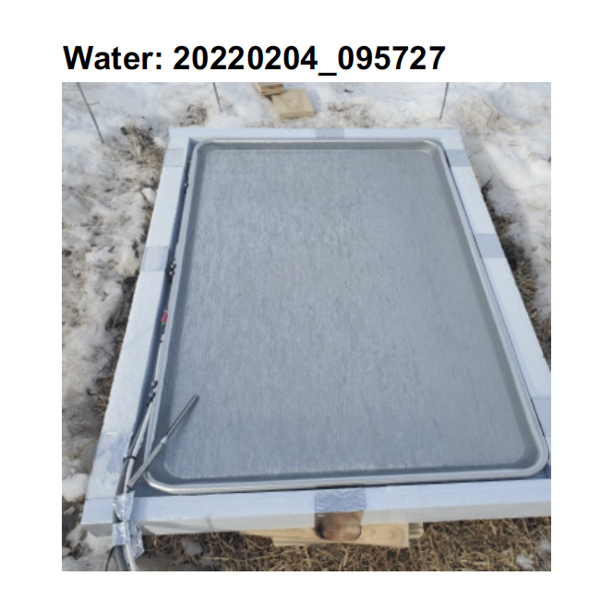
Emis: Water
incident angle: 45.32°
Discrepancy between reference calcs and measurements in FIR needs to be further analyzed
Previously 700-1100 cm⁻¹ range has been carefully studied by Nick Nalli at NOAA STAR for ocean emissivity vs. wind speed (Nalli et al., 2008; Nalli et al., 2008)
200-600cm⁻¹ range measurements are unique and not found in the literature for water emissivity?
Huang Reference Calc: Huang et al., Journal Atm. Sciences, 2016

Slide 16
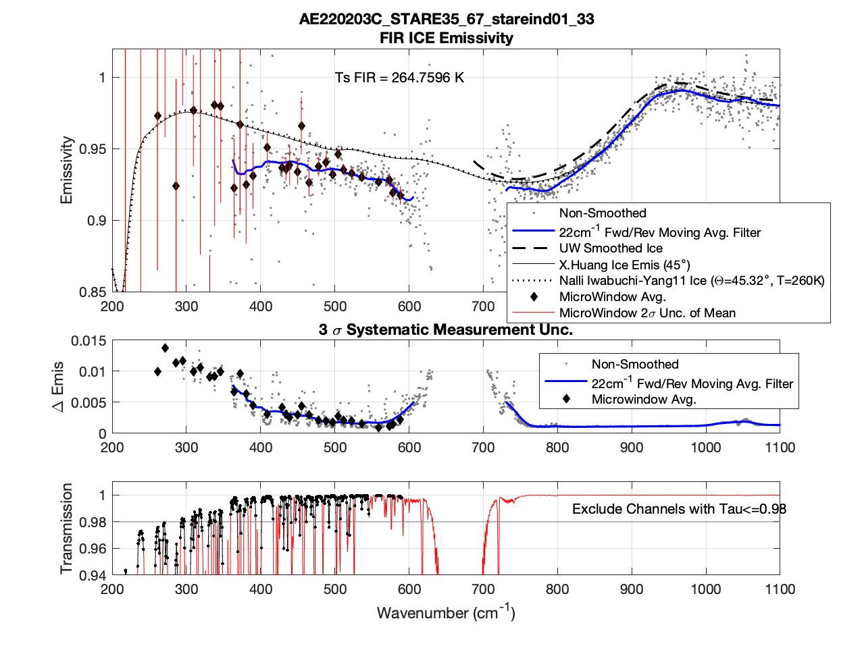
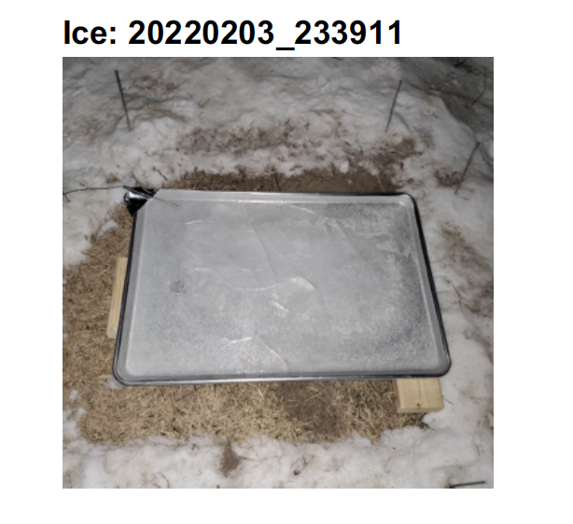
Emis: Ice
incident angle: 45.32°
Discrepancy between reference calculations and measurements in FIR needs to be further analyzed
Previously 700-1100 cm⁻¹ range has been carefully studied by Bob Knuteson using MOSAIC data
200-600 cm⁻¹ range for ice has been studied by Bellisario et al. (JGR, 2017), and Murray et al., (JGR, 2020) (using measurements)

Slide 17
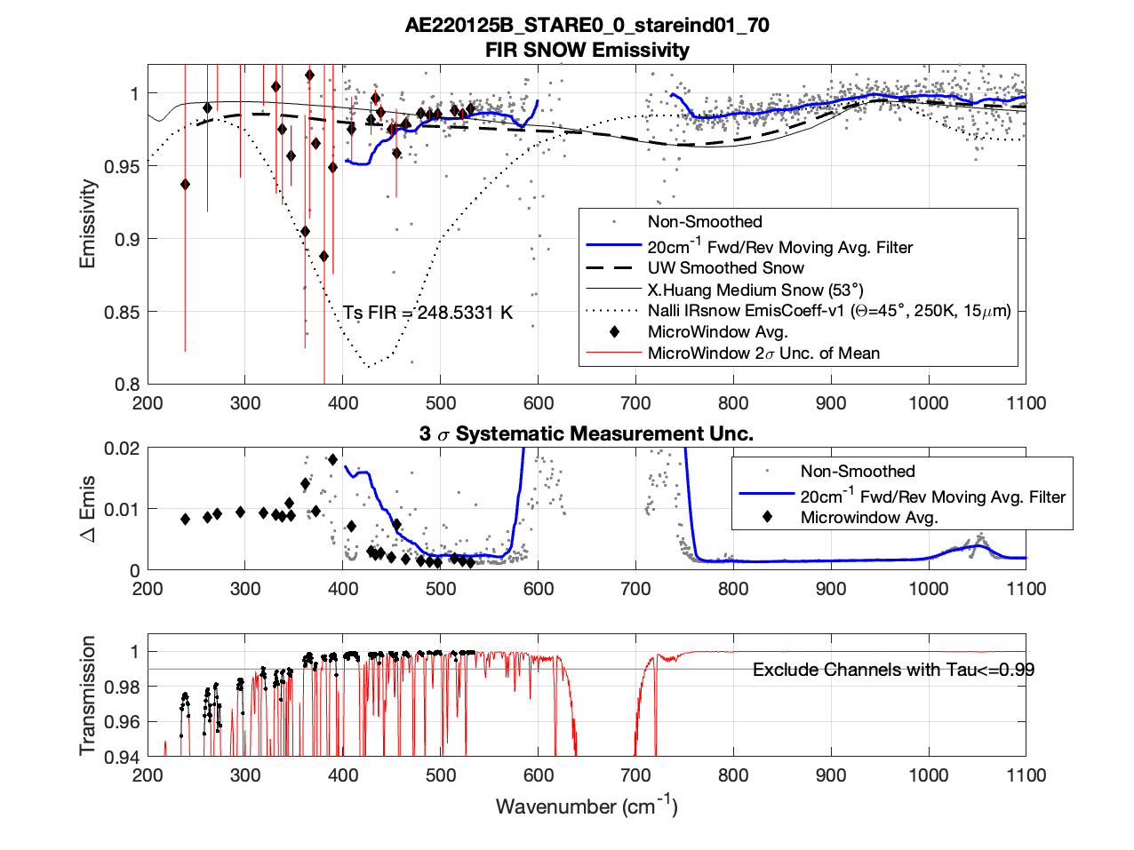
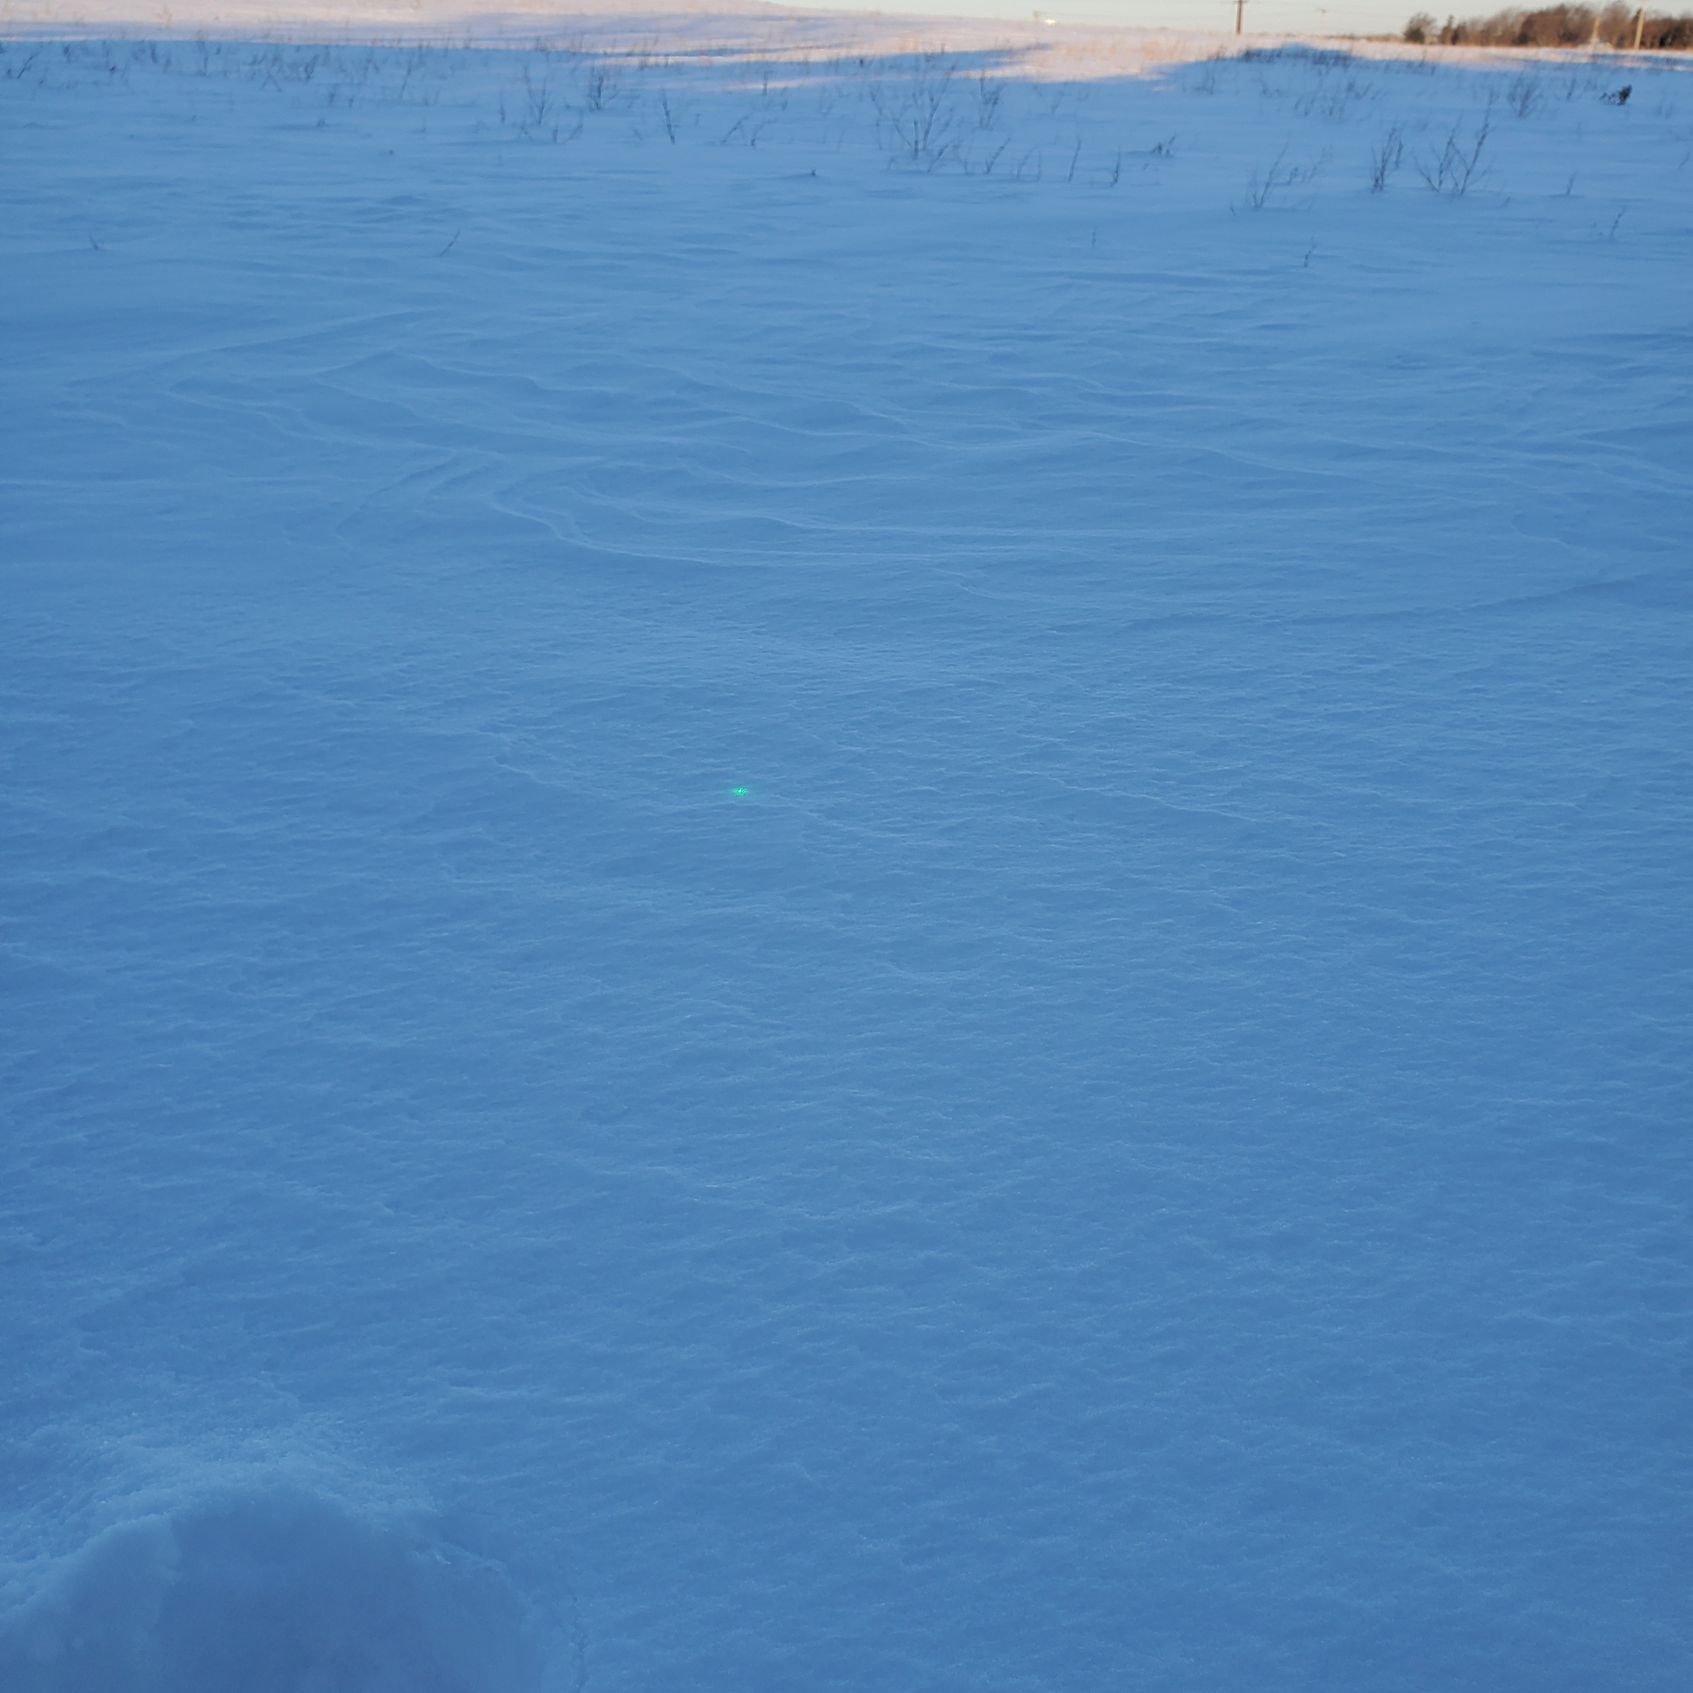
Emis: Snow (Diffuse)
Light, powdery snow
Nalli reference agrees in 700-950 cm⁻¹ and Huang agrees in 950-1100, <600cm⁻¹
Note Huang calc for 53° (rather than measurement angle of 45°)
incident angle: 45.32°
Photo Credit: Doug Adler
Snow fell on 1/24
Picture taken at time of measurement
Sample Temp: 248 K

Slide 18
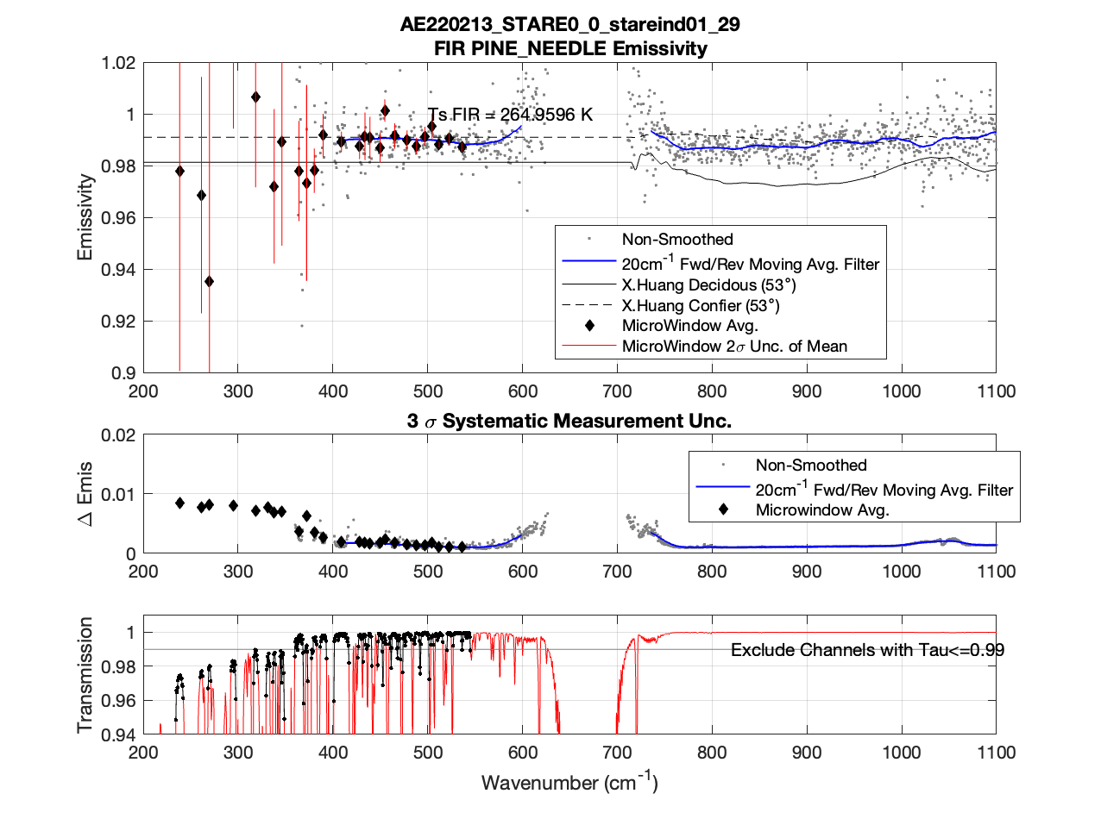
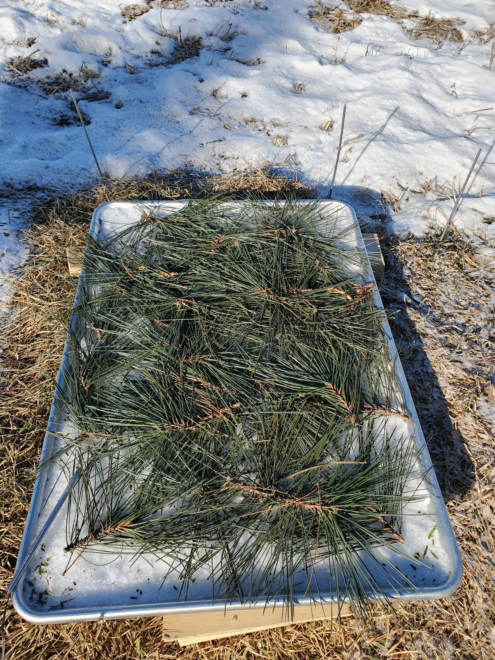
Emis: Pine (Diffuse)
incident angle: 45.32°

Slide 19
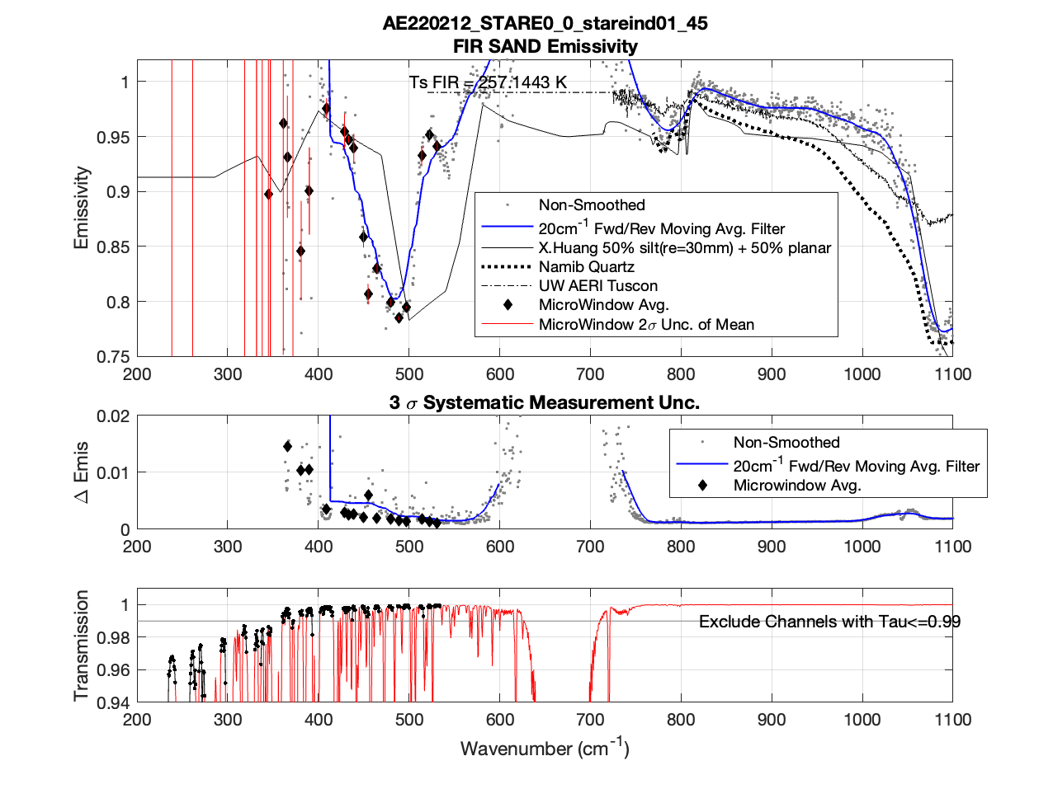
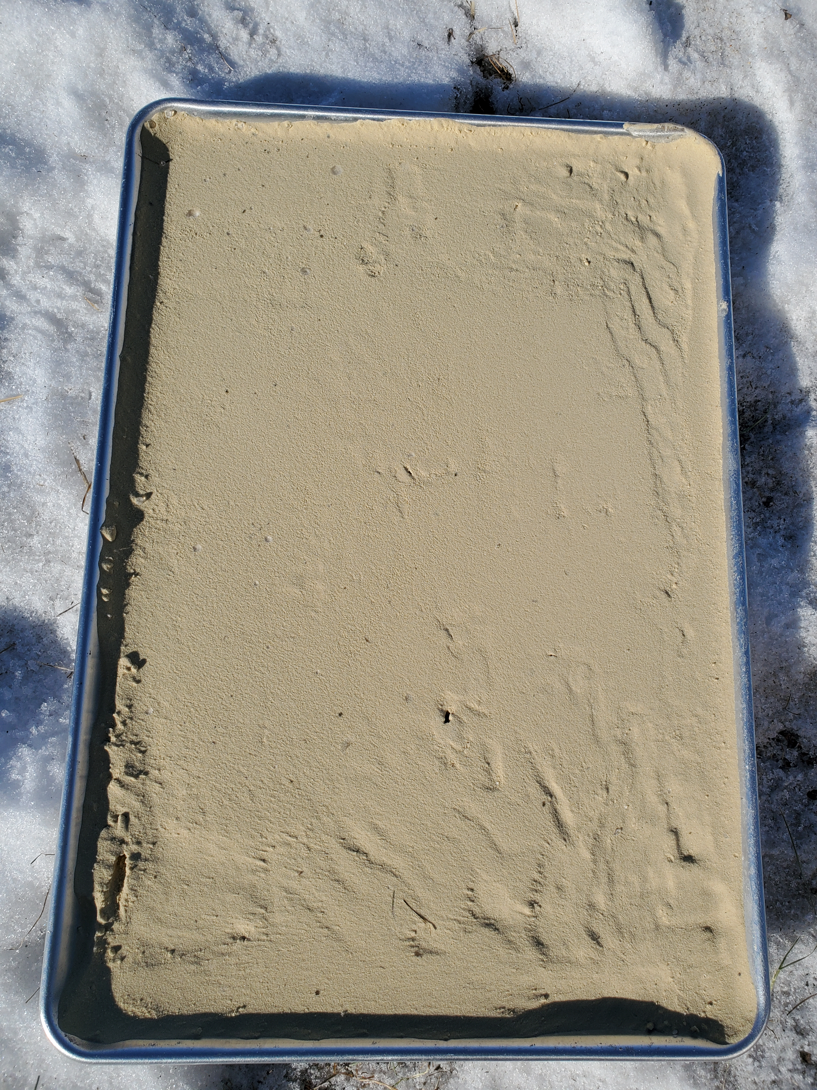
Emis: Fine Sand (Diffuse)
incident angle: 45.32°

Slide 20
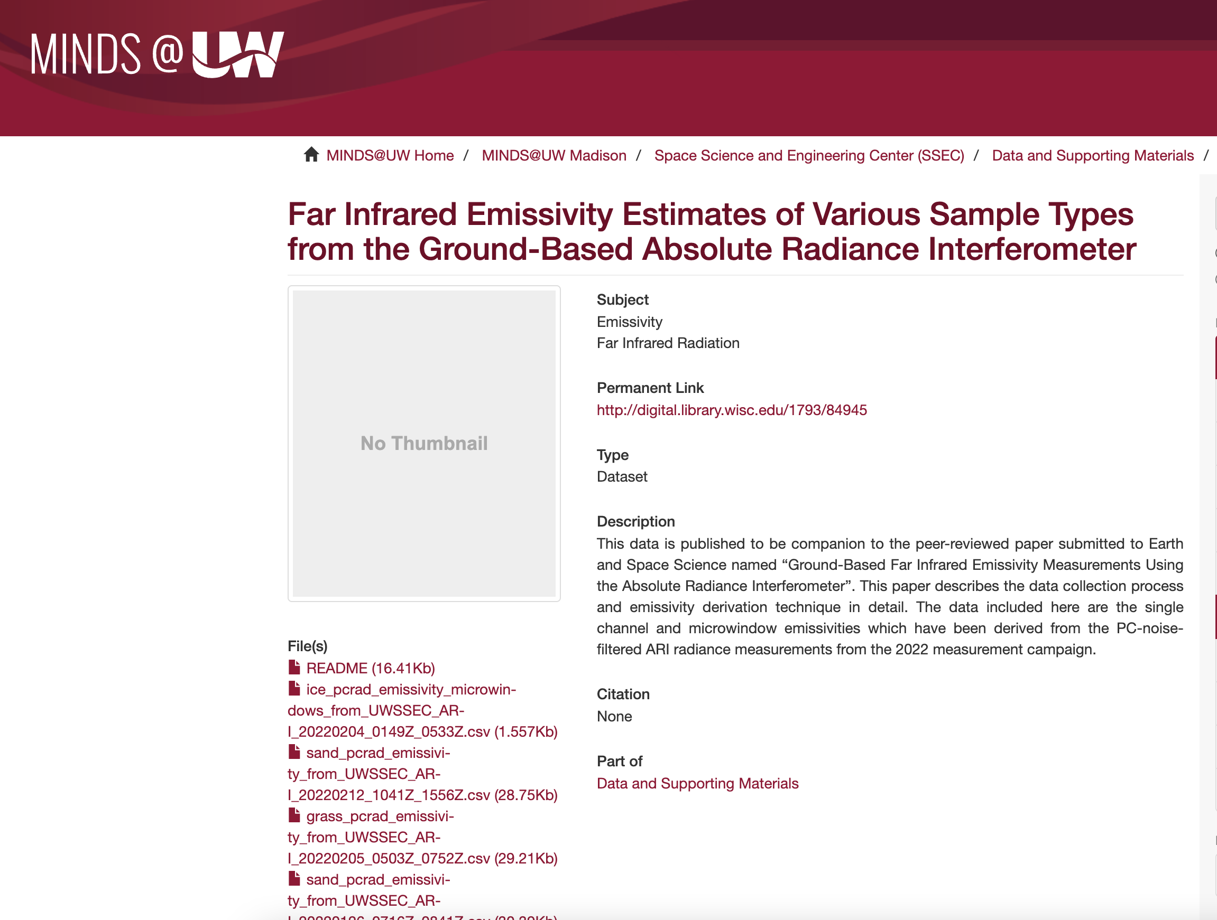
ARI Emissivity Measurements
(averaged by sample type and smoothed)
http://digital.library.wisc.edu/1793/84945

Slide 21
Initial Results

Slide 22
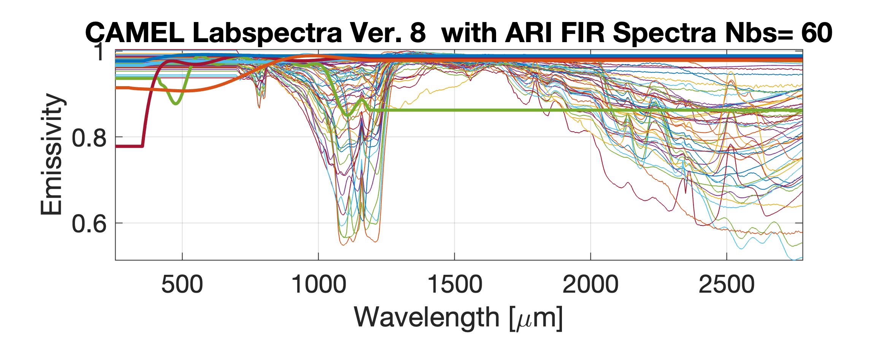
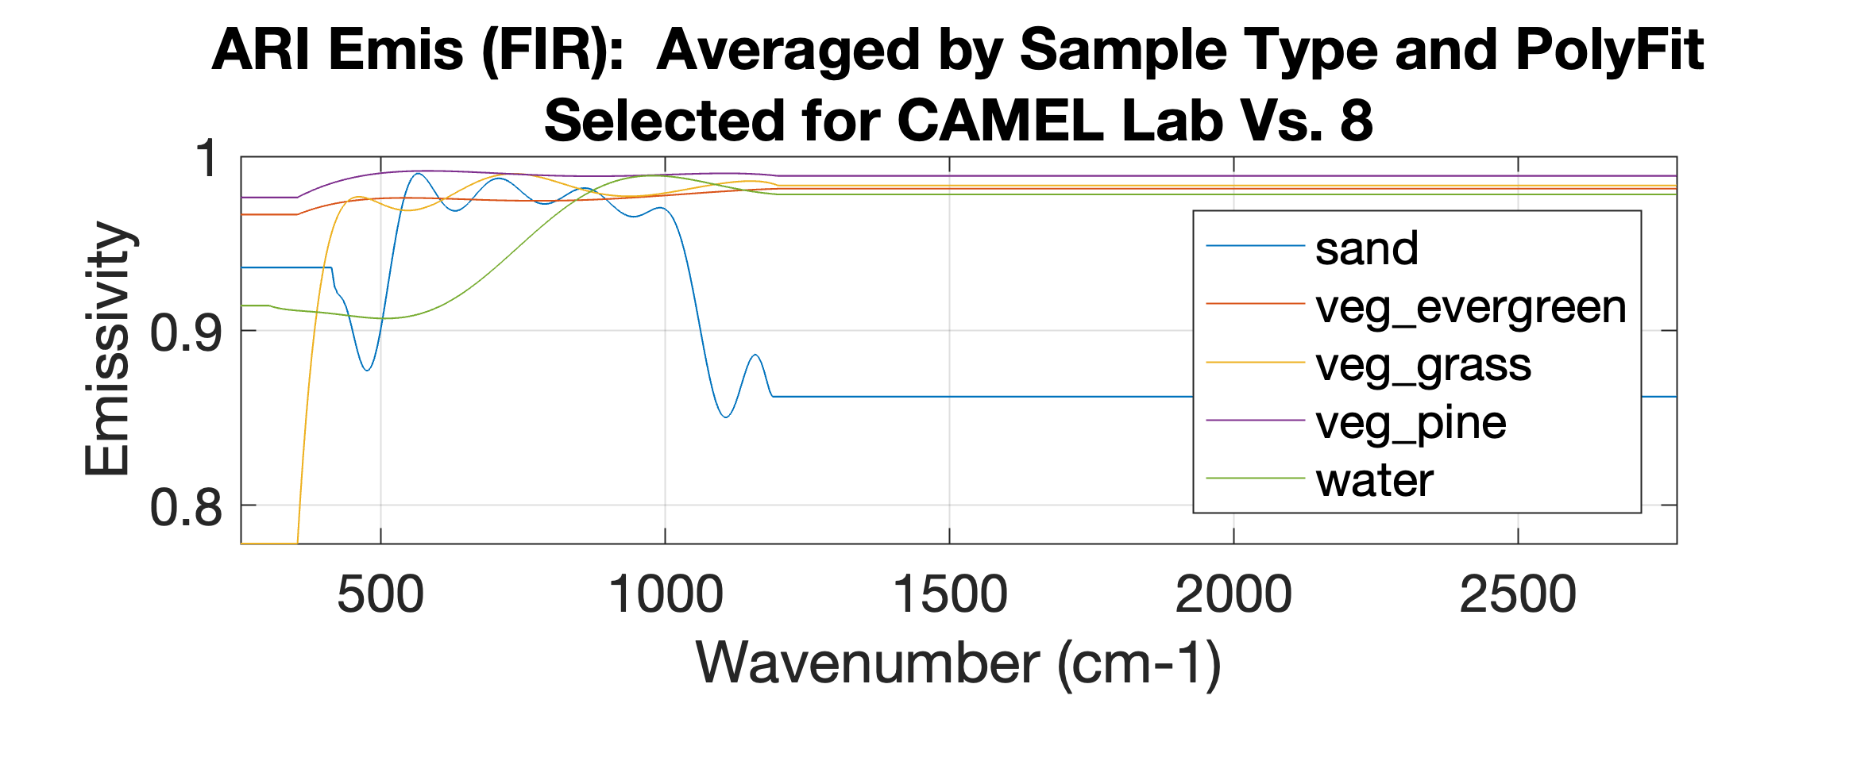
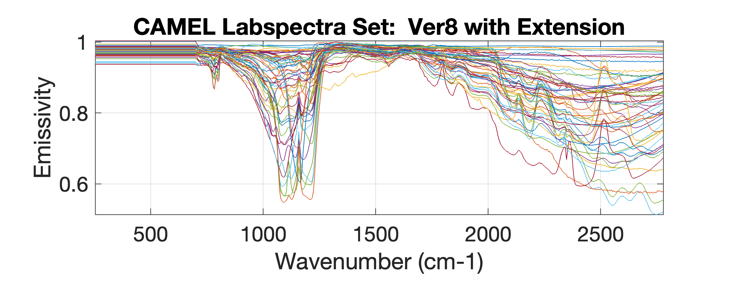
Goal: Creation of Lab Dataset Version *.4
ARI Far IR Emis
CAMEL Lab Emis
+
=
Task 1: Determine Hinge Points
Task 2: Define Methodology for Extension of Lab Spectra to Far IR
Task 3: Create PCs for Far IR + CAMEL Emis
Task 4: Create Far IR High Spectral Resolution Module for RTTOV
Task 5: Validate Using RTTOV with ERA5 compared to Greenland airborne TAFTS radiances/emissivity
Task 6: Validate Using RTTOV with ERA5 compared to NASA PREFIRE radiances

Slide 23
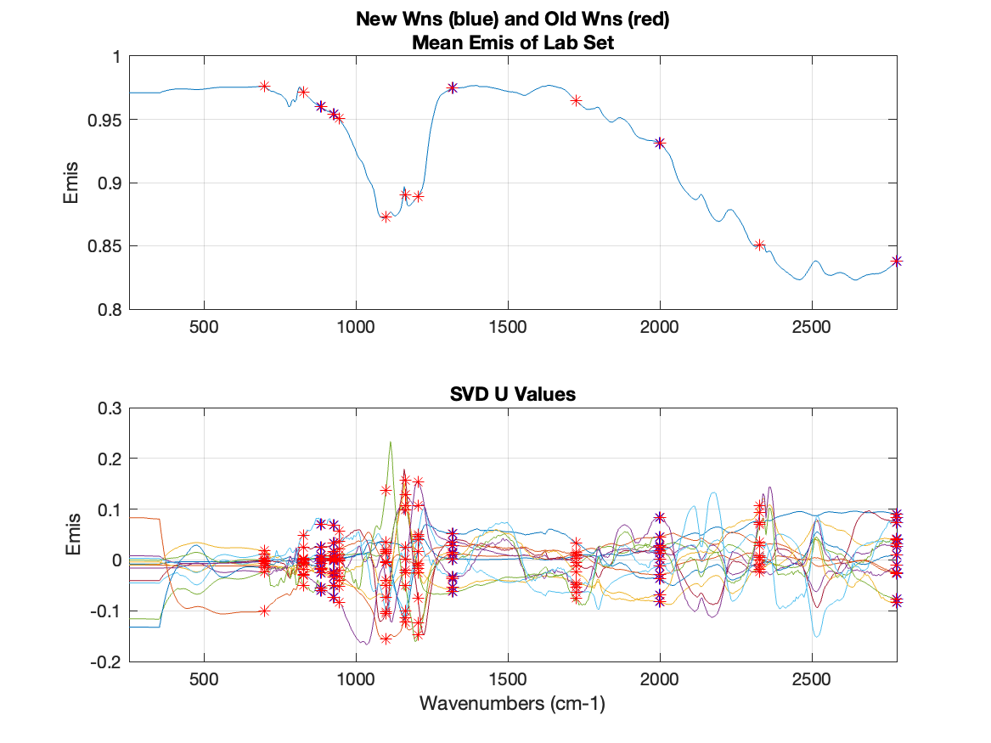
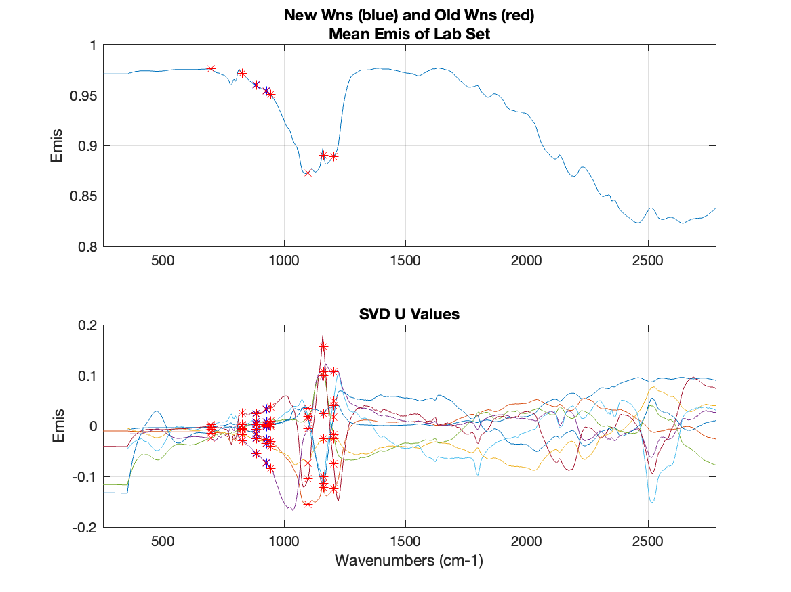
Task1: Evaluate Number of Hinge Points to Use
Use Lab Dataset Version 8.4.1 to create two different sets of PCs:
1. fit on all 13 CAMEL hingepoints
2. fit using only CAMEL hingepoints which overlap with Far IR spectra
13 hinge points
8 Hinge Points

Slide 24
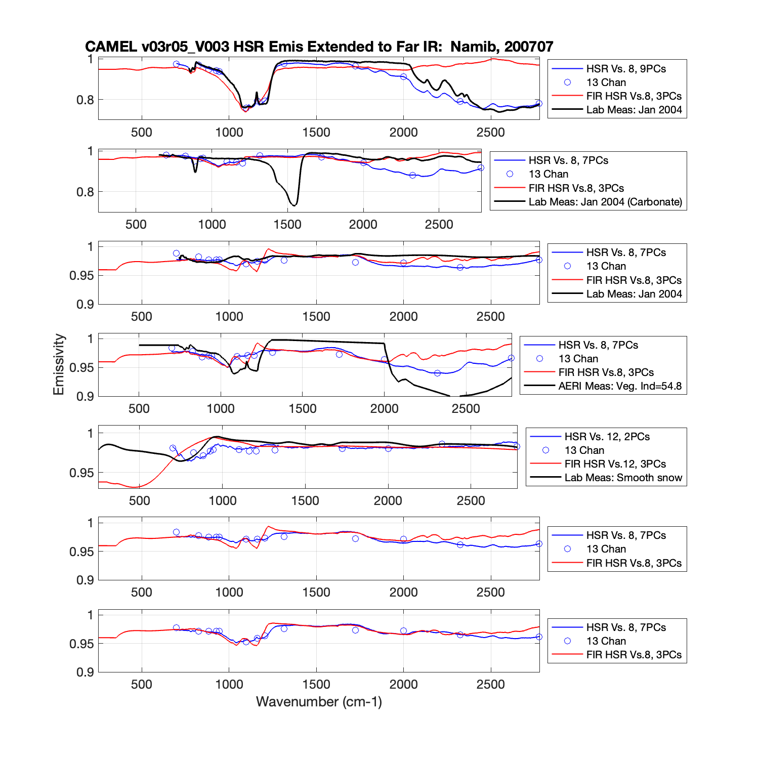
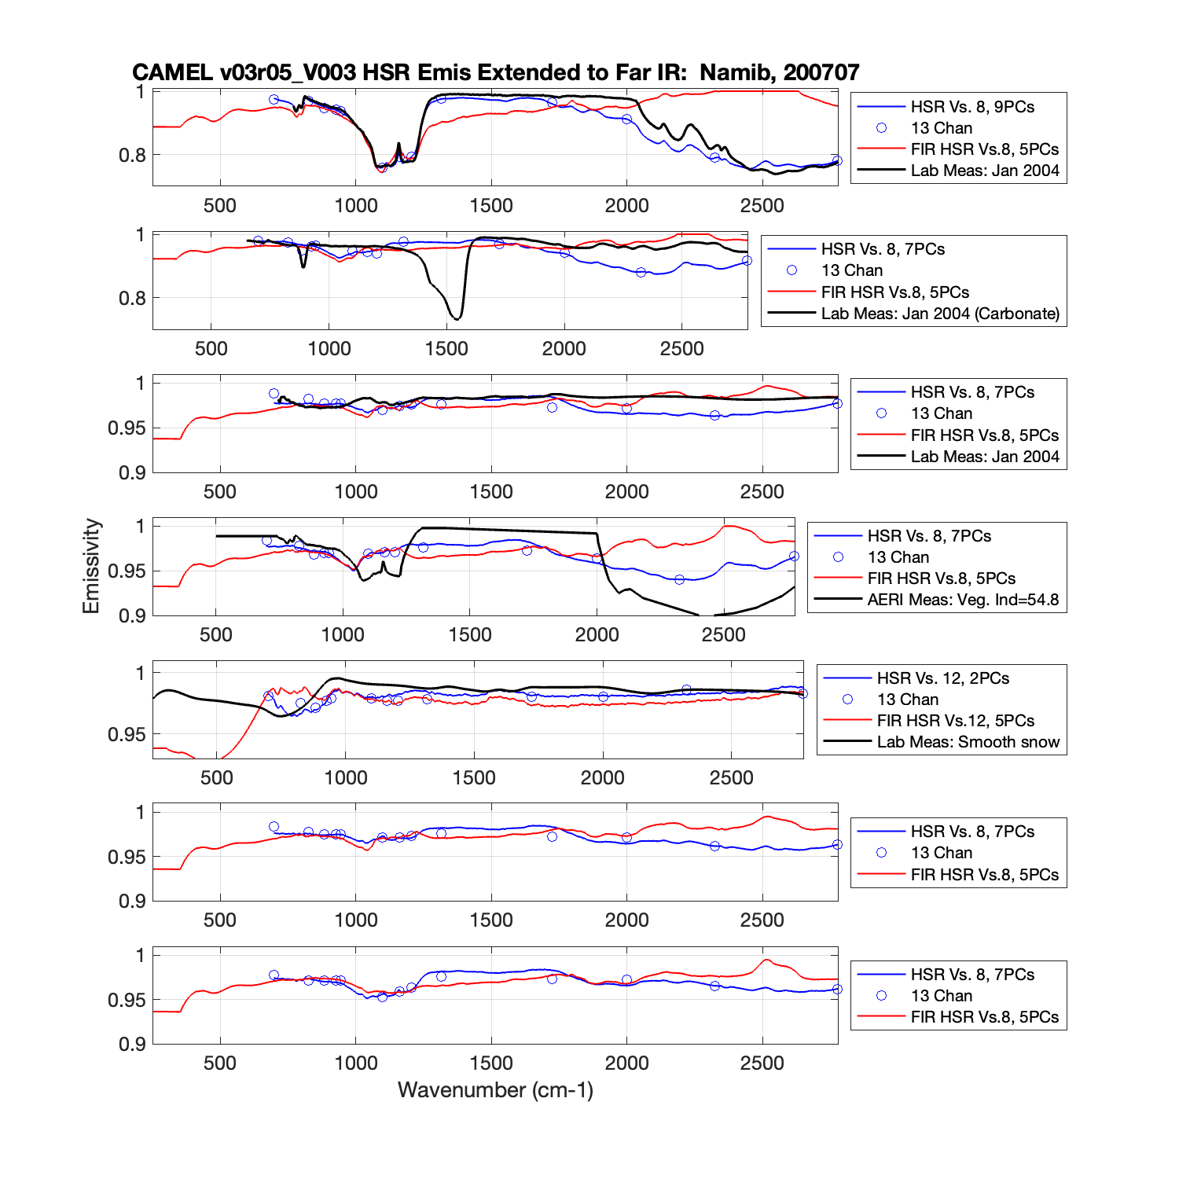
Test Results: Lab Dataset Version 8.4.1 (13 hinge points)
3 PCs
5 PCs

Slide 25
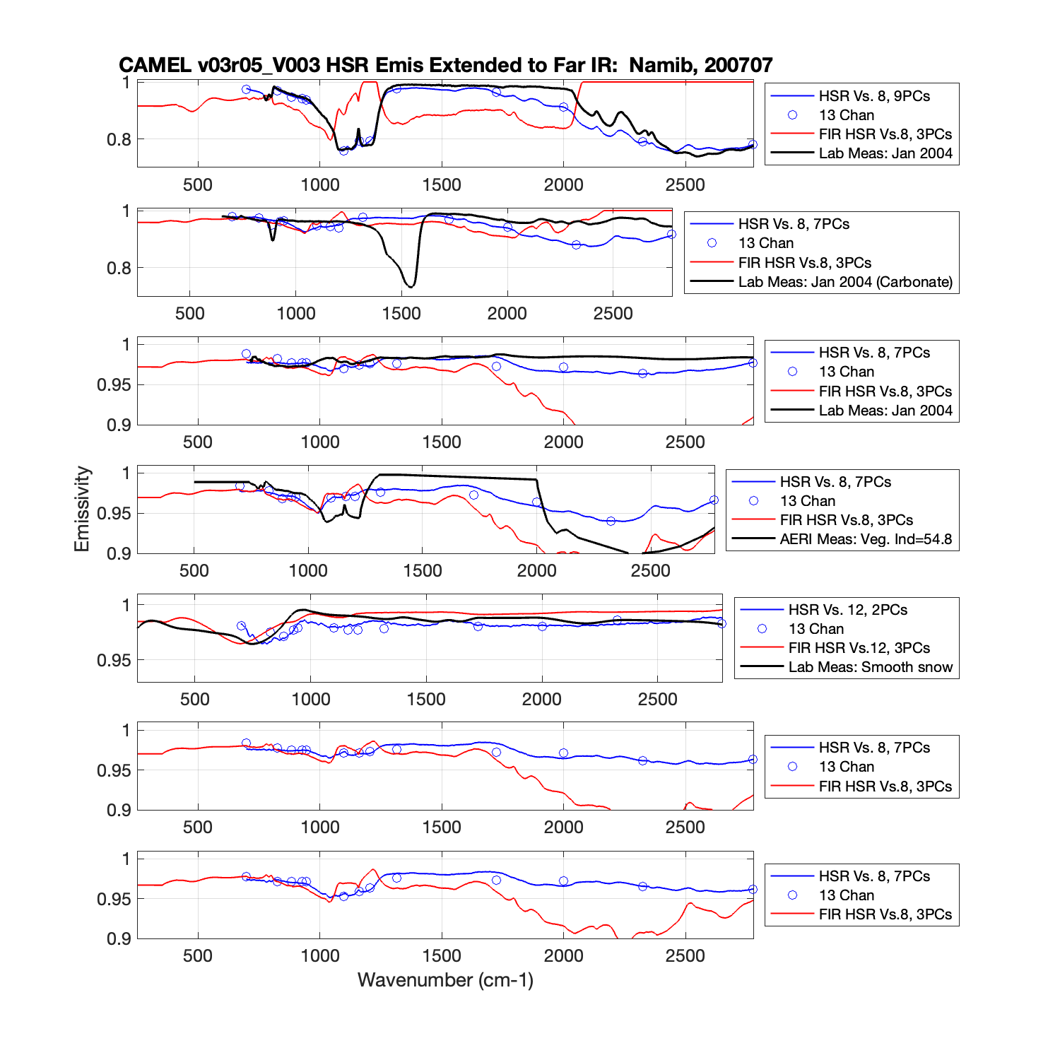
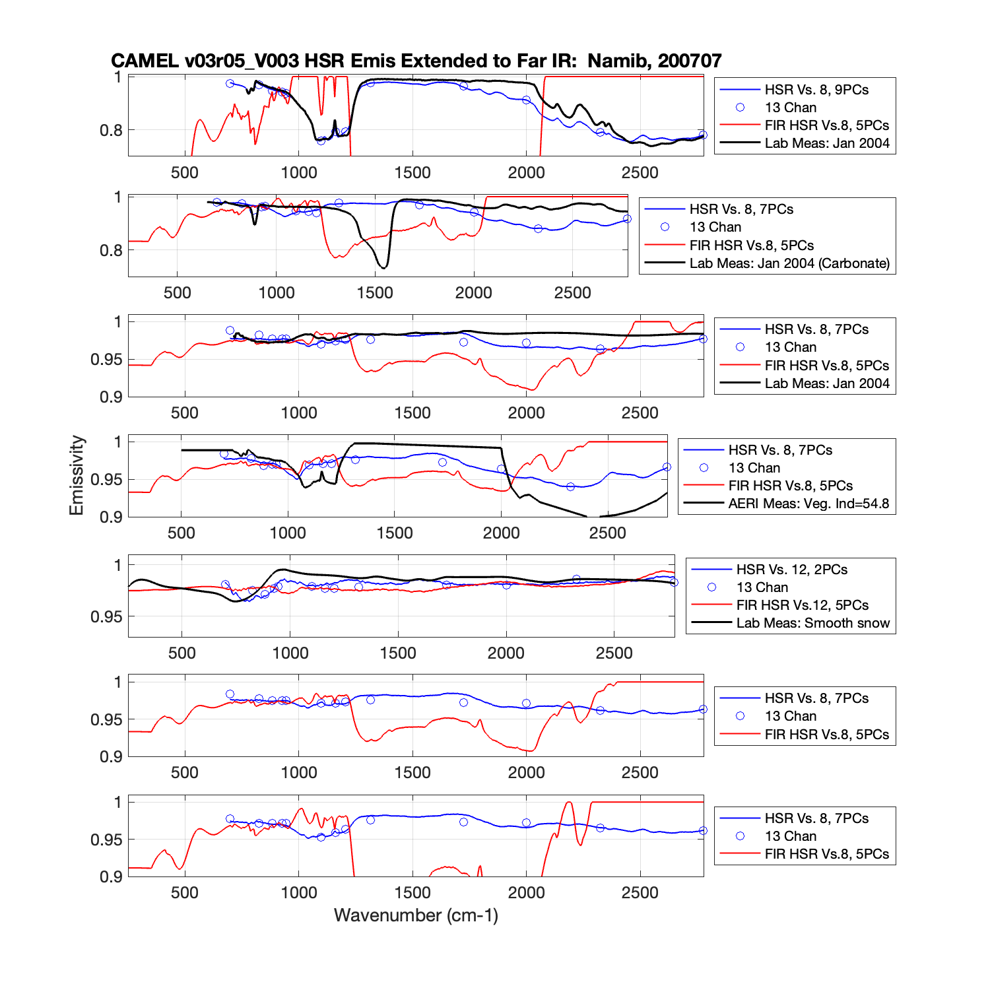
Test Results: Lab Dataset Version 8.4.1 (8 hinge points)
3 PCs
5 PCs

Slide 26
Task1: Evaluate Number of Hinge Points to Use
Use Lab Dataset Version 8.4.1 to create two different sets of PCs:
1. fit on all 13 CAMEL hingepoints
2. fit using only CAMEL hingepoints which overlap with Far IR spectra
13 hinge points
8 Hinge Points
Maintaining 13 hinge points allows for consistency with CAMEL Version 3

Slide 27
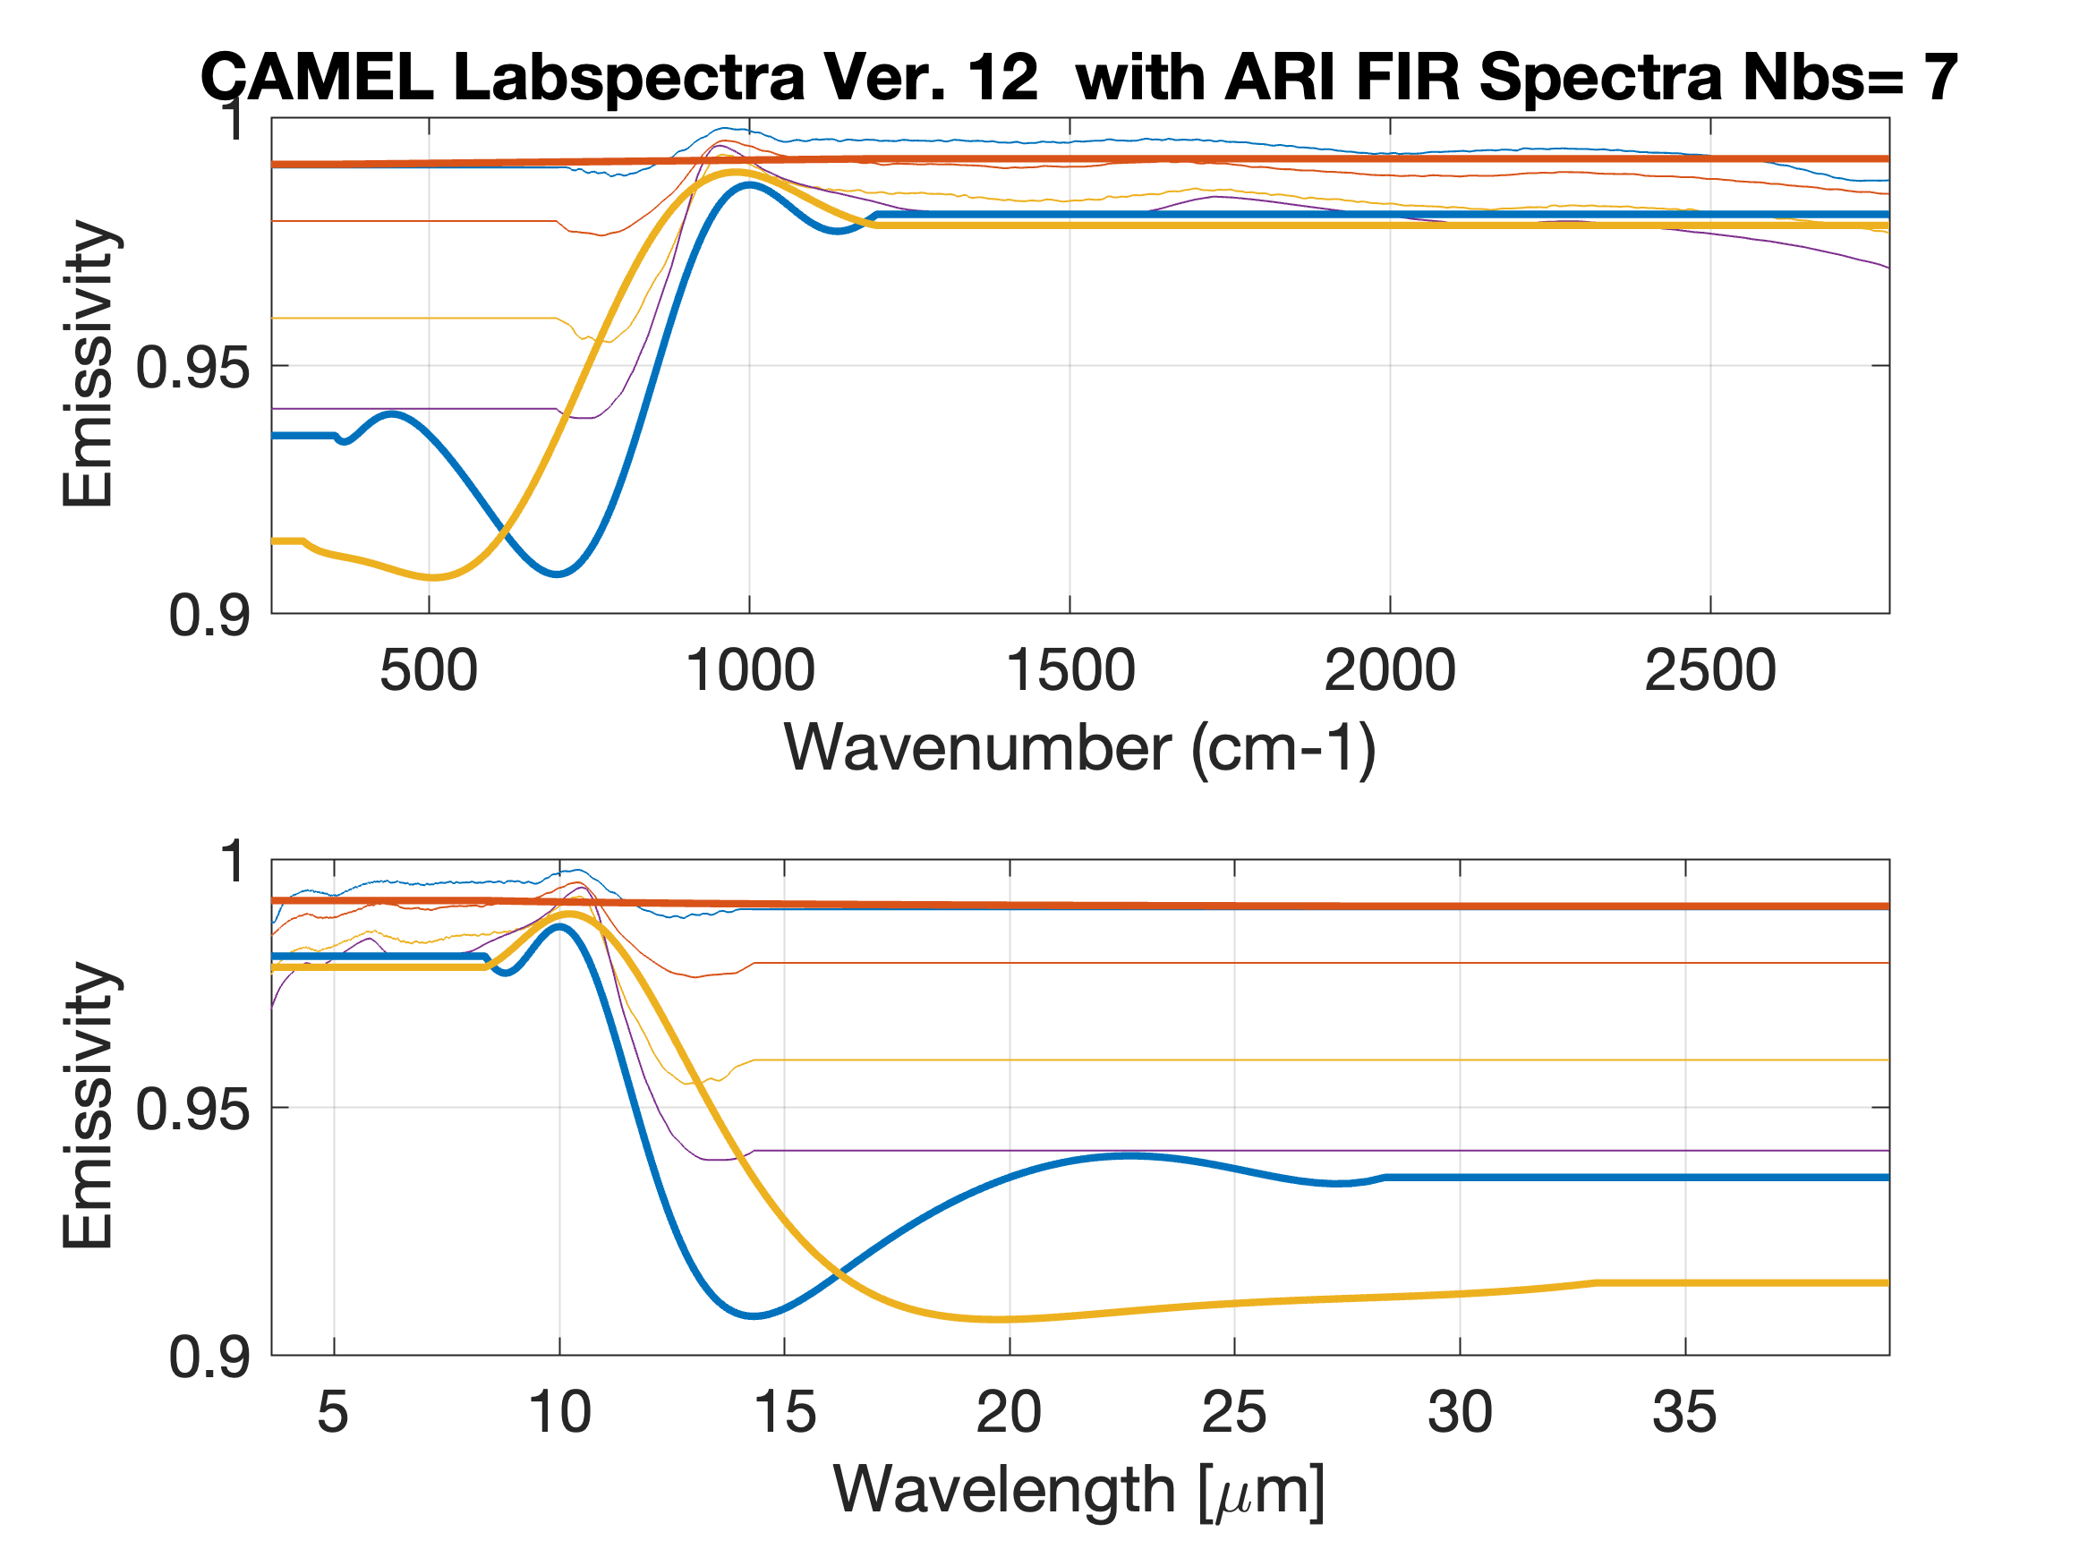
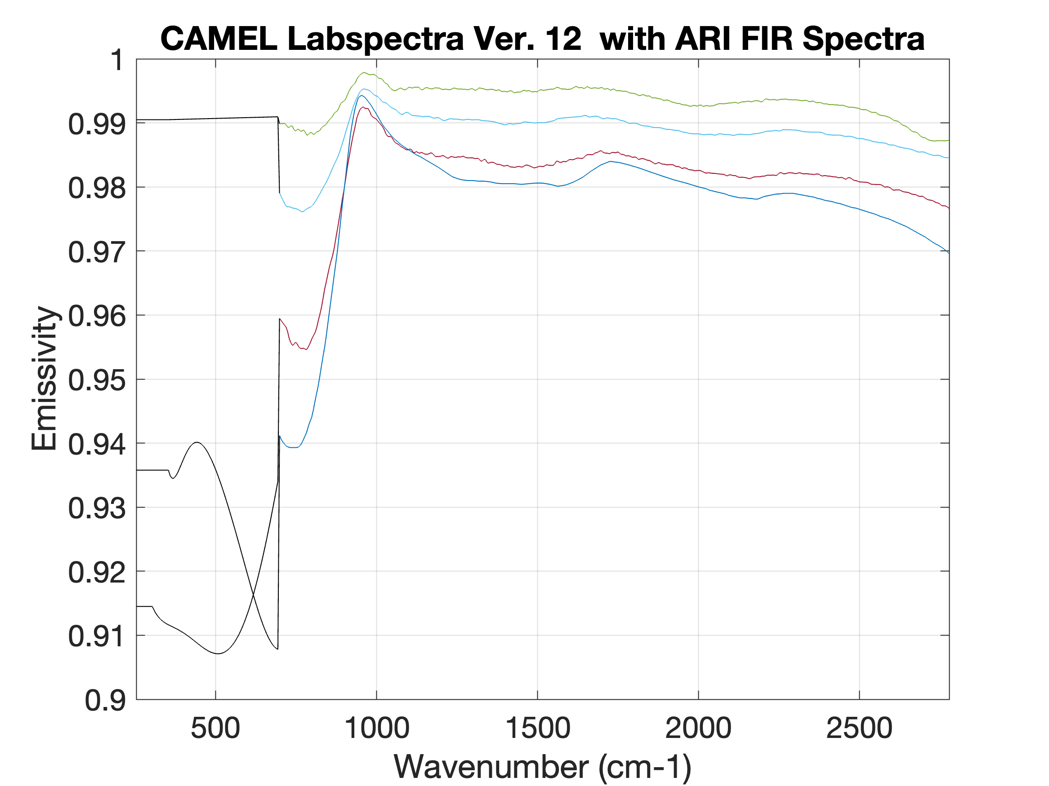
Task 2: Extend CAMEL Lab Set with UW SSEC ARI Observations

Slide 28
Task 3: Create Principle Components for Far IR + CAMEL Emissivity
Include example of CAMEL Principle Components.

Slide 29
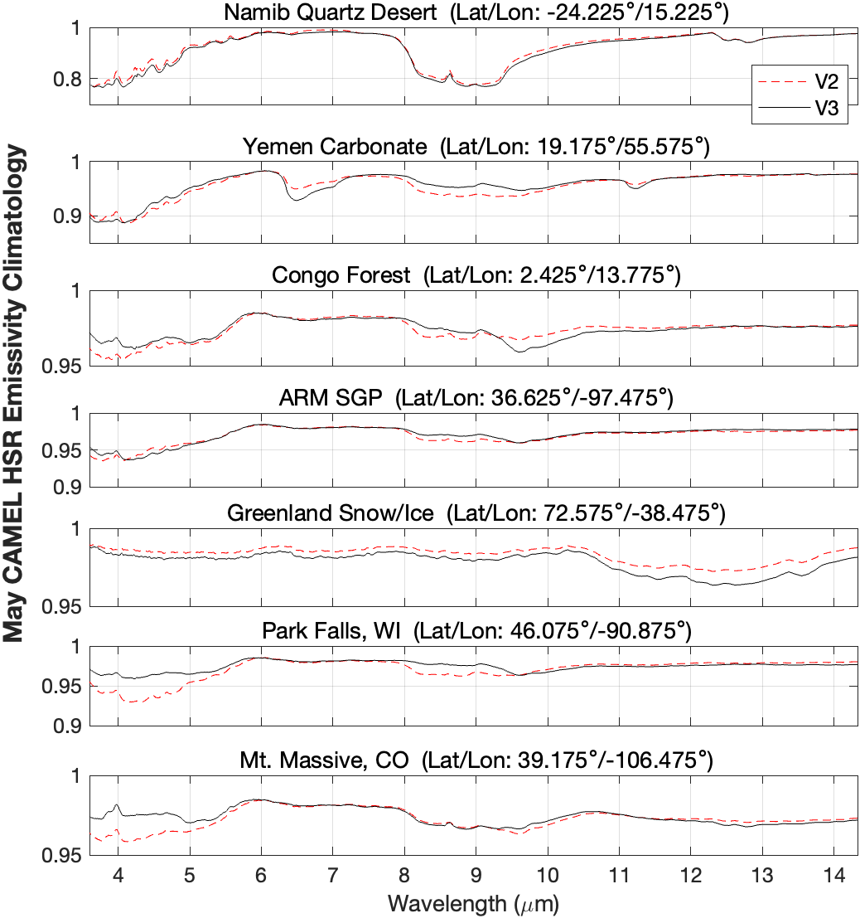
Task 4: Create Far IR High Spectral Resolution Module for RTTOV
CAMEL HSR for RTTOV
FarIR + CAMEL HSR for RTTOV
?
Extend to Far IR

Slide 30
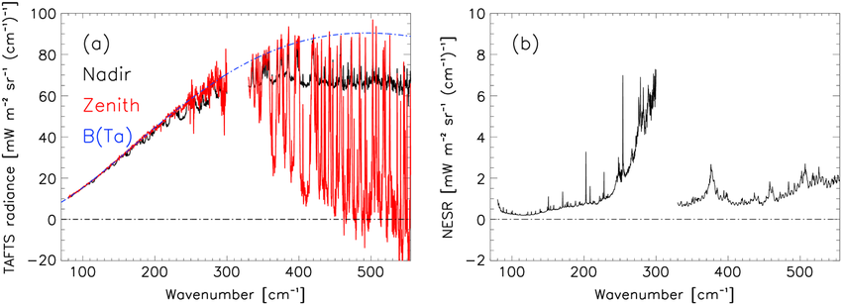
Task 5: Validate Using RTTOV with ERA5 compared to Greenland airborne TAFTS
Bellisario, Christophe, Helen E. Brindley, Jonathan E. Murray, Alan Last, Juliet Pickering, R. Chawn Harlow, Stuart Fox et al. "Retrievals of the far infrared surface emissivity over the Greenland Plateau using the Tropospheric Airborne Fourier Transform Spectrometer (TAFTS)." Journal of Geophysical Research: Atmospheres 122, no. 22 (2017): 12-152. Atmospheres, 122, 12,152–12,166. https://doi.org/10.1002/2017JD027328
lw
sw
Left Panel: TAFTS Radiance viewing Surface (black line) and viewing sky above aircraft (red line)
    Blue line is Planck Radiance at FAAM aircraft Tair (~252K) much warmer than Tsurface (~232 K).
Right Panel: TAFTS Noise level for “lw” and “sw” bands. Only ”sw” band is useful for this evaluation.

Slide 31
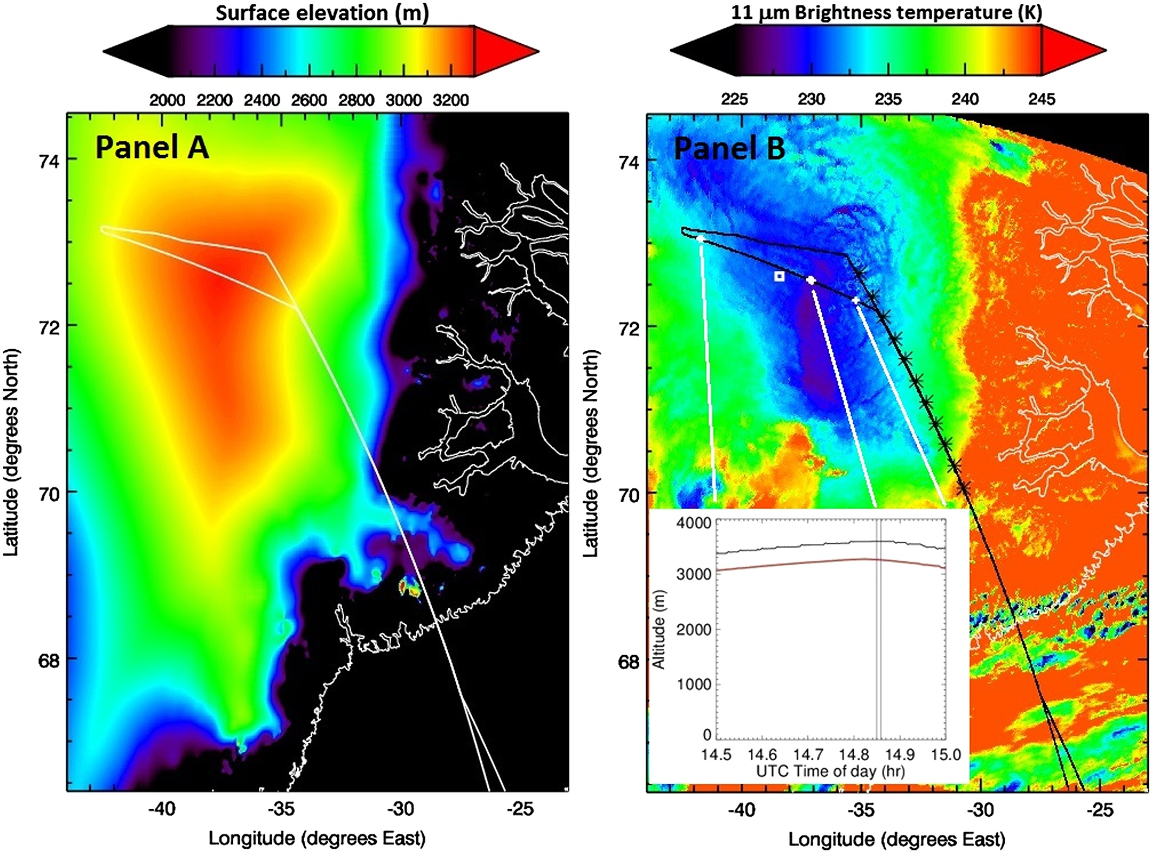
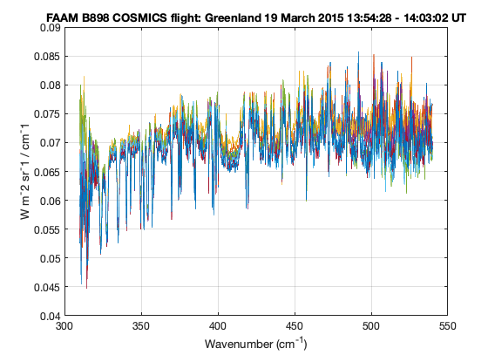
Task 5: Validate Using RTTOV with ERA5 compared to Greenland airborne TAFTS
TAFTS upwelling radiance over Greenland
TAFTS “sw” band
Data Access: FAAM B898 COSMICS flight 19 March 2015 Greenland
https://catalogue.ceda.ac.uk/uuid/b5758a268bf74497b658628e8b4d7199/
Filename: imp-tafts_faam_20150319135500_r0_b898.nc

Slide 32

Task 6: Validate Using RTTOV with ERA5 compared to NASA PREFIRE radiances
Polar Radiant Energy in the Far-InfraRed Experiment
https://science.nasa.gov/mission/prefire/
https://www.nasa.gov/missions/prefire/nasa-mission-gets-its-first-snapshot-of-polar-heat-emissions/

Slide 33
Discussion
Feedback on the proposed tasks is welcome.
Are there additional test cases that should be considered?
Establish collaboration with end users of FarIR extension of CAMEL RTTOV module.

