Slide 1
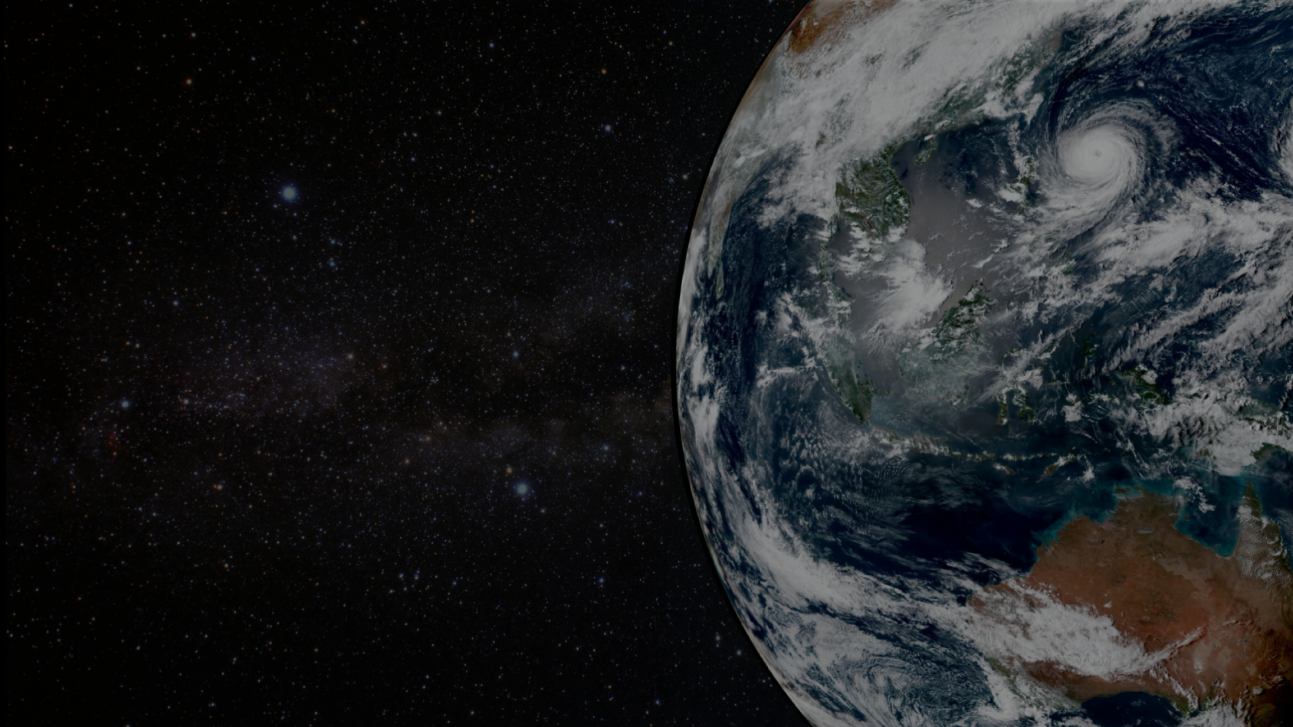


The Community Radiative Transfer Model
Benjamin T. Johnson (Project Lead, UCAR/JCSDA)
Cheng Dang (UCAR/JCSDA) | Andrew Collard (EMC)
Ming Chen (STAR) | Isaac Moradi (GMAO)
Yingtao Ma (STAR) | Emily Liu (EMC)
Pan Liang (AER) | Bryan Karpowicz (GMAO)
Quanhua Liu (STAR) | Nick Nalli (now at NRO)
Aerosol Model Collaborators:
Jerome Barré, Virginie Buchard, Peter Colarco, Arlindo da Silva (NASA
Peng Xian, Jeff Reid (NRL)
James Hocking (Met Office)
Shih-Wei Wei, Cheng-Hsuan (Sarah) Lu (JCSDA/UCAR, University at Albany, SUNY)
Additional contributions from Greg Thompson, Soyoung Ha, Fabio Diniz, Francois Hebert NOAA EMC Meeting 12/17/2024

Slide 2

AOP 2024 CRTM v2.4.0 – v3.2-pre summary
https://github.com/JCSDA/CRTMv3
What’s New Since ~v2.4.0 to now (maybe a few missing items, just to give you an idea)
Quiet Printing and Logging Improvements
Multiple PRs focused on making the model’s output less verbose and more controllable. This includes adding quiet print options, commenting out unnecessary informational outputs, and fixing the quiet option inside src/CRTM_LifeCycle.f90.
Aerosol, Cloud, and Active Sensor Capabilities
Significant enhancements were made to support aerosol and cloud data handling, including a new CRTM AOD module and aerosol bypass functionality. Several PRs merged Active Sensor and DDA cloud coefficients
Transition to CMake
A major structural update involved moving from ecbuild to a standalone CMake-based build system. This included reworking CMakeLists.txt, removing hard-coded installation prefixes, and providing options to build either shared or static libraries. These changes improve portability, maintainability, and flexibility in various build environments.
Performance and Stability Fixes
OpenMP-related segfaults were addressed, as well as issues involving thread settings for certain profile cases. Additional memory and initialization fixes (e.g., zeroing allocated arrays in RTV_Create).
Data I/O and Coefficient Handling
Enhancements were made to improve reading/writing of cloud, aerosol, and surface emissivity data. Tools for handling CRTM coefficient files were expanded, enabling binary-to-netCDF conversions, generating associated ACCoeff and NLTECoeff NetCDF files, and allowing local tarball specification for coefficient downloads.
Surface Properties and Reflectance Output
Changes ensured that surface properties (reflectivity, direct_reflectivity, emissivity) are bounded correctly, though one bounding PR was later reverted. Reflectance output capabilities were added to enable direct reflectance assimilation.
Miscellaneous Maintenance and Housekeeping
Numerous smaller fixes were made, including correcting typos, removing redundant code lines, updating versioning for releases, ensuring make install works properly, and merging tested changes back into the develop branch. These collectively improve the overall cleanliness and reliability of the codebase.
Multiple new sensor coefficients added (detailed later)

Slide 3
AOP 2024 CRTM v3.x
https://github.com/JCSDA/CRTMv3
Status: v3.1.1 released as release/REL-3.1.1 (Aug. 12, 2024; updated Sept. 3, 2024)
What’s New Since v3.1.0:
Merge of SpcCoeff, TauCoeff, and CloudCoeff Utilities into Develop (#160) (@BenjaminTJohnson)
This change merges critical binary and NetCDF utilities into the develop branch, streamlining file management and data format compatibility, a major enhancement for users working with CRTM's coefficient files.
Added Option to Build Shared or Static Libraries (#175) (@BenjaminTJohnson)
Introduces flexibility in choosing between shared and static libraries during the build process, enhancing the overall usability of the build system, especially when resolving linking issues​
Fix for User Emissivity AD (#155) (@BenjaminTJohnson)
For user specified surface emissivity and scattering cases, the surface emissivity jacobian became User_Emissivity_AD = sum(SfcOptics_AD%Emissivity(1:nZ,1)) (contributed by Mark Liu, STAR)
Patch for "Make Install" (#140) (@rhoneyager-tomorrow)
This patch ensures that the make install command functions as expected, fixing an issue noted by tomorrow.io colleagues.
CMakeLists Update to Remove Hardcoded Paths (#131) (@climbfuji)
A small but useful improvement to the build system, making it more flexible by removing hardcoded install paths​
Fix for Number of Stream Selection in CRTM (#122) (@chengdang)
This fix corrects how the number of streams is selected, improving the model's configurability​ and computational efficiency.
Reflection Correction Module Update (#147) (@BenjaminTJohnson)
Incorporates updates from a prior release version (REL-2.4.0_emc), ensuring that the latest reflection correction capabilities are available​ (Identified by Andrew Collard / Emily Liu, EMC)

Slide 4
AOP 2024 CRTM v3.2 (1/3)
https://github.com/JCSDA/CRTMv3
Status: v3.2.0 under development (expected Q3)
New Features (completed):
Enhance SpcCoeff_BIN2NC to Support Generation of Associated ACCoeff and NLTECoeff NetCDF Files (#171) (@BenjaminTJohnson)
Enhances the SpcCoeff_BIN2NC tool, allowing it to generate associated ACCoeff and NLTECoeff NetCDF files during binary-to-NetCDF conversions.
First Attempt at Not Breaking CMake Paths for Everyone Else (#180) (@BenjaminTJohnson)
Improves the CMake build system by ensuring paths remain functional for all users, increasing build system flexibility.
Add CRTM Coefficient Tarball Download Logic (#181) (@eap)
Adds logic to allow users to specify a local tarball for CRTM coefficient downloads, offering more flexibility in obtaining coefficient files (thanks Evan!)
All binary coefficients converted to netCDF format: SpcCoeff, TauCoeff, ACCoeff/NLTECoeff , cloud coefficients, aerosol coefficients, emissivity coefficients, etc. All internal version numbers updated/normalized (e.g., HIRS). (fix_REL-3.1.1.2.tgz) (@BenjaminTJohnson)

Slide 5
AOP 2024 CRTM v3.2 (2/3)
https://github.com/JCSDA/CRTMv3
Status: v3.2.0 under development (delayed to Jan. 2025)
New Features (under development):
Land Surface emissivity model updates (e.g., CAMEL v3 land emissivity atlas) [discussion of land types]
Various Surface emissivity interface updates (replacing NESDIS* routines) [continuous updates]
SURFEM fast ocean surface emissivity model implementation for MW/IR (ala RTTOV, PARMIO) [needs FTE support]
Default netCDF support for all files [complete]
  Requires minor changes to CRTM defaults and UFO interface to CRTM
Generic Optical Properties Interface (C. Dang) #110 [forward complete]
New Sensors: GEOXO-Sounder (GXS, via STAR), tomorrow.io (tmos), Orbital Microsystems (gems-2), PolSIR, AMPR, 3dS-INSAT imgr/sndr (via STAR),
  under development: GOES-19 coefficients (IR only so far, via STAR), PACE coefficients (vis / near-IR), AOS (TBD)
Surface Object updates (stretch goal)
  Proposed development of a generic method for surface objects
  Purpose: enable integration with a wider variety of surface RT objects (radiance, reflectance, radar surface return, fire, etc.), improve integration with community models like CSEM.
  This will permit users to specify an arbitrary number of self-describing surface objects
  Enables flexibility in AI/ML training
  Similar approach (if successful) will be adopted for optical properties

Slide 6
AOP 2024 CRTM v3.2 (3/3)
Status: v3.2.0 under development (expected Q3)
New Features (under development) (Cheng Dang’s work):
New features:
MW water emissivity: updated MW water emissivity I/O modules to remove the dependent on binary look-up tables (F ASTEM 6).
ADA solver: downward adding-doubling calculation for solar channels (under code review).
Aircraft-level calculation: forward and tangent linear modules for upward/downward radiance/BT calculations at user-specified pressure level. (under code review, in collaboration with STAR)
Aerosols:
GEMS/WRF-Chem/MPAS AOD DA: new modules for offline CRTM/WRF-Chem calculations, including aerosol species mapping and WRF-Chem data I/O. (in collaboration with S. Ha, MMM)
Sensitivity tests for species mapping.
Under investigation:
K-matrix calculations for aircraft level radiance/brightness temperature (in collaboration with STAR)
UFO forward calculations for PolSIR coefficients.
General:
General support for CRTM user guide updates and code branch maintenance.
Code sprint for CRTM surface emissivity.

Slide 7
AOP 2024 CRTM Coefficient Generation Package
https://github.com/JCSDA/CRTM_Coef
Status: Under continuous development
Recent Updates (@BenjaminTJohnson):
Updated all TROPICS coefficients to reflect correct polarization basis, polarization angles, version numbers. Deliveries on 9/12/24, 8/30/24, and 4/18/24.
Added COSMIR / COSMIR-H development support (NASA GSFC)
Created/delivered PolSIR coefficients (to Vanderbilt) (6 ch and 12 ch)
Created/delivered AMPR coefficients (to NASA JPL)
Created Tomorrow.io sounder coefficients (still validating against theirs)
Updated GEMS-2 coefficients (Orbital Microsystems) (still validating against theirs).
Work Needed (incomplete list) (this is at least 2 FTEs of work):
Ozone contribution(s) at submillimeter frequencies (114 GHz, 240 GHz, and higher) – monoRTM integration into coefficient generation package (or use STAR package).
Visible coefficients for reflectance calculations
Proper treatment of polarization basis across scans for various instruments
Updates to CO2 profiles used in training (severely outdated)
Improved constituent training / profiles
Hyperspectral Microwave support in CRTM / UFO (coefficient, testing, evaluation)
Hyperspectral Infrared support in CRTM / UFO (coefficient, testing, evaluation)

Slide 8
CRTM Coefficient generation (STAR)
Worked on coefficient generation for GXS-GeoXO (the GeoXO Sounder). GXS is a grating type hyperspectral infrared sounder proposed for the next generation geostationary satellites. It can provide nearly constant information about the vertical distribution of atmospheric moisture, winds, and temperature.
Collaborating with the DRSA-PRECIP4 project to assess the performance of the new cloud scattering dataset in the regional/CAM model. The updated cloud coefficients depends on: Microphysical scheme, mass-dimension (m-D) ratio and temperature. Cloud LUTs were created for 4 snow schemes * 5 graupel mass-D relations * 5 microwave temperatures.
Coefficients were created for MWR-AWS (the MicroWave Radiometer on the Arctic Weather Satellite). The AWS is a planned European Space Agency (ESA) constellation of meteorological microsatellites.
Delivered CRTM coefficients for ABI-GOES19.

Slide 9
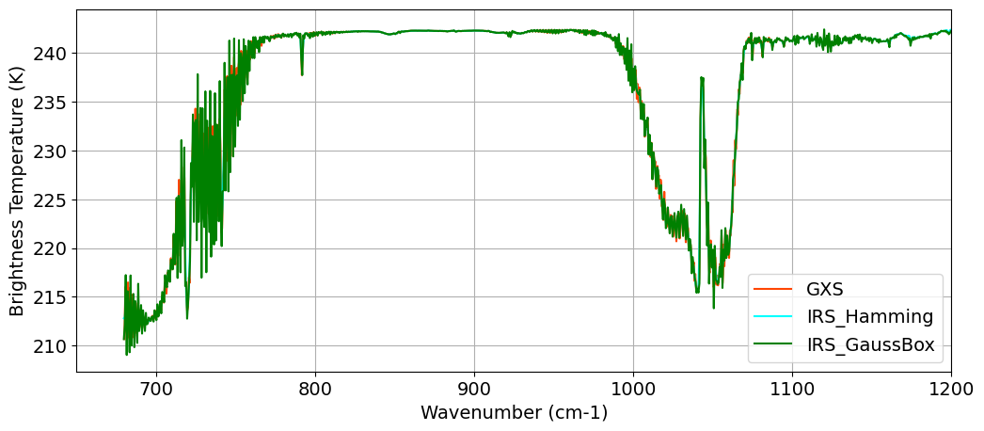
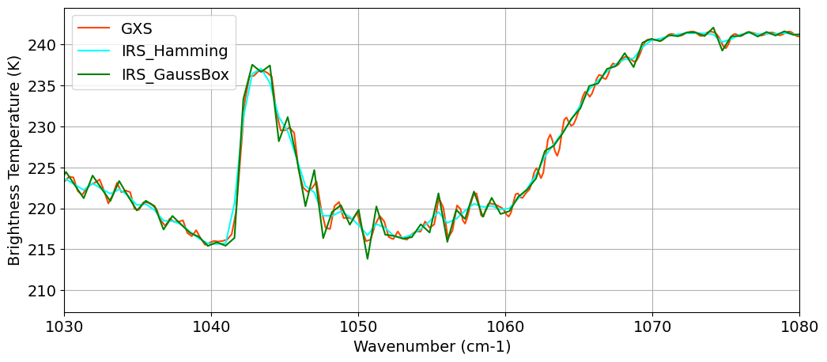
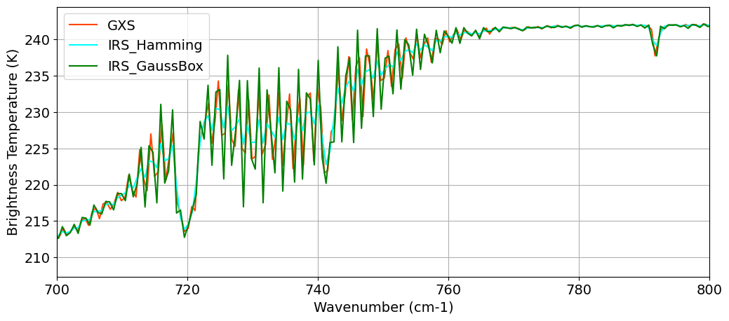
CRTM simulation of GXS and IRS (STAR, Y. Ma.)
O₃
CO₂
CRTM simulation of longwave bands from GXS and IRS
Slide courtesy of Yingtao Ma (NOAA STAR)

Slide 10
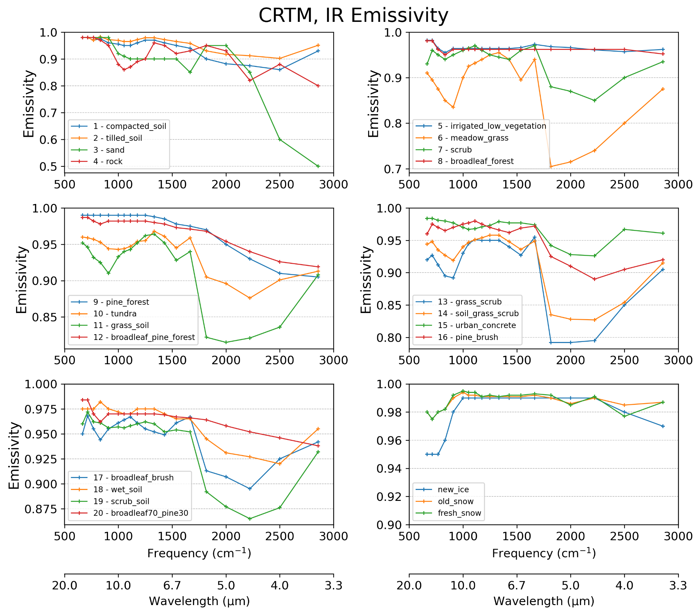
Current status:
Default IR emissivity (NPOESS)
No angular dependence no temperature dependence no polarization information no spatial dependence
AOP 2024 Land Surface Emissivity Updates

Slide 11
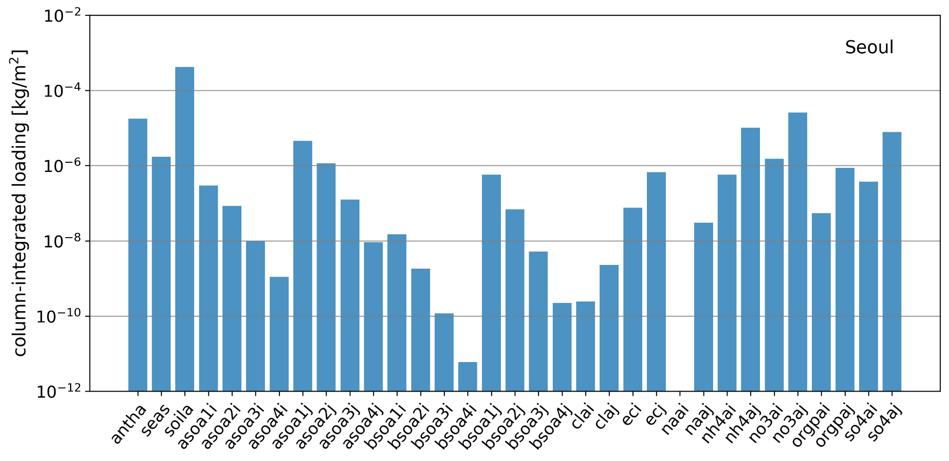
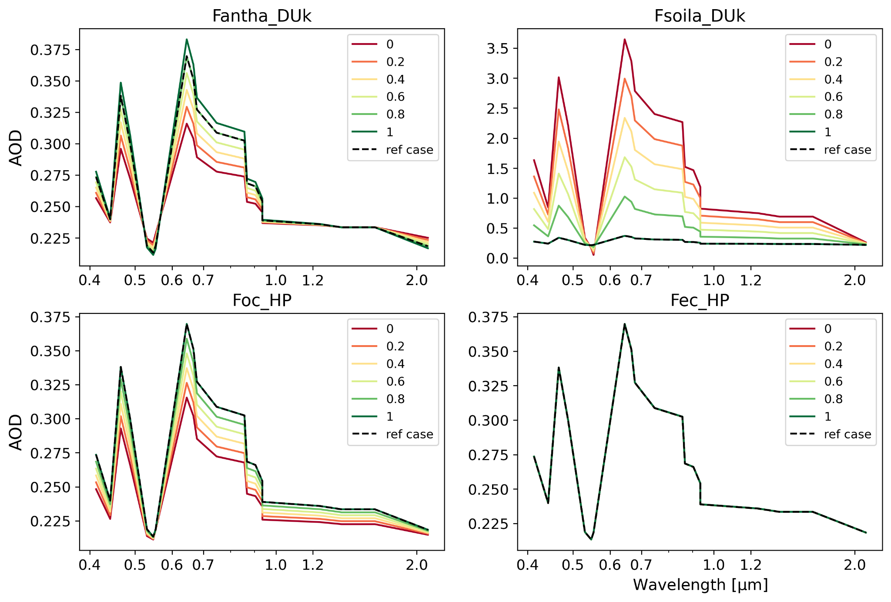
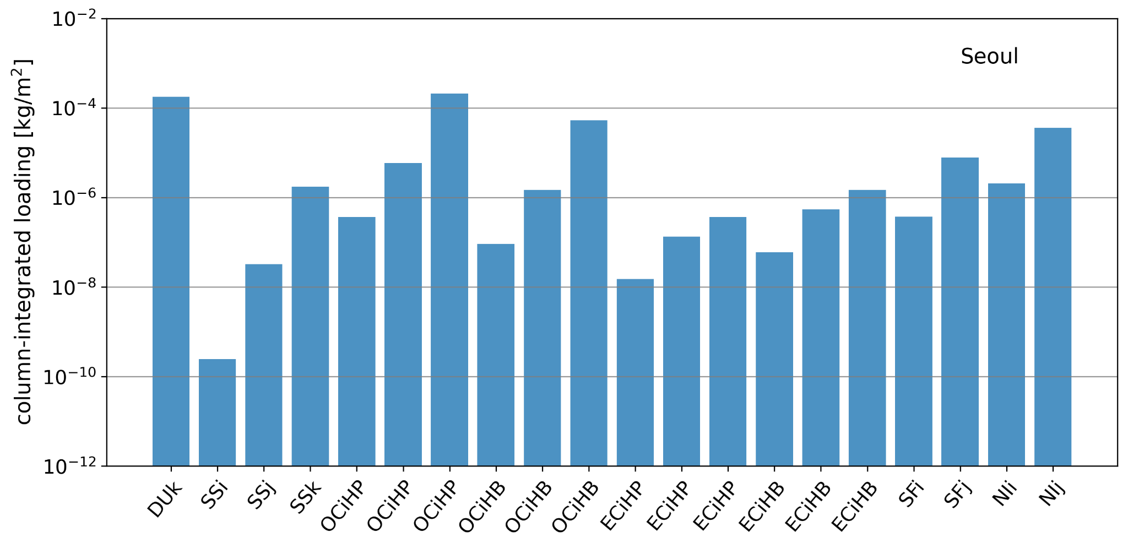
WRF-Chem/CRTM offline AOD Sensitivity test
Change of column total AOD with respect to four different mapping factors:
Fantha_DUk: fraction of coarse mode dust in anthropogenic aerosols.
Fsoila_DUk: fraction of coarse mode dust in soil aerosols.
Fochp: fraction of hydrophilic organic carbon.
Fechp: fraction of hydrophilic organic carbon.
Top/bottom: WRF-Chem column-integrated aerosol loading before and after mapping (site Seoul)

Slide 12
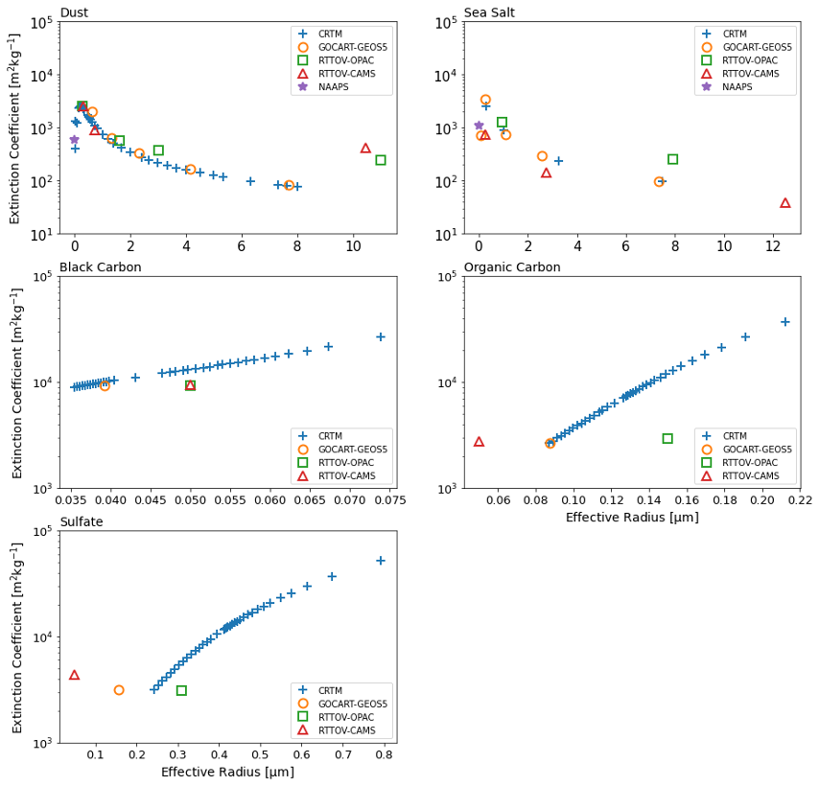
Aerosol
CRTM Version | Aerosol model | Aerosol species | Aerosol properties
All versions Binary | CRTM (Default) Chin et al., 2002; Han, 2006 | dust, sea salt, organic carbon, black carbon, sulfate | effective radius, hygroscopicity (implicit)
v2.4 – v3.1 NetCDF | CMAQ Binkowski and Roselle, 2003; Liu and Lu 2016 | dust, sea salt, water-soluble, soot, sulfate, water, insoluble, dust-like | effective radius, hygroscopicity (implicit) radius standard deviation
v2.4.1 – v3.1 | GOCART -GEOS5 Colarco et al., 2010 | dust, sea salt, organic carbon, black carbon, sulfate, nitrate | effective radius, hygroscopicity
v2.4.1 – v3.1 | NAAPS Lynch et al., 2016 | Bulk aerosol properties: dust, sea salt, smoke, anthropogenic and biogenic fine particles | hygroscopicity
v2.4.1 – v3.1 (internal) | RTTOV-OPAC RTTOV-CAMS RTTOV v13 | dust, sea salt, organic carbon, black carbon, sulfate, nitrate CAMS: aerosol climatology developed by Copernicus Atmosphere Monitoring Service | effective radius, hygroscopicity
Dust and Sea Salt: dry particle, RH = 0 for all schemes
BC, OC, Sulfate
•CRTM: for all effective radii available.
•The rest: dry particle, RH = 0.
Figures: Aerosol extinction coefficients of selected species across the CRTM default, GOCART-GEOS5, NAAPS, and RTTOV LUTs. [550nm]

Slide 13
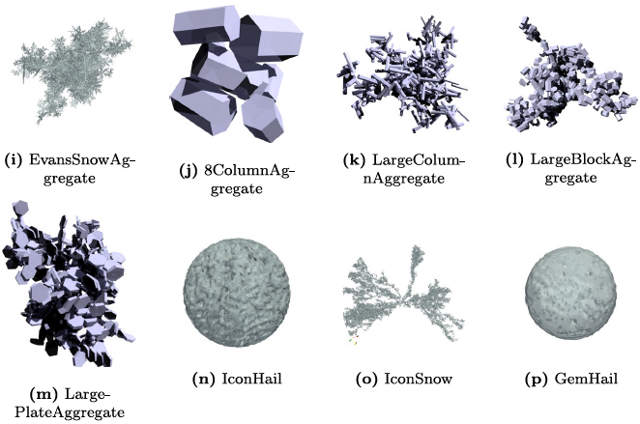
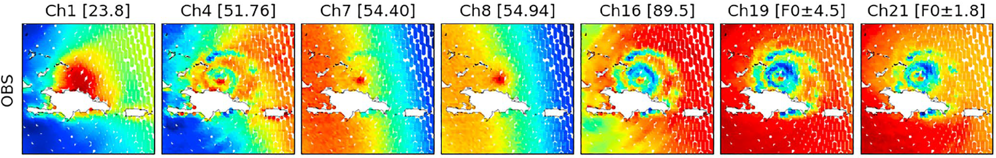
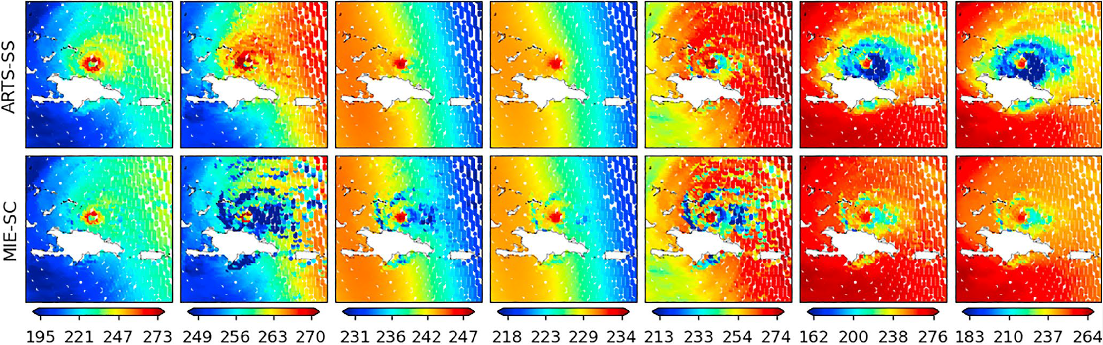
Cloud
CRTM Version | Cloud Schemes | Table Content/Highlight
All versions Binary | CRTM (Default) Liu and Lu, 2016 | Water, rain, snow, graupel, ice/hail Spherical assumptions all hydrometeors. Mie-Lorenz theory. Single-scattering properties and phase functions. Temperature (liquid only), effective radius, and frequency.
v2.4 – v3.1 NetCDF | PSU | Experimental tables with liquid and solid hydrometeors based on scheme (1) GFDLFV3 (2)Thompson08 (3) WSM6. Microwave bands only.
v2.4.1 – v3.1 | Moradi Moradi et al., 2022 | Non-spherical hydrometeors in the microwave bands. Discrete Dipole Approximation (DDA) technique. ARTS Single scattering database from Eriksson et al (2018) Introduces cloud water content as model input. Adds new parameter backscattering coefficients. Higher resolution for temperature, water content and frequency.
v3.2 (incoming) | TAMU Tong et al., 2023 | Non-spherical particle shape for graupel/snow over UV/VIS/IR/MW spectral ranges. Temperature-dependent ice refractive index for MW frequencies. Extended spectral range and particle size range. Polarized phase matrix.
Example of aggregates from the ARTS database included in the CRTM cloud lookup tables. [Moradi et al., 2022]
Figures: ATMS observed versus CRTM simulated Tbs for Hurricane Irma using IFS as input and different CRTM lookup tables. The first row in top panel shows ATMS observations and all other rows show simulations performed using CRTM with either ARTS or Mie lookup tables. [Moradi et al., 2022]
Notes:
Send an email to Yingtao
Issac’s cloud table? What are the differences between Yingtao’s table versus Issac’
Add experimental tables

Slide 14
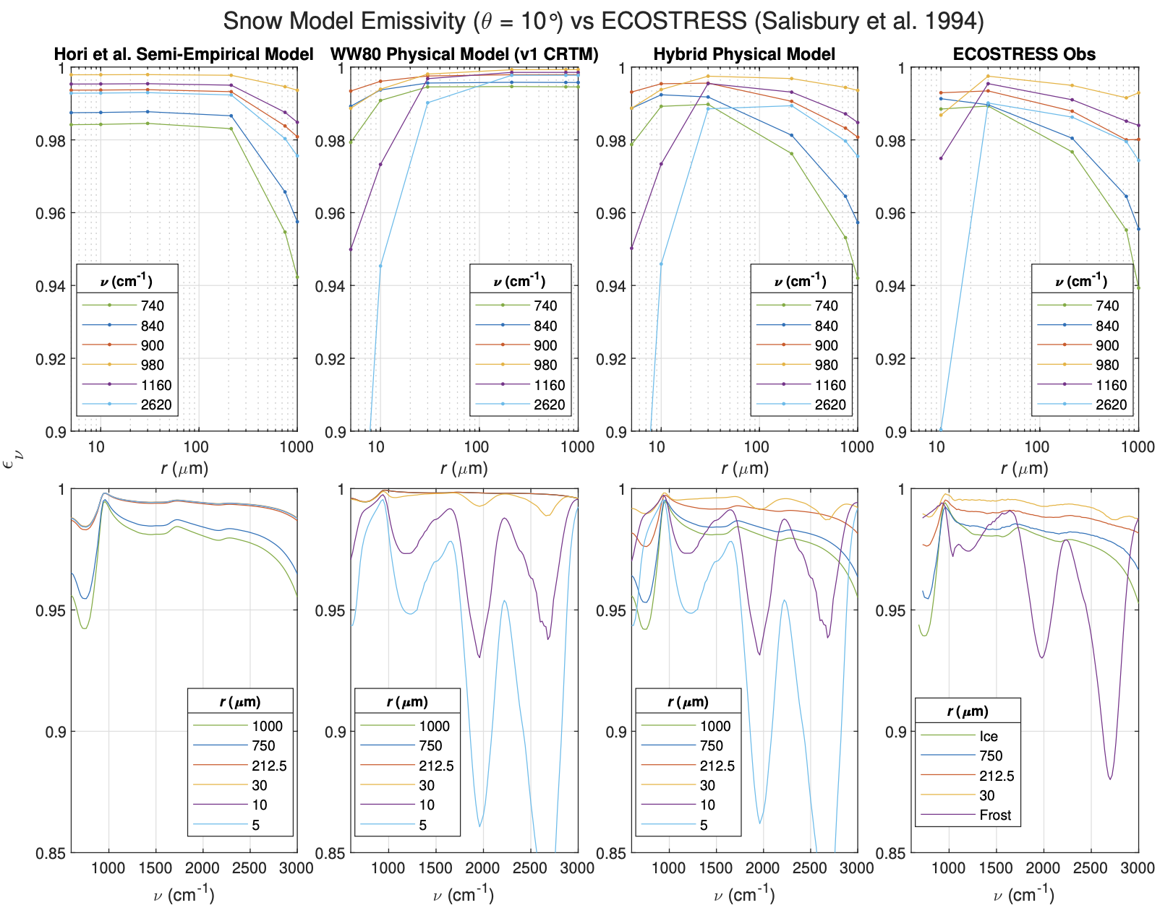
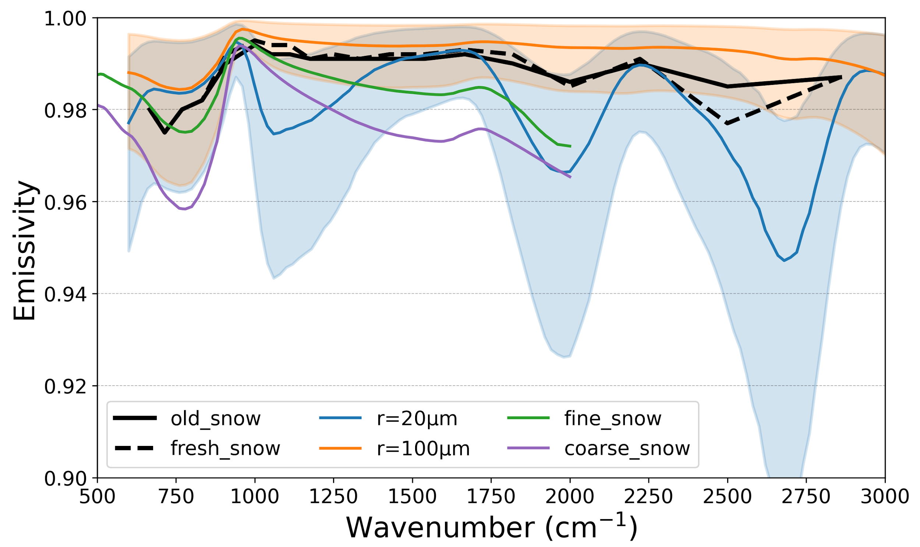
Surface
CRTM Version | Surface | Table Content/Highlight
All versions Binary | Water Land Ice Snow Liu and Lu, 2016 | Visible, IR, MW Land types Ice/Snow age Water
v2.4.1 – v3.1 NetCDF | TIR Water Nalli et al., 2023a | Infrared Sea Surface Effective-Emissivity (IRSSE) Model Temperature-dependent water optical constants modeling thermal IR “effective emissivity” in a manner that accounts for both surface emission and quasi-specular reflectance.
v2.4.1 – v3.1 | TIR Snow Nalli et al., 2023b | Physically based snow/ice emissivity model A hybrid of layer-scattering model and specular-facet model. Temperature-dependent ice optical constants Zenith-angle/snow grain size dependence.
      Figures: TIR snow/ice model spectral emissivity calculations versus ECOSTRESS laboratory measurements for an observer zenith angle of 10. [Nalli et al., 2023b]
      Figures: snow spectral emissivity:
      1. CRTM (old/fresh snow)
      2. Nalli ( r=20 and 100 microns)
      Orange and blue shades: zenith angle from 0 – 75 degrees
      3. U Michigan (fine/coarse snow)
Notes:
Check Nick’s paper!

Slide 15
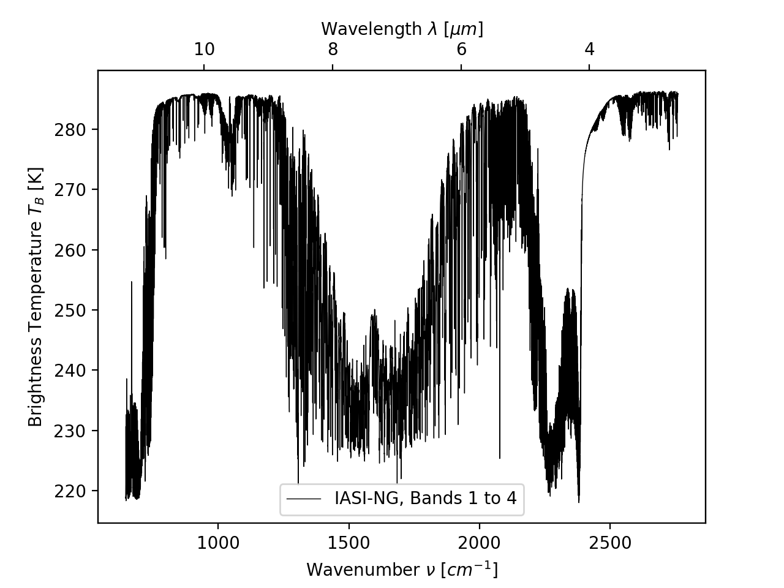
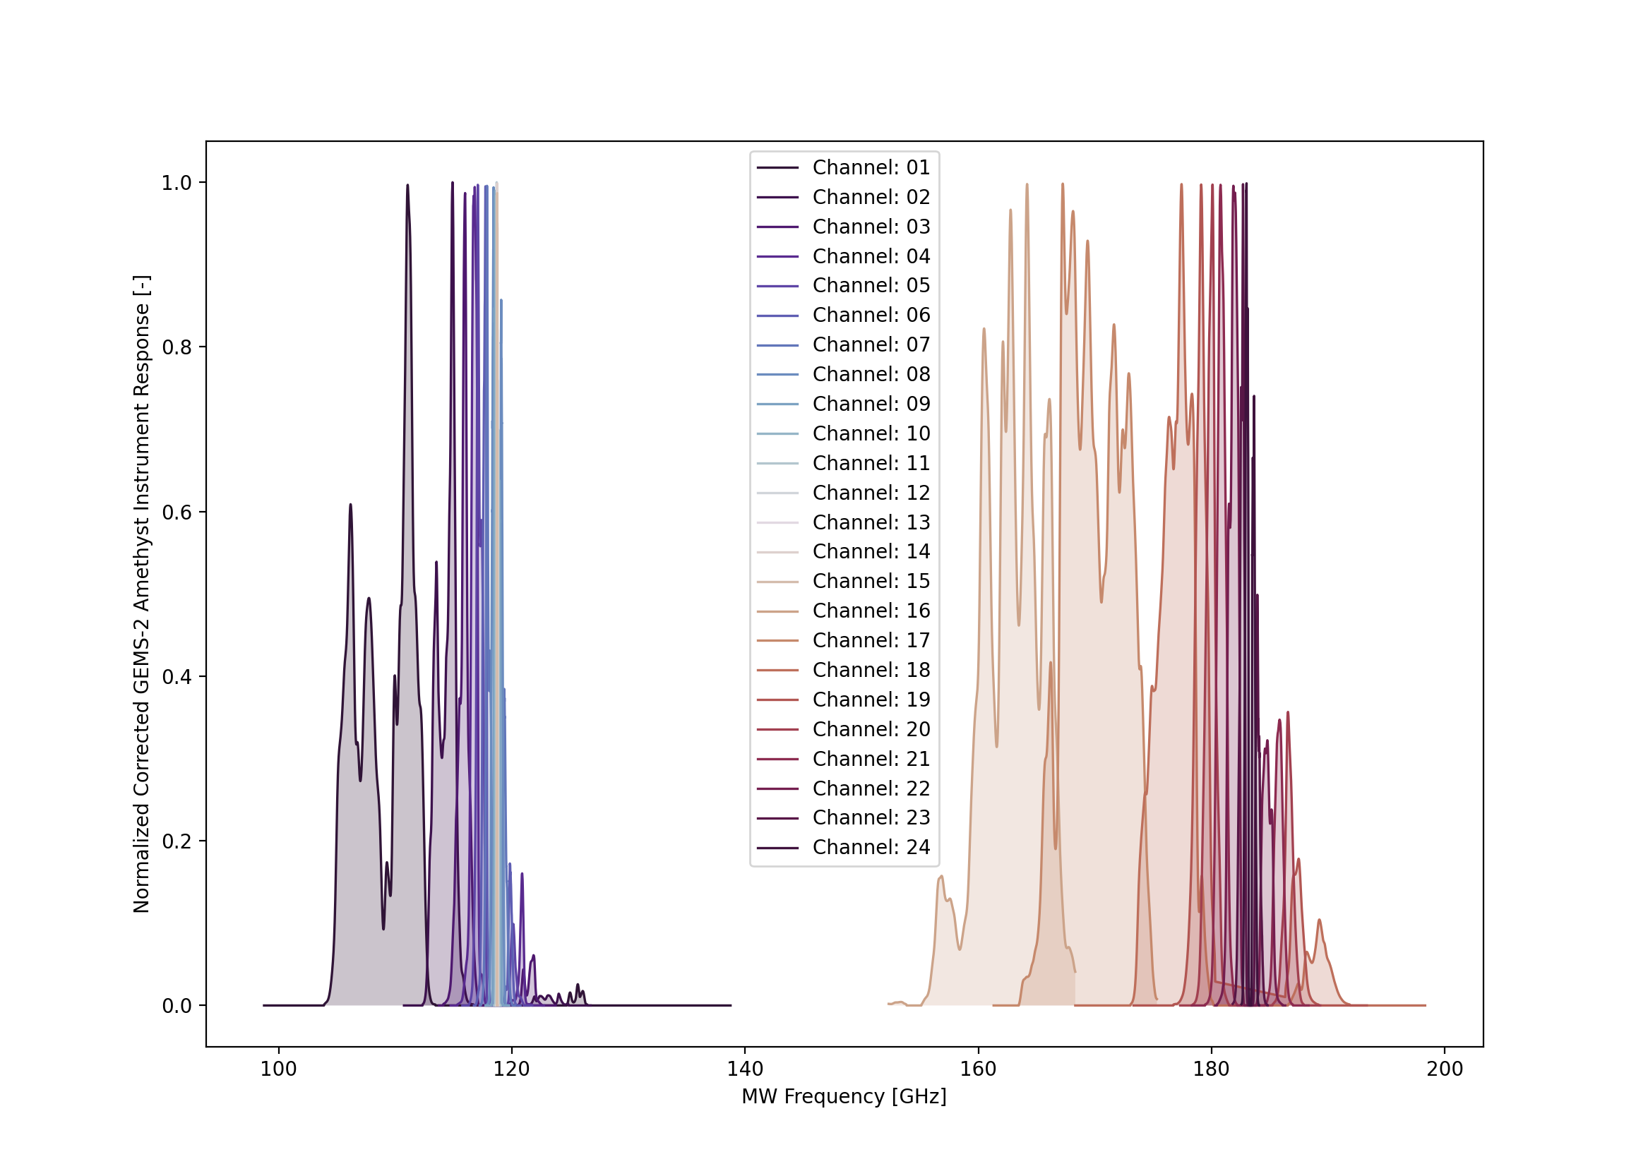
Instrument Coefficients
CRTM transmittance/spectral coefficient generation package: https://github.com/JCSDA-internal/CRTM_coef
(please email us for access to this internal repository)
Selected list of recently developed instrument coefficients
- TROPICS (the entire constellation)
- GEMS 1&2
- ATMS-NG (hyperspectral MW concept study)
- IASI-NG
- ATMS NOAA-21
- VIIRS NOAA-21
- PolSIR
- Tomorrow.io
Notes:
Check Nick’s paper!

Slide 16
Solvers
Polarized Radiative Transfer Solvers
Active sensor solvers.
Upgrades to adding-doubling method for upward/downward radiance at user-defined level such as Aircraft level.
ML based surrogate model for instrument coefficient generation, forward, and jacobian calculations
Notes:
Check Nick’s paper!

Slide 17
Model infrastructure and support
Cmake building systems
Unit tests
NetCDF interface
CRTM public GitHub repository
CRTM user guide (updated to v3.1)
Notes:
Check Nick’s paper!

Slide 18
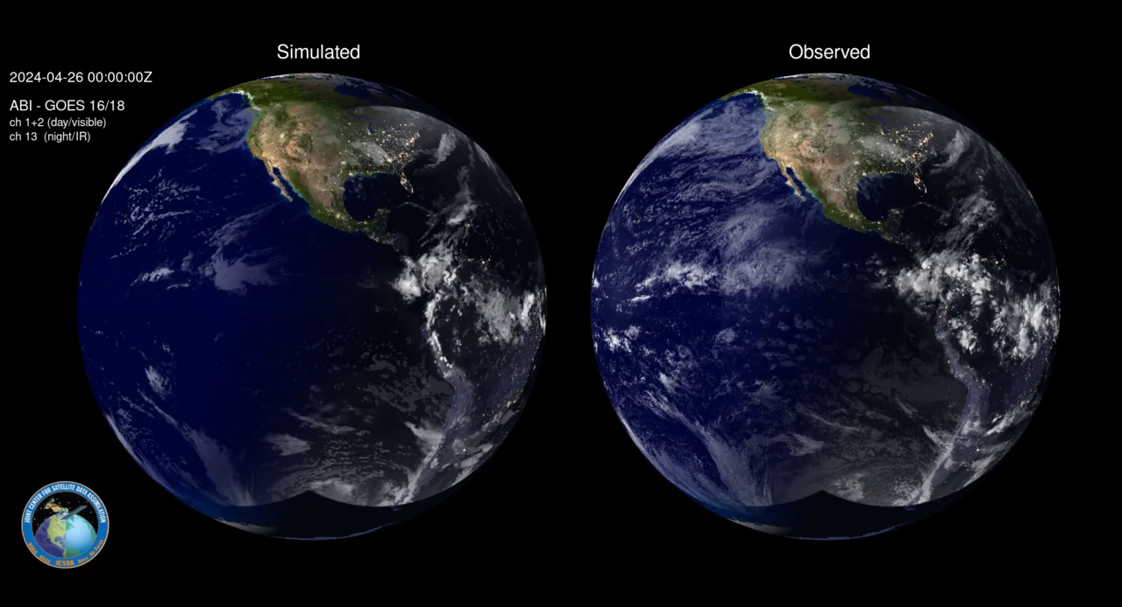
Animation of GOES 16/18 ABI & MRMS (Sluka/Thompson, CRTM/UFO)

Slide 19
CRTM-AI (Lucas Howard, CU / Greg Thompson, JCSDA)
3 hidden layers x 512 nodes per layer
  Some tuning to arrive at this architecture using earlier datasets
  ~1.1 million trainable parameters
Input:
  All CRTM profile, surface, and meta input variables
Output:
  Predicted CRTM ABI brightness temperature for channels 7-16
  Predicted error (NN-CRTM) standard deviation by channel
Cost function (to be minimized):
  Continuous rank probability score (CRPS), penalizes inaccuracy and imprecision

Slide 20
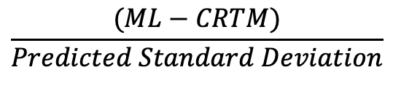
Errors Compared to CRTM Radiances
Trained on 30 days of 6-hour timestep GOES-ABI simulated observations
Predicts brightness temperature and uncertainty for channels 7-16 (near IR and IR)
Normalized error :
Normalized RMSE should be ~1
$$\frac{(ML−CRTM)}{Predicted Standard Deviation}$$

Slide 21
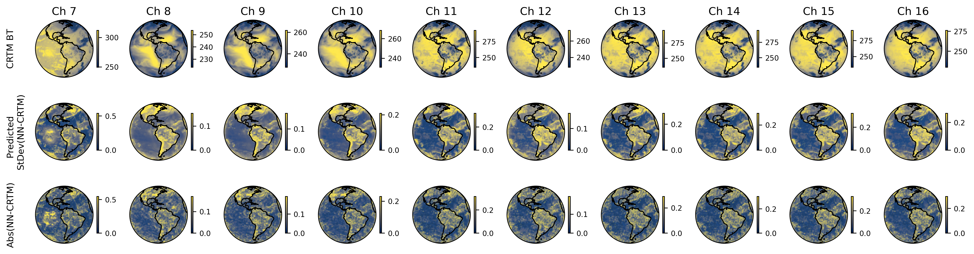
Single Scan Results
Norm

Slide 22
Water Vapor Impact on ML Results
mean(|SHAP|) gives you an average measure of how strongly a feature influences the model’s predictions across the dataset. It is commonly used to rank feature importance.
  Analogous to a Jacobian

Slide 23
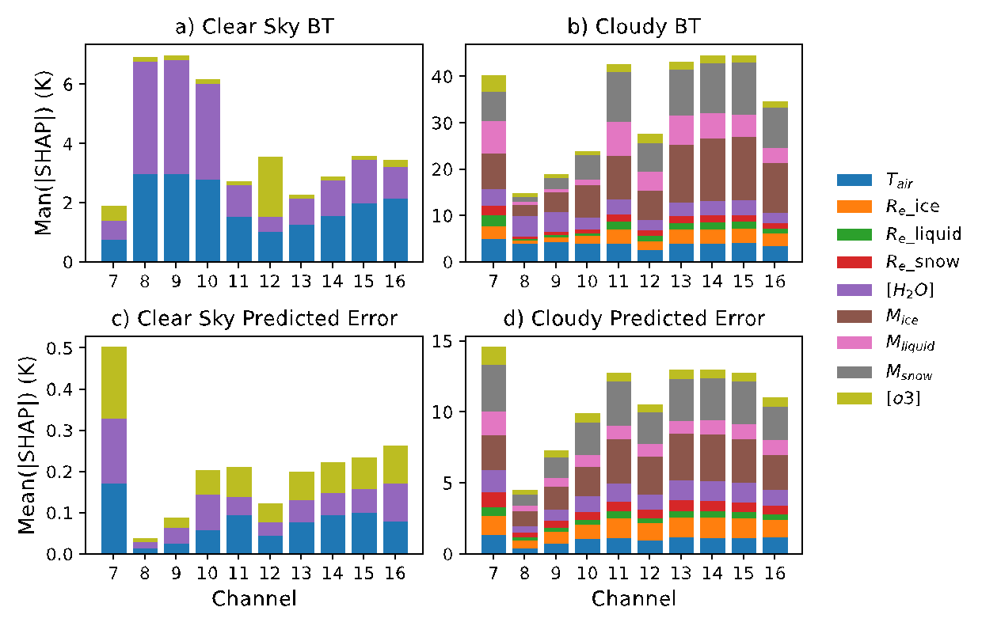
Impact of all atmospheric variables on all channels
Summed vertically and averaged over samples
CRTM AI training data and plots courtesy of Lucas Howard, CU-Boulder

Slide 24
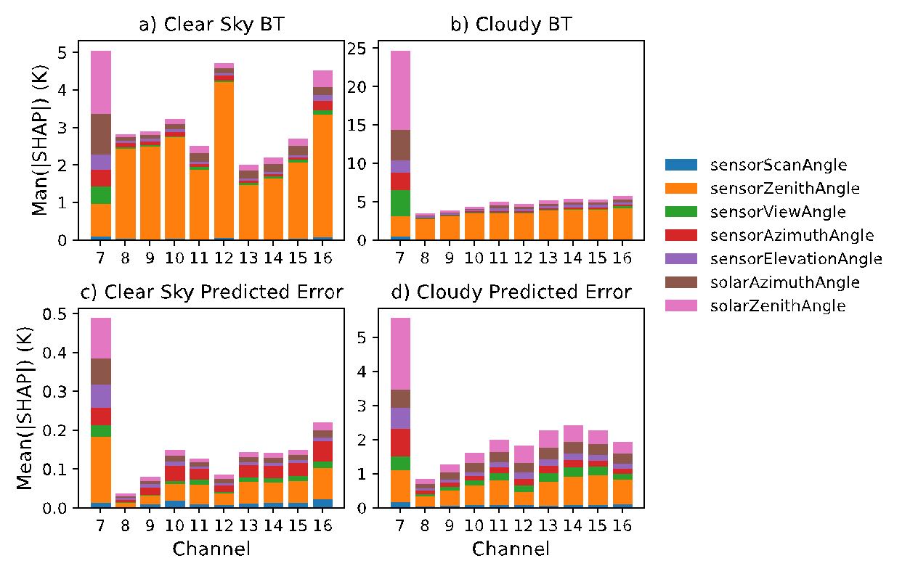
Impact of all meta variables on all channels
CRTM AI training data and plots courtesy of Lucas Howard, CU-Boulder

Slide 25
AOP24+ Future Tasks (Team)
General work plan for CRTM (1-5 years)
Standardize and improve the NetCDF interface for all coefficient LUTs (version #, release #, generic I/O modules
Aerosol: TAMU 2020, experimental table for Asian aerosols (for GEMS AOD DA)
Surface: UV/Visible/IR reflectance models for snow/ice. Improved IR/MW thermal emission models
Solver:
  add and test TOA reflectance in support of DA of solar sensors.
  Full polarization support for MW/IR, work with UFO support for pol. radiance simulation
Offline packages in support of CRTM development and tests.
Cloud / Aerosol coefficient generation package.
Exploratory: Genericization of surface and optical property interfaces, separation of concerns
Initial pivot toward AI front-end development for CRTM (CRTM v4.x). Coordinated effort with JCSDA partners, CU-Boulder.
Melting layer simulation improvements (Moradi / Johnson 2025+)
(Marine) boundary layer resolution improvements (NASA partners, TBD)
Ocean Color integration (OASIM? VLIDORT w/SOCA team)
And to maximize confusion: PCRTM integration in CRTM (STAR, Xu Liu/NASA)

Slide 26
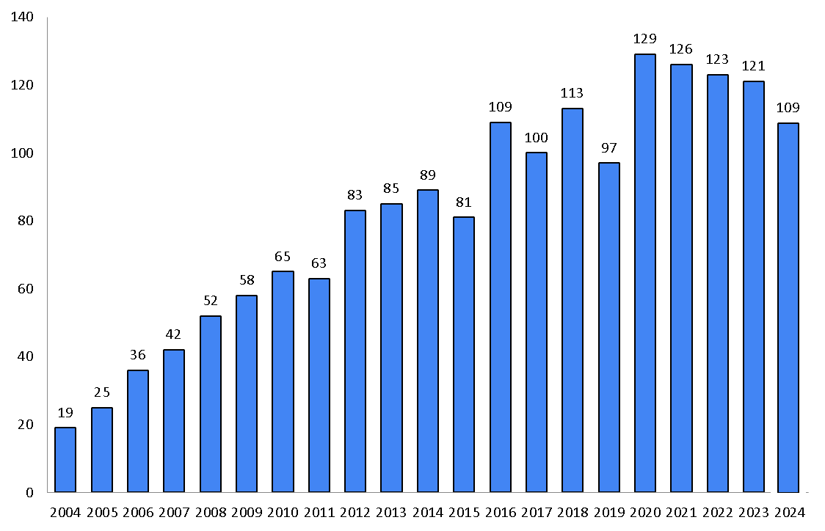
CRTM Publications
Unique citations of the CRTM model by year (citations from previous years take about 3 months to filter in)
Recent Publications
Johnson, Benjamin T., Cheng Dang, Patrick Stegmann, Quanhua Liu, Isaac Moradi, and Thomas Auligne. "The Community Radiative Transfer Model (CRTM): Community-focused collaborative model development accelerating research to operations." Bulletin of the American Meteorological Society 104, no. 10 (2023): E1817-E1830.
Moradi, I., Johnson, B., Stegmann, P., Holdaway, D., Heymsfield, G., Gelaro, R. and McCarty, W., 2023. Developing a Radar Signal Simulator for the Community Radiative Transfer Model. IEEE Transactions on Geoscience and Remote Sensing.
Nalli, N.R., Dang, C., Jung, J.A., Knuteson, R.O., Borbas, E.E., Johnson, B.T., Pryor, K. and Zhou, L., 2023. Physically Based Thermal Infrared Snow/Ice Surface Emissivity for Fast Radiative Transfer Models. Remote Sensing, 15(23), p.5509.
Liu, Q. and Liang, X., 2023. Physics constraint Deep Learning based radiative transfer model. Optics Express, 31(17), pp.28596-28610.
Jung, J., Nalli, N.R., Dang, C., Lim, A.H., Liu, E.H., Johnson, B. and Kalluri, S., Reduced Global Sea Surface Temperature Biases from Upgrades to the CRTM Infrared Sea Surface Emissivity Model.
Stegmann, P.G., Johnson, B., Moradi, I., Karpowicz, B. and McCarty, W., 2022. A deep learning approach to fast radiative transfer. Journal of Quantitative Spectroscopy and Radiative Transfer, 280, \
p.108088.

Slide 27


Support / Contact
Website: https://www.jcsda.org/jcsda-project-community-radiative-transfer-model
Support:
https://groups.google.com/forum/#!forum/crtm-support
Support email:
crtm-support@googlegroups.com
Email: Benjamin.T.Johnson@noaa.gov for direct support, questions, and comments

