Slide 1
Real-time depiction of stratospheric intrusions in RAQMS/WRF-Chem
R. Bradley Pierce
NOAA/NESDIS
Collaborators:
RAQMS (Todd Schaack and Allen Lenzen, UW-Madison/SSEC)
RR-Chem (Georg Grell and Steve Peckham, NOAA/ESRL),
AJAX measurements (Emma Yates and Laura Iraci, NASA Ames)
EPA SI Working Group (Gail Tonnesen, US EPA, and Patrick Reddy, CDPHE)
Modeling Air Quality from the Global to Local Scale May 11-15 2015 Boulder, Colorado

Slide 2
Retrospective
Real-time depiction of stratospheric intrusions in RAQMS/WRF-Chem
R. Bradley Pierce
NOAA/NESDIS
Collaborators:
RAQMS (Todd Schaack and Allen Lenzen, UW-Madison/SSEC)
RR-Chem (Georg Grell and Steve Peckham, NOAA/ESRL),
AJAX measurements (Emma Yates and Laura Iraci, NASA Ames)
EPA SI Working Group (Gail Tonnesen, US EPA, and Patrick Reddy, CDPHE)
Modeling Air Quality from the Global to Local Scale May 11-15 2015 Boulder, Colorado

Slide 3
Real-time depiction of stratospheric intrusions in RAQMS/WRF-Chem
R. Bradley Pierce
NOAA/NESDIS
Collaborators:
RAQMS (Todd Schaack and Allen Lenzen, UW-Madison/SSEC)
RR-Chem (Georg Grell and Steve Peckham, NOAA/ESRL),
AJAX measurements (Emma Yates and Laura Iraci, NASA Ames)
EPA SI Working Group (Gail Tonnesen, US EPA, and Patrick Reddy, CDPHE)
RR-Chem
Modeling Air Quality from the Global to Local Scale May 11-15 2015 Boulder, Colorado

Slide 4
Can coupled global/regional ozone predictions help inform Stratospheric Intrusion (SI) Exceptional Event monitoring?
Nested RAQMS¹/WRF-CHEM² Configurations
1x1 degree RAQMS global ozone analysis
Constrained with Microwave Limb Sounder (MLS) stratospheric ozone profiles and Ozone Monitoring Instrument (OMI) cloud cleared Total Column Ozone
12km WRF-CHEM v3.4.1
GOCART RACM-KPP mechanism
YSU PBL scheme (Yonsei University, Non-local-K scheme)
13km NOAA/ESRL RR-CHEM (North American Domain)
RADM2 chemical mechanism/MADE Aerosol parameterization
YSU PBL scheme (Yonsei University, Non-local-K scheme)
¹Realtime Air Quality Modeling System (RAQMS, http://raqms.ssec.wisc.edu/)
²Weather Research and Forecasting (WRF) model with chemistry (WRF-CHEM, http://ruc.noaa.gov/wrf/WG11/)

Slide 5
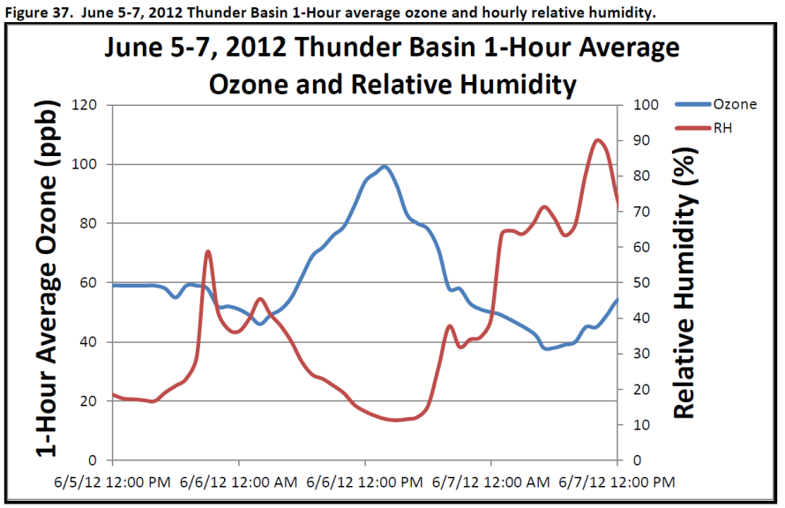
Background
The Clean Air Act requires that states and tribes attain the National Ambient Air Quality Standard (NAAQS) for ozone¹.
If the NAAQS is violated, EPA may designate areas nonattainment for the ozone standard, necessitating the development of plans for improvement in air quality.
Ozone caused by exceptional events can be excluded from determinations of nonattainment with appropriate documentation.
¹Currently defined as a 3-year average of the 4th highest daily 8-hour average ozone greater than 75 ppb.
“The Wyoming Department of Environmental Quality/Air Quality Division (WDEQ/AQD) has determined that a stratospheric intrusion created elevated ozone readings resulting in an 8-hour ozone standard exceedance at the Thunder Basin, Wyoming ozone monitor located in northeastern Wyoming on June 6, 2012” (Executive Summary)

Slide 6
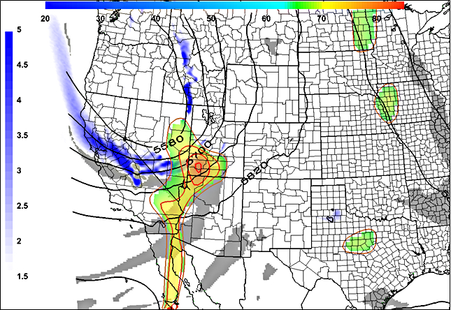
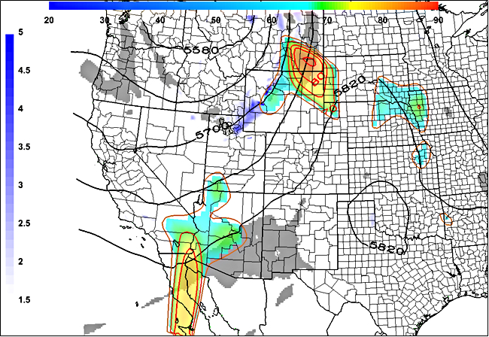
Synoptic conditions prior to Thunder Basin, WY ozone exceedance
June 5, 2012 NAM-12 analysis, 11 am MST
June 6, 2012 NAM-12 analysis, 11am MST
Thunder Basin, WY
Thunder Basin, WY
High Isentropic Potential Vorticity (IPV) and low relative humidity (RH) at base of large amplitude trough over CA/NV on June 5 is associated with high surface ozone over SW Utah on June 5 and NE WY on June 6, 2012
Legend:
500 mb heights in meters (contours)
600 mb IPV >= 1.5 PVUs (blue)
600 mb RH <= 10% (grey)
EPA AQS Daily Max 8-hour O3 in ppb >= 65 ppb (rainbow contours and shading)
Figures courtesy Patrick Reddy (Colorado Department of Public Health and Environment)

Slide 7
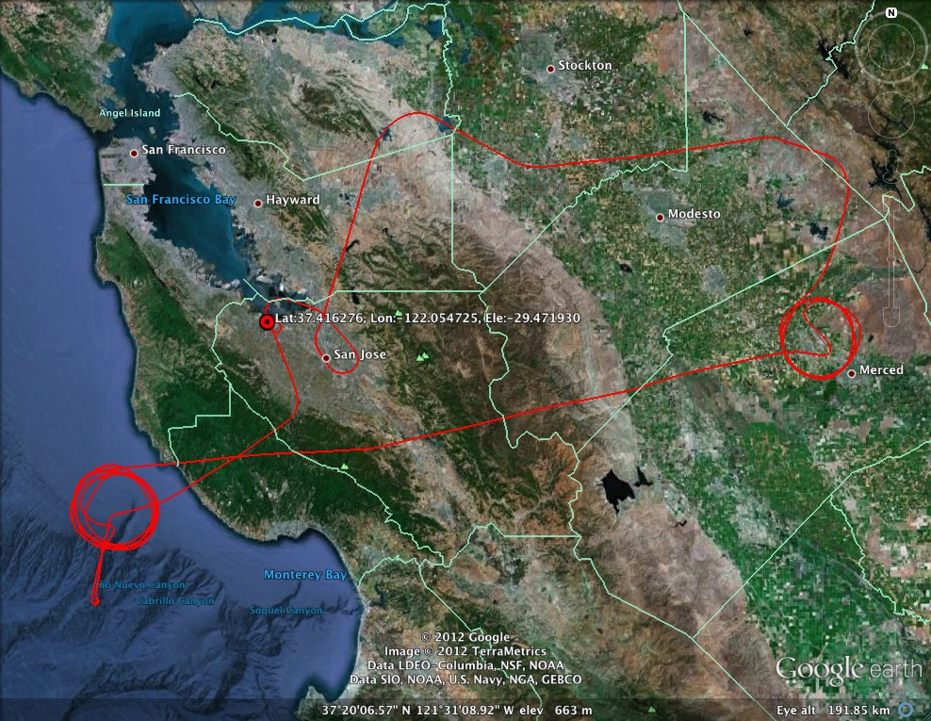
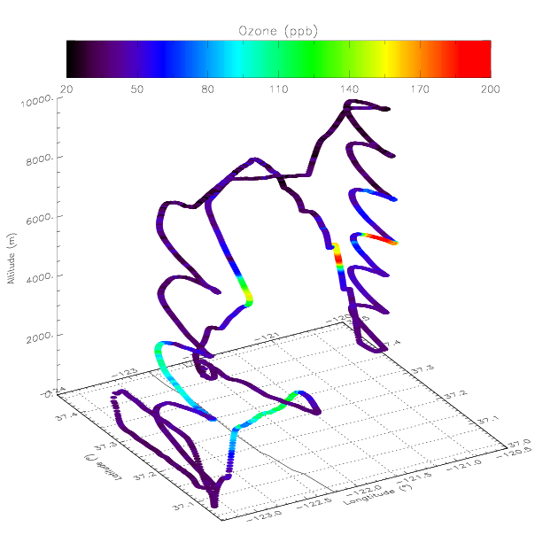
Alpha Jet Atmospheric eXperiment (AJAX) (Emma Yates and Laura Iraci, NASA Ames)
Description:
Based at and operated from Moffett Field, CA
Flight duration:
Approximately 2.5 hrs
Measurements:
O3, CH4, CO2, water vapor
O₃ Mission San Joaquin Valley/Off Shore
5 June 2012
Filament of high (>190ppbv) O3 sampled during onshore profile
https://espo.nasa.gov/missions/ajax/content/AJAX

Slide 8
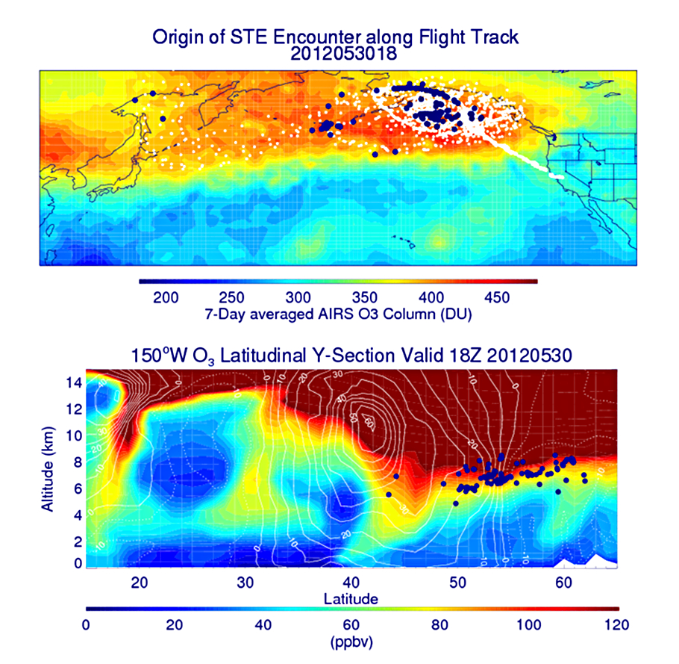
Origin of the tropospheric fold and subsequent Stratospheric Intrusion (SI)
Backward trajectories (white) beginning
at the AJAX Flight 47 path, and ending on May 30, 2012 (blue)
RAQMS ozone analysis at 150º W at 18Z on May 30, 2012 combined with the location of the SI trajectories on May 30, 2012 (blue)
Back-trajectory analysis shows that the origin of the SI event was within a region of high total column ozone over the Gulf of Alaska

Slide 9
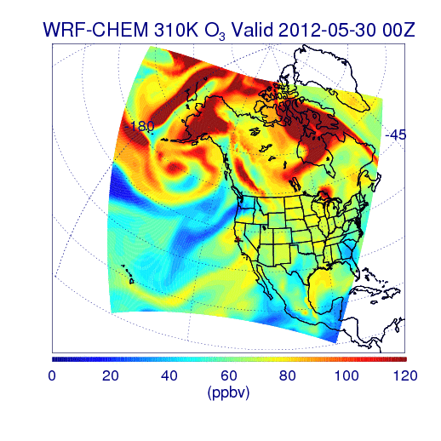
310K O3 from RAQMS/WRF-CHEM Simulation
00Z 05/30 – 00Z 06/07, 2012
Stratosphere/tropospheric exchange processes within a quasi-stationary low pressure system over the Gulf of Alaska played a critical role in the SI event

Slide 10
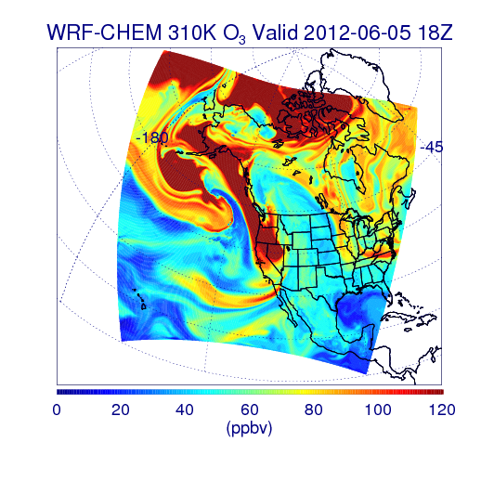
310K O3 from RAQMS/WRF-CHEM Simulation
Southeasterly transport of stratospheric air along the 310K isentropic surface leads to the SI event sampled by the AJAX flight over CA on June 5, 2012

Slide 11
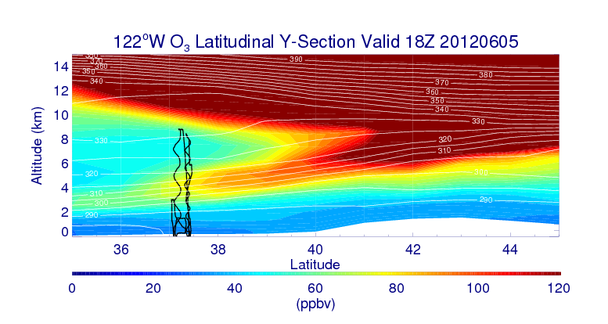
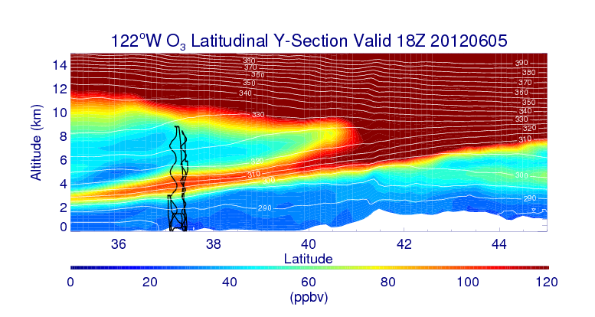
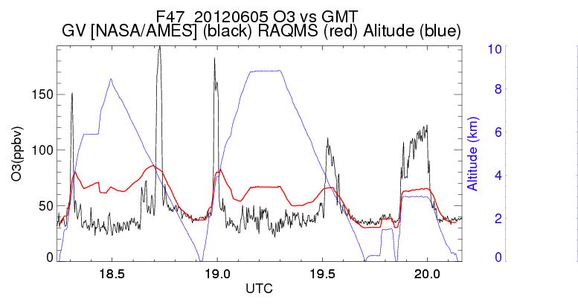
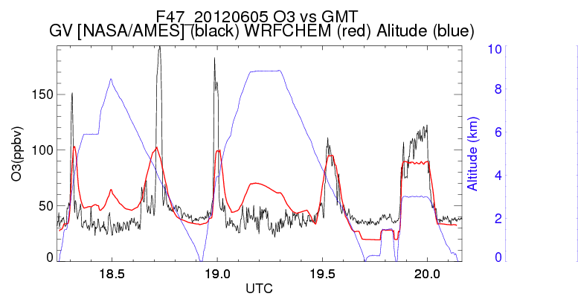
NASA AJAX Flight 47, June 5, 2012
RAQMS
Nested RAQMS/WRFCHEM
310K isentrope
RAQMS (red)
AJAX (black)
WRFCHEM (red)
AJAX (black)
(A)
(B)
(A)
(B)
Nested RAQMS/WRFCHEM simulations significantly improve the agreement with AJAX measurements during the off-shore spiral (B) but still underestimate ozone within the narrow filament sampled during the spiral over the San Joaquin Valley, CA (A)

Slide 12
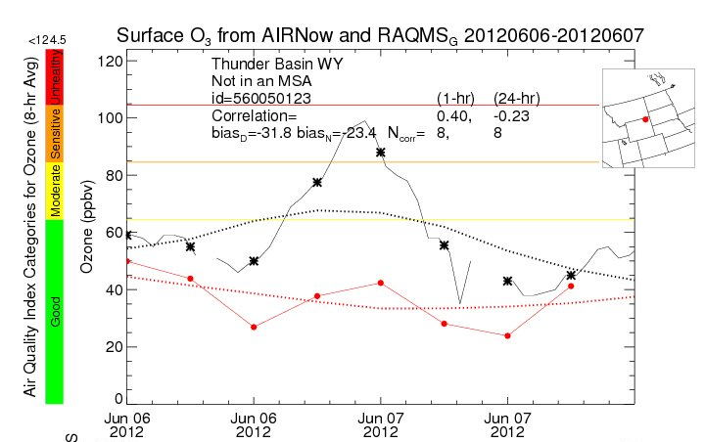
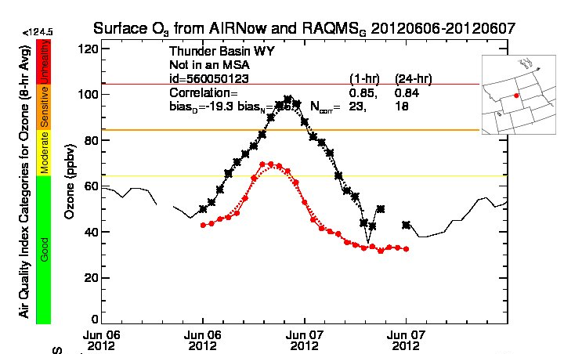
June 6-7, 2012 Surface ozone comparison: Thunder Basin, WY
RAQMS
Nested RAQMS/WRFCHEM
Surface O3 from AIRNow and RAQMS
Surface O3 from AIRNow and Nested RAQMS/WRF-CHEM
RAQMS (red)
AIRNow (black)
WRFCHEM (red)
AIRNow (black)
Improved estimates of ozone within the SI event lead to significant improvements (19.3 vs 31.8ppbv daytime bias) in predictions of ozone at the Thunder Basin, WY surface site in the nested RAQMS/WRF-CHEM simulation.
However, peak ozone mixing ratios are still underestimated by nearly 30ppbv

Slide 13
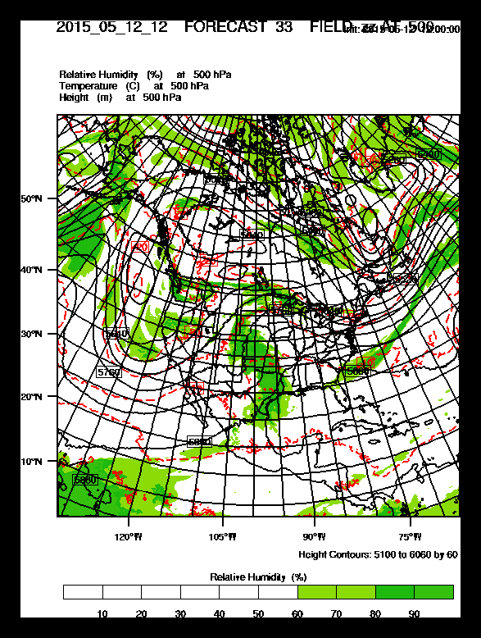
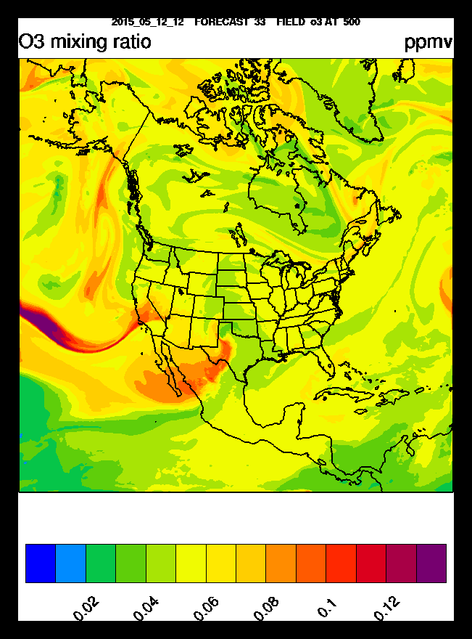
Real-time Nested RAQMS/Rapid Refresh with Chemistry
(RR-Chem) predictions
The RR-Chem model is a research version of the NOAA Rapid Refresh configuration of the Weather Research and Forecasting model with chemistry (WRF-Chem) run in real-time at NOAA/ESRL using GFS meteorological and RAQMS chemical boundary conditions.
RR-Chem 33hr 500mb Met/O3 forecast valid at 21Z May 13, 2015 (3:00pm Mountain) initialized at 12Z May 12, 2015
RR-Chem is configured and run by Georg Grell and Steven Peckham at NOAA/ESRL.
(http://ruc.noaa.gov/wrf/WG11_RT/)

Slide 14
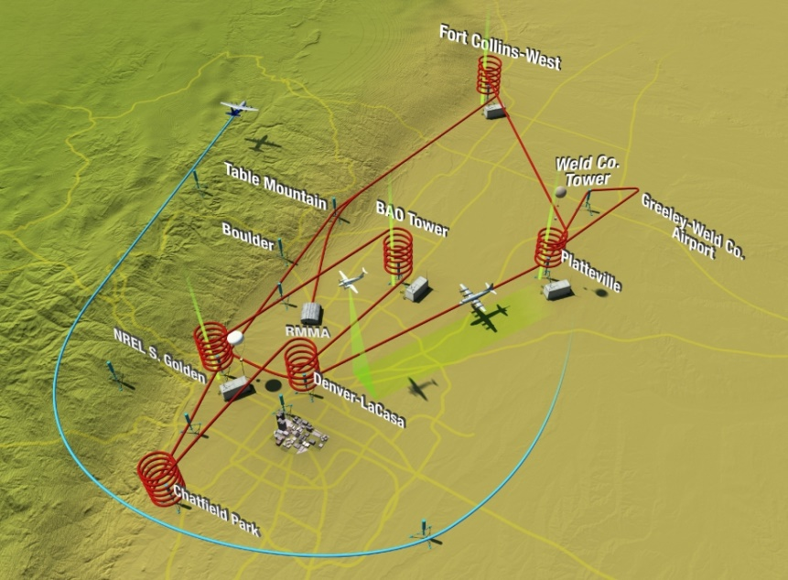
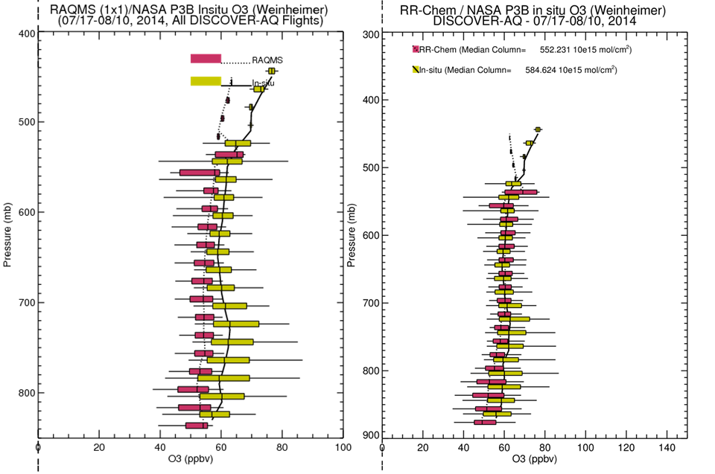
Verification of RAQMS/RR-Chem
Real-time forecasts during the 2014 FRAPPE/DISCOVER-AQ mission
Nested RAQMS/RR-Chem forecasts show reduced biases and improved variability compared to airborne insitu measurements between 700-500mb.
However, biases are similar (15-20 ppbv) below 700mb and neither model captures the upper 90% of the observed ozone
Reduced bias

Slide 15
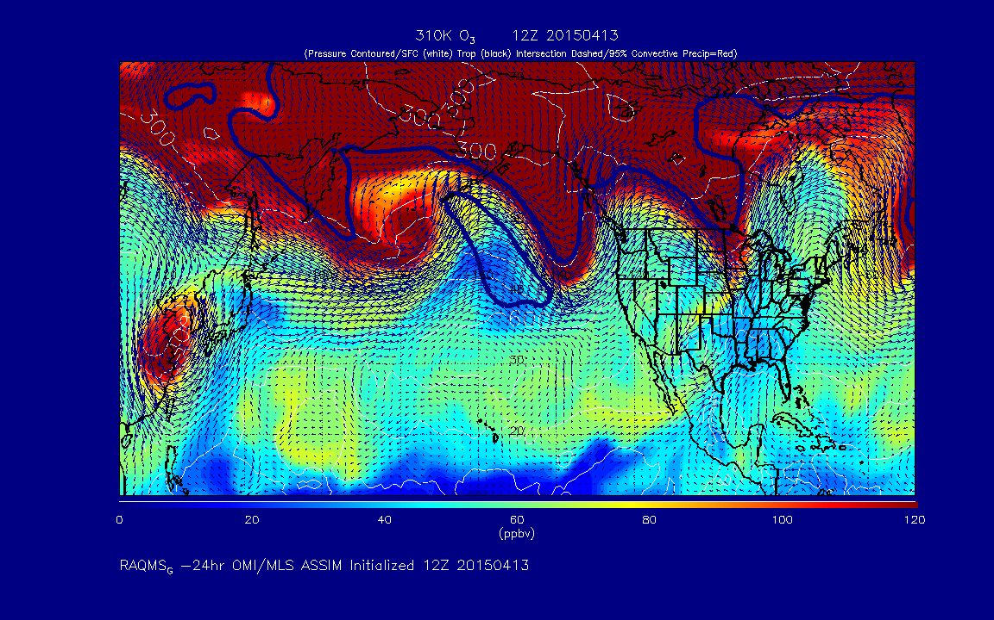
Real-time RAQMS/RR-Chem SI Forecasting Case Study
310K O3 from RAQMS Forecast 12Z 04/13 – 12Z 04/18, 2015
http://raqms-ops.ssec.wisc.edu/

Slide 16
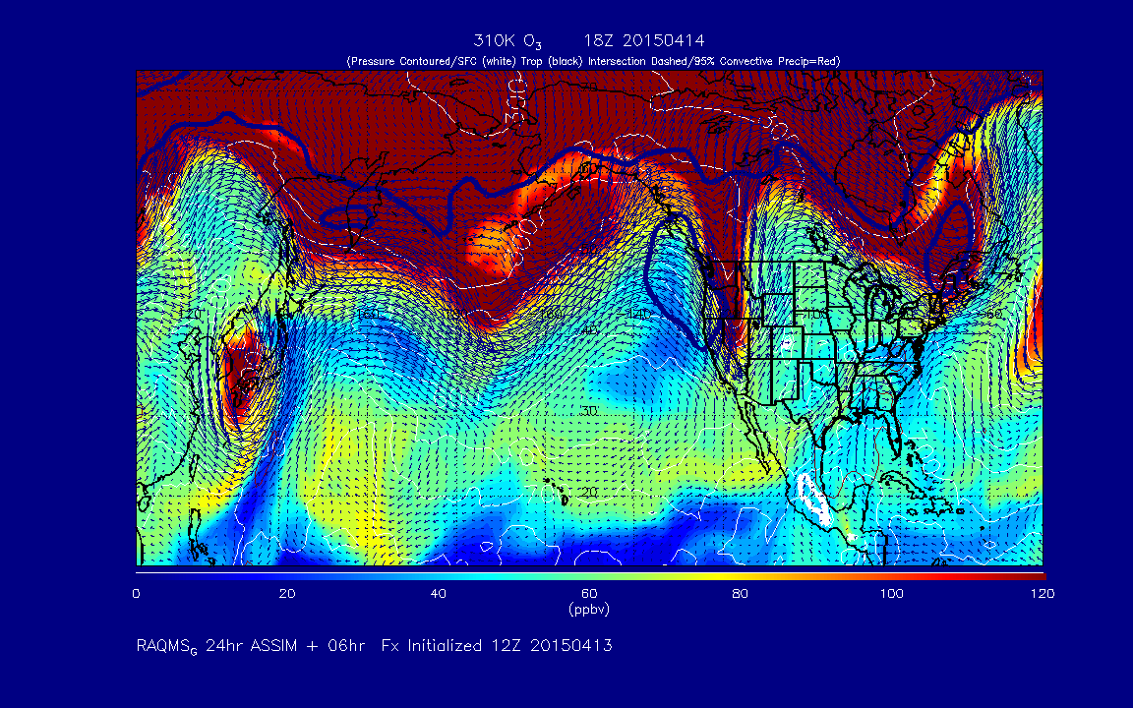
Real-time RAQMS/RR-Chem SI Forecasting Case Study
310K O3 from RAQMS Forecast @ 18Z 04/14, 2015
http://raqms-ops.ssec.wisc.edu/

Slide 17
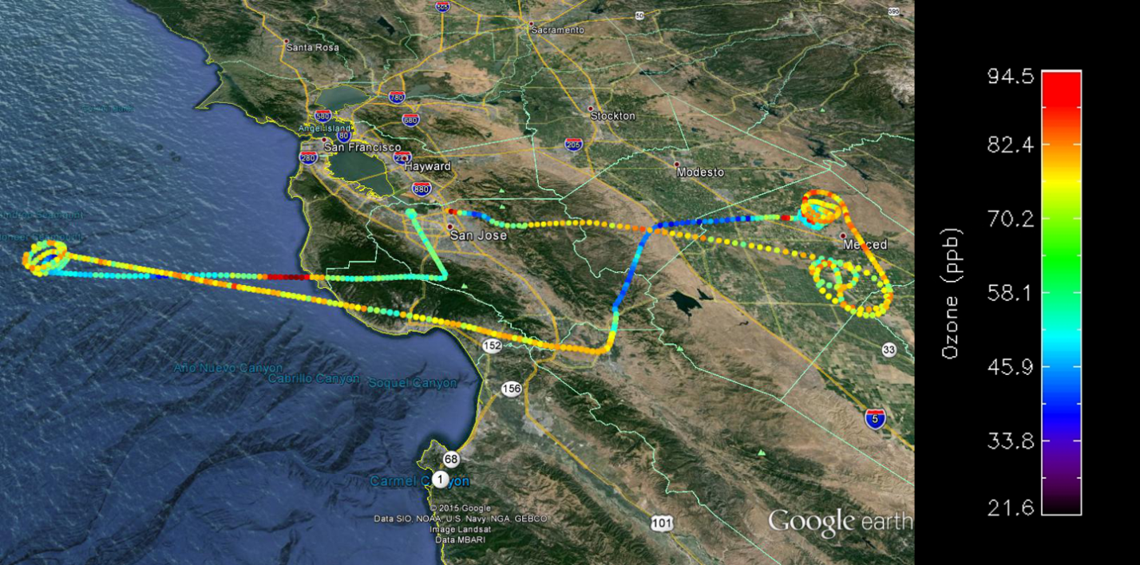
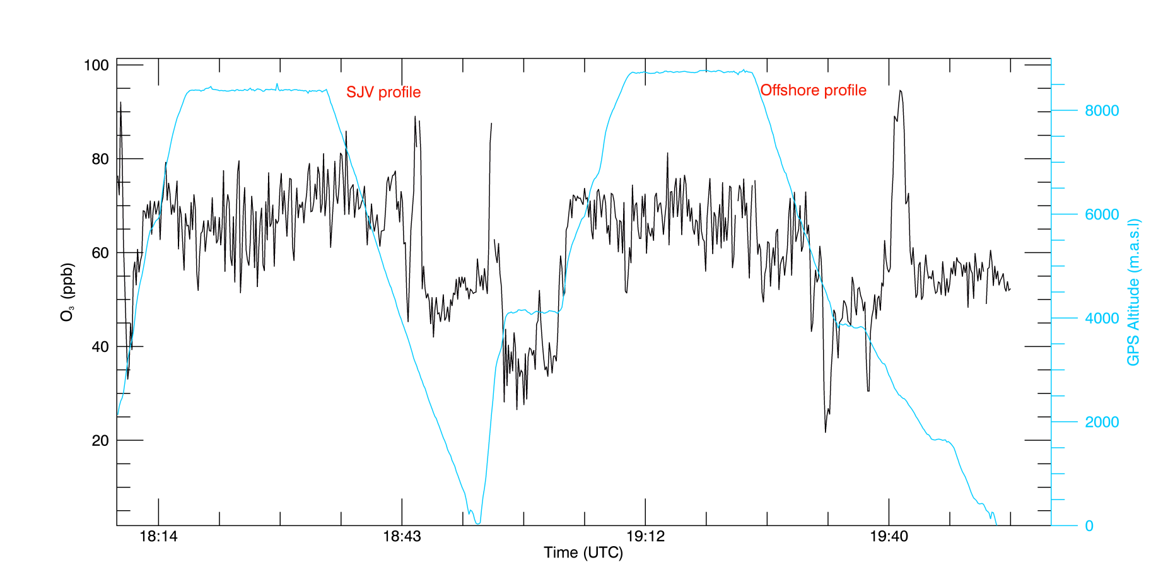
Alpha Jet Atmospheric eXperiment (AJAX) (Emma Yates and Laura Iraci, NASA Ames)
April 14, 2015
AJAX flight 155 observes a narrow O3 lamina near 3km to the SW of San Francisco, CA at 19:40Z on April 14, 2015
https://espo.nasa.gov/missions/ajax/content/AJAX

Slide 18
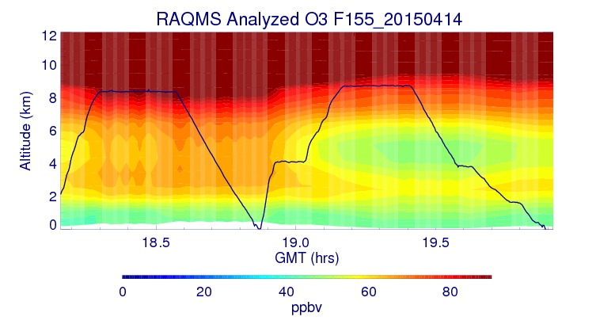
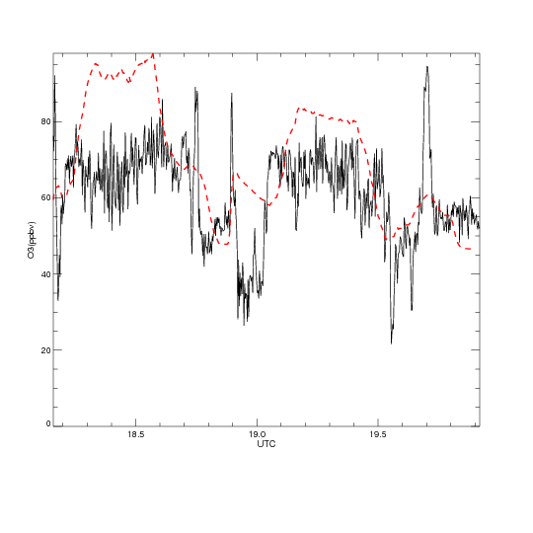
35ppbv bias
RAQMS O3 analysis captures location of narrow O3 lamina but significantly underestimates the amplitude of the SI event.

Slide 19
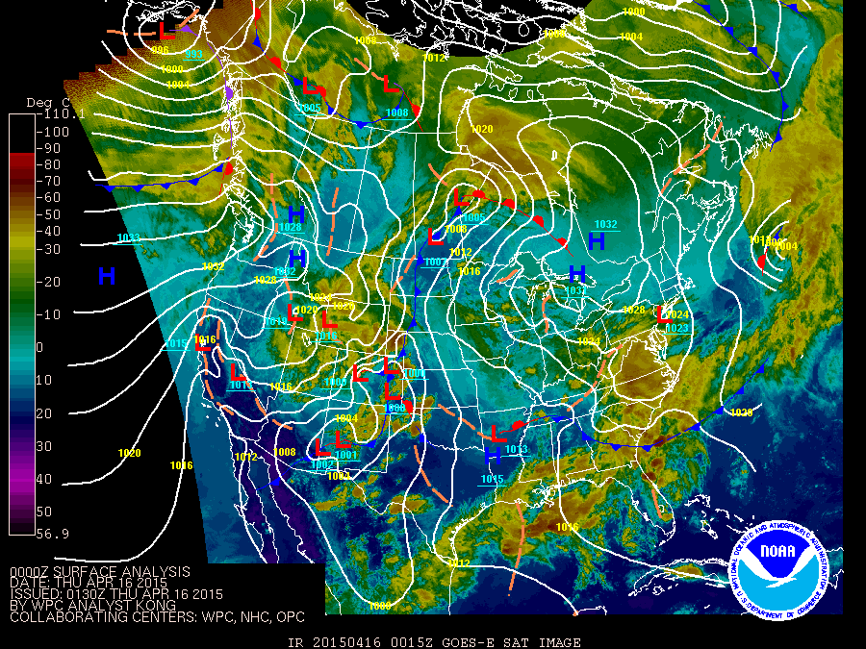
Low pressure system North of Four Corners Region at 00Z on 04/16, 2015

Slide 20
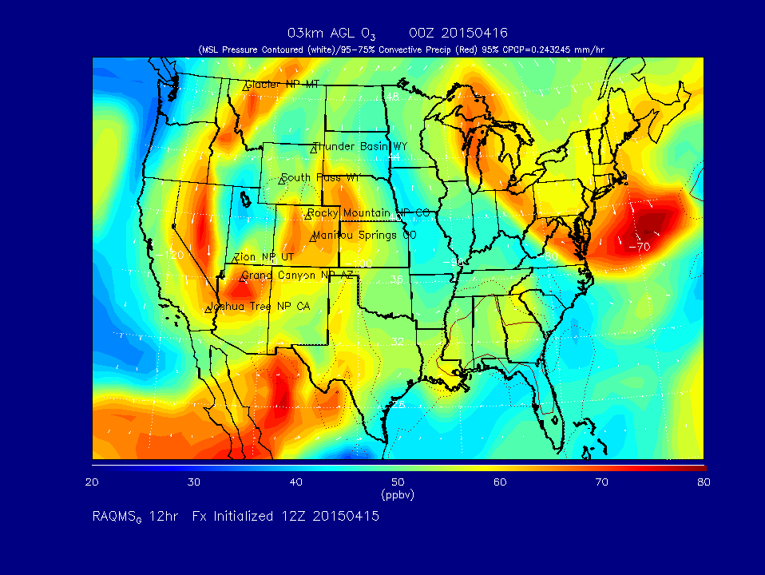
RAQMS predicts high O3 wrapping around Low pressure system at 3km AGL at 00Z on 04/16, 2015

Slide 21
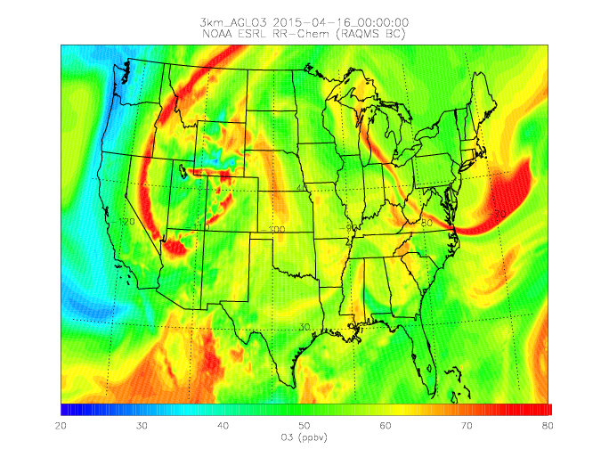
Manitou Springs
Nested RAQMS/RR-CHEM shows much sharper band of high O3 wrapping around Low pressure system at 3km AGL at 00Z on 04/16, 2015 – also strong signatures of precipitation scavenging

Slide 22
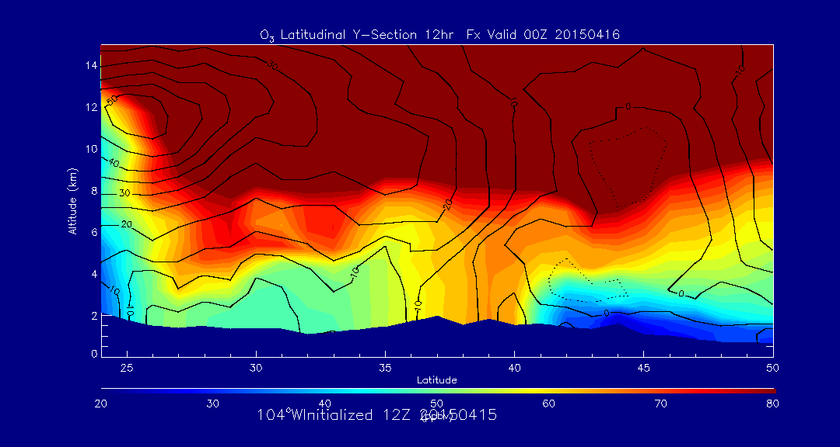
RAQMS predicts significant (65-70ppbv) O3 extending to surface over Manitou Springs, CO at 00Z on 04/16, 2015
Manitou Springs

Slide 23
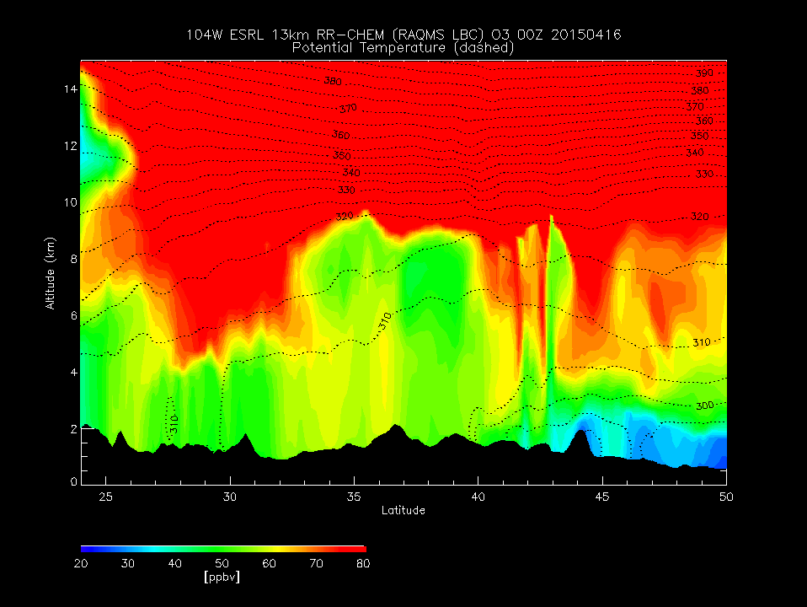
Nested RAQMS/RR-CHEM predicts no O3 enhancement extending to surface over Manitou Springs, CO at 00Z on 04/16, 2015
Manitou Springs

Slide 24
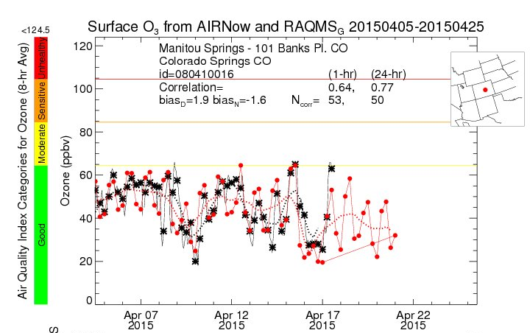
RAQMS accurately predicts maximum surface ozone concentration of 65ppbv at Manitou Springs, CO 04/16, 2015

Slide 25
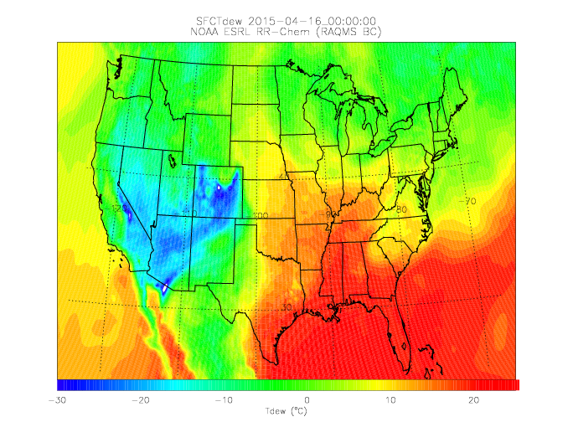
Manitou Springs
Nested RAQMS/RR-CHEM predicts significant (Tdew=-30ºC) dry air extending to surface over Manitou Springs CO at 00Z on 04/16, 2015

Slide 26
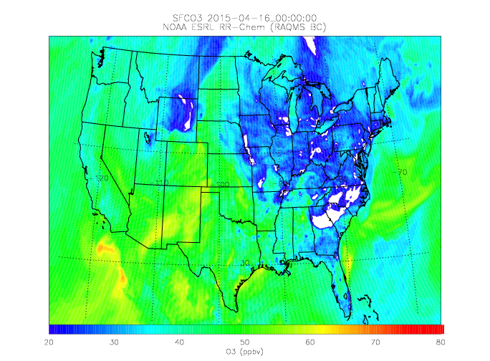
Manitou Springs
Nested RAQMS/RR-CHEM predicts <60ppbv surface ozone at Manitou Springs CO at 00Z on 04/16, 2015

Slide 27
Conclusions
Case studies using retrospective and real-time nested global and regional models show mixed results regarding the advantages of high resolution regional modeling of specific stratospheric intrusion events:
Retrospective nested RAQMS/WRF-CHEM forecasts show that high resolution regional model predictions are needed to accurately capture the high ozone mixing ratios associated with a stratospheric intrusion observed off-shore of California by the NASA AJAX aircraft on June 5, 2012.
The retrospective nested forecasts show significant improvement relative to the coarser global prediction in the prediction of surface ozone exceedances associated with this stratospheric intrusion at Thunder Bay, WY on June 6, 2012.
On the other hand, real-time nested RAQMS/RR-CHEM forecasts of a stratospheric intrusion observed by the NASA AJAX aircraft on April 14, 2015 that led to moderate enhancements in surface ozone over Manitou Springs, CO on April 16, 2015 demonstrate that errors on regional scale representation of precipitation processes can lead to degradation of the predictions of the impacts of stratospheric intrusions on surface ozone.

Slide 28
EPA Work Group for Analysis of Ozone Stratospheric Intrusion Events
(Lead, Gail Tonnesen, EPA Region 8)
Goals of the Ozone SI Workgroup
Develop standardized technical methods for analysis of SI
Promote collaboration and data sharing between the states, academics and federal researchers
Develop analyses of selected events
Promote archiving of key data sets
Participants include state agencies, EPA, NOAA, NCAR and NASA researchers.

