Slide 1
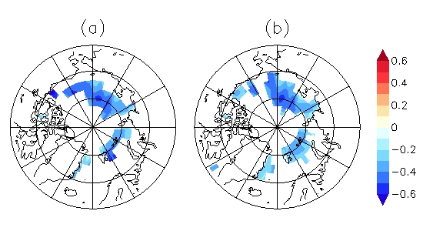
Advances in Real-time Assimilation of Satellite Trace Gas and Aerosol Retrievals for Air Quality Forecasting R. Bradley Pierce NOAA/NESDIS/STAR
Virtual Institute for Satellite Integration Training (VISIT)
Satellite Chat
Wed 16 April 2014
1530&1930 UTC
08Z 4/17 2010
11 μm AOD

Slide 2
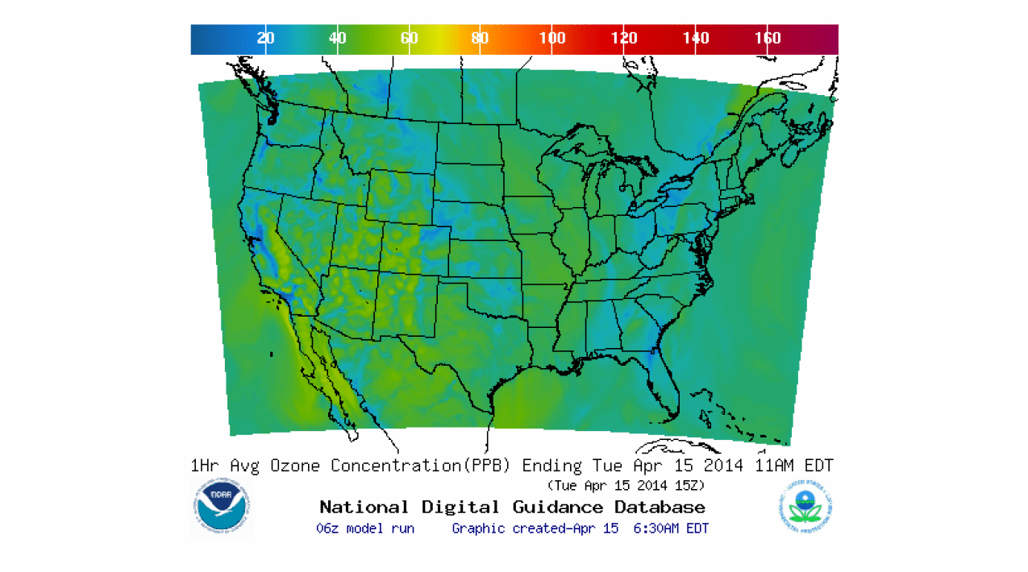
Background
NWS National Air Quality Forecasting Capability (NAQFC) provides operational predictions of ozone and wildfire smoke nationwide and operational predictions of airborne dust over the contiguous 48 states.
http://airquality.weather.gov/

Slide 3
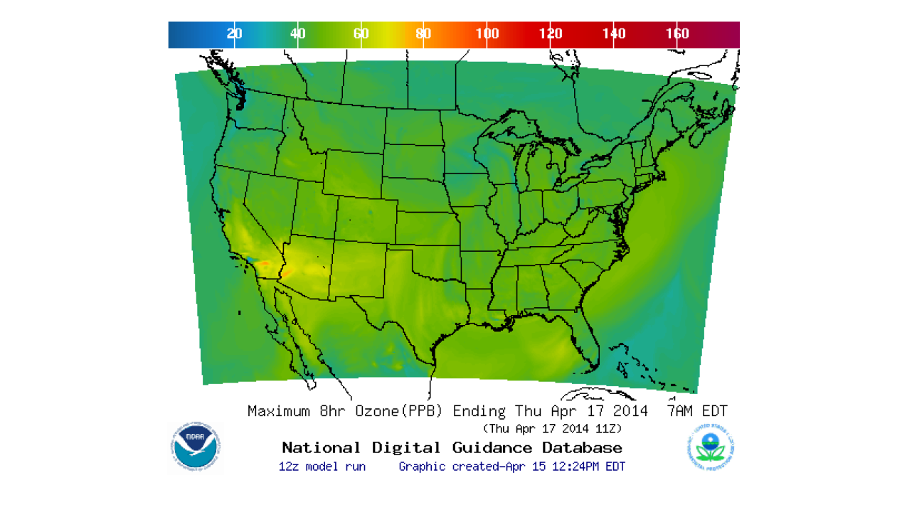
Background
State and local Air Quality forecasters use the NWS forecast guidance to determine whether the surface ozone will exceed the National Ambient Air Quality Standards (NAAQS) of maximum 8hr average ozone > 75ppbv.
http://airquality.weather.gov/

Slide 4
Focus of this presentation
Impacts of intercontinental pollution transport and stratosphere/tropospheric exchange processes on regional scale air quality predictions
Advances in real-time trace gas and aerosol assimilation within the Real-time Air Quality Modeling System (RAQMS)
Collaborative NESDIS/NWS/ESRL real-time nested global/regional air quality forecasting

Slide 5
Online global chemical and aerosol assimilation/forecasting system
Real-time assimilation:
Microwave Limb Sounder (MLS) stratospheric ozone profiles (above 50mb)
Ozone Monitoring Instrument (OMI) total ozone column (cloud cleared)
Moderate Resolution Imaging Spectroradiometer (MODIS) Aerosol Optical Depth (AOD)
Real-time fire detection:
Moderate Resolution Imaging Spectroradiometer (MODIS)
RAQMS has been used to develop capabilities to assimilate global satellite composition measurements and support airborne field missions
http://raqms-ops.ssec.wisc.edu/

Slide 6
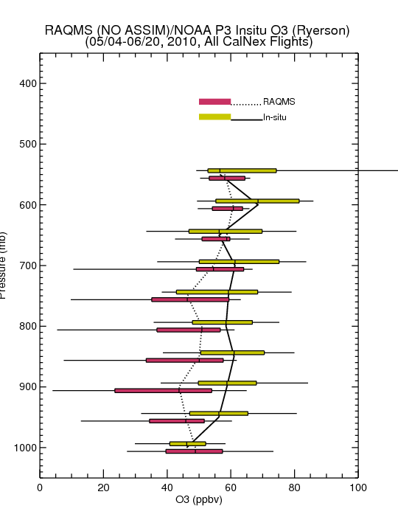
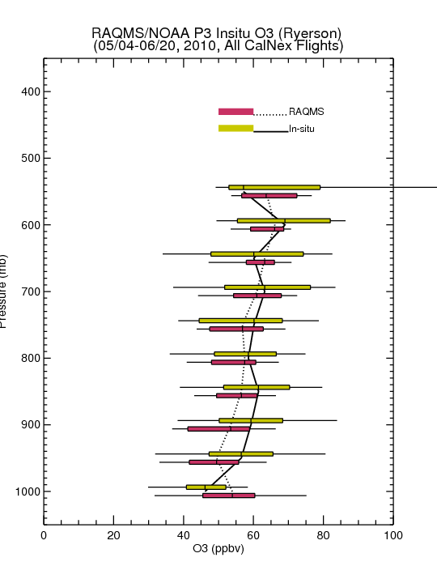
Comparison with NOAA P3 Insitu O3 Measurements
(CalNex primarily LA Basin/Central Valley)
No Assim
MLS+OMI Assim
NOAA P3 Flight Tracks
Assimilation of MLS+OMI O3 retrievals results in increased lower-tropospheric O3 (and improved agreement with airborne insitu O3) over Southern California
Insitu O3 from Tom Ryerson, NOAA ESRL

Slide 7
Evaluation of Real-time AQ Model Forecasts during CalNex
Lead by Stu McKeen (NOAA/ESRL)
From Stu McKeen (NOAA/ESRL) AGU Annual Meeting, San Francisco CA, December, 2010

Slide 8
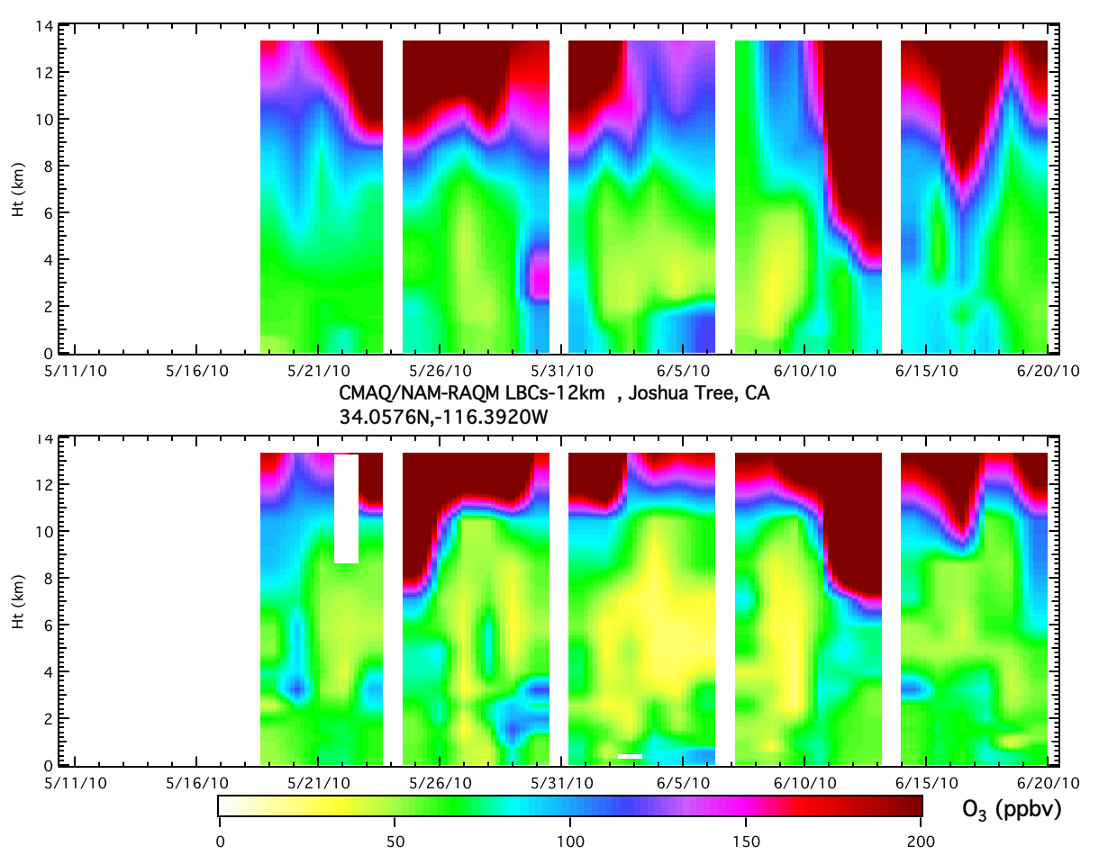
CMAQ/RAQM-LBCs at Joshua Tree
Model
NAM-CMAQ does not resolve sharp gradient in ozone at tropopause resulting in higher ozone in free troposphere
Obs.
From Stu McKeen (NOAA/ESRL) AGU Annual Meeting, San Francisco CA, December, 2010

Slide 9
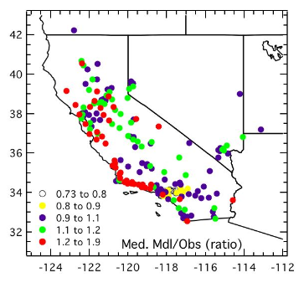
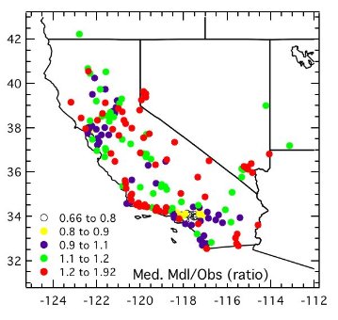
Median Model to Observed Ratio
max 8-hr average O₃ , 5/19/10 - 7/15/10
CMAQ, no RAQMS-LBC
CMAQ, with RAQMS-LBC
Increased free tropospheric ozone leads to increased surface ozone,
which results in model high bias along CA/NV boarder
From Stu McKeen (NOAA/ESRL) AGU Annual Meeting, San Francisco CA, December, 2010

Slide 10
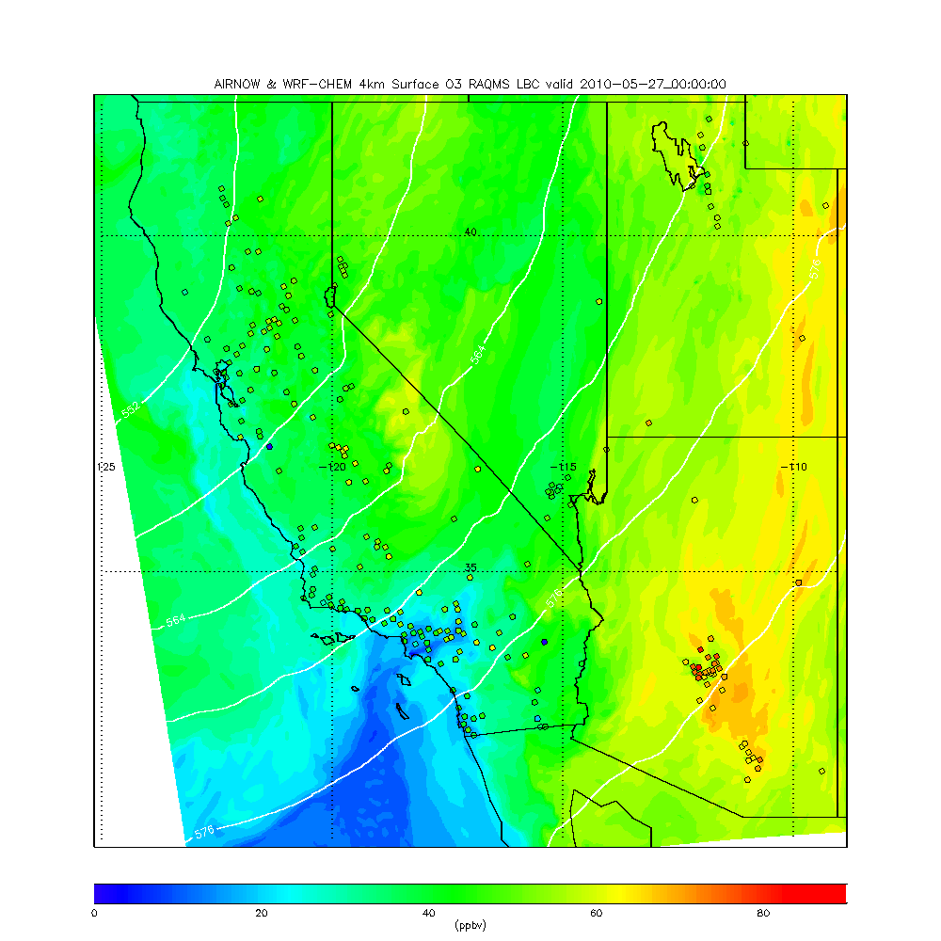
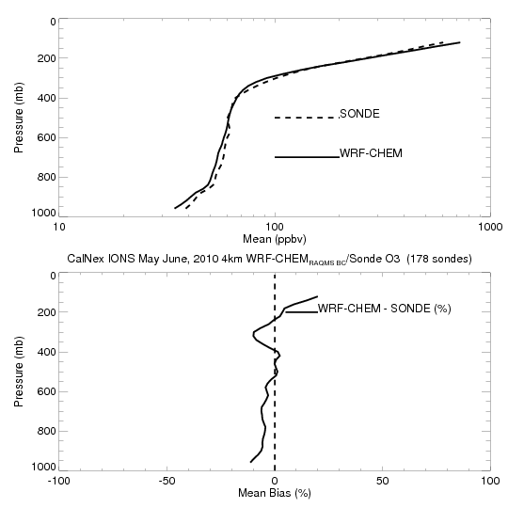
Retrospective 4km WRF-CHEM CalNex forecasts
(RAQMS 1x1 MLS+OMI ozone analyses)
WRF-CHEM does resolve sharp gradient in ozone at tropopause resulting in very small (<10%) biases in free tropospheric ozone
= EPA AIRNow Surface ozone measurements

Slide 11
MODIS True Color Image April 14, 2014
https://earthdata.nasa.gov/labs/worldview/

Slide 12
AIRS Carbon Monoxide (CO) Column April 14, 2014
https://earthdata.nasa.gov/labs/worldview/

Slide 13
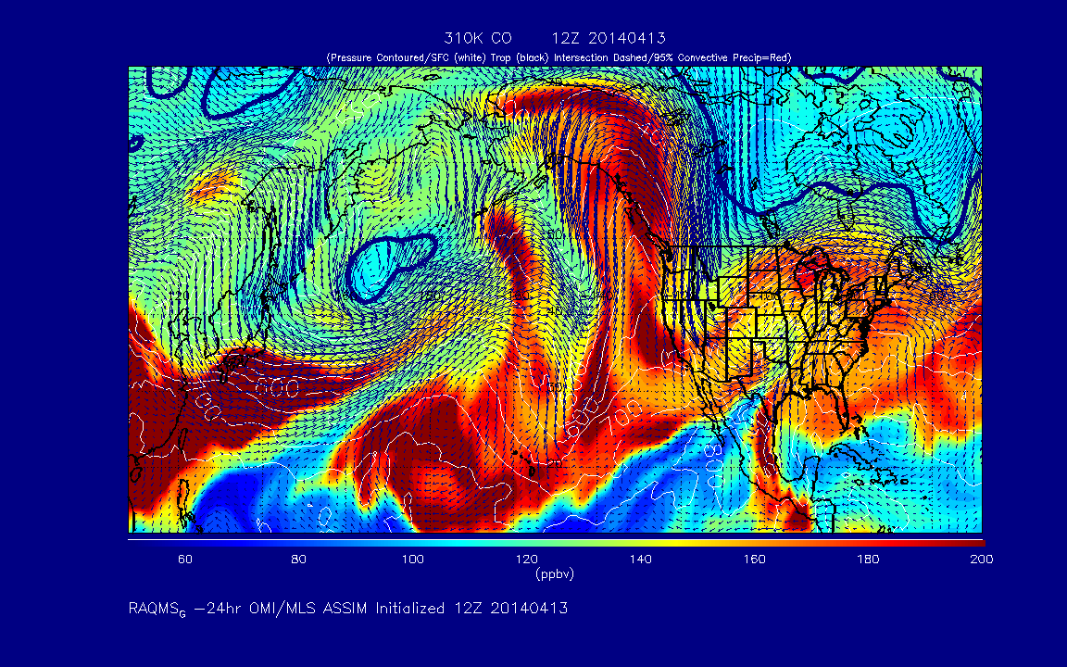
Current real-time RAQMS air quality analysis/forecasts
310K Carbon Monoxide (CO)
http://raqms-ops.ssec.wisc.edu/

Slide 14
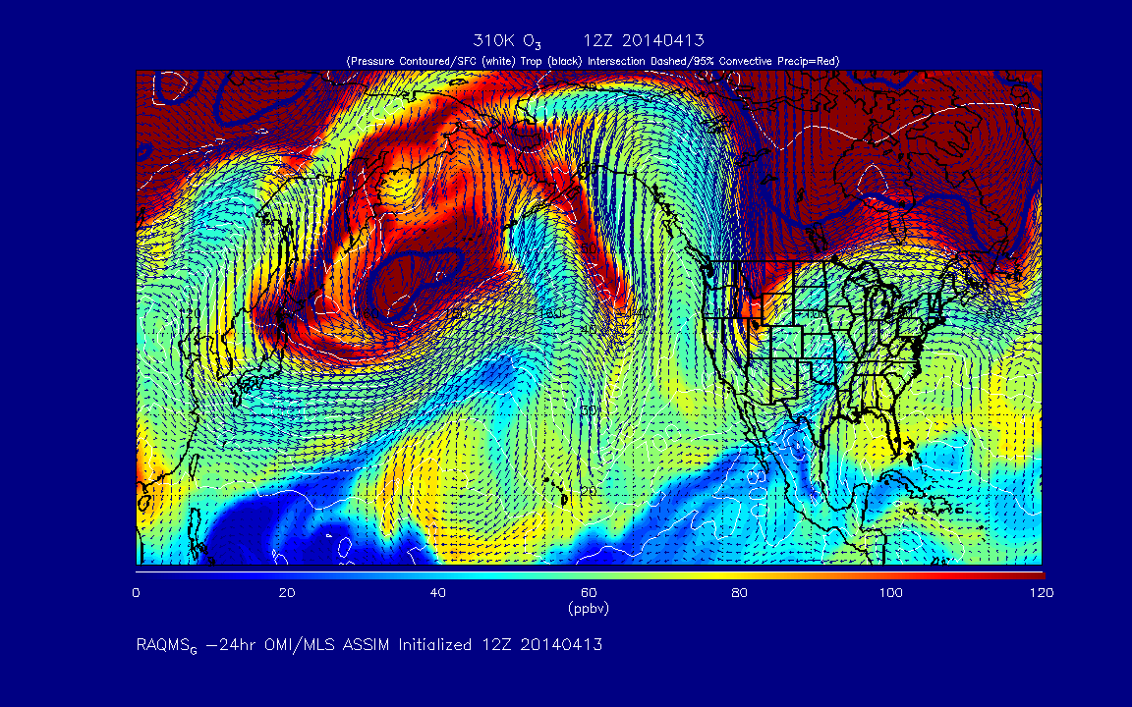
Current real-time RAQMS air quality analysis/forecasts
310K Ozone (O3)
http://raqms-ops.ssec.wisc.edu/

Slide 15
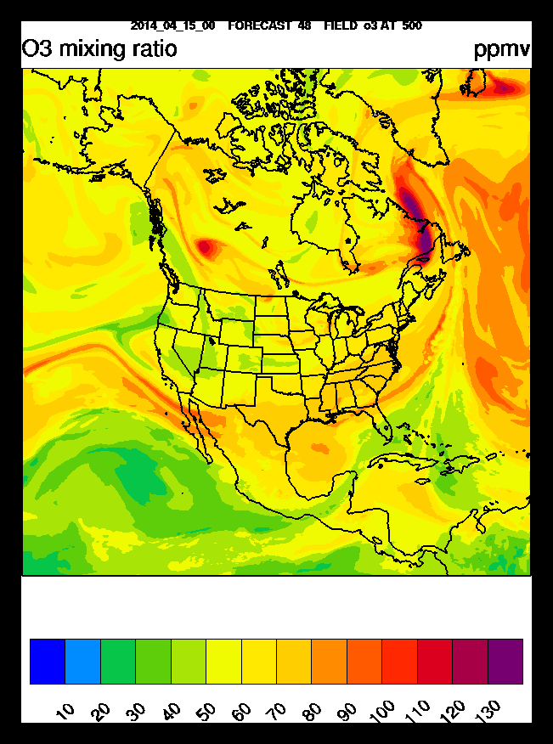
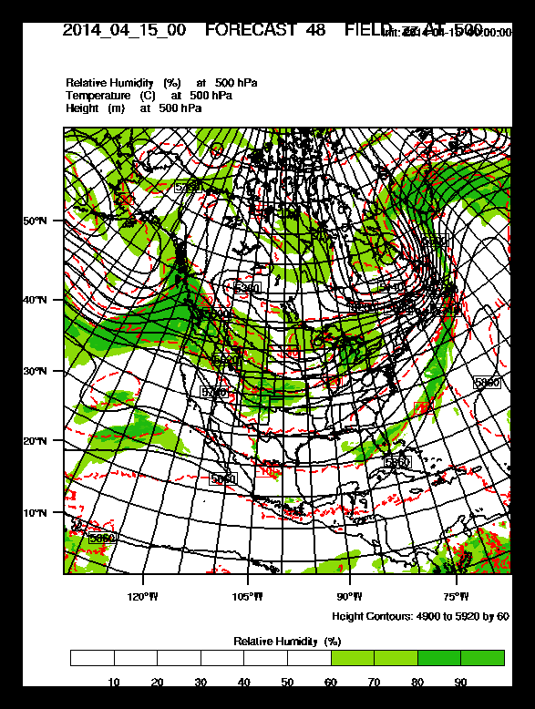
RAQMS/Rapid Refresh (RAP) with Chemistry
Real time weather and air quality forecasts
The 13km Rapid Refresh (RAP) model with chemistry is used to predict air pollution over CONUS twice daily (00Z and 12Z) using RAQMS forecasts for lateral boundary conditions. In collaboration with Georg Grell and Steve Peckham (NOAA/ESRL).
RAP 500mb Ozone (ppbv)
00Z April 17, 2014
RAP 500mb Heights
00Z April 17, 2014
http://rapidrefresh.noaa.gov/

Slide 16
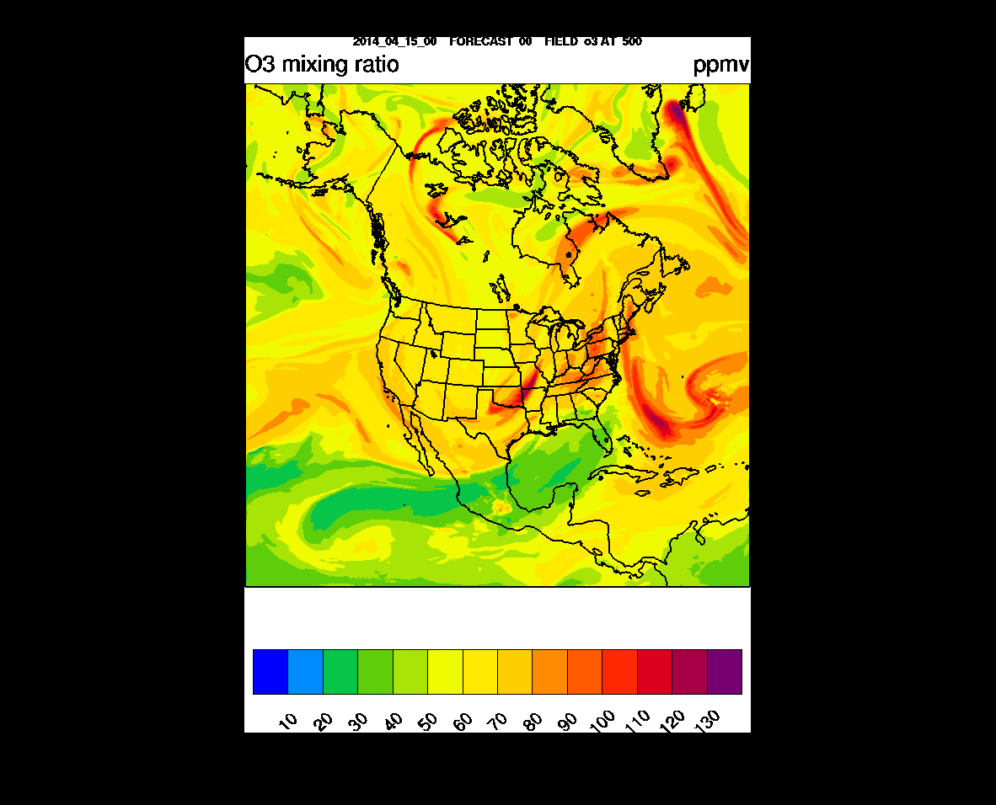
ppbv
RAQMS/RAP-Chem 500mb O3 Forecast
00Z April 15 –
00Z April 17, 2014
http://ruc.noaa.gov/wrf/WG11_RT/

Slide 17
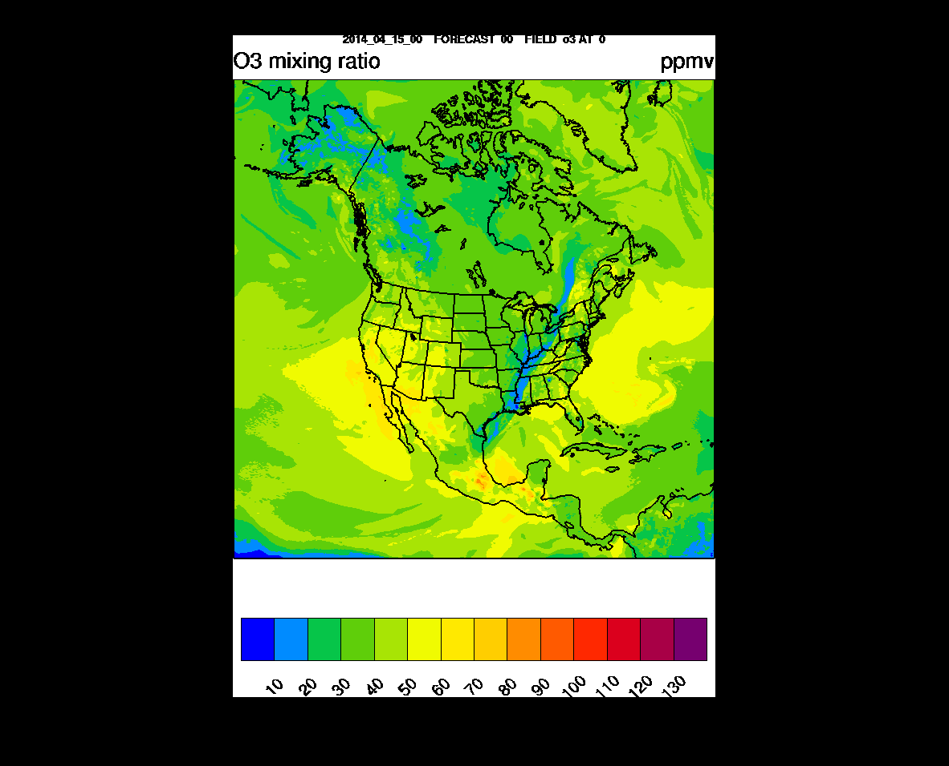
ppbv
RAQMS/RAP-Chem Surface O3 Forecast
00Z April 15 –
00Z April 17, 2014
http://ruc.noaa.gov/wrf/WG11_RT/

Slide 18
Conclusion
Intercontinental pollution transport and stratosphere/troposphere exchange processes can contribute to increased surface ozone and potentially lead to violations of the ozone standard.
EPA is proposing to strengthen the 8-hour “primary” ozone standard to a level within the range of 60-70 parts per billion (ppb), which will likely lead to more violations in the western US.
Assimilation of trace gas and aerosol retrievals within a global chemical and aerosol data analysis system can provide improved constraints on the impacts of intercontinental pollution transport and stratosphere/tropospheric exchange processes on regional scale air quality predictions.

