Slide 1
Visibility Algorithm Validation for 100% Delivery
Presented by R. Bradley Pierce

Slide 2
Product Overview
(Visibility)
ABI Visibility retrieval is average visibility over the depth of the planetary boundary layer (PBL)
Primary validation dataset is NWS Automated Surface Observing Systems (ASOS) raw (1 minute) extinction measurements Archived at NCDC Class
Secondary validation data sets include High Spectral Resolution Lidar (HSRL) and Cloud-Aerosol Lidar and Infrared Pathfinder Satellite Observations (CALIPSO) 550 nanometer extinction coefficients.

Slide 3
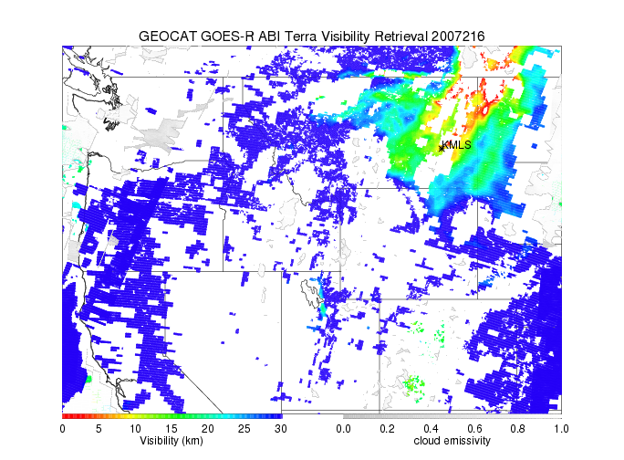
Example Product Output

Slide 4
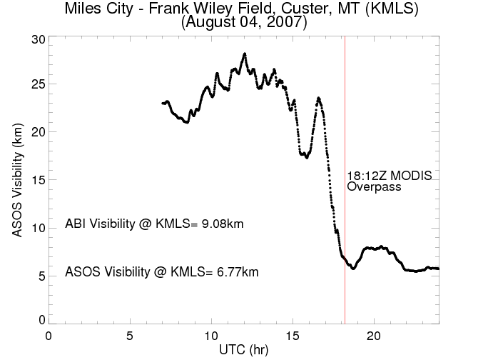
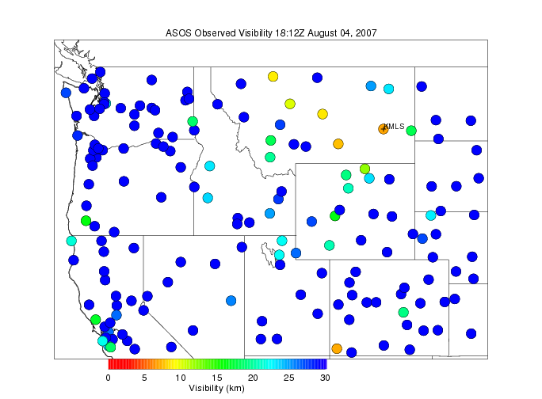
Example ASOS Visibility

Slide 5
Example ASOS Visibility

Slide 6
Visibility Requirements
Name | Output format for each coverage | Geographic Coverage (G, H, C, M) | Vertical Resolution | Horizontal Resolution | Mapping Accuracy | Measurement Range | Measurement Accuracy | Refresh Rate/Coverage Time Option (Mode 3) | Refresh Rate Option (Mode 4) | Data Latency | Product Measurement Precision
Visibility | NetCDF McIDAS | FD | N/A | 10km | 5 km | Clear (vis ≥ 30 km) Moderate (10 km ≤ Vis < 30 km) Low (2 km ≤ vis < 10 km); Poor (vis < 2 km) (under the conditions of clear up through clouds of only layer) | 80% correct classification | 60 min | 5 min | 806 sec | 1.5 categories
FD – Full Disk

Slide 7
Visibility Product Qualifiers
Name | Geographic Coverage (G, H, C, M) | Temporal Coverage Qualifiers | Product Extent Qualifier | Cloud Cover Conditions Qualifier | Product Statistics Qualifier
Visibility | FD | Day | Quantitative out to at least 70 degrees LZA and qualitative at larger LZA | Clear conditions down to feature of interest associated with threshold accuracy | Over specified geographic area
FD – Full Disk

Slide 8
Validation Approach

Slide 9
Visibility Validation
Visibility product validation is performed with the following test data
MODIS L1B 1KM calibrated and geo-located radiances
MODIS L2 V5.1 Cloud Optical Thickness retrievals
MODIS L2 V5.1 Aerosol Optical Depth retrievals
Collocated ASOS harmonic mean 1-minute visibility measurements

Slide 10
Visibility Validation: Details (1)
Method: Co-locate ABI visibility retrievals with ASOS visibility measurements obtained from harmonically averaged 1-minute ASOS extinction measurements and compare the categorical accuracy and precision with specifications
Visibility accuracy specification: 80% correct classification
Approach: Compute categorical histograms for ASOS and ABI visibility retrievals

Slide 11
Visibility Validation: Details (2)
Quantitative measures
- Percent correct classification, precision, Heike Skill Score, and false alarm rate
Validity criteria:
- 80% correct classification for co-located ASOS measurements

Slide 12
Validation Results

Slide 13
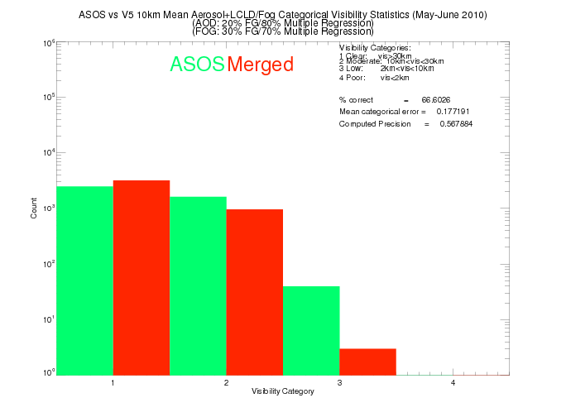
Visibility Validation Results
Merged ABI V5 vs ASOS visibility May-June 2010
Histogram of ASOS & ABI Merged Aerosol and Fog categorical visibility classifications for 4165 coincident ASOS/MODIS
measurement pairs during May-June 2010.
The merged visibility retrieval results in a 66.6% categorical success rate and an estimated precision of 0.57.
13
Notes:
13

Slide 14
Visibility Validation Results
Skill Score and False Alarm Rate (May-June, 2010)
V5 Heidke Skill Score (Hit Rate)
V5 False Alarm Rate
Visibility Category | Merged retrieval
1 (Clear) | 0.261098
2 (Moderate) | 0.257462
3 (Low) | 0.0452322
4 (Poor) | NA
Visibility Category | Merged retrieval
1 (Clear) | 0.324468
2 (Moderate) | 0.364389
3 (Low) | 0.666667
4 (Poor) | NA
The V5 Visibility retrieval shows equivalent skill and false alarm rates for Clear and Moderate visibility classes and degrades for low visibility. No coincident poor visibility cases were found during the May-June 2010 validation period.
*Heidke Skill Score measures the fractional improvement relative to chance

Slide 15
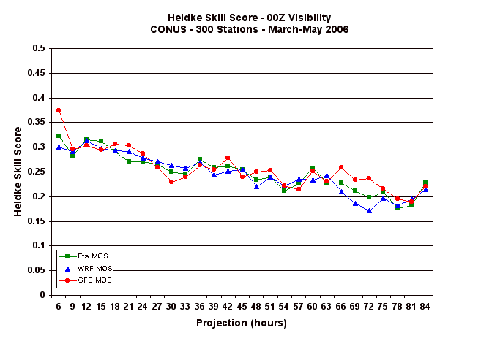
Visibility Validation Results
Eta, WRF, GFS Model Output Statistics (MOS) validation for 5 visibility classes: <0.5 (0.8), 0.5-1.0 (0.8-1.6), 1.0-3.0 (1.6-4.8), 3-5 (4.8-8.0), >5 (8.0) miles (km)
ABI Retrieval Score for Clear (>30km) and Moderate (10-30km) visibilities
MOS validation period: March 1, 2006, through May 31, 2006
http://www.nws.noaa.gov/tdl/synop/wrfeval/vis_conus_heidke.gif

Slide 16
Visibility Validation Results: Summary
Statistics (Visibility categorical accuracy and precision). MODIS clear sky down to feature of interest data (May-June 2010)
Accuracy | F&PS | Visibility Algorithm
Percent correct classification | 80% | 66.6%
Precision | F&PS | Visibility Algorithm
RMS categorical error | 1.5 | 0.57
Preliminary estimates show that the algorithm meets precision requirements but does not meet the accuracy requirements

Slide 17
Visibility Error Budget
Consider May-June 2010 Co-located ABI visibility retrievals at ASOS stations as “truth”
Introduce range of errors to each predictor
Compute average percentage error in visibility classification as a function of (+/-) percentage error for individual predictors

Slide 18
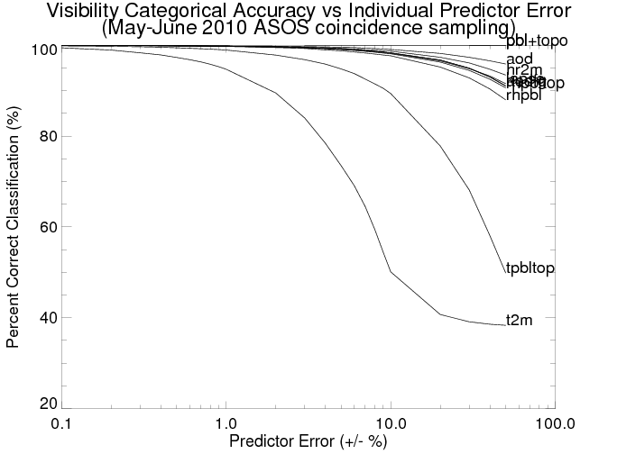
Visibility Error Budget
Results
The ABI visibility retrieval is most sensitive to errors in 2m Temperature (t2m) and Temperature at the top of the PBL (tpbltop) during May-June 2010
A +/- 2% (4 %) error in 2m Temperature alone would result in a categorical accuracy
of 89% (78%) for the May-June 2010 coincident ASOS/MODIS pairs.

Slide 19
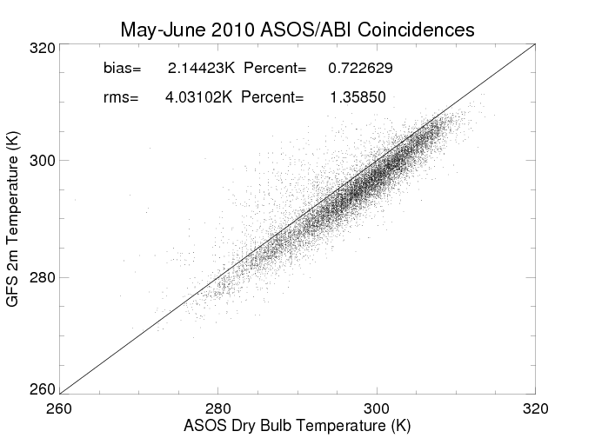
Visibility Error Budget
Results
Comparison of GFS 2m Temperature and ASOS Dry Bulb Temperature (K) for coincident ASOS/MODIS pairs during May-June 2010 shows that actual biases are ~2K (less than 1%) with rms errors on the order of 4K (1.3%)

Slide 20
Summary
The GOES-R ABI visibility algorithm provides a new capability for estimating boundary layer visibility from space that complements current surface measurements
The Heidke Skill Scores for Clear and Moderate visibility are comparable to MOS estimates for Low and Poor visibility categories and provide information about aerosol driven visibility reductions
The GOES-R AWG visibility algorithm is very sensitive to errors in the 2m Temperature and Temperature at the top of the PBL – a >4% error in 2m Temperature alone would result in the ABI visibility retrieval not meeting performance requirements.

