Slide 1

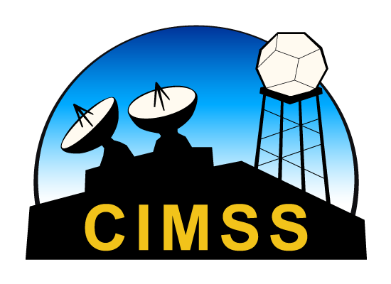
Overview of UW-Madison
SSEC and CIMSS:
Strengths, Aspirations, Concerns
UNIVERSITIES SPACE RESEARCH ASSOCIATION
Council of Institutions Region VI Meeting
Iowa State University
September 28, 2023
Brad Pierce, Director UW-Madison Space Science and Engineering Center, Professor UW-Madison Atmospheric and Oceanic Sciences Department

Slide 2
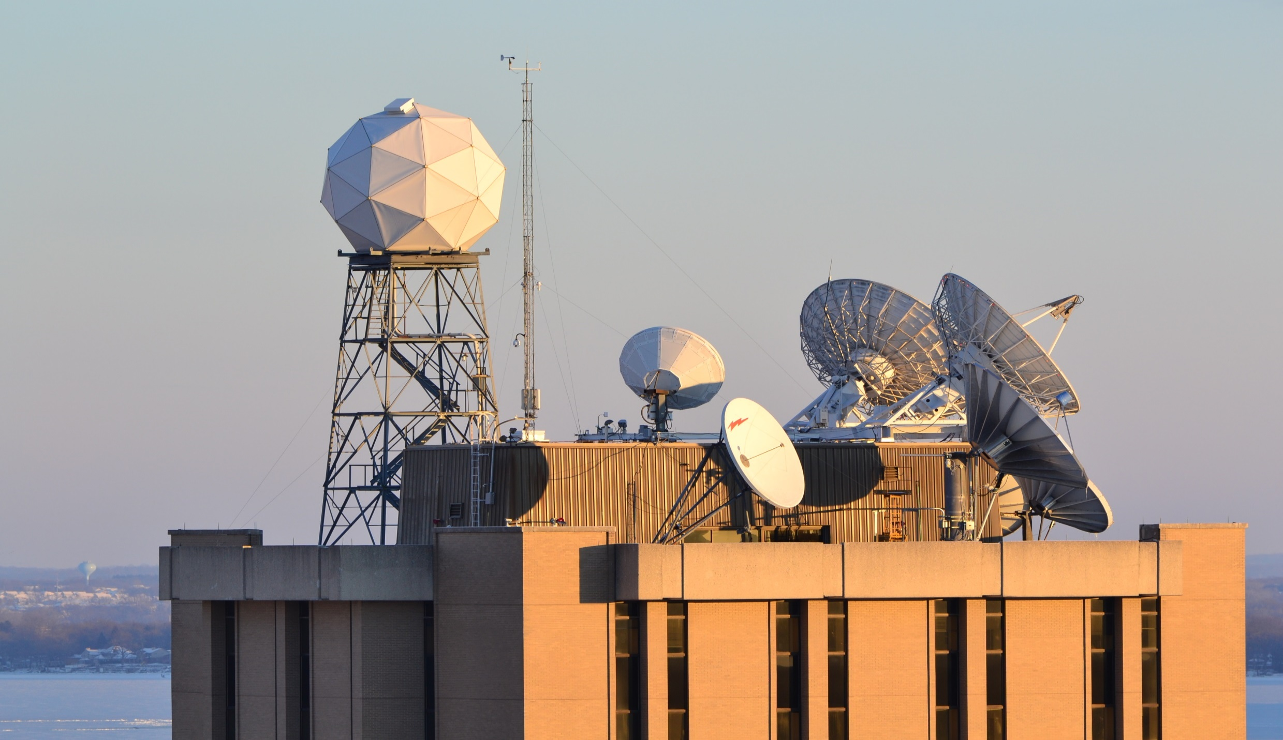
UW Madison
Space Science and Engineering Center (SSEC)
SSEC Director: Dr. R. Bradley Pierce
SSEC an interdisciplinary research center within the UW-Madison Office of the Vice Chancellor for Research and Graduate Education (OVCRGE) that develops and utilizies space-, aircraft- and ground-based instrumentation to collect and analyze observations of the Earth’s atmosphere, oceans, land surface, and other planetary atmospheres to improve our understanding of weather, climate, and atmospheric processes.
NOAA: GOES-R Advance Baseline Imager (ABI), Joint Polar Satellite System (JPSS) Proving Ground Risk Reduction (PGRR), JPSS Sensor Data Records (SDR) Calibration, Next Generation Global Prediction System (NGGPS), Community Satellite Processing Package (CSPP), Geostationary Extended Observations (GeoXO) satellite system
NASA: Time-Resolved Observations of Precipitation structure and storm Intensity with a Constellation of Smallsats (TROPICS) mission, Polar Radiant Energy in the Far-InfraRed Experiment (PREFIRE) mission, Tropospheric Emissions: Monitoring Pollution (TEMPO) mission, Suomi-NPP Sensor Data Records (SDR) Calibration, Suomi-NPP Atmosphere Science Investigator-led Processing System (SIPS), Atmosphere Observing System (AOS) Lidar Working Group
NSF: U.S. Ice Drilling Program (IDP), Antarctic Meteorological Research Center (AMRC), Community Instruments and Facilities (CIF), SSEC Portable Atmospheric Research Center (SPARC)
DOD/DOE: High Spectral Resolution LIDAR, Atmospheric Emitted Radiance Interferometer (AERI) instrument development, field campaigns, instrument mentorship
University of Wisconsin – Madison Space Science and Engineering Center (SSEC)

Slide 3
Space Science and Engineering Center (SSEC)
SSEC FY22 Spending by Source

Slide 4




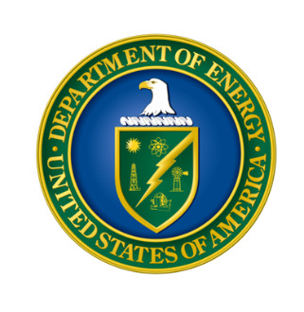
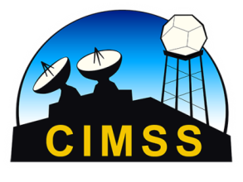


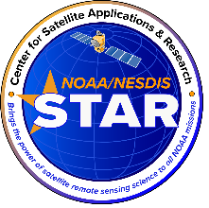

Cooperative Institute for Meteorological Satellite Studies (CIMSS)
CIMSS Director: Dr. Tristan L’Ecuyer
Research Themes
Satellite Meteorology Research and Applications - to support weather analysis and forecasting through participation in NESDIS product assurance and risk reduction programs and the associated transitioning of research progress into NOAA operations
Satellite Sensors and Measurement Techniques - to conduct instrument trade studies and sensor performance analysis supporting NOAA’s future satellite needs as well as assisting in the long term calibration and validation of remote sensing data and derived products
Environmental Models and Data Assimilation - to work with the Joint Center for Satellite Data Assimilation (JCSDA) on improving satellite data assimilation techniques in operational weather forecast models
Outreach and Education - to engage the workforce of the future in understanding and using environmental satellite observations for the benefit of an informed society
DOD
AOS
DOE
NOAA
NSF
NASA
Through its position in SSEC, CIMSS bridges to AOS and across campus and reaps the benefits of cross-agency research collaborations
Connecting Academia to Agencies

Slide 5
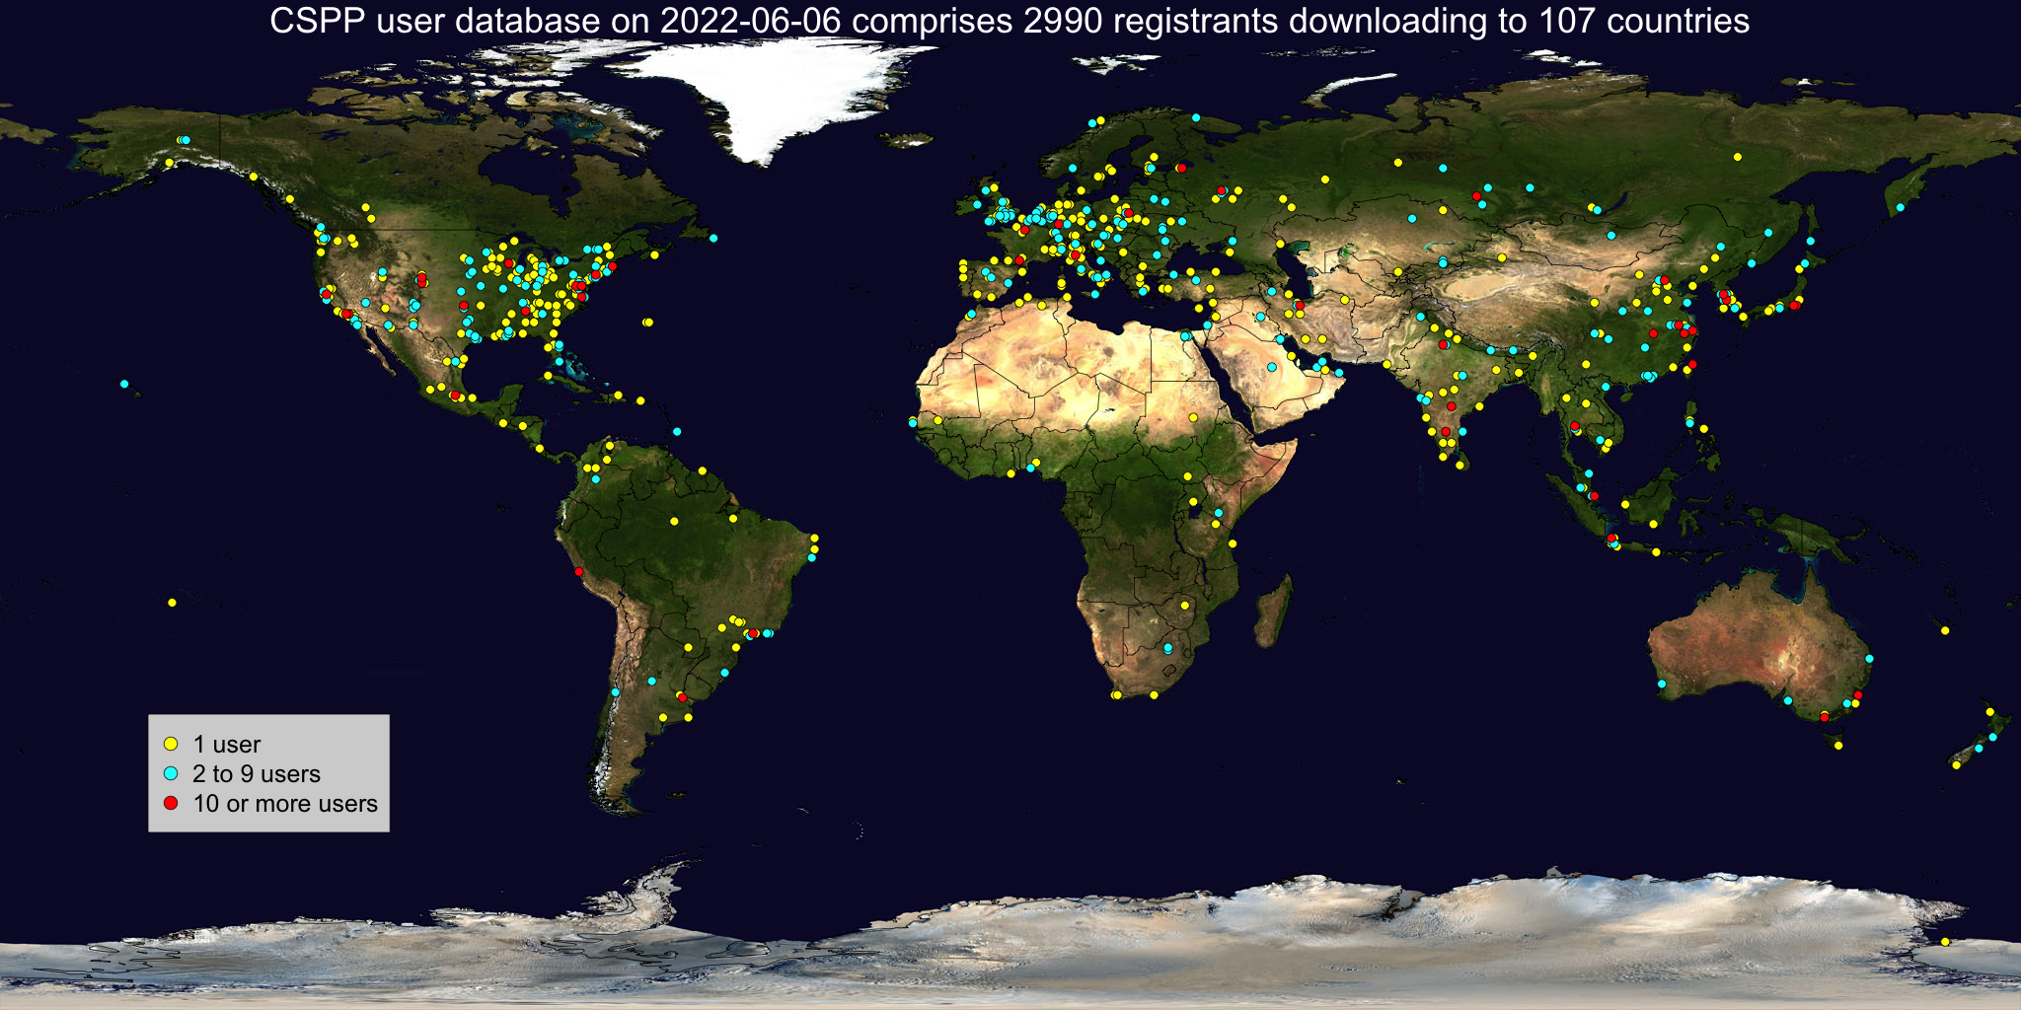
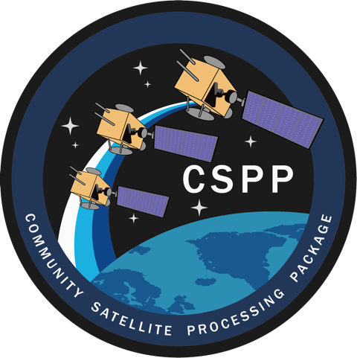
Satellite Meteorology Research and Applications
The Community Satellite Processing Package (CSPP) supports the Direct Broadcast (DB) meteorological and environmental satellite community through the packaging and distribution of open source science software and through training in local product applications.
Users include NOAA, NASA, international meteorological agencies, receiving station vendors, data and weather service providers, and the university and research community
Quad nations June 2022 Summit announce inclusion of CSPP in cooperative civil Earth observation programs
Community Satellite Processing Package (CSPP): Allen Huang and Kathy Strabala (CIMSS)

Slide 6
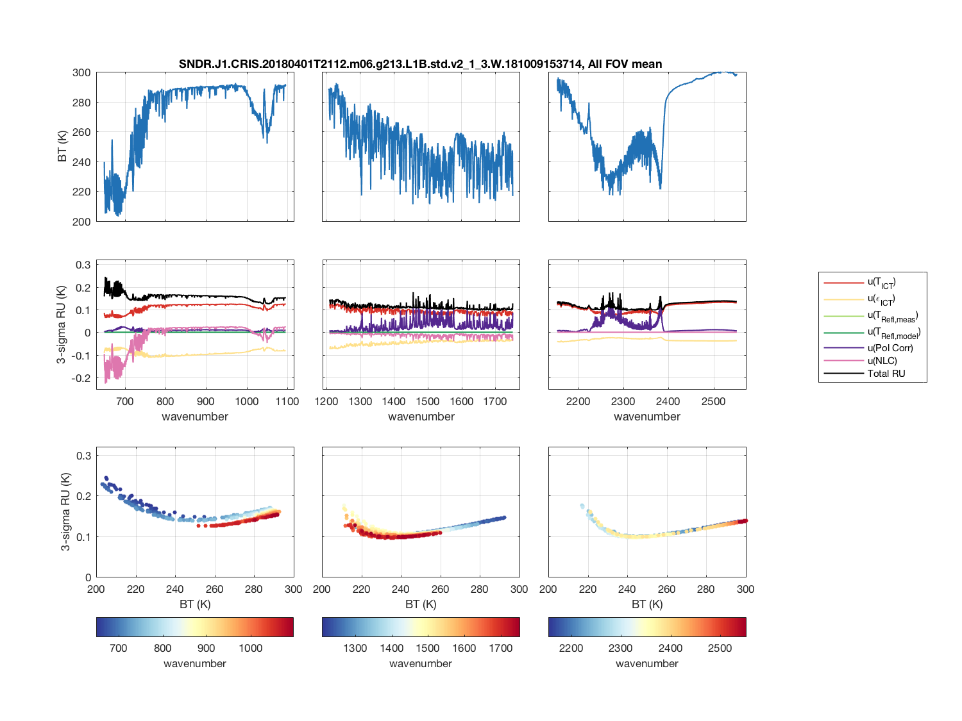
Satellite Sensors and Measurement Techniques
Example CrIS spectra and Calibration Uncertainties
Sensor Calibration:
  VAS, HIRS, ITS, HIS, S-HIS, NAST-I, IMG, AIRS, IASI, GIFTS, CrIS, HIRAS, CLARREO, ABI, MODIS, VIIRS, ARI
Current projects:
  Responsible for Cross-track Infrared Sounder (CrIS) NASA L1B product and long-standing major contributor to the NOAA CrIS SDR calibration team, for SNPP through JPSS-4
  CrIS and Visible Infrared Imaging Radiometer Suite (VIIRS) pre-launch Thermal Vacuum Testing and calibration characterization, SNPP through JPSS-4
  Absolute Radiance Interferometer (ARI): IR CLARREO pathfinder – unprecedented accuracy demonstration in Thermal Vacuum at SSEC
High Information content observations with low and well characterized uncertainties for climate, sounding, and composition applications
IR Hyperspectral and Imager sensor design, calibration, and cal/val, for both LEO and GEO: Dave Tobin (SSEC)

Slide 7
Environmental Models and Satellite Data Assimilation
Three new atmospheric motion vectors (AMVs) types, shortwave infrared (SWIR), clear-air water vapor (CAWV), and visible (VIS), are assimilated in the operational Hurricane WRF NWP system.
The impact of the three new AMV types on tropical cyclone forecasts is assessed by conducting assimilation experiments for 25 Atlantic tropical cyclones from the 2015 and 2016 hurricane seasons.
Assimilation of more hourly AMVs improves tropical cyclone intensity forecasts
HWRF data assimilation and forecast domains.
Hurricane WRF Tropical Cyclone Forecasting: Agnes Lim, Jim Jung, and Sharon Newbula (CIMSS)

Slide 8
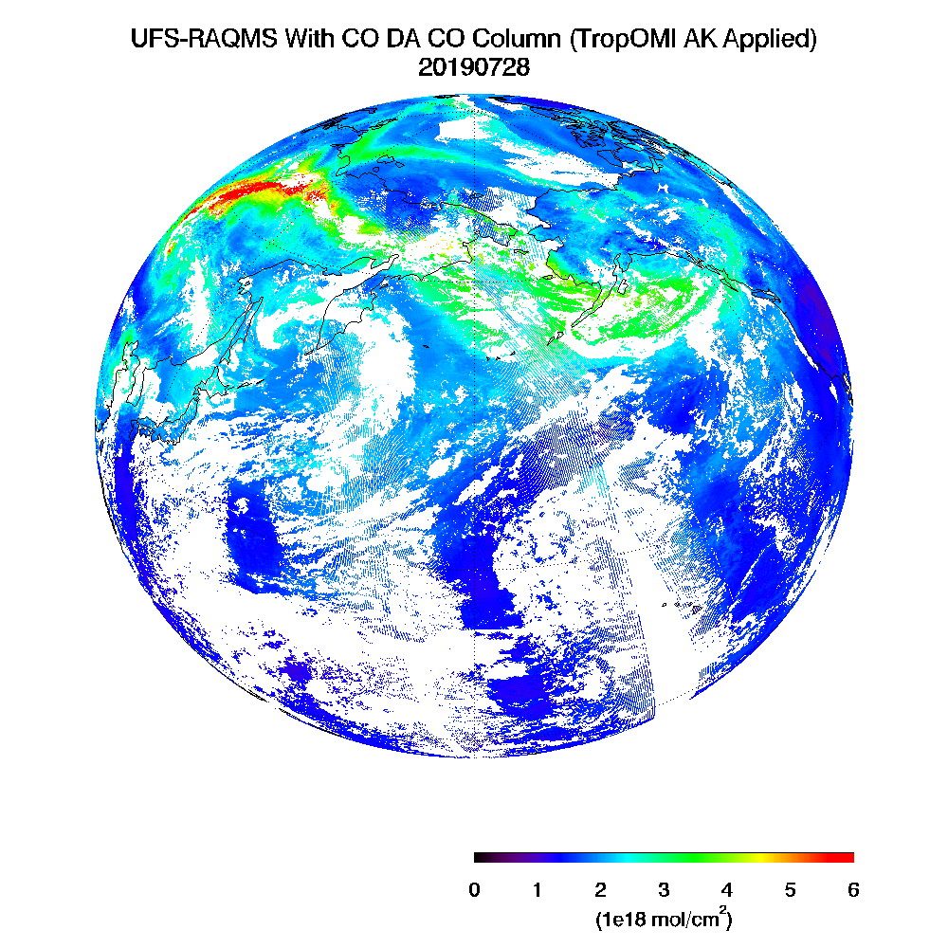
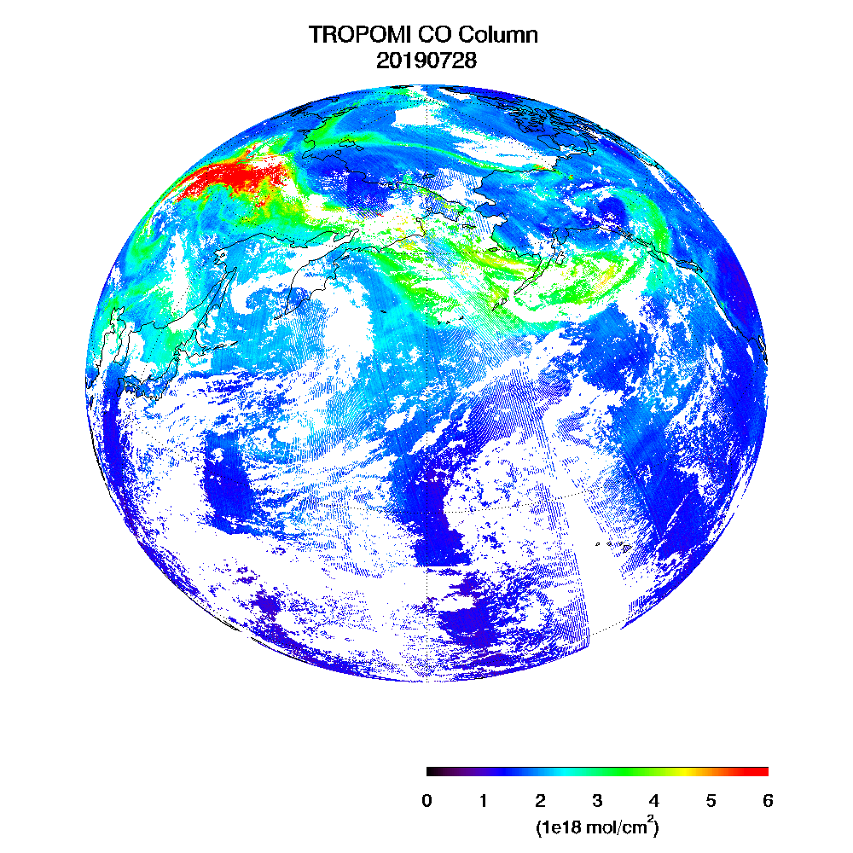
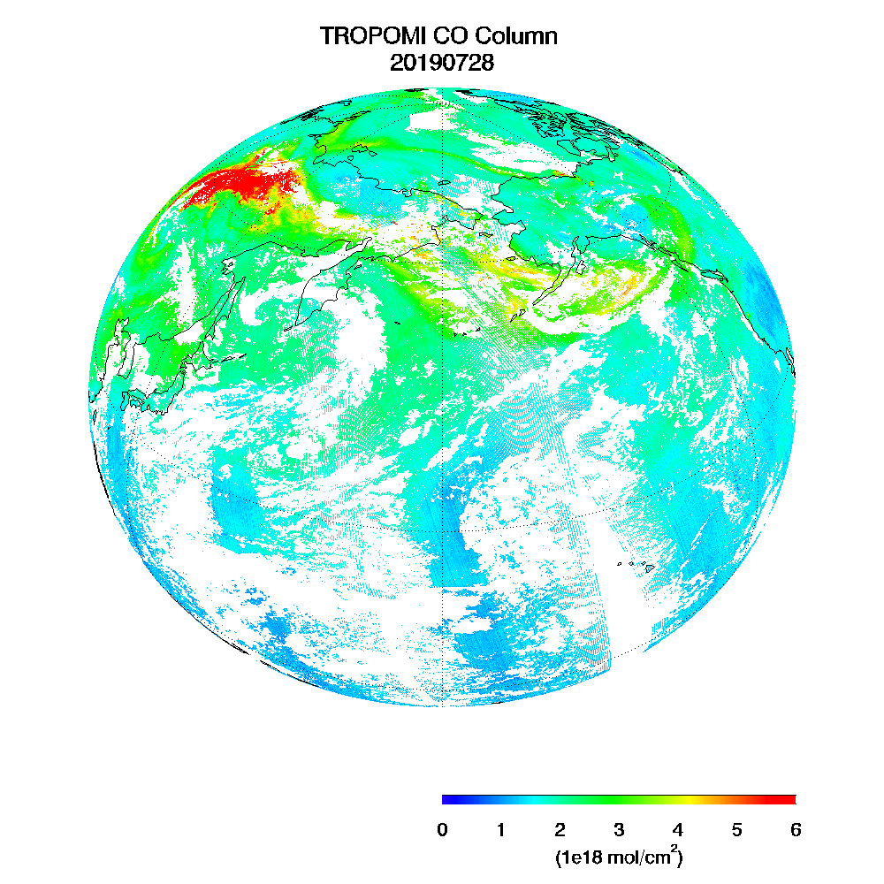
Environmental Models and Satellite Data Assimilation
Real-time Air Quality Modeling System (RAQMS) unified stratosphere/ troposphere chemical module has been incorporated into the Unified Forecasting System (UFS)
JPSS Proving Ground/Risk Reduction Project is developing capabilities for assimilation of atmospheric composition and aerosol retrievals
Collaborating with the Global Systems Lab to transition to NOAA/ESRL for pre-operational testing
Member of the Next Generation Global Prediction System (NGGPS) Atmospheric Composition Working Group
UFS-RAQMS (left) and TROPOMI (right) column carbon monoxide (1e¹⁸mol/cm²) on July 28, 2019
Unified Forecast System (UFS) Composition Forecasting: Brad Pierce, Allen Lenzen, Adtiya Kumar (SSEC), Maggie Bruckner (AOS)

Slide 9
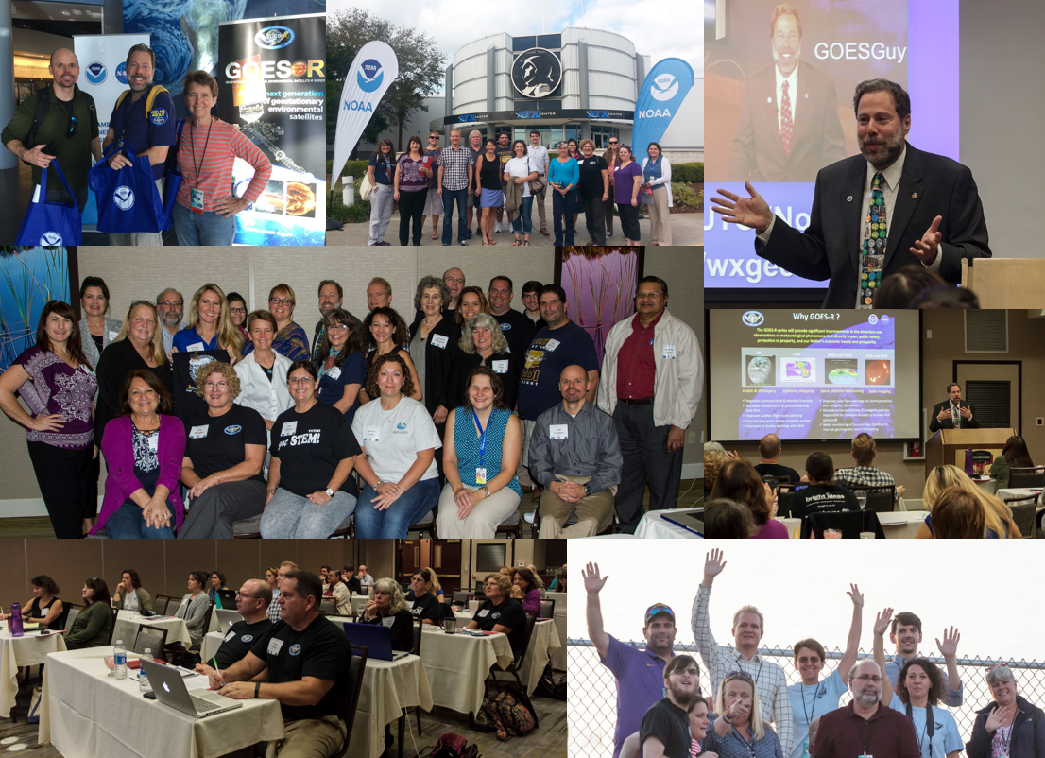
Education and Outreach
Education, outreach, and community training are priorities at CIMSS:
Leadership in professional training for users (e.g. SHyMet, VISITView,
Online instruction (education modules and Massive Open On-Line Course, MOOC)
Satellite summer school
k-12 education (Science on a Sphere, workshops, CIMSS summer camp, virtual science fair)
Public engagement (Through the Atmosphere, CIMSS satellite blog, CIMSS website)
Undergrad summer programming internships
15 graduate students in last 5 years
CIMSS Education and Outreach (Margaret Mooney) and close ties with AOS REU efforts (Brad Pierce, Mike Foster)

Slide 10
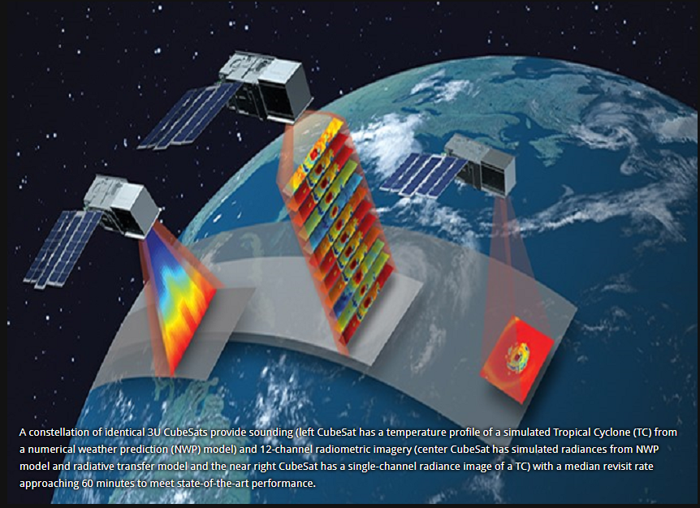
NASA Earth Venture Program: Time-Resolved Observations of Precipitation structure and storm Intensity with a Constellation of Smallsats (TROPICS)
Lead by MIT Lincoln Laboratory
TROPICS is comprised of four 3U cubesats, each hosting a 12-channel passive microwave radiometer.
Measures temperature and humidity soundings and precipitation with spatial resolution comparable to current operational passive microwave sounders but with unprecedented temporal resolution (median revisit time of 60 minutes)
SSEC is responsible for the NASA TROPICS Ground System (Cube Sats Deployed May, 2023)

Slide 11
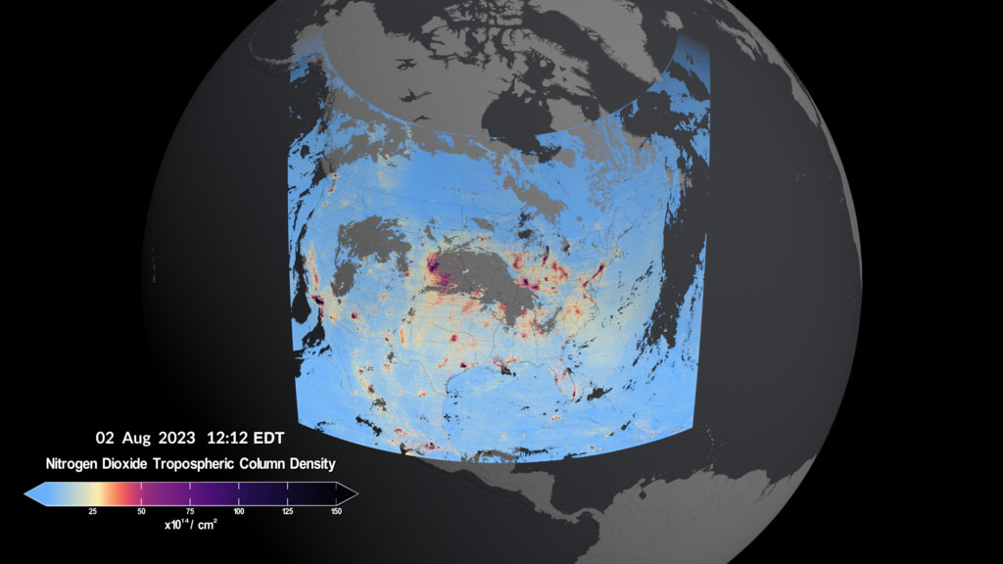
NASA Earth Venture Program: Tropospheric Emissions: Monitoring Pollution (TEMPO)
Lead by Smithsonian Astrophysical Observatory
Measuring O3, aerosol, and ozone precursors (e.g., NO2, CH2O), which have strong diurnal cycles in emissions and photochemical production.
Detailed information about spatial gradients and the evolution of plumes
Tracking accidental release of hazardous chemicals.
Frost et al, 2020, A Value Assessment of an Atmospheric Composition Capability on the NOAA Next-Generation Geostationary and Extended Orbits (GEO-XO) Missions (https://doi.org/10.25923/1s4s-t405)
SSEC is participating in NASA TEMPO validation and data assimilation (First Light August 02, 2023)

Slide 12
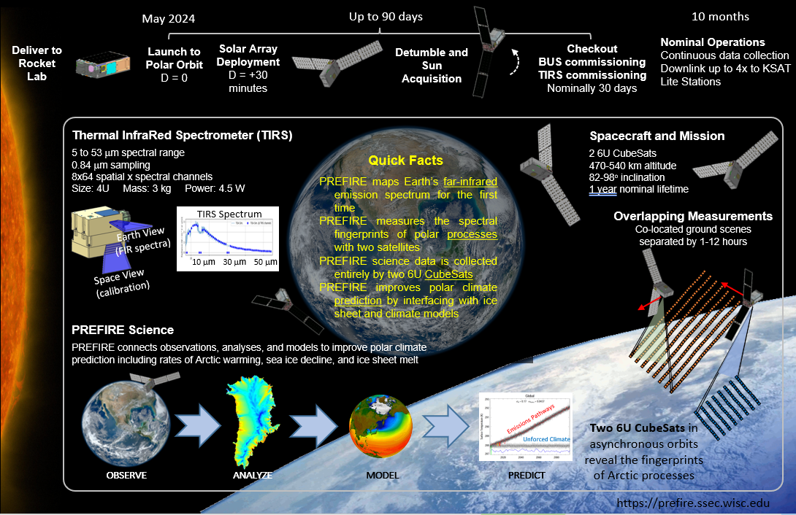
NASA Earth Venture Program: Polar Radiant Energy in the Far-InfraRed Experiment (PREFIRE)
Lead by UW-Madison SSEC
PREFIRE maps Earth’s far-infrared emission spectrum for the first time
PREFIRE measures the spectral fingerprints of polar processes with two satellites
PREFIRE science data is collected entirely by two 6U CubeSats
PREFIRE improves polar climate prediction by interfacing with ice sheet and climate models
SSEC is Leading PREFIRE (Tristan L’Ecuyer, PREFIRE PI)

Slide 13
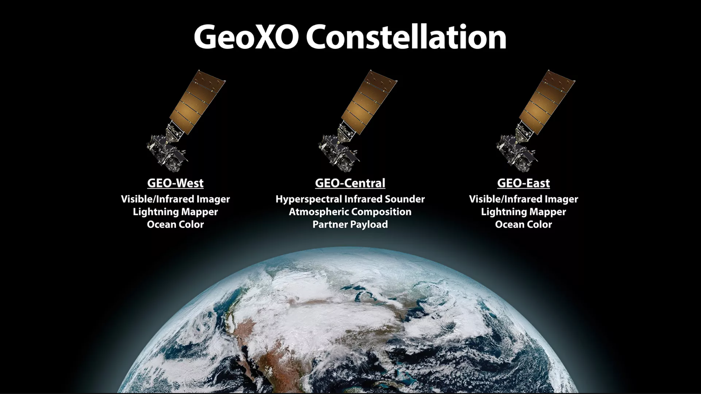
Future Opportunities: Geostationary Extended Observations (GeoXO)
Recommended Capabilities
Lightning Mapping: Data continuity; spatial resolution improvements
Infrared Sounding: New capability for numerical weather prediction and nowcasting
Day/Night Imagery: New capability for nighttime cloud, fog, and smoke tracking
Ocean Color Imagery: New capability for ocean health and productivity monitoring
Atmospheric Composition Measurement: New capability for detection of air quality threats
Geostationary Extended Observations (GeoXO)

Slide 14
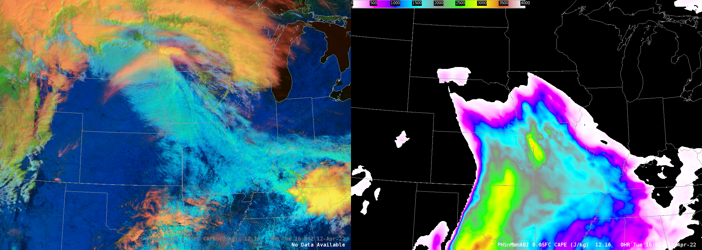
GeoXO Hyperspectral Sounder Demonstration
Combine infrared radiance spectra from polar satellite hyperspectral sounding (PHS) with high temporal and horizontal resolution infrared radiances from the GOES Advanced Baseline Imager (ABI)
Assimilate this blended product (PHSnABI) within high resolution regional forecast system
April 12th, 2022 Tornado outbreak
Analyzed PHSnABI CAPE 16Z April 12th to 00Z April 13th
GeoXO high temporal resolution hyperspectral retrievals determine timing and location of convection (situational awareness).
2022 HWT GeoXO Hyperspectral Sounder demonstration: William Smith and Scott Lindstrom (SSEC) and Qi Zhang (Hampton, U)

Slide 15
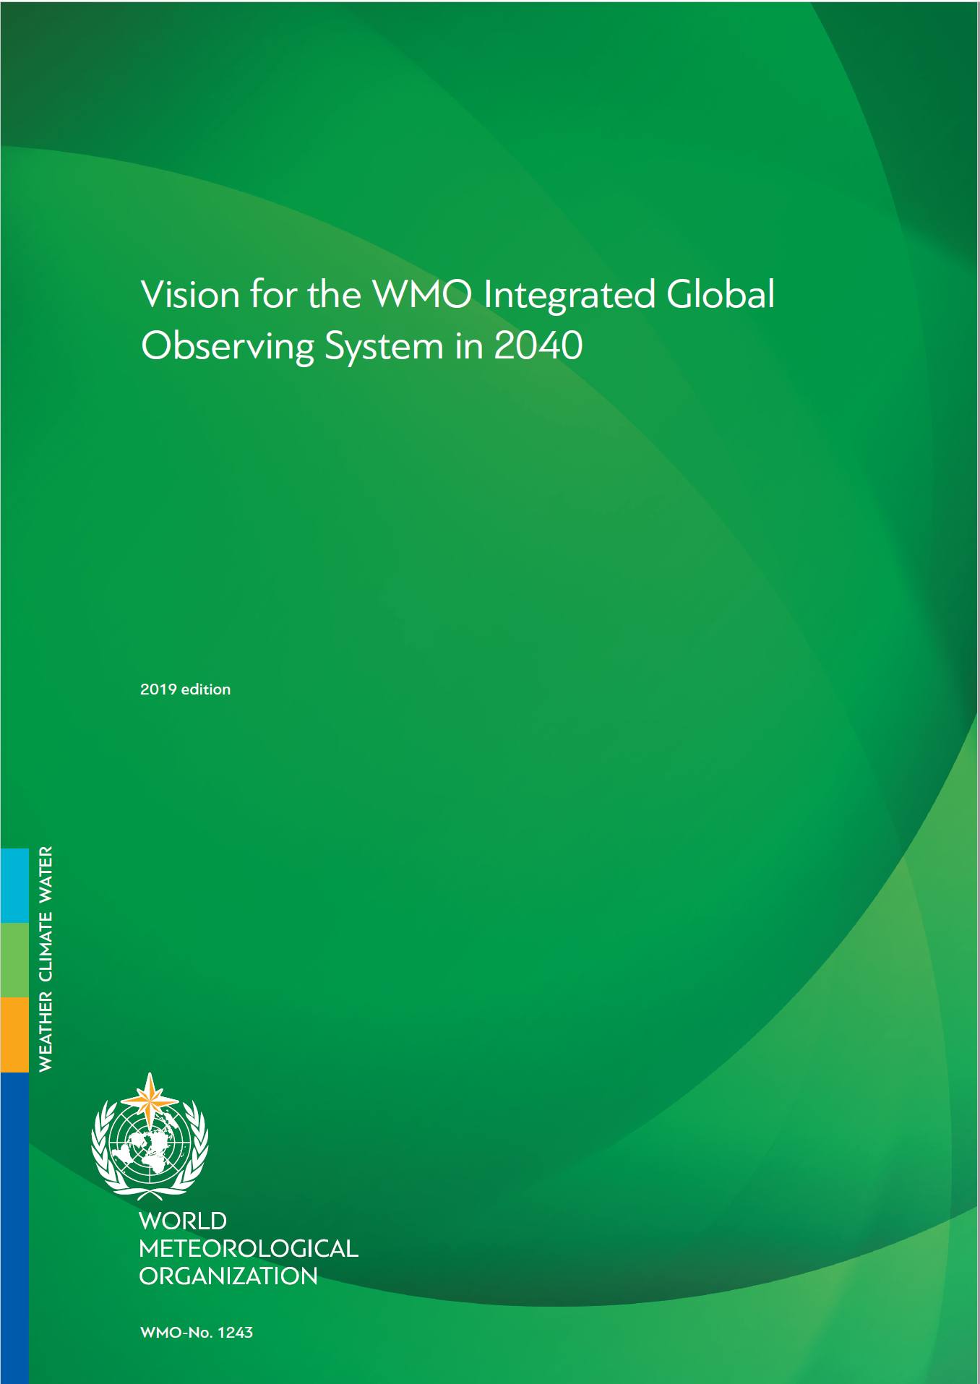
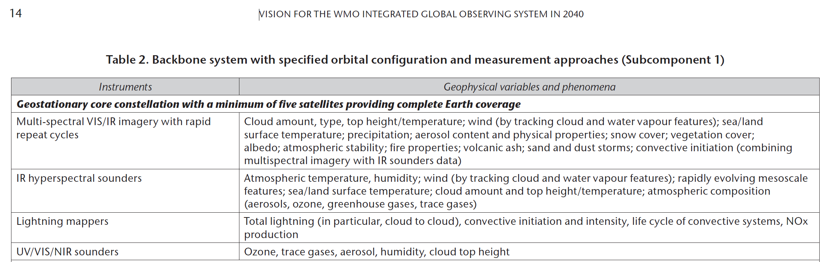
GeoXO Hyperspectral Sounder Summary
GeoXO Hyperspectral Sounder is a key component of the WMO vision for an Integrated Global Observing System

Slide 16
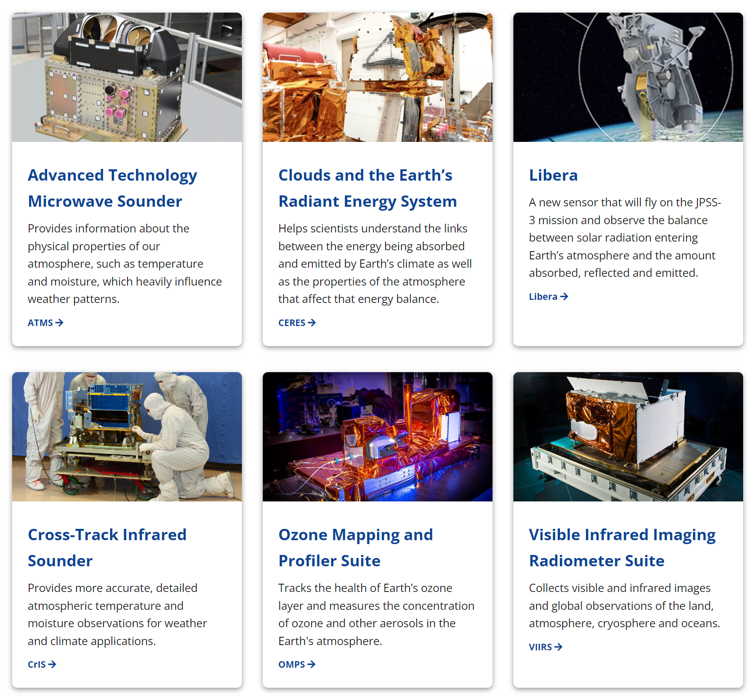
JPSS Instrument Suite
Concerns
NASA Earth Observing System (EOS) and NOAA Joint Polar Satellite System (JPSS) continuity for satellite climate data records
  NASA EOS
    Terra (https://terra.nasa.gov/)
    Aqua (https://aura.gsfc.nasa.gov/)
    Aura (https://aura.gsfc.nasa.gov/)
  NOAA JPSS
    https://www.nesdis.noaa.gov/our-satellites/currently-flying/joint-polar-satellite-system
It is critical that NASA continues to provide funding to support JPSS science as we transition from EOS to JPSS
Libera (CERES continuity mission) launch delay will impact satellite climate data records.
Concerns: NASA EOS and NOAA JPSS continuity for satellite climate data records

