Slide 1
CIMSS WRF-Chem
Portable aerosol forecast application for local needs.

Slide 2
Initialization and Lateral Boundary Conditions
The CIMSS WRF-Chem system enables utilization of Real-time Air Quality Modeling System (RAQMS) 1x1 degree global aerosol analyses and forecasts constrained with real time MODIS Terra and Aqua Aerosol Optical Depth (AOD) and fire detection retrievals.
This is a significant improvement since the model gains access to realistic initial conditions and lateral boundary conditions, better suited for the air quality forecasting and analysis.

Slide 3
Emissions
The CIMSS WRF-Chem system enables utilization of standard WRF-Chem options (see EDGAR .5X.5 deg) for global emissions as well as high resolution (.1x.1 deg) Task Force on Hemispheric Transport of Air Pollution (HTAP) emissions.
It is a significant improvement since the model gains access to a high resolution, harmonized emissions data base dataset, better suited for the air quality forecasting and analysis.

Slide 4
HTAP vs EDGAR emissions examples form currently used experimental setups
European/Africa Domain focusing on Saharan Dust transport

Slide 5
HTAP vs EDGAR emissions examples form currently used experimental setups
Mideast domain focusing on local dust events
UAE

Slide 6
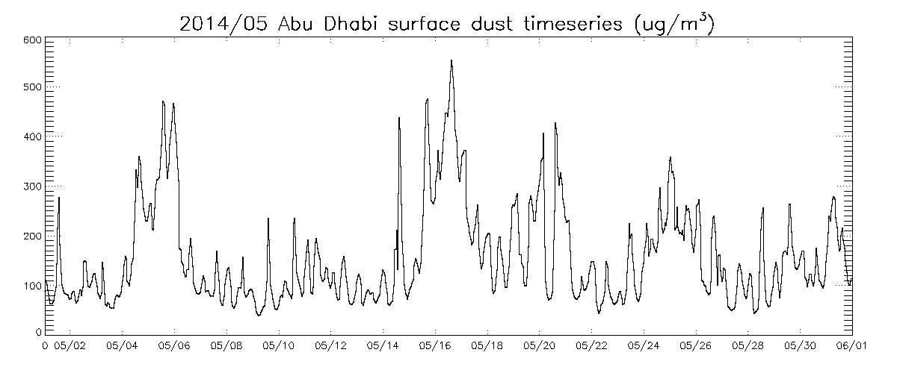
May 2014 Abu Dhabi Surface Dust predictions
FEA Standard
UAE Federal Environment Agency (FEA) Standard for PM10 is 150 μg/m³

Slide 7
May 14-18th, 2014 Abu Dhabi Dust event
UAE

