Slide 1
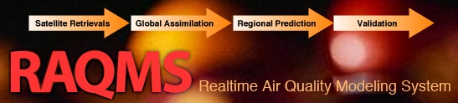
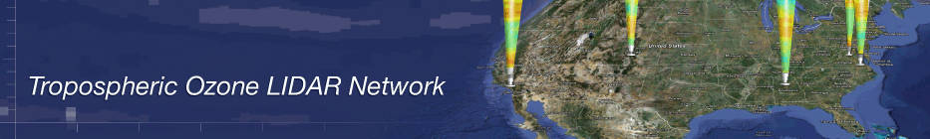

Understanding Background Ozone
over the Continental US:
A Global Ozone Assimilation Perspective
Brad Pierce
NOAA/NESDIS
Collaborators:
RAQMS (Todd Schaack and Allen Lenzen, UW-Madison/SSEC)
RR-Chem (Georg Grell and Steve Peckham, NOAA/ESRL),
AJAX measurements (Emma Yates and Laura Iraci, NASA Ames)
EPA SI Working Group (Gail Tonnesen, US EPA, and Patrick Reddy, CDPHE)
Mount Bachelor Observatory (Dan Jaffe, Pao Baylon, Univerisity of Washington)
Second Annual Tropospheric Ozone Lidar Network (TOLNet) Working Group Meeting, June 16-18, 2015 Boulder, CO

Slide 2
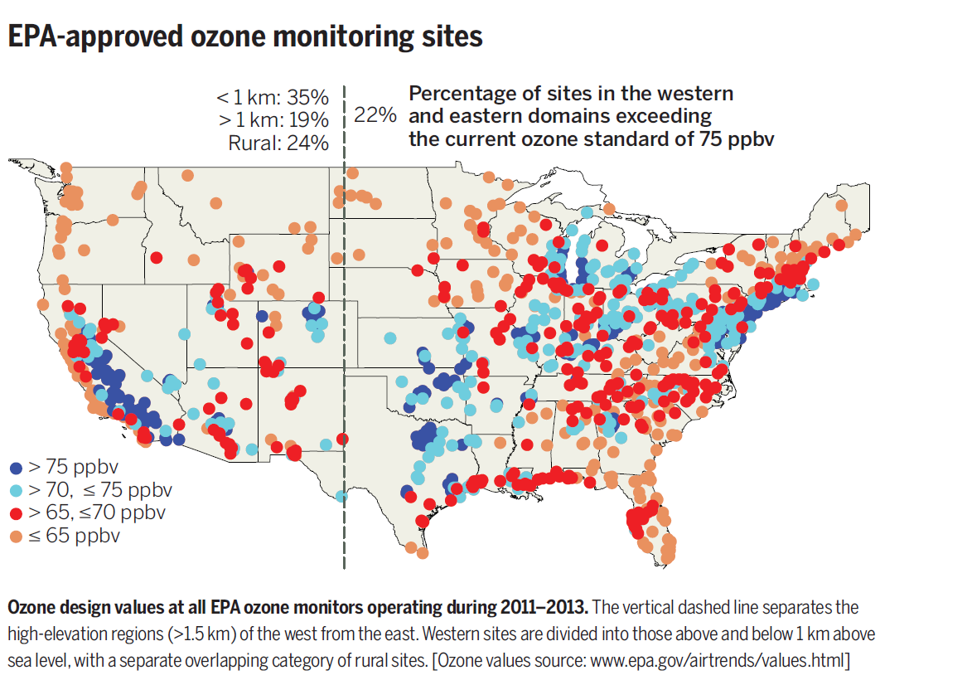
Current ozone National Ambient Air Quality Standard (NAAQS) requires that the three-year average of the fourth-highest annual maximum daily 8-hour ozone concentration (MDA8) be 75 ppbv or below.
The proposed new standard is between 60 and 70 ppbv (U.S. EPA, 2010).
Cooper O. R. et al, (2015) Challenges of a lowered U.S. ozone standard, Science, Vol. 348 no. 6239 pp. 1096-1097, DOI: 10.1126/science.aaa5748

Slide 3
Model Description
Online global chemical and aerosol assimilation/ forecasting system
UW-Madison hybrid θ−η coordinate model (UW-Hybrid) dynamical core
Unified stratosphere/troposphere chemical prediction scheme (LaRC-Combo) developed at NASA LaRC
Aerosol prediction scheme (GOCART) developed by Mian Chin (NASA GSFC).
Statistical Digital Filter (OI) assimilation system developed by James Stobie (NASA/GFSC)
Real-time assimilation of Microwave Limb Sounder (MLS) stratospheric ozone profiles
Real-time assimilation of Ozone Monitoring Instrument (OMI) total ozone column
Real-time assimilation of Moderate Resolution Imaging Spectroradiometer (MODIS) Terra and Aqua Aerosol Optical Depth (AOD)
Real-time incorporation of MODIS Terra and Aqua fire detection
Notes:
3

Slide 4
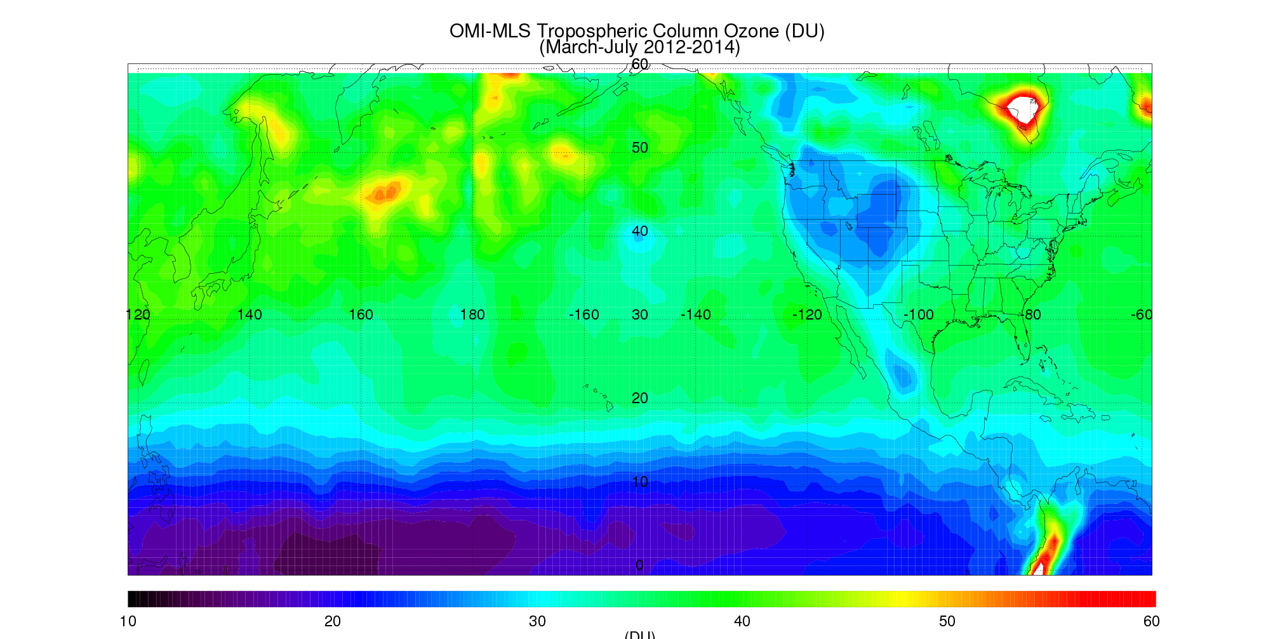
2012-2014 distribution of O3/CO
(135W-125W)
Total, “Pollution” (O3>60ppbv, CO>150ppbv) , and “Stratospheric” (O3>60ppbv, CO<75ppbv) contributions

Slide 5
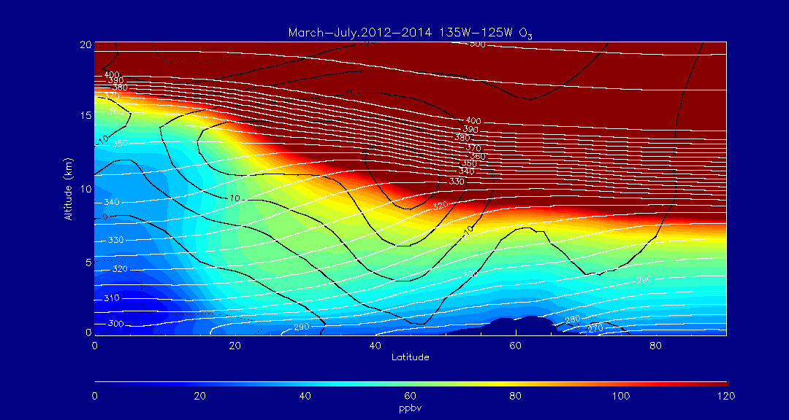
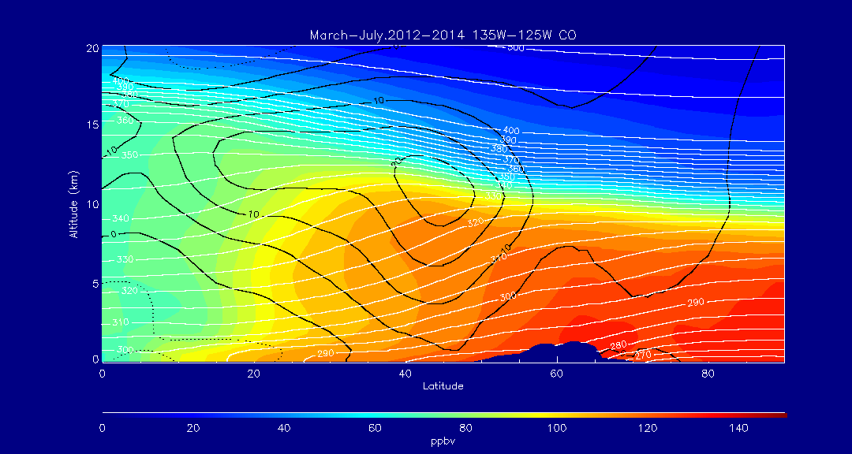
RAQMS Zonal Mean O3 March-July 2012-14 (135W-125W)
Mean O3 >60ppbv
extends below 3km at 25N
RAQMS Zonal Mean CO March-July 2012-14 (135W-125W)
Mean CO shows significant NS gradient above O3>60ppbv isopeth – mixing of stratospheric (high O3/low CO) air with polluted (high O3/high CO) air

Slide 6
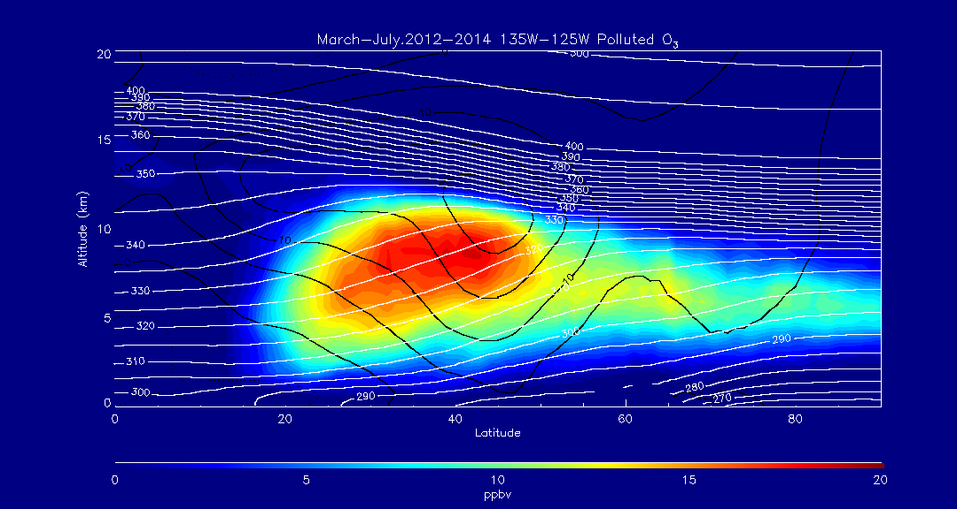
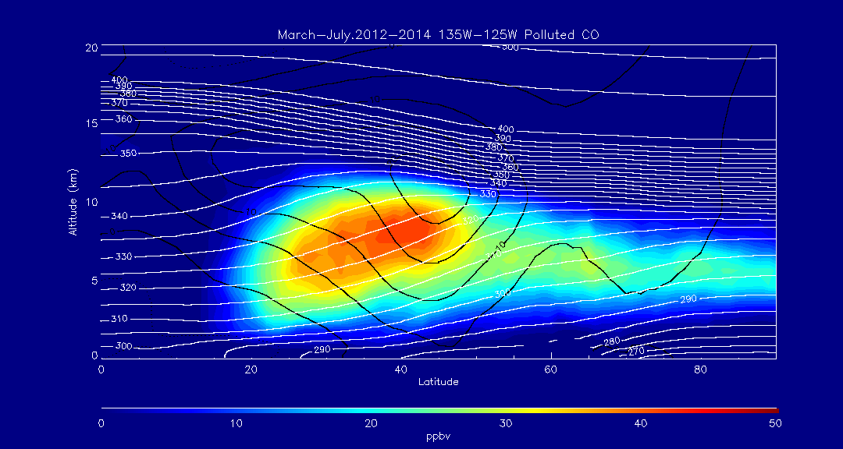
RAQMS Zonal Mean “Pollution” O3 March-July 2012-14 (135W-125W)
Mean Pollution O3 >15ppbv
Pollution
(O3>60ppbv,CO>150ppbv))
RAQMS Zonal Mean “Pollution” CO March-July 2012-14 (135W-125W)
Mean Pollution CO >40ppbv

Slide 7
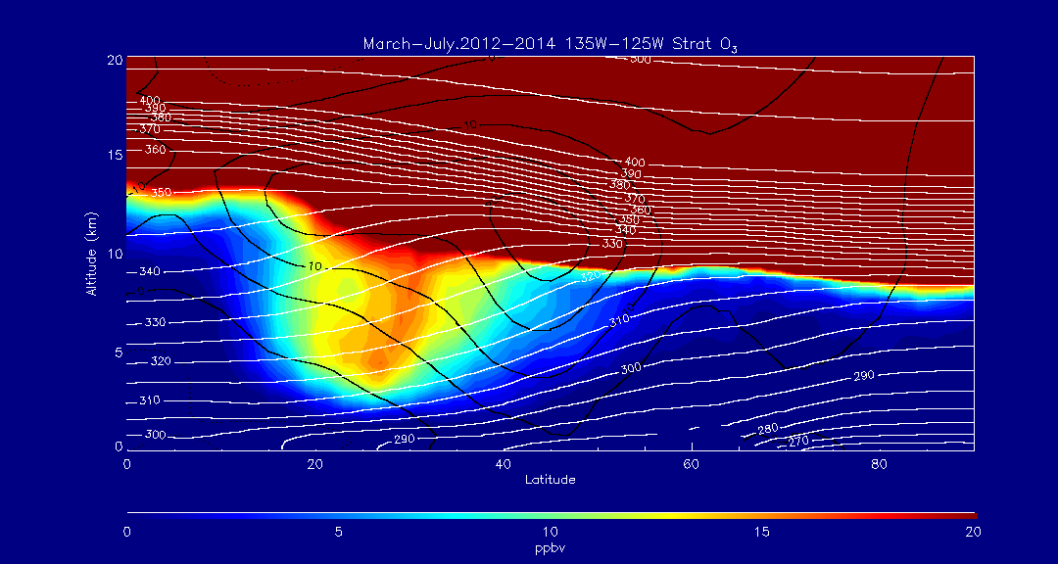
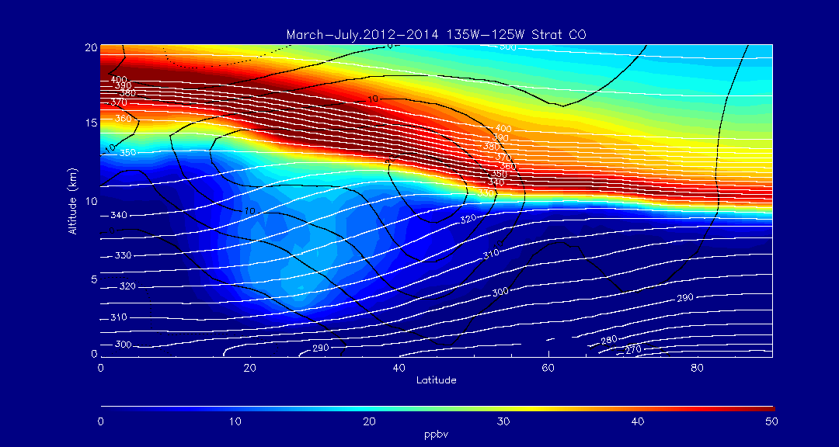
RAQMS Zonal Mean “Strat” O3 March-July 2012-14 (135W-125W)
Mean Stratospheric O3 >15ppbv
Stratospheric
(O3>60ppbv,CO<75ppbv))
RAQMS Zonal Mean “Strat” CO March-July 2012-14 (135W-125W)
Mean Stratospheric CO <20ppbv

Slide 8
Contribution of Asian Wildfires to Background Ozone
(April 2008 ARCPAC/ARCTAS Campaigns)

Slide 9
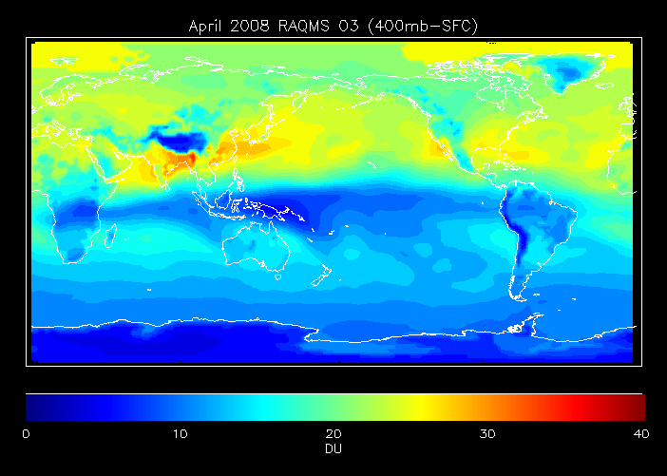
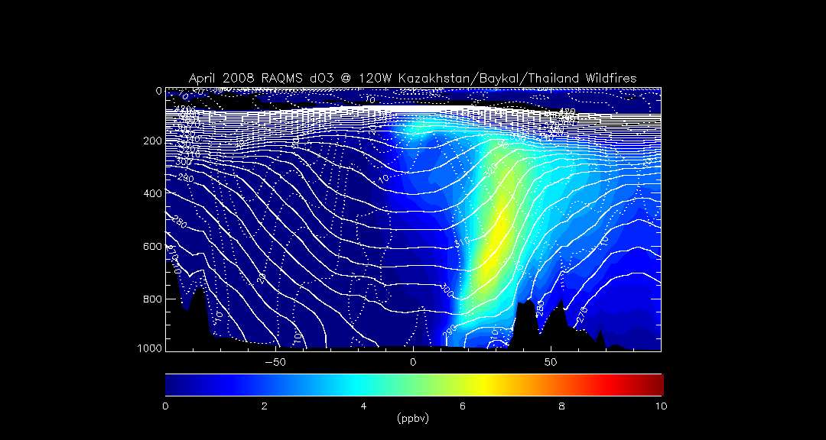
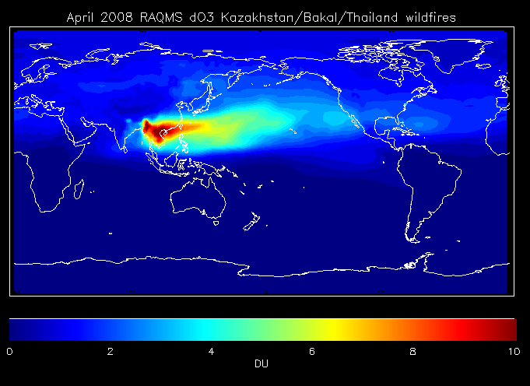
Impacts of Kazakhstan/Baykal/Thailand wildfires
120W
Impact of Kazakhstan/Baykal/Thailand wildfires on tropospheric ozone production extends into North America with potential US Air Quality impacts
Natarajan, M., et al. (2012), Radiative forcing due to enhancements in tropospheric ozone and carbonaceous aerosols caused by Asian fires during spring 2008, J. Geophys. Res., 117, D06307, doi:10.1029/2011JD016584.
Notes:
9

Slide 10
Contribution from East Asian Emissions
to
Background Ozone
(May-June 2010 CalNex Campaign)

Slide 11
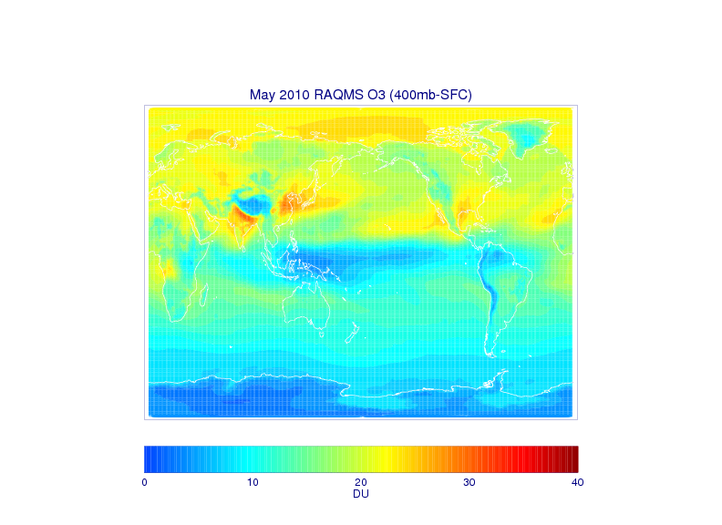
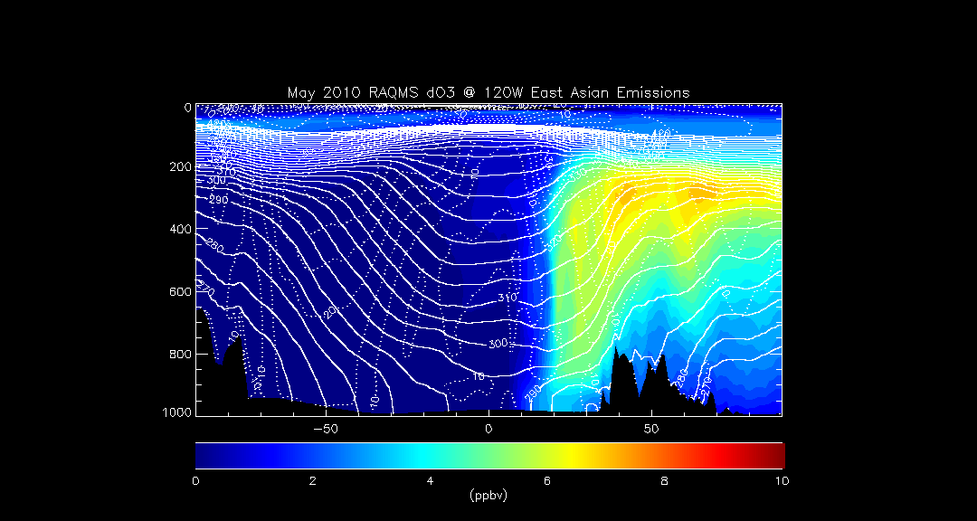
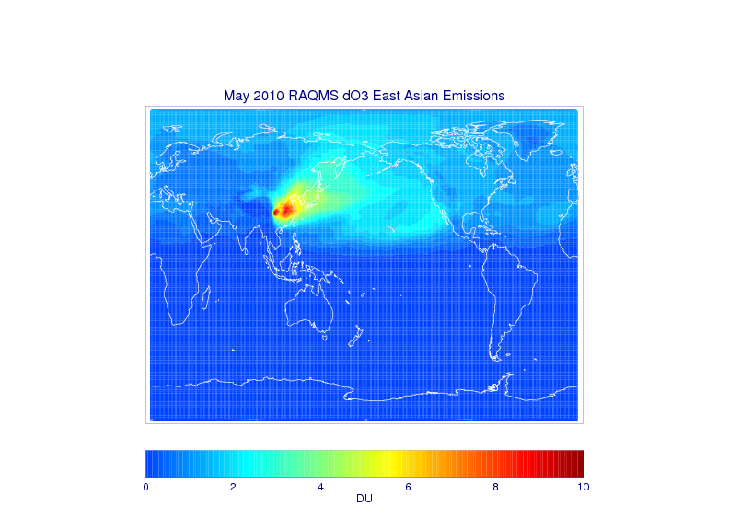
Impacts of East Asian Emissions – May 2010
120W
Impact of East Asian ozone production extends into North America with potential US Air Quality impacts
The Task Force on Hemispheric Transport of Air Pollution (TF HTAP) is an international scientific cooperative effort to improve the understanding of the intercontinental transport of air pollution across the Northern Hemisphere.
Notes:
11

Slide 12
Contribution from Stratospheric Intrusions
to
Background Ozone
(June 2012 Wyoming Exceptional Event Demonstration)

Slide 13
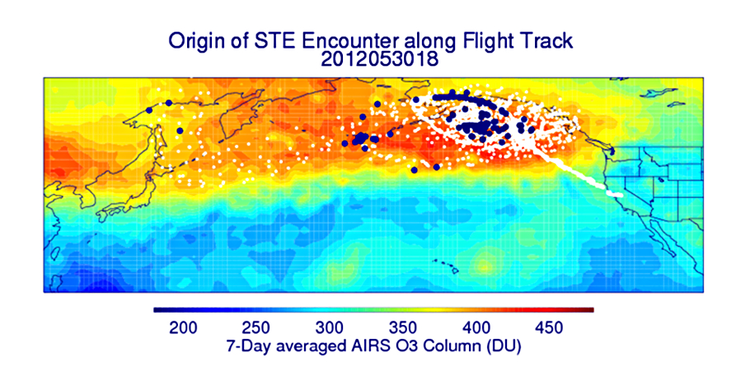
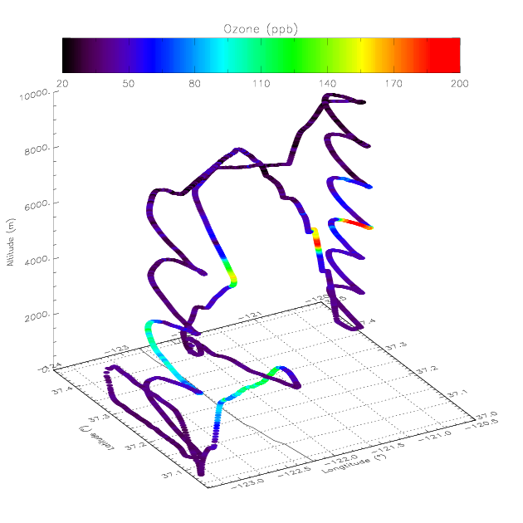
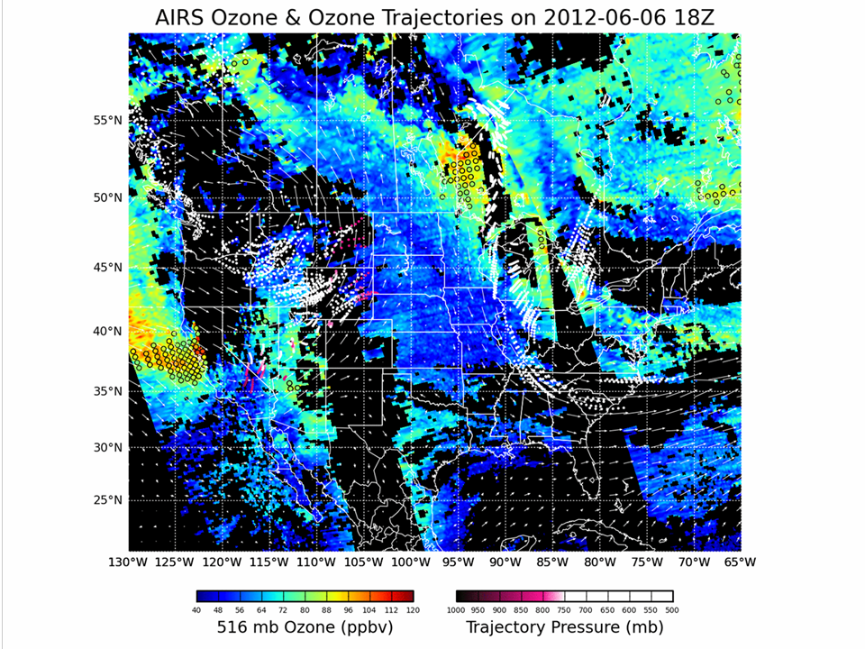
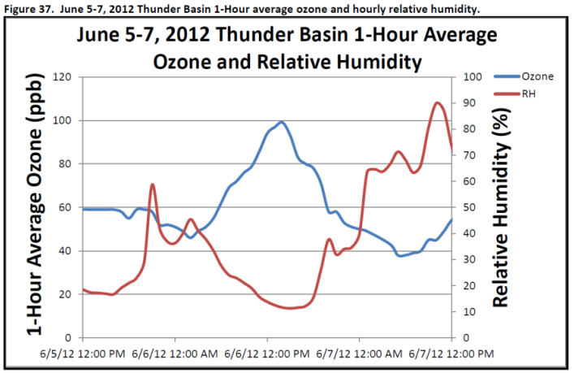
Impacts of Stratospheric Intrusions
Alpha Jet Atmospheric eXperiment (AJAX)
(Emma Yates and Laura Iraci, NASA Ames)
5 June 2012
  1) AJAX samples filament of high O3
  2) Back trajectories show origin within high Column Ozone
4) Possible Exceptional Event Designation at Thunder Basin, WY
3) IDEA-I SI forecast shows descent to surface over Wyoming
Fiore, A. M., et al., Detecting and Attributing Episodic High Background Ozone Events, Environ. Manager, Feb 2014, p. 22.

Slide 14
Inter-annual Variability in Background Ozone
(May 2012-2014 Mount Bachelor Observatory)

Slide 15
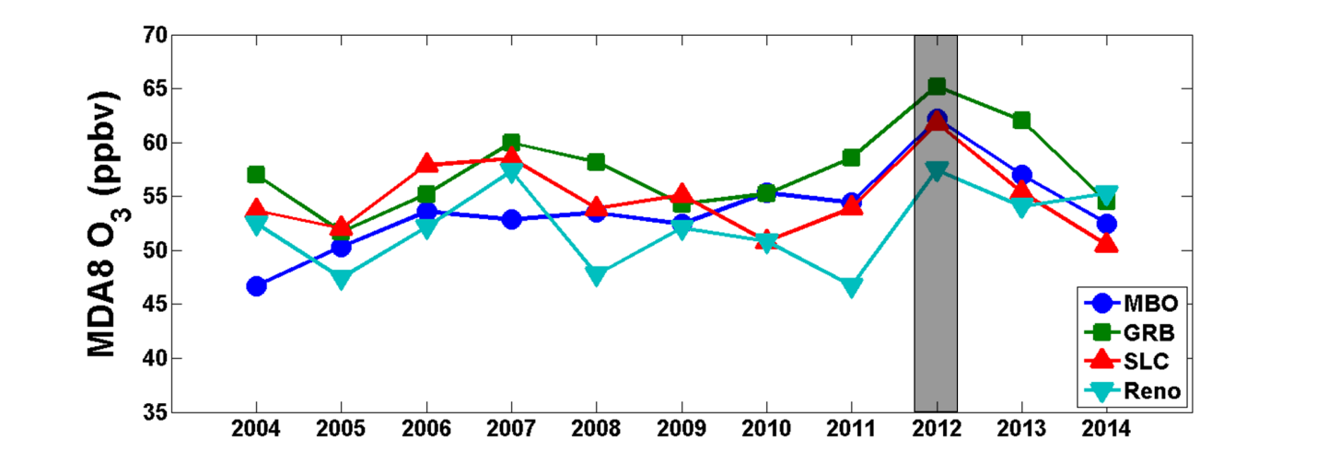
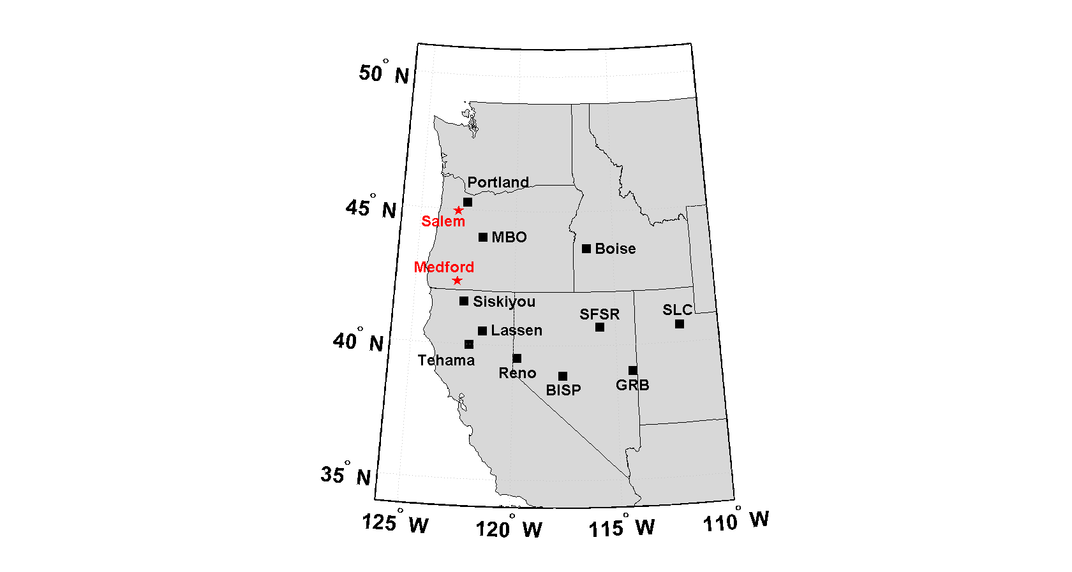
Mount Bachelor Observatory (MBO) MDA8 O3 and downwind sites
May MDA8 2004-2014
May 2012 shows highest MDA8 O3 since 2004
From “Elevated Springtime 2012 Ozone in the Western U.S.”
Pao M. Baylon, Dan A. Jaffe, R. Bradley Pierce (in preparation)

Slide 16
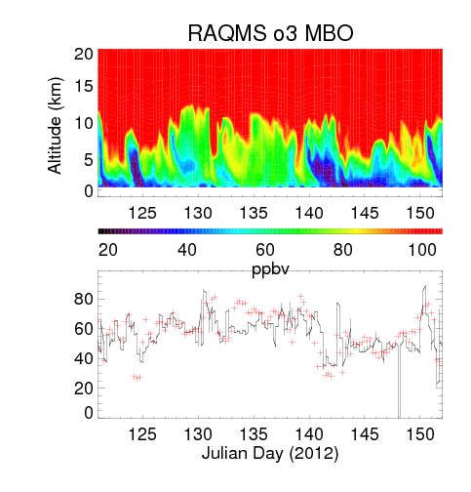
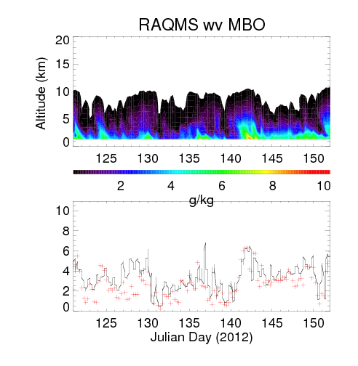
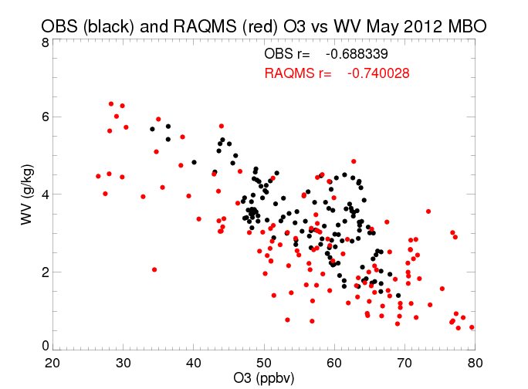
May O3 2012
r=0.69
Bias=0.72g/kg
r=0.75
Bias=-1.4ppbv
Strong anti-correlation between surface ozone and surface water vapor (WV) suggests upper troposphere/ lower stratosphere influence

Slide 17
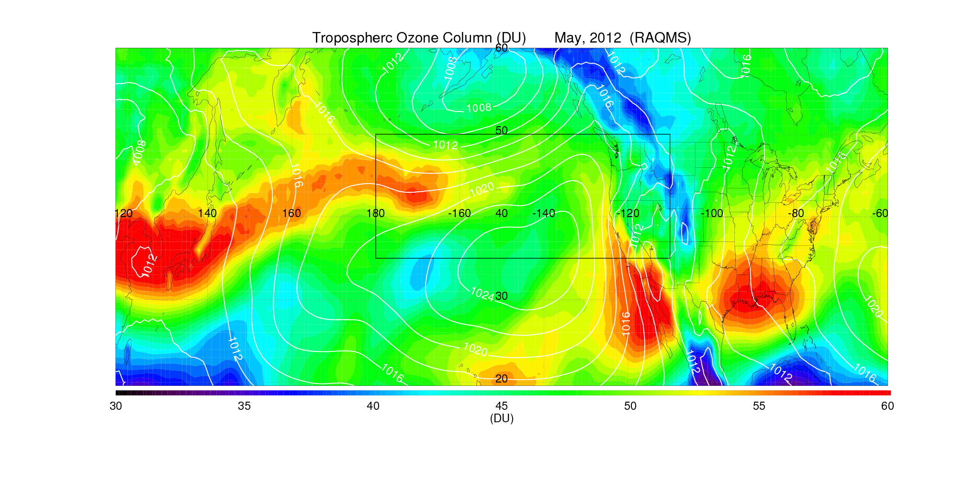
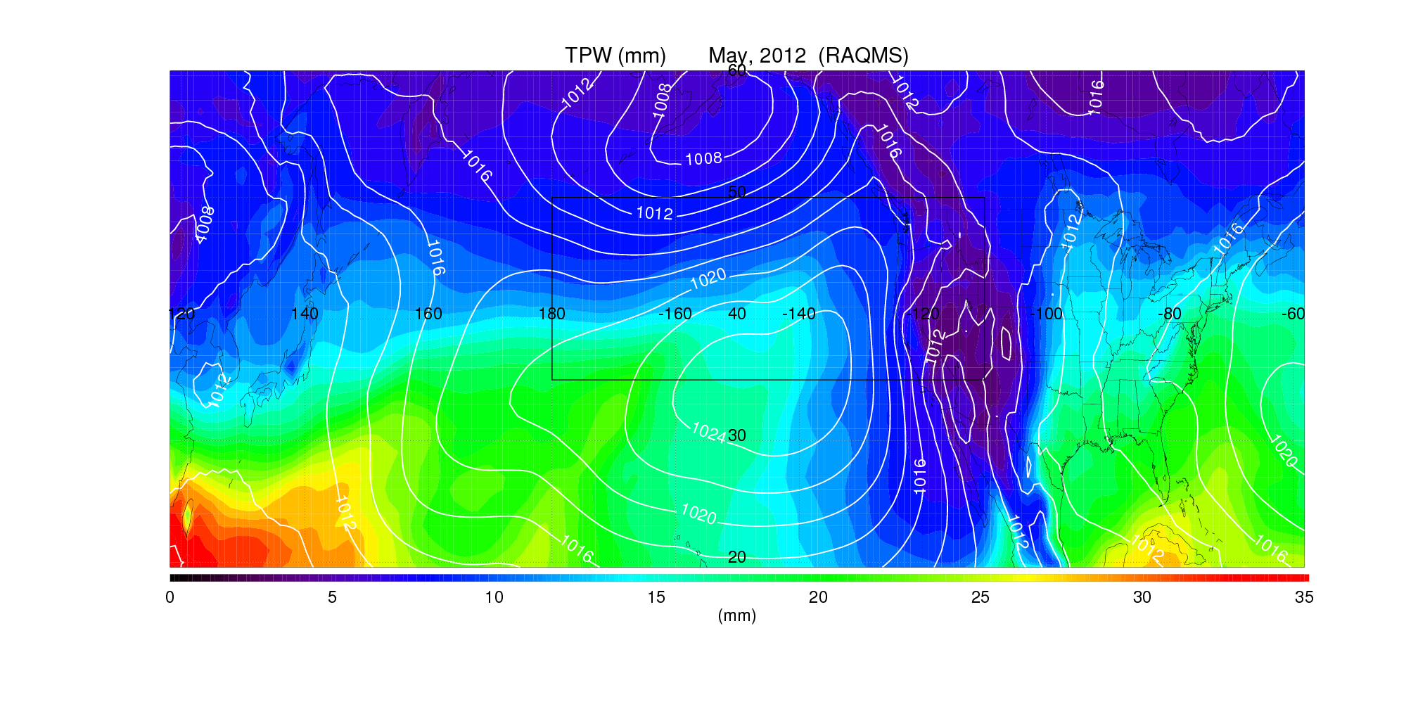
May 2012
Tropospheric
Ozone Column (TCO)
and
Total Precipitable Water (TPW)
(Surface Pressure contoured in white)
TOLNet Table Mountain Facility (JPL)

Slide 18
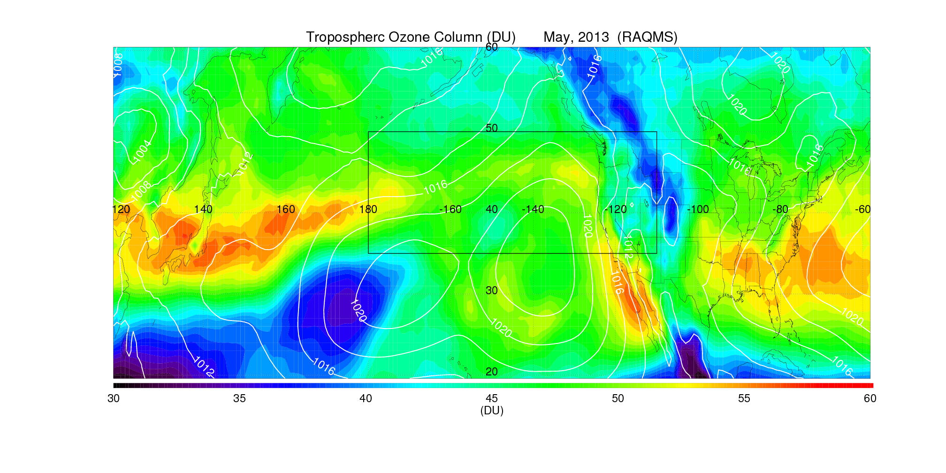
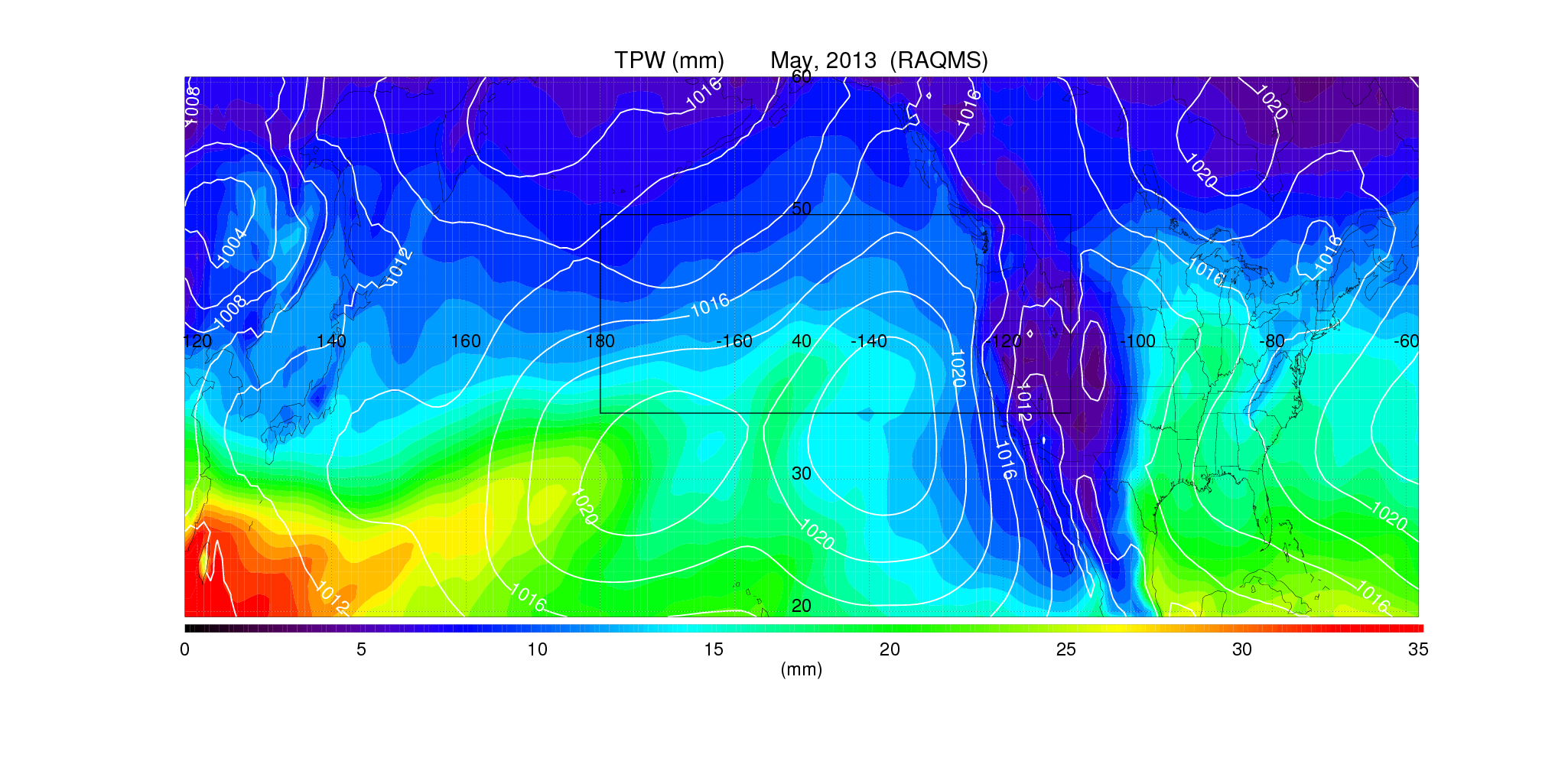
May 2013
Tropospheric
Ozone Column (TCO)
and
Total Precipitable Water (TPW)
(Surface Pressure contoured in white)
TOLNet Table Mountain Facility (JPL)

Slide 19
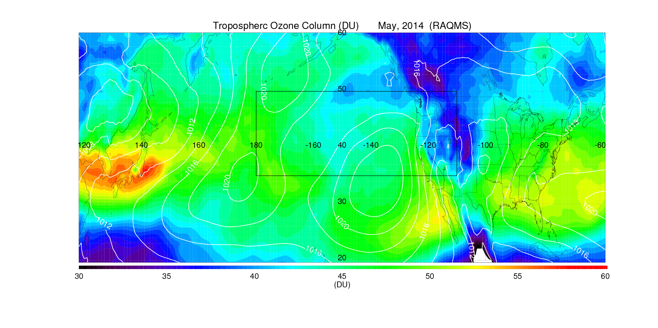
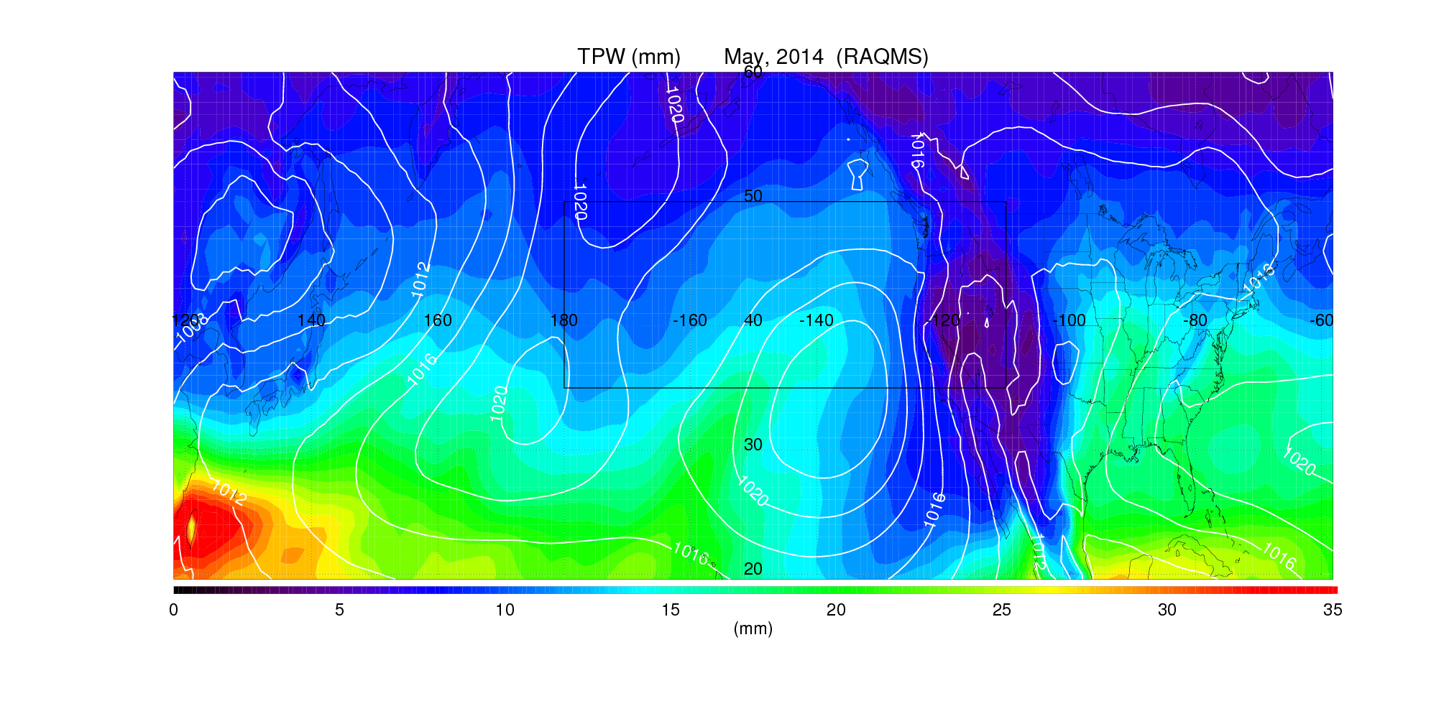
May 2014
Tropospheric
Ozone Column (TCO)
and
Total Precipitable Water (TPW)
(Surface Pressure contoured in white)
TOLNet Table Mountain Facility (JPL)

Slide 20
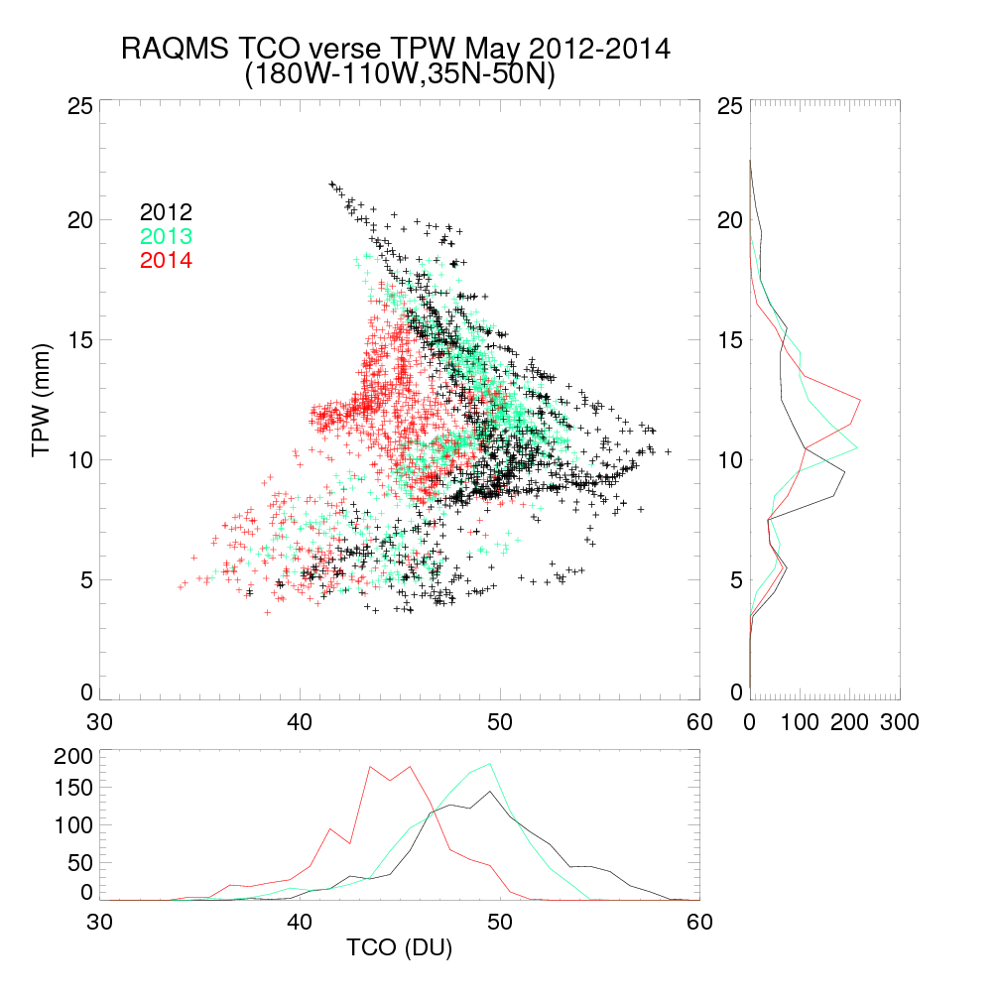
Scatter plots of
May 2012-2014
TPW vs TCO
upstream from MBO
2012 driest median TPW
2012 highest TCO

Slide 21
Inter-annual Variability in Background Ozone
(May 2012-2014 JPL-Table Mountain Facility)

Slide 22
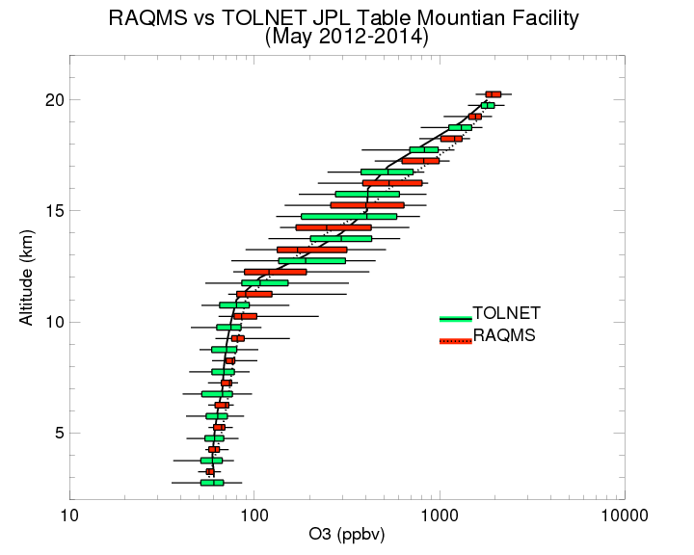
TOLNet JPL-Table Mountain Facility Tropospheric Ozone Lidar (Thierry Leblanc, JPL)

Slide 23
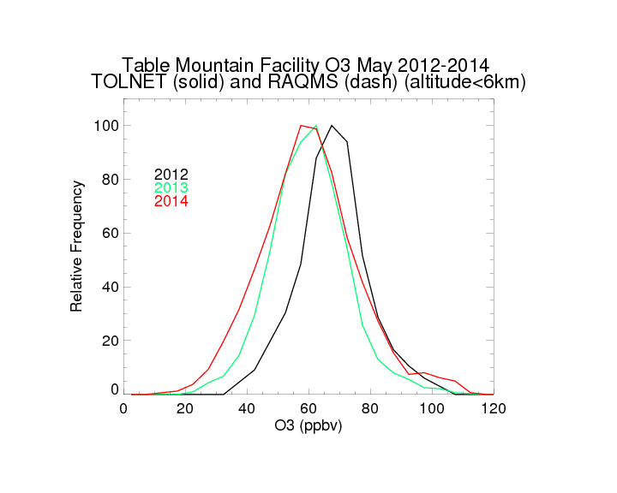
TOLNet JPL-Table Mountain Facility Tropospheric Ozone Lidar (Thierry Leblanc, JPL)

Slide 24
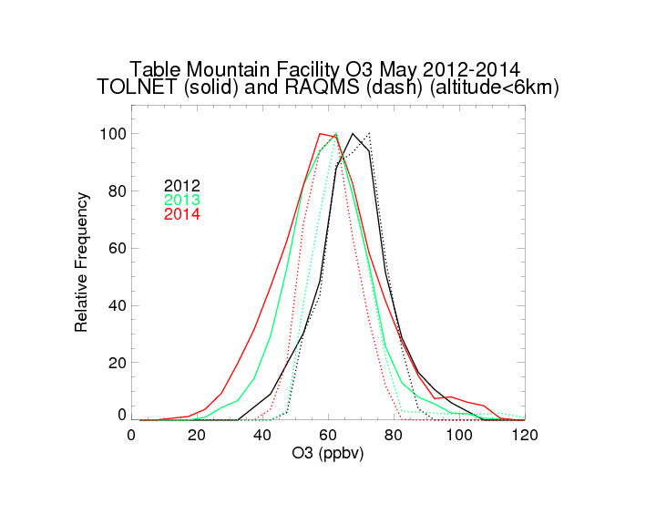
TOLNet JPL-Table Mountain Facility Tropospheric Ozone Lidar (Thierry Leblanc, JPL)

Slide 25
Daily Variability in Background Ozone
(July-August 2014, FRAPPE/DISCOVER-AQ Front Range Experiment)

Slide 26
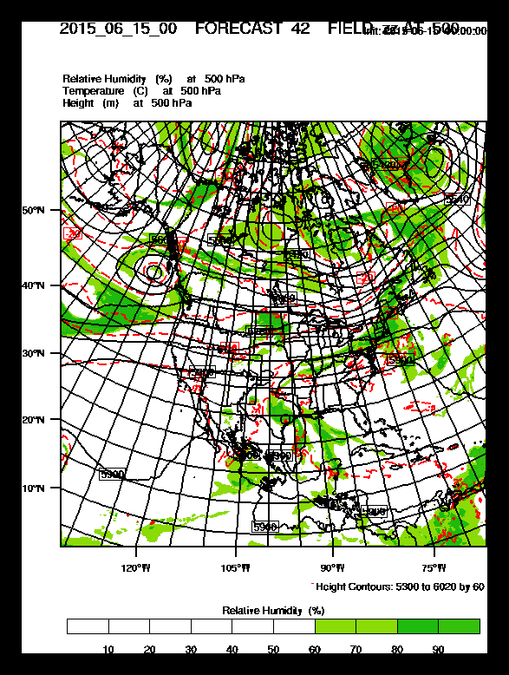
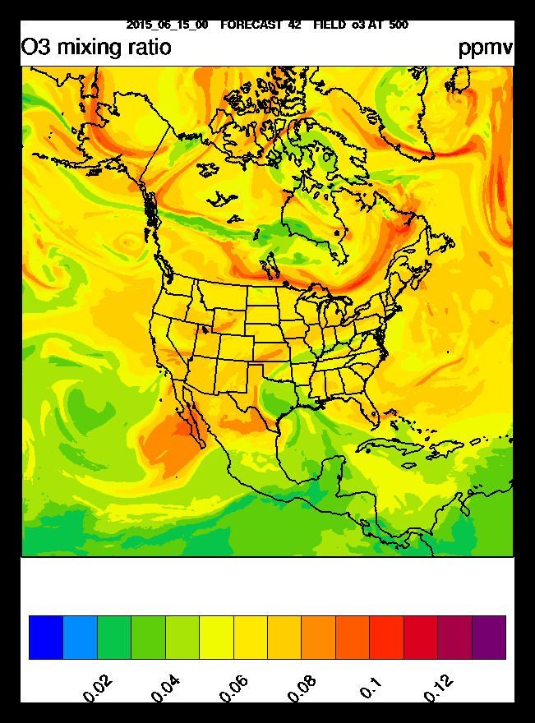
Real-time Nested RAQMS/Rapid Refresh with Chemistry
(RR-Chem) predictions
The RR-Chem model is a research version of the NOAA Rapid Refresh configuration of the Weather Research and Forecasting model with chemistry (WRF-Chem) run in real-time at NOAA/ESRL using GFS meteorological and RAQMS chemical boundary conditions.
RR-Chem 42hr 500mb Met/O3 forecast valid at 18Z June 16, 2015 (12:00pm Mountain) initialized at 00Z June 15, 2015
RR-Chem is configured and run by Georg Grell and Steven Peckham at NOAA/ESRL.
(http://ruc.noaa.gov/wrf/WG11_RT/)

Slide 27
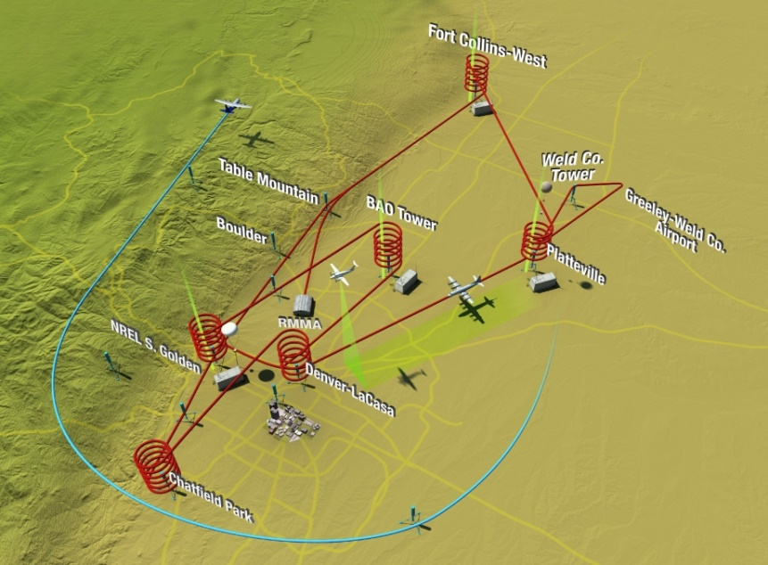
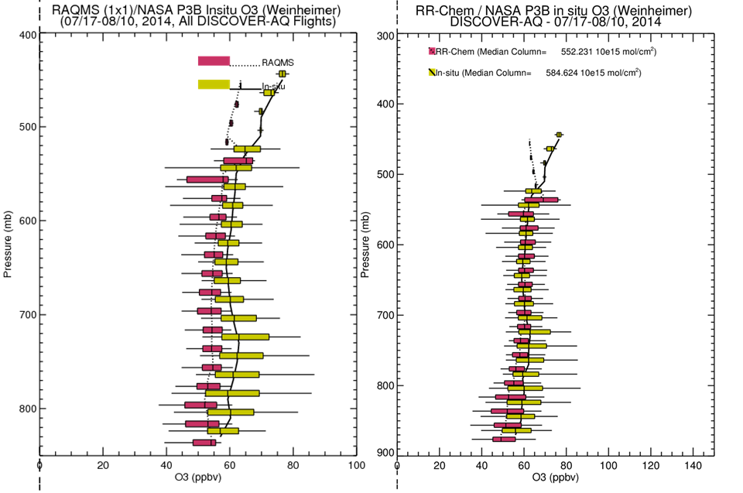
Verification of RAQMS/RR-Chem
Real-time forecasts during the 2014 FRAPPE/DISCOVER-AQ mission
TOLNet Ft Collins DISCOVER-AQ (GSFC)
Nested RAQMS/RR-Chem forecasts show reduced biases and improved variability compared to airborne insitu measurements between 700-500mb.
Reduced bias

Slide 28
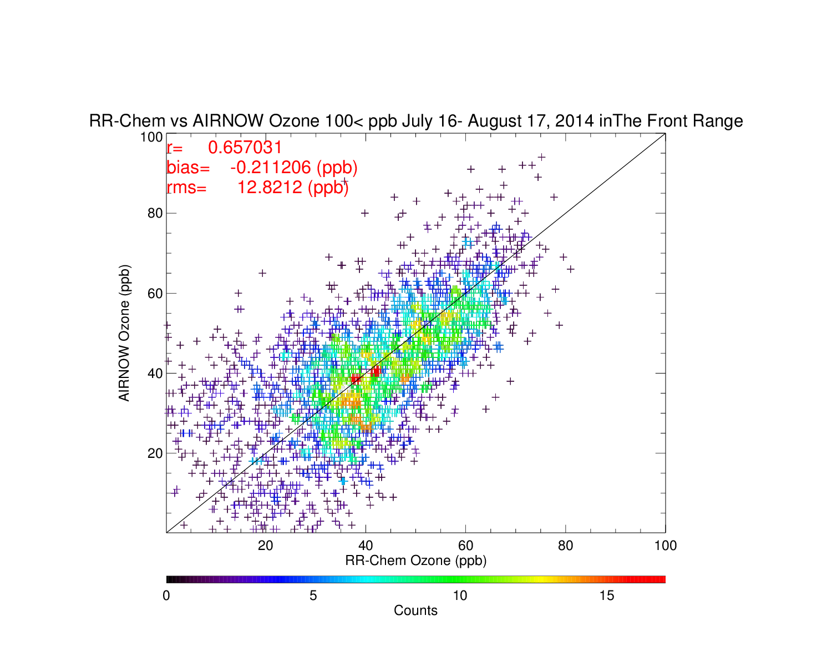
RR-Chem vs AIRNow surface O3
(July 16-August 178, 2014)

Slide 29
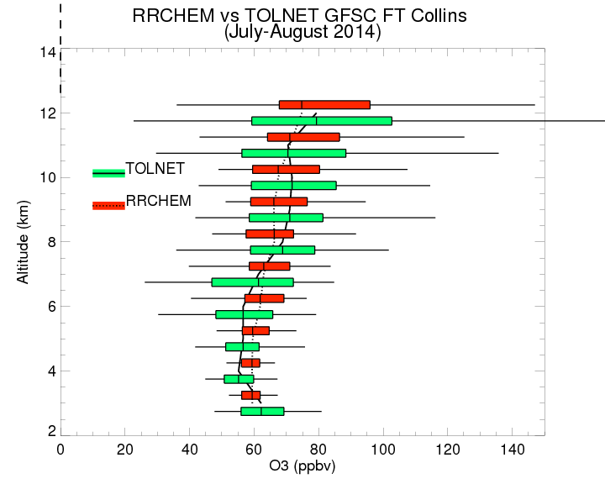
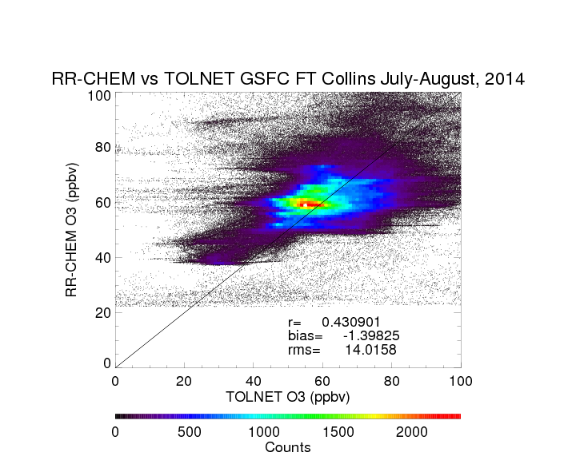
TOLNet GSFC Tropospheric Ozone Lidar (TROPOZ) (Thomas J. McGee, NASA/GSFC, John Sullivan, UMBC/JCET)

Slide 30
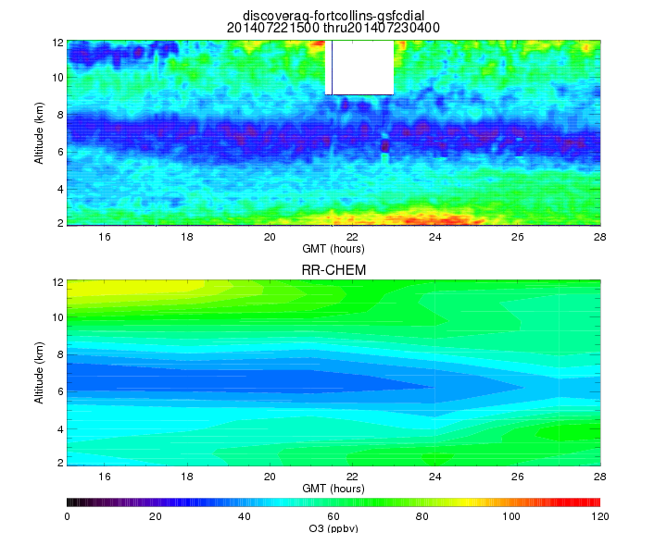
RR-CHEM vs TOLNet Ft. Collins July 22, 2014
TOLNet GSFC Tropospheric Ozone Lidar (TROPOZ) (Thomas J. McGee, NASA/GSFC, John Sullivan, UMBC/JCET)

Slide 31
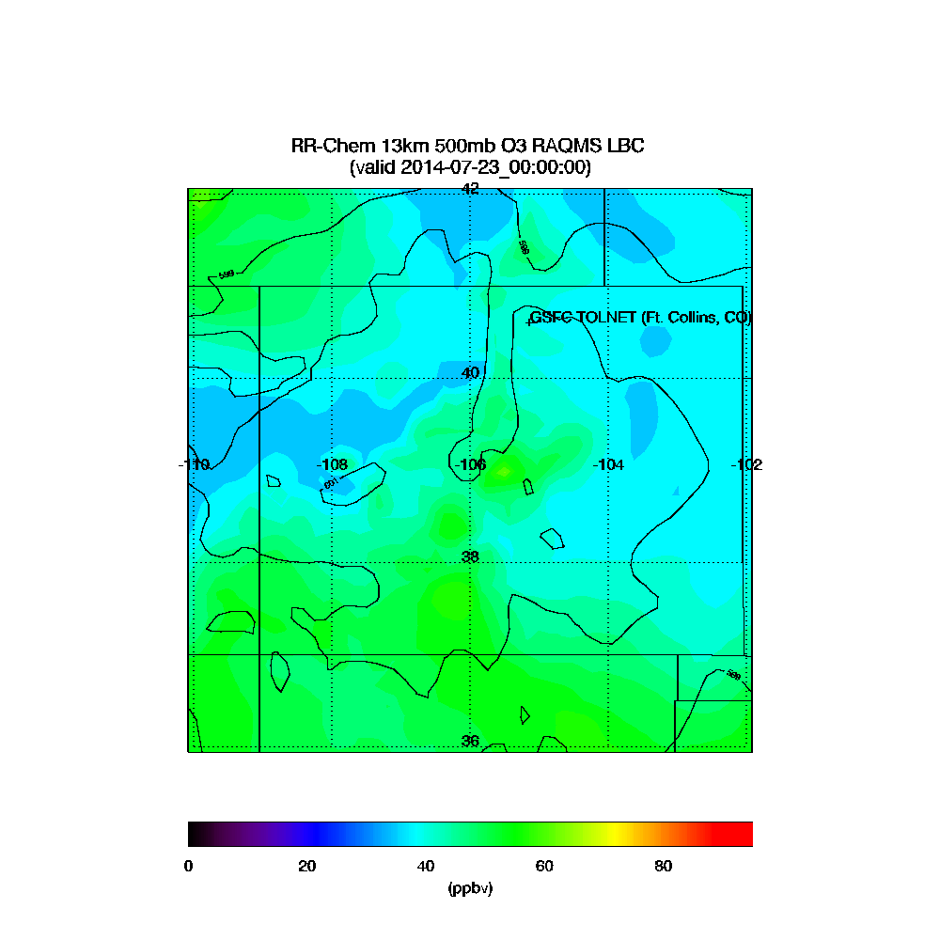
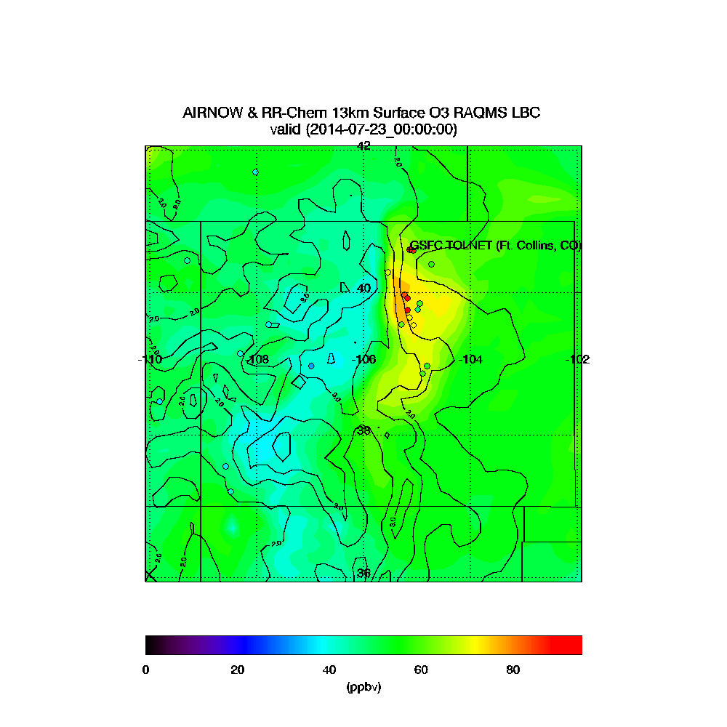
RR-CHEM 500mb/SFC O3 00Z July 23, 2014

Slide 32
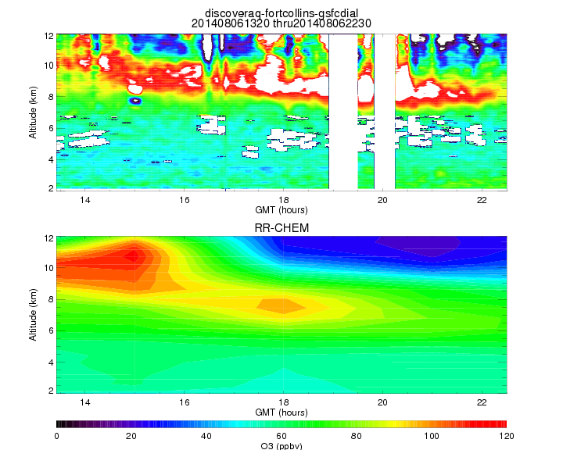
RR-CHEM vs TOLNet Ft. Collins August 6, 2014
TOLNet GSFC Tropospheric Ozone Lidar (TROPOZ) (Thomas J. McGee, NASA/GSFC, John Sullivan, UMBC/JCET)

Slide 33
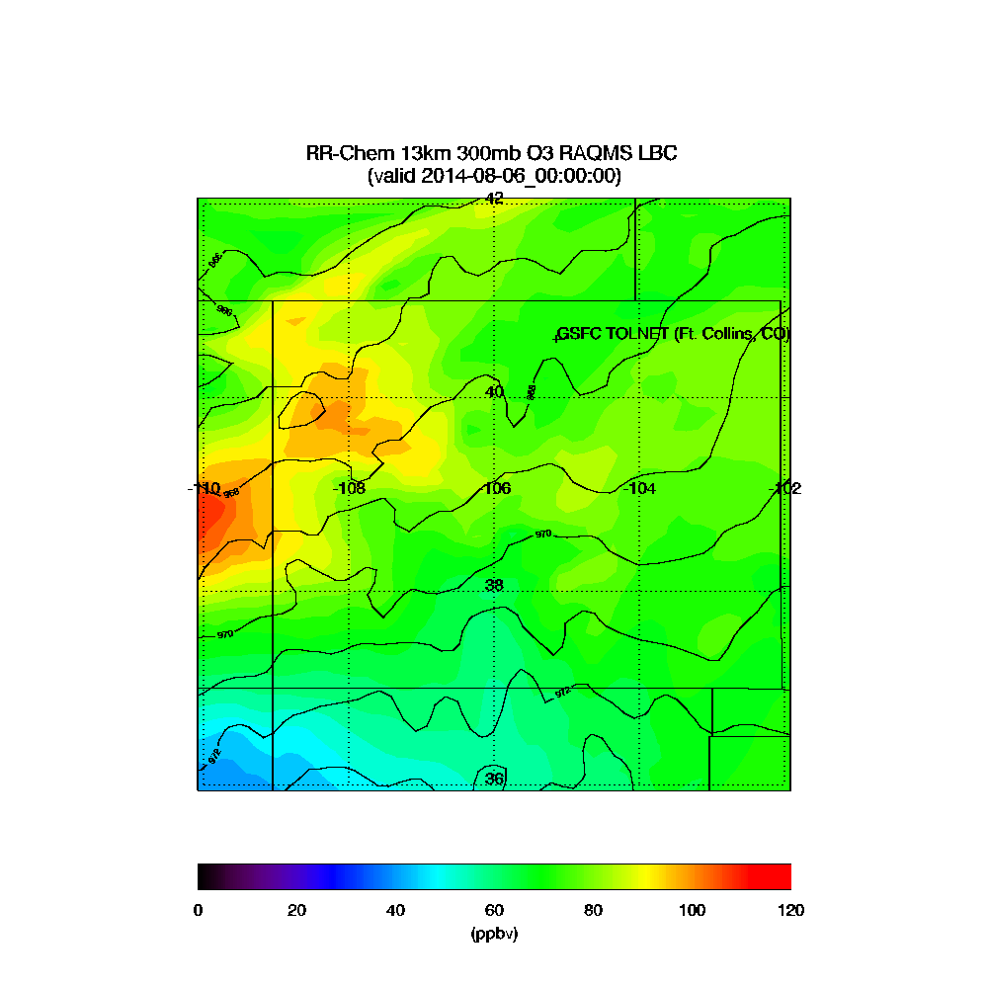
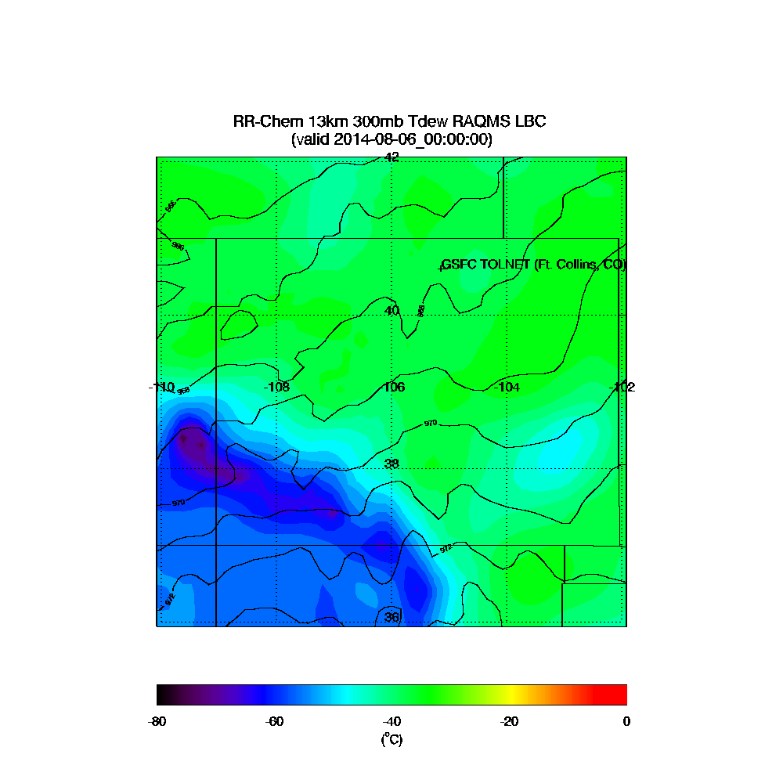
RR-CHEM 300mb O3/Tdew August 0, 2014

Slide 34
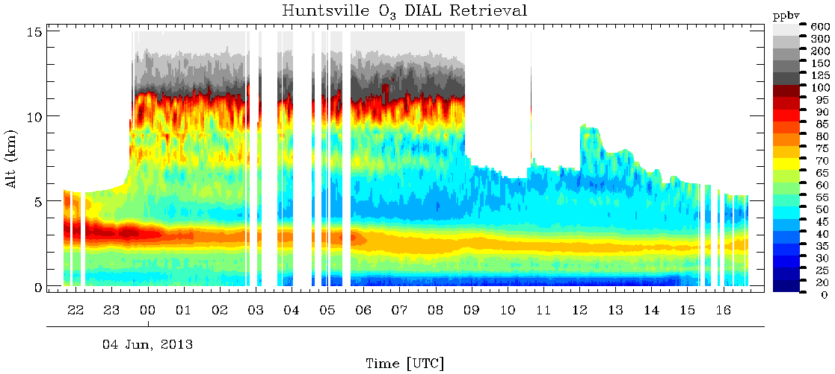
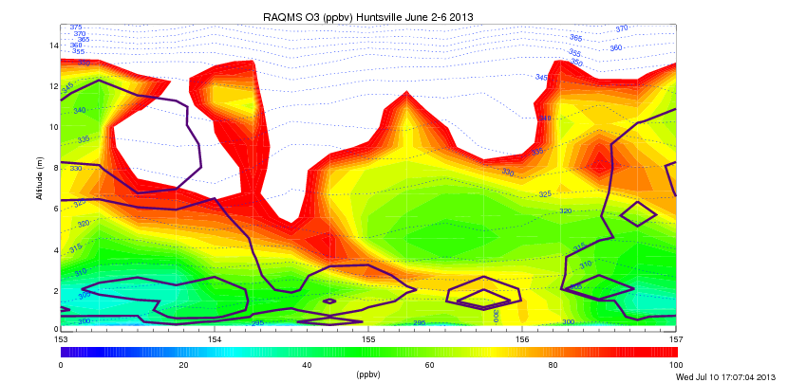
00Z on June 5, 2013
Clouds contoured (note different color scale)

Slide 35

00Z on June 5, 2013
RAQMS generally overestimates daytime O3 at Huntsville during June, 2013.
Significant overestimate at 00Z on June 4, 8, 9, 11. Good agreement at 00Z on June 5.
Strong diurnal variation in both observed and RAQMS surface O3 on June 5, 2013 suggests significant photochemical contributions

