Slide 1
TEMPO Science Team Meeting:
EPA Model Applications of Satellite Data
Presenter: Barron H. Henderson
US EPA Office of Air Quality Planning and Standards
Co-Authors: James East, Shannon N. Koplitz, Sergey Napelenok, OAQPS Satellite Forum
Disclaimer: Although this work was reviewed by EPA and approved for publication, it may not necessarily reflect official Agency policy.

Slide 2
Where can TEMPO add value for the EPA model applications?
How does EPA currently use satellite data in model applications?
  Satellite screening of model inputs
  Satellite model evaluation
Progress on data assimilation
  Assimilation webinar overview
  Assimilation and inverse emissions methodology
  Preliminary research results
Considerations for TEMPO

Slide 3
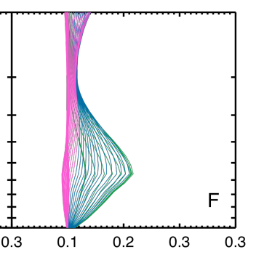
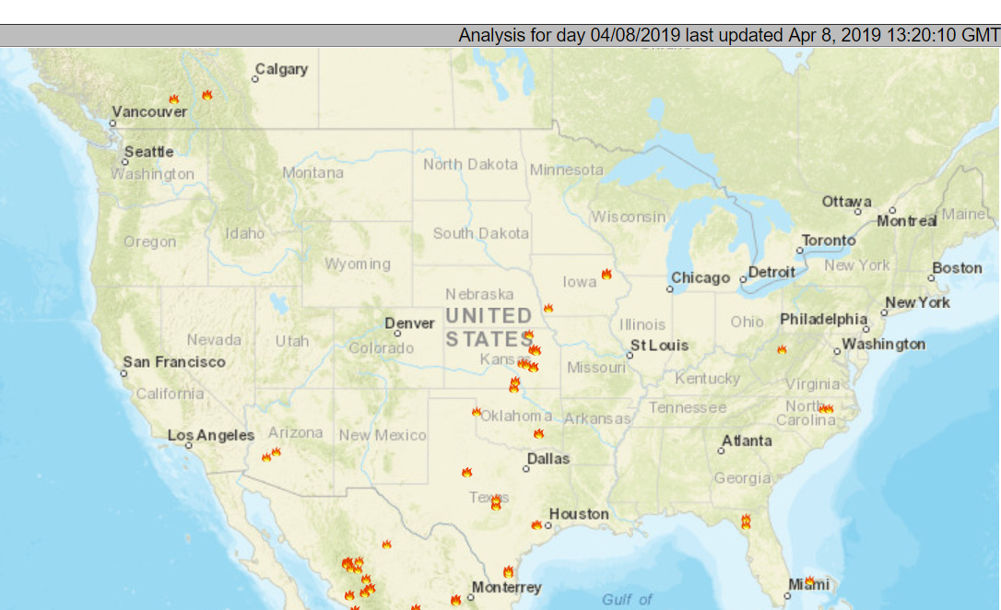
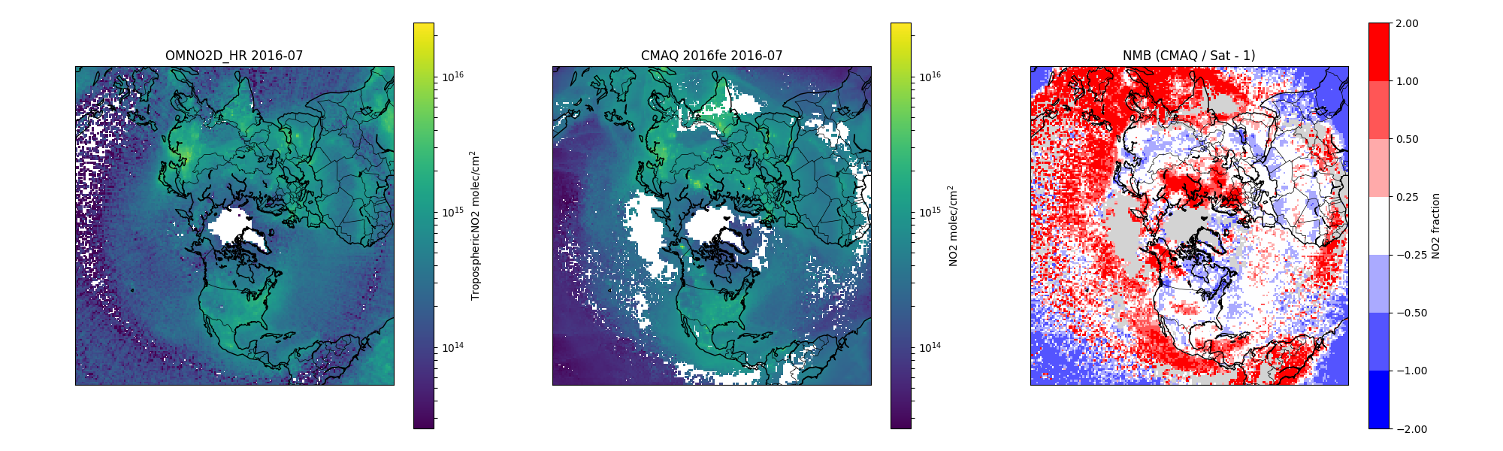
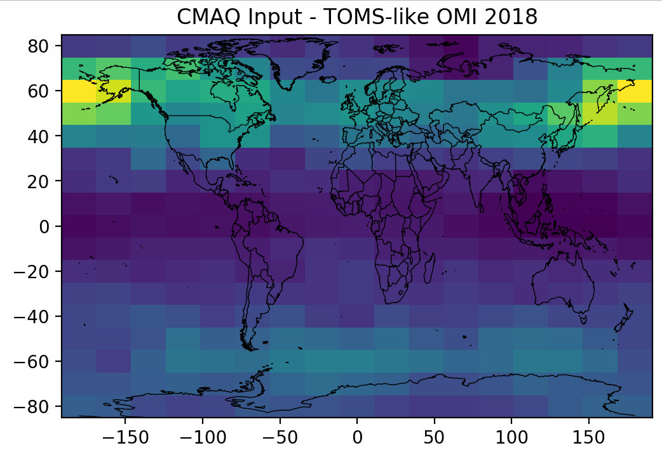
How does EPA use satellite data regularly?
OMI O3 Averaging Kernel
100
Often not directly interpretable as surface
  Most often total column measurement with low sensitivity to the surface for some species.
  Requires model “priors” and “kernels” or “assimilation” for interpretation to ground level.
Pressure (hPa)
Meteorological Model Inputs
  Land use/Land Cover, Digital Elevation Maps
  GHR Sea Surface Temperatures
  Data assimilation (e.g, GEOS, CAMS, GDAS, WRF)
1000
Emissions Model Inputs
  e.g., MEGAN, FINN, GFED, BlueSky
  Fire detection, land area burned
Fu et al. 10.5194/acp-13-3445-2013
Fires from NOAA’s Hazard Mapping System
Air Quality Model Inputs
  Land use/Land Cover, Digital Elevation Maps
  Daily coarse TOMS/OMI Ozone to adjust j-values
  Other existing products, new products?
OMI NO2
CMAQ Bias
Air Quality Model or Emissions Evaluation*
  OMI Nitrogen Dioxide Tropospheric Columns
  OMI Ozone Tropospheric Columns
  OMI Formaldehyde Columns
  MODIS Aerosol Optical Depth
  CRIS Ammonia
OMI Nitrogen Dioxide
CMAQ Model Input
2020 Ozone Policy Assessment
Moving towards assimilation!*
*More detail on next slides
Notes:
Contributors
https://docserver.gesdisc.eosdis.nasa.gov/repository/Mission/OMI/3.3_ScienceDataProductDocumentation/3.3.2_ProductRequirements_Designs/README.OMI_DUG.pdf

Slide 4
Qualitative emission input screening
Newer data confirms EPA choice
2016 hemispheric model emissions options
  Hemispheric Transport of Air Pollutants v2 mosaic inventory was the base
  CEDS CMIP6 inventory was released in time for us to incorporate updated trends out to 2014.
  CEDS showed increase NOx/SOx;
  Zhao et al [2015] showed decreases in recent years and lower magnitudes.
Satellite showed decreases
  van der A et al. 2017 doi:10.5194/acp-17-1775-2017; Krotkov, et al. 2016. doi: 10.5194/acp-16-4605-2016
  Likely related to recent controls.
  Updates to CEDS confirm decrease
Notes:
Bryan – I think I might want to split this into two. Maybe take the second half and make it its own slide pushing assimilation. The first half really highlights that we are relying on satellite data already, but much of that is semi-quantitative. Quantitative analyses feeding qualitative decisions.
Duncan et al. 2015 doi: 10.1002/2015JD024121 would also be a good citation.
OMI NO2

Slide 5
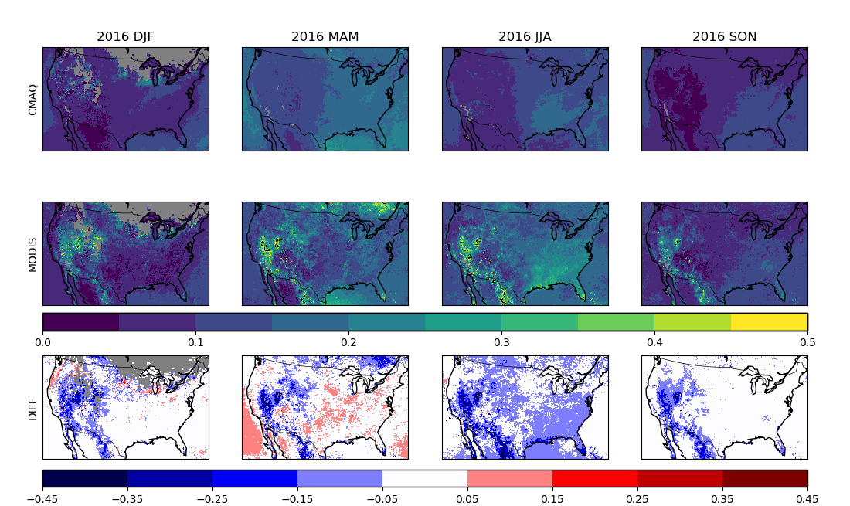
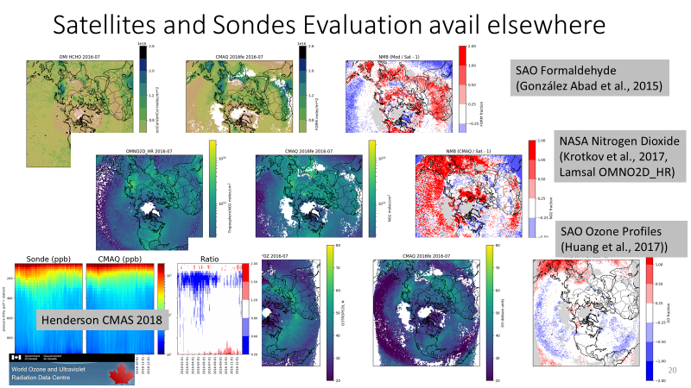
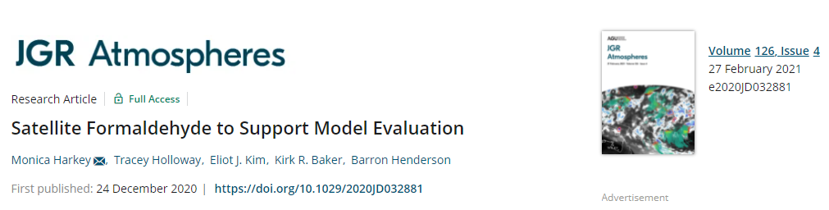
Evaluation for surface concentration estimates
CMAQ v5.3
*Aerosol Optical Depth
MODIS
Model evaluation*
  2020 Ozone Policy Assessment included evaluation against nitrogen dioxide, ozone, and formaldehyde
  Evaluation is performed quantitatively, but also considers uncertainties (e.g., AMF) qualitatively
Diff
*Gases: NO2, O3, HCHO
Emissions Quality Assurance
  NO2 and SO2 comparisons informed global emission inventory
  Useful for evaluating current inventories even if not directly applied
What about direct feedback?
Model processes and performance varies by time of day and at fine spatial scales that benefit from geostationary.
Notes:
Difference

Slide 6
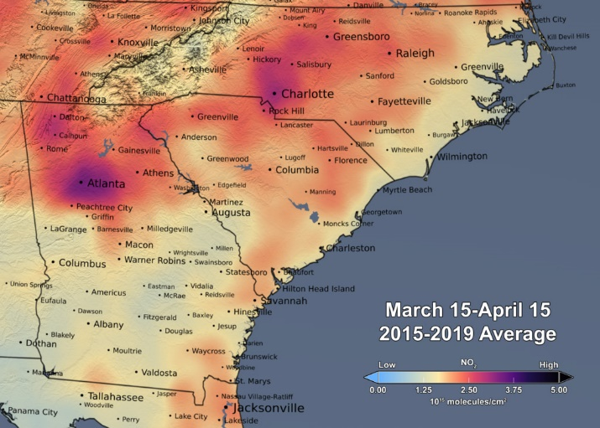
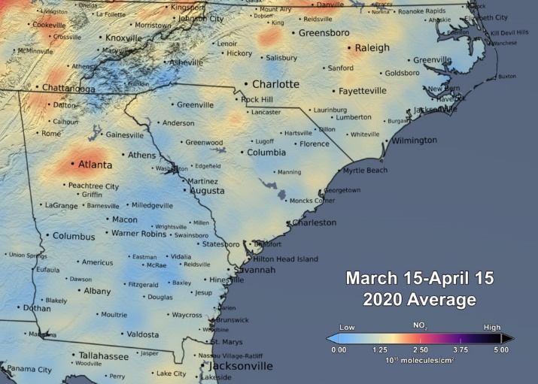
Policy-relevant modeling opportunities for satellite assimilation
NASA OMI Team
Direct application of assimilation is not right for every application because it removes deterministic relationship between emissions and concentration.
Regional modeling is dependent on global “boundary conditions”
  Inter-continental anthropogenic transport and natural emissions largely contribute to what enters our model and is not the focus of controls.
  International inventories are often updated less frequently or are a challenge to integrate into our platform
Emission Inventory Development
  Quality assurance by evaluation and comparison
    Temporal and spatial variation
    Existence or absence of “hotspots” or Regional outliers
  Constraints on uncertain sources (NOx/VOC, but aerosol precursors)
    Wildland fires, Soil NOx
    International Emissions, Area sources
Several reasons for interest in assimilation.
Pre-COVID
OMI NO₂
Most areas of the Eastern U.S. decreased by ~30-40% after stay-at-home orders came into effect.
Post-COVID
Notes:
Bryan - In some ways this is a duplicate of slide 4, but it is a very explicit enumeration.
Barron: I thought to put these images here since this is timely and support your points in the next slides. Note: Again, you don’t have to spend time on the images. Just say something about large decreases in NO2 (~30-40% during lockdowns), which is not dissimilar to the decrease (20-60%) in urban NO2 associated with emissions controls over the OMI record (2005-present).

Slide 7



Recent Webinar on Chemical Assimilation helping EPA toward routine application
Motivated by Health and Air Quality Applied Science Team (HAQAST) project with Brad Pierce and Daniel Tong
  Tiger Team projected included technology transfer.
  Research fellow James East implementing at EPA
Assimilation experts from NASA and Academia advised on:
  Numerical assimilation frameworks that can improve air quality predictions
  Practical applications relevant to criteria pollutants and associated uncertainties
  Ongoing research needs for satellite validation and retrieval improvements
Huge success! Great panelists! Great attendance!
Chairs:
Barron H. Henderson
Bryan N. Duncan
Panelists:
Ron C. Cohen
R. Bradley Pierce
Kazuyuki Miyazaki
Zhen Qu
Attendees:
112 around the world
https://haqast.org/tiger-teams/#2017-tiger-teams

Slide 8

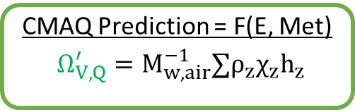
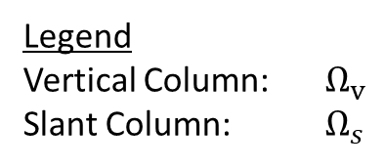
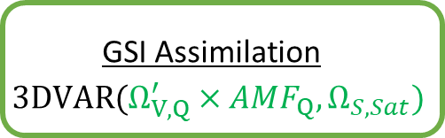
Assimilation overview
HAQAST Collaboration:
  R.B. Pierce, D. Tong, A. Lenzen
  Provided framework and support
Hemispheric CMAQ Platform (2018)
  Global emissions: HTAPv2 + China
  Regional: EPA 2016 platform
  Year-specific meteorology, biogenics, and fires
Gridpoint Statistical Interpolation (GSI)
  3d-variational assimilation
  Using OMI and TropOMI observation operators for comparison
Assimilation
  Improves fidelity w/r/t satellite = Good for improving lateral boundary conditions.
  Removes deterministic relationship and mass conservation = Not as good for attribution.
  Need for emission constraints.
James East
ORISE Research Fellow
Assimilation CMAQ/GSI
CMAQ Prediction = F(E, Met)
$$Ω_{V,Q}^{′}=M_{w,air}^{−1}∑ρ_{z}χ_{z}h_{z}$$
Hourly
GSI Assimilation
$$3DVAR({Ω_{V,Q}^{′}×AMF_{Q}, Ω}_{S,Sat})$$
Legend
Vertical Column: $Ω_{v}$
Slant Column: $Ω_{s}$
Notes:
http://www.dtcenter.org/community-code/gridpoint-statistical-interpolation-gsi/documentation

Slide 9
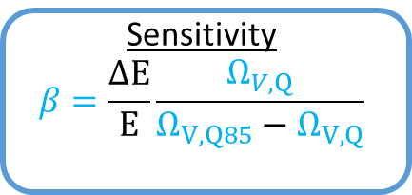
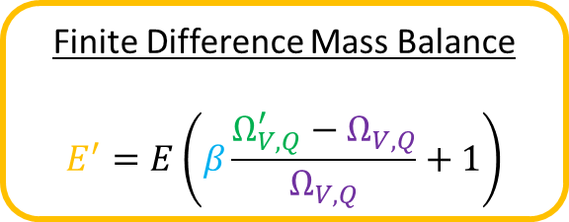
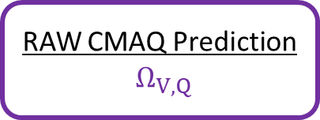
Iterative Inverse Emissions Estimation
J. East
Posterior Emissions
Initial E
Convergence Check
E’ - E < tolerance
Yes
A Priori Emissions
Global: HTAPv2 or Regional: EPA platform
E=E’
E’ is new E
Assimilation CMAQ/GSI
85%
100%
Finite Difference Mass Balance
$$E^{′}=E\left(β\frac{Ω_{V,Q}^{′}−Ω_{V,Q}}{Ω_{V,Q}}+1\right)$$
CMAQ Prediction = F(E, Met)
$$Ω_{V,Q}^{′}=M_{w,air}^{−1}∑ρ_{z}χ_{z}h_{z}$$
Hourly
Sensitivity
$$β=\frac{ΔE}{E}\frac{Ω_{V,Q}}{Ω_{V,Q85}−Ω_{V,Q}}$$
Monthly
GSI Assimilation
$$3DVAR({Ω_{V,Q}^{′}×AMF_{Q}, Ω}_{S,Sat})$$
Monthly
RAW CMAQ Prediction
$$Ω_{V,Q}$$
Legend
Vertical Column: $Ω_{v}$
Slant Column: $Ω_{s}$
*Only grid cells with substantial anthropogenic emissions are adjusted
Notes:
Only grid cells with substantial anthropogenic emissions are adjusted

Slide 10
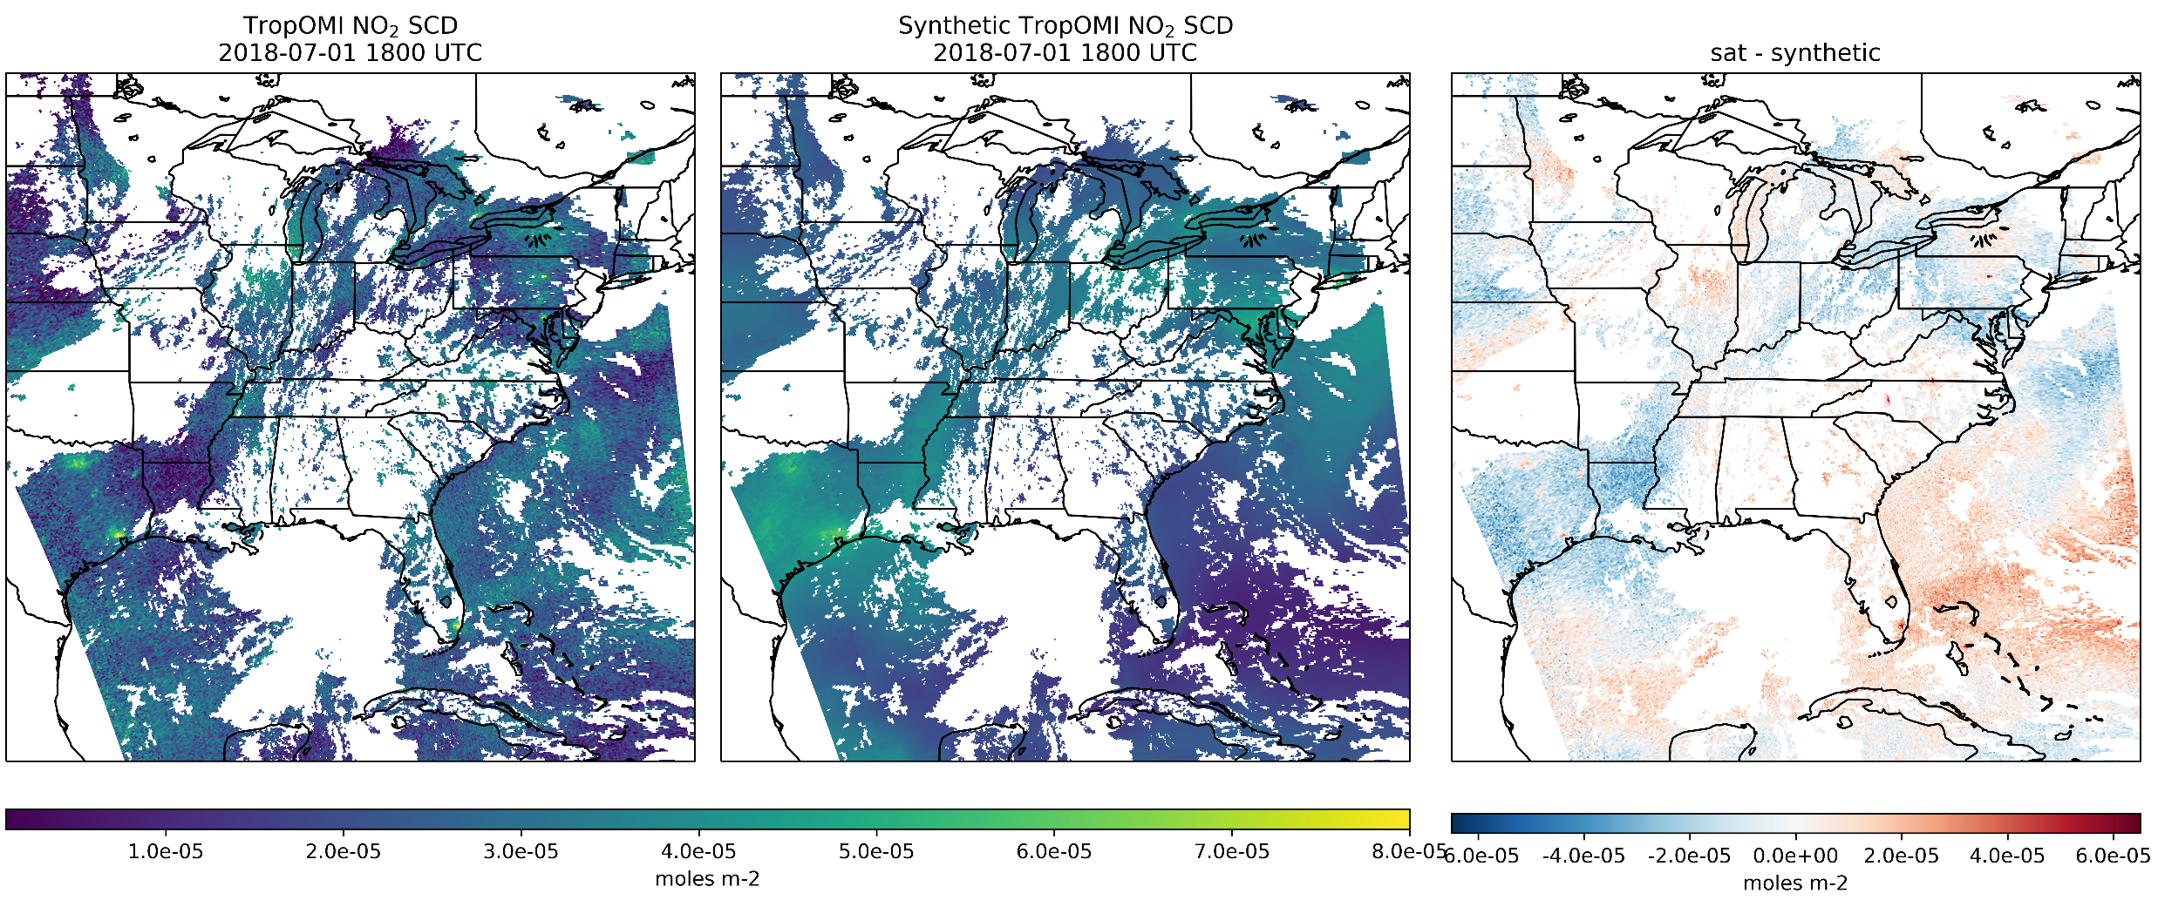
TropOMI Slant Column Comparison
Slant column comparison is the basis of assimilation.
This prevents AMF uncertainty from direct influence
GSI operator:
  Interpolates to TropOMI
  Applies scattering weight
  Applies tropopause
James East
ORISE Research Fellow

Slide 11
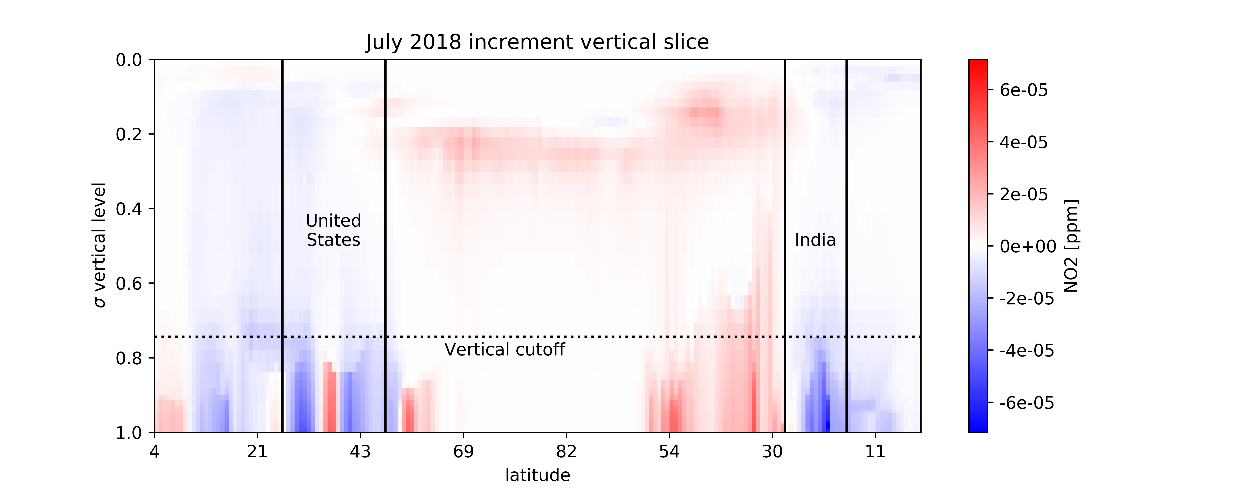
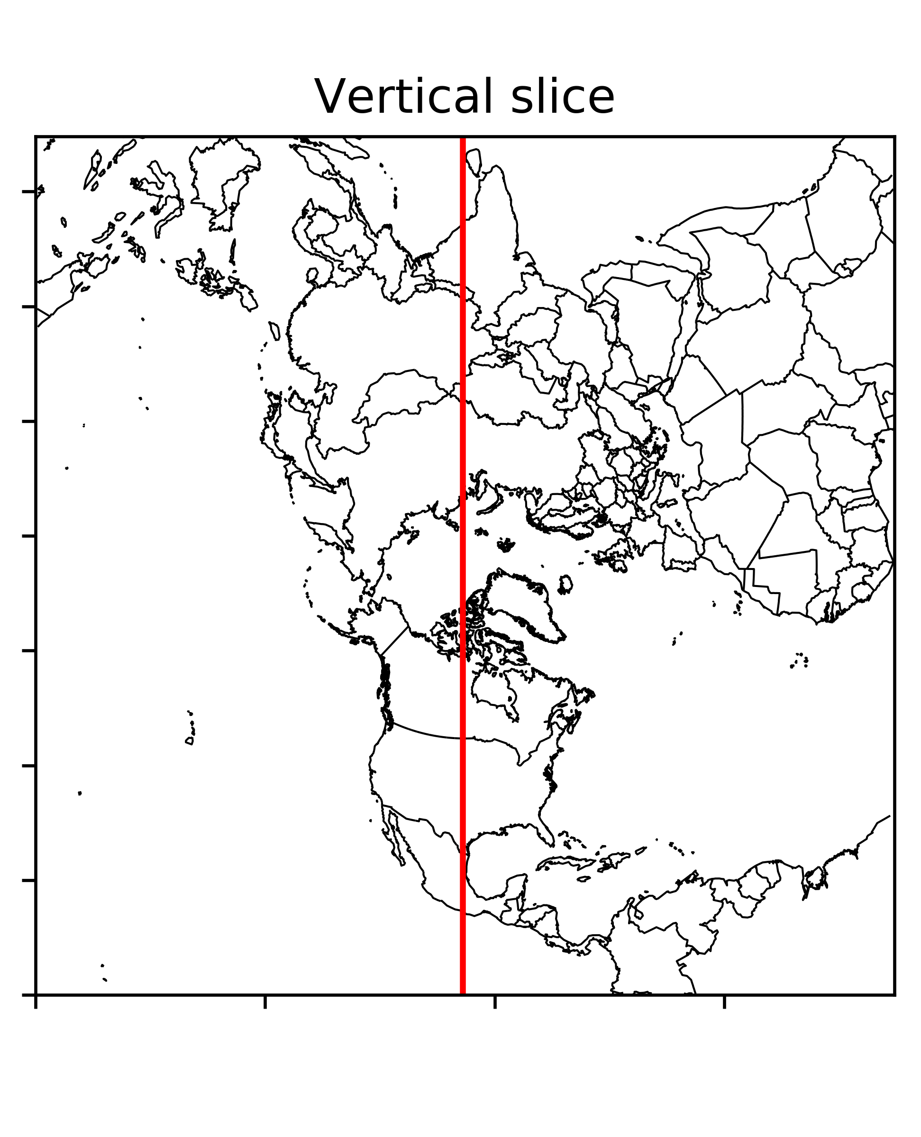
Challenges – vertical distribution of increment
Cooper et al. (2017) showed spatial “smearing” by finite difference.
  Conceptual disconnect between increment and assumptions in beta.
  Adjoint accounts for this implicitly
Step in the right direction: finite difference is to limit the vertical influence.

Slide 12
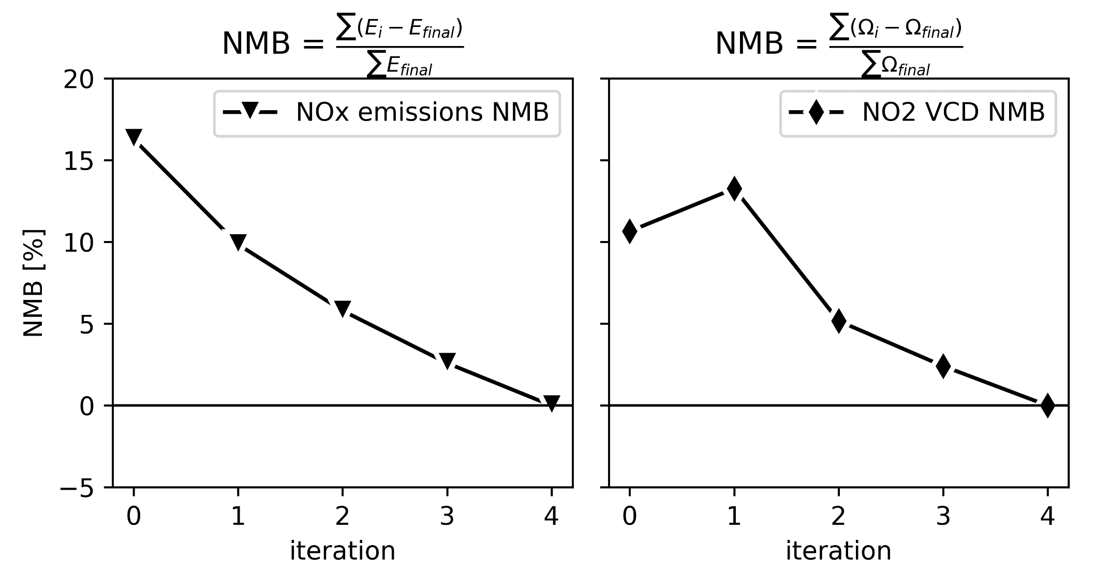
Iterative mass balance analysis
Cooper et al. (2017)
Cooper et al. (2017) showed that basic mass balance converged toward the “truth” with an asymptote 4 or 5 iterations.
Work in progress:
  synthetic “truth” experiment not complete
  iterative results show nominal convergence
  More iterations in progress
Notes:
Cooper et al. (2017) https://agupubs.onlinelibrary.wiley.com/doi/full/10.1002/2016JD025985

Slide 13
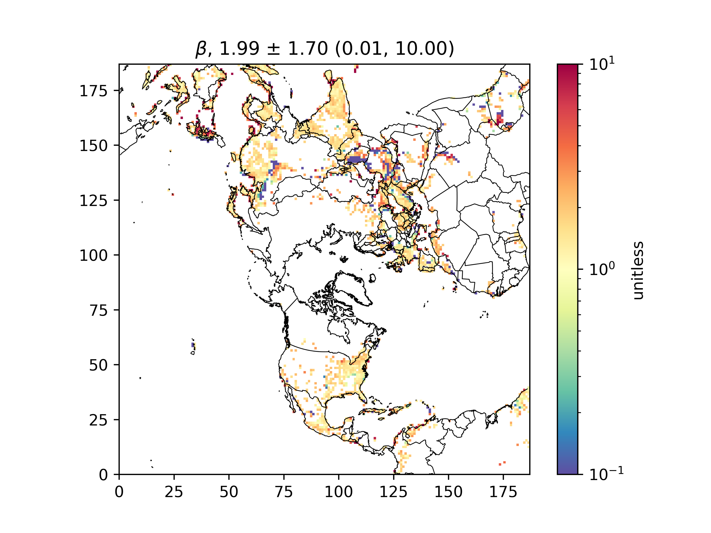
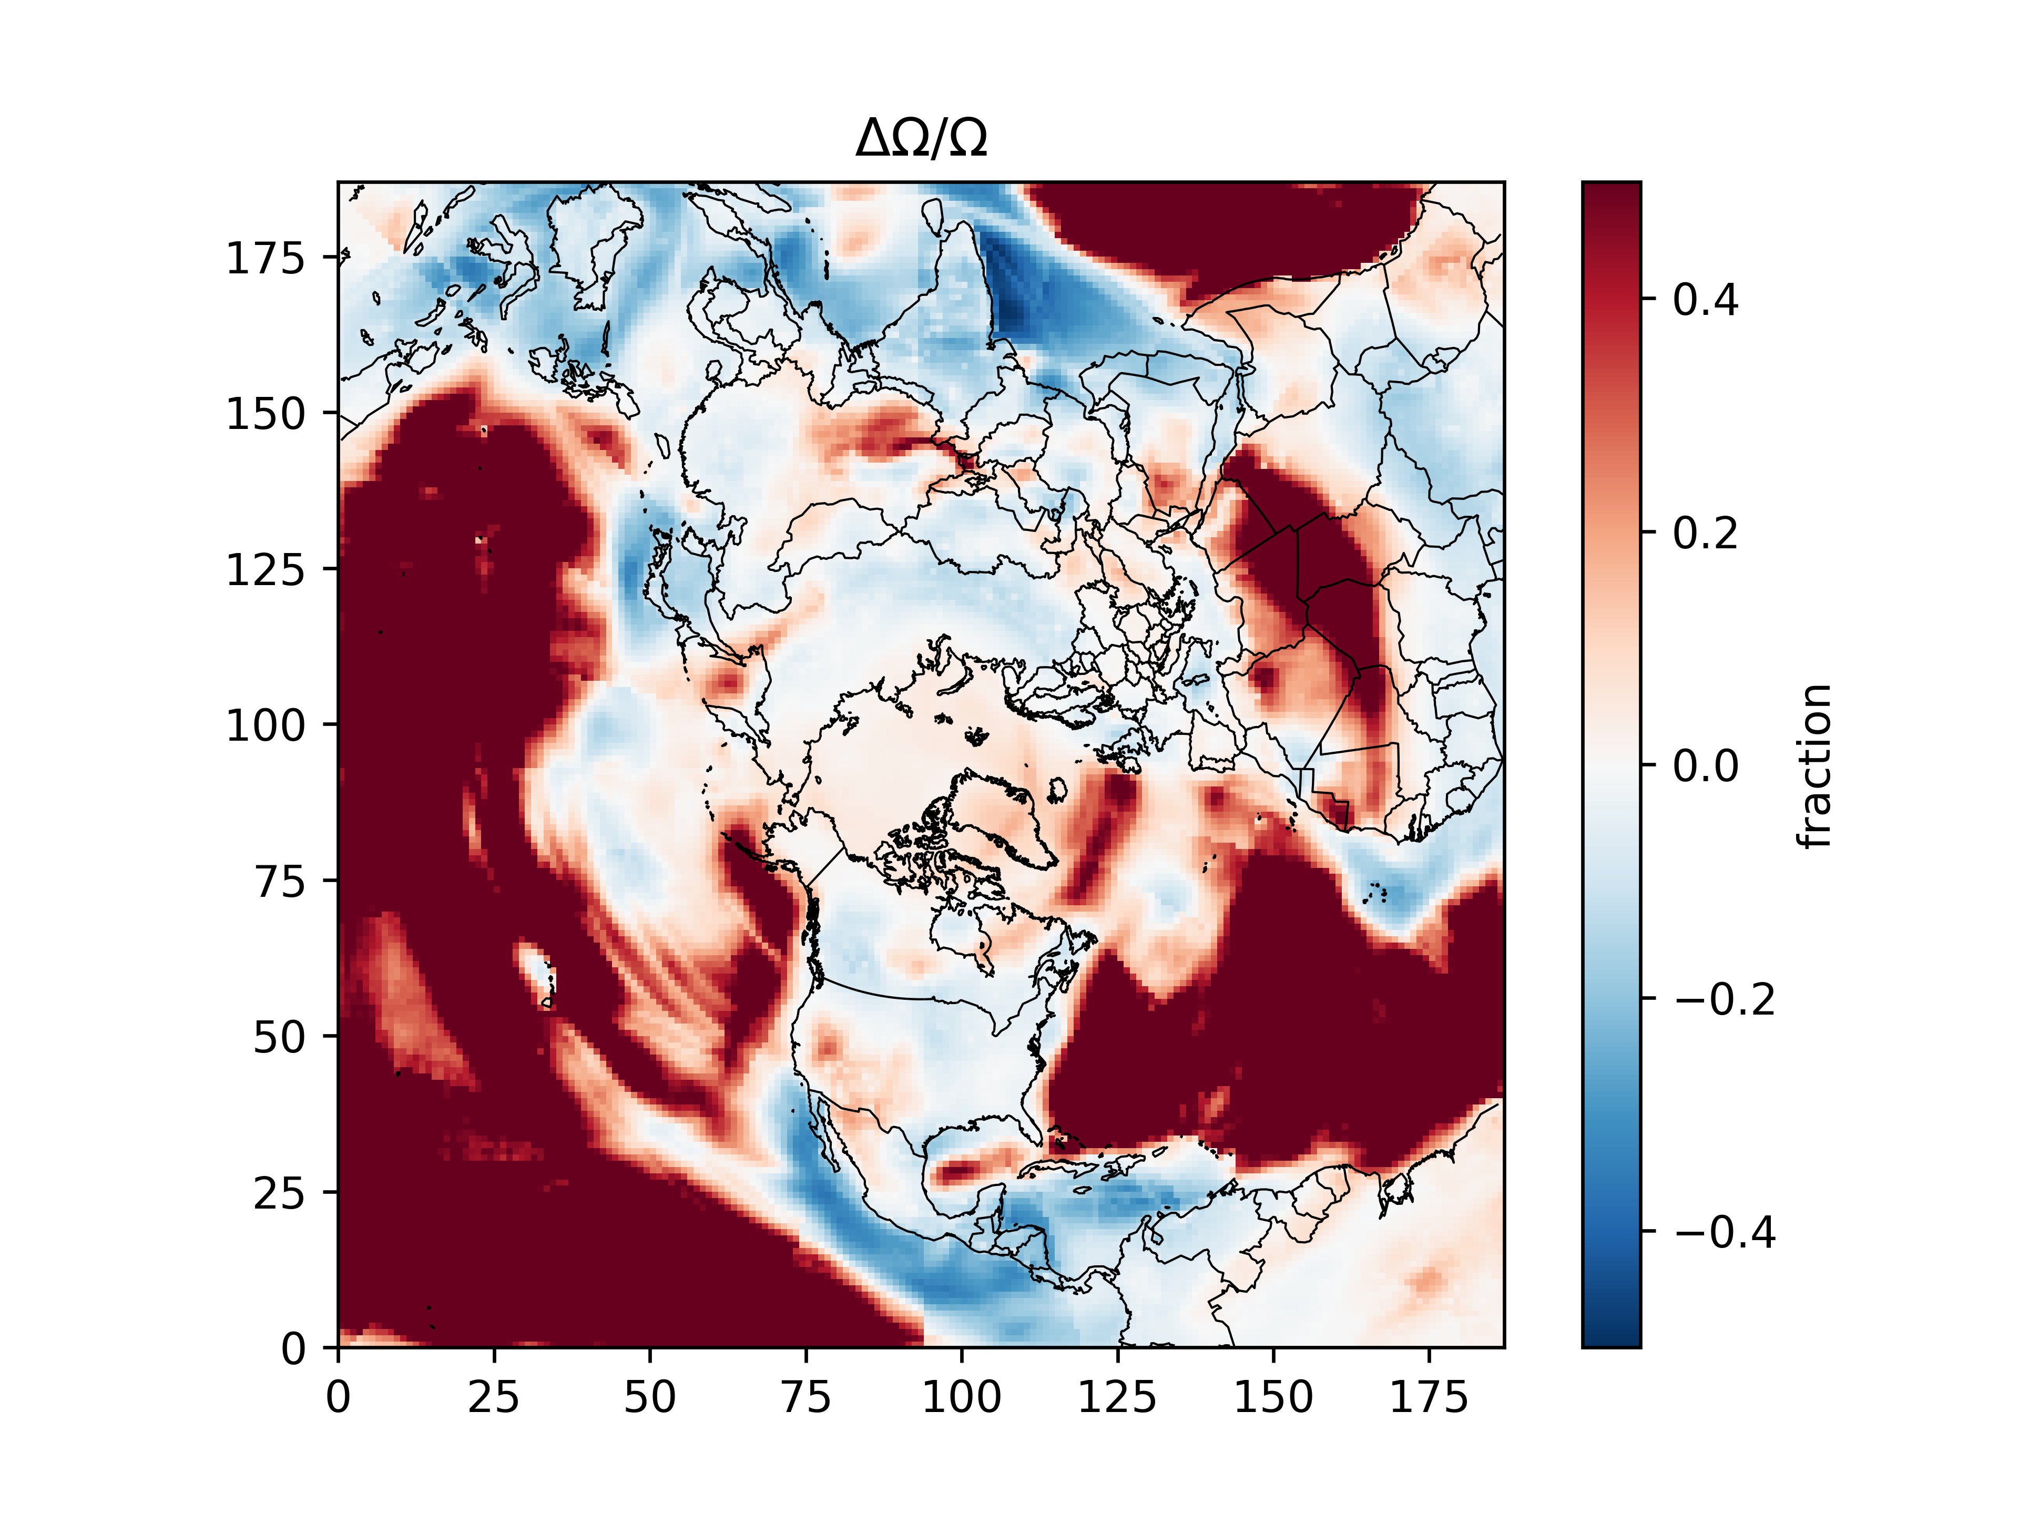
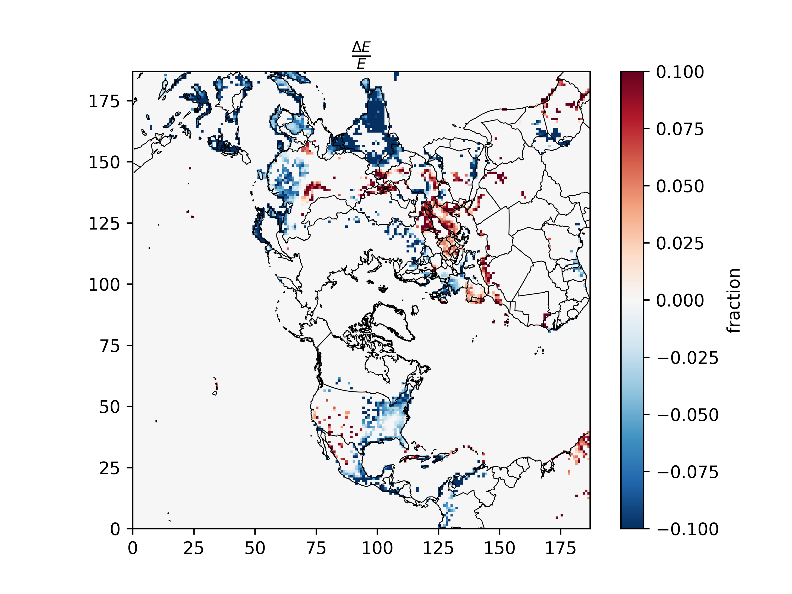
Preliminary Assimilation and inversion results
The sensitivity parameter is higher than previous literature results (largely forced by large outliers)
Large changes are seen over areas with little emissions and low vertical columns (lifetime or emissions?)
Preliminary results show a combination of increases and decreases nationally and globally

Slide 14
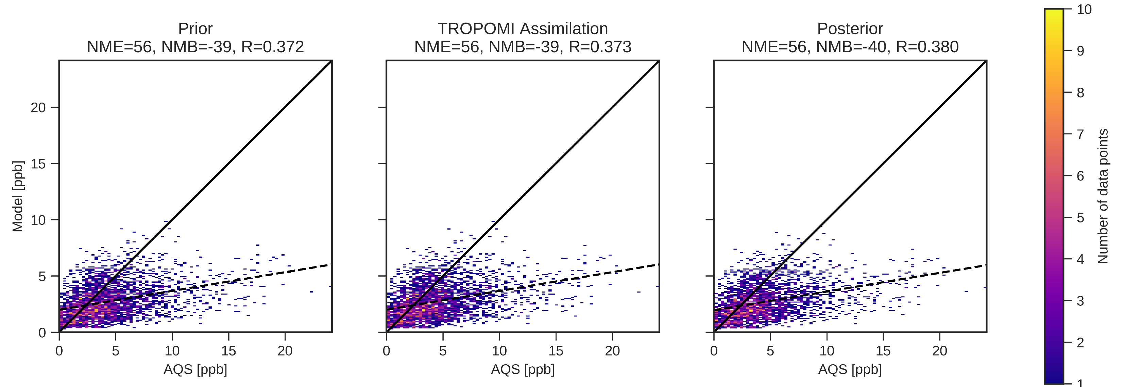
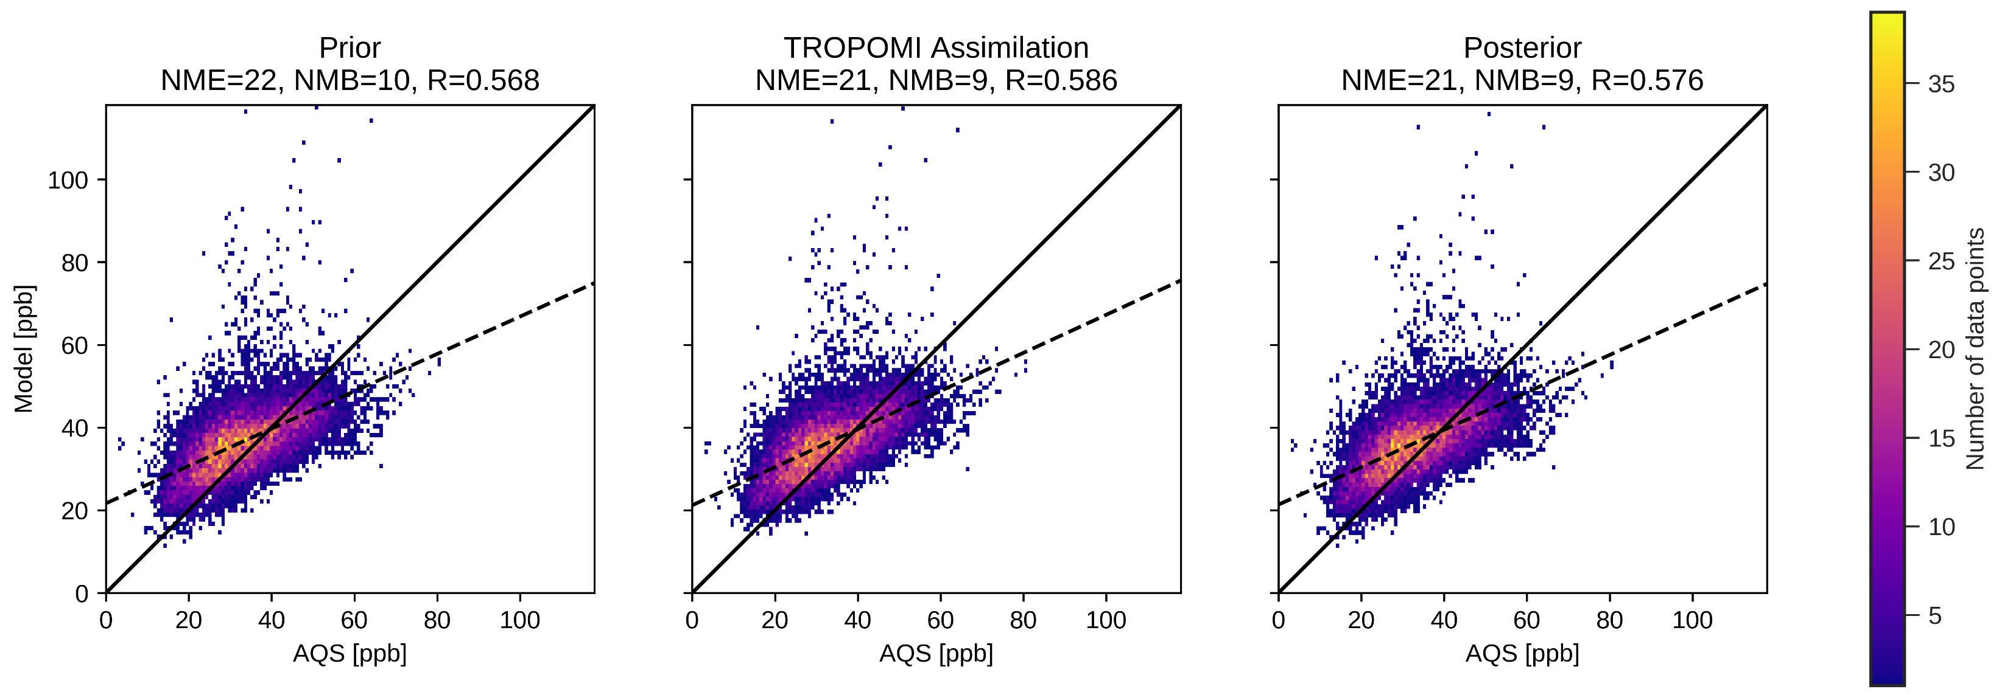
Impacts of preliminary assimilation and emissions update on model performance
Satellite performance improves, but what about surface?
Small improvements in the right direction
Correlation improved in both NO2 and ozone at the surface
  NO2 correlation better in posterior than assimilation (better localization?)
  Ozone correlation better in assimilation than posterior (more impact in the free trop?)
No measurements from biggest changed areas (India and China)
  Need surface measurements
  OpenAQ processing
NO2
Ozone
Notes:
NO2, daily avg, antbe0 used for updated emissions

Slide 15
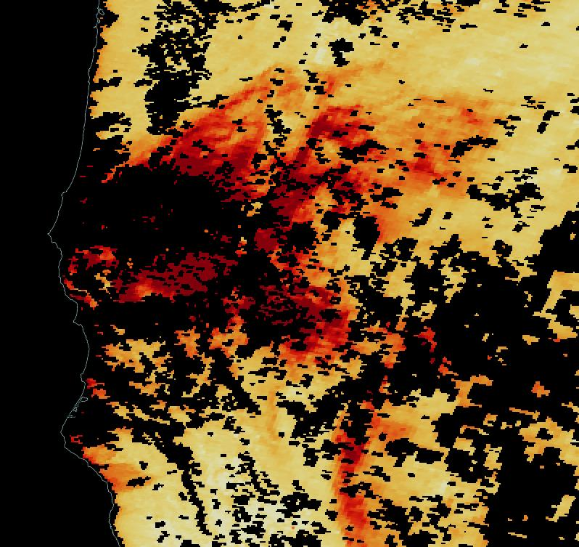
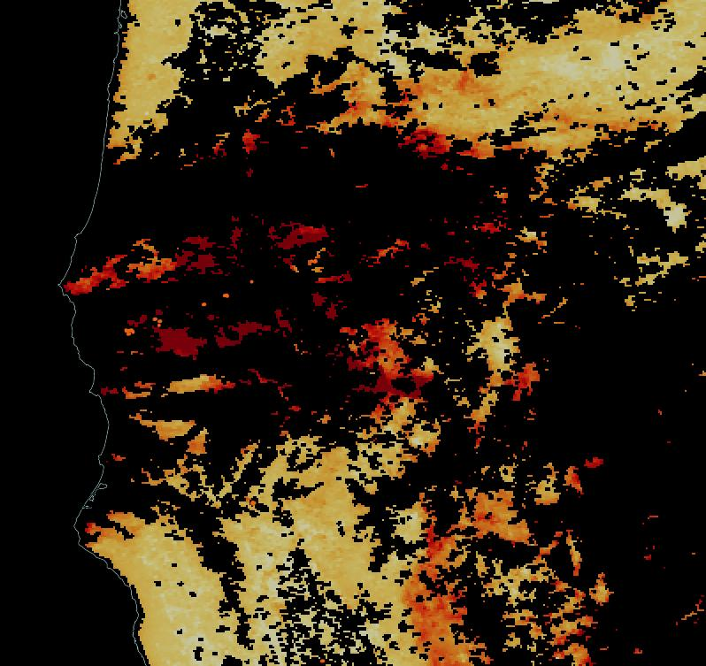
Possibilities with geostationary satellite information
Imagine if we weren’t looking once a day, but all day!
  e.g., commuter traffic is at a minimum at mid-day
  e.g., does the polar orbit cover peak electrical load times?
  More complete coverage of episodic events – e.g. wildfire plumes
  Better characterization of diurnal dynamics and interactions with emissions – e.g. land-sea breeze changes near coastal monitors
Imagine if we had finer spatial resolution
  More refined differentiation of proximal emission sources and chemical processes
  Increased confidence in relationships between satellite data and surface concentrations
The data management challenge will not be trivial.
  Larger granules and more of them.
  We need to start working with the data now to be ready when it arrives.
Terra MODIS AOD 7/23/18
Aqua MODIS AOD 7/23/18
Images created with NASA Worldview

Slide 16
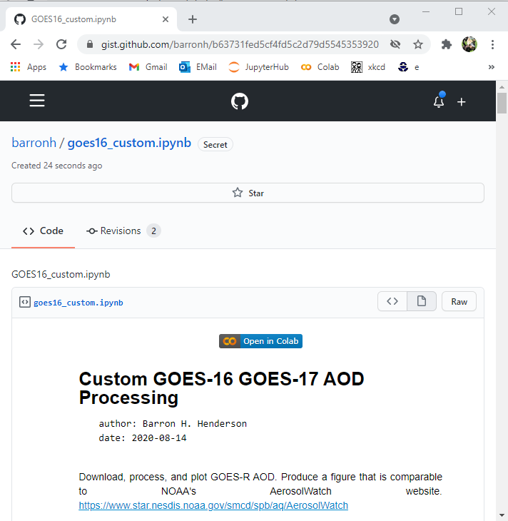
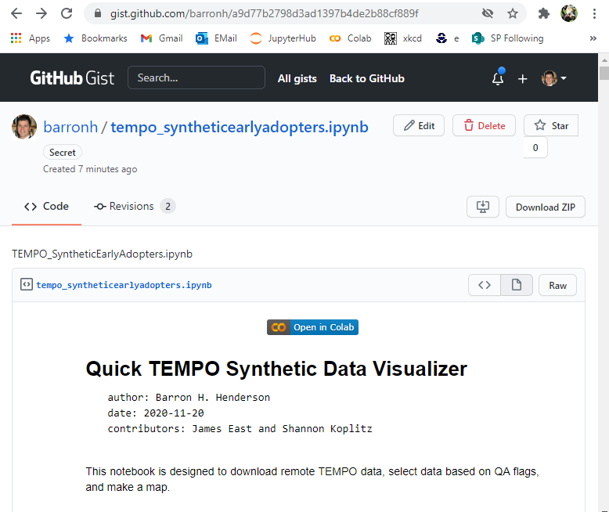
Processing for GOES and Synthetic TEMPO Data
If you want to get started with geostationary satellite data but aren’t sure how, try plotting GOES-16 AOD or TEMPO Synthetic NO2 data.
These are primers, and not targeted toward specific applications.
https://gist.github.com/barronh/a9d77b2798d3ad1397b4de2b88cf889f
https://gist.github.com/barronh/b63731fed5cf4fd5c2d79d5545353920

