Slide 1




High-resolution CMAQ modeling during LMOS
Brad Pierce
(UW-Madison, SSEC)
and
Jason Otkin (UW-Madison, CIMSS), Monica Harkey (UW-Madison, SAGE), Allen Lenzen (UW-Madison, SSEC)
Lee Cronce (UW-Madison, CIMSS), Dave Henderson (UW-Madison, CIMSS), Chris Hain (NASA/MSFC), Jon Case (NASA/MSFC), Zac Adelman (LADCO), Gail Good (WDNR)
Work supported by NASA Applied Science Program project “A satellite constrained meteorological modeling platform
for LADCO States SIP development” (Jason Otkin, PI)
TEMPO STM June 2-3, 2021

Slide 2
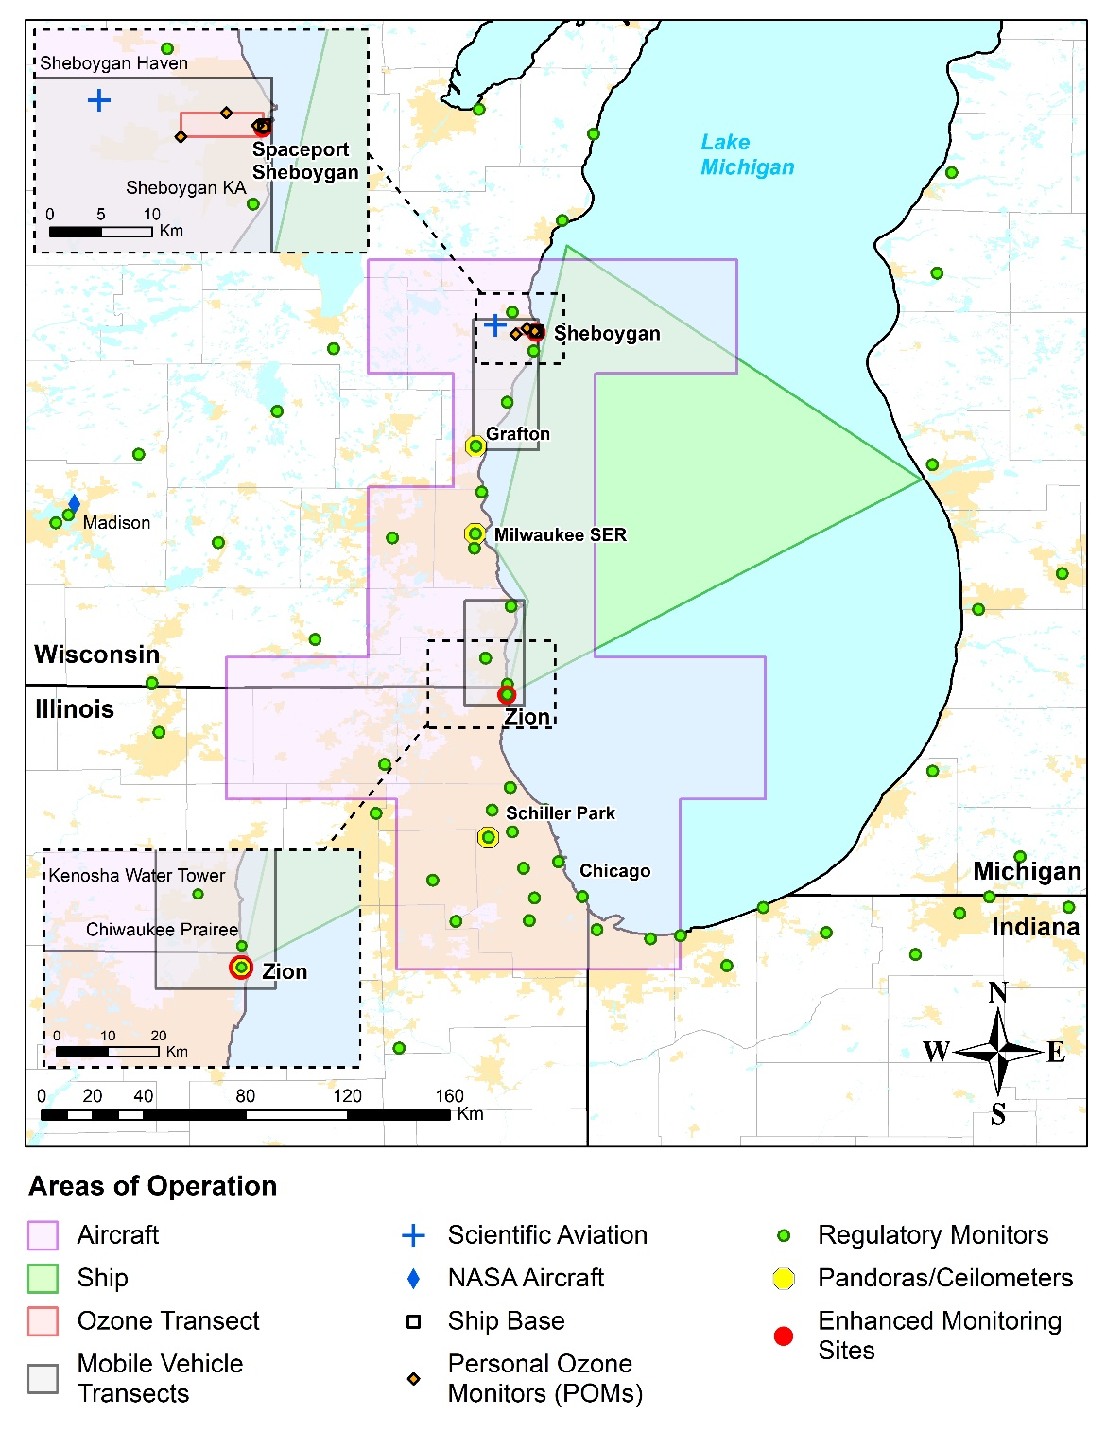
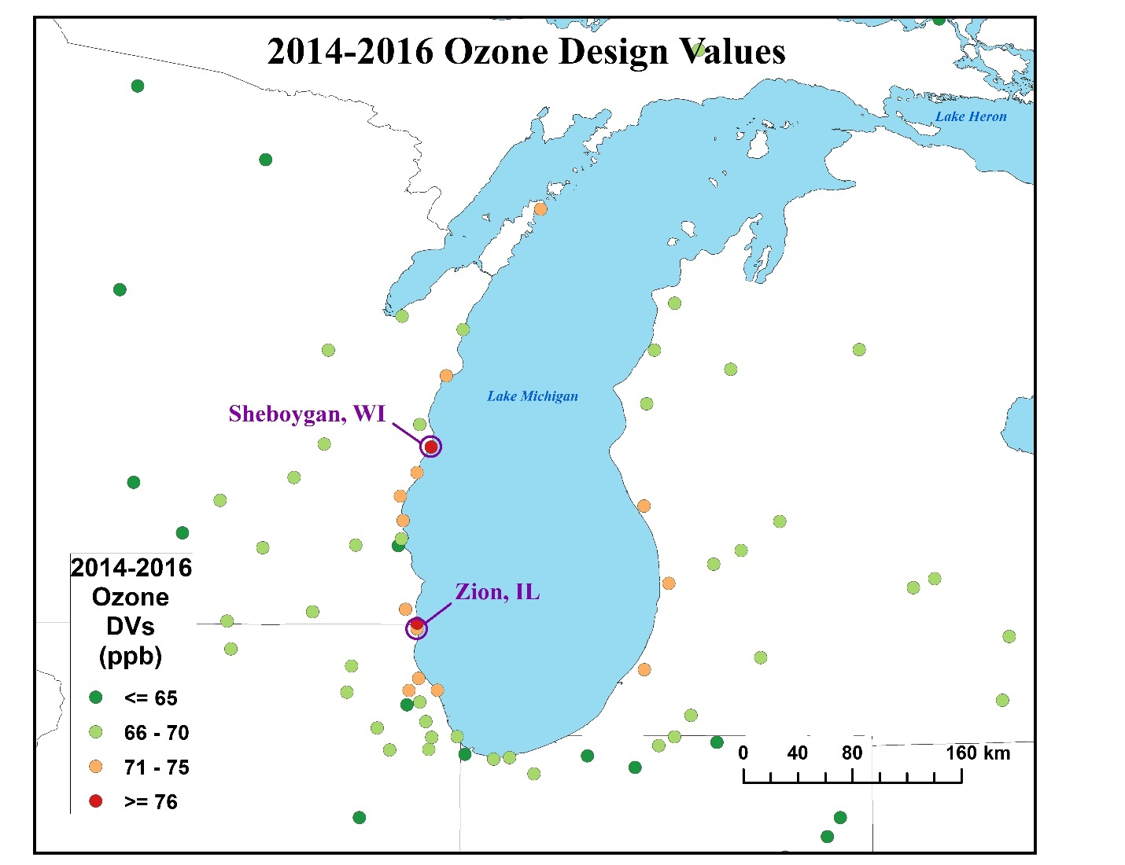
The Lake Michigan Ozone Study (LMOS 2017) was an enhanced observational study aimed at better understanding ozone formation and transport over Lake Michigan and surrounding coastal communities.
LMOS 2017 observations
From Stanier et al., “Overview of the Lake Michigan Ozone Study 2017” (Accepted May, 2021 BAMS)

Slide 3
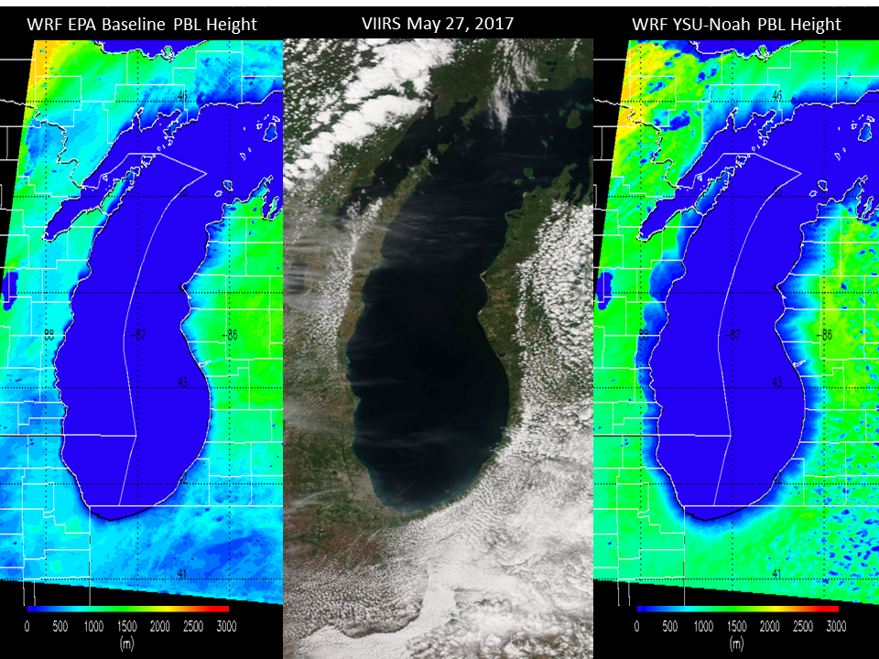
LMOS 2017 observations
Meteorological modeling for this region is challenging due to the influence of mesoscale lake breeze circulations on the transport and chemistry along the Lake Michigan shoreline.
VIIRS true color image with 1.3-km resolution planetary boundary layer height forecasts (m) for the EPA Baseline (Pleim-Xiu) LSM (left) and WRF Noah LSM at 19Z on May 27, 2017

Slide 4
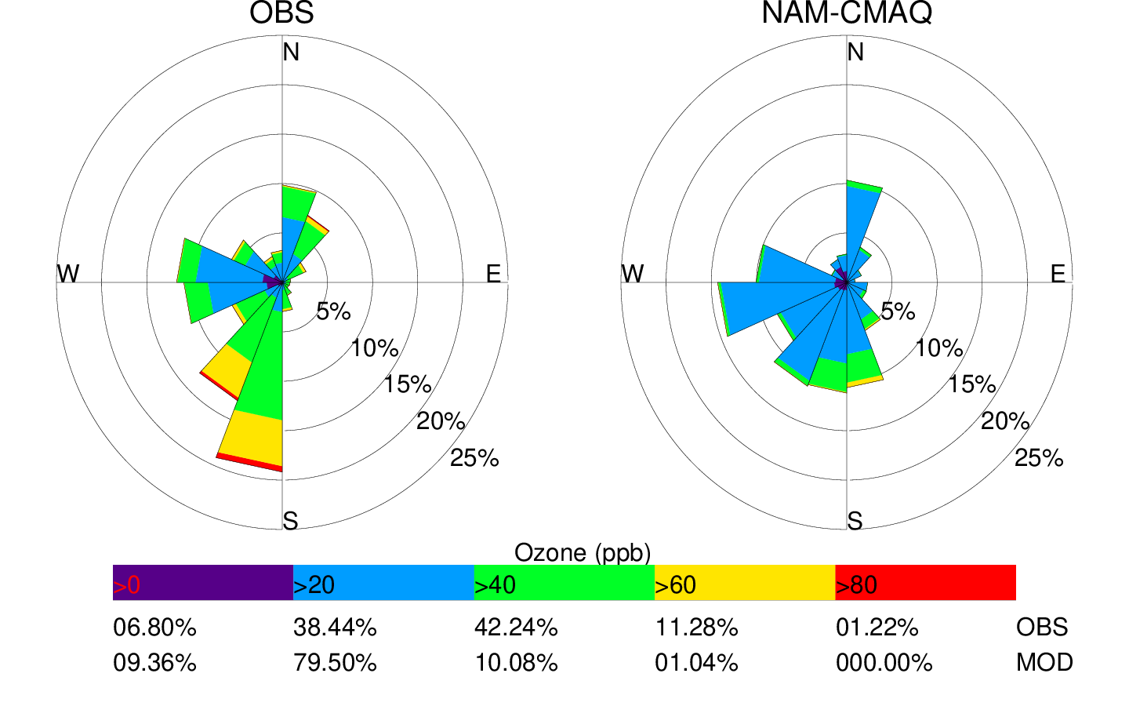
Ozone pollution roses at Sheboygan Kohler-Andrae (KA)
NWS NAM-CMAQ forecasts underestimate the frequency of lake breeze circulations (SSW winds) at Sheboygan KA, and peak ozone concentrations.
NAM-CMAQ is the NOAA National Weather Service Operational Air Quality forecast

Slide 5
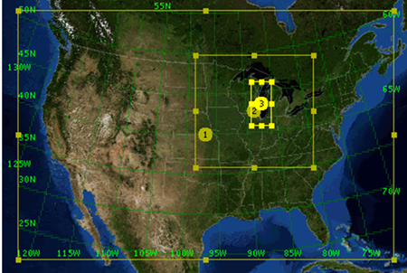
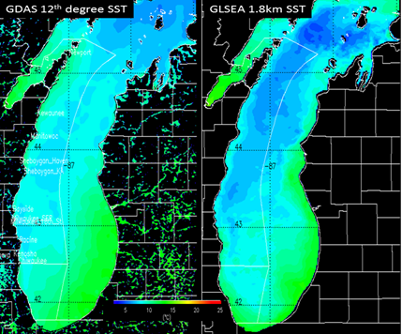
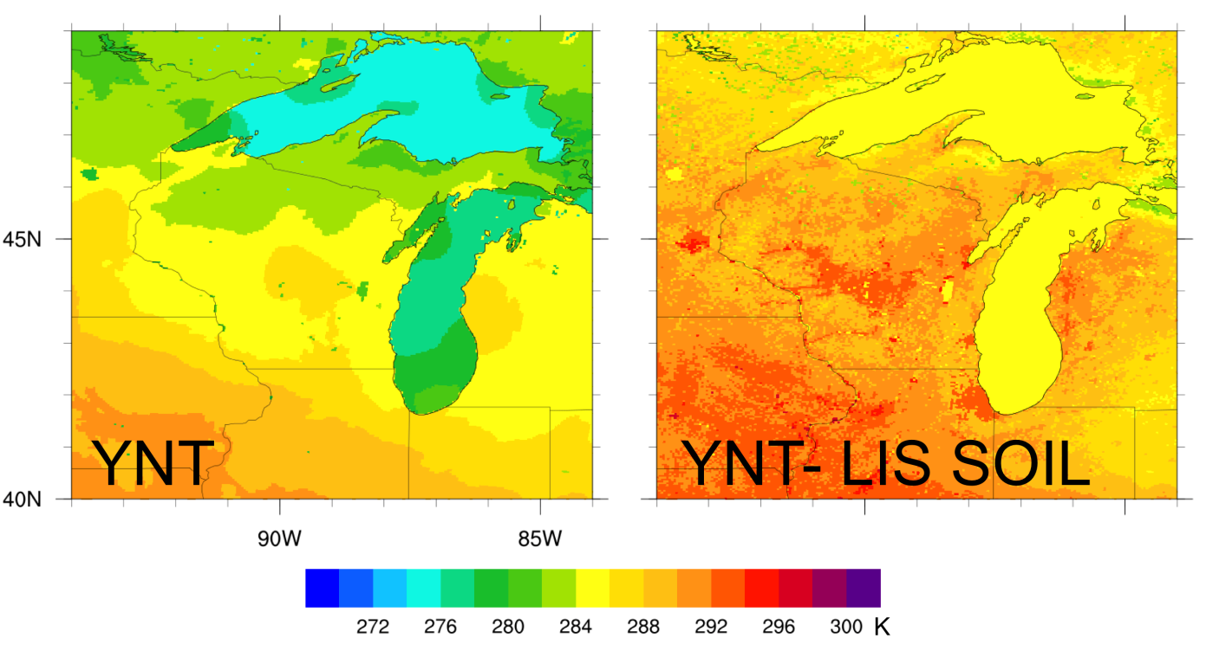
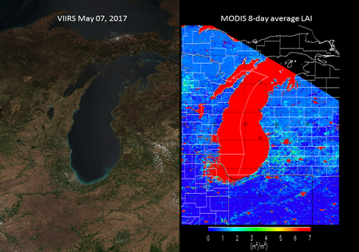
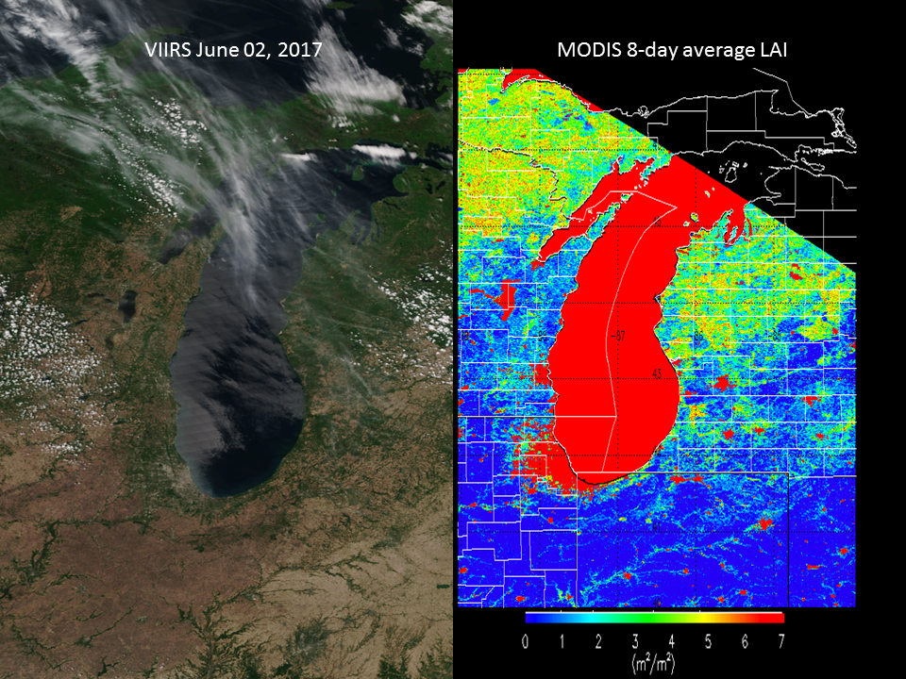
LADCO Modeling Platform (12km, 4km, and 1.3km)
High resolution (1.8km) Great Lakes Environmental Research Laboratory (GLERL) daily SST analyses
Addresses the needs of the Lake Michigan Air Directors Consortium (LADCO) State Implementation Plan (SIP) modeling through development, verification, and delivery of a satellite-constrained meteorological modeling platform for the Lake Michigan region.
NASA SPoRT-LIS Soil Moisture, Soil Temperature, and VIIRS GVF/LAI Analyses

Slide 6
WRF Model Simulations
EXPERIMENT SST GVF SOIL Nudging status
EPA -- -- -- -- complete
YNT -- -- -- -- complete
YNT-SST ✔ -- -- -- complete
YNT-GVF -- ✔ -- -- complete/rerun
YNT-SOIL -- -- ✔ -- complete
YNT-nudge2km -- -- -- ✔ complete
YNT-SST-SOIL ✔ -- ✔ -- complete
YNT-GVF-SST ✔ ✔ -- -- complete/rerun
YNT-GVF-SOIL -- ✔ ✔ -- complete/rerun
YNT-GVF-SOIL-SST ✔ ✔ ✔ -- complete/rerun
YNT-GVFSOIL-SST-nudge2km ✔ ✔ ✔ ✔ complete/rerun
YNT-SOIL-SST-nudge2km ✔ -- ✔ ✔ complete
“EPA” simulations follow the EPA operational forecasting model configuration, including the Pleim-Xu land surface model (LSM), Morrison 2-moment cloud microphysics, and ACM2 PBL parameterization schemes
“YNT” simulations use the YSU PBL, Noah LSM, and Thompson microphysics, respectively
“SST” refers to the high-resolution, real-time GLSEA SST dataset
”SOIL” refers to high-resolution soil moisture/temperature analyses provided by NASA SPoRT
“GVF” refers to the high-resolution VIIRS green vegetation fraction dataset
“nudge2km” refers to nudging temperature, moisture, and horizontal winds above 2 km

Slide 7
WRF Model Simulations
EXPERIMENT SST GVF SOIL Nudging status
EPA -- -- -- -- complete
YNT -- -- -- -- complete
YNT-SST ✔ -- -- -- complete
YNT-GVF -- ✔ -- -- complete/rerun
YNT-SOIL -- -- ✔ -- complete
YNT-nudge2km -- -- -- ✔ complete
YNT-SST-SOIL ✔ -- ✔ -- complete
YNT-GVF-SST ✔ ✔ -- -- complete/rerun
YNT-GVF-SOIL -- ✔ ✔ -- complete/rerun
YNT-GVF-SOIL-SST ✔ ✔ ✔ -- complete/rerun
YNT-GVFSOIL-SST-nudge2km ✔ ✔ ✔ ✔ complete/rerun
YNT-SOIL-SST-nudge2km ✔ -- ✔ ✔ complete
Baseline
Optimized
“EPA” simulations follow the EPA operational forecasting model configuration, including the Pleim-Xu land surface model (LSM), Morrison 2-moment cloud microphysics, and ACM2 PBL parameterization schemes
“YNT” simulations use the YSU PBL, Noah LSM, and Thompson microphysics, respectively
“SST” refers to the high-resolution, real-time GLSEA SST dataset
”SOIL” refers to high-resolution soil moisture/temperature analyses provided by NASA SPoRT
“GVF” refers to the high-resolution VIIRS green vegetation fraction dataset
“nudge2km” refers to nudging temperature, moisture, and horizontal winds above 2 km

Slide 8
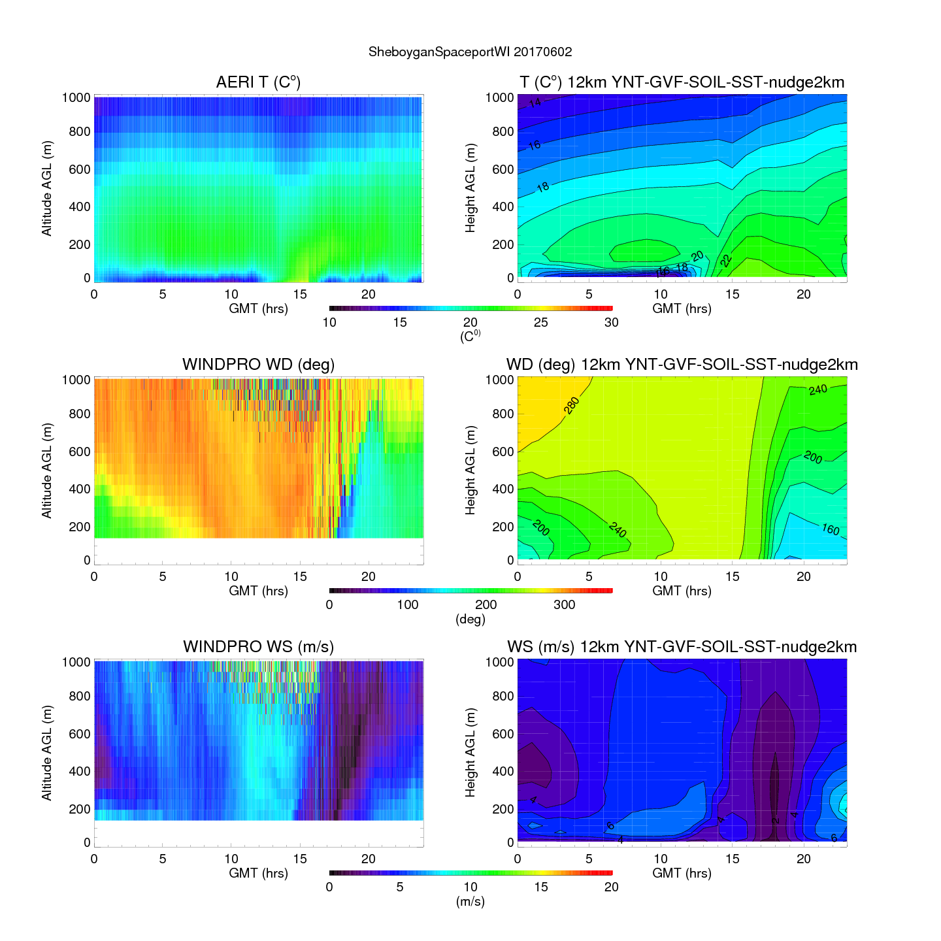
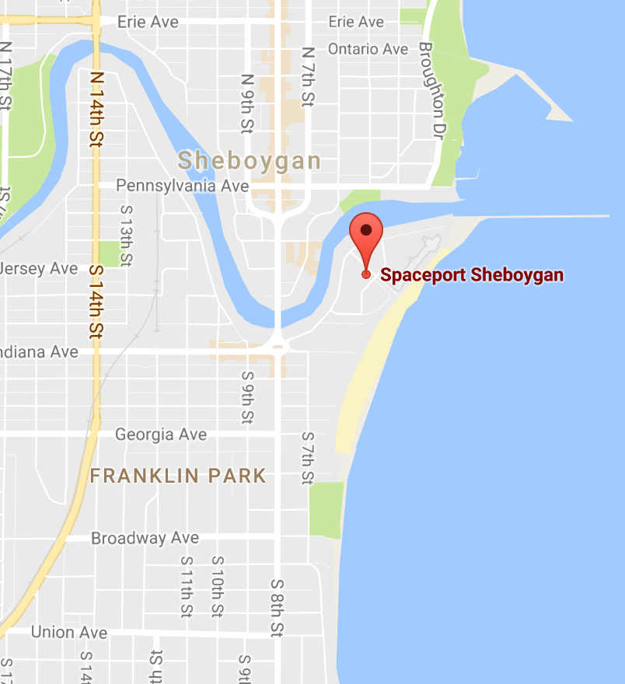
Spaceport Sheboygan: 12km Optimized WRF
Lake Breeze
Nocturnal BL
Lake Breeze
Nocturnal BL
Lake Breeze
Lake Breeze
Observed Temperature and Wind (left)
Verses 12km YNT-GVFSOIL-SST-nudge2km
June 2, 2017 (Lake Breeze/Ozone Exceedance)
Nocturnal BL
Lake Breeze
Lake Breeze
Atmospheric Emitted Radiance Interferometer (AERI)

Slide 9
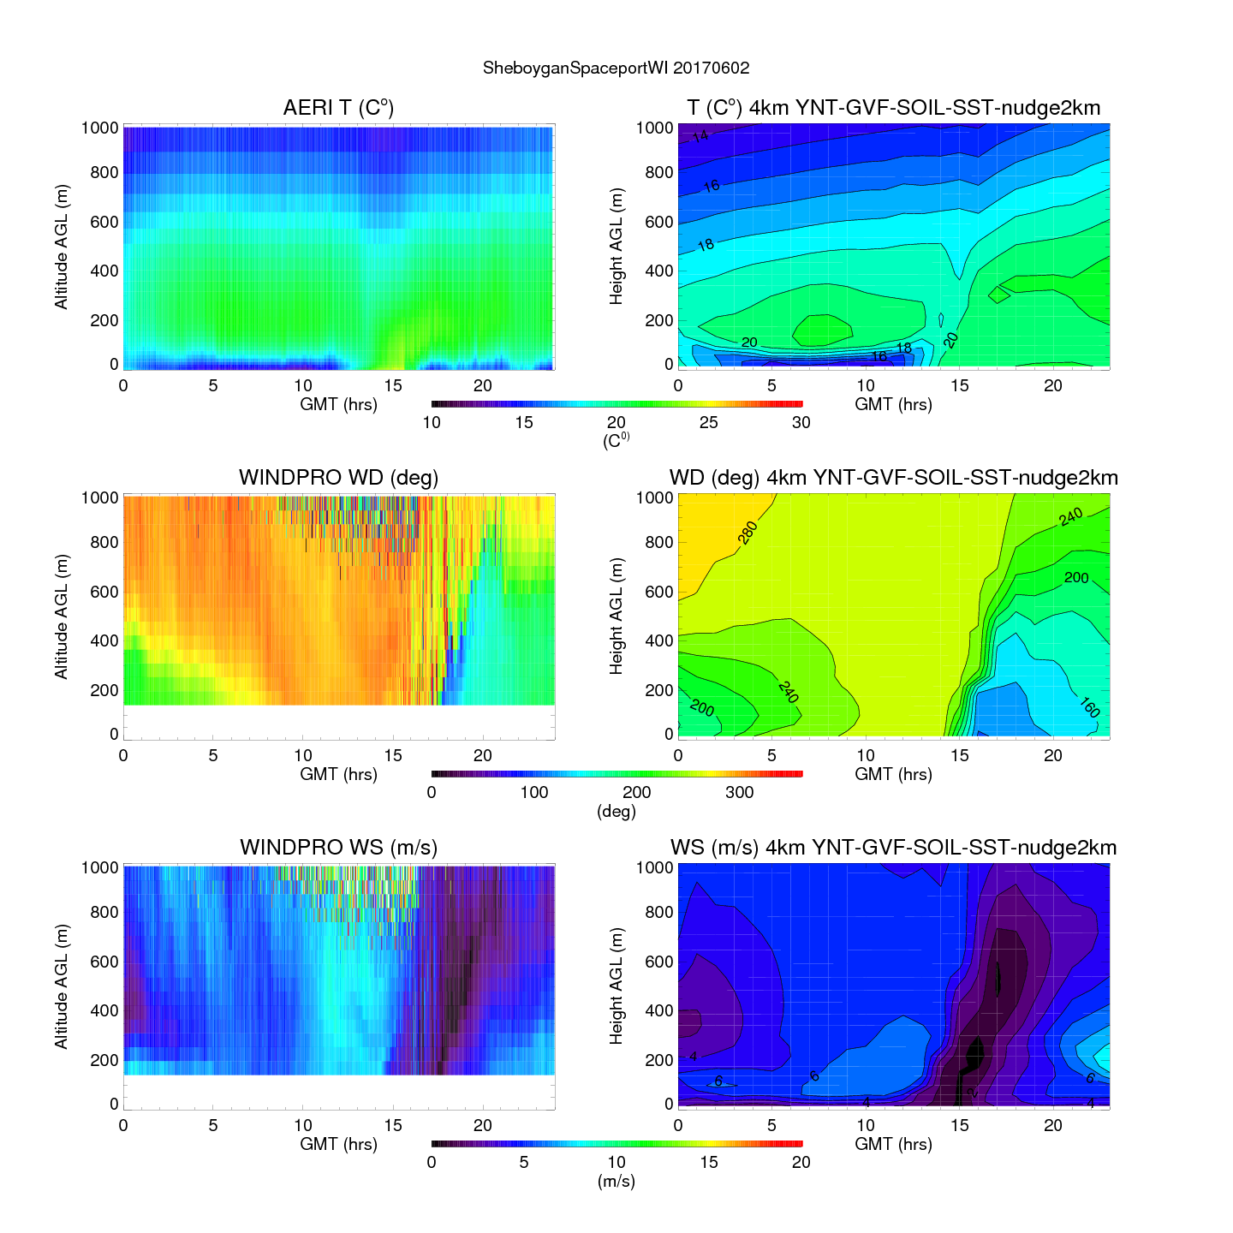
Spaceport Sheboygan: 4km Optimized WRF
Lake Breeze
Nocturnal BL
Lake Breeze
Nocturnal BL
Lake Breeze
Lake Breeze
Observed Temperature and Wind (left)
Verses 4km YNT-GVFSOIL-SST-nudge2km
June 2, 2017 (Lake Breeze/Ozone Exceedance)
Nocturnal BL
Lake Breeze
Lake Breeze
Atmospheric Emitted Radiance Interferometer (AERI)

Slide 10
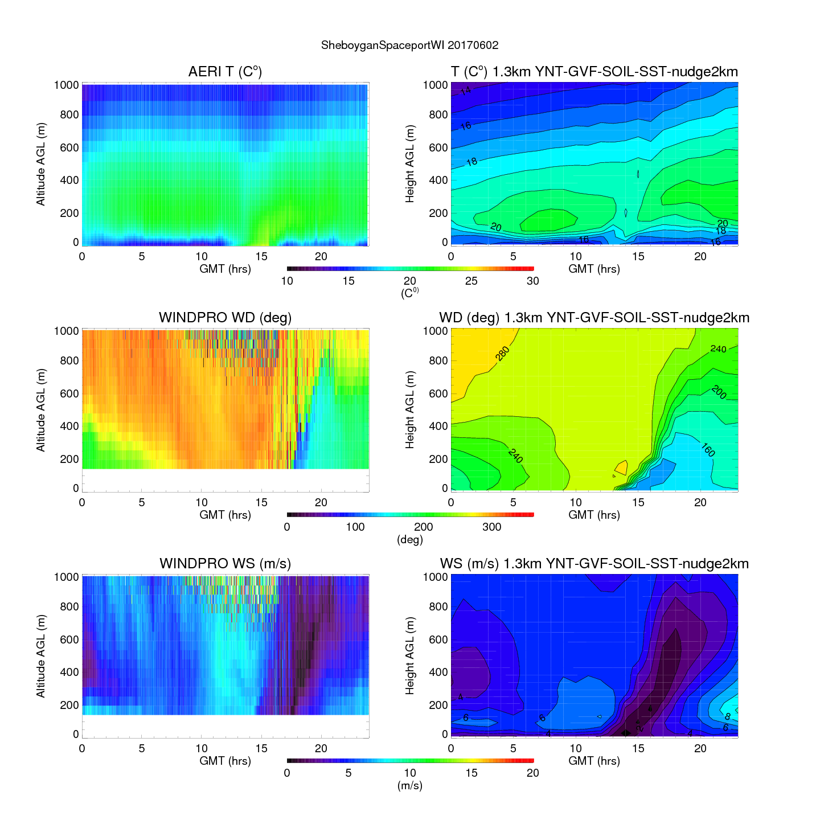
Spaceport Sheboygan: 1.3km Optimized WRF
Lake Breeze
Nocturnal BL
Lake Breeze
Nocturnal BL
Lake Breeze
Lake Breeze
Observed Temperature and Wind (left)
Verses 1.3km YNT-GVFSOIL-SST-nudge2km
June 2, 2017 (Lake Breeze/Ozone Exceedance)
Nocturnal BL
Lake Breeze
Lake Breeze
Atmospheric Emitted Radiance Interferometer (AERI)

Slide 11
CMAQ 12km EPA Baseline vs 1.3km Optimized WRF
(with 2016fi* 12km and interpolated 4km area source emissions)
*National Emissions Inventory Collaborative version V1 with resolution of airport emissions and Emissions Modeling System (CEMS) multi-unit EGU emissions issues
https://www.epa.gov/sites/production/files/2021-03/documents/preparation_of_emissions_inventories_for_2016v1_north_american_emissions_modeling_platform_tsd.pdf

Slide 12
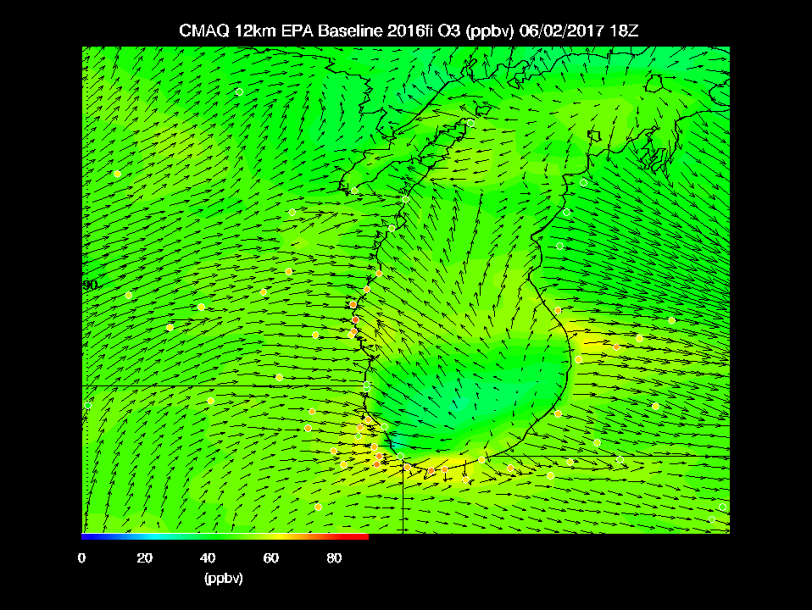
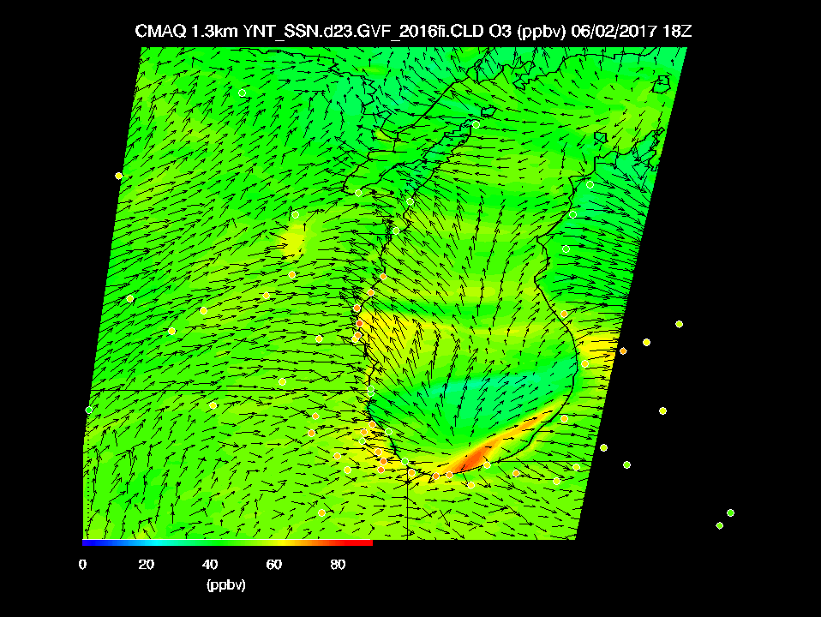
Surface O3
June 02, 2017
12km EPA Baseline
1.3km Optimized

Slide 13
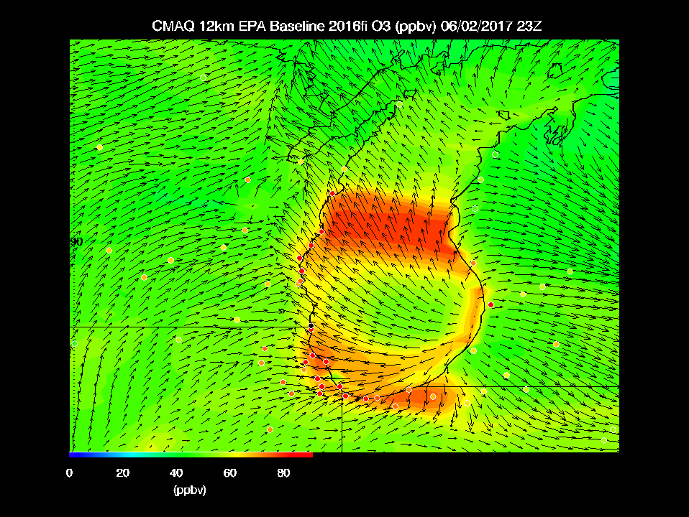
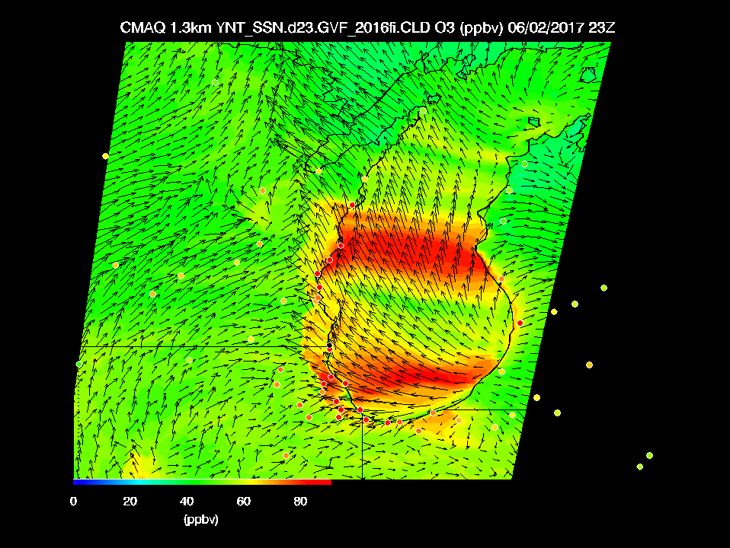
Surface O3
23Z (6pm CDT) June 02, 2017
12km EPA Baseline
1.3km Optimized
1.3km Optimized configuration shows further inland penetration of high ozone (particularly along the WI/IL boarder)

Slide 14
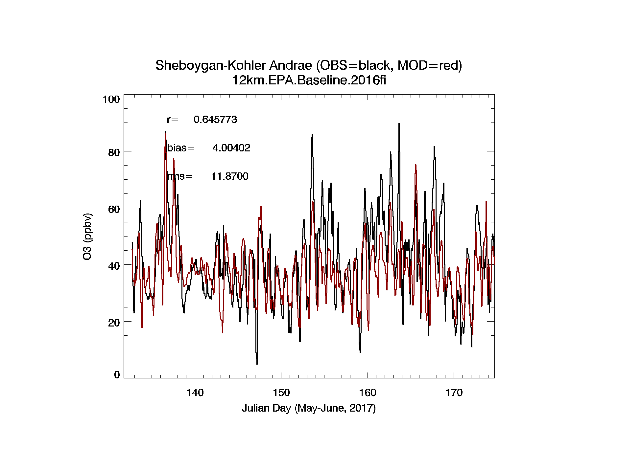
12km EPA Baseline
June 2, 2017

Slide 15
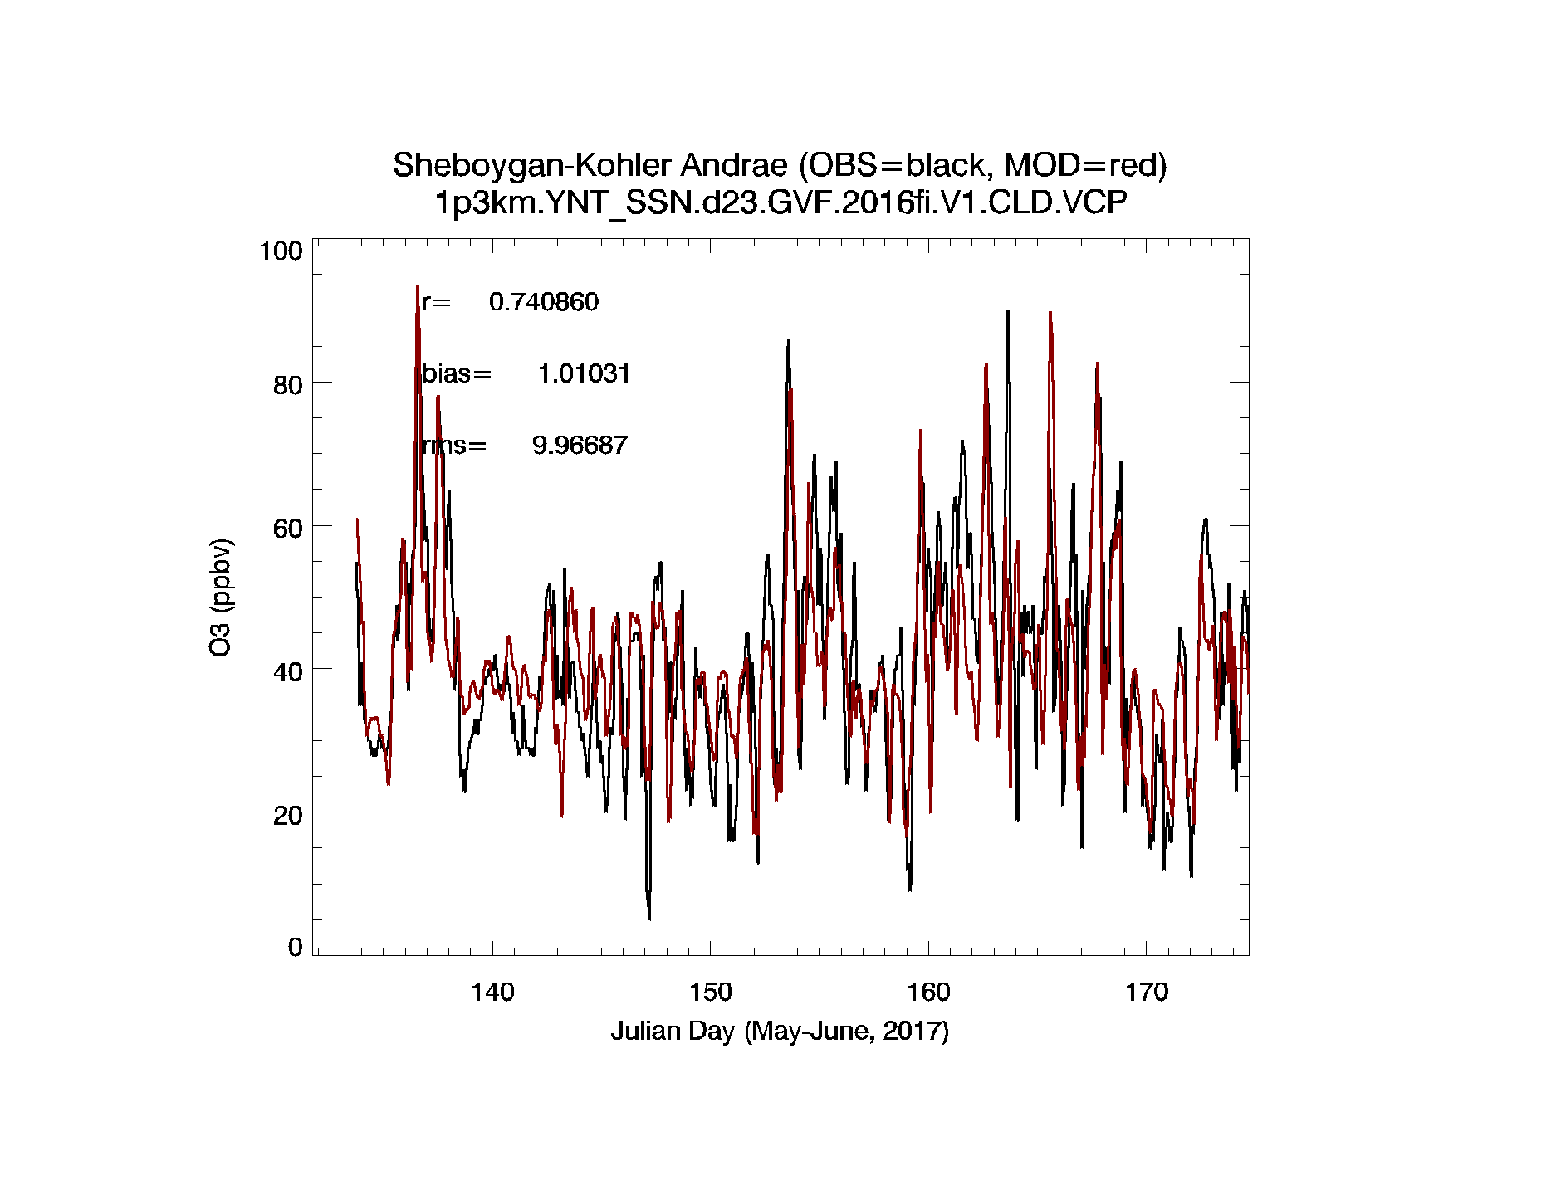
1.3km Optimized
June 2, 2017
Improved correlation, reduced bias, reduced rms error

Slide 16
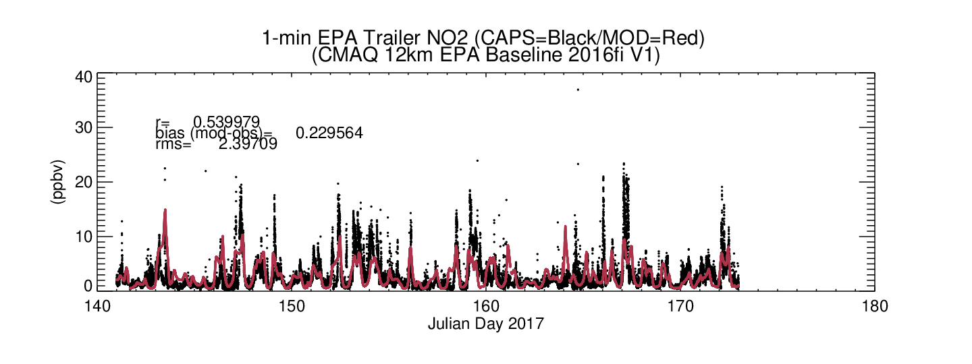
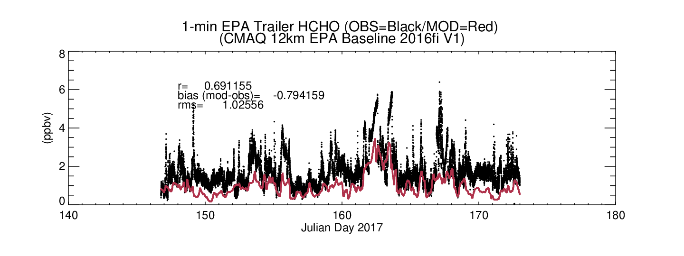
12km EPA Baseline
LMOS Sheboygan Ground Site

Slide 17
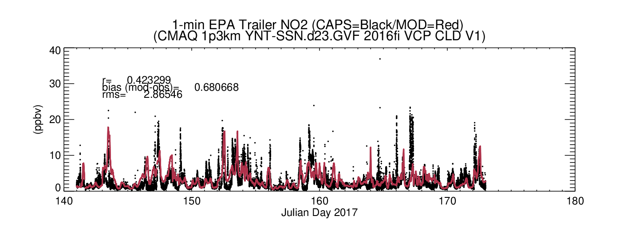
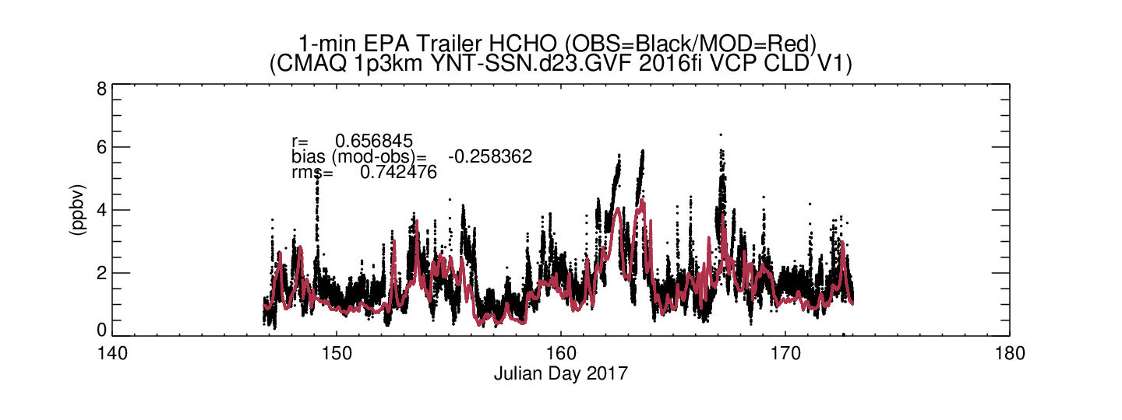
1.3km Optimized
LMOS Sheboygan Ground Site
Reduced NO2 correlation, increased low bias and increased RMS
Reduced HCHO correlation, reduced HCHO low bias and reduced RMS

Slide 18
CMAQ vertical profiles of HCHO and NO₂ at Spaceport Sheboygan EPA ground site
June 2nd, 2017
HCHO enhancements extend higher than NO2 and
NO2 shows lofted features that are decoupled from the surface
Figure provided by Jerrold Acdan (UW-Madison AOS)

Slide 19
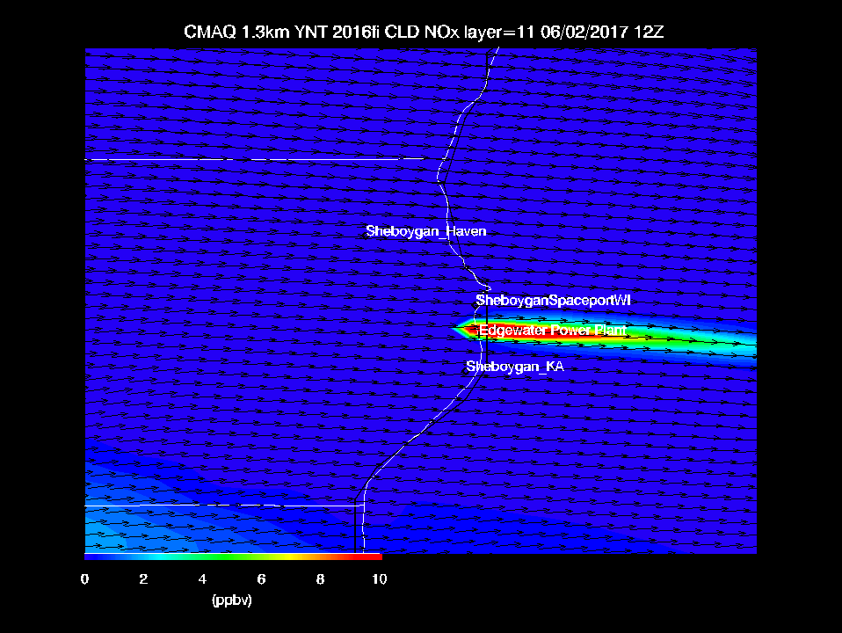
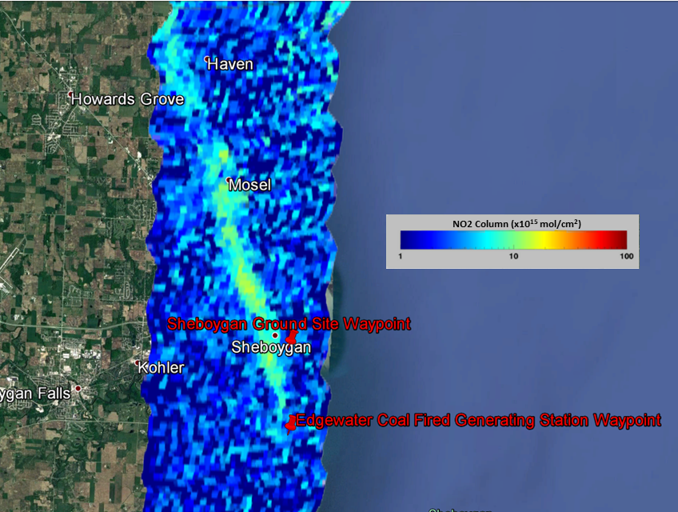
GEOTASO vs 1.3km Edgewater Power Plant plume
(June 2nd, 2017)
1.3km Optimized CMAQ
GEOTASO
1.3km Optimized CMAQ simulation captures lofted power plant plumes

Slide 20
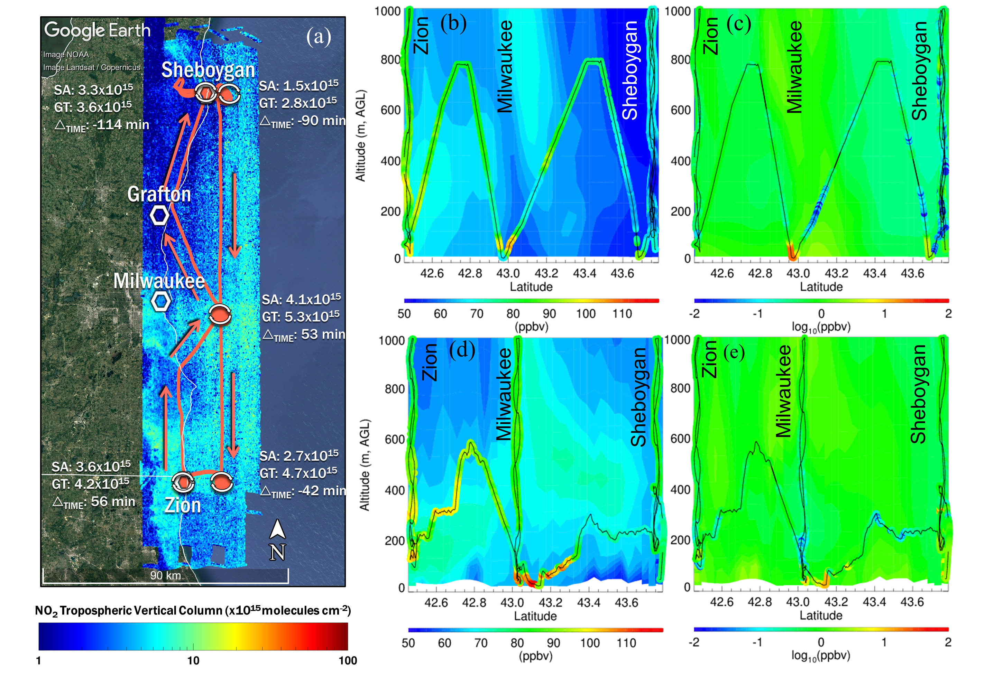
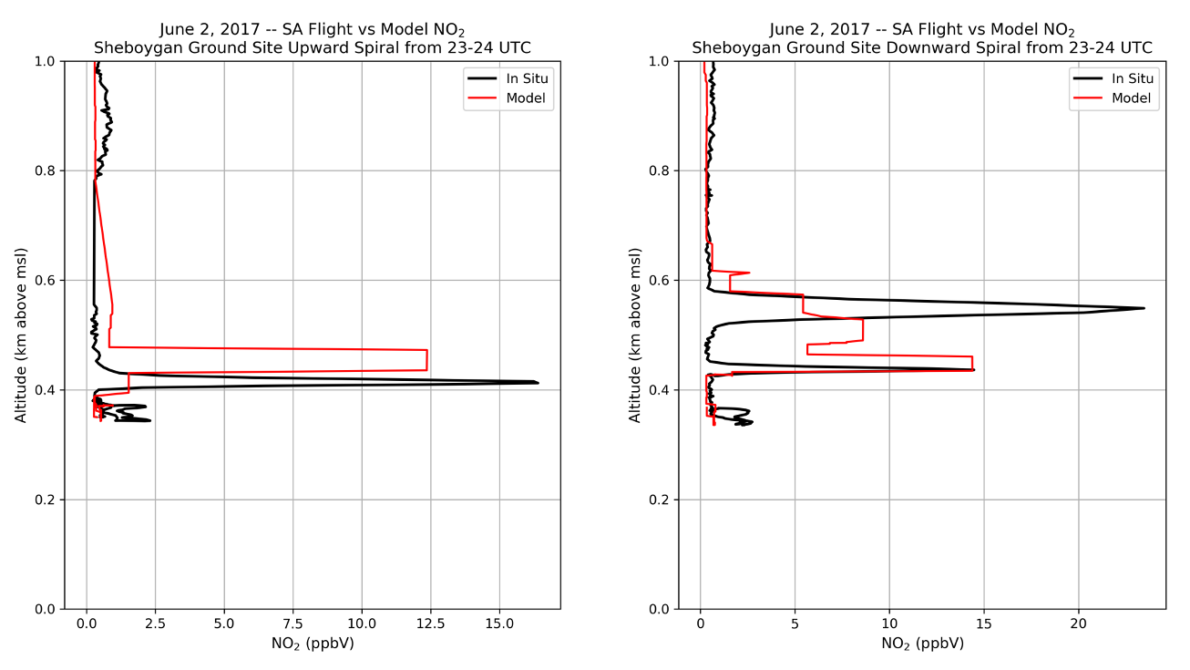
Comparison with Scientific Aviation (SA) insitu NO2
SA insitu measurements confirm that lofted NO2 in 1.3km Optimized CMAQ is realistic
Figure provided by Jerrold Acdan (UW-Madison AOS)

Slide 21
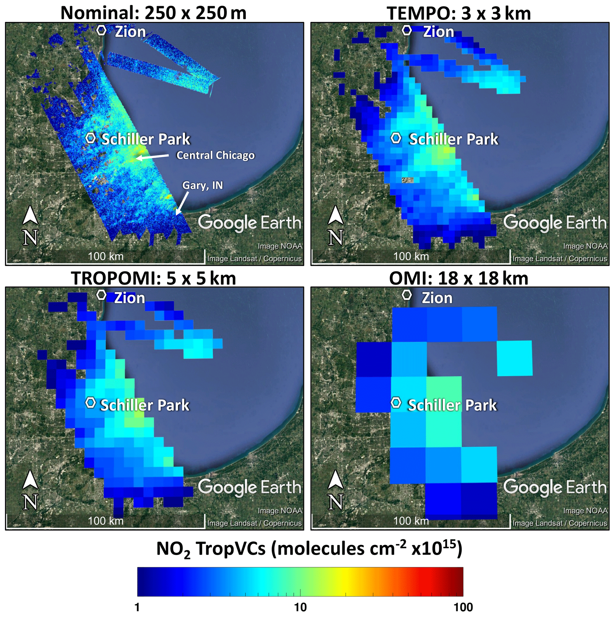
GEOTASO evaluation of spatial resolution on Tropospheric NO2 columns
Maps of GeoTASO NO2 TropVC on a log10 color scale averaged to the labeled pixel sizes to demonstrate the spatial detail that would be observed from the midday raster in the Chicago area on 22 May 2017.
Judd, L. M., et al.: Evaluating the impact of spatial resolution on tropospheric NO₂ column comparisons within urban areas using high-resolution airborne data, Atmos. Meas. Tech., 12, 6091–6111, https://doi.org/10.5194/amt-12-6091-2019, 2019.

Slide 22

GEOTASO evaluation of spatial resolution on Tropospheric NO2 columns
Maps of GeoTASO NO2 TropVC on a log10 color scale averaged to the labeled pixel sizes to demonstrate the spatial detail that would be observed from the midday raster in the Chicago area on 22 May 2017.
Steel Mill currently owned by ArcelorMittal S.A.
Judd, L. M., et al.: Evaluating the impact of spatial resolution on tropospheric NO₂ column comparisons within urban areas using high-resolution airborne data, Atmos. Meas. Tech., 12, 6091–6111, https://doi.org/10.5194/amt-12-6091-2019, 2019.

Slide 23
Conclusions
Air Quality assessment modeling within the Lake Michigan region requires high resolution (1.3km) meteorology and chemistry modeling to capture diurnal lake breeze circulations and associated coastal gradients in ozone production
  High resolution diurnal NO2 and HCHO observations from TEMPO will help verify these assessment model simulations
  Decoupling between lofted and surface NO2 enhancements can make interpretation of TEMPO ratios of column HCHO and column NO2 measurements as indicators of ozone production regimes difficult to interpret
New high resolution air quality simulations will push the spatial resolution of TEMPO to their limit

