Slide 1
High Resolution WRF-CMAQ modeling during LISTOS
Ana Torres-Vazquez, Jon Pleim
Office of Research and Development
Atmospheric and Environmental Systems Modeling Division

Slide 2
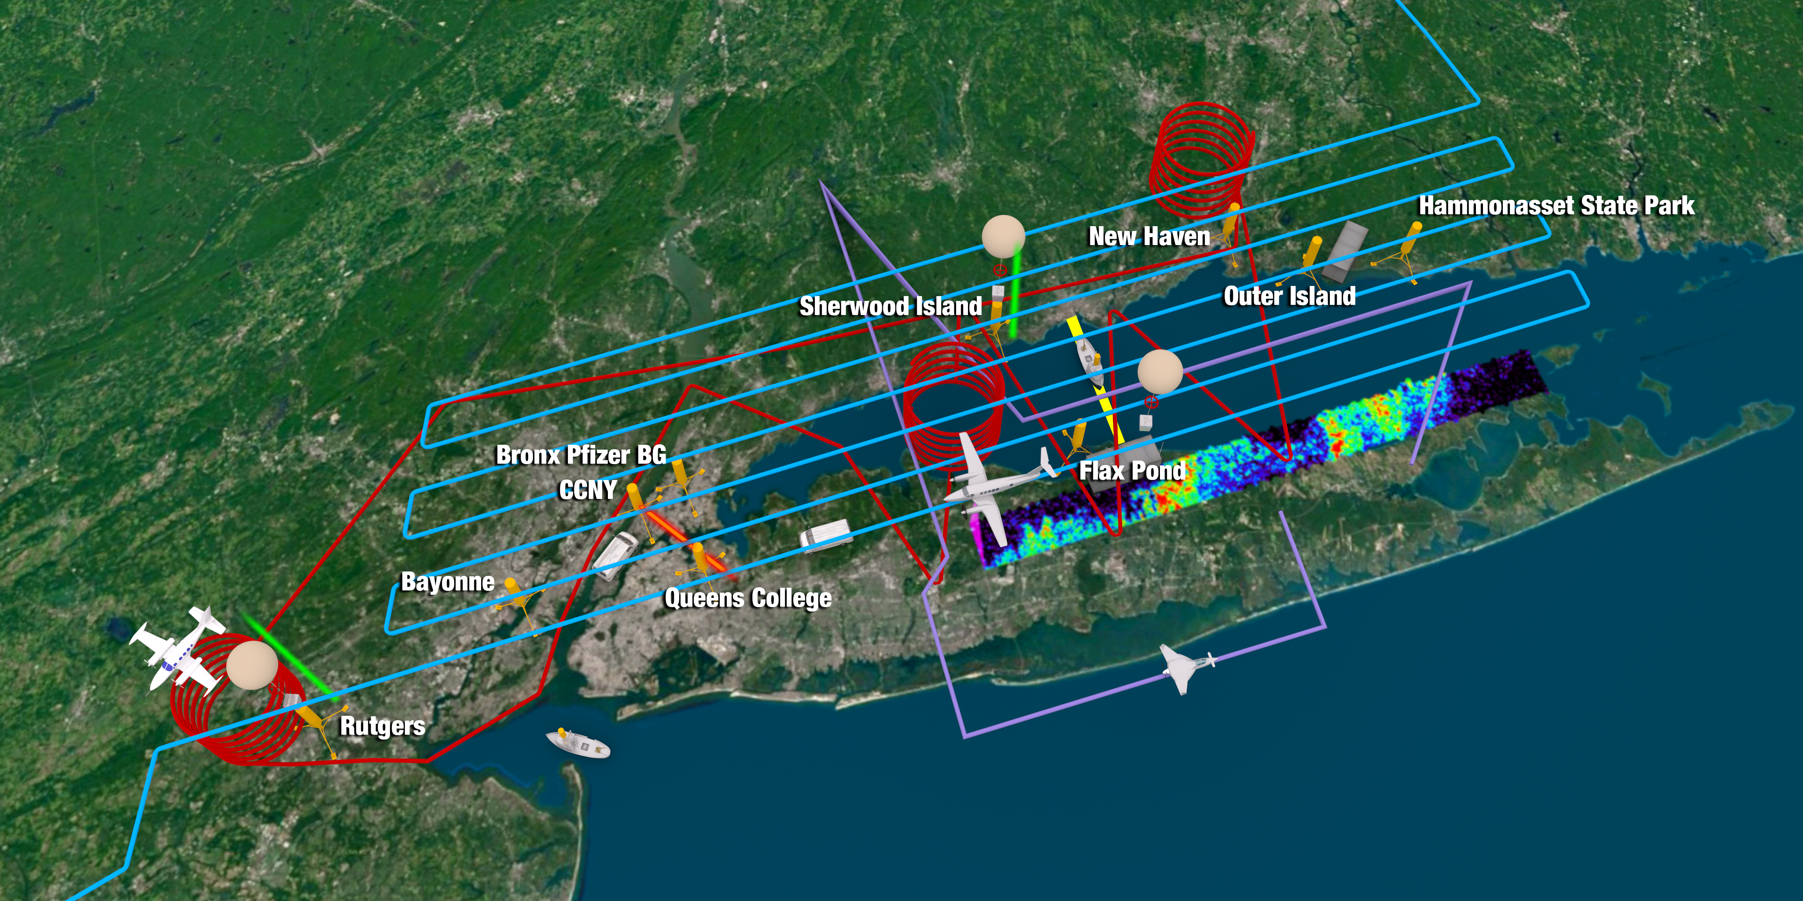
Long Island Sound Tropospheric Ozone Study (LISTOS)
LISTOS was a multi-agency collaborative field campaign organized by the Northeast States for Coordinated Air Use Management
(NESCAUM) with the goal to improve our understanding of ozone chemistry and transport from New York City to areas downstream, especially the Long Island Sound and adjacent Connecticut coastline.
Image credit: NASA Langley Research Center
How well does WRF-CMAQ model represent transport features like:
the flow regimes that are conducive to high ozone on CT coast?
land/sea breezes along the CT and Long Island coastlines?
low level jets (LLJs)?
and their impacts to pollutant transport and production?
Can we improve model performance with modifications to physics or data assimilation?
Science Questions

Slide 3
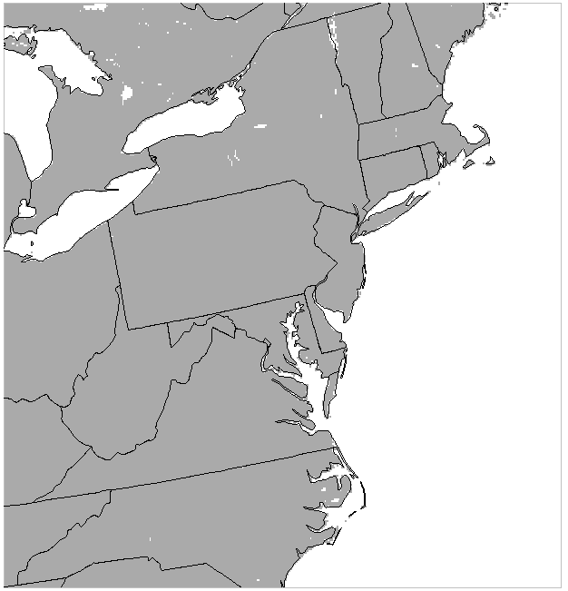
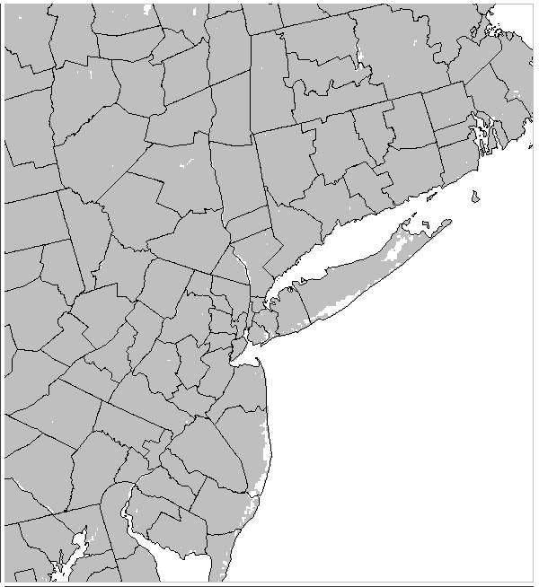
Modeling Approach
4km
Model Versions | Coupled WRF-CMAQ; WRFv4.1.1, CMAQv5.3.1
Initial Conditions for 12km simulation | NAM 12km Analysis 108km Hemispheric CMAQ
Run period | 12km: 2018 4km & 1.33km : May – Sept 2018.
Emissions | 2016ff projected forward to 2018; 1.33km domain had additional county-specific information.
1.33 km

Slide 4
Modeling Approach
Updates to meteorological modeling:
Updated sea surface temperature using high resolution surface data: GHRSST (1 km).
Surface data assimilation using UnRestricted Mesoscale Analysis (URMA) (2 km) through PX LSM soil moisture and temperature nudging
Updated land-use, tree canopy and imperviousness information using 2016 NLCD-MODIS data
Key aspects of emissions
Onroad mobile sources – Run MOVES with county specific updated VMT, age distribution, temporal profile from 2017 (adjust for day of week for 2018 )
Marine – hourly GPS ship data from 2017 (adjust for day of week for 2018)
Tree canopy fraction for 1.33-km domain
Impervious surface
fraction for 1.33-km domain

Slide 5
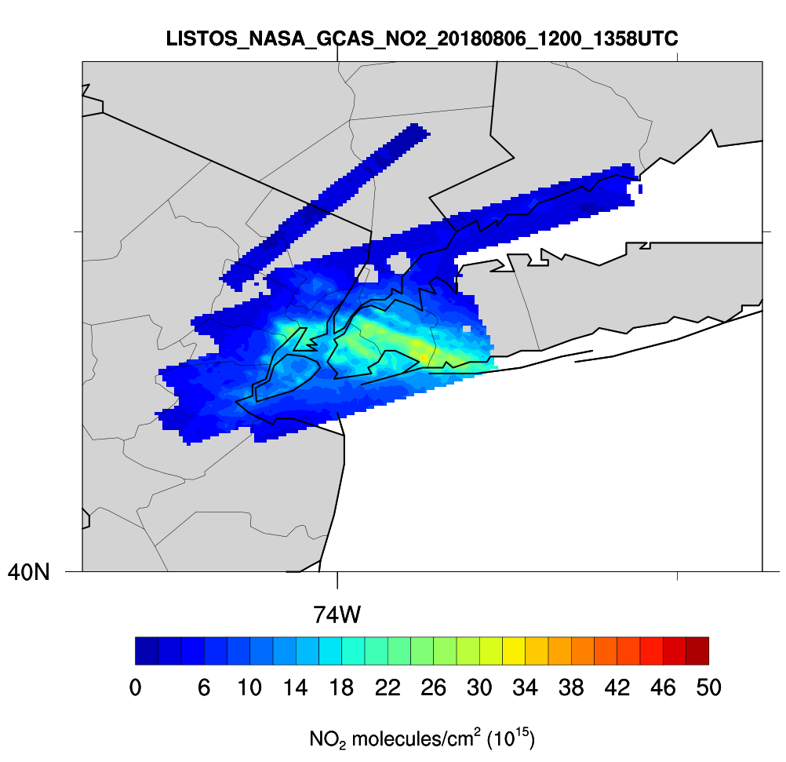
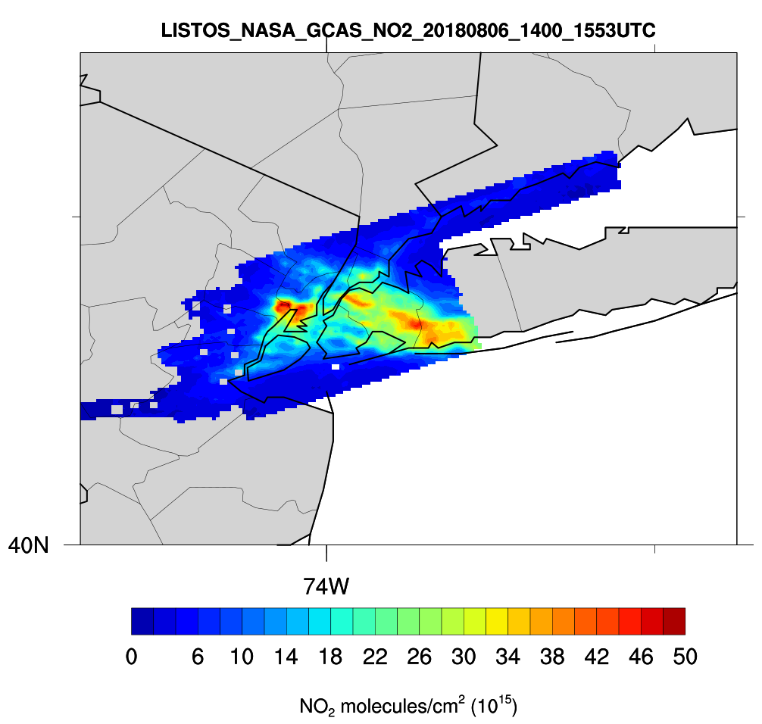
GCAS captures NO₂ sources and their transport in the early morning of August 6, 2018
12-13:58 UTC
14-15:53 UTC
Notes:
Mention NYS MESONET

Slide 6
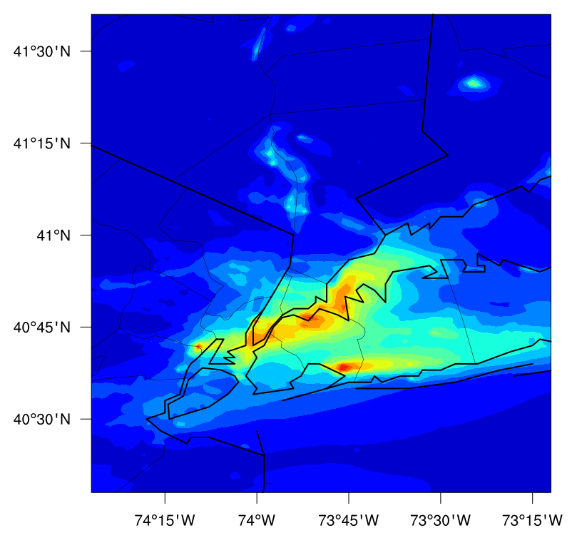
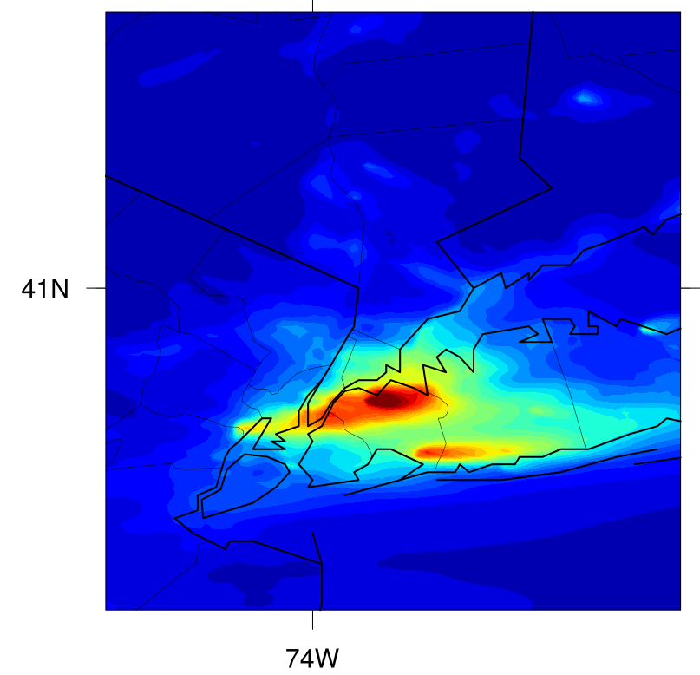
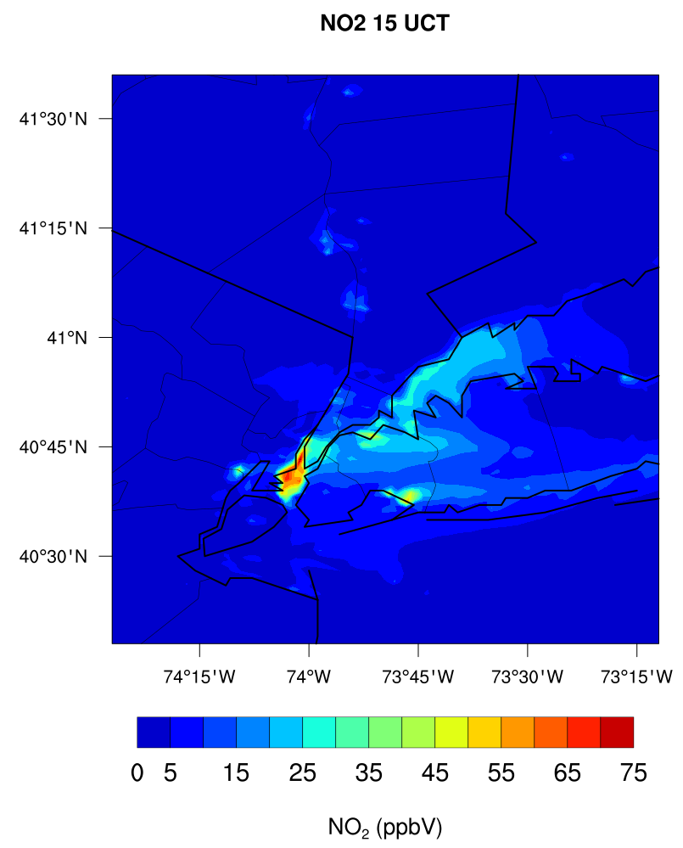
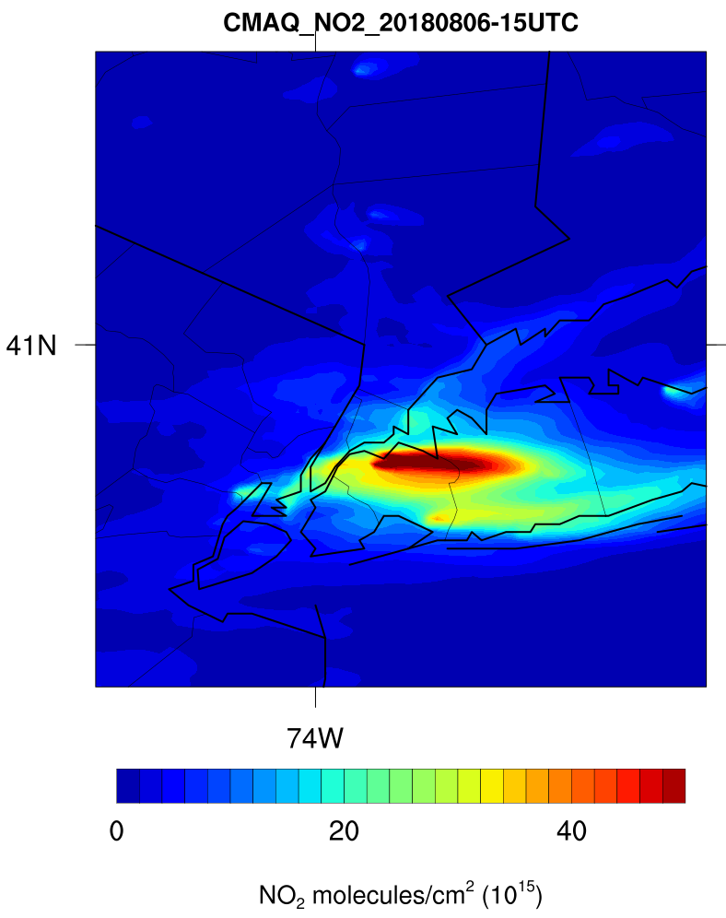
GCAS captures NO₂ sources and their transport in the early morning of August 6, 2018
Our 1.33km simulations replicates some of these sources at the surface but simulates different transport and timing regimes along the columns.
12-13:58 UTC
NO₂
13 UTC
NO₂ Vertical Column Density
13 UTC
NO₂
15 UTC
NO₂ Vertical Column Density
15 UTC
14-15:53 UTC
Notes:
Mention NYS MESONET

Slide 7
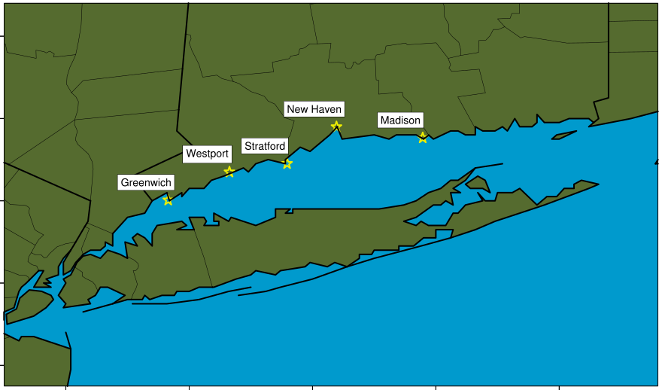
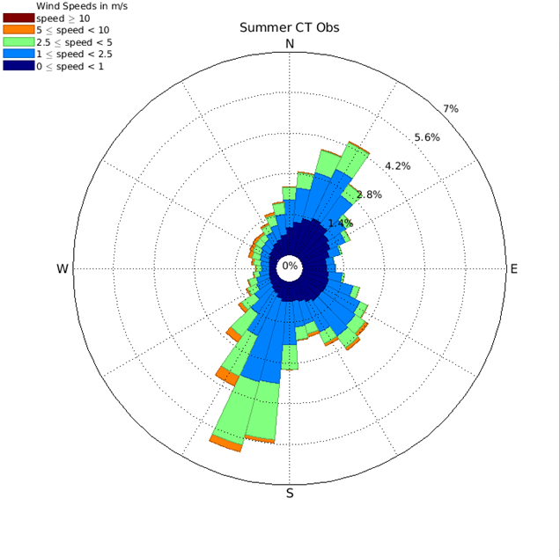
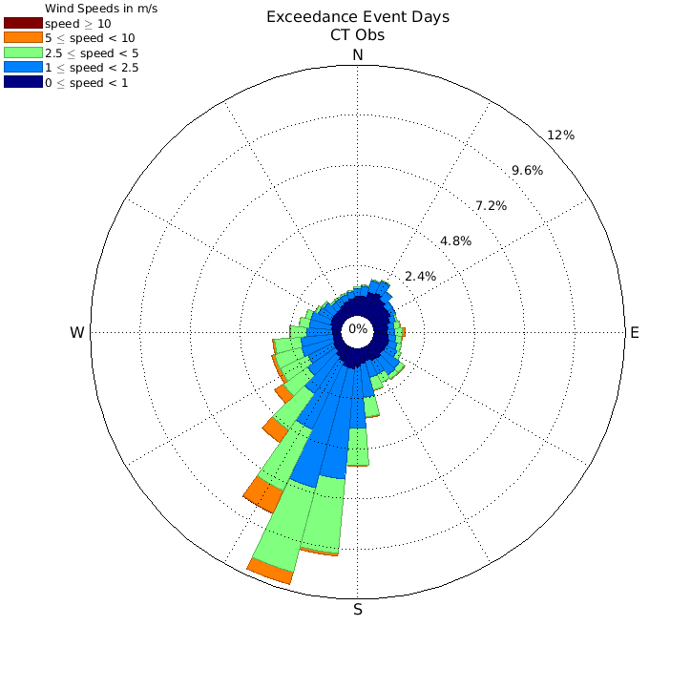
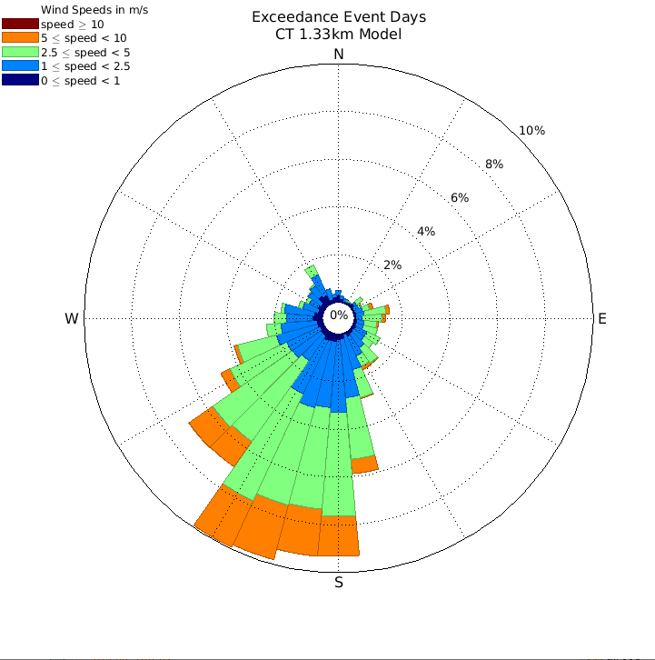
Surface-level wind flow
Summer-long flow is predominantly SSW, with NE and SE activity.
Measurements during the 21 exceedance events show predominant SSW flow.
Model captures general character of observed flow, but overestimates wind speeds and flow variance.
1-minute wind observations from ground stations managed by the Connecticut Department of Energy and Environmental Protection (CT DEEP).
Observations from the full summer
Observations from the 21 exceedance events
Modeled winds during the 21 exceedance days

Slide 8
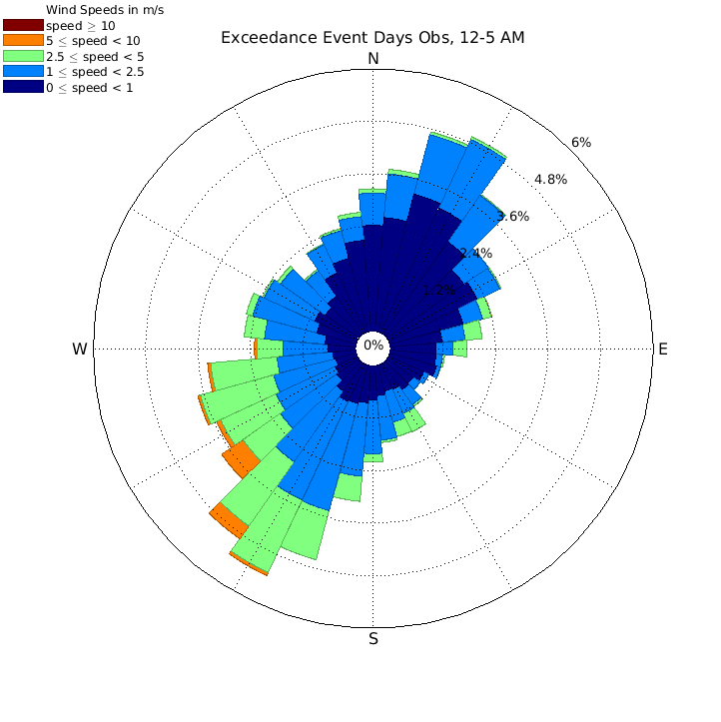
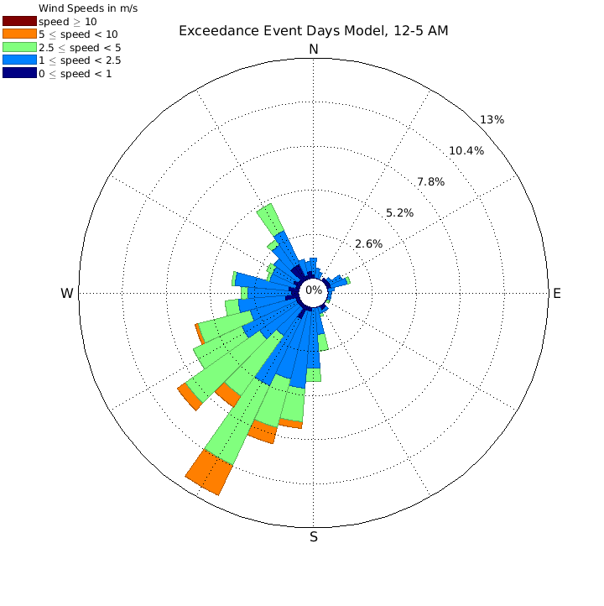
Surface-level wind flow
Summer-long flow is predominantly SSW, with NE and SE activity.
Measurements during the 21 exceedance events show predominant SSW flow.
Model captures general character of observed flow, but overestimates wind speeds and flow variance.
Model does not capture NNE land-breeze-like wind shift between 12 AM – 5 AM.
1-minute wind observations from ground stations managed by the Connecticut Department of Energy and Environmental Protection (CT DEEP).
12 AM – 5 AM Exceedance Event Observations versus Model

Slide 9
Surface-level wind flow along the CT coast on July 10
Wind Direction
1-min ozone
Model does not simulate overnight land breeze processes along coastal CT stations.
Subsequently, residual ozone from the previous day was not fully cleared out.
At Greenwich: a delay in onset of on-shore breeze coincides with a delay in ozone production, which suggests importance of flow to adequate simulation of ozone.
At Madison: onset of ozone production preceded SW flow shift, suggesting localized production.
Model misses max. ozone concentrations at all stations.

Slide 10
Surface-level wind flow along the CT coast on July 10
Wind Direction
1-min ozone
Model does not simulate overnight land breeze processes along coastal CT stations.
Subsequently, residual ozone from the previous day was not fully cleared out.
At Greenwich: a delay in onset of on-shore breeze coincides with a delay in ozone production, which suggests importance of flow to adequate simulation of ozone.
At Madison: onset of ozone production preceded SW flow shift, suggesting localized production.
Model misses max. ozone concentrations at all stations.
NO₂
Breeze-ozone-NO₂ relationships recreated by the model.

Slide 11
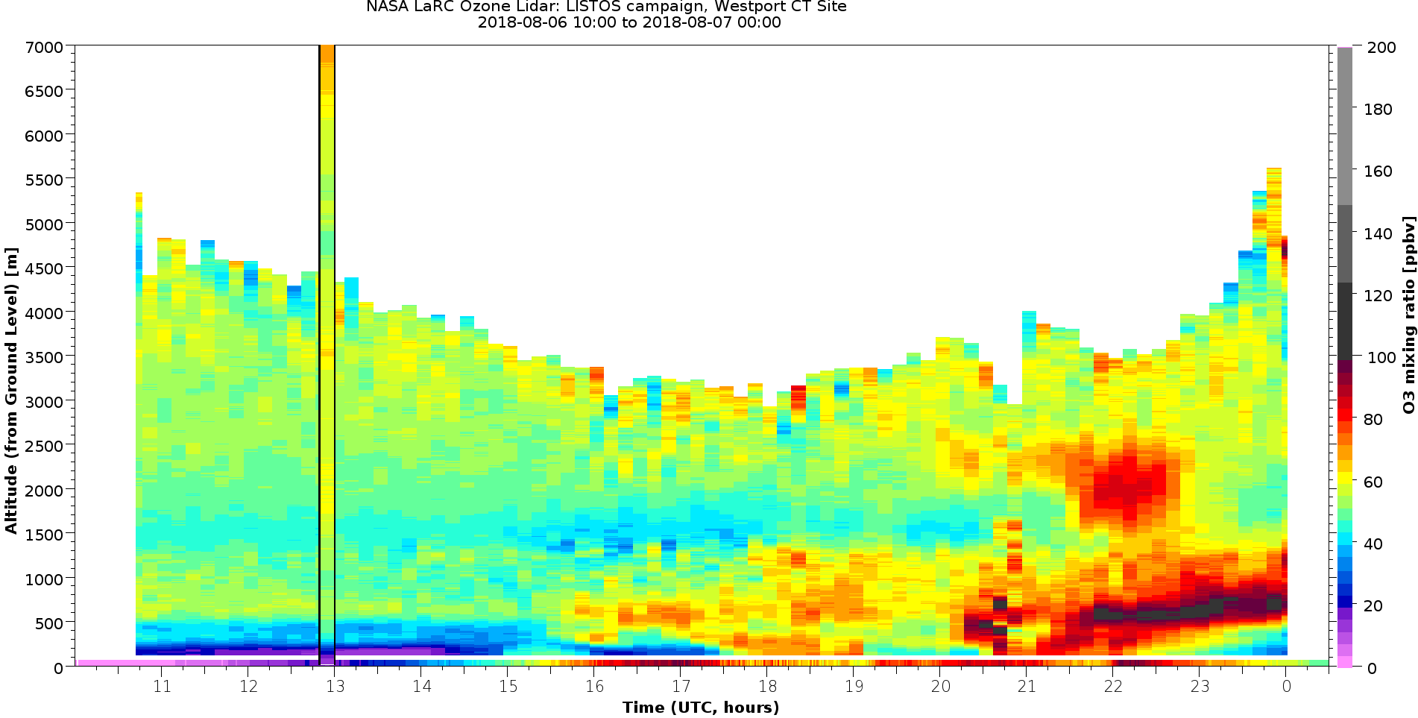
Ozone LIDAR at Westport
Potential evidence of:
Rapid growth within shallow surface layer
Localized low-level jets
…and a plume transporting high ozone concentrations over Westport.
Ozone LIDAR data at Westport provides us with an encompassing snapshot of processes related to ozone production and ozone exceedances along the CT coast.
Data courtesy of Tim Berkoff, NASA.

Slide 12
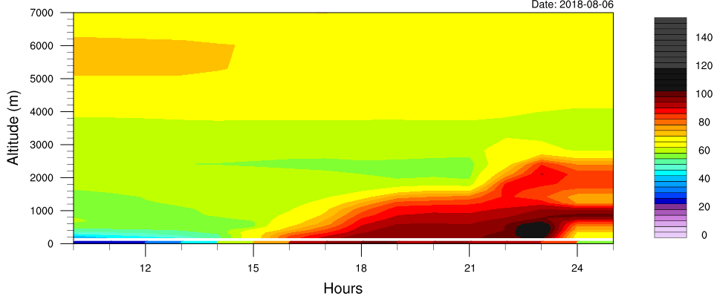
Rapid growth within shallow surface layer
Model captures surface level growth, but it’s very similar to behavior higher along the column.
Plume transporting high ozone concentrations over Westport.
Timing of plume arrival later than observed.
** NOTE: there are discrepancies between LIDAR vertical column ozone values and those captured by the ozone sondes.
Data courtesy of Tim Berkoff, NASA.

Slide 13
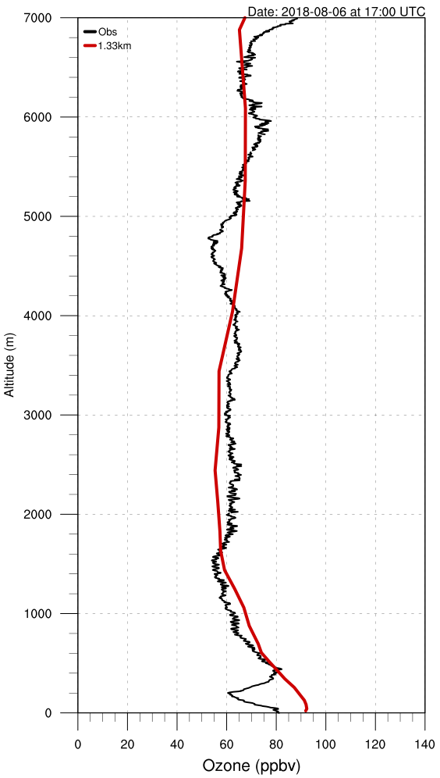
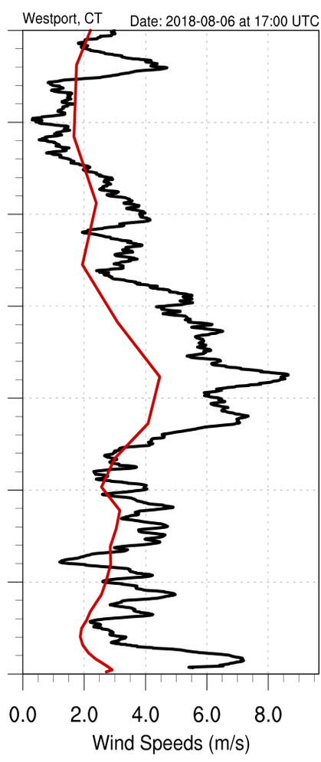
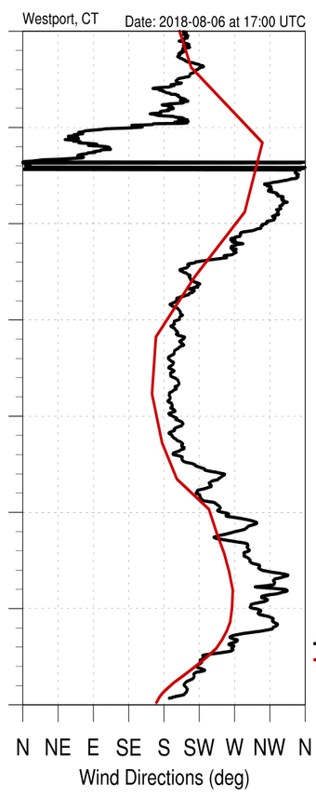
Potential evidence of localized low-level jets
Ozone
Wind Speed
Wind Direction
** NOTE: there are discrepancies between LIDAR vertical column ozone values and those captured by the ozone sondes.
Data courtesy of Tim Berkoff, NASA.

Slide 14
To summarize
The model captured prevailing wind flows and general high ozone concentrations over the region but struggled to adequately represent sea and land breezes and low-level jets, even at 1.33km grid lengths.
Evidence that transport issues are both local and regional.
There is evidence of this impacting the representation of NO2 and ozone.

