Slide 1
Regional O3 OSSEs
Brad Pierce (NOAA)
GEOCAPE Regional and Urban OSSE WG members
Co-Leads: Brad Pierce (NOAA) and Vijay Natraj (JPL)
Regional Nature run: Brad Pierce and Allen Lenzen (CIMSS)
Forward modeling: Vijay Natraj, Susan Kulawit, (JPL)
Urban Nature run: Ken Pickering and Chris Loughner (NASA/GSFC)
Averaging Kernel regression development: Helen Worden (NCAR)
Additional contributions from Jerome Vidot (Meteo/France) and Eva Borbas (UW-Madison/SSEC) who have provided the WG with the High Spectral Resolution (HSR) IR emissivity and VIS reflectivity data bases for the OSSE studies.
4th TEMPO Science Team Meeting, June 1-2, 2016 Washington, DC

Slide 2
GEOCAPE O3 OSSE Goals
July 2011 DISCOVER-AQ Period
Utilize independent modeling systems for generation of Nature atmosphere and conducting assimilation impact experiments
Account for realistic atmospheric variability, which requires evaluation of the nature runs with respect to observations
Include realistic variability in the synthetic radiances, which requires using realistic albedos and emissivities
Include realistic sensitivities, which requires generation of averaging kernels (AK) for each retrieval for use in assimilation studies

Slide 3
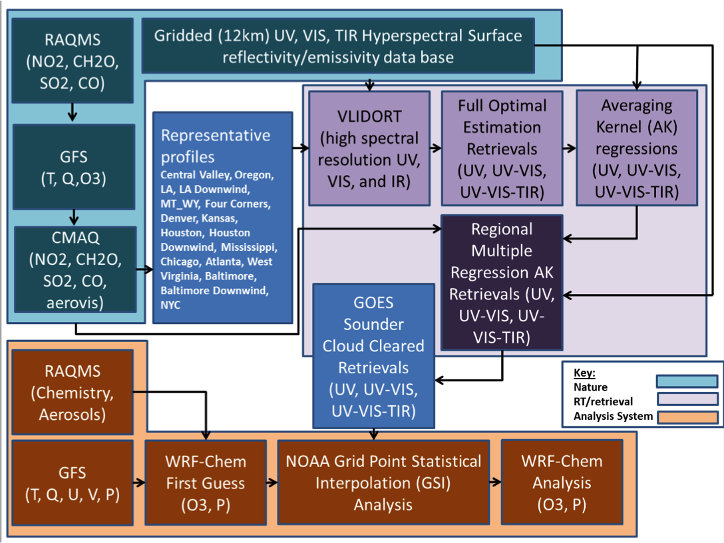
OSSE Flow Chart

Slide 4
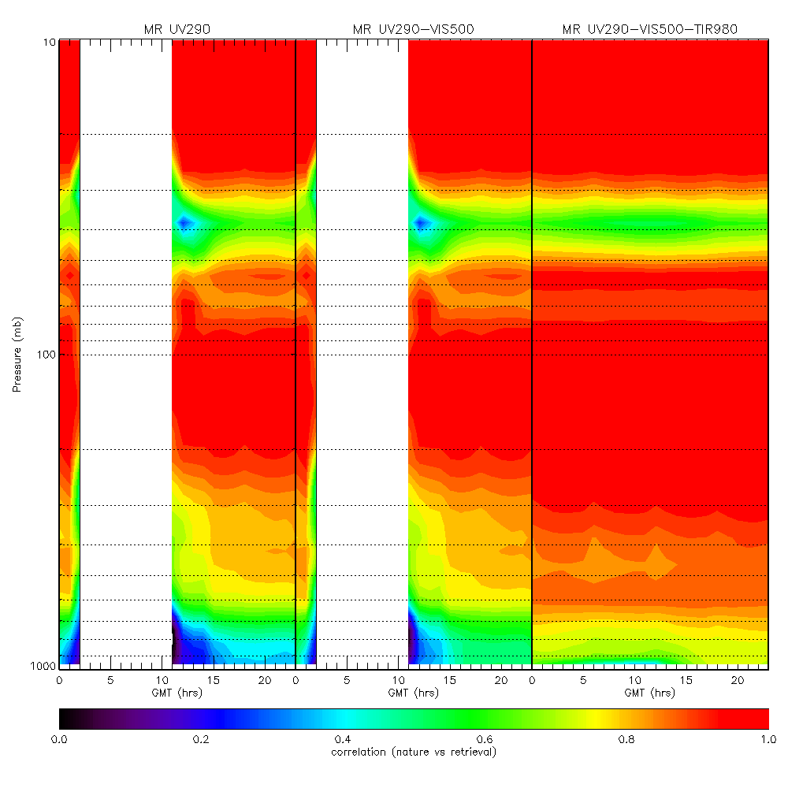
Nature/Retrieval Correlations
Regional Multiple Regression AK Retrievals (UV, UV-VIS, UV-VIS-TIR)
All retrievals show high correlations (>0.9) in upper troposphere/lower stratosphere
UV-VIS-TIR shows the highest correlations (>0.8) in the mid and lower troposphere
UV-VIS shows improvement over the UV only retrievals below 800mb
18km
12km
6km
3km
1km

Slide 5
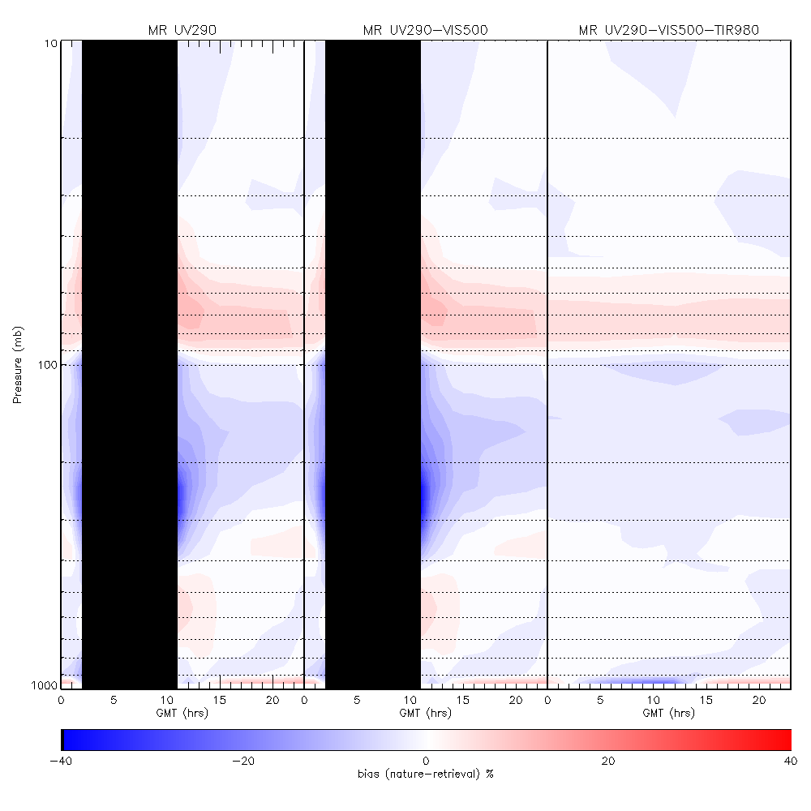
Nature/Retrieval Biases
Regional Multiple Regression AK Retrievals (UV, UV-VIS, UV-VIS-TIR)
Generally low biases (<20%) except:
between 200-400mb at sunrise and sunset (UV and UV-VIS only)
Below 900mb (underestimate daytime and overestimate nighttime O3)
18km
12km
6km
3km
1km

Slide 6
July 2011 WRF-CHEM/GSI OSSE Experiments
Synthetic OMI (using actual retrieval efficiency factors and apriori)
OMI+ Multiple Regression GEOCAPE UV-VIS-TIR synthetic retrievals
OMI+ Multiple Regression GEOCAPE UV-VIS synthetic retrievals
OMI+ Multiple Regression GEOCAPE UV synthetic retrievals
Multiple Regression GEOCAPE UV-VIS-TIR synthetic retrievals
Multiple Regression GEOCAPE UV-VIS synthetic retrievals
Multiple Regression GEOCAPE UV synthetic retrievals
All OSSE experiments include:
1 hour cycling
Inflation of background error covariances near surface
Application of linear observation operator (AK) in GSI enter loop
needed for stability during initial large UTLS adjustments
Results compared to nature run integrated over atmospheric layers
(12-18km, 6-12km, 0-6km, 0-3km, 0-1km)

Slide 7
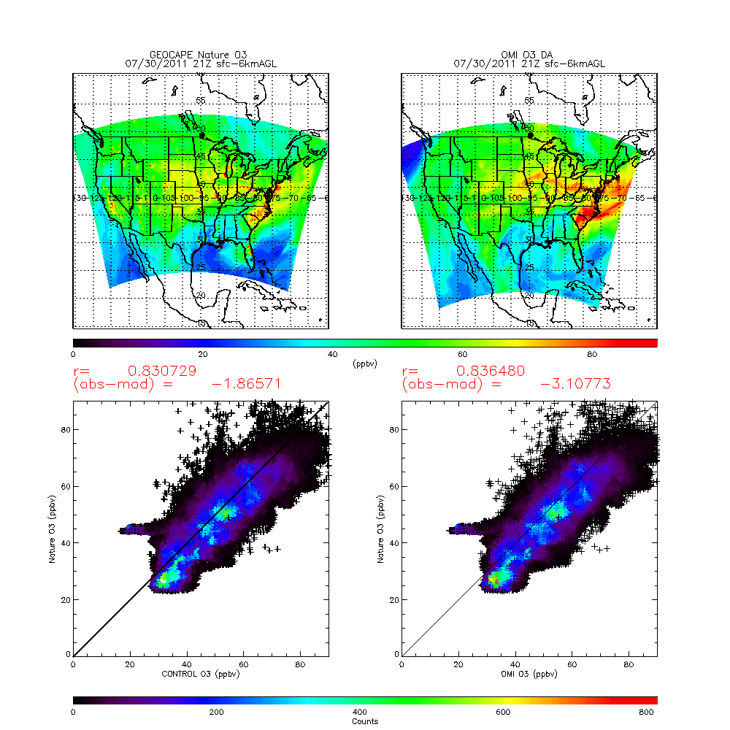
sfc-6km Nature vs OMI DA 21Z 07/30/2011

Slide 8
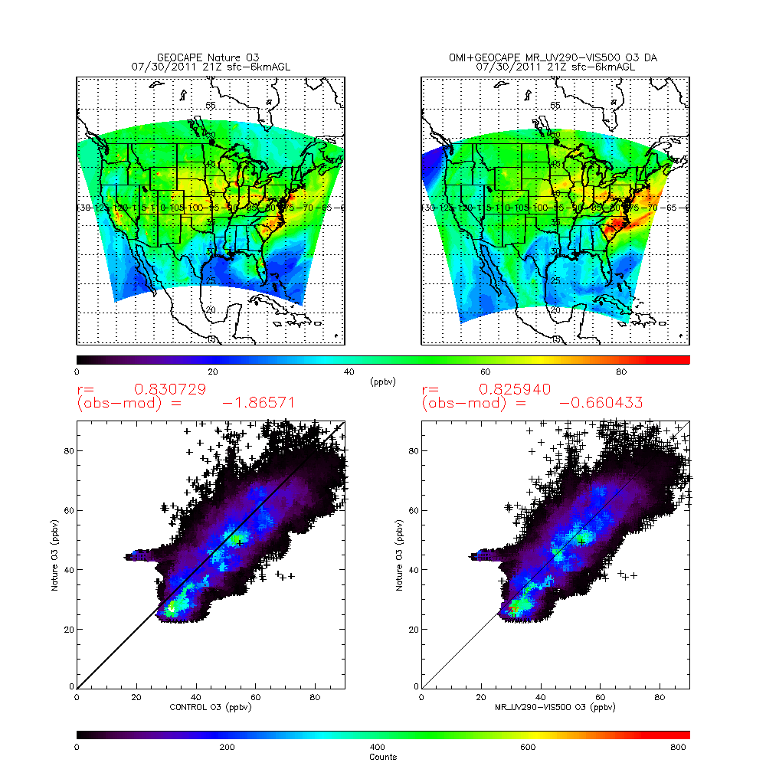
sfc-6km Nature vs OMI+UVVIS DA 21Z 07/30/2011

Slide 9
OMI+MR OSSE results
Diurnal Averaged Bias
Significant reductions in high biases introduced by OMI for all MR retrievals except the surface-1km and surface-3km layers
OMI+MR UV and OMI+MR UVVIS show similar results
OMI+UVVISTIR shows lower biases between 12-18km but larger biases then UV or UVVIS below 12km
12-18km
6-12km
sfc-6km
sfc-3km
sfc-1km

Slide 10
MR OSSE results
Diurnal Averaged Bias
Significant reductions in high biases introduced by OMI for all MR retrievals except the surface-1km and surface-3km layers
OMI+MR UV and OMI+MR UVVIS show similar results
OMI+UVVISTIR shows lower biases between 12-18km but larger biases then UV or UVVIS below 12km
12-18km
6-12km
sfc-6km
sfc-3km
sfc-1km

Slide 11
MR OSSE results
Diurnal Averaged RMS Error
Slight improvements in RMS error over OMI for all MR retrievals except the surface-1km layer
OMI+MR UV and OMI+MR UVVIS show similar results
OMI+UVVISTIR shows largest improvements
12-18km
6-12km
sfc-6km
sfc-3km
sfc-1km

Slide 12
OMI+MR OSSE results
Diurnal Averaged RMS Error
Slight improvements in RMS error over OMI only for all MR retrievals
OMI+MR UV and OMI+MR UVVIS show similar results
OMI+UVVISTIR shows largest improvements
12-18km
6-12km
sfc-6km
sfc-3km
sfc-1km

Slide 13
OMI+MR OSSE results
Diurnal Averaged Correlation
Slight improvements in correlation over OMI only for all MR retrievals
OMI+MR UV and OMI+MR UVVIS show similar results
OMI+UVVISTIR shows largest improvements
12-18km
6-12km
sfc-6km
sfc-3km
sfc-1km

Slide 14
MR OSSE results
Diurnal Averaged Correlation
Slight improvements in correlation over OMI for all MR retrievals
MR UV and UVVIS retrievals show similar results
OMI+UVVISTIR shows largest improvements
12-18km
6-12km
sfc-6km
sfc-3km
sfc-1km

Slide 15
Summary
Hourly geostationary UV, UVVIS, and UVVISTIR ozone retrievals show high correlations with nature run (>0.8) except for sunrise/sunset UV and UVVIS retrievals and below 700mb (3km)
Hourly geostationary UV, UVVIS, and UVVISTIR ozone retrievals show fairly low biases relative to nature run (<20%) except for sunrise/sunset UV and UVVIS retrievals and below 900mb (1km)
Assimilation of hourly geostationary UV, UVVIS and UVVISTIR ozone retrievals improves correlation, rms error and bias relative to control and OMI polar orbit retrievals in the upper troposphere lower stratosphere (12-18km), middle troposphere (6-12km) and lower troposphere (0-6km)
Surface-1km and surface-3km layers show neutral results for correlation and rms errors and slight increases in diurnally averaged biases when hourly geostationary UV, UVVIS, and UVVISTIR ozone retrievals are assimilated.
These WRF-CHEM/GSI results suggest that it will be difficult to obtain improvements in boundary layer ozone analyses through 3D variational assimilation of geostationary ozone retrievals alone due to the strong dependence on ozone precursor emissions.

