Slide 1
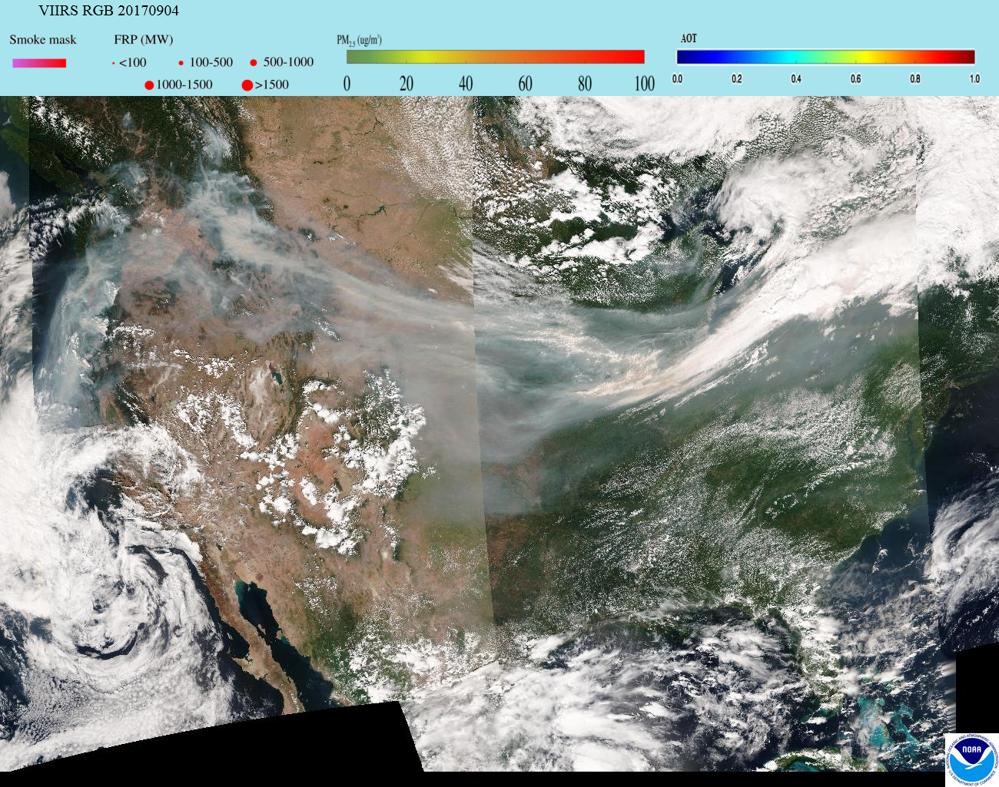
A Cross Disciplinary, Multi-Tool Approach to Support Regional and Global Air Quality Assessment and Forecasting
R. Bradley Pierce
NOAA/NESDIS@CIMSS

Slide 2
A Cross Disciplinary, Multi-Tool Approach to Support Regional and Global Air Quality Assessment and Forecasting
R. Bradley Pierce
NOAA/NESDIS@CIMSS
“Think globally, act locally”

Slide 3
Outline:
Background
  Pollution health & ecosystem effects
  Regional trends
Regional Air Quality
  2017 Lake Michigan Ozone Study – “The Wisconsin Idea”
Global Air Quality
  Global Trends
  Aura Chemical Reanalysis
Vision: SSEC – Opportunities and Challenges

Slide 4
Outline:
Background
  Pollution health & ecosystem effects
  Regional trends
Regional Air Quality
  2017 Lake Michigan Ozone Study – “The Wisconsin Idea”
Global Air Quality
  Global Trends
  Aura Chemical Reanalysis
Vision: SSEC – Opportunities and Challenges

Slide 5

  Ozone Pollution health & ecosystem effects
Tropospheric ozone (O3) is formed by photochemical reactions involving sunlight and precursor pollutants, including volatile organic compounds (VOCs), nitrogen oxides (NOX), and carbon monoxide (CO).
In the troposphere, O3 acts as a powerful oxidizing agent, which can harm living organisms and materials.
  Short-term exposure to elevated O3 concentrations leads to respiratory and cardiovascular effects and increased mortality
  Long-term exposure to elevated O3 concentrations leads to reduced vegetation growth, productivity, and yield and quality of agricultural crops
U.S. EPA. Integrated Science Assessment (ISA) of Ozone and Related Photochemical Oxidants (Final Report, Feb 2013). U.S. Environmental Protection Agency, Washington, DC, EPA/600/R-10/076F, 2013.

Slide 6
  Ozone Pollution health & ecosystem effects
Tropospheric ozone (O3) is formed by photochemical reactions involving sunlight and precursor pollutants, including volatile organic compounds (VOCs), nitrogen oxides (NOX), and carbon monoxide (CO).
In the troposphere, O3 acts as a powerful oxidizing agent, which can harm living organisms and materials.
  Short-term exposure to elevated O3 concentrations leads to respiratory and cardiovascular effects and total mortality
  Long-term exposure to elevated O3 concentrations leads to reduced vegetation growth, productivity, and yield and quality of agricultural crops
Tropospheric Formaldehyde (HCHO, a VOC), Nitrogen Dioxide (NO2, part of NOx), CO and O3 columns can all be observed from Satellites
U.S. EPA. Integrated Science Assessment (ISA) of Ozone and Related Photochemical Oxidants (Final Report, Feb 2013). U.S. Environmental Protection Agency, Washington, DC, EPA/600/R-10/076F, 2013.

Slide 7
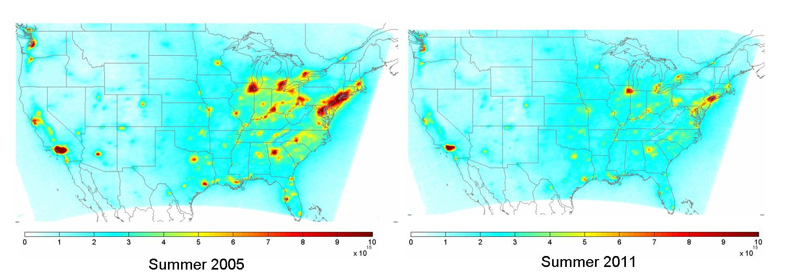
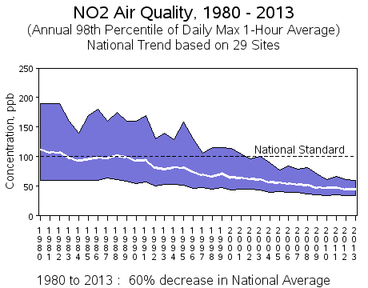
Background: National Trends in Nitrogen Dioxide (NO2) Levels
OMI Berkeley High-Resolution (BEHR) NO2 Column Retrievals
Overall, surface and column NO2 amounts are declining over the US due to regulations from the Clean Air Act
EPA NO2 trends from ground monitoring
32±7% reduction 2005-2011
http://www.epa.gov/airtrends/nitrogen.html
Russell et al., ACP 12, 12197-12209, doi:10.5194/acp-12-12197-2012, 2012.

Slide 8
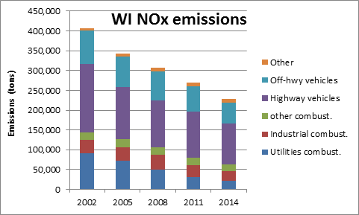
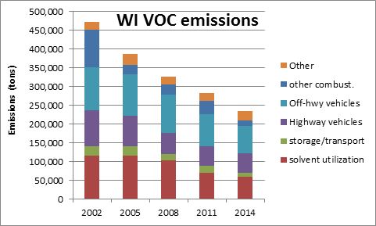
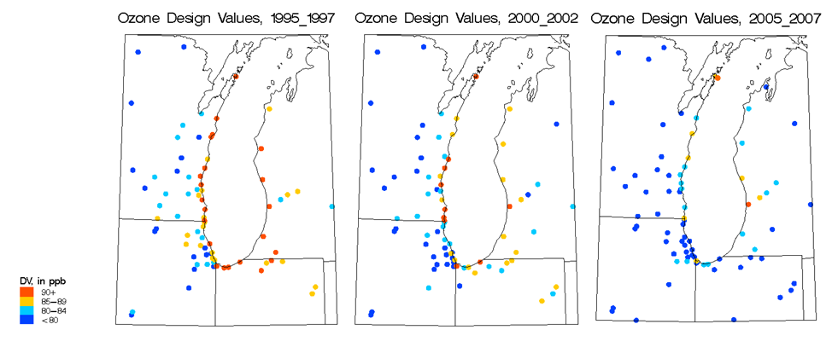
Wisconsin emissions are declining and ozone is improving
NOx= NO+NO2 (nitrogen oxides) VOC=Volatile Organic Compounds, both are ozone precursors
Provided by Angie Dickens (WDNR)
and Donna Kenski (LADCO)

Slide 9
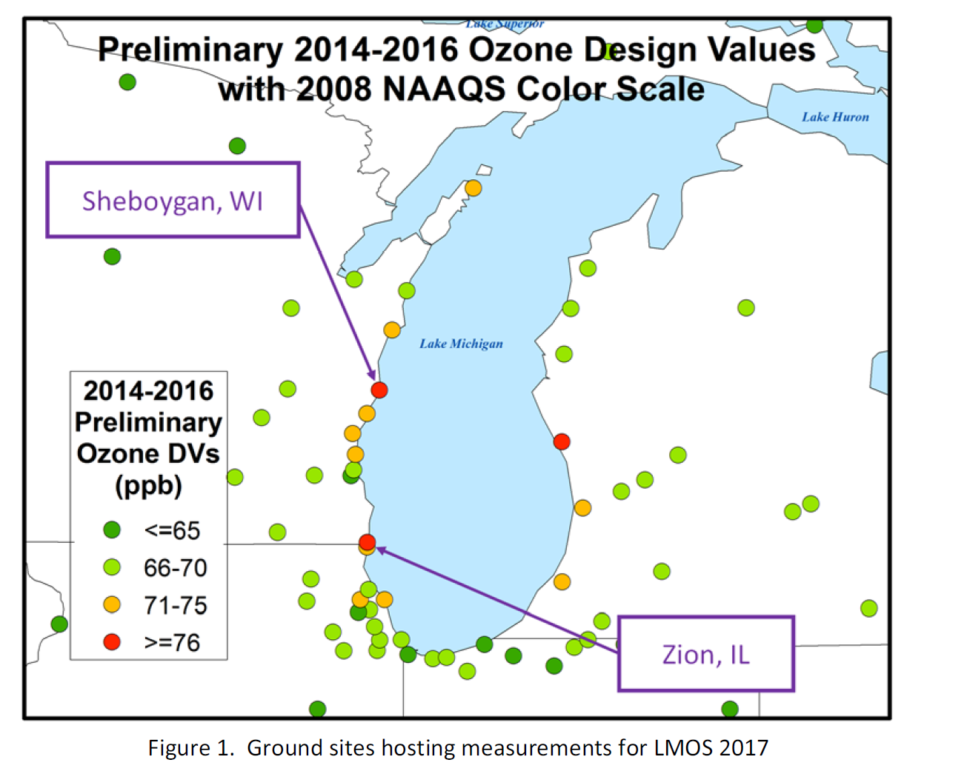
But there are still coastal sites which are still above the new ozone standard (70ppbv)
Anticipated new non-attainment areas with new, lower ozone standard and persistent exceedances of the old (2008) ozone standard.
Impact of high ozone on public health in high density urban areas (Chicago, Milwaukee, Detroit, Windsor). Also, these areas serve as large emissions sources.
2017 Lake Michigan Ozone Study White Paper: http://www.ladco.org/

Slide 10
Outline:
Background
  Pollution health & ecosystem effects
  Regional trends
Regional Air Quality
  2017 Lake Michigan Ozone Study – “The Wisconsin Idea”
Global Air Quality
  Global Trends
  Aura Chemical Reanalysis
Vision: SSEC – Opportunities and Challenges

Slide 11











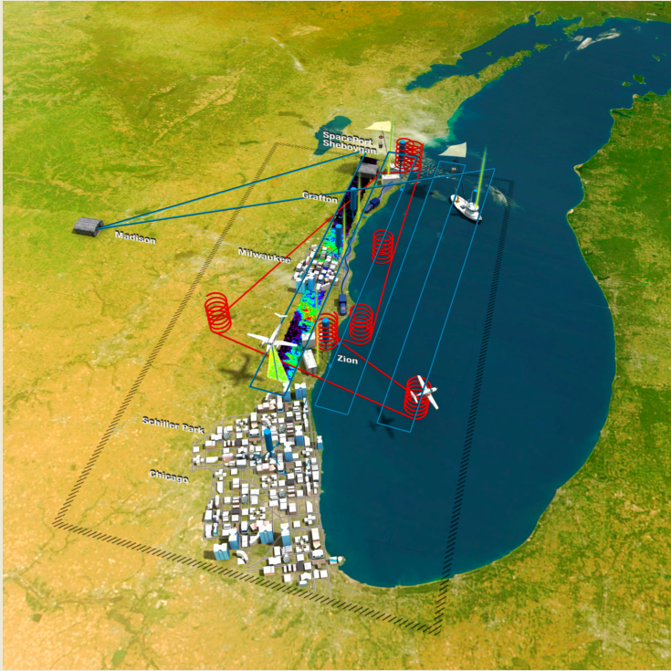

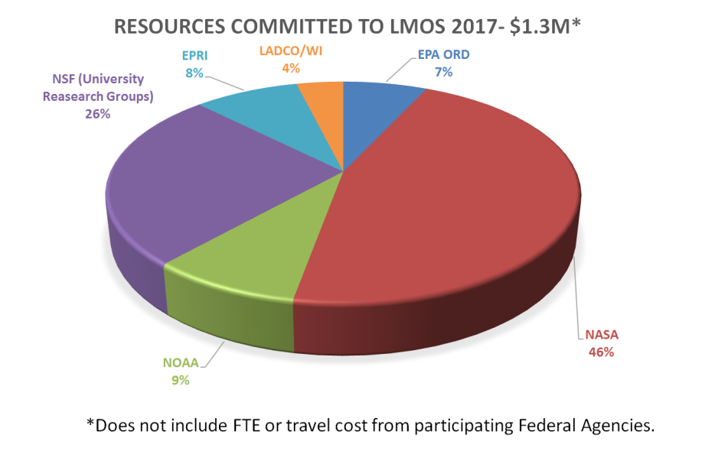
During May and June 2017, federal and state agencies, universities, and other partners measured air quality over Lake Michigan.
The 2017 Lake Michigan Ozone Study (LMOS)

Slide 12
During May and June 2017, federal and state agencies, universities, and other partners measured air quality over Lake Michigan.
The 2017 Lake Michigan Ozone Study (LMOS)
Objectives:
Improved ozone forecasts for the region, which states and EPA use to meet state and federal Clean Air Act requirements.
Better understanding of the lakeshore gradient in ozone concentrations, which could influence how EPA addresses future regional ozone issues.
Improved knowledge of how emissions influence ozone formation in the region.

Slide 13
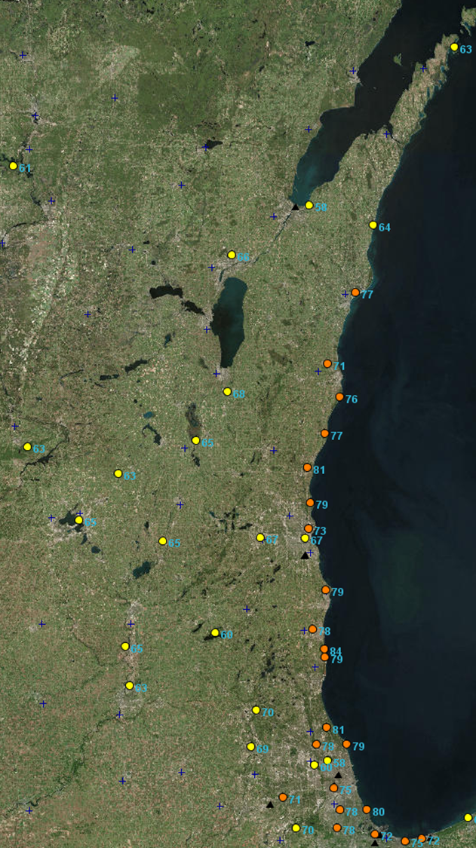
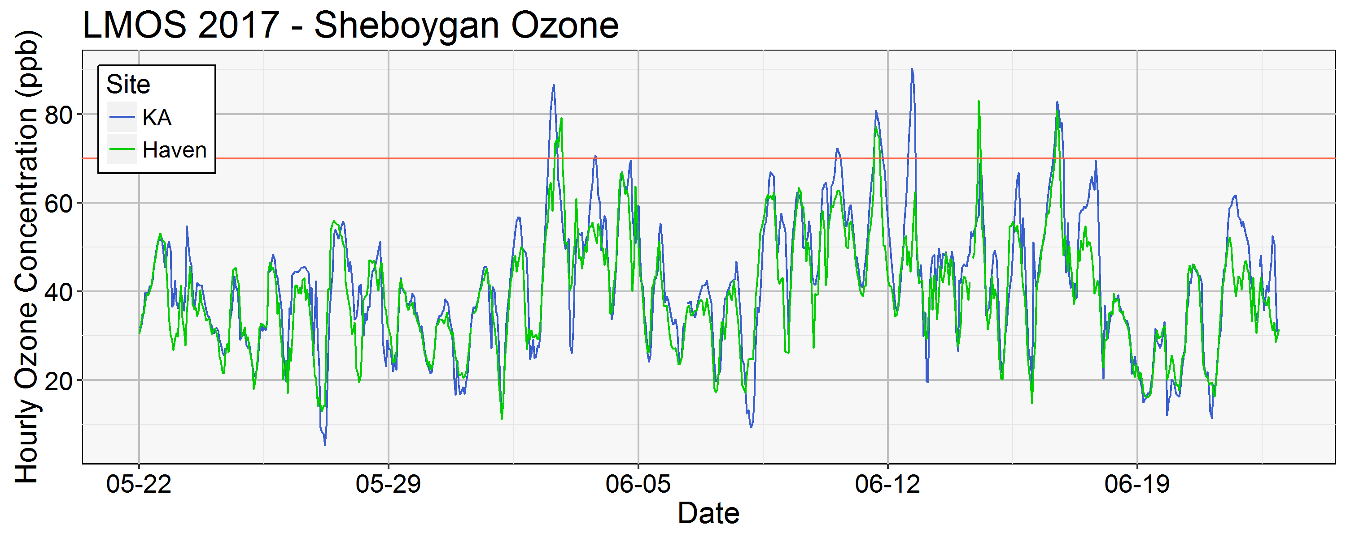
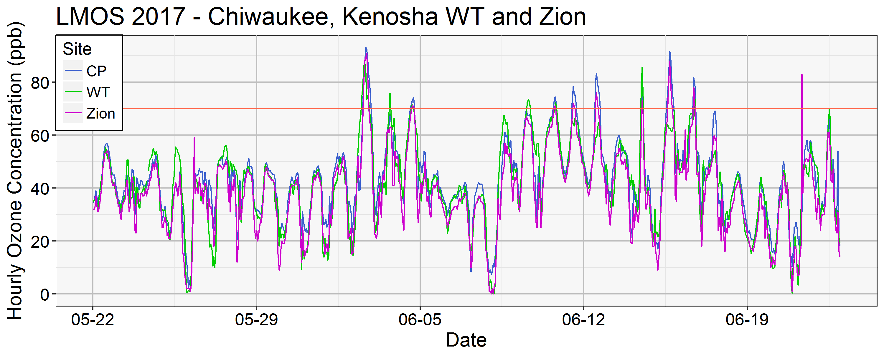
Lakeshore ozone during LMOS 2017
June 02, 2017 MDA8
June 02, 2018
June 02, 2018
Provided by Angie Dickens (WDNR)
MDA8=Maximum Daily 8 hour Average

Slide 14
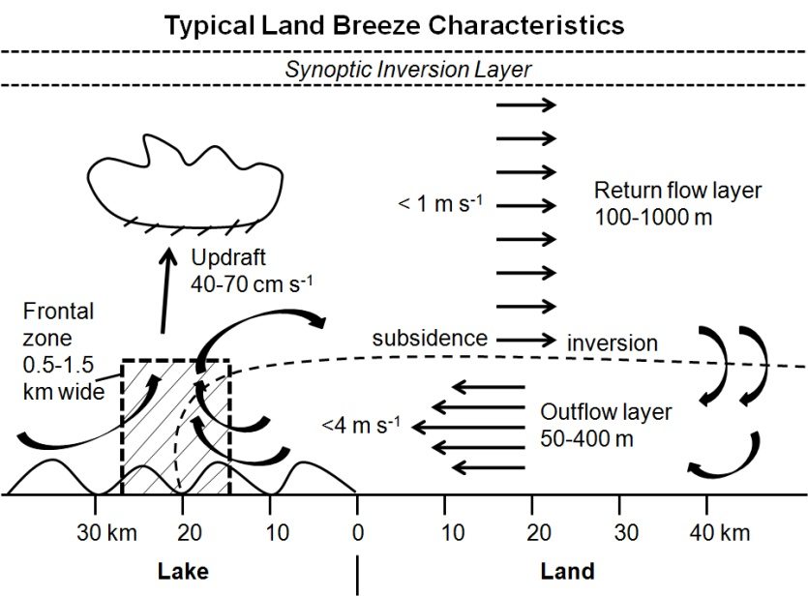
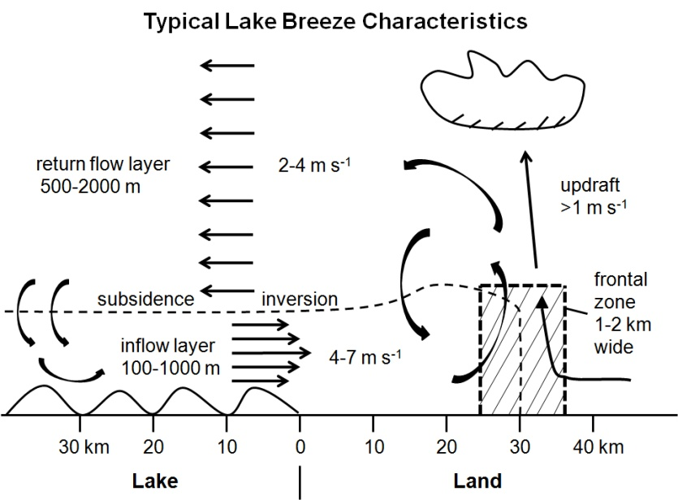
Lake Michigan and Ozone Formation
Land breeze blows ozone precursor compounds from rush hour over lake.
The boundary layer height is low due to cold water chilling the air above.
The pollutants are concentrated near the surface where ozone forms.
An afternoon lake breeze transports the ozone back onto land.
2017 Lake Michigan Ozone Study White Paper: http://www.ladco.org/

Slide 15
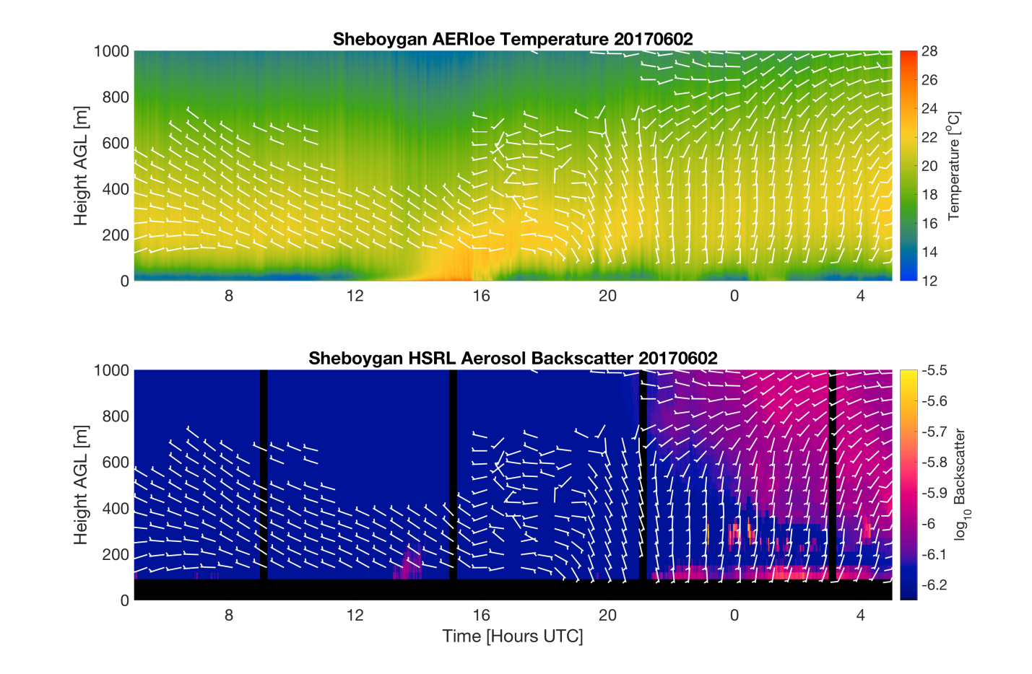
LMOS 2017 SSEC SPARC Remote Sensing Measurements: June 02, 2017
Temp and watervapor measurements from Atmospheric Emitted Radiance Interferometer (AERI), aerosol backscatter measurements from the High Spectral Resolution LIDAR (HSRL), and Doppler Lidar wind measurements.
Provided by Tim Wagner (UW-Madison SSEC)

Slide 16
LMOS 2017 SSEC SPARC Remote Sensing Measurements: June 02, 2017
Sunrise
Nocturnal boundary layer
Temp and watervapor measurements from Atmospheric Emitted Radiance Interferometer (AERI), aerosol backscatter measurements from the High Spectral Resolution LIDAR (HSRL), and Doppler Lidar wind measurements.
Provided by Tim Wagner (UW-Madison SSEC)

Slide 17
LMOS 2017 SSEC SPARC Remote Sensing Measurements: June 02, 2017
Sunrise
Growth of daytime convective boundary layer
Temp and watervapor measurements from Atmospheric Emitted Radiance Interferometer (AERI), aerosol backscatter measurements from the High Spectral Resolution LIDAR (HSRL), and Doppler Lidar wind measurements.
Provided by Tim Wagner (UW-Madison SSEC)

Slide 18
LMOS 2017 SSEC SPARC Remote Sensing Measurements: June 02, 2017
Sunrise
Lake breeze: shift in the wind direction from westerly to easterly and then southerly, new inversion forms as the marine boundary layer air moves onshore
Temp and watervapor measurements from Atmospheric Emitted Radiance Interferometer (AERI), aerosol backscatter measurements from the High Spectral Resolution LIDAR (HSRL), and Doppler Lidar wind measurements.
Provided by Tim Wagner (UW-Madison SSEC)

Slide 19
LMOS 2017 SSEC SPARC Remote Sensing Measurements: June 02, 2017
Sunrise
The HSRL lidar shows very clean air prior to 21:30 UTC (4:30pm CDT)
However,
Temp and watervapor measurements from Atmospheric Emitted Radiance Interferometer (AERI), aerosol backscatter measurements from the High Spectral Resolution LIDAR (HSRL), and Doppler Lidar wind measurements.
Provided by Tim Wagner (UW-Madison SSEC)

Slide 20
LMOS 2017 SSEC SPARC Remote Sensing Measurements: June 02, 2017
Sunrise
After 21:30 UTC, air within the lake breeze inversion shows higher aerosol backscatter that has been transported from the south.
However,
Temp and watervapor measurements from Atmospheric Emitted Radiance Interferometer (AERI), aerosol backscatter measurements from the High Spectral Resolution LIDAR (HSRL), and Doppler Lidar wind measurements.
Provided by Tim Wagner (UW-Madison SSEC)

Slide 21
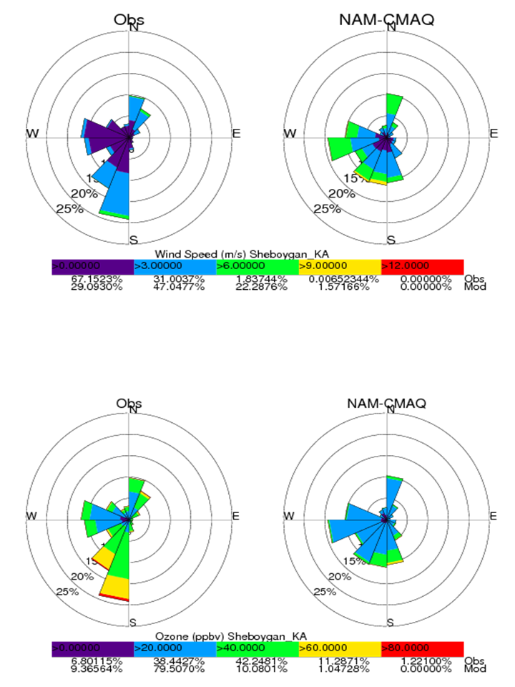
National Weather Service NAM-CMAQ ozone forecasts during LMOS 2017
(http://airquality.weather.gov/)
May 22 through June 22, 2017
The North American Model (NAM) meteorology drives the Environmental Protection Agency’s (EPA) Community Multiscale Air Quality Model (CMAQ)

Slide 22
National Weather Service NAM-CMAQ ozone forecasts during LMOS 2017
(http://airquality.weather.gov/)
NAM-CMAQ underestimates the frequency of the prevailing southerly winds and overestimates the frequency of westerly winds and wind speeds at Sheboygan, KA.
May 22 through June 22, 2017
The North American Model (NAM) meteorology drives the Environmental Protection Agency’s (EPA) Community Multiscale Air Quality Model (CMAQ)

Slide 23
National Weather Service NAM-CMAQ ozone forecasts during LMOS 2017
(http://airquality.weather.gov/)
May 22 through June 22, 2017
NAM-CMAQ underestimates the occurrence of high ozone (>60ppbv) during Southerly and Southwesterly flow at Sheboygan, KA.
The North American Model (NAM) meteorology drives the Environmental Protection Agency’s (EPA) Community Multiscale Air Quality Model (CMAQ)

Slide 24
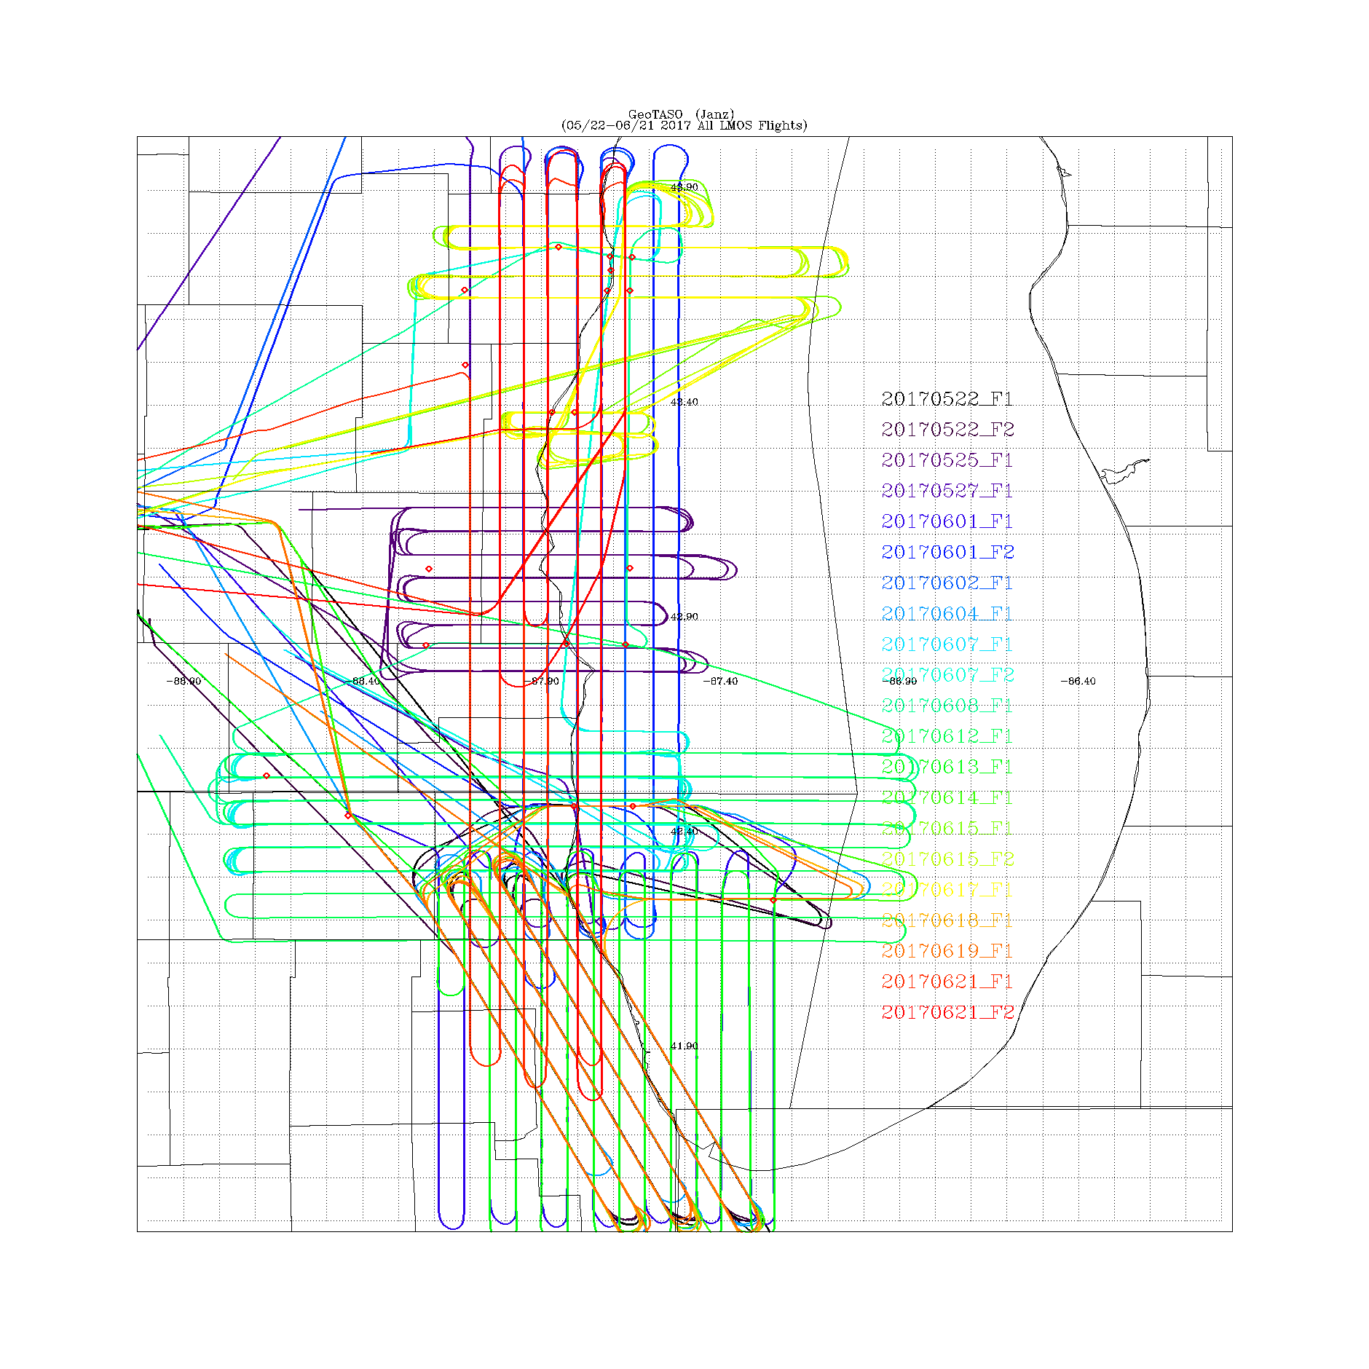
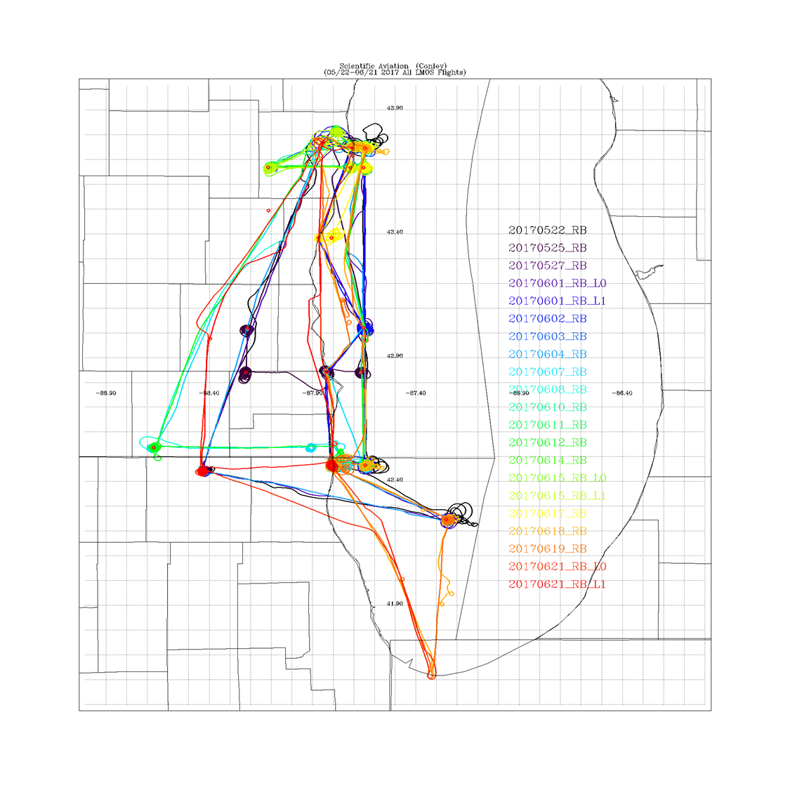
LMOS 2017 Aircraft Measurements
NASA GeoTASO remote sensing Flights
Scientific Aviation insitu sampling Flights
GeoTASO (Geostationary Trace gas and Aerosol Sensor Optimization) is an airborne hyperspectral mapping instrument that is being used as an airborne testbed for future high-resolution trace-gas observations from geostationary sensors such as TEMPO
The Electric Power Research Institute (EPRI) provided funding for Scientific Aviation Flights during LMOS

Slide 25
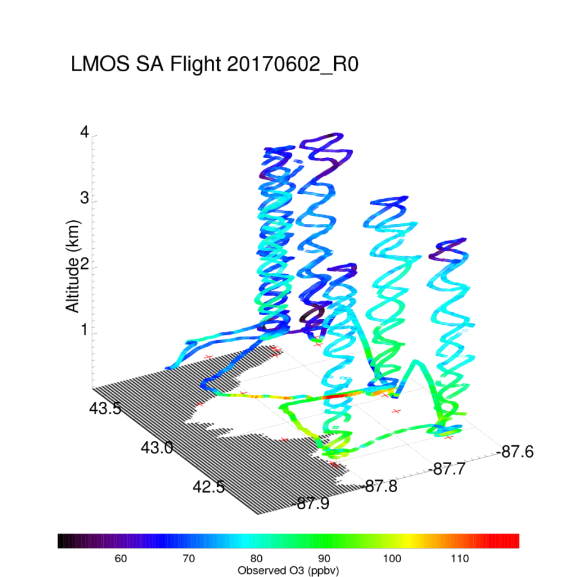
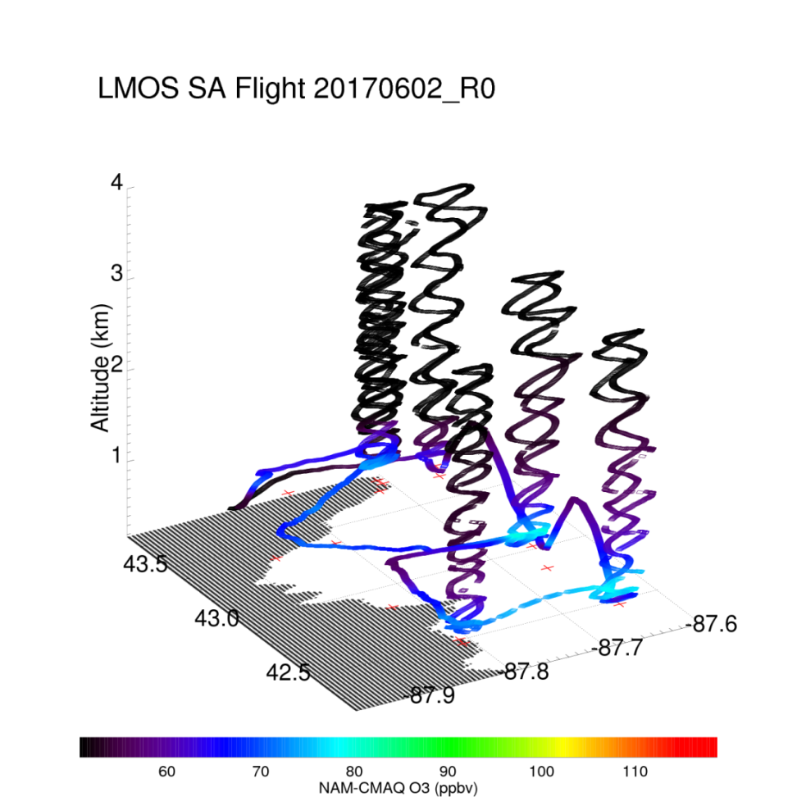
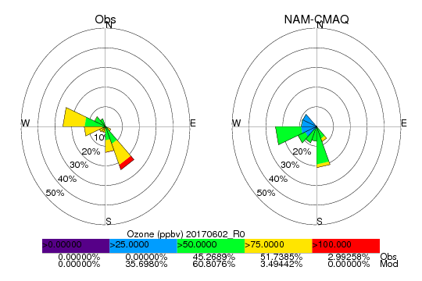
Coastal Ozone Exceedance Day
Max Observed O3 > 110ppbv
Max NAM-CMAQ O3 < 80ppbv

Slide 26
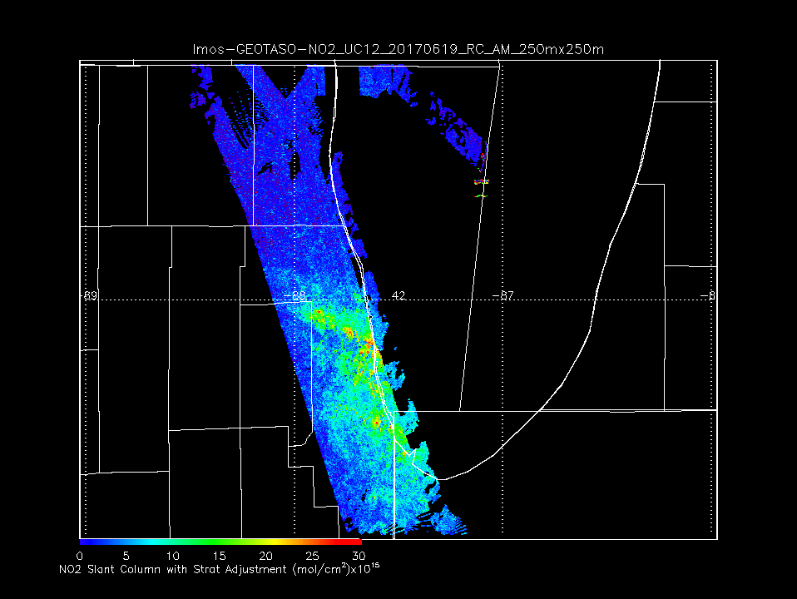
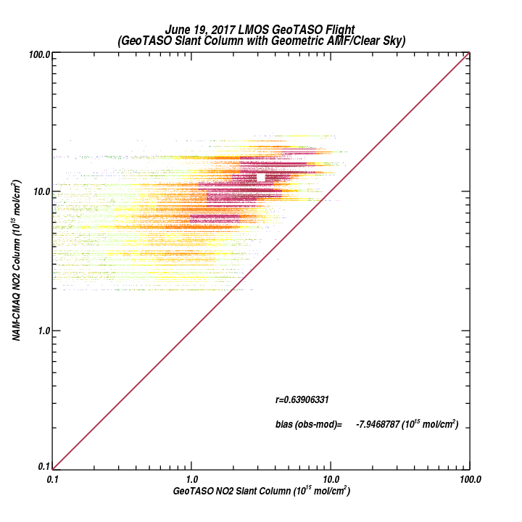
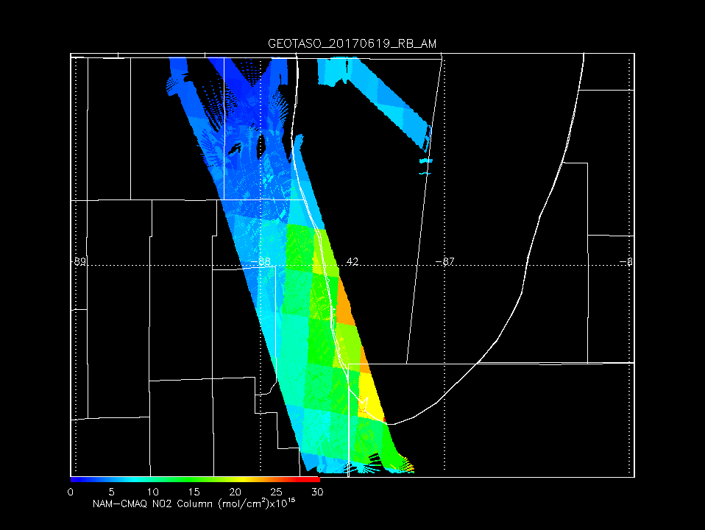
GeoTASO NO2 Slant Column June 19, 2017
LMOS Chicago Emissions Mapping
(weekday morning rush hour)
NAM-CMAQ significantly overestimates observed NO2 column
NAM-CMAQ NO2 Column June 19, 2017

Slide 27
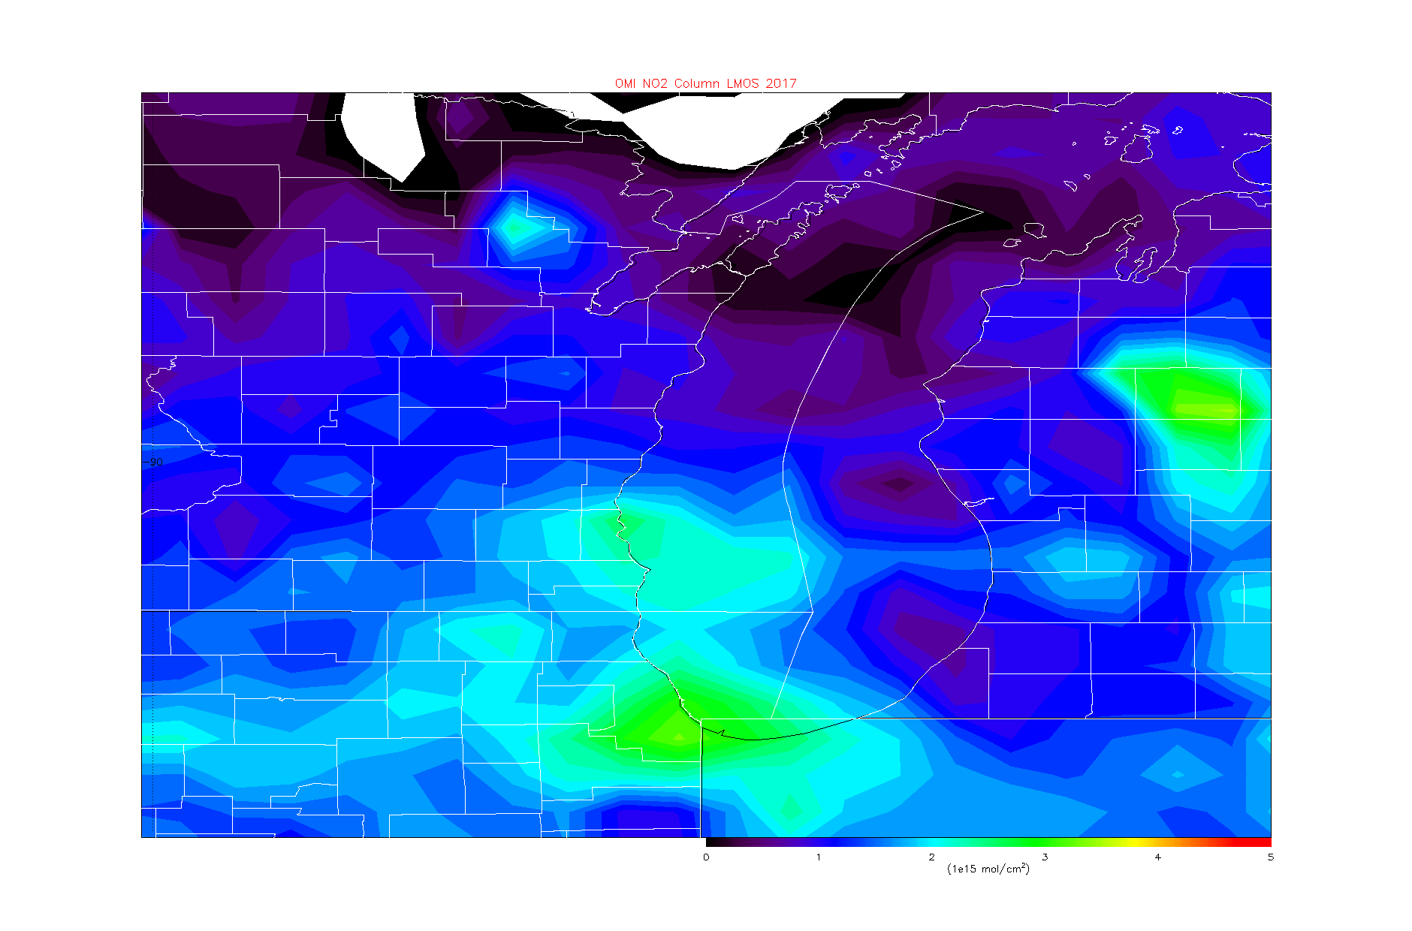
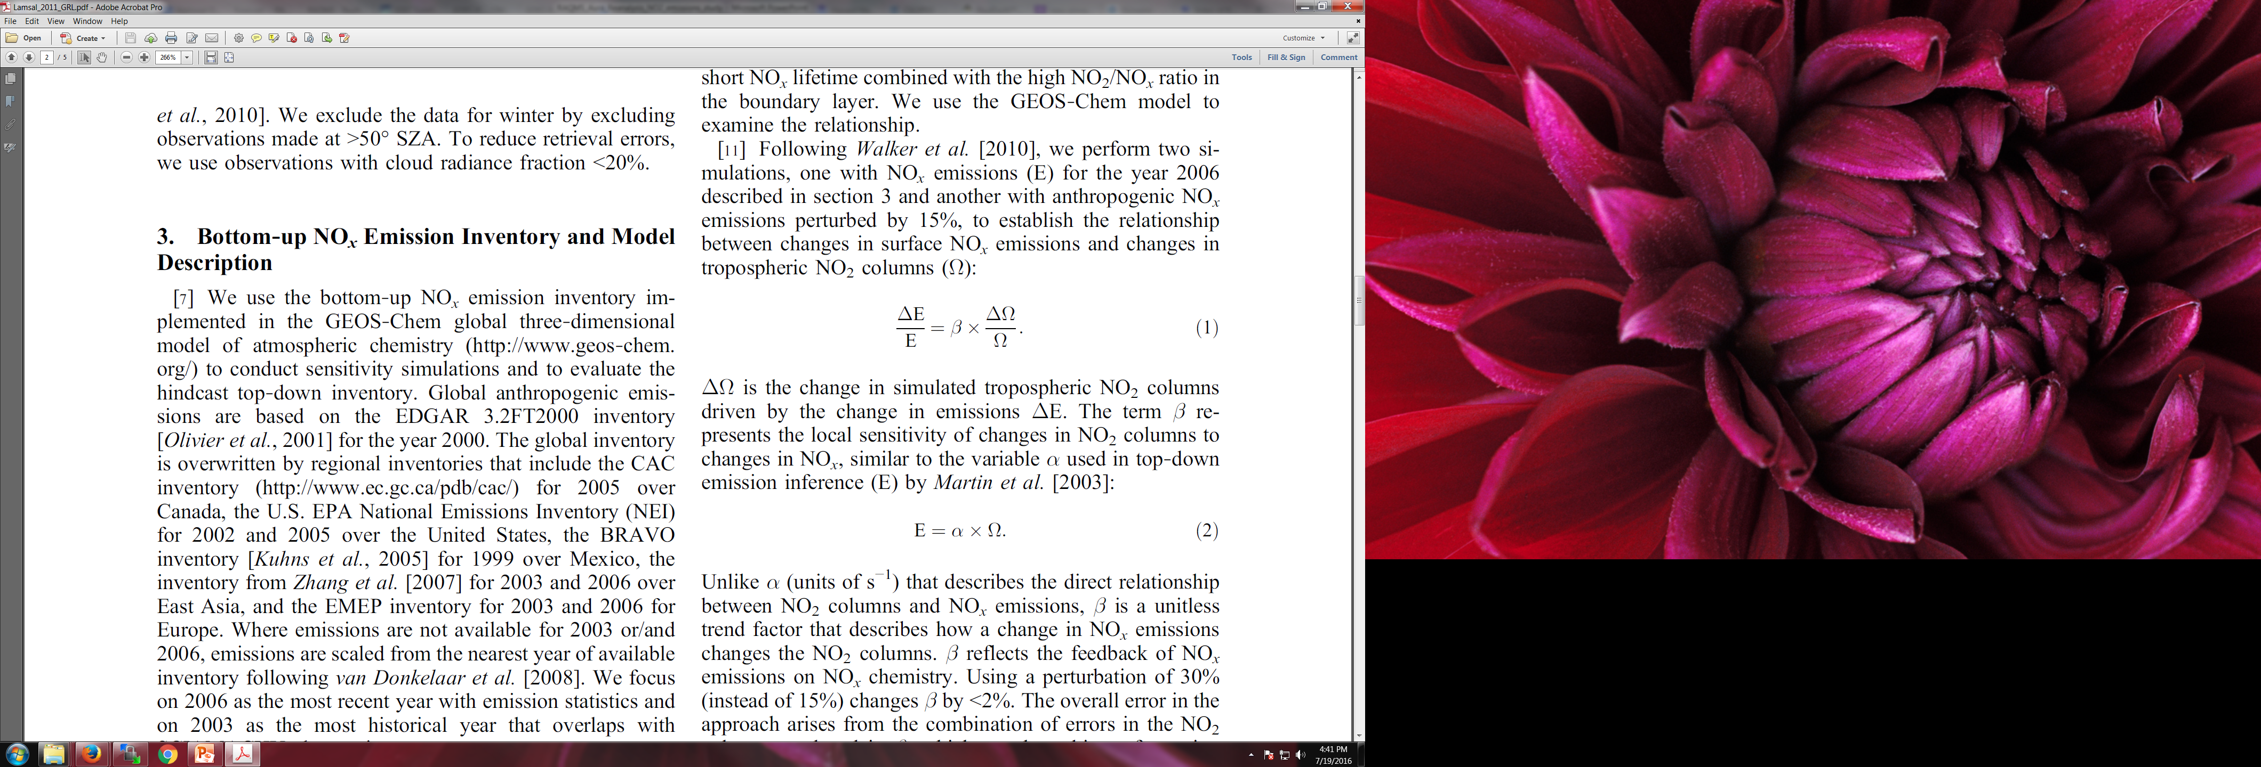
Aura Ozone Monitoring Instrument (OMI) Tropospheric NO2 column Data Assimilation
With Monica Harkey (UW-Madison SAGE), Allen Lenzen (UW-Madison SSEC)
OMI Tropospheric NO2 column during LMOS 2017
NOx emissions adjustments (ΔE) are constrained using OMI tropospheric NO2 column analysis increments (ΔΩ)
β accounts for the sensitivity of the NO2 column to changes in NOx emissions following Lamsal et al 2011.
Lamsal, L. N., et al. (2011), Application of satellite observations for timely updates to global anthropogenic NOx emission inventories, Geophys. Res. Lett., 38, L05810, doi:10.1029/2010GL046476.

Slide 28
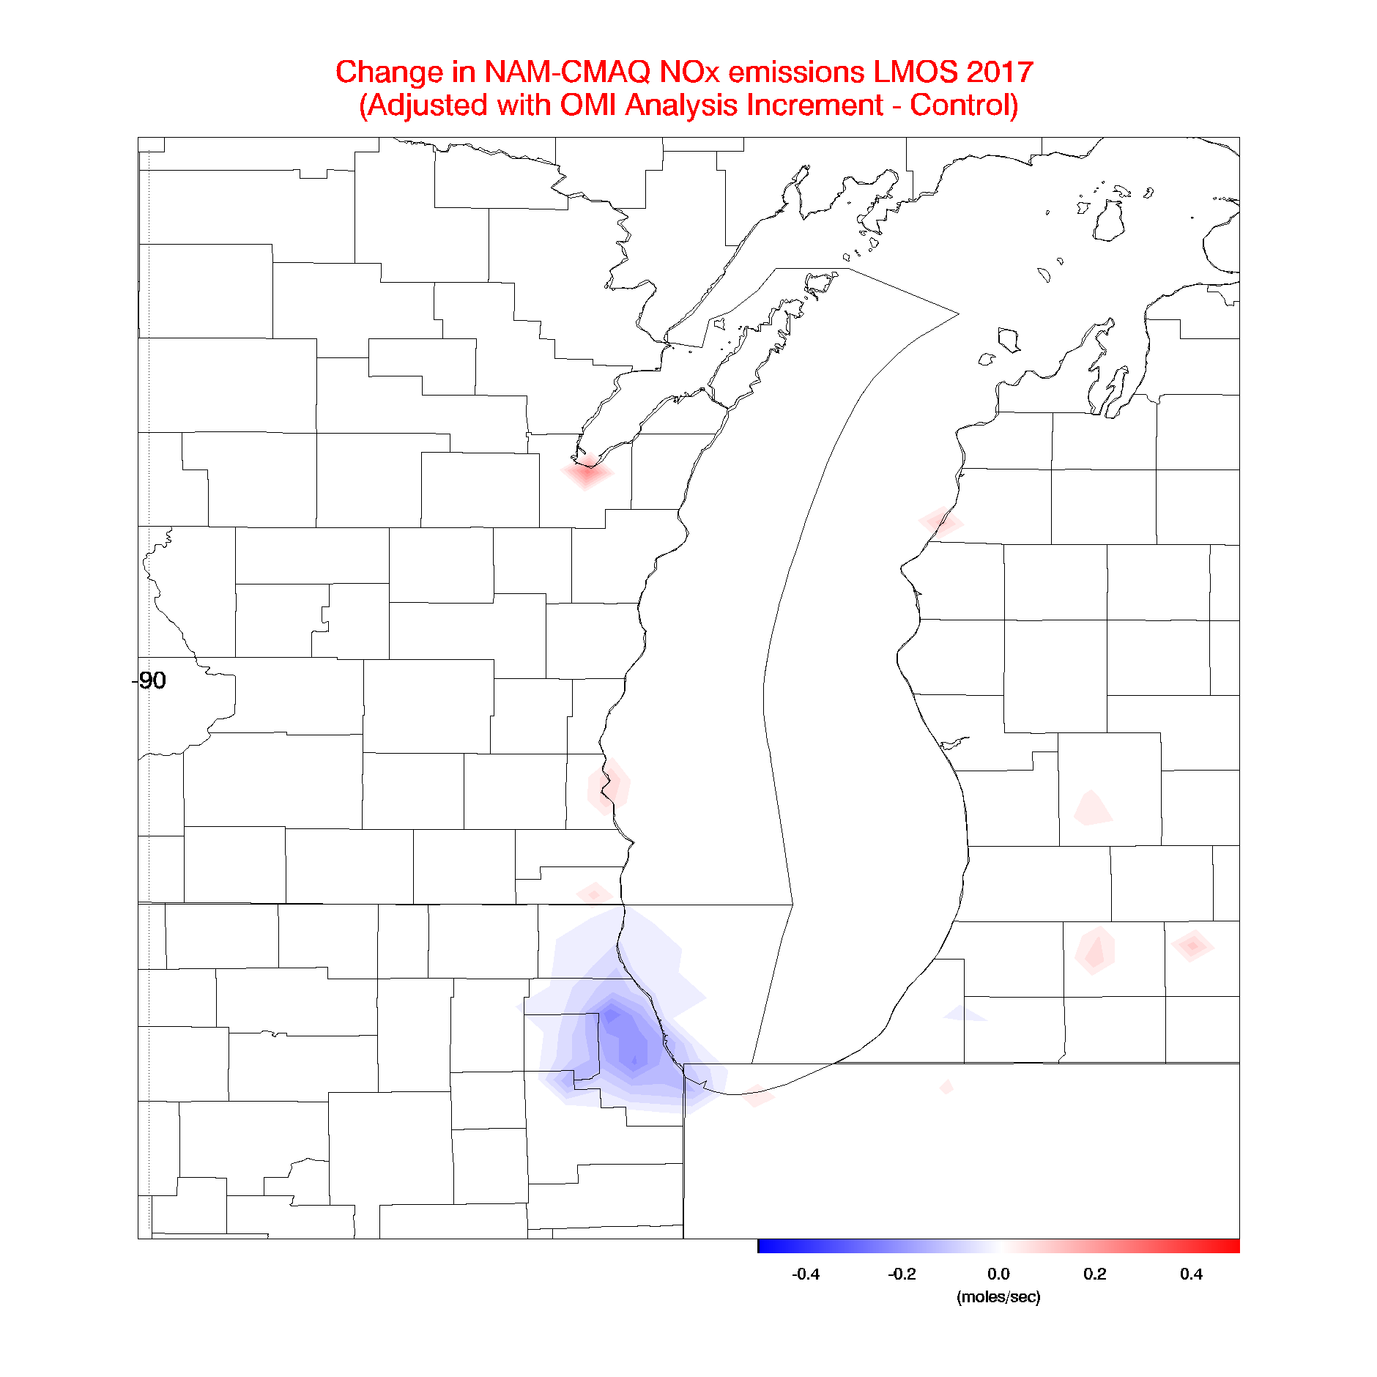
Aura Ozone Monitoring Instrument (OMI) Tropospheric NO2 column Data Assimilation
With Monica Harkey (UW-Madison SAGE), Allen Lenzen (UW-Madison SSEC)
OMI Tropospheric NO2 column during LMOS 2017
Assimilation of OMI NO2 results in small (~4%) reductions in NOx emissions over Chicago
Lamsal, L. N., et al. (2011), Application of satellite observations for timely updates to global anthropogenic NOx emission inventories, Geophys. Res. Lett., 38, L05810, doi:10.1029/2010GL046476.

Slide 29
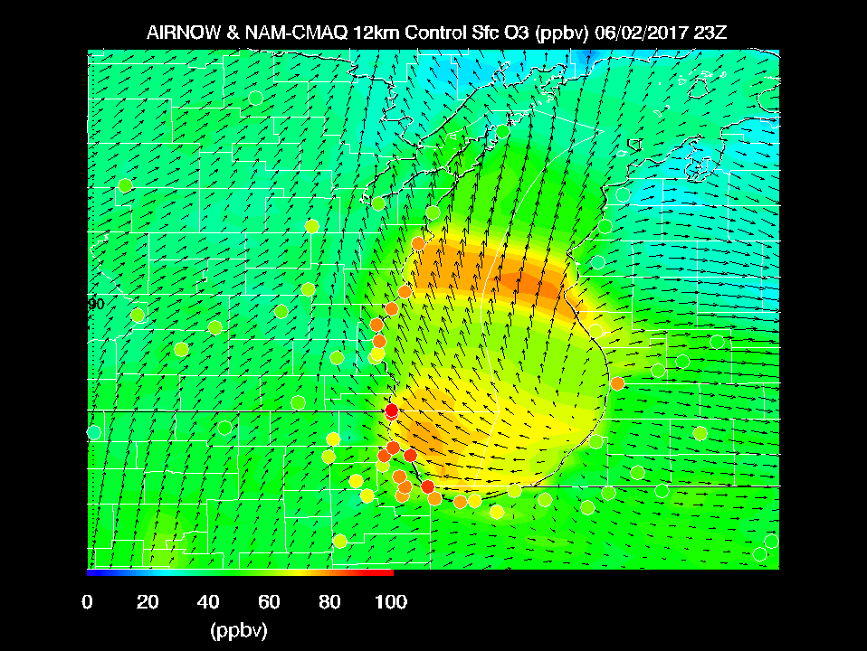

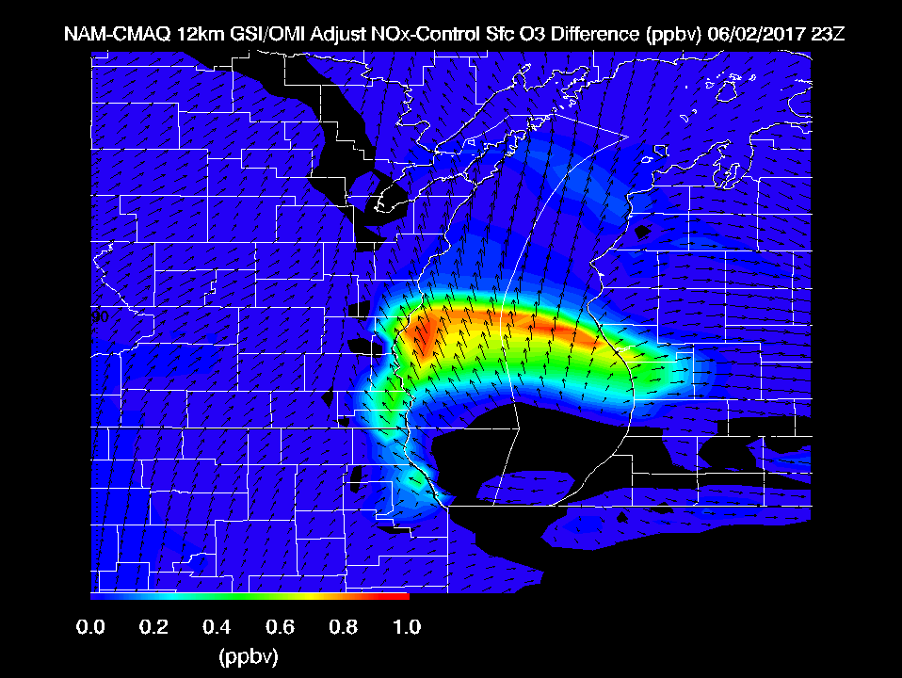
Max Observed O3 > 110ppbv
Reductions in NOx emissions on high ozone day leads to slight (~1ppbv) increases in surface ozone

Slide 30
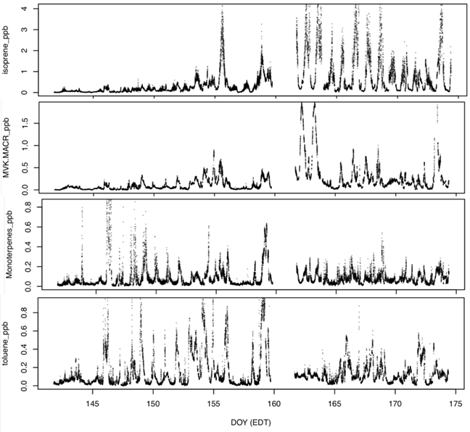
In-situ measurements of volatile organic compounds at Zion by high-resolution proton-transfer time-of-flight mass spectrometry
May
June
Biogenic VOC
Anthropogenic VOC
Zion VOC measurements show significantly higher biogenic contributions during the second half of LMOS 2017 – spring leaf out has a strong influence on biogenic VOC emissions
Provided by Dylan Millet (University of Minnesota)

Slide 31

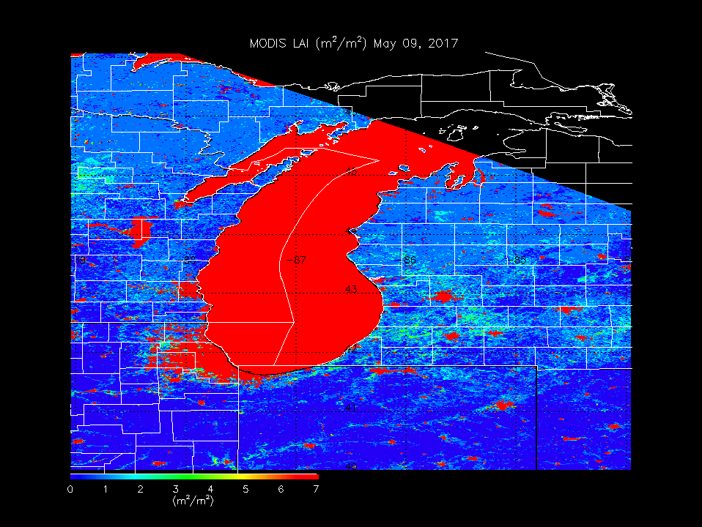
Satellite True Color Image
VIIRS May 07, 2017
Satellite Land Surface Retrieval
MODIS 8-day average LAI
Low Leaf Area Index (LAI) prior to leaf out

Slide 32
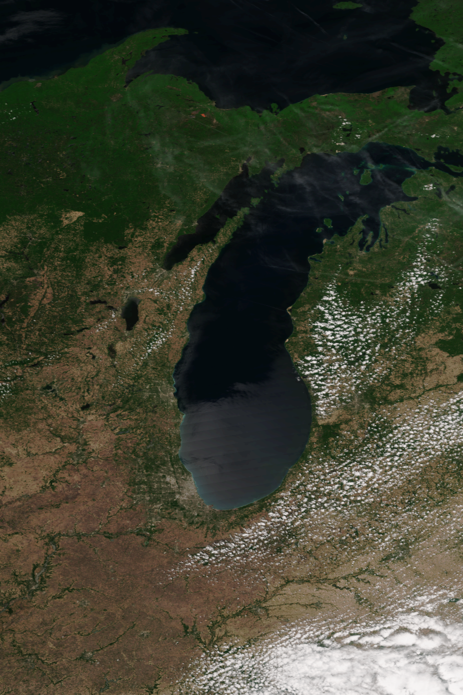
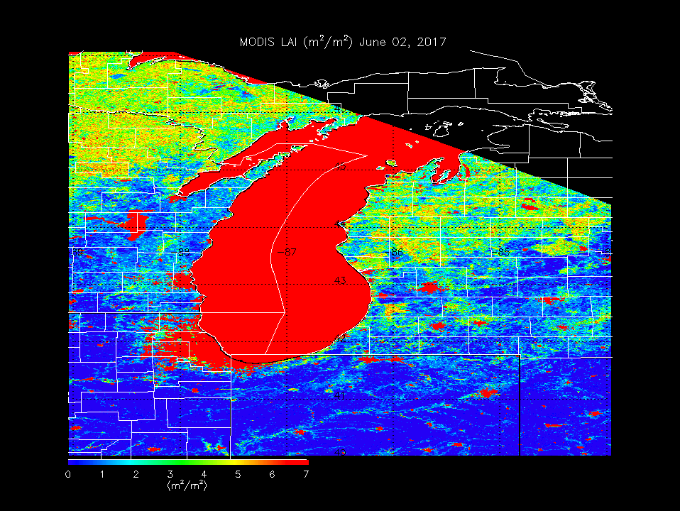
Satellite True Color Image
VIIRS June 07, 2017
Satellite True Color Image
VIIRS JUne 07, 2017
Satellite Land Surface Retrieval
MODIS 8-day average LAI
VIIRS June 02, 2017
MODIS 8-day average LAI
Increased Leaf Area Index (LAI) during leaf out

Slide 33
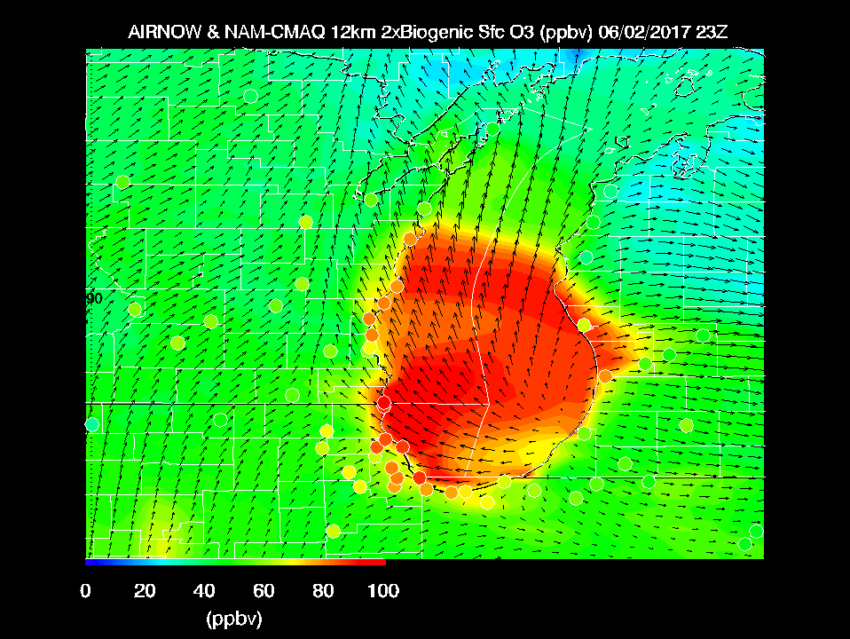
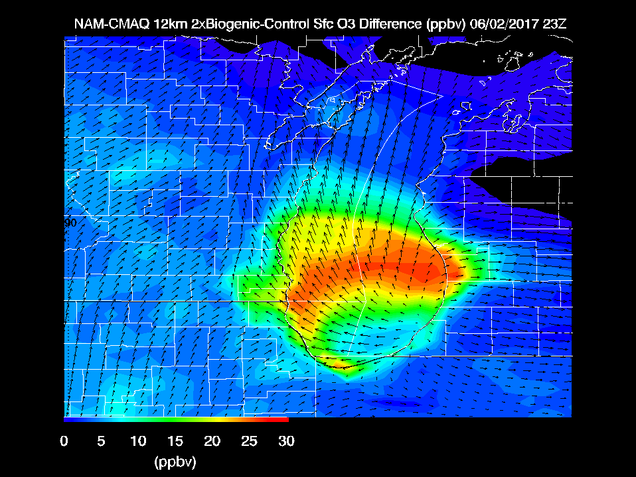
Max Observed O3 > 110ppbv
Doubling Biogenic VOC emissions within NAM-CMAQ leads to large (25-30 ppbv) increases in surface ozone

Slide 34
Outline:
Background
  Pollution health & ecosystem effects
  Regional trends
Regional Air Quality
  2017 Lake Michigan Ozone Study – “The Wisconsin Idea”
Global Air Quality
  Global Trends
  Aura Chemical Reanalysis
Vision: SSEC – Opportunities and Challenges

Slide 35
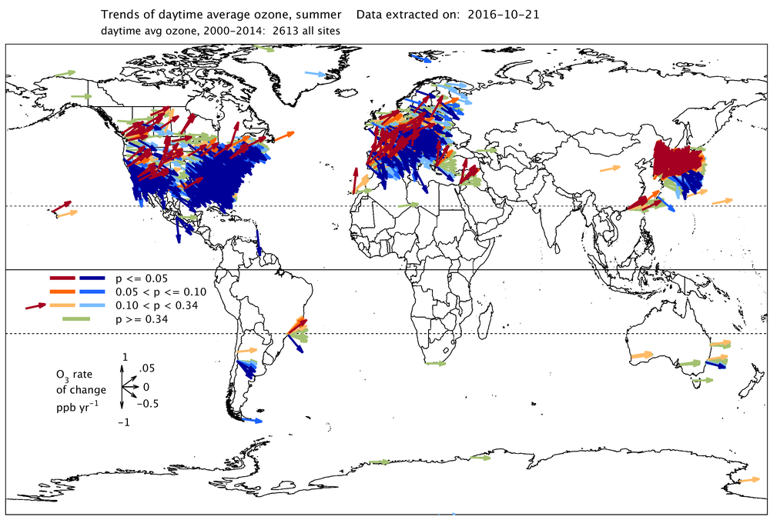
Chang, K-L, et al 2017 Regional trend analysis of surface ozone observations from monitoring networks in eastern North America, Europe and East Asia. Elem Sci Anth, 5: 50,https://doi.org/10.1525/elementa.243

Slide 36
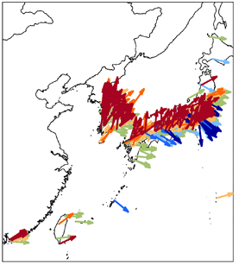
Chang, K-L, et al 2017 Regional trend analysis of surface ozone observations from monitoring networks in eastern North America, Europe and East Asia. Elem Sci Anth, 5: 50,https://doi.org/10.1525/elementa.243

Slide 37
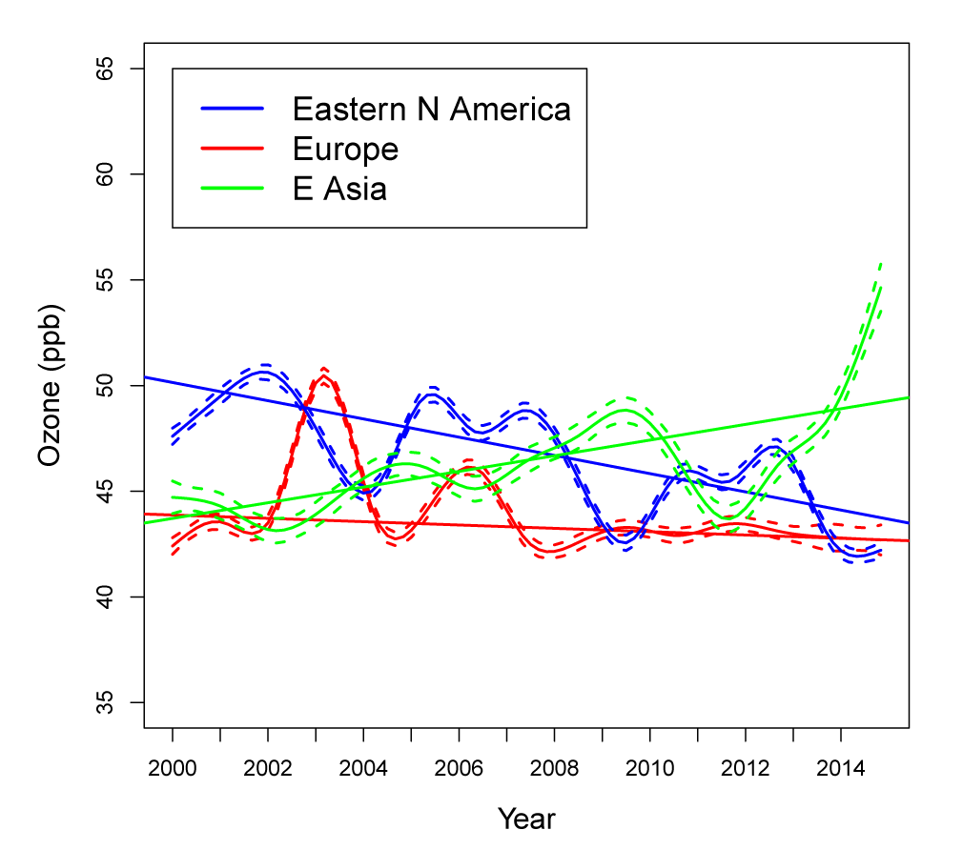
Maximum Daily 8 hour Average (MDA8) Ozone Trends
Chang, K-L, et al 2017 Regional trend analysis of surface ozone observations from monitoring networks in eastern North America, Europe and East Asia. Elem Sci Anth, 5: 50,https://doi.org/10.1525/elementa.243

Slide 38
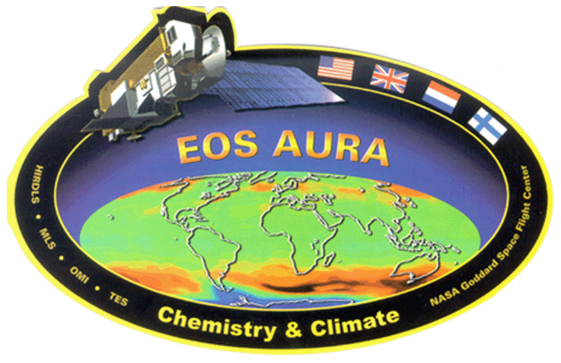
RAQMS Aura Chemical Reanalysis
Project Summary
  Utilize the Real-time Air Quality Modeling System (RAQMS) to conduct a multi-year global chemical and aerosol reanalysis using NASA Aura and A-Train measurements.
  Follows the path lead by the European Center for Medium Range Weather Forecasting (ECMWF) for development of operational air quality forecasting.
  Provides a comprehensive chemical and aerosol analyses for assessing global air quality and for providing lateral boundary conditions for regional air quality management activities.
Assimilated Satellite Data
Terra/Aqua MODIS Aerosol Optical Depth and Fire Detection
Aqua AIRS Carbon Monoxide Retrieval
Aura MLS and OMI ozone Retrievals
Aura OMI Tropospheric NO2 Retrievals
Funded by the NASA Health and Air Quality Applications Program
Notes:
Monitoring Atmospheric Composition and Climate - Interim Implementation (MACC-II) project

Slide 39
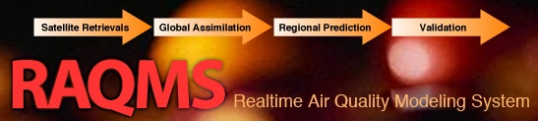

RAQMS Description
Online global chemical and aerosol assimilation/ forecasting system
UW-Madison hybrid θ−η coordinate model (UW-Hybrid) dynamical core
Unified stratosphere/troposphere chemical prediction scheme (LaRC-Combo) developed at NASA LaRC
Aerosol prediction scheme (GOCART) developed by Mian Chin (NASA GSFC).
http://raqms-ops.ssec.wisc.edu/index.php
RAQMS was developed by NASA Langley Research Center and the UW- Madison SSEC and has provided real-time global air quality forecasts since January, 2010
Notes:
39

Slide 40
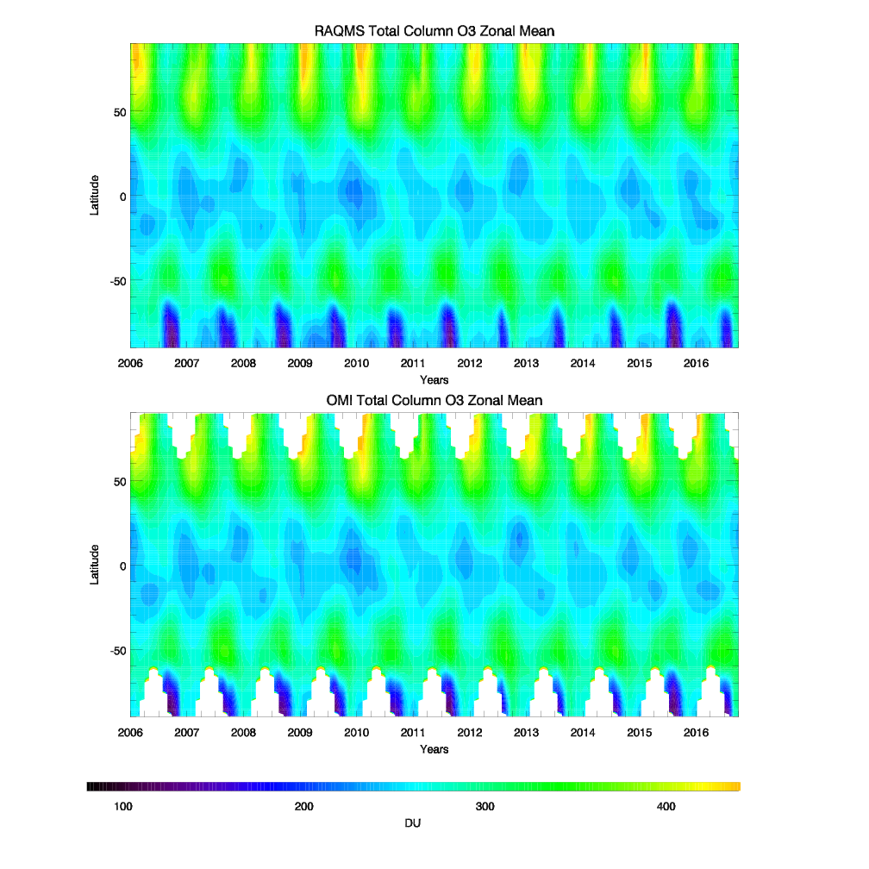
Analyzed vs OMI
Total Column O3
Aura Reanalysis captures inter-annual variability of Total Column O3 including: tropical quasi-biennial oscillation (QBO, Camp et al, 2003), Antarctic ozone hole, and unprecedented Arctic ozone loss in 2011 (Manney et al, 2011)
Provided by Margaret Bruckner (UW-Madison AOS)
Camp, C. D., M. S. Roulston, and Y. L. Yung, Temporal and spatial patterns of the interannual variability of total ozone in the tropics, J. Geophys. Res., 108(D20), 4643, doi:10.1029/2001JD001504, 2003.
Manney, G. L., Santee, M. L., Rex, M., Livesey, N. J., Pitts, M. C., Veefkind, P., et al. (2011).
Unprecedented Arctic ozone loss in. Nature, 478(7370), 469–475.

Slide 41
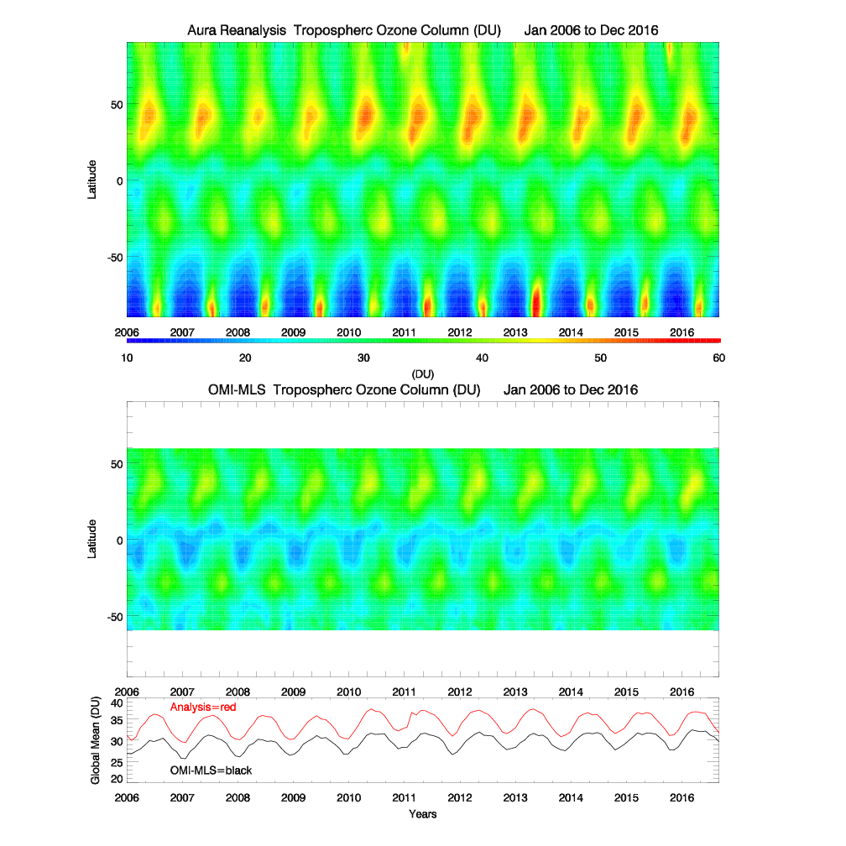
Analyzed Tropospheric Ozone Column (TOC)
vs
OMI-MLS Tropospheric Ozone Residuals (TOR)
Aura Reanalysis captures seasonal variation but shows a systematic high bias relative to the OMI-MLS TOR
Ziemke, et al. (2006), Tropospheric ozone determined from Aura OMI and MLS: Evaluation of measurements and comparison with the Global Modeling Initiative’s Chemical Transport Model, J. Geophys. Res., 111, D19303, doi:10.1029/2006JD007089.

Slide 42

HIPPO
Airborne measurements from NSF HIPPO-I field campaign are used to verify Aura Reanalysis TOC over the Pacific Ocean during January 2009
HIPPO
Wofsy S. et al., 2011,HIAPER Pole-to-Pole Observations (HIPPO): fine-grained, global-scale measurements of climatically important atmospheric gases and aerosols, Phil. Trans. R. Soc. A (2011) 369, 2073–2086 doi:10.1098/rsta.2010.0313

Slide 43
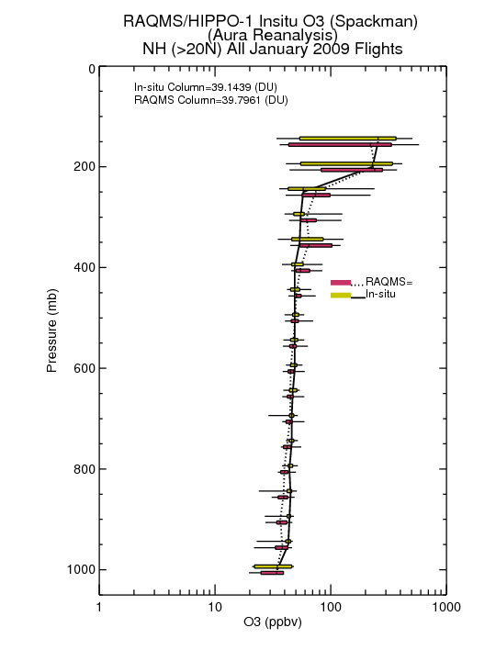
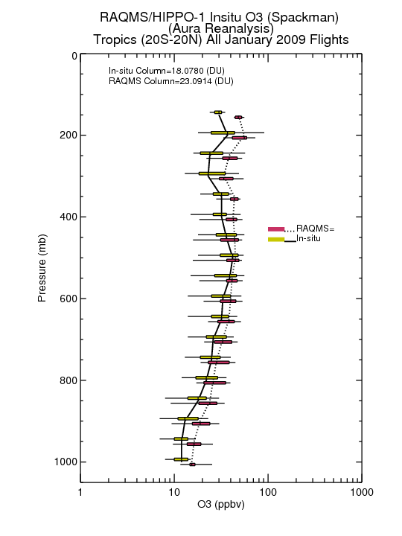
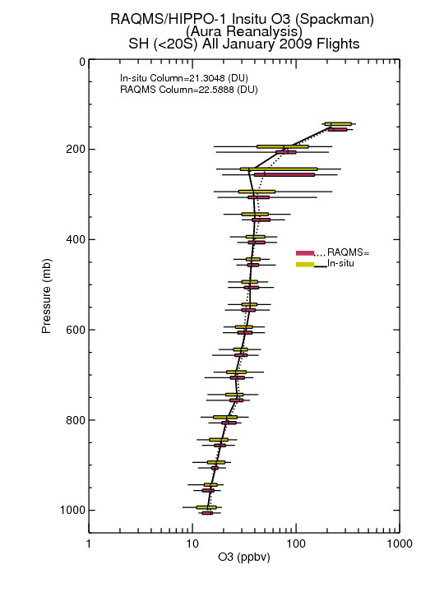
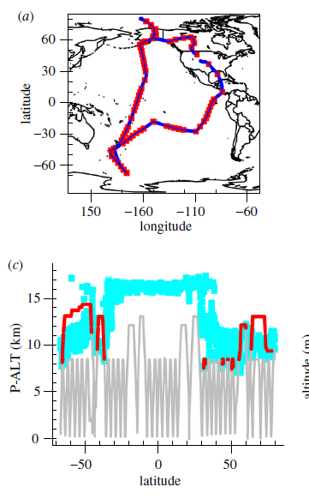
HIPPO-1 January 2009 O3 Verification
Northern Hemisphere
Tropics
Southern Hemisphere
<1DU (<2%) NH Bias
5DU (28%) Tropical Bias
1.3 DU (6%) SH Bias
Tropical Pacific region (20N-20S) dominates the high bias in tropospheric ozone column

Slide 44
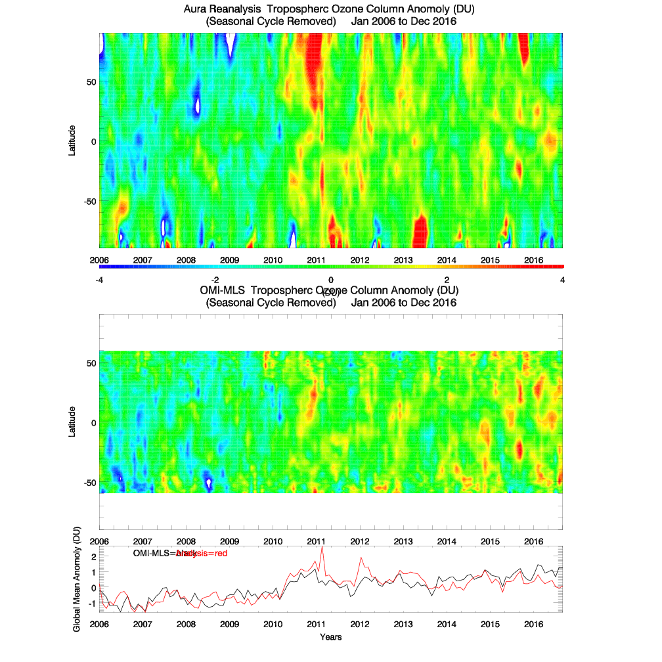
Analyzed Tropospheric Ozone Column (TOC) Anomoly –
Annual Cycle Removed
vs
OMI-MLS Tropospheric Ozone Residuals (TOR)
Anomoly –
Annual Cycle Removed
Correlation=0.668

Slide 45
Analyzed Tropospheric Ozone Column (TOC) Anomoly –
Annual Cycle Removed
vs
OMI-MLS Tropospheric Ozone Residuals (TOR)
Anomoly –
Annual Cycle Removed
El Niño
La Niña
Neutral

Slide 46
Analyzed Tropospheric Ozone Column (TOC) Anomoly –
Annual Cycle Removed
vs
OMI-MLS Tropospheric Ozone Residuals (TOR)
Anomoly –
Annual Cycle Removed
More frequent late spring stratospheric intrusions occur following strong La Niña Winters (Lin et al, 2015)
El Niño
Lin. M et al, 2015, Climate variability modulates western US ozone air quality in spring via deep stratospheric intrusions, NATURE COMMUNICATIONS DOI: 10.1038/ncomms8105
La Niña
Neutral

Slide 47
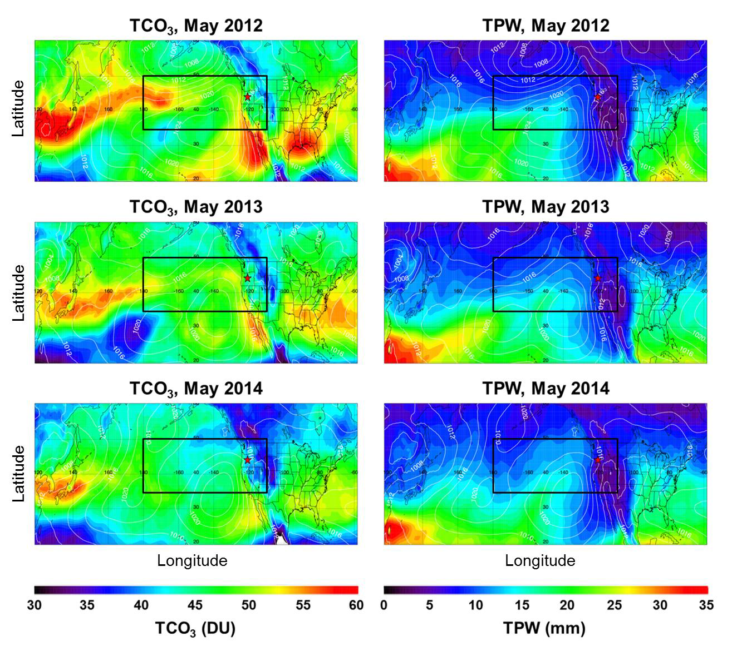
RAQMS Total Column Ozone (TCO) and Total Precipitable Water (TPW) May 2012-2014
Higher TCO and lower TPW during May 2012
Signatures of Stratospheric intrusions (high ozone and low water vapor)
Baylon, P. M., et al, 2016, Interannual Variability in Baseline Ozone and Its Relationship to Surface Ozone in the Western U.S., Environ. Sci. Technol. 2016, 50, 2994−3001, DOI: 10.1021/acs.est.6b00219

Slide 48
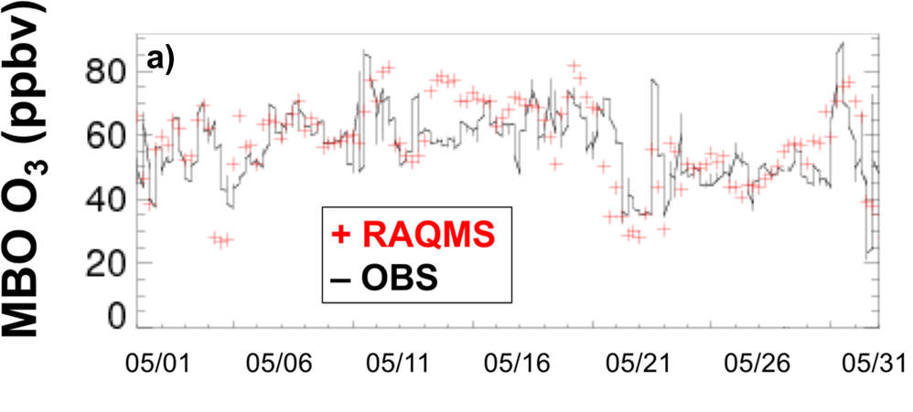
Comparison with Surface Ozone at Mount Bachelor Observatory (MBO), May 2012
“Enhanced UT/LS events in Spring 2012
shifted the MDA8 O3 distribution to higher values, and as a result increased the number of exceedance days across some sites in the
western U.S.”
Higher TCO and further eastward transport in Western Pacific during May 2012
Baylon, P. M., et al, 2016, Interannual Variability in Baseline Ozone and Its Relationship to Surface Ozone in the Western U.S., Environ. Sci. Technol. 2016, 50, 2994−3001, DOI: 10.1021/acs.est.6b00219

Slide 49
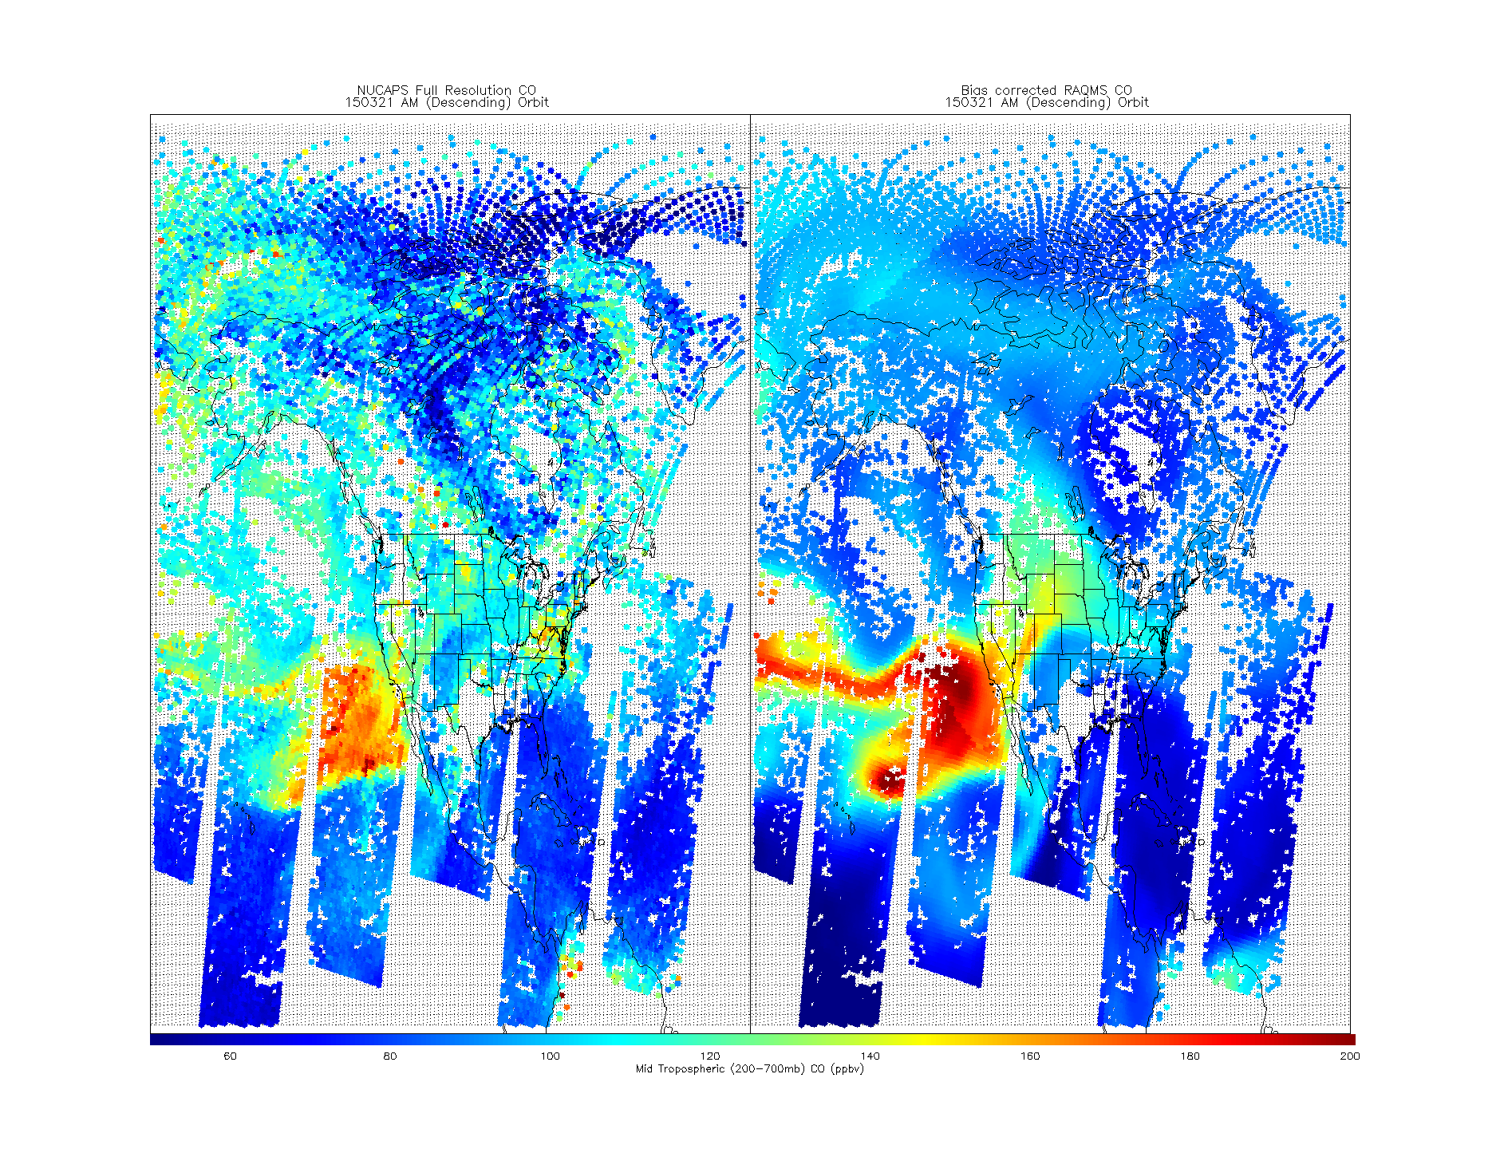
Future directions:
Currently preparing report for Lake Michigan Air Directors Consortium (LADCO) summarizing LMOS 2017 preliminary findings and recommendations for State Implementation Plan modeling
Supported by the NOAA Research Transition Acceleration Program (RTAP) to implement a reduced version of RAQMS chemistry into the Next Generation Global Prediction System (NGGPS)
Plan to extend the RAQMS Aura Reanalysis beyond 2016 using trace gas and aerosol retrievals from Suomi National Polar-orbiting Partnership (S-NPP) and NOAA-20
S-NPP CrIS Full Spectral Resolution CO
RAQMS CO
Mid-tropospheric (200-700mb) Cross-track Infrared Sounder (CrIS) CO and RAQMS (ppbv) on March 21, 2015

Slide 50
Outline:
Background
  Pollution health & ecosystem effects
  Regional trends
Regional Air Quality
  2017 Lake Michigan Ozone Study – “The Wisconsin Idea”
Global Air Quality
  Global Trends
  Aura Chemical Reanalysis
Vision: SSEC – Opportunities and Challenges

Slide 51

Why I’m applying for the SSEC Director position
I have a strong commitment to the continued success of SSEC as an international leader in development and utilization of space based Earth observations
  SSEC has played a critical role in my ability to accomplish my research goals throughout my career
  I feel a sense of responsibility to contribute to the continued success in a leadership role

Slide 52

SSEC Research Support
Technical Computing
Engineering
Satellite Data Services
Three cornerstones of SSEC research: advancing satellite instrument observing capabilities, acquiring and validating the associated measurements, and deriving useful products and information.

Slide 53



SSEC Large Programs
Atmosphere Science Investigator-led Processing Systems (SIPS)
Ice Drilling Design and Operations (IDDO)
Cooperative Institute for Meteorological Satellite Studies (CIMSS)

Slide 54
SSEC Science Team
Participation
S-NPP
AIRS
MODIS
Applied Sciences
GPM
CloudSat
OCO-2
Hazardous Wx Testbed
Proving Ground
GOES-R AWG
JPSS
RTAP
FRAPPE
PECAN
TORERO

Slide 55



Opportunities: SSEC NASA Earth Venture participation
The Tropospheric Emissions: Monitoring of Pollution (TEMPO) measure air pollution of North America hourly and at high spatial resolution. TEMPO observations are from the geostationary vantage point, flying on a geostationary commercial communications host spacecraft. (PI: Kelly Chance, Smithsonian Astrophysical Observatory) (Brad Pierce, Co-I, Air Quality forecasting and data assimilation)
The Time-Resolved Observations of Precipitation structure and storm Intensity with a Constellation of Smallsats (TROPICS) mission will measure environmental and inner-core conditions for tropical cyclones (TCs) at an unprecedented combination of horizontal and temporal resolution (PI, William Blackwell, MIT Lincoln Laboratory) (Chris Velden, Co-I, SSEC responsible for ground system)
The Polar Radiant Energy in the Far Infrared Experiment (PREFIRE) will fly a pair of small CubeSat satellites to probe a little-studied portion of the radiant energy emitted by Earth for clues about Arctic warming, sea ice loss, and ice-sheet melting. (PI: Tristan L’Ecuyer of the University of Wisconsin, Madison)
These Earth Venture missions were in response to the 2007 Decadal Survey

Slide 56
Challenges: Supporting SSEC engineering infrastructure to support SSEC and campus research.
  Strengthen SSEC’s collaboration with the UW-Madison Physical Sciences Lab (PSL) to provide more sustained funding for SSEC engineering staff.
  Pursue NASA and/or NOAA Incubation funding to support the development of expanded capabilities for the S-HIS, including short wave infrared channels for retrieving methane, carbon monoxide, and carbon dioxide
Challenges: Increasing the number of PI level staff and external UW collaborations at SSEC.
  Continue collaboration with Astronomy and Physics Departments, and strengthen collaboration with other departments through programs such as UW2020, Data Science Initiative (Institute for Foundations of Data Science)

Slide 57
Challenges: Supporting SSEC engineering infrastructure to support SSEC and campus research.
  Strengthen SSEC’s collaboration with the UW-Madison Physical Sciences Lab (PSL) to provide more sustained funding for SSEC engineering staff.
  Pursue NASA and/or NOAA Incubation funding to support the development of expanded capabilities for the S-HIS, including short wave infrared channels for retrieving methane, carbon monoxide, and carbon dioxide
Challenges: Increasing the number of PI level staff and external UW collaborations at SSEC.
  Continue collaboration with Astronomy and Physics Departments, and strengthen collaboration with other departments through programs such as UW2020, Data Science Initiative (Institute for Foundations of Data Science)

Slide 58
Challenges: Supporting SSEC engineering infrastructure to support SSEC and campus research.
  Strengthen SSEC’s collaboration with the UW-Madison Physical Sciences Lab (PSL) to provide more sustained funding for SSEC engineering staff.
  Pursue NASA and/or NOAA Incubation funding to support the development of expanded capabilities for the S-HIS, including short wave infrared channels for retrieving methane, carbon monoxide, and carbon dioxide
Challenges: Increasing the number of PI level staff and external UW collaborations at SSEC.
  Continue collaboration with Astronomy and Physics Departments, and strengthen collaboration with other departments through programs such as UW2020, Data Science Initiative (Institute for Foundations of Data Science)

Slide 59
Challenges: Supporting SSEC engineering infrastructure to support SSEC and campus research.
  Strengthen SSEC’s collaboration with the UW-Madison Physical Sciences Lab (PSL) to provide more sustained funding for SSEC engineering staff.
  Pursue NASA and/or NOAA Incubation funding to support the development of expanded capabilities for the S-HIS, including short wave infrared channels for retrieving methane, carbon monoxide, and carbon dioxide
Challenges: Increasing the number of PI level staff and external UW collaborations at SSEC.
  Continue collaboration with Astronomy and Physics Departments, and strengthen collaboration with other departments through programs such as UW2020, Data Science Initiative (Institute for Foundations of Data Science)

Slide 60
Path Forward:
Develop a coordinated plan to target Small and Medium missions recommended under the 2017 Decadal Survey for Earth Observation from Space
Increase the focus on data assimilation and NWP to capture funding opportunities under the Weather Research and Forecasting Innovation Act
Provide stronger support for post-doctoral recruitment efforts and pursue more interdisciplinary funding opportunities with UW faculty.

Slide 61
Questions?

Slide 62
Extra Slides

Slide 63

Chicago Emission Mapping Weekend/Weekday
GeoTASO (Geostationary Trace gas and Aerosol Sensor Optimization) is an airborne hyperspectral mapping instrument built by Ball Aerospace (Leitch et al., 2014) and is being used as an airborne testbed for future high-resolution trace-gas observations from geostationary sensors such as TEMPO (Analysis by Laura Judd, NASA/LaRC)

Slide 64

Lake Michigan Ozone Study (LMOS) 2017
Campaign Study Period May 22- June 22, 2017
Primary science objectives focusing on characterizing the recirculation, aging, and mixing of the Chicago and Milwaukee urban plumes as they move over Lake Michigan and their impact on surface ozone.
Lake Michigan Ozone Study White Paper: http://www.ladco.org/

Slide 65



“In wintertime, monotonic decrease of CO2 with altitude can be observed from all regions, in which high PBL CO2 is mainly driven by surface emissions and reduced vertical mixing (Denning et al., 1999; Stephens et al., 2007)”
” Surface CO2 decreases dramatically in the growing season in those regions influenced by high plant activity, such as the NM and MW regions.”
LMOS during May-June transition to summer-time drawdown

Slide 66


NOAA/ESRL Park Falls Tall Tower Aircraft measurements during LMOS
High CH4 within PBL and low CH4 aloft
High CO2 within PBL on May 30, 2017 (CO2/CH4 positively correlated)
CO2 draw down within PBL on June 27, 2017 (CO2/CH4 anti-correlated)
LMOS occurred during leaf out and transition to summer-time CO2 drawdown – also strong influence on biogenic VOC emissions

Slide 67



Coastal Ozone Exceedance Day
Polluted Marine BL
CO2 and CH4 anti-correlated except for offshore of Sheboygan KA (region of higher CO2 below 1km)
Terrestrial PBL to
Free Trop transition

Slide 68

Signatures of Stratospheric intrusions include: high ozone and low water vapor
May 2012 (black) shows highest TCO and lowest TPW
May 2014 (red) shows lowest TCO and highest TPW
Baylon, P. M., et al, 2016, Interannual Variability in Baseline Ozone and Its Relationship to Surface Ozone in the Western U.S., Environ. Sci. Technol. 2016, 50, 2994−3001, DOI: 10.1021/acs.est.6b00219

Slide 69



Impacts of East Asian Emissions – May 2010
120W
Impact of East Asian ozone production extends into North America with potential US Air Quality impacts
Huang, M et al, 2017 Impact of intercontinental pollution transport on North American ozone air pollution: an HTAP phase 2 multi-model study, Atmos. Chem. Phys., 17, 5721–5750, 2017, doi:10.5194/acp-17-5721-2017
Notes:
69

Slide 70




2005-2015 NO2 emissions for Aura Reanalysis
Multiple Linear Regression
Of OMI urban NO2 trends
Multiple Linear Regression of OMI urban NO2 trends used to generate 2005-2015 global NO2 emissions (applied uniformly across each region)
Benjamin de Foy, B. et al. (2016), Impacts of control strategies, the Great Recession and weekday variations on NO2 columns above North American cities, http://dx.doi.org/10.1016/j.atmosenv.2016.04.038
Notes:
Collaboration with Ben de Foy at Saint Louis University who provided multiple linear regression of OMI NO2 trends for global cities
Start in Upper left (OMI NO2 with US city locations identified), then map of trends (%/year), then say same done for each HTAP region (note that there are 4 in the US)
Then go to right hand side to discuss results
Trends from multiple cities within each HTAP sub region are used, trend is applied uniformly across each HTAP region
Timeseries are all changes in percent relative to 2010
US time series shows a minimum during the 2007 recession followed by a slight increase and then decline
SE Asian time series shows a maximum in 2011 with sharp decline during 2012 Beijing Olympics and then continuing decline

Slide 71


Slide 72
Summary of measurements made during the LMOS 2017 field campaign
Location | Measurement* | Research Institution*
Ground Sites
Spaceport Sheboygan | Remote sensing of meteorology (SPARC Trailer) | UW-Madison -SSEC
 | In situ measurements of pollutants | U.S. EPA ORD
Zion, IL | Remote sensing of meteorology (Sodar/MW Radiometer) | Univ. Northern Iowa
 | Detailed in situ chemical measurements | Univ. Iowa, UW-Madison, Univ. Minnesota
 | Routine measurements of ozone | Illinois EPA
Various† | Remote sensing of pollutants and boundary layer height | U.S. EPA ORD
Sheboygan transect | In situ measurements of ozone at four locations | U.S. EPA ORD
Airborne Platforms
Lakeshore region | Airborne remote sensing of NO₂ (GeoTASO) | NASA
 | Airborne remote sensing of clouds (AirHARP) | Univ. Maryland, Baltimore County
 | Airborne in situ profiling of pollutants and meteorology | Scientific Aviation (and NOAA?)
Shipboard Platform
Lake Michigan | In situ measurements of pollutants | U.S. EPA ORD
 | Remote sensing of pollutants and boundary later height | U.S. EPA ORD
Mobile Platforms
Northeast IL and Southeast WI | In situ measurements of pollutants (GMAP) | U.S. EPA Region 5
Grafton to Sheboygan | In situ measurements of ozone and meteorology | UW-Eau Claire
GeoTASO = Geostationary Trace gas and Aerosol Sensor Optimization instrument
AirHARP = Airborne Hyper Angular Rainbow Polarimeter
GMAP = Geospatial Mapping of Pollutants
† These measurements were made at Spaceport Sheboygan, Zion, two Wisconsin DNR monitoring locations (Grafton and Milwaukee SER) and one Illinois EPA monitoring location (Schiller Park).

