Slide 1
Satellite based support for stratospheric intrusion special event analysis
(Brad Pierce, NOAA/NESDIS)
With significant support from the CIMSS IMAPP/CSPP team
(James Davies, Kathy Strabala, Nadia Smith, Elisabeth Weisz, Rebecca Cintineo)
2013 Western Air Quality Modeling Workshop – Technical Methods and Applications July 9-11, 2013 Boulder, CO

Slide 2
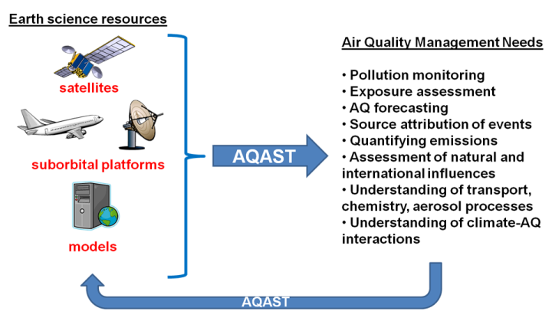
AQAST Tiger Team Project FY2013 (Brad Pierce, PI)
Satellite based support for Stratospheric Intrusion Exceptional Event Analysis
Objective: Provide satellite based support to state and local air quality management for stratospheric intrusion (SI) related exceptional event analysis. (Gail Tonnesen and Pat Reddy POCs)
Approach: Add capabilities to IDEA-I (http://cimss.ssec.wisc.edu/imapp/ideai_v1.0.shtml) within the International AIRS/MODIS Processing Package (IMAPP) and the Community Satellite Processing Package (CSPP) to produce trajectory based SI forecasts initialized with real-time AIRS, IASI, and CrIS ozone retrievals.

Slide 3
The Infusing Satellite Data Into Environmental Applications - International (IDEA-I) SI forecast is being developed under the Community Satellite Processing Package (CSPP)
CSPP supports the Direct Broadcast (DB) satellite community through the packaging and distribution of open source science software.
Funded by NOAA Joint Polar Satellite System (JPSS)
IDEA-I AIRS, CrIS, and IASI SI forecast capability is currently being beta tested at CIMSS using the UW-Madison Dual Regression retrieval
Extensive testing for June 6, 2012 Wyoming SI Exceptional Event Analysis
Testing for May 2013 SI events underway
http://sunset.ssec.wisc.edu/idea-test2/

Slide 4
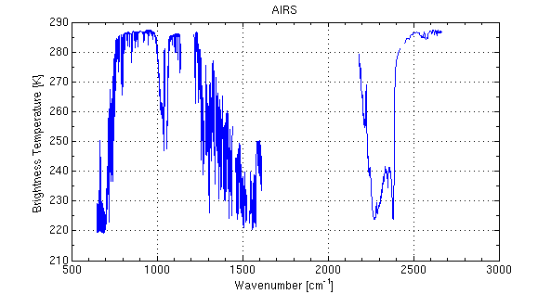
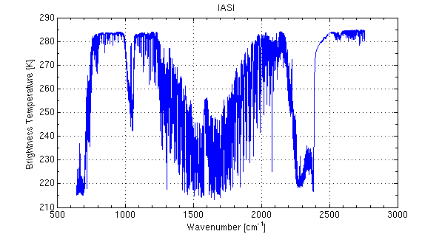
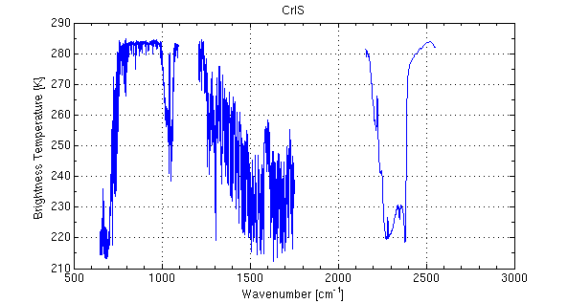
Atmospheric Profile and Cloud Parameter Retrievals from Hyperspectral Infrared Radiances
University of Wisconsin (UW) Hyper-spectral (HS) retrieval package V1.0
For AIRS, IASI and CrIS L1 to L2 Processing
Released under CSPP on 28 November 2012
AIRS (nch=2378) on Aqua
IASI (nch=8461) on Metop-A, Metop-B
CrIS (nch=1305) on Suomi-NPP
The UW hyper-spectral retrieval package, based on the Dual-Regression (DR) retrieval algorithm, is the only publicly available retrieval software package to convert hyper-spectral radiance measurements (Level 1) to retrieval (Level 2) products.
Elisabeth Weisz, Bill L. Smith Sr., Nadia Smith, Kathy Strabala, et al.

Slide 5
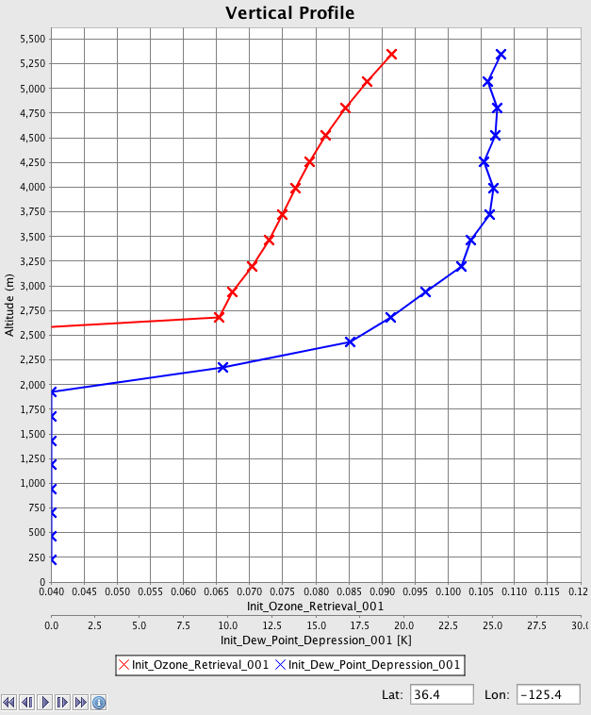
Dual-Regression Retrieval Parameters
atmospheric temperature [K] at 101 pressure levels
atmospheric humidity [g/kg] at 101 pressure levels
atmospheric ozone [ppmv] at 101 pressure levels
atmospheric relative humidity [%] at 101 pressure levels
atmospheric dew point temperature [K] at 101 pressure levels
surface skin temperature [K]
surface emissivity at instrument spectral resolution
total precipitable water (vertically integrated from 100 hPa to surface) [cm]
precipitable water 1, 2, 3 (vertically integrated from 900 hPa to surface, 700 to 900, 300 to 700 hPa) [cm]
total ozone amount (vertically integrated) [dobson units]
lifted index [ºC]
convective available potential energy [J/kg]
CO₂ concentration [ppmv]
cloud top pressure [hPa]
cloud top temperature [K]
cloud optical thickness
effective cloud emissivity
cloud mask (values: 0 clear, 1 cloud)
Output Format: hdf5
Used in SI
initialization
O3VMR (ppmv)
DPD (K)
http://cimss.ssec.wisc.edu/cspp/uwhsrtv_edr_v1.1.shtml

Slide 6
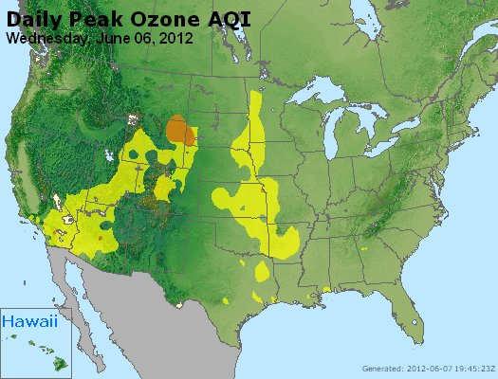
On May 21, 2013, the State of Wyoming Department of Environmental Quality/Air Quality Division released a document entitled “Exceptional Event Demonstration Package for the Environmental Protection Agency Thunder Basin, Wyoming Ozone Standard Exceedance June 6, 2012” for public comment.
Following the public comment period, this document will be submitted to the US Environmental Protection Agencey (US EPA) to demonstrate that the surface ozone exceedances were due to an exceptional event associated with a stratospheric intrusion (SI).
“The Wyoming Department of Environmental Quality/Air Quality Division (WDEQ/AQD) has determined that a stratospheric intrusion created elevated ozone readings resulting in an 8-hour ozone standard exceedance at the Thunder Basin, Wyoming ozone monitor located in northeastern Wyoming on June 6, 2012” (Executive Summary)

Slide 7
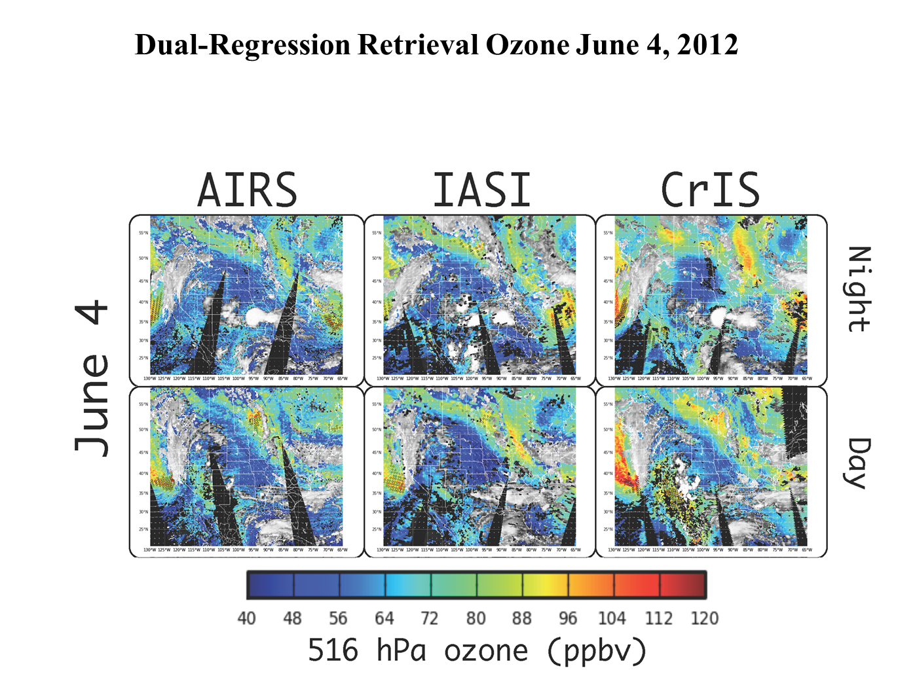
Two day’s prior to Wyoming SI exceptional Event
(6 initialization opportunities each day!)

Slide 8
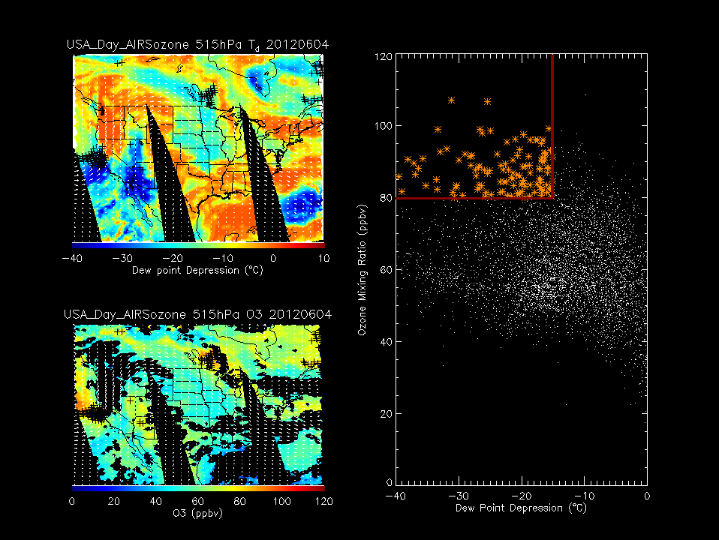
Basis for initialization point selection criteria
stratospheric air;
dry air with high ozone
Plevs threshold: >500mb
O3VMR threshold: >80ppbv
Dewpnt-Tair threshold: <-15K
4 June, 2012

Slide 9
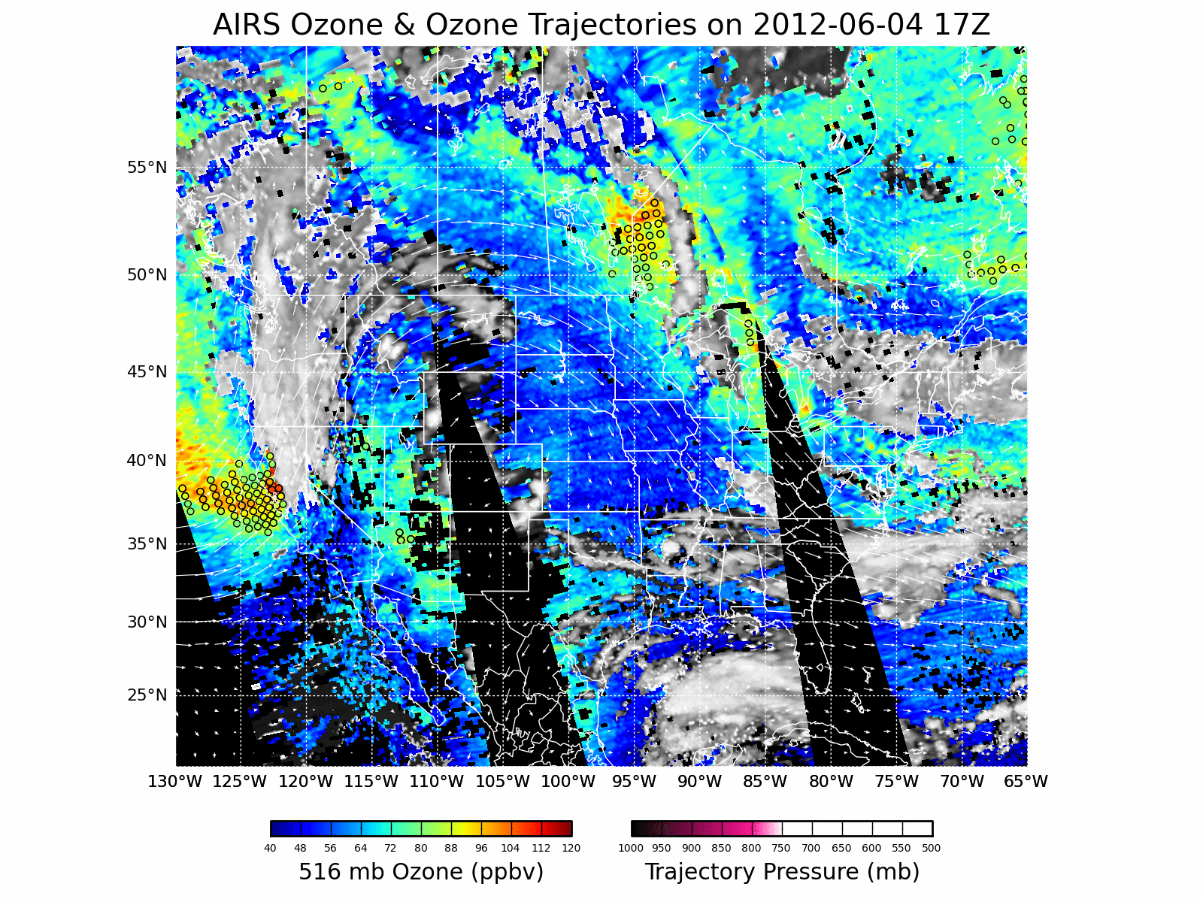
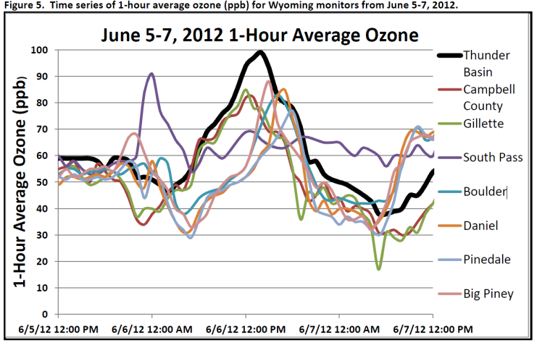
AIRS trajectory forecast showing descent into WY
Starting June 4
(two days before)

Slide 10
Starting June 4
(two days before)
AIRS trajectory forecast showing descent into WY
Last frame of web animation @ 2012-06-07 00Z
Each “worm” is 6 hours of air parcel history
500 hPa GFS winds
Initialization points

Slide 11
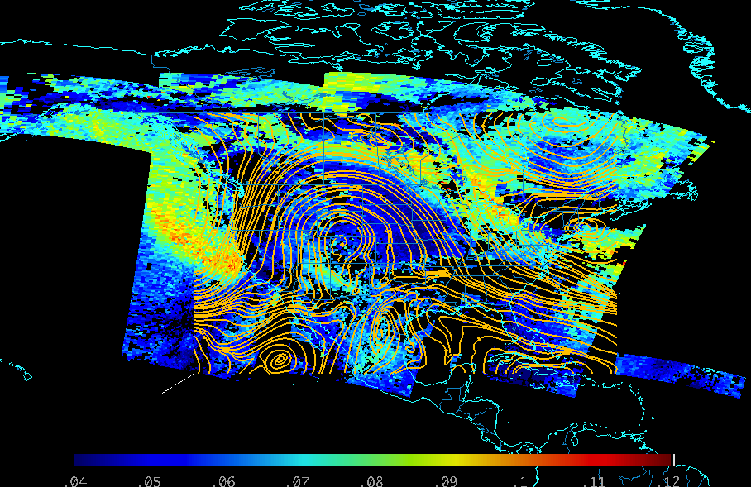
IASI 516 hPa ozone (ppmv) and 500mb stream lines, June 4, 2012
Archived gridded data netCDF file includes ozone retrieval swaths and GFS data fields

Slide 12
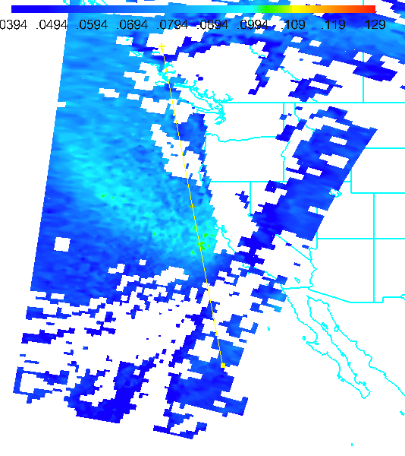
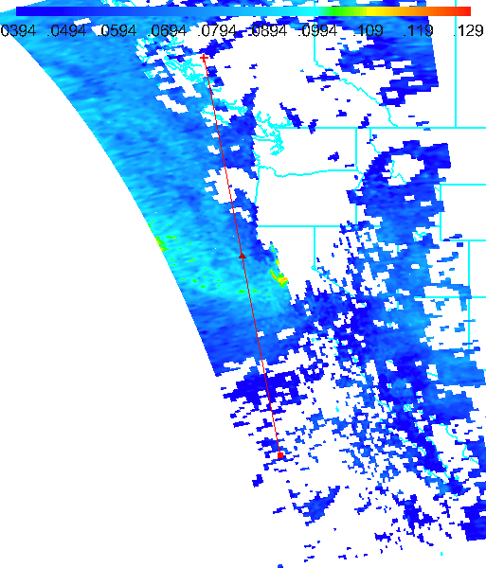
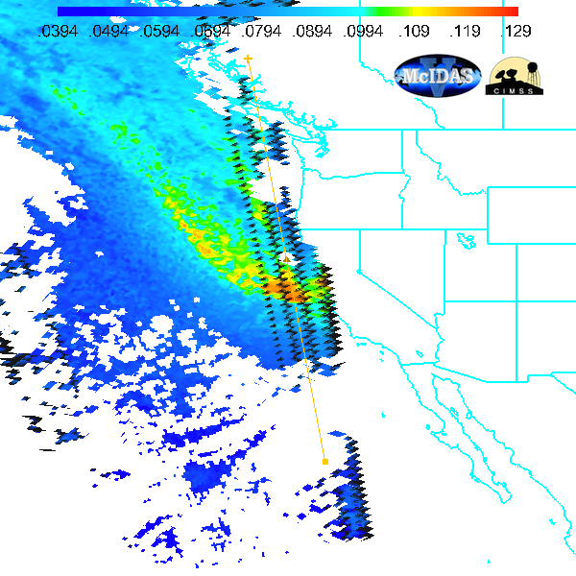
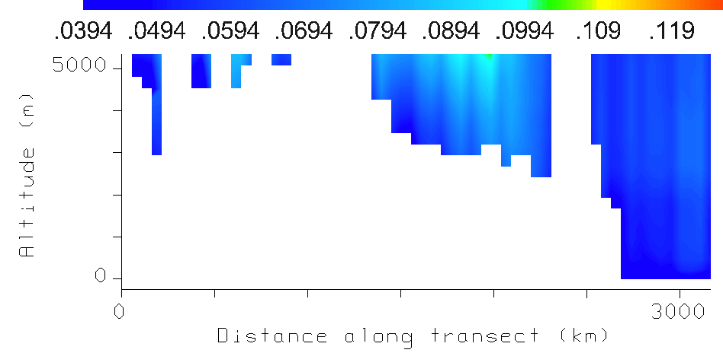
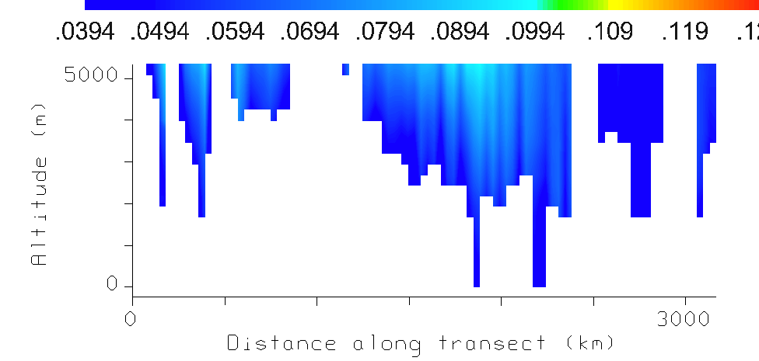
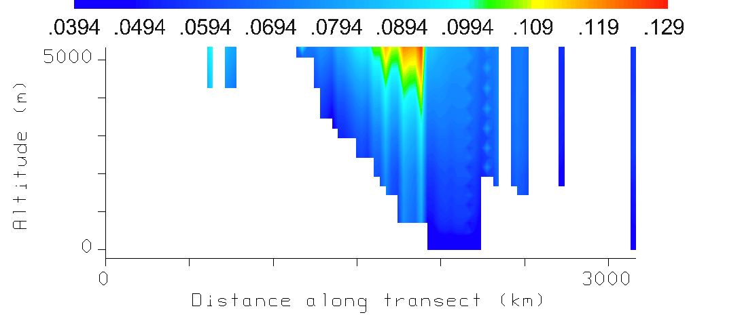
516 hPa Ozone and Cross-sections June 4, 2012
IASI 1840Z
AIRS 2100Z
CrIS 2150Z
Ozone from IASI, AIRS, and CrIS can be viewed and compared in McIDAS-V

Slide 13
Future Plans
Release IDEA-I SI forecast package to CSPP Beta users for testing in July, 2013
Conduct retrospective case studies during 2013 SI events for evaluation by EPA SI Working Group
Release IDEA-I SI forecast package publically in October, 2013
Add MODIS/VIIRS/GOES wildfire detection trajectories (wildfire Exceptional event analysis)
Add AIRS/IASI CO trajectories (wildfire Exceptional event analysis and identifing long-range pollution transport)
Maintain IDEA-I SI forecast capability at CIMSS for use by State and local AQ forecasters

Slide 14
Input from State and Local AQ management on future plans appreciated!
brad.pierce@noaa.gov

Slide 15
Extra Slides

Slide 16
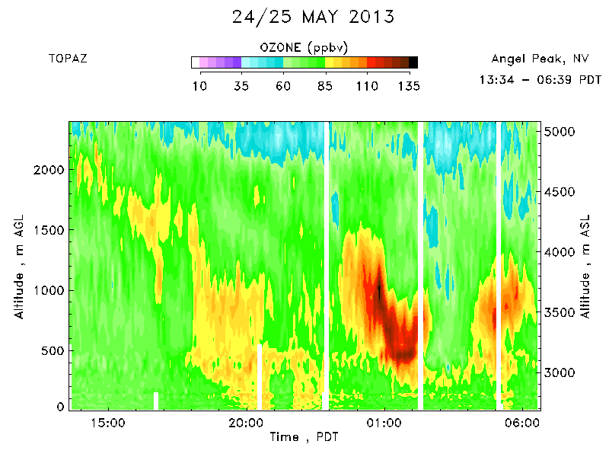
Las Vegas Ozone Study (LVOS)
Where: Angel Peak, Nevada
When: May - June 2013
NOAA ESRL CSD Tunable Optical Profiler for Aerosol and oZone (TOPAZ) lidar.
TOPAZ data provided by Andrew Langford (NOAA/ESRL)
http://www.esrl.noaa.gov/csd/projects/lvos.html

Slide 17
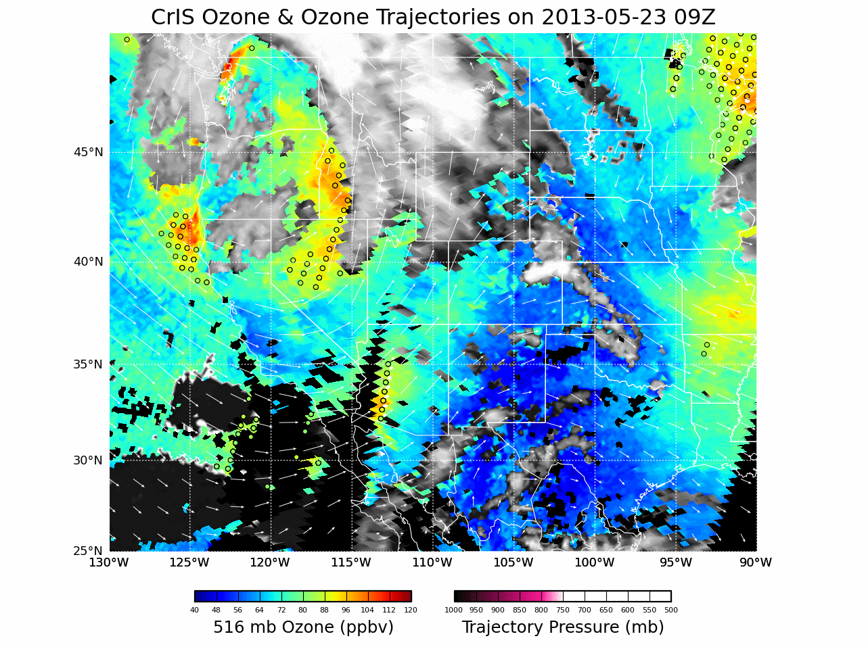

Slide 18
Dual-Regression Retrieval
Radiances
AIRS L1B,
IASI L1C, CrIS SDR
Training Set
Simulated Radiances
Regression Coefficients
Retrieval
Temperature, Moisture and Ozone profiles,
Surface and cloud parameters ….

