Slide 1
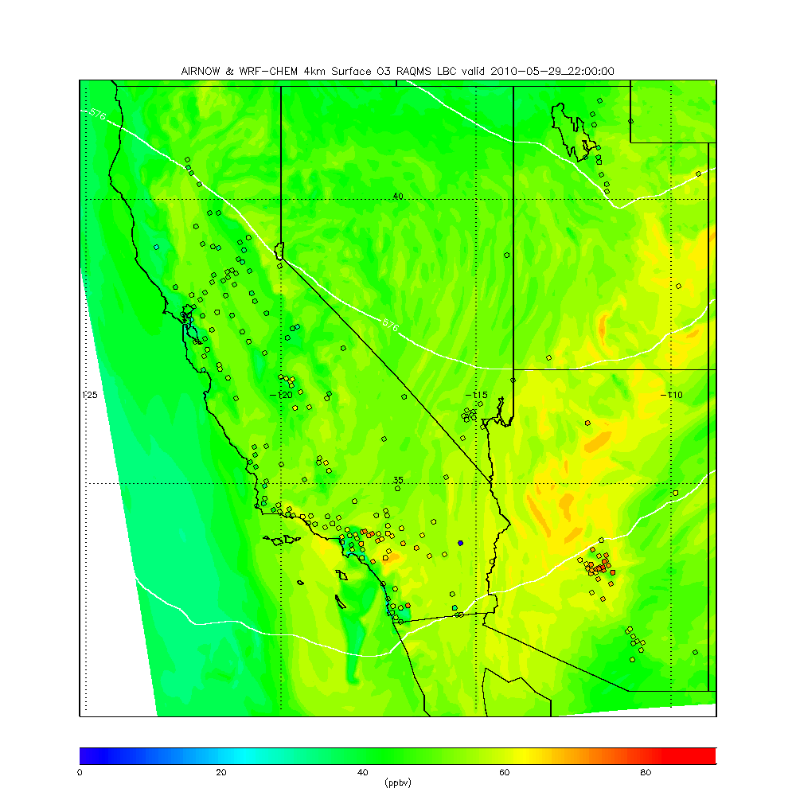
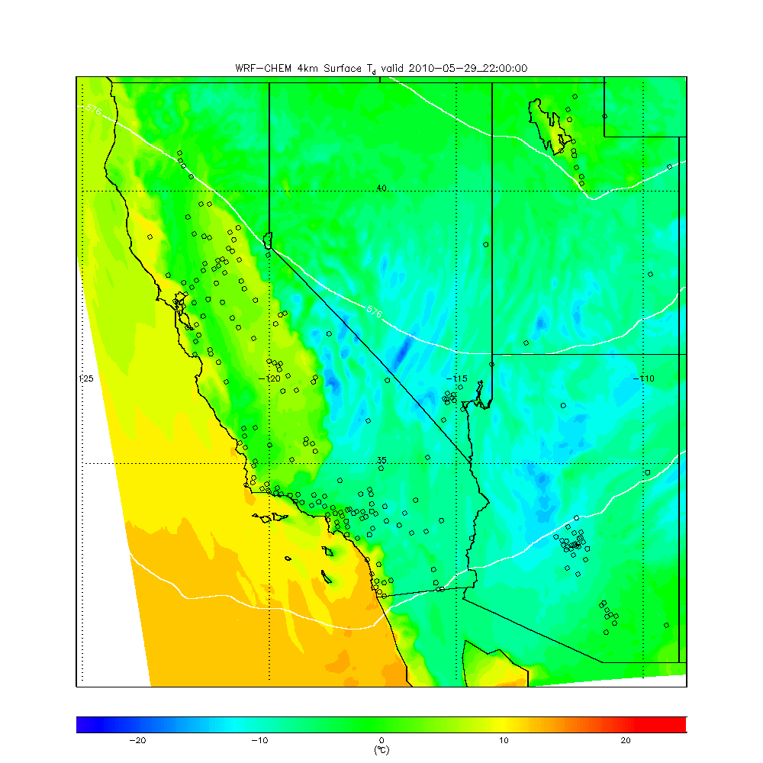
Nested RAQMS/WRF-CHEM simulations of stratospheric influence on surface ozone during CalNex
Brad Pierce, NOAA/NESDIS
Thanks to Andrew Langford, Christoph Senff, Owen Cooper and Tom Ryerson (NOAA/ESRL) for motivation and CalNex Data
Air Quality Applied Sciences Team 4th Meeting (AQAST 4) November 29-30, 2012 , Sacramento, CA

Slide 2
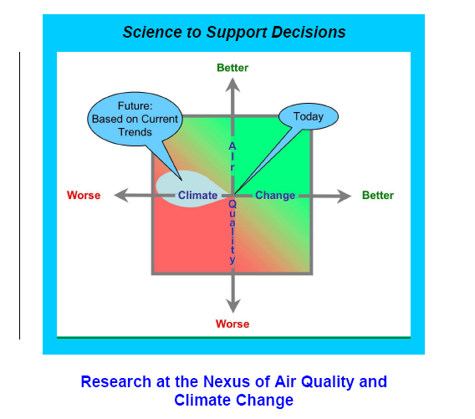
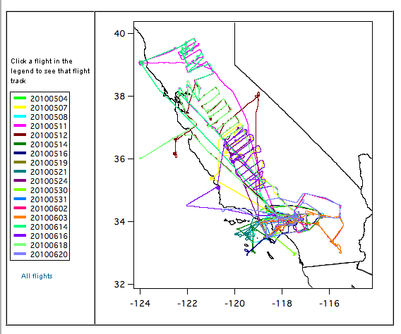
NOAA CalNex Field Mission
During May-June 2010 the National Oceanic and Atmospheric Administration (NOAA) and the California Air Resources Board (CARB), conducted a joint field study of atmospheric processes over California and the eastern Pacific coastal region called CalNex emphasizing the interactions between air quality and climate change issues.
NOAA WP-3D Flight Track Map
http://www.esrl.noaa.gov/csd/calnex/

Slide 3

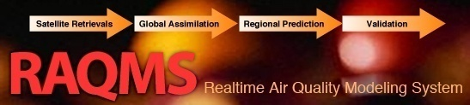

Online global chemical and aerosol assimilation/forecasting system
Real-time assimilation:
Microwave Limb Sounder (MLS) stratospheric ozone profiles (above 50mb)
Ozone Monitoring Instrument (OMI) total ozone column (cloud cleared)
Moderate Resolution Imaging Spectroradiometer (MODIS) Aerosol Optical Depth (AOD)
Real-time fire detection:
Moderate Resolution Imaging Spectroradiometer (MODIS)
This talk presents results from post mission studies focused on:
Evaluation of nested RAQMS/WRF-CHEM ozone predictions using airborne and ground based measurements during CalNex
Assessing the ability of nested ozone predictions to capture the observed influences of Stratospheric Intrusions (SI) on surface ozone within the LA Basin during CalNex

Slide 4
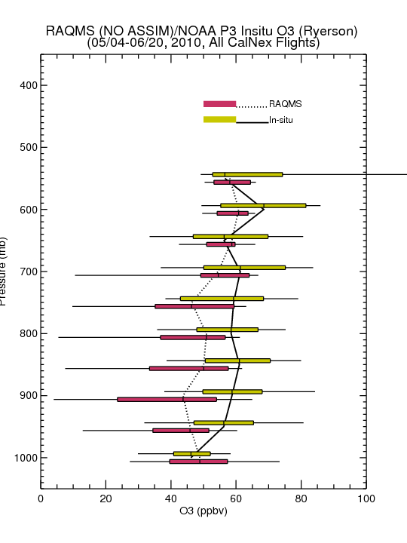
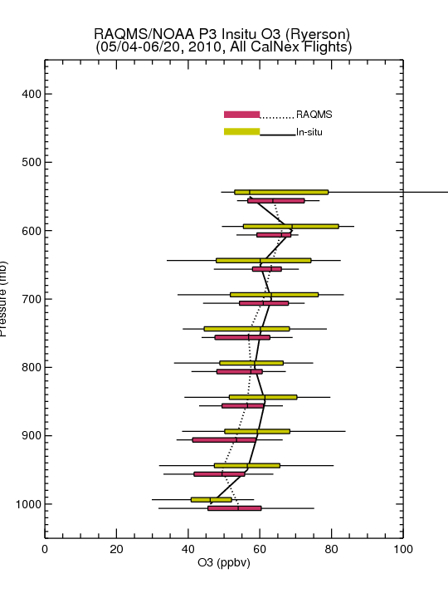
Comparison with NOAA P3 Insitu O3 Measurements
(Primarily LA Basin/Central Valley)
No Assim
MLS+OMI Assim
Assimilation of MLS+OMI O3 retrievals results in increased lower-tropospheric O3 (and improved agreement with airborne insitu O3) over Southern California
Insitu O3 from Tom Ryerson, NOAA ESRL

Slide 5
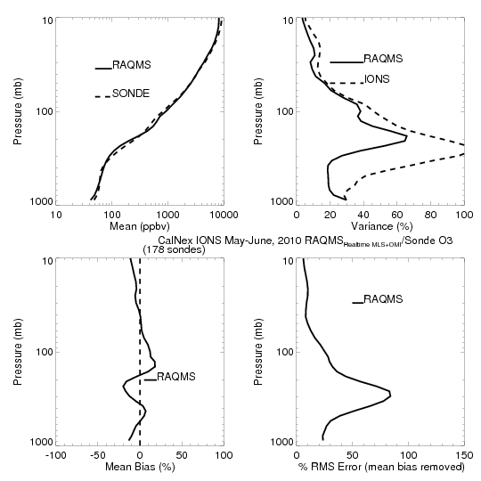
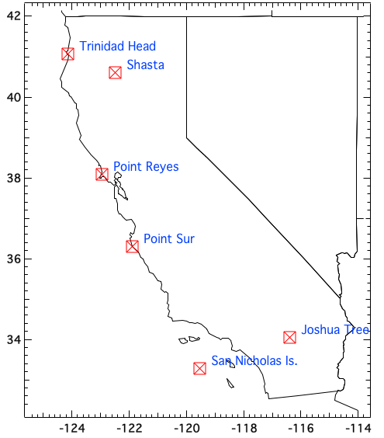
CalNex-2010 O₃ sondes – Owen Cooper (NOAA ESRL)
CalNex Ozonesonde
MLS+OMI
ASSIM
RAQMS MLS+OMI
analysis is within
20% of Ozonesonde

Slide 6
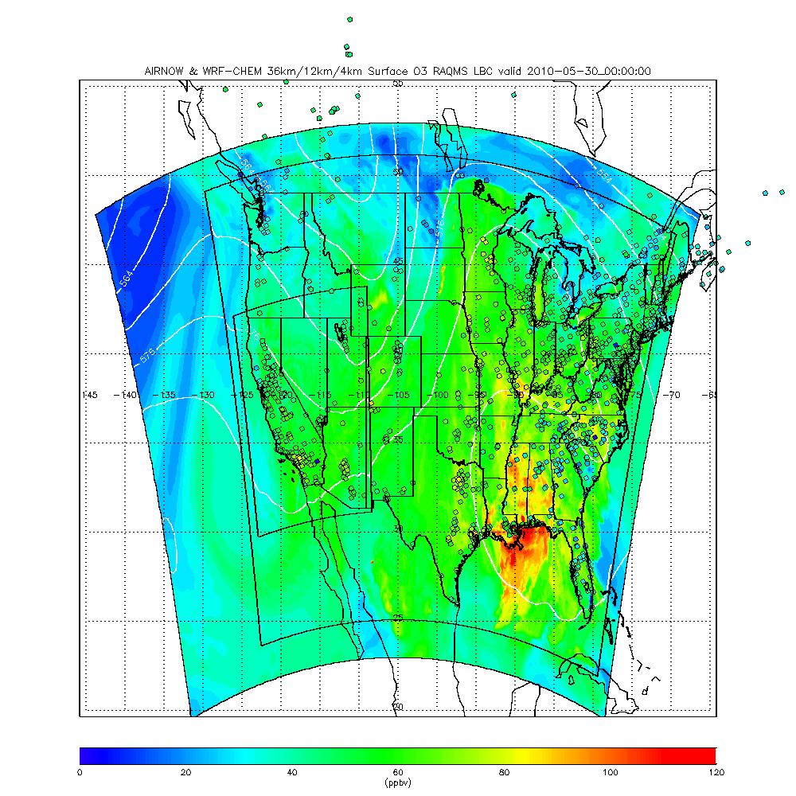
Nested RAQMS/WRF-CHEM ozone predictions
(04/27-07/02, 2010)
40 vertical layers, top=50mb
GOCART RACM – KPP mechanism
Anthropogenic emissions – high resolution (4km) NEI-99, version 3
GOES (WF-ABBA) fire detection
4km
12km
36km

Slide 7
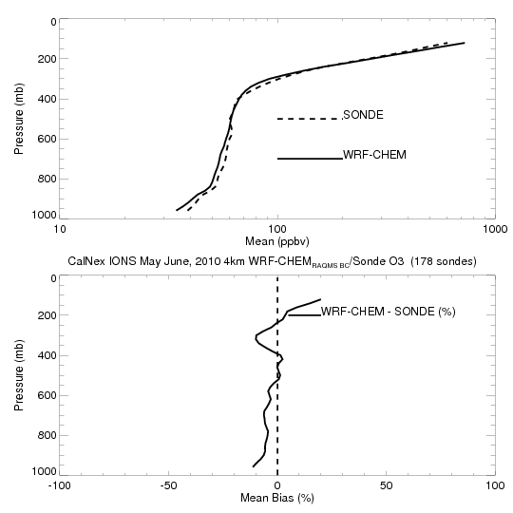
CalNex-2010 O₃ sondes – Owen Cooper (NOAA ESRL)
RAQMS MLS+OMI
analysis is within
20% of Ozonesonde
Nested WRF-CHEM is generally within 10% of Ozonesonde

Slide 8
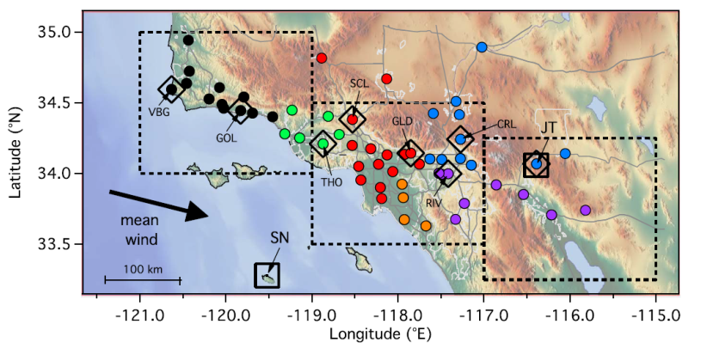
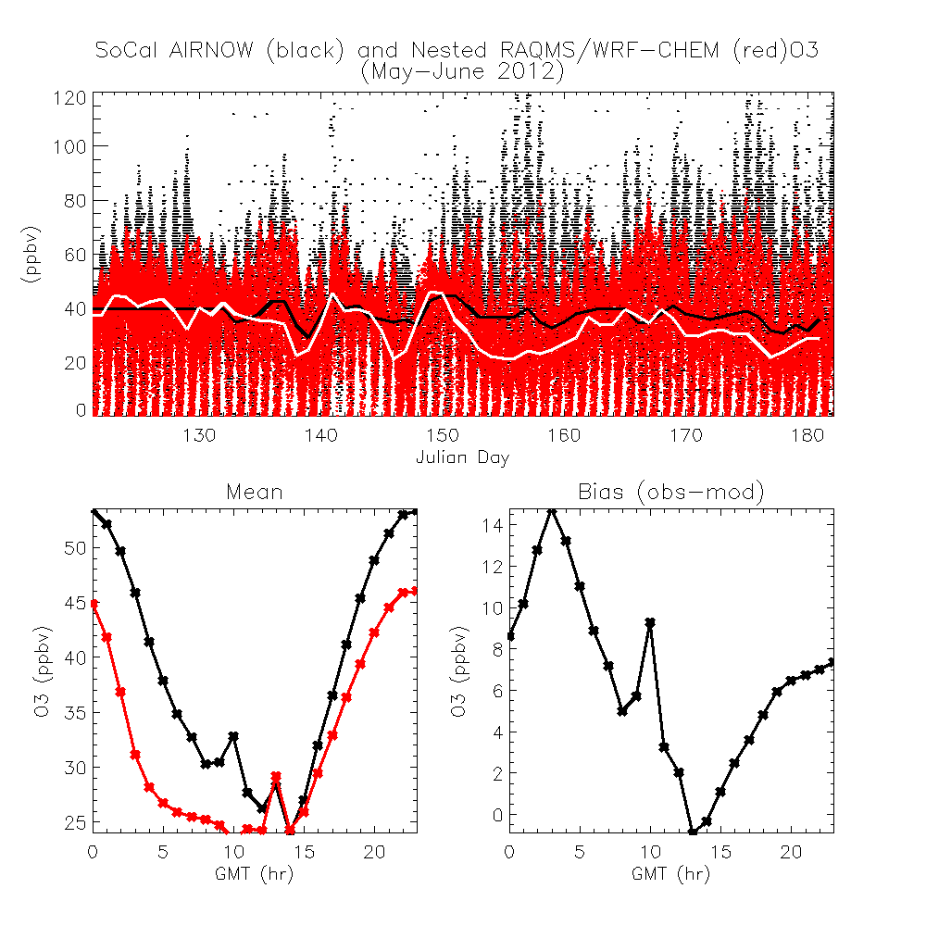
Southern California (SoCal) Surface O3
(121.5W to 115W, 33N to 35N)
AIRNOW data limited
to <120 ppbv
RAQMS/WRF-CHEM underestimates diurnal maximum (00Z/4pm PST) by 8ppbv
Good agreement for diurnal minimum (14Z/6am PST)
PST=GMT-8

Slide 9

Stratospheric Intrusion (SI) signature in SoCal surface measurements
Langford, A. et al. (2012), Stratospheric influence on surface ozone in the Los Angeles area during late spring and early summer of 2010, J. Geophys. Res., 117, D00V06, doi:10.1029/2011JD016766.

Slide 10
Principle Component Analysis (PCA) Results
Loadings
Amplitudes
30 May
5 June
59%
16%
Langford, A. et al. (2012), Stratospheric influence on surface ozone in the Los Angeles area during late spring and early summer of 2010, J. Geophys. Res., 117, D00V06, doi:10.1029/2011JD016766.

Slide 11
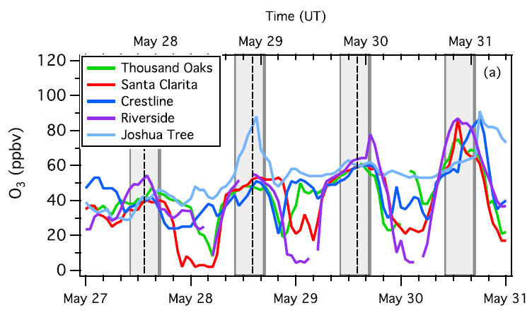
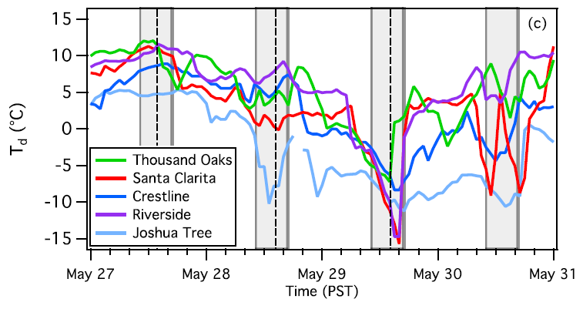
Low surface dew point temperatures (T_{d}) indicate dry air that is potentially of stratospheric origin
Increases in surface O3 and decreases in T_{d} at Joshua Tree, Riverside and Santa Clarita AIRNOW sites

Slide 12
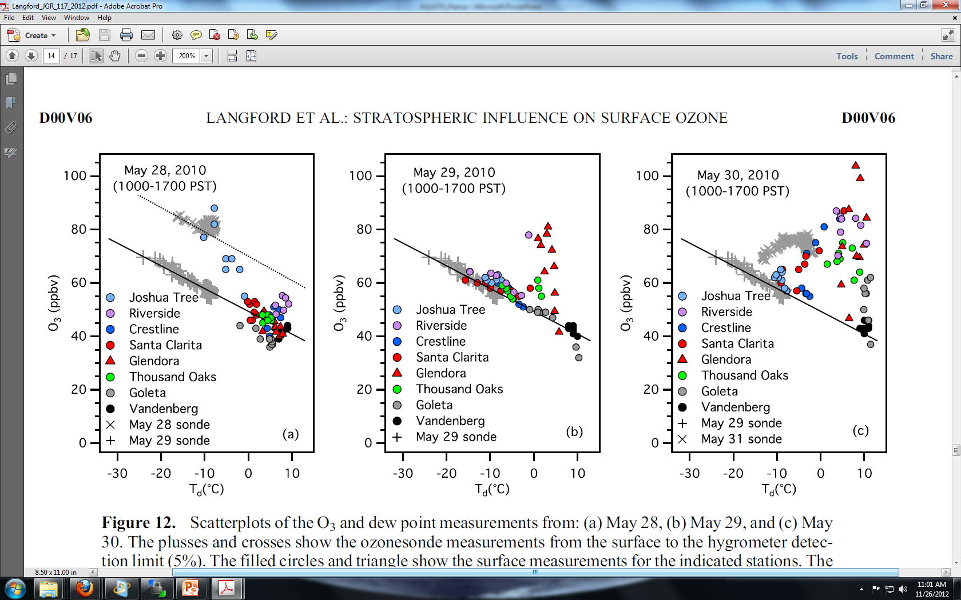
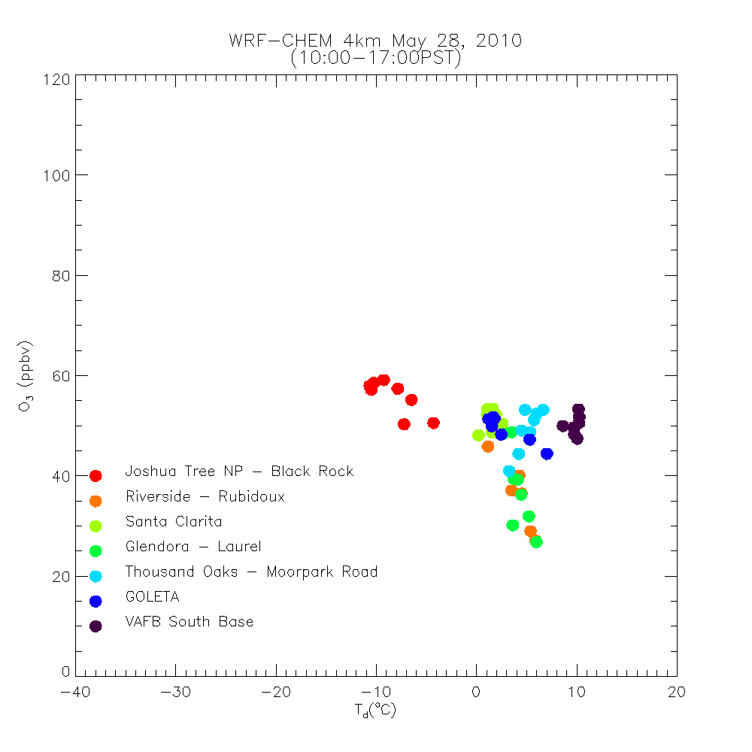
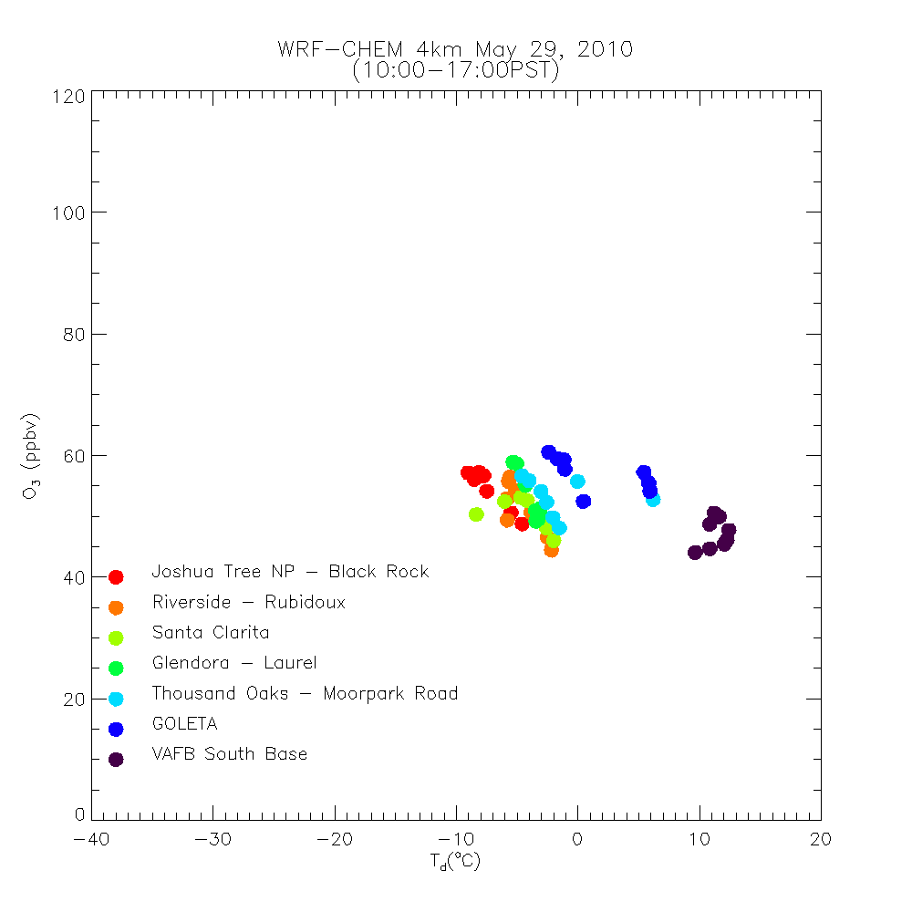
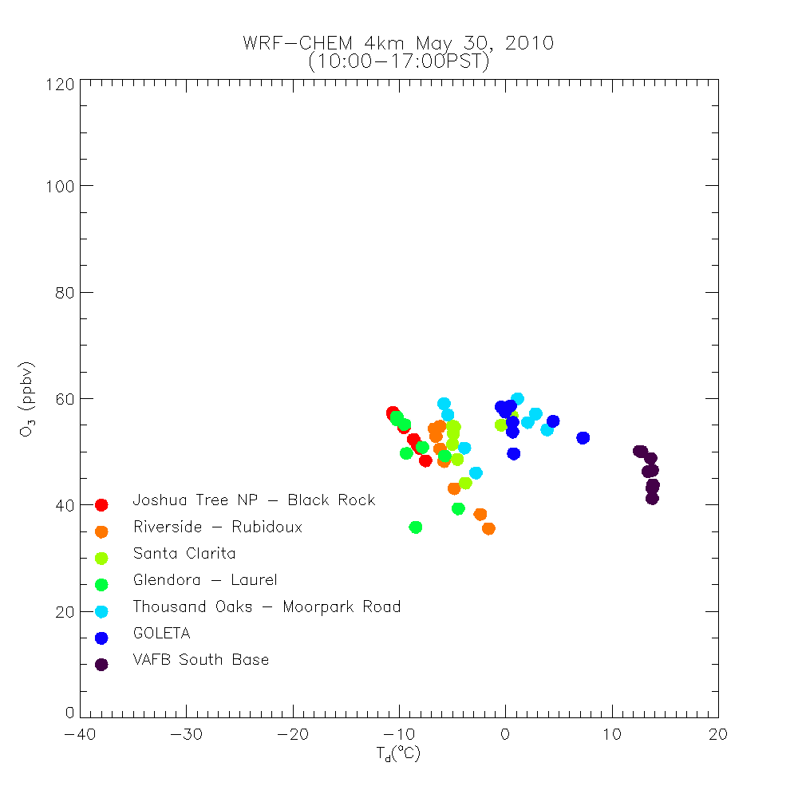
Surface O3/Td relationship within LA Basin
AIRNOW
O₃ PL
O₃ PL
SI
SI
WRFCHEM
O₃ PL
May 28, 2010
(1000-1700 PST)
May 29, 2010
(1000-1700 PST)
May 30, 2010
(1000-1700 PST)
O₃ PL
SI
SI

Slide 13
Surface O3/Td relationship within LA Basin
AIRNOW
O₃ PL
O₃ PL
SI
SI
Nested RAQMS/WRF-CHEM simulations underestimate signatures of both SI and insitu O3 production within LA Basin during May 27-May 31, 2010 SI event
WRFCHEM
O₃ PL
May 28, 2010
(1000-1700 PST)
May 29, 2010
(1000-1700 PST)
May 30, 2010
(1000-1700 PST)
O₃ PL
SI
SI

Slide 14
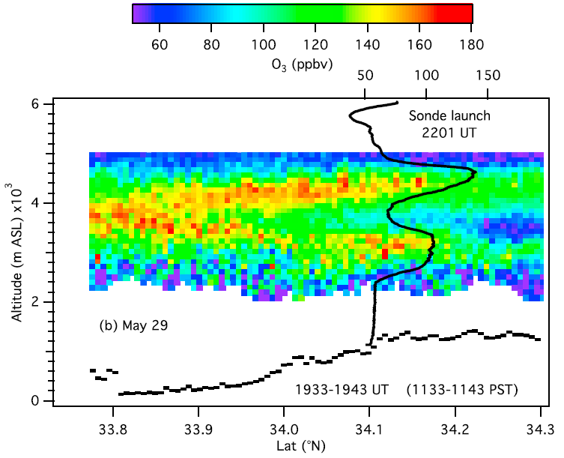
N-S transect 10km west of Joshua Tree by the TOPAZ airborne ozone lidar aboard the NOAA Twin Otter on May 29, 2010
The solid black curve shows the May 29 Joshua Tree ozonesonde profile.
Langford, A. et al. (2012), Stratospheric influence on surface ozone in the Los Angeles area during late spring and early summer of 2010, J. Geophys. Res., 117, D00V06, doi:10.1029/2011JD016766.

Slide 15
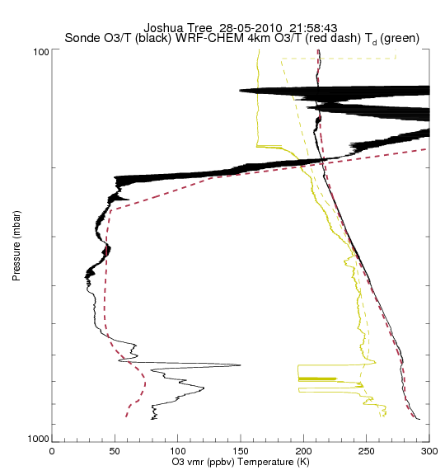
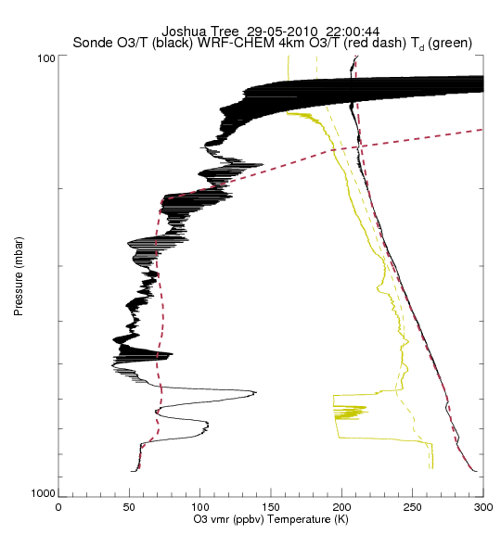
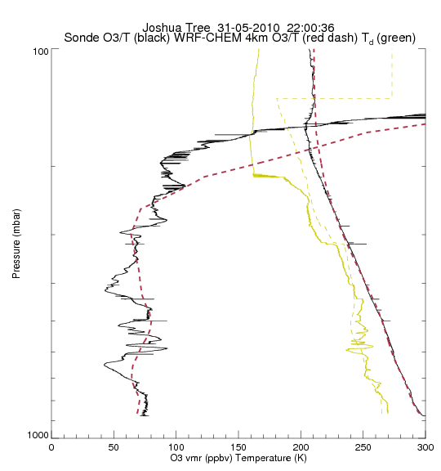
Joshua Tree WRF-CHEM vs IONS
May 28, 2010
May 29, 2010
May 31, 2010
IONS O3/T (black), WRF-CHEM O3/T (dashed red)
IONS Td (solid green), WRF-CHEM Td (dashed green)

Slide 16
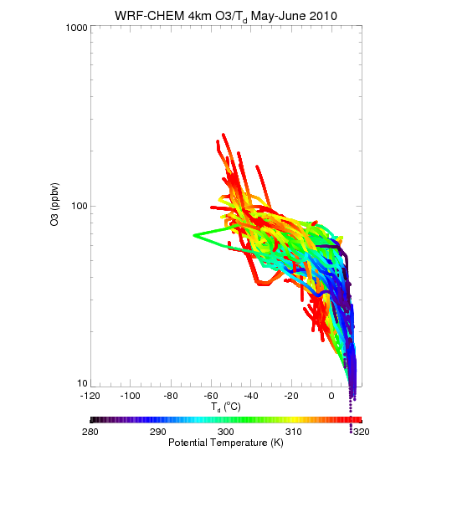
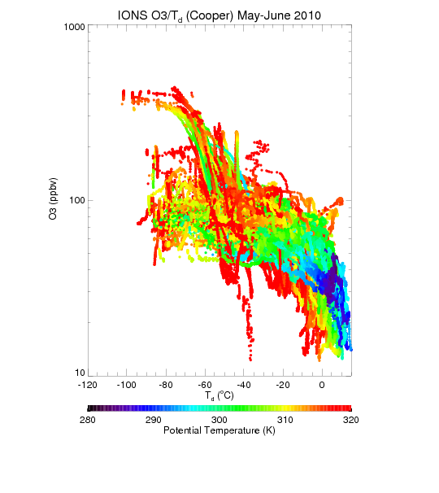
WRF-CHEM vs IONS O3/T_{d} relationship
WRF-CHEM underestimates the frequency of extremely dry air (Td<60oC) for potential temperatures above 310K and underestimates the frequency of high ozone mixing ratios (O3>100ppbv) above 300K

Slide 17
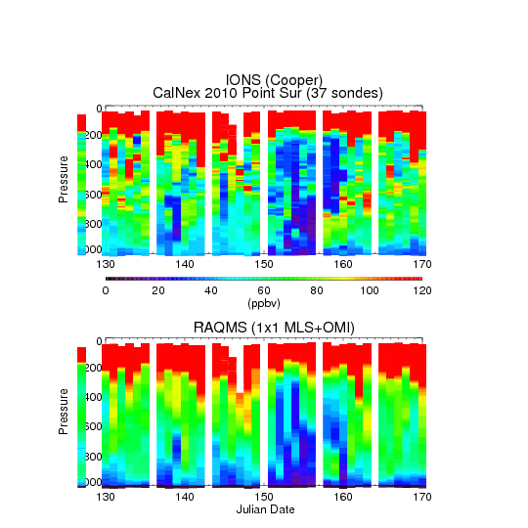
Point Sur RAQMS vs IONS
RAQMS fails to capture thin lamina of high ozone (>120ppbv) in the upper troposphere which leads to localized SI over LA Basin on May 29, 2010

Slide 18
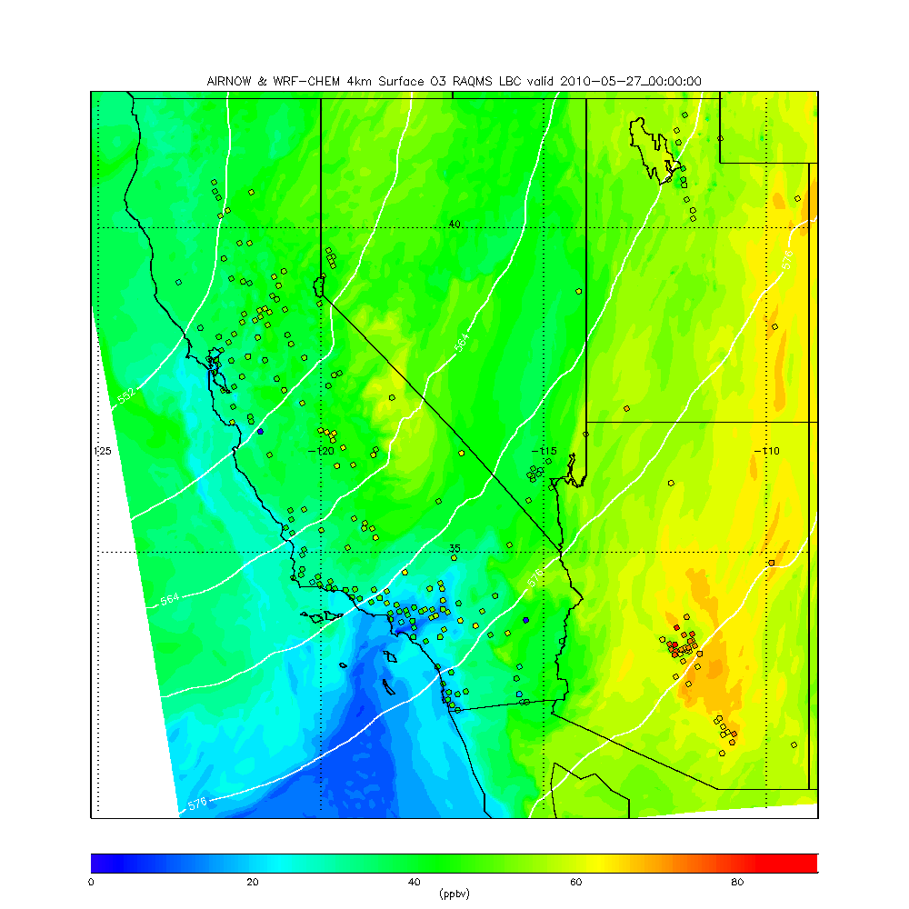
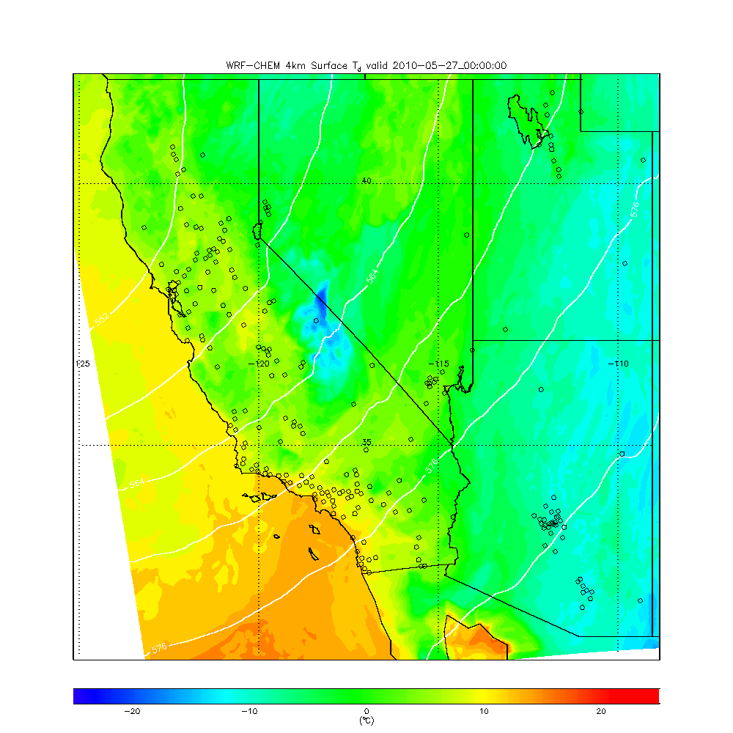
AIRNOW and WRF-CHEM Surface ozone and T_{d}
May 27 – May 31, 2010
Ozone
Dew Point (T_{d})
Nested RAQMS/WRF-CHEM surface O3/Td shows signature of SI event on regional scale

Slide 19
AIRNOW and WRF-CHEM Surface ozone and T_{d}
May 29 22Z, 2010
Ozone
Dew Point (T_{d})
Nested RAQMS/WRF-CHEM surface O3/Td shows signature of SI event on regional scale

Slide 20
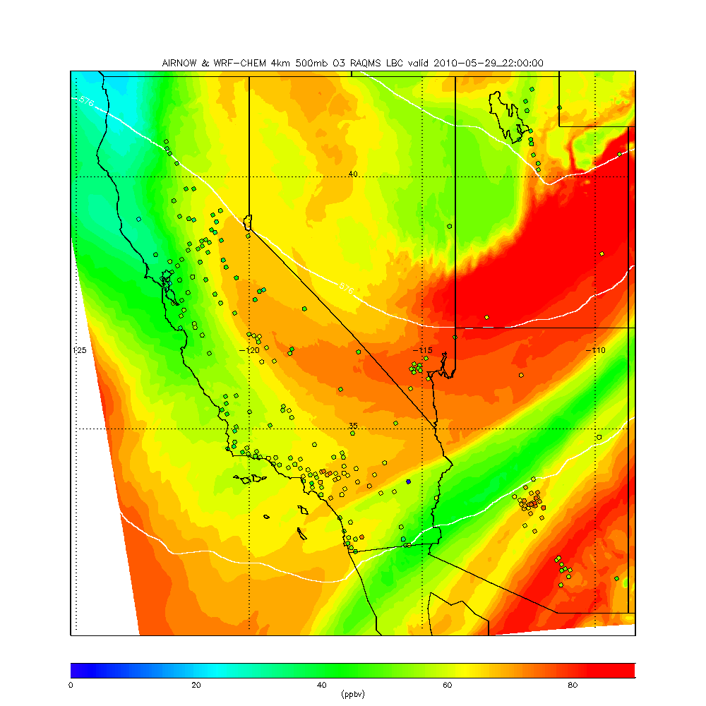
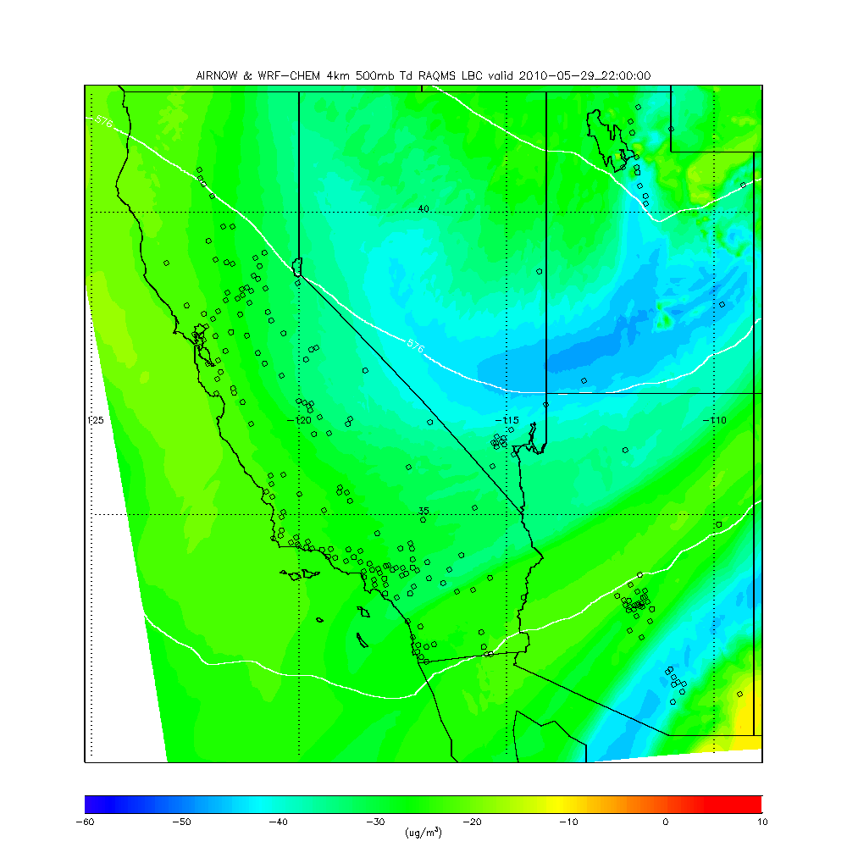
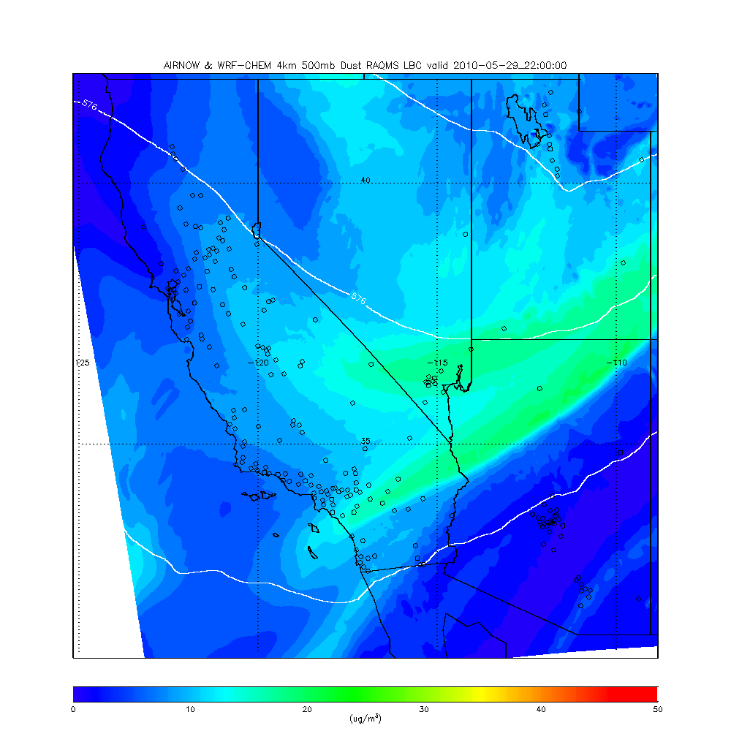
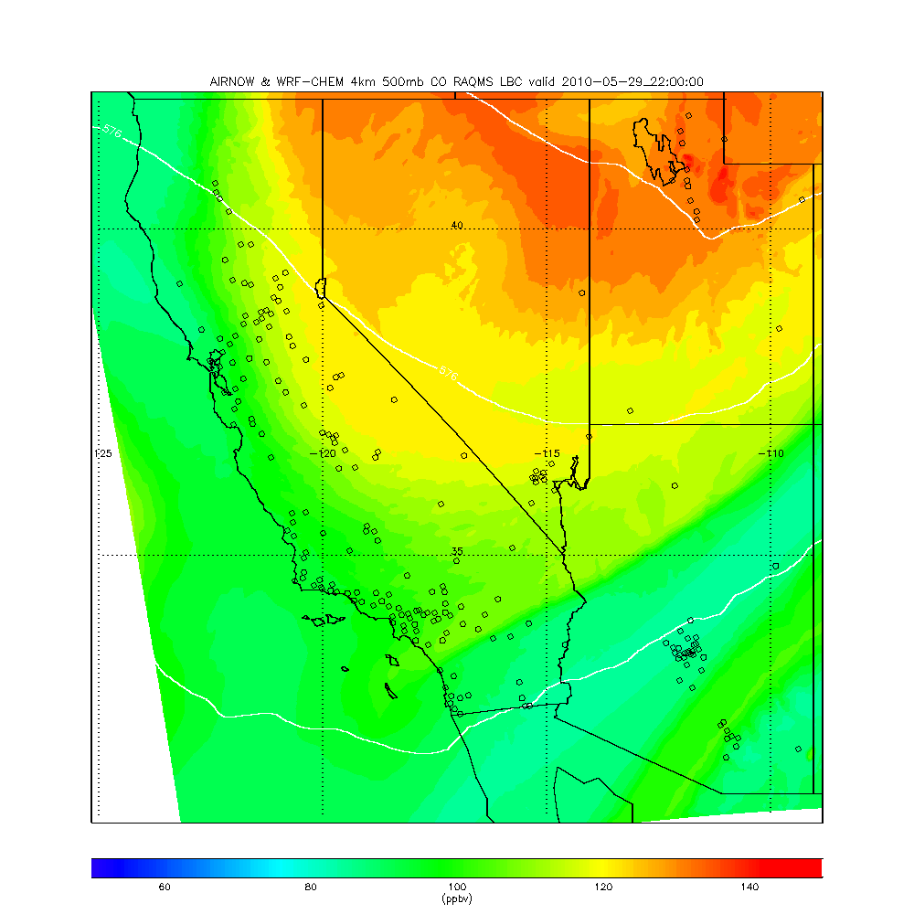
May 29, 22Z 2010
500mb
O3
Td
SI O3/T_{d} signature is mixed with signatures of long-range pollution (CO) and dust transport at 500mb.
Joshua Tree SI signature is part of larger synpotic scale SI event
Dust
CO

Slide 21
Conclusions
Real-time assimilation of OMI total column ozone and MLS stratospheric ozone profiles improves agreement with airborne insitu measurements within the LA Basin and Central Valley during CalNex
High resolution nested global/regional scale simulations are able to represent the mean ozone profiles observed by IONS to within 10% during CalNex
  However, the large mid-tropospheric variance observed by IONS is underestimated
High resolution nested global/regional scale simulations are not able to represent the observed relationship between surface ozone and dew point temperatures associated with SI events within the LA Basin found by Langford et al due to lack of representation of fine scale SI features within the RAQMS LBC
  However, the synoptic O3/T_{d} SI signature is captured by nested global/regional scale simulations and is found to be pervasive over the western US during the May 27-31, 2010 case study
The May 27-31, 2010 SI event is mixed with signatures of long-range pollution and dust transport in the mid-troposphere (500mb)

