Slide 1


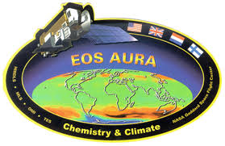

Aura Chemical Reanalysis in support Air Quality Applications
PI Brad Pierce
(NOAA/NESDIS)
Presented by
Allen Lenzen
(UW-Madison, SSEC)
2015 NASA Health and Air Quality Applications Program Review, September 16-17, 2015, Park City, UT

Slide 2
Aura Chemical Reanalysis in support Air Quality Applications
Solicitation – ROSES 2013 Aura Science Team
Project Summary
  Utilize the Real-time Air Quality Modeling System (RAQMS) in conjunction with the NOAA Operational Gridpoint Statistical Interpolation (GSI) 3-dimensional variational data assimilation (DA) system to conduct a multi-year global chemical and aerosol reanalysis using NASA Aura and A-Train measurements.
Project Objectives
  Provide the air quality community with a multi-year global chemical and aerosol reanalysis using NASA Aura and A-Train measurements.
  Conduct regional chemical data assimilation experiments to quantify the influences in changes in NOx emissions on US air quality during the Aura period.
  Provide global 3 dimensional O3, CH4, N2O production and loss rates for next generation NOAA global forecast system.
  Collaborate with International, Federal, State and Local air quality management communities in the utilization of the Aura and A-Train measurements and reanalysis for air quality assessment activities.
|‌ 2

Slide 3
Aura Chemical Reanalysis in support Air Quality Applications
As of July 16, 2015
Budget – NASA’s Monthly Financial Report
  The uncosted FY14 amount due to costing/reporting from multiple entities –
  Cooperative Institute for Meteorological Satellite Studies (CIMSS), NESDIS Center
  for Satellite Applications and Research (STAR) Cooperative Research Program (CoRP)
  FY15 Funds received by CIMSS on August 19, 2015

Slide 4
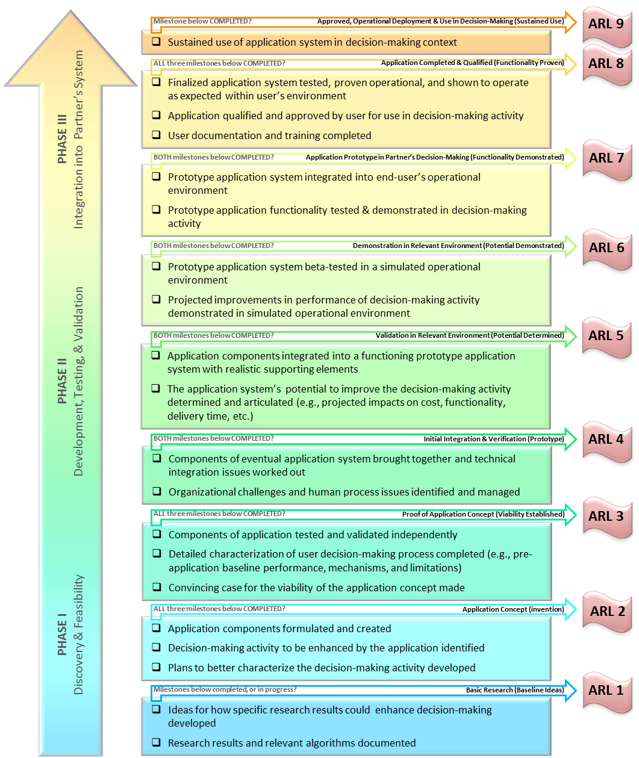
Applications Readiness Level (ARL)
Aura Chemical Reanalysis in support Air Quality Applications
ARL was not required for this Project at Project Start in July 2014
Credentials established in eBooks to input deliverables in July 2015
Retroactively submitted Aug 14, Nov 14, Feb 15, May 15 ARLs
Projected (at completion) :
ARL 7 (Functionality Demonstrated)
Current Status:
ARL 4 (Prototype)
Project Initiation:
ARL 3 (Viability Established)
|‌ 4
Notes:
August 15 ARL not submitted yet (still having problems with eBooks notifications)
Currently at ARL4 based on successfully completing the RAQMS/GSI MLS+OMI O3 and NO2 DA experiments and providing Pius Lee (NOAA/ARL) with RAQMS global analyses for his regional re-analysis under the AQAST tiger team.
Will be providing the Aura reanalysis to users through the NASA DAAC, I think we will reach ARL 7 by the end of the 3-year funding cycle.

Slide 5
Aura Chemical Reanalysis in support Air Quality Applications
Results and Milestones (Year 1)
  Global emissions development based on Hemispheric Transport of Air Pollution (HTAP) 0.1x0.1 degree emission inventory
  Participation in HTAP Work Package 3.2 “Inflow processes influencing air quality over western North America” (Lead: Owen R. Cooper, NOAA/ESRL)
  2010 data denial studies conducted for OMI O3 total column, MLS stratospheric O3 profiles, OMI tropospheric NO2 column retrieval assimilation within coupled RAQMS/GSI Analysis system

Slide 6
Aura Chemical Reanalysis in support Air Quality Applications
Results and Milestones (Year 1)
  Global emissions development based on Hemispheric Transport of Air Pollution (HTAP) 0.1x0.1 degree emission inventory
  Participation in HTAP Work Package 3.2 “Inflow processes influencing air quality over western North America” (Lead: Owen R. Cooper, NOAA/ESRL)
  2010 data denial studies conducted for OMI O3 total column, MLS stratospheric O3 profiles, OMI tropospheric NO2 column retrieval assimilation within coupled RAQMS/GSI Analysis system

Slide 7
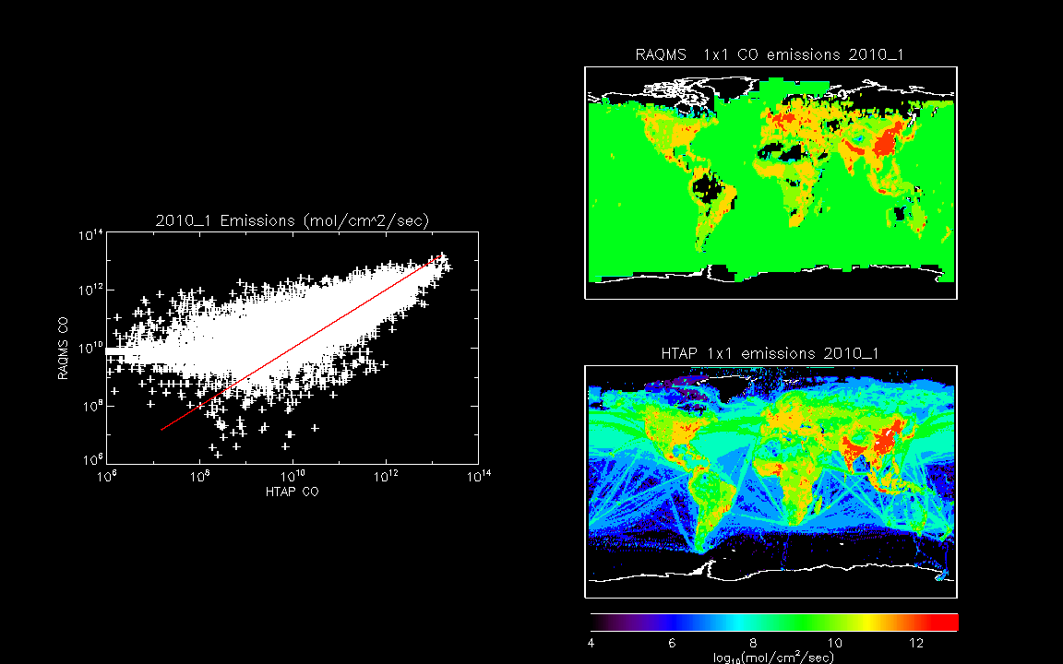
Comparison between the standard RAQMS CO emissions and the EDGAR HTAP_V2 CO emissions for January 2010.
RAQMS assumes a uniform oceanic background CO emission to account for unresolved oceanic VOCs which results in an overall high bias in the RAQMS CO emissions at the low end of the global emission distribution.
EDGAR HTAP_V2 emissions are higher than RAQMS in SE Asia and India which results in overall low bias in the RAQMS CO emissions at the high end of the global emissions.

Slide 8
Aura Chemical Reanalysis in support Air Quality Applications
Results and Milestones (Year 1)
  Global emissions development based on Hemispheric Transport of Air Pollution (HTAP) 0.1x0.1 degree emission inventory
  Participation in HTAP Work Package 3.2 “Inflow processes influencing air quality over western North America” (Lead: Owen R. Cooper, NOAA/ESRL)
  2010 data denial studies conducted for OMI O3 total column, MLS stratospheric O3 profiles, OMI tropospheric NO2 column retrieval assimilation within coupled RAQMS/GSI Analysis system

Slide 9
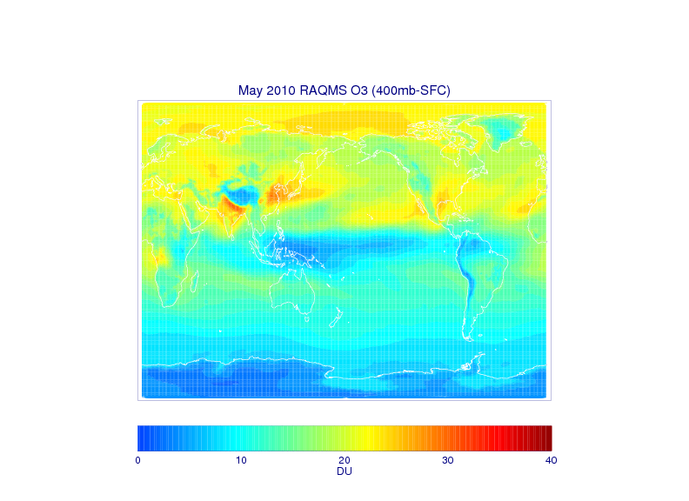
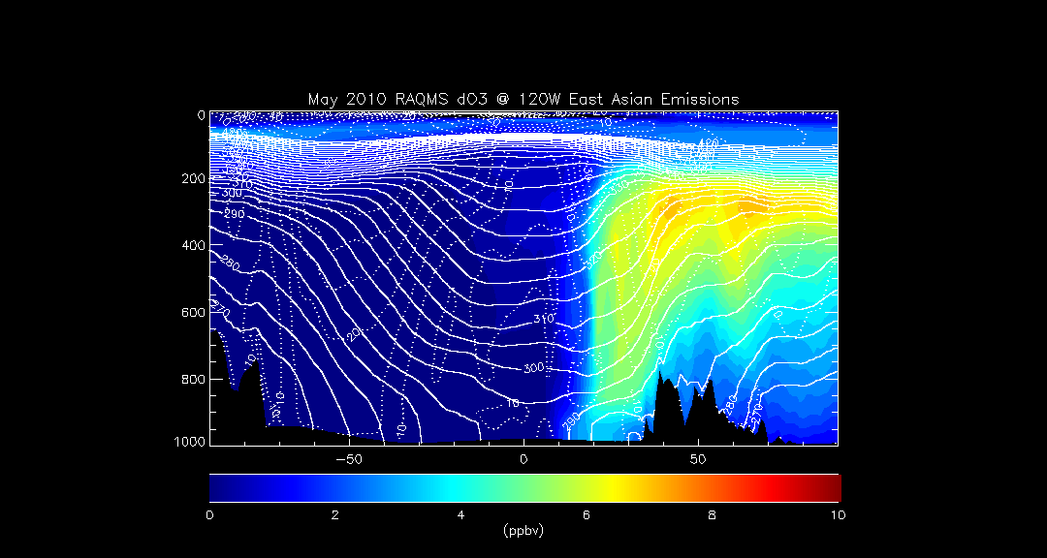
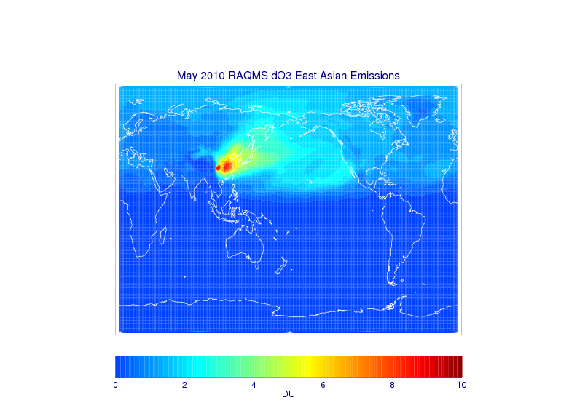
Impacts of East Asian Emissions – May 2010
120W
Impact of East Asian ozone production extends into North America with potential US Air Quality impacts
The Task Force on Hemispheric Transport of Air Pollution (TF HTAP) is an international scientific cooperative effort to improve the understanding of the intercontinental transport of air pollution across the Northern Hemisphere.
Notes:
9

Slide 10
Aura Chemical Reanalysis in support Air Quality Applications
Results and Milestones (Year 1)
  Global emissions development based on Hemispheric Transport of Air Pollution (HTAP) 0.1x0.1 degree emission inventory
  Participation in HTAP Work Package 3.2 “Inflow processes influencing air quality over western North America” (Lead: Owen R. Cooper, NOAA/ESRL)
  2010 data denial studies conducted for OMI O3 total column, MLS stratospheric O3 profiles, OMI tropospheric NO2 column retrieval assimilation within coupled RAQMS/GSI Analysis system

Slide 11
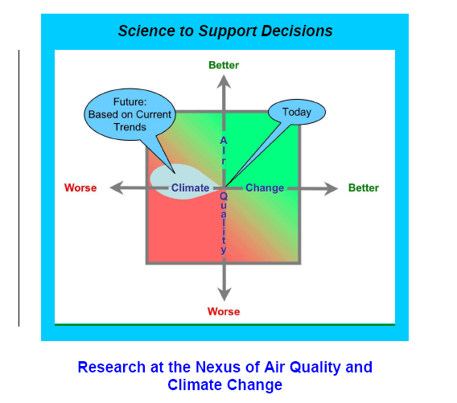
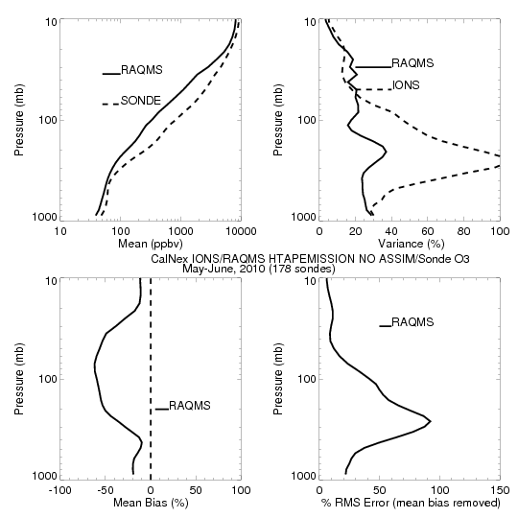
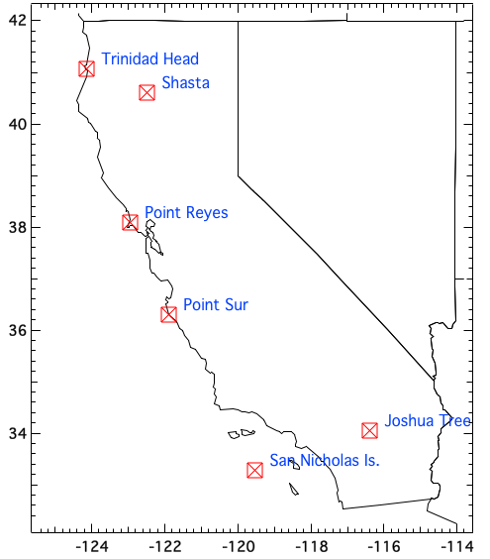
Aura Chemical Reanalysis in support Air Quality Applications
CalNex-2010 O₃ sondes – Owen Cooper (NOAA ESRL)
CalNex Ozonesonde
May-June, 2010
CalNex was organized by the California Air Resources Board (CARB) and NOAA to investigate scientific issues at the nexus between air quality and climate change.
RAQMS baseline (no assimilation) underestimates ozone and ozone variance in the stratosphere and troposphere
+/- 10%
CalNex ozonesonde measurements provide an opportunity to assess the impact of MLS and OMI O3 assimilation on ozone within the Aura Reanalysis along the California coast

Slide 12
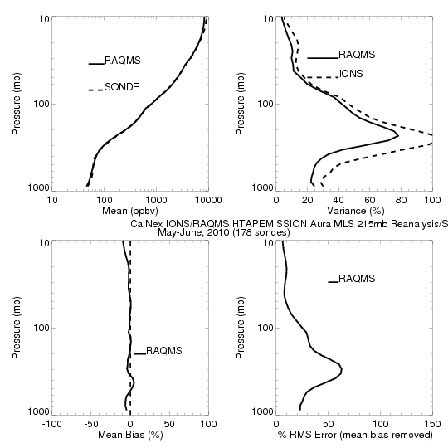
Aura Chemical Reanalysis in support Air Quality Applications
CalNex-2010 O₃ sondes – Owen Cooper (NOAA ESRL)
CalNex Ozonesonde
May-June, 2010
CalNex was organized by the California Air Resources Board (CARB) and NOAA to investigate scientific issues at the nexus between air quality and climate change.
RAQMS Aura Reanalysis improves ozone and ozone variance in the stratosphere and troposphere
+/- 10%
CalNex ozonesonde measurements provide an opportunity to assess the impact of MLS and OMI O3 assimilation on ozone within the Aura Reanalysis along the California coast

Slide 13
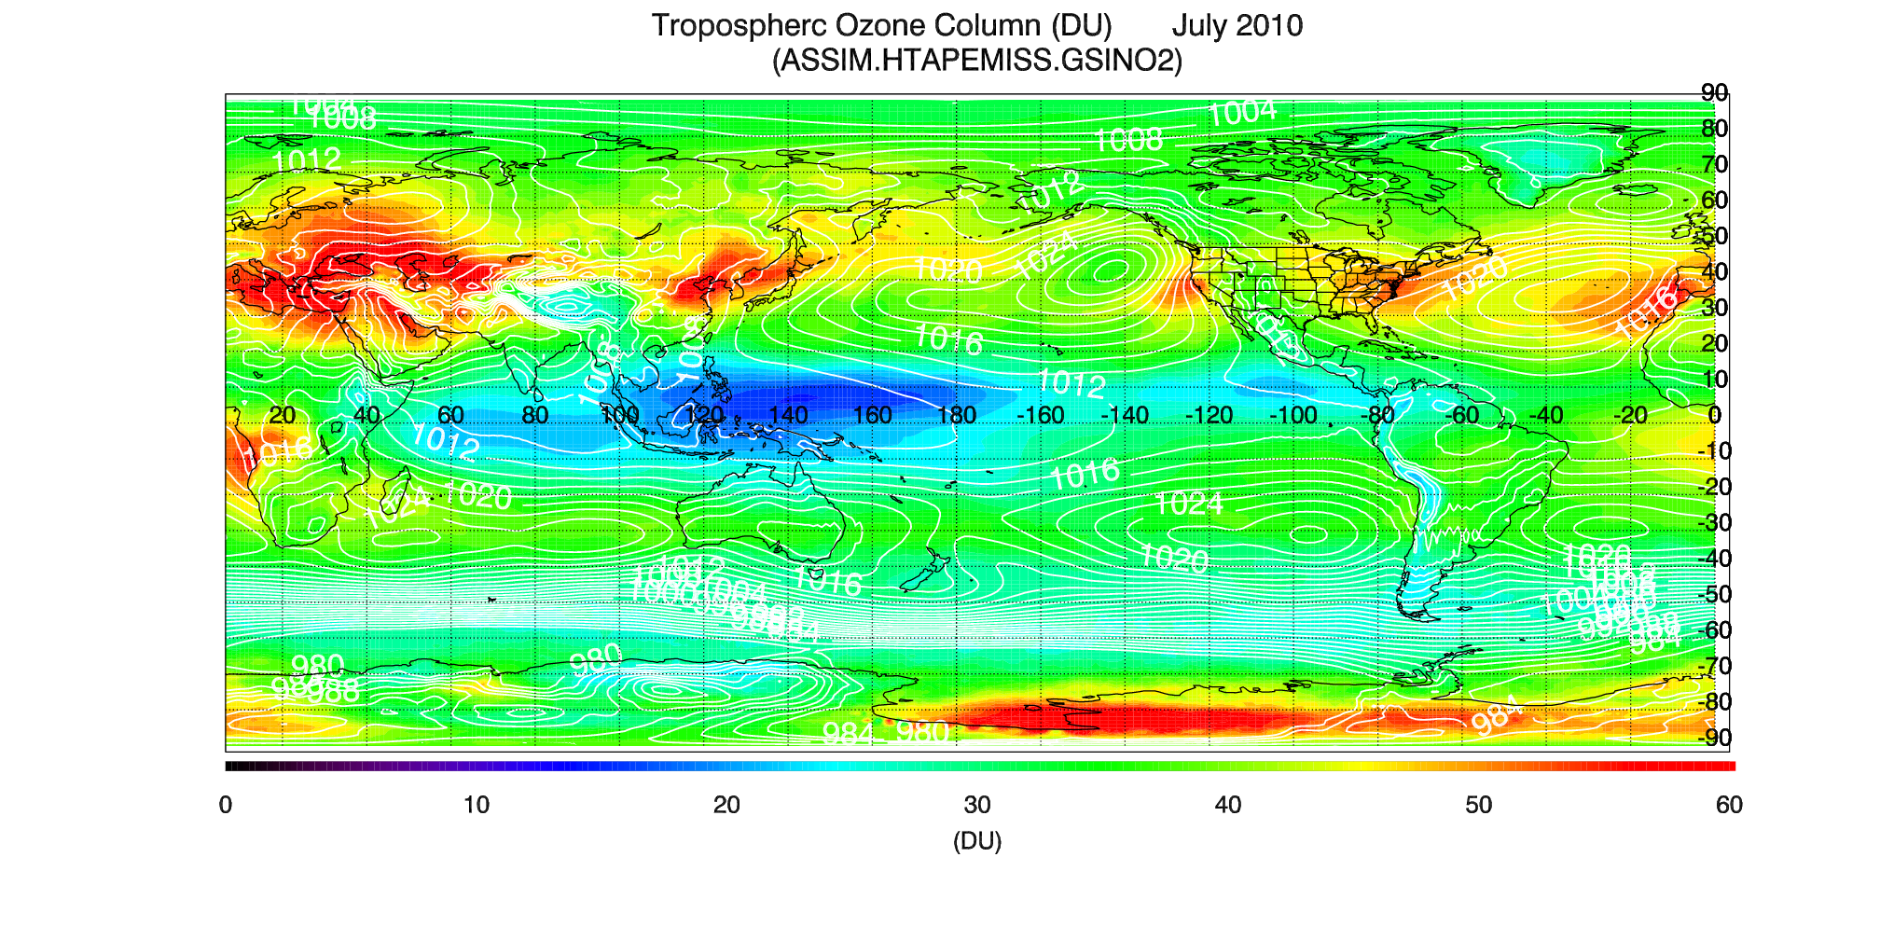
Aura Chemical Reanalysis in support Air Quality Applications
July 2010 OMI NO2 Data Assimilation Studies
RAQMS Tropospheric Ozone Column: July 2010
High Tropospheric ozone over major urban/industrial and biomass burning regions
Export of E. Asian and US emissions and accumulation within oceanic high pressure systems

Slide 14
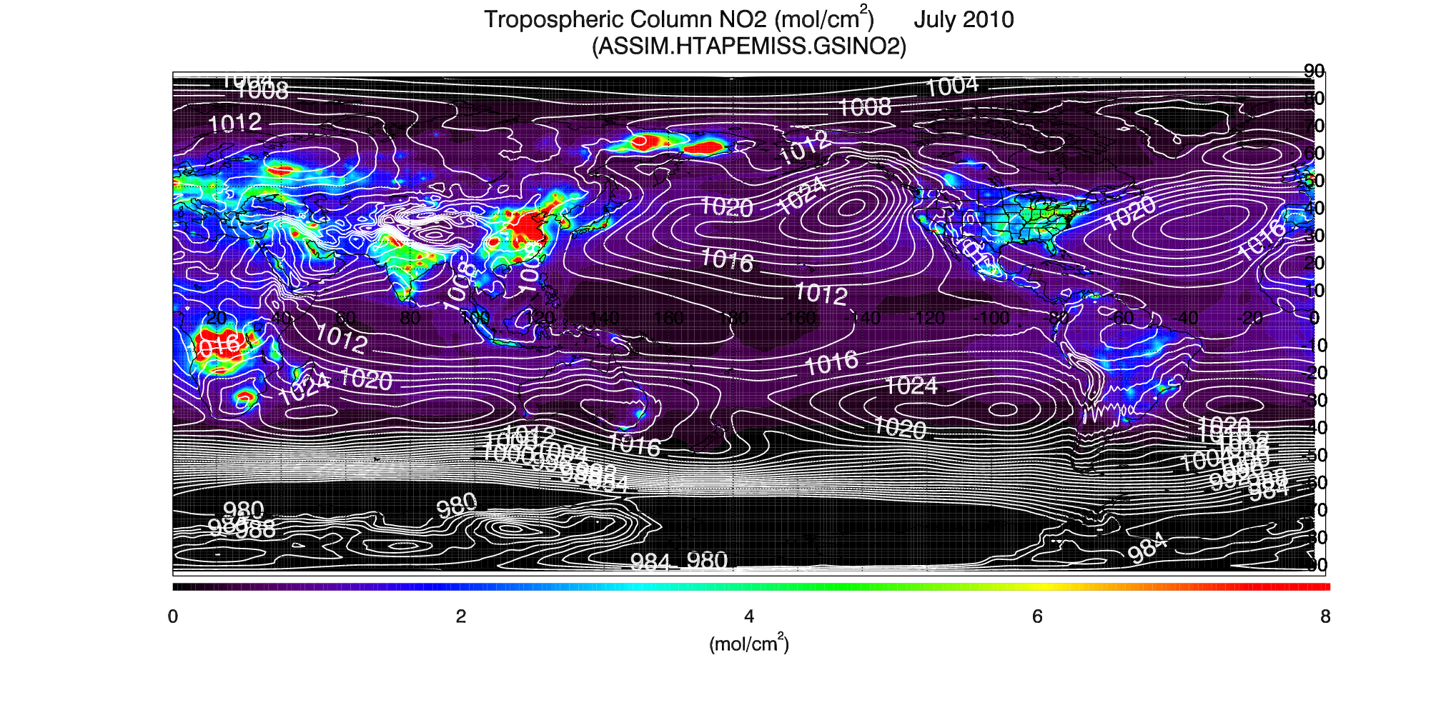
Aura Chemical Reanalysis in support Air Quality Applications
July 2010 OMI NO2 Data Assimilation Studies
RAQMS Tropospheric NO2 Column: July 2010
High Tropospheric NO2 over major urban/industrial and biomass burning regions

Slide 15
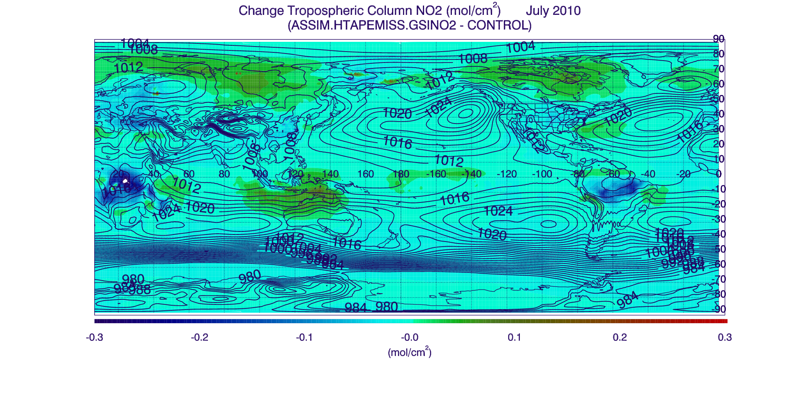
Aura Chemical Reanalysis in support Air Quality Applications
July 2010 OMI NO2 Data Assimilation Studies
Impact on Tropospheric NO2 Column due to OMI Tropospheric NO2 assimilation : July 2010
Largest reduction over South Africa and South American Biomass burning regions
Largest increase over Asia and North America at high latitudes

Slide 16
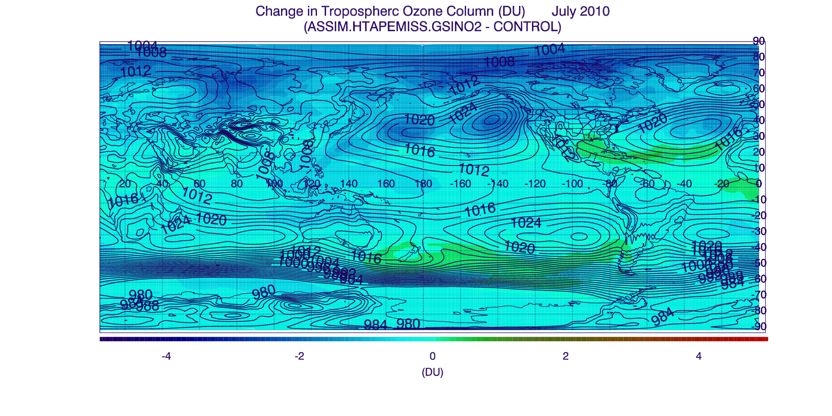
Aura Chemical Reanalysis in support Air Quality Applications
July 2010 OMI NO2 Data Assimilation Studies
Change in Tropospheric Ozone due to Tropospheric NO2 Column assimilation : July 2010
Largest reduction is over Arctic and within Oceanic high pressure systems
Largest increase is over Gulf of Mexico and South of Atlantic High pressure system

Slide 17
Aura Chemical Reanalysis in support Air Quality Applications
Ongoing activities
Collaboration with Wisconsin Department of Natural Resources (WDNR) and Lake Michigan Air Directors Consortium (LADCO) on influence of Chicago NO2 emissions on ozone exceedances at Sheboygan, WI (exceeded limit for the 2013-15 design value in 2015)
  Conducted regional and urban WRF-CHEM simulations for July 2011 investigating influence of Chicago, Milwaukee, and Green Bay NO2 emissions on Sheboygan, WI exceedances
  Planning 2011 CMAQ OMI NO2 data assimilation experiments using OMI standard and enhanced spatial resolution NO2 retrievals
PI is member of Aerosol and Atmospheric Composition Task Force for development of NOAA’s Next Generation Global Prediction System (NGGPS)
  Planning on FY16 testing of the use of climatological tropospheric ozone production and loss rates generated from RAQMS/GSI Aura Reanalysis within NGGPS Atmospheric Composition forecast

Slide 18
Extra Slides

Slide 19
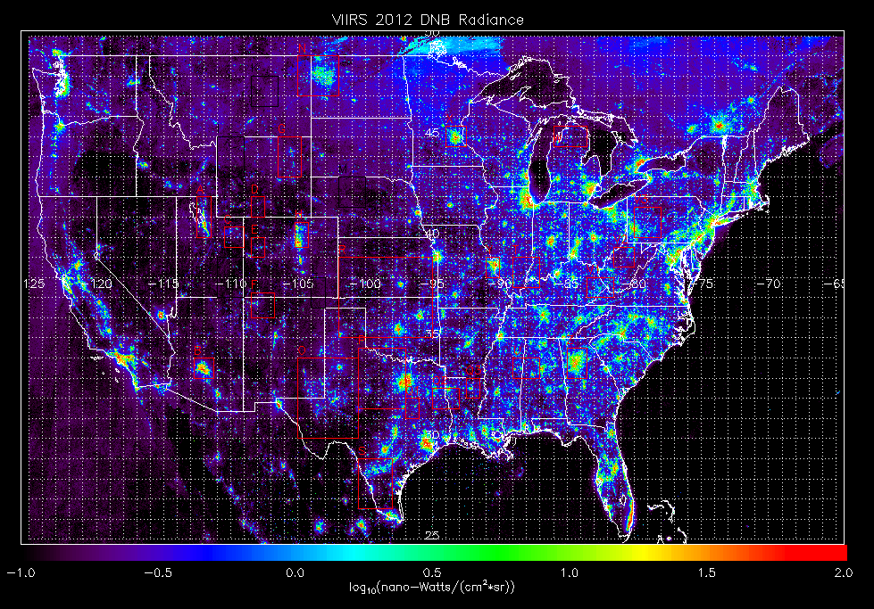
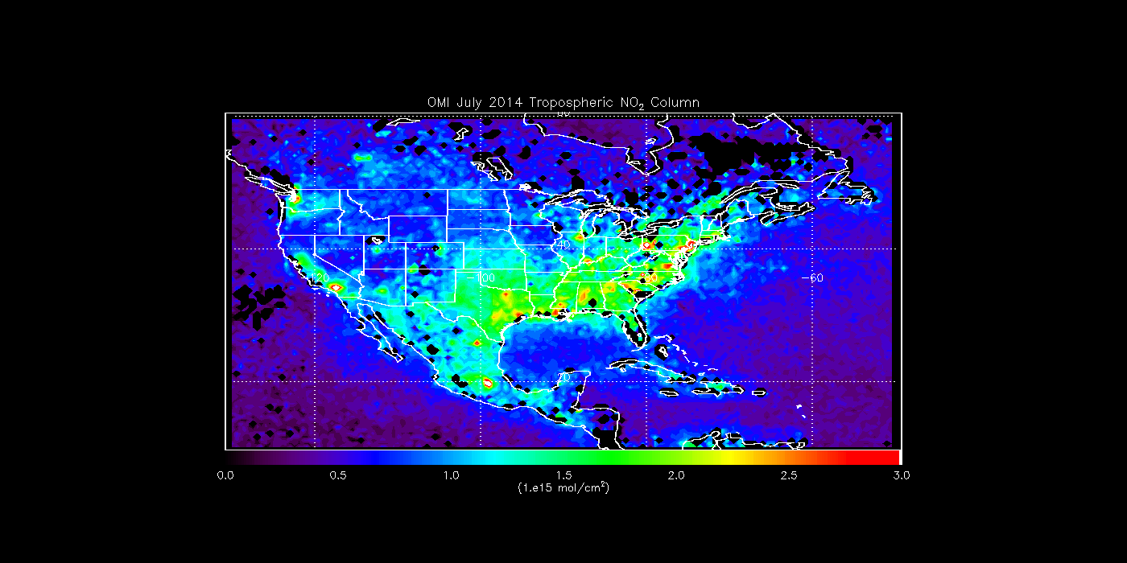
High resolution OMI NO2 retrievals for urban scale AQ monitoring using VIIRS day-night-band radiances
Objective: Use high resolution VIIRS Day-Night-Band (DNB) radiance composites to redistribute OMI tropospheric NO2 column retrievals within the OMI pixel and conduct high resolution air quality modeling/DA to assess the impact of urban NOx emissions on US Air Quality
VIIRS DNB cloud free composite from NOAA National Geophysical Data Center

Slide 20
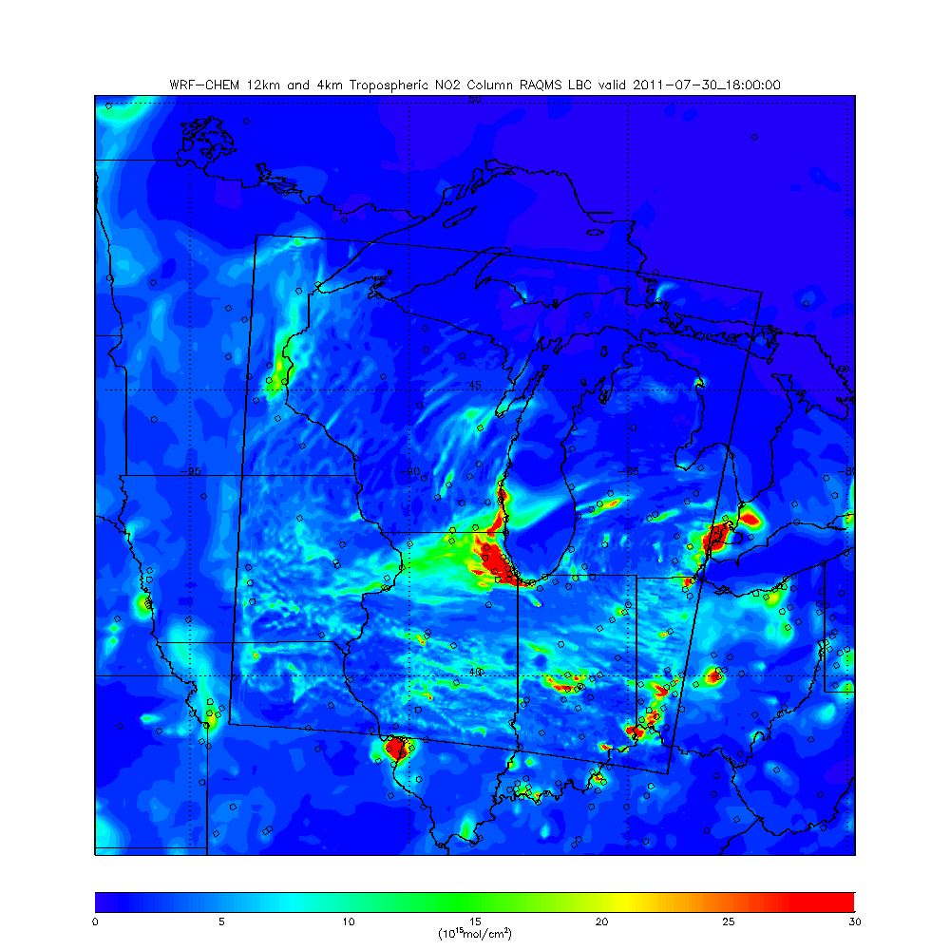
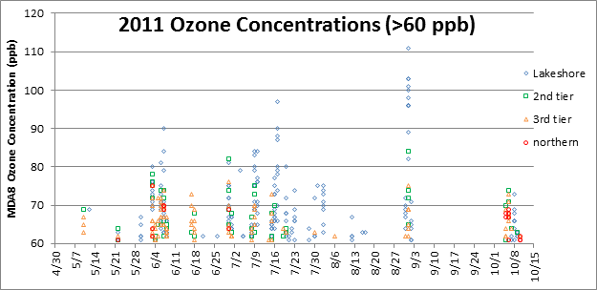
Application to
Wisconsin DNR/LADCO Lake Breeze Study (July 2011)
With Rob Kaleel (LADCO) and Angie Dickens (WDNR)
Wisconsin AIRNow surface O3 2011
12km/4km WRF-CHEM Tropospheric NO2 Column 18Z 07/30, 2011
4km WRF-CHEM Tropospheric NO2 column shows values in excess of 30x10¹⁵ mol/cm² over Chicago

Slide 21
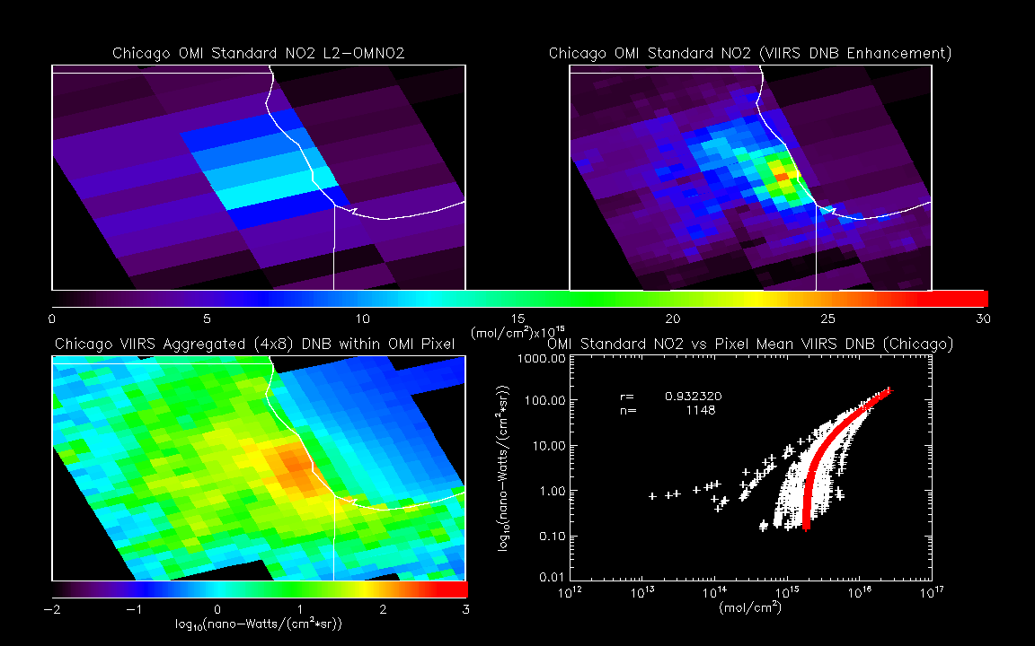
Chicago OMI Standard and Enhanced NO2 Columns
17:39Z July 30, 2011
OMI Enhanced Tropospheric NO2 column shows values in 15-25x10¹⁵ mol/cm² over Chicago

Slide 22
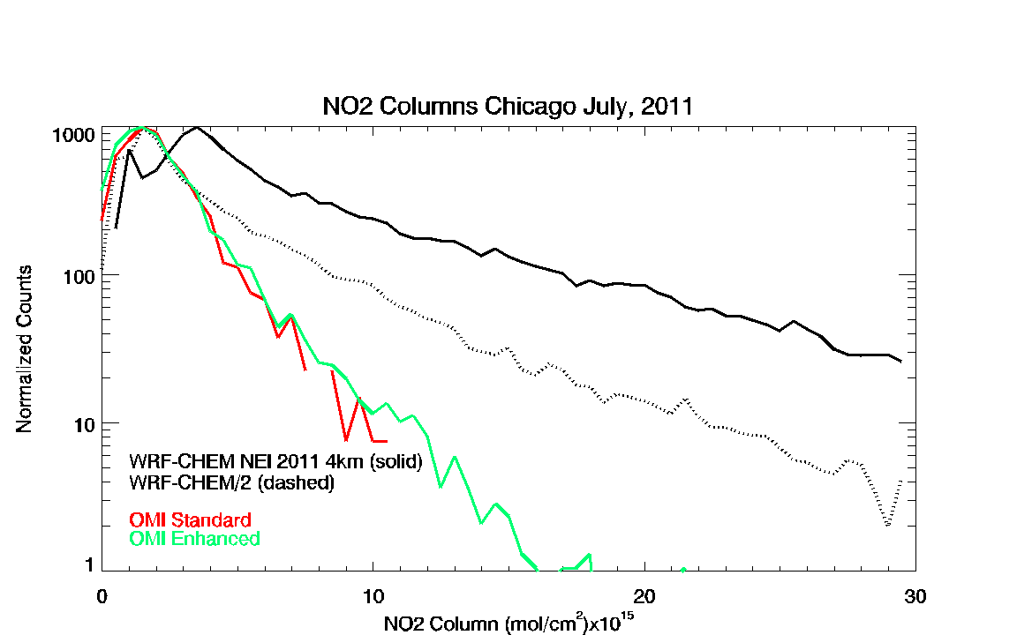
Histograms of the 4km WRF-CHEM NO2 columns (black) show median values that are 2x larger then either the OMI Enhanced retrieval (green) than the OMI Standard retrieval (red)

Slide 23
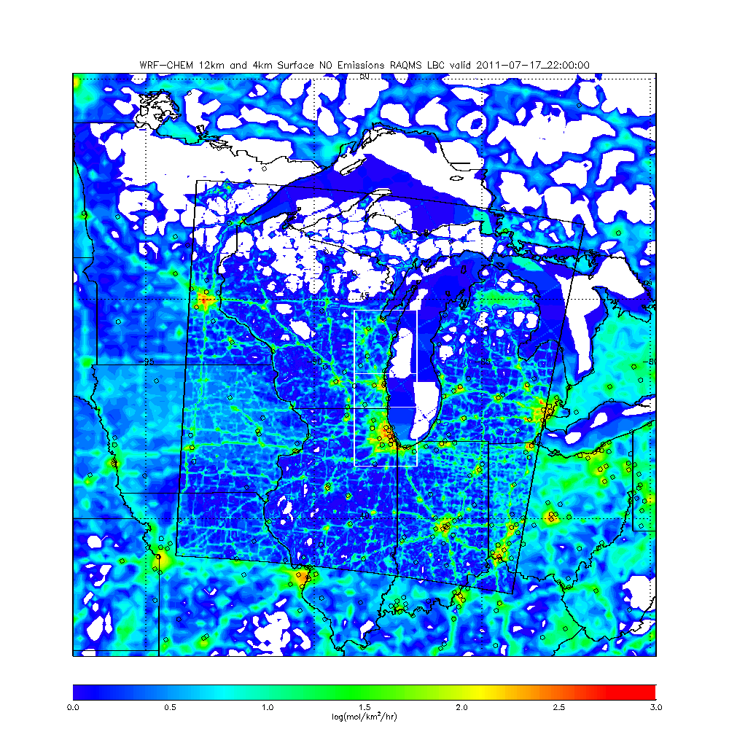
4km WRF-Chem NEI 2011 NO emission O3 sensitivity studies
July, 2011
Green Bay (GB) domain
Milwaukee (ML) domain
Chicago (CH) domain
Green Bay domain includes mobile sources long Western Lake Michigan and Fox River Valley

Slide 24
Summary of 4km WRF-Chem NEI NO emission O3 sensitivity studies for Western Lake Michigan AIRNow sites July 17-18, 2011
AIRNow vs WRF-CHEM O3
Correlation
50% reductions in Chicago (CH), Chicago & Milwaukee (CH&ML), Chicago & Milwaukee & Green Bay (CH&ML&GB) NO emissions show progressive increases in correlations and reductions in surface ozone biases during the July 17-18, 2011 ozone episode.
Bias (ppbv)

