Slide 1
Site Visit to Chiwaukee Prairie (WI) and Zion (IL) monitors
Chiwaukee Prairie
(300m inland)
Zion (1000m inland)

Slide 2
Zion (IL)
ca. 1100m W of lake

Slide 3
Zion (IL)

Slide 4
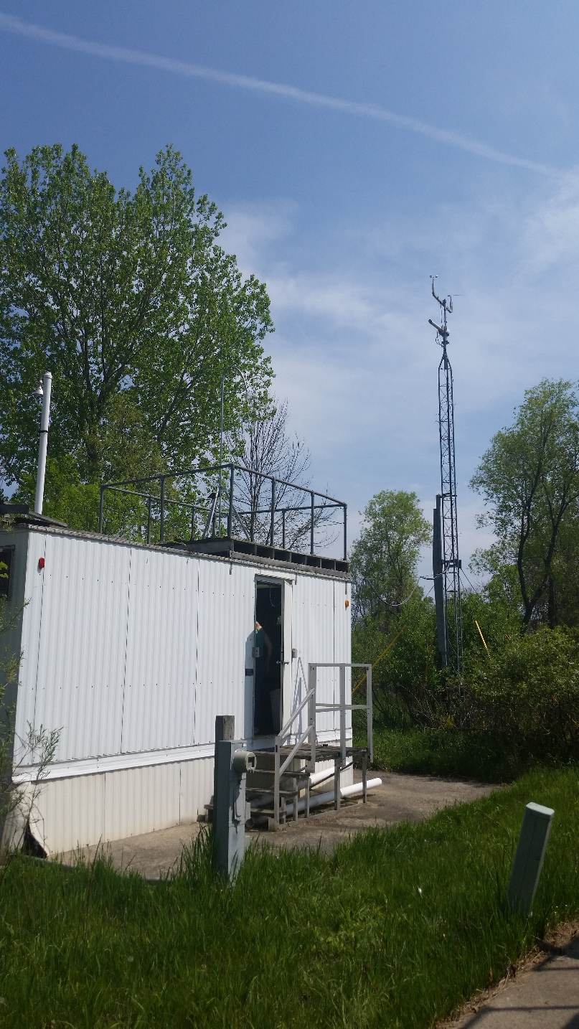
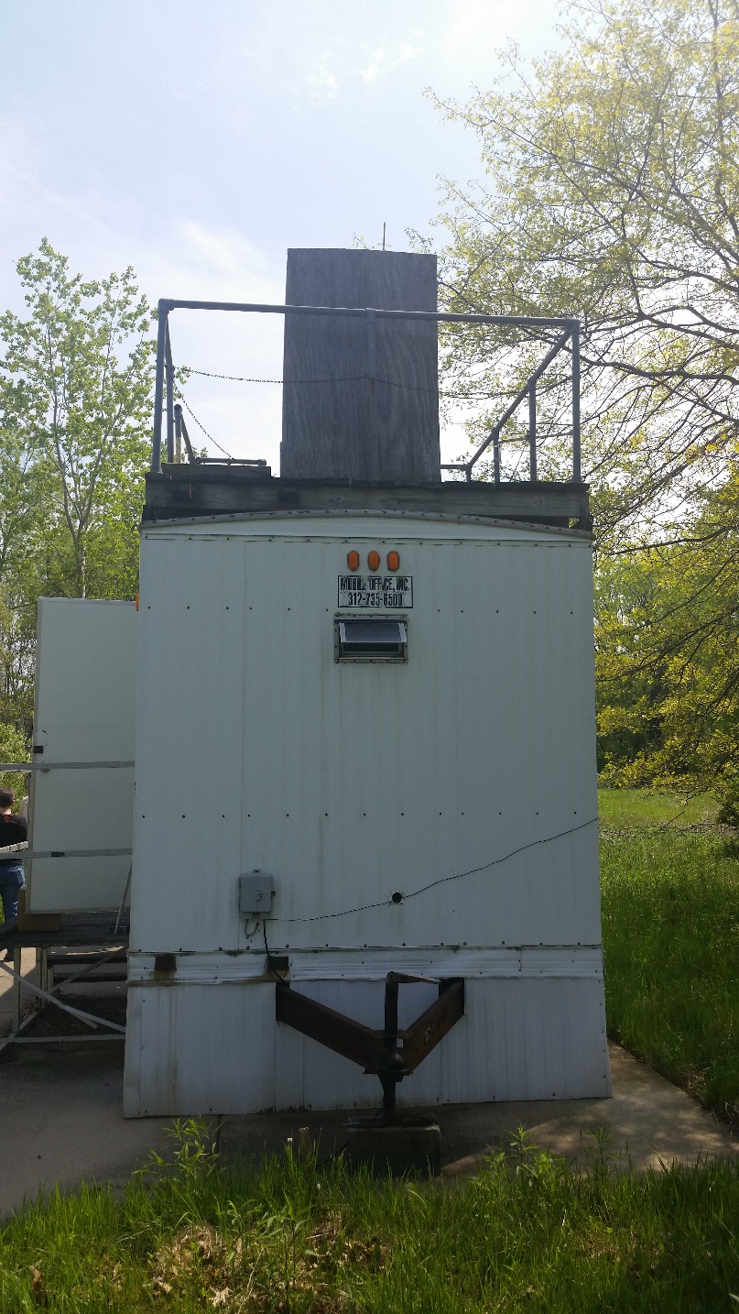
Zion (IL): Two trailers
Current O₃ location
Vacant

Slide 5
Zion (IL): Video of the site location
Video taken from roof of proposed sampling trailer

Slide 6
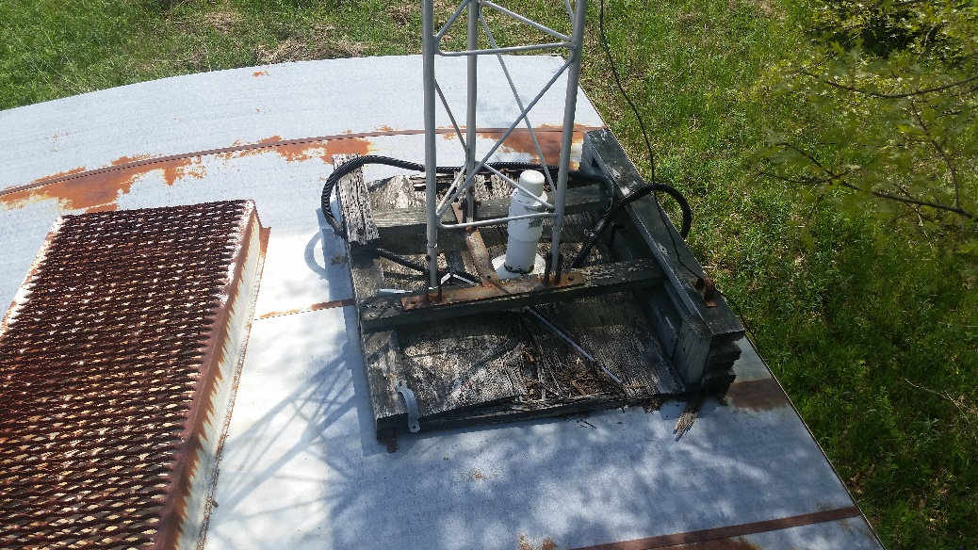
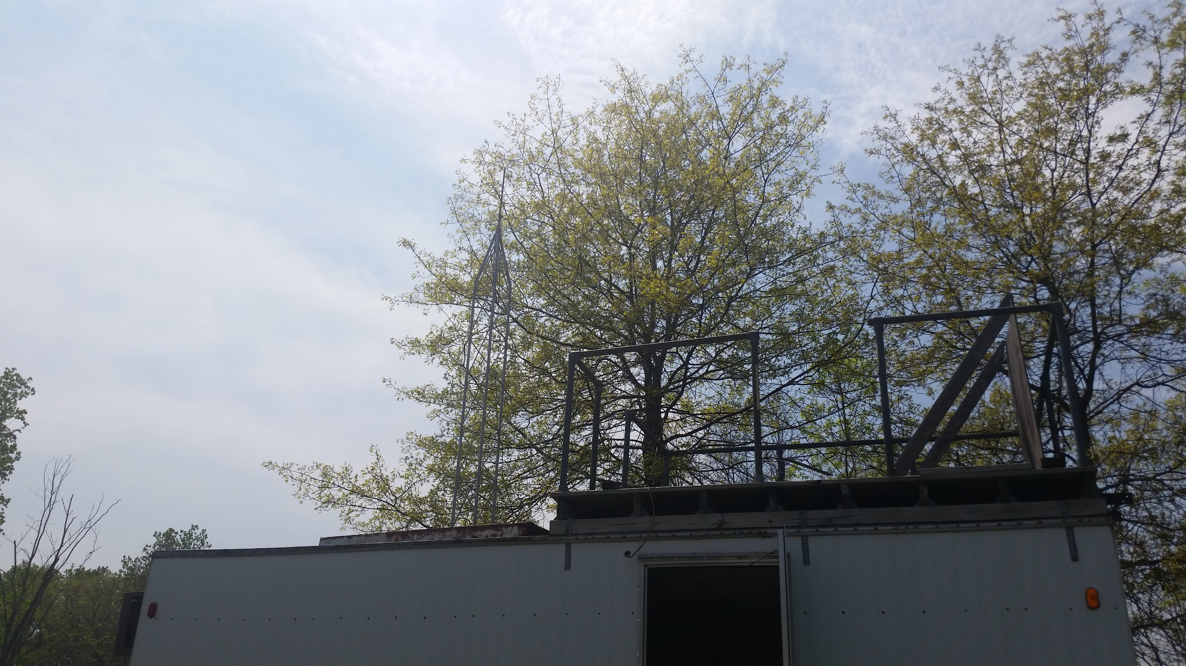
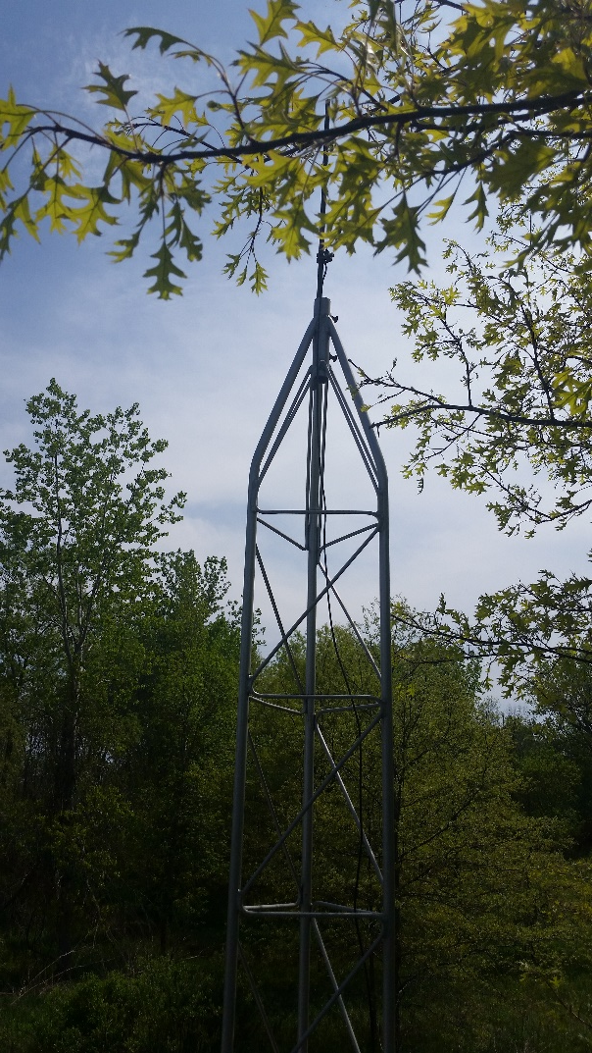
Zion (IL): Roof of vacant, proposed trailer
Tower base

Slide 7
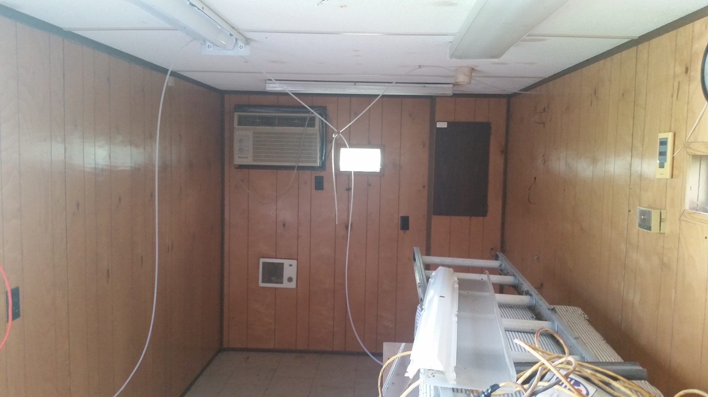
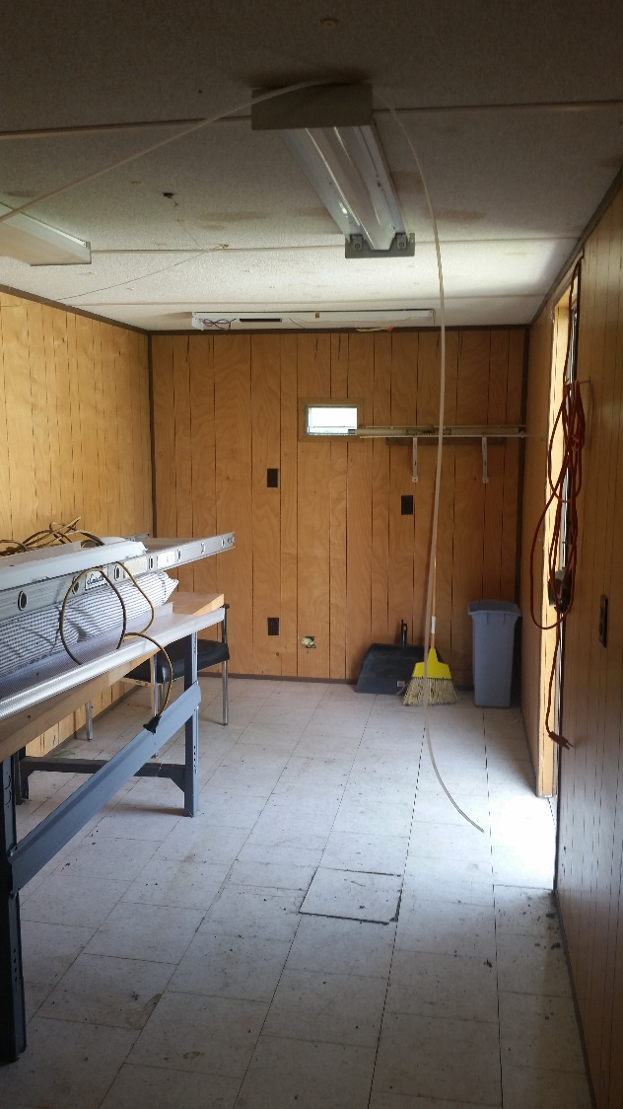
Zion (IL)

Slide 8
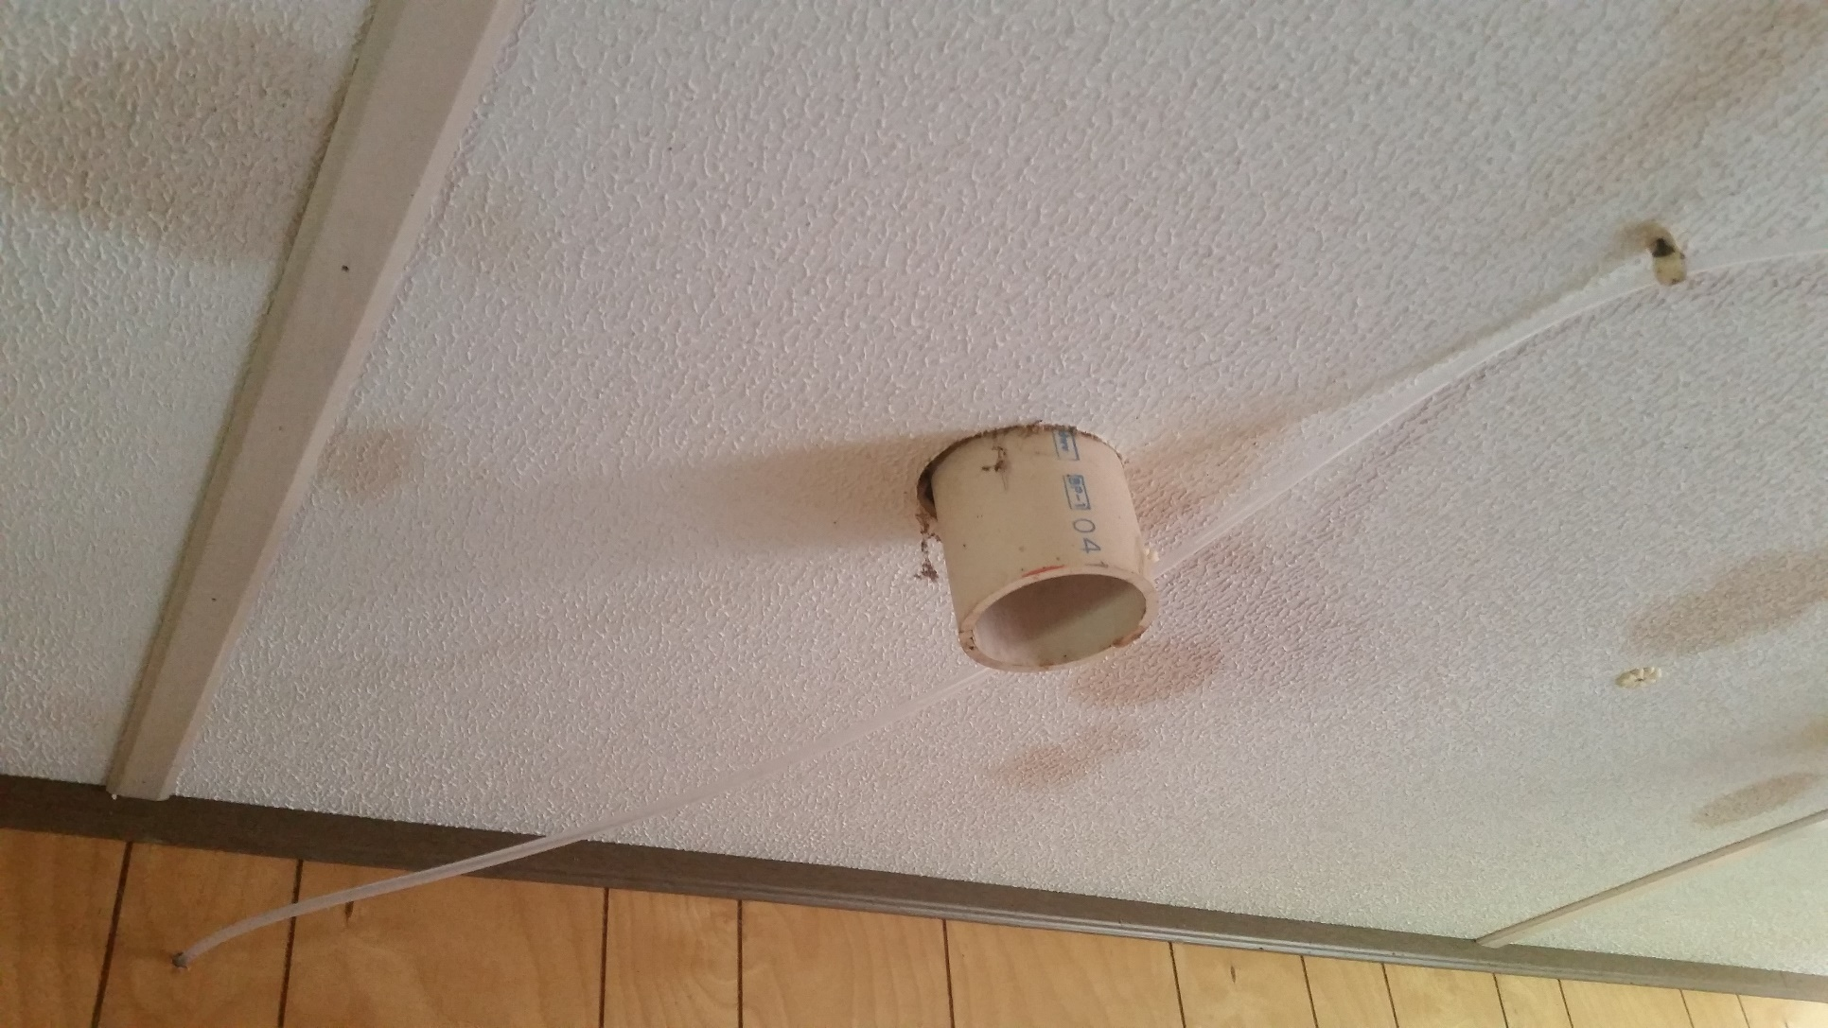
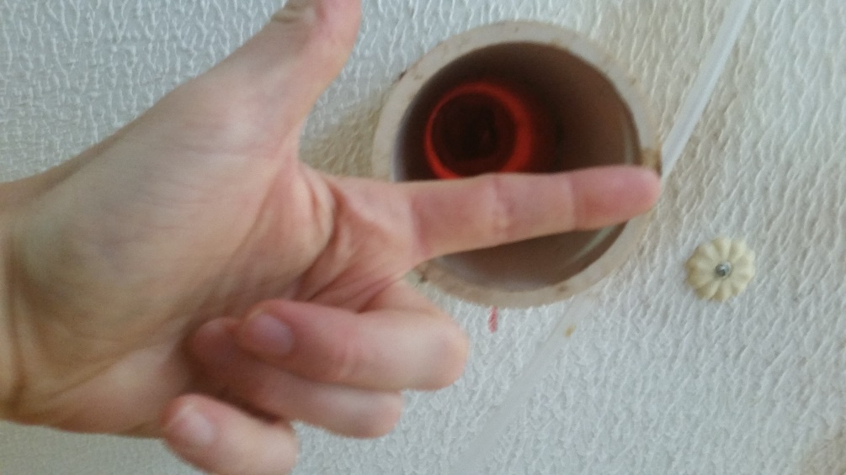
Zion (IL): Inlet manifold

Slide 9
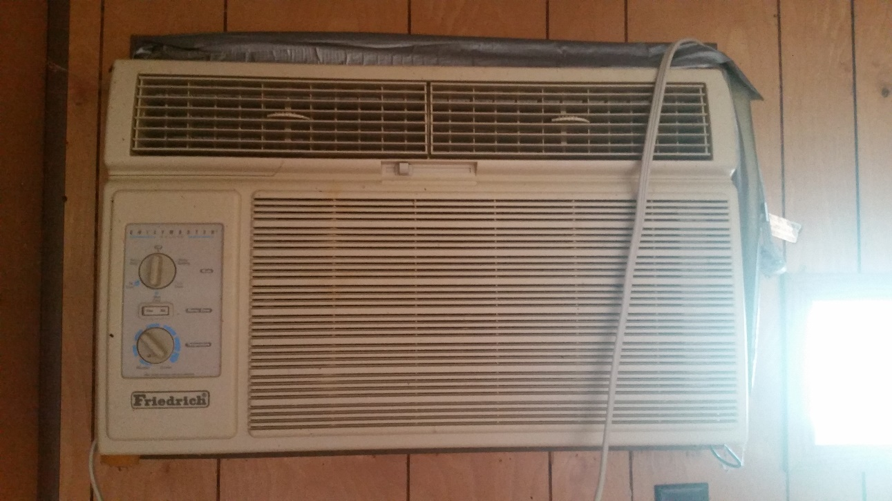
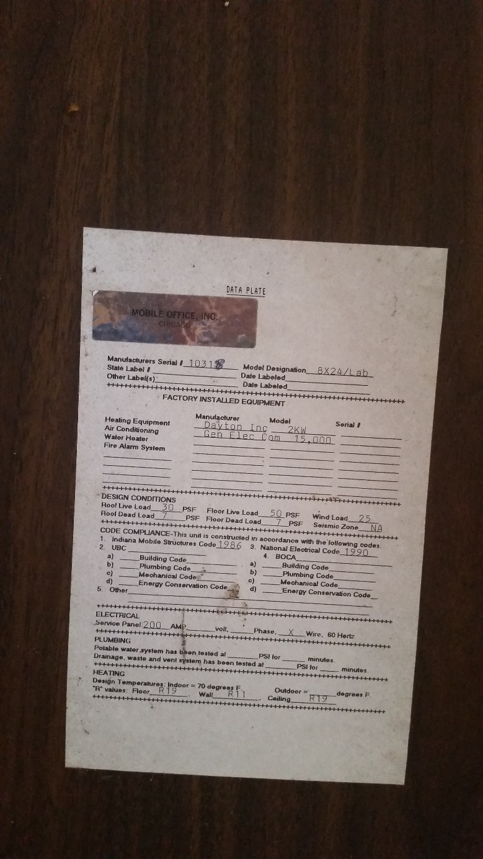
Zion (IL): Air conditioning

Slide 10
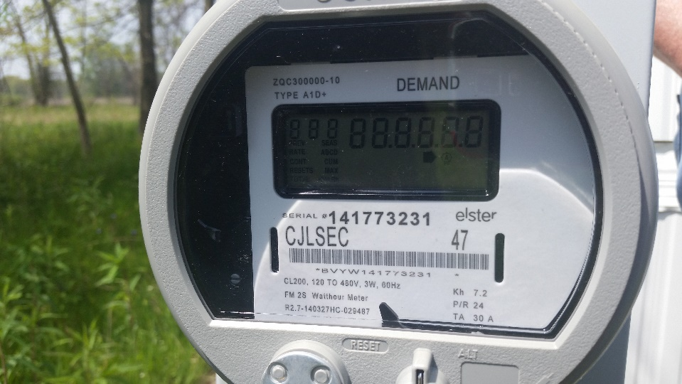
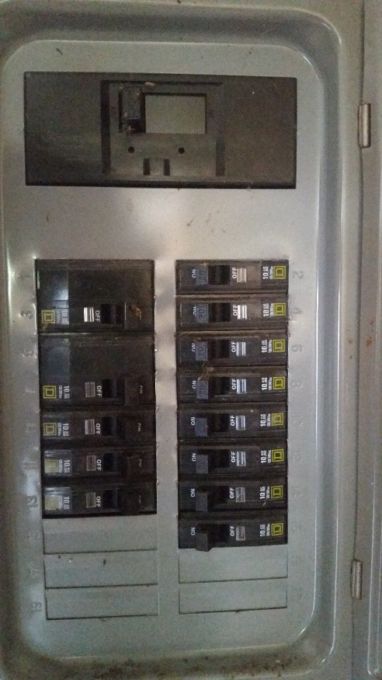
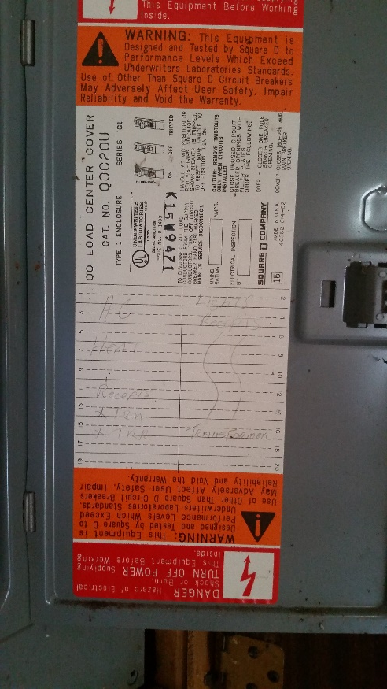
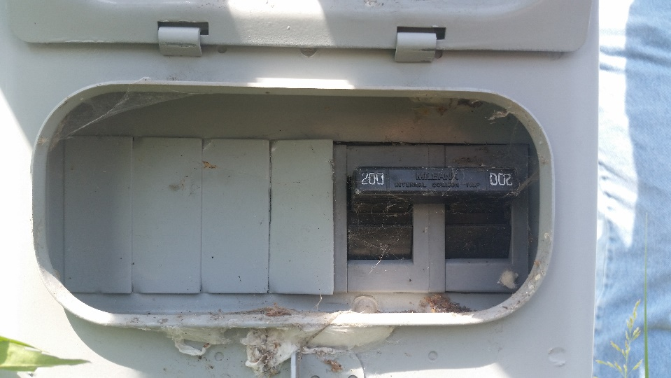
Zion (IL): Power

Slide 11
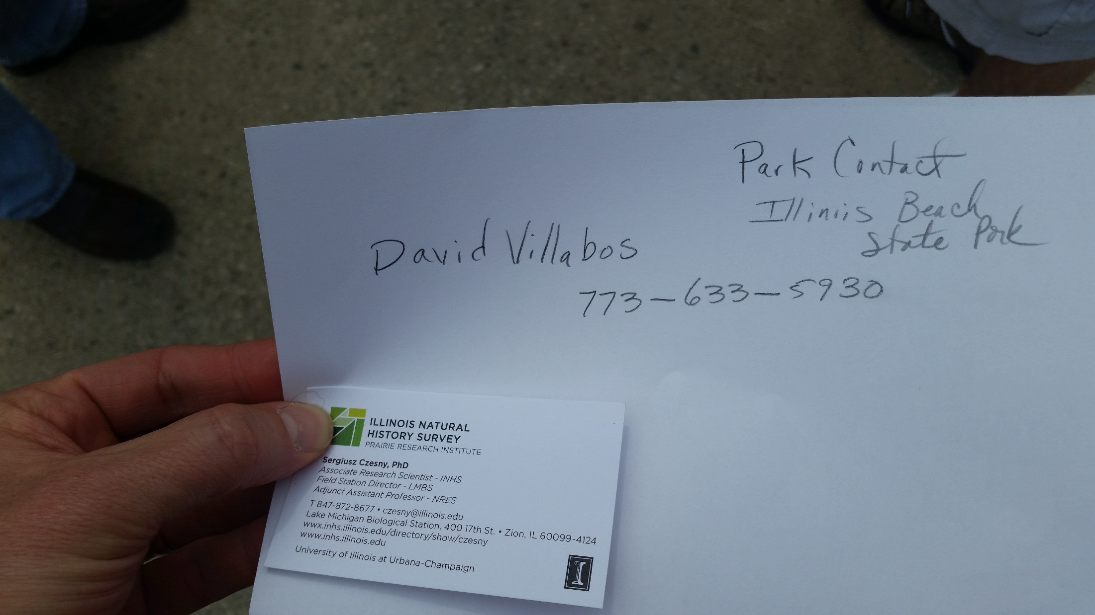
Zion (IL): Important Contact Information

Slide 12
Chiwaukee (WI)
ca. 300m W of lake

Slide 13
Chiwaukee (WI)

Slide 14
Chiwaukee (WI): Video of site (we could not enter it)

Slide 15
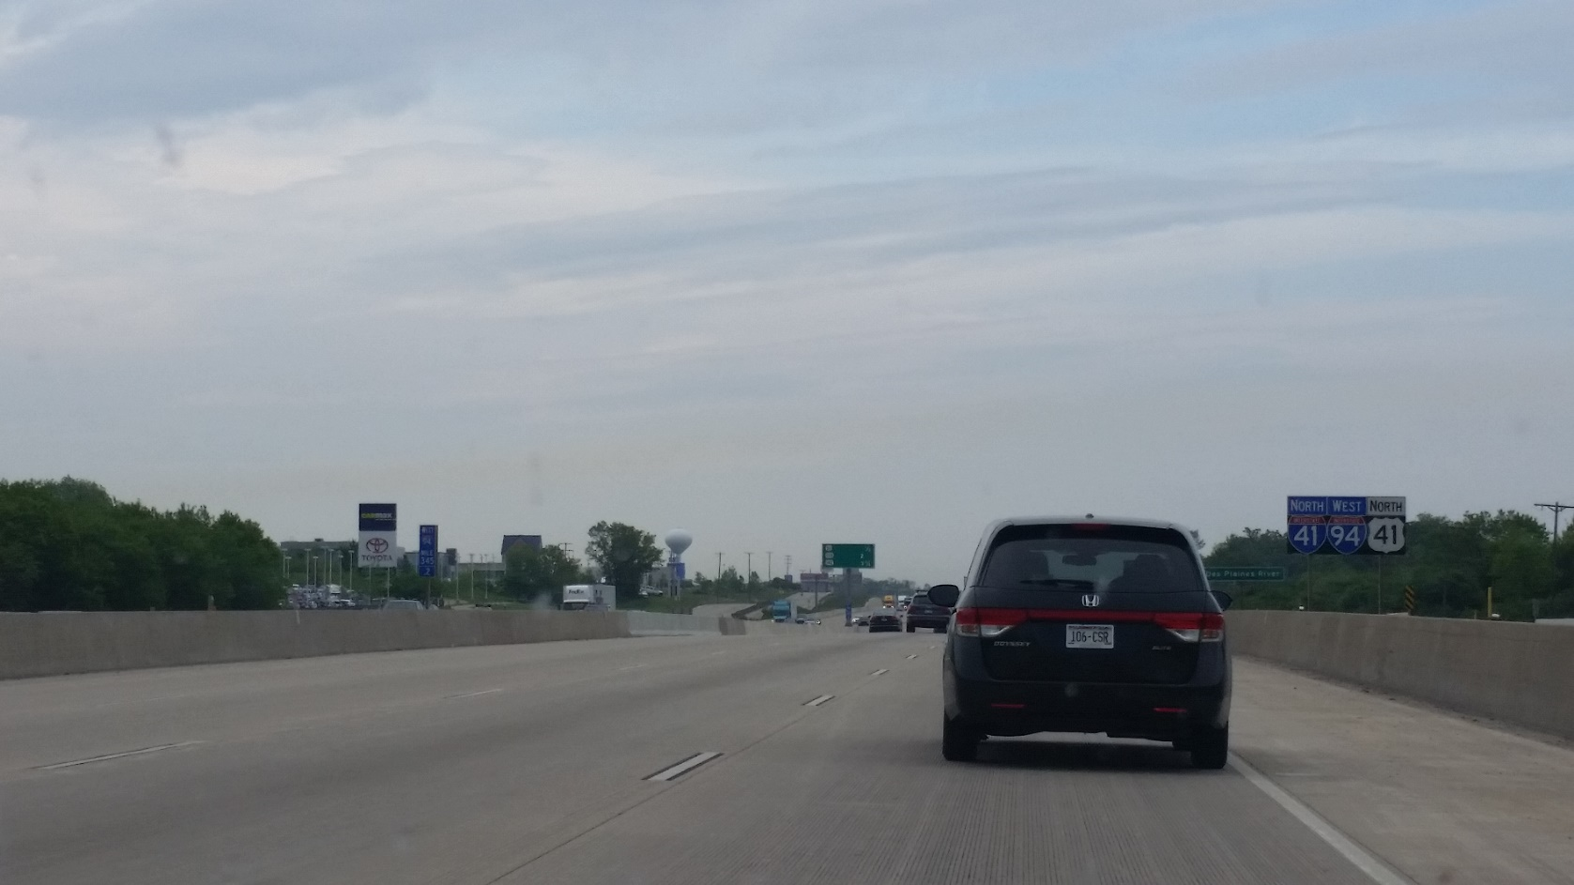
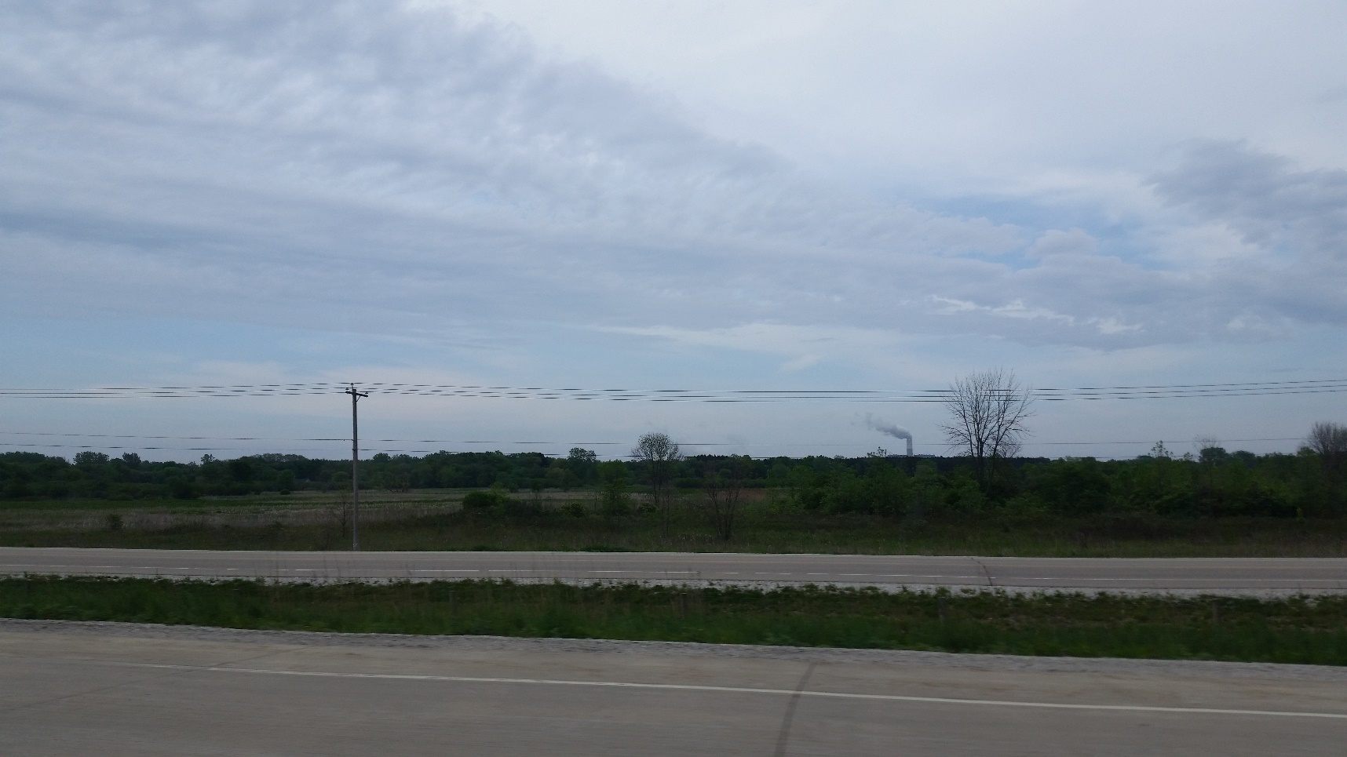
Interesting layer observed outside of Kenosha
(pleasant prairie power plant)

