Slide 1
2017 Lake Michigan Ozone Study (LMOS)
Brad Pierce
NOAA/NESDIS/STAR
Sheboygan County Chamber of Commerce First Friday Forum, Sheboygan WI, August 3, 2018

Slide 2
2017 Lake Michigan Ozone Study (LMOS)
What are the potential outcomes/benefits of LMOS 2017?
LMOS 2017 measurements provide critical observations for evaluating a new generation of air quality models attempting to better simulate ozone episodes in the region. Over the long term, the information collected is expected to result in:
Improved modeled ozone forecasts for this region, which states and EPA use to meet state and federal Clean Air Act requirements.
Better understanding of the lakeshore gradient in ozone concentrations, which could influence how EPA addresses future regional ozone issues.
Improved knowledge of how emissions influence ozone formation in the region.
What institutions are involved in LMOS 2017?
Researcher institutions: NOAA, NASA, U.S. EPA, University of Wisconsin, University of Iowa, University of Minnesota, University of Northern Iowa, University of Maryland Baltimore County, Scientific Aviation.
Air quality management agencies: Lake Michigan Air Directors Consortium (LADCO), Wisconsin DNR, Illinois EPA, Indiana DEM.
Nonprofit organizations: Electric Power Research Institute (EPRI)
Commercial Services: Scientific Aviation

Slide 3
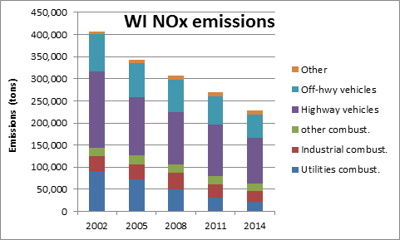
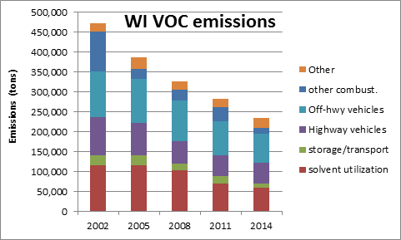
Wisconsin emissions are declining and ozone is improving
NOx= NO+NO2 (nitrogen oxides) VOC=Volatile Organic Compounds, both are ozone precursors
Provided by Angie Dickens (WDNR)
and Donna Kenski (LADCO)

Slide 4
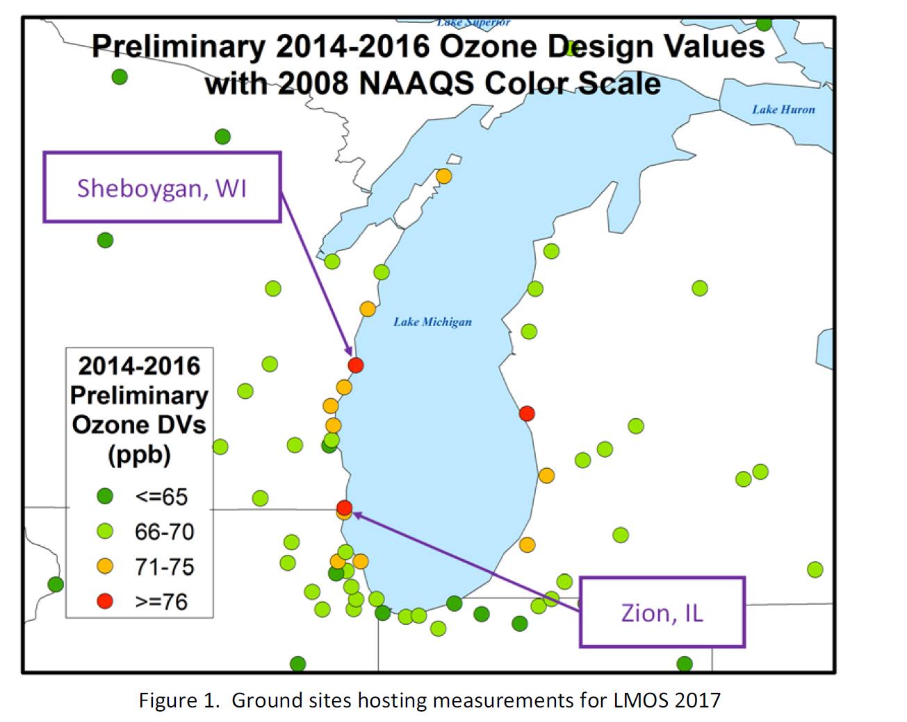
But there are still coastal sites which are above the new ozone standard (70ppbv)
Anticipated new non-attainment areas with new, lower ozone standard and persistent exceedances of the old (2008) ozone standard.
Impact of high ozone on public health in high density urban areas (Chicago, Milwaukee).
2017 Lake Michigan Ozone Study White Paper: http://www.ladco.org/

Slide 5
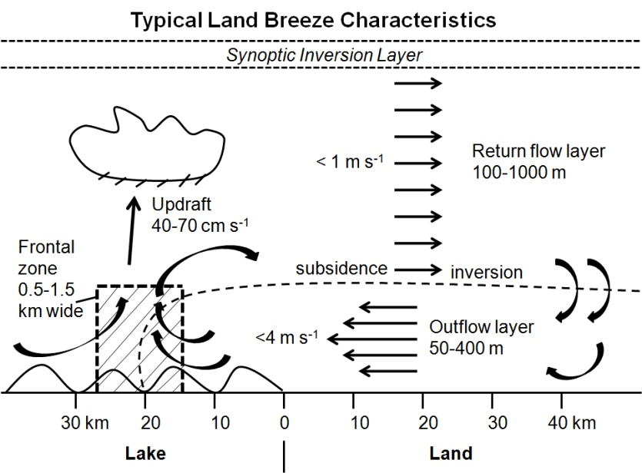
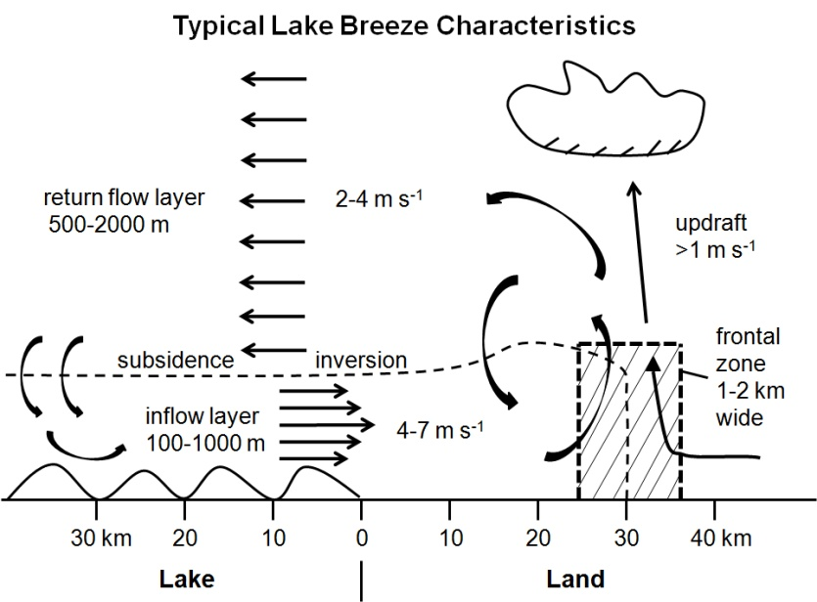
Lake Michigan and Ozone Formation
Land breeze blows ozone precursor compounds from rush hour over lake.
The boundary layer height is low due to cold water chilling the air above.
The pollutants are concentrated near the surface where ozone forms.
An afternoon lake breeze transports the ozone back onto land.
White Paper: http://www.ladco.org/

Slide 6
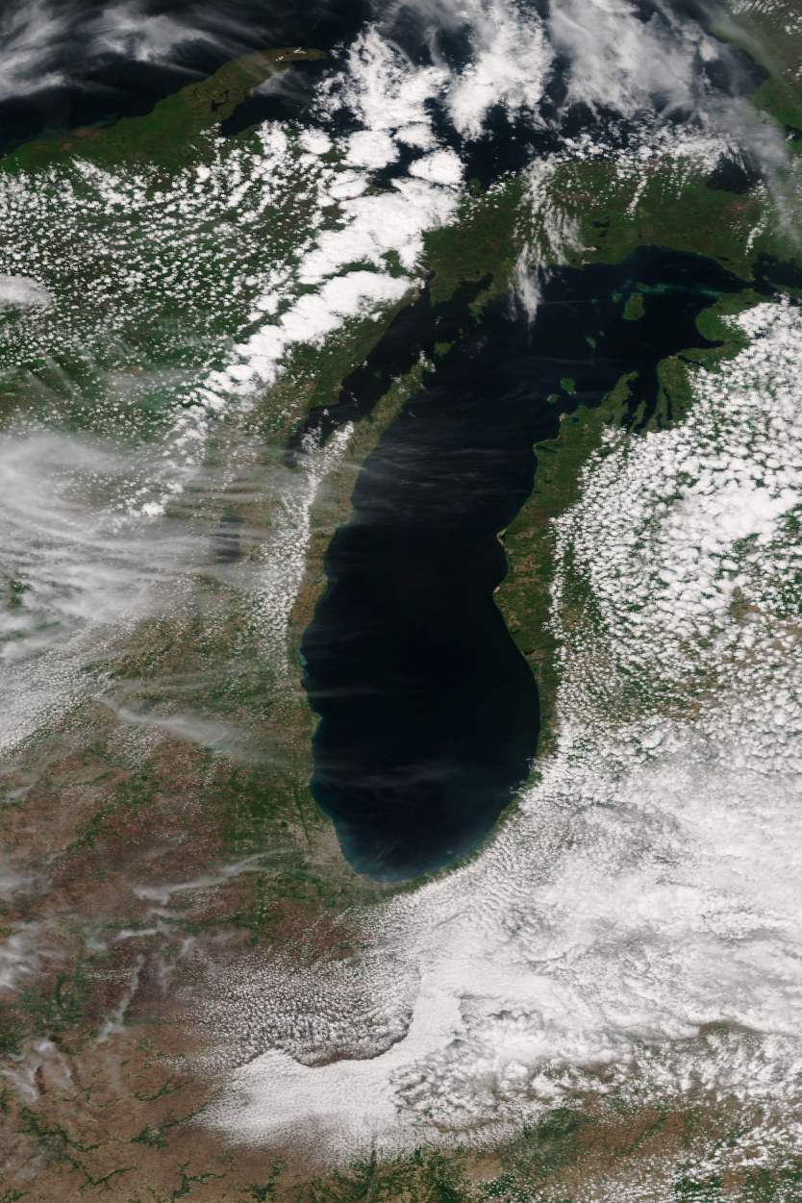
VIIRS Image May 27, 2011
Satellite image of Lake Michigan showing
Lake Breeze Front

Slide 7
VIIRS Image May 27, 2011
Lake Breeze
Front
Satellite image of Lake Michigan showing
Lake Breeze Front
Prevailing winds

Slide 8
Summary of measurements made during the LMOS 2017 field campaign
Location | Measurement* | Research Institution*
Ground Sites
Spaceport Sheboygan | Remote sensing of meteorology (SPARC Trailer) | UW-Madison -SSEC
 | In situ measurements of pollutants | U.S. EPA ORD
Zion, IL | Remote sensing of meteorology (Sodar/MW Radiometer) | Univ. Northern Iowa
 | Detailed in situ chemical measurements | Univ. Iowa, UW-Madison, Univ. Minnesota
 | Routine measurements of ozone | Illinois EPA
Various† | Remote sensing of pollutants and boundary layer height | U.S. EPA ORD
Sheboygan transect | In situ measurements of ozone at four locations | U.S. EPA ORD
Airborne Platforms
Lakeshore region | Airborne remote sensing of NO₂ (GeoTASO) | NASA
 | Airborne remote sensing of clouds (AirHARP) | Univ. Maryland, Baltimore County
 | Airborne in situ profiling of pollutants and meteorology | Scientific Aviation
Shipboard Platform
Lake Michigan | In situ measurements of pollutants | U.S. EPA ORD
 | Remote sensing of pollutants and boundary later height | U.S. EPA ORD
Mobile Platforms
Northeast IL and Southeast WI | In situ measurements of pollutants (GMAP) | U.S. EPA Region 5
Grafton to Sheboygan | In situ measurements of ozone and meteorology | UW-Eau Claire
GeoTASO = Geostationary Trace gas and Aerosol Sensor Optimization instrument
AirHARP = Airborne Hyper Angular Rainbow Polarimeter
GMAP = Geospatial Mapping of Pollutants
† These measurements were made at Spaceport Sheboygan, Zion, two Wisconsin DNR monitoring locations (Grafton and Milwaukee SER) and one Illinois EPA monitoring location (Schiller Park).

Slide 9
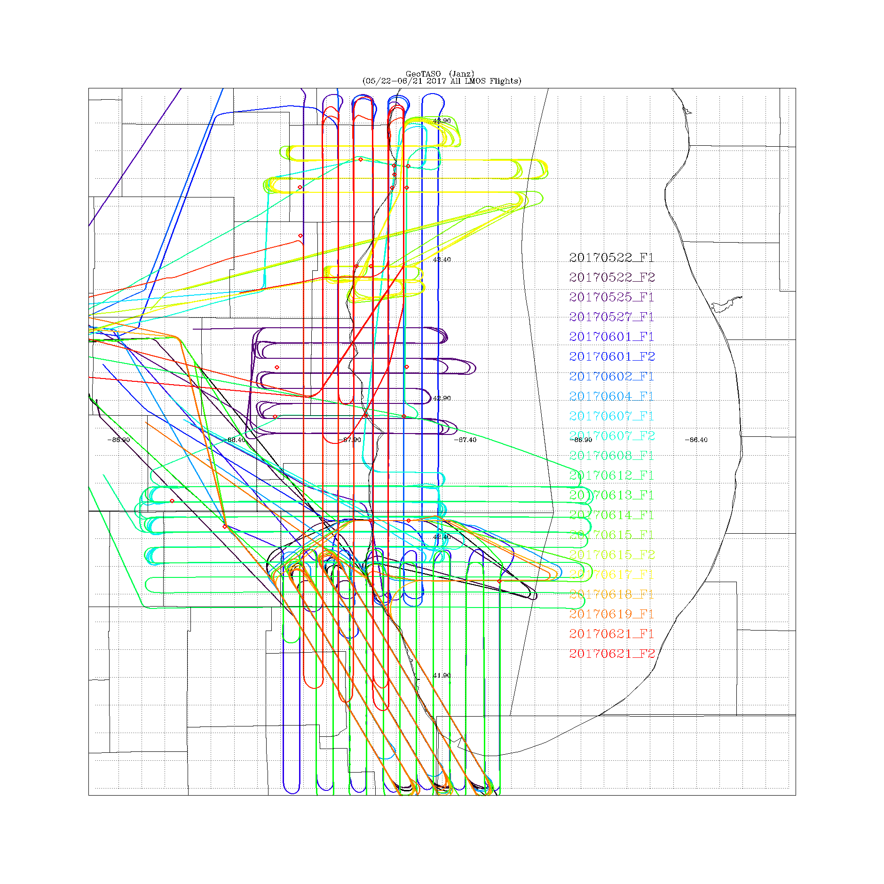
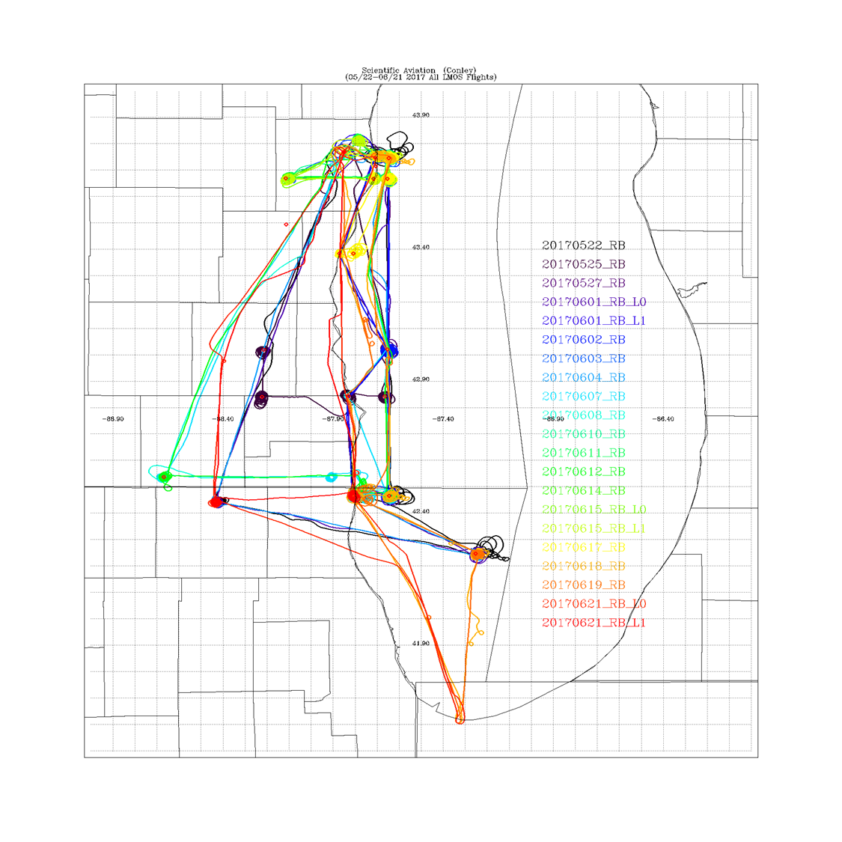
LMOS 2017 Aircraft Measurements
NASA GeoTASO remote sensing Flights
Scientific Aviation insitu sampling Flights
GeoTASO (Geostationary Trace gas and Aerosol Sensor Optimization) is an airborne hyperspectral mapping instrument that is being used as an airborne testbed for future high-resolution trace-gas observations from geostationary sensors such as TEMPO
The Electric Power Research Institute (EPRI) provided funding for Scientific Aviation Flights during LMOS

Slide 10
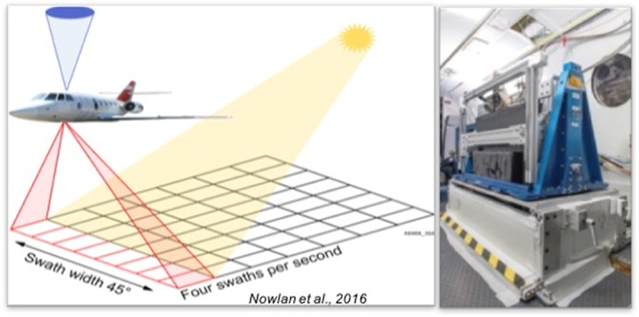
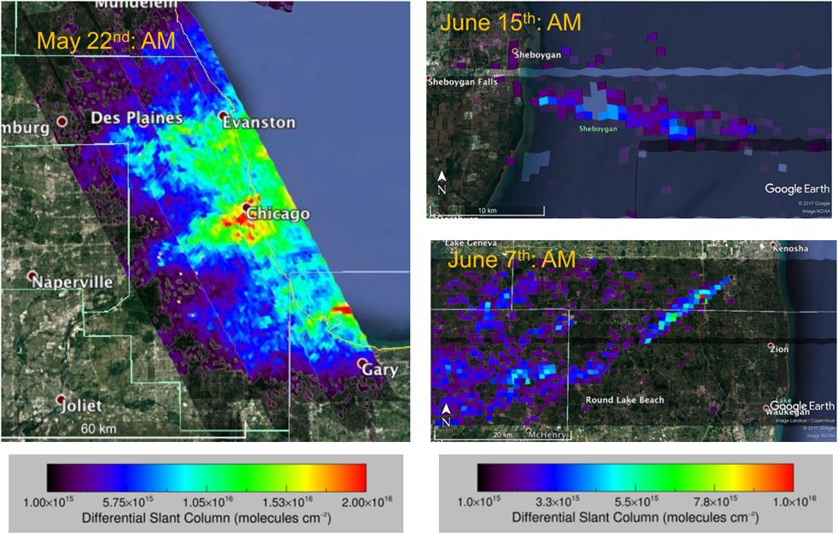
NASA GeoTASO remote sensing Flights
NO₂ differential slant columns (DSCs) were retrieved from GeoTASO spectra via Differential Optical Absorption Spectroscopy (DOAS).
The DOAS technique provides a column amount relative to a reference scene, which ideally is unpolluted and cloud-free.

Slide 11
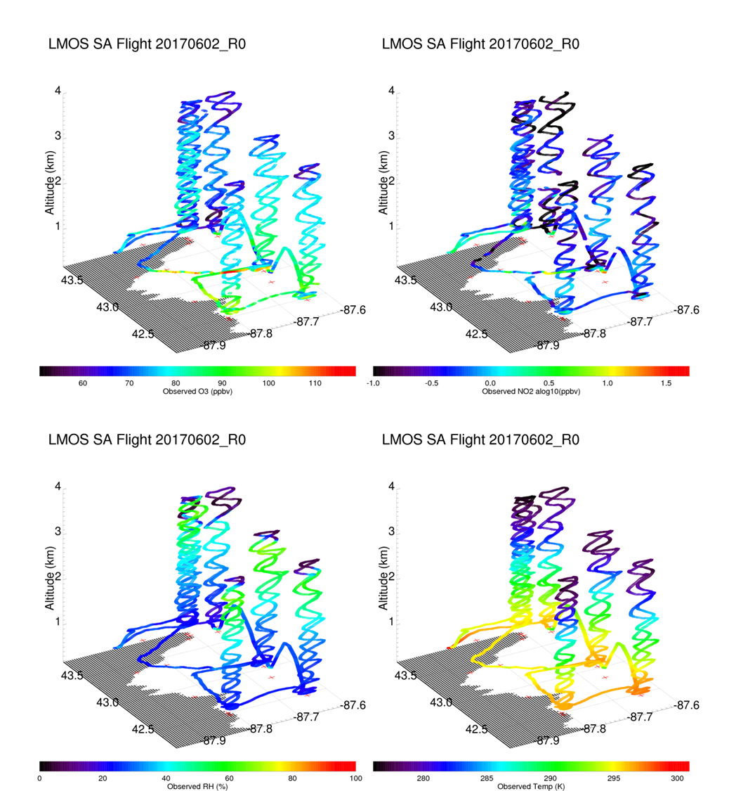
Scientific Aviation in situ profiling Flights
Scientific Aviation (SA) was contracted by the Electric Power Research Institute (EPRI) to participate in LMOS 2017 with airborne in situ profiling of O₃, NO₂, CO₂, CH₄, altitude, T, RH, winds, and pressure.
SA flights provided vertical profiles over and offshore from selected ground sites (Sheboygan and Zion), offshore profiles east of Milwaukee and Chicago.

Slide 12
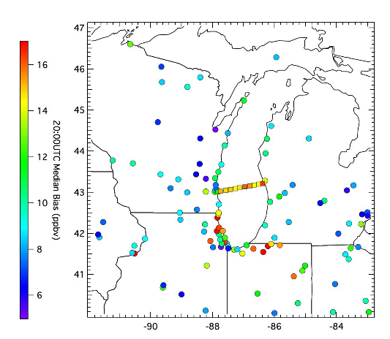
NOAA National Weather Service (NWS) Air Quality Forecast
NWS air quality forecasts were evaluated during LMOS 2017
NWS operational air quality forecasts use the North American Model (NAM) meteorology to drive the EPA Community Multiscale Air Quality Model (CMAQ) to perform twice daily forecasts of air quality over the continental US (http://airquality.weather.gov/)
2008 to 2010 NWS NAM-CMAQ model bias for air quality EPA station monitors (circles) and Lake Express ferry (boxes) (From Cleary et al, 2015)
Cleary et al., 2015, Ozone distributions over southern Lake Michigan: comparisons between ferry-based observations, shoreline-based DOAS observations and model forecasts Atmos. Chem. Phys. (doi:10.5194/acp-15-5109-2015)

Slide 13
NAM-CMAQ Comparison with Sheboygan KA Monitor during LMOS 2017
Observations at Sheboygan KA monitor show that the highest ozone (>60ppbv) is associated with the prevailing SW winds
NAM-CMAQ underestimates the frequency of the prevailing southerly winds and overestimates the frequency of westerly winds at Sheboygan KA
NAM-CMAQ forecasts consistently underestimates ozone mixing ratios with nearly 88% of the NAM-CMAQ ozone forecasts predicting less than 40 ppbv at Sheboygan KA

Slide 14
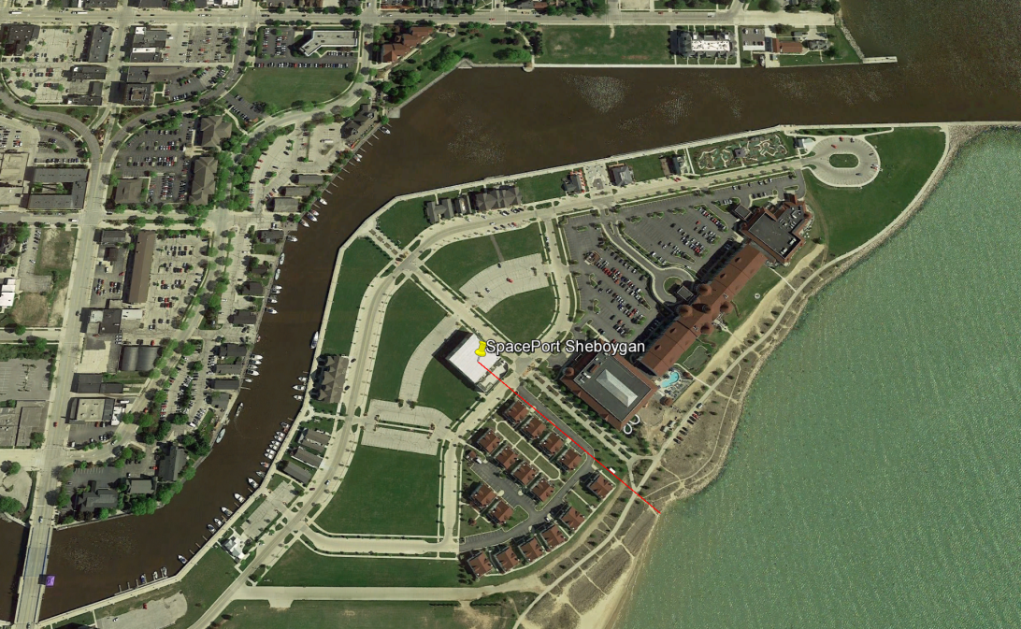
Location of the LMOS EPA measurements in Sheboygan, WI
220m

Slide 15
Summary of EPA Measurements at Sheboygan, WI, during LMOS 2017
Measurement | Measurement Principle | Model/Manufacturer | Time Resolution | Relevant Reference
O₃ | Scrubberless Ultraviolet Photometric (SL-UV) | 2B Technology M211* | 10-seconds | EQOA-0514-215
 | Ultraviolet Photometric | 2B Personnel Ozone Monitors | 1-minute | EQOA–0815–227.
NO/NO₂/NOx | Cavity attenuated phase shift spectroscopy (CAPS) | Teledyne T500U* | 10-seconds | EQNA-0514-212
 | O₃ Chemiluminescence with Molybdenum converter | Teledyne T200U | 10-seconds | RFNA-1194-099
NOy | O₃ Chemiluminescence with external Molybdenum converter at 10m | Teledyne T200U | 10-seconds | NA
HCHO | Quantum Cascade Laster (1765 cm-1) | Aerodyne Research* | 1- seconds | Herndon et al., 2007
O₃/NO₂/HCHO column densities | Sun-sky radiances 280-525nm | NASA Goddard Pandora Spectrometer | Total columns every 80-s | Herman et al., 2009
*WS, WD, T, RH, BP, Prec. | Various | Vaisala WXT520 with ultrasonic wind sensors

Slide 16
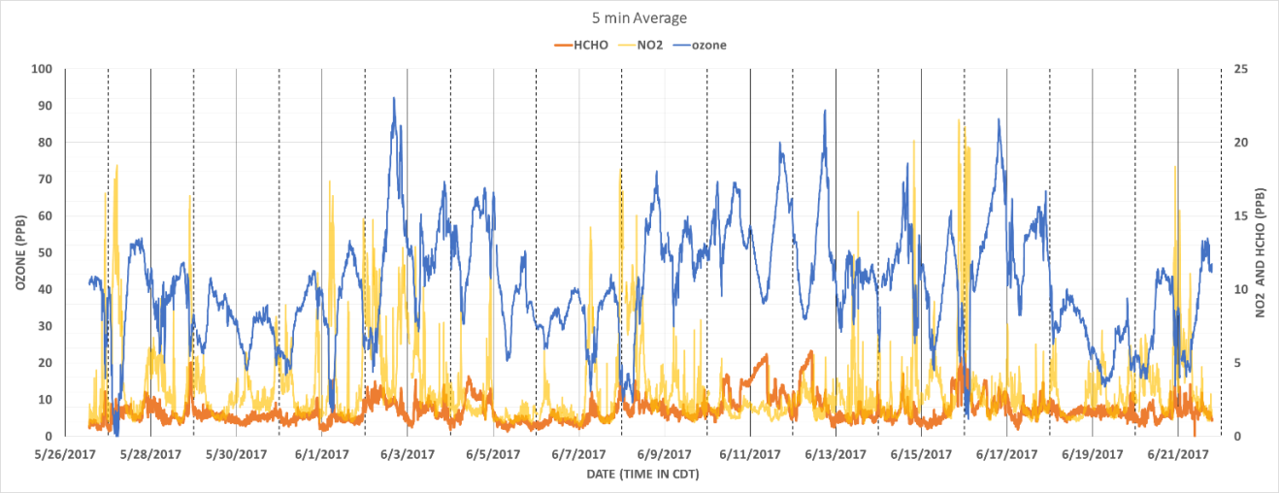
Time series of O3, NO2 and HCHO measurements at Spaceport Sheboygan
Formaldehyde (HCHO) and nitrogen dioxide (NO2) serve to indicate the chemical regime for ozone formation (i.e., NOx limited and volatile organic compound (VOC) limited) at Sheboygan.
(Jim Szykman, EPA)

Slide 17
Time series of O3, NO2 and HCHO measurements at Spaceport Sheboygan
Likely influence of power plant plumes
Formaldehyde (HCHO) and nitrogen dioxide (NO2) serve to indicate the chemical regime for ozone formation (i.e., NOx limited and volatile organic compound (VOC) limited) at Sheboygan.
(Jim Szykman, EPA)

Slide 18
Time series of O3, NO2 and HCHO measurements at Spaceport Sheboygan
Ozone Exceedance Day: June 02, 2017 (wind and temperature profiles)
Formaldehyde (HCHO) and nitrogen dioxide (NO2) serve to indicate the chemical regime for ozone formation (i.e., NOx limited and volatile organic compound (VOC) limited) at Sheboygan.
(Tim Wagner, UW-Madison/SSEC)

Slide 19
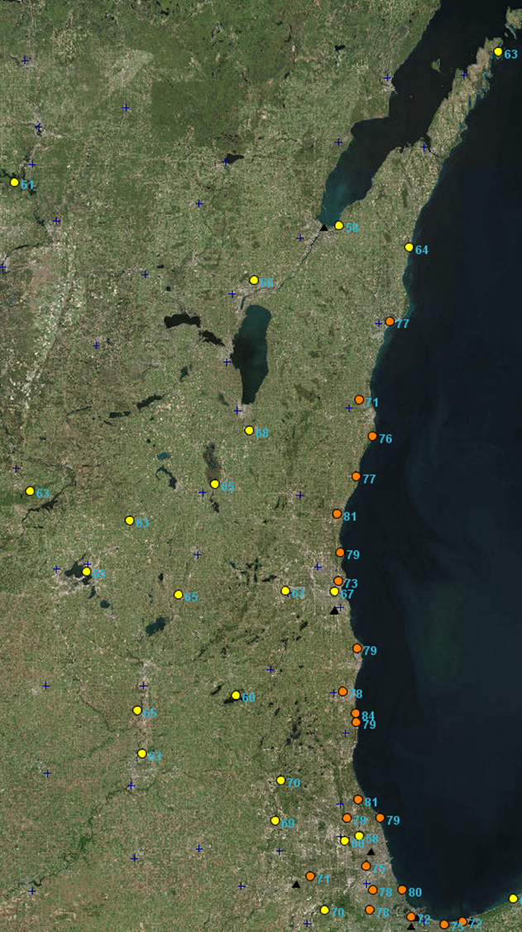
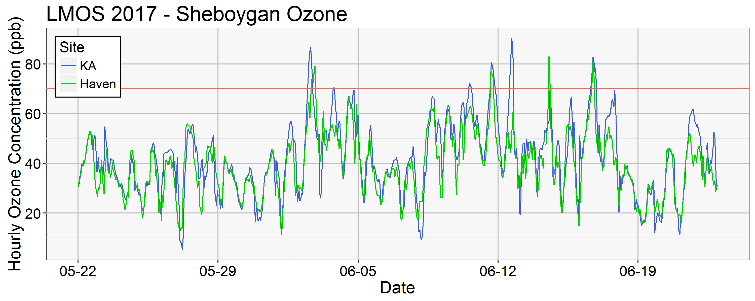
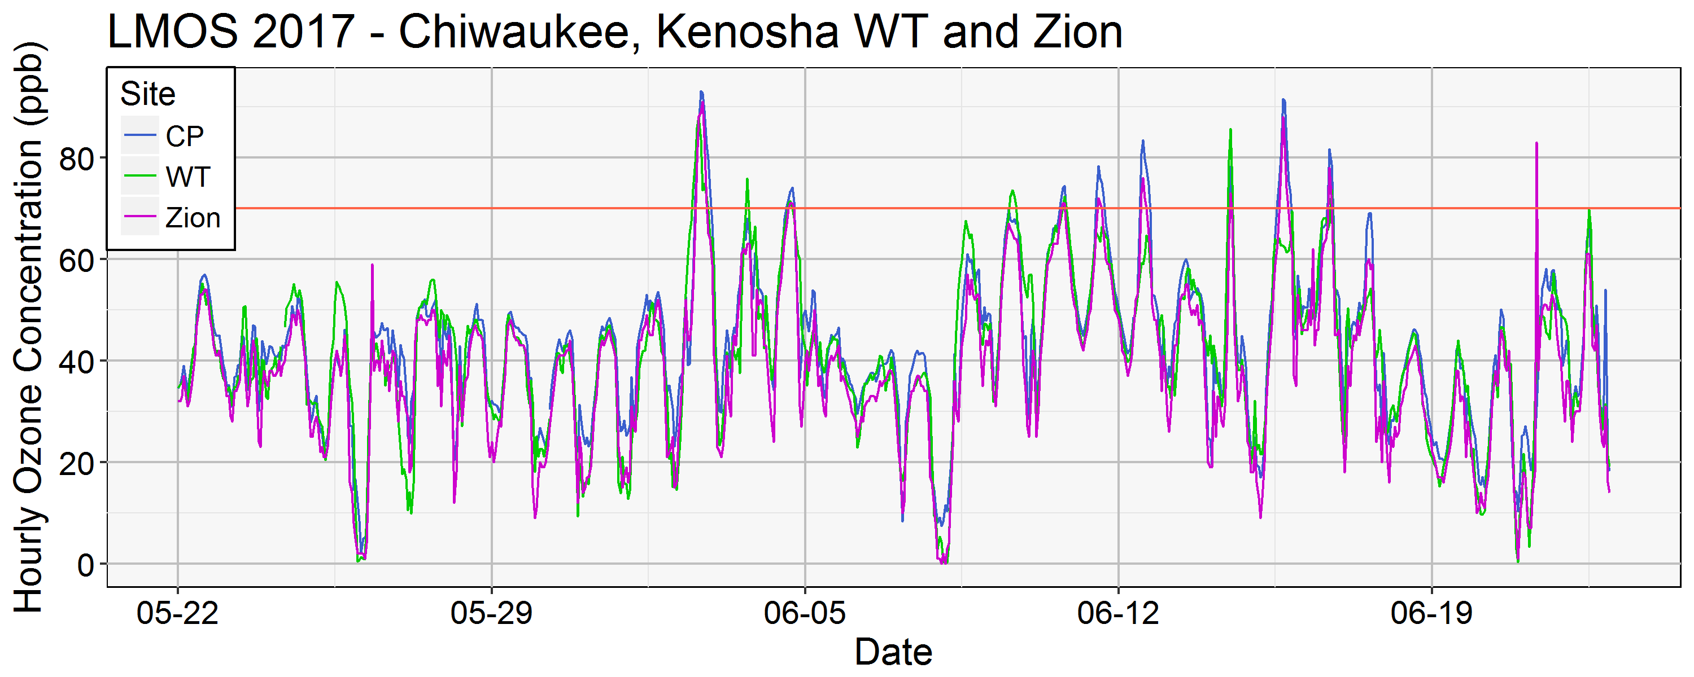
Lakeshore ozone during LMOS 2017
June 02, 2017 MDA8
June 02, 2018
June 02, 2018
(Angie Dickens , WDNR)
MDA8=Maximum Daily 8 hour Average

Slide 20
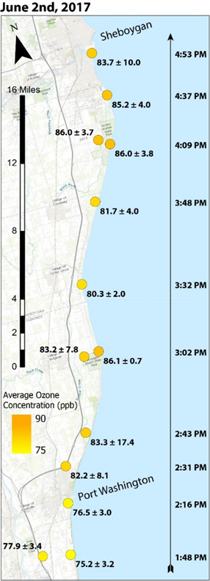
Along shore O3 gradients
June 02, 2017 MDA8
Kohler-Andrae Dunes
Harrington Beach Park
Grafton
UW-Eau Claire automobile platform ozone measurements show increasing coastal ozone concentrations through the afternoon of June 2, 2017
(Patricia Cleary, UW-Eau Claire)
MDA8=Maximum Daily 8 hour Average

Slide 21
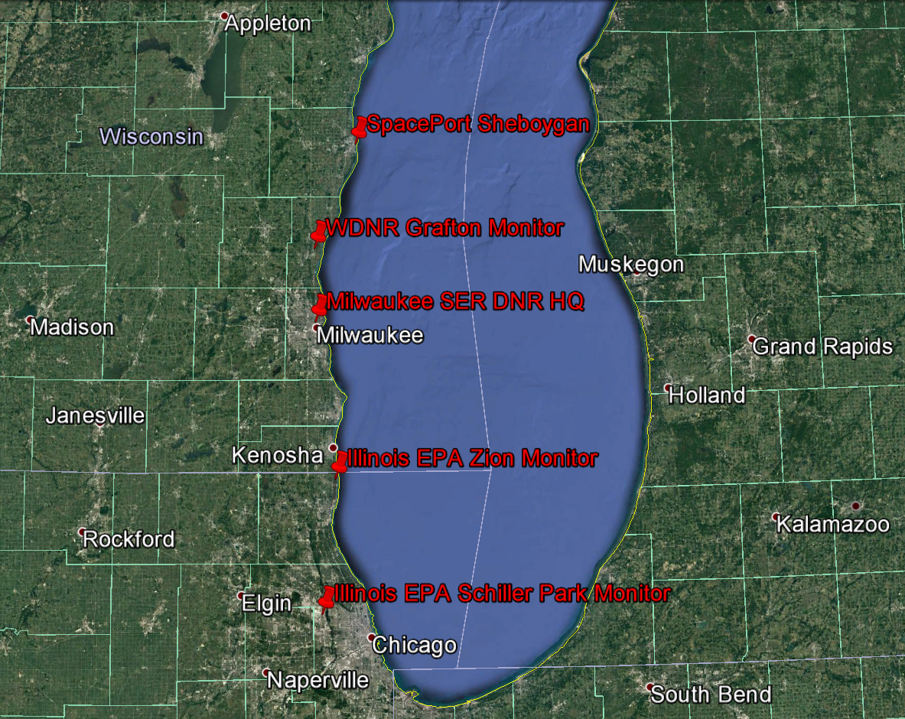
Ground based UV/visible grating spectrometers (Pandoras) column NO2 measurements during LMOS 2017
Pandora NO2 column measurements show high values at Zion, Grafton, and Sheboygan on June 2, 2017
(Luke Valin, EPA)

Slide 22
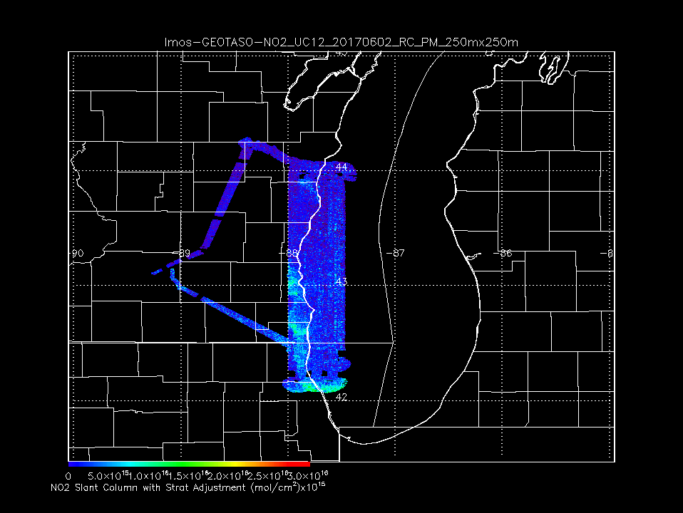
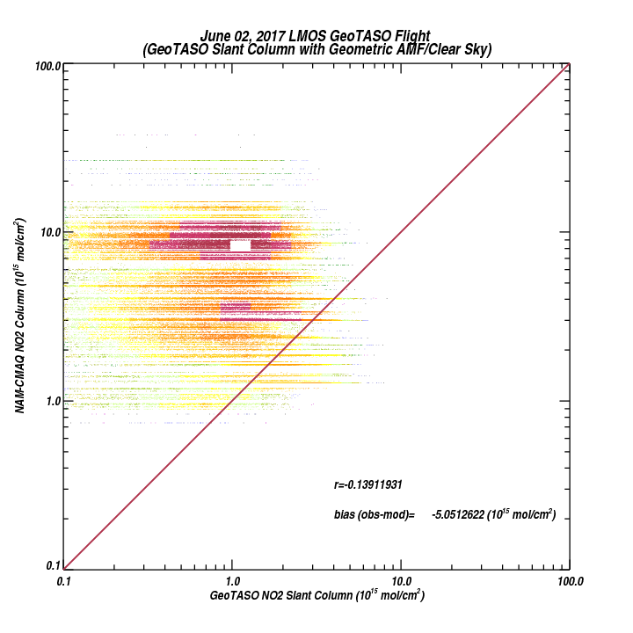
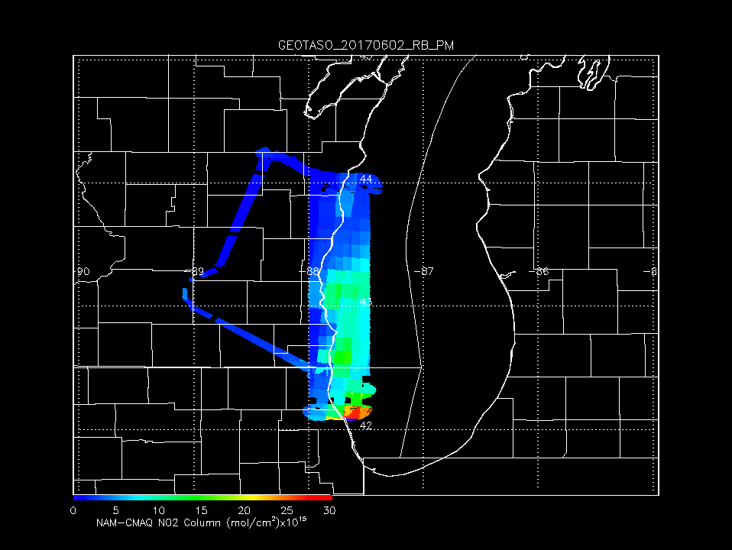
GeoTASO NO2 Slant Column June 02, 2017
GeoTASO Coastal Survey Flight
June 02, 2017
NWS NAM-CMAQ significantly overestimates observed NO2 column
NAM-CMAQ NO2 Column June 02, 2017

Slide 23
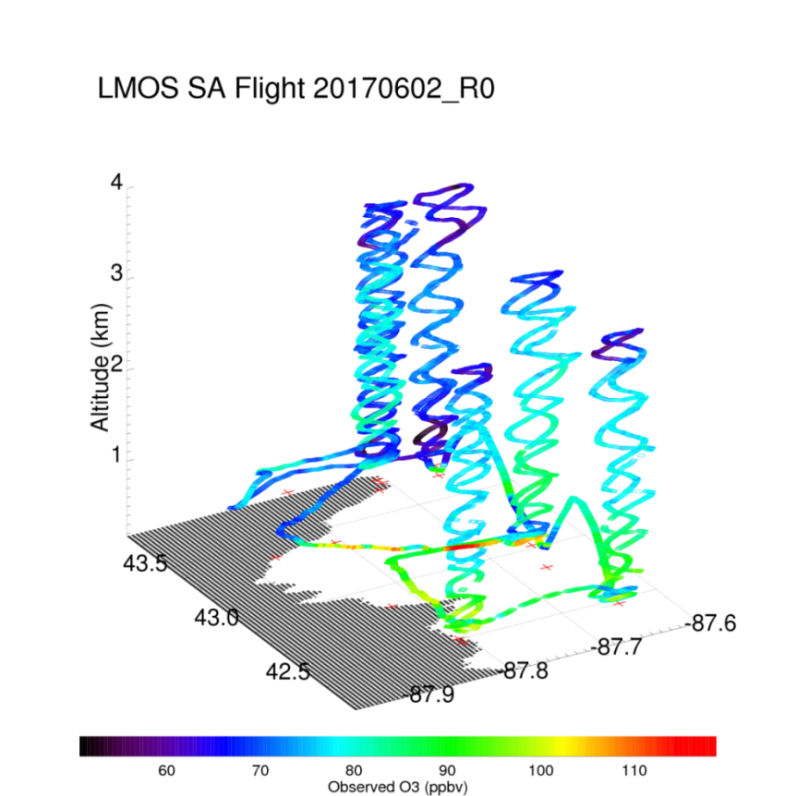
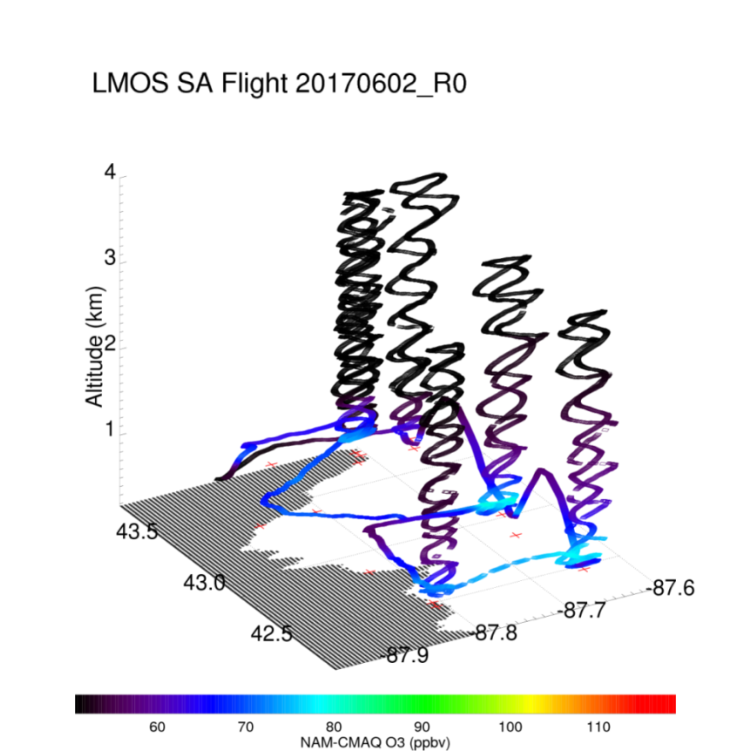
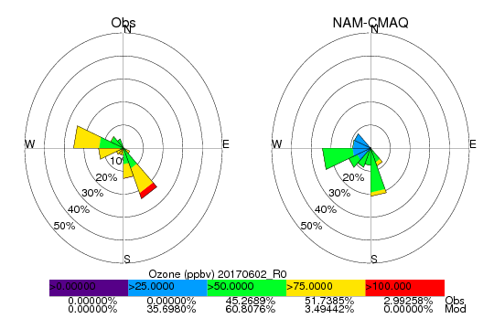
Coastal Ozone Exceedance Day
NWS NAM-CMAQ significantly underestimates ozone concentrations within the marine boundary layer
Max Observed O3 > 110ppbv
Max NAM-CMAQ O3 < 80ppbv

Slide 24
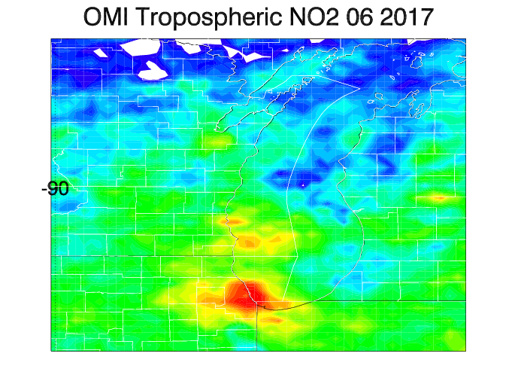
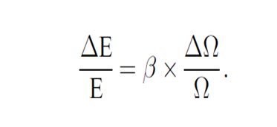
Aura Ozone Monitoring Instrument (OMI) Tropospheric NO2 column Data Assimilation
OMI Tropospheric NO2 column during June 2017
NOx emissions adjustments (ΔE) are constrained using OMI tropospheric NO2 column analysis increments (ΔΩ)
β accounts for the sensitivity of the NO2 column to changes in NOx emissions following Lamsal et al 2011.
Lamsal, L. N., et al. (2011), Application of satellite observations for timely updates to global anthropogenic NOx emission inventories, Geophys. Res. Lett., 38, L05810, doi:10.1029/2010GL046476.

Slide 25
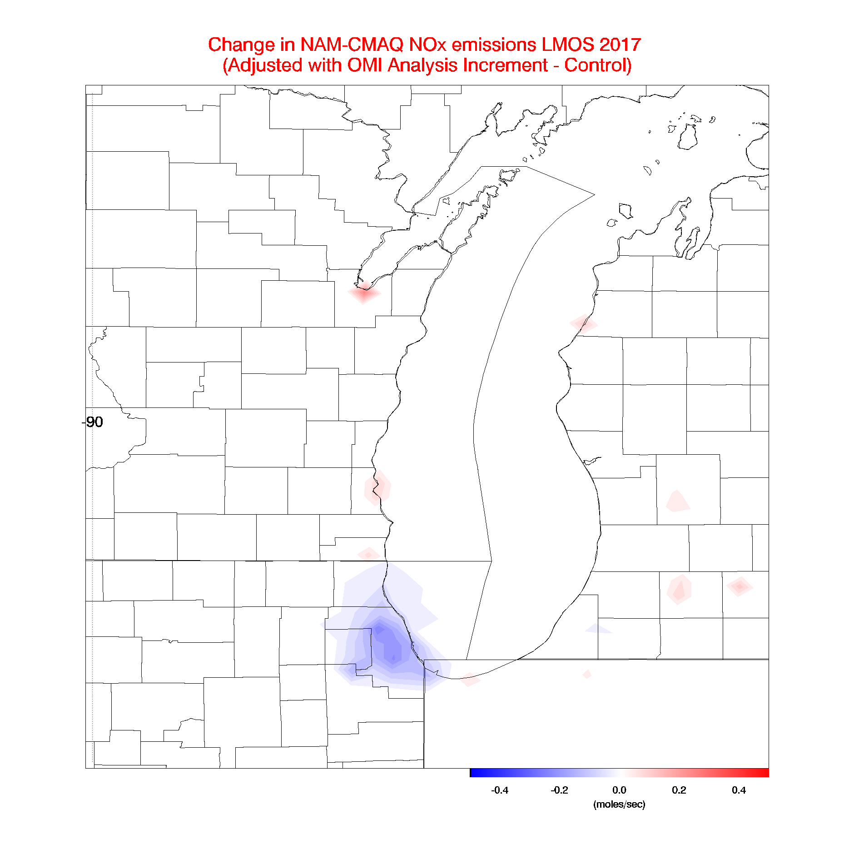
Aura Ozone Monitoring Instrument (OMI) Tropospheric NO2 column Data Assimilation
OMI Tropospheric NO2 column during LMOS 2017
Assimilation of OMI NO2 results in small (~4%) reductions in NOx emissions over Chicago
Lamsal, L. N., et al. (2011), Application of satellite observations for timely updates to global anthropogenic NOx emission inventories, Geophys. Res. Lett., 38, L05810, doi:10.1029/2010GL046476.

Slide 26
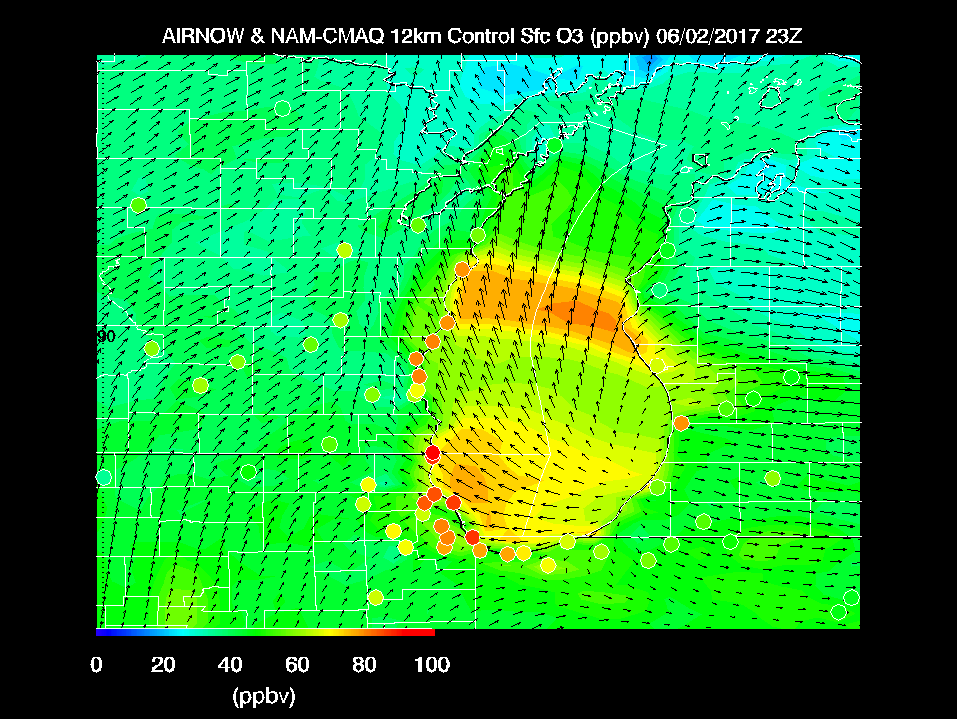
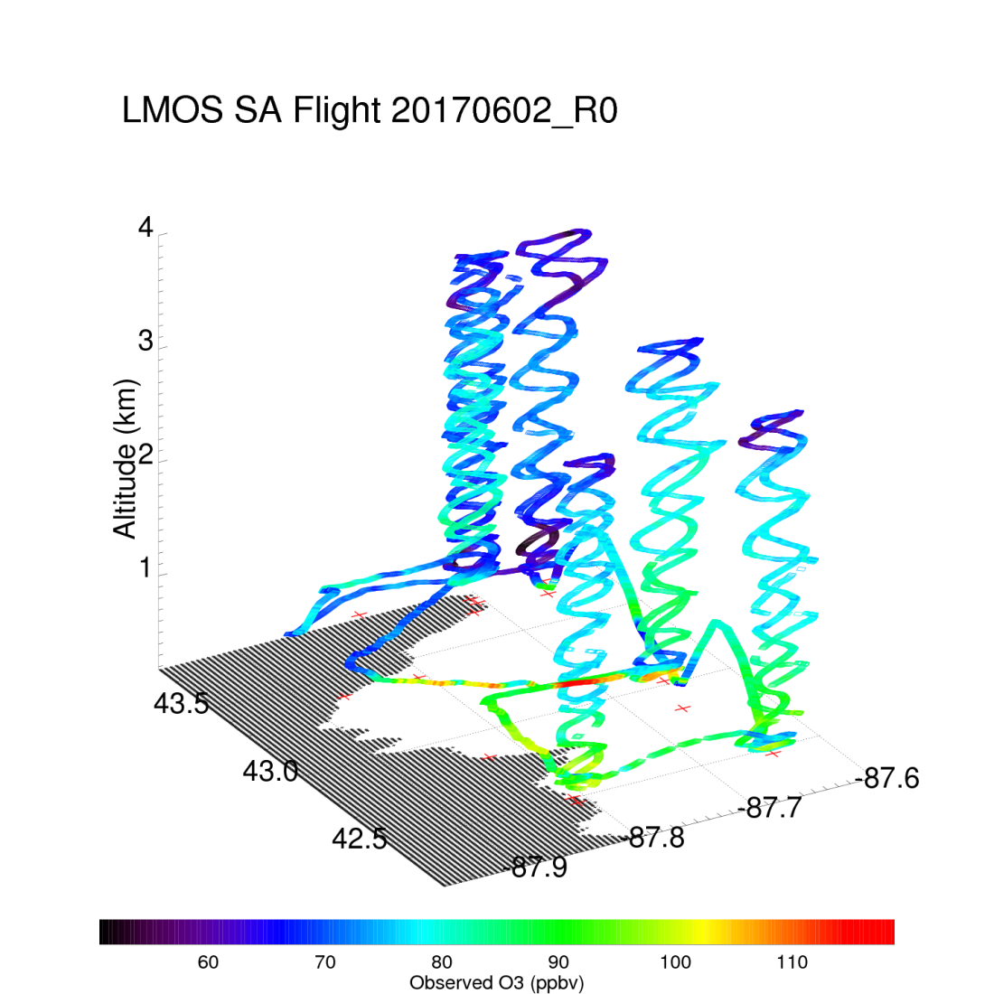
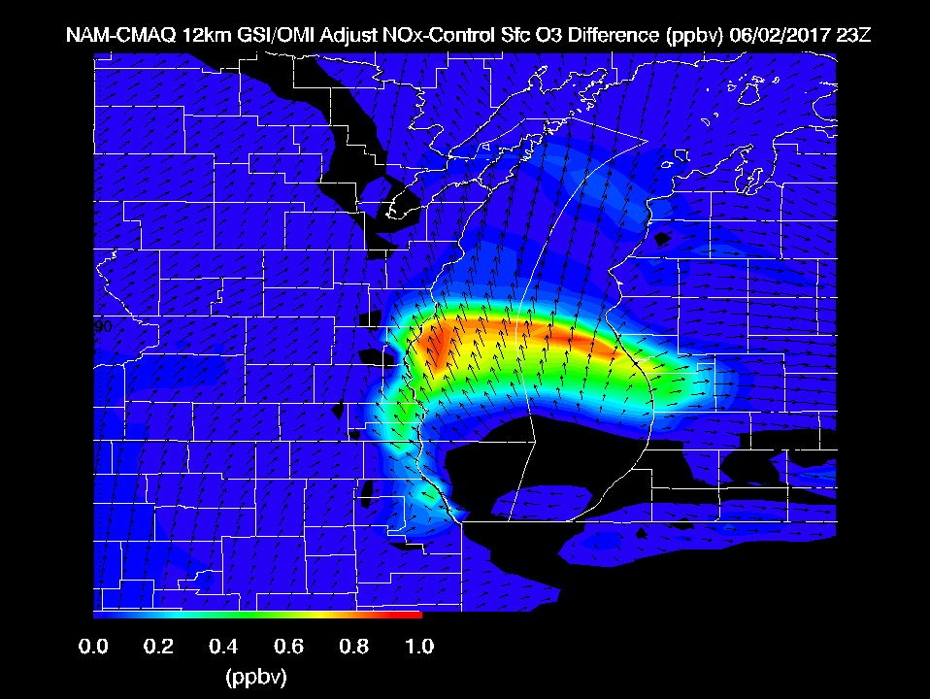
Max Observed O3 > 110ppbv
Reductions in NOx emissions on high ozone day leads to slight (~1ppbv) increases in surface ozone

Slide 27
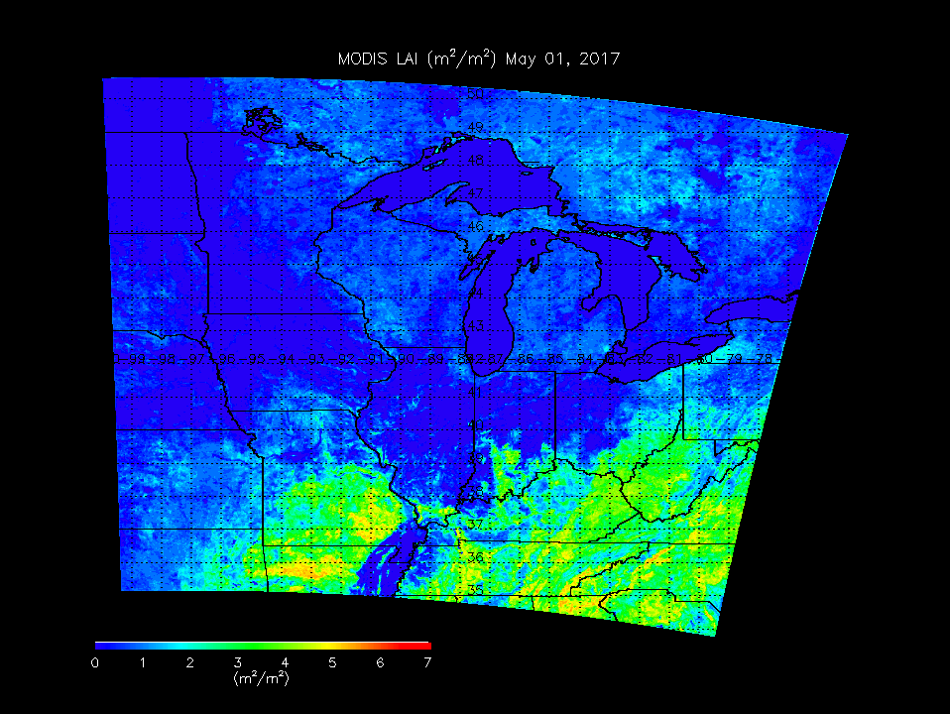
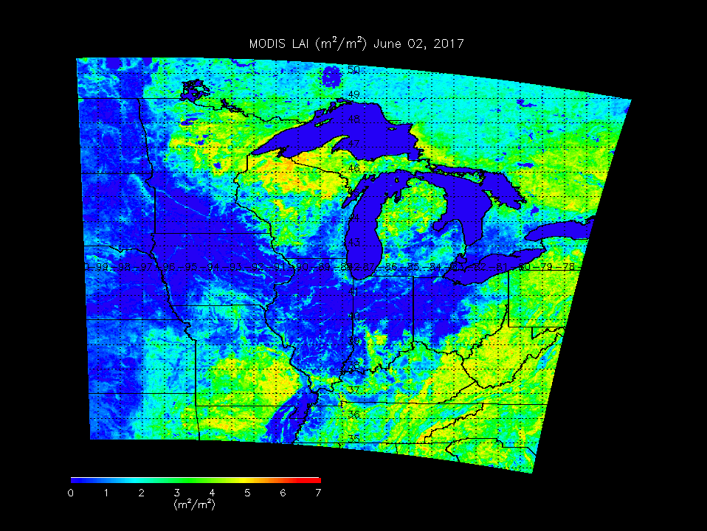
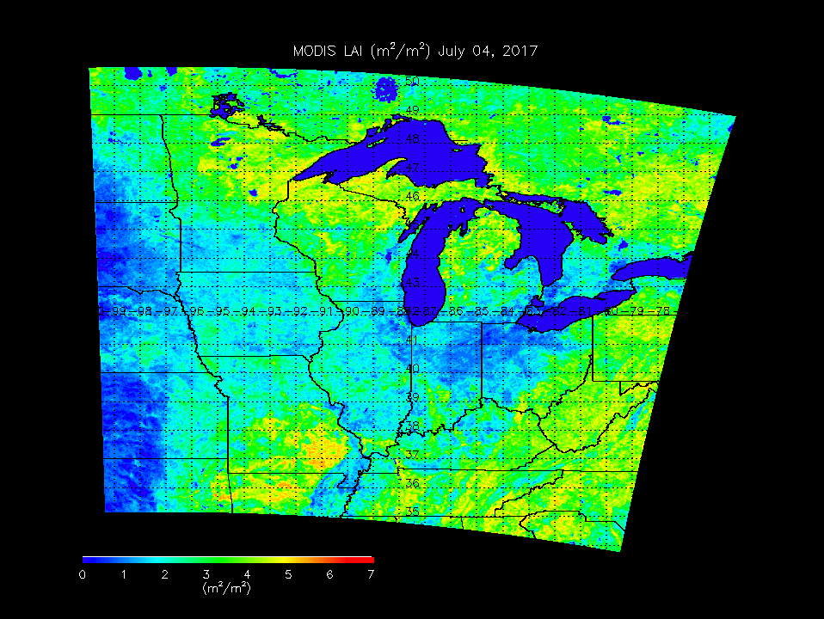
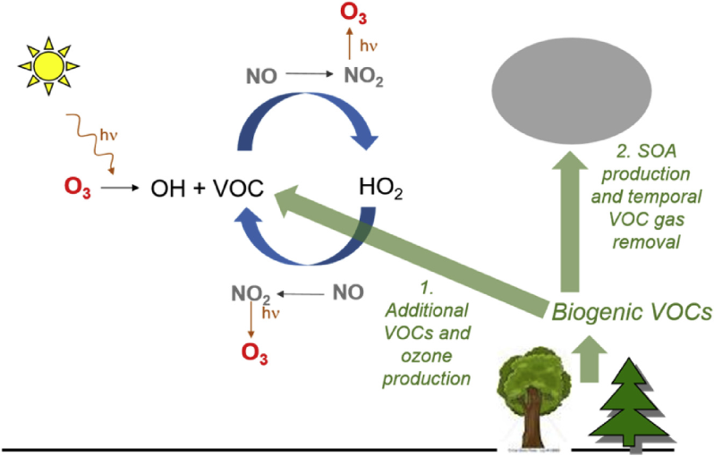
Leaf Area Index May 01, 2017
Biogenic VOC Sensitivity Studies
NAM-CMAQ 2x Biogenic emission Experiment
May 22 – June 13, 2018
Leaf Area Index June 02, 2017
Increased biogenic VOCs can enhance ozone production in urban plumes
Isoprene (biogenic VOC) emissions increase with leaf area (leaf out)
Leaf Area Index July 04, 2017

Slide 28
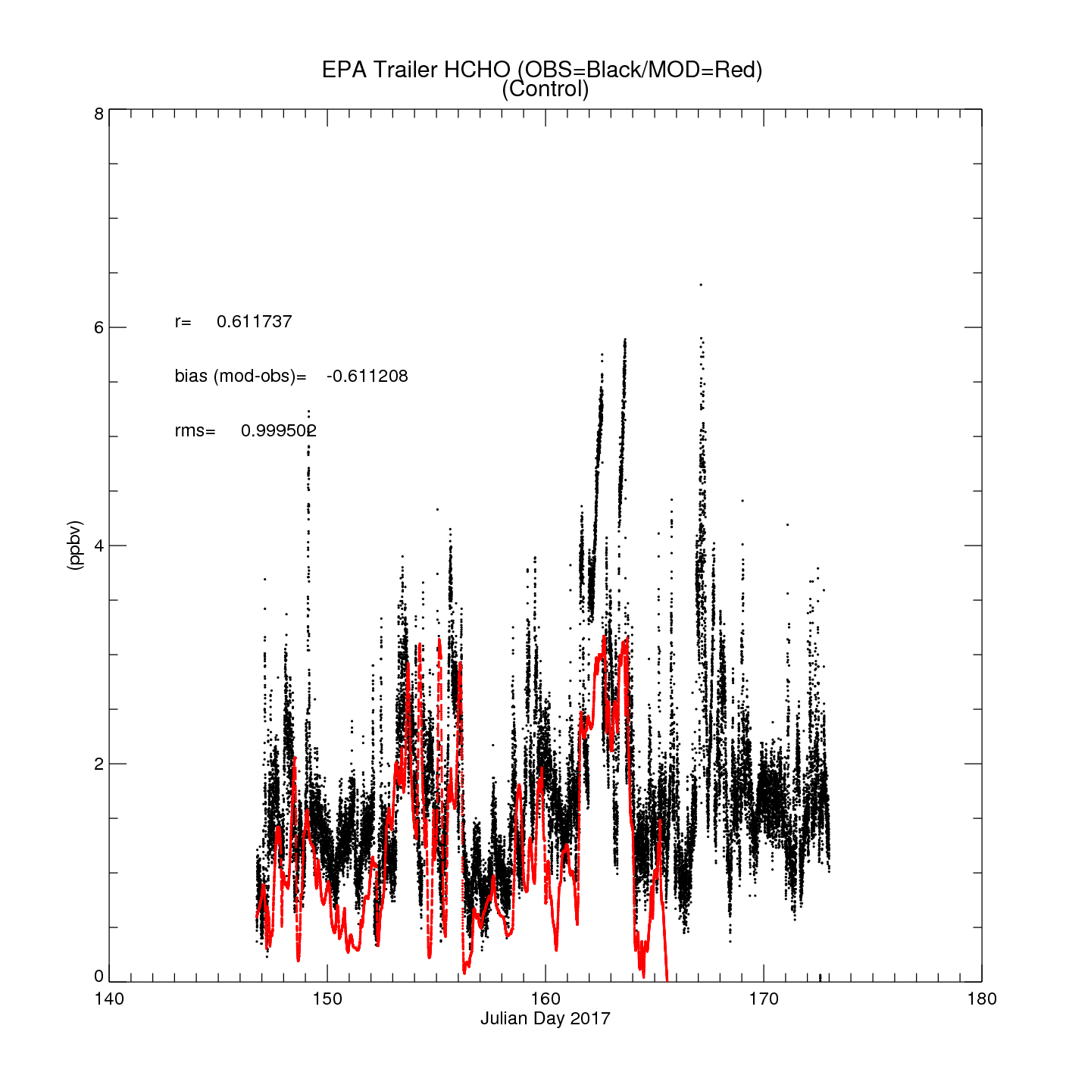
NAM-CMAQ Control
NAM-CMAQ HCHO
EPA Trailer HCHO (Sheboygan, WI)
Insitu HCHO provided by Jim Szykman (EPA)

Slide 29
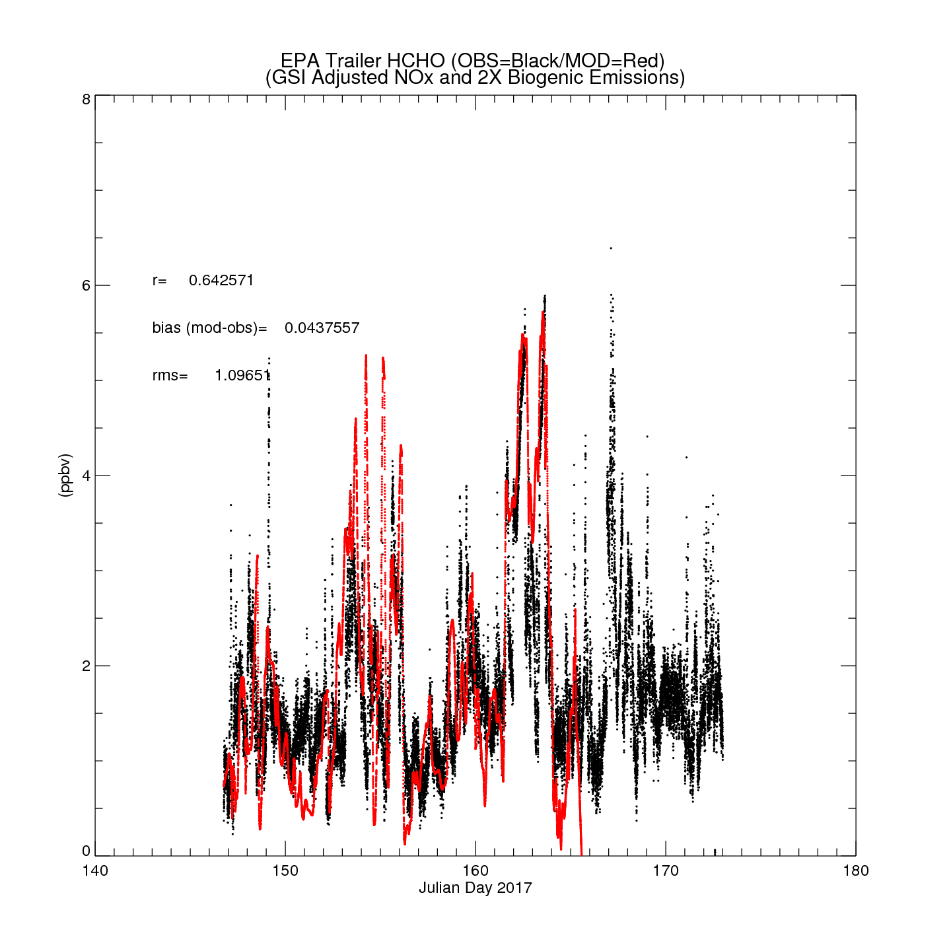
NAM-CMAQ OMI/NO2 + 2X Biogenic VOC
NAM-CMAQ HCHO
EPA Trailer HCHO (Sheboygan, WI)
Insitu HCHO provided by Jim Szykman (EPA)

Slide 30
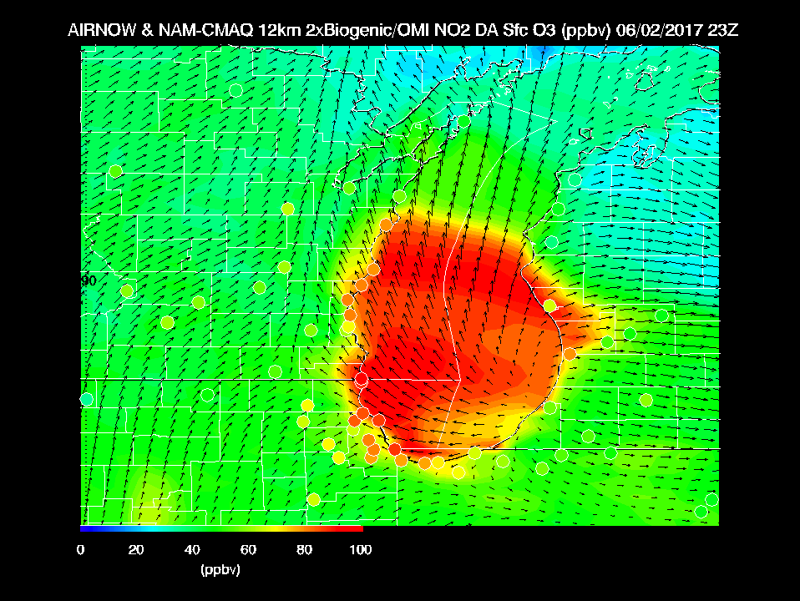
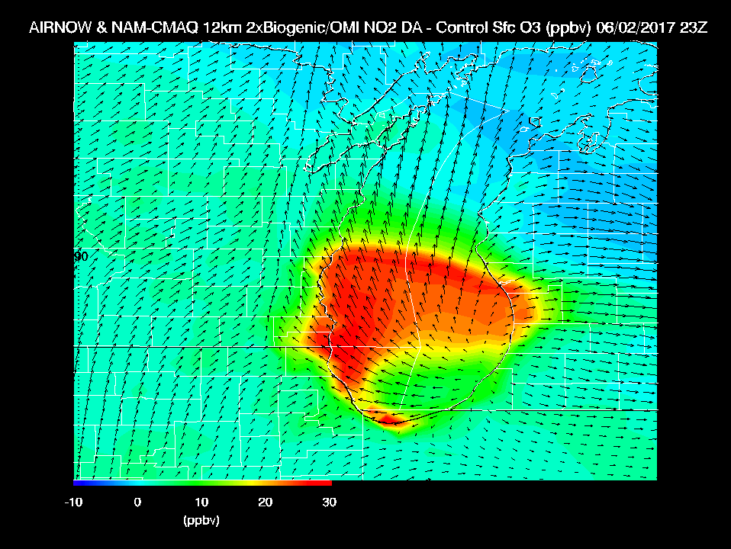
Max Observed O3 > 110ppbv
2X Biogenic emissions on high ozone day leads to large (~30ppbv) increases in surface ozone

Slide 31
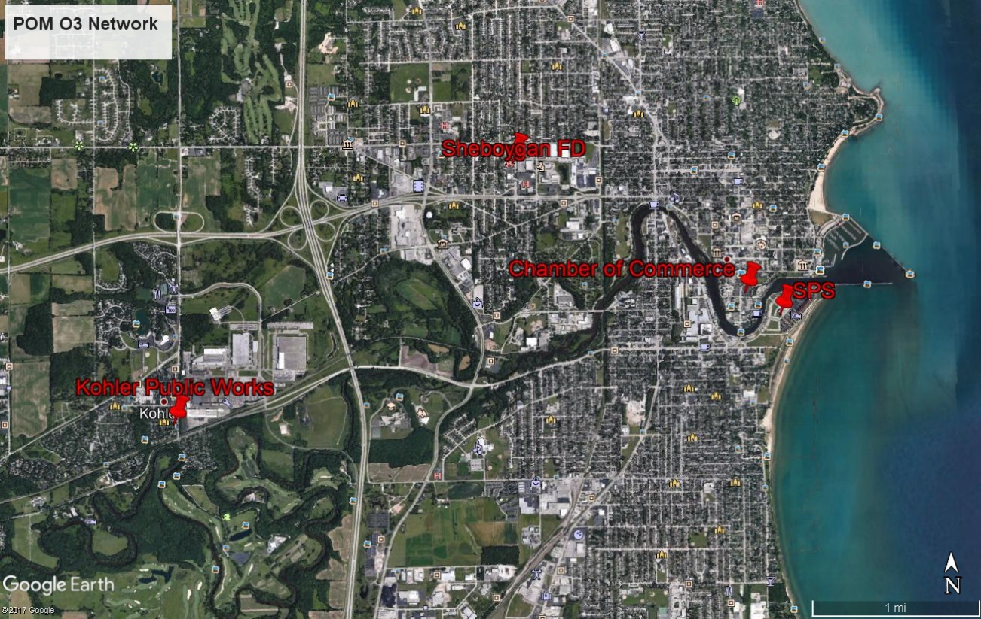
Locations of the 2B-Personal Ozone Monitors for inland gradient study
Intermittent data capture issues were experienced with all of the 2B-POM instruments. The data capture rate was 95.8% at Spaceport Sheboygan (SPS), 22.2% at Sheboygan Chamber of Commerce, 27.3% at Sheboygan Fire Department, and 27.3% at Kohler Public Works.
(Jim Szykman, EPA)

Slide 32
Regression of the inland 2B-POMs against the Spaceport Sheboygan data
The regressions indicate that the furthest site inland from the lakeshore (Kohler Public Works, KPW) experiences ozone values 5-6% lower than the lakeshore site (Spaceport Sheboygan).
(Jim Szykman, EPA)

Slide 33
Summary and Conclusions
Significant ozone events occurred during LMOS 2017, with exceedances of the 70 ppb 8-hr ozone threshold on June 2, June 11-12, and June 14-16. The LMOS 2017 aircraft observed polluted layers with rapid ozone formation occurring in a shallow layer near the Lake Michigan surface.
Modeling and observations show that this polluted layer over the lake is an important factor in coastal ozone exceedance events, but that meteorological and photochemical model skill in forecasting these needs improvement.
Comparisons between NAM-CMAQ forecasts, ground based monitors, in situ, and remote airborne measurements showed that NAM-CMAQ underestimated peak ozone concentrations and overestimated NO2 concentrations during ozone exceedance events during LMOS 2017.
NAM-CMAQ sensitivity studies show that reductions in anthropogenic NOx emissions and increases in biogenic volatile organic compounds (VOCs) emissions are necessary to increase the predicted surface ozone during high ozone events during LMOS 2017.
An experimental network of lower cost ozone monitors (2B-POM monitors) was deployed over a 6 km area of Sheboygan to measure differences in concentrations with respect to distance from the lake.
Inland ozone values were found to be 5-6% lower than the lakeshore site. However, intermittent data capture from these devices limits the drawing of detailed conclusions regarding spatial gradients.

Slide 34
Disclaimer
Any opinions, findings, and conclusions or recommendations expressed in this presentation are those of the author and do not necessarily reflect the views of the National Science Foundation nor should they be construed as an official National Oceanic and Atmospheric Administration or U.S. Government position, policy, or decision.
The United States Environmental Protection Agency’s Office of Research and Development partially performed and funded the research described within this presentation. This presentation has not undergone a full EPA review. As such, the results presented are not approved for external publication. Mention of trade names or commercial products does not constitute endorsement or recommendation for use.

Slide 35
Acknowledgments
The LMOS 2017 Science Team acknowledges the NASA Airborne Science Program and the NASA GEOstationary Coastal and Air Pollution Events (GEO-CAPE) Mission Pre-formulation Science Working Group for supporting the airborne remote sensing instruments, NSF (award number 1712909) and NOAA GOES-R Program Office for supporting the measurements at the Zion ground site, EPA and NOAA GOES-R program office for supporting the measurements at the Sheboygan ground site, and the Electric Power Research Institute (EPRI) for supporting the Scientific Aviation airborne in situ measurements.

Slide 36
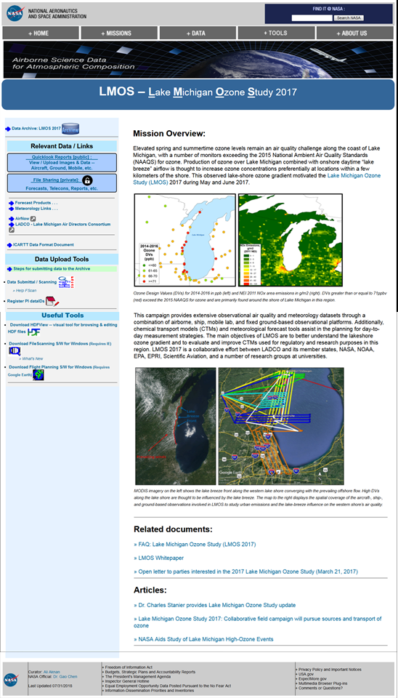
LMOS 2017 Data Archive
(Became publically available 8/2/2018)
https://www-air.larc.nasa.gov/missions/lmos/index.html

Slide 37
Extra Slides

Slide 38
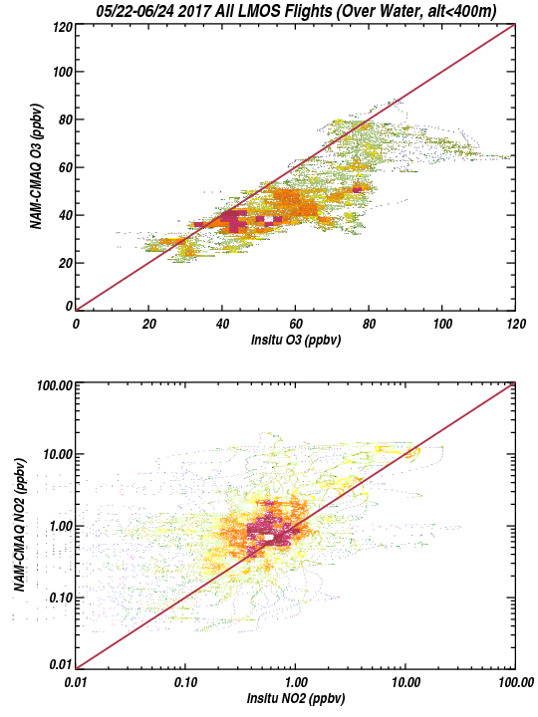
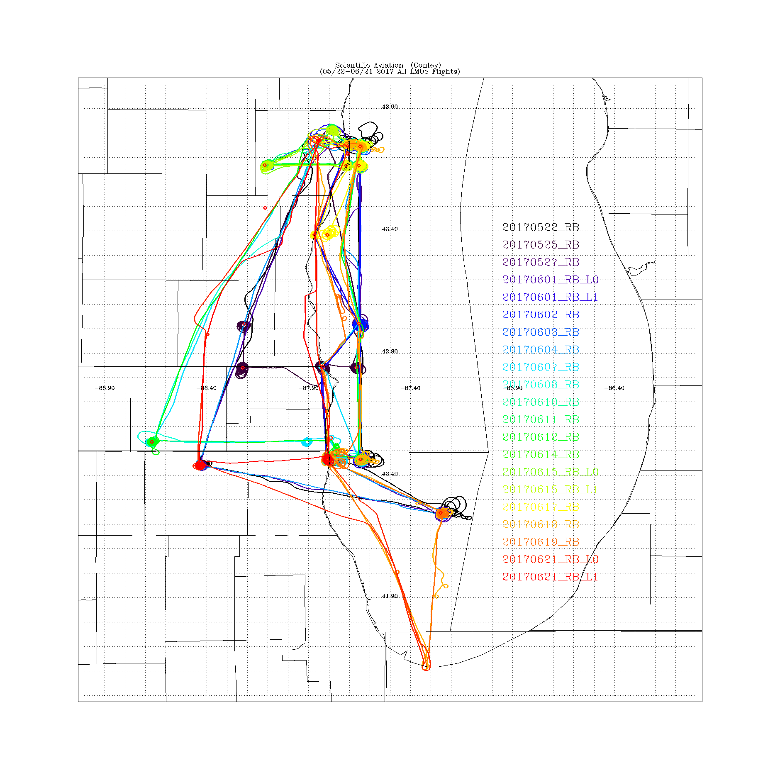
NAM-CMAQ vs Scientific Aviation
(Over Water, Altitude <400m)
1 to 1
+/- 15ppb
All Scientific Aviation Flights
1 to 1
+/- 3X
NAM-CMAQ underestimates O3 and overestimates NO2 over Lake Michigan
Steve Conley (Scientific Aviation PI)

Slide 39
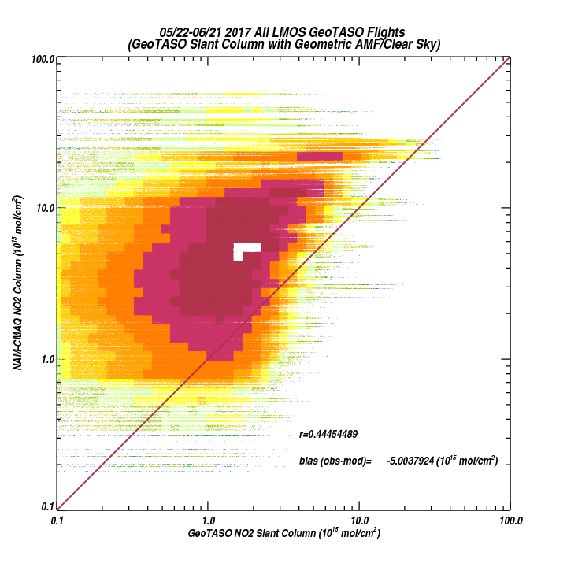
LMOS May 22 through June 21, 2017
NAM-CMAQ vs GeoTASO Differential Slant Column
All GeoTASO Flights
NAM-CMAQ overestimates NO2 columns compared to GeoTASO differential slant columns (currently not accounting for instrument sensitivity to NO2 profile)

