Slide 1
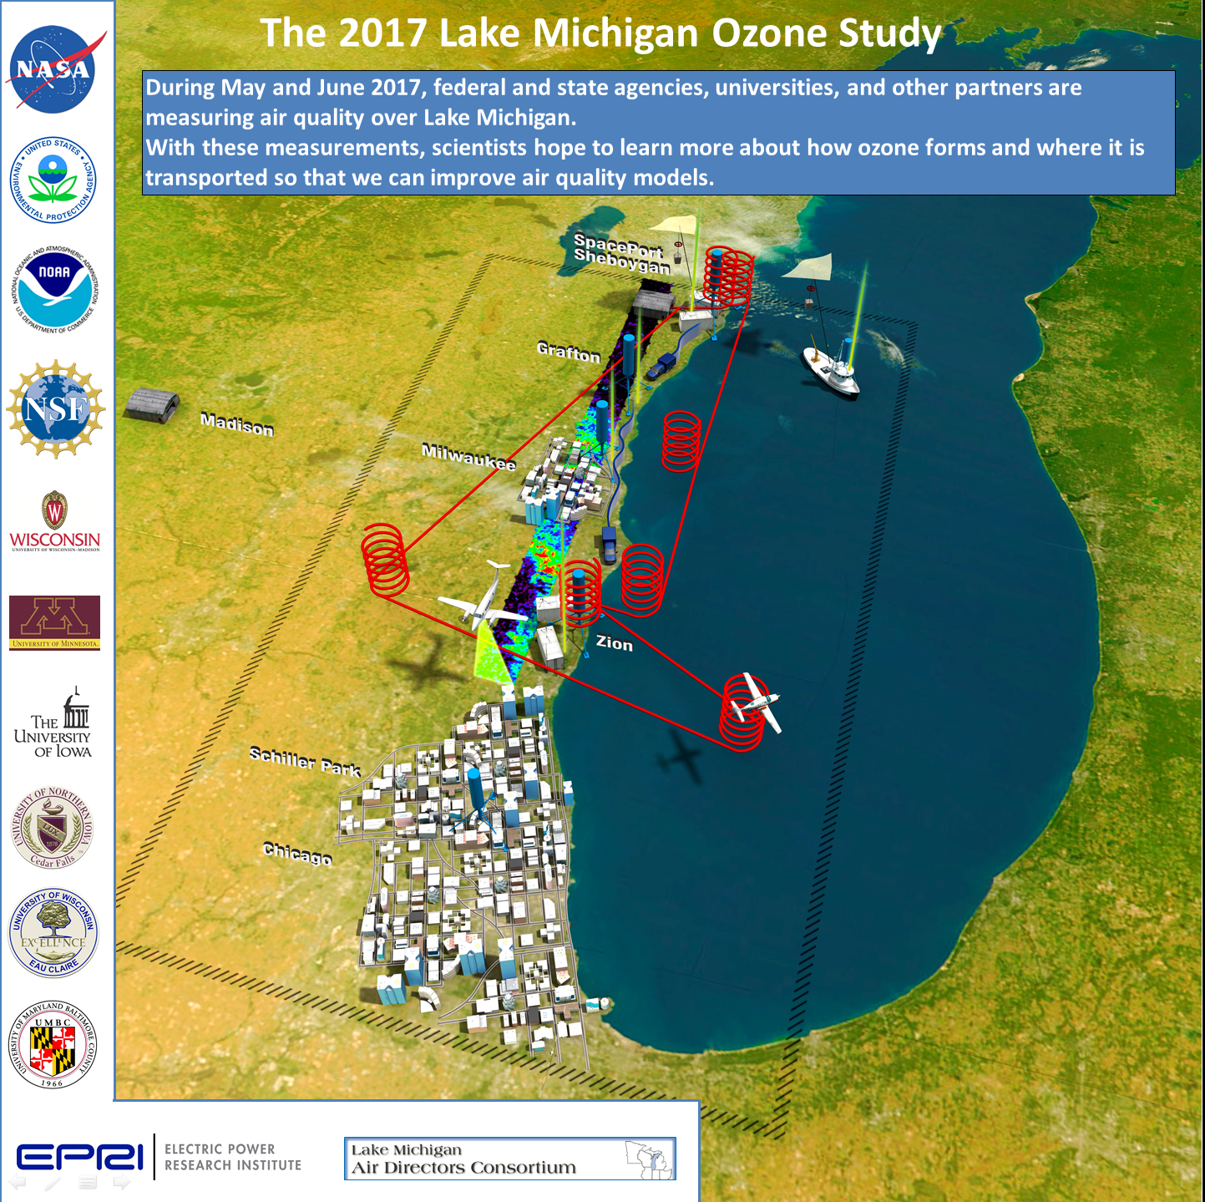
2017 Lake Michigan Ozone Study (LMOS)
Brad Pierce
UW-Madison
Space Science and Engineering Center
LADCO States Briefing Friday May 10, 2019

Slide 2
2017 Lake Michigan Ozone Study (LMOS)
What are the potential outcomes/benefits of LMOS 2017?
LMOS 2017 measurements provide critical observations for evaluating a new generation of air quality models attempting to better simulate ozone episodes in the region. Over the long term, the information collected is expected to result in:
Improved modeled ozone forecasts for this region, which states and EPA use to meet state and federal Clean Air Act requirements.
Better understanding of the lakeshore gradient in ozone concentrations, which could influence how EPA addresses future regional ozone issues.
Improved knowledge of how emissions influence ozone formation in the region.
What institutions are involved in LMOS 2017?
Researcher institutions: NOAA, NASA, U.S. EPA, University of Wisconsin, University of Iowa, University of Minnesota, University of Northern Iowa, University of Maryland Baltimore County, Scientific Aviation.
Air quality management agencies: Lake Michigan Air Directors Consortium (LADCO), Wisconsin DNR, Illinois EPA, Indiana DEM.
Nonprofit organizations: Electric Power Research Institute (EPRI)
Commercial Services: Scientific Aviation

Slide 3
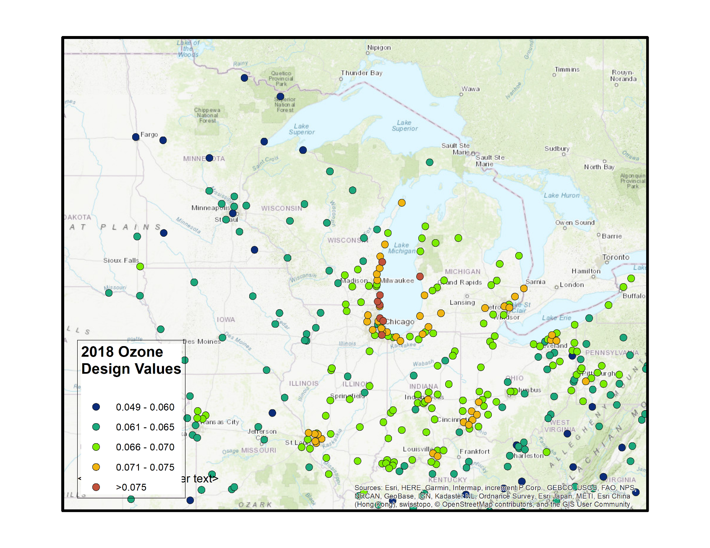
2018 Ozone Design Values
48 sites over 0.070 ppmv (70 ppbv)
8 sites over 0.075 ppmv
Highest 8 all around Lake Michigan.
4th highest value of daily 8-hour maximum ozone values are averaged over 3 years to derive the design value, which is the metric that is compared to the National Ambient Air Quality Standards (NAAQS) and determines attainment or nonattainment.
From Donna Kenski (LADCO)

Slide 4
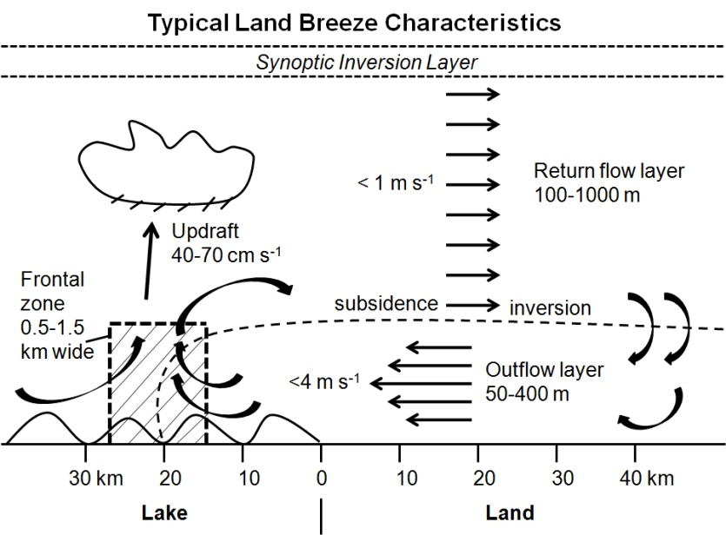
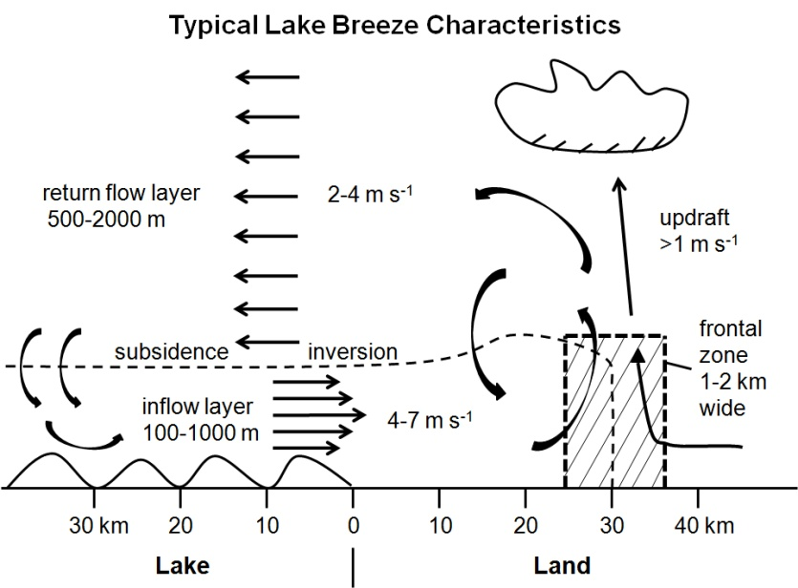
Lake Michigan and Ozone Formation
Land breeze blows ozone precursor compounds from rush hour over lake.
The boundary layer height is low due to cold water chilling the air above.
The pollutants are concentrated near the surface where ozone forms.
An afternoon lake breeze transports the ozone back onto land.
White Paper: http://www.ladco.org/

Slide 5
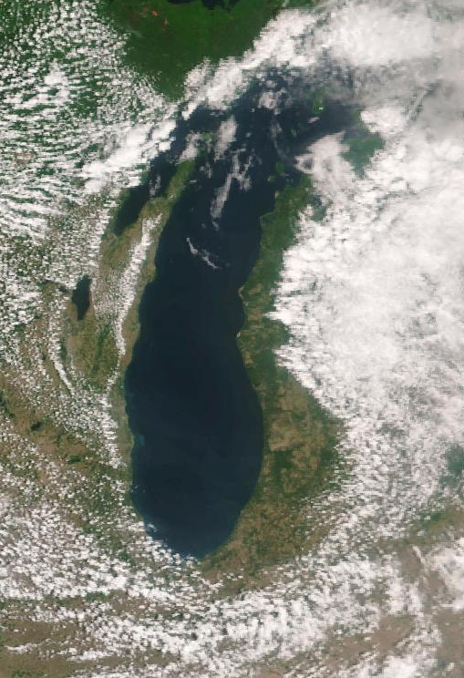
VIIRS Image June 09, 2017
Satellite image of Lake Michigan showing
Lake Breeze Front

Slide 6
VIIRS Image June 09, 2017
Lake Breeze
Front
Satellite image of Lake Michigan showing
Lake Breeze Front

Slide 7
Summary of measurements made during the LMOS 2017 field campaign
Location | Measurement* | Research Institution*
Ground Sites
Spaceport Sheboygan | Remote sensing of meteorology (SPARC Trailer) | UW-Madison -SSEC
 | In situ measurements of pollutants | U.S. EPA ORD
Zion, IL | Remote sensing of meteorology (Sodar/MW Radiometer) | Univ. Northern Iowa
 | Detailed in situ chemical measurements | Univ. Iowa, UW-Madison, Univ. Minnesota
 | Routine measurements of ozone | Illinois EPA
Various† | Remote sensing of pollutants and boundary layer height | U.S. EPA ORD
Sheboygan transect | In situ measurements of ozone at four locations | U.S. EPA ORD
Airborne Platforms
Lakeshore region | Airborne remote sensing of NO₂ (GeoTASO) | NASA
 | Airborne remote sensing of clouds (AirHARP) | Univ. Maryland, Baltimore County
 | Airborne in situ profiling of pollutants and meteorology | Scientific Aviation
Shipboard Platform
Lake Michigan | In situ measurements of pollutants | U.S. EPA ORD
 | Remote sensing of pollutants and boundary later height | U.S. EPA ORD
Mobile Platforms
Northeast IL and Southeast WI | In situ measurements of pollutants (GMAP) | U.S. EPA Region 5
Grafton to Sheboygan | In situ measurements of ozone and meteorology | UW-Eau Claire
GeoTASO = Geostationary Trace gas and Aerosol Sensor Optimization instrument
AirHARP = Airborne Hyper Angular Rainbow Polarimeter
GMAP = Geospatial Mapping of Pollutants
† These measurements were made at Spaceport Sheboygan, Zion, two Wisconsin DNR monitoring locations (Grafton and Milwaukee SER) and one Illinois EPA monitoring location (Schiller Park).

Slide 8
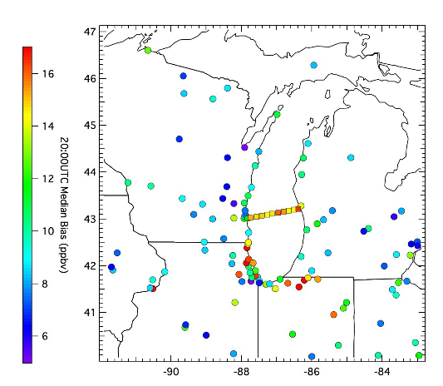
NOAA National Weather Service (NWS) Air Quality Forecast
NWS air quality forecasts were evaluated during LMOS 2017
NWS operational air quality forecasts use the North American Model (NAM) meteorology to drive the EPA Community Multiscale Air Quality Model (CMAQ) to perform twice daily forecasts of air quality over the continental US (http://airquality.weather.gov/)
2008 to 2010 NWS NAM-CMAQ model bias for air quality EPA station monitors (circles) and Lake Express ferry (boxes) (From Cleary et al, 2015)
Cleary et al., 2015, Ozone distributions over southern Lake Michigan: comparisons between ferry-based observations, shoreline-based DOAS observations and model forecasts Atmos. Chem. Phys. (doi:10.5194/acp-15-5109-2015)

Slide 9
NOAA National Weather Service (NWS) Air Quality Forecast
NAM-CMAQ Comparison with Sheboygan KA Monitor during LMOS 2017
Observations at Sheboygan KA monitor show that the highest ozone (>60ppbv) is associated with the prevailing SW winds
NAM-CMAQ underestimates the frequency of the prevailing southerly winds and overestimates the frequency of westerly winds at Sheboygan KA
NAM-CMAQ forecasts consistently underestimates ozone mixing ratios with nearly 88% of the NAM-CMAQ ozone forecasts predicting less than 40 ppbv at Sheboygan KA during LMOS 2017

Slide 10
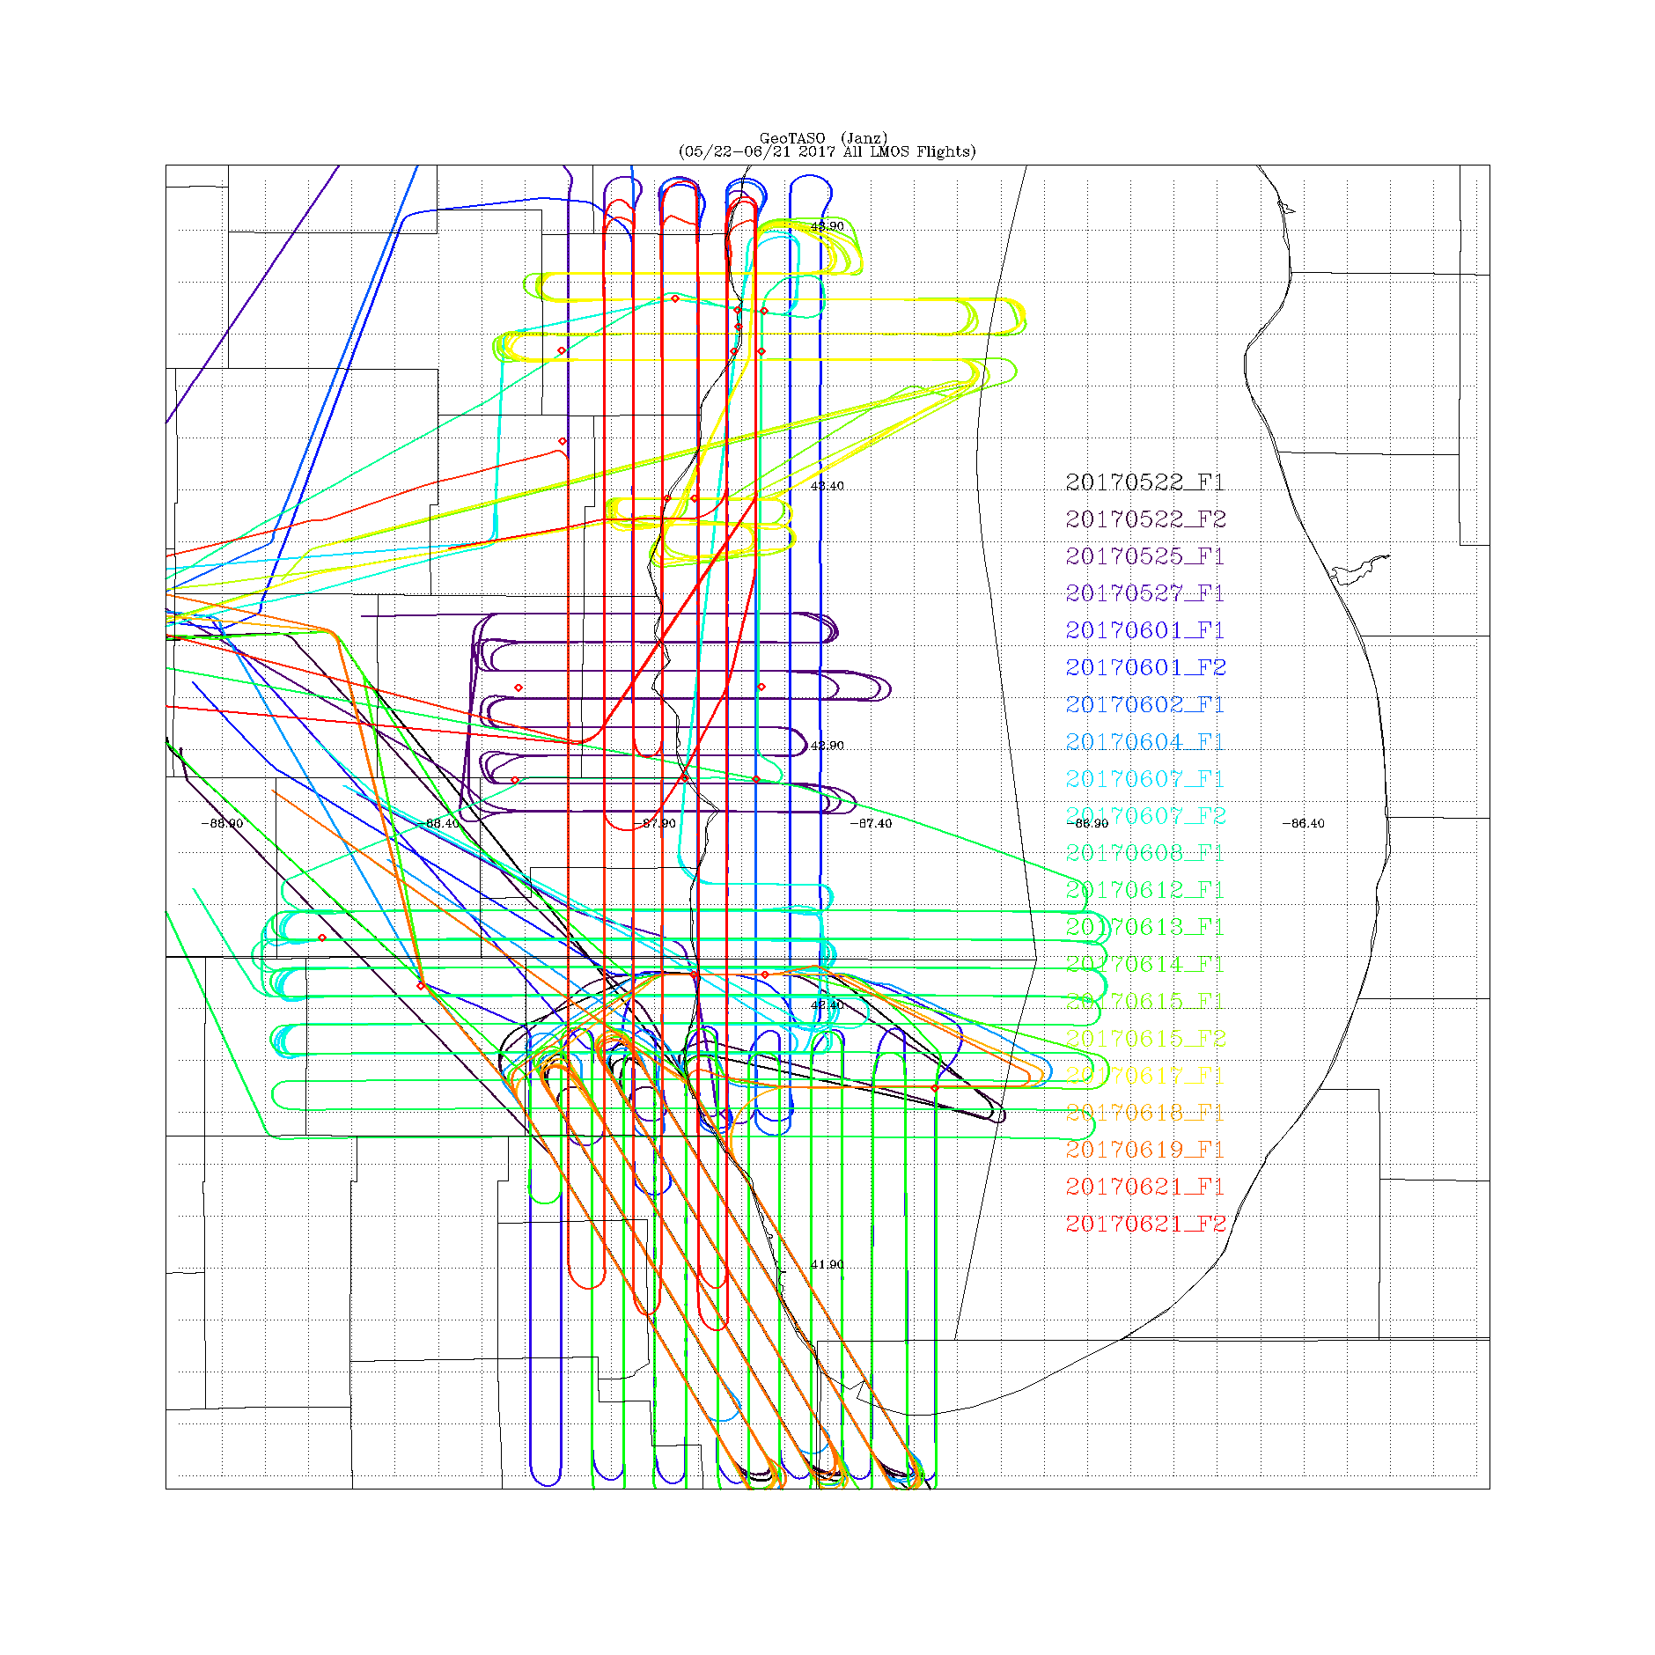
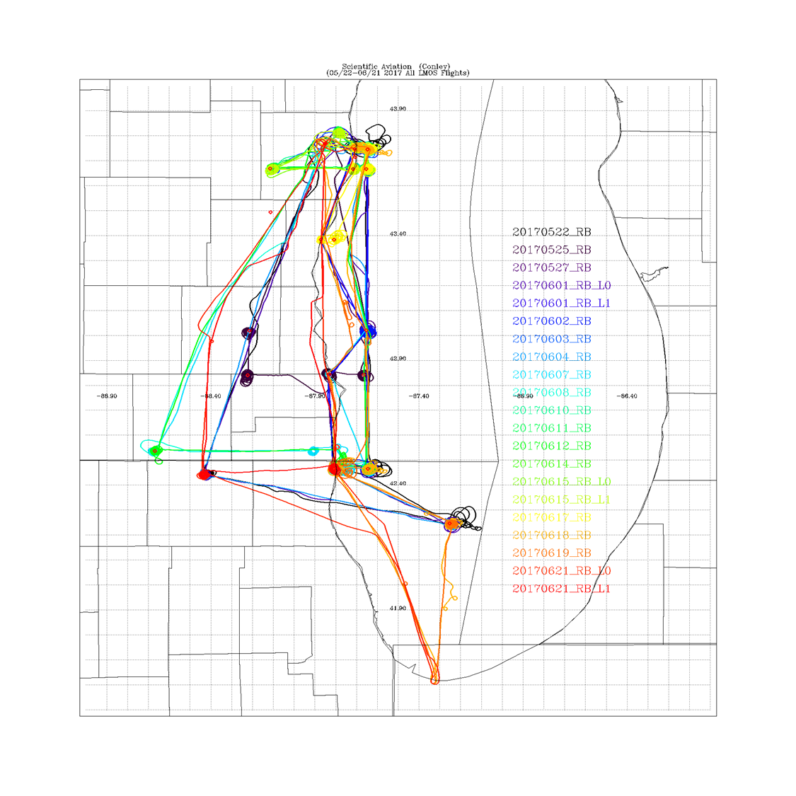
LMOS 2017 Aircraft Measurements
NASA GeoTASO remote sensing Flights
Scientific Aviation insitu sampling Flights
GeoTASO (Geostationary Trace gas and Aerosol Sensor Optimization) is an airborne hyperspectral mapping instrument that is being used as an airborne testbed for future high-resolution trace-gas observations from geostationary sensors such as TEMPO
The Electric Power Research Institute (EPRI) provided funding for Scientific Aviation Flights during LMOS

Slide 11
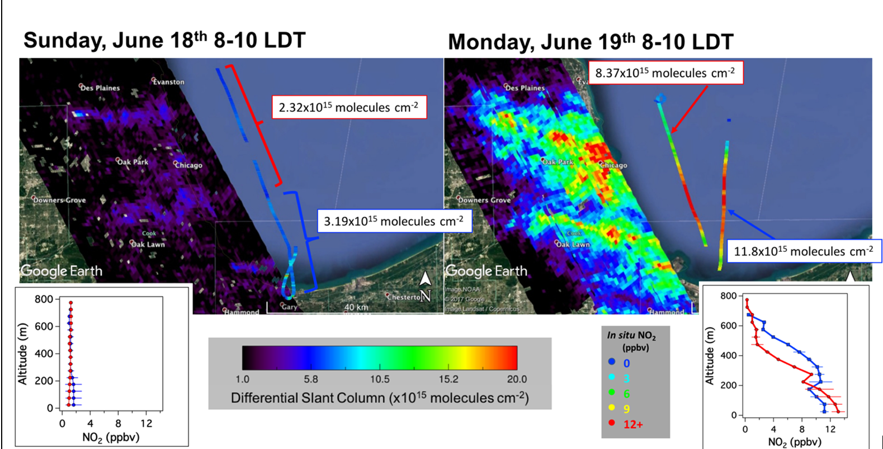
Chicago Emission Mapping Weekend/Weekday
GeoTASO NO2 columns and Scientific Aviation NO2 profiles show large differences between weekend and weekday NO2 abundances. LMOS measurements provide constraints on emissions from commuter traffic (Analysis by Laura Judd, NASA/LaRC)

Slide 12
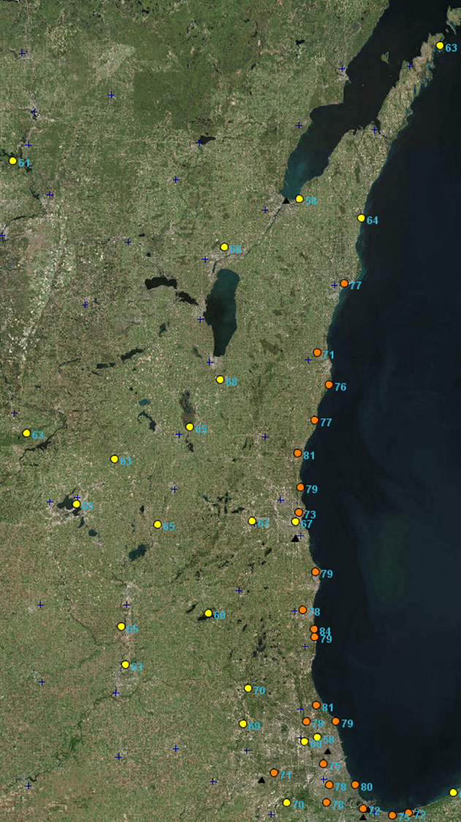
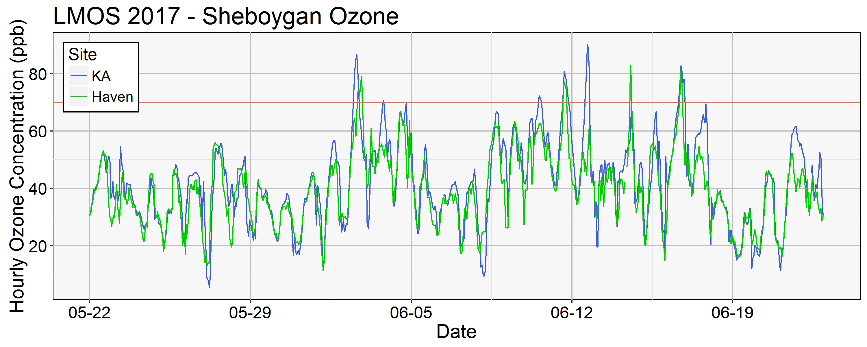
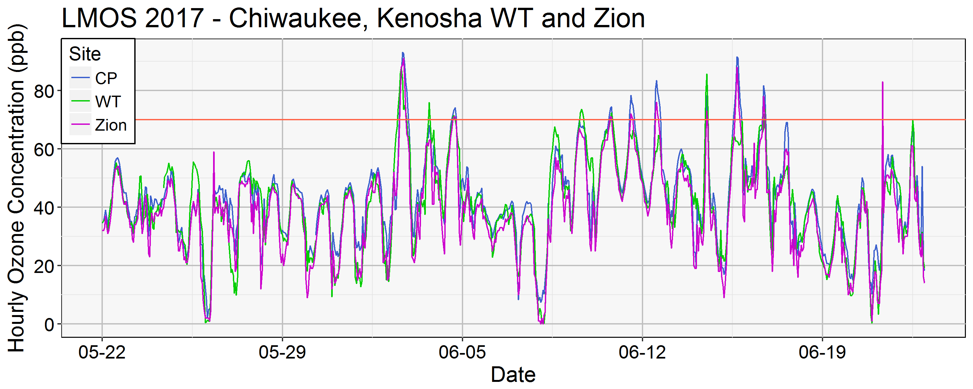
Lakeshore ozone during LMOS 2017
June 02, 2017 MDA8
June 02, 2018
June 02, 2018
(Angie Dickens , WDNR)
MDA8=Maximum Daily 8 hour Average

Slide 13
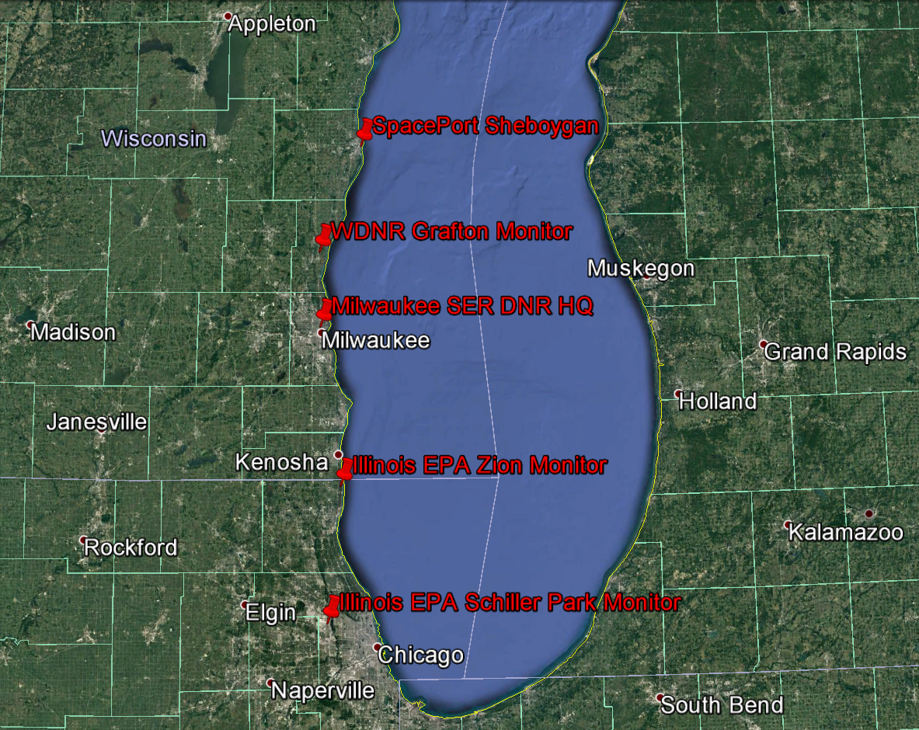
Ground based UV/visible grating spectrometers (Pandoras) column NO2 measurements during LMOS 2017
Pandora NO2 column measurements show high values at Zion, Grafton, and Sheboygan on June 2, 2017
(Luke Valin, EPA)

Slide 14
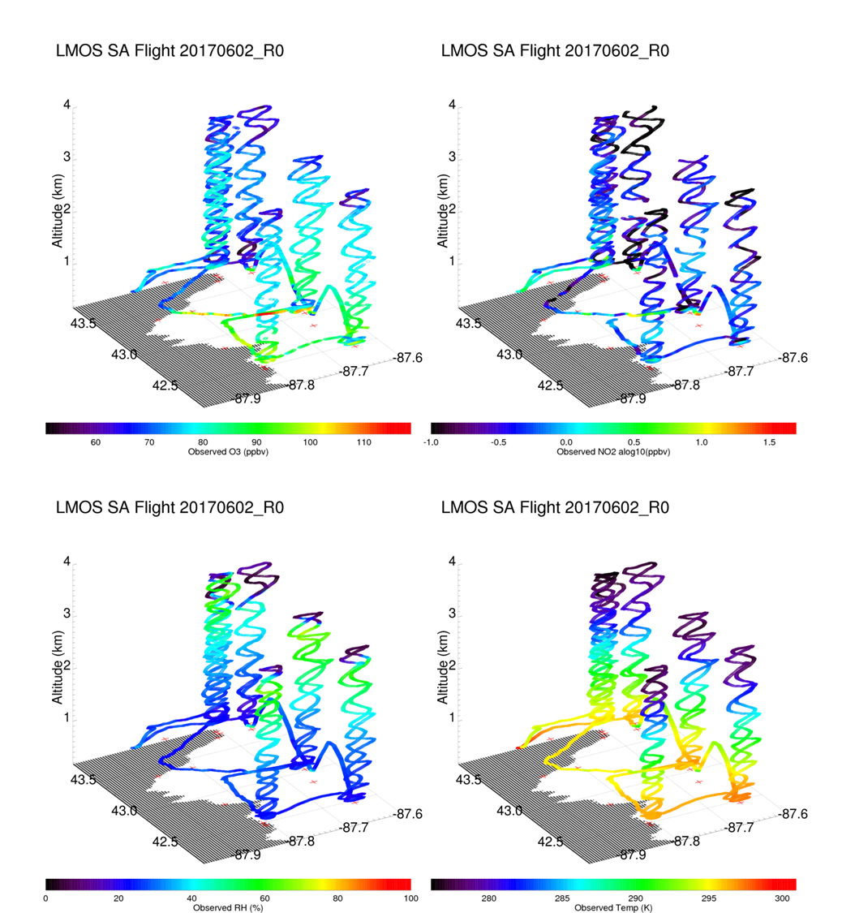
Coastal Ozone Exceedance Day
Ozone
NO2
Highest observed O3 and NO2 enhancements are confined to a very shallow marine boundary layer (higher RH/lower Temperature)
RH
Temp

Slide 15
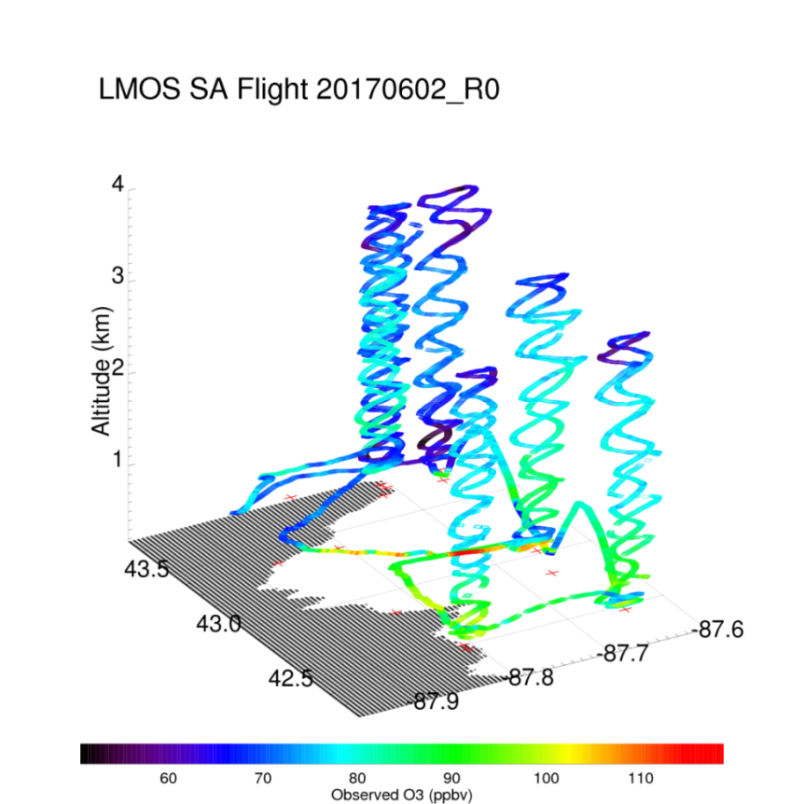
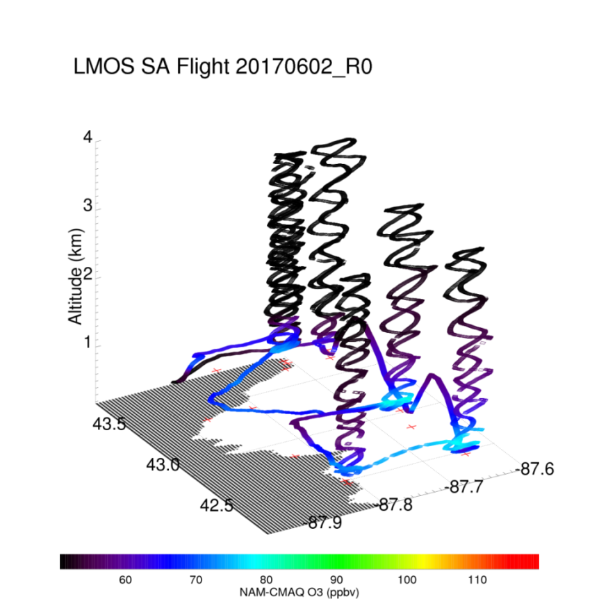
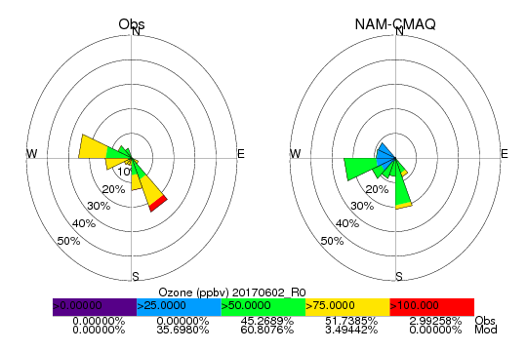
Coastal Ozone Exceedance Day
Observed Ozone
NAM-CMAQ Ozone
NWS NAM-CMAQ significantly underestimates ozone concentrations within the marine boundary layer and aloft
Max Observed O3 > 110ppbv
Max NAM-CMAQ O3 < 80ppbv

Slide 16
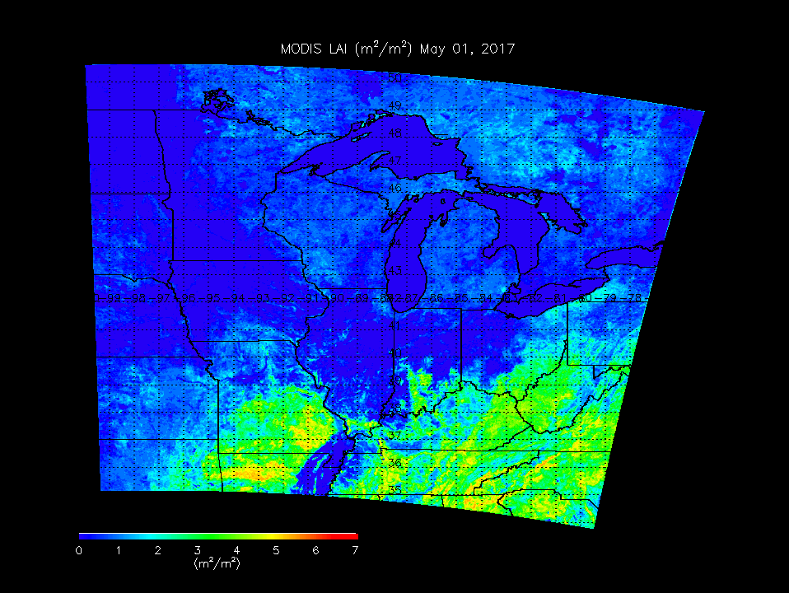
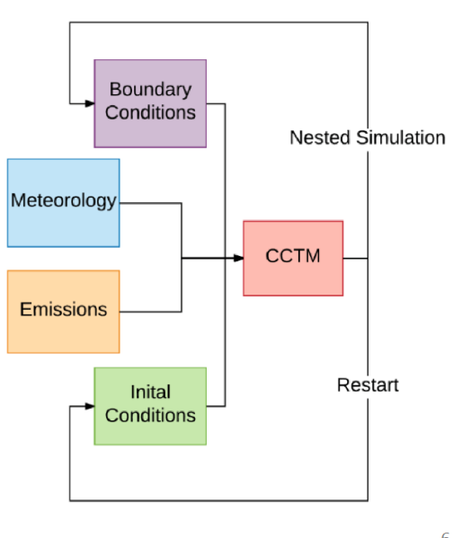
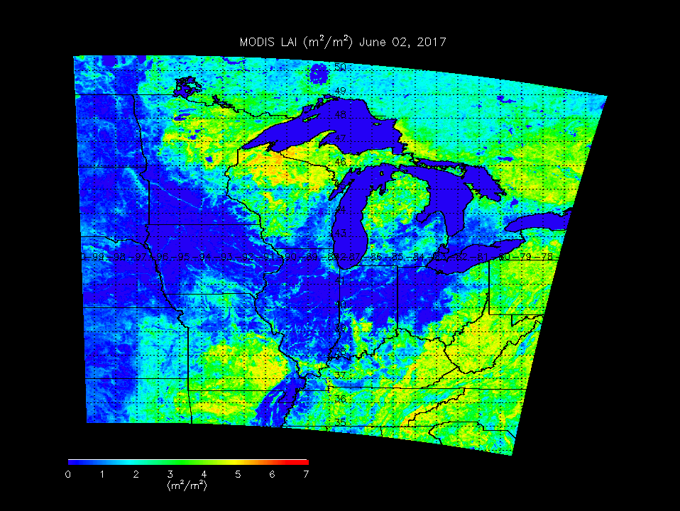
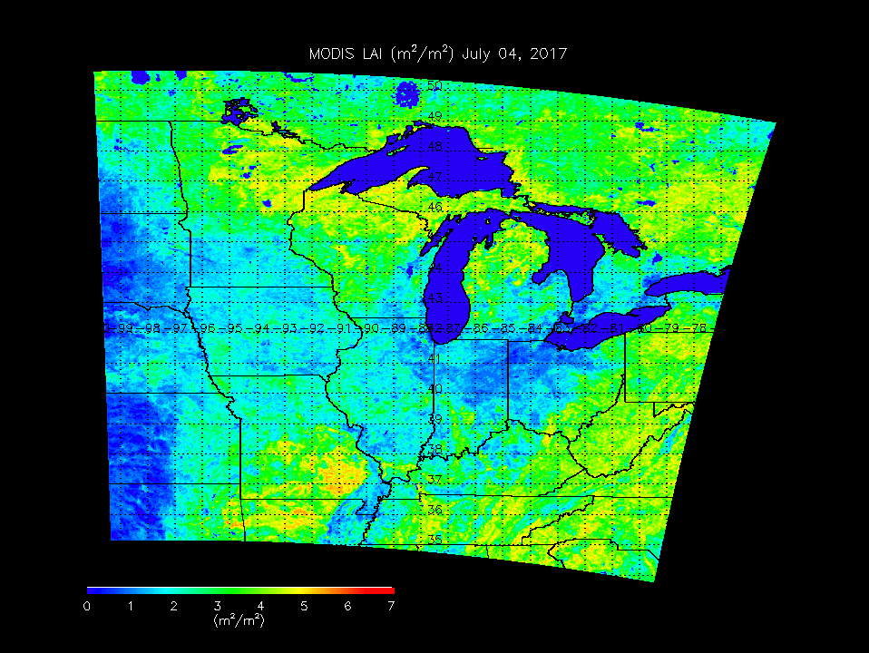
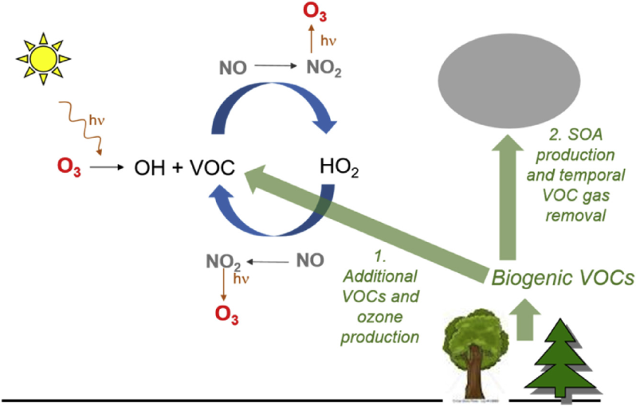
Leaf Area Index May 01, 2017
2x Biogenic VOC
Sensitivity Studies
Isoprene (biogenic VOC) emissions increase with leaf area (leaf out)
Leaf Area Index June 02, 2017
Increased biogenic VOCs can enhance ozone production in urban plumes
Leaf Area Index July 04, 2017

Slide 17
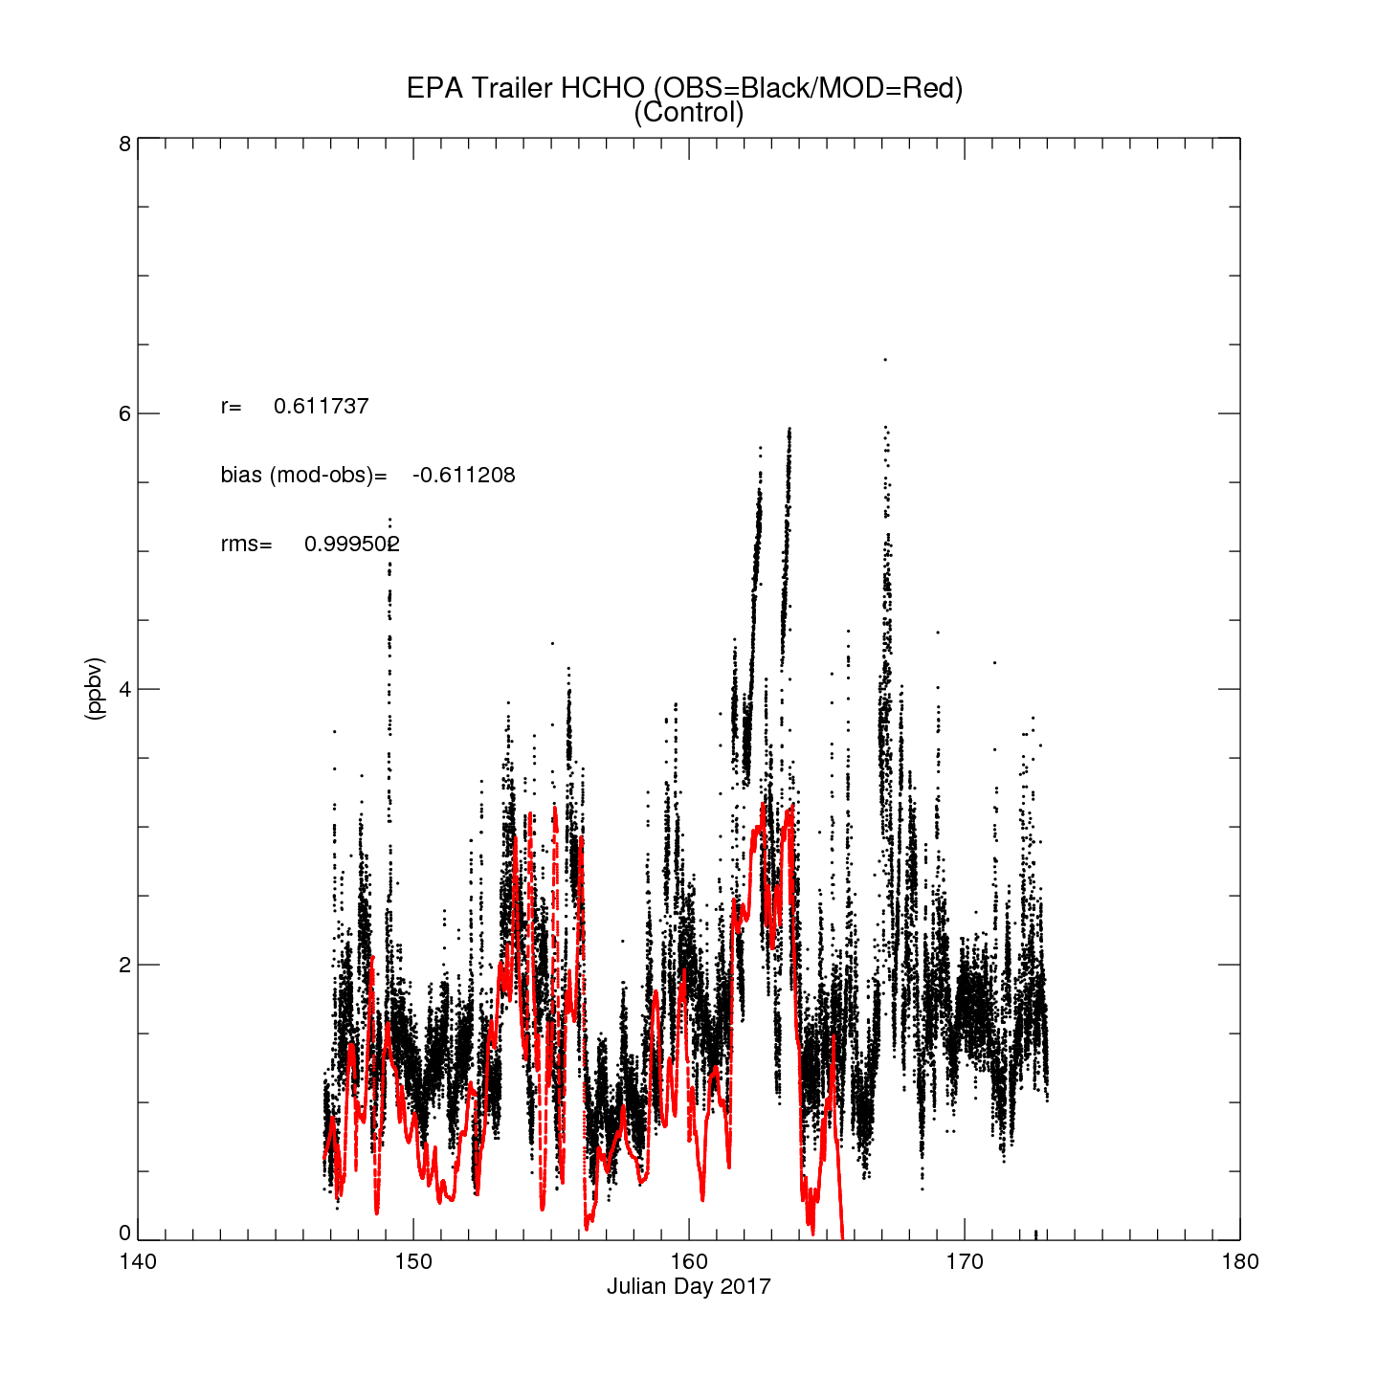
NAM-CMAQ Control
NAM-CMAQ HCHO
EPA Trailer HCHO (Sheboygan, WI)
Insitu HCHO provided by Jim Szykman (EPA)

Slide 18
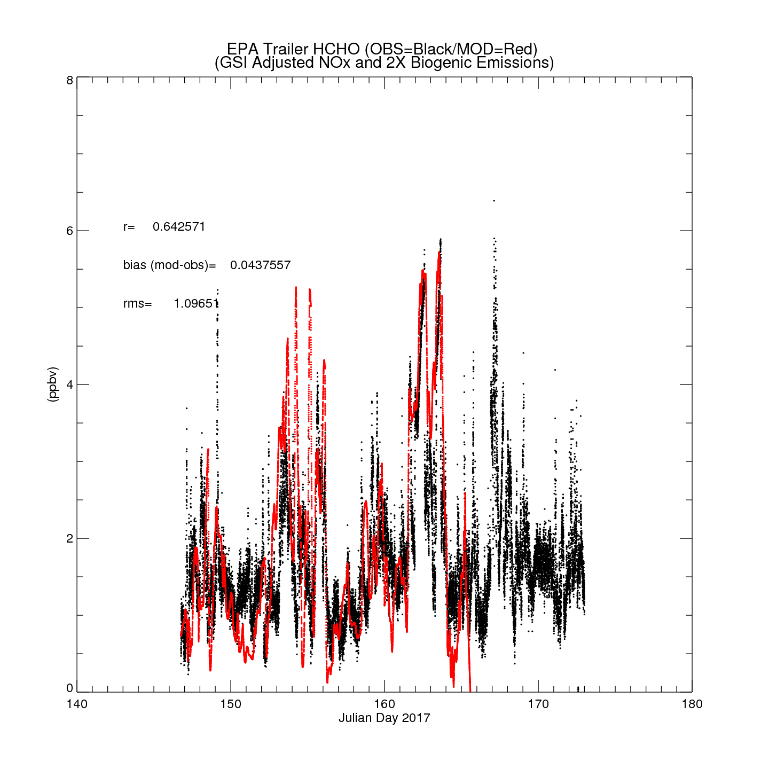
NAM-CMAQ OMI/NO2 + 2X Biogenic VOC
NAM-CMAQ HCHO
EPA Trailer HCHO (Sheboygan, WI)
Insitu HCHO provided by Jim Szykman (EPA)

Slide 19
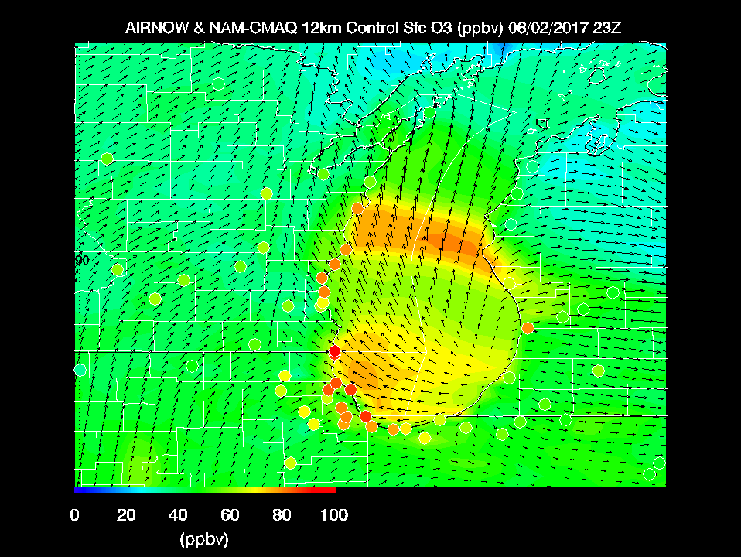
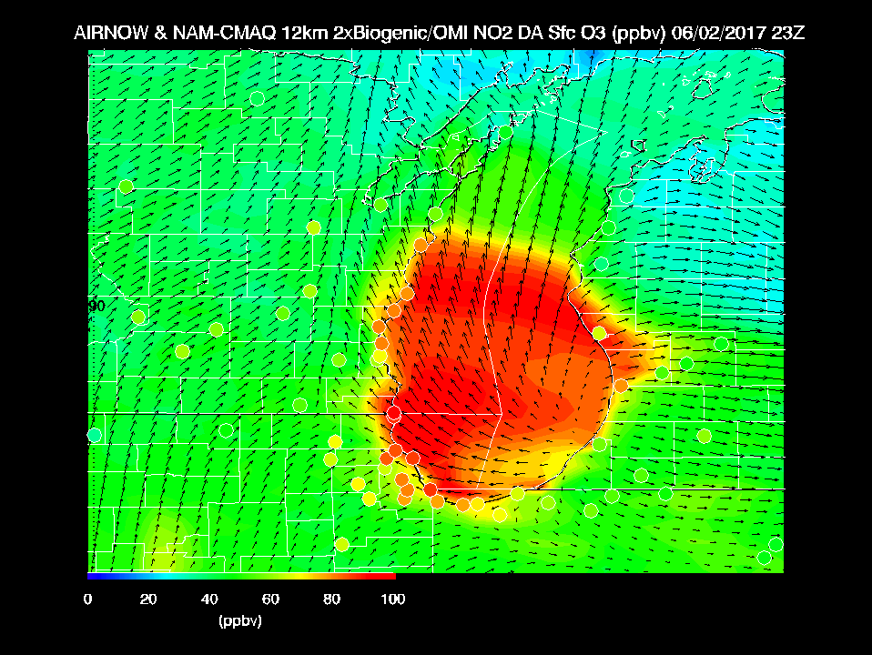
Max Observed O3 > 110ppbv
2X Biogenic emissions on high ozone day leads to large (~30ppbv) increases in surface ozone

Slide 20
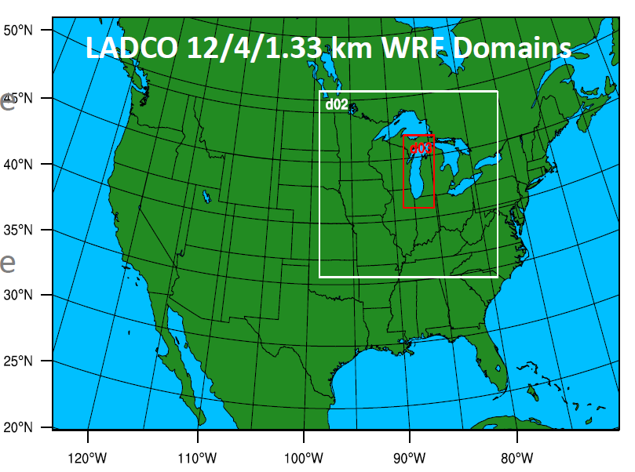
Regulatory Model Development
WRF Physics/Resolution Testing
EPA Baseline scheme uses Asymmetric Convection Model version 2 (ACM2) PBL and Xiu-Pleim land surface scheme
YSU-Noah-Thompson (YNT) scheme uses Yonsei University (YSU) PBL and Noah land surface scheme

Slide 21
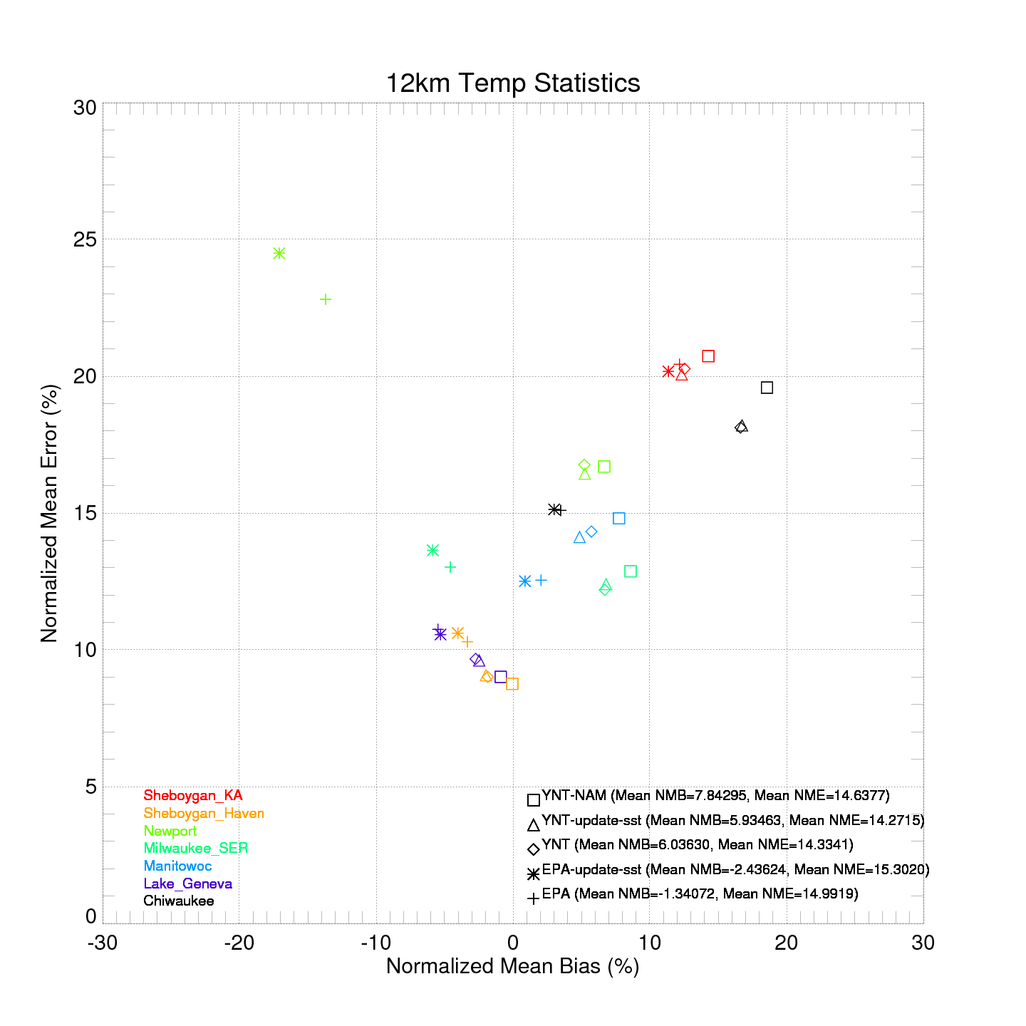
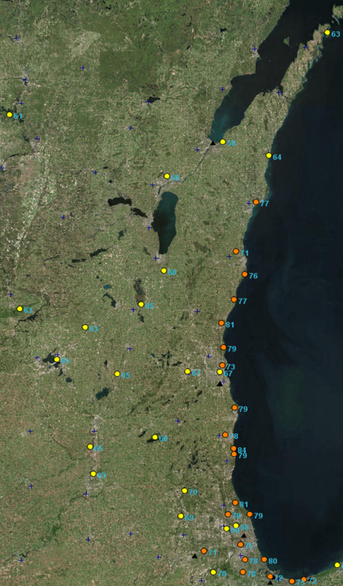
Largest Errors and Biases @ Sheboygan_KA (all) and Chiwaukee (YNT)

Slide 22
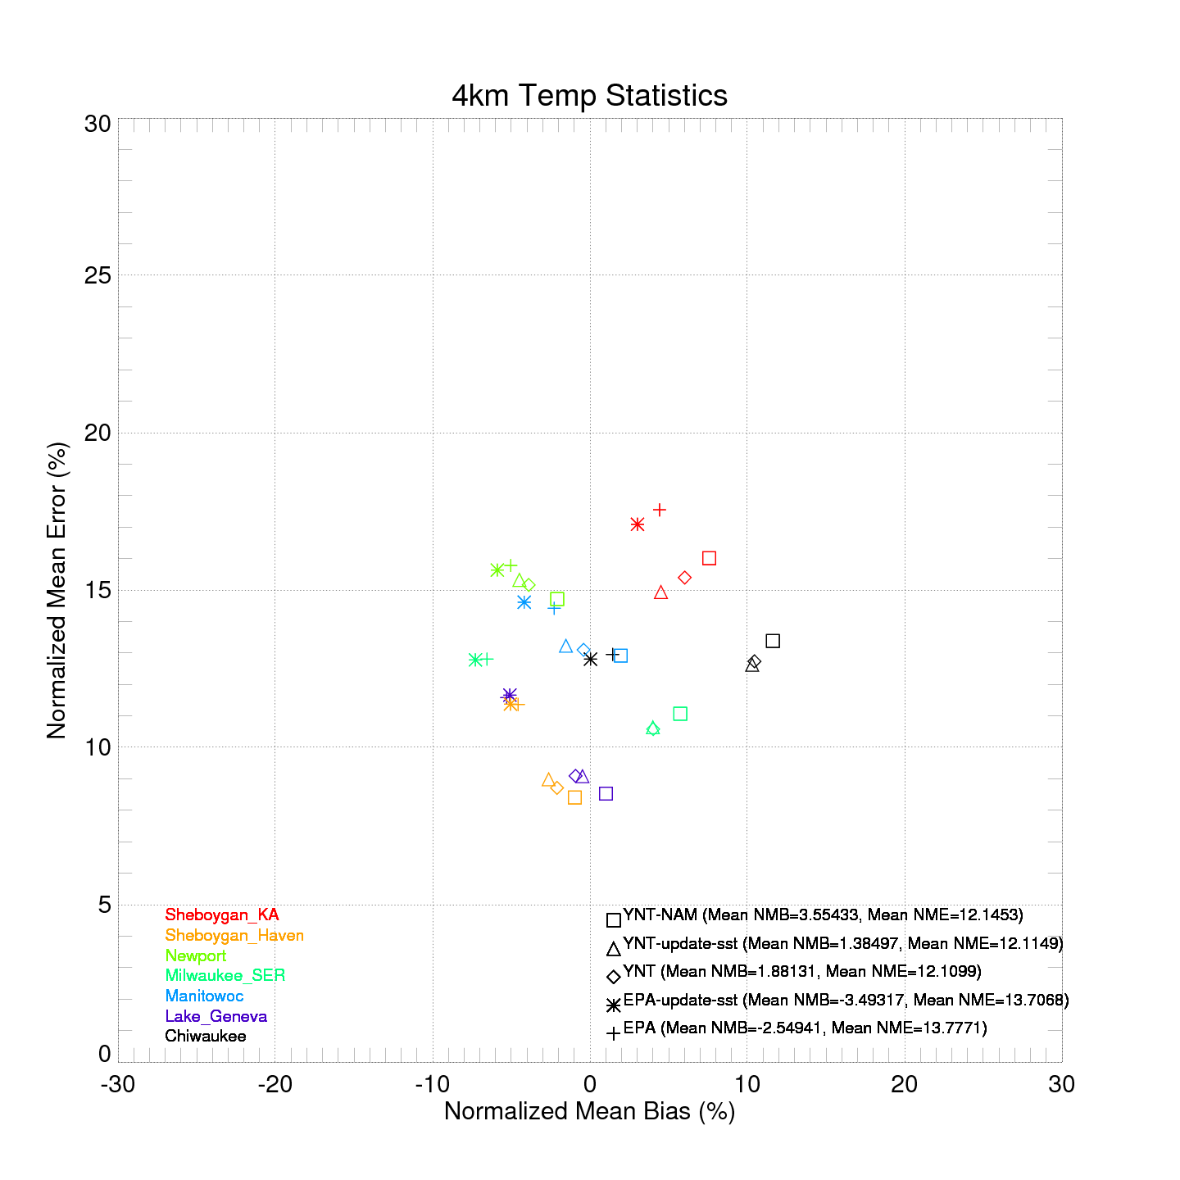
Reduction in Errors and Biases @ Sheboygan_KA and Chiwaukee

Slide 23
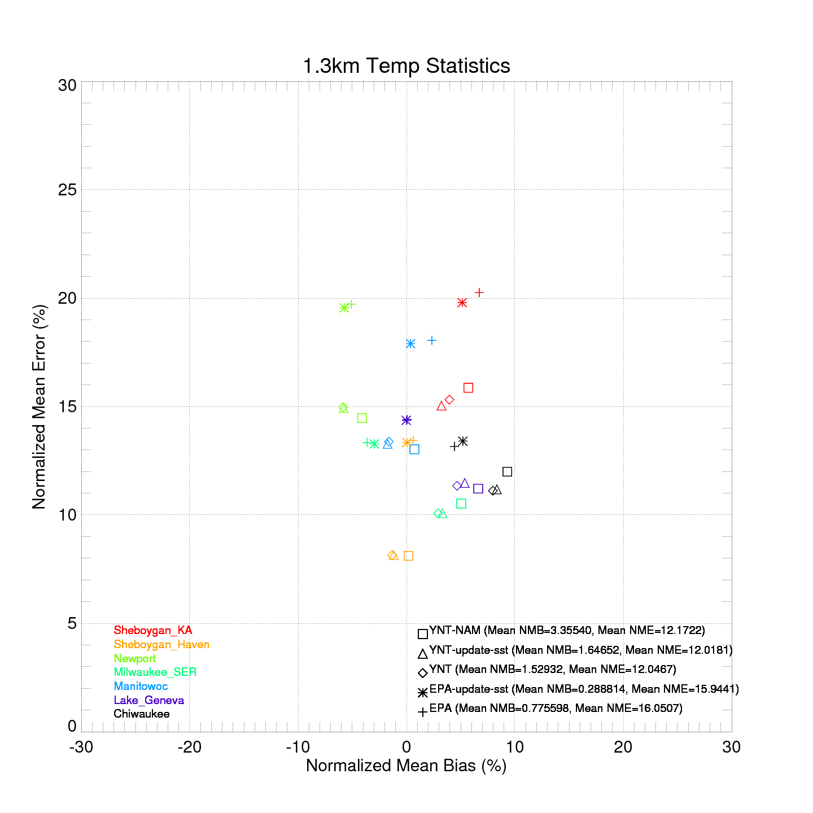
Reduction in Errors and Biases @ Sheboygan_KA and Chiwaukee (YNT)
Increase in Errors and Biases @ Sheboygan_KA and Chiwaukee (EPA Baseline)

Slide 24
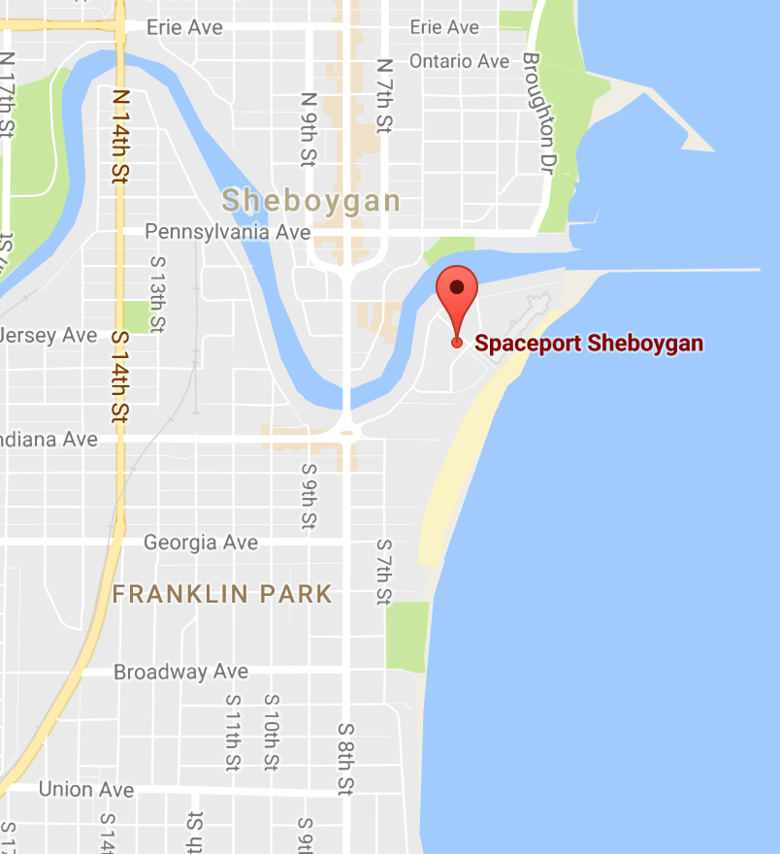
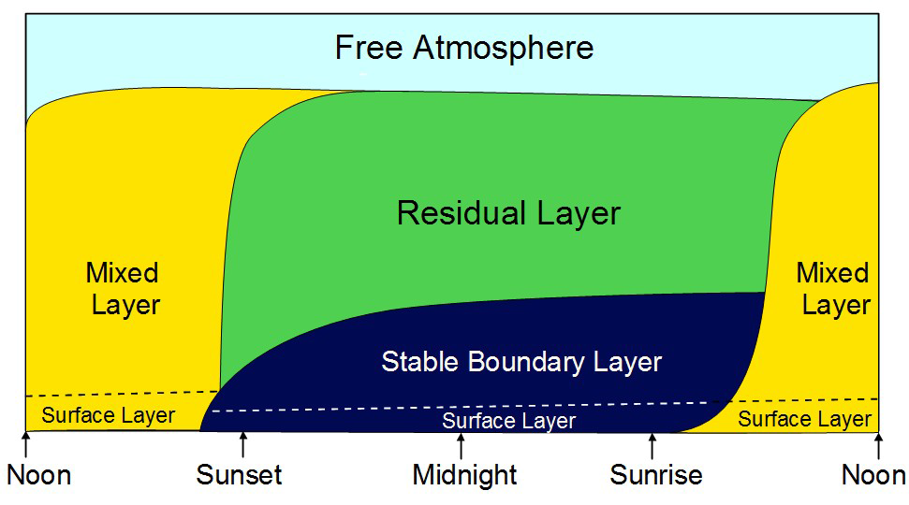
Sheboygan Ground Site: Spaceport Sheboygan
UW-Madison SPARC Trailer
Boundary Layer Meteorology
Profiles: (T, Q, wind, extinction) Atmospheric Emitted Radiance Interferometer (AERI), HSRL Lidar, Doppler lidar wind profiler.

Slide 25
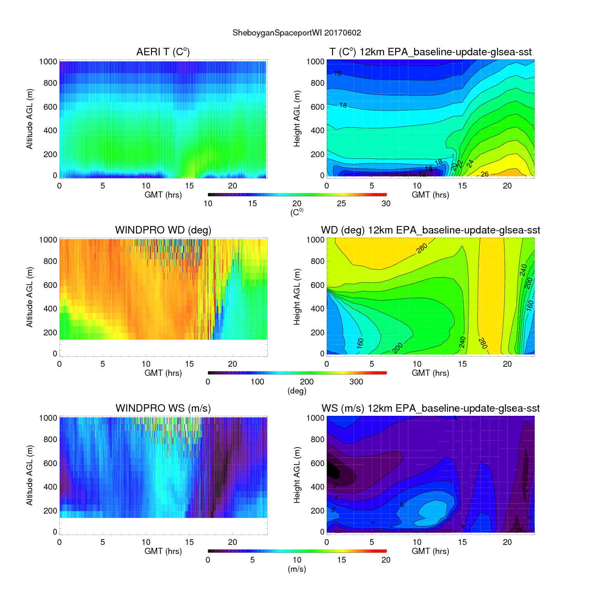
Lake Breeze
12km EPA Baseline
June 02, 2017
Poor performance for Lake Breeze
Underestimate in low level wind speeds
Lake Breeze

Slide 26
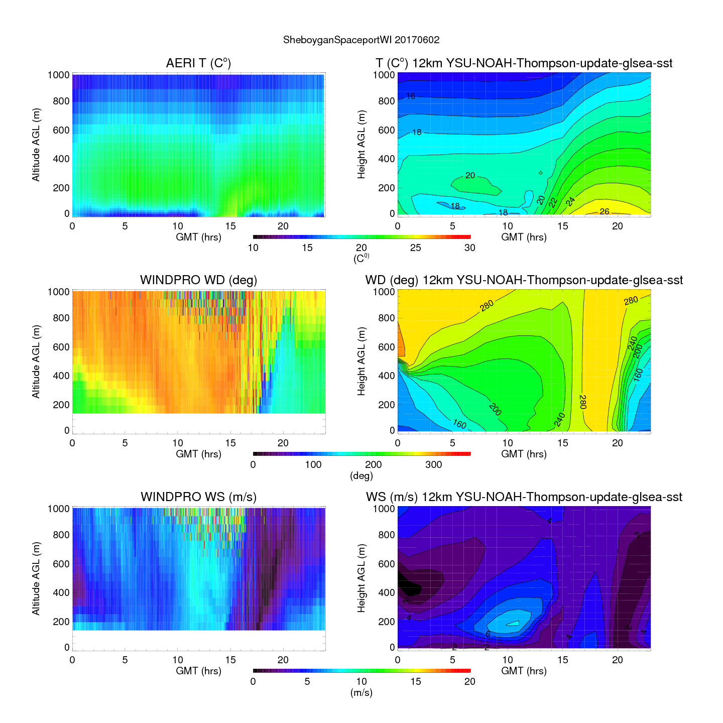
Lake Breeze
12km YSU-NOAH-Thompson
June 02, 2017
Poor performance for Lake Breeze
Underestimate in low level wind speeds
Lake Breeze

Slide 27
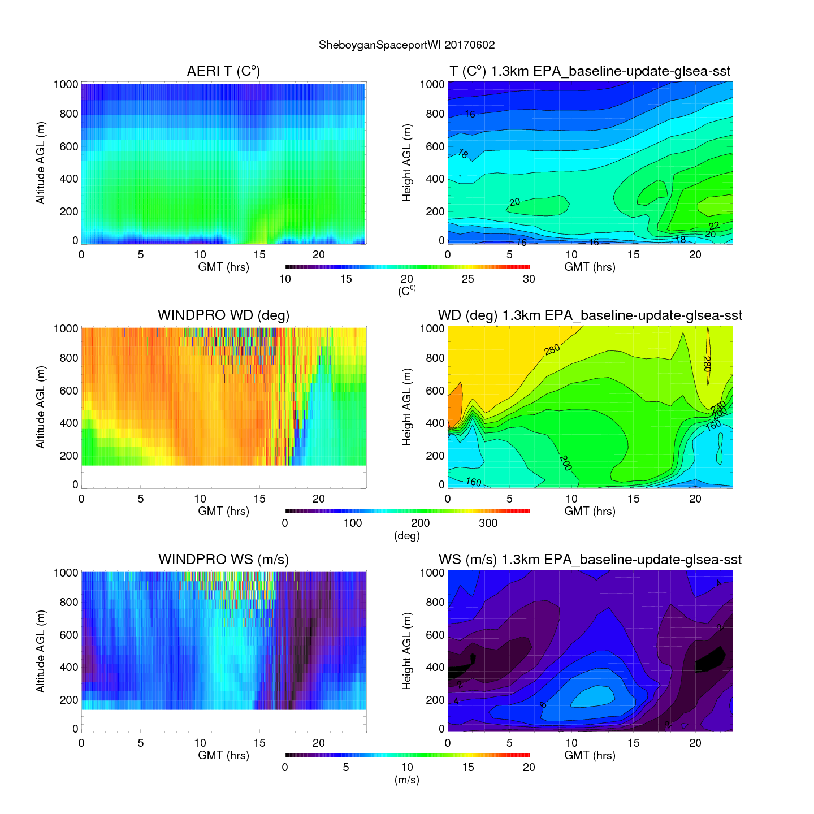
Lake Breeze
1.3km EPA Baseline
June 02, 2017
Poor performance for Lake Breeze
Underestimate in low level wind speeds
Lake Breeze

Slide 28
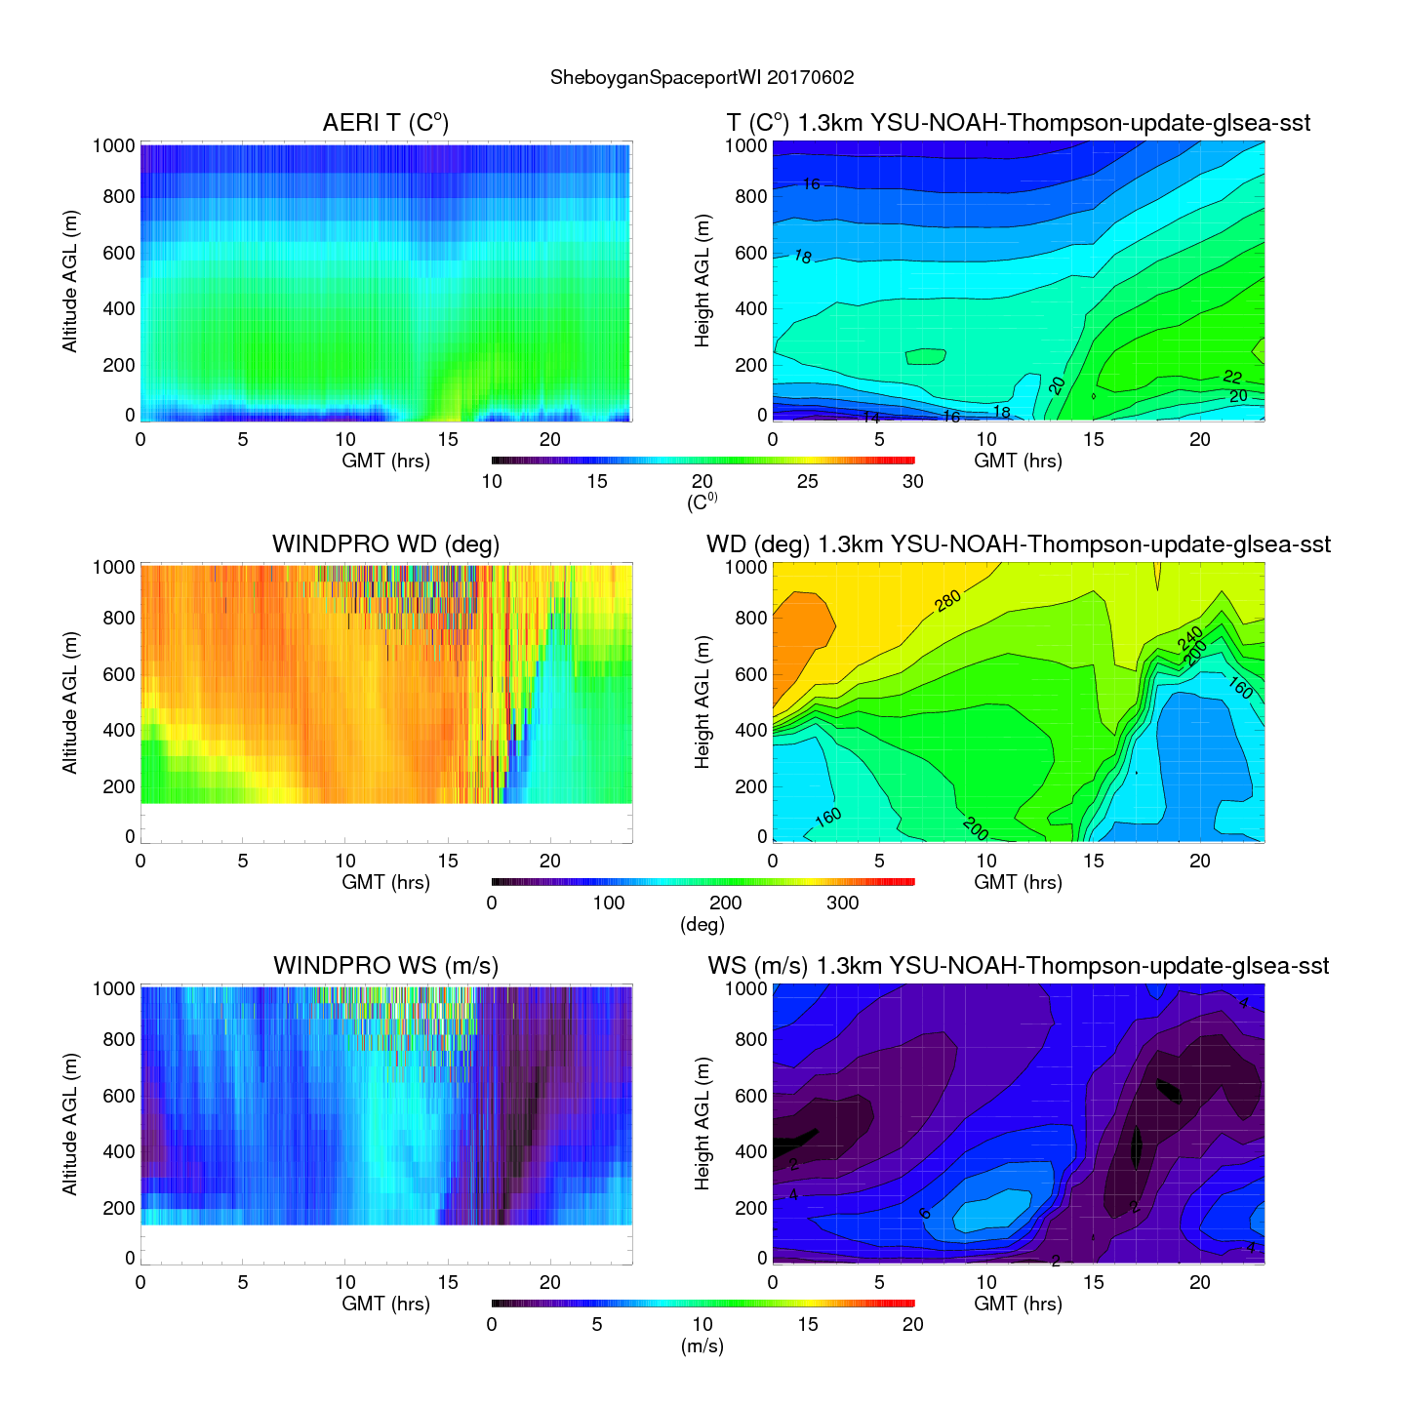
Lake Breeze
1.3km 12km YSU-NOAH-Thompson
June 02, 2017
Improved performance for Lake Breeze
Underestimate in low level wind speeds
Lake Breeze

Slide 29
Summary (Part 1)
NWS NAM-CMAQ underestimates coastal ozone during LMOS 2017 high ozone events
Lake Michigan ozone production during LMOS 2017 appears to be driven by a high NOx urban plume interacting with biogenic VOCs within the stable marine boundary layer.
WRF meteorological modeling studies show that neither EPA baseline or YSU-Noah-Thompson (YNT) platforms are able to capture lake breeze circulations at 12km
YNT platform is better at capturing lake breeze circulations at 1.3km

