Slide 1
Chiwaukee WRF EPA Baseline (12,4,1.3km)

Slide 2
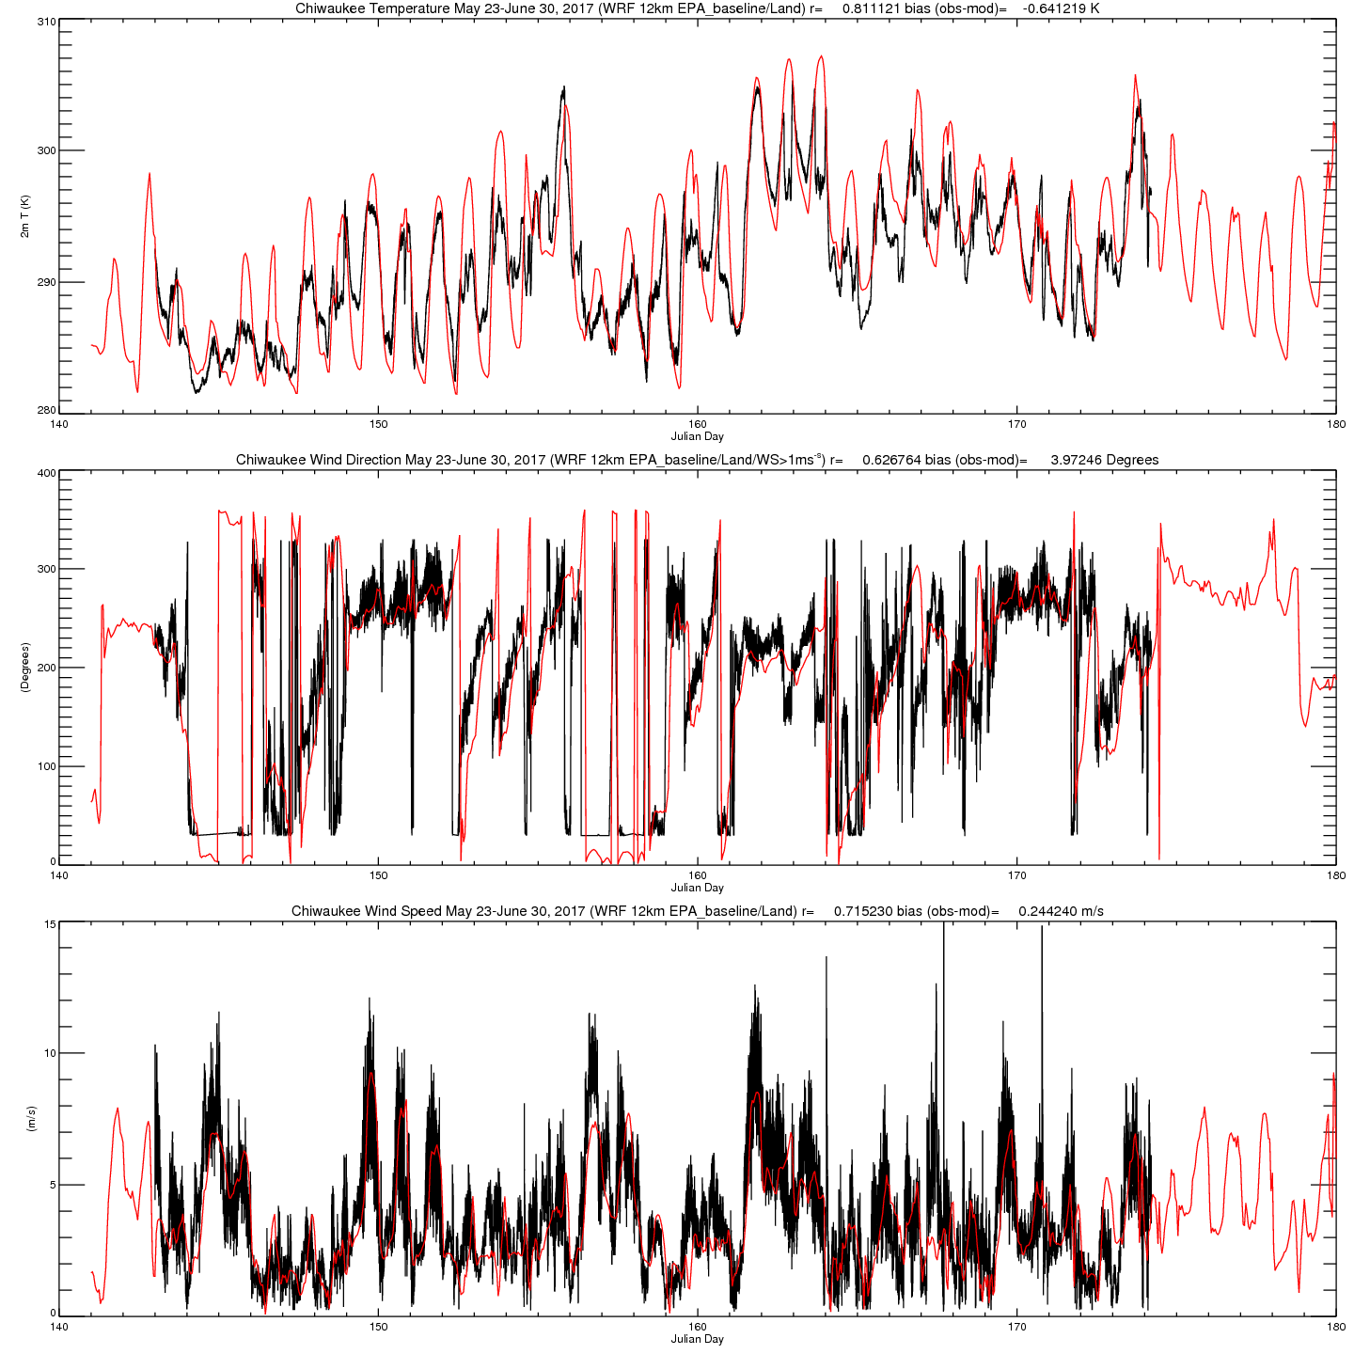
June 2
June 4
June 10-12
June 14-16
Green=Ozone >70ppbv
D
D
S
S
D
S
S
D=Deep Lake Breeze
S=Shallow Lake Breeze

Slide 3
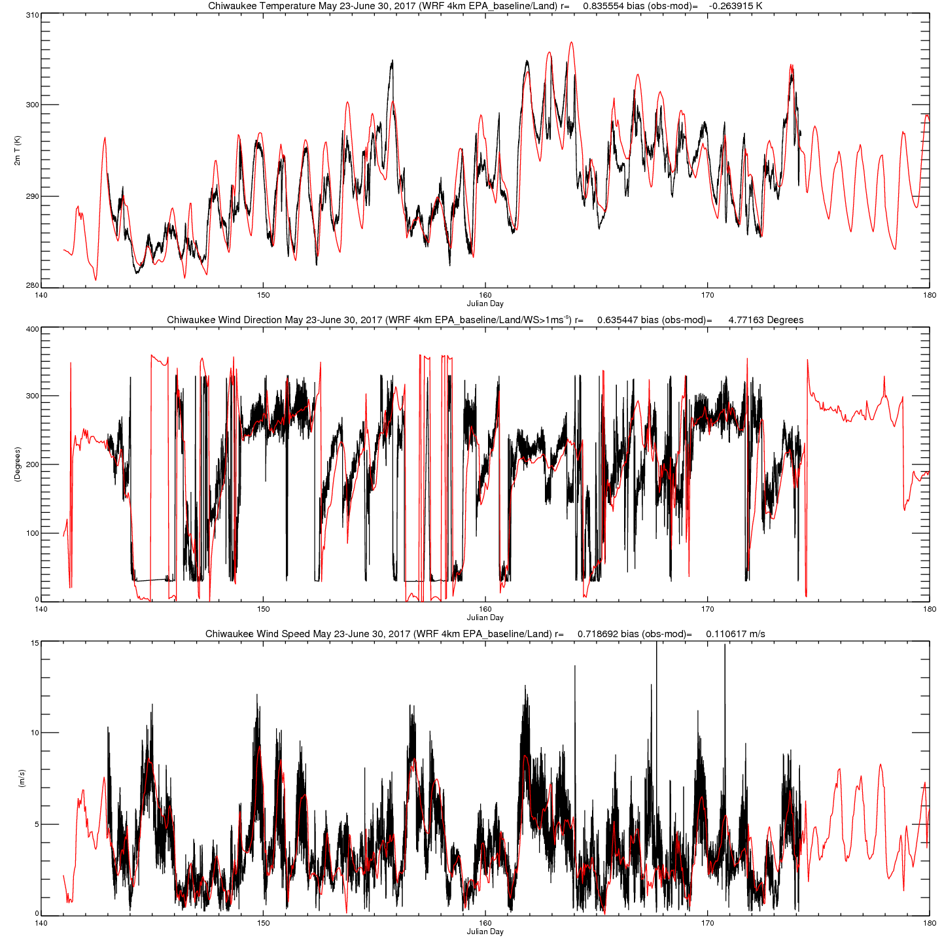
June 2
June 4
June 10-12
June 14-16
Green=Ozone >70ppbv
D
D
S
S
D
S
S
D=Deep Lake Breeze
S=Shallow Lake Breeze

Slide 4
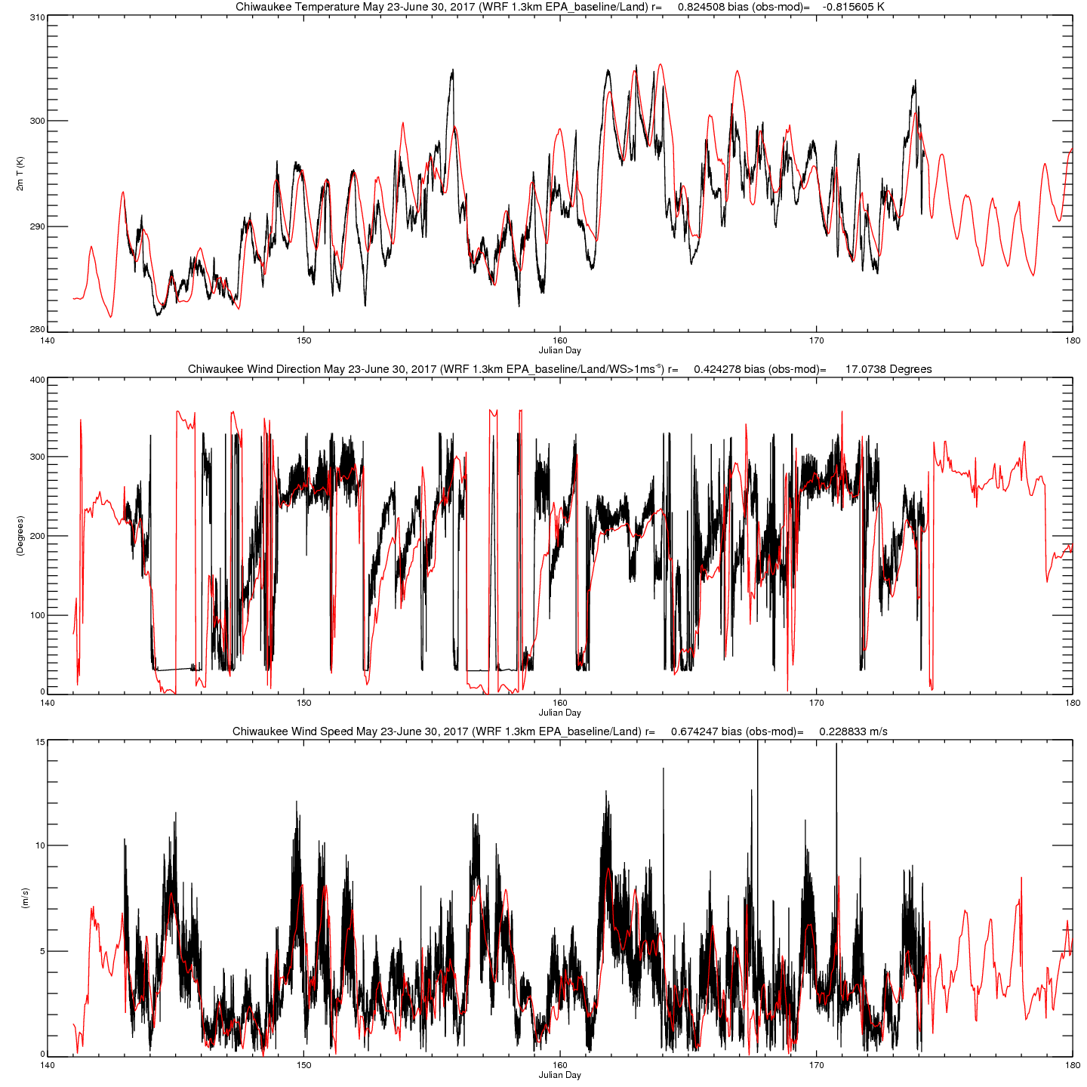
June 2
June 4
June 10-12
June 14-16
Green=Ozone >70ppbv
D
D
S
S
D
S
S
D=Deep Lake Breeze
S=Shallow Lake Breeze

Slide 5
Chiwaukee WRF EPA Baseline (12,4,1.3km)
GLSEA SST, MODIS LAI

Slide 6
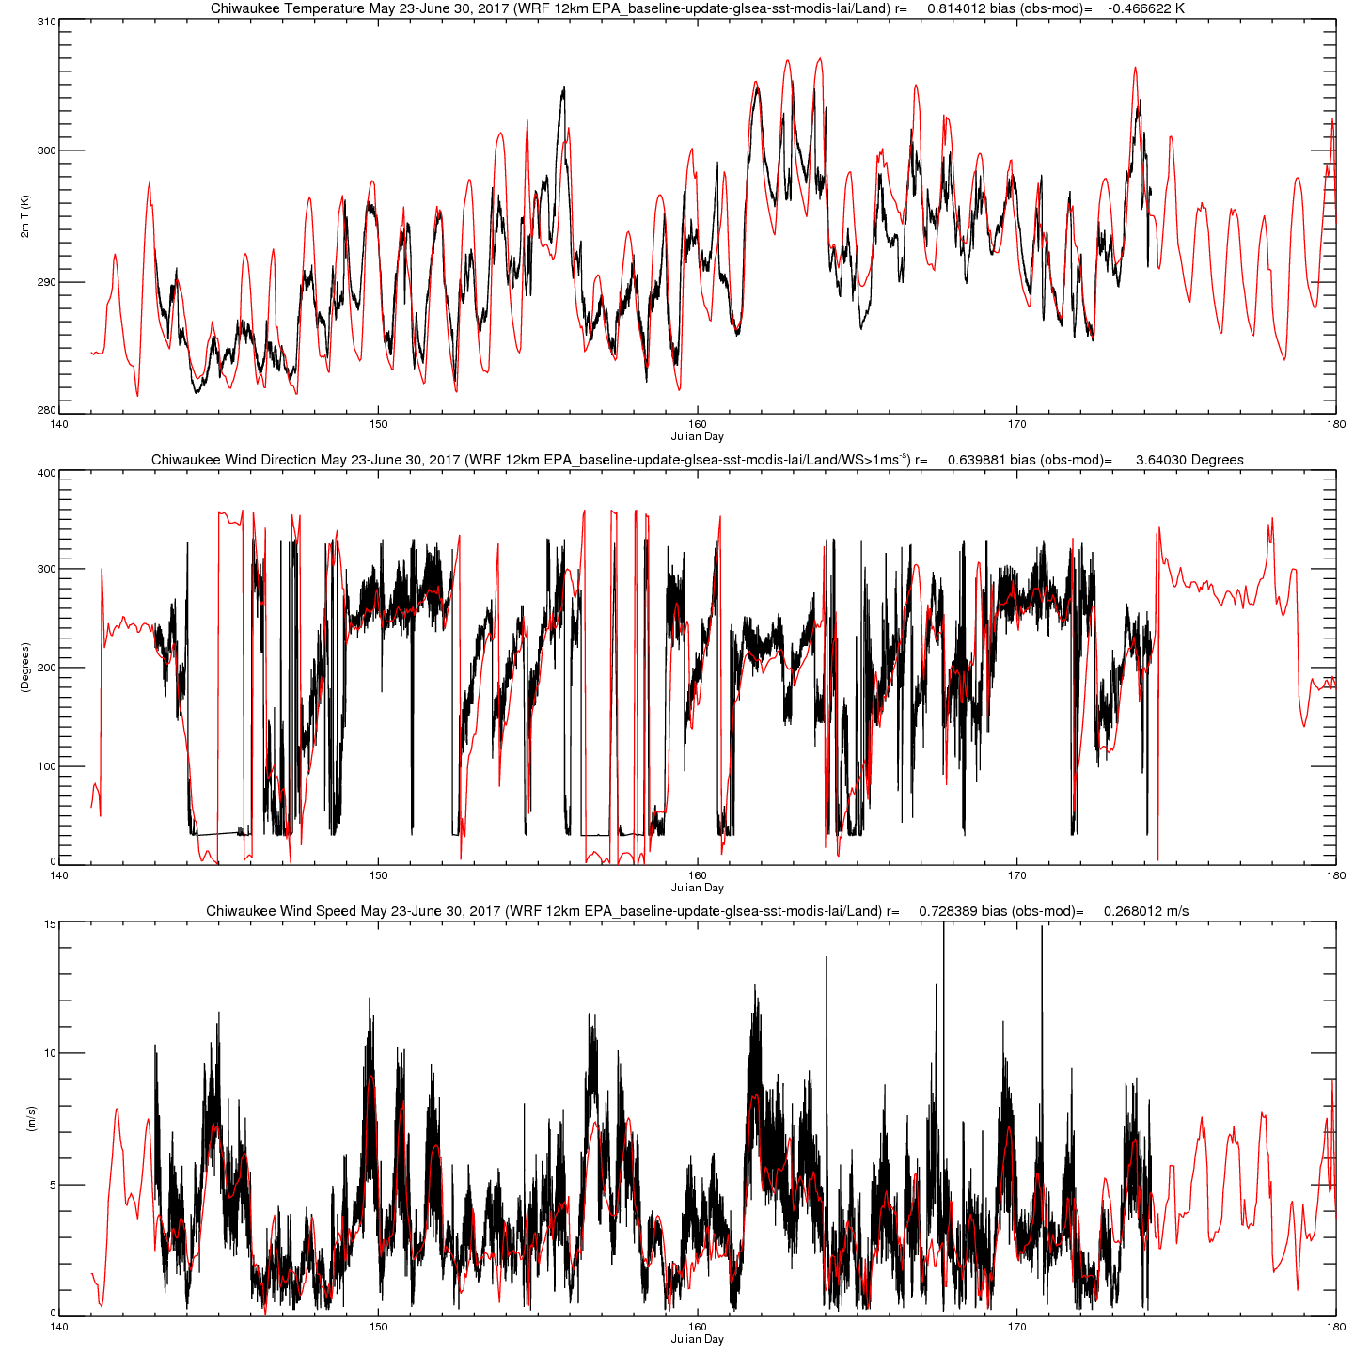
June 2
June 4
June 10-12
June 14-16
Green=Ozone >70ppbv
D
D
S
S
D
S
S
D=Deep Lake Breeze
S=Shallow Lake Breeze

Slide 7
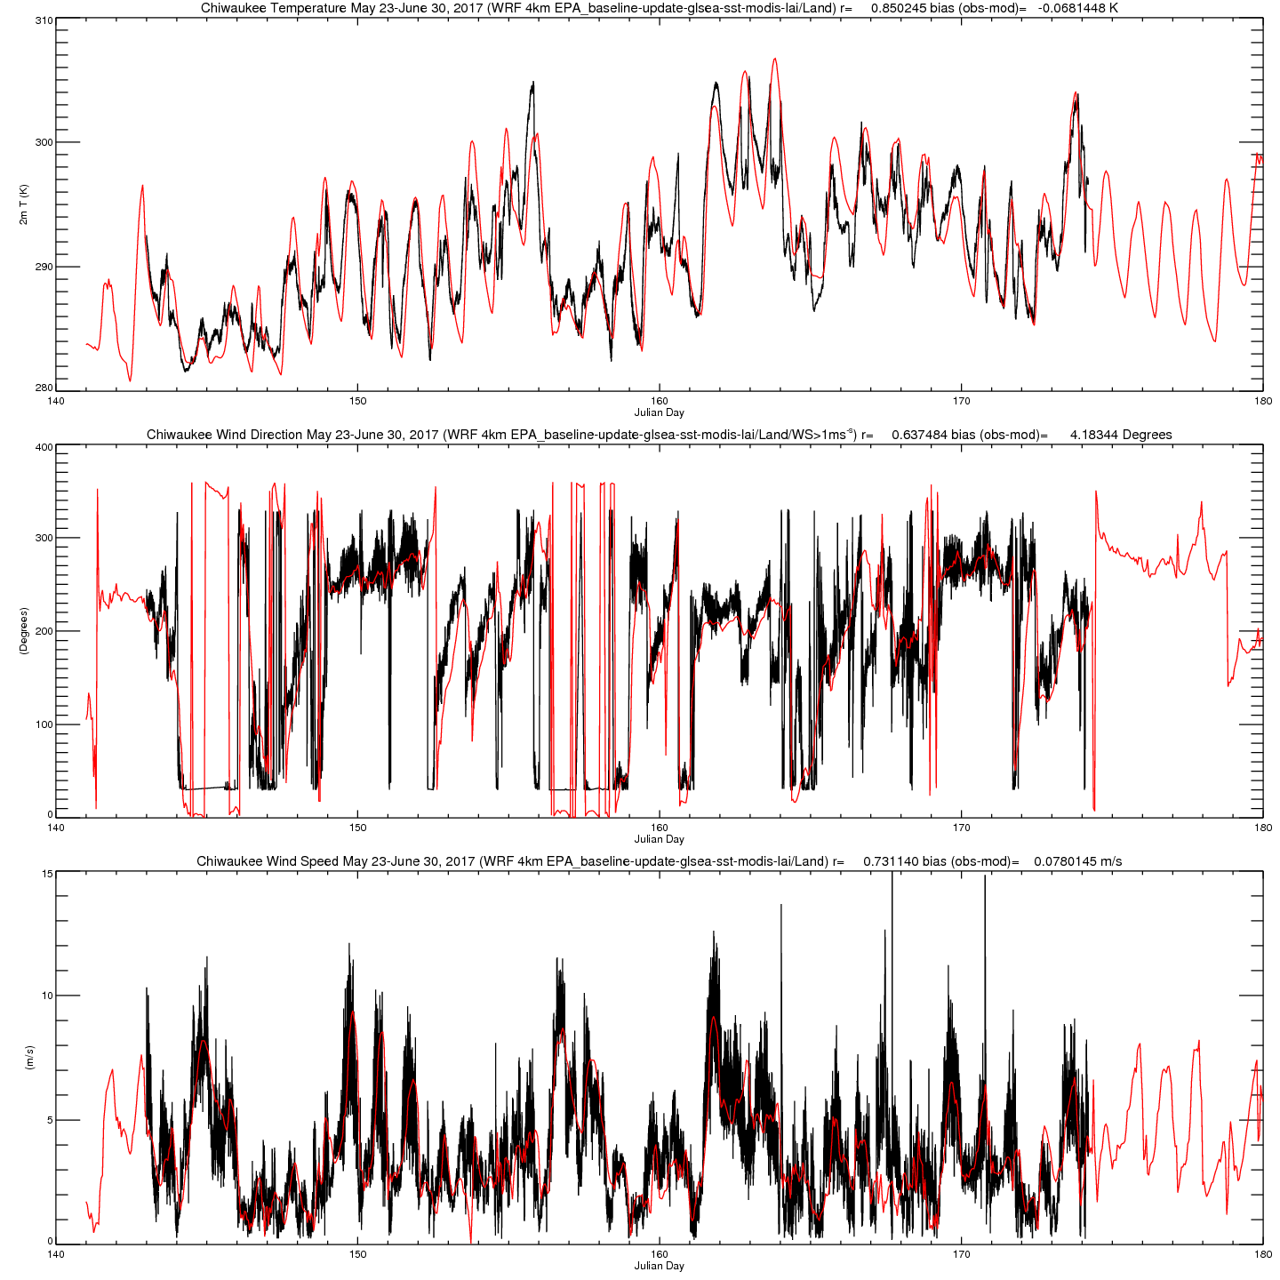
June 2
June 4
June 10-12
June 14-16
Green=Ozone >70ppbv
D
D
S
S
D
S
S
D=Deep Lake Breeze
S=Shallow Lake Breeze

Slide 8
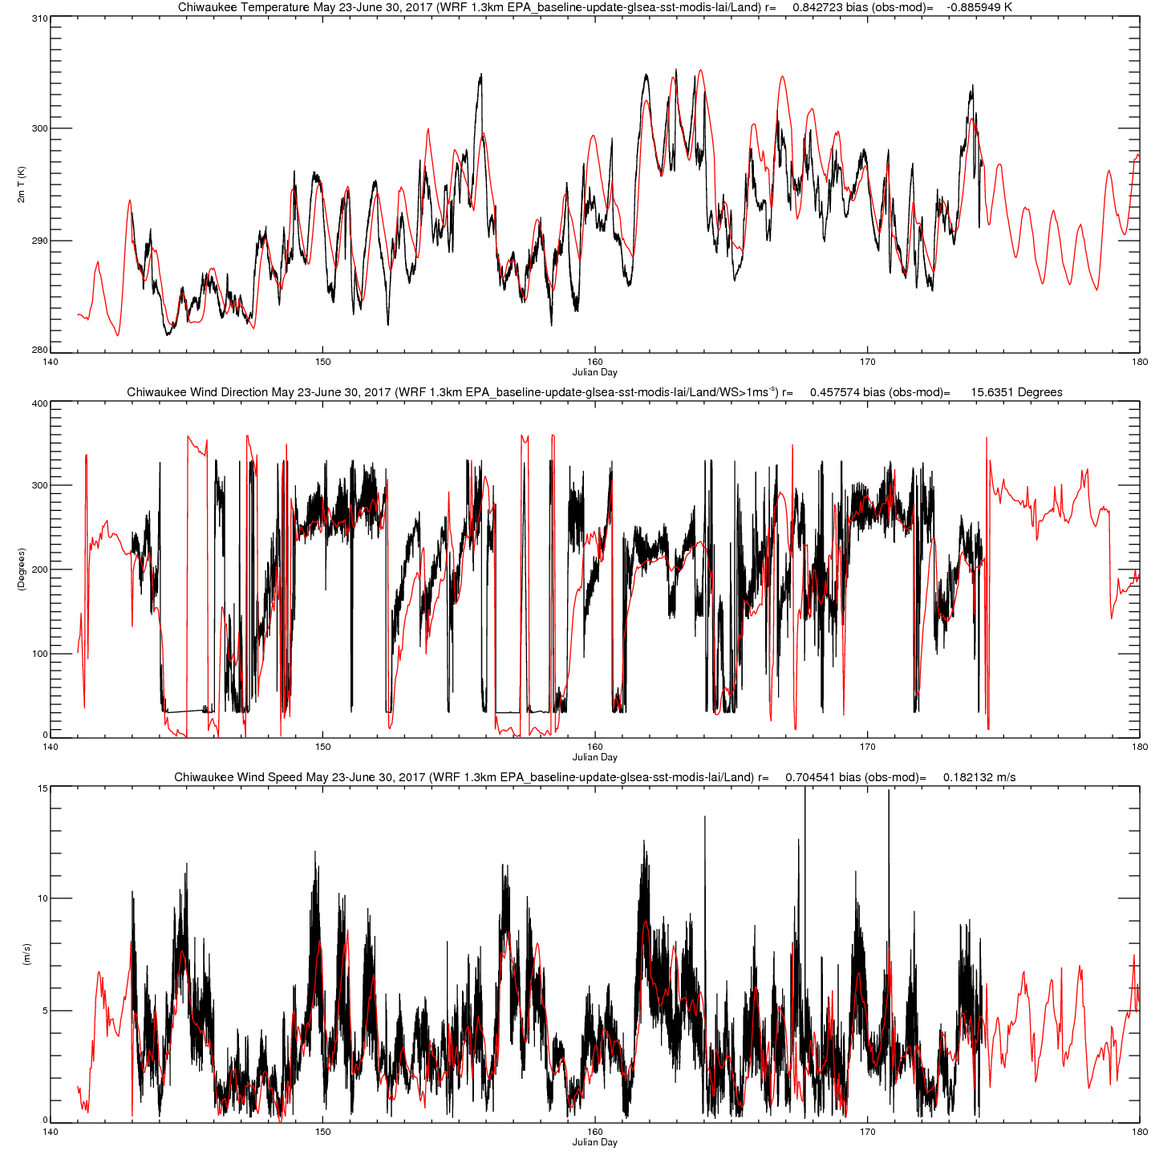
June 2
June 4
June 10-12
June 14-16
Green=Ozone >70ppbv
D
D
S
S
D
S
S
D=Deep Lake Breeze
S=Shallow Lake Breeze

Slide 9
Chiwaukee WRF YSU-NOAH-Thompson (12,4,1.3km)

Slide 10
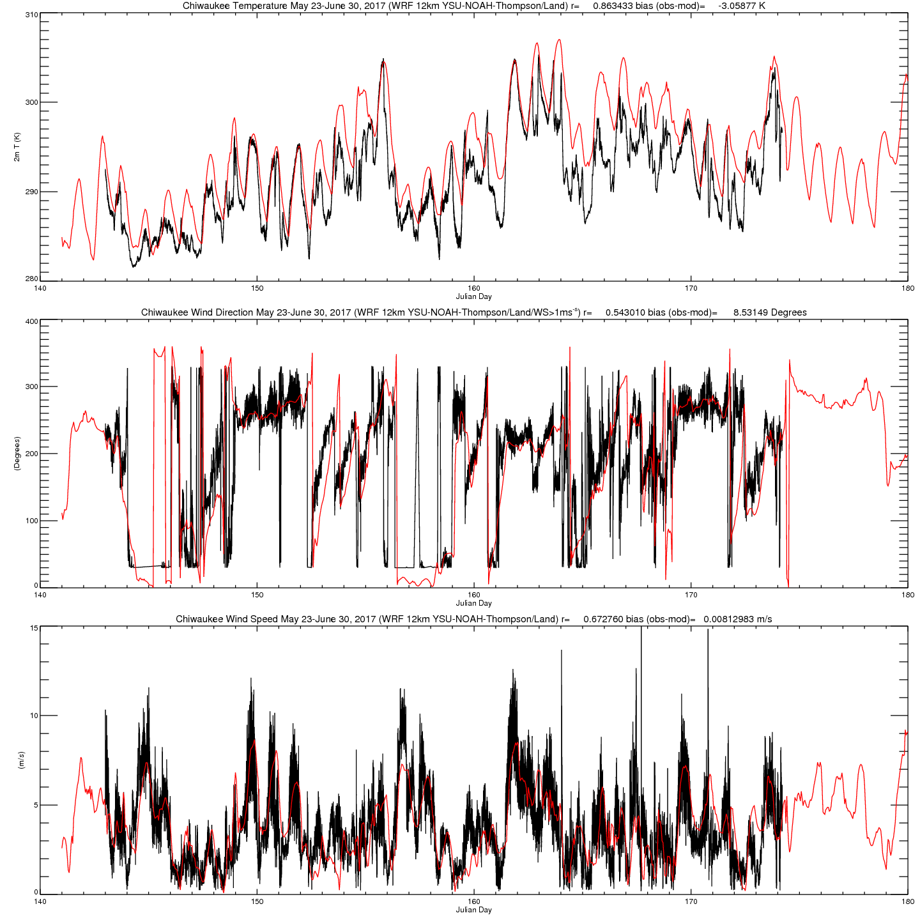
June 2
June 4
June 10-12
June 14-16
Green=Ozone >70ppbv
D
D
S
S
D
S
S
D=Deep Lake Breeze
S=Shallow Lake Breeze

Slide 11
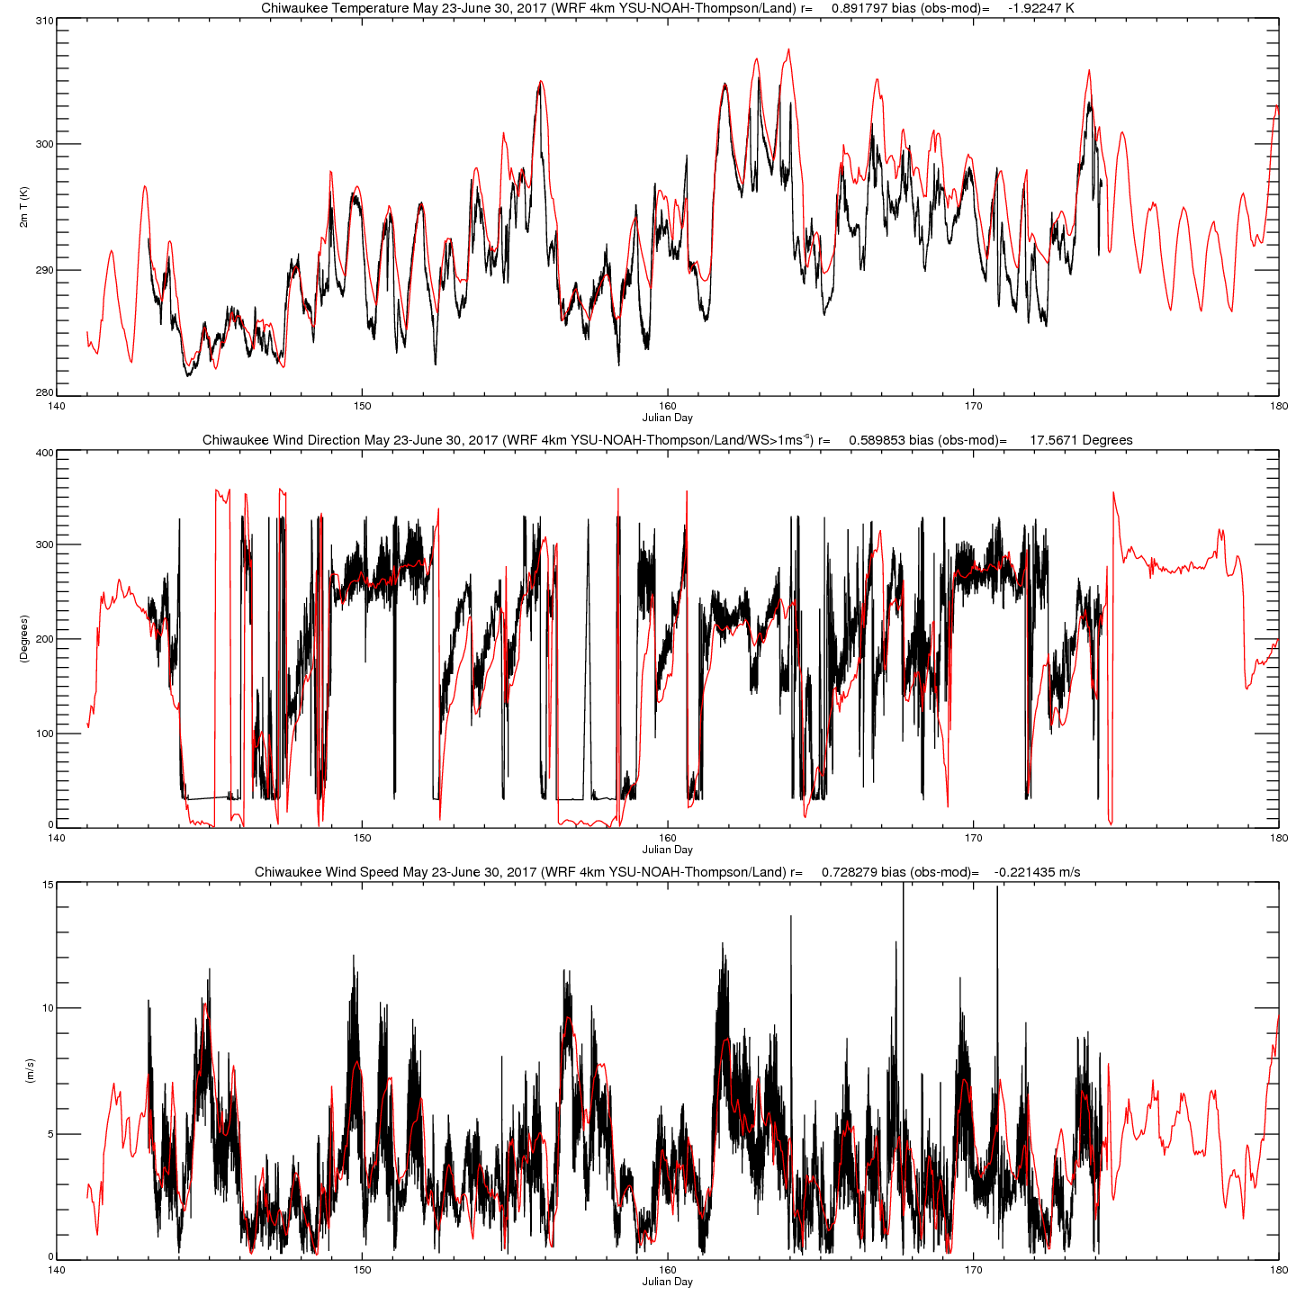
June 2
June 4
June 10-12
June 14-16
Green=Ozone >70ppbv
D
D
S
S
D
S
S
D=Deep Lake Breeze
S=Shallow Lake Breeze

Slide 12
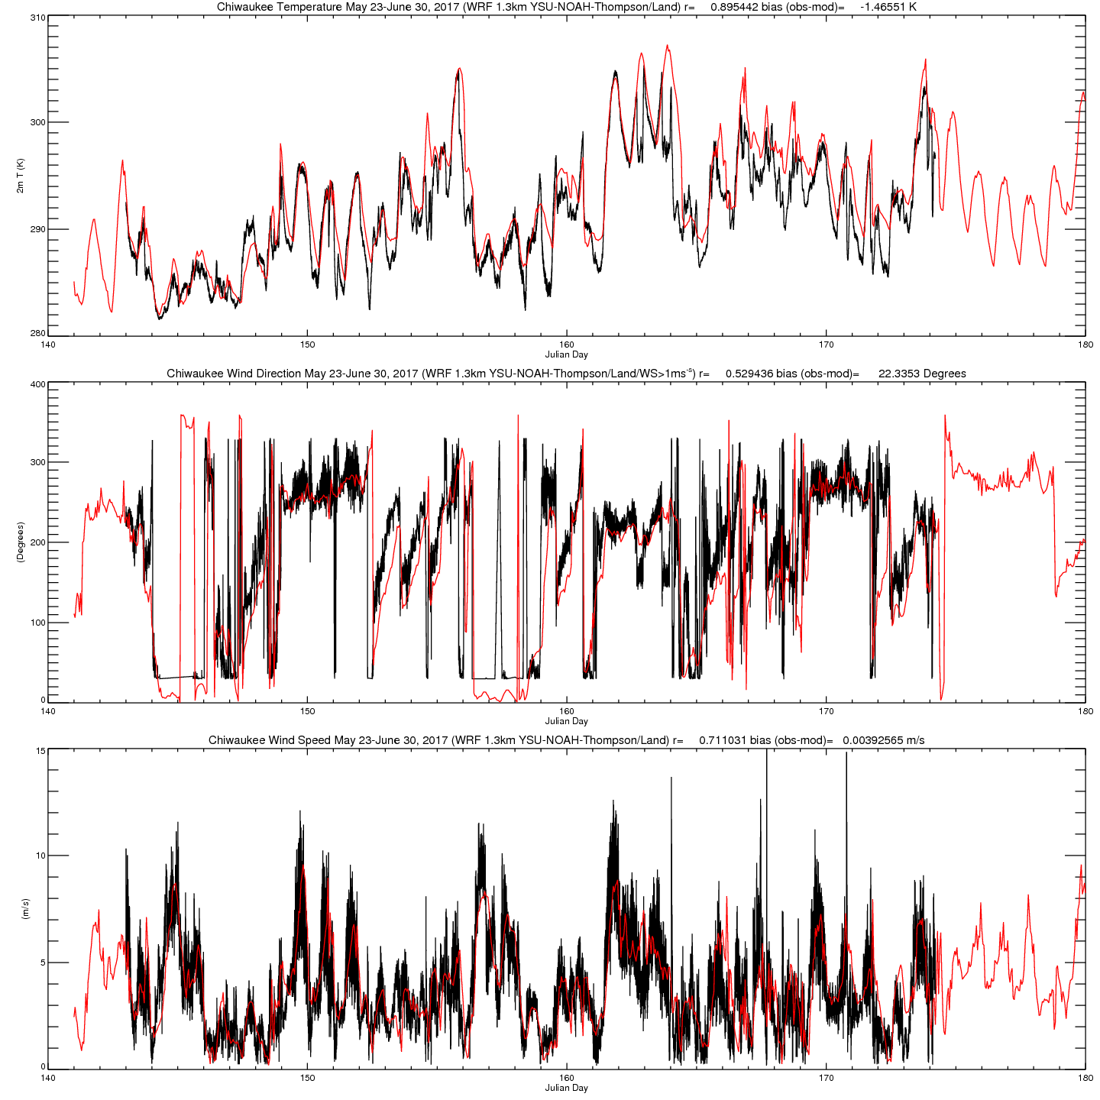
June 2
June 4
June 10-12
June 14-16
Green=Ozone >70ppbv
D
D
S
S
D
S
S
D=Deep Lake Breeze
S=Shallow Lake Breeze

Slide 13
Chiwaukee WRF YSU-NOAH-Thompson (12,4,1.3km)
NAM

Slide 14
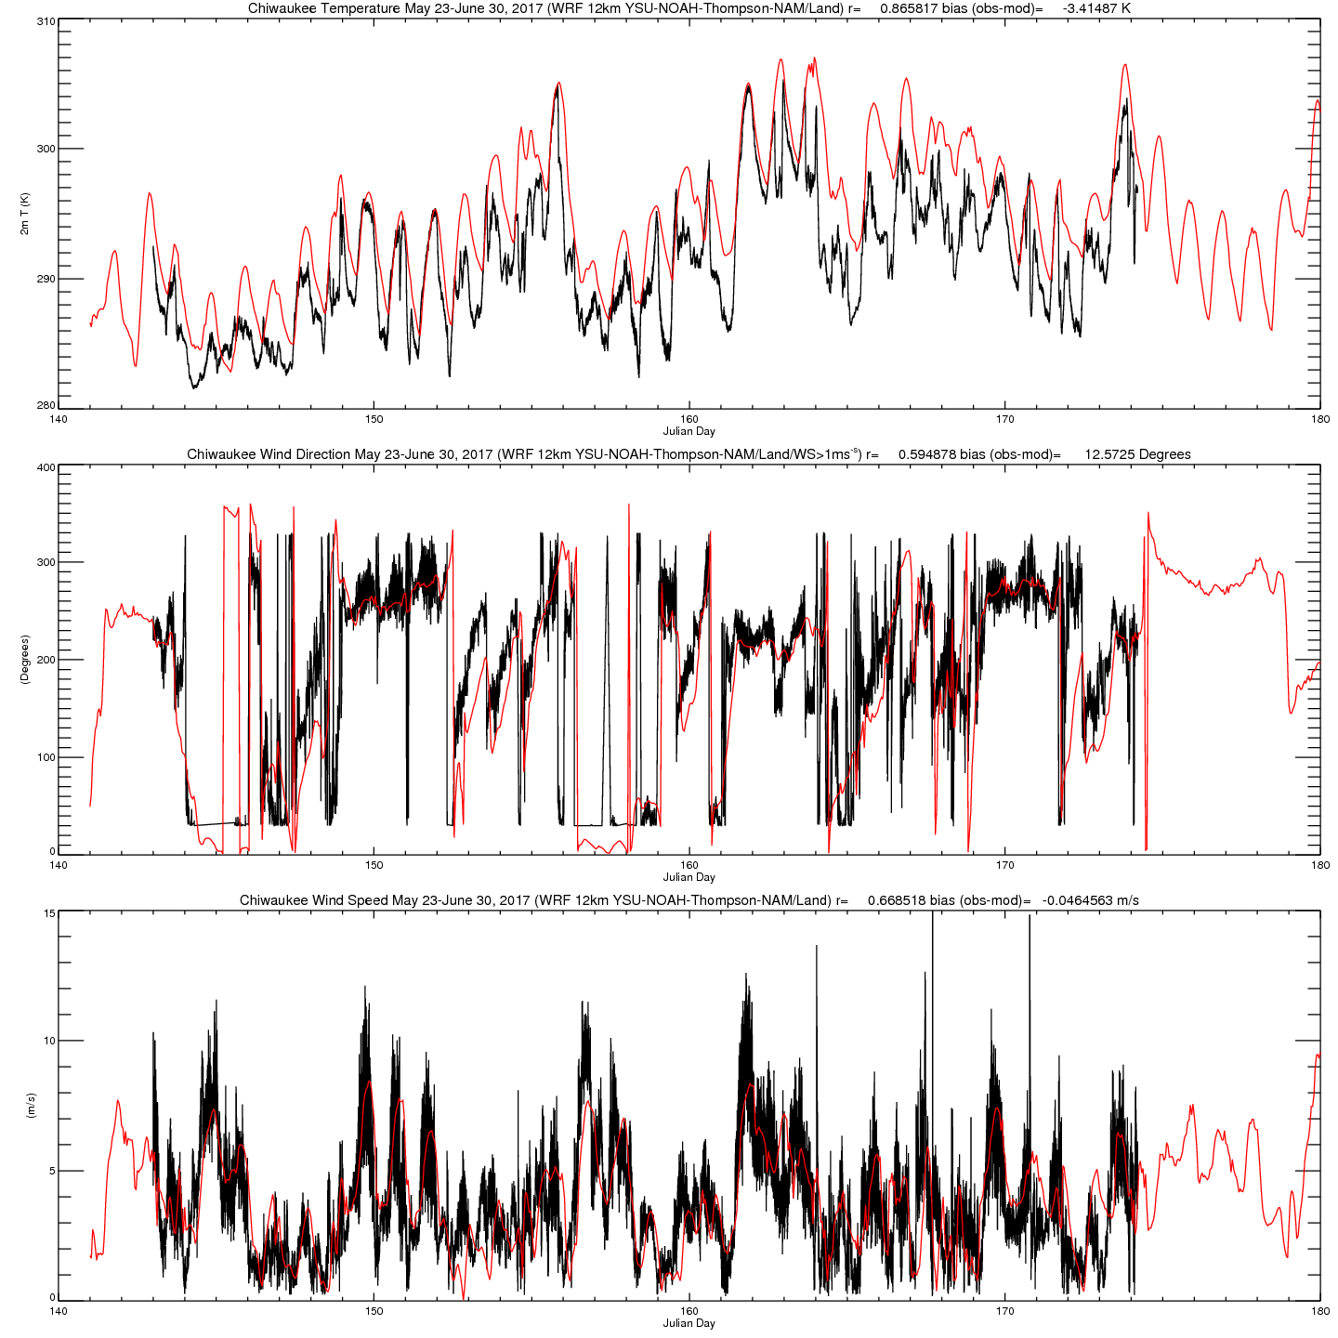
June 2
June 4
June 10-12
June 14-16
Green=Ozone >70ppbv
D
D
S
S
D
S
S
D=Deep Lake Breeze
S=Shallow Lake Breeze

Slide 15
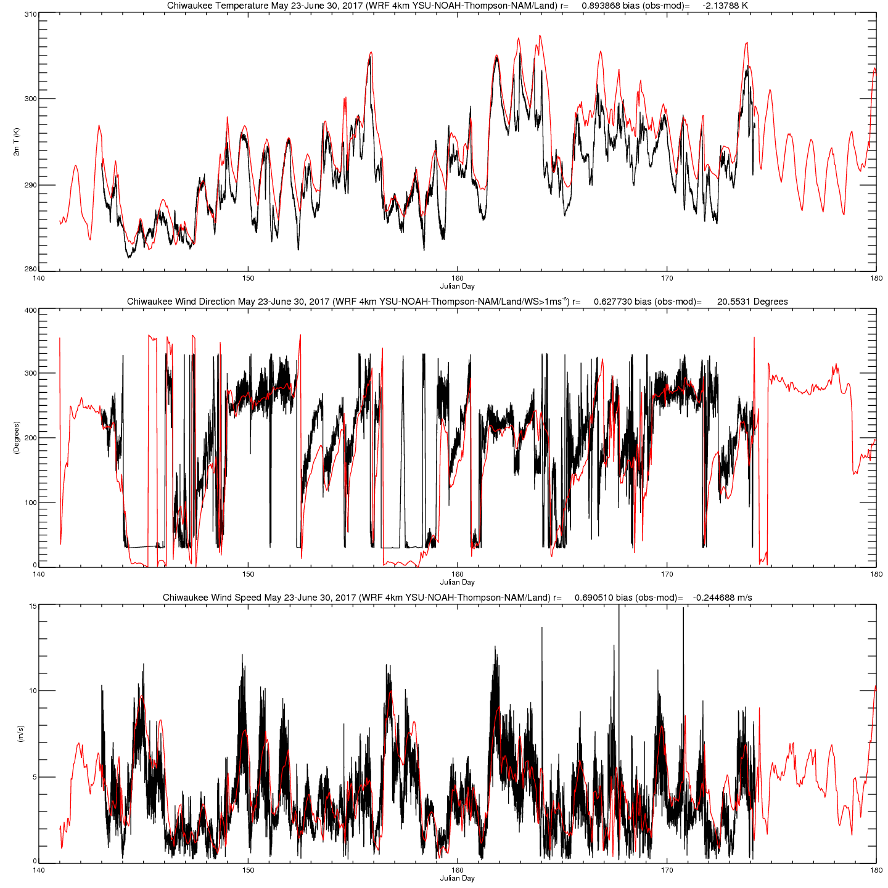
June 2
June 4
June 10-12
June 14-16
Green=Ozone >70ppbv
D
D
S
S
D
S
S
D=Deep Lake Breeze
S=Shallow Lake Breeze

Slide 16
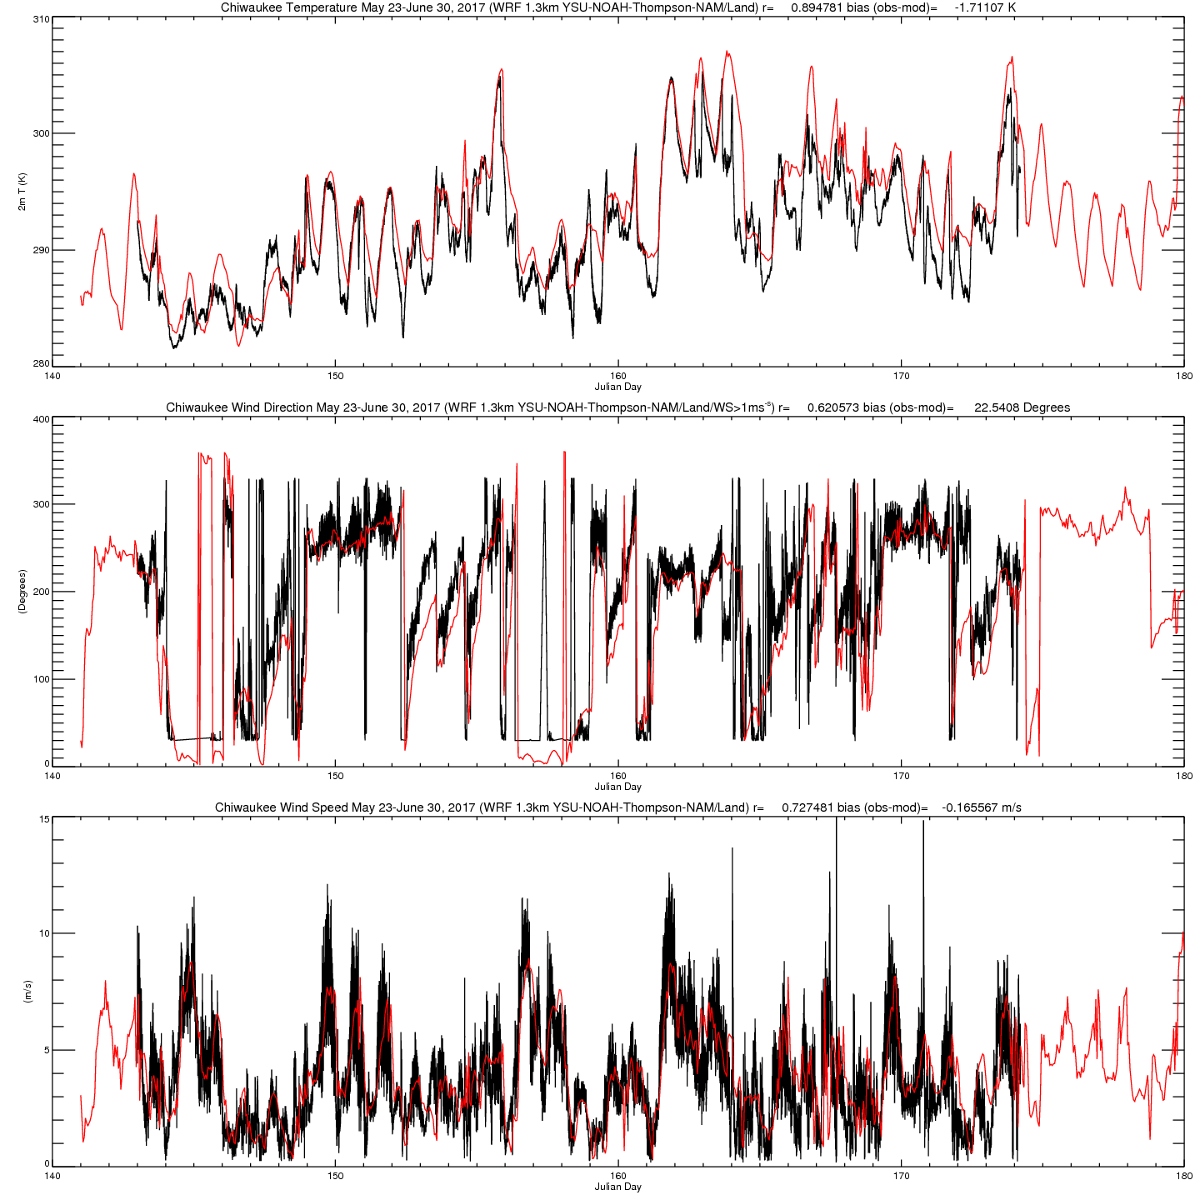
June 2
June 4
June 10-12
June 14-16
Green=Ozone >70ppbv
D
D
S
S
D
S
S
D=Deep Lake Breeze
S=Shallow Lake Breeze

Slide 17
Chiwaukee WRF YSU-NOAH-Thompson (12,4,1.3km)
GLSEA SST, MODIS LAI

Slide 18
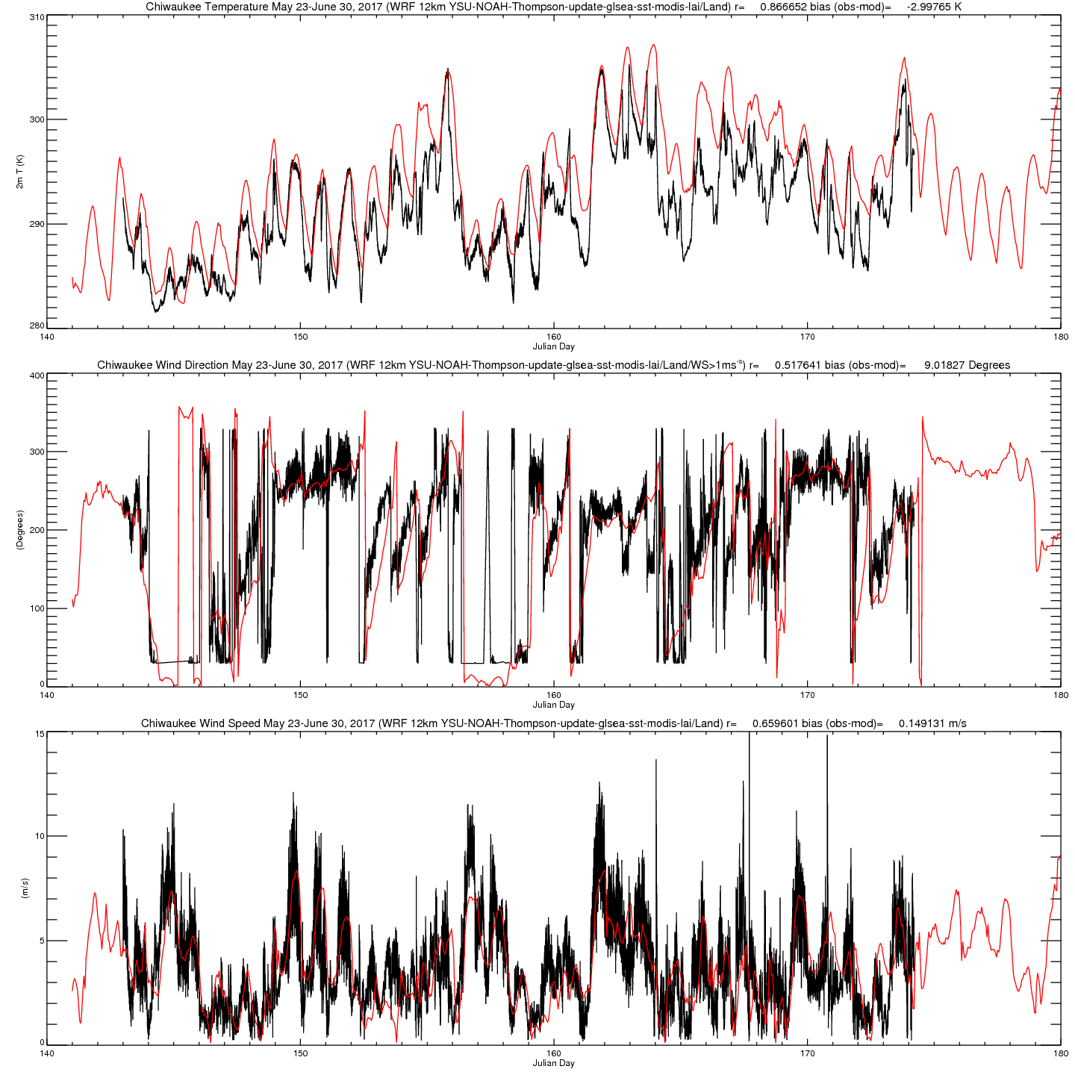
June 2
June 4
June 10-12
June 14-16
Green=Ozone >70ppbv
D
D
S
S
D
S
S
D=Deep Lake Breeze
S=Shallow Lake Breeze

Slide 19
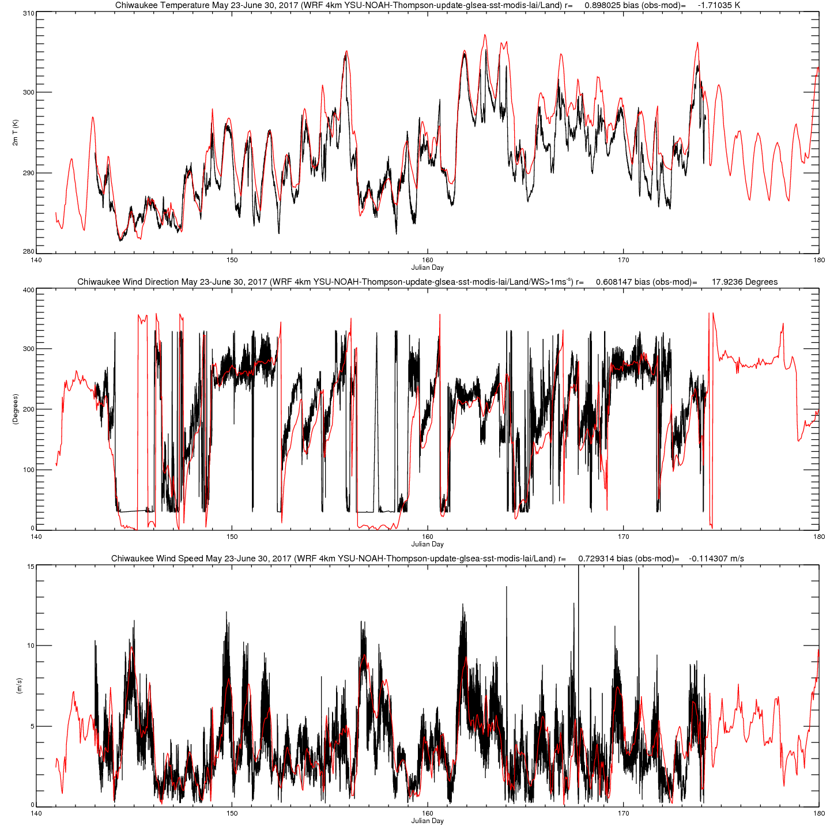
June 2
June 4
June 10-12
June 14-16
Green=Ozone >70ppbv
D
D
S
S
D
S
S
D=Deep Lake Breeze
S=Shallow Lake Breeze

Slide 20
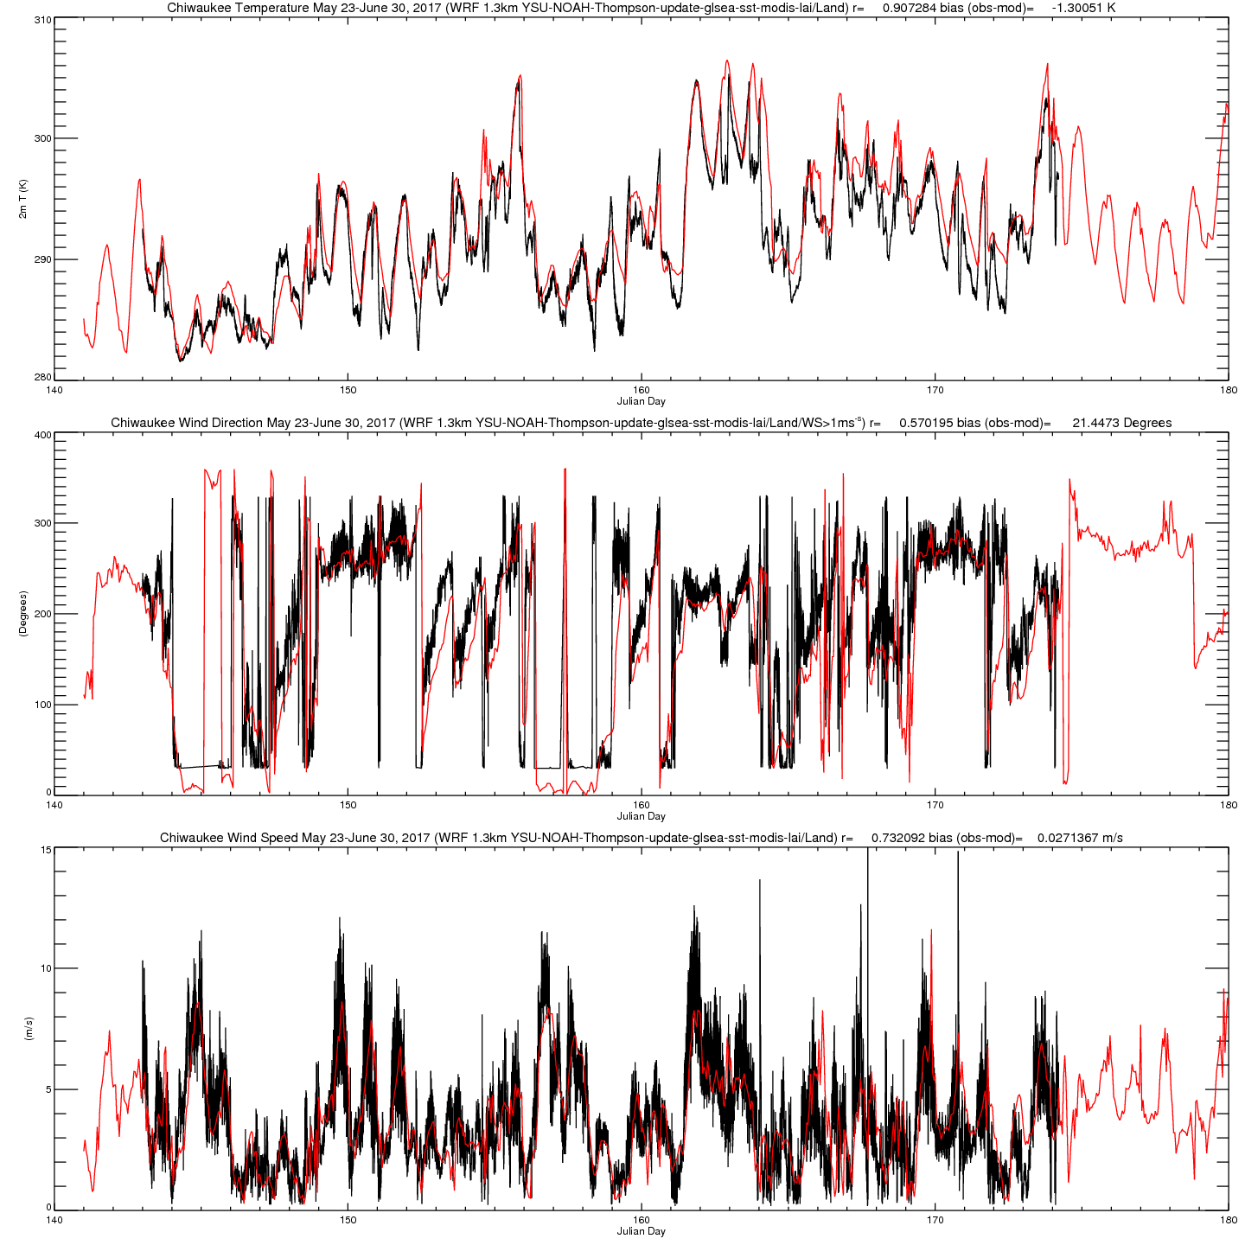
June 2
June 4
June 10-12
June 14-16
Green=Ozone >70ppbv
D
D
S
S
D
S
S
D=Deep Lake Breeze
S=Shallow Lake Breeze

