Slide 1
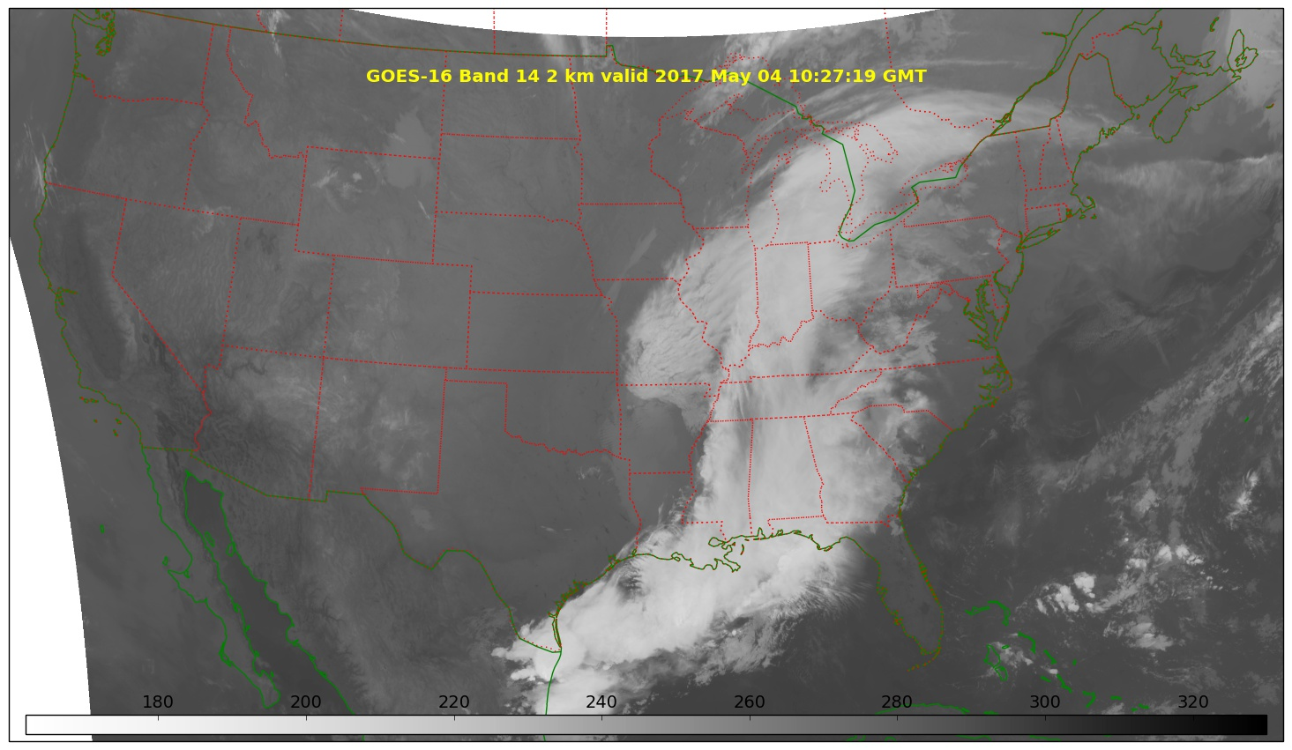
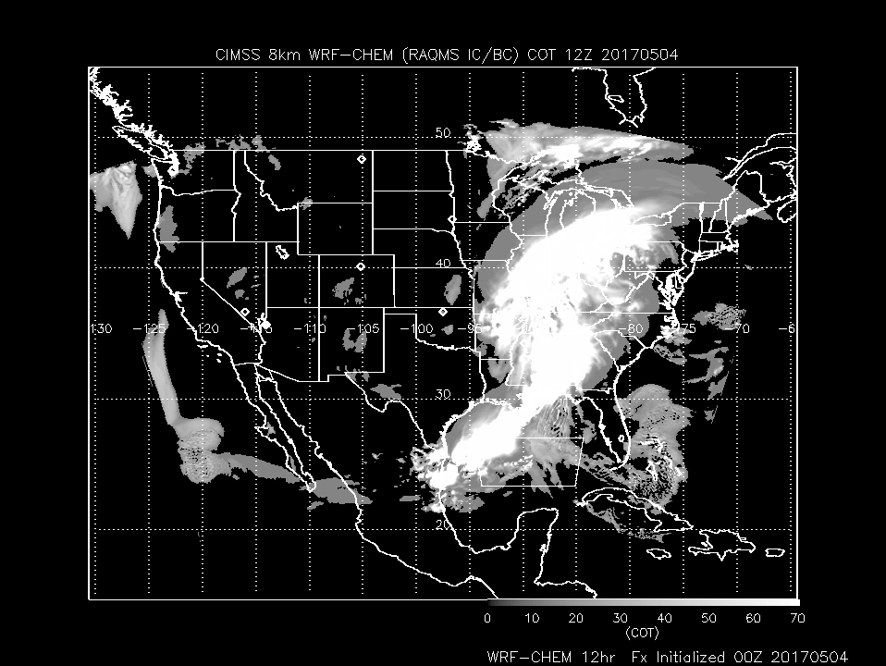
CIMSS FX 20170504
Low pressure system over Ohio River Valley extending to Gulf bringing cirrus into Southern WI and clouds over Chicago
Note 2 hour time difference
WRF-CHEM at 12Z (7:00am CDT)
GOES-16 at 10Z (5:00am CDT)

Slide 2
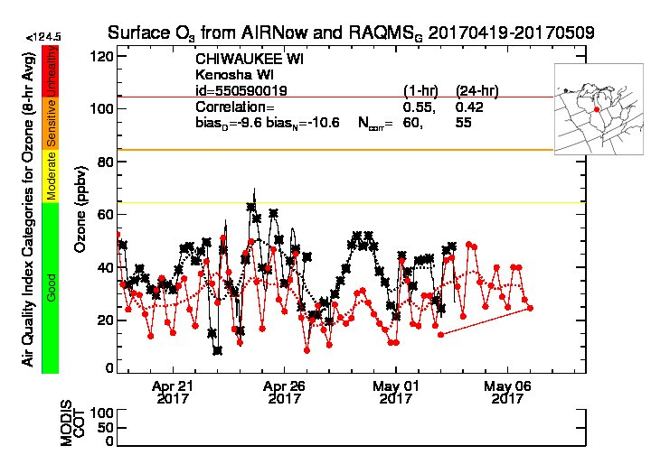
RAQMS (red, 1x1 degree) underestimates SFC O3 (black) at Chiwaukee by 9.6ppbv (daytime, more significantly April 28-May 1)
http://raqms.ssec.wisc.edu/o3_verification/ts/latest/WI/3800/550590019

Slide 3
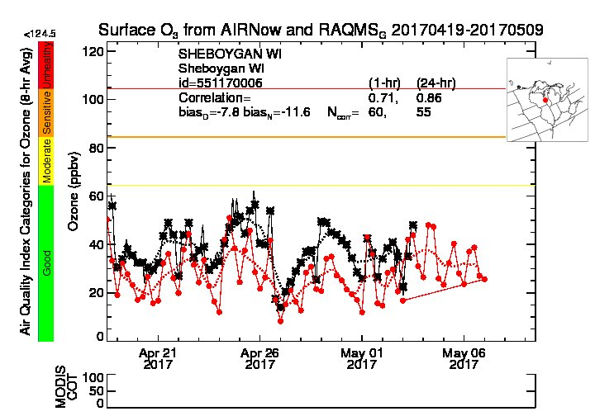
RAQMS (red, 1x1 degree) underestimates SFC O3 (black) at Sheboygan by 7.8ppbv (daytime, more significantly April 28-May 1)
http://raqms.ssec.wisc.edu/o3_verification/ts/latest/WI/7620/551170006

Slide 4
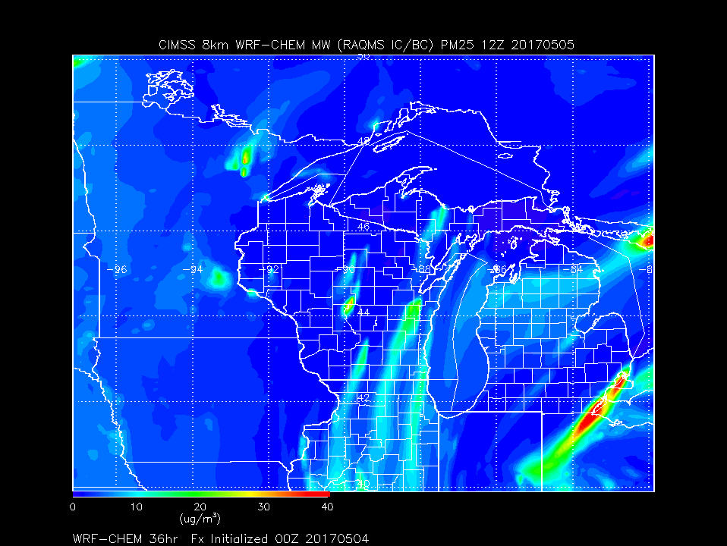
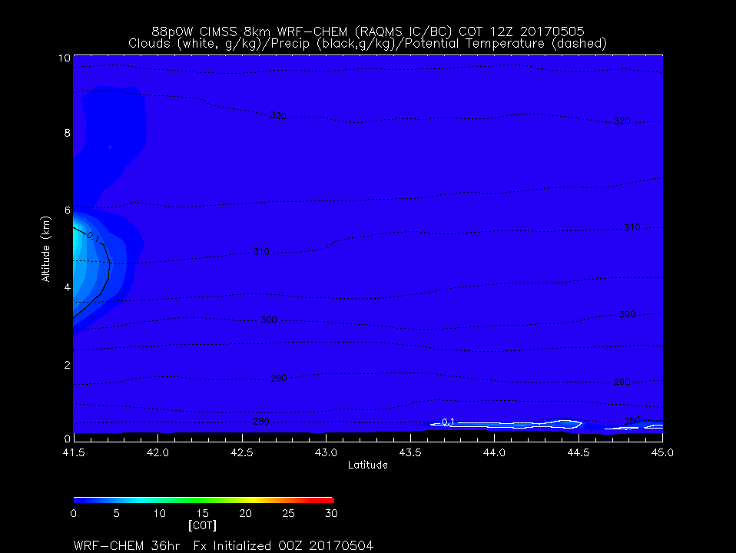
Day 1
7:00am CDT
Midlevel
Clouds South of 42N
Lowlevel
Clouds North of 43.5

Slide 5
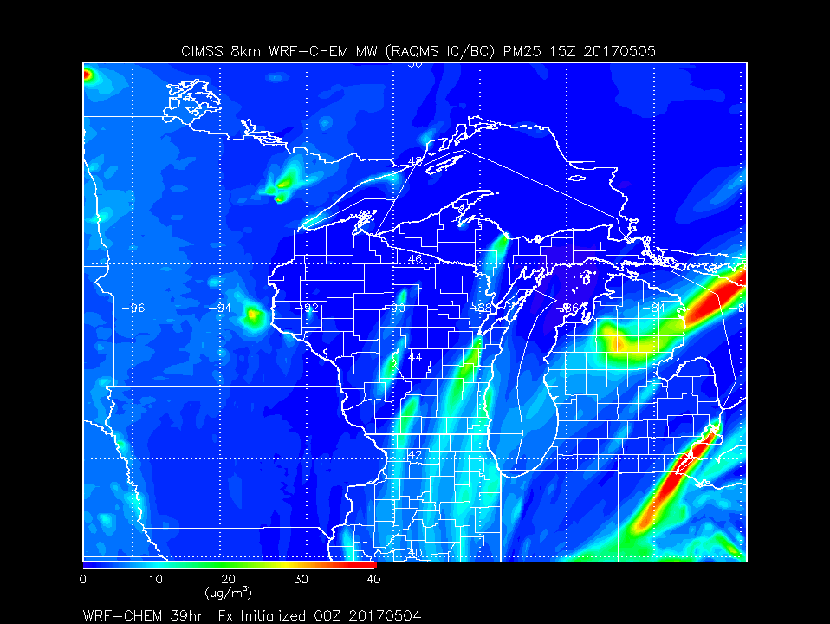
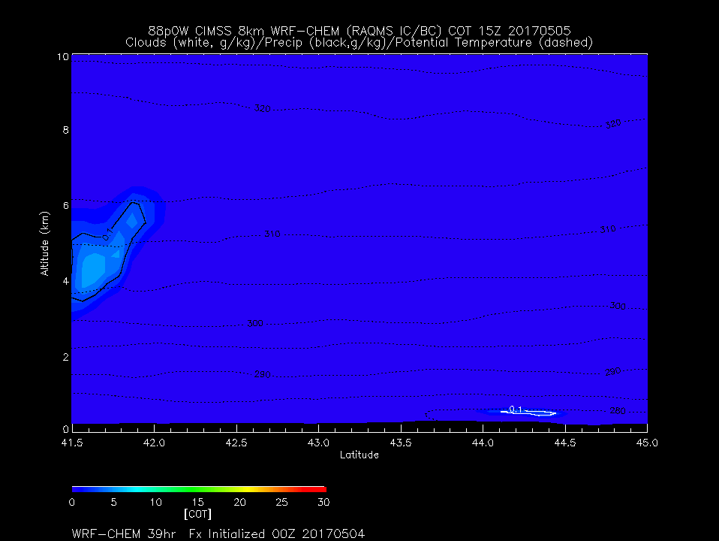
Day 1
10:00am CDT
Midlevel
Clouds South of 42N
Lowlevel
Clouds diminishing
North of 44N

Slide 6
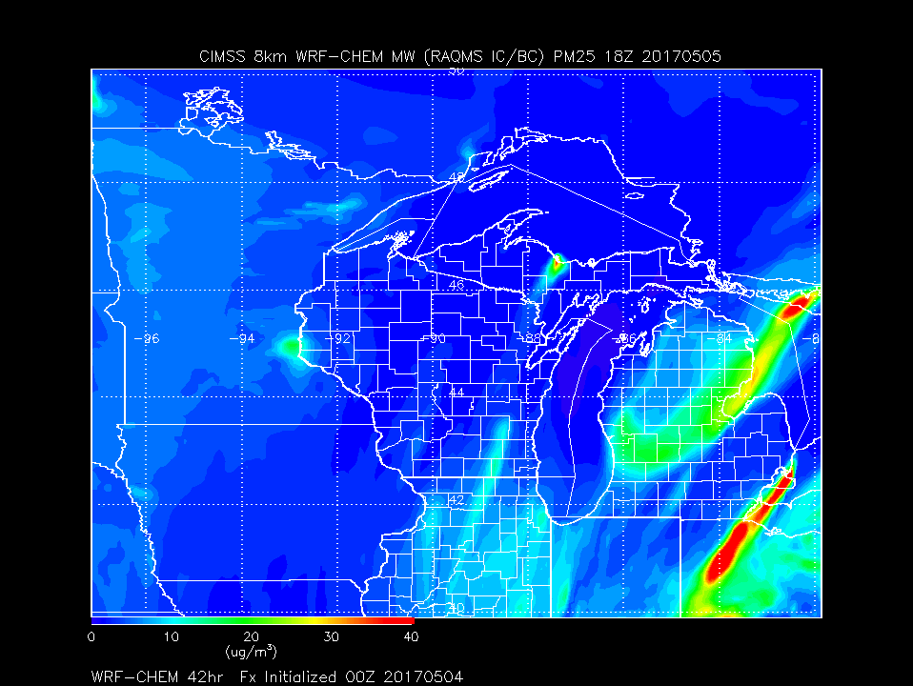
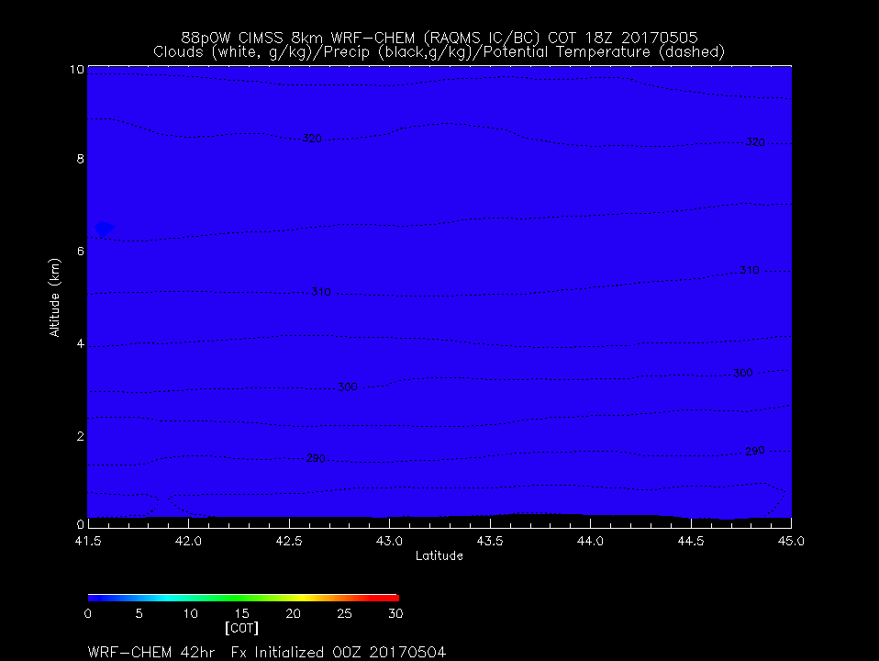
Day 1
1:00pm CDT
Clear

Slide 7
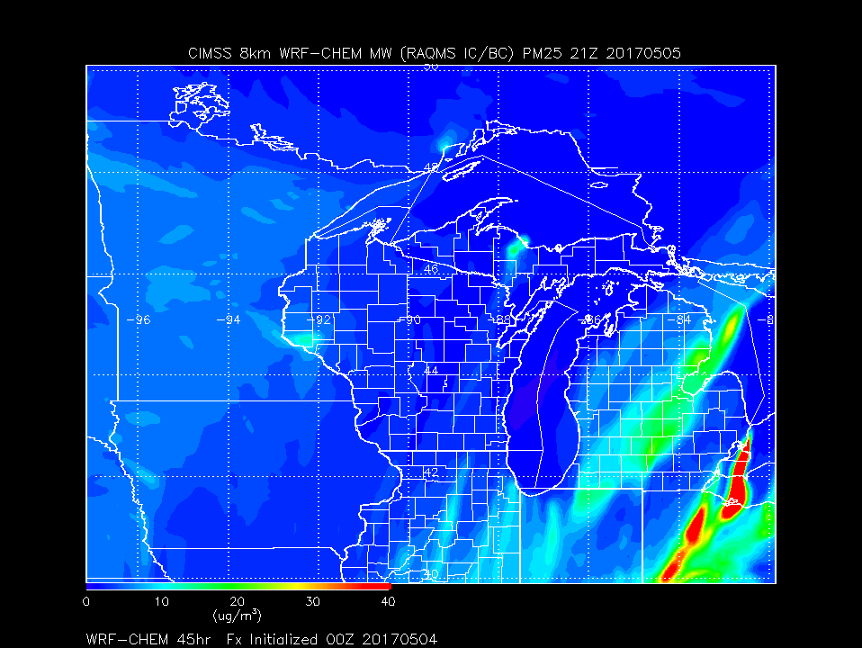
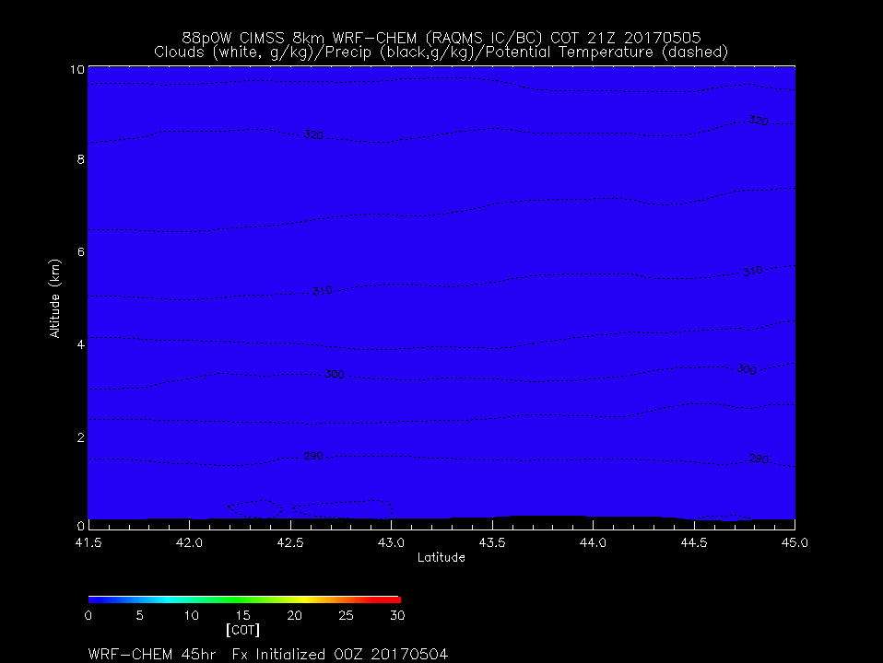
Day 1
4:00pm CDT
Clear
North North Easterly flow over Region

Slide 8
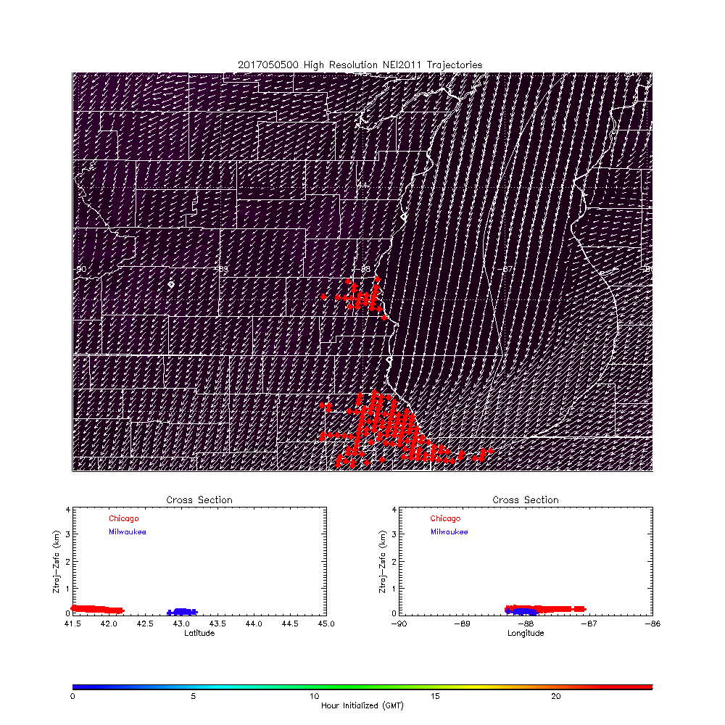
Day 1 Loop
7:00pm (Thursday) CDT
Initialization
Initial Location of Milwaukee
And Chicago NOx emission Trajectories
Initialized every hour from 00Z-24Z

Slide 9
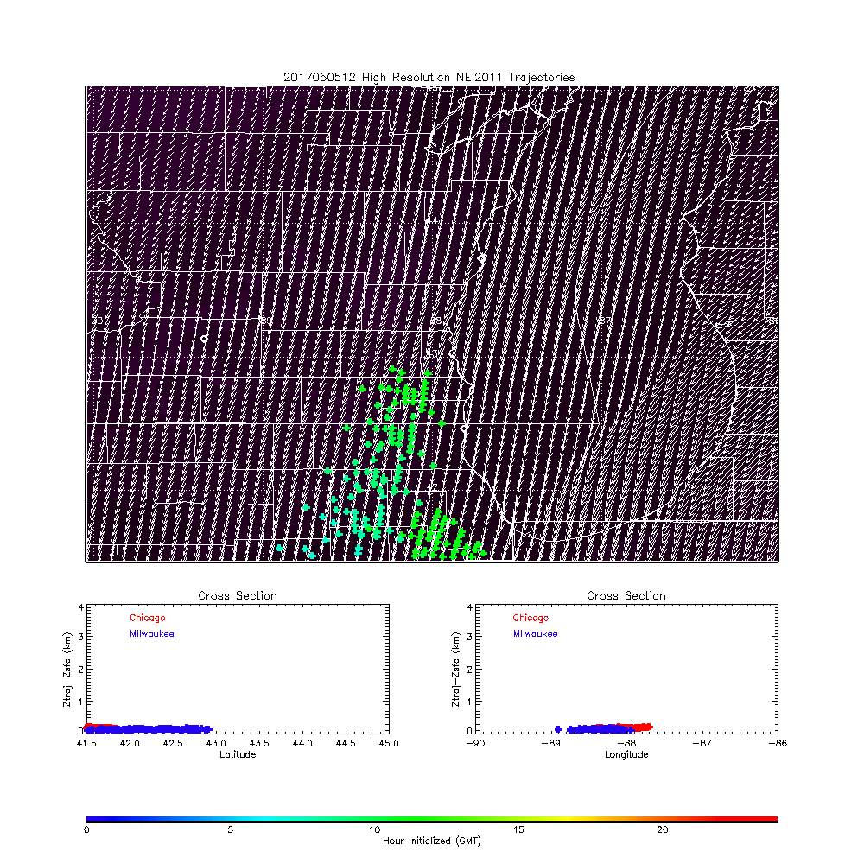
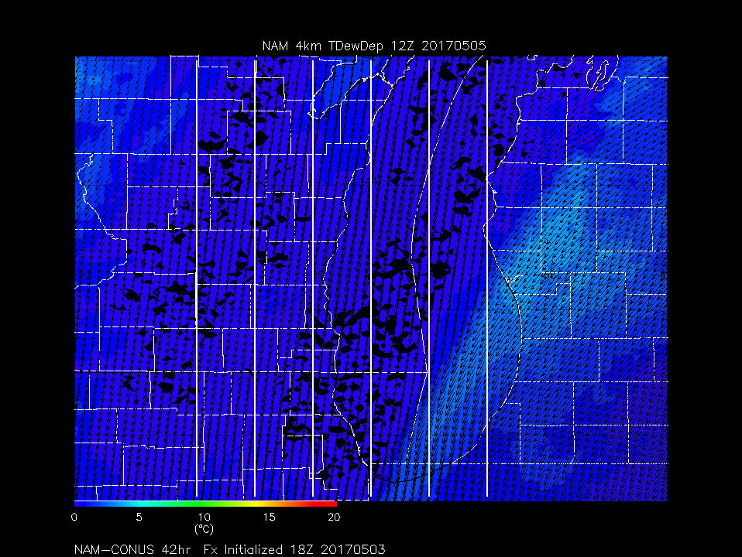
Day 1
7:00am CDT
Dew point Depression (red is dry)

Slide 10
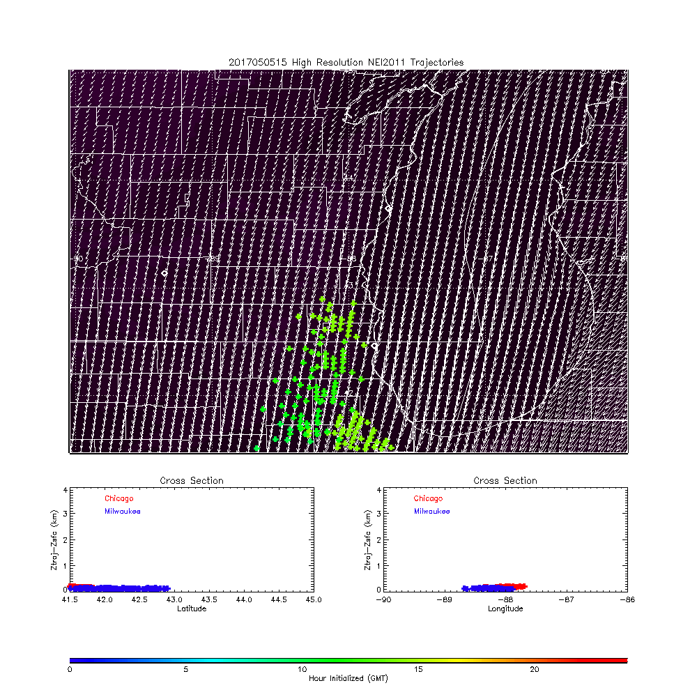
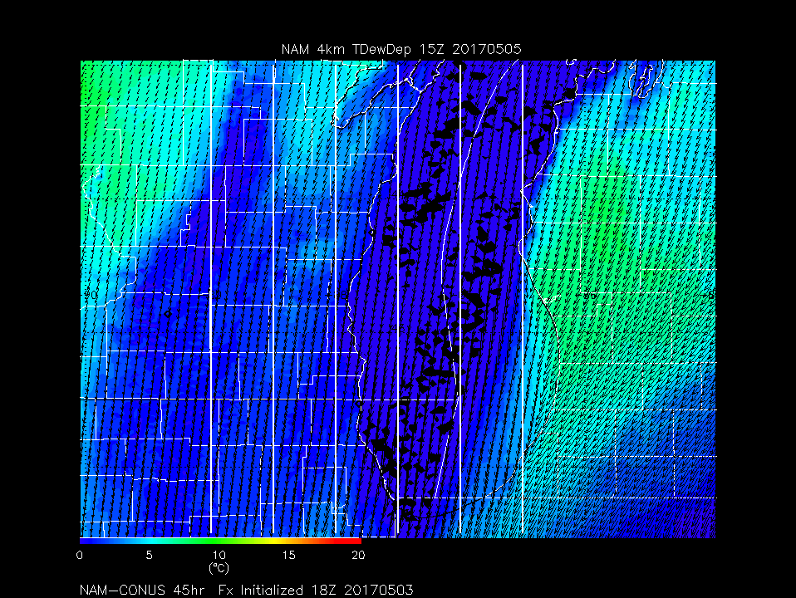
Day 1
10:00am CDT
Dew point Depression (red is dry)

Slide 11
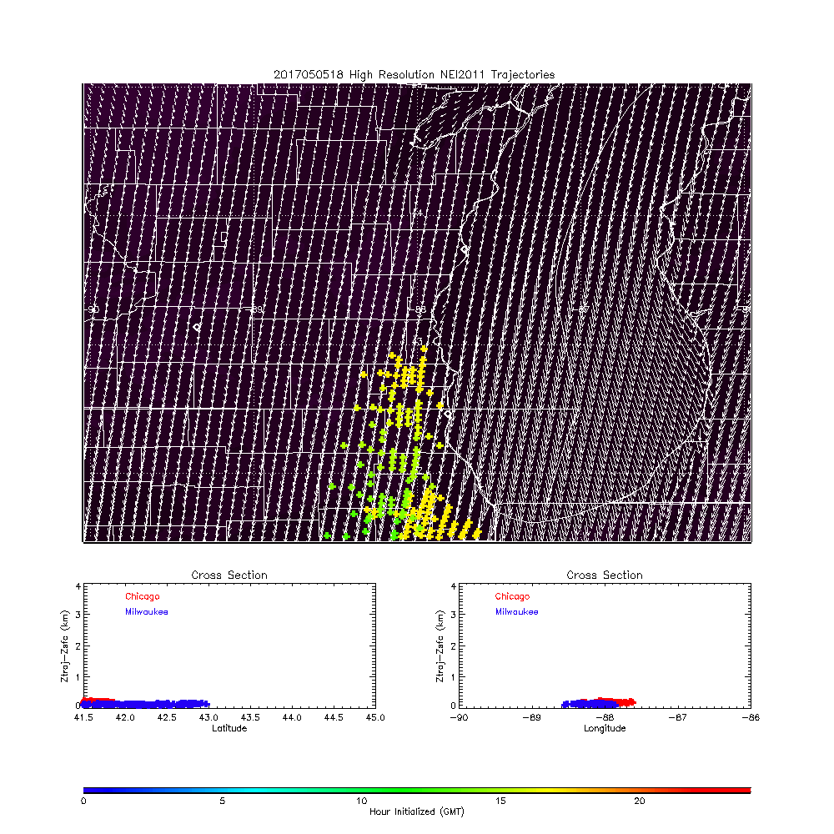
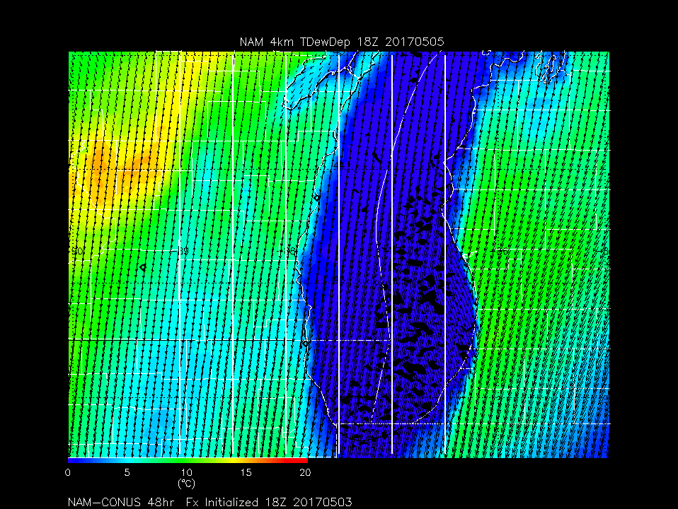
Day 1
1:00pm CDT
Dew point Depression (red is dry)

Slide 12
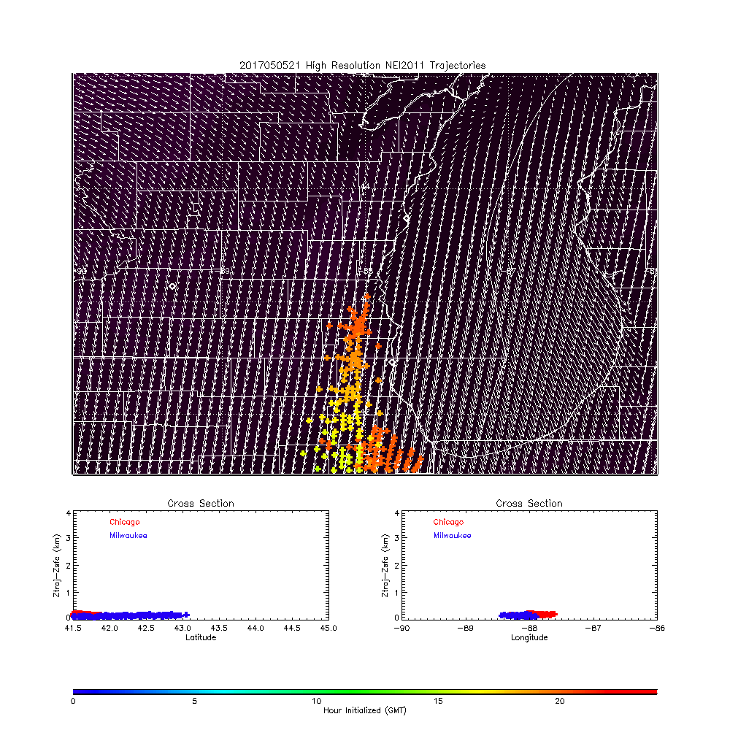
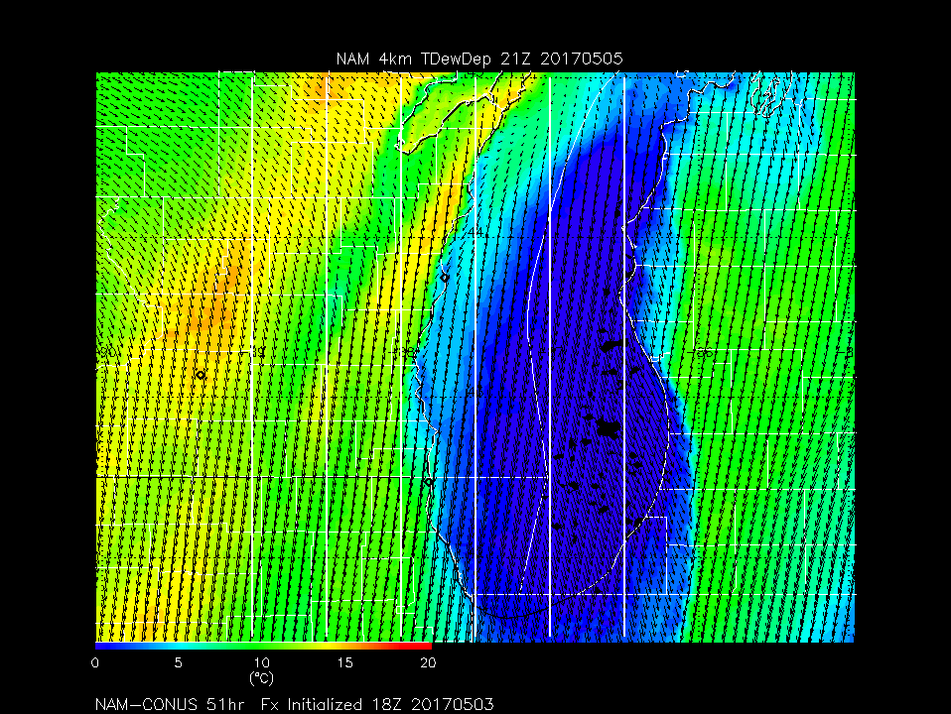
Day 1
4:00pm CDT
Dew point Depression (red is dry)
Flow out of NorthEast turning Northerly transports emissions to the SSW and South.
NAM shows small surface dewpoint depressions air over the region in the morning then becoming drier over land in the afternoon

