Slide 1
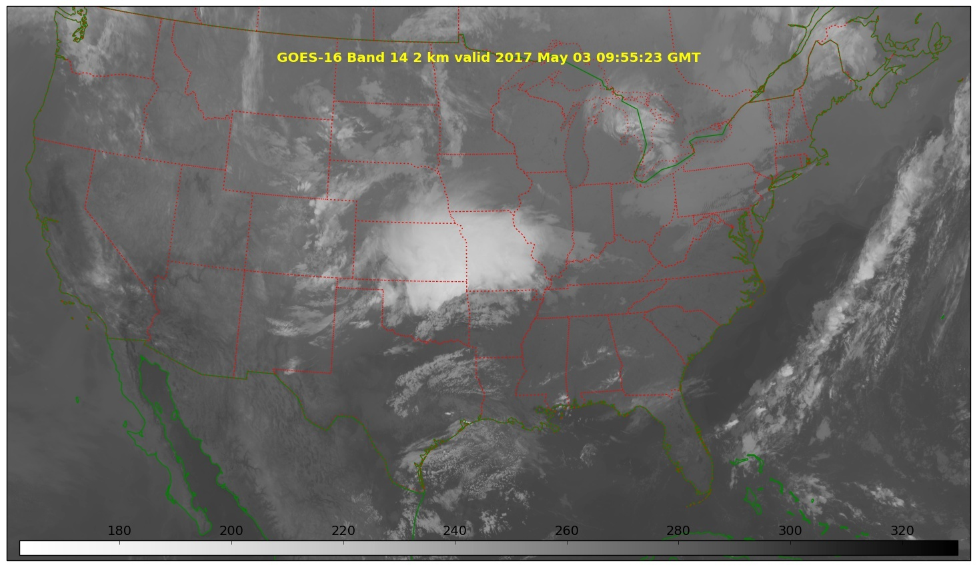
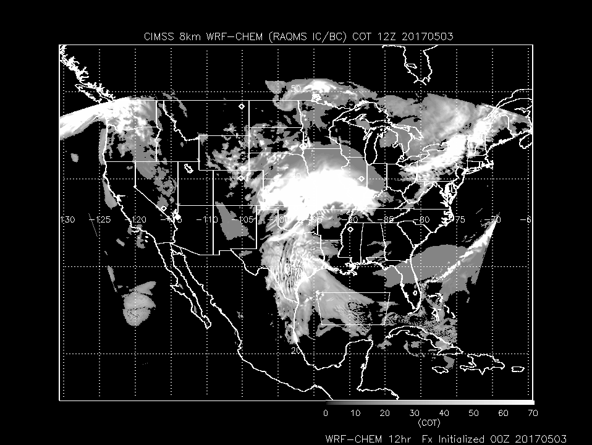
CIMSS FX 20170503
Low pressure system over Central Plains bringing cirrus into SE WI
Note 2 hour time difference
WRF-CHEM at 12Z (7:00am CDT)
GOES-16 at 10Z (5:00am CDT)

Slide 2
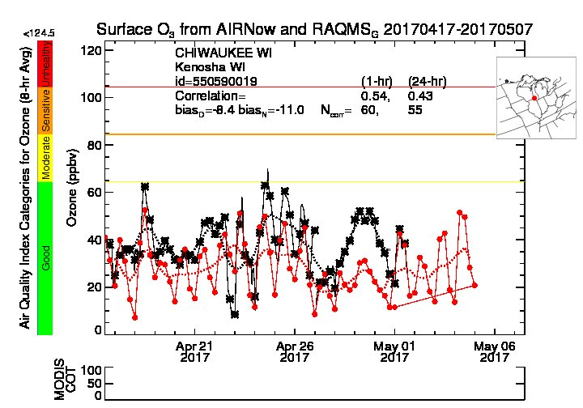
RAQMS (red, 1x1 degree) underestimates SFC O3 (black) at Chiwaukee by 5ppbv (daytime, more significantly April 28-May 1)
http://raqms.ssec.wisc.edu/o3_verification/ts/latest/WI/3800/550590019

Slide 3
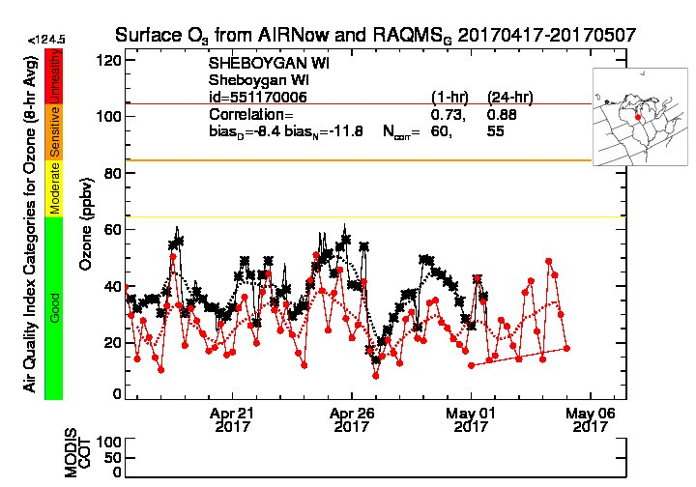
RAQMS (red, 1x1 degree) underestimates SFC O3 (black) at Sheboygan by 5.3ppbv (daytime, more significantly April 28-May 1)
http://raqms.ssec.wisc.edu/o3_verification/ts/latest/WI/7620/551170006

Slide 4
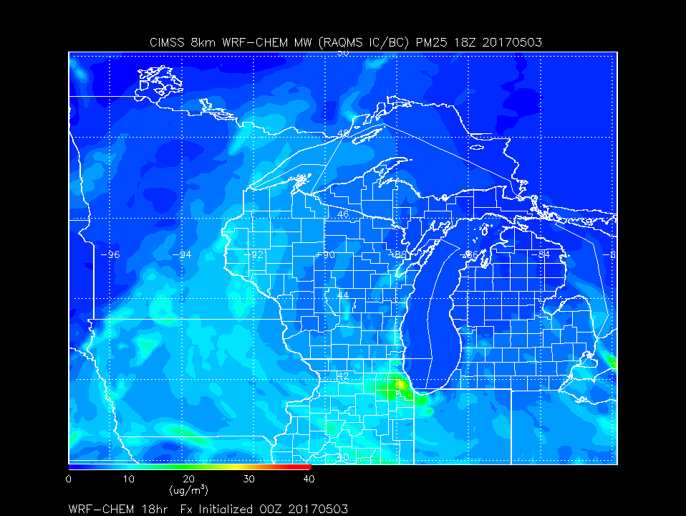
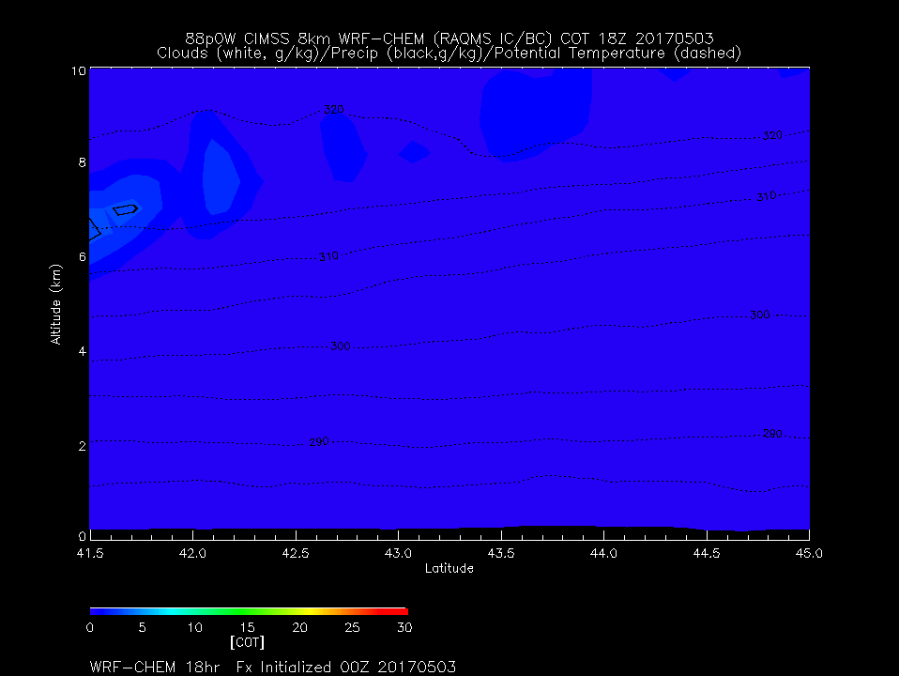
Day 0
1:00pm CDT
Cirrus Clouds

Slide 5
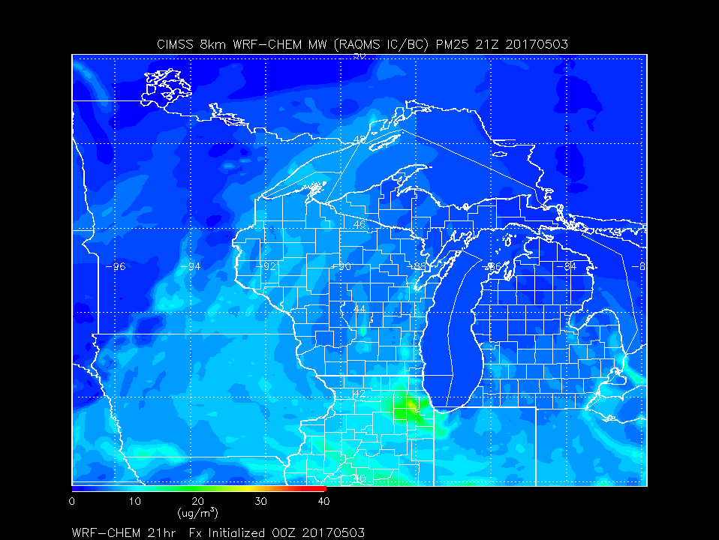
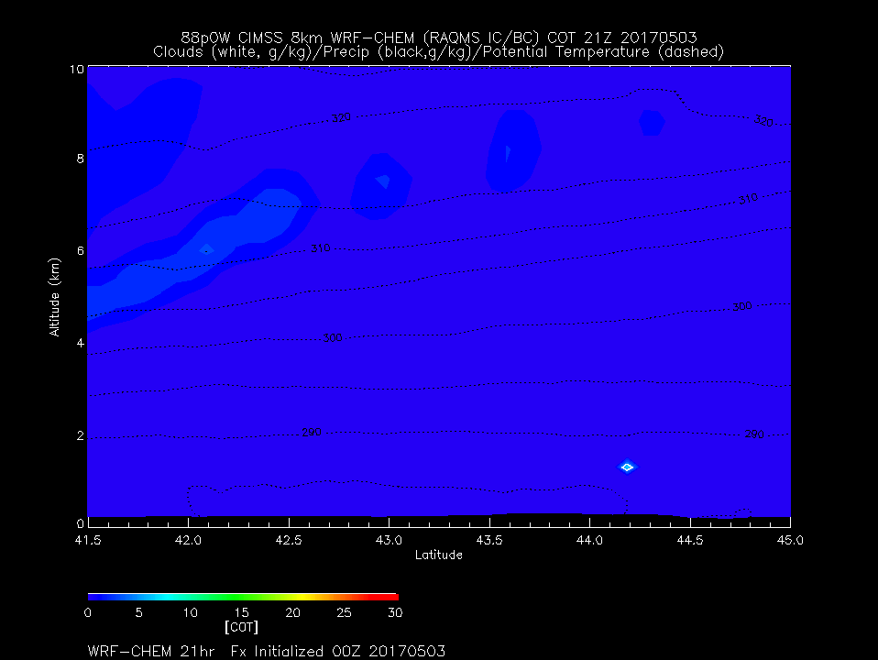
Day 0
4:00pm CDT
Cirrus Clouds
Urban Emissions remain near Chicago

Slide 6
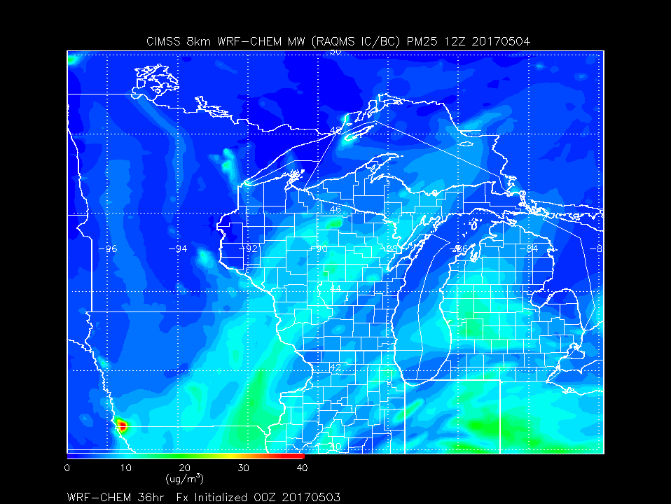
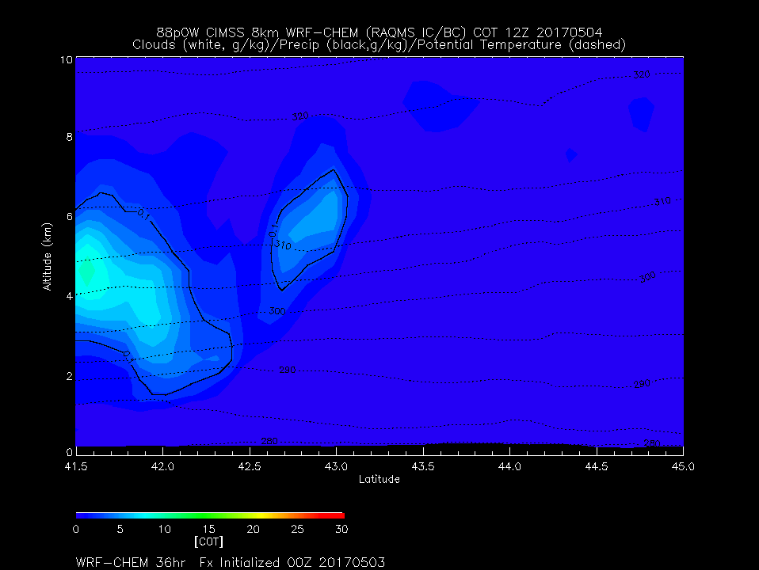
Day 1
7:00am CDT
Clouds South of 43N

Slide 7
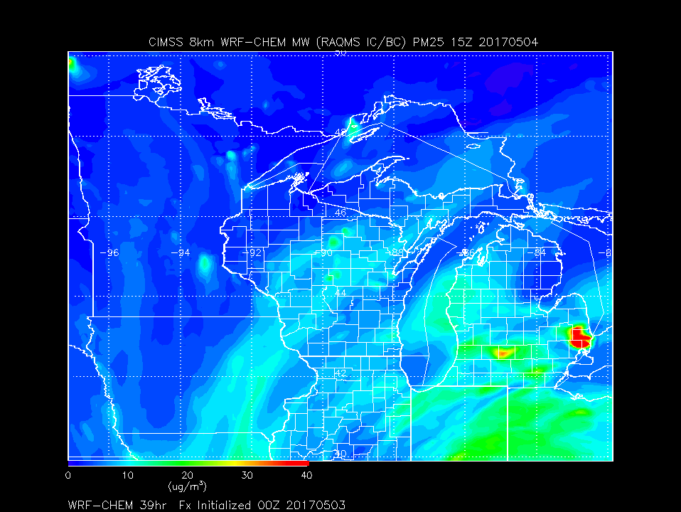
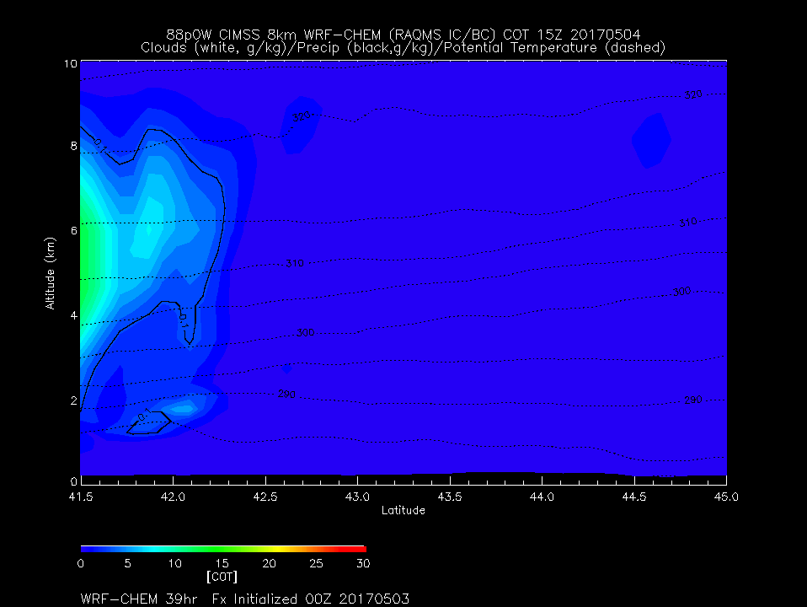
Day 1
10:00am CDT
Clouds South of 42.5N

Slide 8
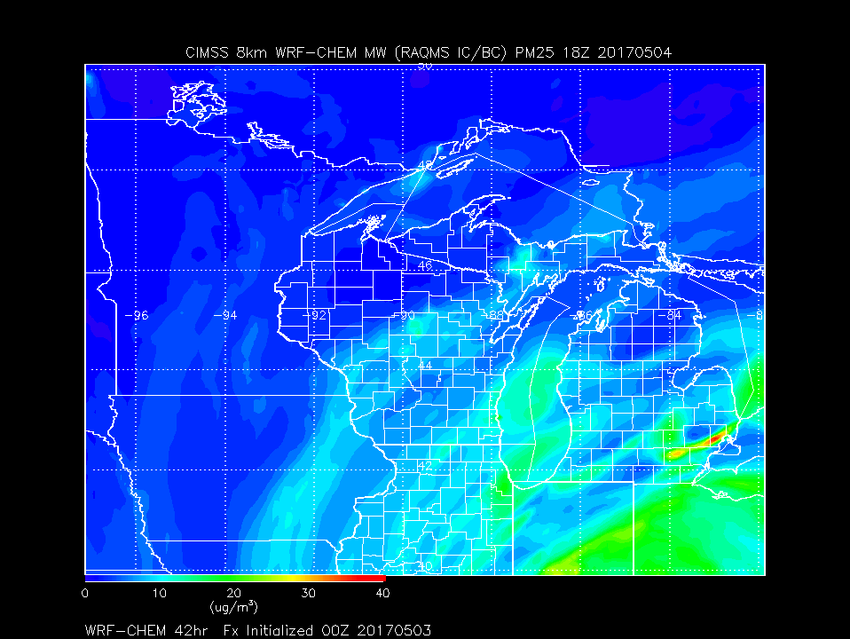
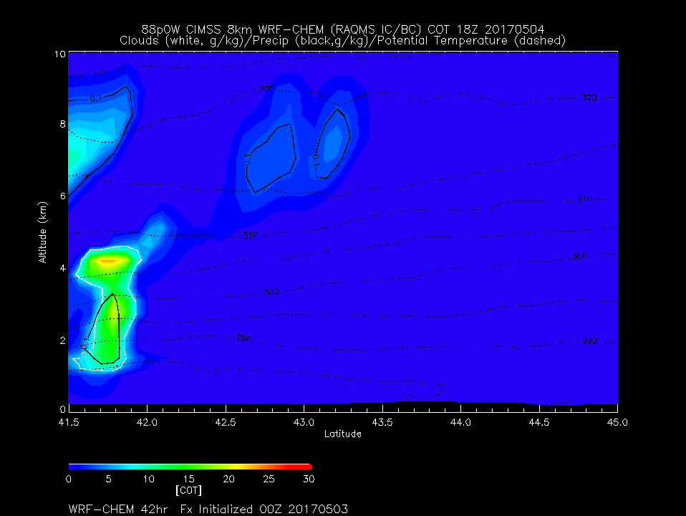
Day 1
1:00pm CDT
High Clouds South of 43.5N

Slide 9
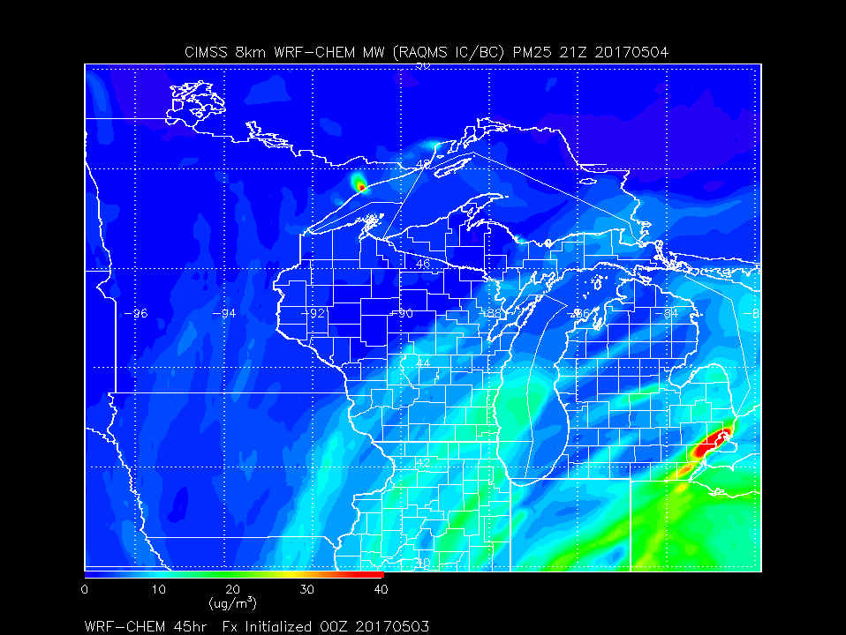
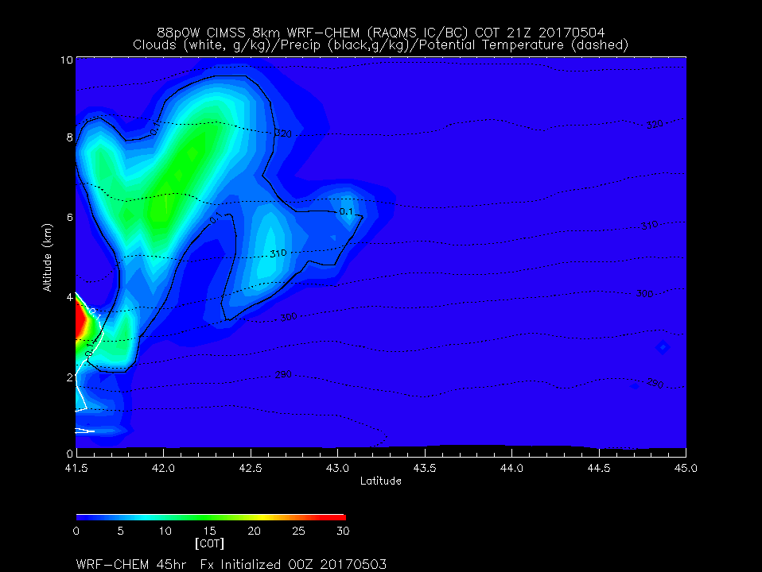
Day 1
4:00pm CDT
Clouds South of 43N
North Easterly flow over region

Slide 10
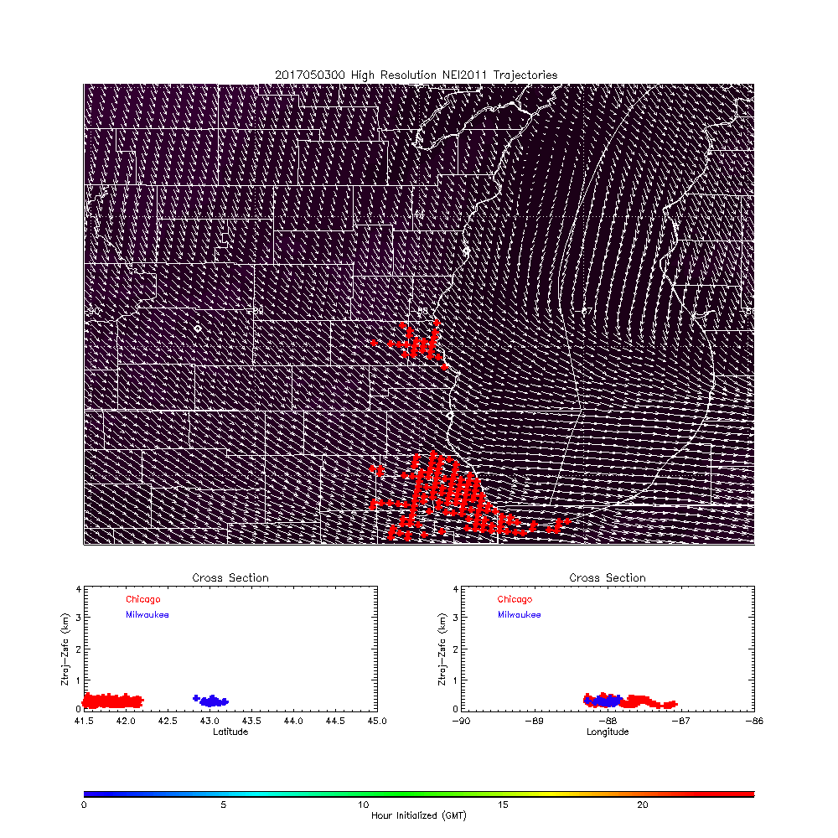
Day 0 Loop
7:00pm (Tuesday) CDT
Initialization
Initial Location of Milwaukee
And Chicago NOx emission Trajectories
Initialized every hour from 00Z-24Z

Slide 11
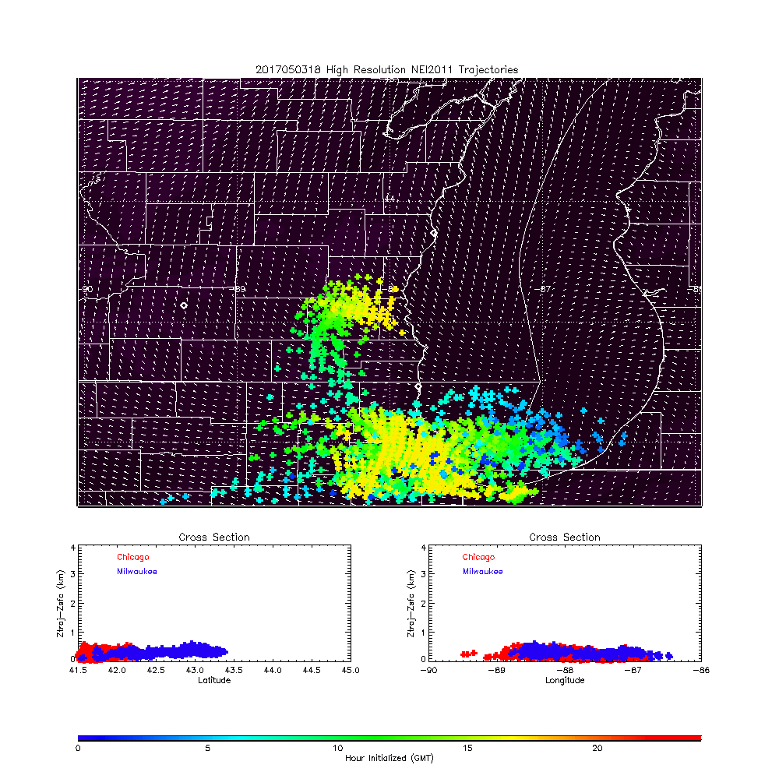
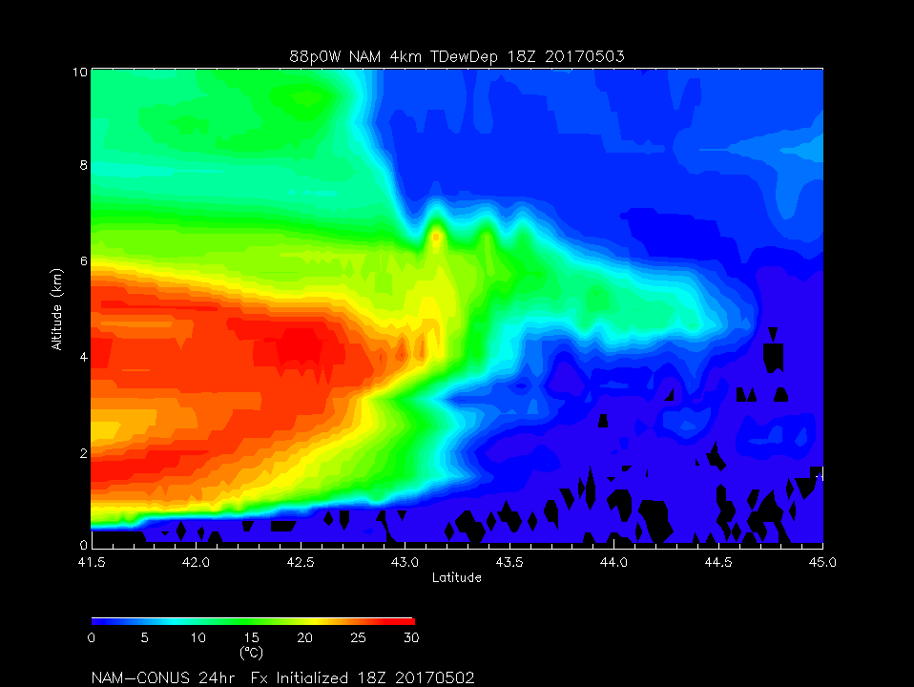
Day 0
1:00pm CDT
Dew point Depression (red is dry)

Slide 12
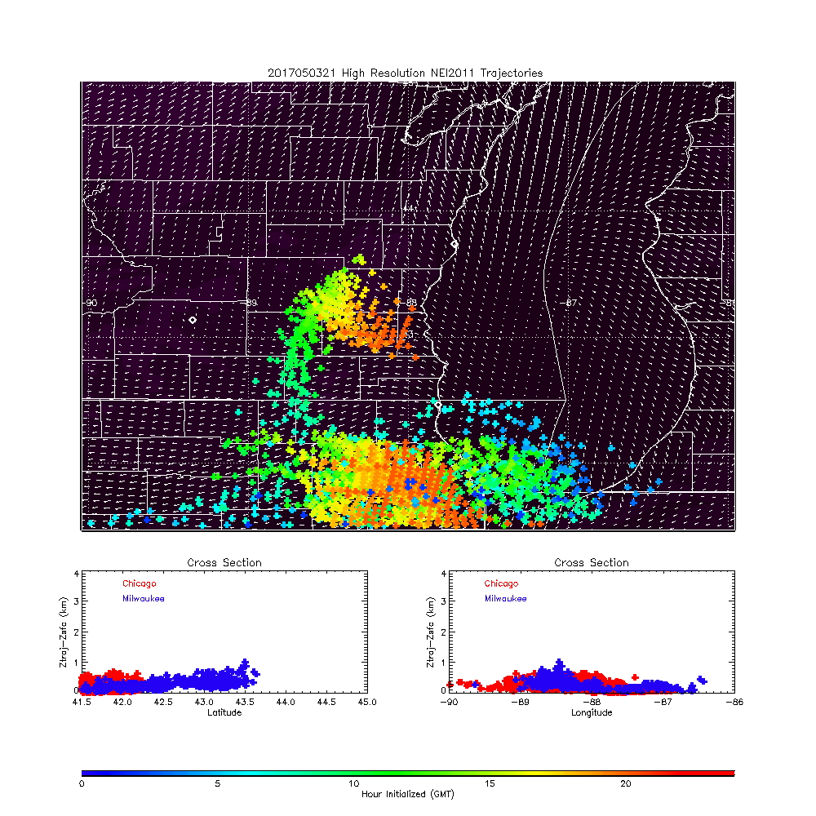
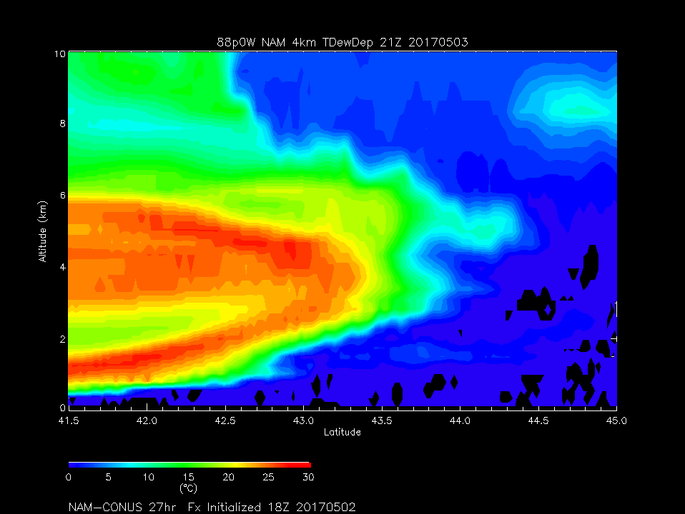
Day 0
4:00pm CDT
Dew point Depression (red is dry)
Dry air moving in from the south at mid levels
Thin cirrus possible above 8km
Milwaukee and Chicago
Emissions remain within the lowest 1km and near there source region throughout most of the day with late afternoon transport to the west

Slide 13
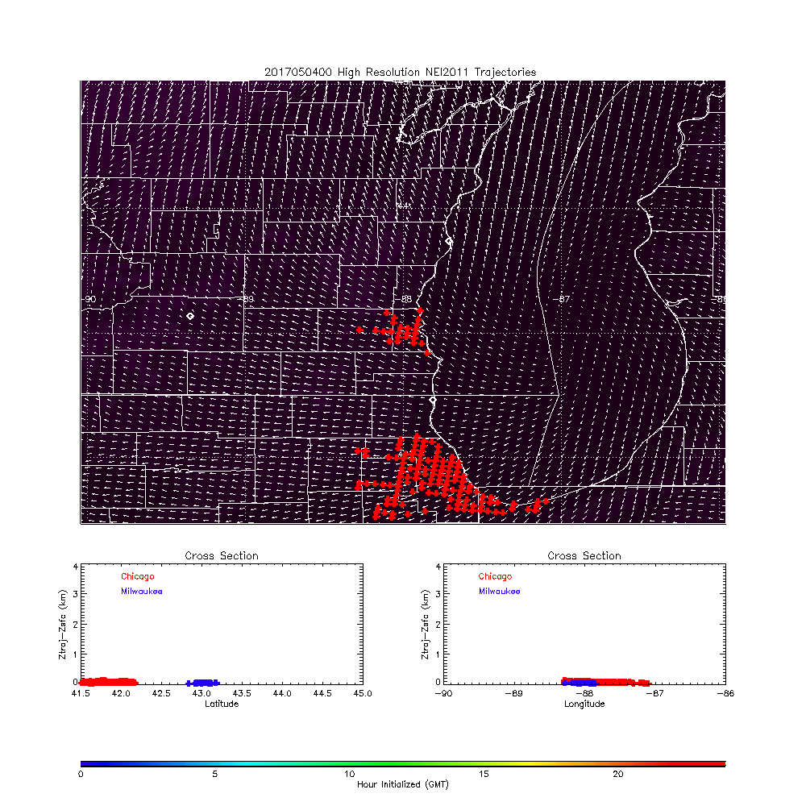
Day 1 Loop
7:00pm (Wednesday) CDT
Initialization
Initial Location of Milwaukee
And Chicago NOx emission Trajectories
Initialized every hour from 00Z-24Z

Slide 14
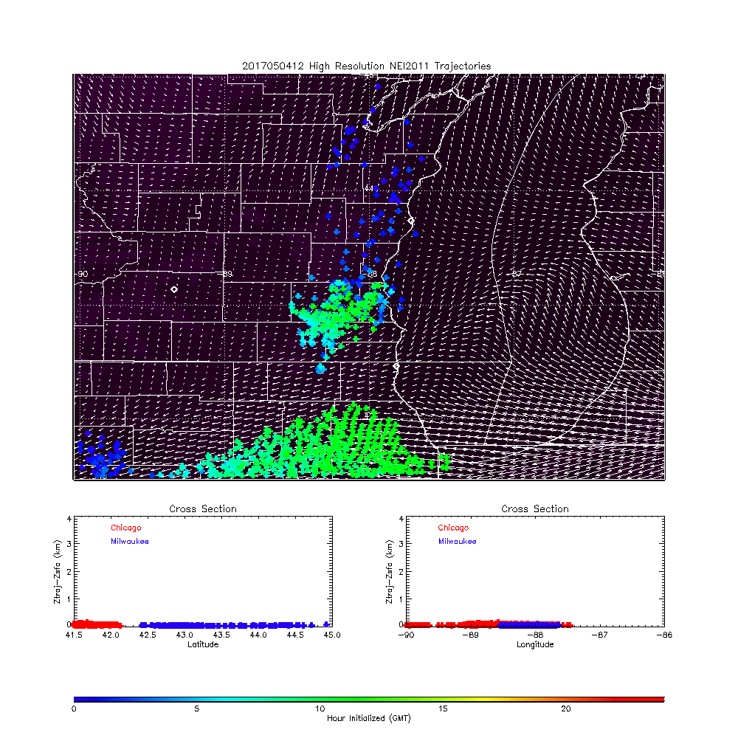
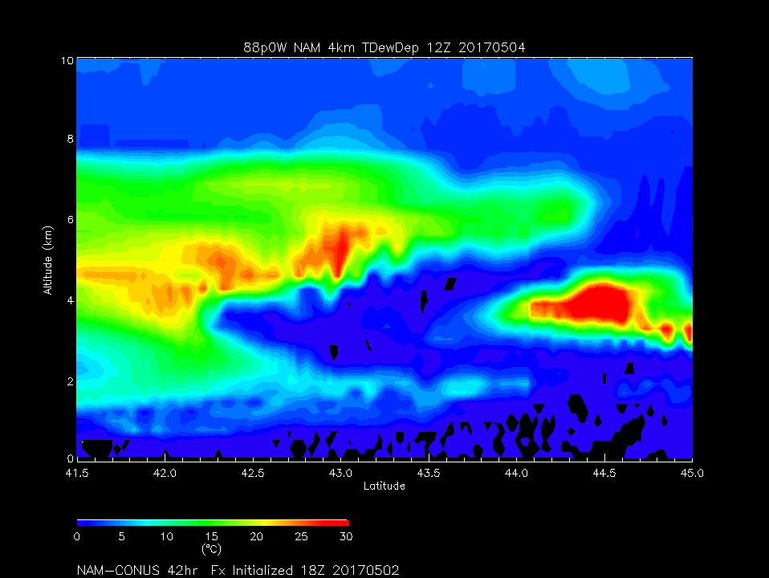
Day 1
7:00am CDT
Dew point Depression (red is dry)

Slide 15
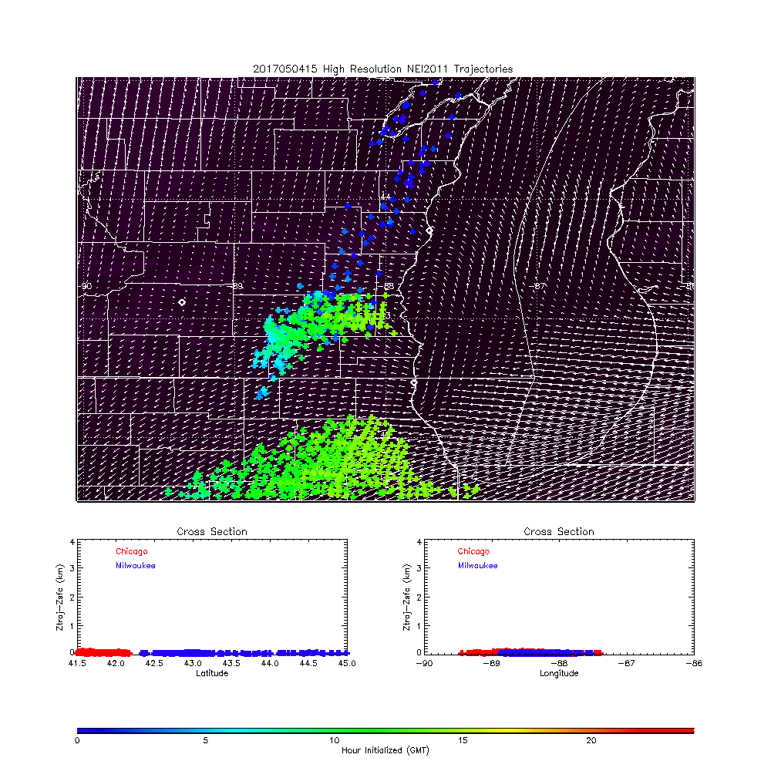
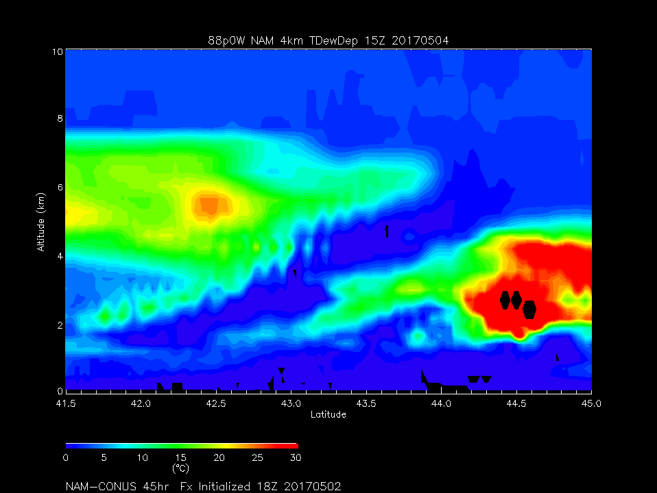
Day 1
10:00am CDT
Dew point Depression (red is dry)

Slide 16
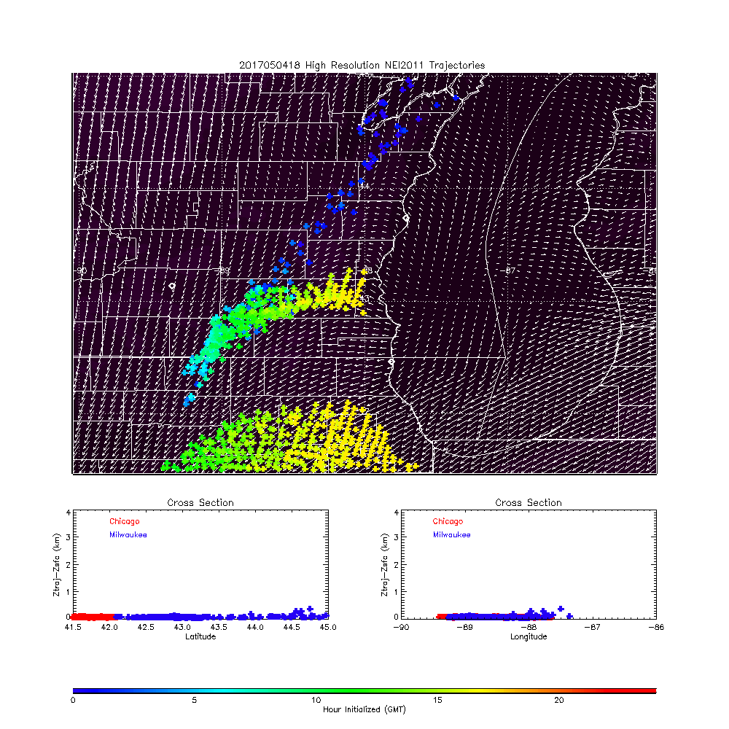
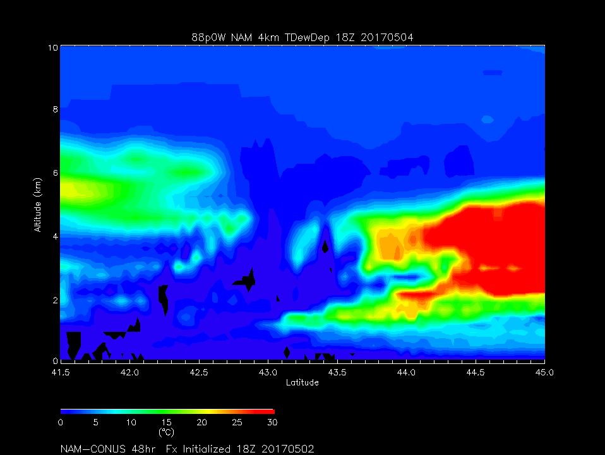
Day 1
1:00pm CDT
Dew point Depression (red is dry)

Slide 17
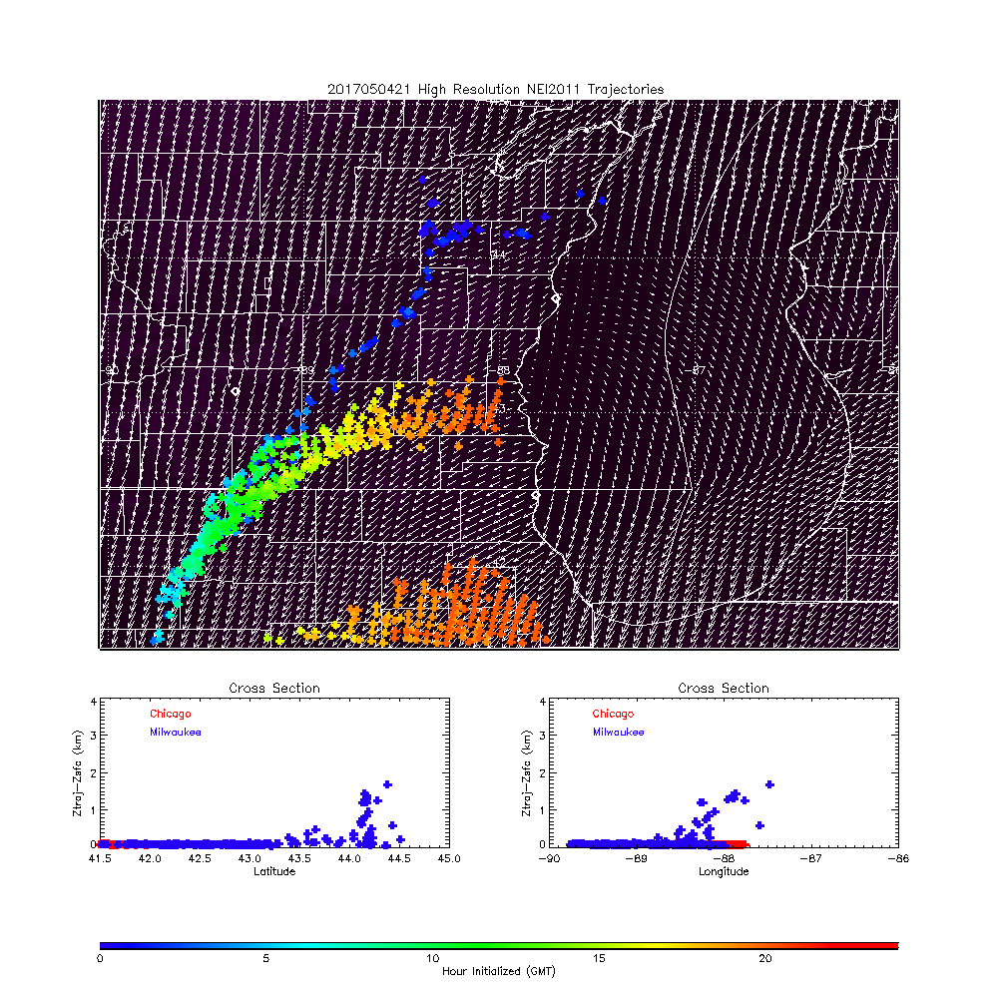
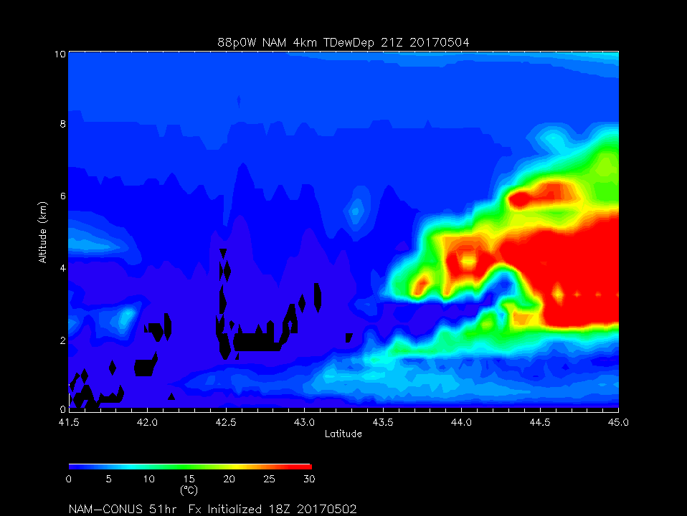
Day 1
4:00pm CDT
Dew point Depression (red is dry)
Flow out of NorthEast by late afternoon transports emissions to the Southwest.
NAM shows dry air aloft over Chicago during the morning and then gradually reaching saturation by late afternoon (different then 8km WRF-CHEM)

