Slide 1
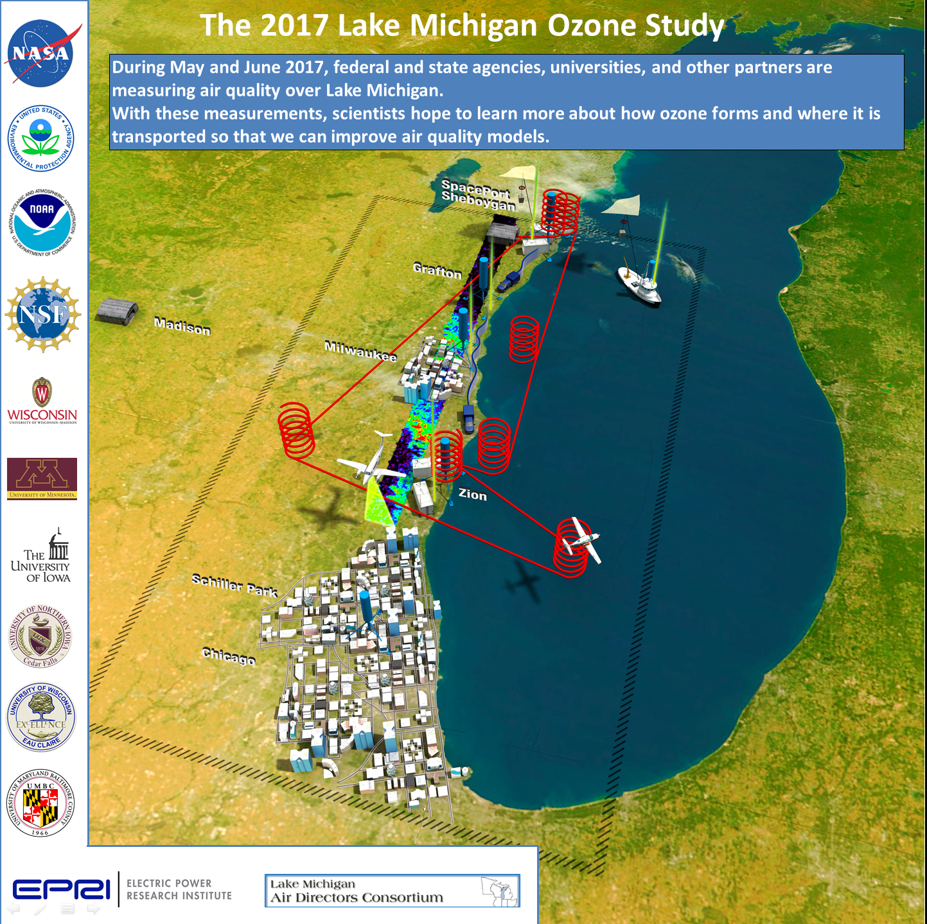
2017 Lake Michigan Ozone Study (LMOS)
Brad Pierce
UW-Madison
Space Science and Engineering Center
With significant contributions from
Angie Dickens
Wisconsin Department of Natural Resources
Electric Power Research Institute, September 17Chicago Ill, September 17th, 2019

Slide 2
2017 Lake Michigan Ozone Study (LMOS)
What are the potential outcomes/benefits of LMOS 2017?
LMOS 2017 measurements provide critical observations for evaluating a new generation of air quality models attempting to better simulate ozone episodes in the region. Over the long term, the information collected is expected to result in:
Improved modeled ozone forecasts for this region, which states and EPA use to meet state and federal Clean Air Act requirements.
Better understanding of the lakeshore gradient in ozone concentrations, which could influence how EPA addresses future regional ozone issues.
Improved knowledge of how emissions influence ozone formation in the region.
What institutions are involved in LMOS 2017?
Researcher institutions: NOAA, NASA, U.S. EPA, University of Wisconsin, University of Iowa, University of Minnesota, University of Northern Iowa, University of Maryland Baltimore County, Scientific Aviation.
Air quality management agencies: Lake Michigan Air Directors Consortium (LADCO), Wisconsin DNR, Illinois EPA, Indiana DEM.
Nonprofit organizations: Electric Power Research Institute (EPRI)
Commercial Services: Scientific Aviation

Slide 3
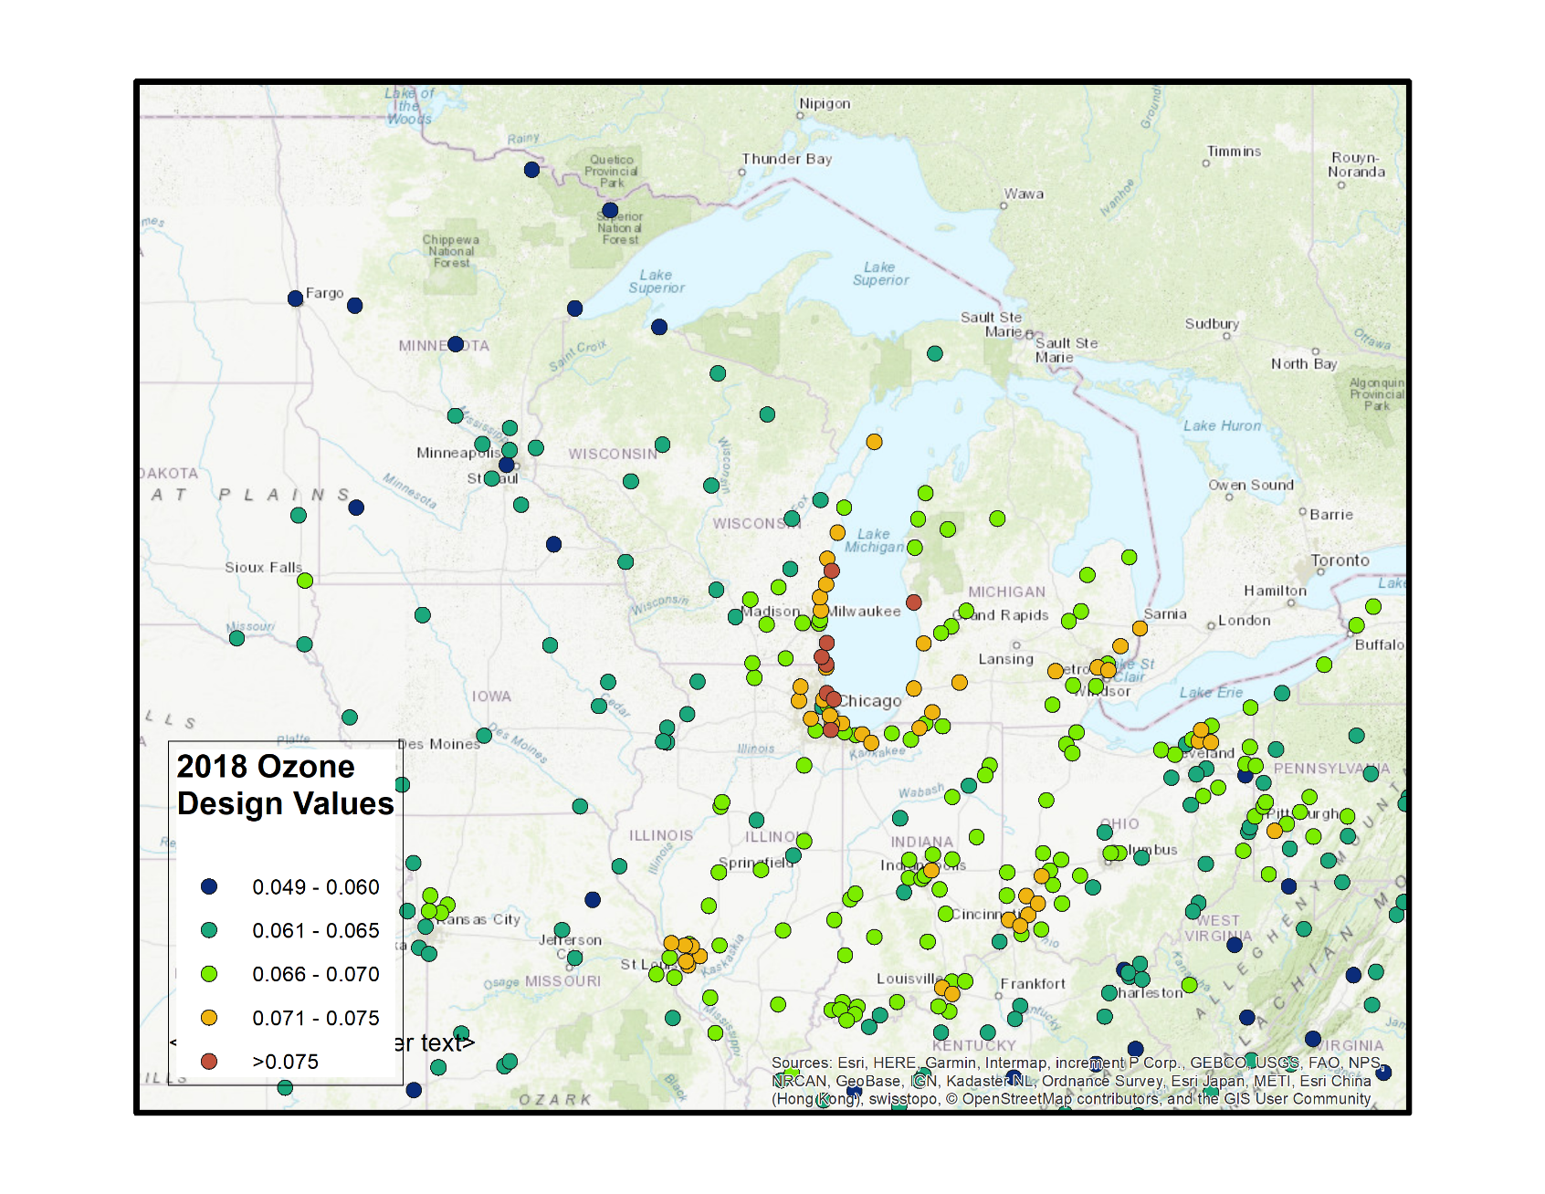
2018 Ozone Design Values
48 sites over 0.070 ppmv (70 ppbv)
8 sites over 0.075 ppmv
Highest 8 all around Lake Michigan.
4th highest value of daily 8-hour maximum ozone values are averaged over 3 years to derive the design value, which is the metric that is compared to the National Ambient Air Quality Standards (NAAQS) and determines attainment or nonattainment.
From Donna Kenski (LADCO)

Slide 4
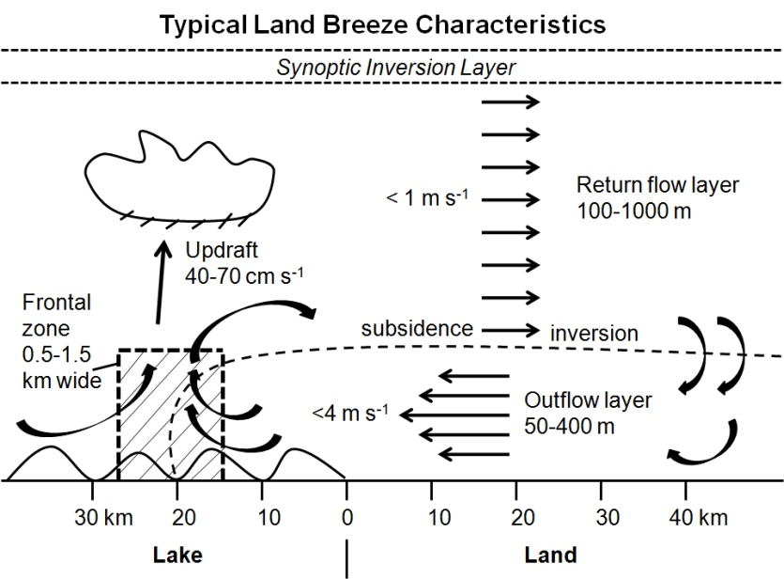
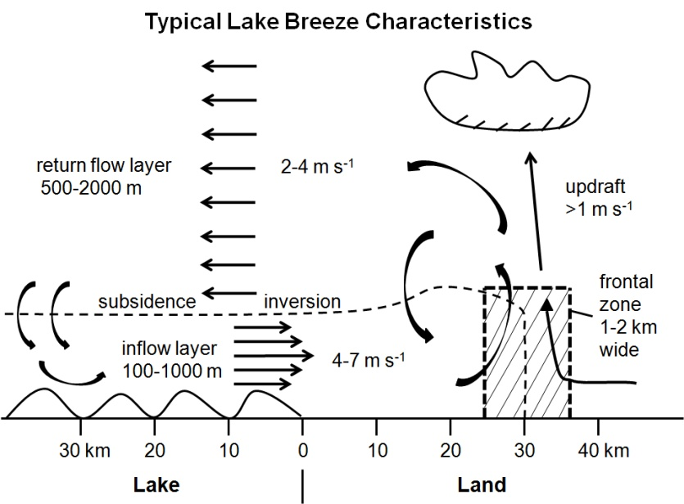
Lake Michigan and Ozone Formation
Land breeze blows ozone precursor compounds from rush hour over lake.
The boundary layer height is low due to cold water chilling the air above.
The pollutants are concentrated near the surface where ozone forms.
An afternoon lake breeze transports the ozone back onto land.
LMOS White Paper: http://www.ladco.org/

Slide 5
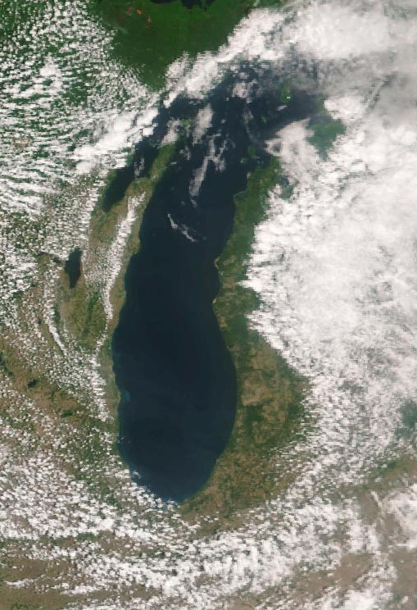
VIIRS Image June 09, 2017
Satellite image of Lake Michigan showing
Lake Breeze Front

Slide 6
VIIRS Image June 09, 2017
Lake Breeze
Front
Satellite image of Lake Michigan showing
Lake Breeze Front

Slide 7
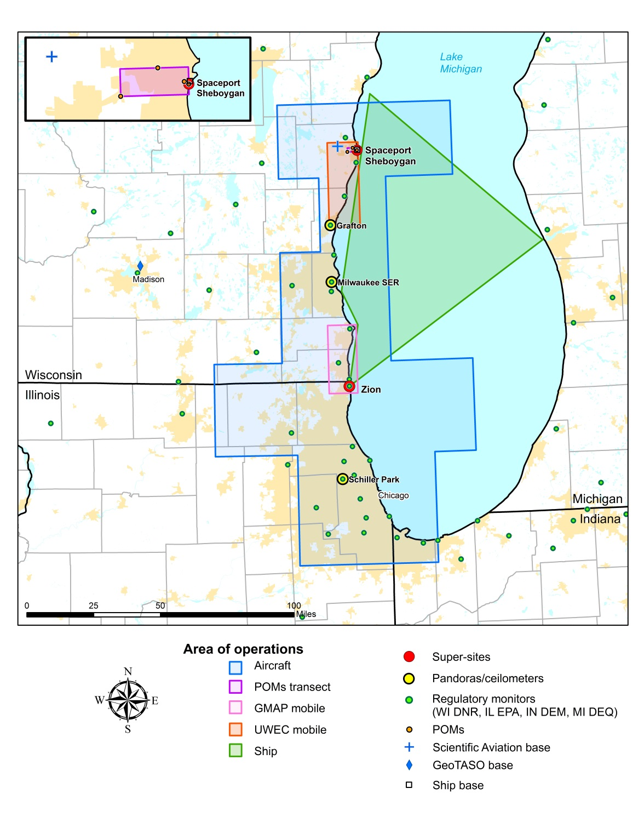
Summary of measurements made during the LMOS 2017 field campaign
Location | Measurement* | Research Institution*
Ground Sites
Spaceport Sheboygan | Remote sensing of meteorology (SPARC Trailer) | UW-Madison -SSEC
 | In situ measurements of pollutants | U.S. EPA ORD
Zion, IL | Remote sensing of meteorology (Sodar/MW Radiometer) | Univ. Northern Iowa
 | Detailed in situ chemical measurements | Univ. Iowa, UW-Madison, Univ. Minnesota
 | Routine measurements of ozone | Illinois EPA
Various† | Remote sensing of pollutants and boundary layer height | U.S. EPA ORD
Sheboygan transect | In situ measurements of ozone at four locations | U.S. EPA ORD
Airborne Platforms
Lakeshore region | Airborne remote sensing of NO₂ (GeoTASO) | NASA
 | Airborne remote sensing of clouds (AirHARP) | Univ. Maryland, Baltimore County
 | Airborne in situ profiling of pollutants and meteorology | Scientific Aviation
Shipboard Platform
Lake Michigan | In situ measurements of pollutants | U.S. EPA ORD
 | Remote sensing of pollutants and boundary later height | U.S. EPA ORD
Mobile Platforms
Northeast IL and Southeast WI | In situ measurements of pollutants (GMAP) | U.S. EPA Region 5
Grafton to Sheboygan | In situ measurements of ozone and meteorology | UW-Eau Claire

Slide 8
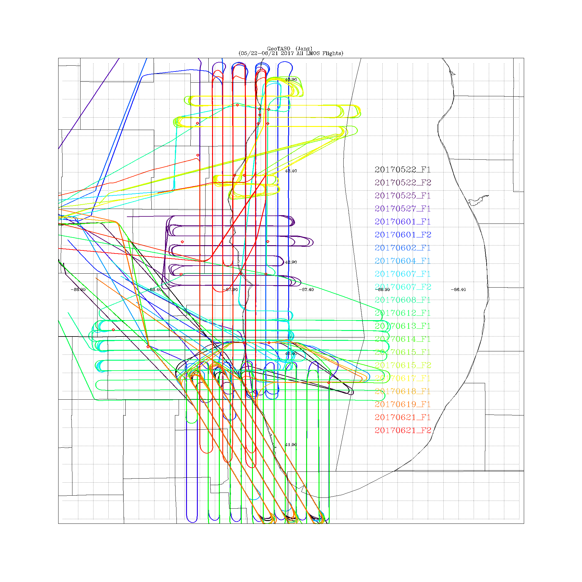
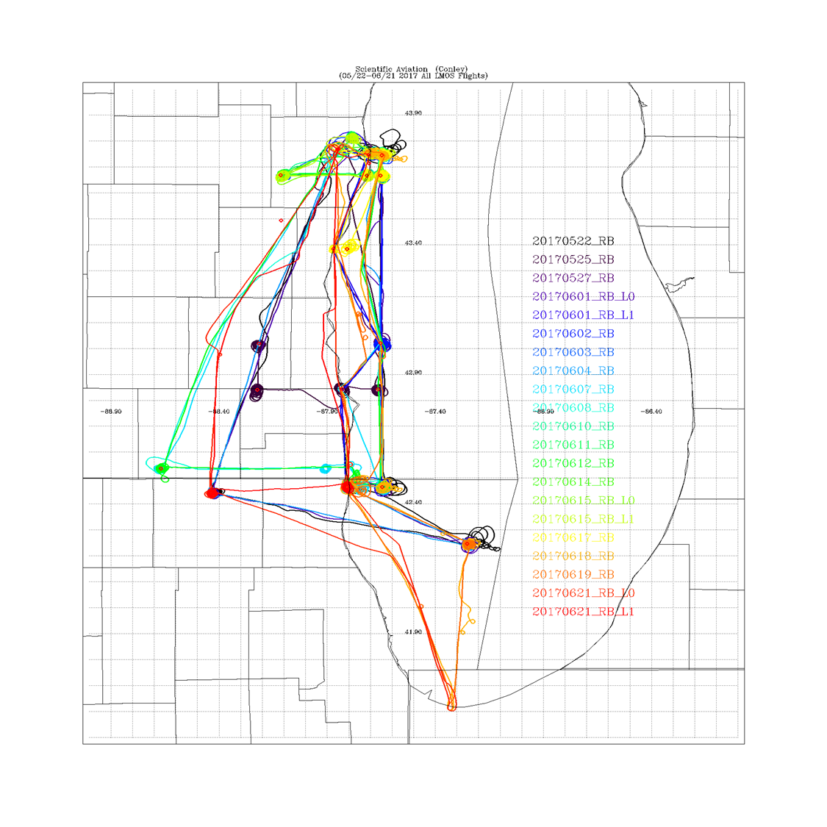
LMOS 2017 Aircraft Measurements
NASA GeoTASO remote sensing Flights
Scientific Aviation insitu sampling Flights
GeoTASO (Geostationary Trace gas and Aerosol Sensor Optimization) is a NASA airborne hyperspectral mapping instrument that is being used as an airborne testbed for future high-resolution trace-gas observations from geostationary sensors such as TEMPO
The Electric Power Research Institute (EPRI) provided funding for Scientific Aviation Flights during LMOS

Slide 9
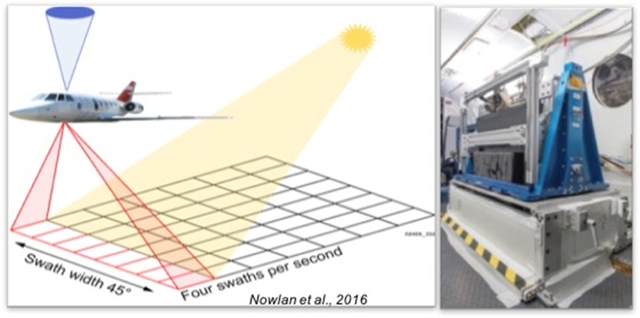
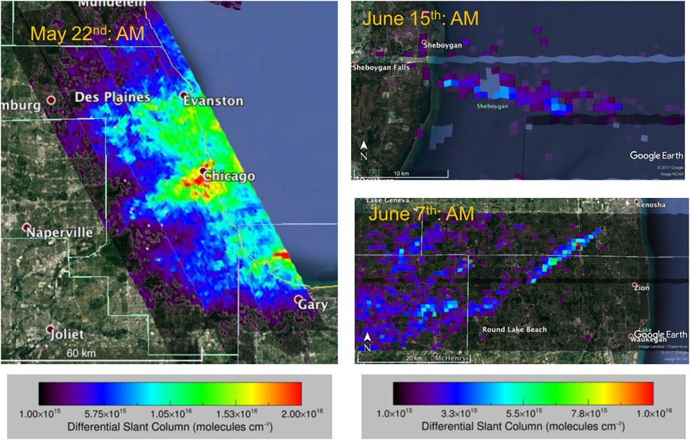
NASA GeoTASO remote sensing Flights
NO₂ differential slant columns (DSCs) were retrieved from GeoTASO spectra via Differential Optical Absorption Spectroscopy (DOAS).
The DOAS technique provides a column amount relative to a reference scene, which ideally is unpolluted and cloud-free.

Slide 10
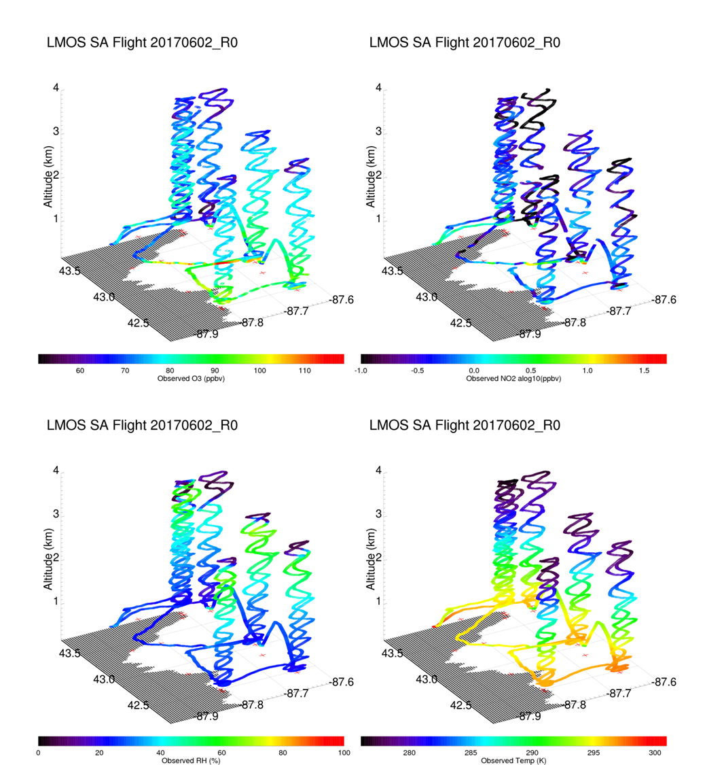
Scientific Aviation in situ profiling Flights
Scientific Aviation (SA) was contracted by the Electric Power Research Institute (EPRI) to participate in LMOS 2017 with airborne in situ profiling of O₃, NO₂, CO₂, CH₄, altitude, T, RH, winds, and pressure.
SA flights provided vertical profiles over and offshore from selected ground sites (Sheboygan and Zion), offshore profiles east of Milwaukee and Chicago.
Ozone (ppbv)
NO2 (ppbv)
Relative Humidity (%)
Temperature (K)

Slide 11
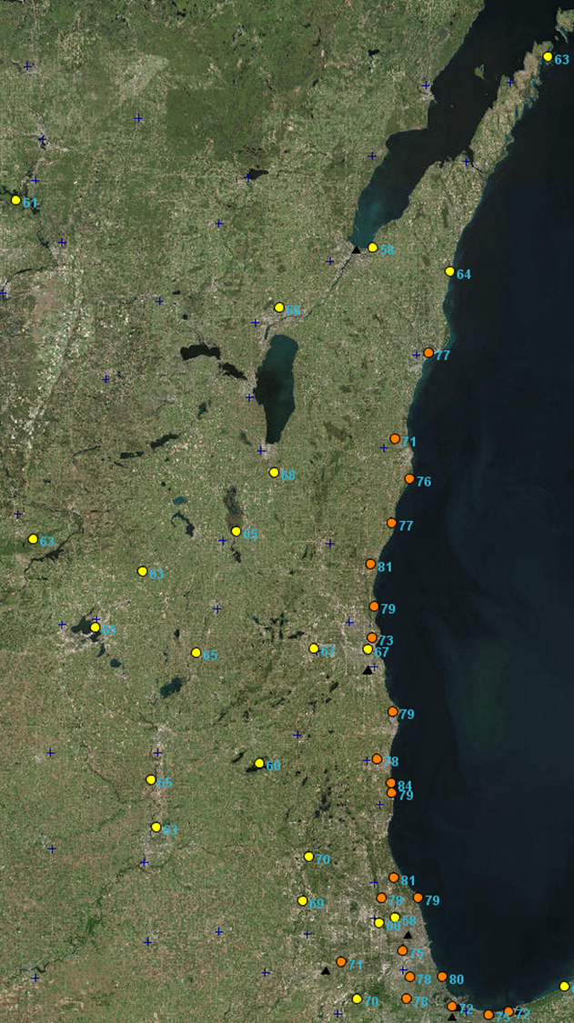
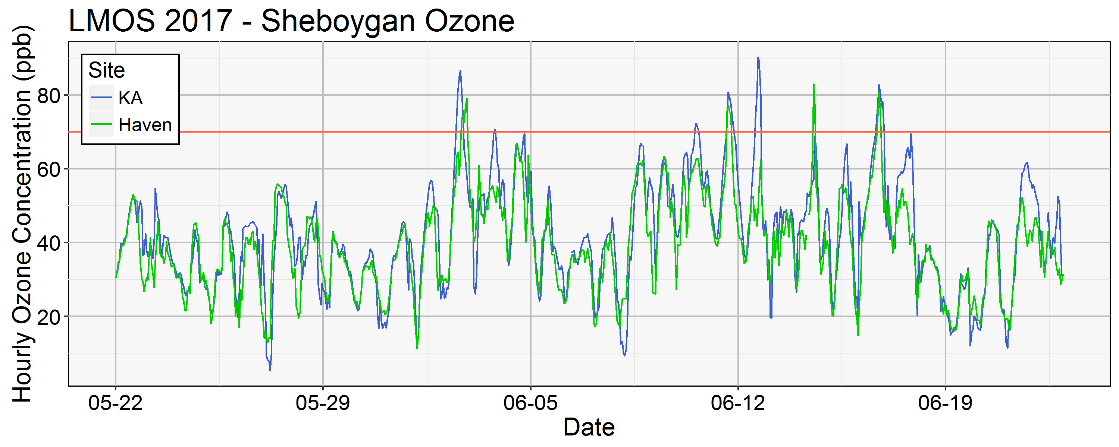
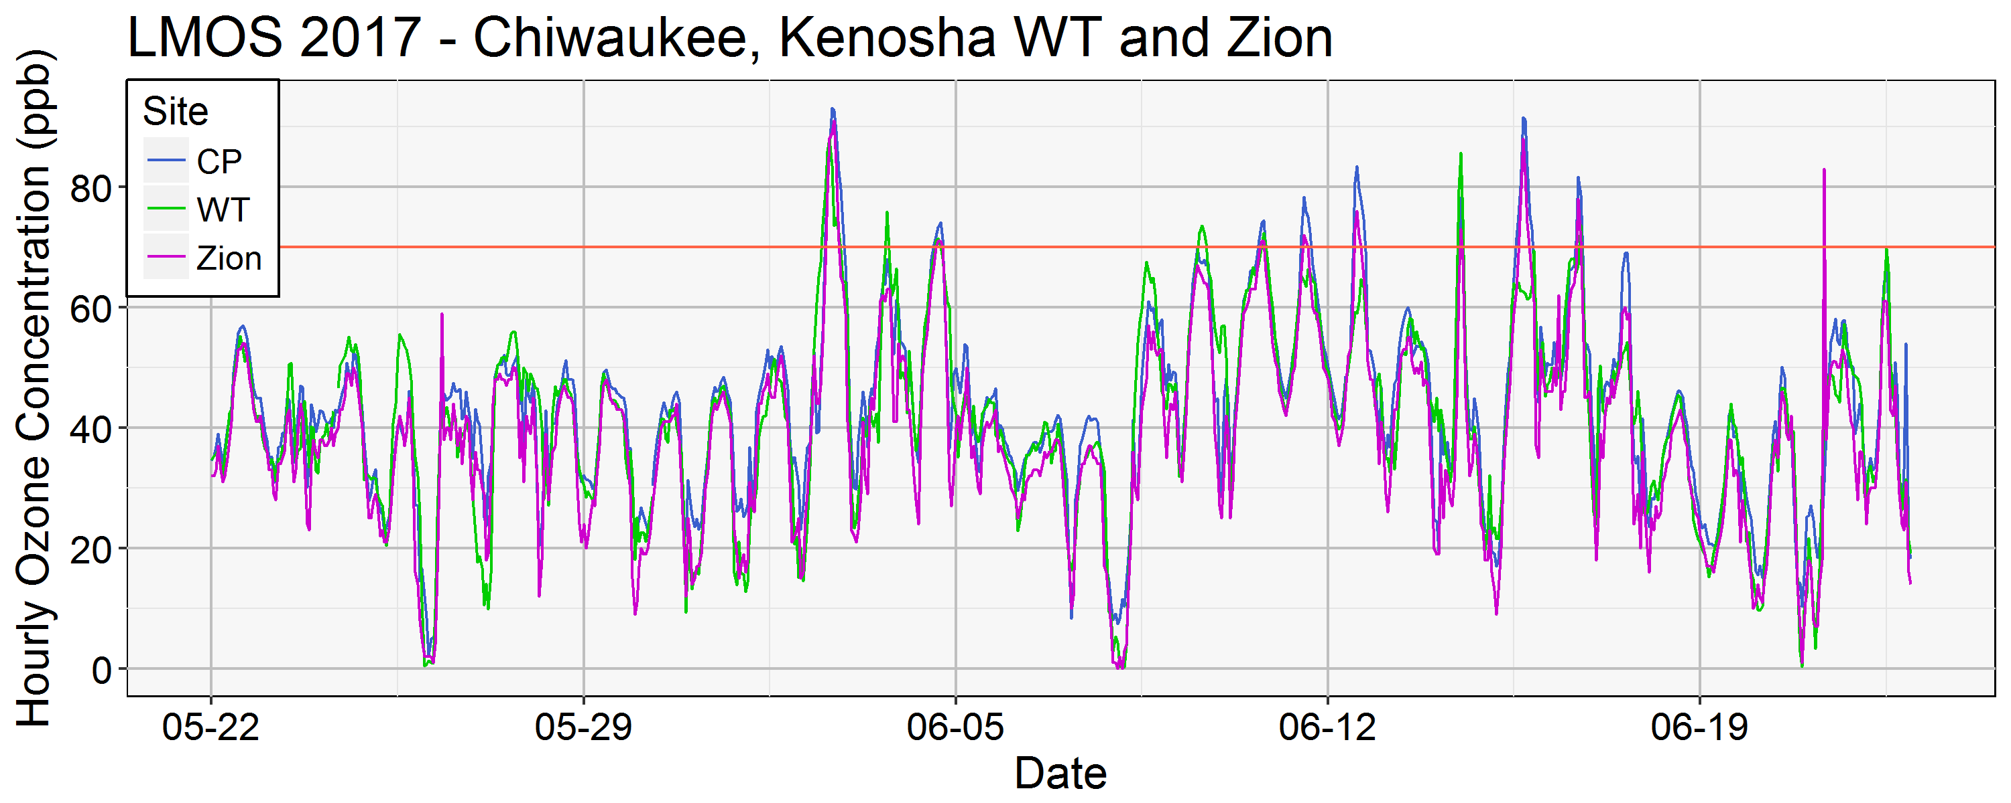
Lakeshore ozone during LMOS 2017
June 02, 2017 MDA8
June 02, 2017
June 02, 2017
(Angie Dickens , WDNR)
MDA8=Maximum Daily 8 hour Average

Slide 12
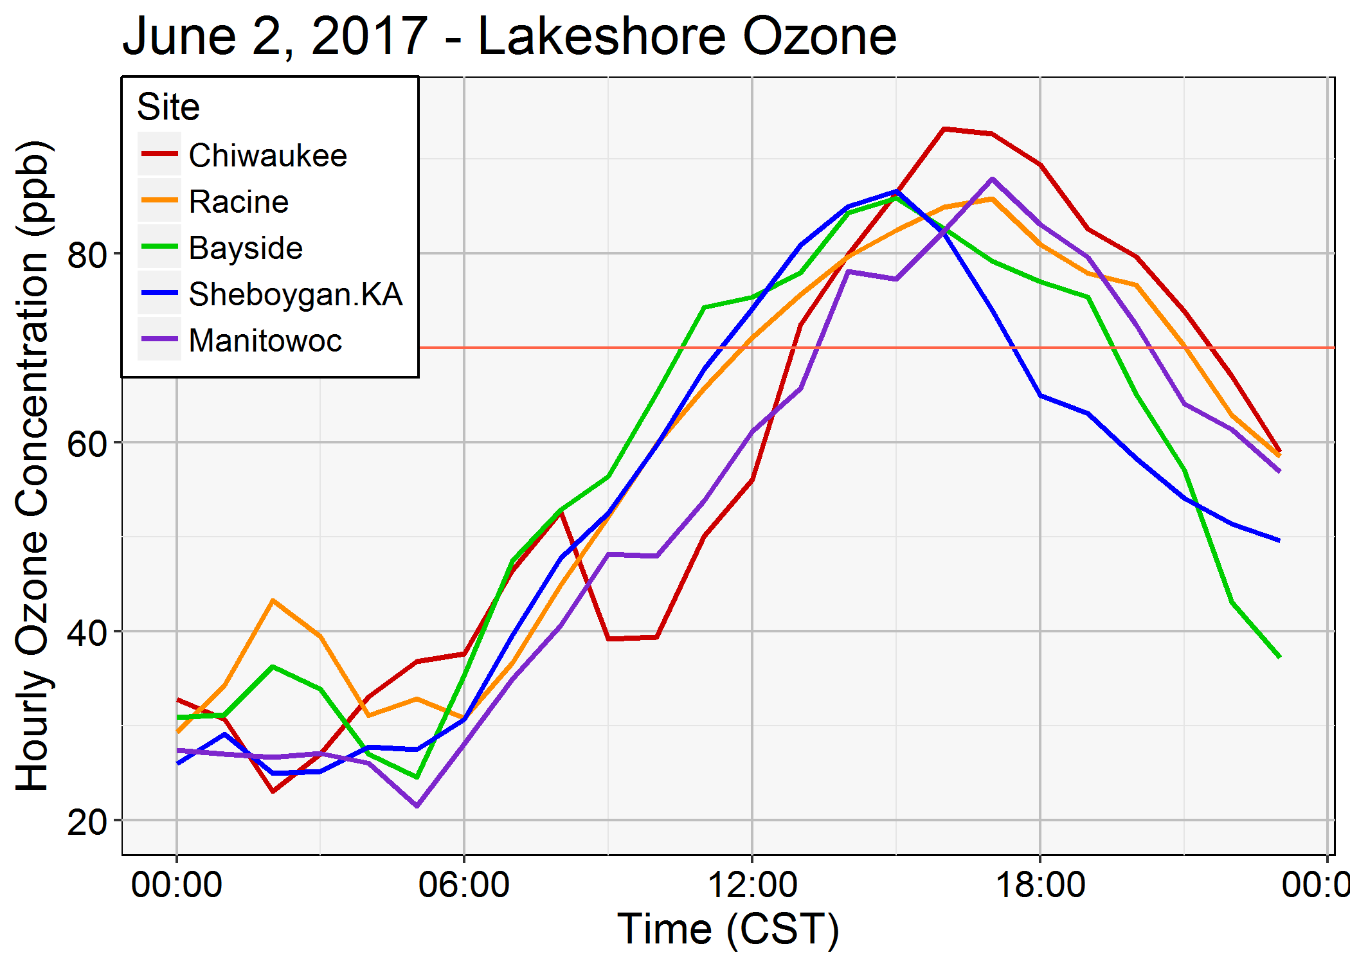
June 2nd (Friday)
MDA8 Ozone
June 02, 2017 MDA8
Deep Lake Breeze at northern & southern sites
MDA8=Maximum Daily 8 hour Average

Slide 13
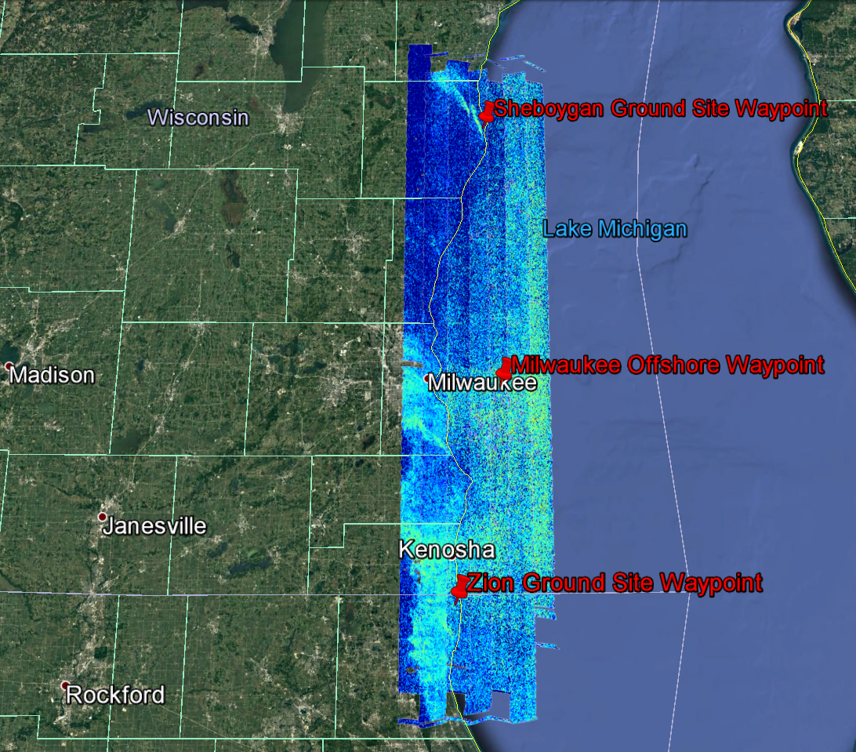
GeoTASO NO2 column retrieval June 02, 2017

Slide 14
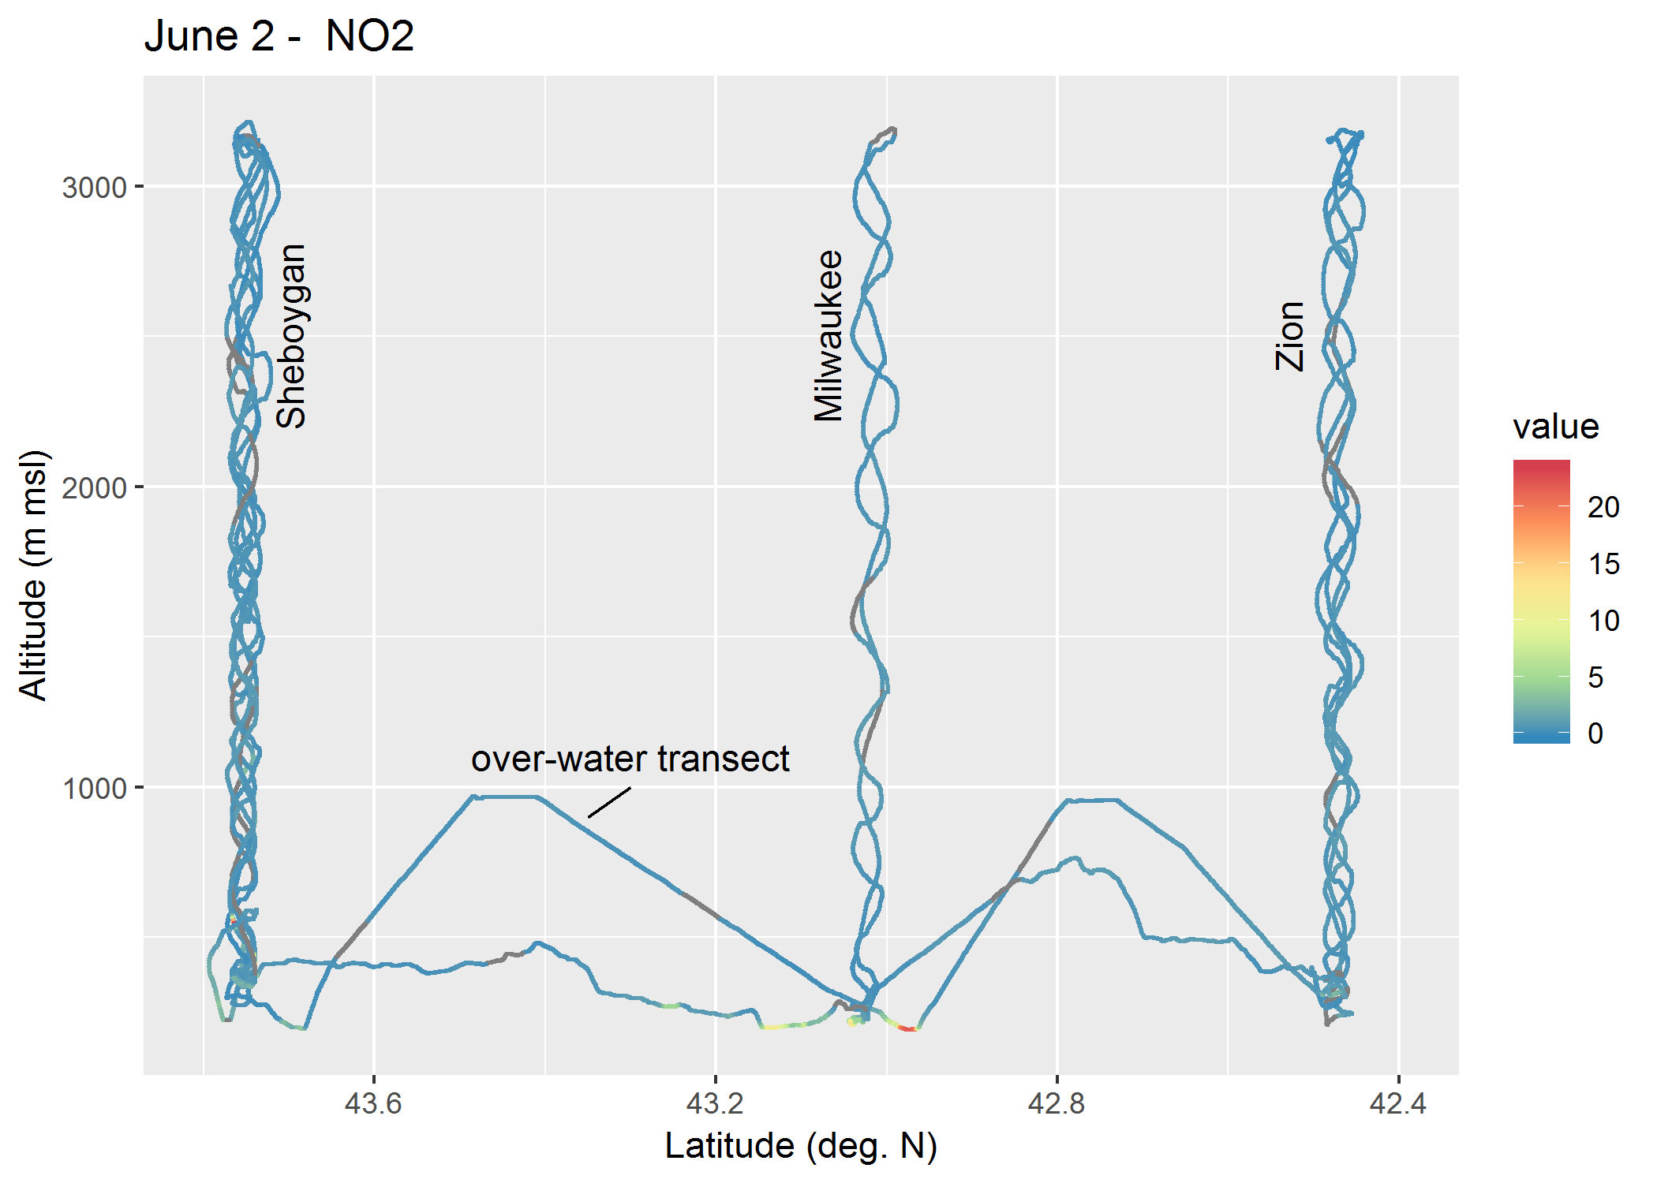
June 2nd (Friday)
NO2 concentrations
(Angie Dickens , WDNR)

Slide 15
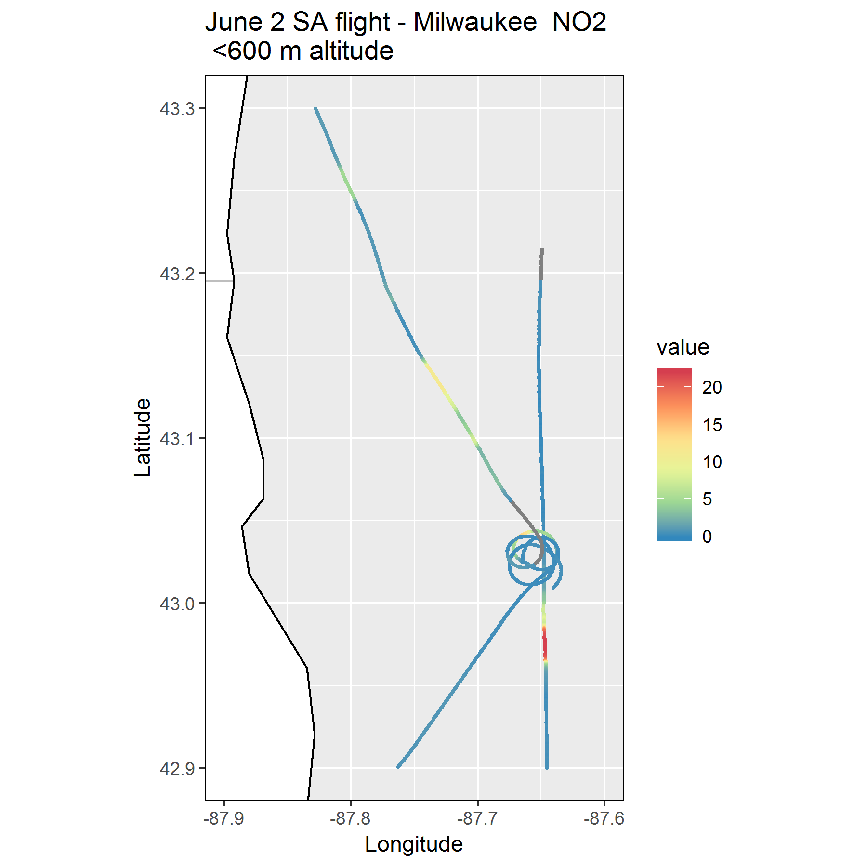
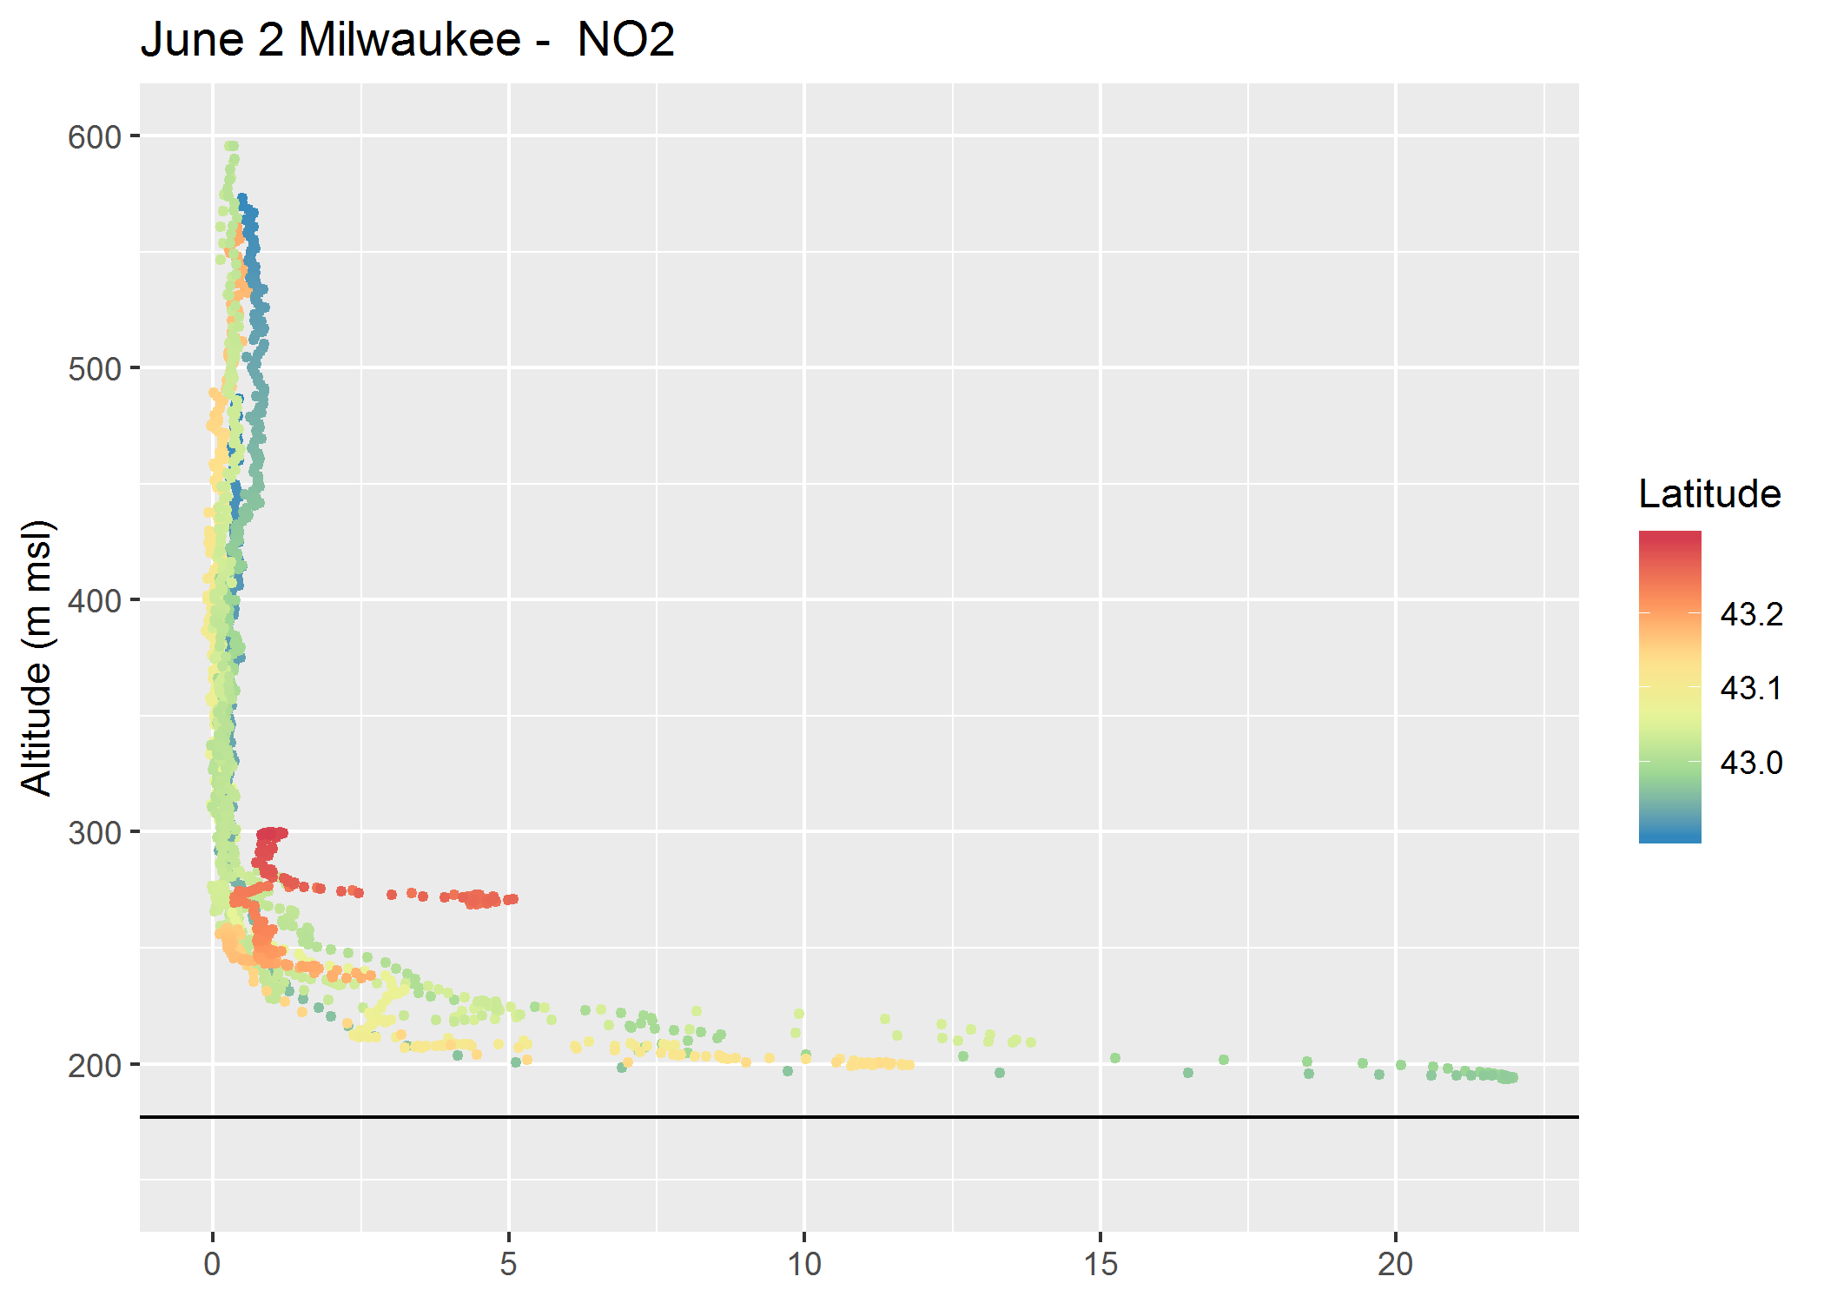
Milwaukee area
High-NO₂ by Milwaukee
NO₂ (ppb)
Altitude (m msl)
16:58
(pre-spiral)
NO₂ (ppb)
92-96 m above lake
32-42 m above lake
22-24 m above lake
16-23 m above lake
Lake level (177 m)
Times are in CST not CDT
NO2 (ppb)

Slide 16
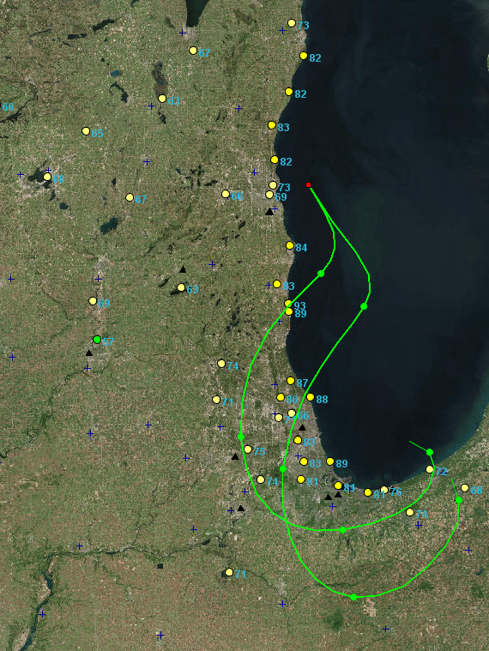
HYSPLIT back-trajectories – Milwaukee area
(24-hour, ending at 100 m at high-NO₂ areas) – June 2nd
High NO₂ measured at 14:40 CST & 16:20-17:00 CST
Both trajectories come from the Chicago area and travel over Lake Michigan
Large NO₂ plume travels from Chicago offshore of Milwaukee
Concentrations over 20 ppb NO₂
Low altitude plume
Maximum in lowest layers (≤ 20 m above the lake surface)
This presents a challenge for remote sensing of this NO₂
Note that NO₂ concentrations on this day were among the highest of the LMOS 2017 campaign
14:00 CST
16:00 CST

Slide 17
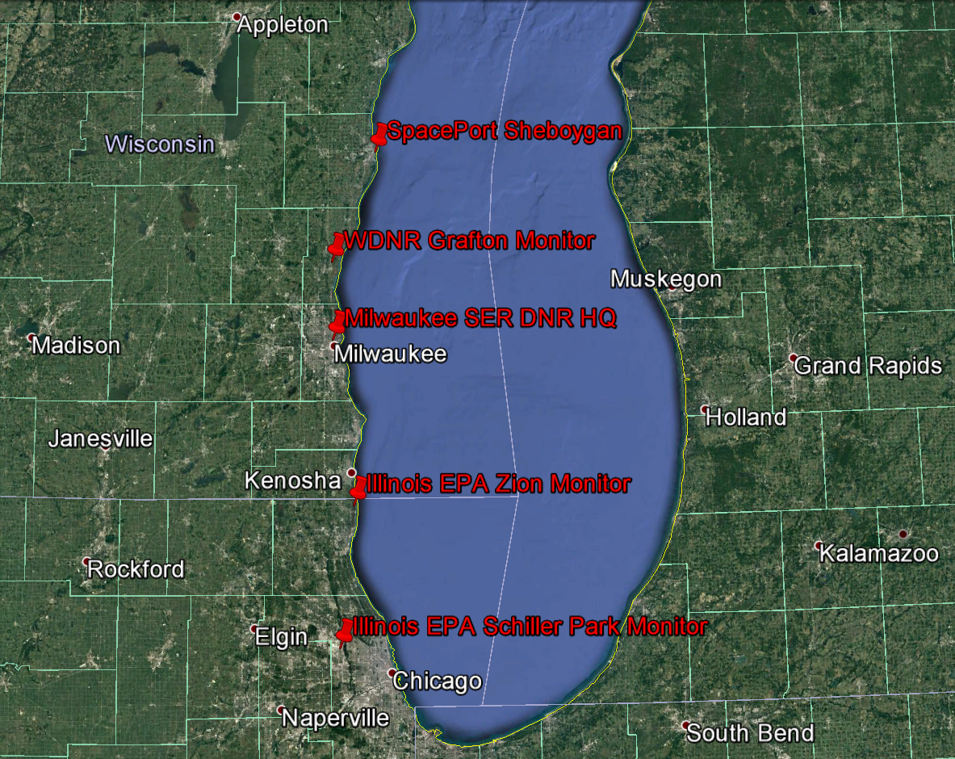
Ground based UV/visible grating spectrometers (Pandoras) column NO2 measurements during LMOS 2017
Pandora NO2 column measurements show high values at Zion, Grafton, and Sheboygan on June 2, 2017
(Luke Valin, EPA)

Slide 18
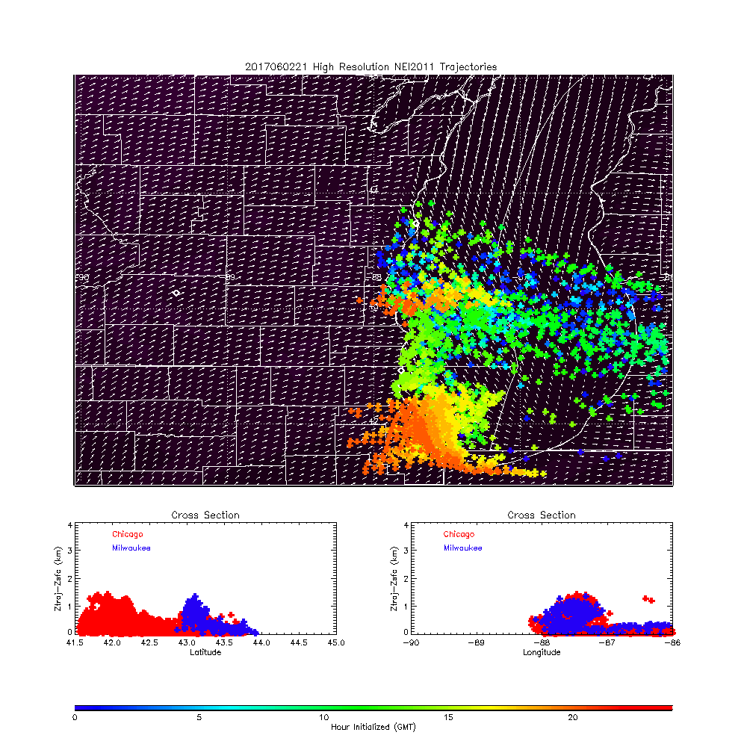
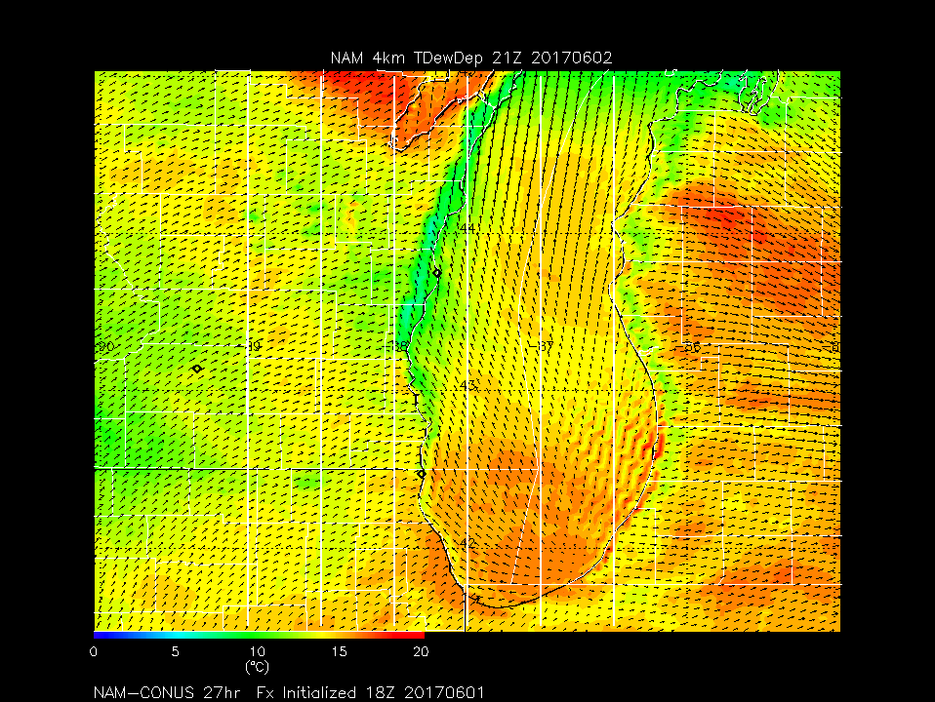
High-resolution (3km) Chicago/Milwaukee NOx emission trajectories
Transport of Chicago/Milwaukee emissions turns North in late afternoon (well defined Lake Breeze)
2m Dew Point Depression (C)
Latitude
Longitude
Hour of emissions (GMT)
21Z June 02, 2017
(4:00pm)

Slide 19
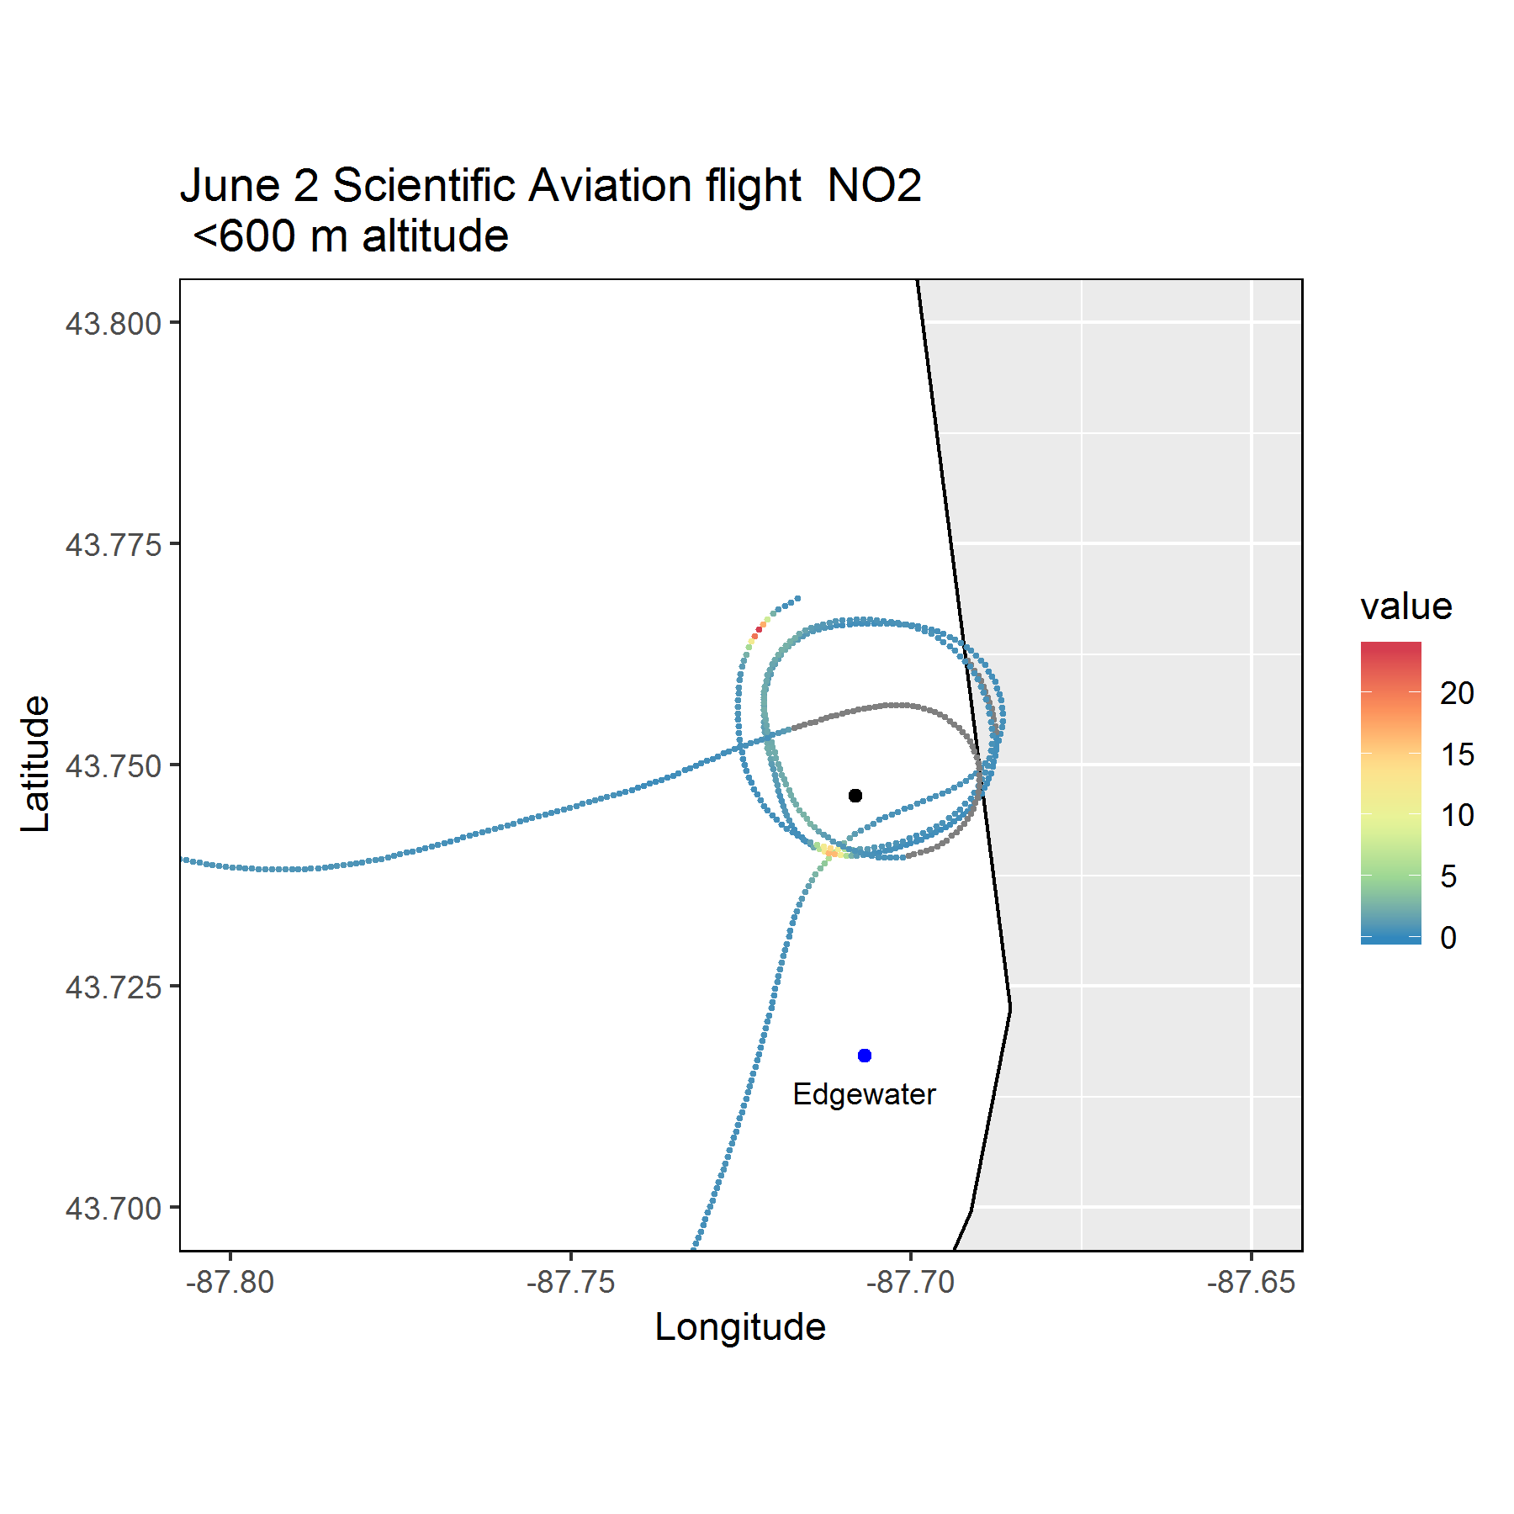
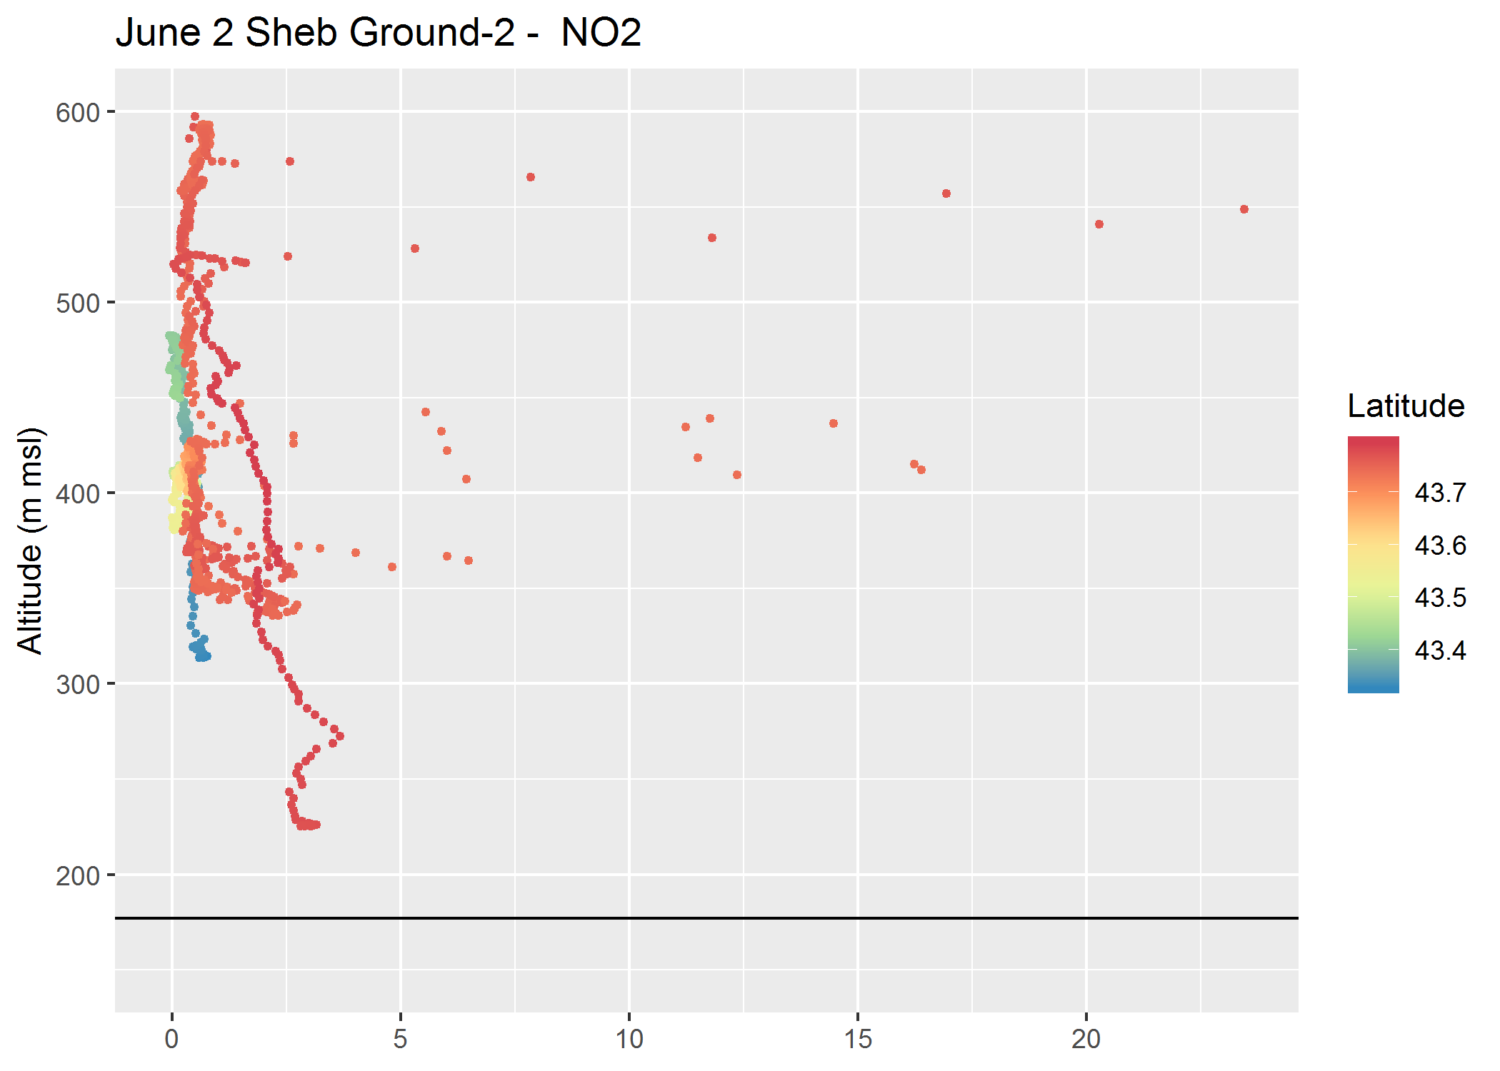
Sheboygan Ground Site-2
High-NO₂ by
Sheboygan Ground
Site-2 Spiral
NO₂ (ppb)
17:40
Altitude (m msl)
17:11
17:39
Shoreline is wrong!
Both points are on the shoreline
17:39
Lake level
NO₂ (ppb)
233-242 m above lake
257-262 m above lake
233-242 m above lake
184-192 m above lake
Slightly elevated NO₂ over land
Very narrow plume from Edgewater
Altitude increases with distance
Plume location consistent over at least 30 minutes
Lake level (177 m)
NO2 (ppb)

Slide 20
Sheboygan Ground Site-2
High-NO₂ by
Sheboygan Ground
Site-2 Spiral
NO₂ (ppb)
17:40
Altitude (m msl)
17:11
17:39
Shoreline is wrong!
Both points are on the shoreline
17:39
Lake level
NO₂ (ppb)
233-242 m above lake
257-262 m above lake
233-242 m above lake
184-192 m above lake
Slightly elevated NO₂ over land
Very narrow plume from Edgewater
Altitude increases with distance
Plume location consistent over at least 30 minutes
Lake level (177 m)
NO2 (ppb)

Slide 21
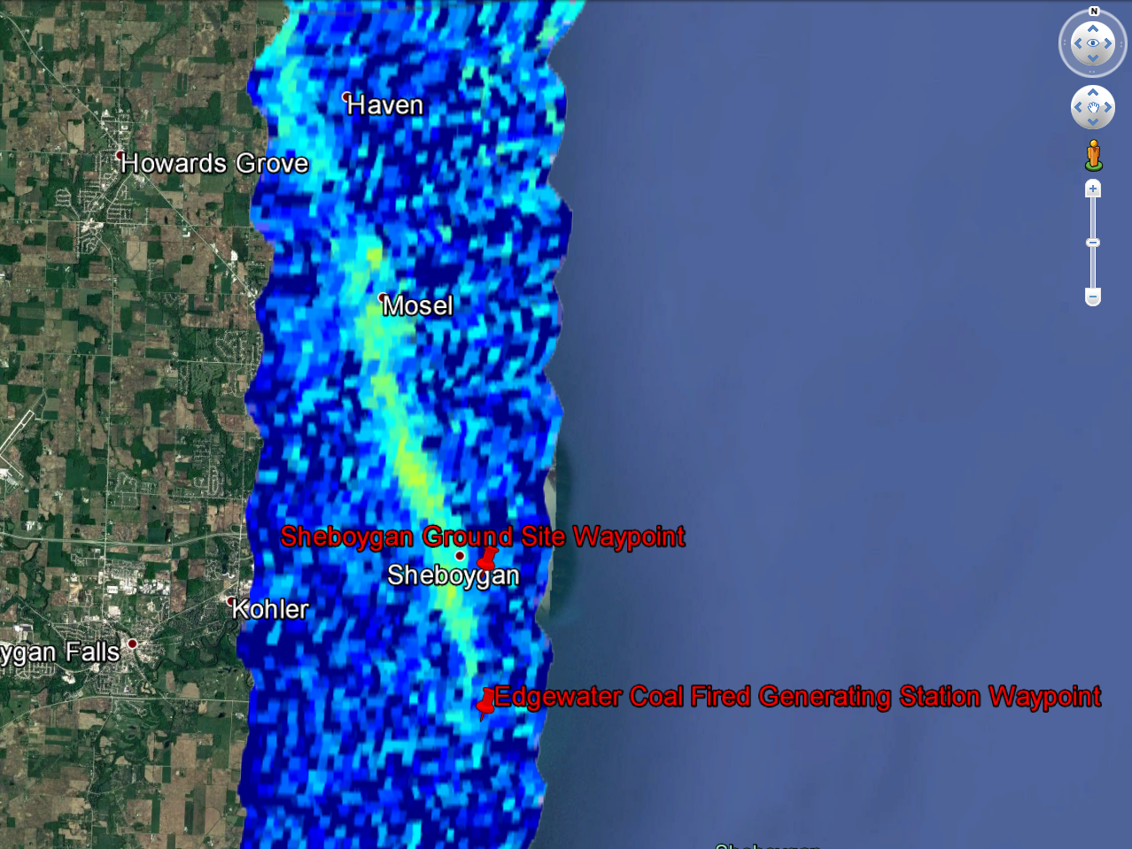
GeoTASO NO2 column retrieval June 02, 2017

Slide 22
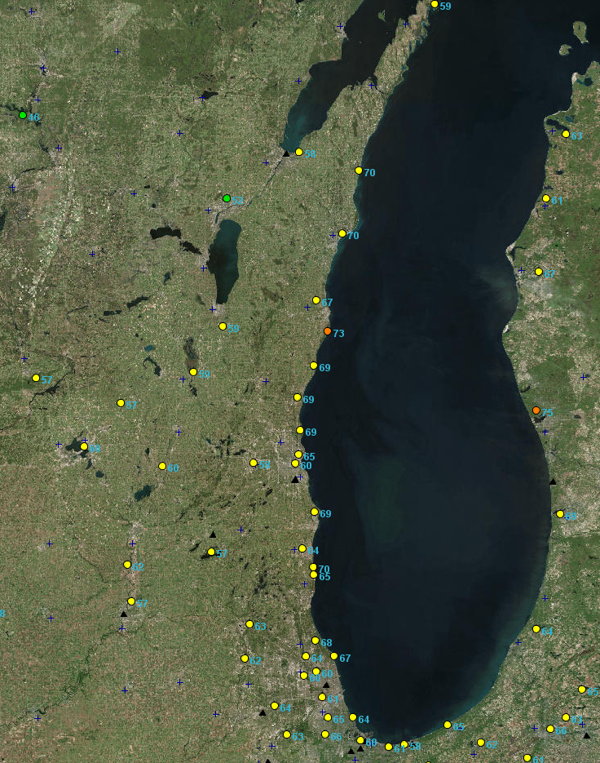
Lakeshore ozone during LMOS 2017
June 11, 2017 MDA8
June 11, 2017
June 11, 2017
(Angie Dickens , WDNR)
MDA8=Maximum Daily 8 hour Average

Slide 23
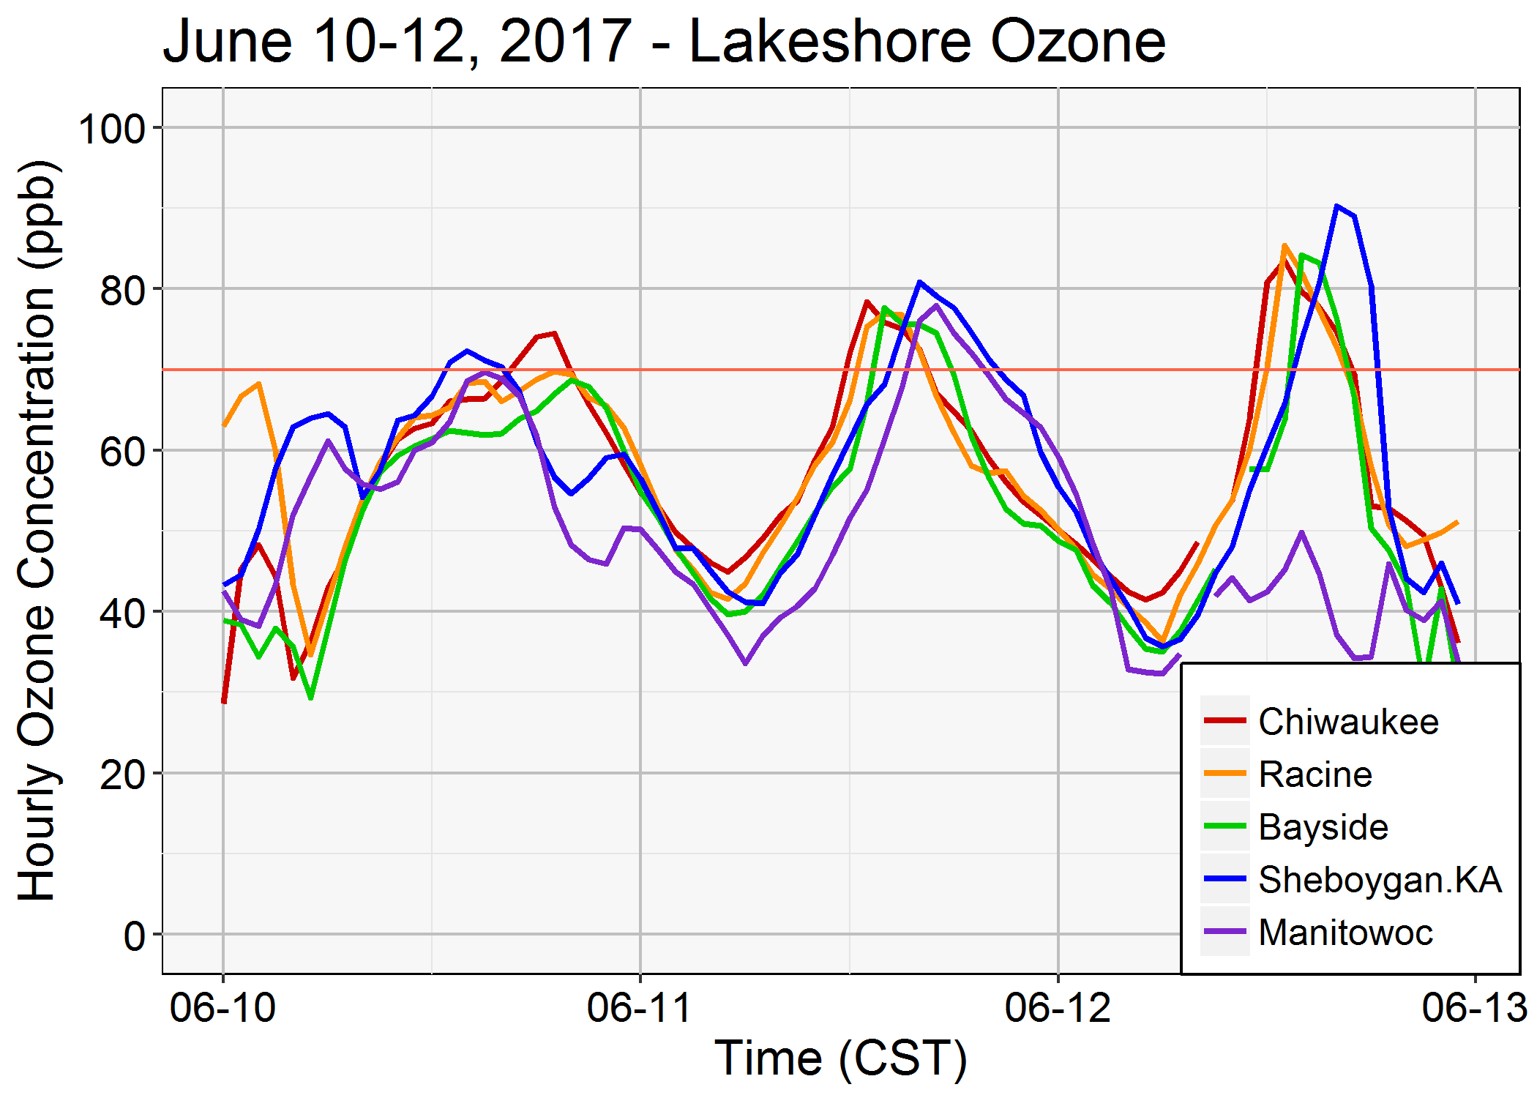
June 11
MDA8 Ozone
June 11, 2017 MDA8
Deep lake breeze @ Sheboygan;
Shallow lake breeze @ Kenosha
MDA8=Maximum Daily 8 hour Average

Slide 24
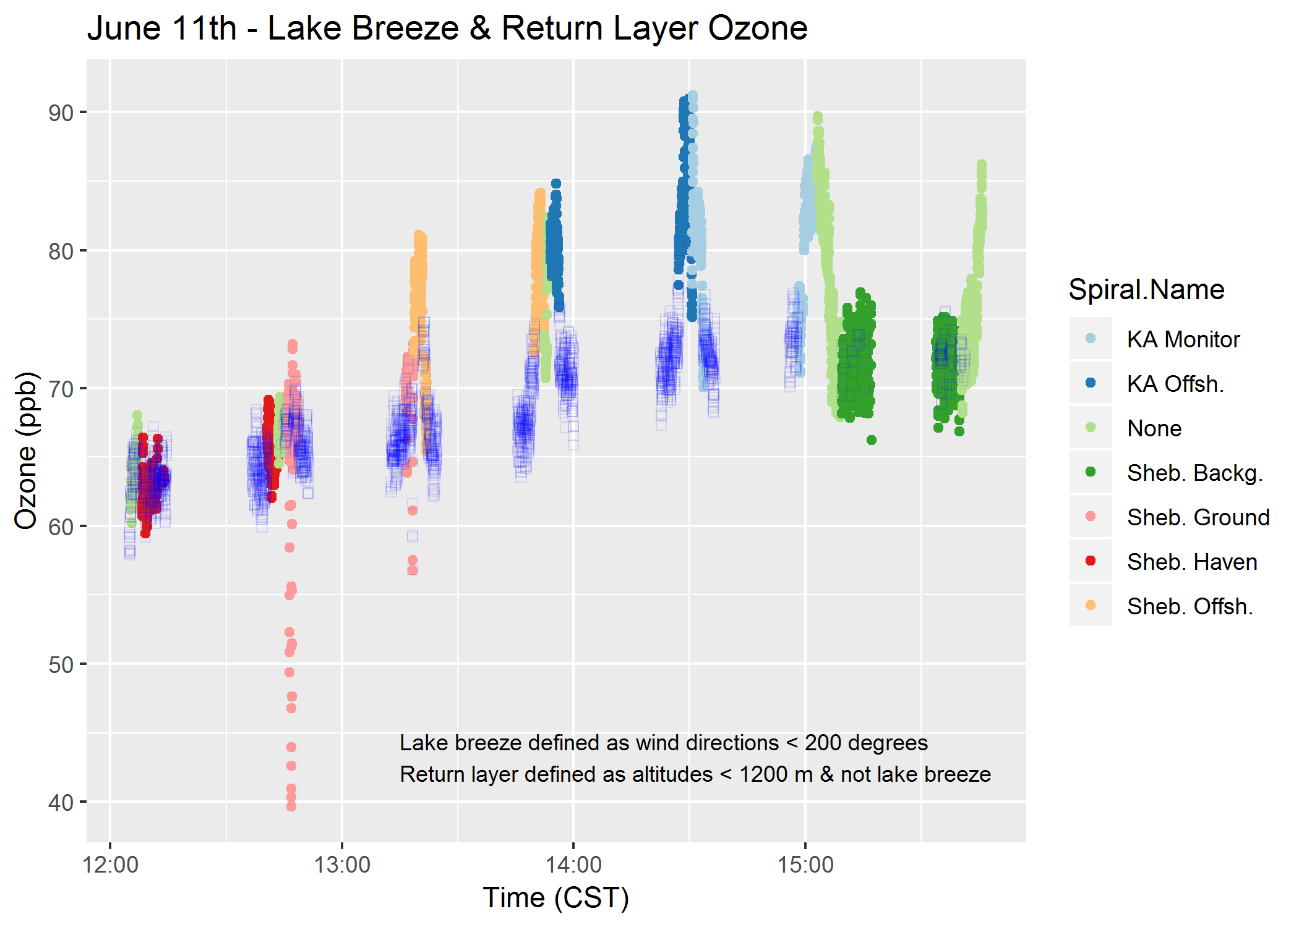
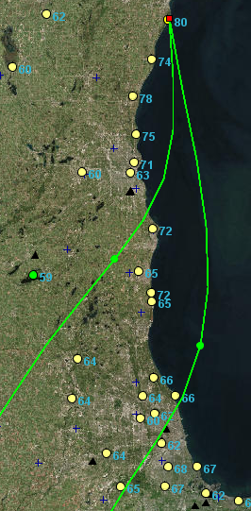
Ozone on high-ozone days
(MDA8 > 70 ppb)
Inland
(prob. not lake breeze)
June 11
Sunday
12:30
13:00
13:30
Lake breeze:
15:30
14:45
14:15
Return layer (blue squares)
13:00
16:00
Titration in NOx plume
Lines are not linear regressions
General increase in mixed layer/return flow (conservatively up to 1200 m) over time
Much greater increase in ozone in lake breeze layer over time
Peak ozone in lake breeze layer but above very lowest layer (<500 m)
Titration in power plant plume
Near lakeshore, time seems more important than space (well-mixed across lat/long in this area)
Note that flights were a few hour before peak ozone
No trend in ozone over time at altitudes >2000 m

Slide 25
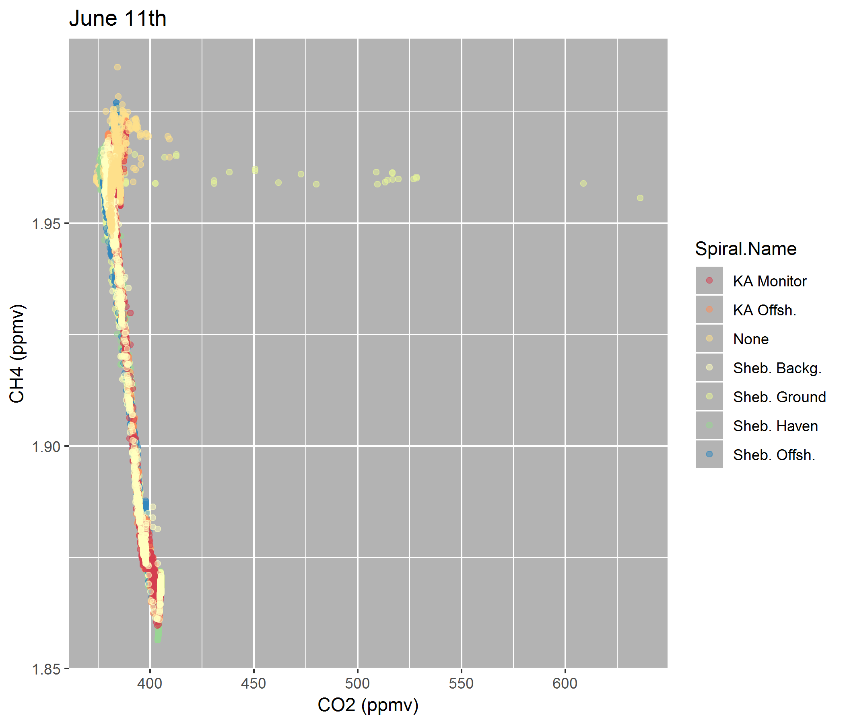
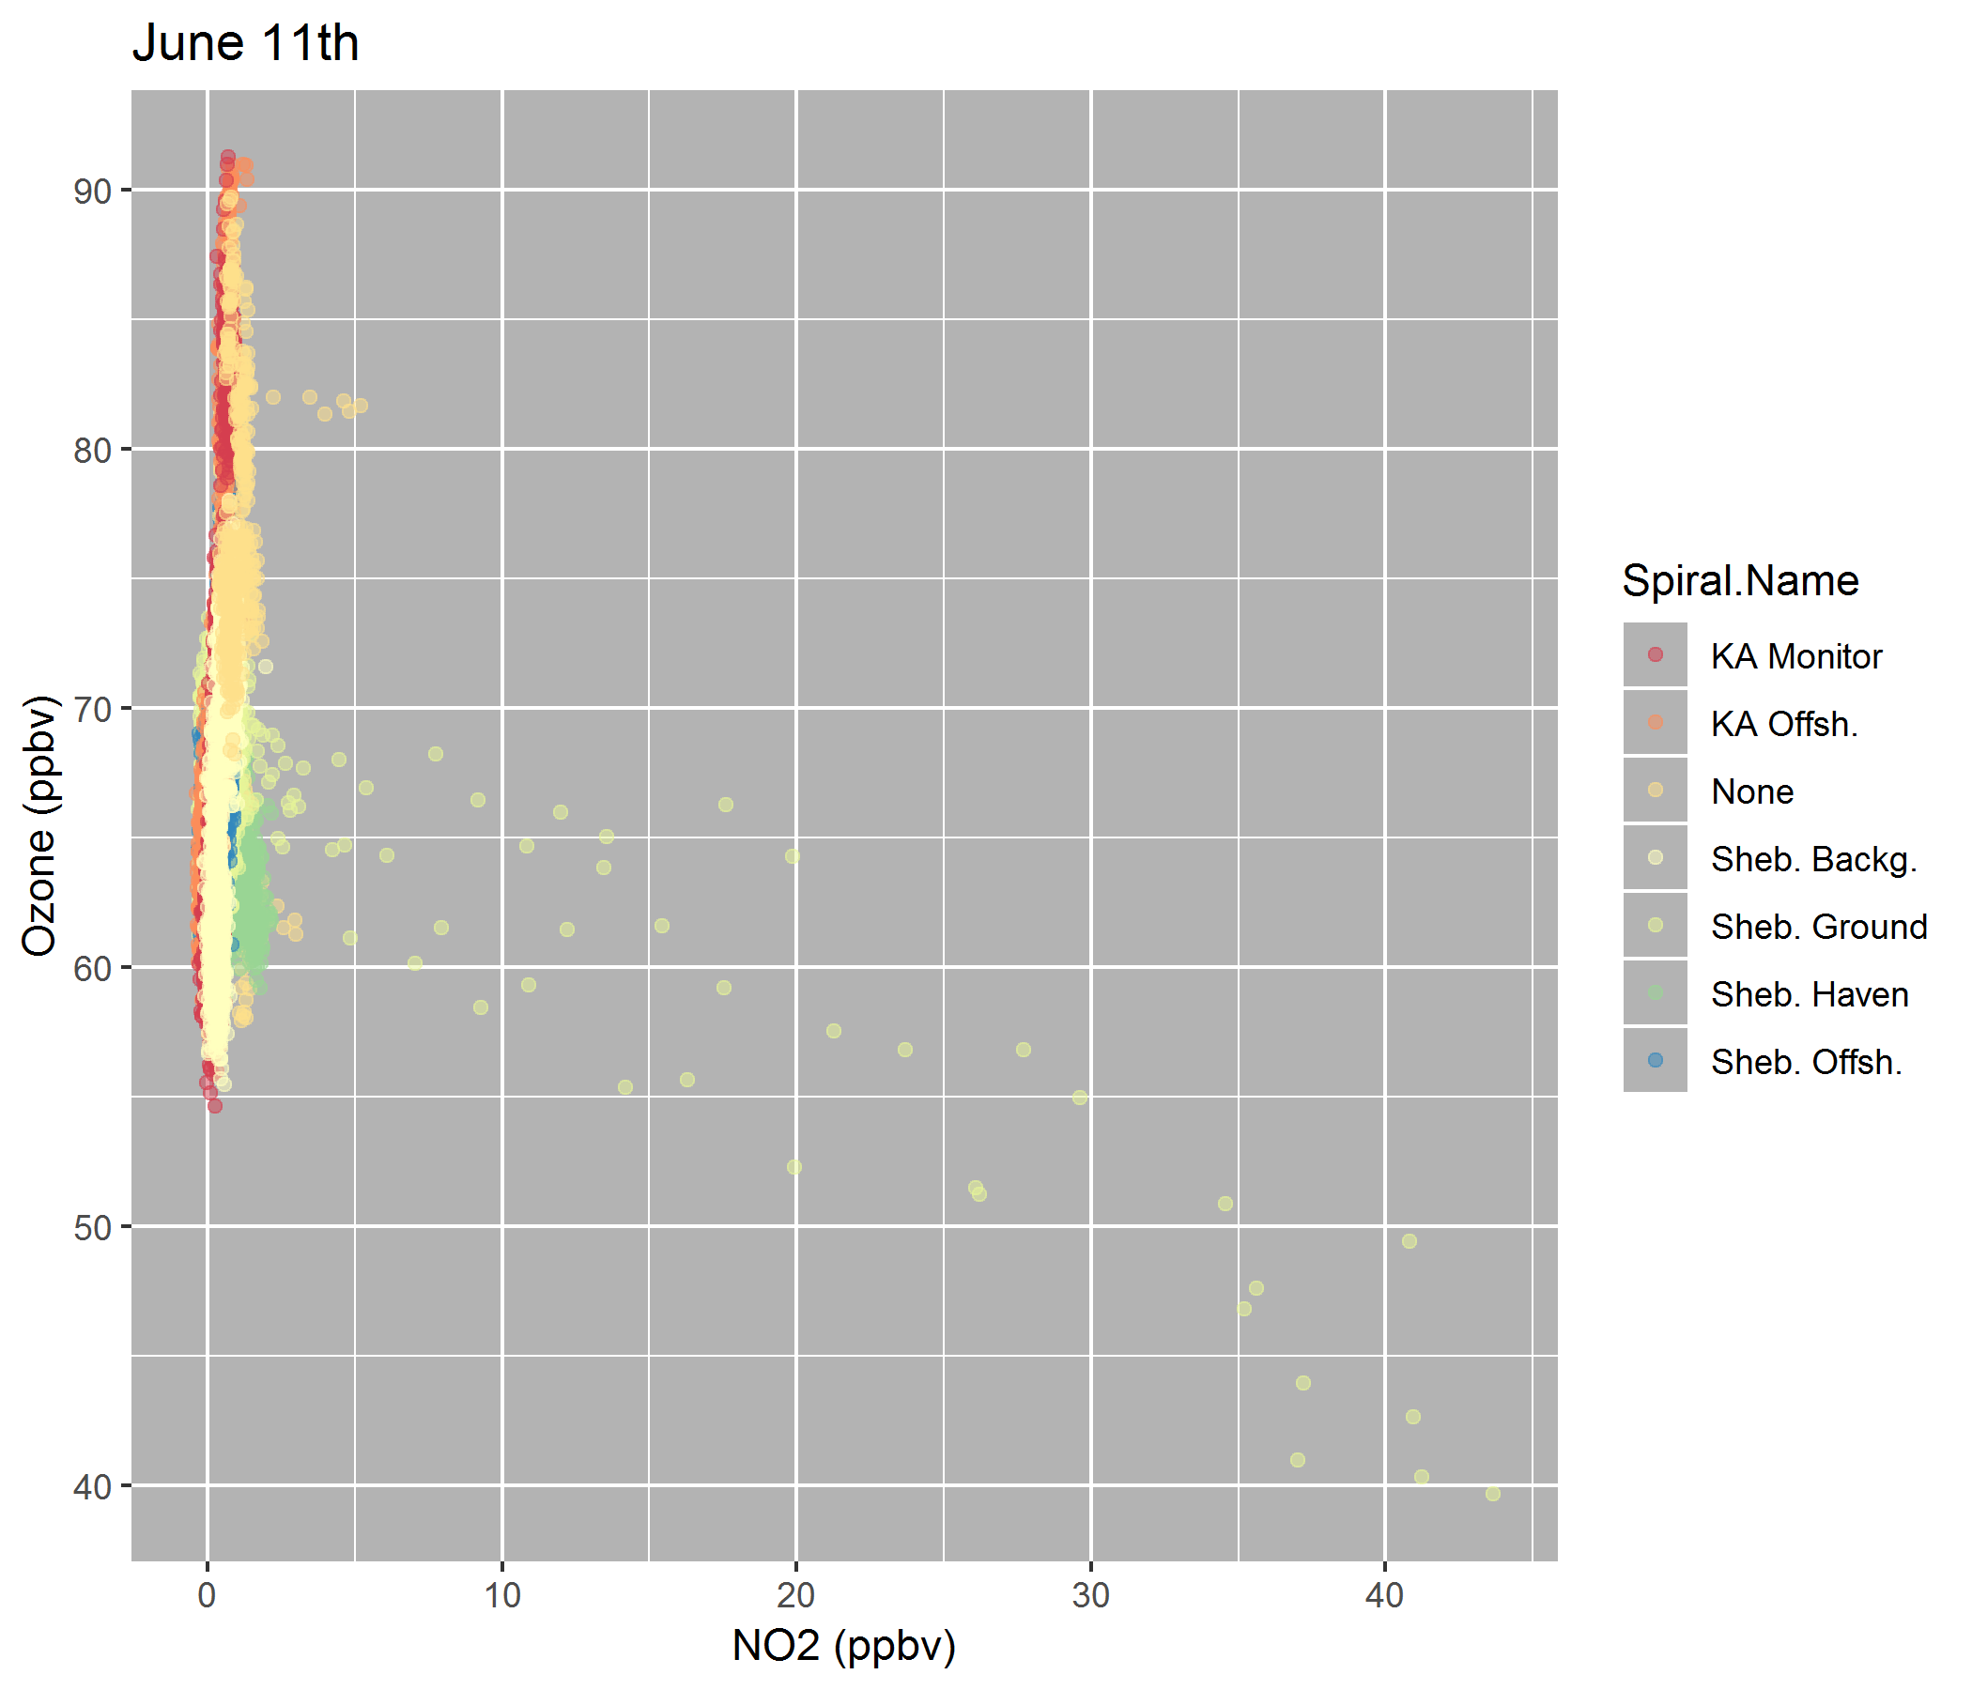
Power plant plume:
High NO2 & CO2, CH4
& low Ozone

Slide 26
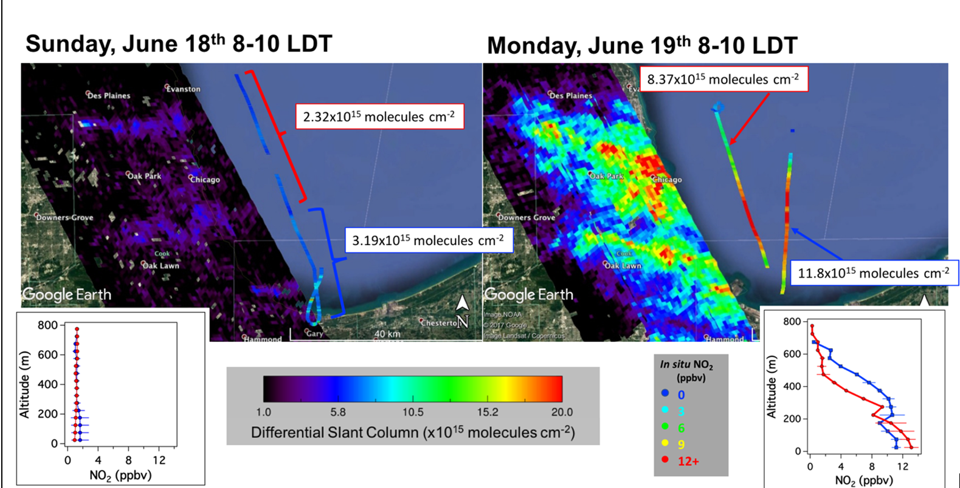
Chicago Emission Mapping and profiling Weekend/Weekday
GeoTASO NO2 columns and Scientific Aviation NO2 profiles show large differences between weekend and weekday NO2 abundances. LMOS measurements provide constraints on emissions from commuter traffic (Analysis by Laura Judd, NASA/LaRC)

Slide 27
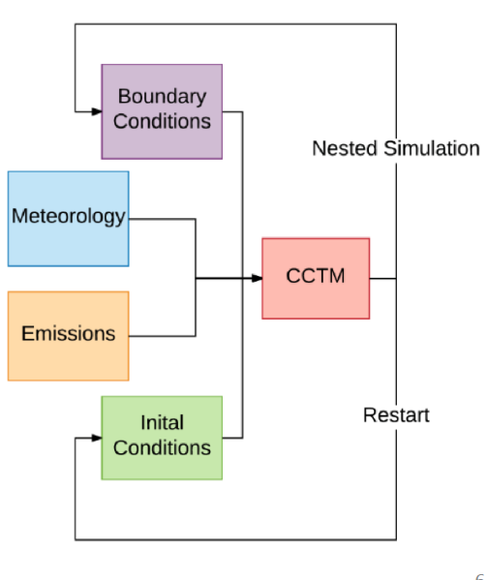
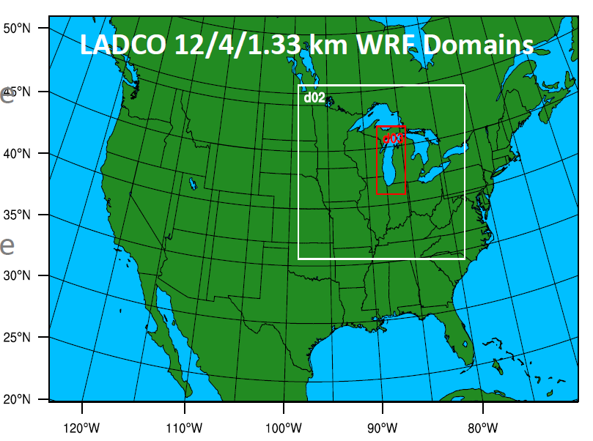
Regulatory Modeling
A Satellite Constrained Meteorological Modeling Platform for LADCO States SIP Development
(Funded by NASA Applied Sciences Program
PI Jason Otkin/SSEC)
From Zac Adelman (LADCO)

Slide 28
Model Sensitivity Simulations
EXPERIMENT GLSEA SST LAI SOIL IC/BC status
EPA -- -- -- GFS complete
EPA-SST ✔ -- -- GFS complete
YNT -- -- -- GFS complete
YNT-NAM -- -- -- NAM complete
YNT-SST ✔ -- -- GFS complete
6) YNT-SST-nudge2km ✔ -- -- GFS complete
7) YNT-SST-SOIL ✔ -- ✔ GFS ongoing
The “EPA” simulation follows the WRF model configuration used by the EPA in their operational forecasting model, except with analysis nudging toward GFS analyses instead of NAM analyses. It employs the Pleim-Xu land surface model (LSM), Pleim-Xu surface layer physics, Morrison 2-moment cloud microphysics, and the ACM2 (Pleim) planetary boundary layer (PBL) parameterization schemes.
The “EPA-SST” simulation is the same as 1, except for replacing the coarse-resolution SST initialization dataset with the high-resolution, real-time GLSEA SST dataset.
The “YNT” simulation is the same as 1, except for replacing the LSM, surface layer physics, cloud microphysics, and PBL parameterization schemes with the Noah LSM, Monin-Obukhov surface layer physics, Thompson microphysics, and YSU PBL, respectively.
The “YNT-NAM” simulation is the same as 4, except that the NAM analyses are used for the lateral boundary and initial conditions instead of GFS.
The “YNT-SST” simulation is the same as 4, except for replacing the coarse-resolution SST initialization dataset with the high-resolution, real-time GLSEA SST dataset.
The “YNT-SST-nudge2km” simulation is the same as 6 (previous slide), except for nudging temperature, moisture, and horizontal winds above 2 km (model level) instead of above the boundary layer
The “YNT-SST-SOIL” simulation will be the same as 6 (previous slide), except for replacing soil temperature and moisture with high-resolution analyses provided by SPoRT-LIS.

Slide 29
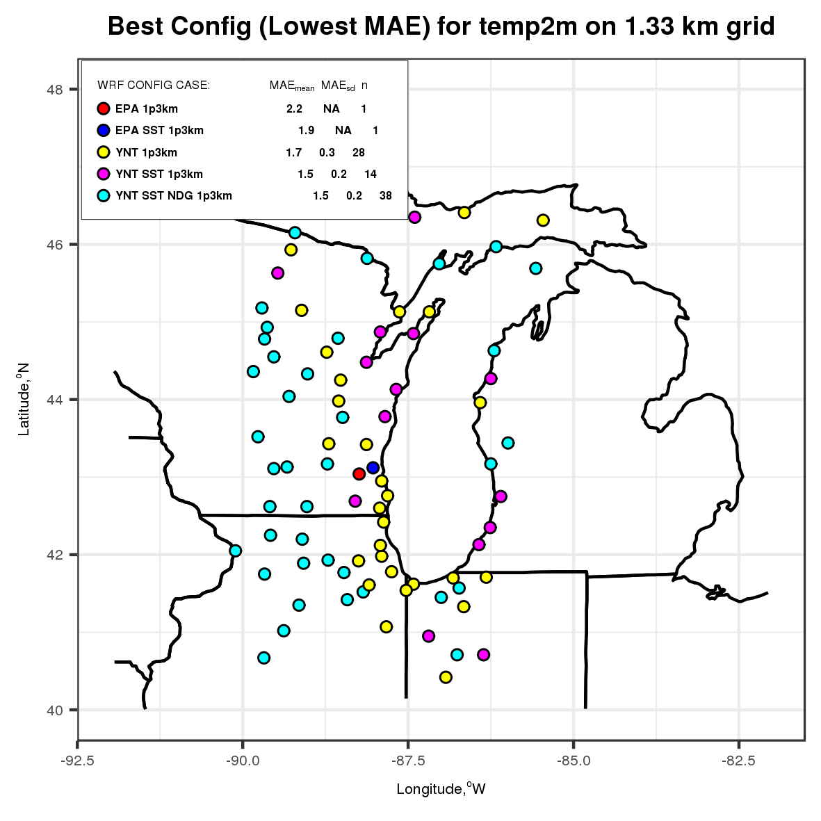
2-m Temperature Statistics (1.33-km Domain)
Best Performing Model Configuration
Statistical Summary
On the highest resolution domain, the YNT configurations greatly outperform the EPA baseline simulations
Clear geographic separation with YNT-SST-nudge2km being the most accurate at western inland locations
YNT and YNT-SST configurations provide superior results along the Lake Michigan shoreline

Slide 30
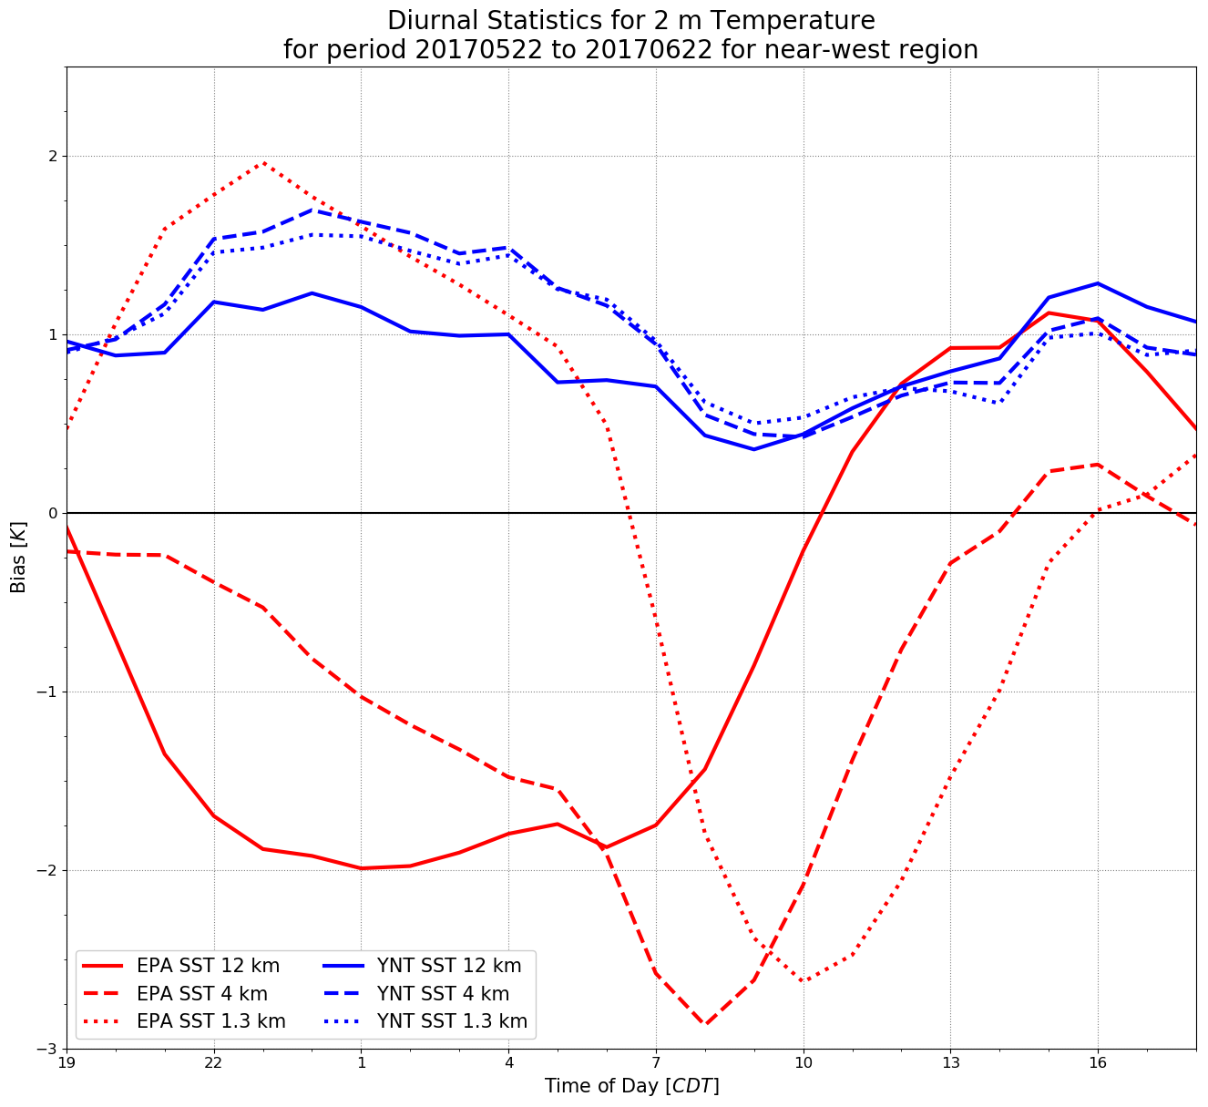
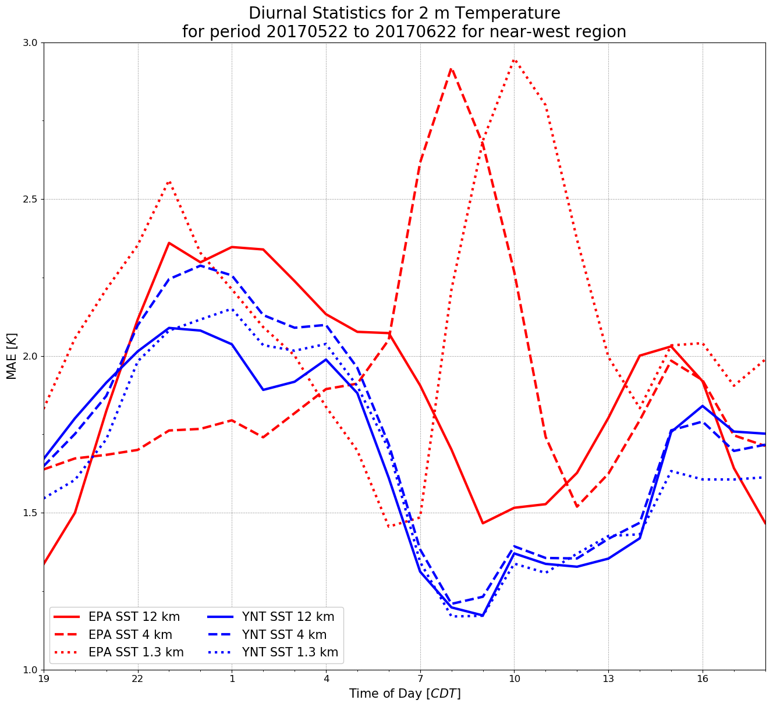
Diurnal Error Statistics Along Western Shoreline
Temperature Bias
Temperature Mean Absolute Error
Most obvious difference is the diurnal cycle of the temperature bias in the EPA baseline simulations compared to the YNT configuration
Coarser (higher) resolution EPA domains show cool (warm) biases during the night that switch to warm (cool) biases later in the day
In contrast, YNT simulations show a consistent warm bias that increases with resolution
Diurnal evolution in MAE is similar for all runs; however, high-resolution EPA baseline run spikes in error near midday

Slide 31
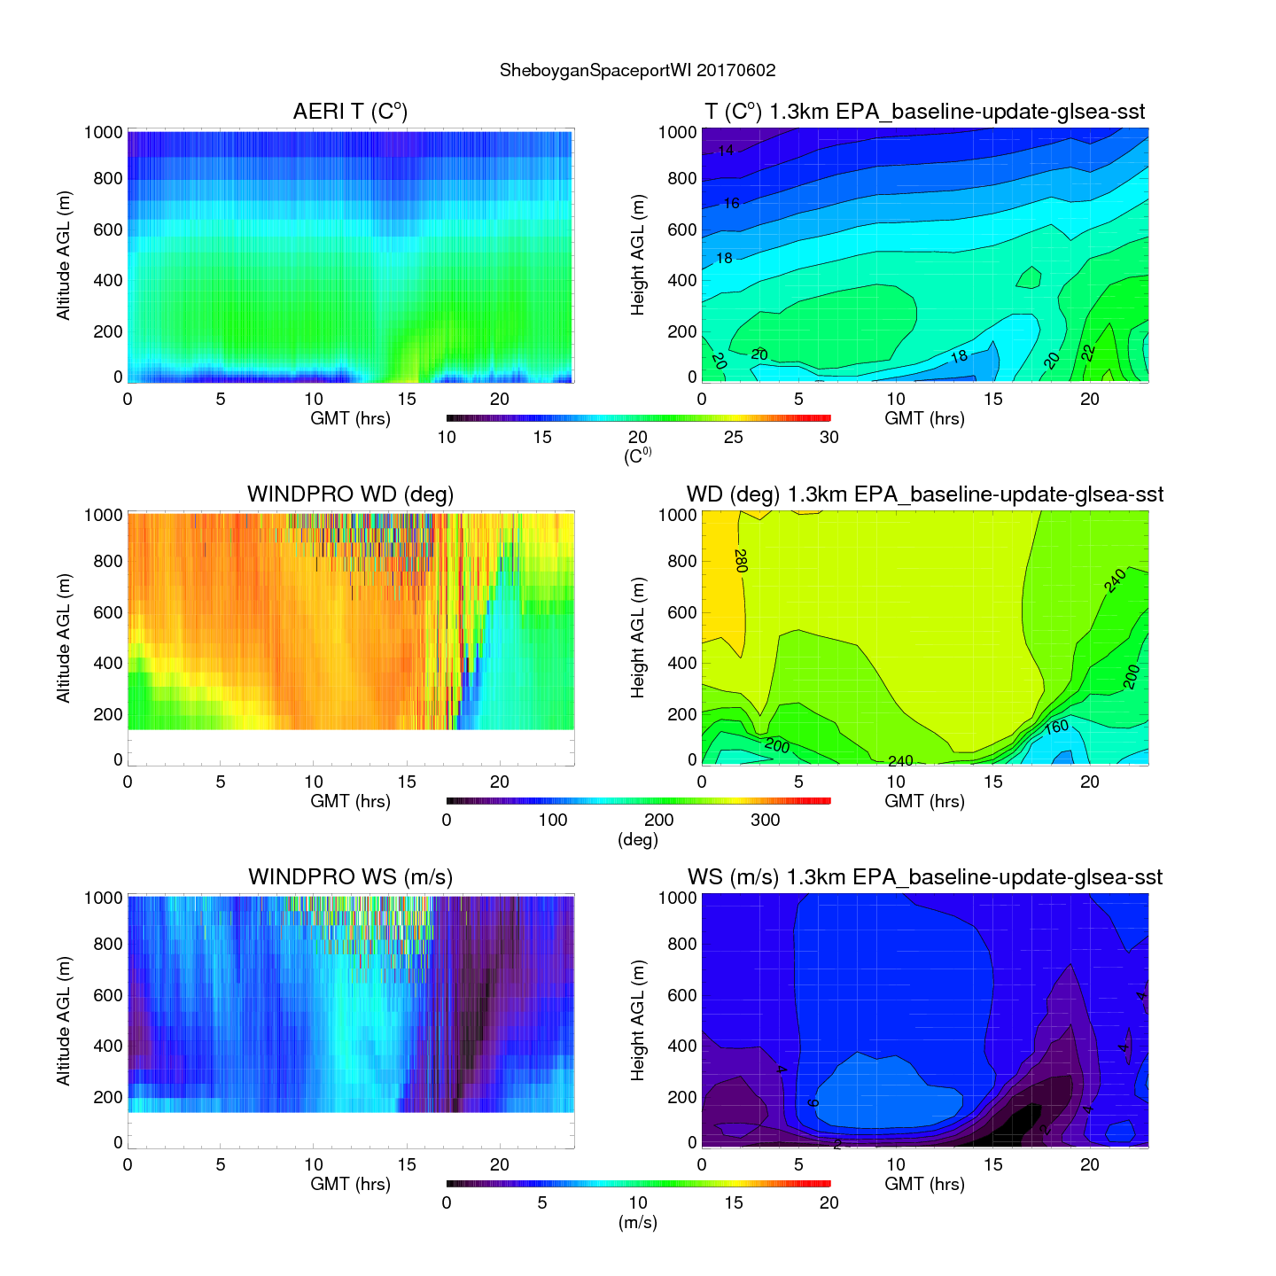
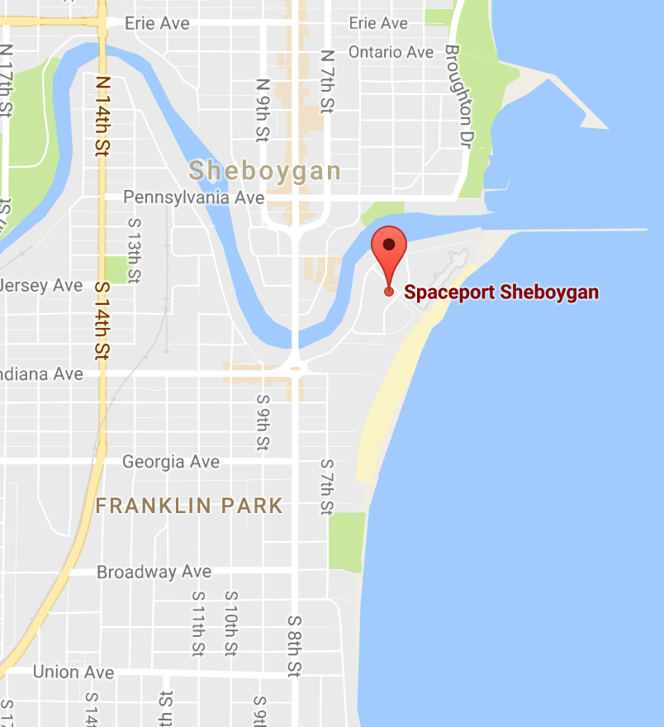
Sheboygan Ground Site: Spaceport Sheboygan
Observed Temperature and Wind (left)
Verses EPA Baseline/GLSEA SST
June 2, 2017 (Lake Breeze/Ozone Exceedance)

Slide 32
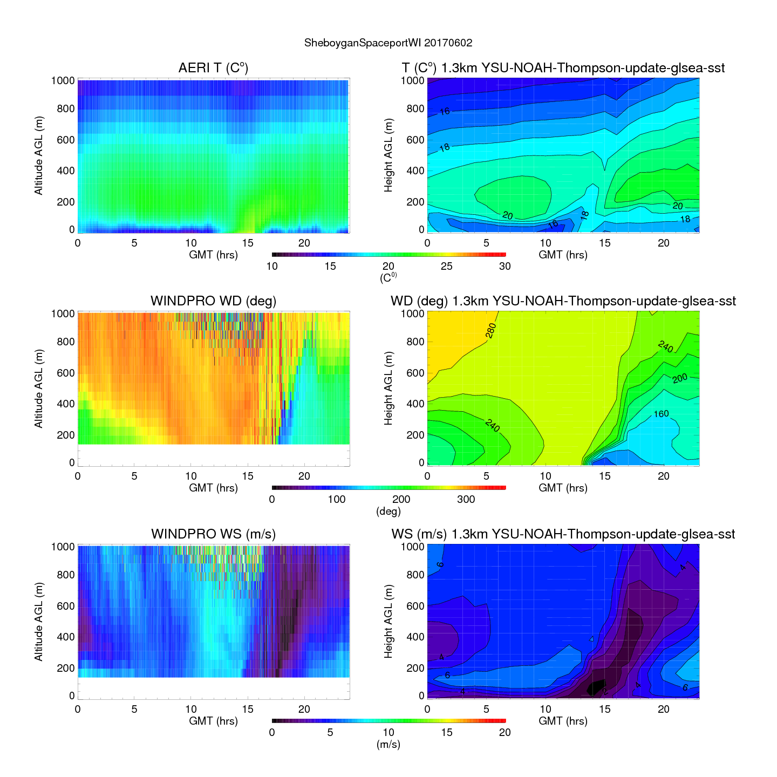
Sheboygan Ground Site: Spaceport Sheboygan
Observed Temperature and Wind (left)
Verses EPA Baseline/GLSEA SST
June 2, 2017 (Lake Breeze/Ozone Exceedance)

Slide 33
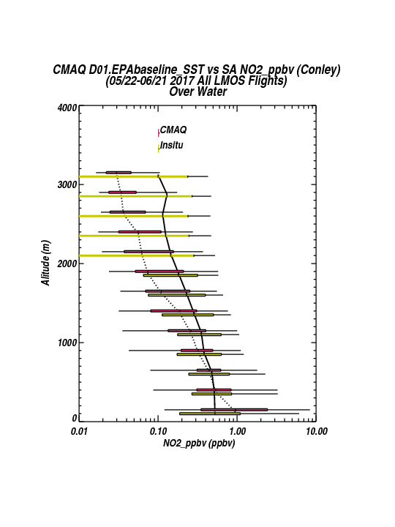
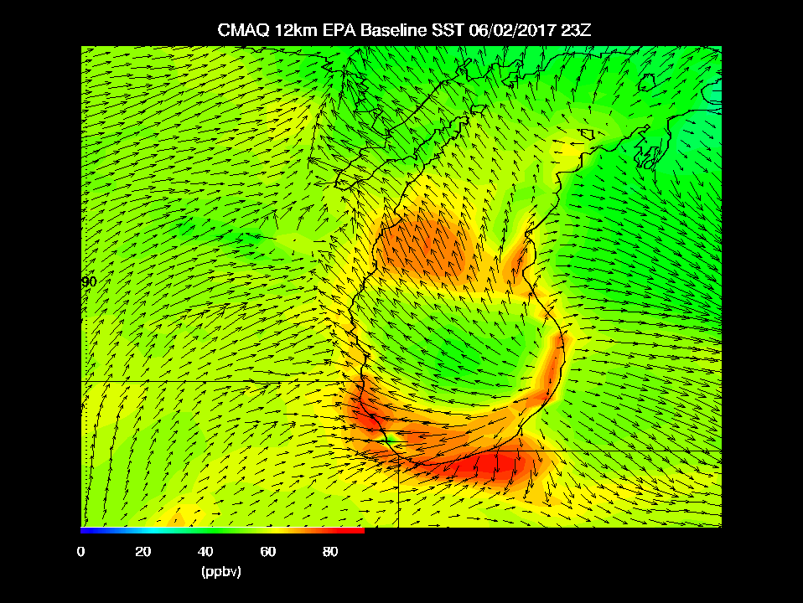
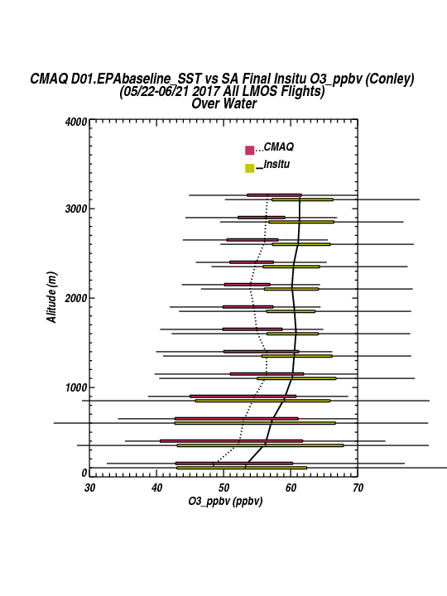
12km CMAQ Model verification
NEI 2014 12km Emission Inventory provided by Kirk Baker, US EPA
EPA Baseline physics overestimates marine boundary layer NO2 by factor of 2x
|‌ 33

Slide 34
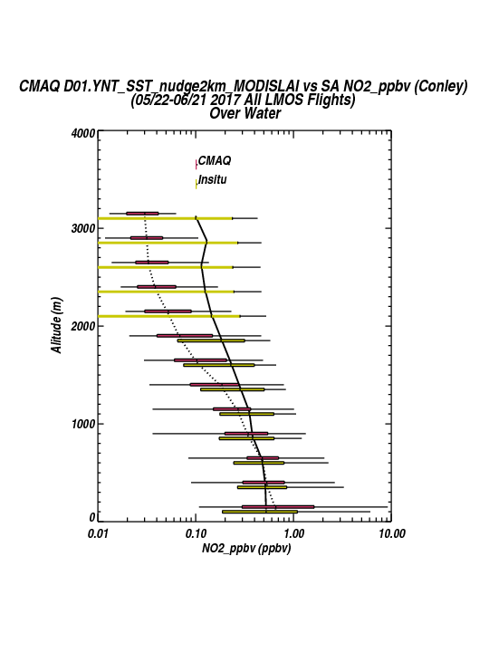
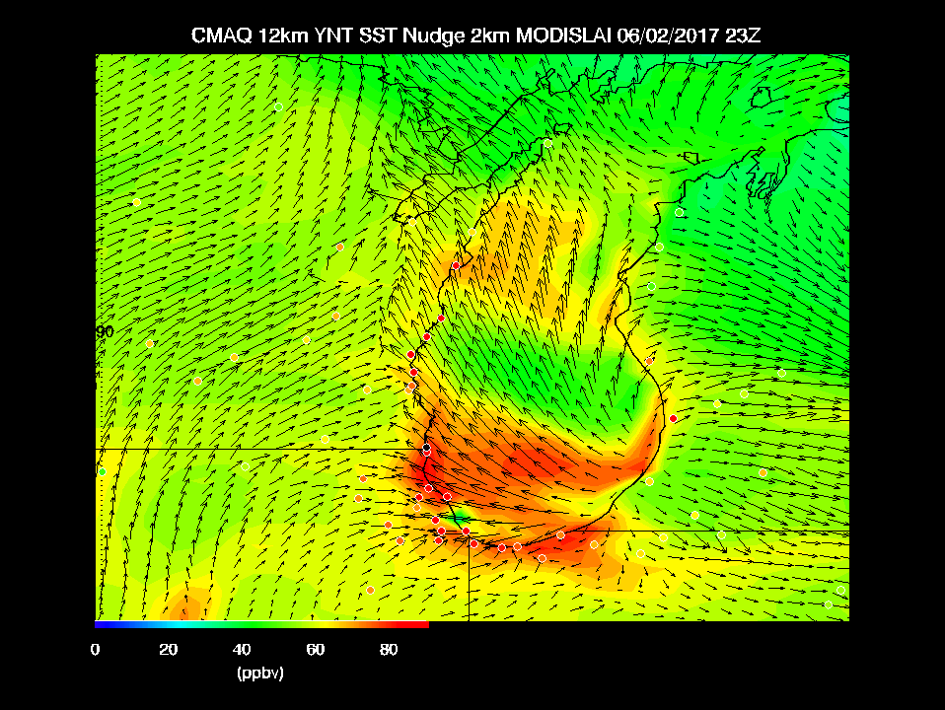
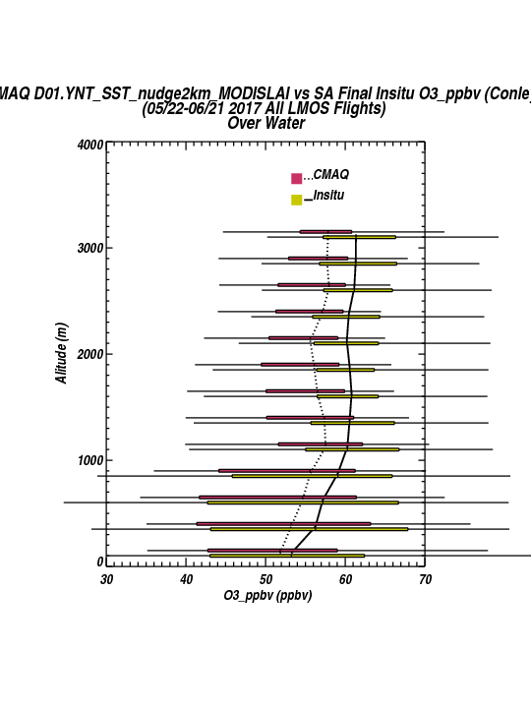
12km CMAQ Model verification
YNT physics and nudging only above 2km improves 12km marine boundary layer NO2 (1.4x overestimate)
Improves Ozone prediction over Lake Michigan
|‌ 34

Slide 35
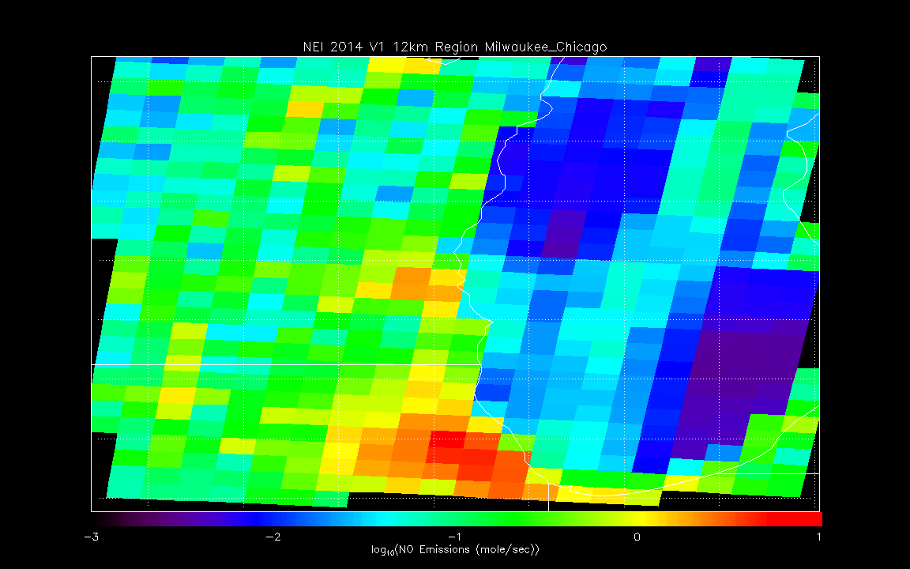
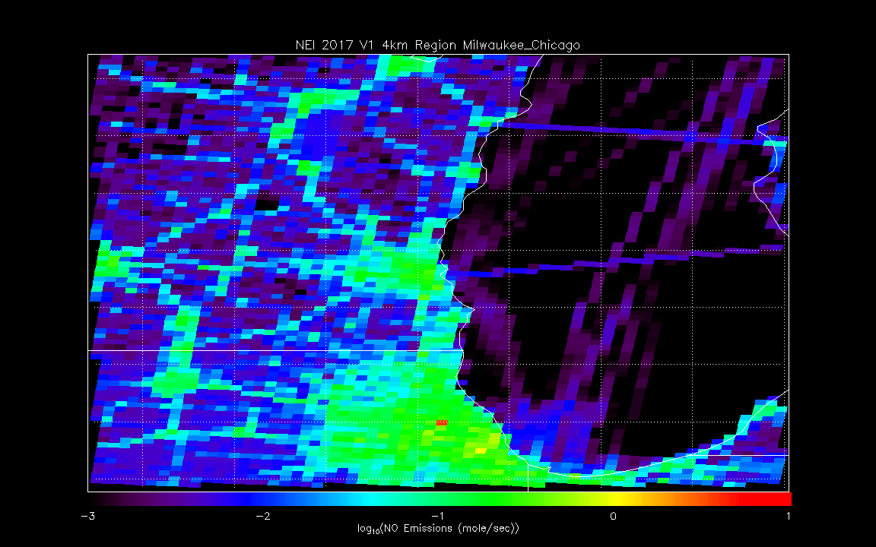
Next Steps: 4km CMAQ Model Simulations
NEI 2017 4km emission inventory
12km NEI 2014 NO Emissions
4km NEI 2017 NO Emissions
NEI 2017 4km Emission Inventory provided by Kirk Baker, US EPA

Slide 36
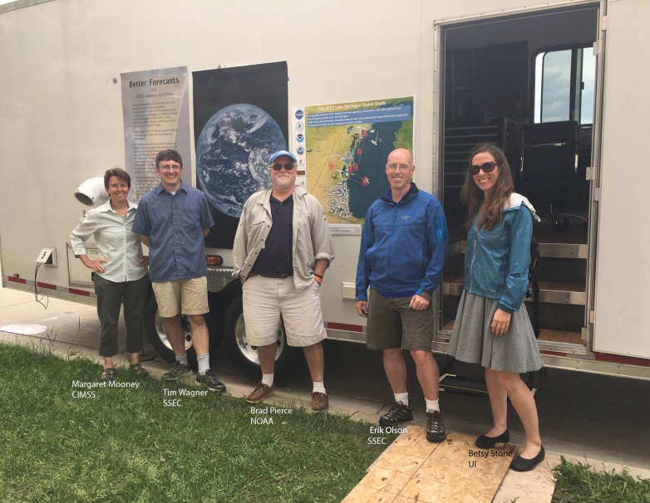
Thank you EPRI for supporting LMOS!
LMOS Public Data Archive
https://www-air.larc.nasa.gov/missions/lmos/index.html

Slide 37
Extra Slides

Slide 38
LISTOS Ozone Exceedance Day (Highest ozone since 2006)
Peak Ozone concentrations
8hr: 115 ppbv
1hr: 143 ppbv
From Paul Miller (NESCAUM)

Slide 39
High-resolution (3km) NYC/I95 Corridor NOx emission trajectories
Early afternoon transport of NYC/I95 Corridor emissions inland over Southern NY (Sea Breeze penetration over CT)
Dew Point Depression (C)
Latitude
Longitude
Hour of emissions (GMT)
18Z July 02, 2018
(2:00pm)

Slide 40
Satellite Measurements to Improve Air Quality Model Results
OMI vs TROPOMI Tropospheric NO2 on 07/08/2018

Slide 41
TEMPO will measure pollution from geostationary orbit and provide hourly measurements to help solve national and international air quality challenges
http://tempo.si.edu/index.html

Slide 42
TEMPO will be the North American component of a global group of satellites tracking air pollution from geosynchronous orbit

