Slide 1
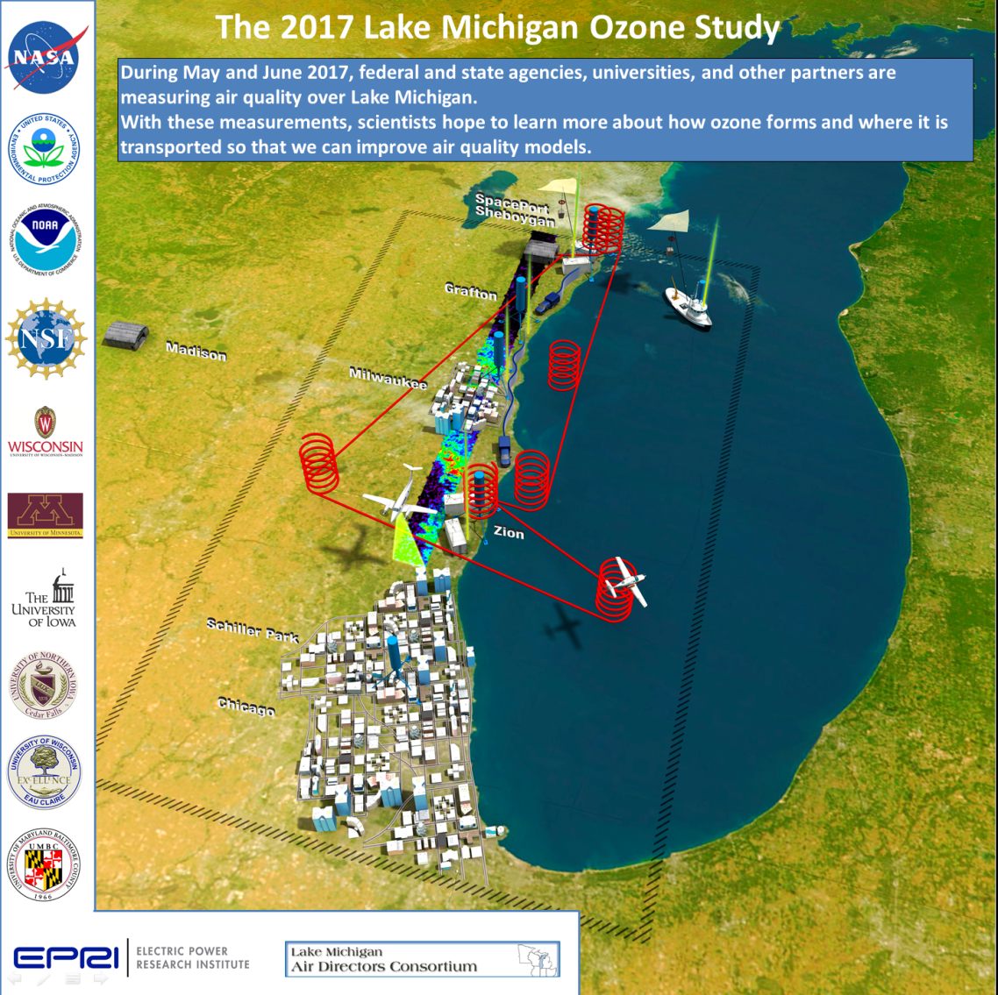
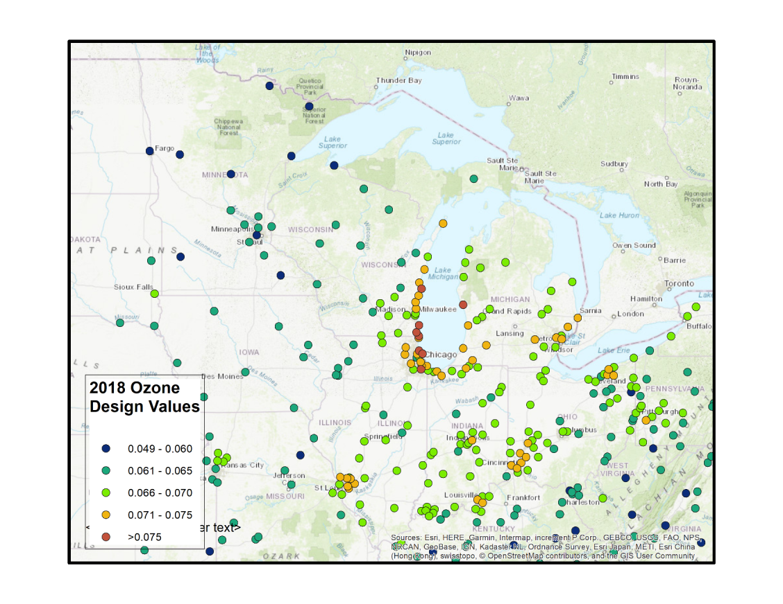
Summary of 2017 Lake Michigan Ozone Study (LMOS) Key Findings
Brad Pierce
UW-Madison
Space Science and Engineering Center
2018 Ozone Design Values
EPA Coastal Ozone Telecon, November 12th , 2019

Slide 2
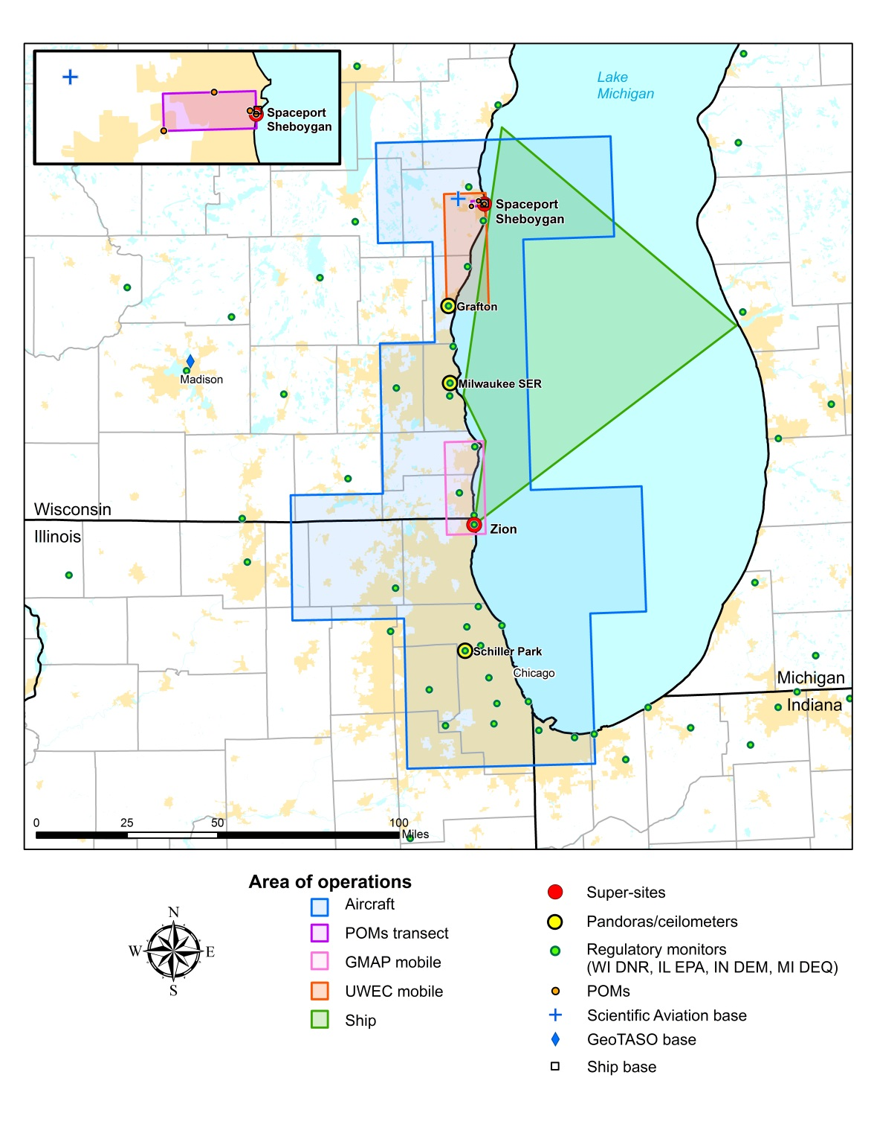
Summary of measurements made during the LMOS 2017 field campaign
Location | Measurement* | Research Institution*
Ground Sites
Spaceport Sheboygan | Remote sensing of meteorology (SPARC Trailer) | UW-Madison -SSEC
 | In situ measurements of pollutants | U.S. EPA ORD
Zion, IL | Remote sensing of meteorology (Sodar/MW Radiometer) | Univ. Northern Iowa
 | Detailed in situ chemical measurements | Univ. Iowa, UW-Madison, Univ. Minnesota
 | Routine measurements of ozone | Illinois EPA
Various† | Remote sensing of pollutants and boundary layer height | U.S. EPA ORD
Sheboygan transect | In situ measurements of ozone at four locations | U.S. EPA ORD
Airborne Platforms
Lakeshore region | Airborne remote sensing of NO₂ (GeoTASO) | NASA
 | Airborne remote sensing of clouds (AirHARP) | Univ. Maryland, Baltimore County
 | Airborne in situ profiling of pollutants and meteorology | Scientific Aviation
Shipboard Platform
Lake Michigan | In situ measurements of pollutants | U.S. EPA ORD
 | Remote sensing of pollutants and boundary later height | U.S. EPA ORD
Mobile Platforms
Northeast IL and Southeast WI | In situ measurements of pollutants (GMAP) | U.S. EPA Region 5
Grafton to Sheboygan | In situ measurements of ozone and meteorology | UW-Eau Claire

Slide 3
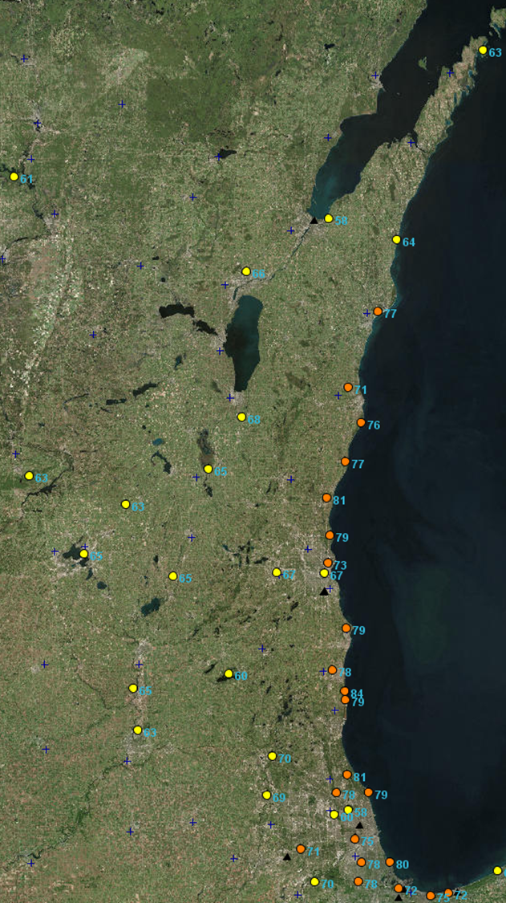
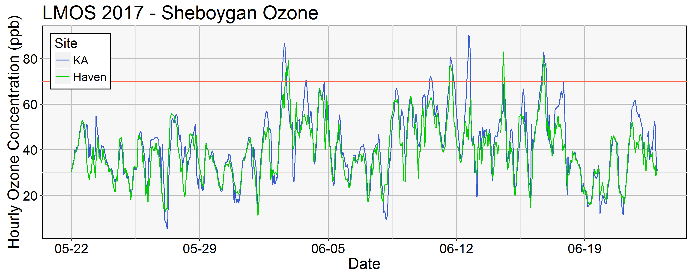
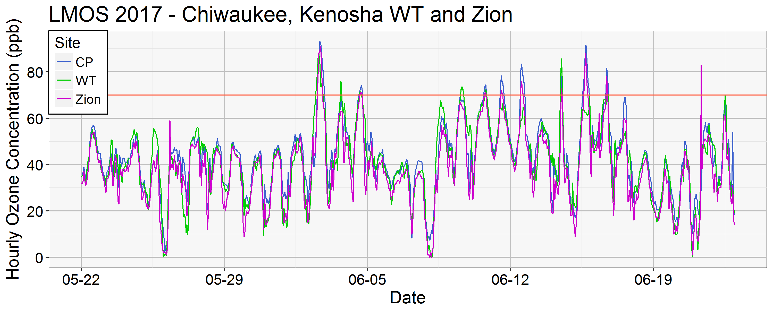
Lakeshore ozone during LMOS 2017
June 02, 2017 MDA8
June 02, 2017
June 02, 2017
(Angie Dickens , WDNR)
MDA8=Maximum Daily 8 hour Average

Slide 4
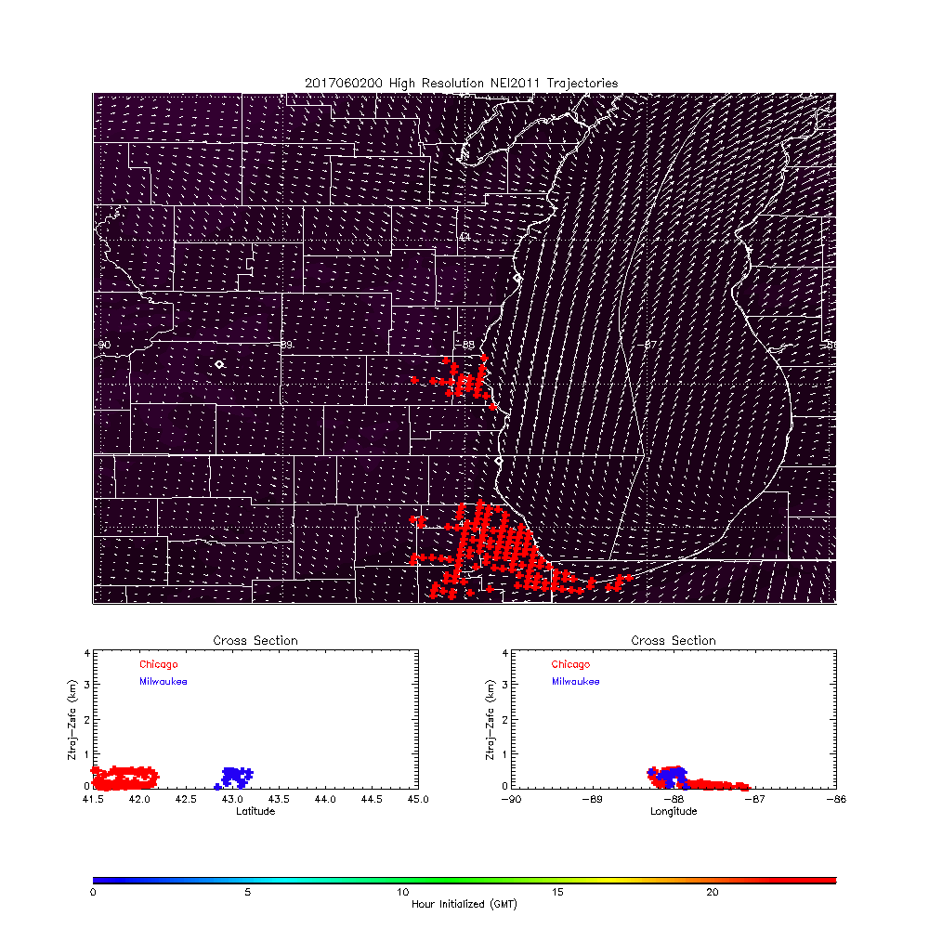
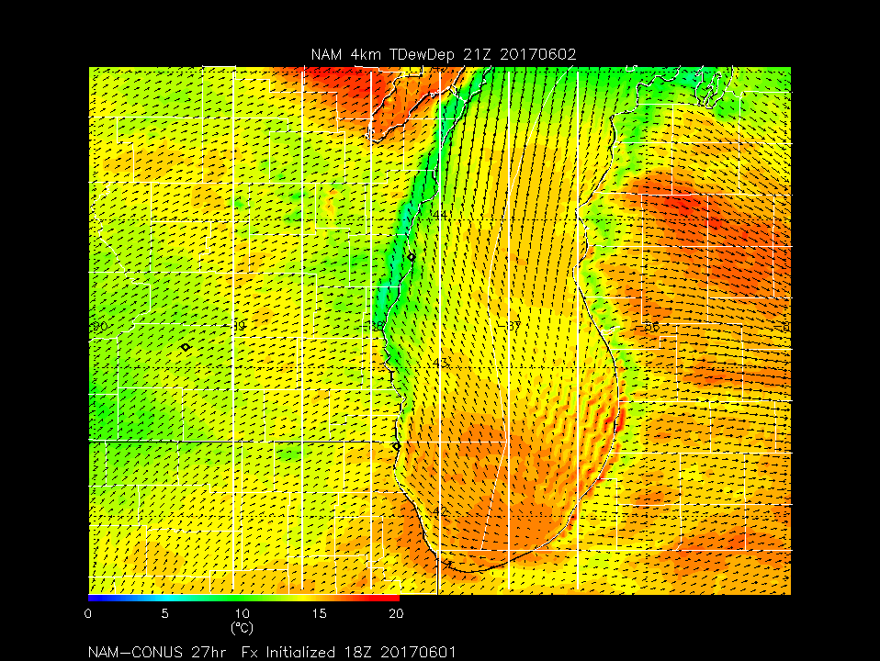
High-resolution (3km) Chicago/Milwaukee NOx emission trajectories
Transport of Chicago/Milwaukee emissions turns North in late afternoon (well defined Lake Breeze)
2m Dew Point Depression (C)
Latitude
Longitude
Hour of emissions (GMT)
21Z June 02, 2017
(4:00pm)

Slide 5
Summary of measurements made during the LMOS 2017 field campaign
Location | Measurement* | Research Institution*
Ground Sites
Spaceport Sheboygan | Remote sensing of meteorology (SPARC Trailer) | UW-Madison -SSEC
 | In situ measurements of pollutants | U.S. EPA ORD
Zion, IL | Remote sensing of meteorology (Sodar/MW Radiometer) | Univ. Northern Iowa
 | Detailed in situ chemical measurements | Univ. Iowa, UW-Madison, Univ. Minnesota
 | Routine measurements of ozone | Illinois EPA
Various† | Remote sensing of pollutants and boundary layer height | U.S. EPA ORD
Sheboygan transect | In situ measurements of ozone at four locations | U.S. EPA ORD
Airborne Platforms
Lakeshore region | Airborne remote sensing of NO₂ (GeoTASO) | NASA
 | Airborne remote sensing of clouds (AirHARP) | Univ. Maryland, Baltimore County
 | Airborne in situ profiling of pollutants and meteorology | Scientific Aviation
Shipboard Platform
Lake Michigan | In situ measurements of pollutants | U.S. EPA ORD
 | Remote sensing of pollutants and boundary later height | U.S. EPA ORD
Mobile Platforms
Northeast IL and Southeast WI | In situ measurements of pollutants (GMAP) | U.S. EPA Region 5
Grafton to Sheboygan | In situ measurements of ozone and meteorology | UW-Eau Claire

Slide 6
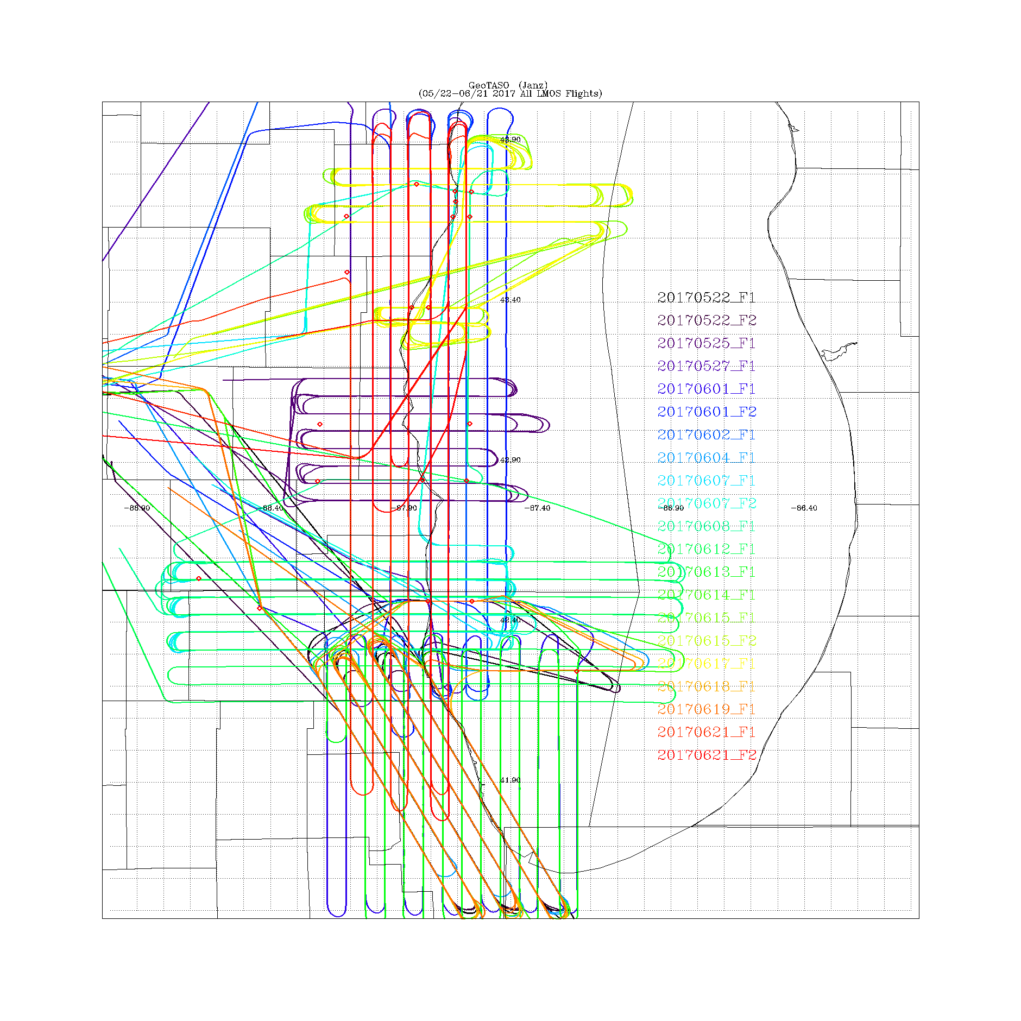
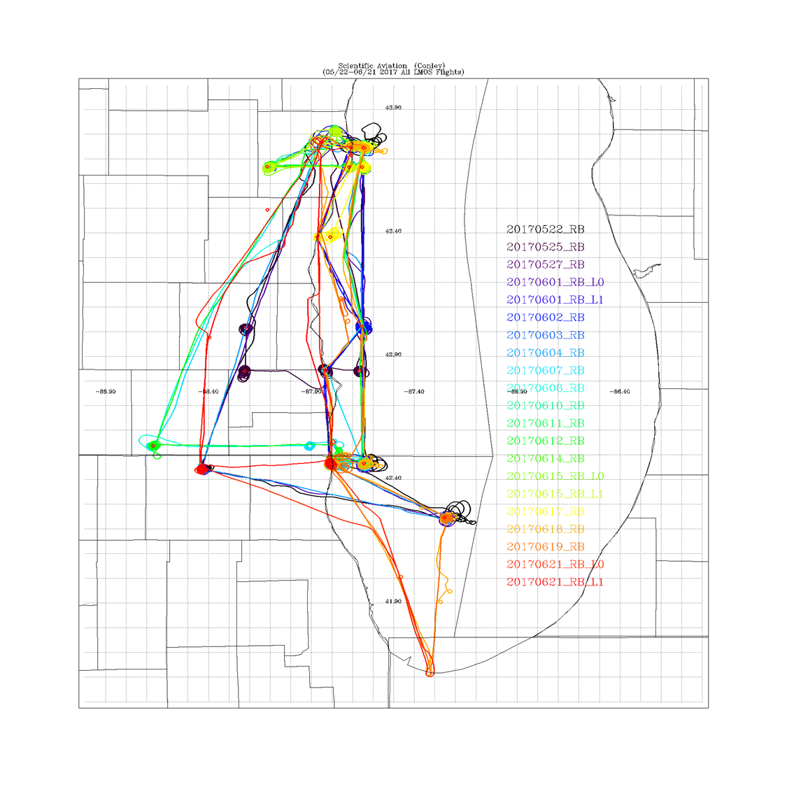
LMOS 2017 Aircraft Measurements
NASA GeoTASO remote sensing Flights
Scientific Aviation insitu sampling Flights
GeoTASO (Geostationary Trace gas and Aerosol Sensor Optimization) is a NASA airborne hyperspectral mapping instrument that is being used as an airborne testbed for future high-resolution trace-gas observations from geostationary sensors such as TEMPO
The Electric Power Research Institute (EPRI) provided funding for Scientific Aviation Flights during LMOS

Slide 7
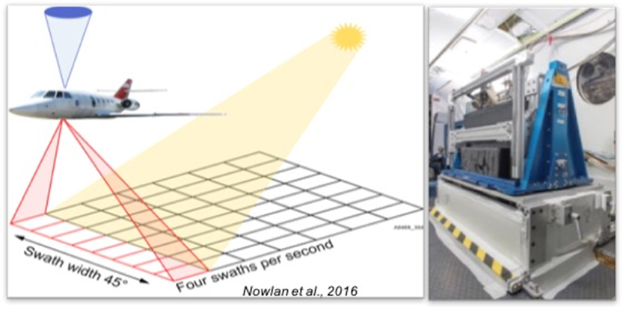

NASA GeoTASO remote sensing
Scientific Aviation in situ profiling
NO₂ differential slant columns (DSCs) were retrieved from GeoTASO spectra via Differential Optical Absorption Spectroscopy (DOAS).
Scientific Aviation (SA) provided in situ profiling of O₃, NO₂, CO₂, CH₄, altitude, T, RH, winds, and pressure.

Slide 8
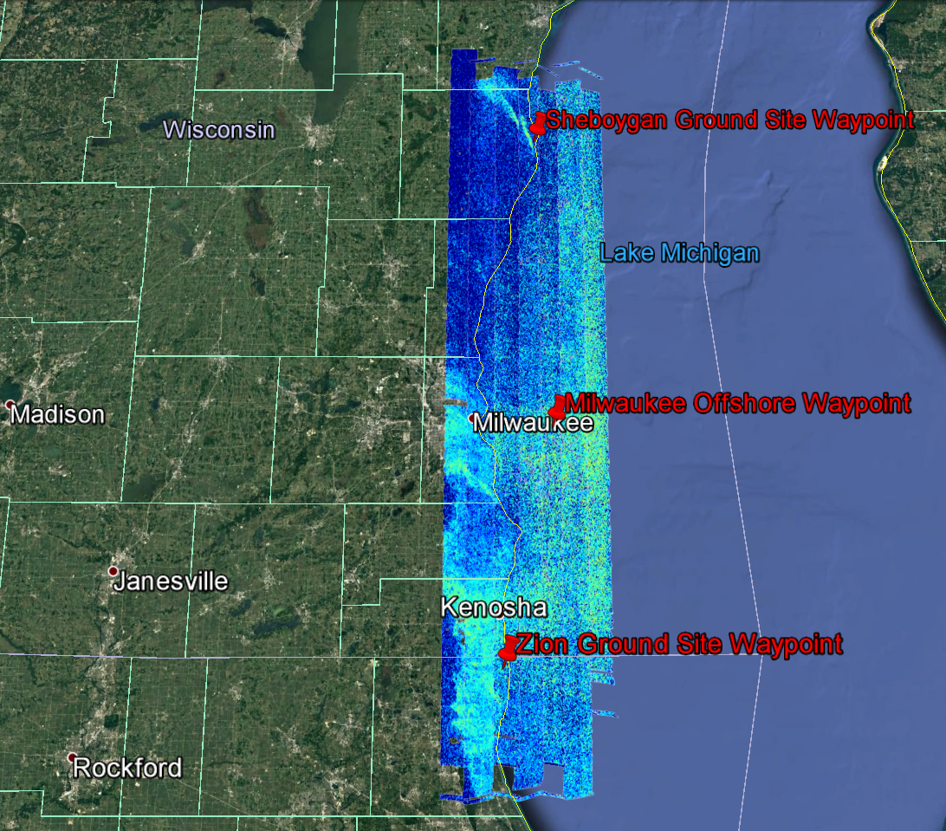
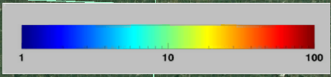
GeoTASO NO2 column retrieval June 02, 2017
NO2 Column (x10¹⁵ mol/cm²)
Scott Janz (NASA/GSFC) and Laura Judd (NASA/LaRC)

Slide 9
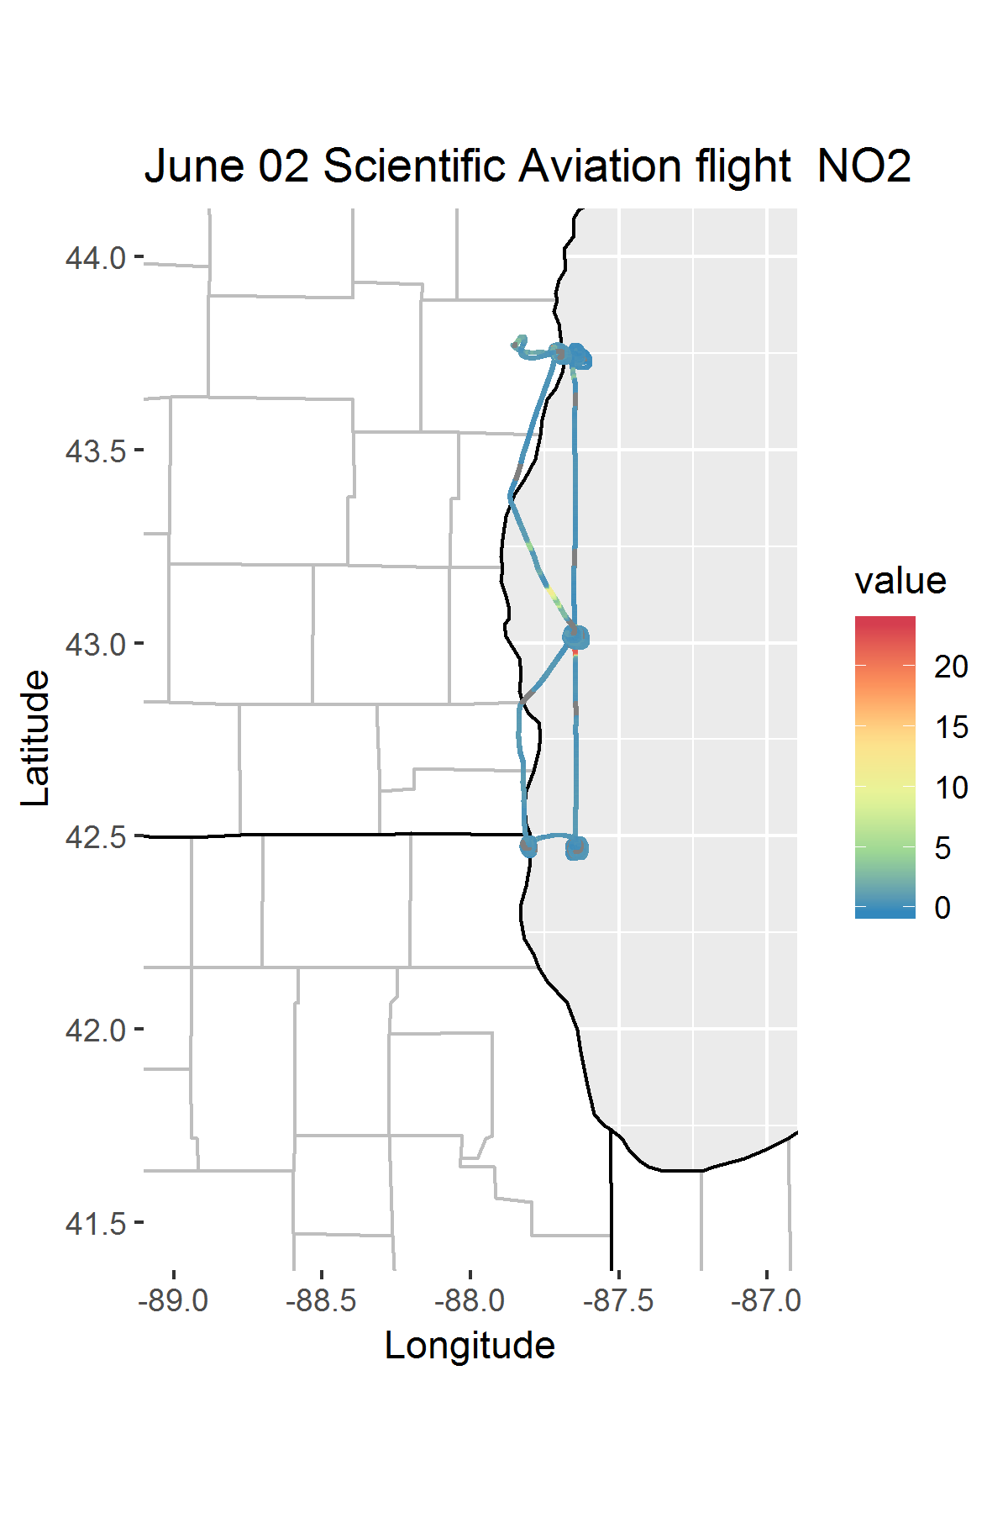
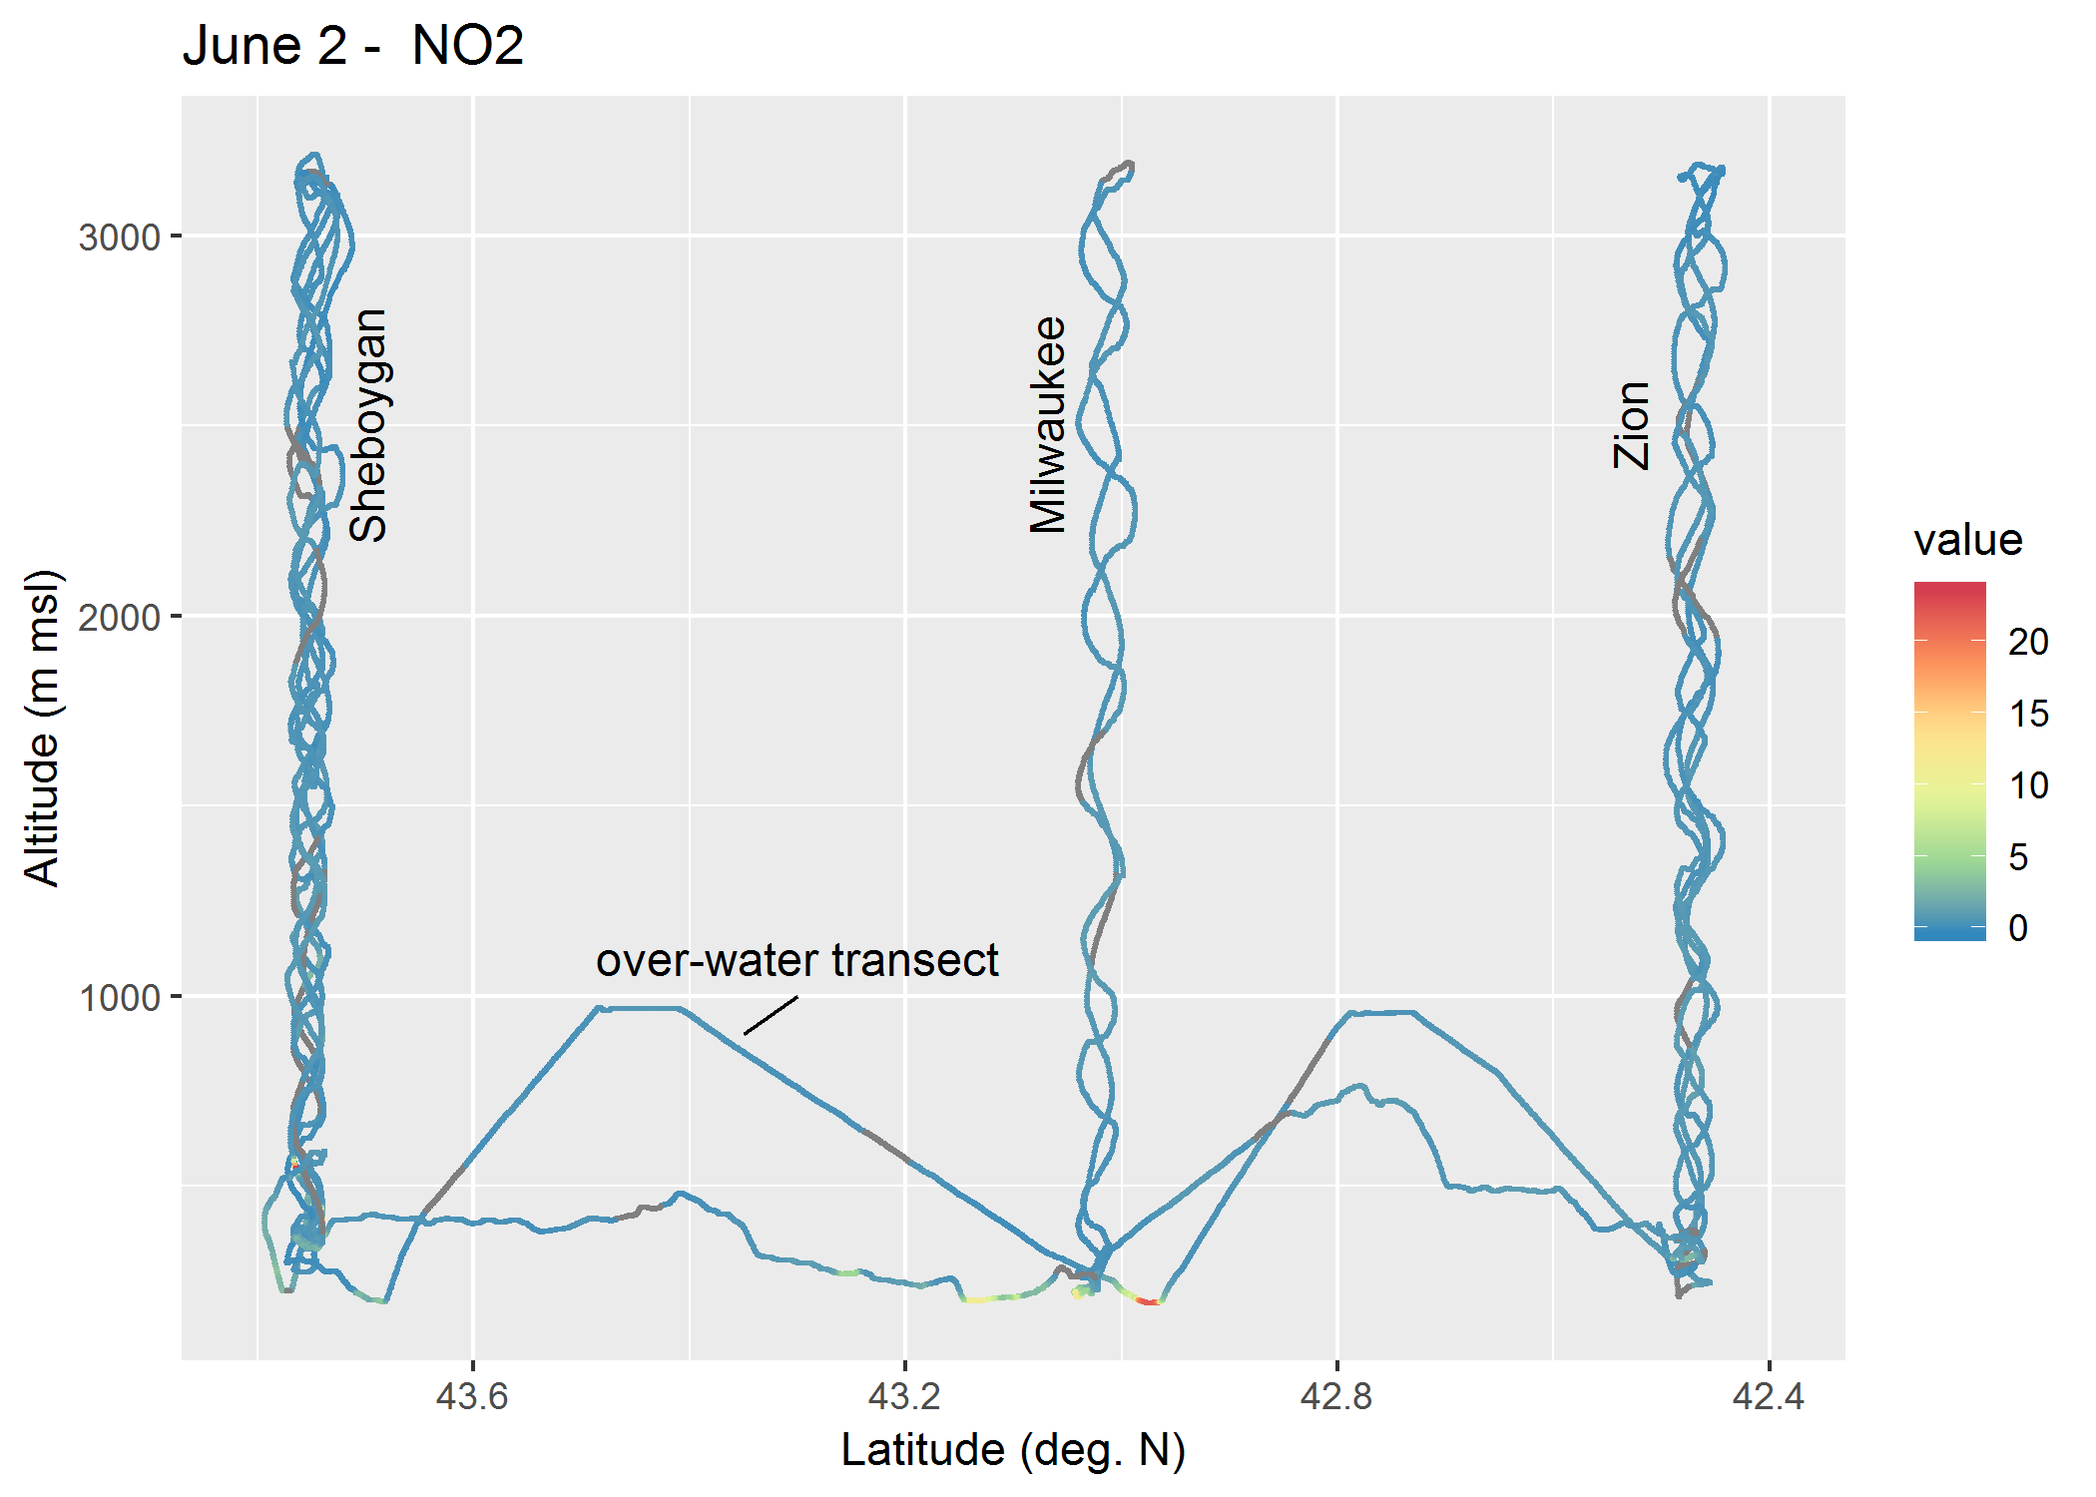
June 2nd (Friday)
NO2 concentrations
(Angie Dickens , WDNR)

Slide 10
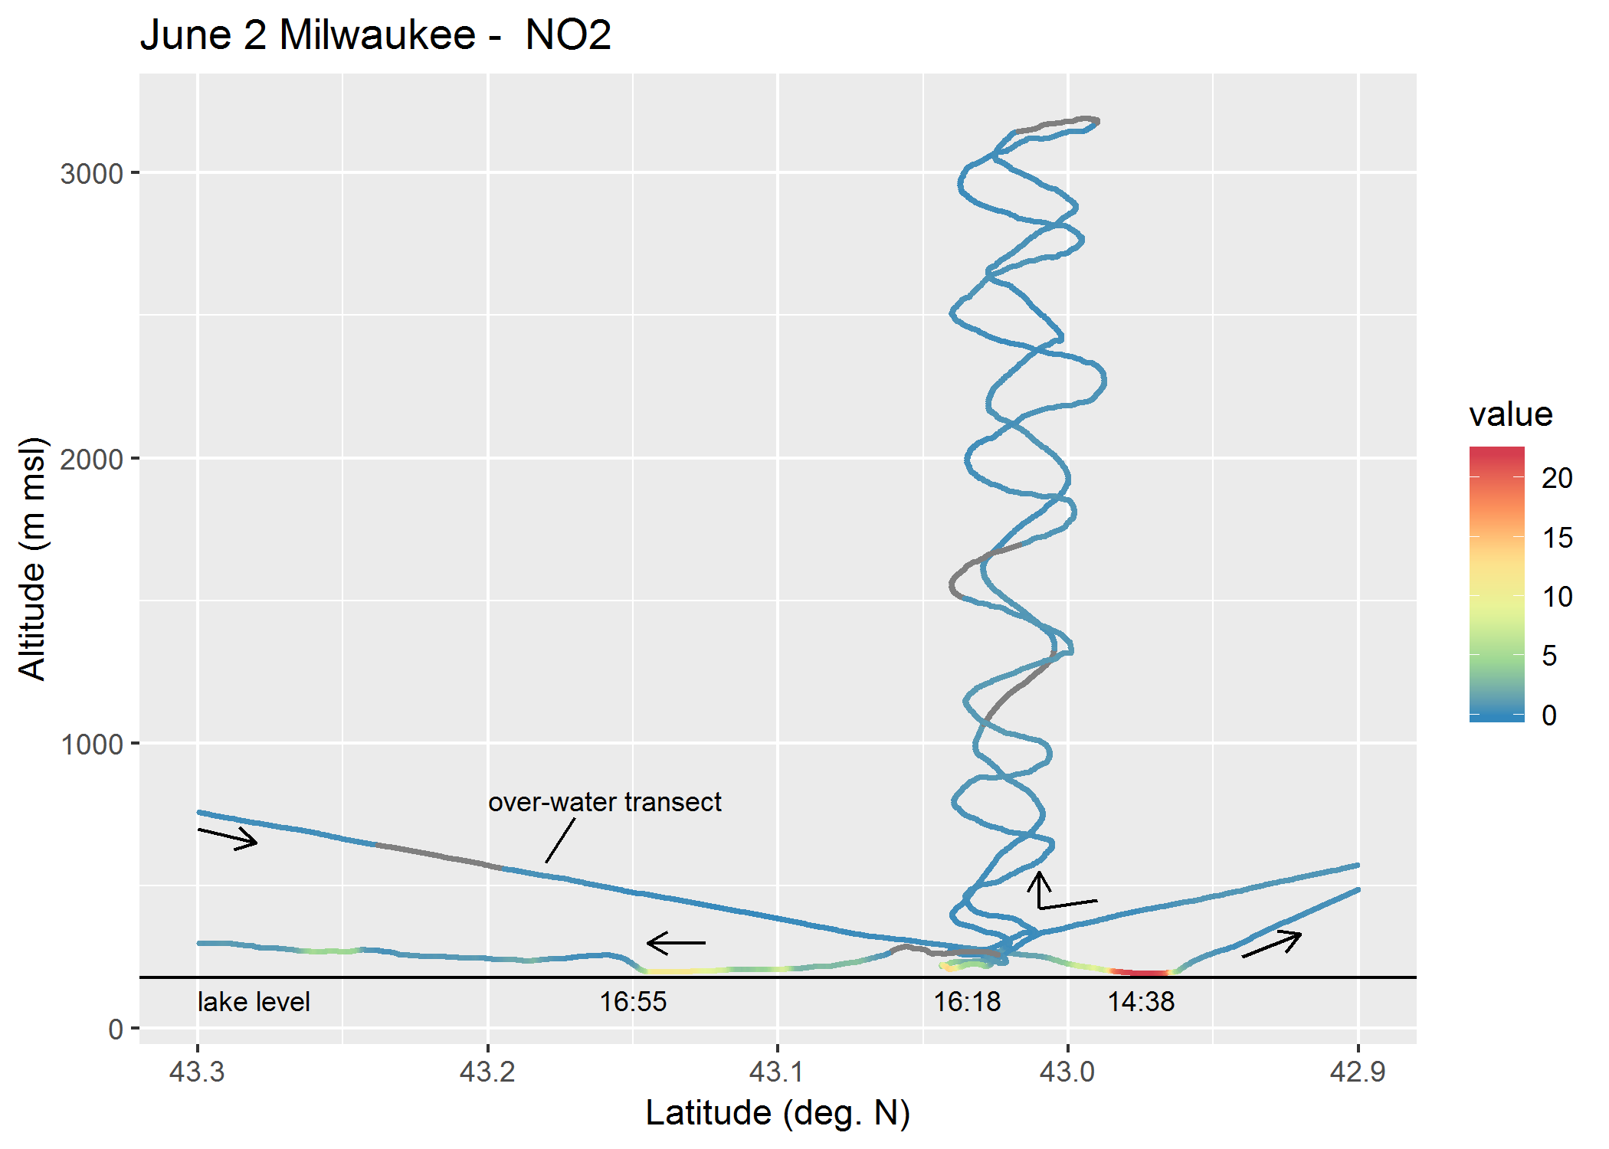
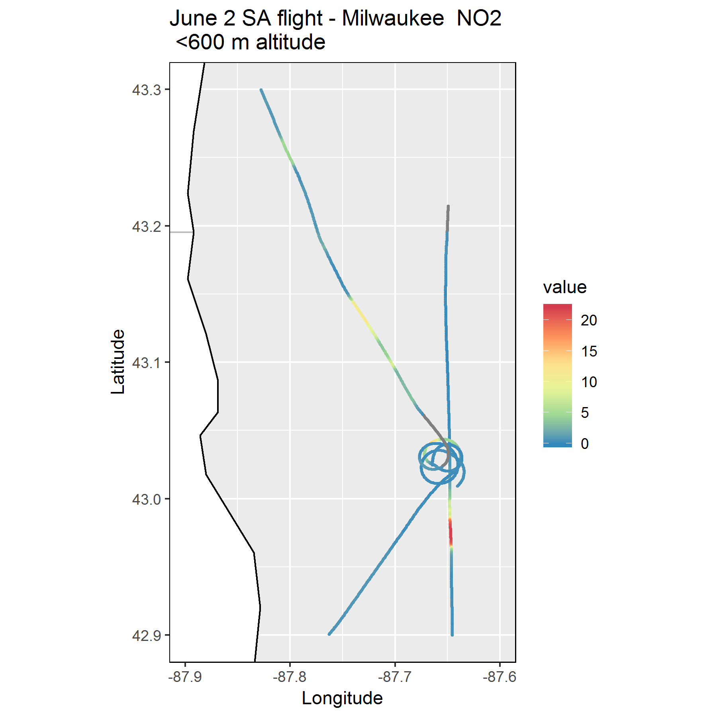
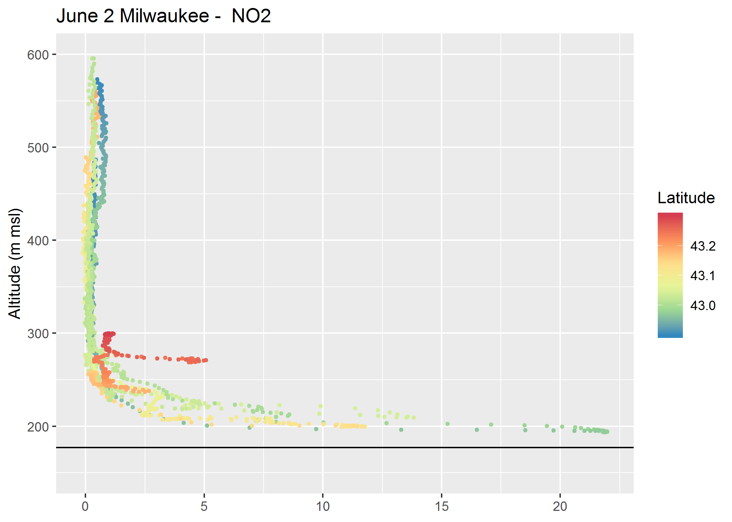
Milwaukee area
High-NO₂ by Milwaukee
NO₂ (ppb)
Altitude (m msl)
16:58
(pre-spiral)
NO₂ (ppb)
92-96 m above lake
32-42 m above lake
22-24 m above lake
16-23 m above lake
Lake level (177 m)
Times are in CST not CDT
NO2 (ppb)

Slide 11
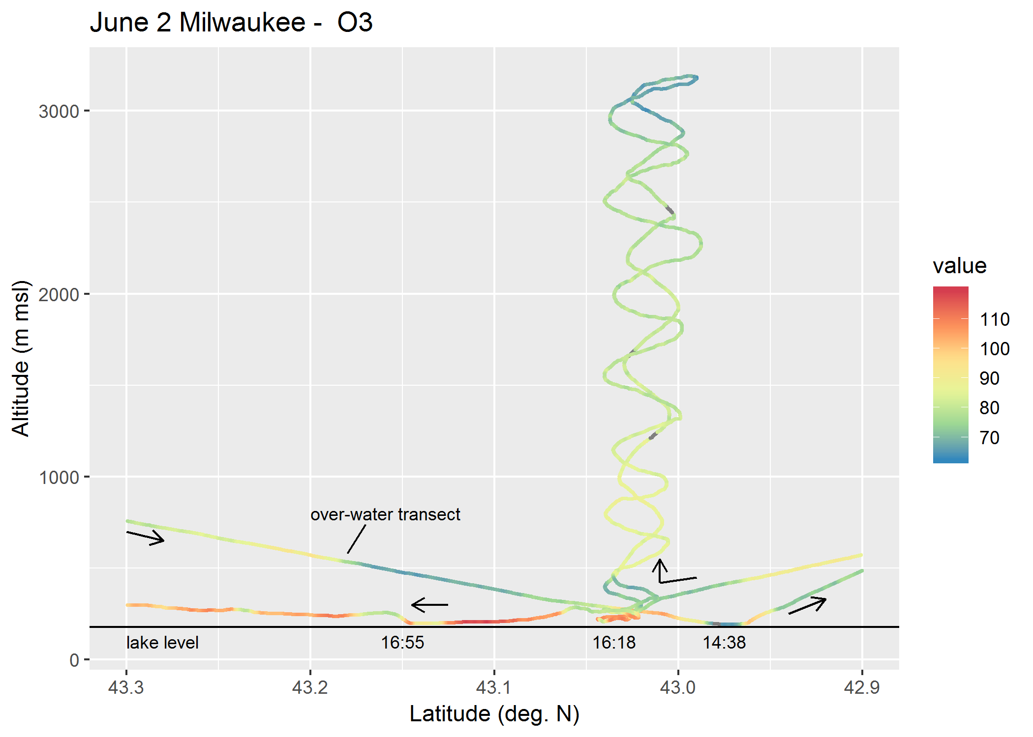
Milwaukee area
High-NO₂ by Milwaukee
NO₂ (ppb)
Altitude (m msl)
16:58
(pre-spiral)
NO₂ (ppb)
Ozone
O₃ (ppb)
Times are in CST not CDT

Slide 12
Summary of measurements made during the LMOS 2017 field campaign
Location | Measurement* | Research Institution*
Ground Sites
Spaceport Sheboygan | Remote sensing of meteorology (SPARC Trailer) | UW-Madison -SSEC
 | In situ measurements of pollutants | U.S. EPA ORD
Zion, IL | Remote sensing of meteorology (Sodar/MW Radiometer) | Univ. Northern Iowa
 | Detailed in situ chemical measurements | Univ. Iowa, UW-Madison, Univ. Minnesota
 | Routine measurements of ozone | Illinois EPA
Various† | Remote sensing of pollutants and boundary layer height | U.S. EPA ORD
Sheboygan transect | In situ measurements of ozone at four locations | U.S. EPA ORD
Airborne Platforms
Lakeshore region | Airborne remote sensing of NO₂ (GeoTASO) | NASA
 | Airborne remote sensing of clouds (AirHARP) | Univ. Maryland, Baltimore County
 | Airborne in situ profiling of pollutants and meteorology | Scientific Aviation
Shipboard Platform
Lake Michigan | In situ measurements of pollutants | U.S. EPA ORD
 | Remote sensing of pollutants and boundary later height | U.S. EPA ORD
Mobile Platforms
Northeast IL and Southeast WI | In situ measurements of pollutants (GMAP) | U.S. EPA Region 5
Grafton to Sheboygan | In situ measurements of ozone and meteorology | UW-Eau Claire

Slide 13
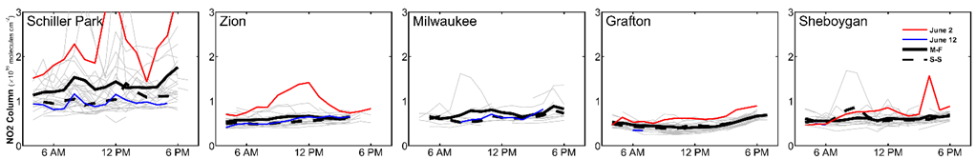
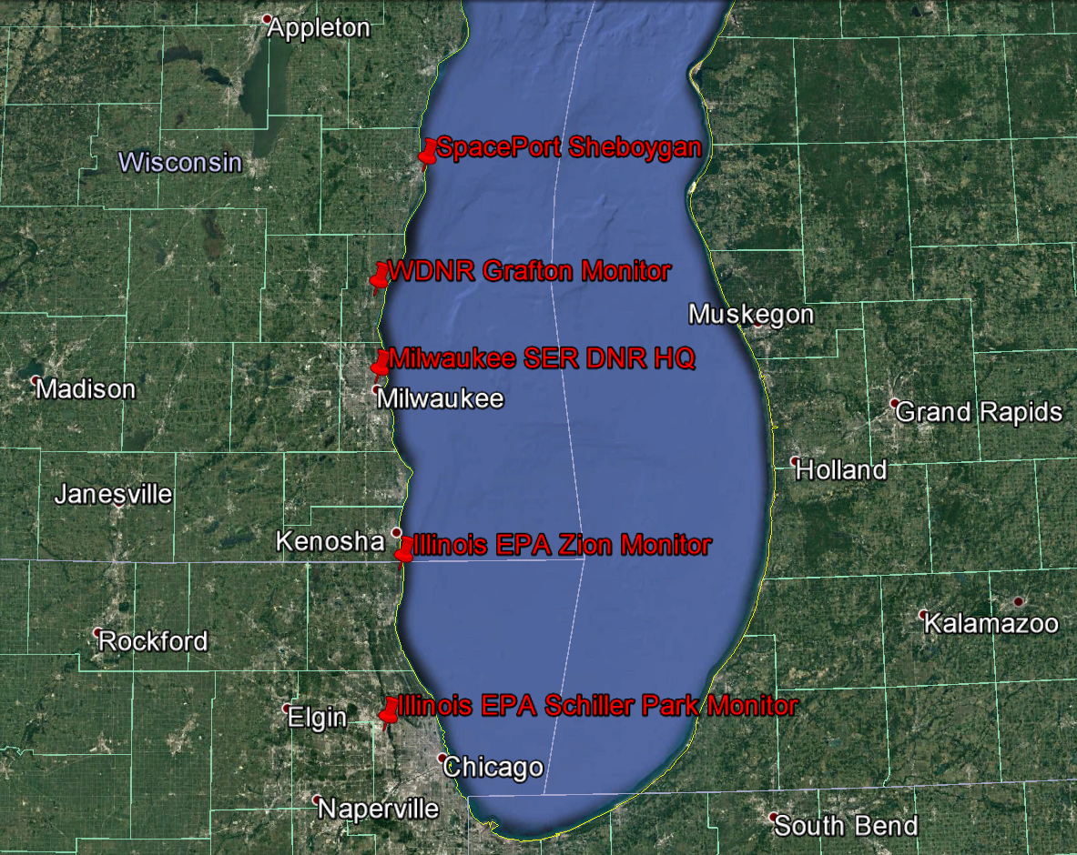
Ground based UV/visible grating spectrometers (Pandoras) column NO2 measurements during LMOS 2017
Pandora NO2 column measurements show high values at Zion, Grafton, and Sheboygan on June 2, 2017
(Luke Valin, EPA)

Slide 14
Ground based UV/visible grating spectrometers (Pandoras) column NO2 measurements during LMOS 2017
Pandora NO2 column measurements show high values at Zion, Grafton, and Sheboygan on June 2, 2017
(Luke Valin, EPA)

Slide 15
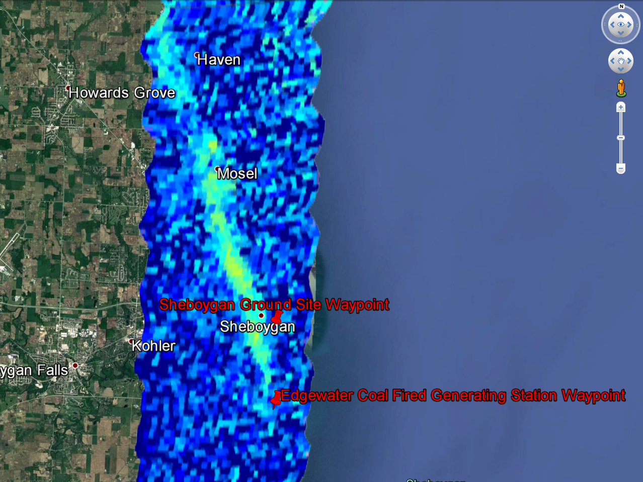
GeoTASO NO2 column retrieval June 02, 2017
NO2 Column (x10¹⁵ mol/cm²)

Slide 16
Summary of measurements made during the LMOS 2017 field campaign
Location | Measurement* | Research Institution*
Ground Sites
Spaceport Sheboygan | Remote sensing of meteorology (SPARC Trailer) | UW-Madison -SSEC
 | In situ measurements of pollutants | U.S. EPA ORD
Zion, IL | Remote sensing of meteorology (Sodar/MW Radiometer) | Univ. Northern Iowa
 | Detailed in situ chemical measurements | Univ. Iowa, UW-Madison, Univ. Minnesota
 | Routine measurements of ozone | Illinois EPA
Various† | Remote sensing of pollutants and boundary layer height | U.S. EPA ORD
Sheboygan transect | In situ measurements of ozone at four locations | U.S. EPA ORD
Airborne Platforms
Lakeshore region | Airborne remote sensing of NO₂ (GeoTASO) | NASA
 | Airborne remote sensing of clouds (AirHARP) | Univ. Maryland, Baltimore County
 | Airborne in situ profiling of pollutants and meteorology | Scientific Aviation
Shipboard Platform
Lake Michigan | In situ measurements of pollutants | U.S. EPA ORD
 | Remote sensing of pollutants and boundary later height | U.S. EPA ORD
Mobile Platforms
Northeast IL and Southeast WI | In situ measurements of pollutants (GMAP) | U.S. EPA Region 5
Grafton to Sheboygan | In situ measurements of ozone and meteorology | UW-Eau Claire

Slide 17
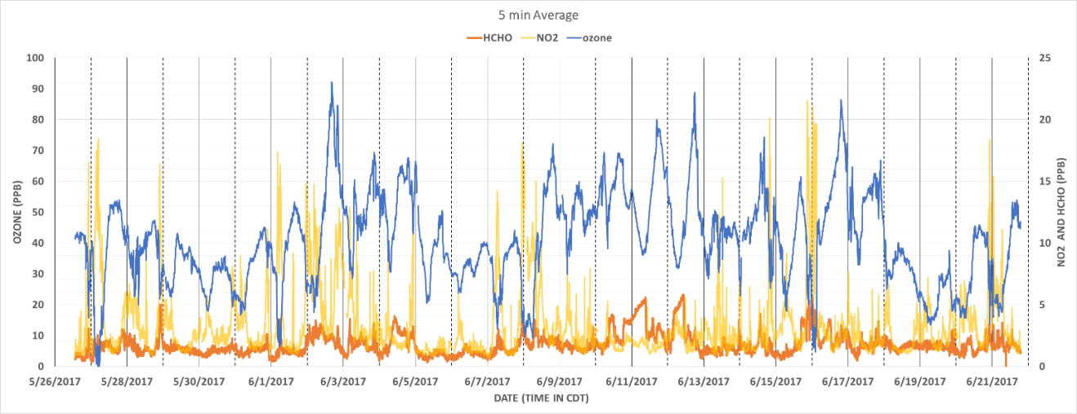
Time series of O3, NO2 and HCHO measurements at Spaceport Sheboygan
Likely influence of power plant plumes
Formaldehyde (HCHO) and nitrogen dioxide (NO2) serve to indicate the chemical regime for ozone formation (i.e., NOx limited and volatile organic compound (VOC) limited) at Sheboygan.
(Andrew Whitehill and Jim Szykman, EPA)

Slide 18
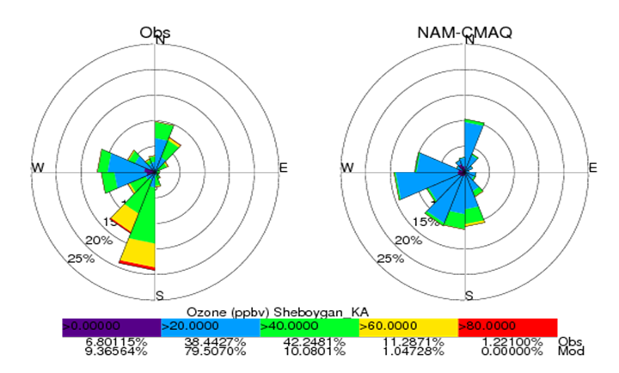
National Weather Service NAM-CMAQ ozone forecasts during LMOS 2017
(http://airquality.weather.gov/)
May 22 through June 22, 2017
During LMOS 2017 NAM-CMAQ underestimates the occurrence of high ozone (>60ppbv) during Southerly and Southwesterly flow at Sheboygan, KA.
The North American Model (NAM) meteorology drives the Environmental Protection Agency’s (EPA) Community Multiscale Air Quality Model (CMAQ)

Slide 19
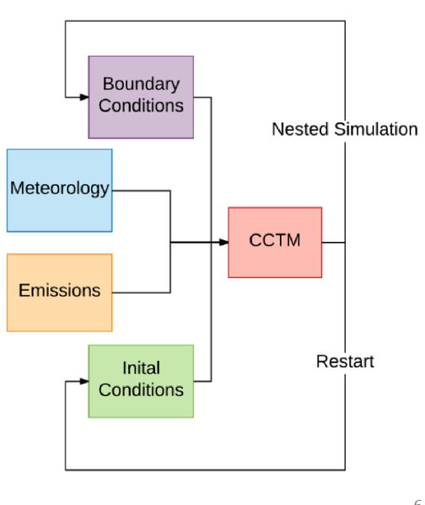
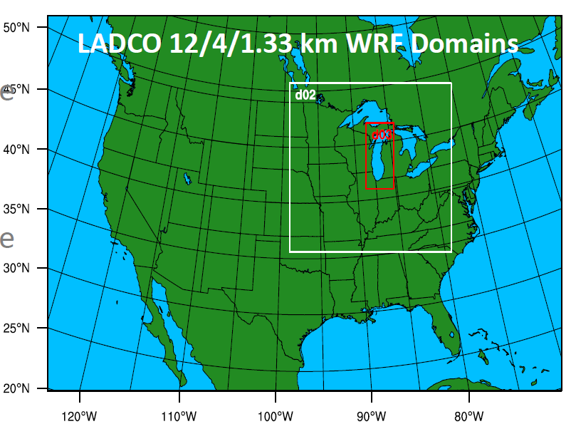
Regulatory Modeling
A Satellite Constrained Meteorological Modeling Platform for LADCO States SIP Development
(Funded by NASA Applied Sciences Program
PI Jason Otkin/SSEC)

Slide 20
Model Sensitivity Simulations
EXPERIMENT GLSEA SST Nudging SOIL IC/BC status
EPA -- -- -- GFS complete
EPA-SST ✔ -- -- GFS complete
YNT -- -- -- GFS complete
YNT-SST ✔ -- -- GFS complete
5) YNT-SST-nudge2km* ✔ ✔ -- GFS complete
6) YNT-SST-SOIL ✔ -- ✔ GFS ongoing
All simulations covered the LMOS field project time period (12 May – 01 July 2017)
“EPA” simulations follow the EPA operational forecasting model configuration, including the Pleim-Xu land surface model (LSM), Morrison 2-moment cloud microphysics, and ACM2 (Pleim) PBL parameterization schemes
“YNT” simulations use the YSU PBL, Noah LSM, and Thompson microphysics, respectively
“SST” refers to the high-resolution, real-time GLSEA SST dataset
“Nudging” refers to nudging temperature, moisture, and horizontal winds above 2 km
”SOIL” refers to high-resolution soil moisture/temperature analyses provided by NASA SPoRT
* Odman, M. T. et al, 2019, Examination of Nudging Schemes in the Simulation of Meteorology for Use in Air Quality Experiments: Application in the Great Lakes Region https://doi.org/10.1175/JAMC-D-18-0206.1

Slide 21
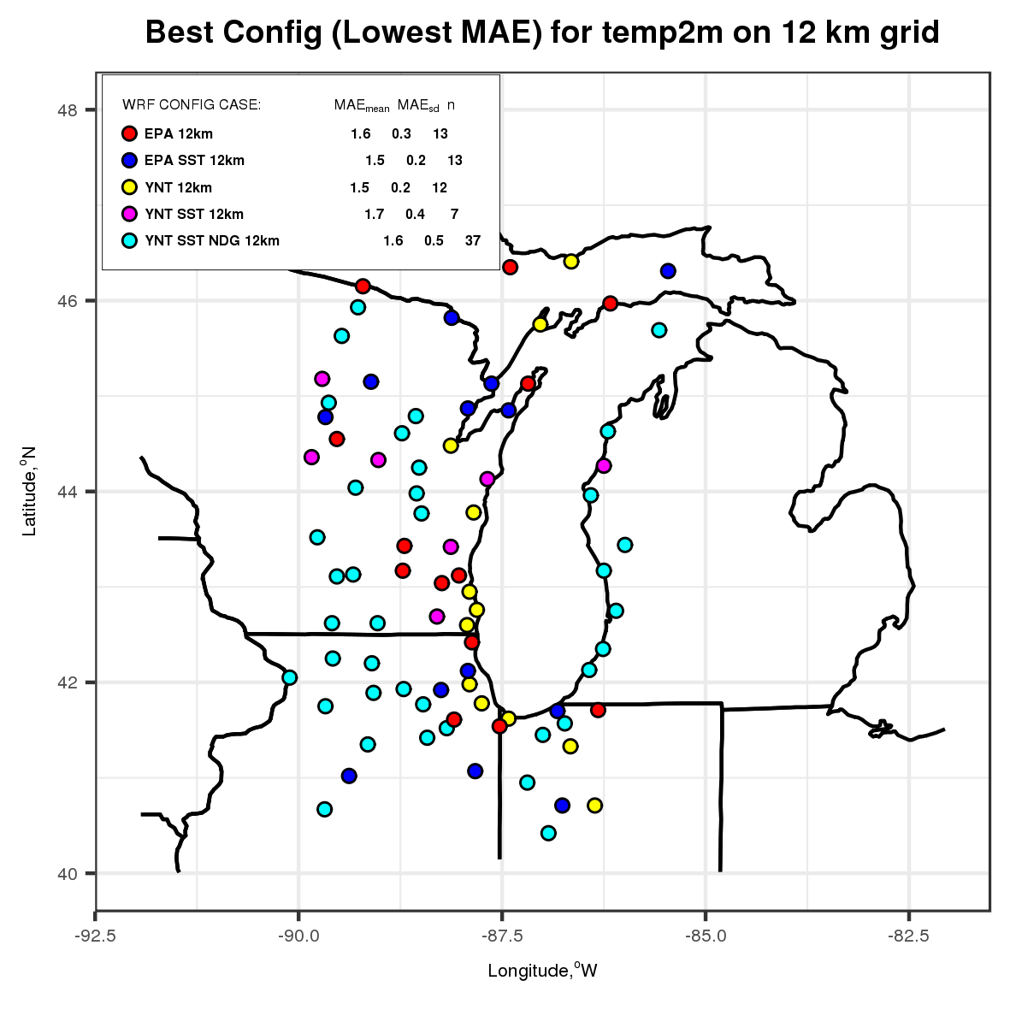
2-m Temperature Statistics (12-km Domain)
Best Performing Model Configuration
Statistical Summary
Statistics computed using data from the entire 7-week period
YNT-SST-nudge2km simulation performs best on this domain, especially inland to the west of Lake Michigan and along the eastern shoreline

Slide 22
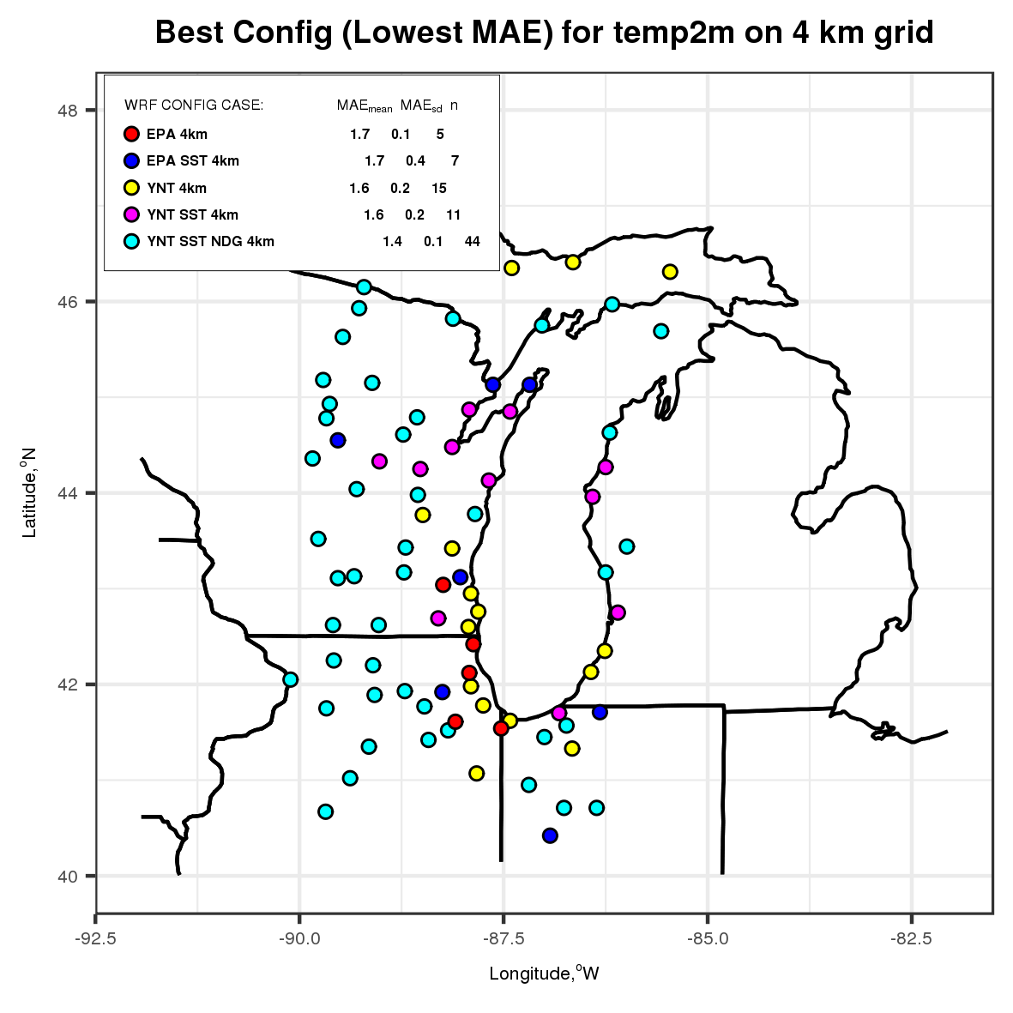
2-m Temperature Statistics (4-km Domain)
Best Performing Model Configuration
Statistical Summary
YNT-SST-nudge2km simulation continues to perform best on this domain, primarily inland to the west of Lake Michigan and along the eastern shoreline
EPA simulations do not perform as well

Slide 23
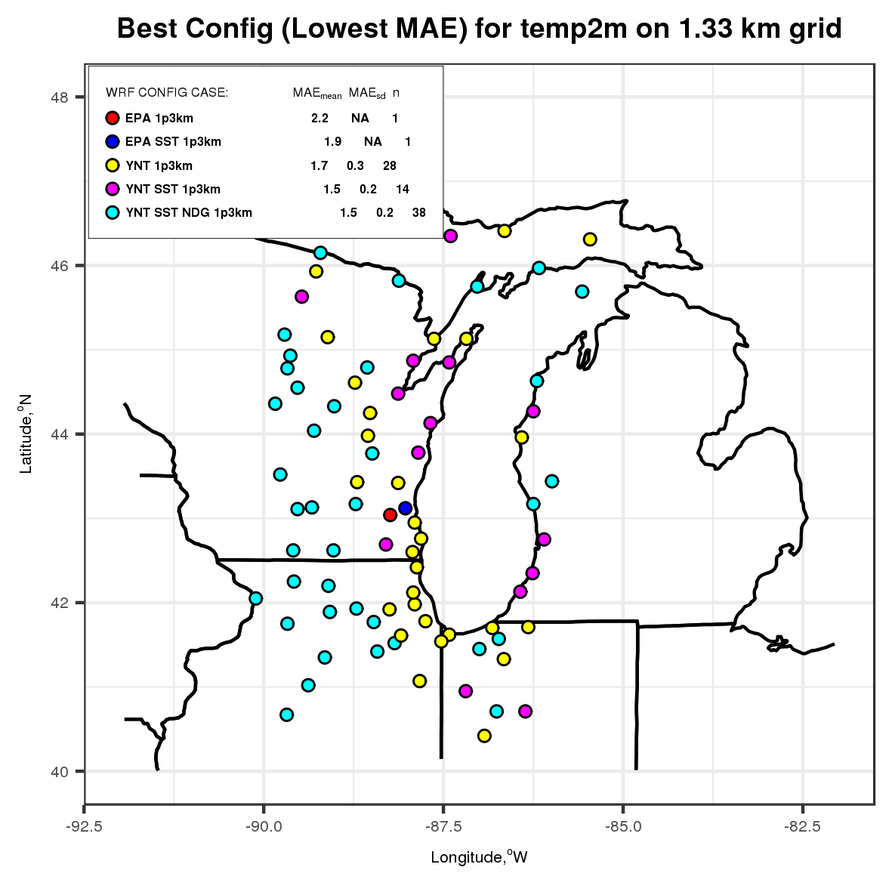
2-m Temperature Statistics (1.33-km Domain)
Best Performing Model Configuration
Statistical Summary
On the highest resolution domain, the YNT configurations greatly outperform the EPA baseline simulations

Slide 24
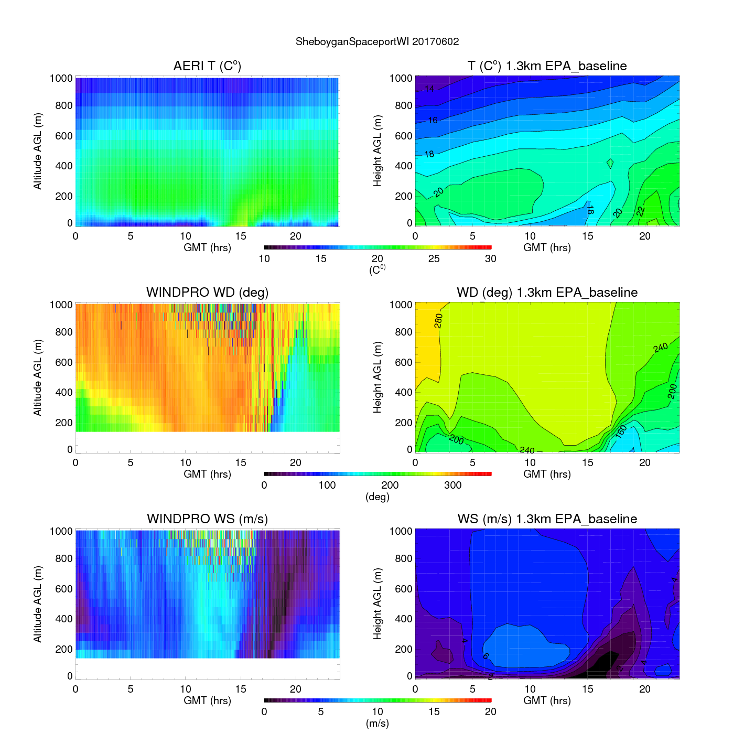
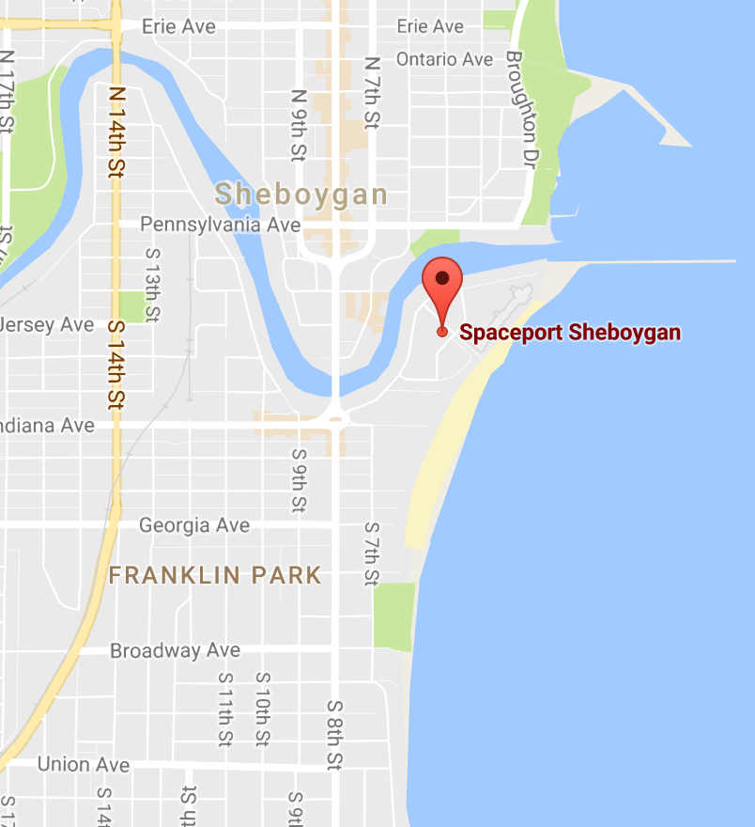
Sheboygan Ground Site:
1.3km EPA Baseline
Observed Temperature and Wind (left)
Verses EPA Baseline
June 2, 2017 (Lake Breeze/Ozone Exceedance)

Slide 25
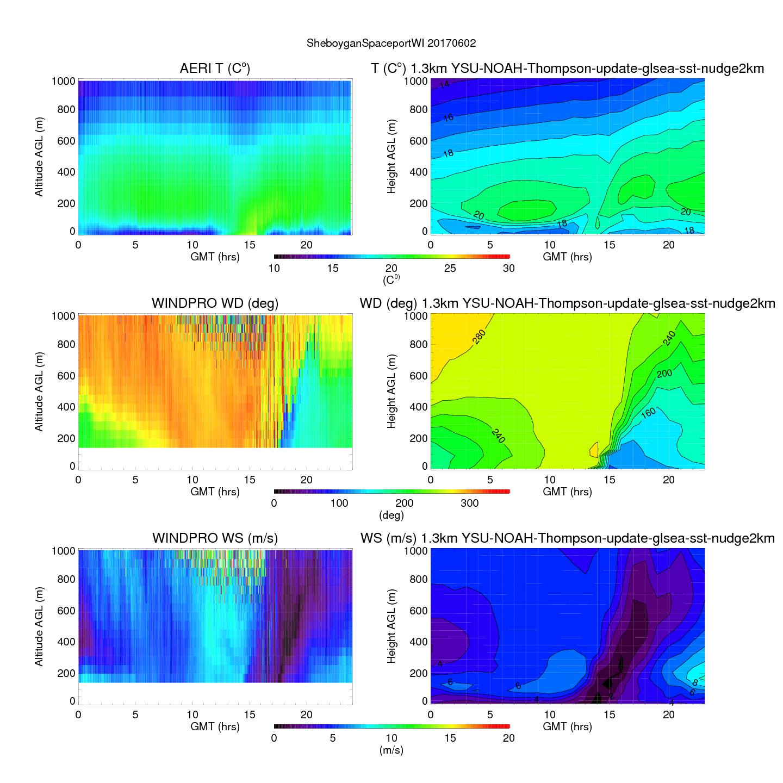
Sheboygan Ground Site:
1.3km YNT+SST+Nudge2km
Observed Temperature and Wind (left)
Verses YNT+GLSEA SST+Nudge2km
June 2, 2017 (Lake Breeze/Ozone Exceedance)

Slide 26
CMAQ 12km Model Sensitivity Simulations
EXPERIMENT GLSEA SST LAI SOIL IC/BC status
EPA-SST ✔ -- -- GFS complete
2) YNT-SST-nudge2km ✔ -- -- GFS complete
The “EPA-SST” simulation follows the WRF model configuration used by the EPA in their operational model, except with analysis nudging toward GFS analyses instead of NAM analyses. It employs the Pleim-Xu land surface model (LSM), Pleim-Xu surface layer physics, Morrison 2-moment cloud microphysics, and the ACM2 (Pleim) planetary boundary layer (PBL) parameterization schemes. The coarse-resolution GFS SST initialization dataset is replaced with the high-resolution, real-time GLSEA SST dataset.
The “YNT-SST-nudge2km ” simulation is the same as 1, except for replacing the LSM, surface layer physics, cloud microphysics, and PBL parameterization schemes with the Noah LSM, Monin-Obukhov surface layer physics, Thompson microphysics, and YSU PBL, respectively. Nudging of temperature, moisture, and horizontal winds above 2 km (model level) instead of above the boundary layer.
Note that each experiment uses 12km NEI 2014 emissions

Slide 27
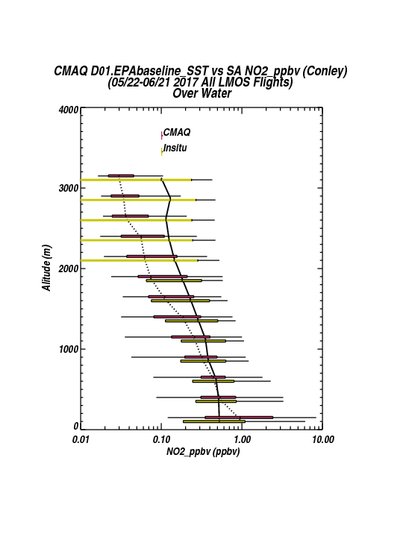

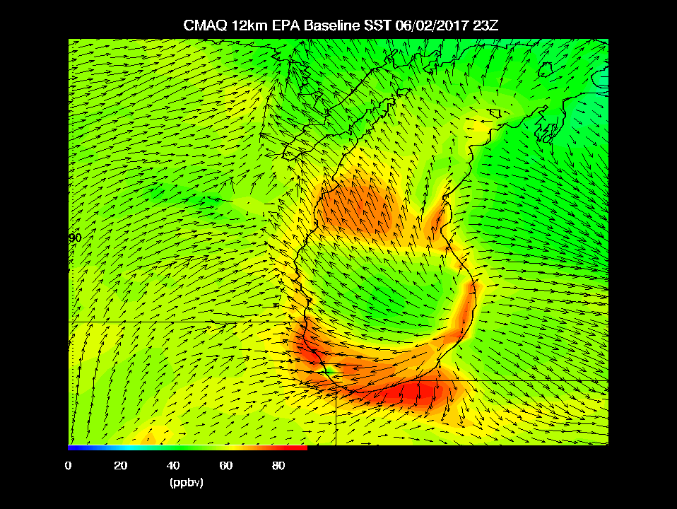
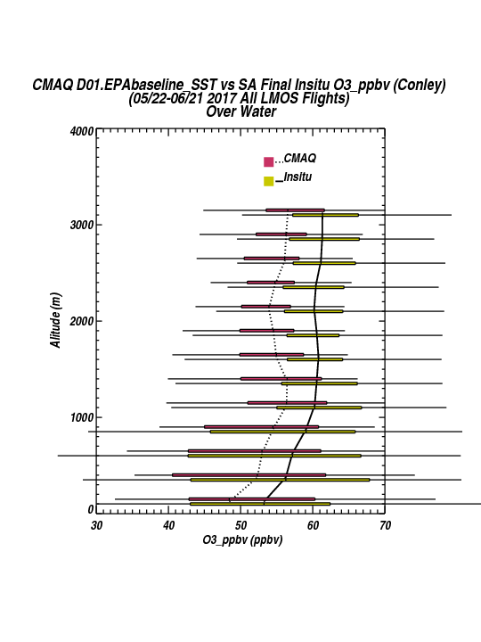
12km CMAQ Model verification
NEI 2014 12km Emission Inventory provided by Kirk Baker, US EPA
EPA Baseline physics overestimates marine boundary layer NO2 by factor of 2x
|‌ 27

Slide 28
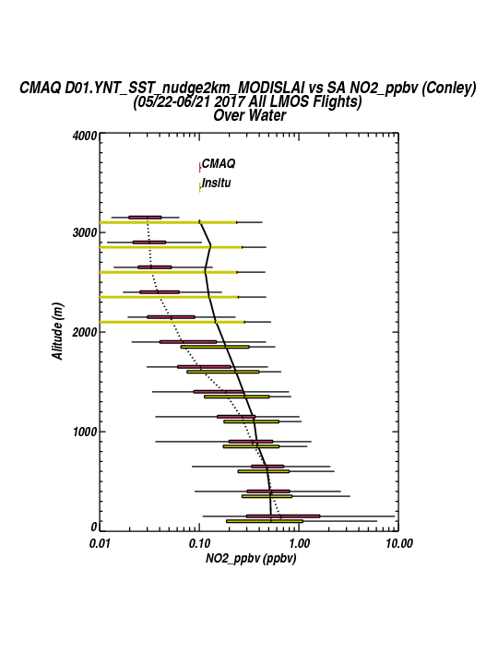
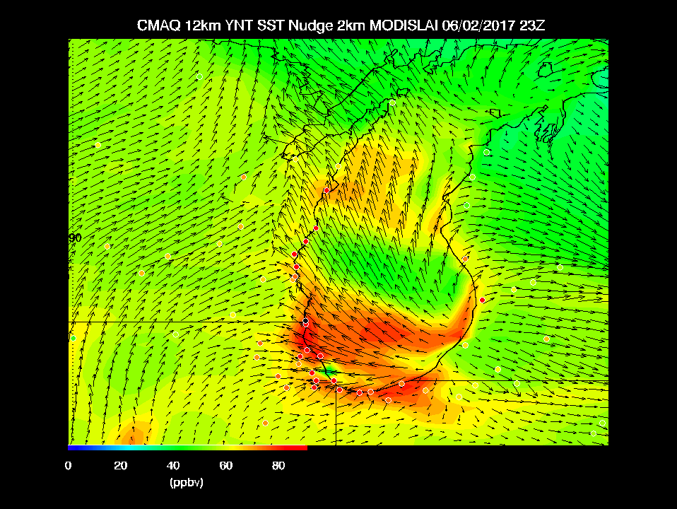
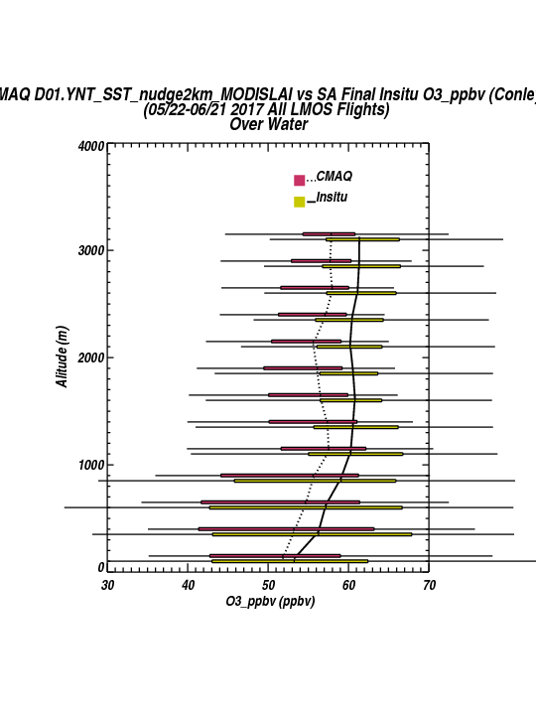
12km CMAQ Model verification
YNT physics and nudging only above 2km improves 12km marine boundary layer NO2 (1.4x overestimate)
Improves Ozone prediction over Lake Michigan
|‌ 28

Slide 29
Summary of measurements made during the LMOS 2017 field campaign
Location | Measurement* | Research Institution*
Ground Sites
Spaceport Sheboygan | Remote sensing of meteorology (SPARC Trailer) | UW-Madison -SSEC
 | In situ measurements of pollutants | U.S. EPA ORD
Zion, IL | Remote sensing of meteorology (Sodar/MW Radiometer) | Univ. Northern Iowa
 | Detailed in situ chemical measurements | Univ. Iowa, UW-Madison, Univ. Minnesota
 | Routine measurements of ozone | Illinois EPA
Various† | Remote sensing of pollutants and boundary layer height | U.S. EPA ORD
Sheboygan transect | In situ measurements of ozone at four locations | U.S. EPA ORD
Airborne Platforms
Lakeshore region | Airborne remote sensing of NO₂ (GeoTASO) | NASA
 | Airborne remote sensing of clouds (AirHARP) | Univ. Maryland, Baltimore County
 | Airborne in situ profiling of pollutants and meteorology | Scientific Aviation
Shipboard Platform
Lake Michigan | In situ measurements of pollutants | U.S. EPA ORD
 | Remote sensing of pollutants and boundary later height | U.S. EPA ORD
Mobile Platforms
Northeast IL and Southeast WI | In situ measurements of pollutants (GMAP) | U.S. EPA Region 5
Grafton to Sheboygan | In situ measurements of ozone and meteorology | UW-Eau Claire

Slide 30

A master mechanism chemical trajectory model, constrained measurements from LMOS 2017, EPA ground-station data, the EPA NEI 2014 emissions, and NOAA meteorological data was developed to understand the NO_{x}-VOC sensitivity of coastal high O₃ events.

Slide 31
Trajectories of modeled O₃ and NO_{x} (colored circles) ending at the Zion site at 17:00 CDT.
June 2nd (Friday)
Comparison of modeled (colored dots) and half-hour average measurements (lines) of NO_{x}*, O₃, HNO₃, and H₂O₂ mixing ratios at Zion, IL.

Slide 32
Increase in O3 from 8:00-17:00 along trajectory on 2 June 2017
Isopleths in ΔO3 were generated by varying NOx and anthropogenic VOC emissions relative to the base case where ENOx and EVOC =1.
The dashed contour corresponds to measured Δ[O3] during this period
The model base case ΔO3 suggests that O3 formation is in a VOC-sensitive regime.

Slide 33
Summary and Conclusions
LMOS 2017 measurements provide critical observations for evaluating a new generation of air quality models attempting to better simulate ozone episodes in the region.
Significant ozone events occurred during LMOS 2017, with exceedances of the 70 ppb 8-hr ozone threshold on June 2, June 11-12, and June 14-16. The LMOS 2017 aircraft observed polluted layers with rapid ozone formation occurring in a shallow layer near the Lake Michigan surface.
Modeling and observations show that this polluted layer over the lake is an important factor in coastal ozone exceedance events, but that meteorological and photochemical model skill in forecasting these needs improvement.
  Comparisons between EPA Baseline and YNT nested WRF meteorological forecasts show that the YNT configuration performs better at high resolution (1.3km)
  Preliminary 12km CMAQ simulations show that limiting nudging to above 2km improves predictions of median NO2 concentrations and ozone within the Lake Michigan marine boundary layer during LMOS 2017.
  Observationally constrained photochemical box model/high resolution trajectory studies show that ozone production is VOC limited during the June 02, 2017 ozone exceedance event
LMOS LADCO Synthesis Report
https://www.ladco.org/wp-content/uploads/Research/LMOS2017/LMOS_LADCO_report_revision_apr2019_final.pdf
NASA LaRC data archive at https://www-air.larc.nasa.gov/cgi-bin/ArcView/lmos

