Slide 1
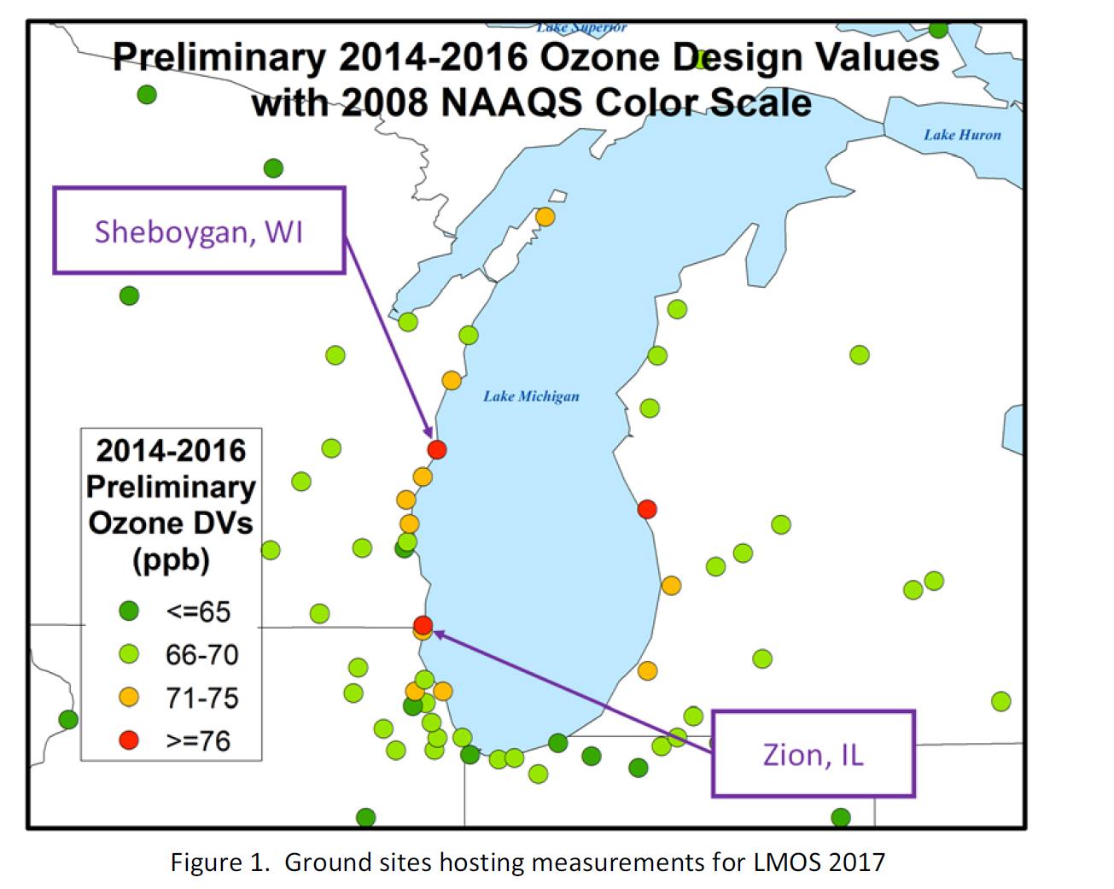
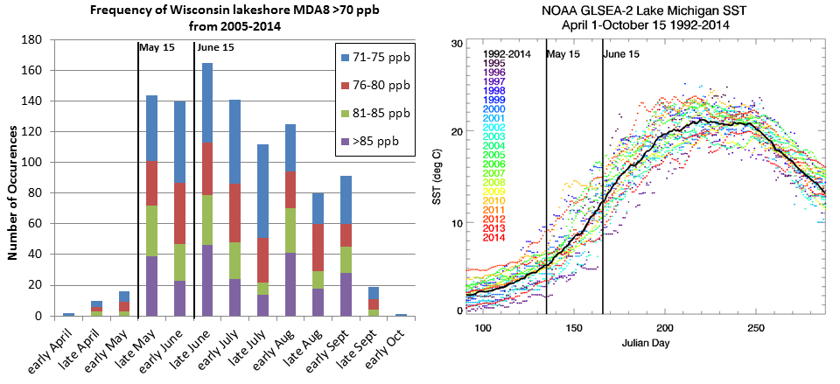
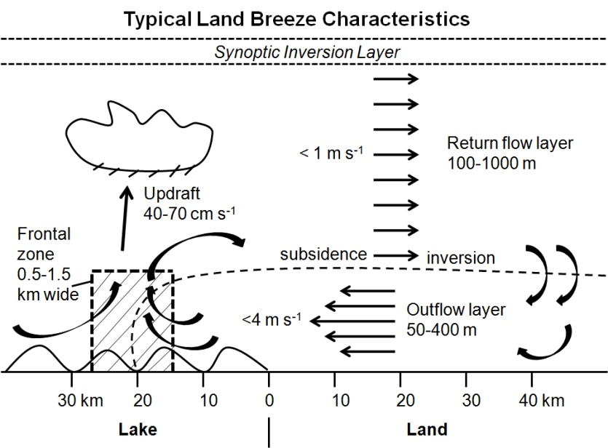
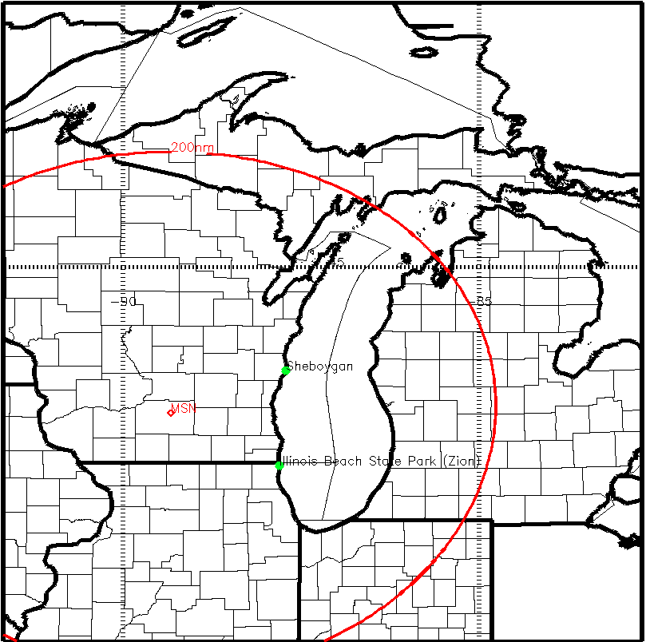
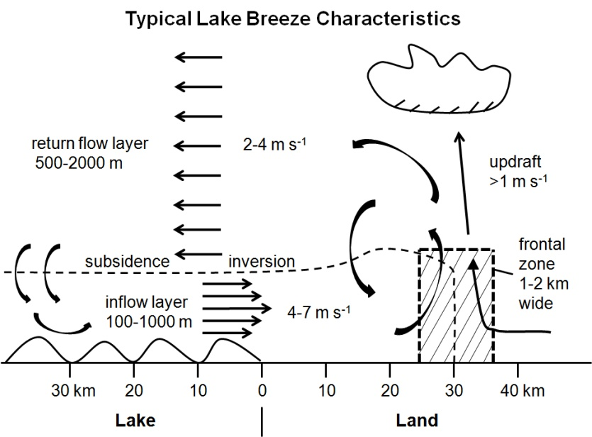
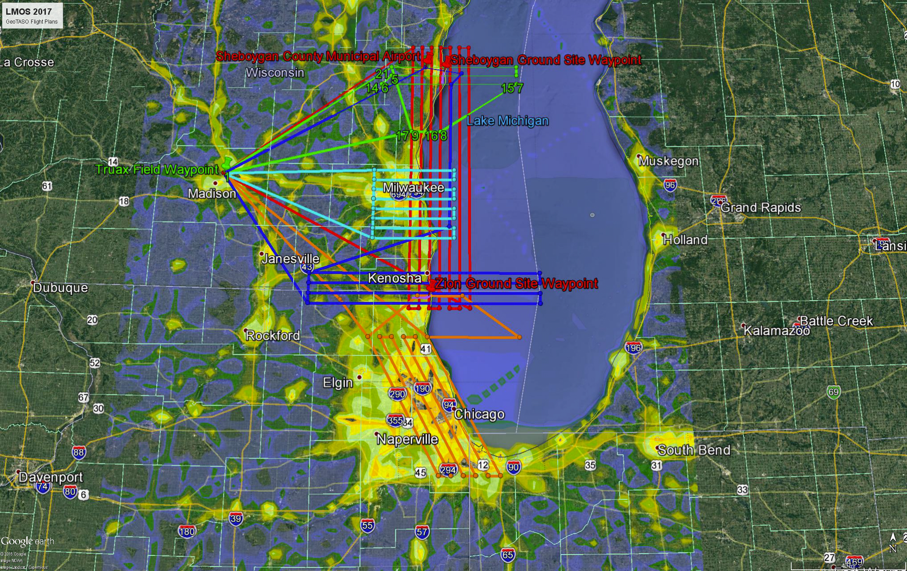
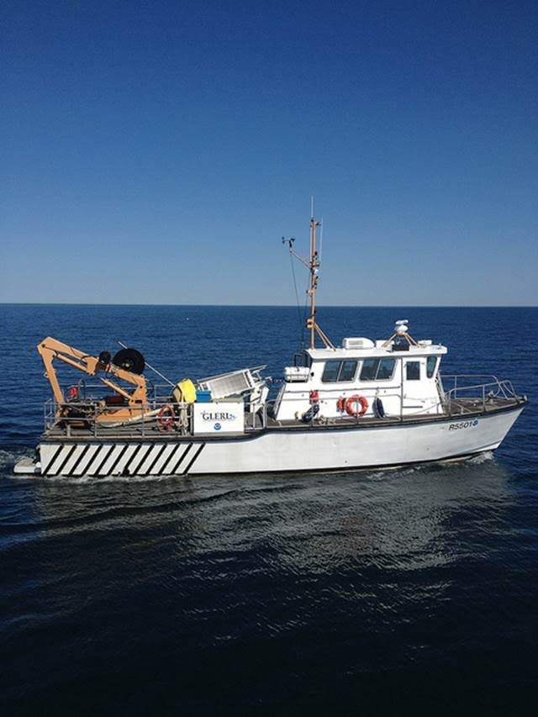
2017 Lake Michigan Ozone Study (LMOS 2017)
Despite dramatic reductions in ozone precursor emissions, many areas bordering Lake Michigan continue to violate federal air quality standards (NAAQS). This problem has persisted for decades and is one of the most challenging air quality issues in the eastern U.S.
LMOS is a multi-institutional (Federal, State, Academic, RPO, Private) effort to support State Implementation Plan (SIP) modeling activities required by the Federal Clean Air Act. The primary science objectives focus on characterizing the recirculation, aging, and mixing of the Chicago and Milwaukee urban pollution plumes as they move over Lake Michigan and their impact on surface ozone along the Western shore of Lake Michigan.
Campaign Study Period May 22- June 22, 2017
LMOS Measurement Suite
SSEC SPARC Trailer (HALO Wind Lidar, AERI T/Q profiles, HSRL aerosol extinction, CIMEL aerosol optical depth),
EPA Pandora (Column NO2, HCHO), insitu (O3, NOx, HCHO)
NASA airborne column NO2, HCHO, O3, and aerosols (GEOTASO Airborne UV-VIS Spectrometer, AirHARP Polarimeter)
NOAA Ship (EPA Pandora, ceilometer, insitu O3, (tethered Kite and shipboard),
EPA Geospatial Measurement of Air Pollution (GMAP) mobile van (O3)
Lake Michigan and Ozone Formation
Land breeze blows ozone precursor compounds from rush hour over lake.
The boundary layer height is low due to cold water chilling the air above.
The pollutants are concentrated near the surface where ozone forms.
An afternoon lake breeze transports the ozone back onto land.
UNI Microwave Radiometer T/Q profiles, SoDAR winds, Pandora (Column NO2, O3)
Insitu super site (UW-Madison/UofM NOy/VOC U-Iowa Aerosol)
GeoTASO Flights with
2011 NOx emissions
Scientific Aviation insitu O3, NO2, meteorology
Ship measurements: NOAA -GLERL Lake
Michigan Field Station Research Vessel R5503
Airborne Measurements: NASA GeoTASO Scientific Aviation insitu O3 and NOx
NASA Beechcraft UC‐12 instrument Geostationary Trace gas and Aerosol Sensor Optimization (GeoTASO) is a UV‐VIS Spectrometer that is an airborne simulator for the future Tropospheric Emissions: Monitoring of Pollution (TEMPO) mission and is used to retrieve column NO2, HCHO, and aerosols.
Scientific Aviation Mooney airplane will be equipped with meteorological, O3 and NO2 measurements. Will provide insitu measurements during spirals over key ground sites and measurements within the boundary layer over land and water. Funded by Electric Power Research Institute (EPRI)
The NOAA Great Lakes Environmental Research Laboratory (GLERL) will be providing the RV R5503 during June 2-22
EPA Pandora, ceilometer, insitu O3 measurements using tethered Kite and shipboard
Based out of Sheboygan, WI during deployment
Contact Information: brad.pierce@noaa.gov

