Slide 1
The Lake Michigan Ozone Study (LMOS) 2017
Brad Pierce
NOAA/NESDIS@CIMSS
Kohler-Andrae State Park, Sheboygan WI
Despite dramatic reductions in ozone precursor emissions, many areas bordering Lake Michigan continue to violate federal air quality standards. This problem has persisted for decades and is one of the most challenging air quality issues in the eastern U.S.
LADCO States Briefing Monday April 24, 2017

Slide 2
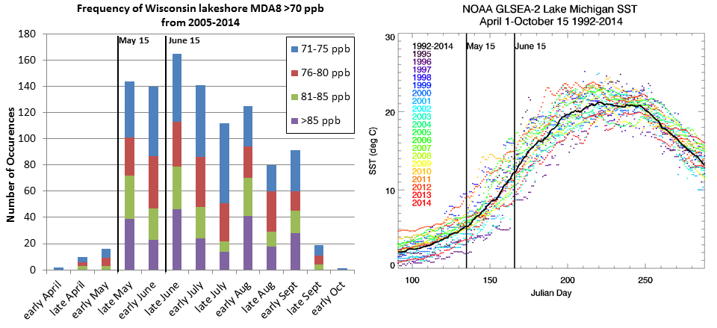
Lake Michigan Ozone Study (LMOS) 2017
Campaign Study Period May 22- June 22, 2017
Primary science objectives focusing on characterizing the recirculation, aging, and mixing of the Chicago and Milwaukee urban plumes as they move over Lake Michigan and their impact on surface ozone.
White Paper: http://www.ladco.org/

Slide 3
Leveraged Resources
*Does not include FTE or travel cost from participating Federal Agencies.

Slide 4
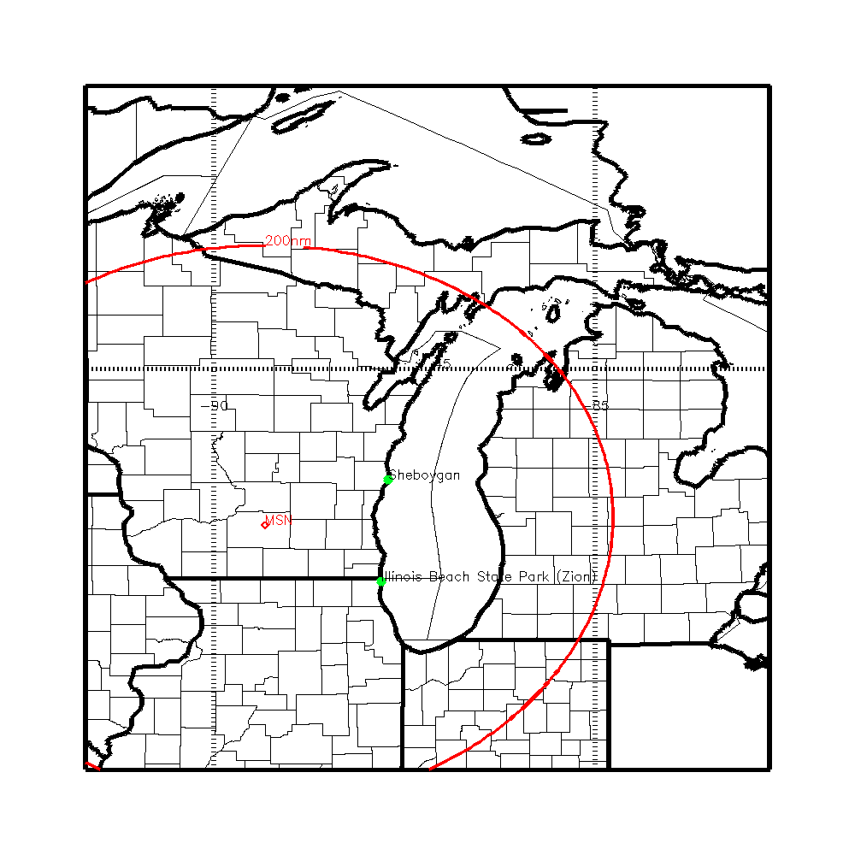
LMOS Measurement Suite
SSEC SPARC Trailer
(HALO Wind Lidar, AERI T/Q profiles, HSRL aerosol extinction, CIMEL aerosol optical depth),
EPA Pandora (Column NO2, HCHO), insitu (O3, NOx, HCHO)
NASA airborne column NO2, HCHO, O3, and aerosols
(GEOTASO Airborne UV-VIS Spectrometer, AirHARP Polarimeter)
NOAA Ship (EPA Pandora, ceilometer, insitu O3, (tethered Kite and shipboard),
EPA Geospatial Measurement of Air Pollution (GMAP) mobile van
(O3)
UNI Microwave Radiometer T/Q profiles, SoDAR winds, Pandora (Column NO2, O3)
Insitu super site (UW-Madison/UofM NOy/VOC U-Iowa Aerosol)
Scientific Aviation insitu O3, NO2

Slide 5
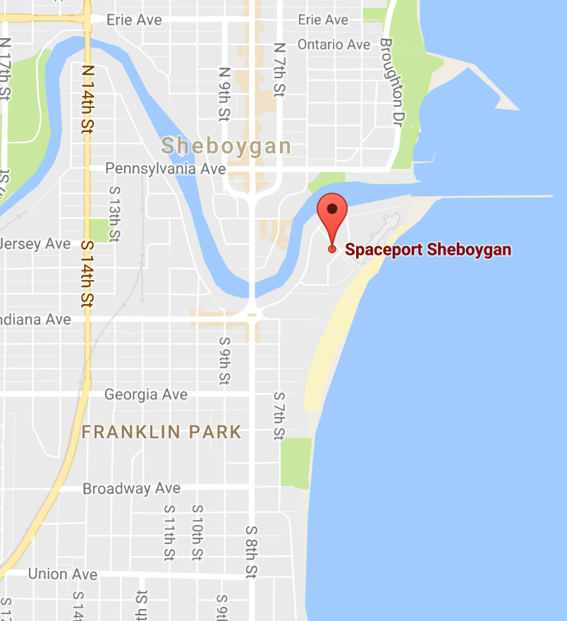
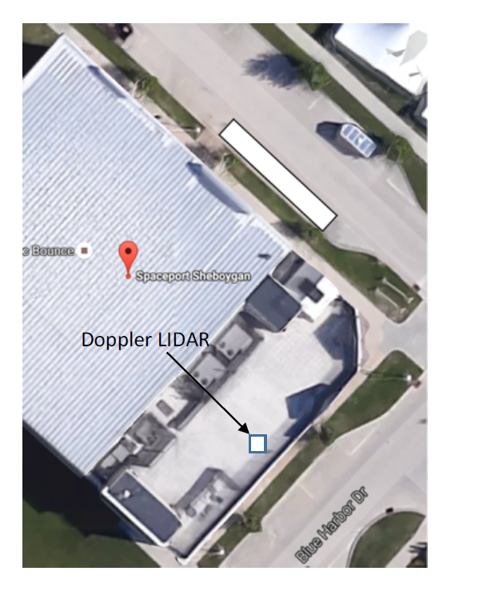
Sheboygan Ground Site: Spaceport Sheboygan

Slide 6
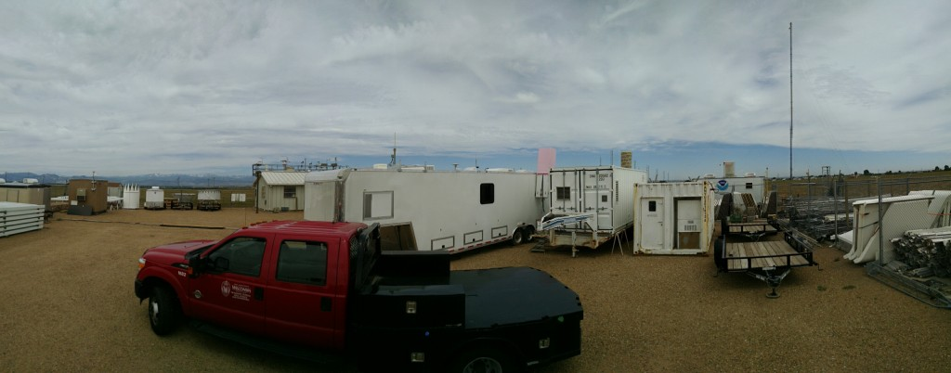
Sheboygan Ground Site: Spaceport Sheboygan
UW-Madison SPARC Trailer
Boundary Layer Meteorology/Surface Meteorology Tim Wagner, Univ. of Wisconsin. SPARC: the SSEC Portable Atmospheric Research Center (funded by NOAA)
Profiles: (T, Q, wind, extinction) Atmospheric Emitted Radiance Interferometer (AERI), HSRL Lidar, Doppler lidar wind profiler.
In situ meteorology: Vaisala T, RH, pressure, wind speed, wind direction, precipitation.
O3 Profiles by Tethered Kite (ozone and meteorology), in conjunction with Dept. of Atmospheric Science, Univ. Wisconsin.
SPARC
The SSEC Portable Atmospheric Research Center (SPARC) during the Front Range Air Pollution Experiment (FRAPPE).

Slide 7
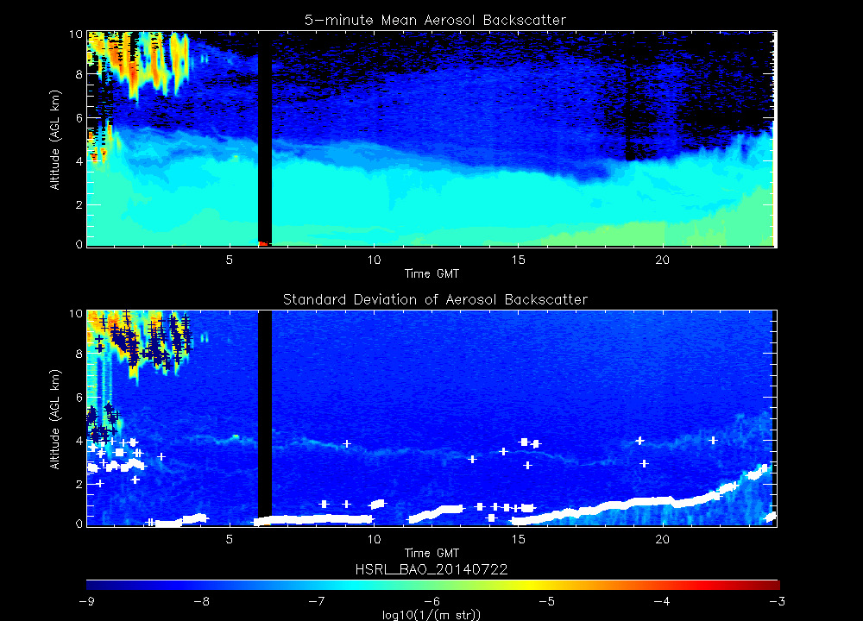
HSRL FRAPPE, Boulder CO
Ceilometer PBL Height

Slide 8
Residual layer
Daytime PBL
HSRL FRAPPE, Boulder CO
Nighttime collapse
Residual layer
Daytime PBL

Slide 9
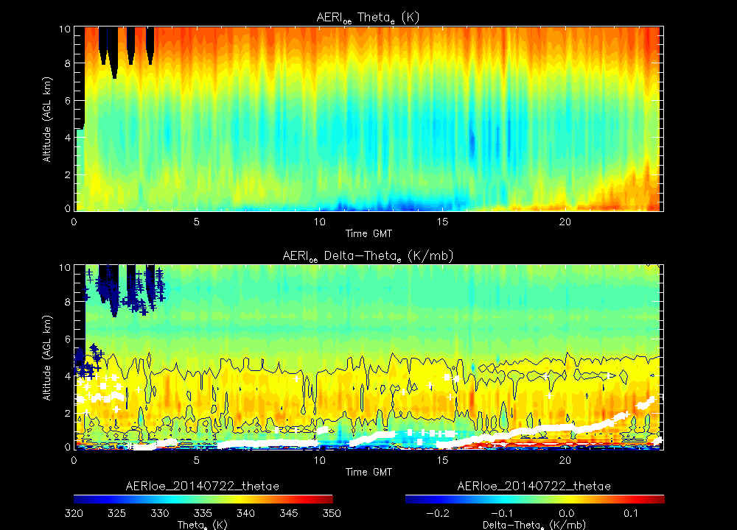
Daytime PBL
AERI FRAPPE, Boulder CO
Super moist adiabatic
Residual layer
Daytime PBL

Slide 10
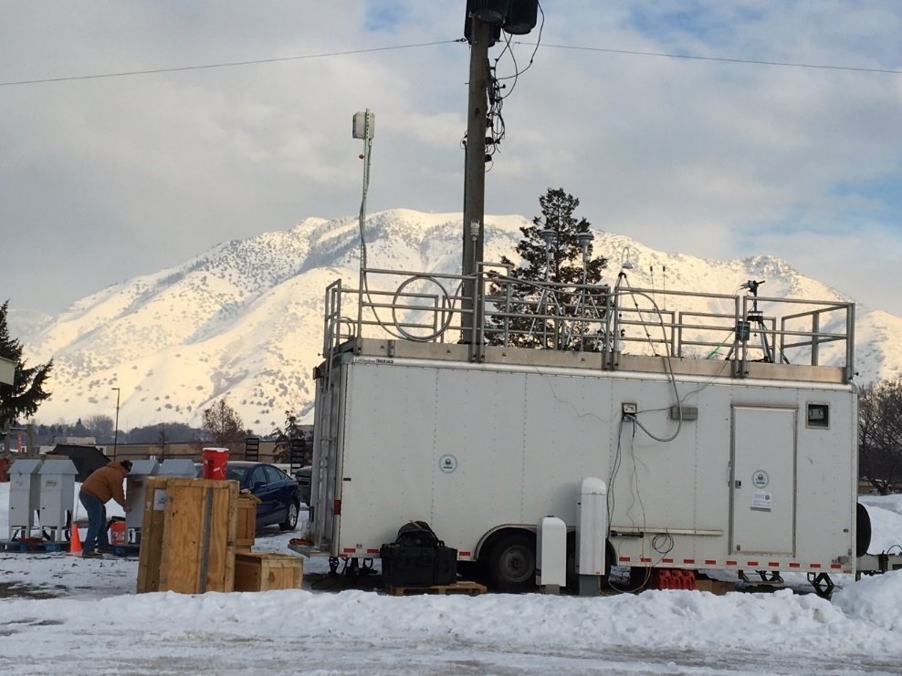
Sheboygan Research Site: Spaceport Sheboygan
EPA Research Trailer
U.S. EPA Federal Reference Methods for Trace Gases along with Formaldehyde (O3 precursor):
NOx/NOy methods:
Teledyne T500U Cavity attenuated phase shift spectroscopy (CAPS)
Teledyne 200EUP Photolytic converter – O₃ chemiluminescence
O₃ method:
2B Technologies M211 Scrubberless UV
HCHO
Aerodyne QCL
EPA Trailer at Logan, Utah January 2017

Slide 11
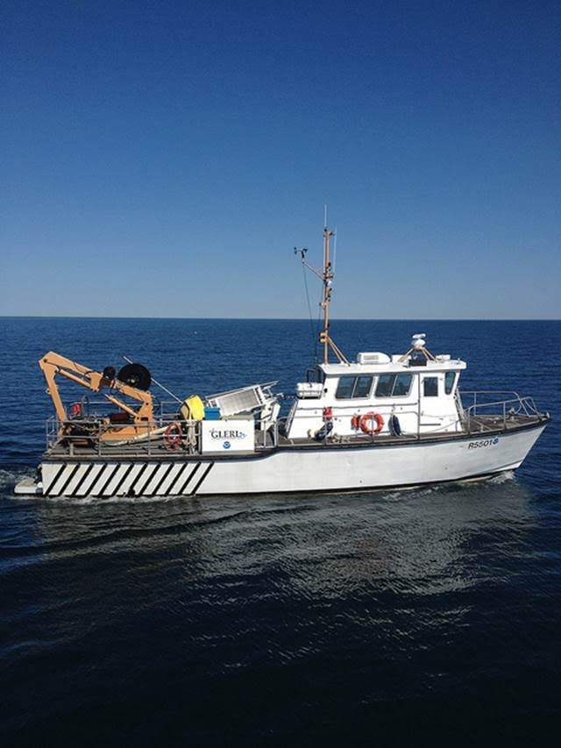
Ship measurements: NOAA -GLERL Lake
Michigan Field Station Research Vessel R5503
The NOAA Great Lakes Environmental Research Laboratory (GLERL) will be providing the RV R5503 during June 2-22
EPA Pandora, ceilometer, insitu O3 measurements using tethered Kite and shipboard
Based out of Sheboygan, WI during deployment

Slide 12
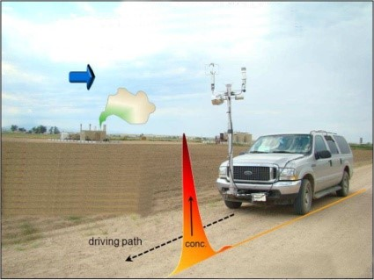
Mobile Van Measurements: EPA Region Geospatial Measurement of Air Pollution (GMAP)
GMAP has an integrated Differential Ultra Violet Absorption Spectroscopy (DUVAS) that can provide high frequency (1 second) measurements while moving or parked.
Will be deployed during high ozone events to measure coastal and inland ozone gradients during LMOS
¹http://www.duvastechnologies.com/index.php?option=com_content&view=featured&Itemid=435

Slide 13
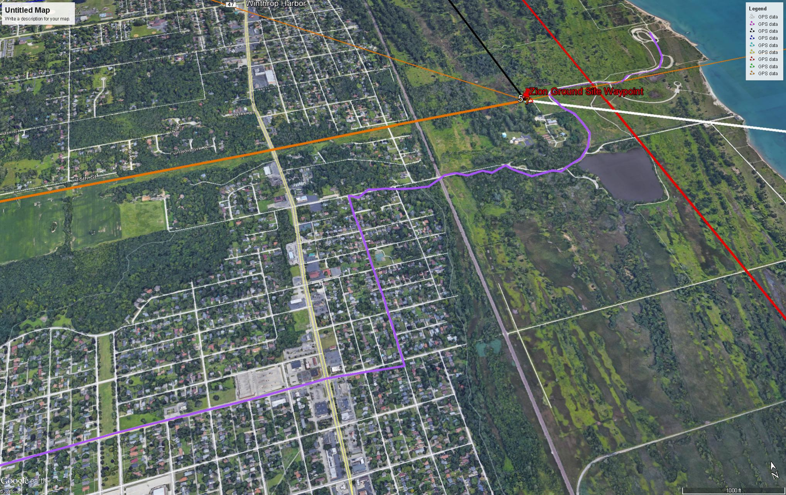
GMAP Zion Inland Gradient route (light purple)

Slide 14
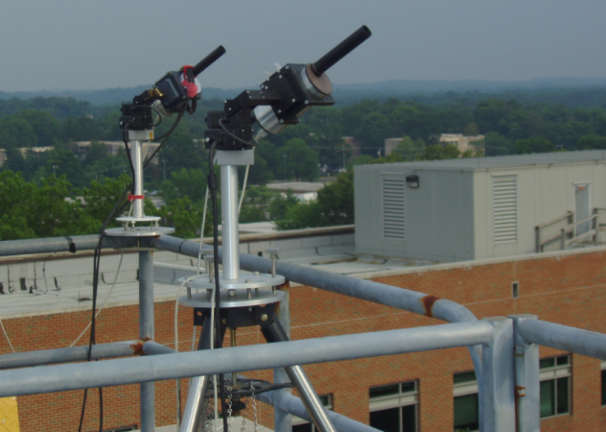
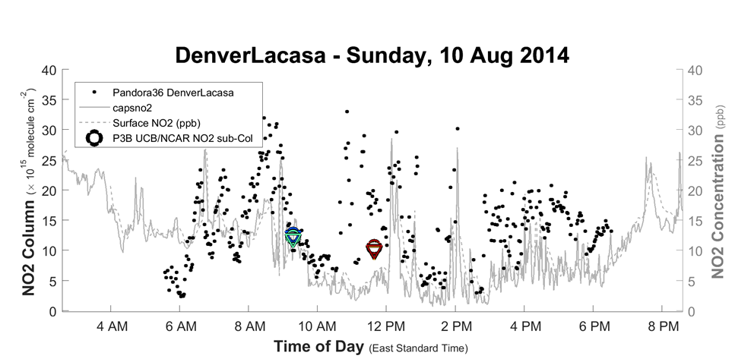
Pandora Ground-Based Spectrometer
Solar source spectrometer (280 - 525 nm: 0.6 nm resolution) – column NO2, O3, HCHO, and SO2 every 80 second.
Column NO2/HCHO ratios to assess of formaldehyde as a radical source (primary and secondary) and ozone formation in an urban and downwind environment.
Deployed with ceilometers at Milwaukee SER, Sheboygan WI, Haven WI, Zion Ill, and NOAA Research Vessel
Pandora DISCOVER-AQ Denver, CO

Slide 15
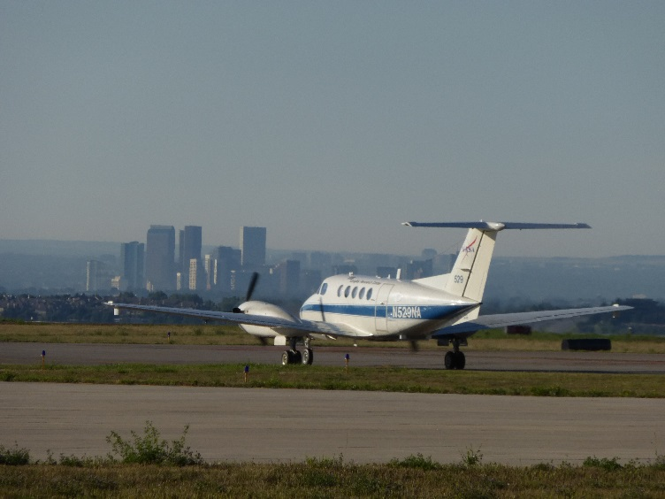
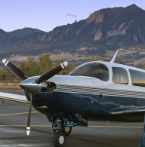
Airborne Measurements: NASA GeoTASO, Scientific Aviation insitu O3 and NO2
NASA Beechcraft UC‐12 instrument Geostationary Trace gas and Aerosol Sensor Optimization (GeoTASO). GeoTASO is a UV‐Vis Spectrometer that is an
airborne simulator for the future Tropospheric Emissions: Monitoring of Pollution (TEMPO) mission and is used to retrieve column NO2, HCHO, and aerosols.
Scientific Aviation Mooney airplane equipped with meteorological, O3 and NO2 measurements. Spirals over key ground sites and measurements within the boundary layer over land and water. Funded by Electric Power Research Institute (EPRI)

Slide 16
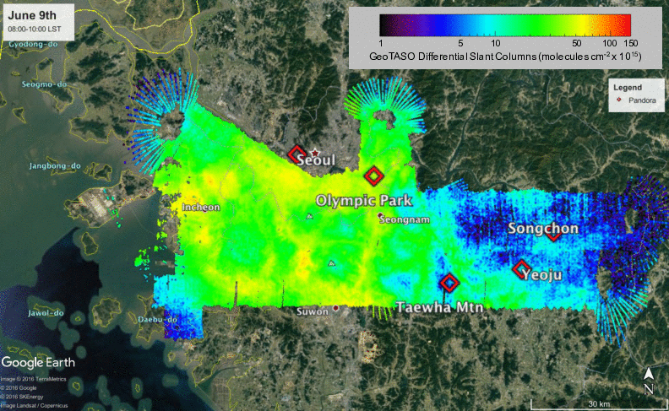
GeoTASO Quick-look differential slant column NO₂ – Seoul, Korea, 2016/06/09 Images courtesy Laura Judd/NASA LaRC and Scott Janz/NASA GSFC
100 km
Data retrieved at approx. 250m x 250m horizontal resolution
Notes:
Differential slant column: within each flight, the minimum column NO2 in the scene is identified and used as a reference. The DOAS technique is then used to retrieve the amount of total column NO2 relative to this reference. Because the reference includes contributions from stratospheric NO2 and possibly regional background tropospheric NO2, the resulting differential slant column primarily shows NO2 resulting from local sources.
The color scale is based on the peak value observed during this day.
Before comparing with other measurements, these slant columns will need to be converted to tropospheric vertical columns using Air Mass Factors, which requires strong collaboration with the air quality modeling teams.

Slide 17
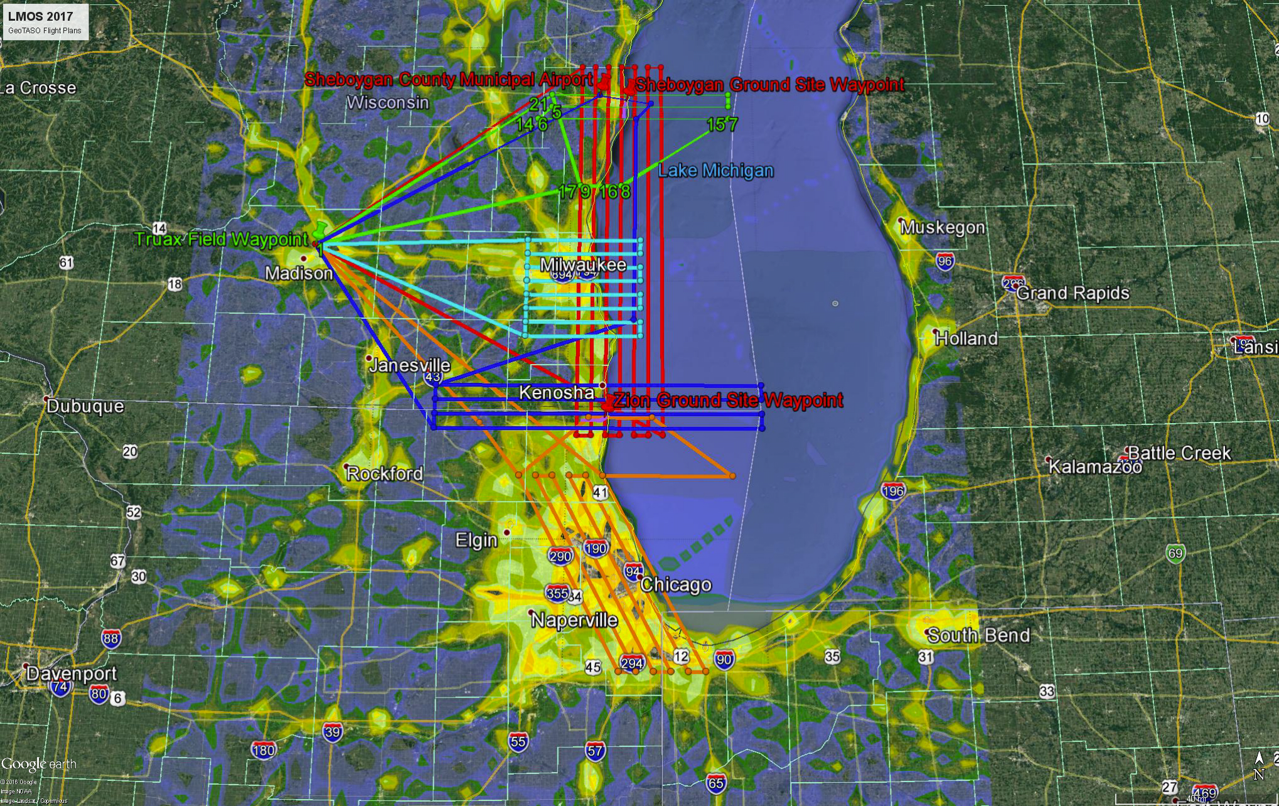
All LMOS GeoTASO Flights with NEI 2011 NOx emissions

Slide 18
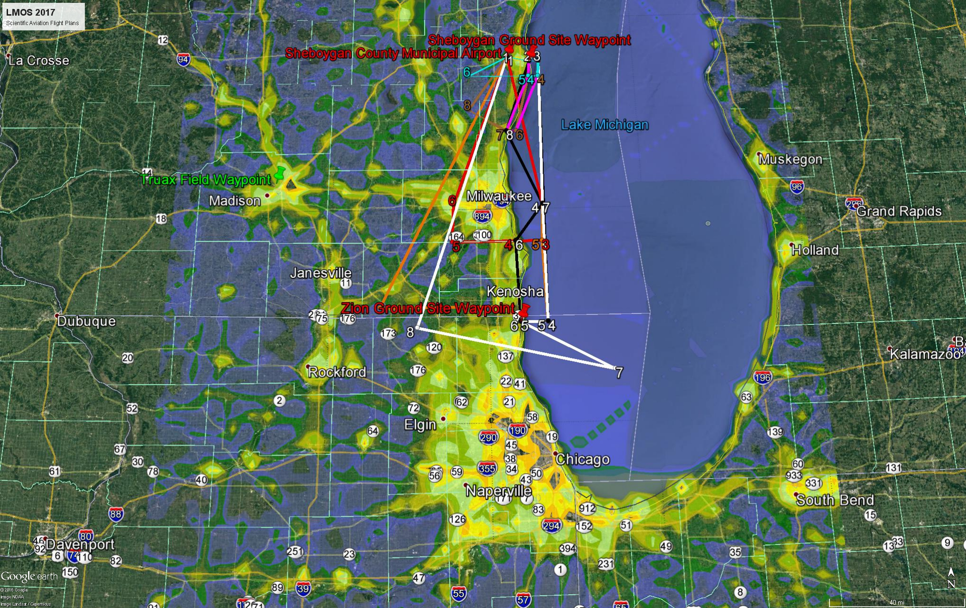
All LMOS Scientific Aviation Flights with NEI 2011 NOx emissions

Slide 19
Flight # | Flight Name | Objective | Duration | Frequency
SA1/GT1 | Sheboygan to Zion | Zion to Sheboygan coastal survey with onshore and offshore profiling | GT: 1507km SA: 182nm (5hrs) | 2 flights GT/SA once a day One early in the mission One during ozone event
SA2/GT2 | Chicago (two GT circuits) | Chicago emissions with background and offshore profiling | GT: 1580 km SA: 248nm (5.4hrs) | 4 flights (Two days, weekday and weekend), SA once a day GT twice a day
SA3/GT3c | Sheboygan inland (three GT circuits) | Sheboygan survey with background, onshore and offshore profiling | GT:1306km SA: 47nm (3.6hrs) | 4 (3) flights (2 days) SA twice a day GT twice a day
SA5/GT3c | Sheboygan coastal (three GT circuits) | Sheboygan/Port Washington survey with onshore and offshore profiling | GT: 1306km SA: 64nm (4.3hrs) | 4 (3) flights (2 days) SA twice a day GT twice a day
SA6/GT5 | Zion (two GT circuits) | Zion survey with background, onshore and offshore profiling | GT: 1583km SA: 215nm (5.3hrs) | 8 (6) flights (4 days) SA twice a day GT twice a day
SA7/GT4 | Milwaukee (three GT circuits) | Milwaukee emissions with background and offshore profiling | GT: 1552km SA: 139nm (4.8hrs) | 2 flights (1 day, diurnal sampling weekday) Non forecast ozone day SA twice a day GT twice a day
Notes:
Currently have 24 GT flights, budget for 22, need to balance Zion (8) and Sheboygan (4+4) at 6&8 or 8&6
Currently have 22 SA flights
SA Flights total 83.2 flight hours, have confirmed that flights longer than 4 hours can be flown twice per day

Slide 20
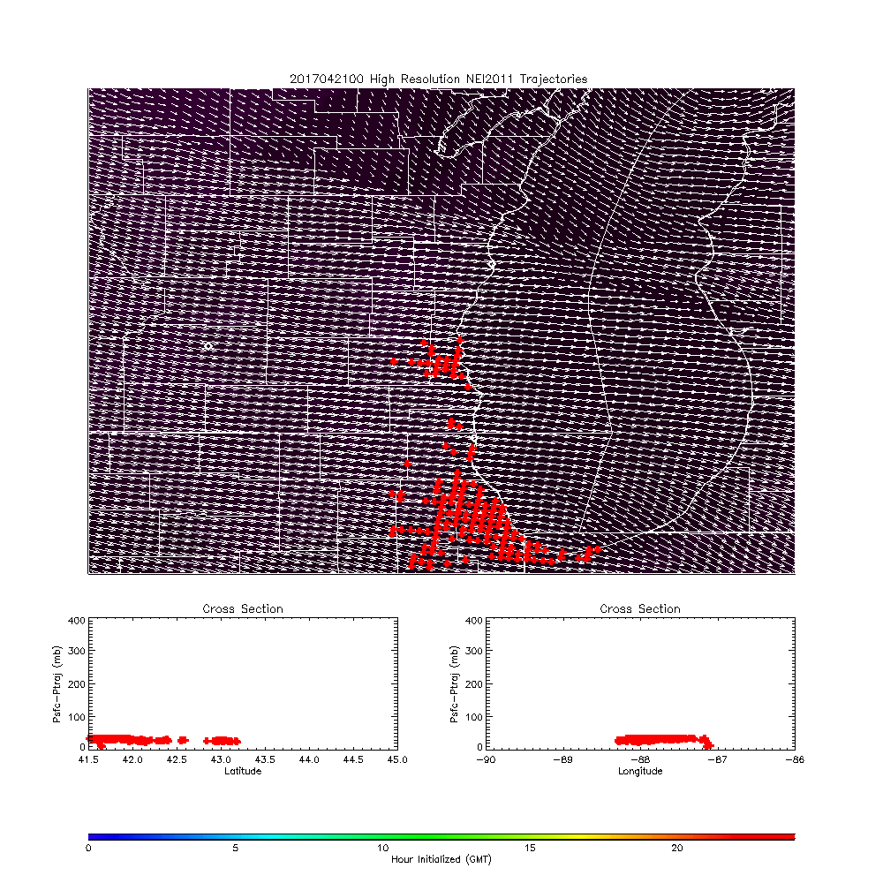
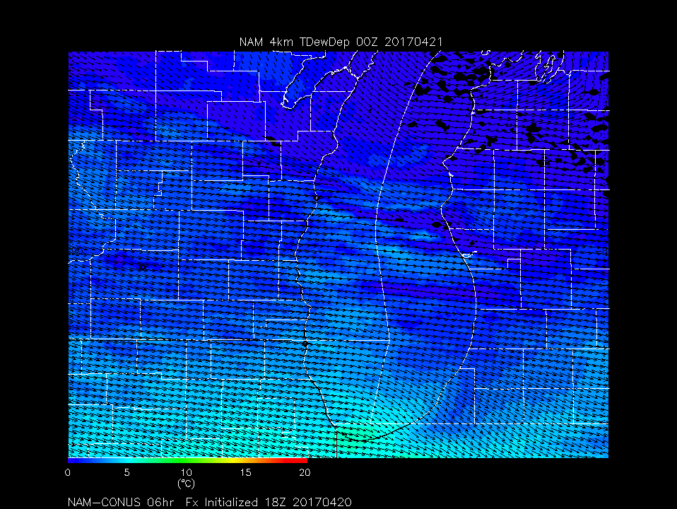
LMOS Forecasting support
Daily 8:00am flight planning meeting
Wisconsin DNR
Daily Ozone forecast
NWS Sullivan (via email)
Daily (6:30am/3:30pm) met briefings
Iowa 4km WRF-Chem
Madison NAM 4km Met/Trajectory

