Slide 1




Off-line Constraints on Urban NOx Emissions within NAM-CMAQ using TropOMI Tropospheric NO2 Retrievals
Brad Pierce
Space Science and Engineering Center*
University of Wisconsin-Madison, Madison, WI
and
Allen Lenzen*, Tommy Jasmin*, Pius Lee & Youhua Tang (NOAA), and Pieternel Levelt (KNMI)
Data Providers
LISTOS Airborne remote sensing retrievals: Scott Janz & Laura Judd (NASA)
LISTOS Ground based remote sensing retrievals: Jim Szykman, Luke Valin (EPA), Bob Swap (NASA)
AMS 2019 Joint Satellite Conference 28 September – 04 October 2019 Boston, MA

Slide 2
Background
One of the key objectives for a Weather Ready Nation outlined in the NOAA Next Generation Strategic Plan is “Healthy people and communities due to improved air and water quality services”.
To support this objective, data assimilation capabilities need to be developed to exploit the next generation of satellite based air quality measurements.
This project focuses on developing capabilities to assimilate TROPOMI retrievals within the NWS regional air quality forecasting system (NAM-CMAQ)

Slide 3

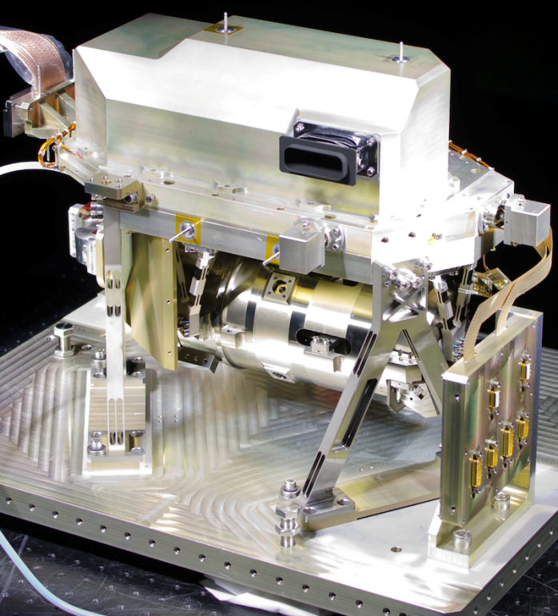

The TROPOspheric Monitoring Instrument (TROPOMI) is the satellite instrument on board the Copernicus Sentinel-5 Precursor (S5P) satellite launched on 13 October 2017.
  UV-VIS-NIR-SWIR push-broom grating spectrometer (270-495 nm, 675-775 nm, 2305-2385 nm).
  Nadir pixel 7x3.5 km² for all spectral bands, with the exception of the UV1 band (7x28 km²) and SWIR bands (7x7 km²).
  S5P is a cooperative undertaking between ESA and the Kingdom of the Netherlands.
The objective of TROPOMI is to provide accurate and timely observations of key atmospheric species, for services on air quality, climate, and the ozone layer.
TROPOMI SWIR module

Slide 4
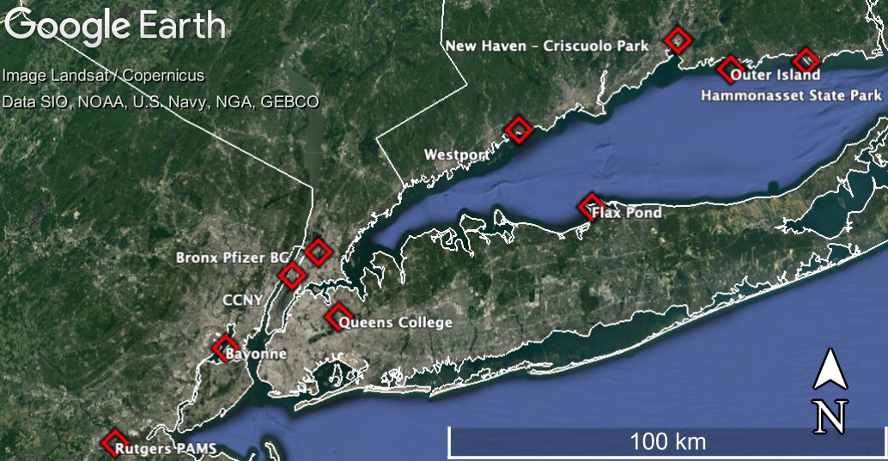
Evaluating TROPOMI NO₂ with Pandora:
10 instruments--June 2018-2019
Preliminary Results
Scatter around the best fit can be mostly attributed to mismatches in spatial representation of the different measurements and retrieval uncertainty
This low bias can be mostly removed by using a higher resolution NO₂ profile shape in the retrieval (manuscript in prep)
No obvious seasonal or across-track dependency to the statistics
10 Pandora instruments installed/maintained through a EPA/NASA/state AQ agencies collaboration
Pandora data averaged over a ± 60-minute temporal window of the TROPOMI overpass with the horizontal bars representing the max/min over that temporal window and the coincidence TROPOMI tropospheric columns with cloud radiative fraction less than 20% with the vertical bars representing the reported precision. The dashed line is the 1:1 relationship and the solid line is the RMA linear fit.
Slide prepared by Laura Judd, NASA LaRC
Notes:
In 2018, Pandoras were installed in 10 locations near NYC/LIS. Throughout the next year, there were 440 coincidences of Pandora data and TROPOMI data with cloud radiative fractions less than 20%.
Overall, the data are highly correlated with much of the scatter being attributed to mismatched spatial representivity between the two instruments. There is a persistant low bias by the TROPOMI product that is pretty well understood as a product of spatially coarse a priori from TROPOMI (1x1 deg TM5-MP a priori). If you use a higher resolution model to supply the profile shape, this low bias is mostly removed (see next slide). [FYI: GCAS/TROPOMI comparisons have very similar statistics but with a tighter correlation].
The bias does not appear to have a seasonal or pixel size (cross track position) dependency.

Slide 5
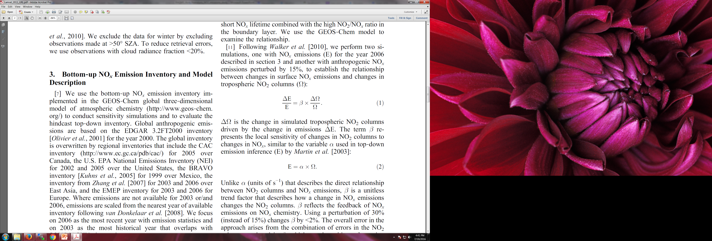
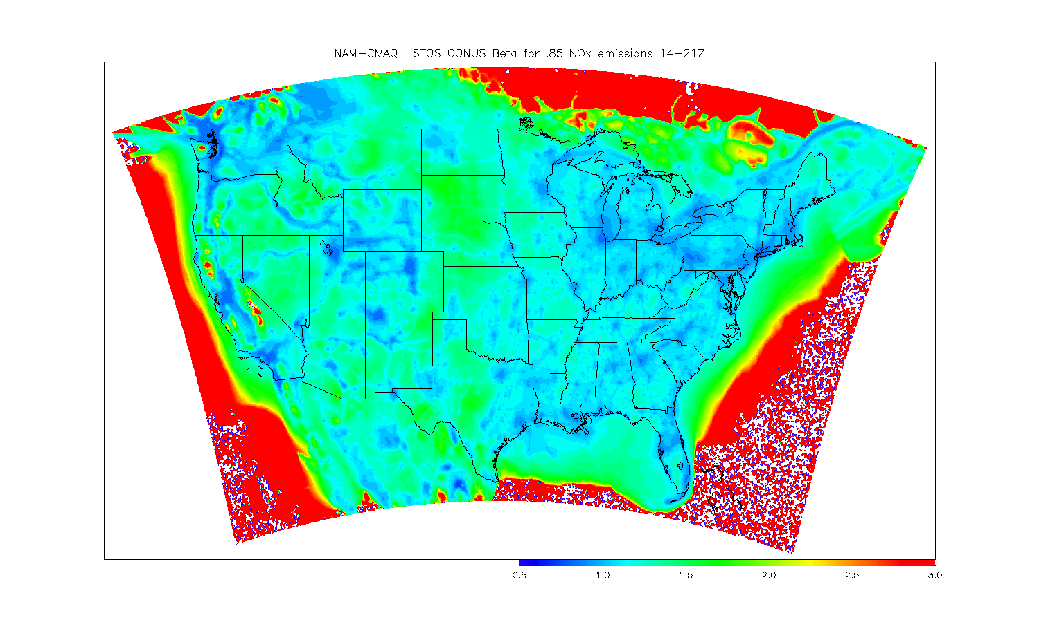
NAM-CMAQ/GSI NOx emission adjustment experiments
Calculate monthly mean NO₂ Jacobian (β) from a 15% NO_{X} emission reduction perturbation experiment following Lamsal et al. 2011
Calculate monthly mean NO₂ analysis increment using NAM-CMAQ/GSI TROPOMI NO₂ assimilation
  NOx emission sensitive background errors (to correct NAM-CMAQ emissions)
Adjust NAM-CMAQ NO_{x} emissions using Jacobian and average analysis increment
  Only adjust daytime emissions since TROPOMI does not provide nightime constraints
Urban areas and transport corridors (β<1), rural areas (β>1)
  NAM-CMAQ Beta for July-August 2018
Lamsal, L. N., et al. (2011), Application of satellite observations for timely updates to global anthropogenic NOx emission inventories, Geophys. Res. Lett., 38, L05810, doi:10.1029/2010GL046476.

Slide 6
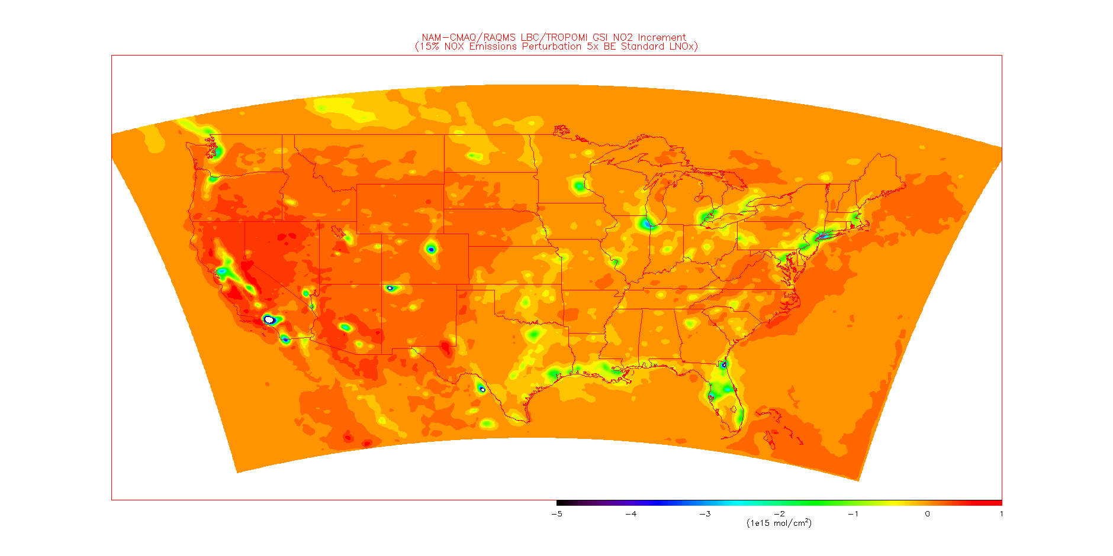
NAM-CMAQ/GSI NOx emission adjustment experiments
Calculate monthly mean NO₂ Jacobian (β) from a 15% NO_{X} emission reduction perturbation experiment following Lamsal et al. 2011
Calculate monthly mean NO₂ analysis increment using NAM-CMAQ/GSI TROPOMI NO₂ assimilation
  NOx emission sensitive background errors (to correct NAM-CMAQ emissions)
Adjust NAM-CMAQ NO_{x} emissions using Jacobian and average analysis increment
  Only adjust daytime emissions since TROPOMI does not provide nightime constraints
July-August, 2018 mean GSI analysis increment shows large reductions in urban areas.
  TropOMI Analysis Increments for July-August 2018
Lamsal, L. N., et al. (2011), Application of satellite observations for timely updates to global anthropogenic NOx emission inventories, Geophys. Res. Lett., 38, L05810, doi:10.1029/2010GL046476.

Slide 7
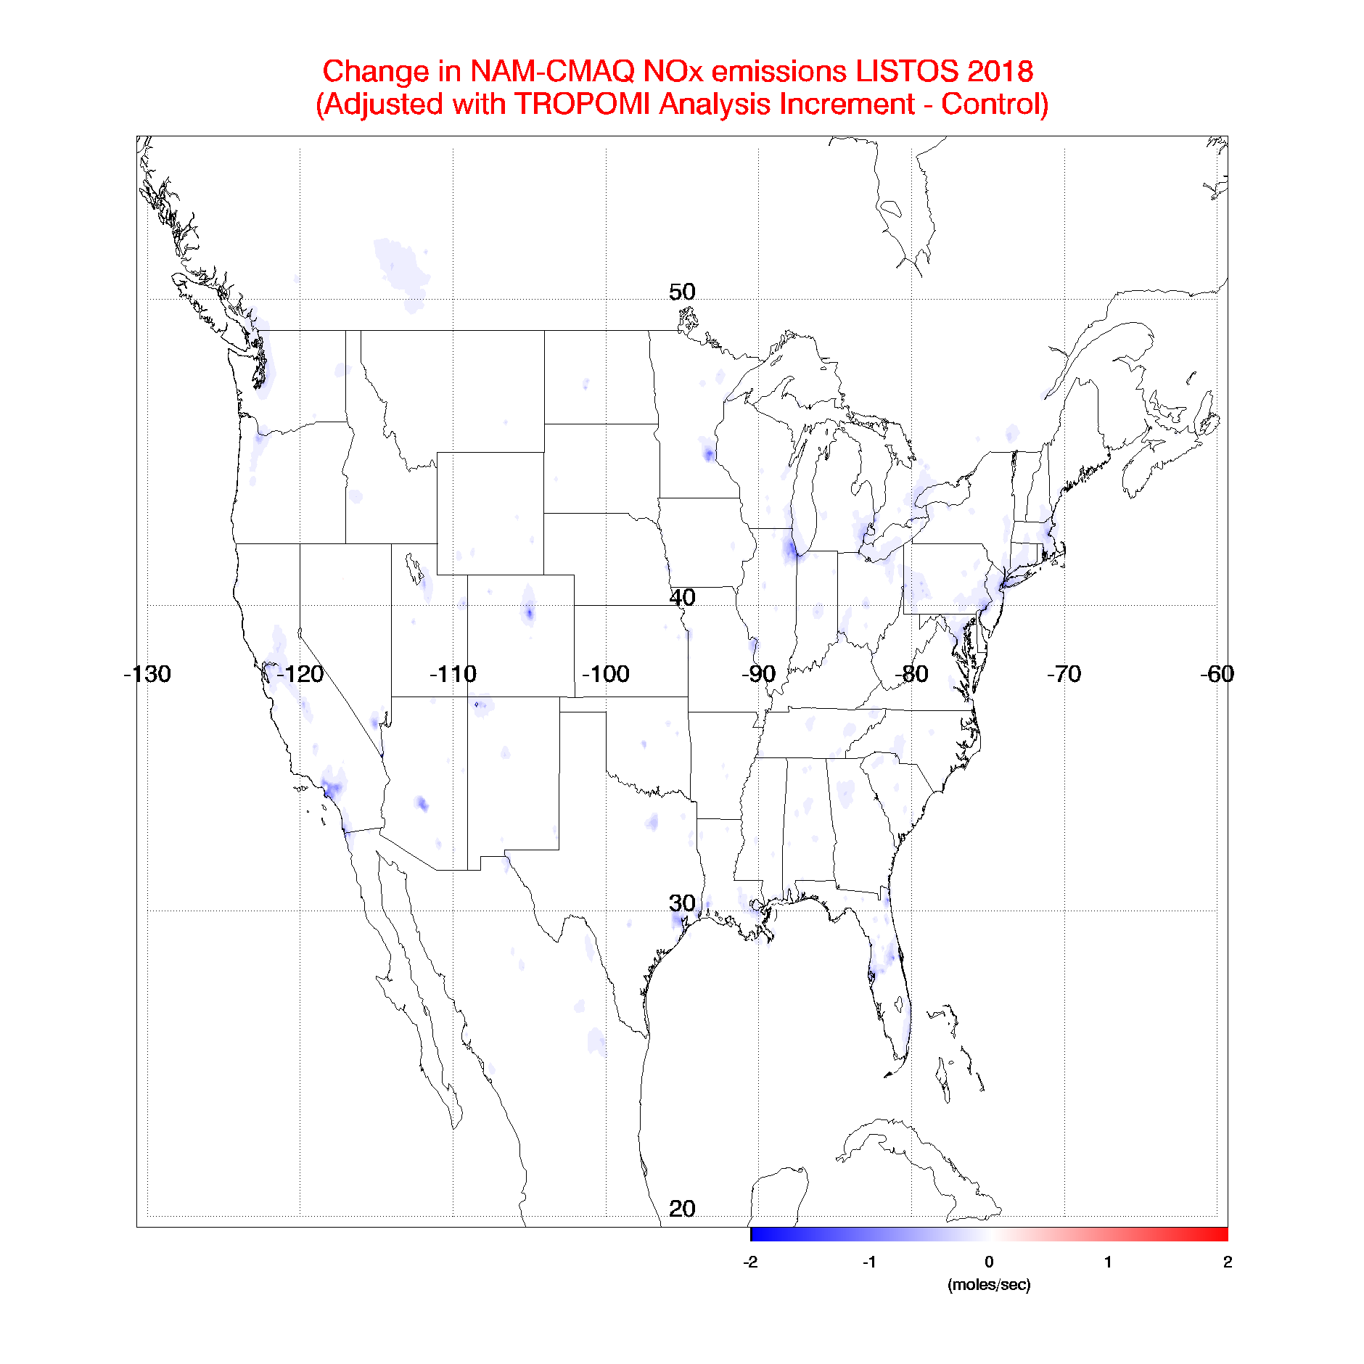
NAM-CMAQ/GSI NOx emission adjustment experiments
Calculate monthly mean NO₂ Jacobian (β) from a 15% NO_{X} emission reduction perturbation experiment following Lamsal et al. 2011
Calculate monthly mean NO₂ analysis increment using NAM-CMAQ/GSI TROPOMI NO₂ assimilation
  NOx emission sensitive background errors (to correct NAM-CMAQ emissions)
Adjust NAM-CMAQ NO_{x} emissions using Jacobian and average analysis increment
  Only adjust daytime emissions since TROPOMI does not provide nightime constraints
Assimilation of TropOMI NO2 results in reductions in NOx emissions over major urban centers during July-August 2018
  Delta NAM-CMAQ NOx emissions July-August 2018
Lamsal, L. N., et al. (2011), Application of satellite observations for timely updates to global anthropogenic NOx emission inventories, Geophys. Res. Lett., 38, L05810, doi:10.1029/2010GL046476.

Slide 8
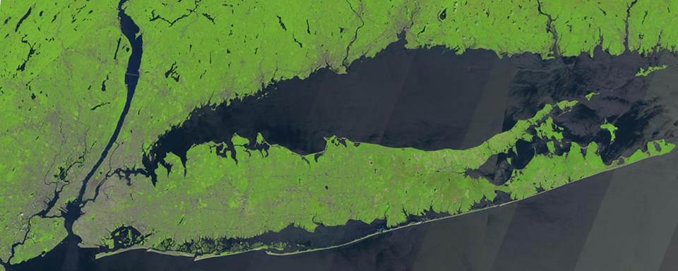
Verification of NAM-CMAQ/GSI
NOx emission
adjustment experiments
Airborne remote sensing measurements during the 2018
Long Island Sound Tropospheric Ozone Study (LISTOS)

Slide 9
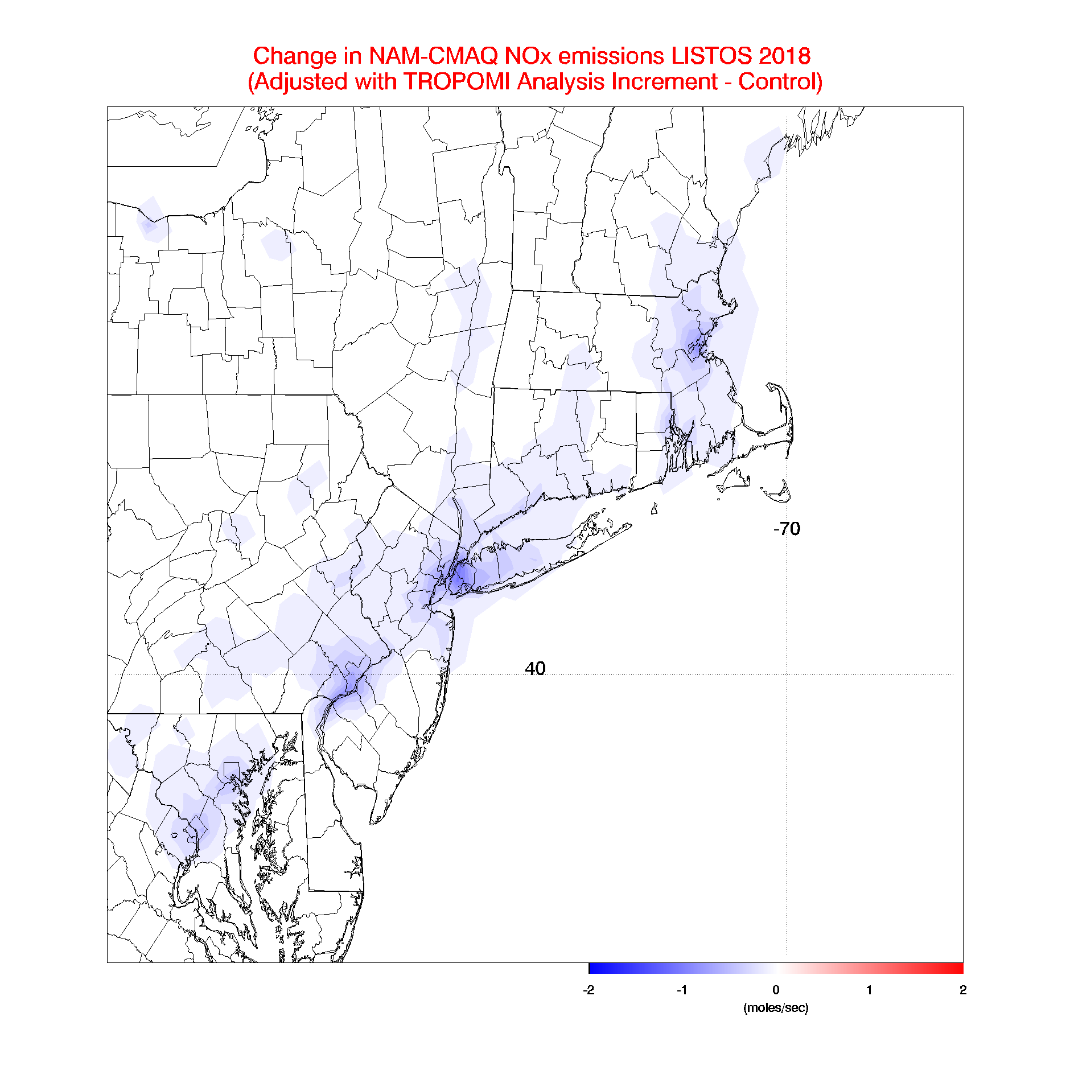
NAM-CMAQ/GSI NOx emission adjustment experiments
Calculate monthly mean NO₂ Jacobian (β) from a 15% NO_{X} emission reduction perturbation experiment following Lamsal et al. 2011
Calculate monthly mean NO₂ analysis increment using NAM-CMAQ/GSI TROPOMI NO₂ assimilation
  NOx emission sensitive background errors (to correct NAM-CMAQ emissions)
Adjust NAM-CMAQ NO_{x} emissions using Jacobian and average analysis increment
  Only adjust daytime emissions since TROPOMI does not provide nightime constraints
Assimilation of TropOMI NO2 results in (~20%) reductions in NOx emissions over NYC during July-August 2018
  Delta NAM-CMAQ NOx emissions July-August 2018
Lamsal, L. N., et al. (2011), Application of satellite observations for timely updates to global anthropogenic NOx emission inventories, Geophys. Res. Lett., 38, L05810, doi:10.1029/2010GL046476.

Slide 10
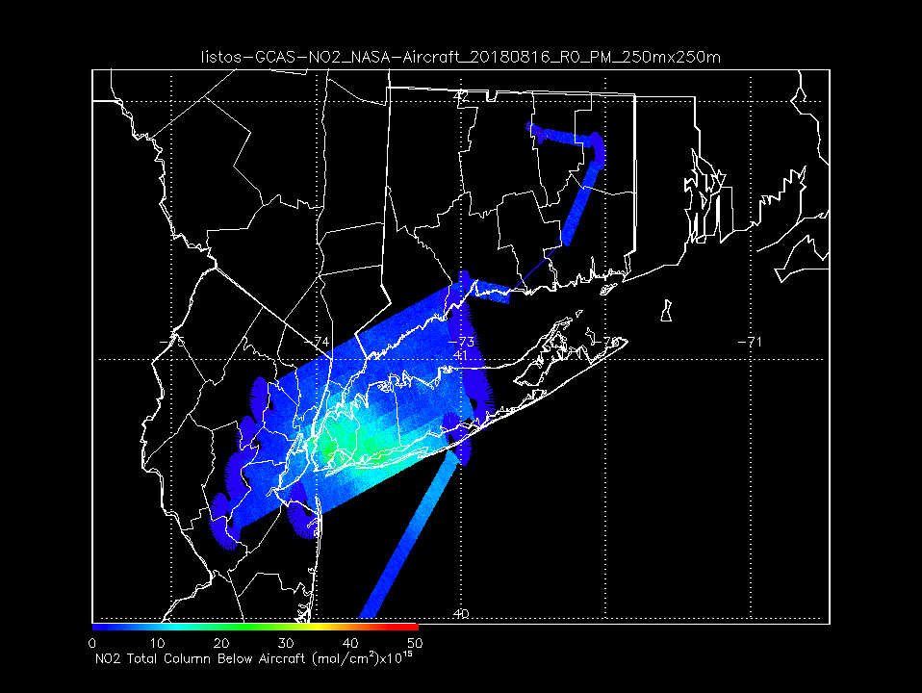
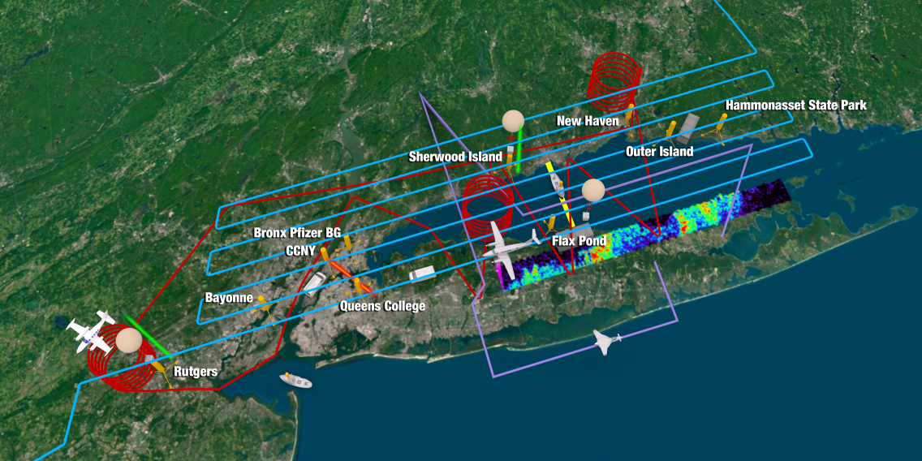
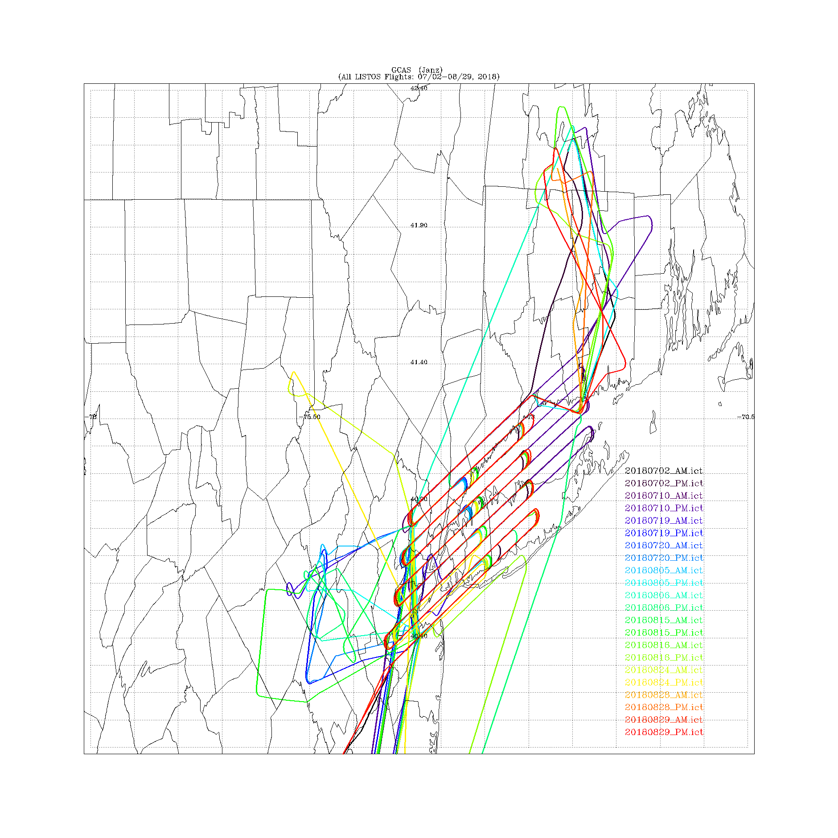
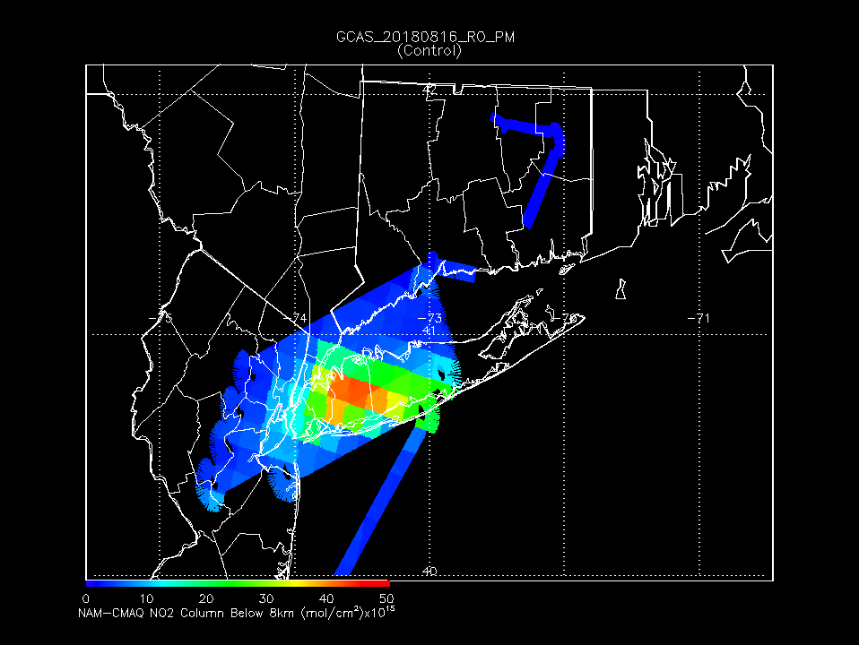
GCAS NO2 Column 08/16/2018 PM
Long Island Sound Tropospheric Ozone Study (LISTOS)
https://www-air.larc.nasa.gov/missions/listos/index.html
GCAS (Janz) LISTOS Flights: 07/02-08/29, 2018
NAM-CMAQ control NO2 column is significantly higher than GCAS
NAM-CMAQ (Control) NO2 Column 08/16/2018 PM
Geostationary Coastal and Air Pollution Events Airborne Simulator (GCAS, PI Scott Janz/NASA GSFC)
total column NO2 retrievals provided by Laura Judd (NASA/LARC)

Slide 11
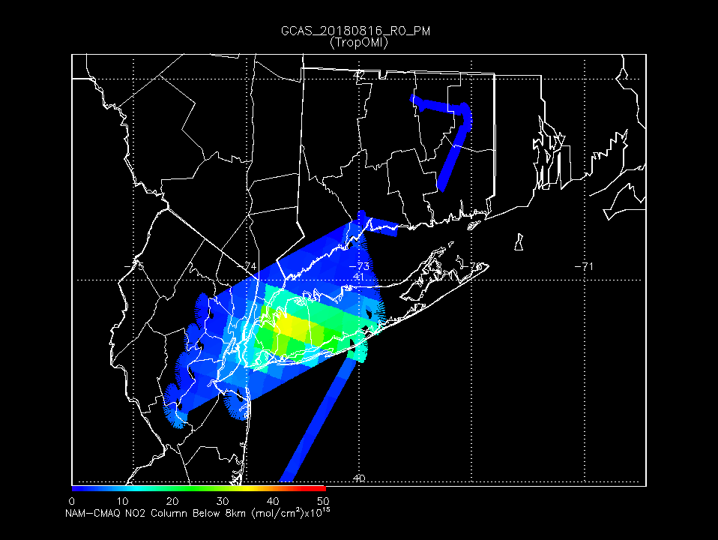
GCAS NO2 Column 08/16/2018 PM
Long Island Sound Tropospheric Ozone Study (LISTOS)
https://www-air.larc.nasa.gov/missions/listos/index.html
GCAS (Janz) LISTOS Flights: 07/02-08/29, 2018
NAM-CMAQ TropOMI NO2 column is in better agreement with GCAS
NAM-CMAQ (TropOMI) NO2 Column 08/16/2018 PM
Geostationary Coastal and Air Pollution Events Airborne Simulator (GCAS, PI Scott Janz/NASA GSFC)
total column NO2 retrievals provided by Laura Judd (NASA/LARC)

Slide 12
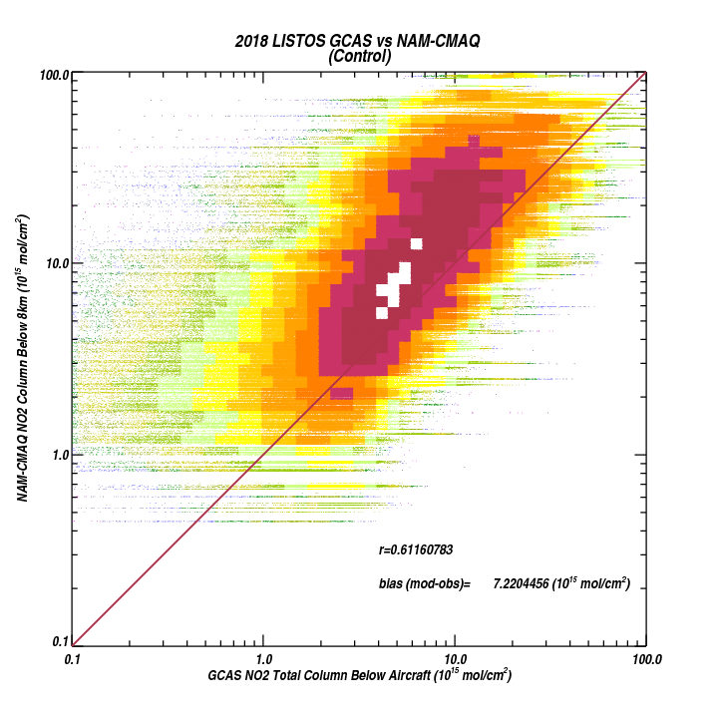
NAM-CMAQ control NO2 column is consistently significantly (7.22e¹⁵ mol/cm²) higher than GCAS
GCAS (Janz) LISTOS Flights: 07/02-08/29, 2018
Geostationary Coastal and Air Pollution Events Airborne Simulator (GCAS, PI Scott Janz/NASA GSFC)
total column NO2 retrievals provided by Laura Judd (NASA/LARC)

Slide 13
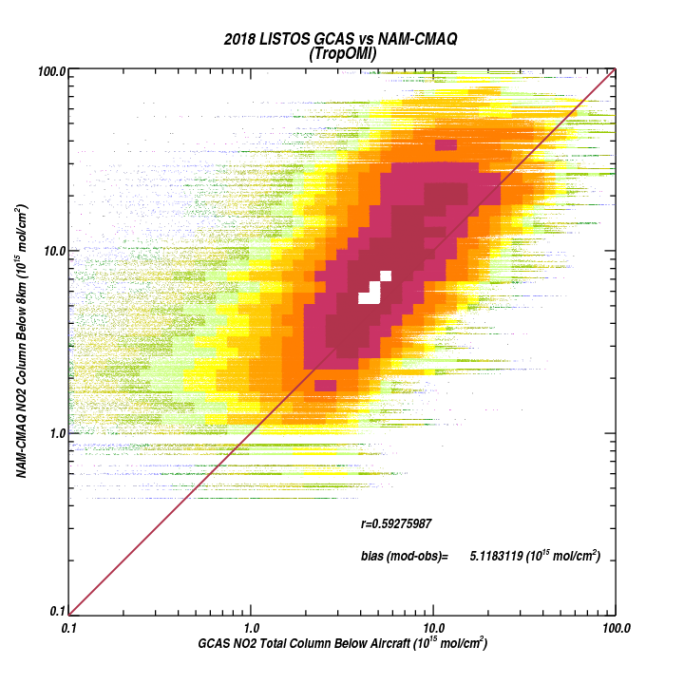
NAM-CMAQ TropOMI NO2 column is consistently (29% reduction in high bias) in better agreement with GCAS
GCAS (Janz) LISTOS Flights: 07/02-08/29, 2018
Geostationary Coastal and Air Pollution Events Airborne Simulator (GCAS, PI Scott Janz/NASA GSFC)
total column NO2 retrievals provided by Laura Judd (NASA/LARC)

Slide 14

Impact of NAM-CMAQ/GSI
NOx emission adjustment
on surface ozone predictions

Slide 15
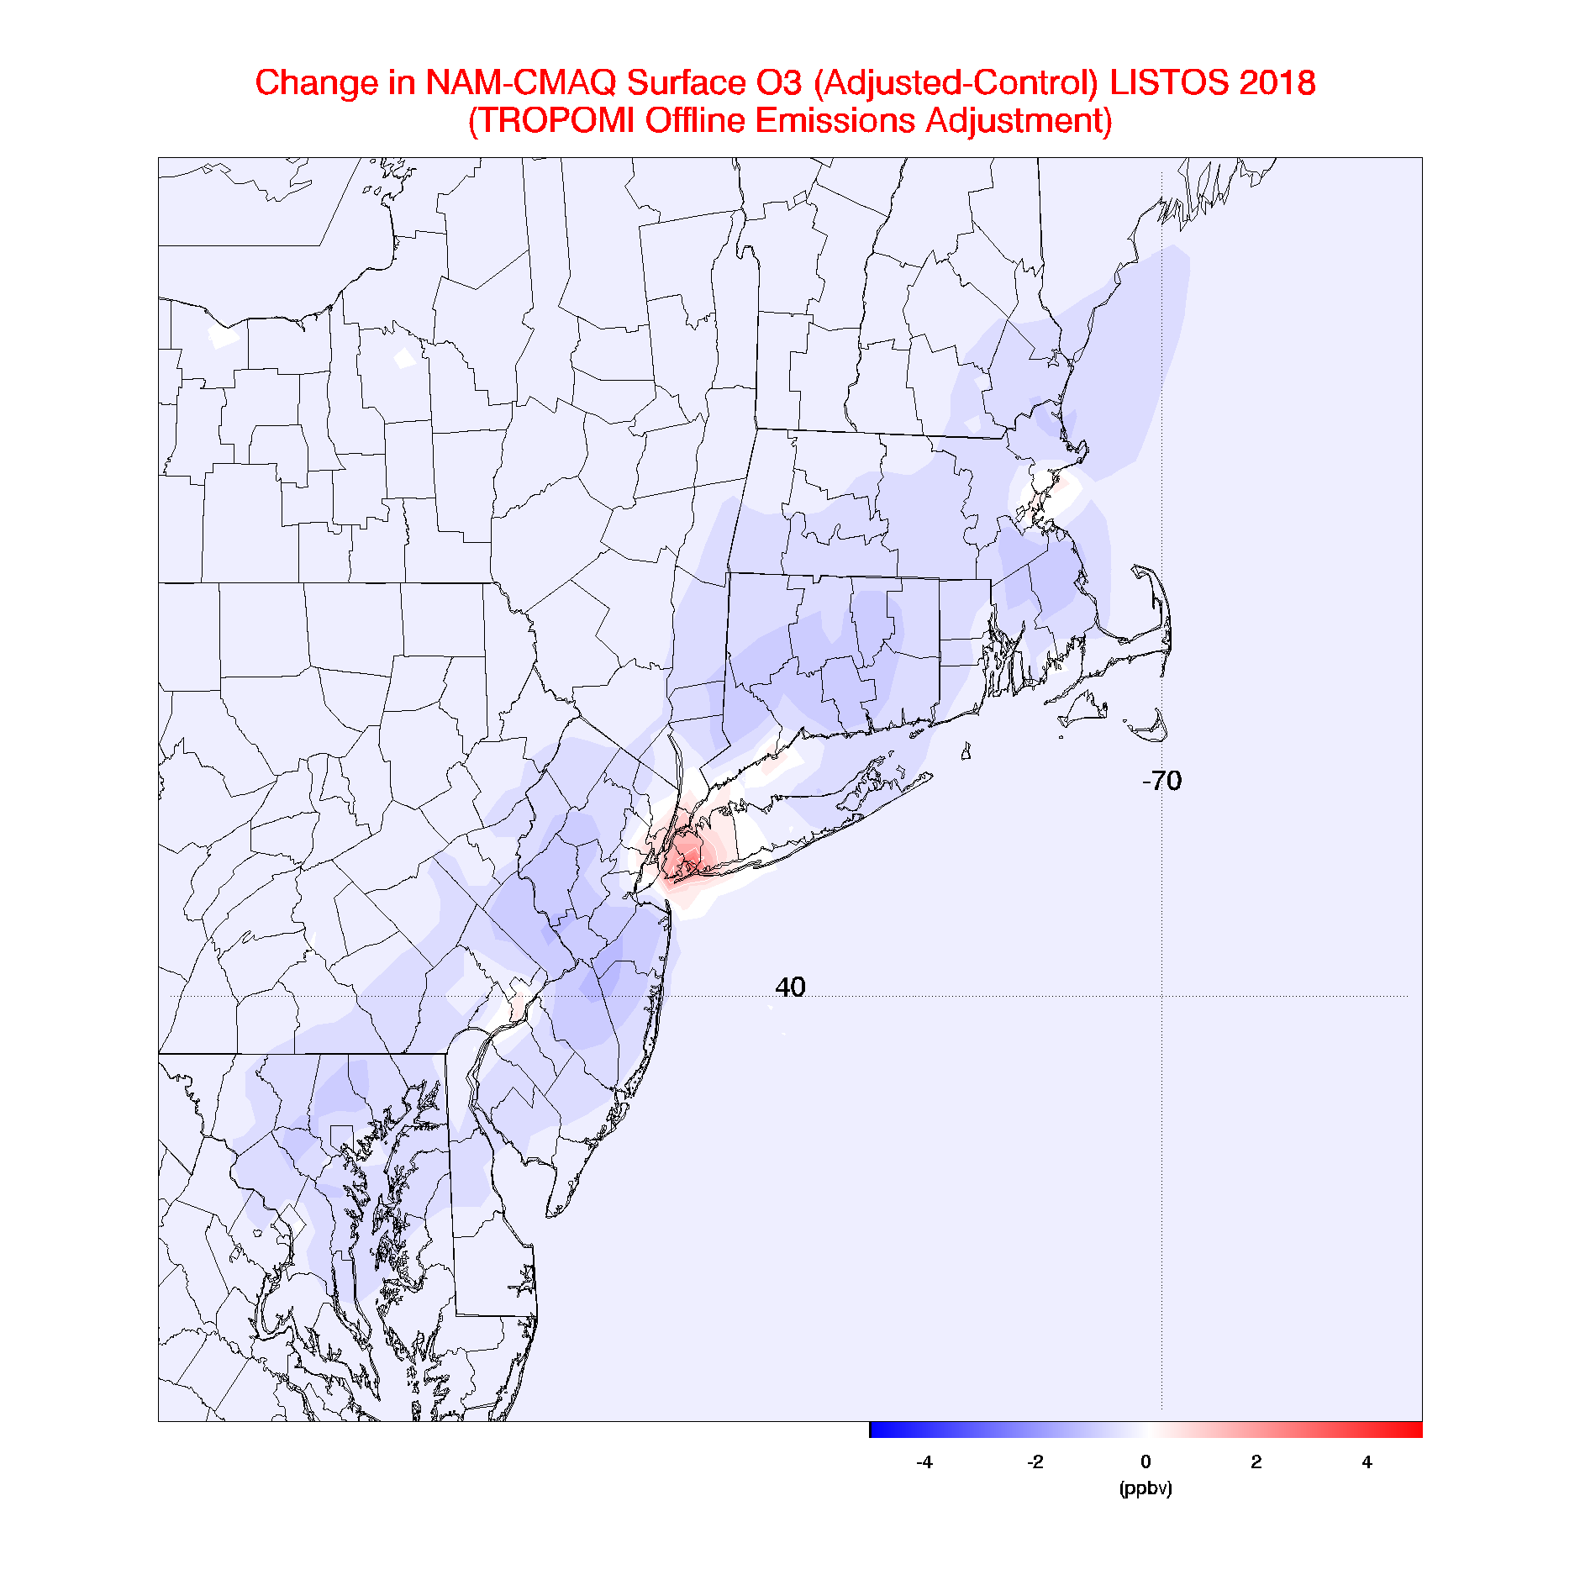
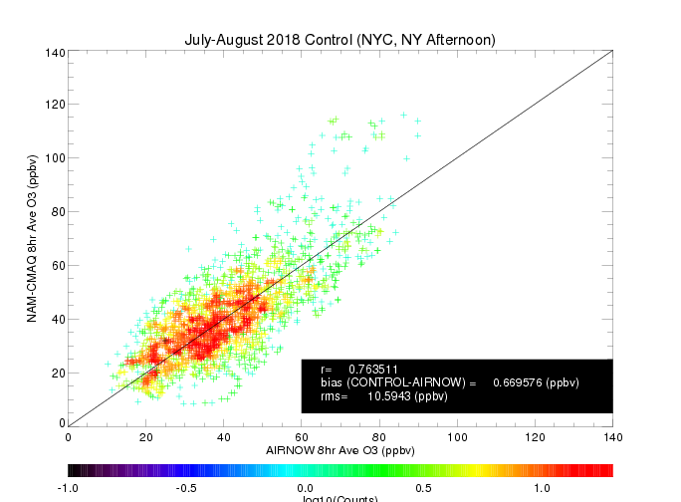
NAM-CMAQ surface ozone response to TropOMI offline NOx emission adjustment
Mean changes of + 2-4ppbv over Southern Long Island
Notes:
NAM-CMAQ TropOMI data assimilation experiments conducted by Allen Lenzen (UW-Madison/SSEC)

Slide 16
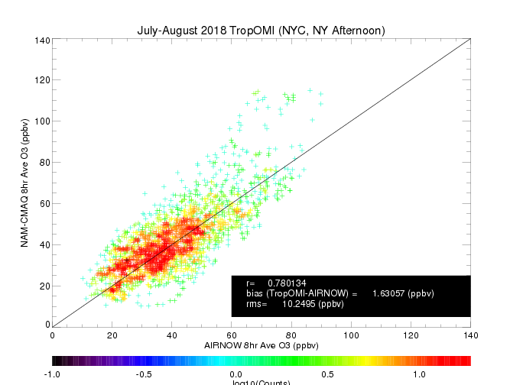
NAM-CMAQ surface ozone response to TropOMI offline NOx emission adjustment
Adjusted emissions result in an additional overestimate in 8hr averaged ozone relative to AIRNOW over NYC
Notes:
NAM-CMAQ TropOMI data assimilation experiments conducted by Allen Lenzen (UW-Madison/SSEC)

Slide 17
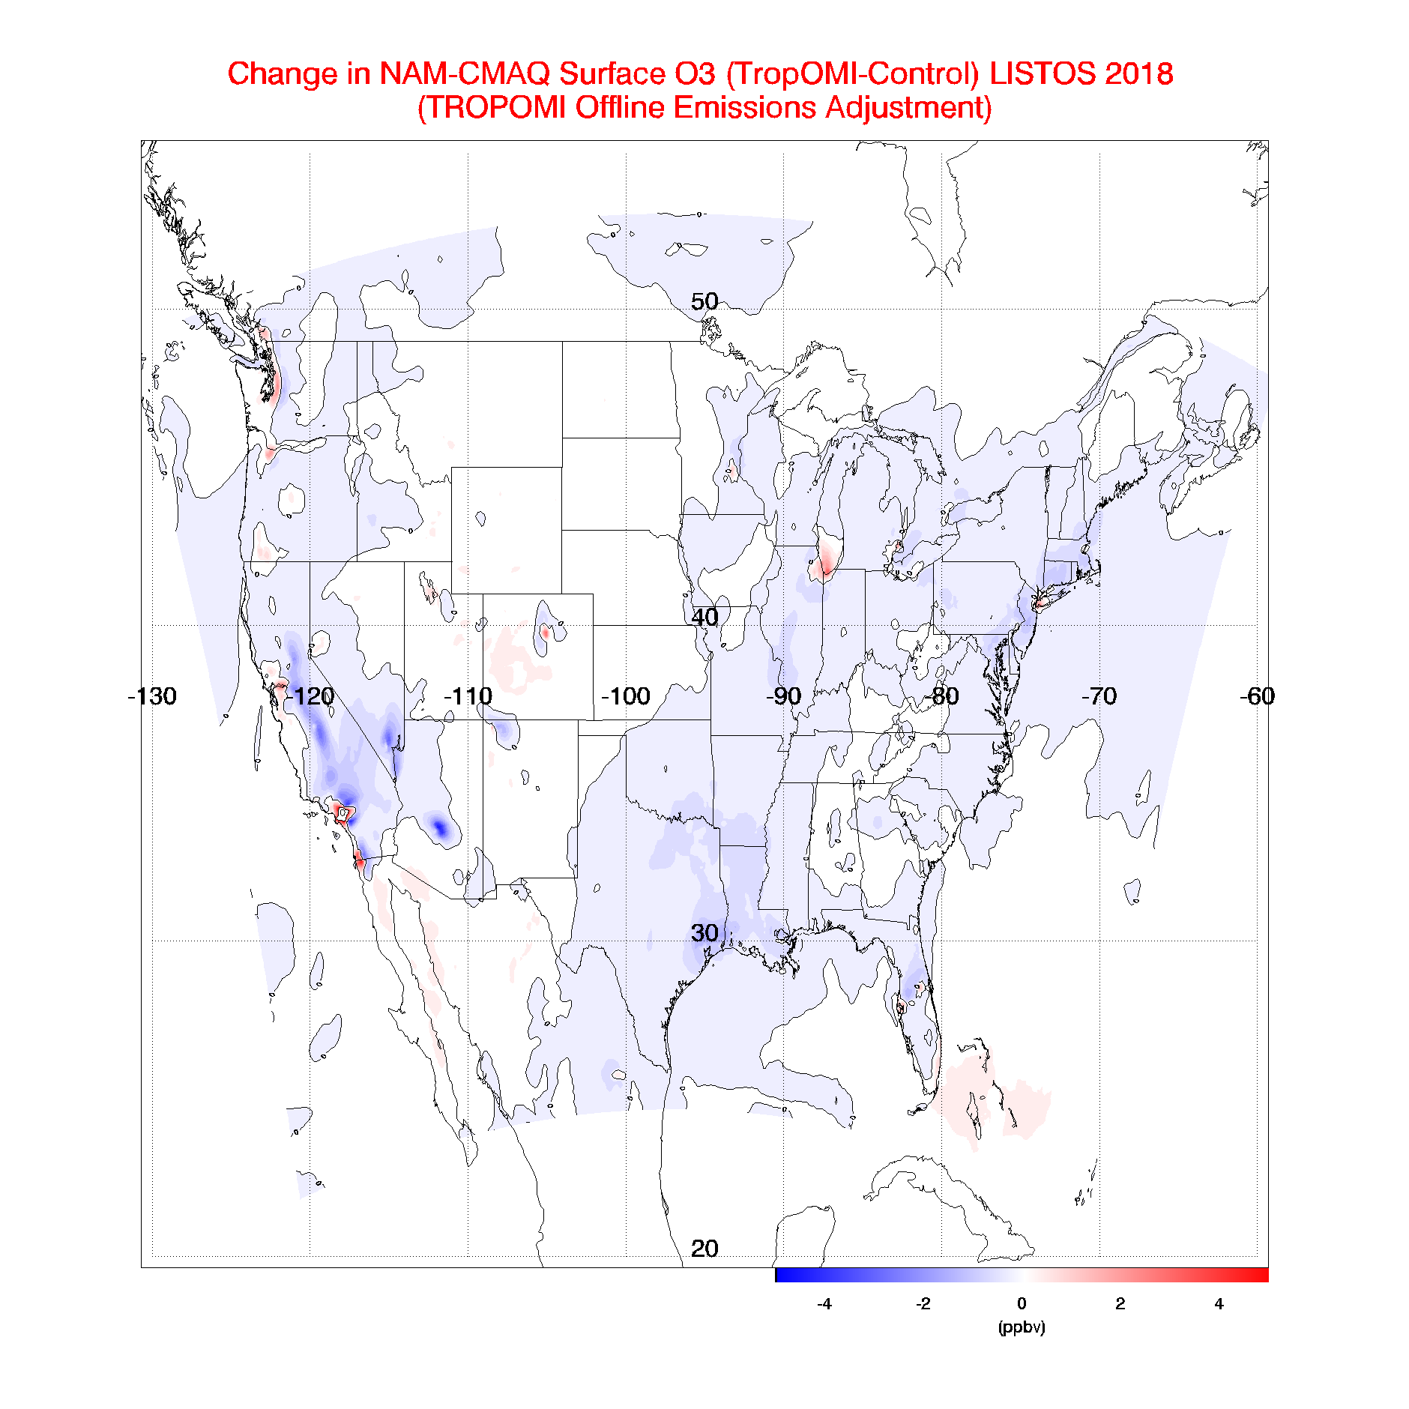
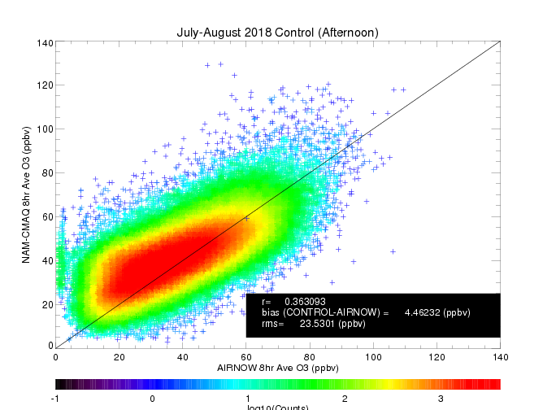
NAM-CMAQ surface ozone response to TropOMI offline NOx emission adjustment
Mean O3 changes of +/- 2-4ppbv in major urban areas over CONUS
Notes:
NAM-CMAQ TropOMI data assimilation experiments conducted by Allen Lenzen (UW-Madison/SSEC)

Slide 18

NAM-CMAQ surface ozone response to TropOMI offline NOx emission adjustment
Adjusted emissions result in neutral impacts for 8hr averaged ozone relative to AIRNOW over CONUS
Notes:
NAM-CMAQ TropOMI data assimilation experiments conducted by Allen Lenzen (UW-Madison/SSEC)

Slide 19
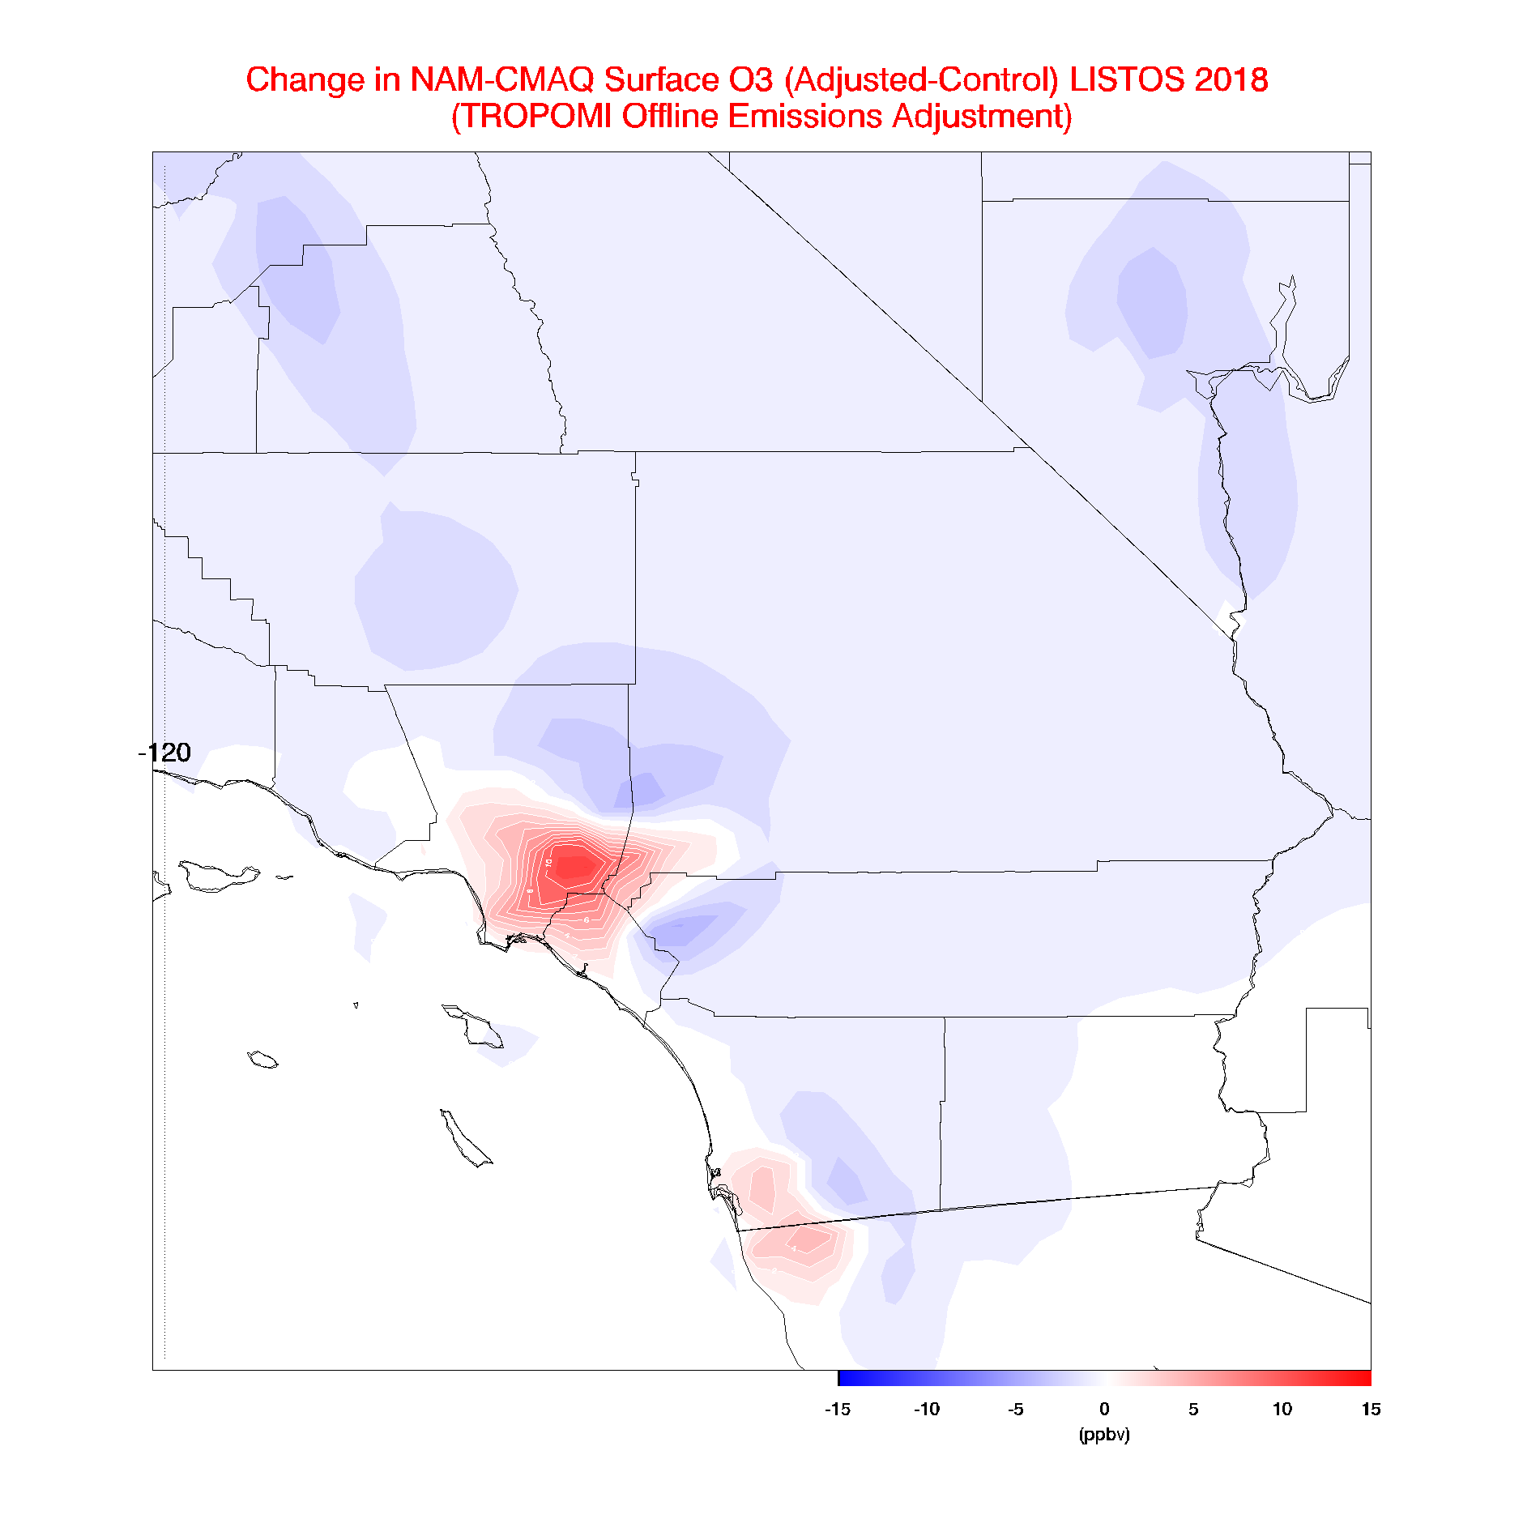
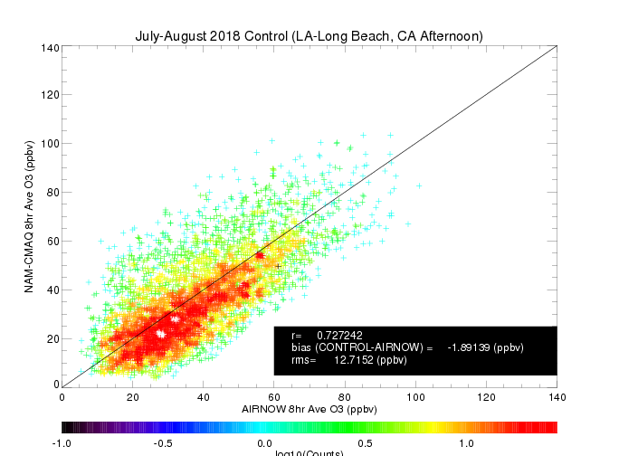
NAM-CMAQ surface ozone response to TropOMI offline NOx emission adjustment
Mean O3 changes of + 10-15 ppbv over LA-Long Beach
Notes:
NAM-CMAQ TropOMI data assimilation experiments conducted by Allen Lenzen (UW-Madison/SSEC)

Slide 20

NAM-CMAQ surface ozone response to TropOMI offline NOx emission adjustment
Adjusted emissions result in reduced biases in 8hr averaged ozone relative to AIRNOW over LA- Long Beach, CA
Notes:
NAM-CMAQ TropOMI data assimilation experiments conducted by Allen Lenzen (UW-Madison/SSEC)

Slide 21
Summary and Conclusions
An off-line approach to adjusting NAM-CMAQ NOx emissions has been demonstrated using TropOMI NO2 retrievals during July-August 2018
  Adjustment results in reductions in NAM-CMAQ NOx emissions within large urban centers
  Adjusted emissions result in improved agreement with GCAS NO2 columns over NYC during the LISTOS campaign
Surface ozone concentrations generally increase within large urban centers
  Adjusted emissions result in neutral impacts of 8hr averaged ozone predictions compared to AIRNOW measurements
  Some urban centers (NYC) show negative impacts while some urban centers (LA) show positive impacts
This work was supported by FY18 NOAA/NESDIS Office of Projects, Planning and Analysis (OPPA) Technology Maturation Program (TMP) Funding

Slide 22
Extra Slides

Slide 23
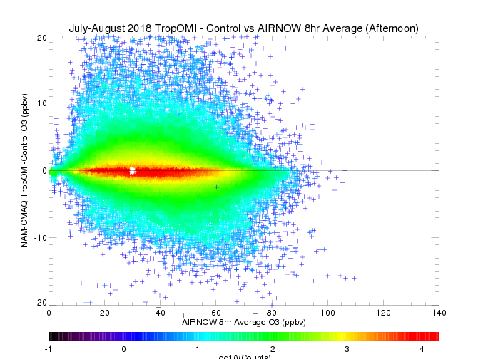
NAM-CMAQ surface ozone response to TropOMI offline NOx emission adjustment
Adjusted emissions result in neutral impacts for 8hr averaged ozone relative to AIRNOW over CONUS
Notes:
NAM-CMAQ TropOMI data assimilation experiments conducted by Allen Lenzen (UW-Madison/SSEC)

Slide 24
Improvement to TROPOMI with higher spatial resolution a priori NO₂ profile shape from NAM-CMAQ
10 instruments July-August, 2018
Standard TROPOMI RPRO v1.2.2. v. Pandora
TROPOMI-NAMCMAQ v. Pandora
3 months of data
3 months of data
Preliminary results
Slide prepared by Laura Judd, NASA LaRC
Notes:
You don’t need to show this unless you want to (or use it instead of the other scatter plot). I just wanted to share this so you see what I used the curtain data for last week!
TROPOMI-NAMCMAQ is the TROPOMI column with a recalculated AMF using the NAM-CMAQ a priori profile shape.
If you can think of a model data source where we could get more consistent profile shapes, let me know! I am very interested to continue something like this.

