Slide 1
Determination of Greenhouse Gas Profiles from Ground-based Infrared Radiance Measurements
W. L. Smith Sr.^{1,2}, L. Rochette³, R. B. Pierce⁴
¹Hampton University – Hampton VA USA
²University of Wisconsin – Madison WI. USA
³LRTec – Quebec QC CA
⁴NOAA/NESDIS – Madison WI. USA
AERI (1990)
ASSIST (2008)
Ground-based
Wavenumber (cm⁻¹)
Spectral Coverage
"Imaging Spectrometry XVII” 13 – 16 August 2012
San Diego California

Slide 2
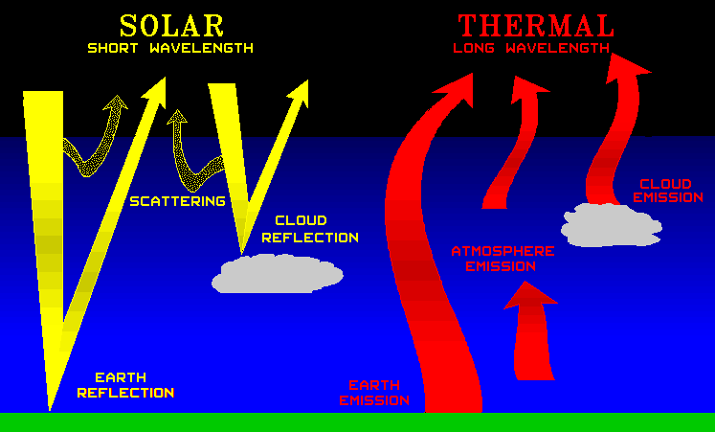
Radiative Processes
D
I
R
E
C
T

Slide 3
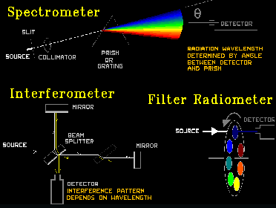
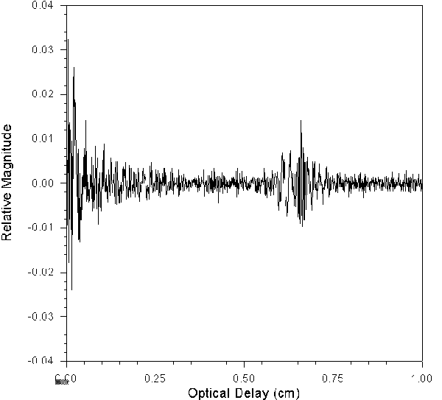
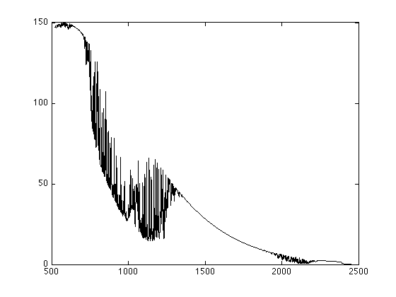
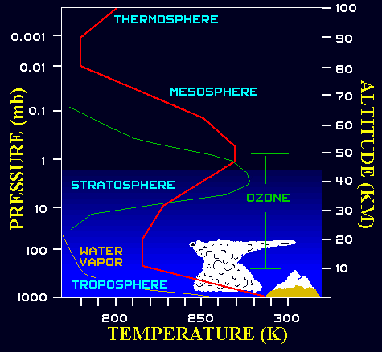
FTS Measurement to Atmospheric Variables
Michelson Interferometer (FTS)
Interferogram
Fixed Mirror
d₁
Source
Beam
Splitter
Moving
Mirror
d2
(d₂-d₁)
Detector
Fourier Transformation
Brightness Temperature (°K)
Radiance (mw/(m²-str-cm⁻¹)
Numerical
Inversion
Vertical Sounding
Wavenumber (cm⁻¹)
Radiance Spectrum

Slide 4
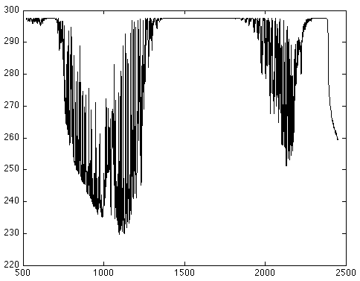
Brightness Temperature/Radiance Spectrum
CO₂
H₂O
CO₂
N₂O
CO
Brightness Temperature (°K)
CH₄
Radiance (mw/(m²-str-cm⁻¹)
H₂O
CH₄
N₂O
N₂O
CO₂
H₂O
H₂O
N₂O
H₂O
O₃
O₃
H₂O
CO
CO₂
Wavenumber (cm⁻¹)
Wavenumber (cm⁻¹)

Slide 5
Jacobian (Radiance Sensitivity)
ΔR_{i} = Σ(dR_{i}/dQ_{j}) ΔQ_{j}
j
Where;
Q_{i} = Temperature, H₂O, O₃, CO, CH₄, and
N₂O concentration, and Aerosol Extinction.

Slide 6
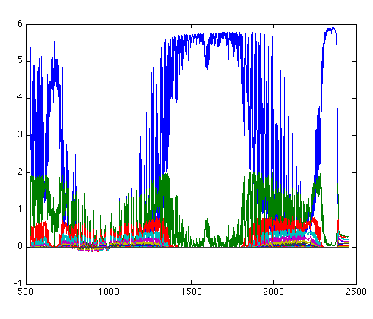
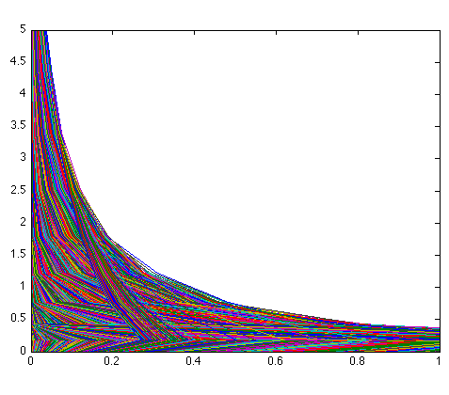
Ground-based ASSIST
Retrieval Sensitivity to Trace Gases
Brightness Temperature/Temperature Jacobian
Jacobian (°K/°K-km)
Altitude (km)
Wavenumber (cm⁻¹)
Jacobian (°K/°K-km)
Wide spectral contribution
Sensitivity strong (>0.2) below 2-km

Slide 7
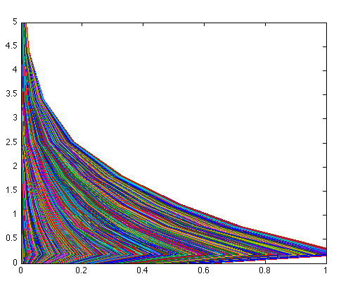
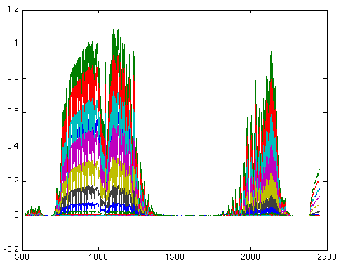
Ground-based ASSIST
Retrieval Sensitivity to Trace Gases
Brightness Temperature/Water Vapor Jacobian
Jacobian (°K/%-km)
Altitude (km)
Wavenumber (cm⁻¹)
Jacobian (°K/%-km)
Moderate wide spectral contribution
Sensitivity strong (>0.2) below 3-km

Slide 8
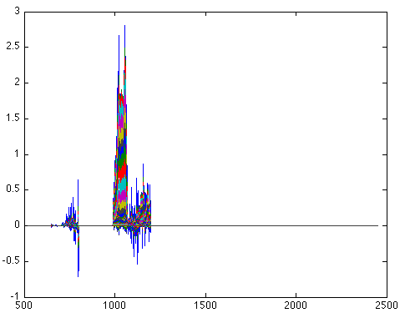
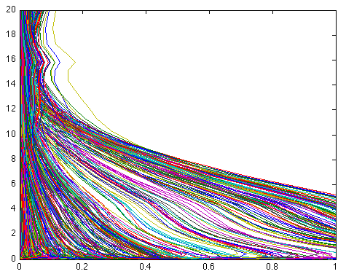
Ground-based ASSIST
Retrieval Sensitivity to Trace Gases
Brightness Temperature/Ozone Jacobian
Jacobian (°K/%-km)
Altitude (km)
Wavenumber (cm⁻¹)
Jacobian (°K/%-km)
Isolated moderate longwave spectral contribution
Sensitivity strong (>0.2) below 10-km

Slide 9
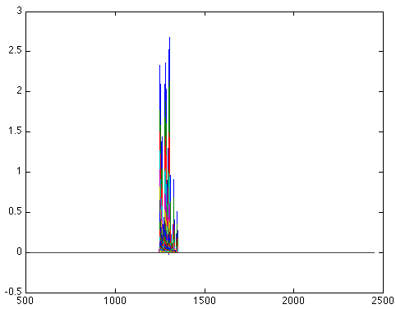
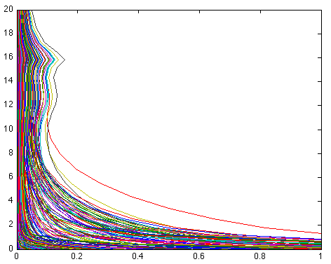
Ground-based ASSIST
Retrieval Sensitivity to Trace Gases
Brightness Temperature/Methane Jacobian
Jacobian (°K/%-km)
Altitude (km)
Wavenumber (cm⁻¹)
Jacobian (°K/%-km)
Isolated moderate midwave contribution
Sensitivity strong (>0.2) below 4-km

Slide 10
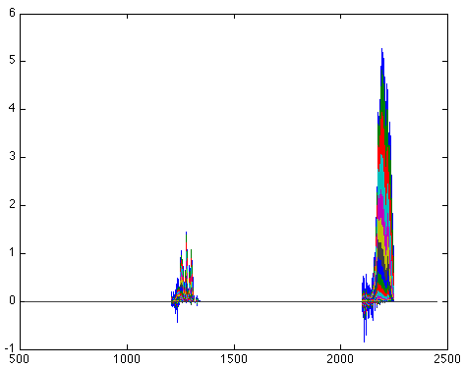
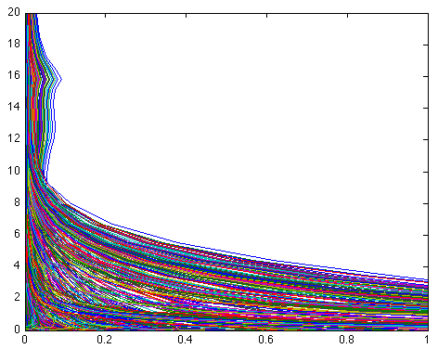
Ground-based ASSIST
Retrieval Sensitivity to Trace Gases
Brightness Temperature/Nitrous Oxide Jacobian
Jacobian (°K/%-km)
Altitude (km)
Wavenumber (cm⁻¹)
Jacobian (°K/%-km)
Weak isolated midwave + strong shortwave spectral contribution
Sensitivity strong (>0.2) below 2-km

Slide 11
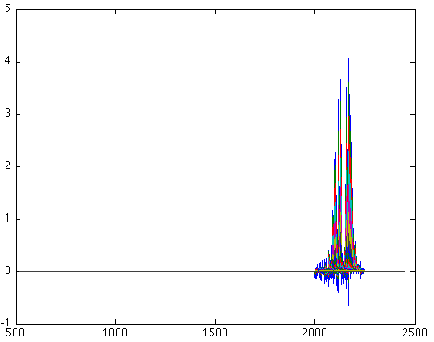
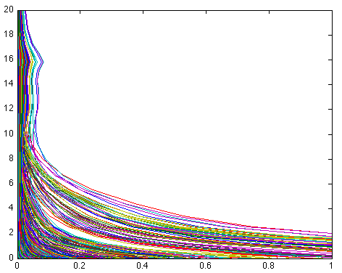
Ground-based ASSIST
Retrieval Sensitivity to Trace Gases
Brightness Temperature/Carbon Monoxide Jacobian
Jacobian (°K/%-km)
Altitude (km)
Wavenumber (cm⁻¹)
Jacobian (°K/%-km)
Isolated strong shortwave spectral contribution
Sensitivity strong (>0.2) below 6-km

Slide 12
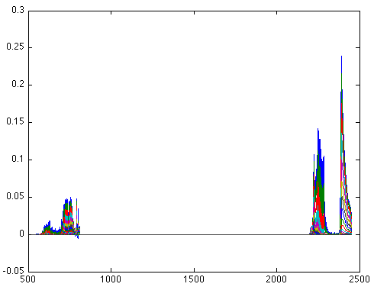
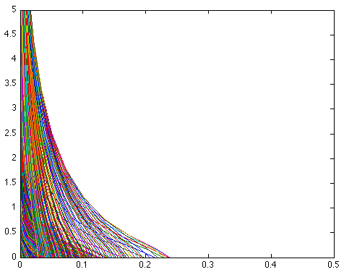
Ground-based ASSIST
Retrieval Sensitivity to Trace Gases
Brightness Temperature/Carbon Dioxide Jacobian
Jacobian (°K/%-km)
Altitude (km)
Wavenumber (cm⁻¹)
Jacobian (°K/%-km)
Weak longwave and shortwave spectral contribution
Sensitivity strong (>0.2) below 0.5 km

Slide 13
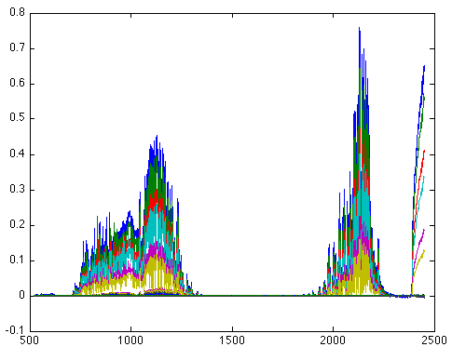
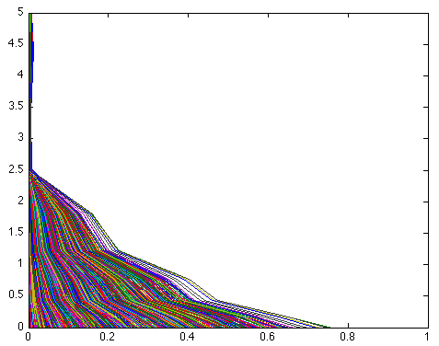
Ground-based ASSIST
Retrieval Sensitivity to Trace Gases
Brightness Temperature/Aerosol Jacobian
Jacobian (°K/%-km)
Altitude (km)
Wavenumber (cm⁻¹)
Jacobian (°K/%-km)
Weak longwave and shortwave “window” spectral contribution
Sensitivity strong (>0.2) below 1-km

Slide 14
Greenhouse Gas Physical Regression (PR) Retrieval Methodology
Q_{ret} = q_{o} + (r_{m}-r_{o})C
C = (R’^{T}R’ + λE^{T}E)⁻¹R’^{T}Q’
q = atmospheric profiles (temperature, water vapor, etc.)
C = statistical covariance about the initial profile q_{o}
r_{o} = radiance calculated from the initial profile q_{o}
Q & R = climatological ensemble of profiles & radiance spectra
( )’ = deviation from the initial conditions q_{o} and r_{o}
E^{T}E = statistical covariance of spectral radiance noise
λ = scaler determined as that value which minimizes the
RMS difference between the retrieval calculated radiance
spectrum and observed radiance spectrum

Slide 15
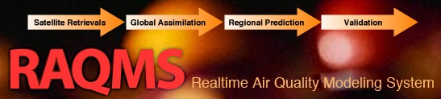
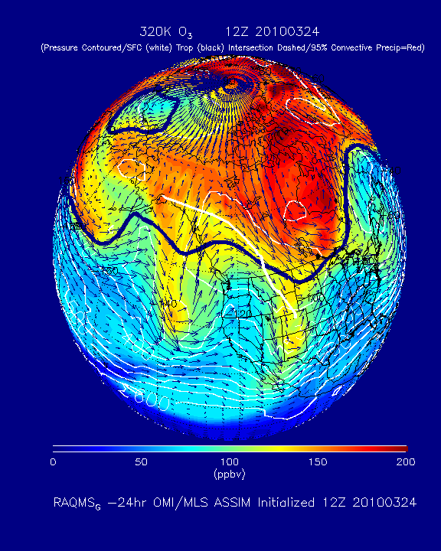
Statistical Data For C-Matrix
Year 2010 Global Product
3,110,400 Space/Time Samples
1-deg Resolution
Monthly Day 15, 0, 6 12, 18 GMT
T, H₂O, O₃, CO, CH₄, N₂O Profiles
Aerosol Extinction Profiles
CO₂ uniformly mixed, randomly varied
Cloud Altitude/Optical Depth Profiles
Separated Into Seasonal/Regional Sets
http://www.esrl.noaa.gov/outreach/events/chemworkshop/pdf/Pierce_RAQMS.pdf

Slide 16
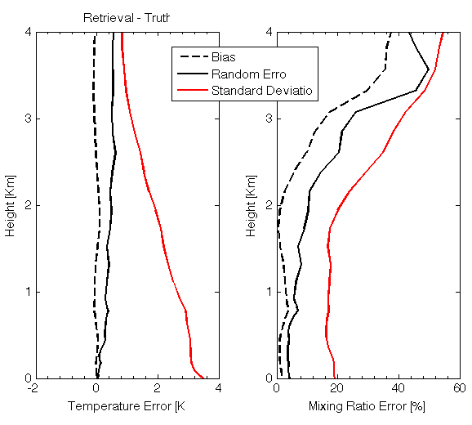
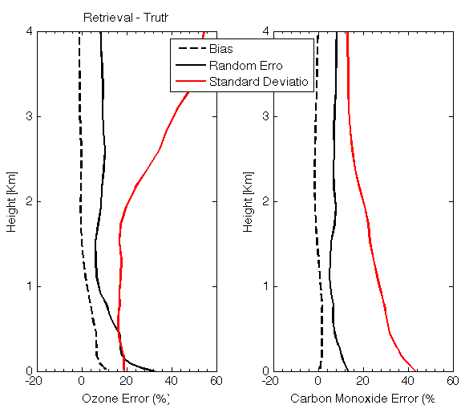
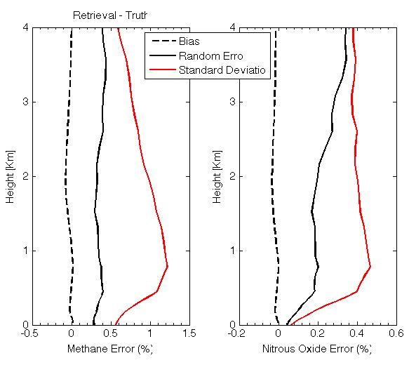
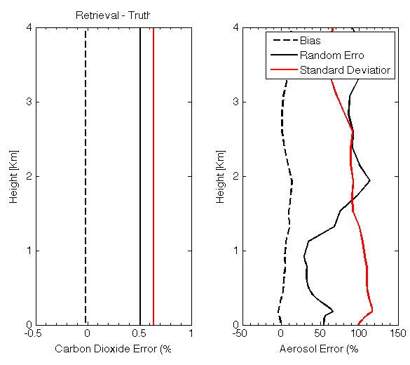
Profile Regression Retrieval Errors
T
H₂O
O₃
CO
CH₄
N2O
CO₂
Aerosol

Slide 17
Accounting for the Influence of Clouds
Cloud-Clearing Partly Cloudy Measurements (N* Method¹)
  N* equation solves for clear radiance from partly clouded IFOVs
  Assumes that only the cloud fraction changes between two IFOVs
t₁
t_{i}
t_{j}
t_{n}
R_{c}(w)
R_{c}(w)
Time (UT)
Time (UT)
¹ Smith, W. L. , 1968: An improved method for calculating tropospheric temperature and moisture from satellite radiometer measurements. Mon. Wea. Rev., 96, 387-396.

Slide 18
Producing Clouded Radiance Retrieval
Cloud Stratification
  Stratifies C-matrix by cloud level (10- cloud levels + clear)
  Define optimal cloud-level as that one for which:
  RMSD [T(p,P_{cld}) - T(p,R_{cc})] = Min
Procedure:
Calculate R_{cc} using the N* procedure outlined above.
Calculate T(p,P_{cld}) using the C-matrices for the 11 cloud altitude classes
For each cloud altitude class, compute the RMSD between T(p,P_{cld}) and T(p,R_{cc})
Assume that the correct cloud class is that one for which RMSD [T(p,P_{cld}) - T(p,R_{cc})] = Min
Set all profile values above the cloud level to be NaN (i.e., missing)

Slide 19
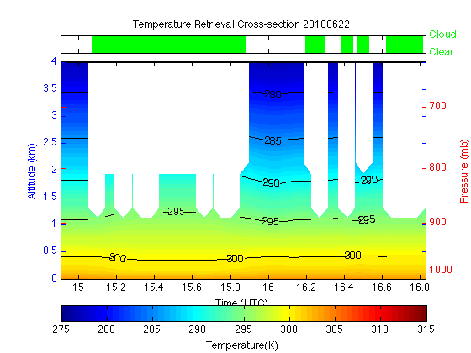
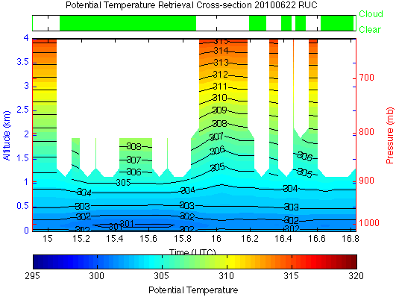
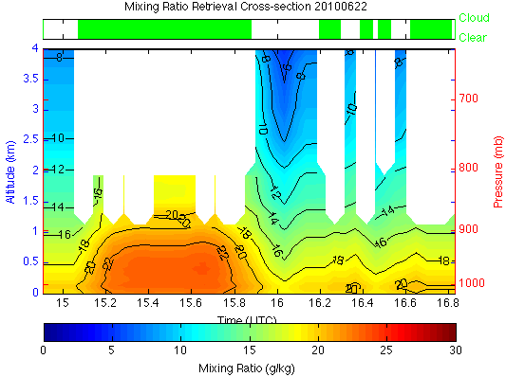
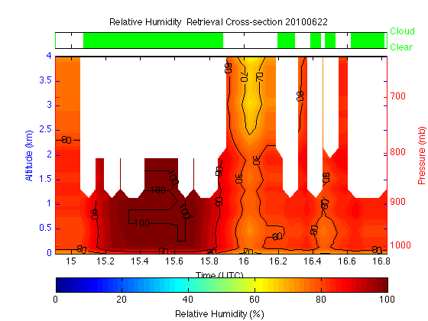
June 22, 2010 Cloudy Case Study
Temperature
Potential
Temperature
Mixing Ratio
Relative
Humidity

Slide 20
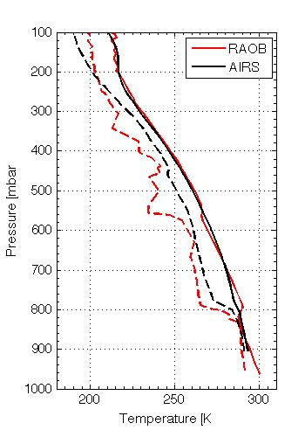
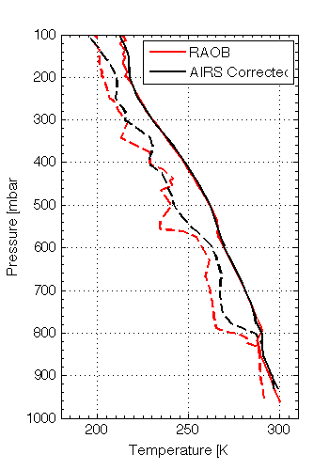
BIAS Corrections Using Forecast Model Profile
Problem: PR method uses a statistical training data set. Imperfect skill, due to lack of vertical resolution in radiances, leads to local bias in PR retrievals.
Solution: Calculate radiances from forecast model profile (FP) and perform PR retrieval using model radiances.
Statistical bias correction = FP – FP radiance retrieved FP
RTVL
Corrected RTVL
Bias
Corrected
Bias Correction removes statistical bias with respect to the model FP

Slide 21
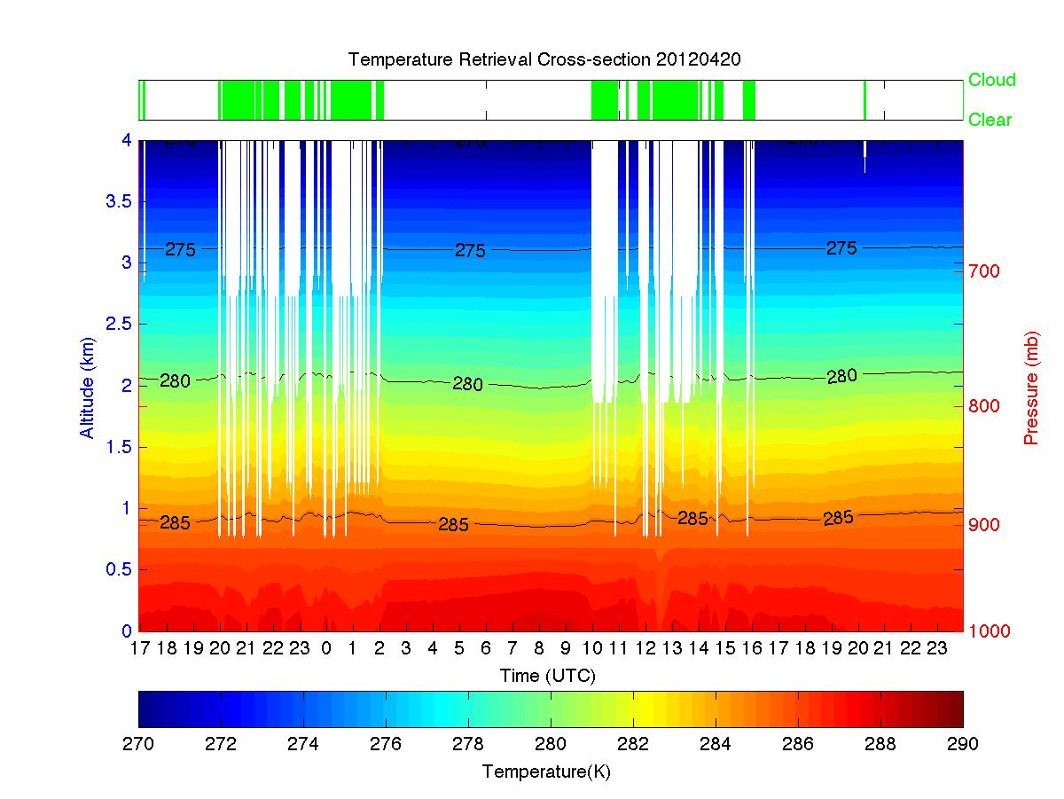
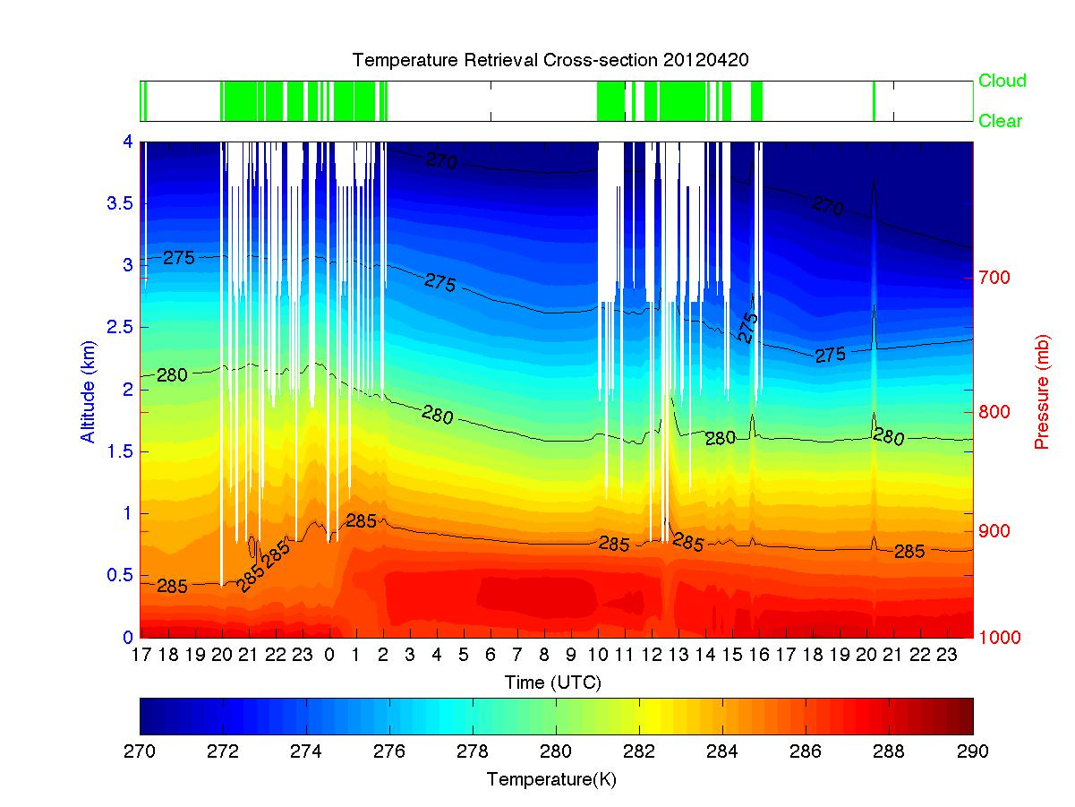
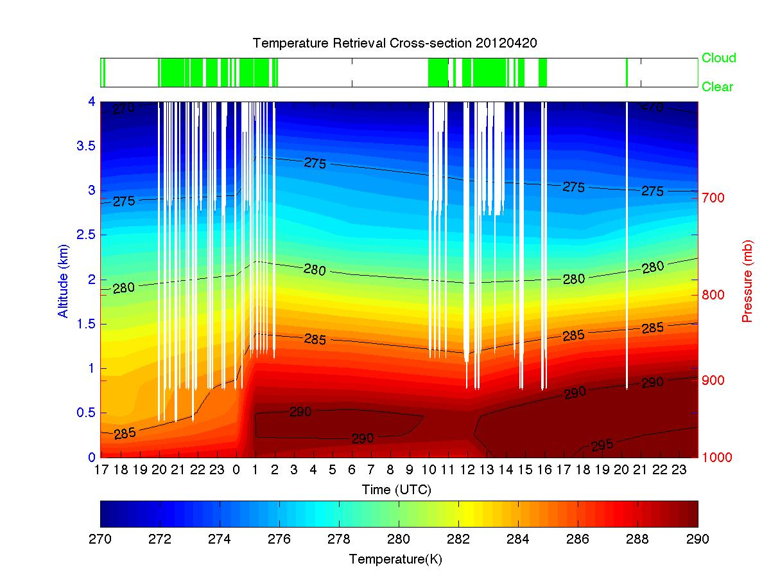
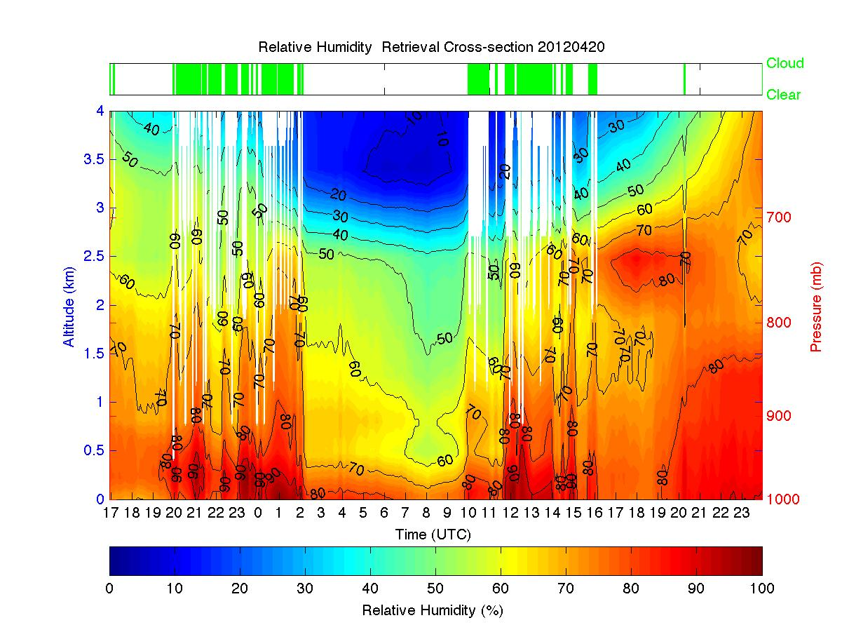
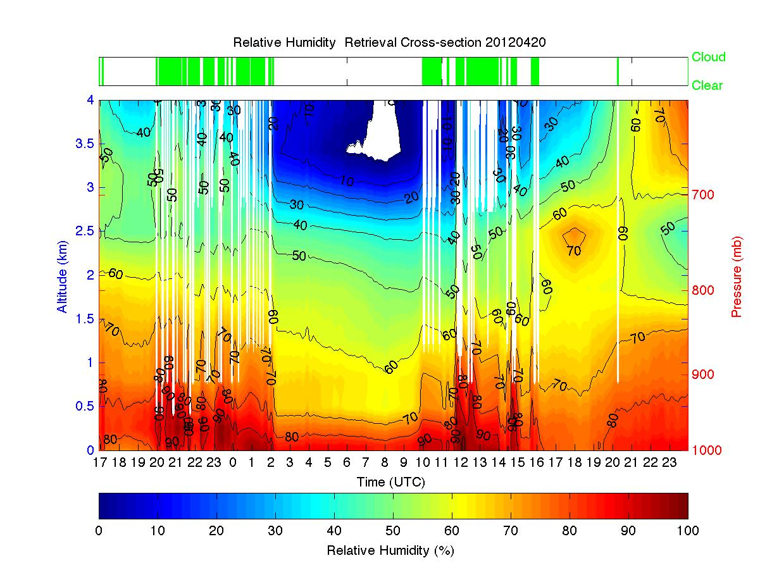
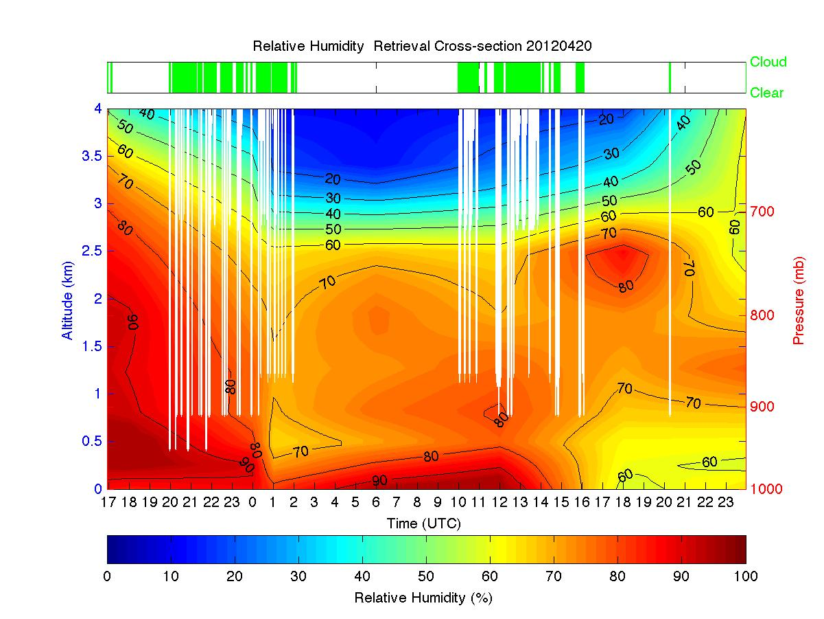
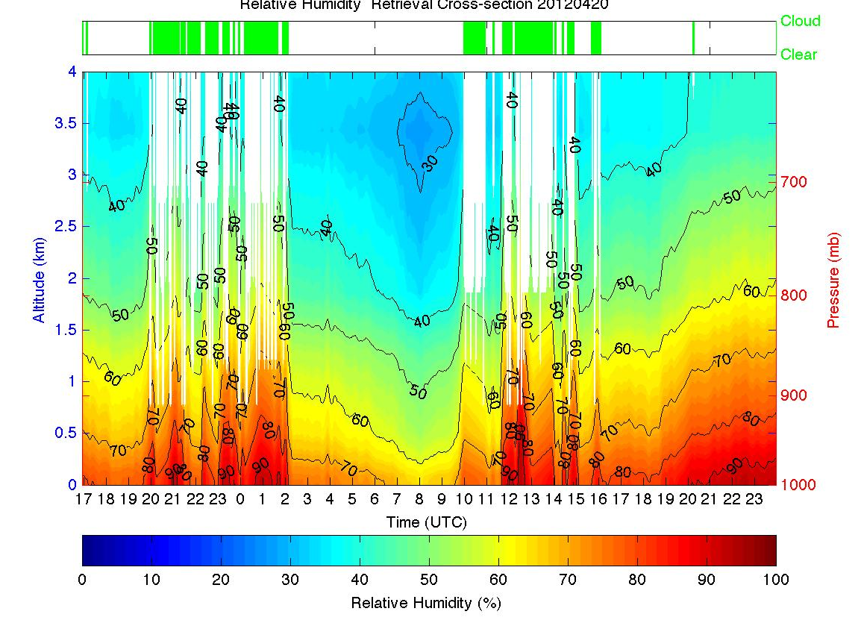
ASSIST Profile Results
April 19 17 UTC – April 21, 00 UTC
Temperature ( 0 – 4 km)
ASSIST - only
ASSIST w BIAS Correction
RAQMS
Relative Humidity ( 0 – 4 km)

Slide 22
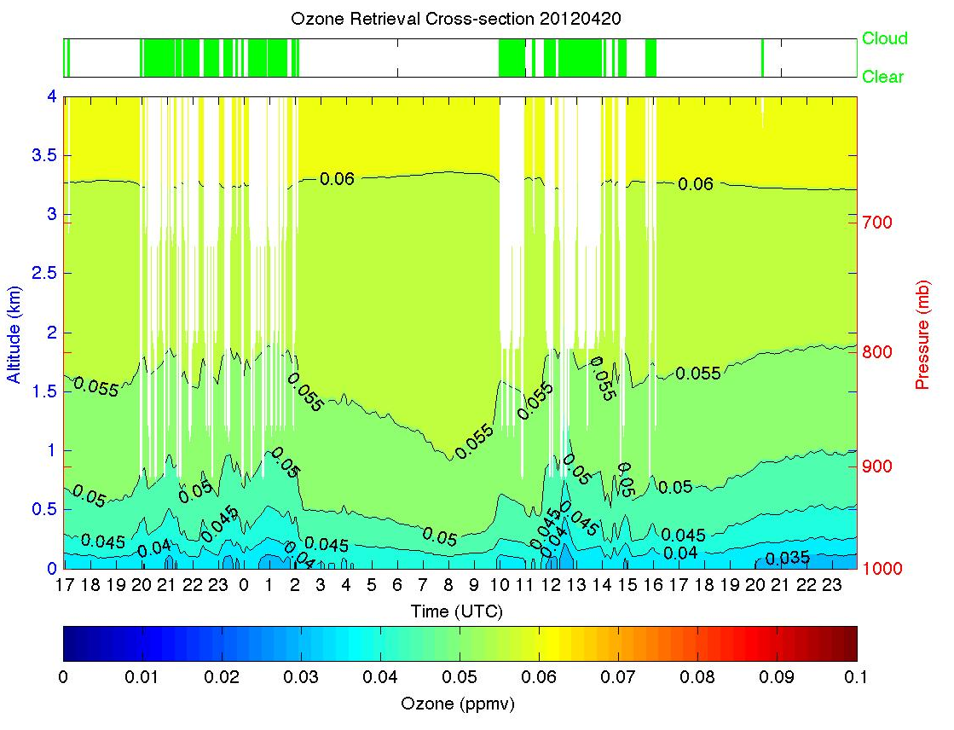
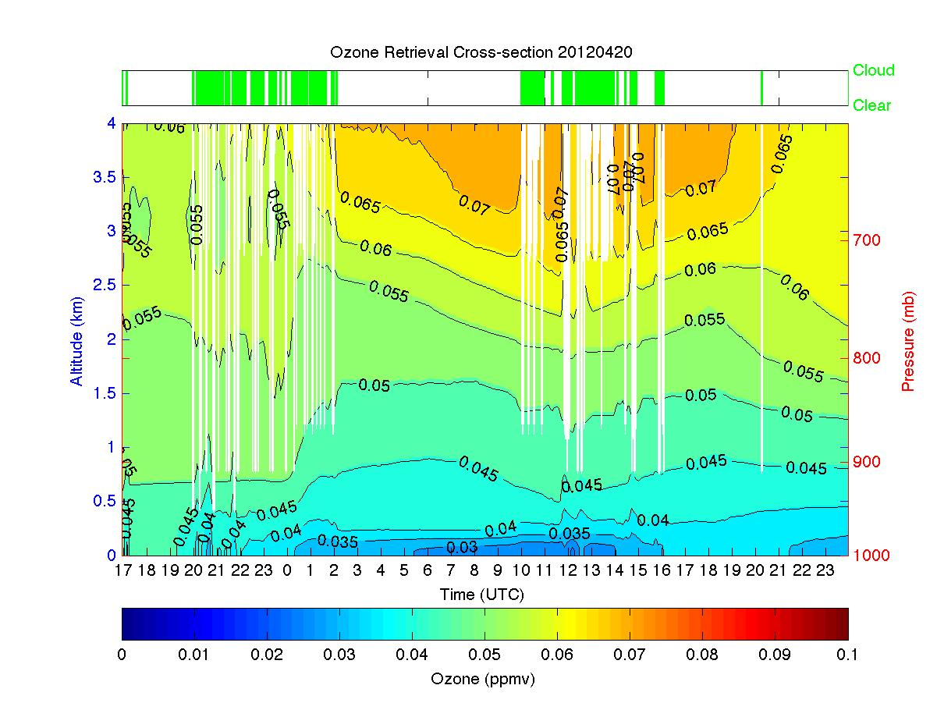
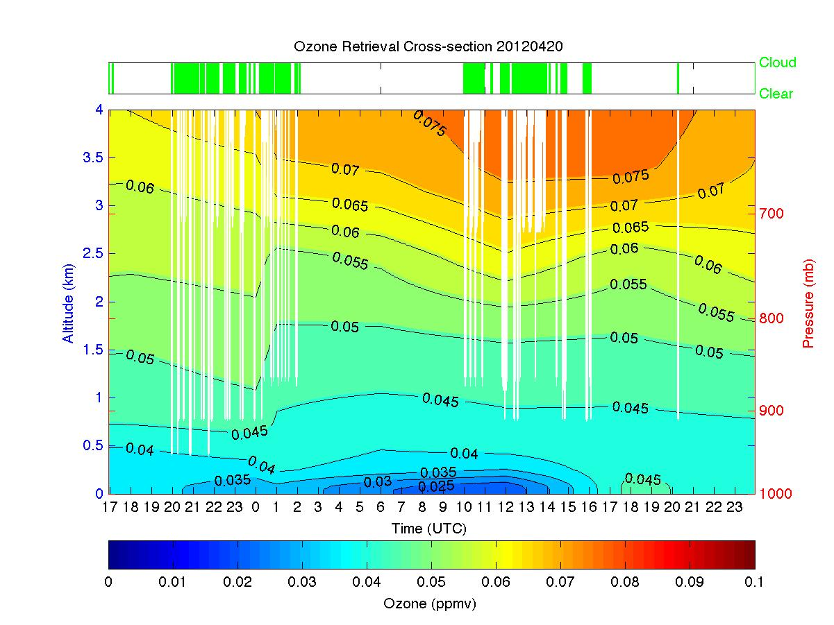
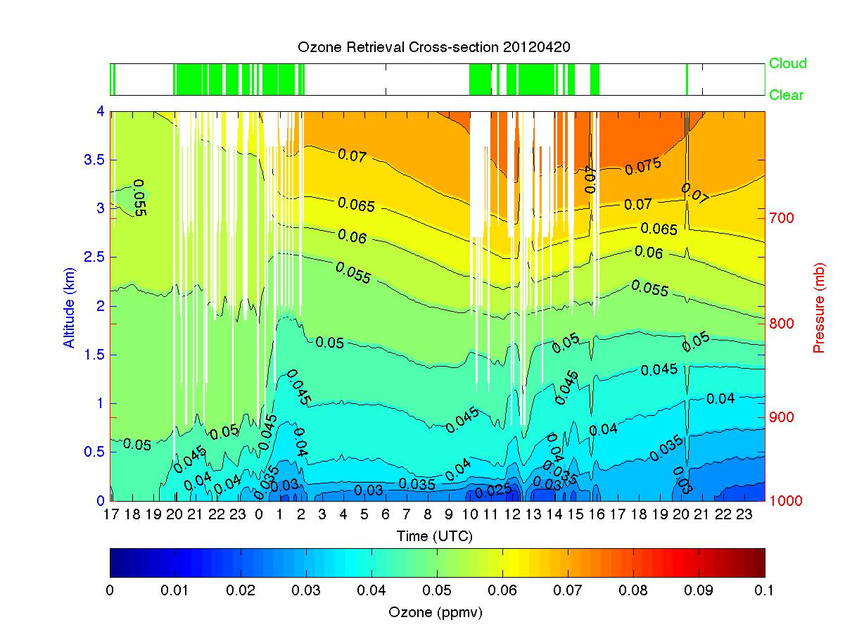
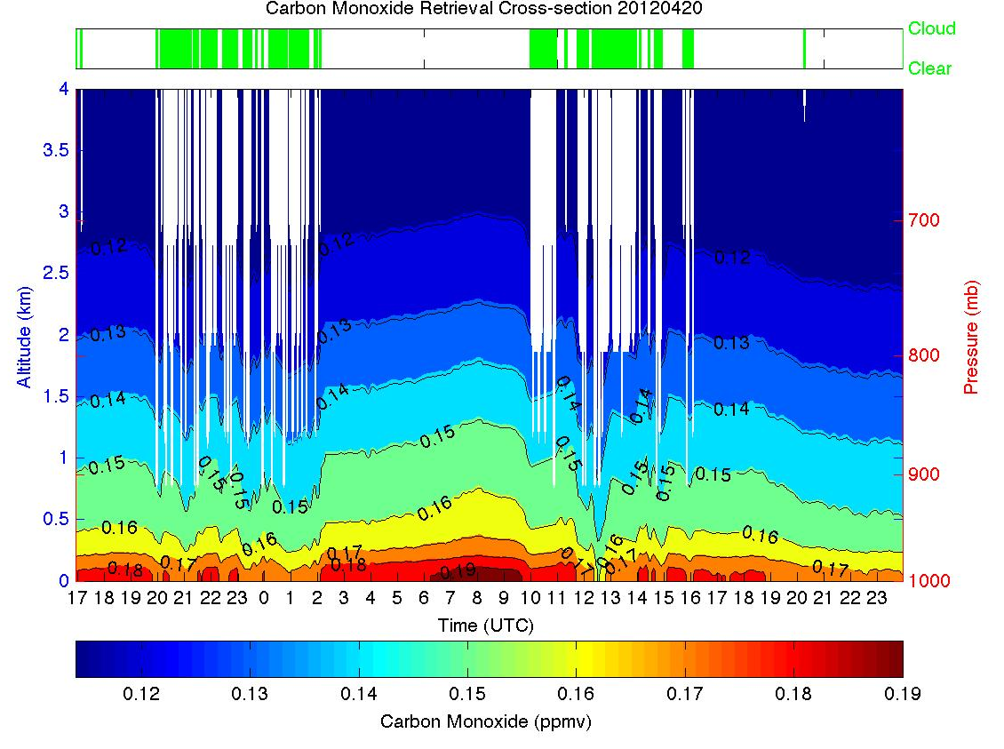
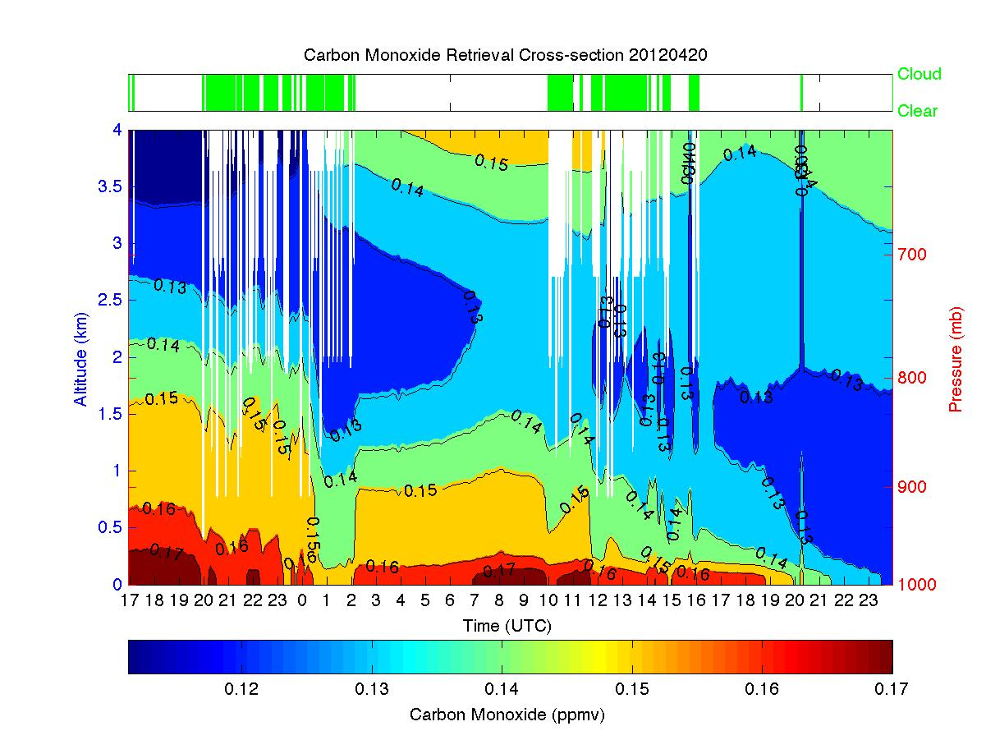
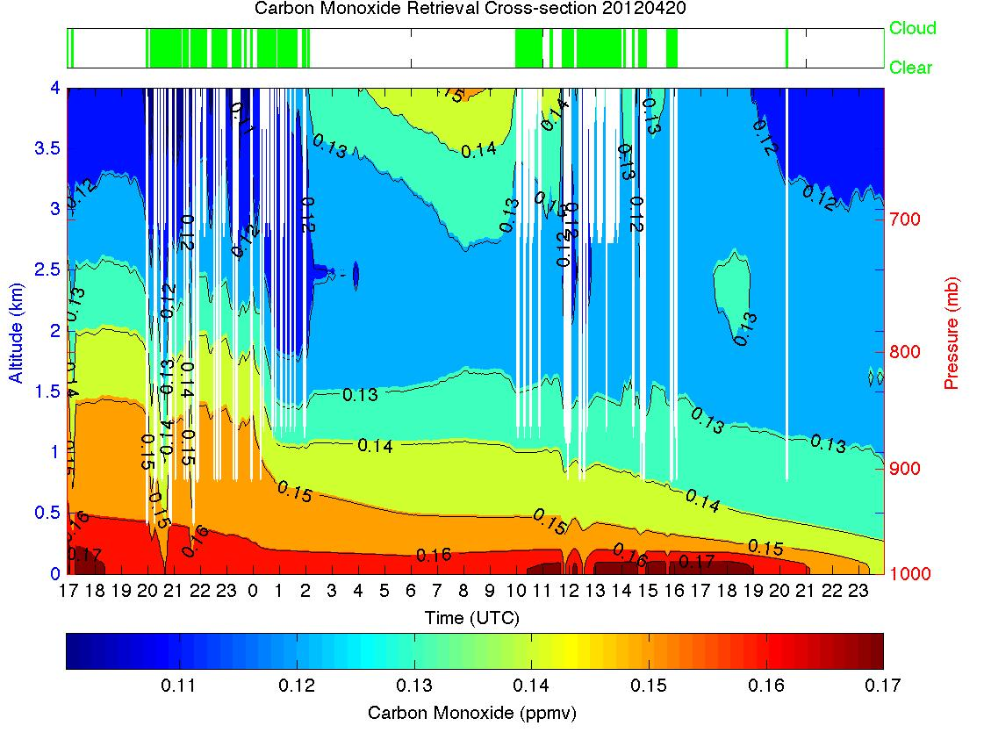
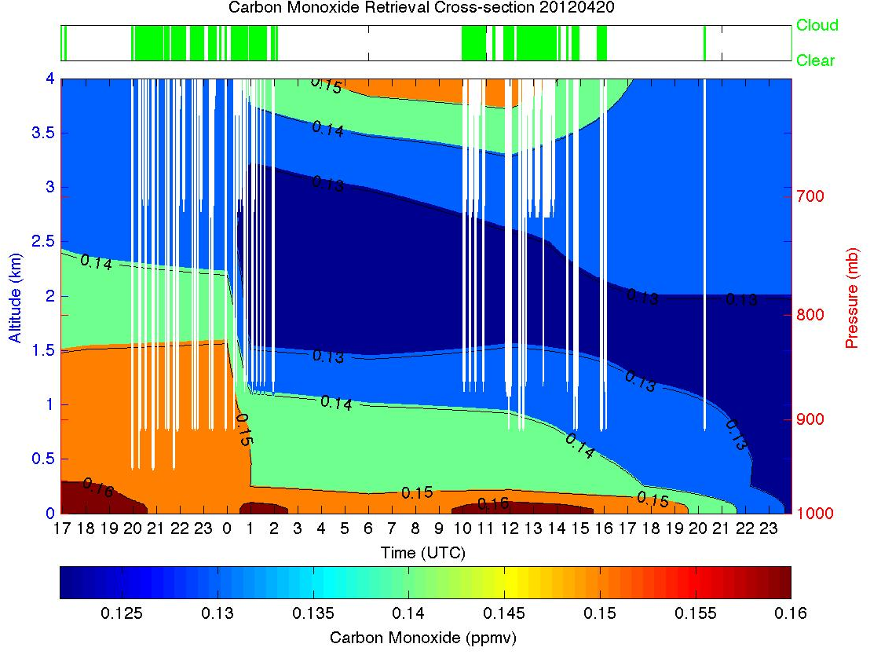
ASSIST Profile Results
April 19 17 UTC – April 21, 00 UTC
Ozone ( 0 – 4 km)
ASSIST - only
ASSIST w BIAS Correction
RAQMS
Carbon Monoxide( 0 – 4 km)

Slide 23
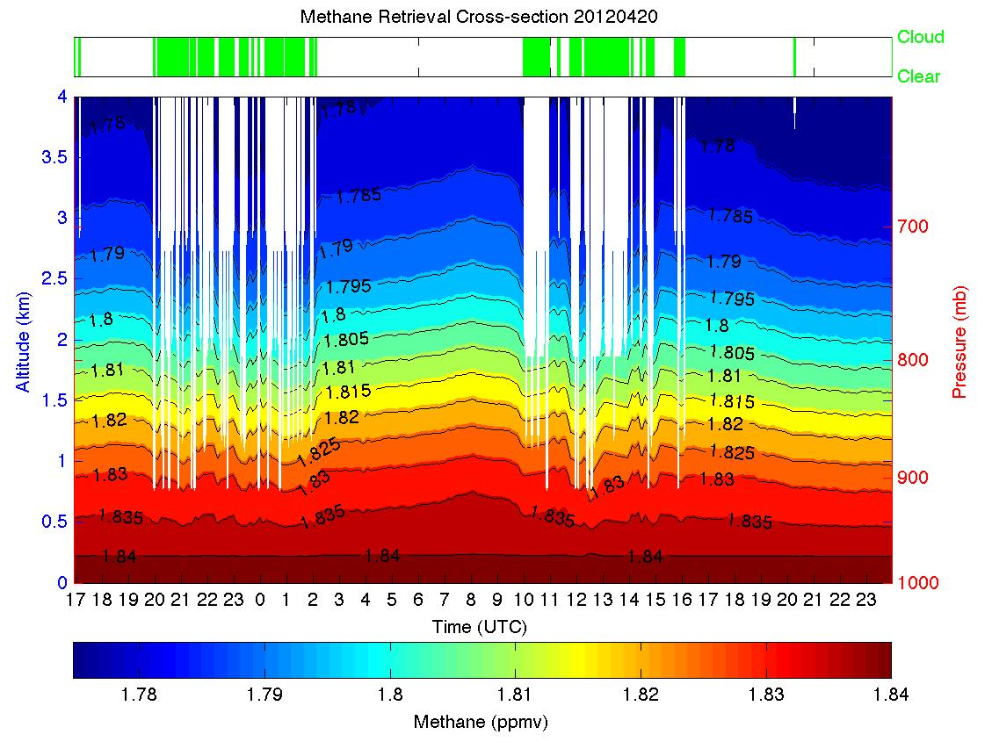







ASSIST Profile Results
April 19 17 UTC – April 21, 00 UTC
Methane ( 0 – 4 km)
ASSIST - only
ASSIST w BIAS Correction
RAQMS
Nitrous Oxide( 0 – 4 km)

Slide 24
Retrieval Procedure Summary
The retrieval procedure involves:
  Using an optimal estimation algorithm which incorporates a climatological covariance matrices for cloud height classes produced by a global dynamical chemistry model
  Obtaining the cloud free radiance spectra from cloud attenuated spectra using the well known “N* Method” used for operational processing of satellite data
  Defining the cloud height and proper cloud class for the statistical retrieval as that one in which the RMSD between the clouded radiance retrieval and the “clear sky radiance” retrieval is a minimum
  Correcting the retrieval for statistical bias using the difference between a real-time dynamical chemistry model model profile and the retrieval obtained from the radiance spectrum simulated from it

Slide 25
Retrieval Flow Chart
ASSIST Radiance
NWP Profile
NWP Radiance
( If Internet Available )
Clear Column
Radiance
Clear Air
Radiance Threshold
RAQMS Regression
Statistics
Cloud Class
Determination
NWP Radiance
Profile Retrieval
ASSIST Radiance
Profile Retrieval
Statistical Bias Correction
(NWP Profile – NWP Retrieval)
ASSIST Final
Profile Retrieval

Slide 26
Cooperative Atmospheric Measurement program (CAMP)
(McKinney Texas Vs Lamont Oklahoma)
Lamont
AERI
McKinney
Lamont
McKinney
ASSIST
ASSIST

Slide 27
McKinney Texas – June 25, 2012

Slide 28






Temperature (FTS, FTS+BC, RAQMS)
McKinney FTS- only
McKinney FTS with BC
McKinney RAQMS
Lamont FTS- only
Lamont FTS + BC
Lamont RAQMS

Slide 29






Relative Humidity (FTS, FTS+BC, RAQMS)
McKinney FTS- only
McKinney FTS with BC
McKinney RAQMS
Lamont FTS - only
Lamont FTS with BC
Lamont RAQMS

Slide 30






Ozone (FTS, FTS+BC, RAQMS)
McKinney FTS- only
McKinney FTS with BC
McKinney RAQMS
Lamont FTS- only
Lamont FTS with BC
Lamont RAQMS

Slide 31






Carbon Monoxide (FTS, FTS+BC, RAQMS)
McKinney FTS- only
McKinney FTS with BC
McKinney RAQMS
Lamont FTS- only
Lamont FTS with BC
Lamont RAQMS

Slide 32






Methane (FTS, FTS+BC, RAQMS)
McKinney FTS- only
McKinney FTS with BC
McKinney RAQMS
Lamont FTS- only
Lamont FTS with BC
Lamont RAQMS

Slide 33






Nitrous Oxide (FTS, FTS+BC, RAQMS)
McKinney FTS- only
McKinney FTS with BC
McKinney RAQMS
Lamont FTS- only
Lamont FTS with BC
Lamont RAQMS

Slide 34

Carbon Dioxide (June 25, 2012)
AERI @ Lamont = 398.0 ppmv
JPL AIRS Retrievals
390.1 - 397.7 ppmv
395.2
397.7
393.1
ASSIST@ McKinney = 396.8 ppmv
390.1
394.2

Slide 35

Retrieval Comparisons with Radiosondes (31)

Slide 36

Summary
Ground-based FTS Provides excellent measurements of the Planetary Boundary Layer (PBL)
  Diurnal variation of temperature and moisture
  Trace gas profiles of O₃ ,CO, CH₄, and N₂O
The retrieval procedure involves:
  Using optimal estimation for cloud 11 height classes
  Obtaining the cloud free radiance spectra from cloud attenuated spectra
  Defining the cloud height and proper cloud class for the statistical retrieval
  Correcting the retrieval for statistical bias using a dynamical chemistry forecast
An NGA Project is underway to validate ground based, airborne, and satellite trace gas measurements
  Emphasis being placed on the estimation of carbon dioxide
  The ground based spectral radiance measurements:
    ASSIST at McKinney Texas
    AERI at the DOE ARM CART-site in Lamont Oklahoma
Improved results to be obtained by combining ground based and satellite (Aqua AIRS, Metop IASI, and NPP CrIS radiance spectra for the thermodynamic and chemistry retrieval process
36

