Slide 1
LADCO Model and Satellite comparison
Discussion
R. Bradley Pierce
NOAA liaison to NASA Air Quality Applied Science Team (AQAST)
NOAA/NESDIS/STAR
(brad.pierce@noaa.gov)
airborne
surface network
LADCO Project Team telecon April 11, 2012

Slide 2
NASA EOS satellites and their AQ measurement capabilities
Satellite Platform | Instruments | Some key data products | Vertical Resolution
NASA Aura | TES | CO, O3 | Trop. column/4 km
 | OMI | O3, NO2 | Trop. column
NASA Aqua | MODIS | Aerosol optical depth | Trop. column
 | AIRS | O3,CO | UTLS
NASA Terra | MOPITT | CO | Trop. column
 | MODIS | Aerosol optical depth | Trop. column
NASA CALIPSO | CALIOP | Aerosol backscatter ratio | Trop. vertical profile

Slide 3
Illustration using RAQMS during LADCO September 01-06, 2011 Case Study

Slide 4
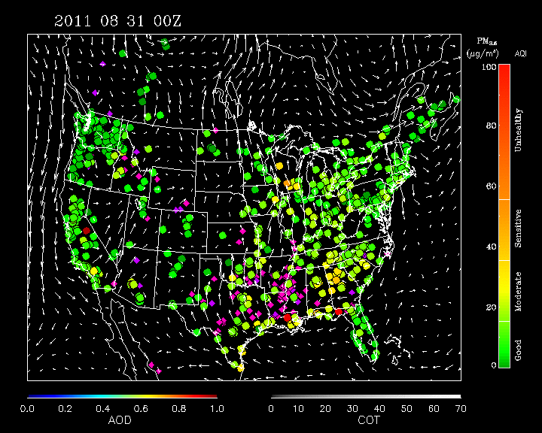
IDEA Composite (AIRNow, WF-ABBA, MODIS, GFS 850mb Winds)
Likely Scenario
Agricultural fires in lower
Mississippi River valley led to poor AQ (Little Rock, AR)
Northward transport led to moderate AQ in Great Lakes region (Maywood, IL)
http://www.star.nesdis.noaa.gov/smcd/spb/aq/

Slide 5
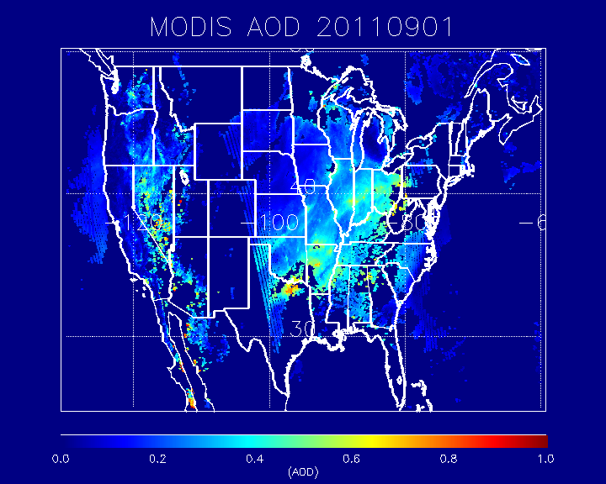
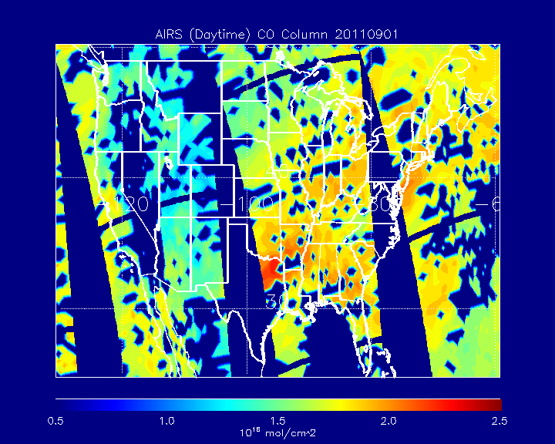
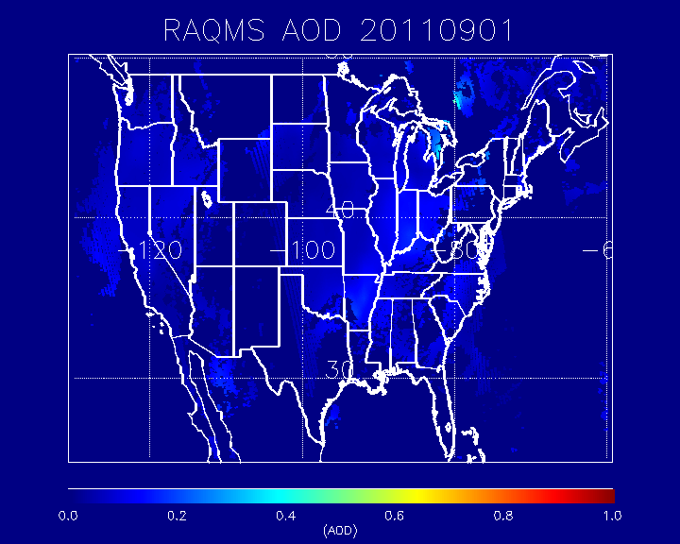
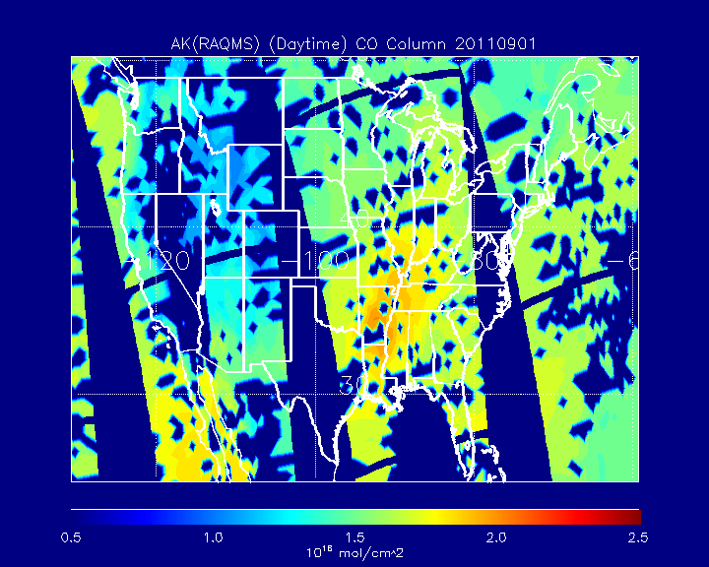
09/01 2011
09/01 2011

Slide 6
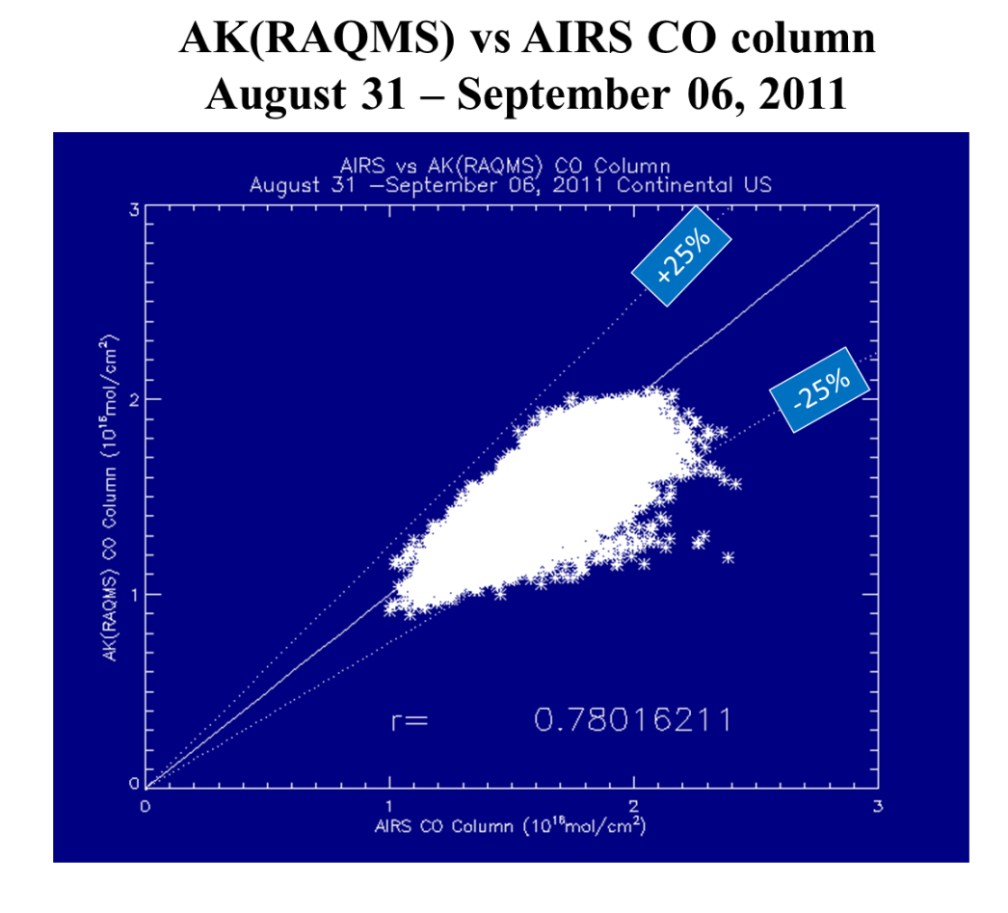
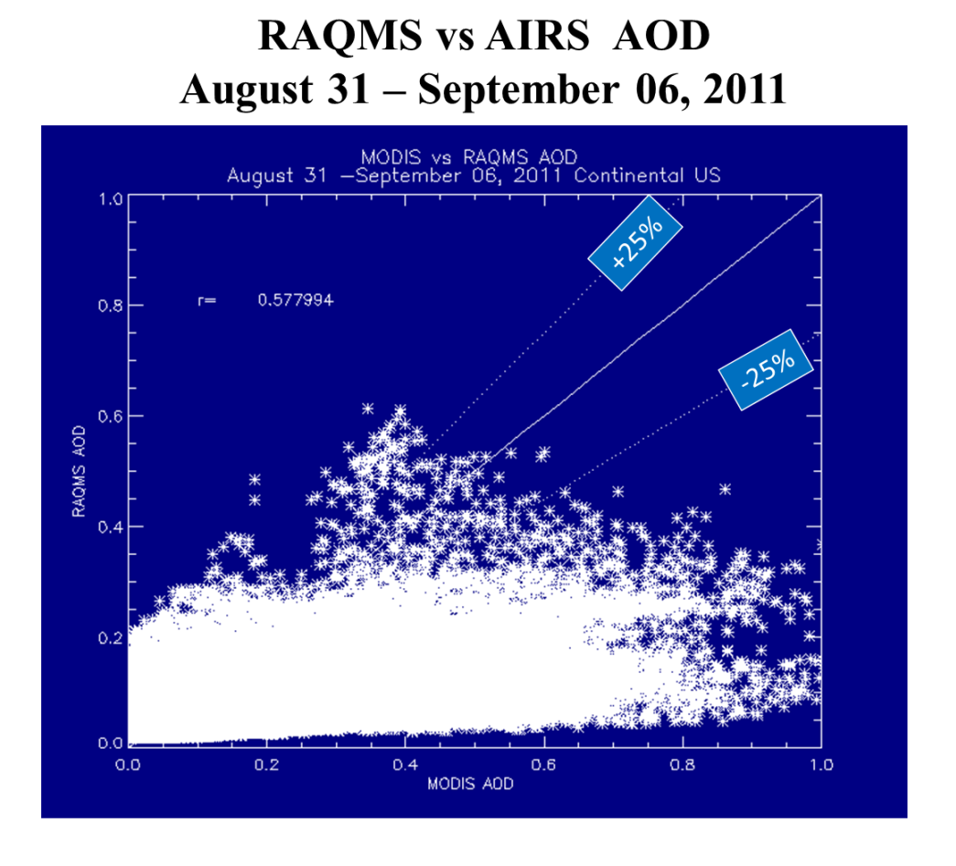
Comparison with AIRS CO shows slight (<25%) low bias
Comparison with MODIS AOD shows significant (2-3x) low bias
Now use Cloud-Aerosol Lidar and Infrared Pathfinder Satellite Observation (CALIPSO) aerosol extinction profiles to verify vertical aerosol structure
AOD = $\sum_{zsfc}^{ztop}{extinction(z)∗dz}$

Slide 7
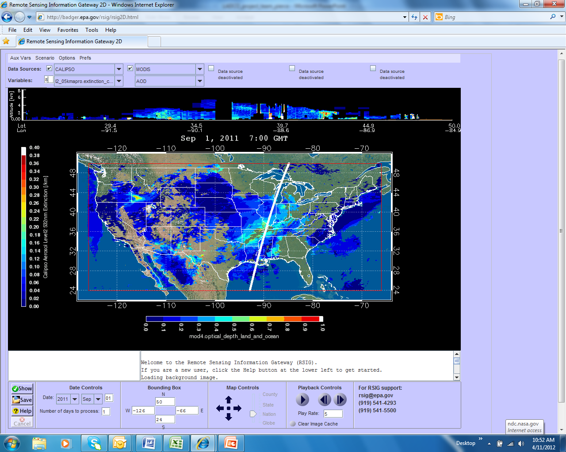
Remote Sensing Information Gateway (RSIG)
RSIG is available on-line and allows users to integrate their selected datasets into a unified visualization. RSIG allows user to access several key satellite aerosol data sets such at CALIPSO extinction & AOD, MODIS AOD and GOES-AOD in addition to EPA CMAQ results and ground station measurements from via AIRNow and EPA's Air Quality System (AQS).
http://badger.epa.gov/rsig/ Contact: Jim Szykman (US EPA AQAST Liaison) szykman.jim@epa.gov

Slide 8
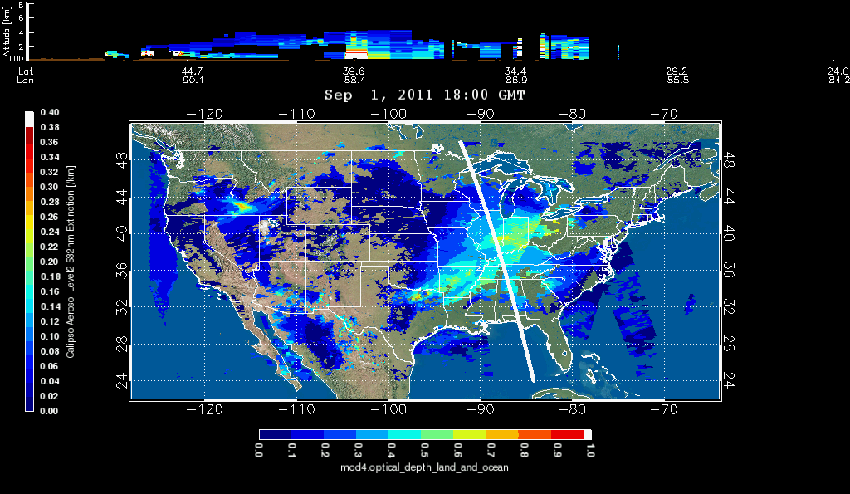
MODIS AOD and CALIPSO Aerosol Extinction at 18Z on September 1, 2011

Slide 9
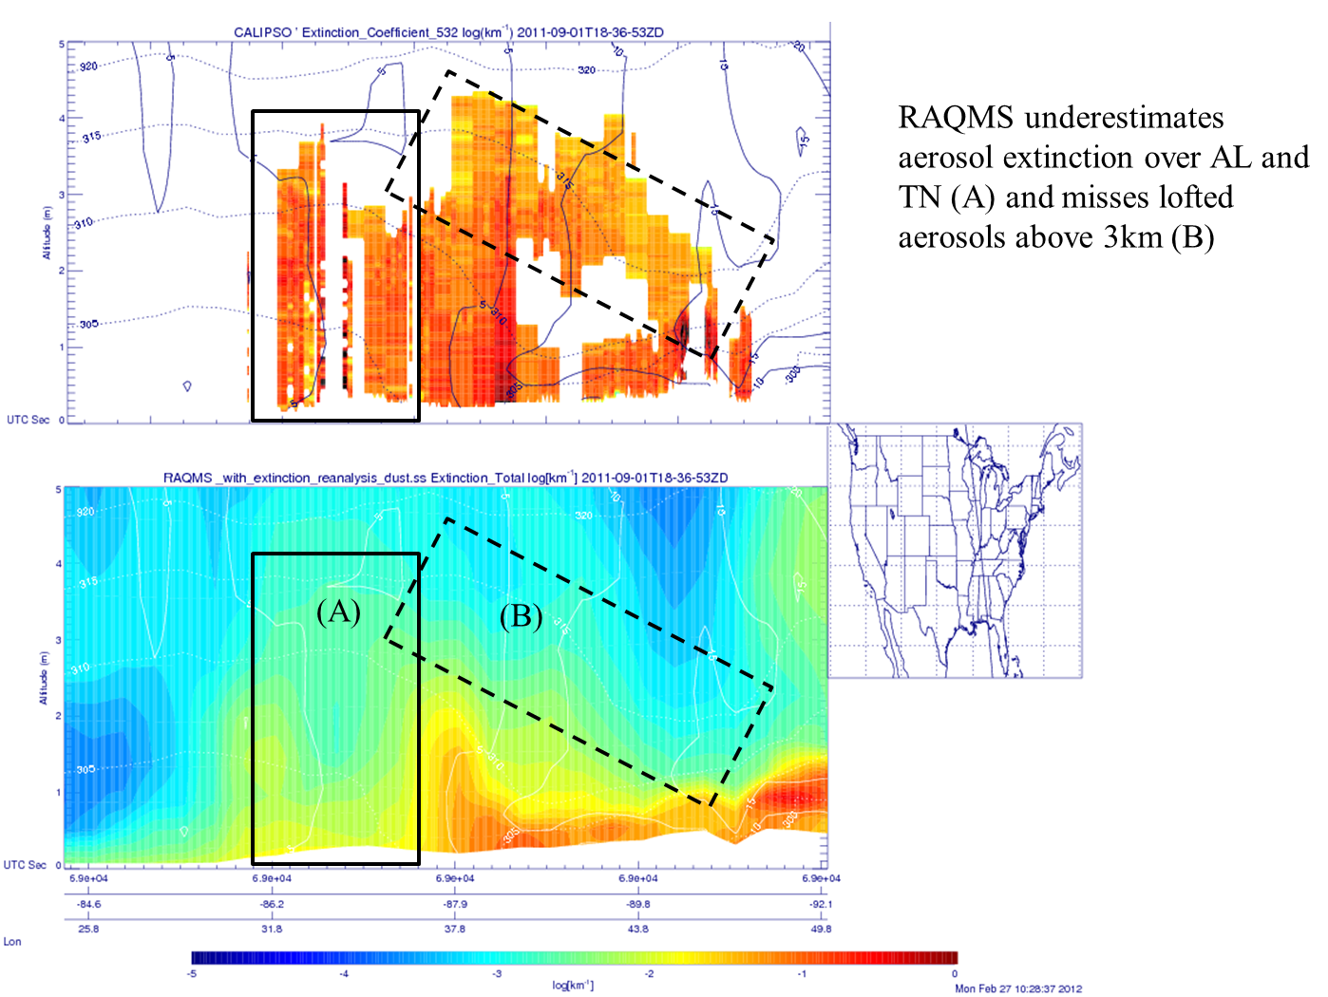

Slide 10
LADCO AQAST Collaborative Study:
LADCO Winter Nitrate Study (Jan-Mar 2009)
Largest event occurred 21-Jan 23-Jan
Reproduced From: LADCO Winter Nitrate Study – Phase I Report – October 2010 – Univ. of Iowa & Univ. of Illinois

Slide 11
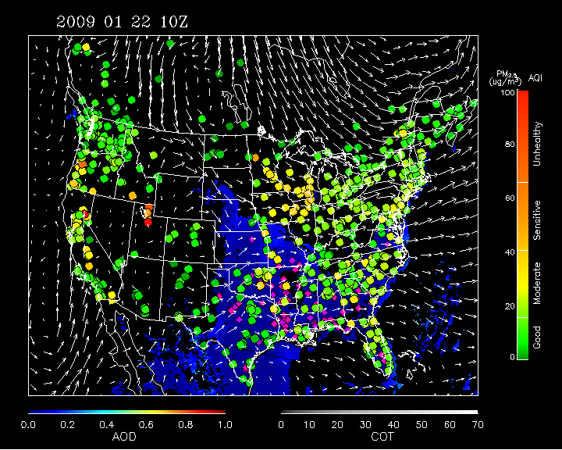
IDEA Composite (AIRNow, WF-ABBA, MODIS, GFS 850mb Winds)
Contributers*:
warm, moist, stagnant air
inversion conditions
fog due to snowpack melting and sublimation
* LADCO Winter Nitrate Study – Phase I Report – October 2010 – Univ. of Iowa & Univ. of Illinois
http://www.star.nesdis.noaa.gov/smcd/spb/aq/

Slide 12
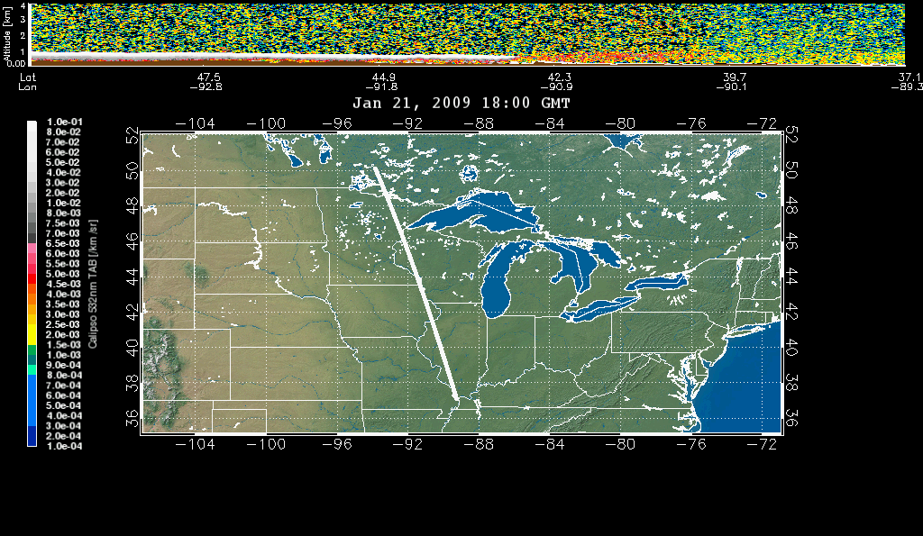
CALIPSO Attenuated Backscatter
January 21, 2009 18:00Z
Low level cloud/fog
underlying aerosols (?)
aerosols

Slide 13
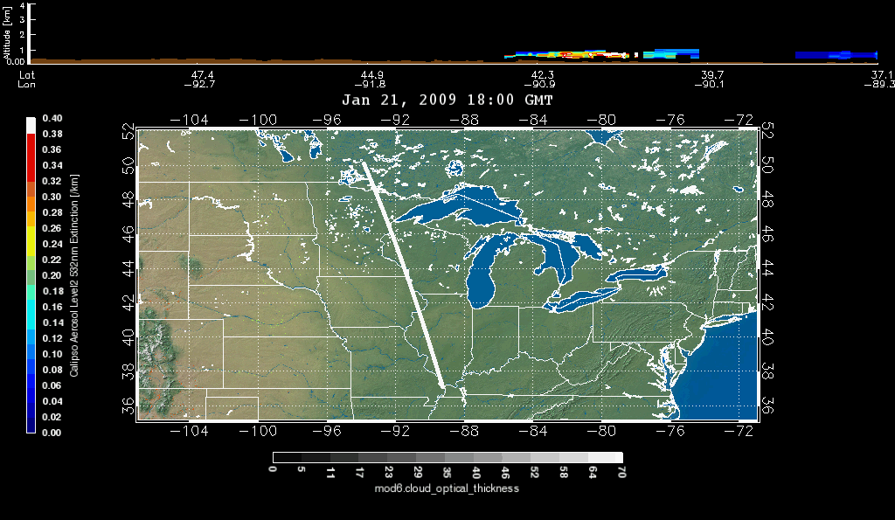
CALIPSO Aerosol Extinction
January 21, 2009 18:00Z
aerosols

Slide 14
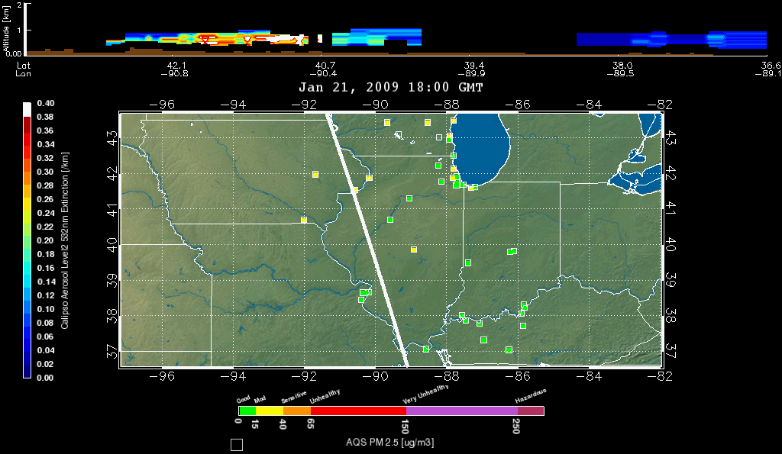
CALIPSO Aerosol Extinction
January 21, 2009 18:00Z

Slide 15
NASA EOS satellites and their AQ measurement capabilities
OMI NO2 retrievals are valuable for emission verification and compare favorably with columns estimated from insitu airborne profiles.
MODIS Aerosol Optical Depth (AOD) retrievals are valuable for primary particulate emission and aerosol transport verification but do not provide a direct measurement of particulate mass.
TES, MOPITT, and AIRS CO retrievals are valuable for model transport verification but the vertical sensitivity of the retrievals and potential biases must be accounted for.
Combining Atmospheric Infrared Sounder (AIRS) CO and Moderate Resolution Imaging Spectroradiometer (MODIS) AOD:
improves verification of model transport since AIRS provides better spatial coverage (cloud clearing)
provides better estimates of boundary layer transport since MODIS is sensitive to boundary layer and free tropospheric aerosols
CALIPSO aerosol extinction and vertical feature mask profiles provide vertically resolved information about aerosols and clouds along a narrow swath

Slide 16
Have contacted Abigail Jaye who will provide 3D CAMx output for satellite intercomparison during 2009 Winter Nitrate Study January 21-23 event.
Mapping of MODIS and CALIPSO to CAMx Grid can be done within RSIG using custom Lambert grid definition.
Would like to report on findings during next NASA Air Quality Applied Science Team (AQAST), on June 13-15 at the University of Wisconsin-Madison (http://www.ssec.wisc.edu/meetings/aqast/) Please Attend!!

