Slide 1
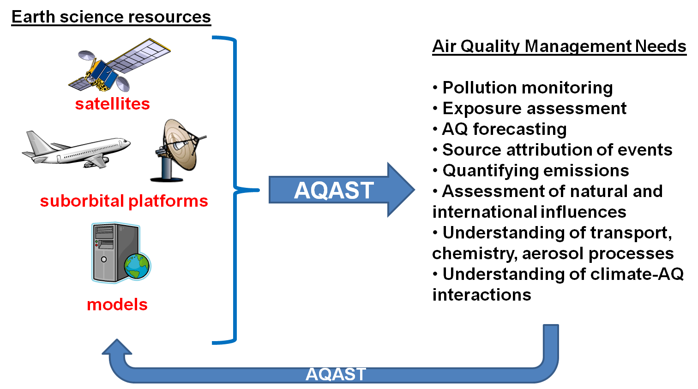
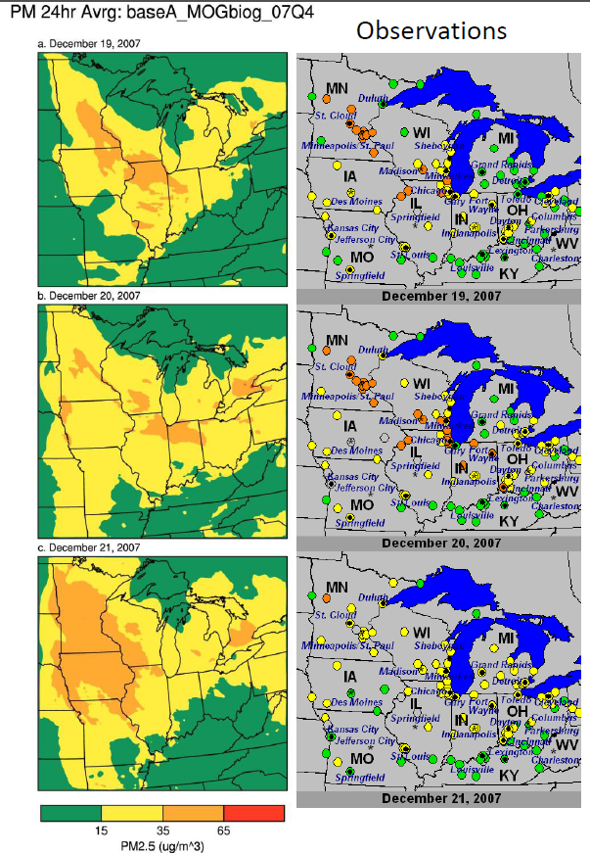
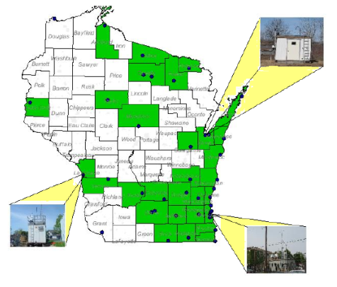
Model and Satellite comparison overview
R. Bradley Pierce
NOAA/NESDIS/STAR
(brad.pierce@noaa.gov)
airborne
surface network
NASA Air Quality Remote Sensing Training LADCO, Madison, Wisconsin March 12 – 15, 2011

Slide 2
Outline
Air Quality Modeling Overview
How can satellite retrievals be used for AQ model verification?
    TEXAQS II Satellite/Model Intercomparison August 2006
      Importance of Averaging Kernels
        Tropospheric Emission Spectrometer (TES) O3, CO
        Measurements Of Pollution In The Troposphere (MOPITT) CO
      Emission Verification
        Ozone Monitoring Instrument (OMI) NO2
      Transport Verification
        Atmospheric Infrared Sounder (AIRS) CO
        Moderate Resolution Imaging Spectroradiometer (MODIS) AOD
      NOAA P3 airborne insitu
    LADCO Case Study September 1-6, 2011
      Transport Verification
        Atmospheric Infrared Sounder (AIRS) CO
        Moderate Resolution Imaging Spectroradiometer (MODIS) AOD
      Vertical Structure Verification
        Cloud-Aerosol Lidar and Infrared Pathfinder Satellite Observation (CALIPSO)
III. Summary

Slide 3
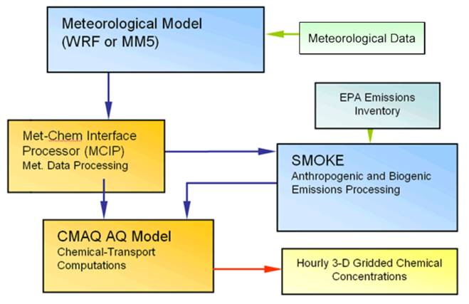
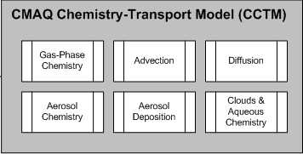
Air Quality Modeling Overview
EPA Community Multiscale Air Quality (CMAQ) Modeling System
Meteorological
Prediction
Input
Chemical
Aerosol
Prediction
Output

Slide 4
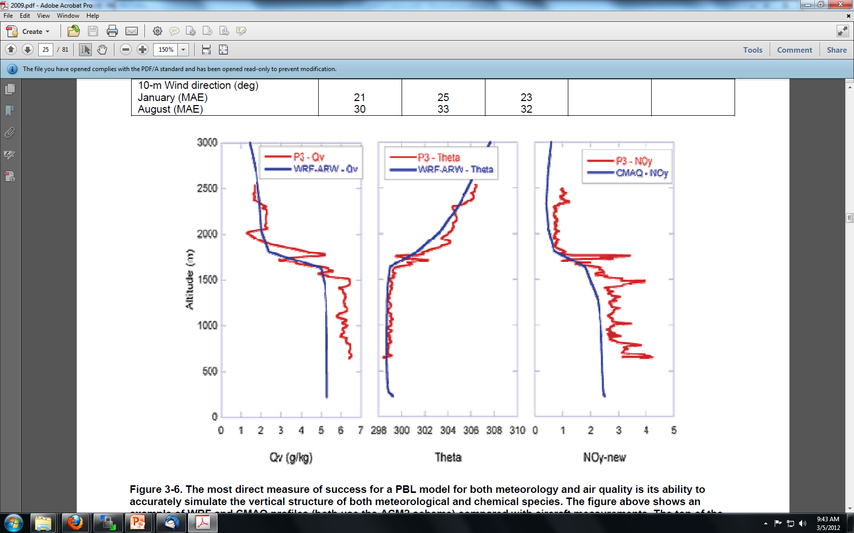
Airborne Validation
EPA Community Multiscale Air Quality (CMAQ) Modeling System
Input
Meteorological
Verification
Output

Slide 5
Airborne Validation
EPA Community Multiscale Air Quality (CMAQ) Modeling System
Input
Chemical
Aerosol
Verification
Output

Slide 6
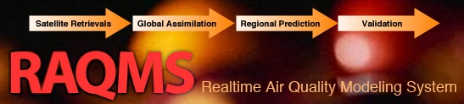

Meteorological
Data
Chemical/Aerosol Retrievals
Model Description
Data Assimilation
Online global chemical and aerosol assimilation/forecasting system
UW-Madison hybrid θ−η coordinate model (UW-Hybrid) dynamical core
Unified stratosphere/troposphere chemical prediction scheme (LaRC-Combo) developed at NASA LaRC
Aerosol prediction scheme (GOCART) developed by Mian Chin (NASA GSFC).
Statistical Digital Filter (OI) assimilation system developed by James Stobie (NASA/GFSC)
Real-time wildfire emissions
RAQMS
Online chemistry
unified strat/trop chemistry/aerosols
GEIA emission
inventories
6 hourly 3-D gridded chemistry/meteorology predictions
http://raqms-ops.ssec.wisc.edu/
RAQMS has been used to support airborne field missions [Pierce et al, 2003, 2007, 2008], develop capabilities for assimilating satellite trace gas and aerosol retrievals [Pierce et al., 2007, 2008, Fishman et al., 2008, Sunita et al., 2008] and assess the impact of global chemical analyses on regional air quality predictions [Song et al., 2008, Tang et al., 2008]
Notes:
6

Slide 7

2006 TexAQS / GoMACCS
Texas Air Quality Study / Gulf of Mexico Atmospheric Composition and Climate Study
NASA EOS satellites and their AQ measurement capabilities
Satellite Platform | Instruments | Some key data products | Vertical Resolution
NASA Aura | TES | CO, O3 | Trop. column/4 km
 | OMI | O3, NO2 | Trop. column
NASA Aqua | MODIS | Aerosol optical depth | Trop. column
 | AIRS | O3,CO | UTLS
NASA Terra | MOPITT | CO | Trop. column
 | MODIS | Aerosol optical depth | Trop. column
NASA CALIPSO | CALIOP | Aerosol backscatter ratio | Trop. vertical profile

Slide 8
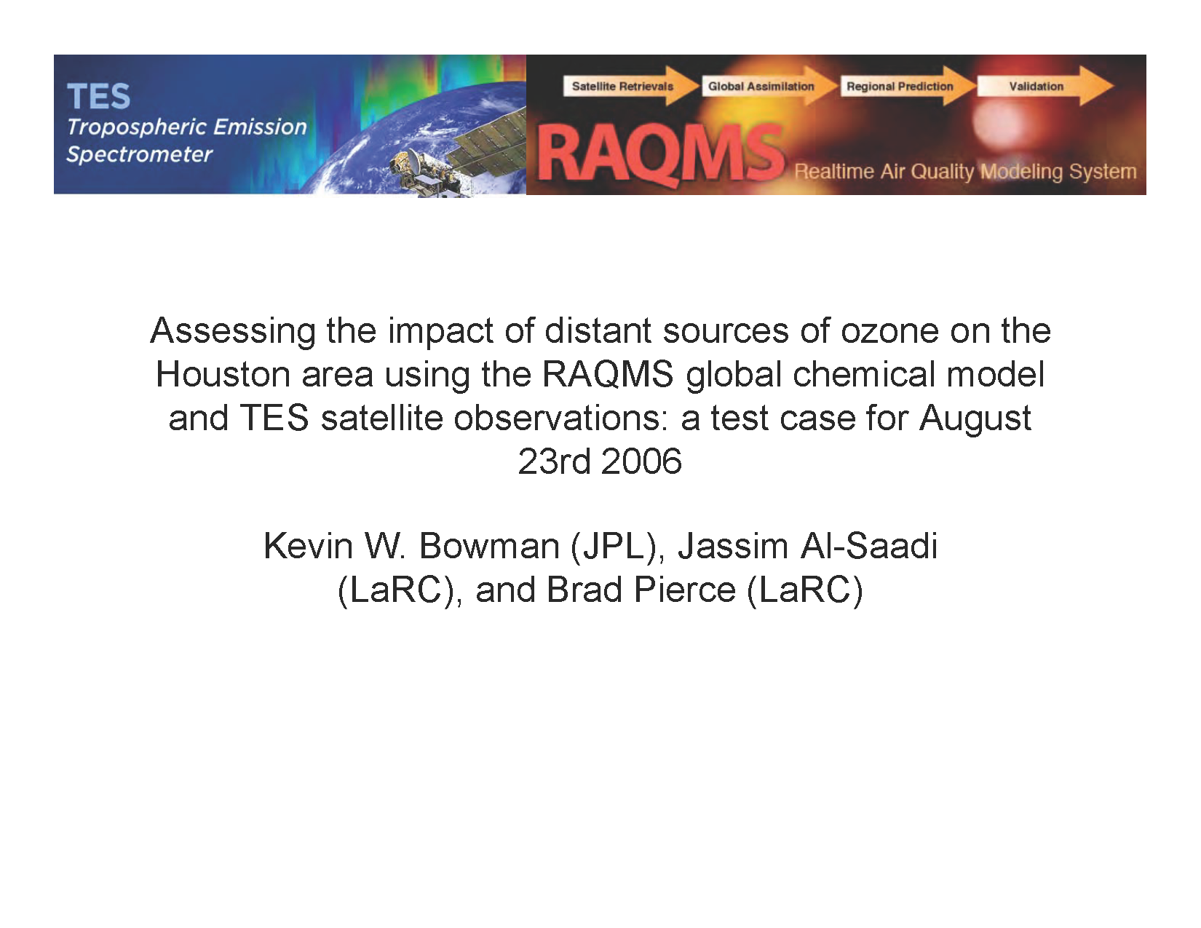
Presented during the TEXAQS II TCEQ Rapid Science Synthesis
http://www.esrl.noaa.gov/csd/2006/rss/

Slide 9
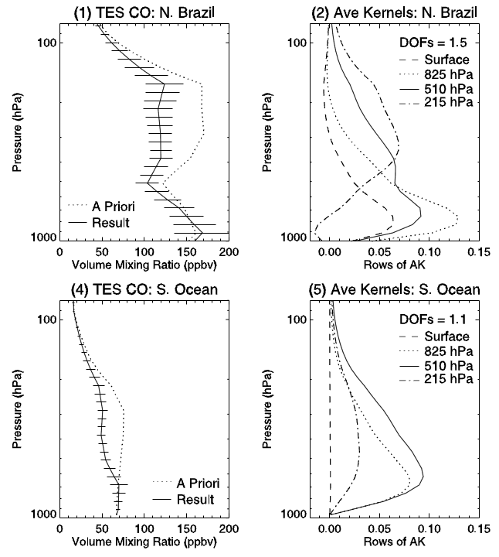
TES Vertical Sensitivity: Averaging Kernel
The retrieval at 215mb
is sensitive to average CO in middle and upper troposphere
The retrieval at 825mb is sensitive to average CO in lower troposphere
  The averaging kernels broaden and overlap under conditions with low thermal contrast – less Degrees of Freedom (DOF)
High thermal contrast between surface and atmosphere – higher sensitivity
Low thermal contrast between surface and atmosphere – lower sensitivity
Rinsland et al., GRL, Vol 33, L22806, doi:10.1029/2006GL027000, 2006

Slide 10
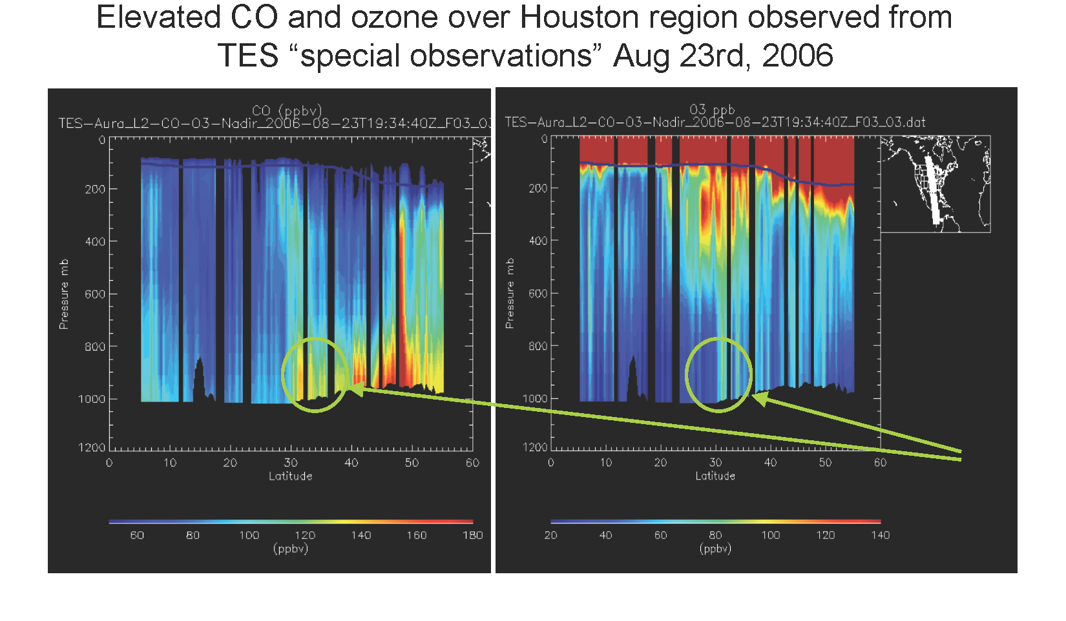
Boundary layer and upper tropospheric CO and O3 enhancements over Houston (30ºN)

Slide 11
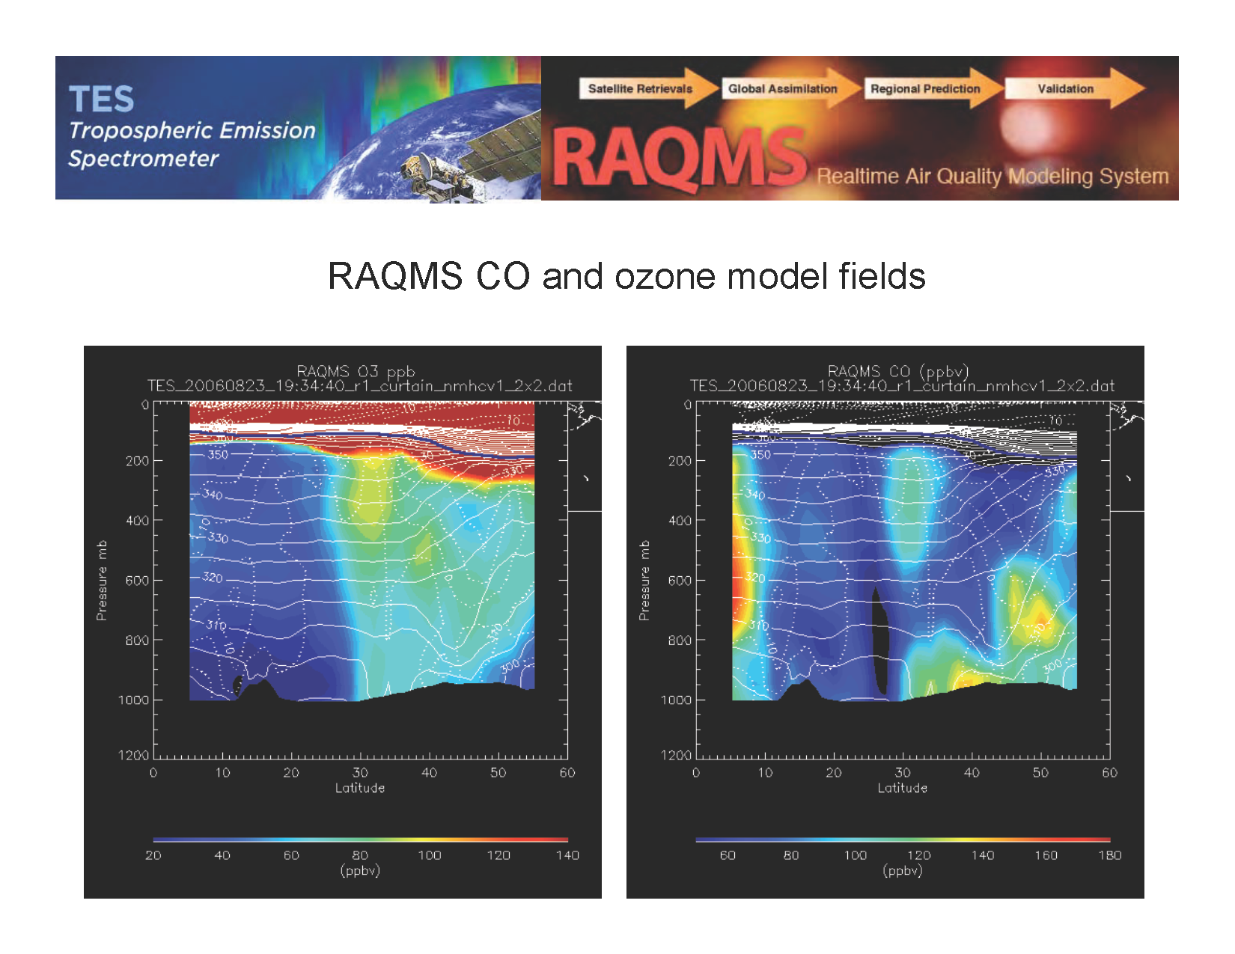
Boundary layer and upper tropospheric CO and O3 enhancements over Houston (30ºN)

Slide 12
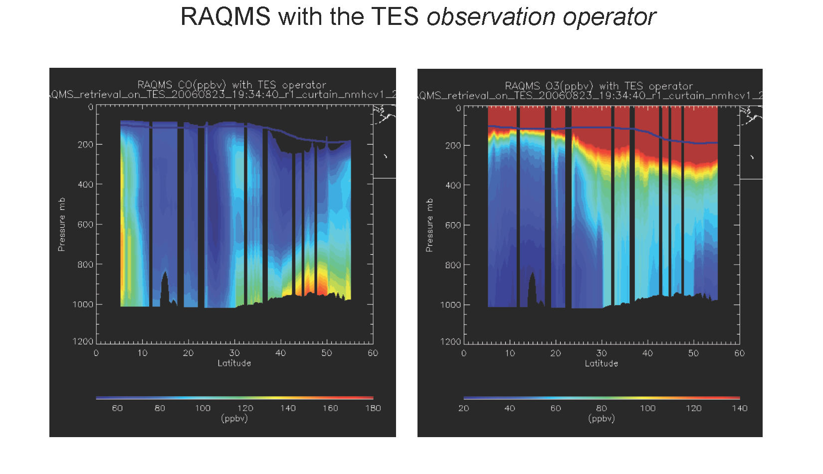

Slide 13
TES provides less information on vertical structure of O3 and CO then RAQMS.
Need to convolve RAQMS with Averaging Kernel for valid comparisons.
Column comparisons are most appropriate.

Slide 14
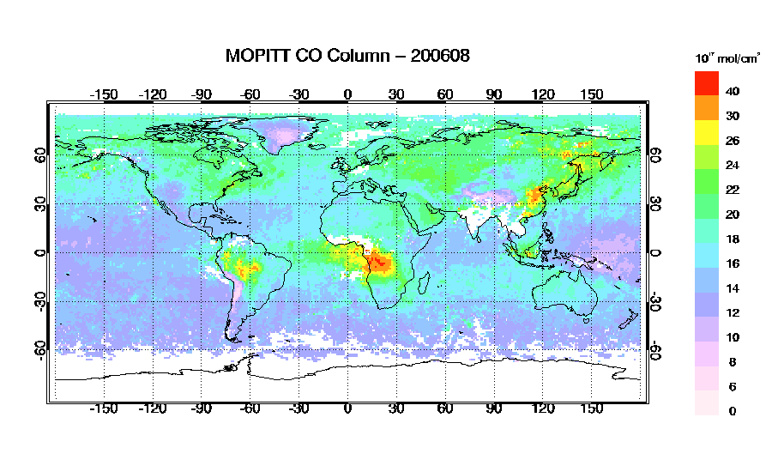
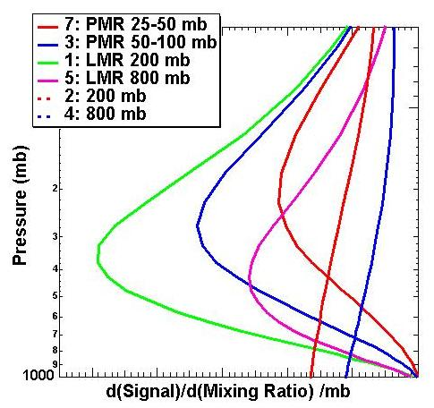
Measurements Of Pollution In The Troposphere (MOPITT)
Combines a Pressure Modulated Radiometer (PMR)
and Length Modulated Radiometer (LMR).
Using PMRs and LMRs with different pressures provides information about the vertical profile.
http://www.acd.ucar.edu/mopitt/

Slide 15
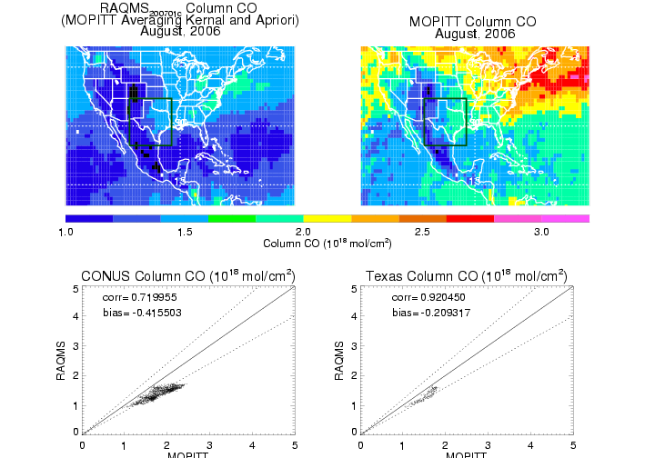
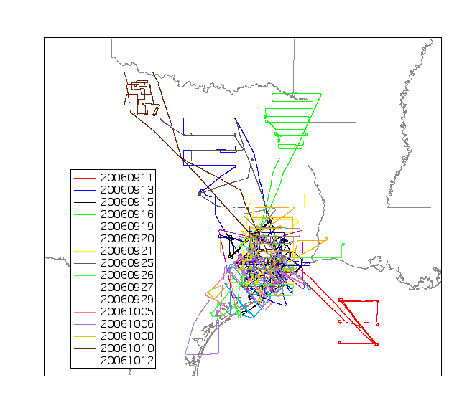
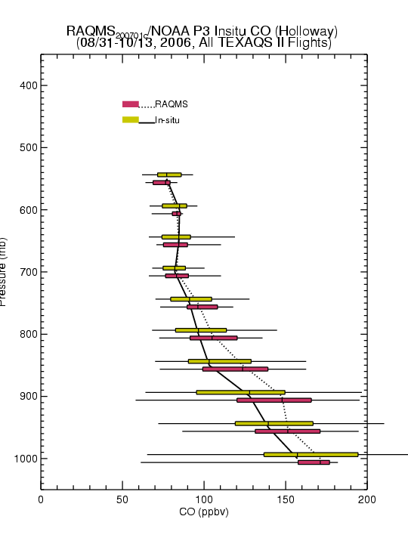
RAQMS Column CO vs MOPITT RAQMS CO vs NOAA P3
RAQMS mean CO column is low relative to V2 MOPITT
RAQMS median O3 profile is high relative to P3 measurements
Beware of potential retrieval biases!
(MOPITT V2 retrieval has high bias relative to insitu that has been corrected in V3)

Slide 16
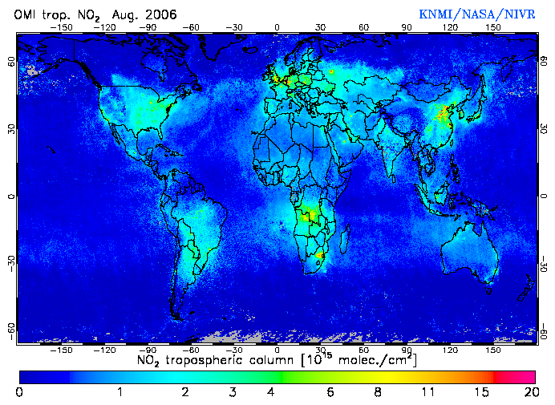
Ozone Monitoring Instrument (OMI)
DOMINO version 2.0 (http://www.temis.nl/airpollution/no2.html)
http://aura.gsfc.nasa.gov/instruments/omi.html

Slide 17
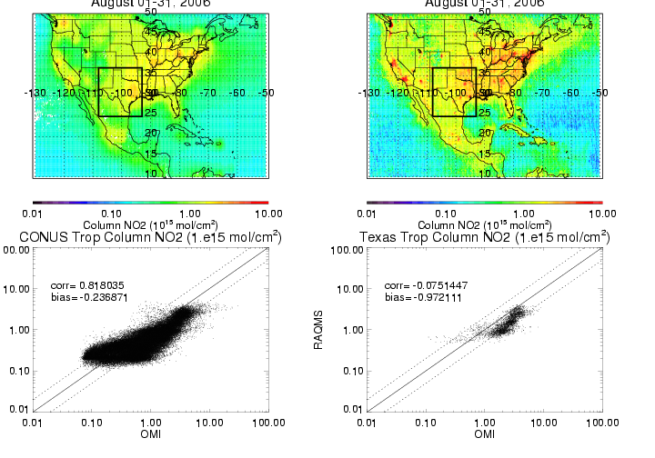
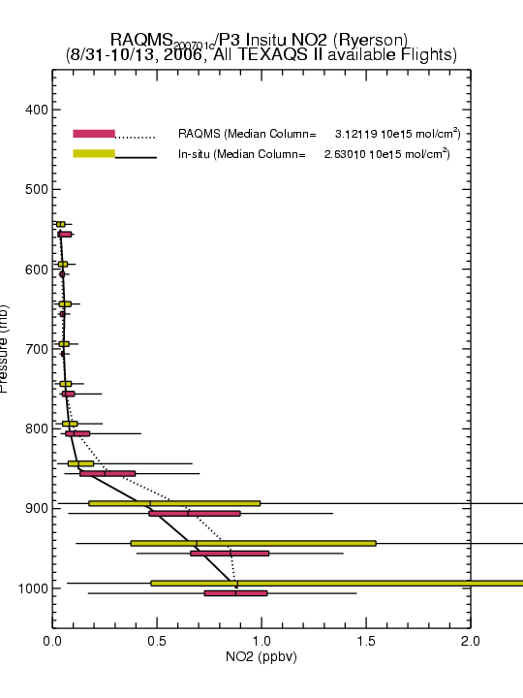
RAQMS Trop NO2 vs OMI RAQMS NO2 vs NOAA P3
RAQMS Tropospheric NO2
CONUS August, 2006
OMI Tropospheric NO2
CONUS August, 2006
RAQMS mean trop NO2 column is low relative to OMI
RAQMS median NO2 profile is high relative to P3 measurements
But RAQMS doesn’t capture high insitu values, which would lead to mean low biases

Slide 18
OMI NO2 retrievals are valuable for emission verification and compare favorably with columns estimated from insitu airborne profiles.
TES and MOPITT CO retrievals are valuable for model transport verification but the vertical sensitivity of the retrievals and potential biases must be accounted for.
Now look at utility of combining Atmospheric Infrared Sounder (AIRS) CO and Moderate Resolution Imaging Spectroradiometer (MODIS) Aerosol Optical Depth (AOD)

Slide 19
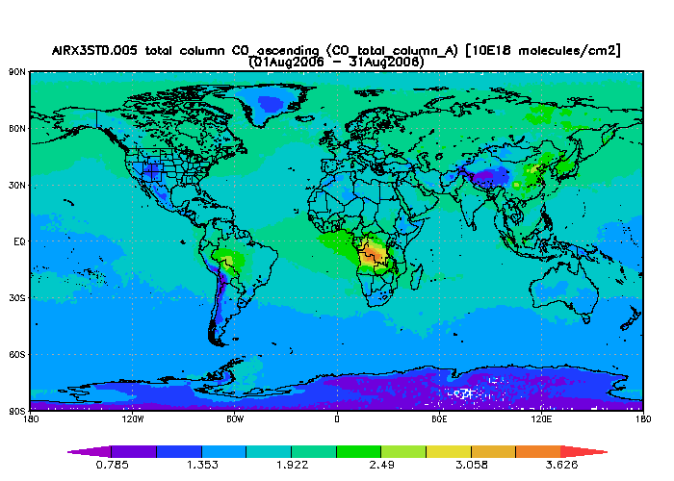
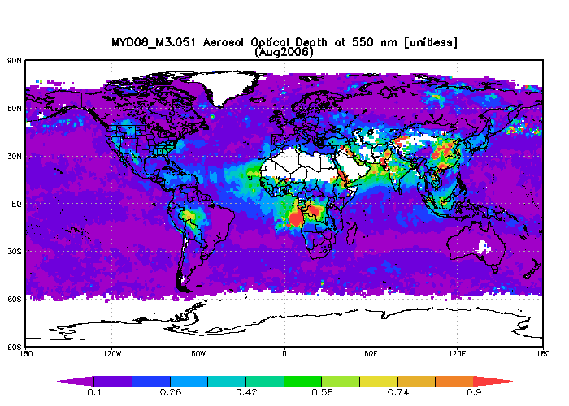
Atmospheric Infrared Sounder (AIRS)
Moderate Resolution Imaging
Spectroradiometer (MODIS)
Total Column CO (10¹⁸ mol/cm²)
Aerosol Optical Depth (AOD)
http://airs.jpl.nasa.gov/
http://modis.gsfc.nasa.gov/
AIRS and MODIS August 2006 analysis produced with the Giovanni online data system, developed and maintained by the NASA GES DISC (http://disc.sci.gsfc.nasa.gov/giovanni/overview/index.html)

Slide 20
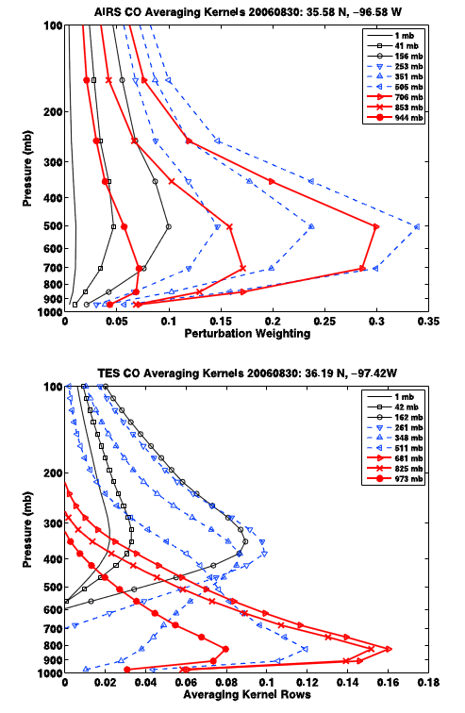
AIRS vs TES CO Averaging Kernels (Houston, TX)
AIRS provides less information about boundary layer CO then TES
McMillan, W. W., et al. (2010), An observational and modeling strategy to investigate the impact of remote sources on local air quality: A Houston, Texas, case study from the Second Texas Air Quality Study (TexAQS II), J. Geophys. Res., 115, D01301, doi:10.1029/2009JD011973.

Slide 21
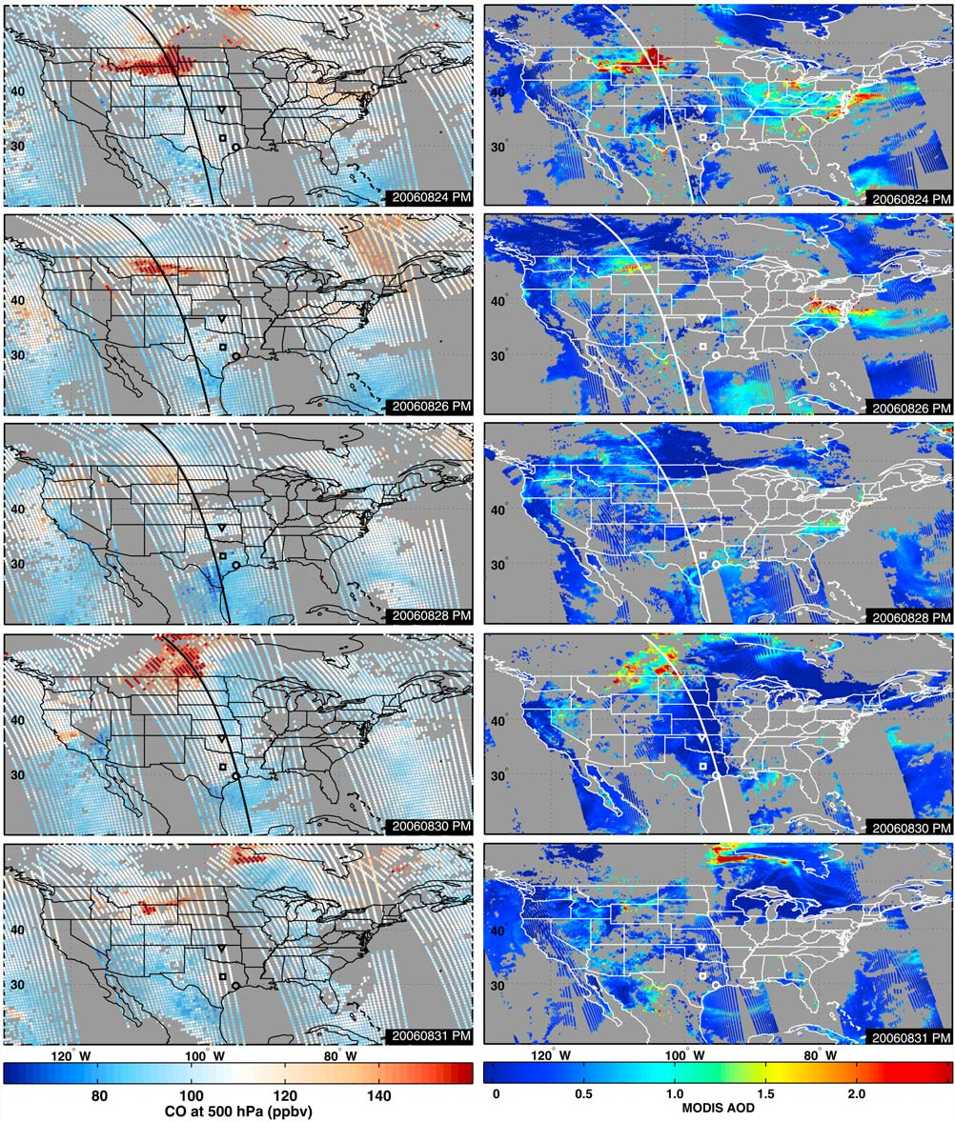
AIRS 500mb CO
MODIS AOD
08/24
AIRS provides better spatial coverage (swath) then TES (nadir)
AIRS provides better spatial coverage (cloud cleared) then MODIS (cloud free)
08/26
08/28
08/30
08/31
McMillan, W. W., et al. (2010), An observational and modeling strategy to investigate the impact of remote sources on local air quality: A Houston, Texas, case study from the Second Texas Air Quality Study (TexAQS II), J. Geophys. Res., 115, D01301, doi:10.1029/2009JD011973.

Slide 22
Combining Atmospheric Infrared Sounder (AIRS) CO and Moderate Resolution Imaging Spectroradiometer (MODIS) AOD:
  improves verification of model transport since AIRS provides better spatial coverage (cloud clearing)
  provides better estimates of boundary layer transport since MODIS is sensitive to boundary layer and free tropospheric aerosols
Now apply the same verification tools to the LADCO September 01-06, 2011 Case Study

Slide 23
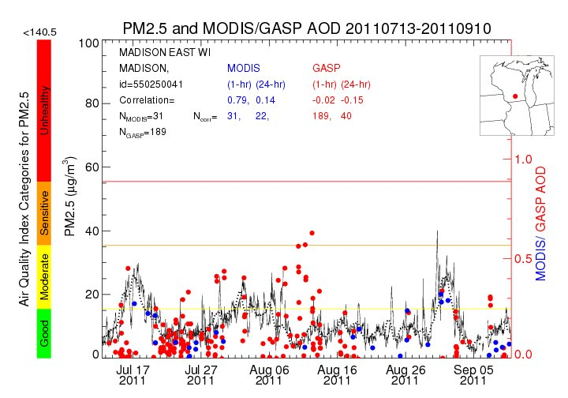
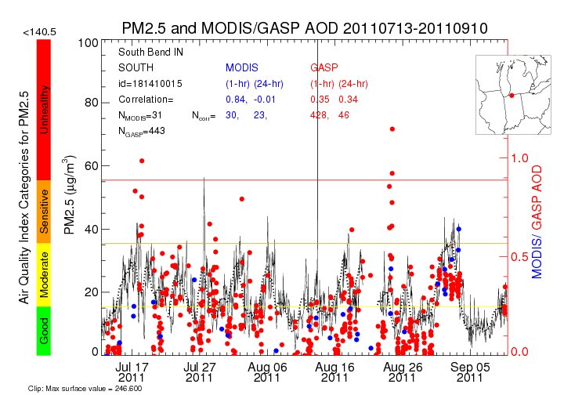
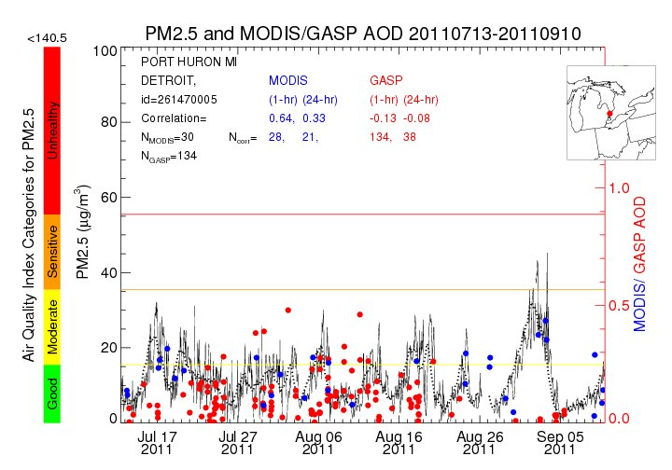
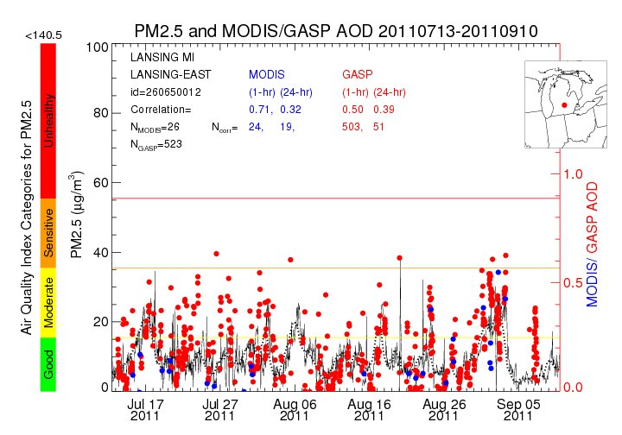
LADCO Case Study: September 1-6, 2011
(High O3/PM2.5 episode)
Madison East, WI
South Bend, IN
Port Huron, MI
Lansing, MI

Slide 24
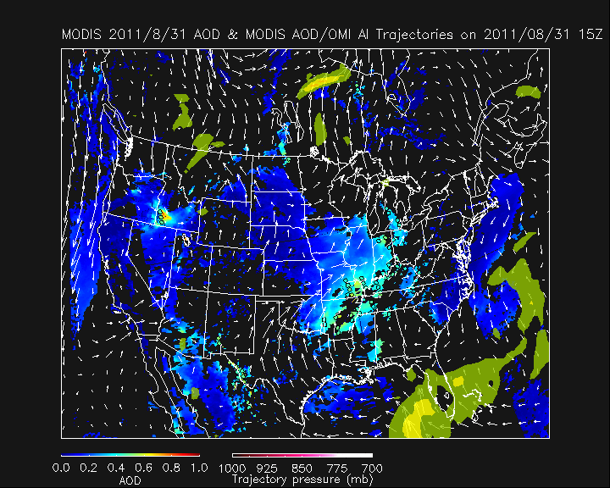
IDEA AOD Trajectory Forecast
http://www.star.nesdis.noaa.gov/smcd/spb/aq/

Slide 25
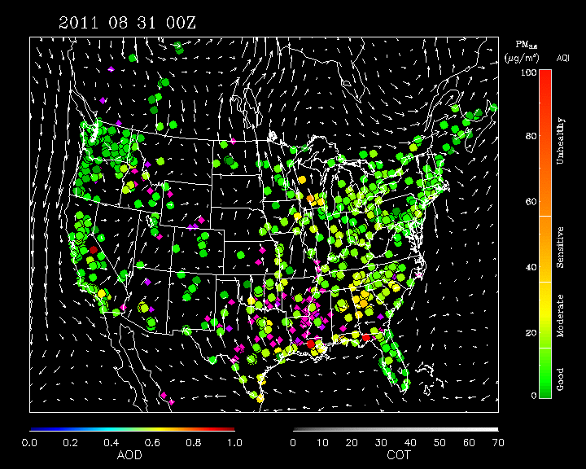
IDEA Composite (AIRNow, WF-ABBA, MODIS, GFS 850mb Winds)
http://www.star.nesdis.noaa.gov/smcd/spb/aq/

Slide 26
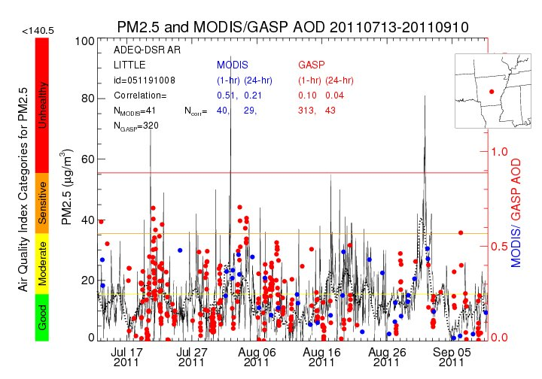
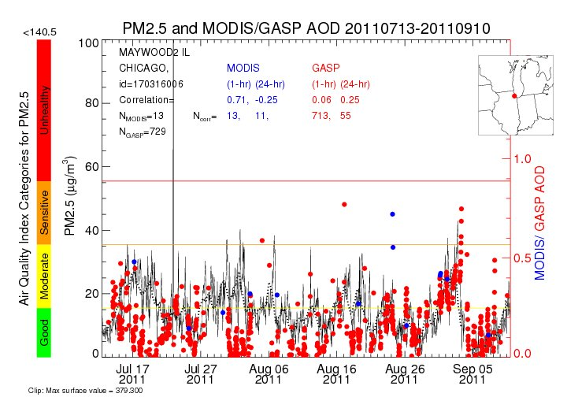
Likely Scenario
Agricultural fires in lower
Mississippi River valley led to poor AQ (Little Rock, AR)
Northward transport led to moderate AQ in Great Lakes region (Maywood, IL)
Little Rock, AR
Maywood2, IL

Slide 27
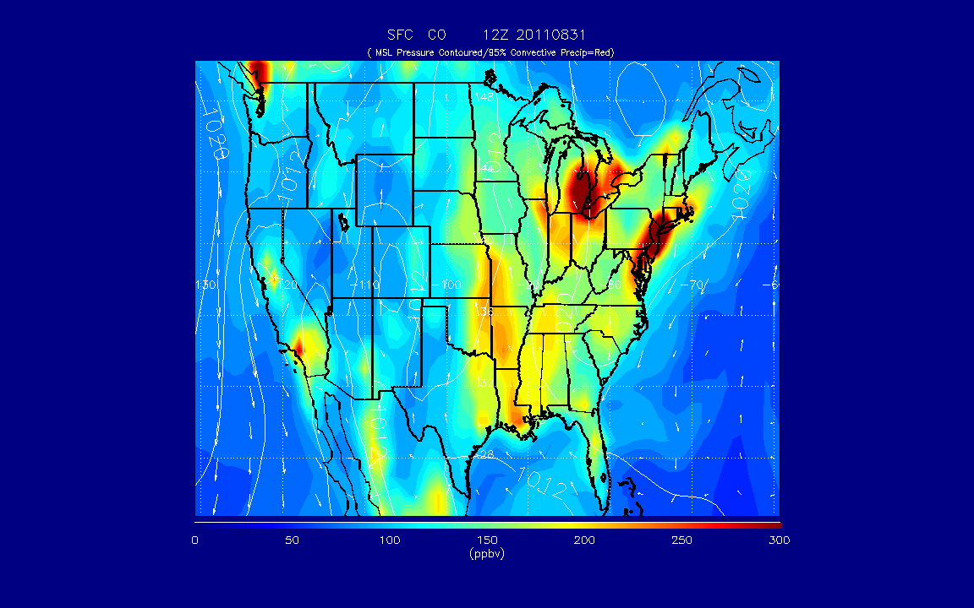
RAQMS Surface CO Analysis 08/31- 09/06

Slide 28
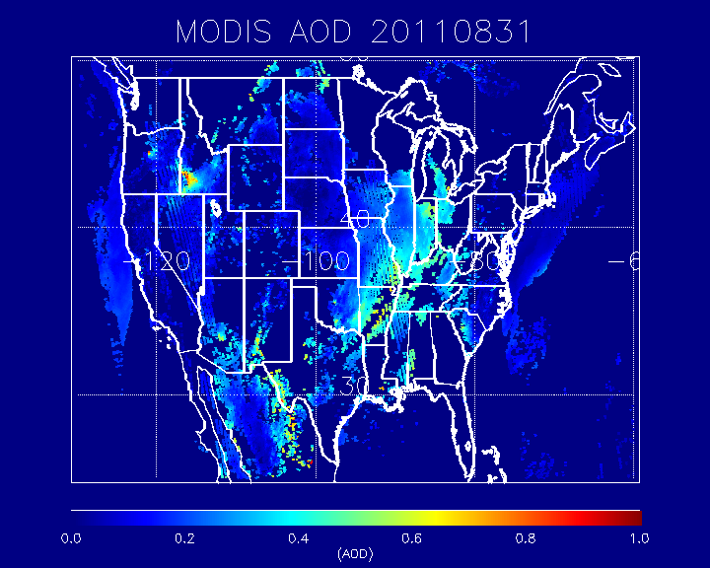
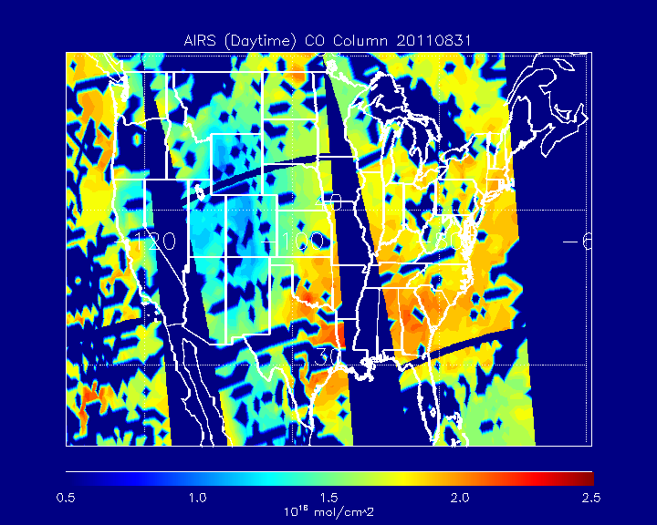
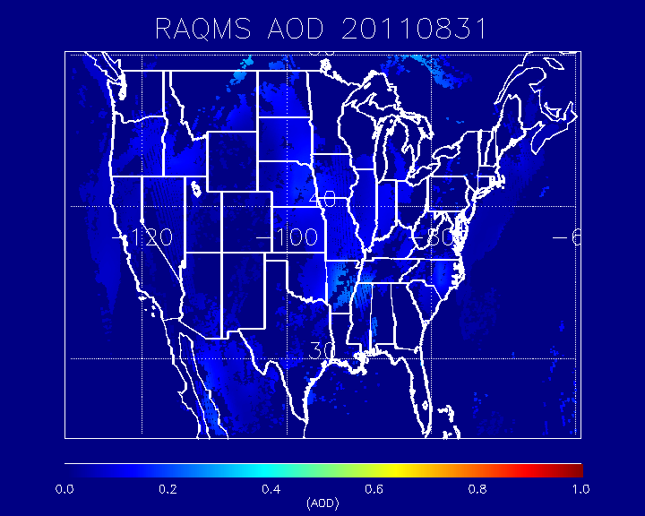
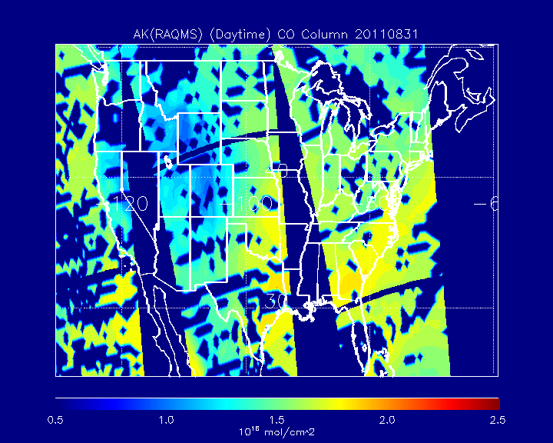
08/31 2011

Slide 29
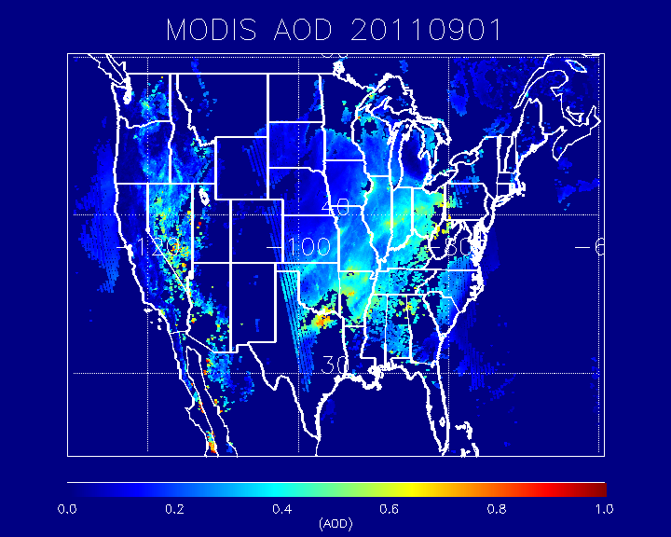
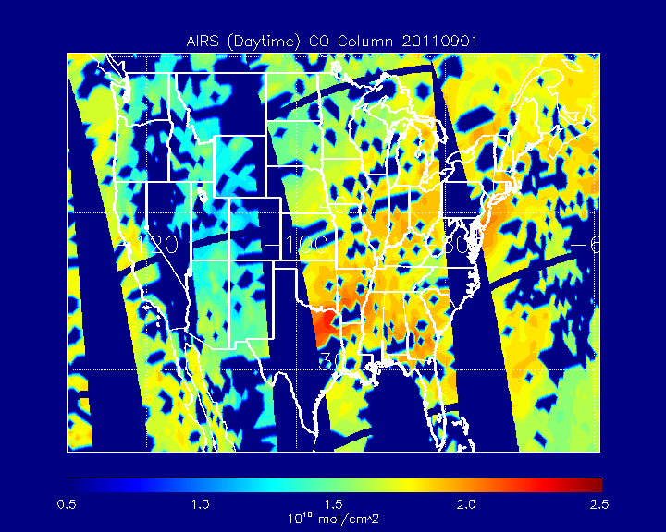
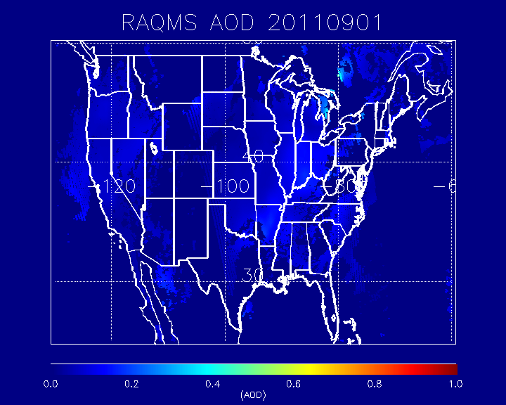
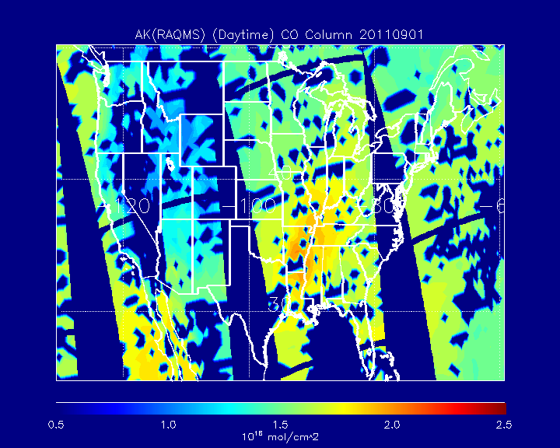
09/01 2011
09/01 2011

Slide 30
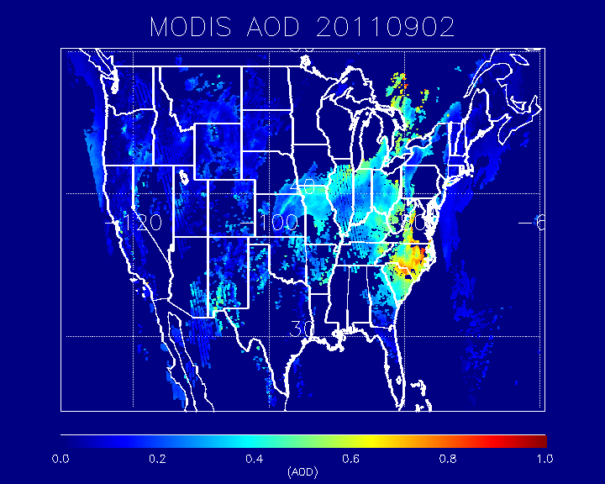
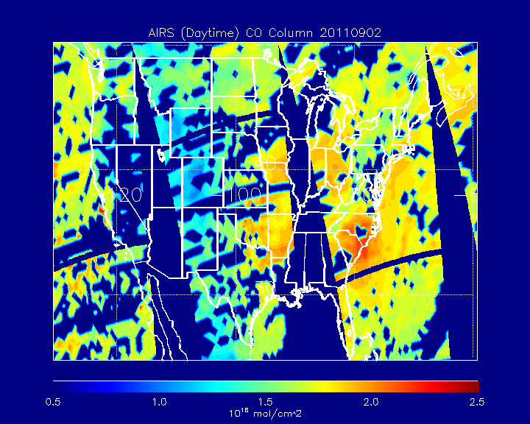
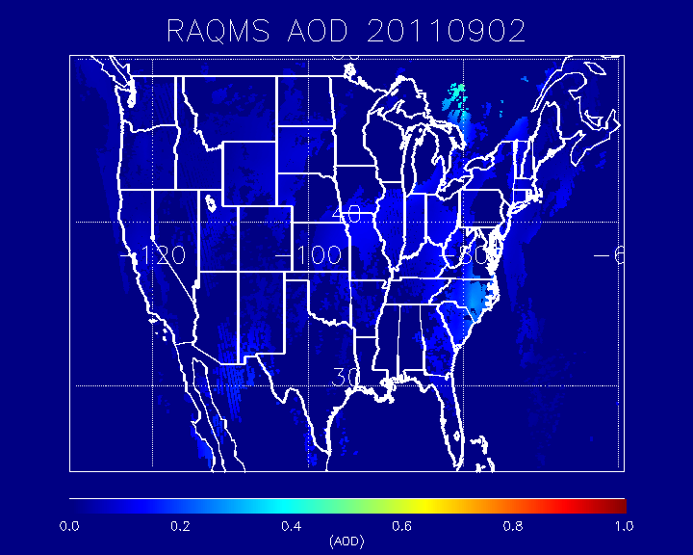
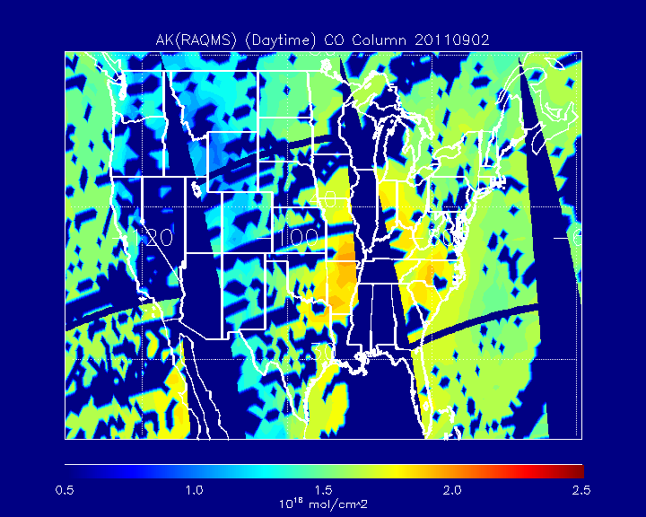
09/02 2011
09/02 2011

Slide 31
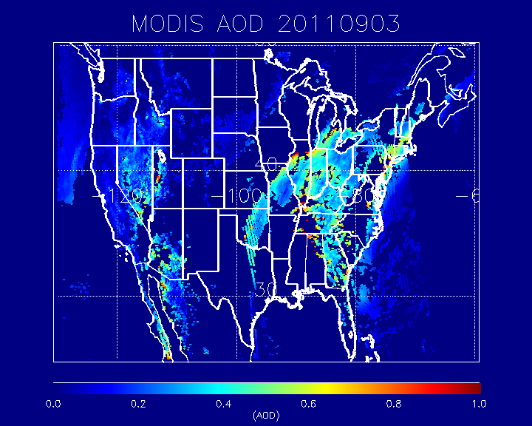
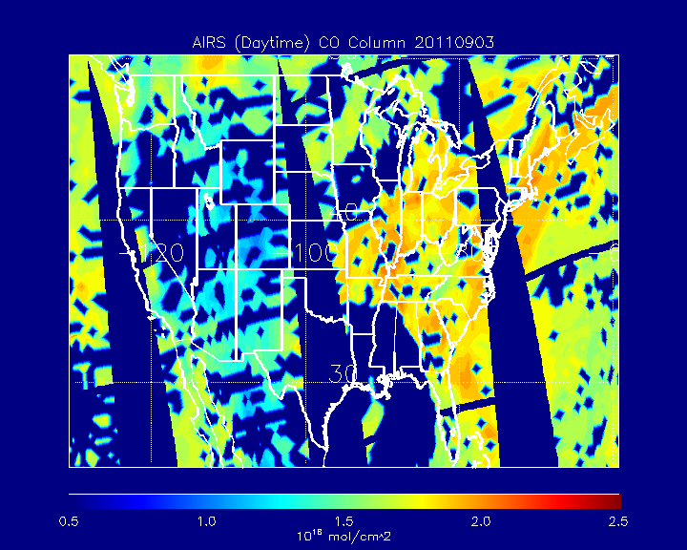
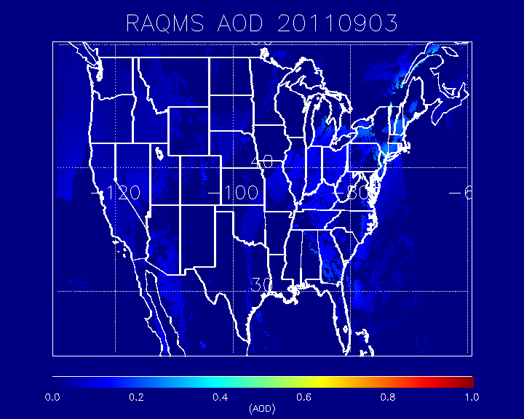
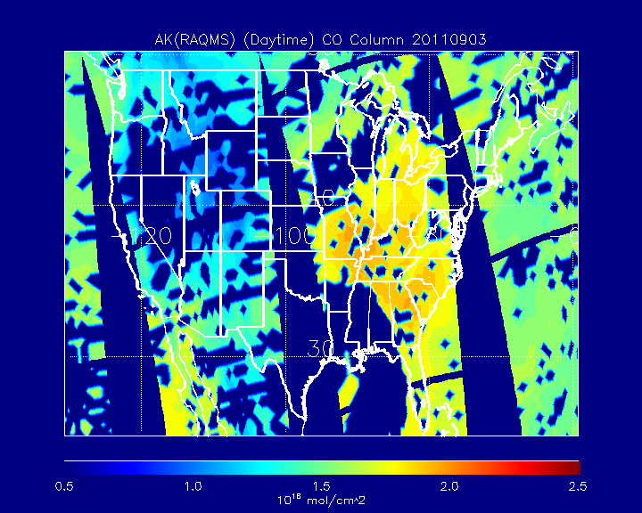
09/03 2011
09/03 2011

Slide 32
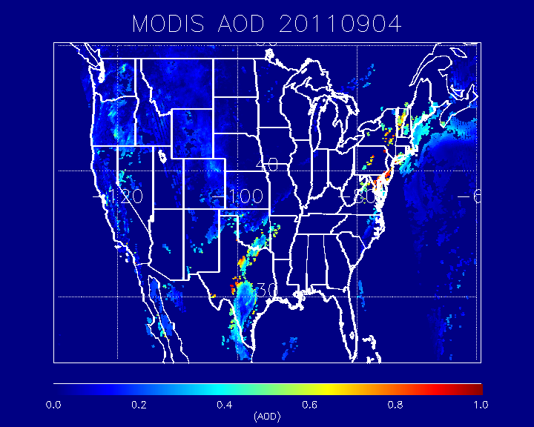



09/04 2011
09/04 2011

Slide 33




09/05 2011
09/05 2011

Slide 34




09/06 2011
09/06 2011

Slide 35

AK(RAQMS) vs AIRS CO column
August 31 – September 06, 2011
+25%
-25%

Slide 36

RAQMS vs AIRS AOD
August 31 – September 06, 2011
+25%
-25%

Slide 37

Comparison with AIRS CO shows slight (<25%) low bias
Comparison with MODIS AOD shows significant (2-3x) low bias
Now use Cloud-Aerosol Lidar and Infrared Pathfinder Satellite Observation (CALIPSO) aerosol extinction profiles to verify vertical aerosol structure
AOD = $\sum_{zsfc}^{ztop}{extinction(z)∗dz}$

Slide 38

Cloud-Aerosol Lidar and Infrared Pathfinder Satellite Observation (CALIPSO)
CloudSat
CALIPSO
Aqua
PARASOL
Aura
CALIPSO flies as part of the Aqua satellite constellation (or A-Train), which consists of the Aqua, CloudSat, CALIPSO, PARASOL, and Aura satellite missions.
http://www-calipso.larc.nasa.gov/

Slide 39

CALIPSO LADCO Daytime Observations 09/01

Slide 40


CALIPSO LADCO Daytime Observations 09/01
Attenuated
Backscatter
Region of interest: 0-5km
Alabama to Wisconsin
Vertical Feature Mask

Slide 41


RAQMS underestimates
aerosol extinction over AL and TN (A) and misses lofted aerosols above 3km (B)
(A)
(B)

Slide 42
Summary
OMI NO2 retrievals are valuable for emission verification and compare favorably with columns estimated from insitu airborne profiles
  see follow-on lecture and activity on NO2 Regridding
TES, MOPITT and AIRS CO retrievals are valuable for model transport verification but the vertical sensitivity of the retrievals must be accounted for.
  TES and MOPITT have some sensitivity to boundary layer CO enhancements
  AIRS is primarily sensitive to mid-tropospheric (500mb) CO
  TES provides profile curtain (no swath)
MODIS AOD retrievals are valuable for both emission verification (wildfires) and transport.
  Combining with AIRS CO improves verification of model transport since AIRS provides better spatial coverage (cloud clearing)
CALIPSO provides aerosol extinction curtain (no swath) that complements MODIS AOD (column)

Slide 43

Summary (cont)
IDL Tools to interpolate CAMX model fields to MOPITT and TES L2 retrievals have been developed and tested using TCEQ CAMX simulations.
  These tools could be expanded to include AIRS, OMI, MODIS, and CALIPSO data for CAMX verification at LADCO
Would be interested in working with CAMX modelers to apply tools to LADCO case studies!!

