Slide 1
Status update
JPSS Fire and Smoke Initiative activities
Analysis of Arizona Juniper wild fire
Brad Pierce¹, Allen Lenzen², James Davies², Russ Dengel², Shobha Kondragunta¹
¹NOAA/NESDIS/STAR
²UW-Madison/SSEC
JPSS Fire and Smoke Initiative Telecon June 10, 2016

Slide 2
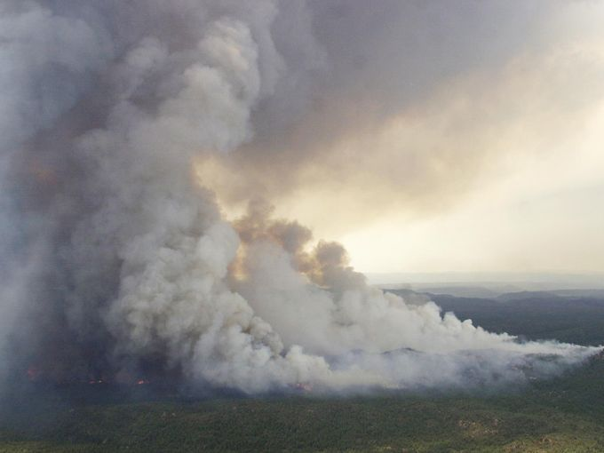
A May 17 lightning strike started the Juniper Fire, which continues to burn in the Sierra Ancha Wilderness of the Tonto National Forest in Arizona.

Slide 3
RealEarth VIIRS fire detections (red dots) and true color image on June 06, 2016

Slide 4
RealEarth VIIRS fire detections (red dots), true color image, and Aerosol Optical Depth (AOD)
on June 06, 2016

Slide 5
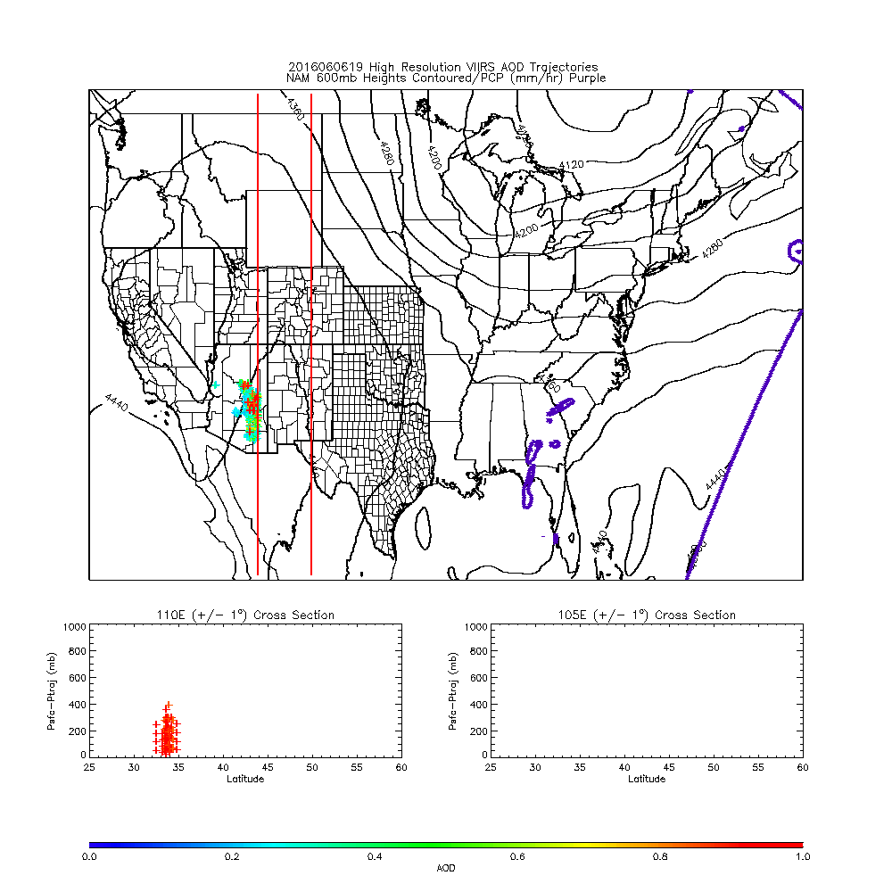
Initial High resolution IDEA-I trajectories
Arizona Juniper wildfire
June 06, 2016
IDEA-I high resolution Trajectories initialized for each 6km VIIRS AOD EDR pixel
High resolution NAM PBL used to define initial depth of trajectory profile

Slide 6
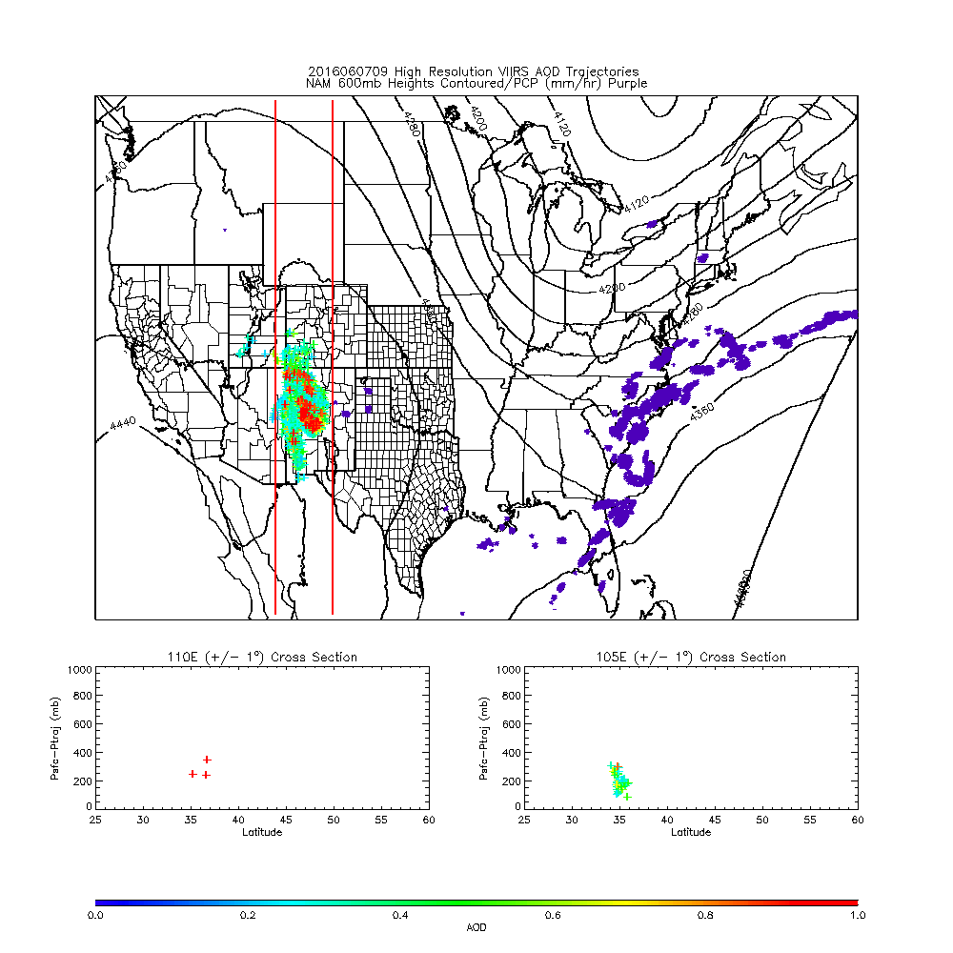
Initial High resolution IDEA-I trajectories
Arizona Juniper wildfire
June 06, 2016
IDEA-I high resolution Trajectories initialized for each 6km VIIRS AOD EDR pixel
High resolution NAM PBL used to define initial depth of trajectory profile

Slide 7
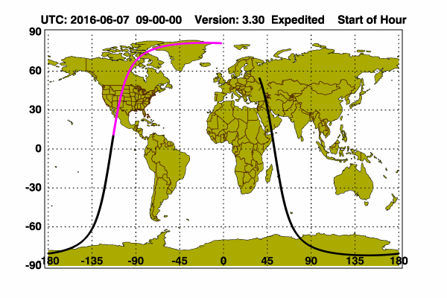
CALIPSO Lidar observations near 4-Corners
(to the east of the Juniper Fire)
09Z June 7, 2016
Juniper Fire plume lofted to 7km (400mb) due to deep PBL over mountain terrain

Slide 8
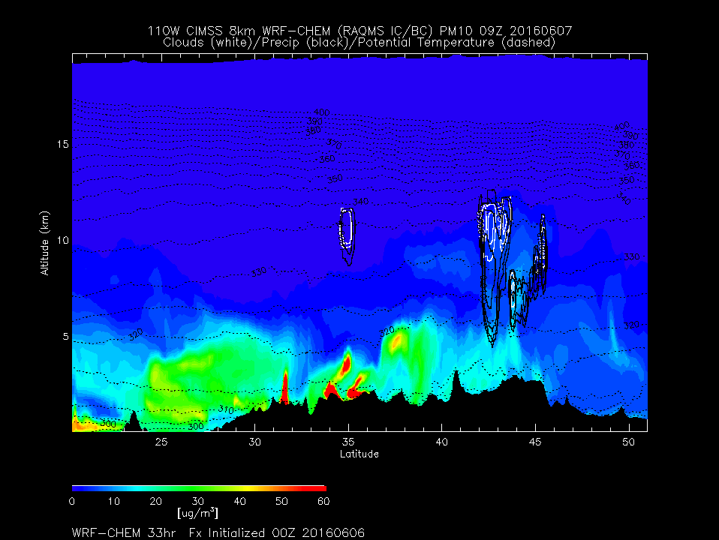
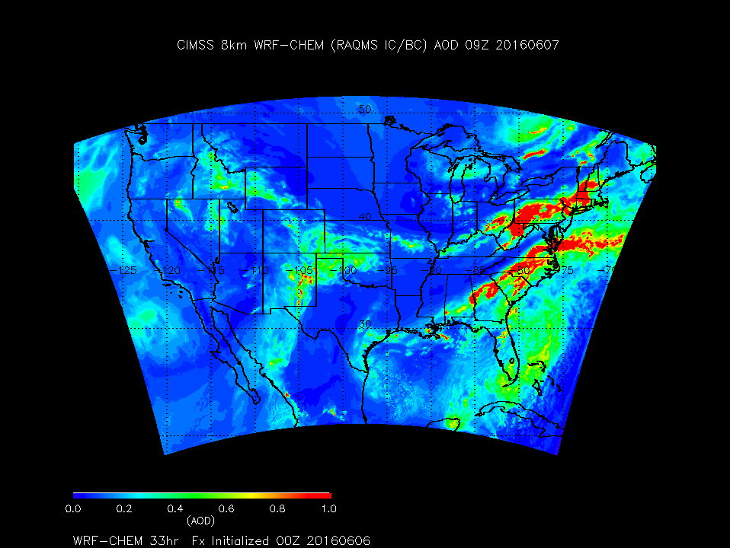
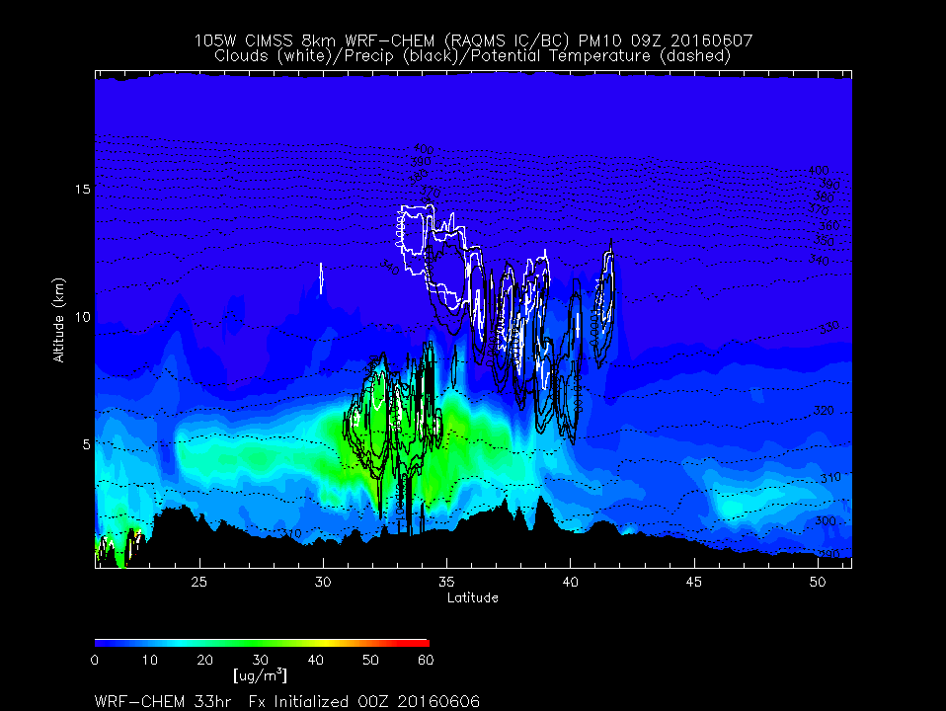
CIMSS 8km WRF-Chem total Aerosol Optical depth (AOD) 33hr FX near 4-Corners
(Juniper Fire)
09Z June 7, 2016
CALIPSO
CIMSS 8km WRF-Chem 33hr aerosol FX predicts lofted aerosol east of Juniper Fire at 09Z June 7, 2016

Slide 9
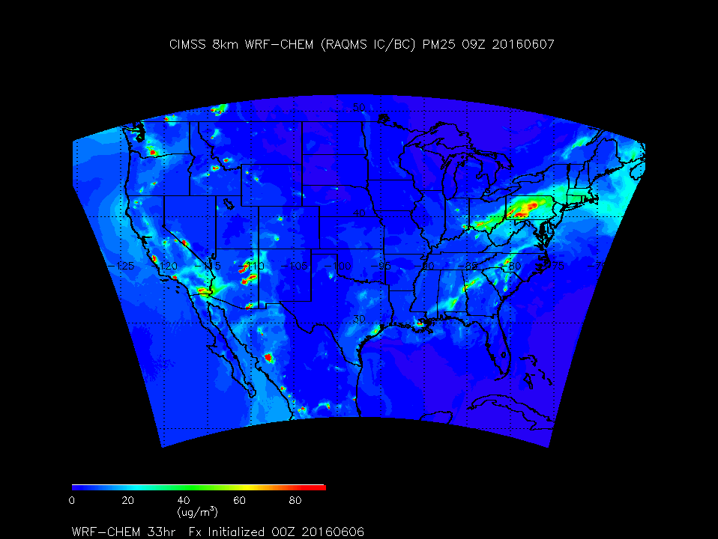
CIMSS WRF-Chem aerosol predicitons near 4-Corners
(Juniper Fire)
09Z June 7, 2016
CALIPSO
CIMSS 8km WRF-Chem 33hr surface aerosol FX predicts Juniper Fire impacts restricted to NE AZ and NW NM

Slide 10
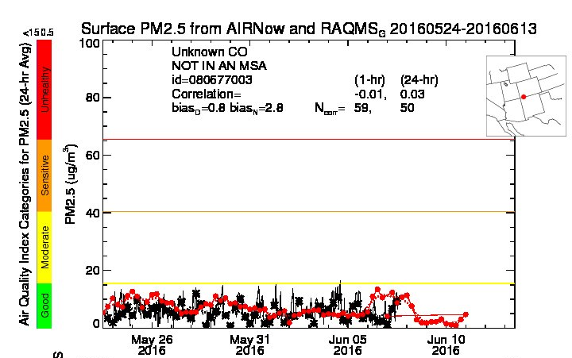
CIMSS WRF-Chem aerosol predicitons near 4-Corners
(Juniper Fire)
09Z June 7, 2016
CALIPSO
Observed PM2.5 (black) confirms no surface impact
Note: RAQMS 1x1 degree analysis (red) shows weak signature of Juniper Fire along CO/NM boarder due to coarse resolution of emissions and transport

Slide 11
Smoke from Juniper Fire is evident near sunset on June 08, 2016 in WRF-Chem ABI Visible Band 2 (0.64 micron) proxy radiances

Slide 12
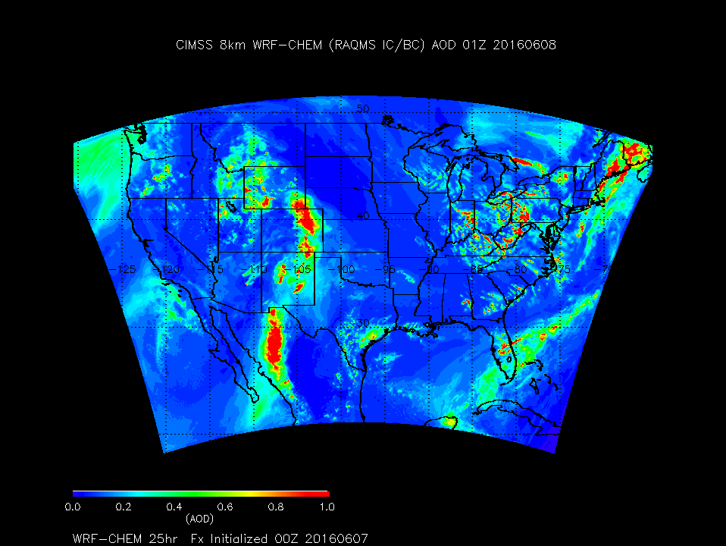
WRF-CHEM (True) 550 nm Aerosol Optical Depth (AOD)

Slide 13
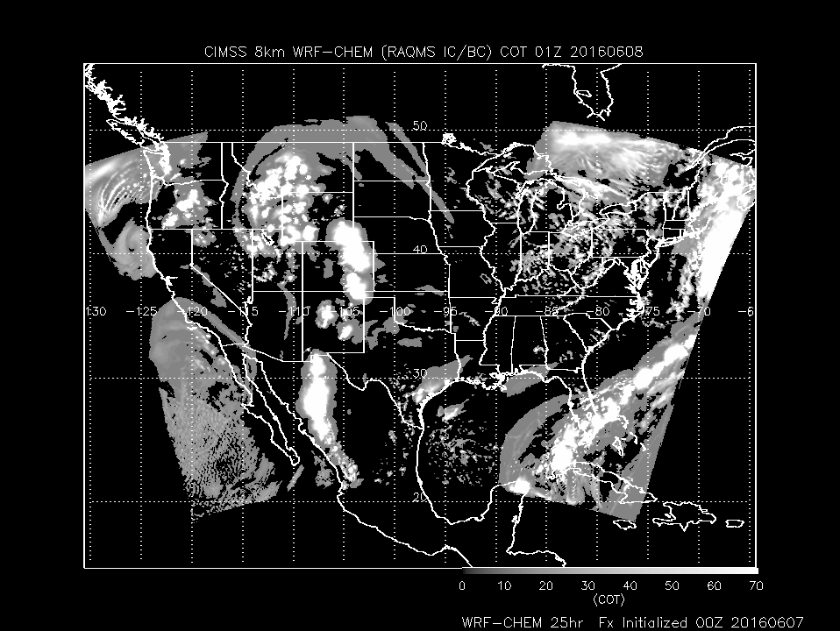
WRF-CHEM (True) Cloud Optical Thickness (COT)

Slide 14
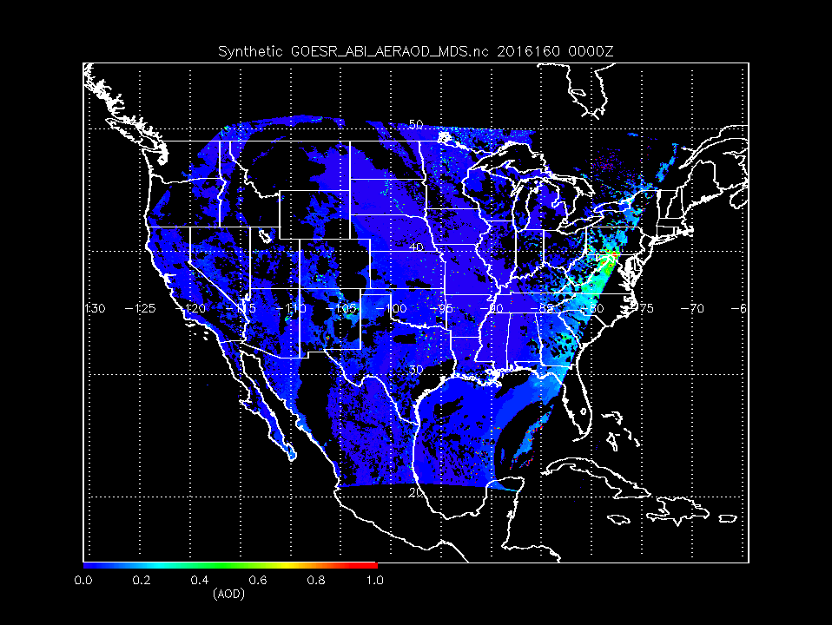
ABI retrieved 550 nm Synthetic Aerosol Optical Depth (AOD)

Slide 15
ABI retrieved 550 nm Synthetic Aerosol Optical Depth (AOD)

