Slide 1
JPSS Fire and Smoke Initiative
Wednesday, September 24, 2014
Initial Verification of July 16-20, 2014 Pacific Northwest Wildfire forecasting
Brad Pierce
Georg Grell
Steve Peckam

Slide 2
Real-time PM2.5 forecasts are compared to surface measurements from US EPA AIRNOW during the period from July 16-July 20, 2014
3km Western US HRRR-chemfire wildfire smoke PM2.5 prediction with 00Z, 06Z, 12Z, 18Z initialization carrying smoke PM2.5 forecast forward (http://rapidrefresh.noaa.gov/hrrrchemzeus)
13km North American RR-Chem full PM2.5 prediction with 00Z and 12Z initialization carrying previous PM2.5 forecast forward (http://ruc.noaa.gov/wrf/WG11_RT/)

Slide 3
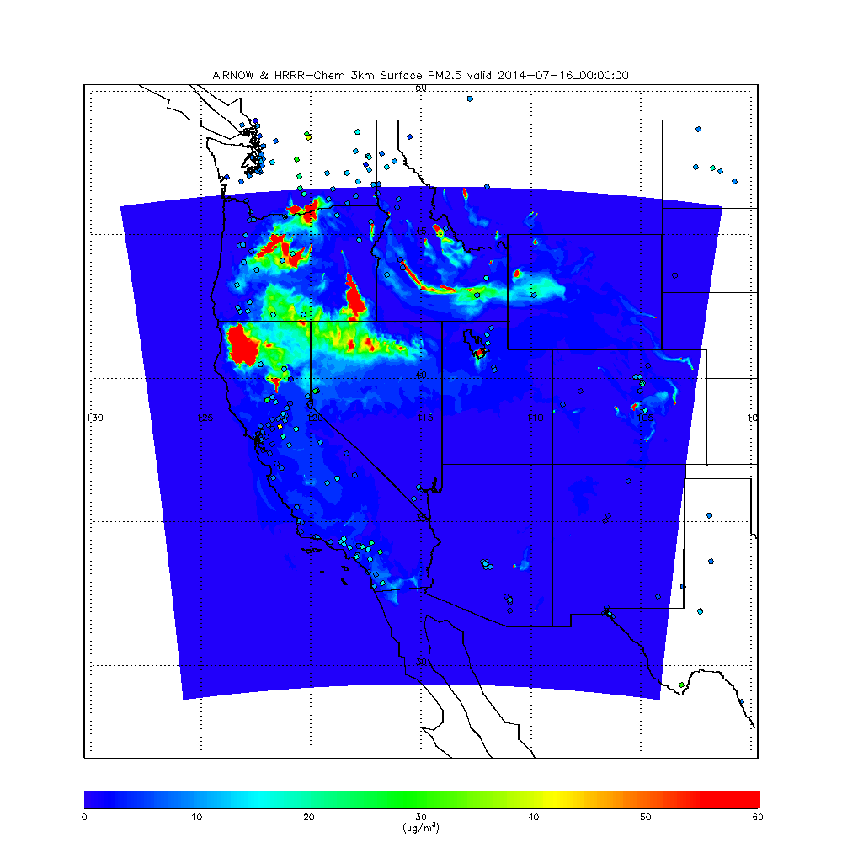
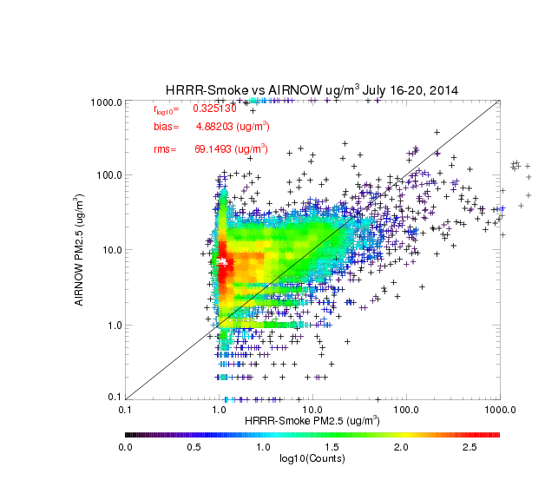
PM2.5 within smoke plumes is overestimated with overall low bias (~5ug/m³) due to neglect of urban, dust, and sea-salt aerosols
Log(PM2.5) correlation = 0.33

Slide 4
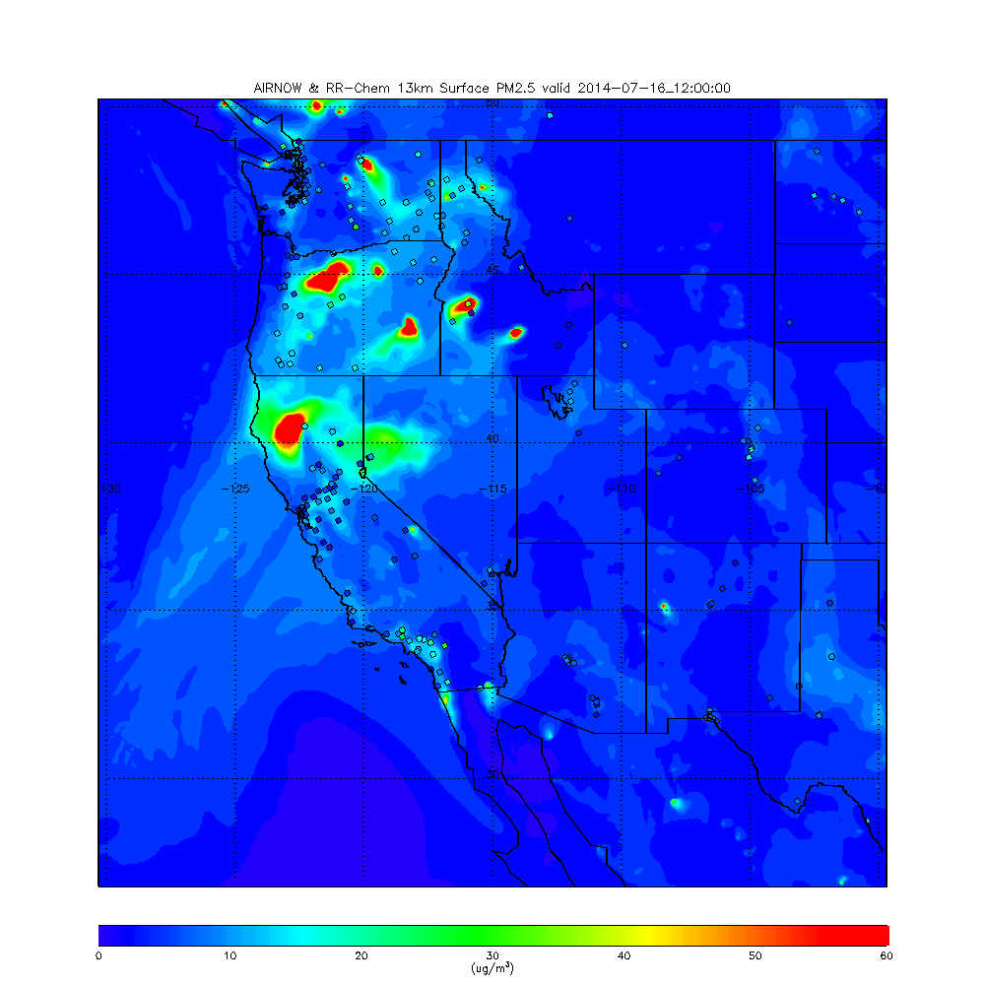
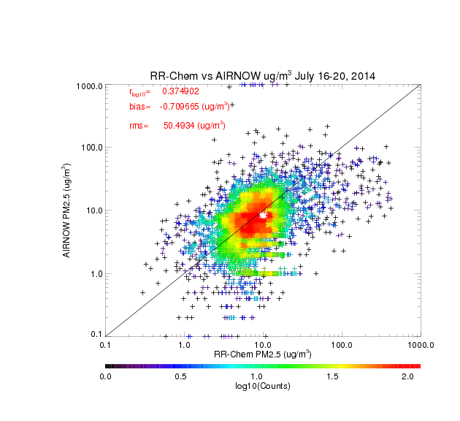
PM2.5 within smoke plumes is overestimated with significantly lower overall bias (<1ug/m³) and reduction in RMS errors (50.49 ug/m³)
Log(PM2.5) correlation = 0.37

Slide 5
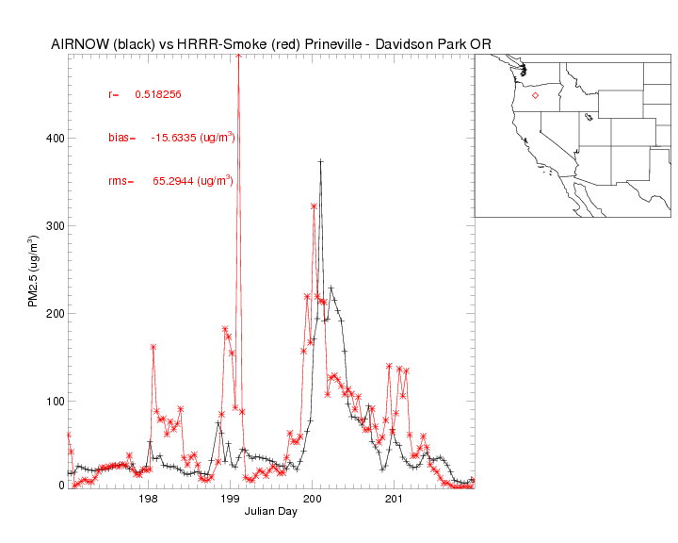
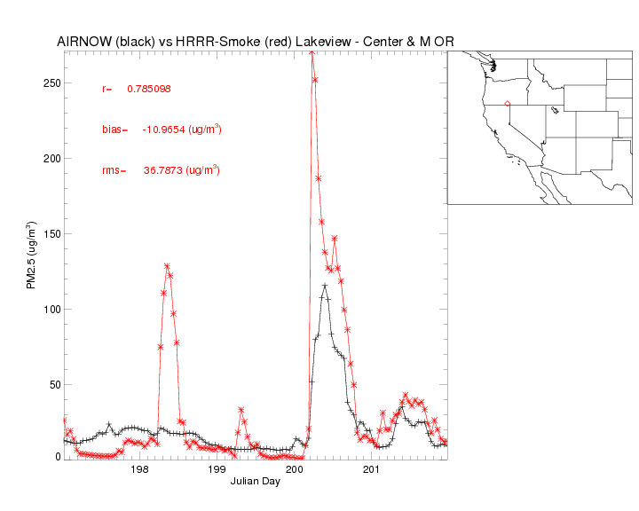
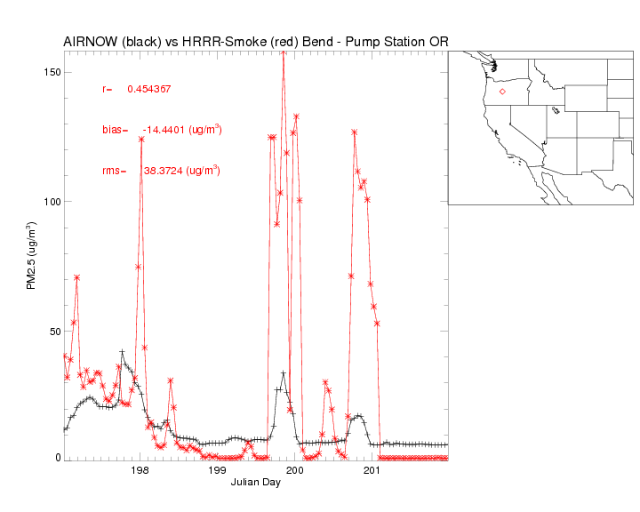
Timeseries for AIRNOW and HRRR-chemfire for Oregon sites with PM2.5 >40ug/m³
HRRR-chemfire overestimates peak PM2.5 during Oregon fire events except for Julian day 200 (July 19, 2014) at Prineville-Davidson Park OR
(hourly coincidence)

Slide 6
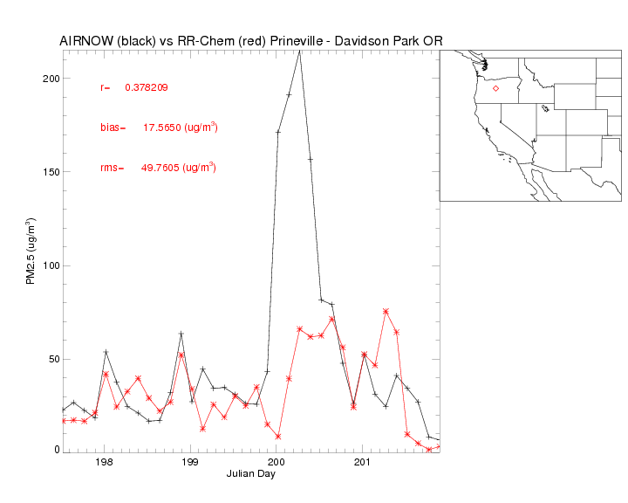
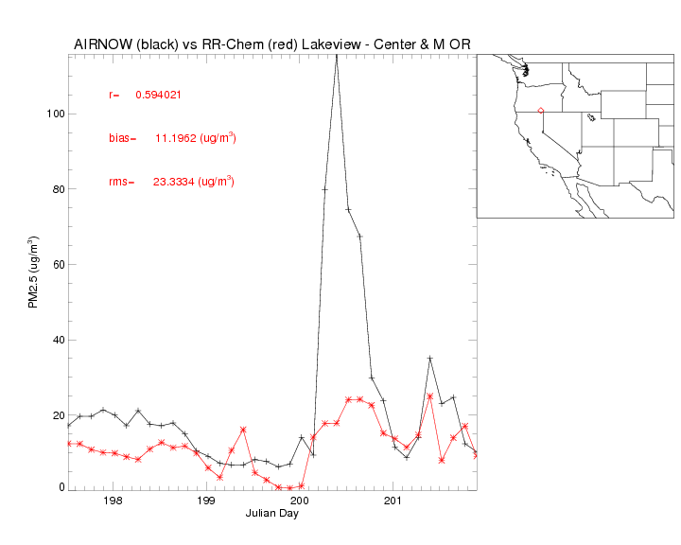
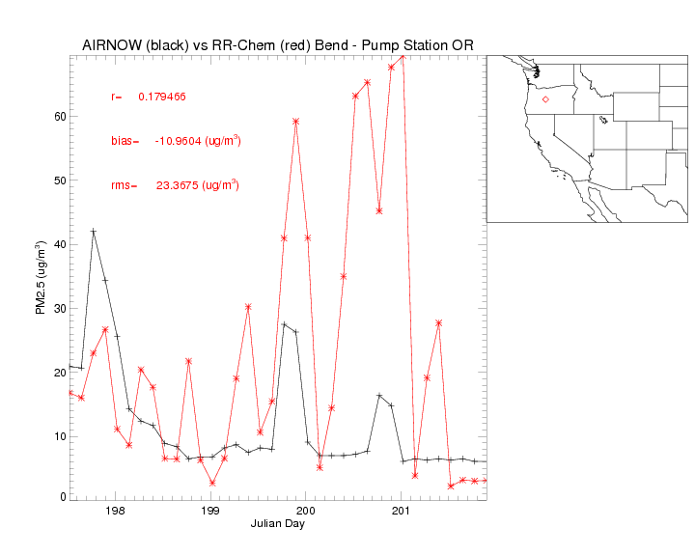
Timeseries for AIRNOW and RR-chem for Oregon sites with PM2.5 >40ug/m³
RR-chem underestimates peak PM2.5 during Oregon fire events except for Julian day 199-200 (July 18-19, 2014) at Bend – Pump Station OR
(3 hour coincidence)

Slide 7
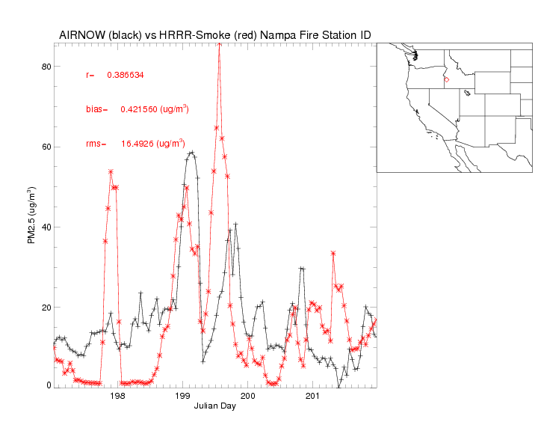
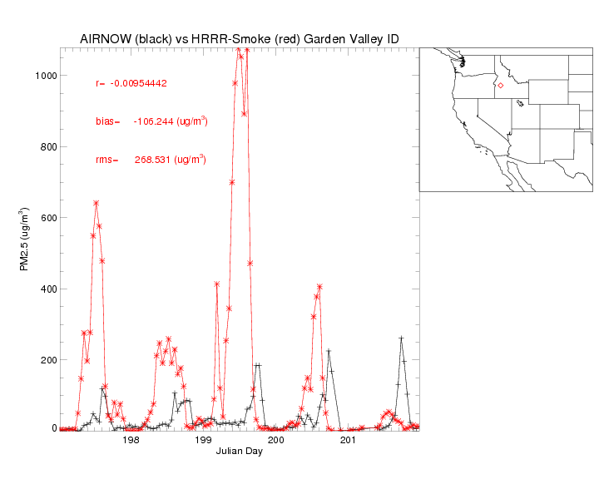
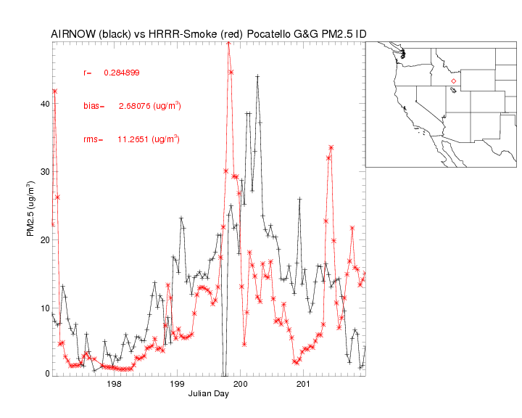
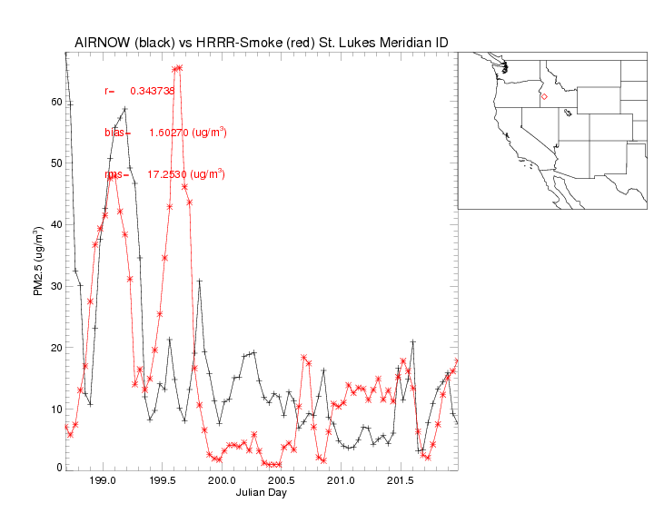
Timeseries for AIRNOW and HRRR-chemfire for Idaho sites with PM2.5 >40ug/m³

Slide 8
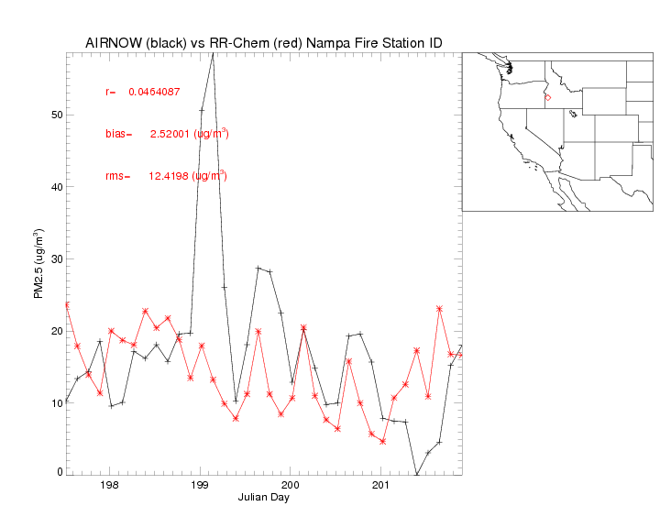
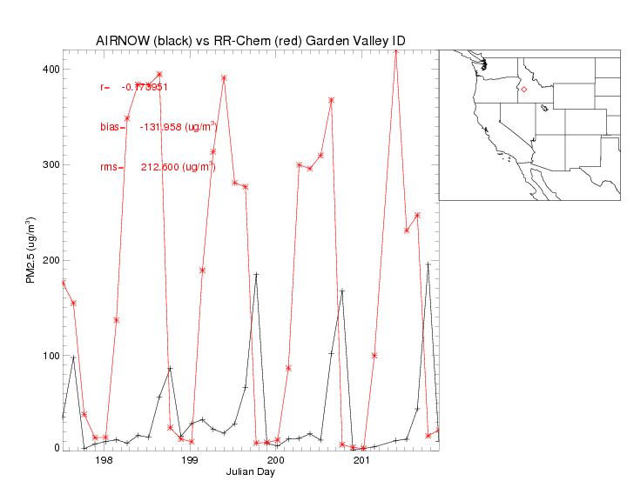
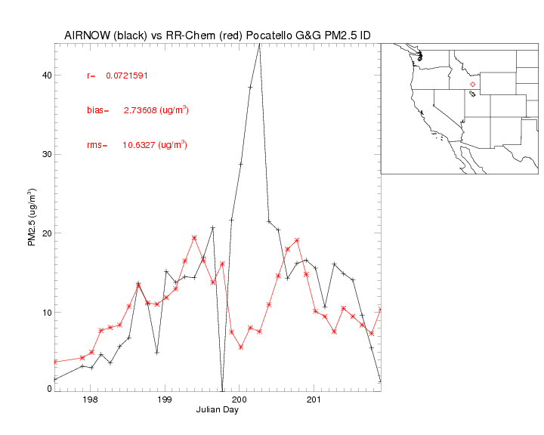
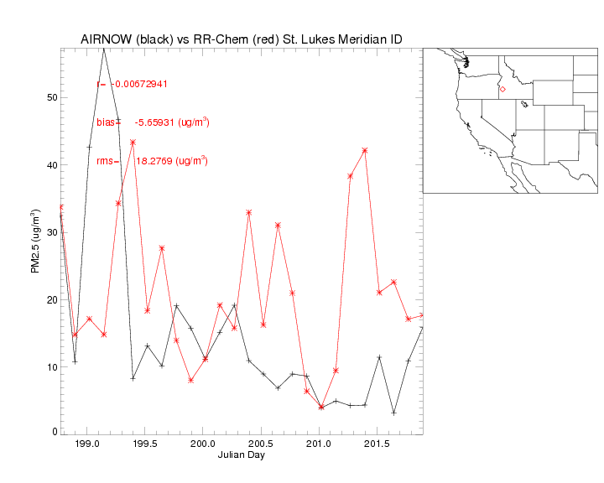
Timeseries for AIRNOW and RR-chem for Idaho sites with PM2.5 >40ug/m³

Slide 9
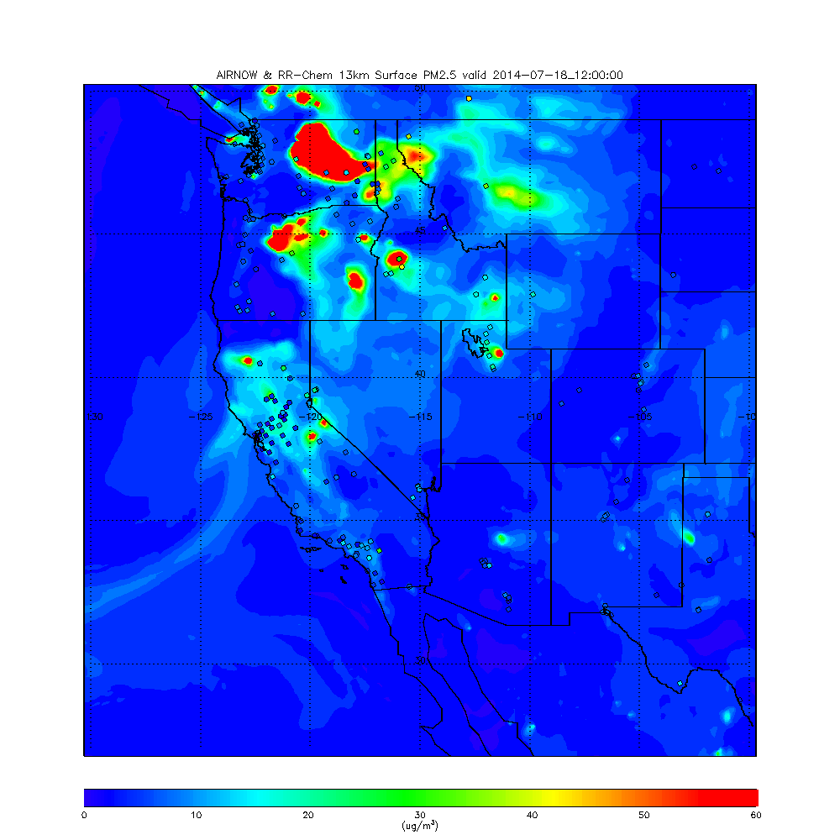
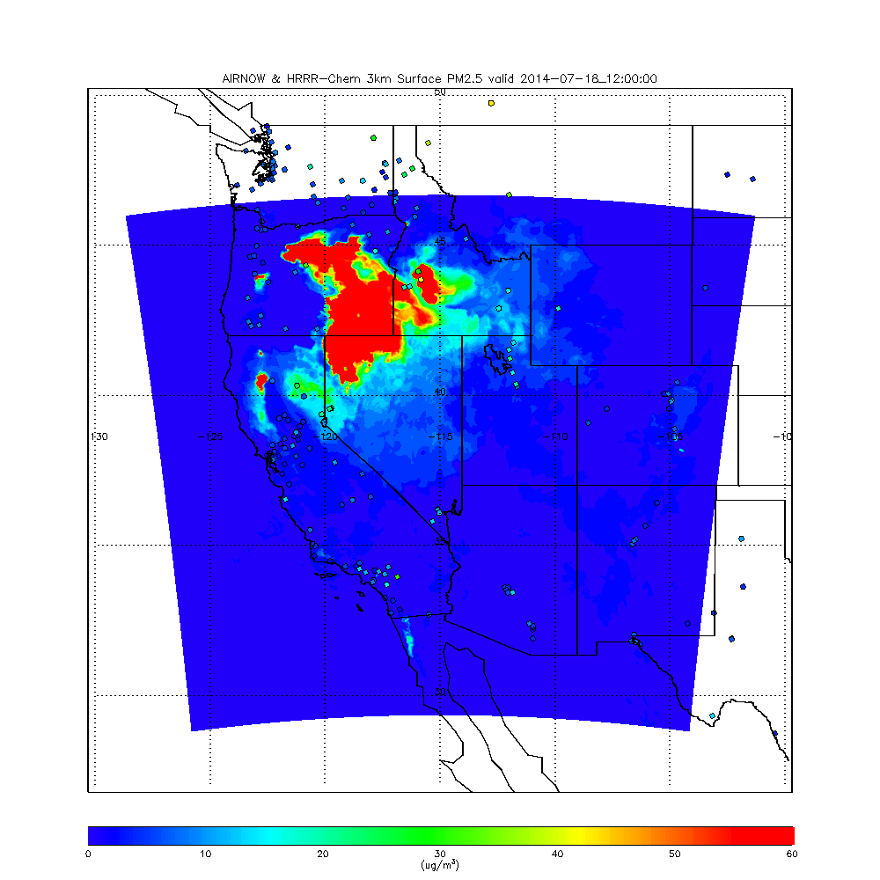
Next steps: Look at skill from a contingency table perspective
Investigate diurnal variation of PM2.5 (drainage flow?, emissions?, pbl depth?)
Impact of AOD assimilation

Slide 10
Extra Slides

Slide 11
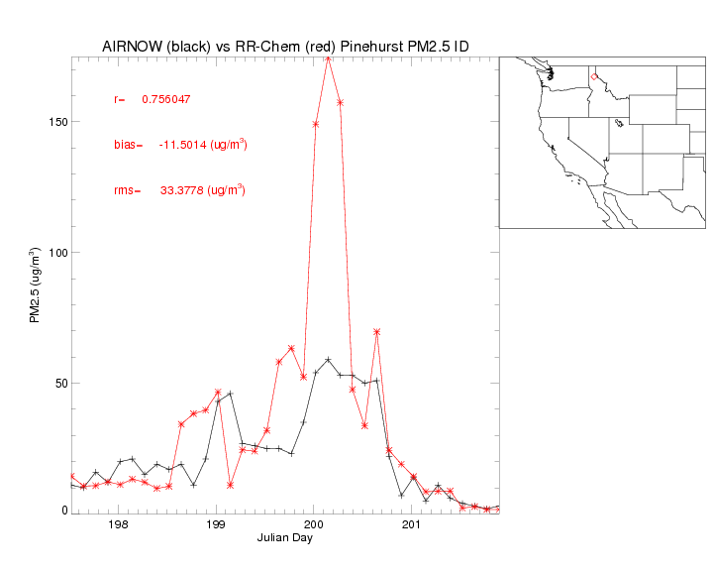
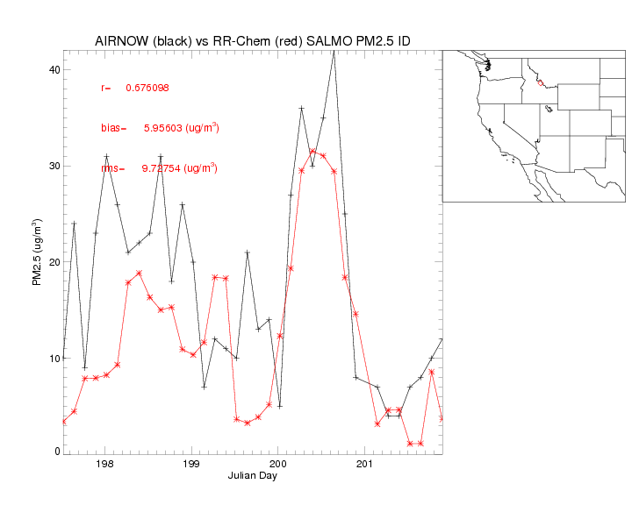
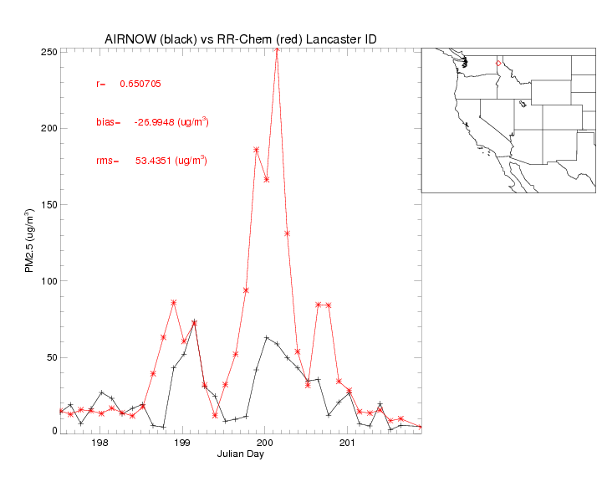
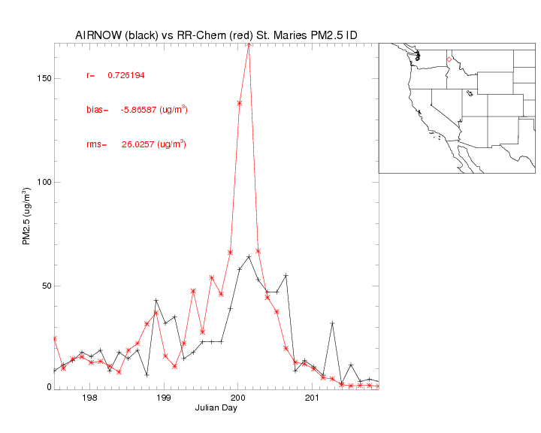
Timeseries for AIRNOW and RR-chem for Idaho sites with PM2.5 >40ug/m³
Outside HRRR-chemfire domain

Slide 12
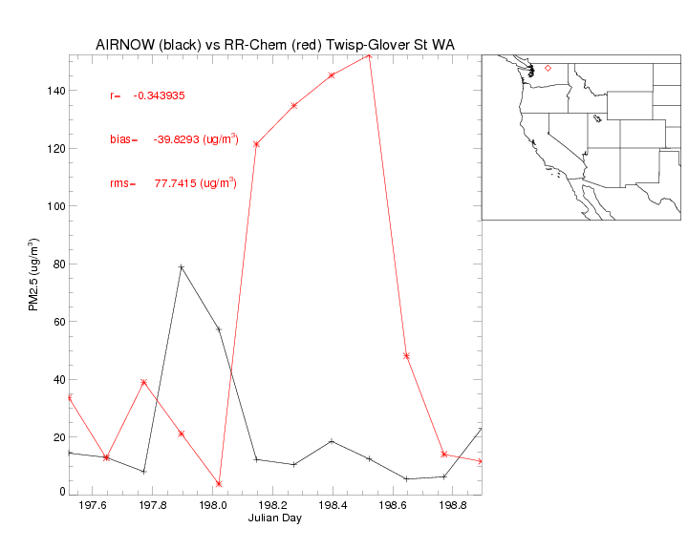
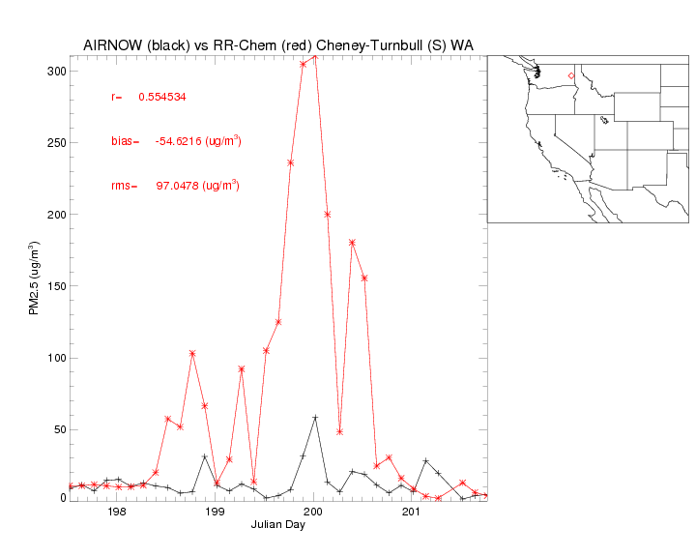
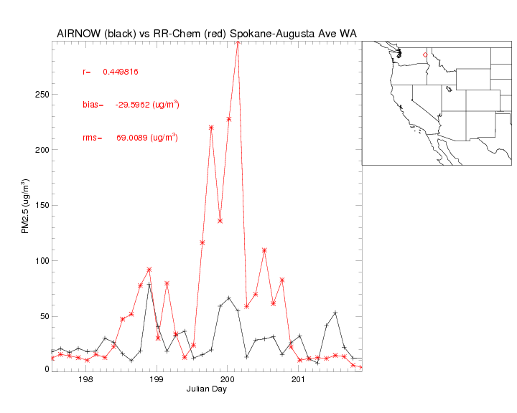
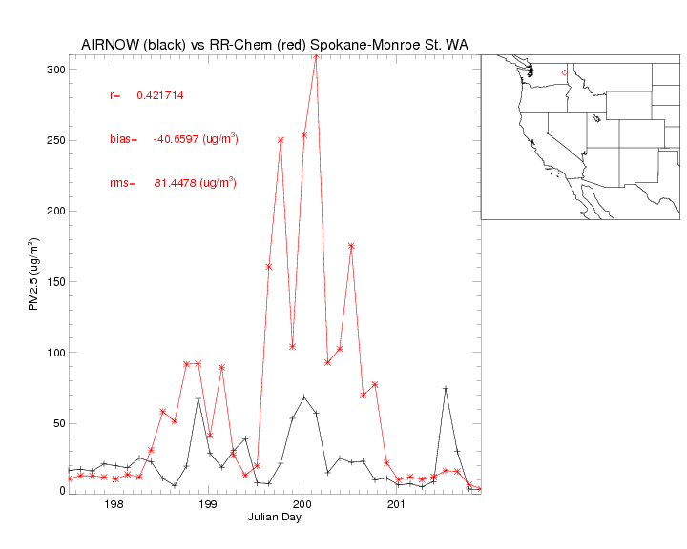
Timeseries for AIRNOW and RR-chem for Washington sites with PM2.5 >40ug/m³
Outside HRRR-chemfire domain

Slide 13
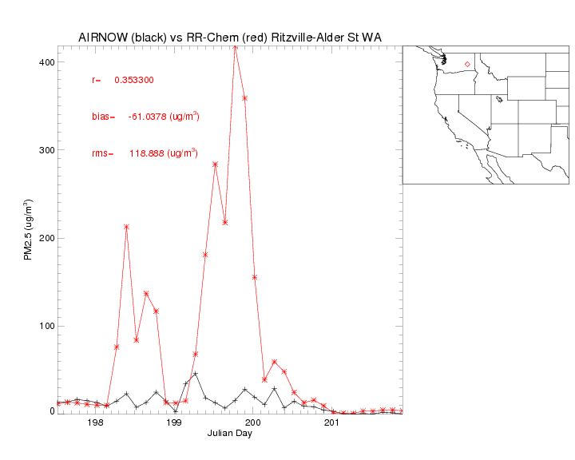
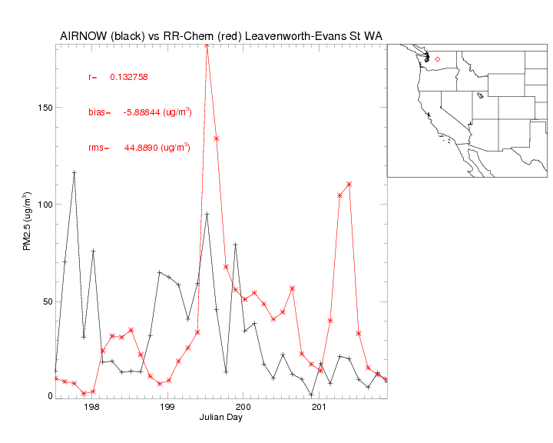
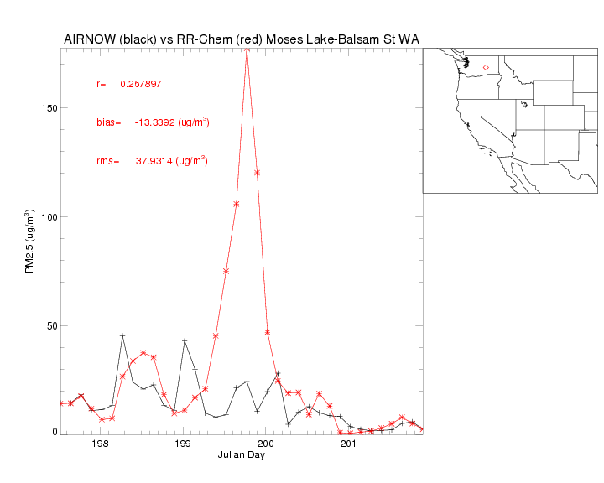
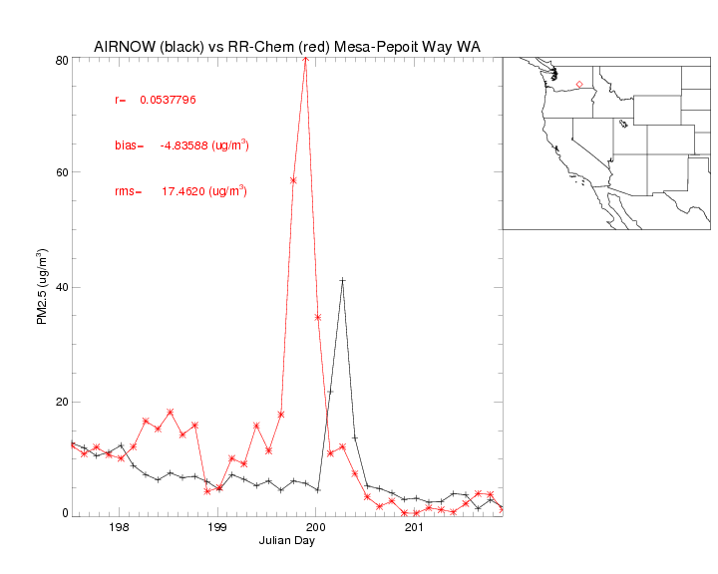
Timeseries for AIRNOW and RR-chem for Washington sites with PM2.5 >40ug/m³
Outside HRRR-chemfire domain

