Slide 1


Constituent and Aerosol Assimilation
R. Bradley Pierce
National Ocean and Atmospheric Administration
National Environmental Satellite, Data, and Information Service
Center for Satellite Applications and Research (STAR)
JCSDA Summer Colloquium on Data Assimilation Santa Fe, New Mexico

Slide 2
Outline
Motivation
  Anthropogenic changes in atmospheric composition
  Radiative influences of trace gases/aerosols
Background
  Tropospheric ozone chemistry and aerosol formation
Satellite trace gas and aerosol assimilation
  TEXAQS-II (http://www.esrl.noaa.gov/psd/programs/texaqs/2006/)
  CalNex (http://www.esrl.noaa.gov/csd/projects/calnex/)
Operational Aerosol and Composition assimilation
  NAAPS (Navy)
  GEMS (EU)
  NAQFC (NCEP)
Current research directions
  Links between Air Quality and Climate Change
  Volcanic Ash assimilation
  Links between aerosols and severe weather (preliminary results)

Slide 3
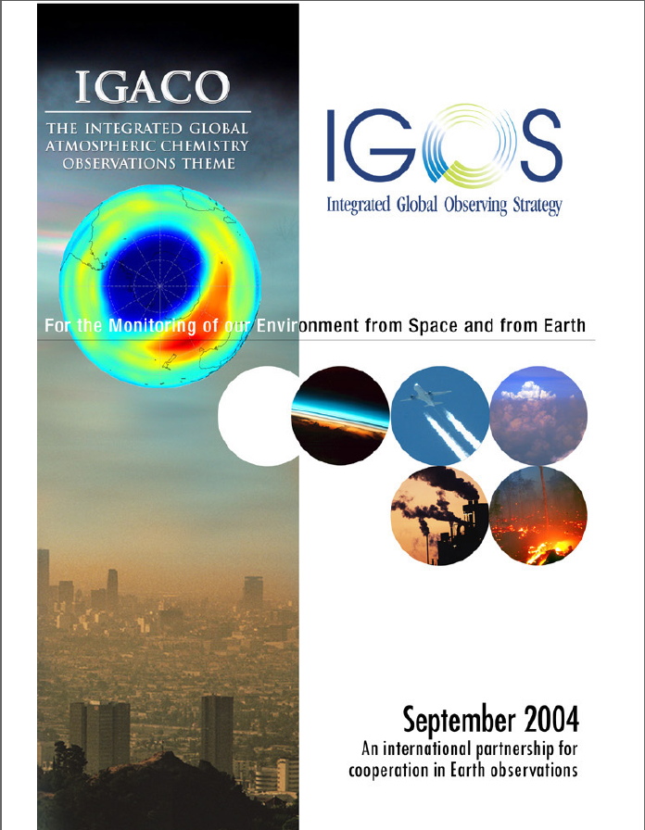
Motivation
Changes in atmospheric composition
since the industrial revolution
• Decreases in stratospheric ozone and increases in surface ultraviolet radiation
• Occurrence of urban smog and increased ozone background in the northern troposphere
• Increases in greenhouse gases and aerosols and associated climate change
• Acid rain and eutrophication of surface waters
• Enhanced aerosol and photo-oxidant levels due to biomass burning
• Increases in fine particles, reduction in visibility and human health effects
• Long-range transport of air pollution
“Many of these changes in atmospheric composition have socio-economic consequences through adverse effects on human and ecosystem health, on water supply and quality, and on crop growth.”
From IGOS Atmospheric Chemistry Theme Report 2004

Slide 4
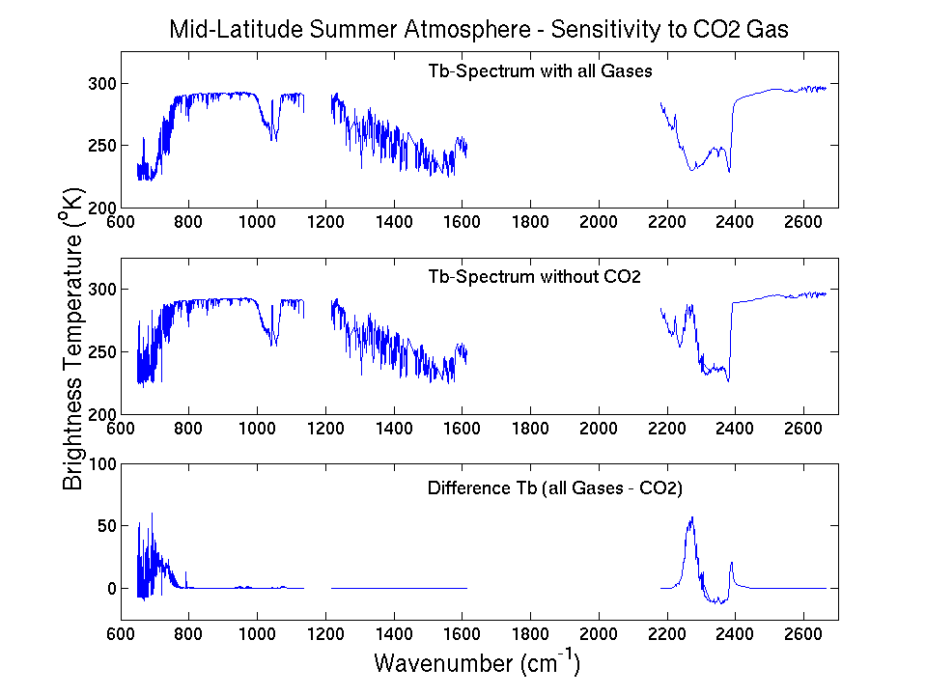
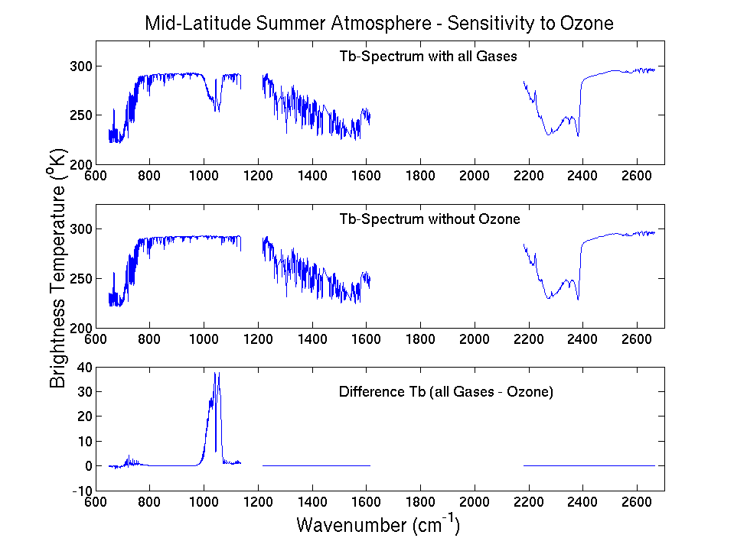
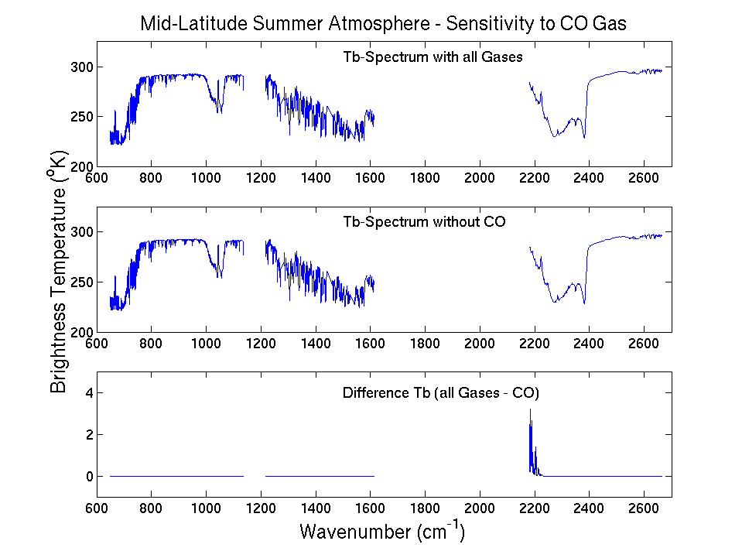
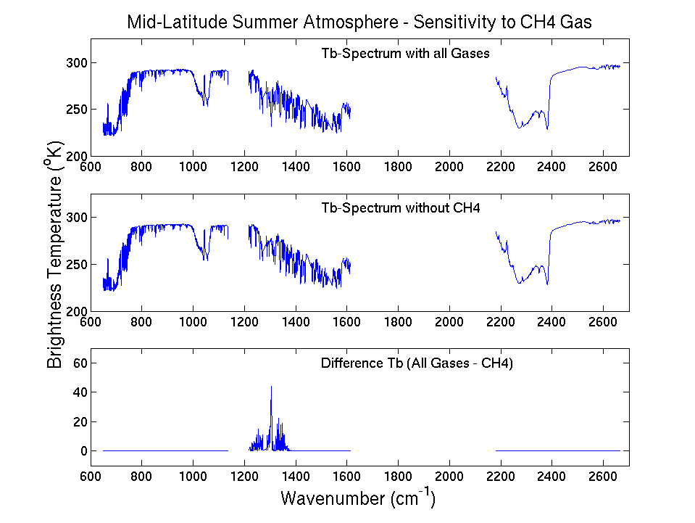
Radiative influences of Trace Gases
Radiative influences of Ozone, CO, CH4, CO2, N2O and other GHG are significant
Temporal/spatial variability should be accounted for in forward radiative transfer modeling
Figure provided by Tim Schmit, NESDIS/STAR

Slide 5
Background
Tropospheric Air Quality
  Tropospheric aerosol formation
  NOx/VOC chemistry

Slide 6
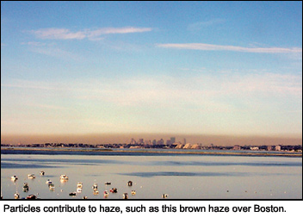

Tropospheric Air Quality is largely determined by
the abundance of Aerosols and Ozone
What are tropospheric aerosols?
Aerosols are a mixture of microscopic solids and liquid droplets suspended in air. This pollution, also known as particulate matter, is made up of a number of components, including acids (such as nitrates and sulfates), organic chemicals, metals, soil or dust particles, and allergens (such as fragments of pollen or mold spores).
Ground-level ozone, a primary ingredient in smog, is formed when volatile organic compounds (VOCs) and NOx react chemically in the presence of sunlight. Car, trucks, power plants and industrial facilities are primary sources of these emissions. Ozone pollution is a concern during the summer months when the weather conditions needed to form ground-level ozone – lots of sun and hot temperatures – normally occur.

Slide 7
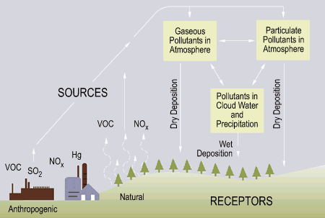
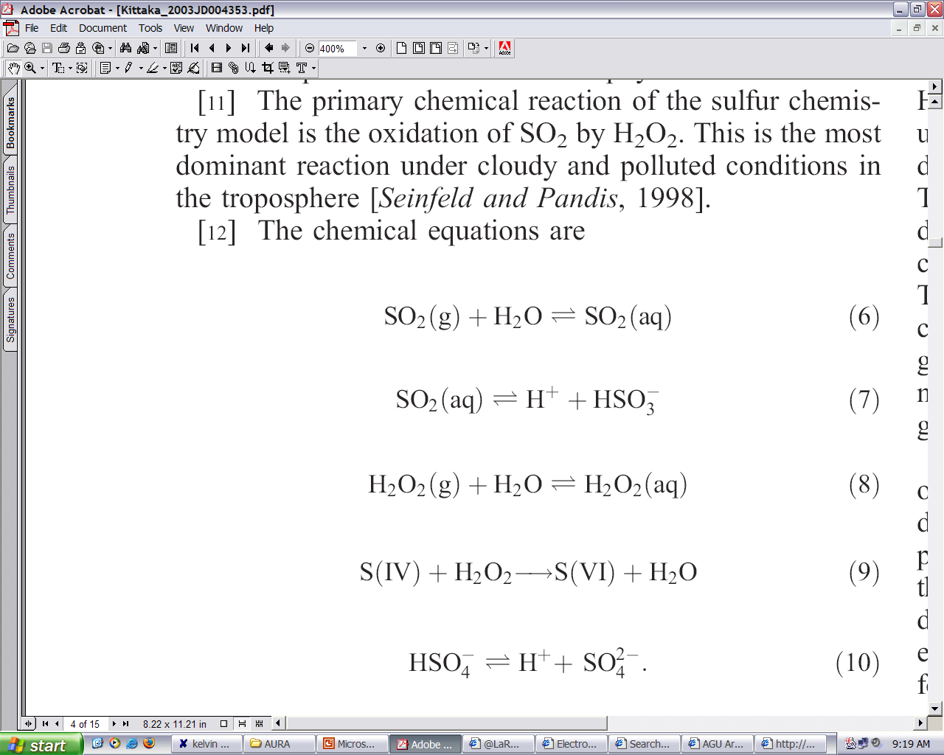
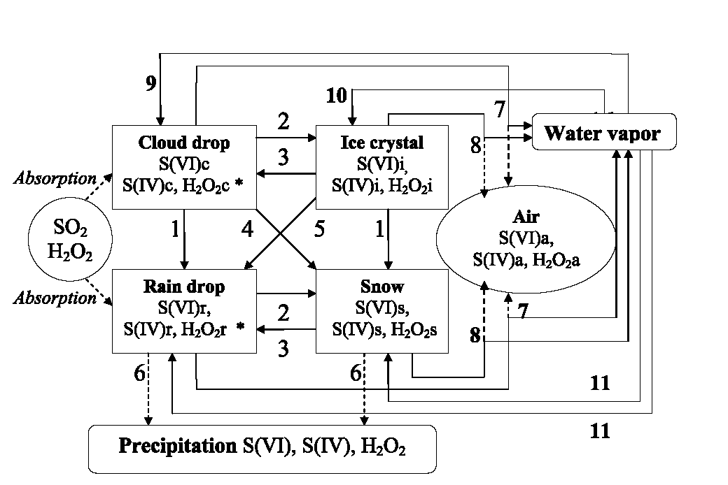
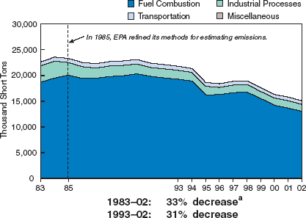
Aerosol formation in polluted environments
Oxidation of Sulfur dioxide (SO2) from by Hydrogen Peroxide (H2O2) produces small (< 2.5 micron) Sulfate (SO4) aerosol particles.
National SO2 emissions (EPA)
In-cloud processing of Sulfate aerosols produces “acid rain”

Slide 8
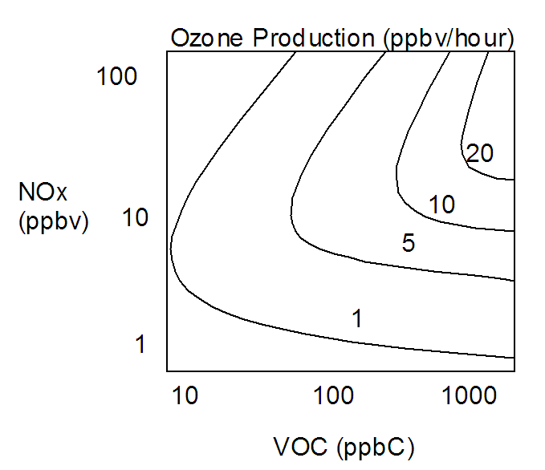
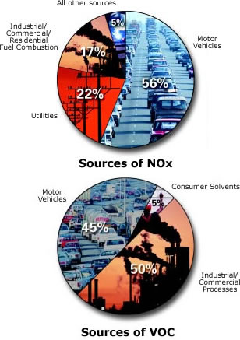
Tropospheric Ozone Production
Ozone production is controlled by the abundance of precursors, such as Nitrogen oxides (NOx) and Volatile Organic Hydrocarbons (VOC)
Schematic diagram of simplified tropospheric
photochemistry. Species in red can be measured
using existing satellite instrumentation.

Slide 9
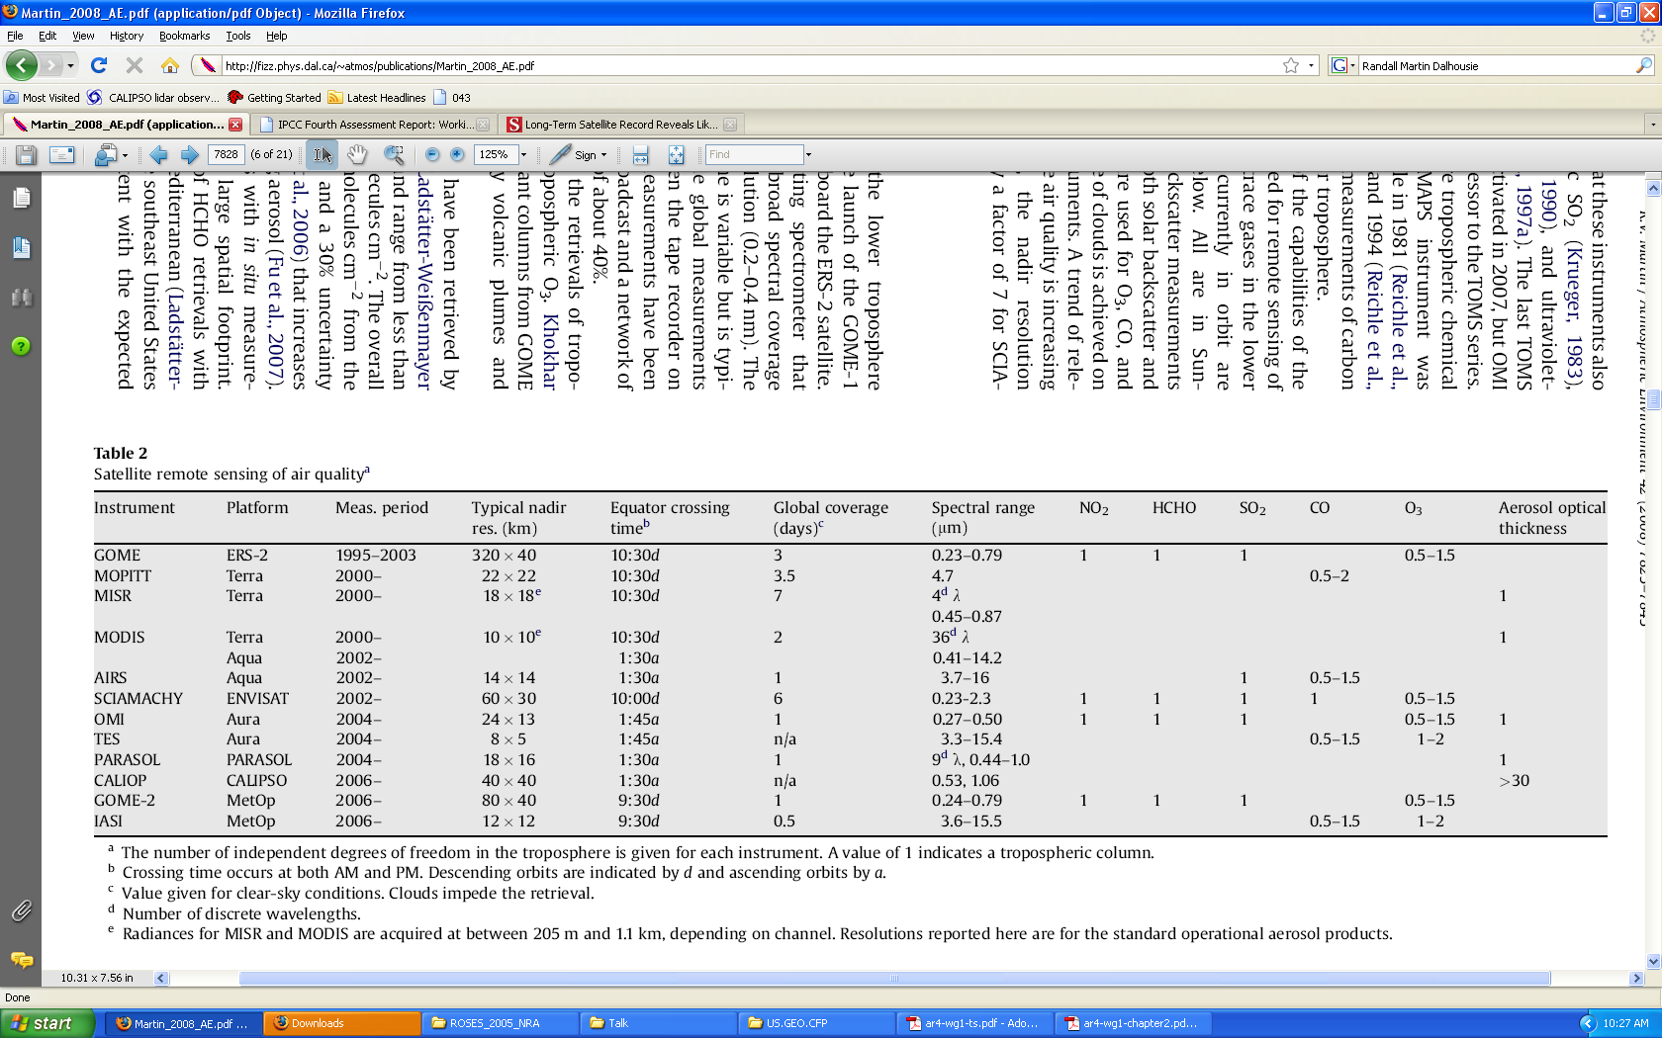
Satellite remote sensing of Air quality
[From Martin, R. V., Atmospheric Environment, 2008]

Slide 10
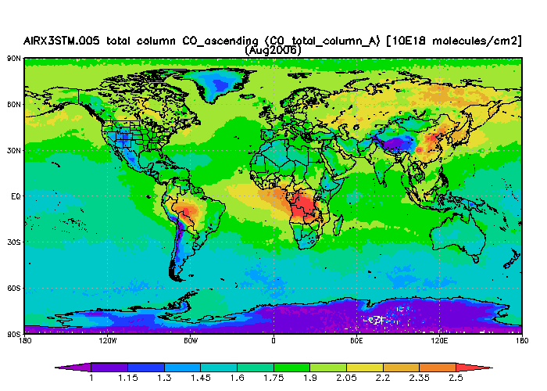
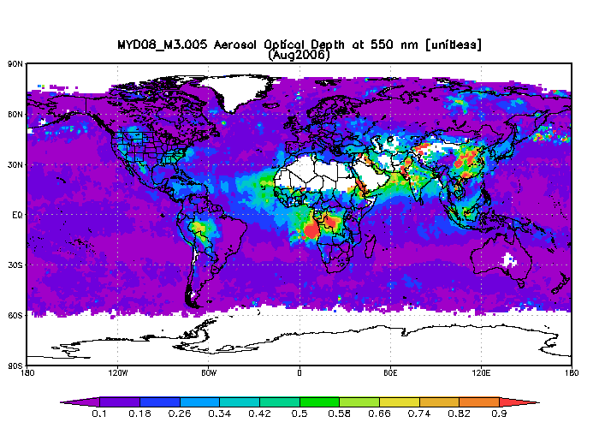
Assimilation of satellite Aerosol and Carbon monoxide measurements
August 2006
Global distribution of carbon monoxide (CO)
From the Atmospheric Infrared Sounder (AIRS)
Global distribution of aerosol optical depth (AOD) from the Moderate Resolution Imaging Spectroradiometer (MODIS)
AIRS, and MODIS maps were produced with the Giovanni online data system [http://disc.sci.gsfc.nasa.gov/giovanni/]

Slide 11
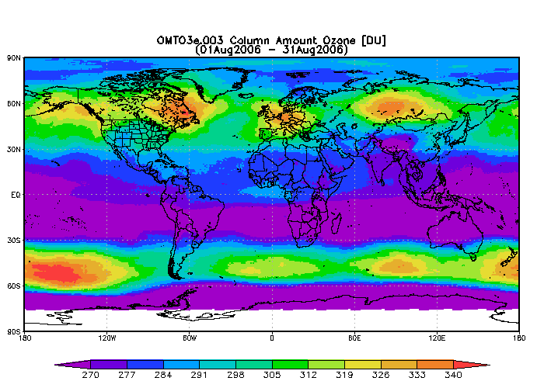
Assimilation of satellite O₃ measurements
Challenge for O3 assimilation is separation of the stratosphere from troposphere to provide constraints on tropospheric analysis
AIRS and OMI maps were produced with the Giovanni online data system [http://disc.sci.gsfc.nasa.gov/giovanni/]

Slide 12
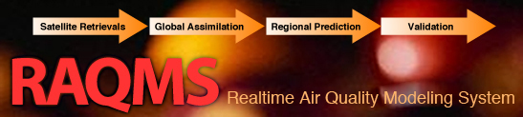
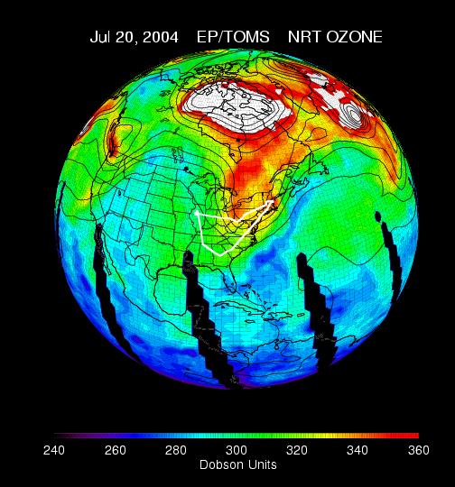
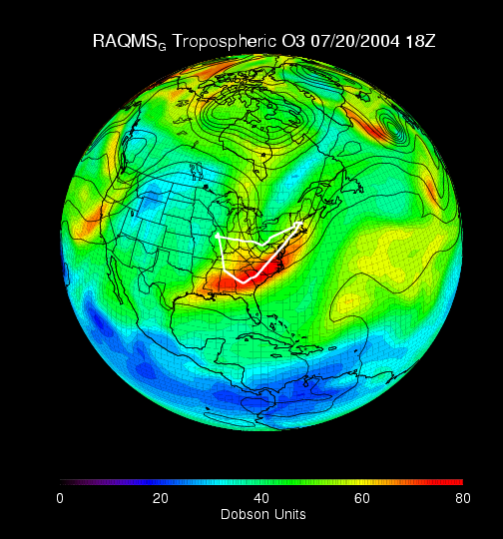
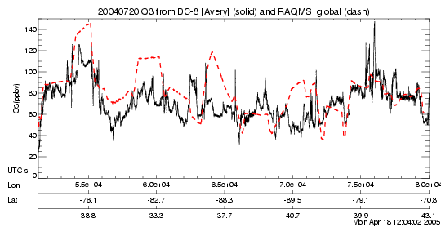
Model Description
Online global chemical and aerosol assimilation/ forecasting system
UW-Madison sigma-theta hybrid coordinate model (UW-Hybrid) dynamical core
Unified stratosphere/troposphere chemical prediction scheme (LaRC-Combo) developed at NASA LaRC
Aerosol prediction scheme (GOCART) developed by Mian Chin (NASA GSFC).
Statistical Digital Filter (OI) assimilation system developed by James Stobie (NASA/GFSC)
RAQMS has been used to support airborne field missions [Pierce et al, 2003, 2007, 2008], develop capabilities for assimilating satellite trace gas and aerosol retrievals [Pierce et al., 2007, 2008, Fishman et al., 2008, Sunita et al., 2008] and assess the impact of global chemical analyses on regional air quality predictions [Song et al., 2008, Tang et al., 2008]

Slide 13
RAQMS 2006 OMI/TES O3/CO Assimilation Procedure
MODIS Rapid Response
Wild fire locations
Ecosystem/Severity Based wildfire emissions
NOAA GFS Global Met
RAQMS Global Met/Chem
Modeled O3/CO +TES Obs Operator
Adjusted O3/CO
Profile Assimilation Cycle
First Guess Profile
Local increment
TES GS Nadir O3/CO Profiles (DAAC)
Modeled O3+OMI Obs Operator
Adjusted O3
OMI O3 Column (OMIDAPS)
Column Assimilation Cycle
First Guess Column
Column increment
Pierce, R. B., et al. (2009), Impacts of background ozone production on Houston and Dallas, Texas, air quality during the
Second Texas Air Quality Study field mission, J. Geophys. Res., 114, D00F09, doi:10.1029/2008JD011337.

Slide 14
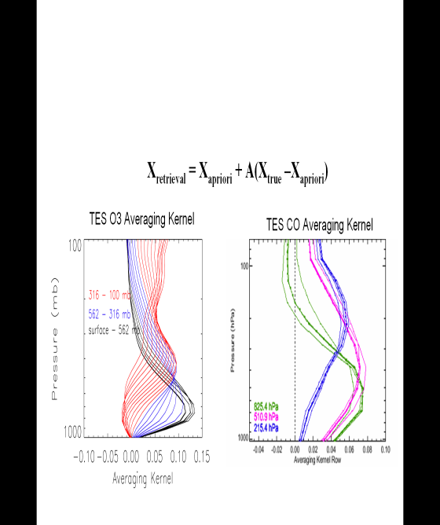
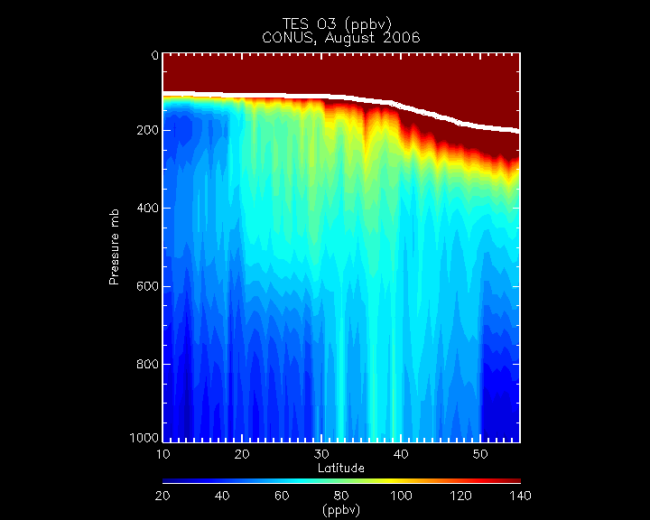
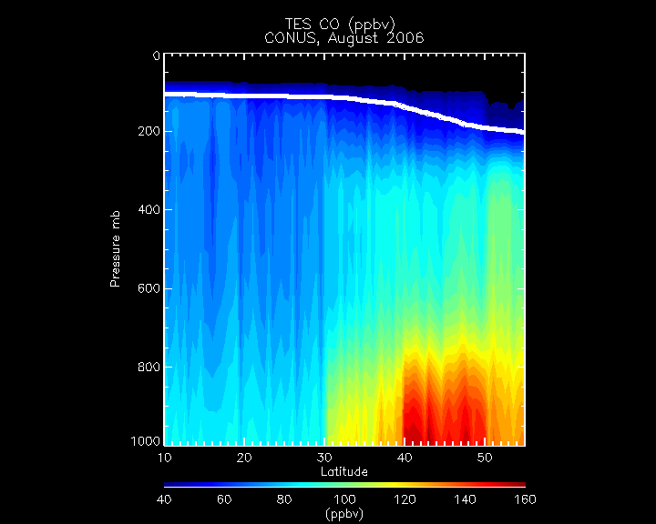
Accounting for averaging kernel and apriori
X_{r} = X_{a} + A_{xx}(X_{t}- X_{a})
where:
X_{r}= retrieval
X_{a}= apriori
X_{t}= truth
and:
A_{xx} =dX_{r}/dX_{t}
A_{xx} is the averaging kernel which determines the sensitivity of the retrieval to the true state of the atmosphere. The vertical resolution is defined as the full-width-half-maximum of the rows of the averaging kernel.
August 2006 Tropospheric Emission Spectrometer (TES) O3 and CO retrievals

Slide 15

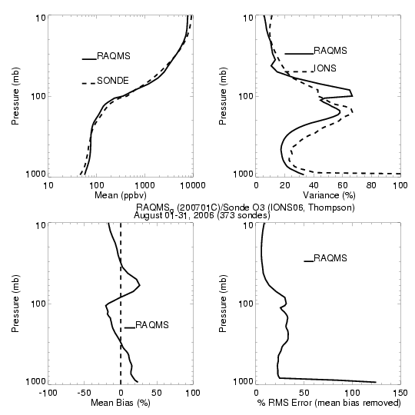
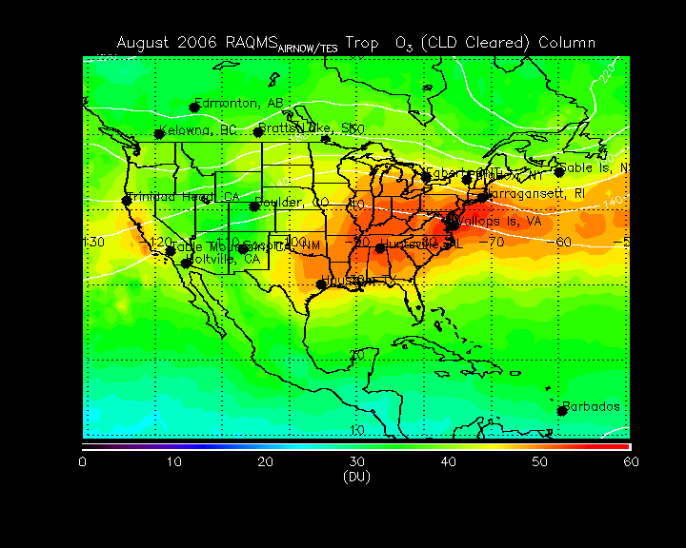
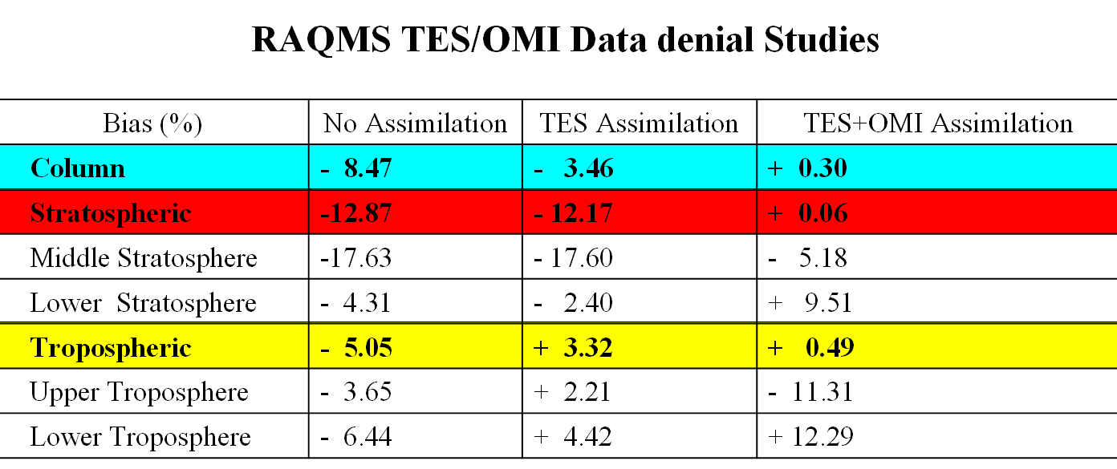
Comparison of RAQMS OMI+TES reanalysis
with IONS ozonesondes
(373 sondes, August, 2006)
PI: ANNE M. THOMPSON Penn State
RAQMS OMI+TES Tropospheric Ozone Column
(August 01-31, 2006)
Pierce, R. B., et al. (2009), Impacts of background ozone production on Houston and Dallas, Texas, air quality during the
Second Texas Air Quality Study field mission, J. Geophys. Res., 114, D00F09, doi:10.1029/2008JD011337.
Notes:
15
15

Slide 16
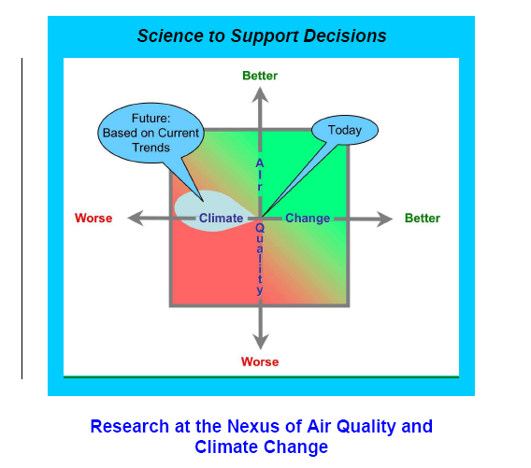
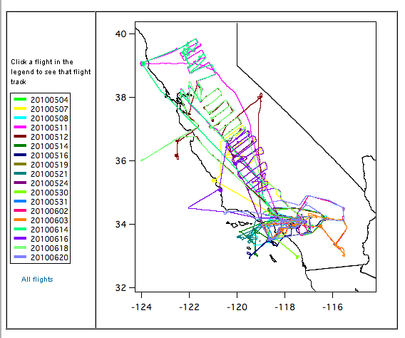
NOAA CalNex Field Mission
During May-June 2010 the National Oceanic and Atmospheric Administration (NOAA) and the California Air Resources Board (CARB), conducted a joint field study of atmospheric processes over California and the eastern Pacific coastal region called CalNex emphasizing the interactions between air quality and climate change issues.
NOAA WP-3D Flight Track Map
http://www.esrl.noaa.gov/csd/calnex/

Slide 17
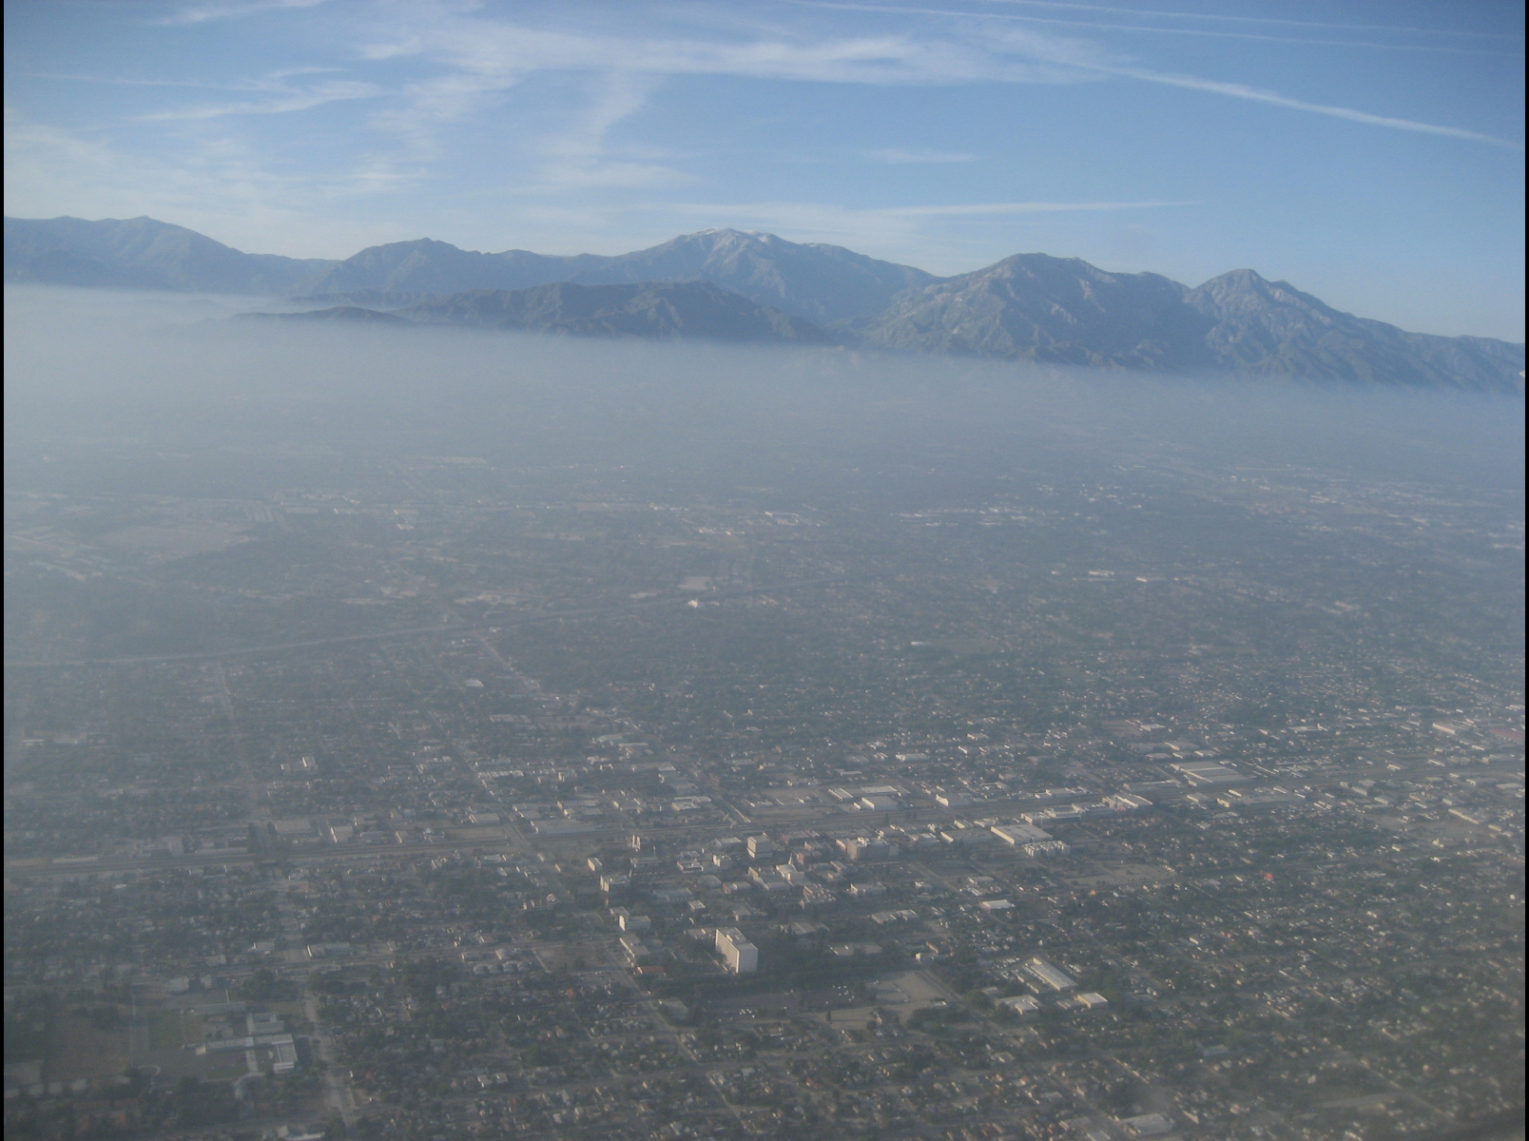
LA Basin Pollution from NOAA P3

Slide 18
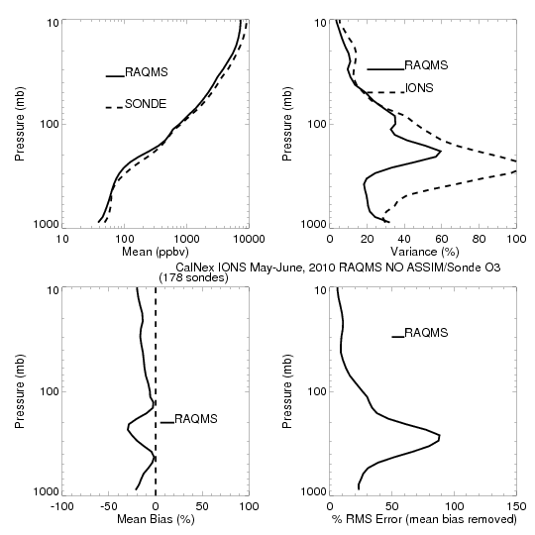
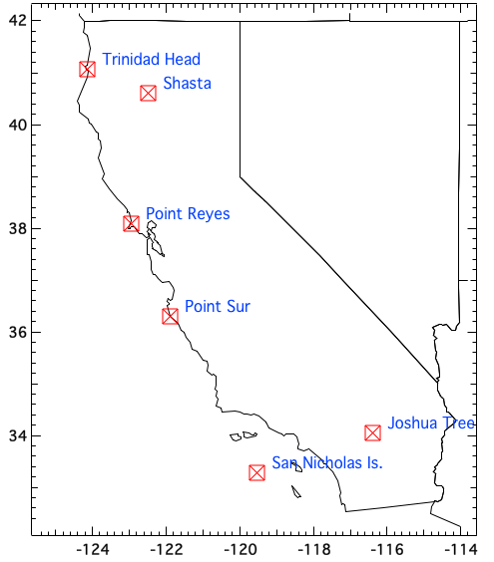
CalNex-2010 O₃ sondes – Owen Cooper (NOAA ESRL)
CalNex Ozonesonde
NO ASSIM
RAQMS NO ASSIM
is low biased up to
30% of Ozonesonde
Tropospheric
low bias

Slide 19
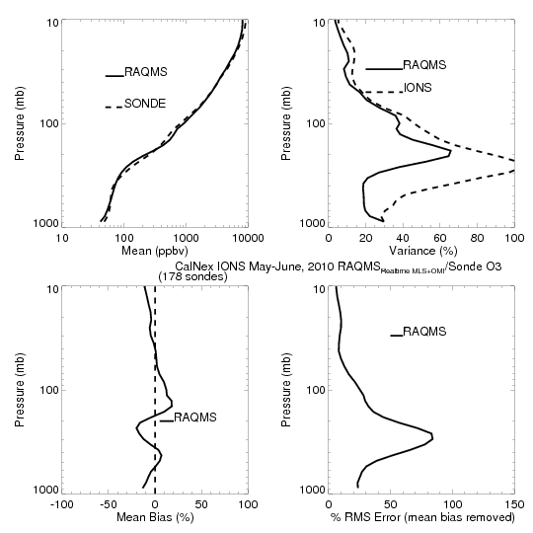
CalNex-2010 O₃ sondes – Owen Cooper (NOAA ESRL)
CalNex Ozonesonde
MLS+OMI
ASSIM
RAQMS MLS+OMI
analysis is within
20% of Ozonesonde
Reduced
tropospheric bias

Slide 20
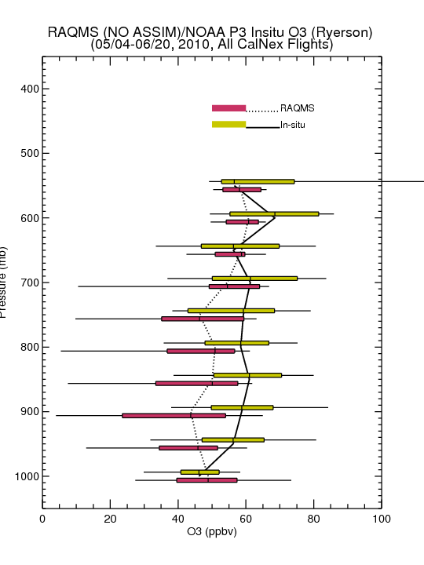
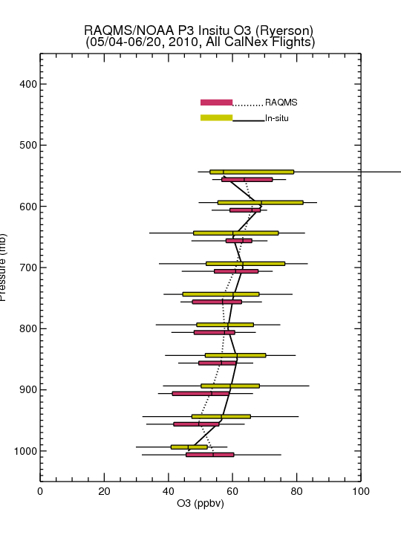
Comparison with NOAA P3 Insitu O3 Measurements
(Primarily LA Basin/Central Valley)
No Assim
MLS+OMI Assim
Assimilation of MLS+OMI O3 retrievals results in increased lower-tropospheric O3 (and improved agreement with airborne insitu O3) over Southern California
Insitu O3 from Tom Ryerson, NOAA ESRL

Slide 21
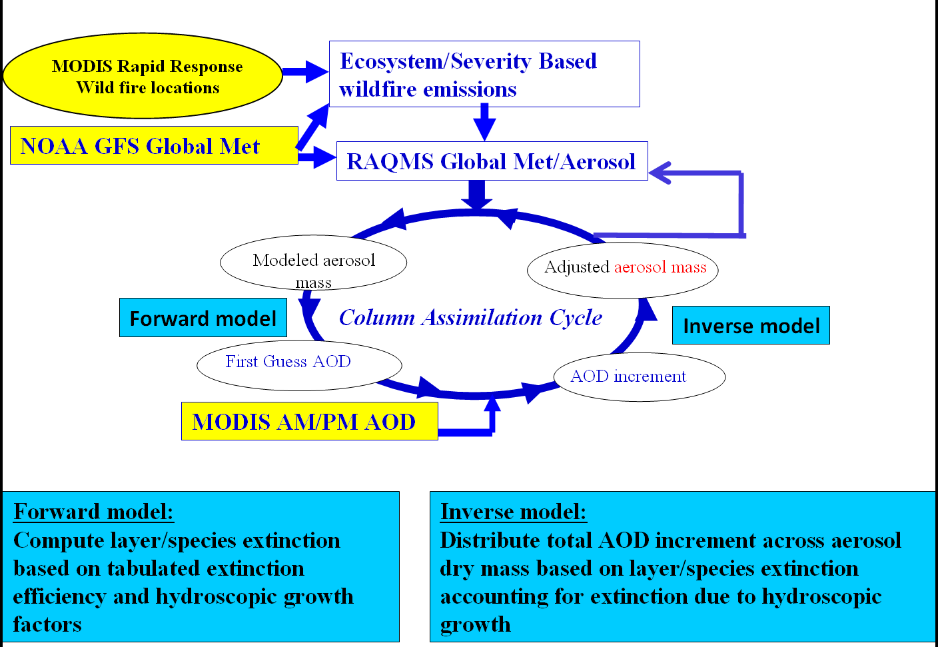
RAQMS CalNex AOD Assimilation Procedure
Demonstration of:
  Real-time assimilation of MODIS Aerosol Optical Depth (AOD)
  Real-time incorporation of MODIS based biomass burning emissions
Notes:
21
21

Slide 22
Forward model:
,
= ext_{ik}
where q_{ik} is the mass mixing ratio and β_{ik} is the mass specific extinction of aerosol species i at the vertical level k. dz is the thickness of the layer. The mass specific extinction is a function of the local relative humidity.
Inverse model:
1) Obtain new extinction for each species
ext_new_{ik}=ext_1stguess_{ik}+aodinc_{i}*ext_1stguess_{ik}/aod1stguess_{i}
2) Obtain new total (water+aerosol) mass for each species based on mass extinction coefficient
totalmass_new=ext_new_{ik}/mass_ext_{ik}
3) extract new dry mass of aerosol based on mole fraction of aerosol in mixture
aeromass_new = totalmass_new*mole_frac_aero*mw_{aero}
(mw_{h2o}*mole_frac_h2o+mw_{aero}*mole_frac_aero)
where mole_frac_h2o=vmr_h2o/(vmr_aero+vmr_h2o)
and mole_frac_aero=vmr_aero/(vmr_aero_vmr_h2o)

Slide 23
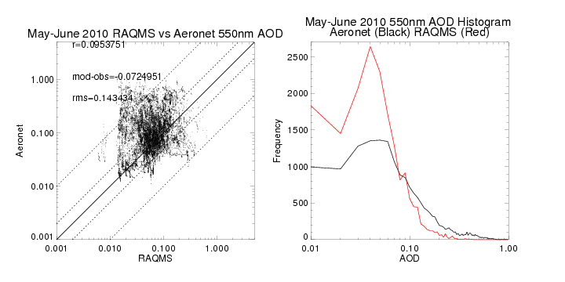
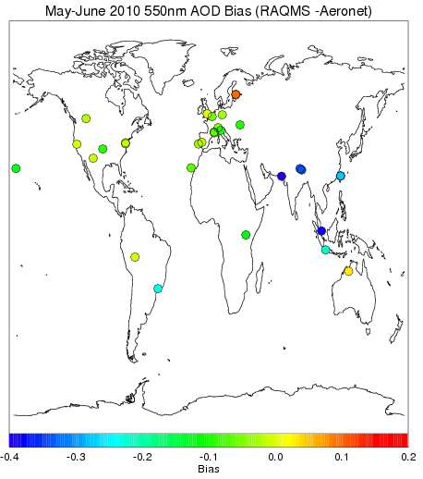
Comparison with Level 2.0 Aeronet Measurements
No MODIS Assimilation
RAQMS (no assim) is not correlated with Aeronet AOD (r=.09) and underestimates clear-sky AOD by 0.07.
RAQMS (no assim) significantly overestimates the frequency of low AOD (<0.1) and significantly underestimates the frequency of high AOD (>0.1).

Slide 24
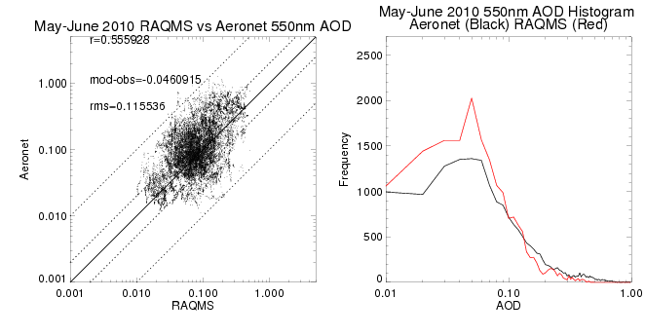
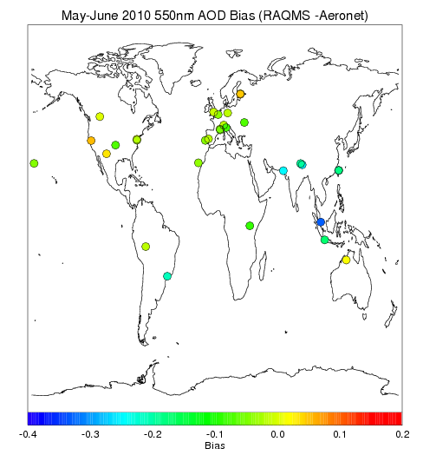
Comparison with Level 2.0 Aeronet Measurements
MODIS Assimilation
MODIS assimilation significantly improves correlation with Aeronet AOD (r=.56) and reduces the overestimates the frequency of low AOD (<0.1) and underestimates the frequency of high AOD (>0.1).

Slide 25
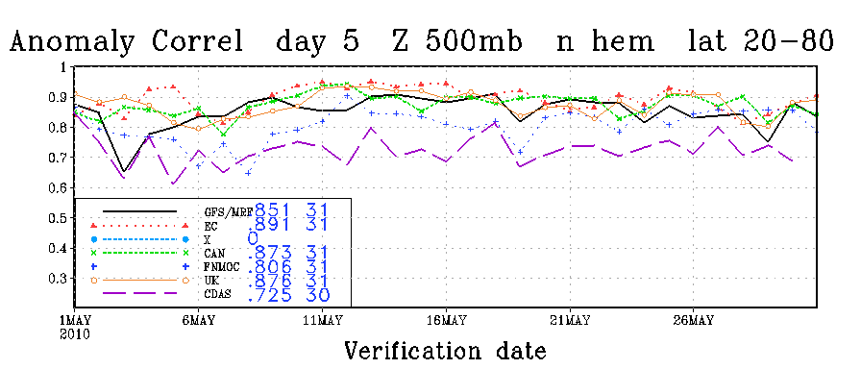
Assessment of Global 850mb O3 and Aerosol Extinction Forecast Skill
  Anomaly Correlations (AC)
    Correlation between forecast and analysis
    May-June mean removed
    Spectrally truncated to wavenumber 20
    Averaged from 20N-80N
useful Skill
http://www.emc.ncep.noaa.gov/gmb/STATS/html/monarch.html

Slide 26
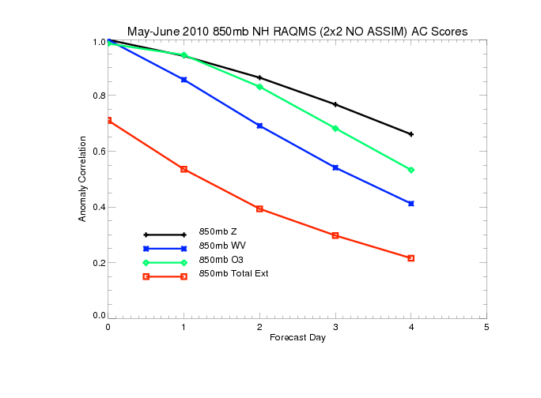
Northern Hemisphere 850mb May-June 2010 Anomaly Correlations (AC)
(No Assimilation)
useful Skill
850mb ozone forecasts have useful skill past 3 days (significantly better than water vapor)
850mb extinction forecasts do not have useful skill at 1 day

Slide 27
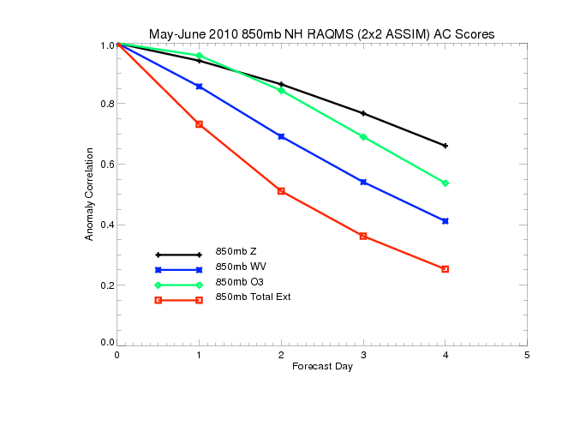
Northern Hemisphere 850mb May-June 2010 Anomaly Correlations (AC)
(With MLS/OMI/MODIS Assimilation)
useful Skill
Assimilation of O3 retrievals results in slight improvements in 850mb ozone forecasts
Assimilation of AOD retrievals results in significant improvement in 850mb extinction
forecasts with useful skill at ~1.5 days

Slide 28
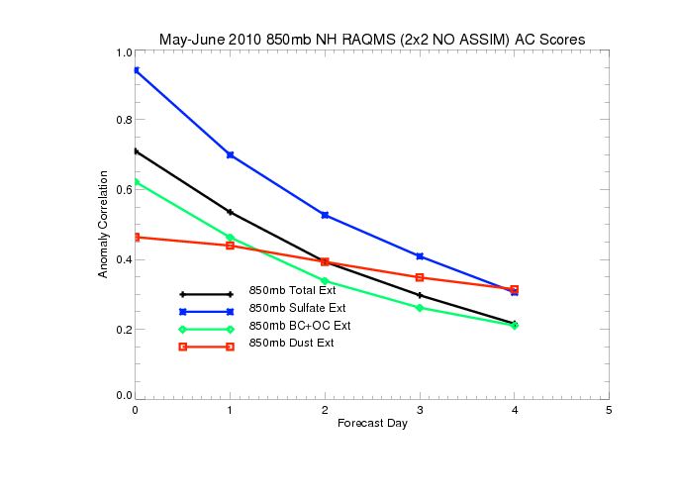
Northern Hemisphere 850mb May-June 2010 Anomaly Correlations (AC)
(No Assimilation)
useful Skill
Only 850mb SO4 extinction forecasts useful skill past 1 day
Black and organic carbon (BC+OC) and dust extinctions are both poorly initialized and
forecasted

Slide 29
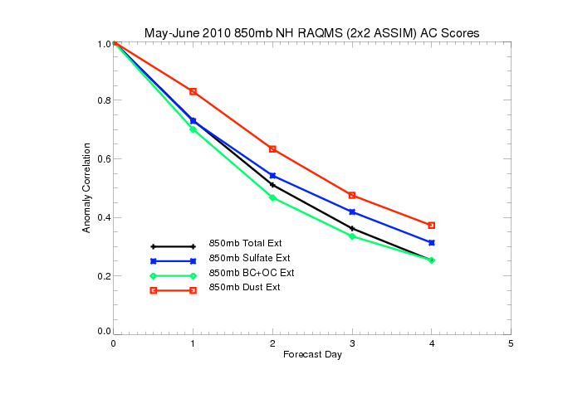
Northern Hemisphere 850mb May-June 2010 Anomaly Correlations (AC)
(With MODIS Assimilation)
useful Skill
MODIS AOD assimilation results in small changes in 850mb SO4 extinction forecasts
MODIS AOD assimilation results in significant improvements in black and organic carbon (BC+OC) and dust forecast skill (dust prediction useful at 2 days)

Slide 30
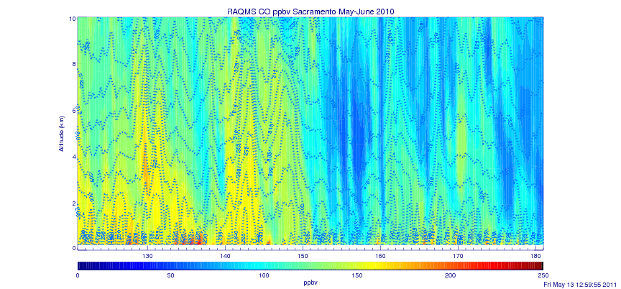
Sacramento CO May-June 2010
RAQMS 1x1 Degree Re-analysis
May 10-12
May 22-24

Slide 31
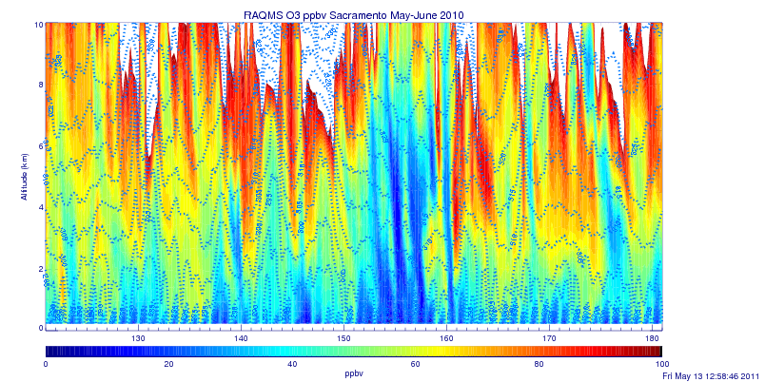
Sacramento O3 May-June 2010
RAQMS 1x1 Degree Re-analysis
May 10-12
May 22-24

Slide 32
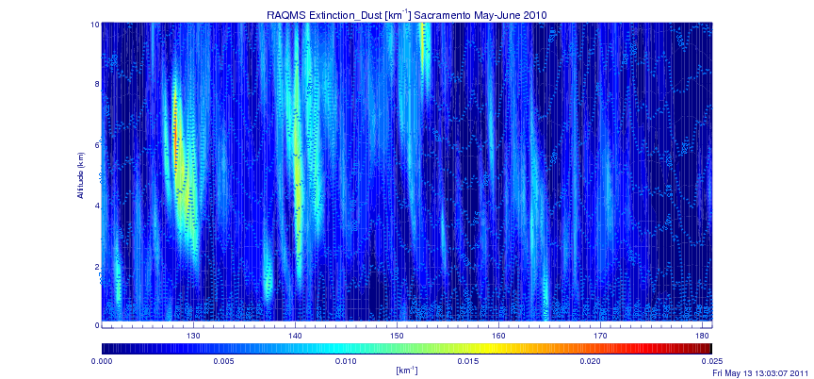
Sacramento Dust Extinction May-June 2010
RAQMS 1x1 Degree Re-analysis
May 10-12
May 22-24

Slide 33
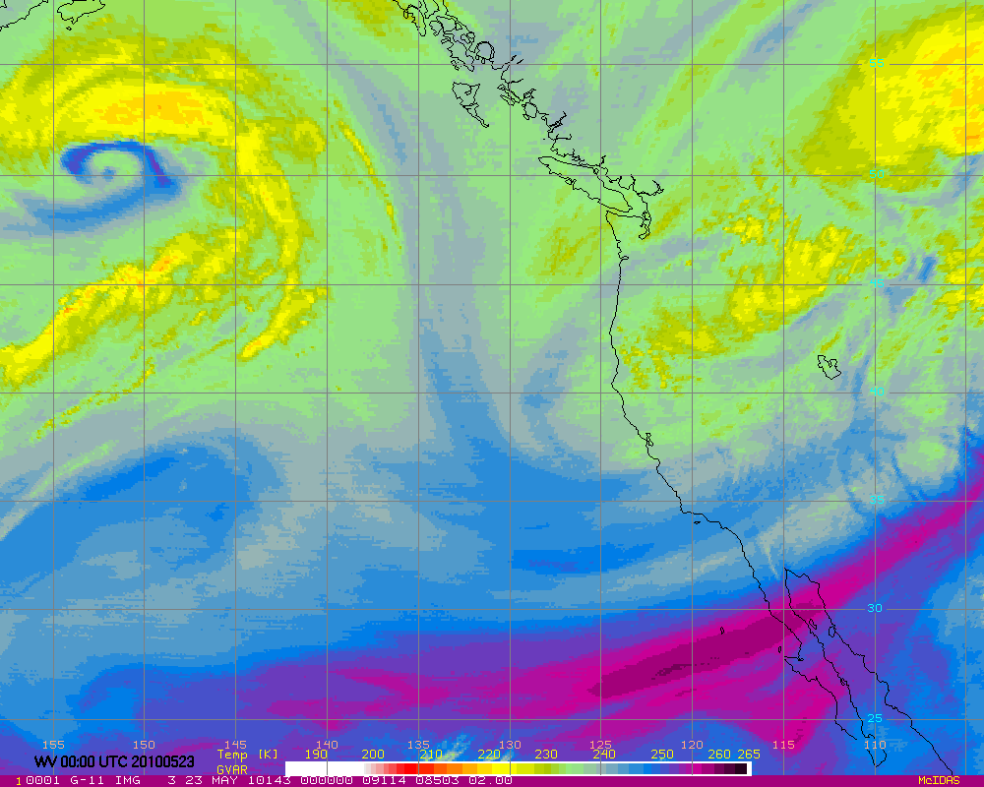
GOES WV 00Z 20100523 (Saturday Afternoon)
Notes:
33

Slide 34
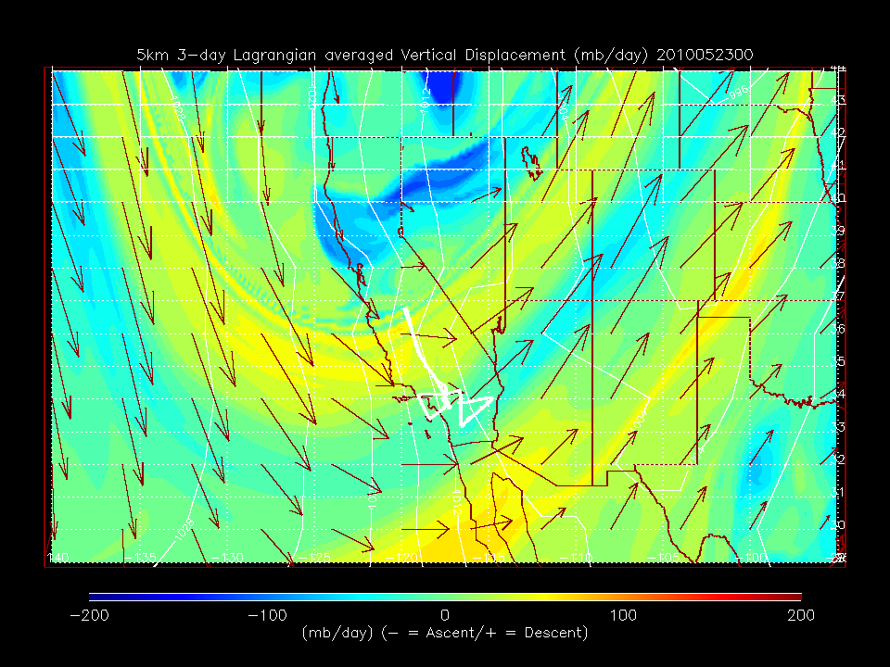
GOES WV 00Z 20100523 (Saturday Afternoon)
RAQMS RDF 5km Lagrangian Descent Forecast
Notes:
34
34

Slide 35
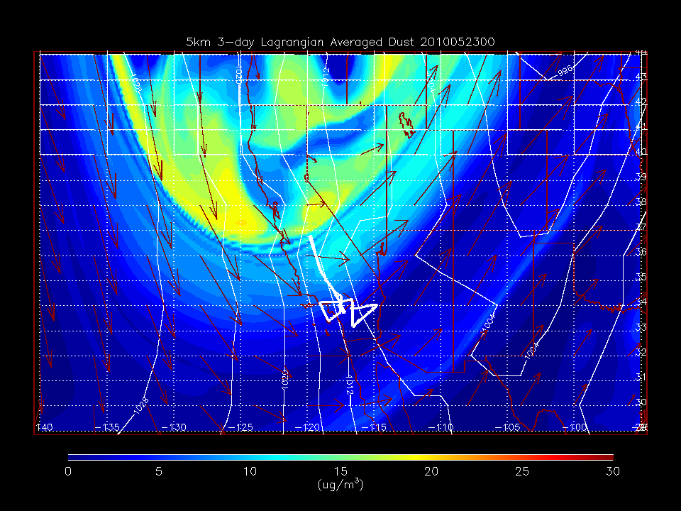
GOES WV 00Z 20100523 (Saturday Afternoon)
RAQMS RDF 5km Dust forecast
Notes:
35
35

Slide 36

HSRL aerosol Scattering Ratio
Saturday, May 22, 2010
HSRL data from Chris Hostetler and Rich Ferrare, NASA LaRC
Notes:
36

Slide 37


Comparison with HSRL Lidar Measurements
(Primarily LA Basin, Chris Hostetler, NASA LaRC)
RAQMS free tropospheric median aerosol extinction is in very good agreement with HSRL
Variability is underestimated, particularly for lower values of aerosol extinction
Largest biases are found within the LA Basin Boundary Layer (below 1000m) were RAQMS median extinction is low

Slide 38


Comparison with NOAA P3 Insitu Aerosol Measurements
(Primarily LA Basin/Central Valley)
RAQMS shows good agreement in median aerosol mass and dry extinction values above 950mb.
RAQMS underestimates median aerosol mass and dry extinction below 950mb.
P3 comparisons suggest that:
Boundary Layer ambient extinction differences arise due to underestimates in local LA sources and neglect of nitrate aerosol in GOCART module
Free tropospheric ambient extinction differences arise due to underestimates in hydroscopic growth of aerosols

Slide 39


CALIPSO and Co-located RAQMS AOD May-June 2010
V3-01 aerosol profile retrievals
5º Lat, 10º Lon, 1km bins
CAD< -20, COT=0.0
QC=0,1 (unadjusted retrievals)
Clear sky CALIPSO scenes are dominated by Saharan Dust and South Asian emissions during May-June 2010
RAQMS overestimates Saharan Dust and SE Asian and S African biomass burning AOD relative to CALIPSO during May-June 2010
New 1x1 degree
Re-analysis with
Corrected dust and
Sea-salt aod calculation
Dave Winker, NASA LaRC

Slide 40

1x1 Degree Re-analysis

Slide 41

1x1 Degree Re-analysis

Slide 42


Slide 43

Operational AOD assimilation
Naval Research Laboratory (NRL)
Aerosol physics uses a version of the NRL operational Atmospheric Variational Data Assimilation System (NAVDAS) called NAVDAS-Aerosol Optical Depth (NAVDAS-AOD)
    2D variational approach
    constant aerosol mass adjustment for all species
    no adjustment for hydroscopic growth
Used to improve the NRL Aerosol Analysis and Prediction System (NAAPS)’s aerosol forecasting capability
Meteorological analysis and forecast fields from the Navy
Operational Global Analysis and Prediction System (NOGAPS)
NAVDAS-AOD assimilates over-water MODIS AOD from the NOAA NESDIS Near Real Time Processing Effort (NRTPE) (latency of 3 h or less in most cases)
Strict QA procedure is necessary to remove outliers associated with cloud artifacts [Zhang and Reid, 2006]
Zhang, J., J. S. Reid, D. L. Westphal, N. L. Baker, and E. J. Hyer (2008), A system for operational aerosol optical depth
data assimilation over global oceans, J. Geophys. Res., 113, D10208, doi:10.1029/2007JD009065

Slide 44


Aeronet Sun photometer validation
January-May 2006
No Assimilation
Aeronet comparisons limited to the coastal and
island AERONET sites
January-May 2006
MODIS Assimilation

Slide 45

GOES and MODIS fire detections
From Fire Locating and Modeling of Burning Emissions ( FLAMBE' )
June 15, 2009
http://www.nrlmry.navy.mil/aerosol/

Slide 46

NAAPS Smoke Analysis
June 15, 2009
http://www.nrlmry.navy.mil/aerosol/

Slide 47

NAAPS Smoke+Dust Analysis
June 15, 2009
http://www.nrlmry.navy.mil/aerosol/

Slide 48

NAAPS Smoke+Dust+Sulfate Analysis
June 15, 2009
http://www.nrlmry.navy.mil/aerosol/

Slide 49

MODIS AOD
June 15, 2009
http://www.nrlmry.navy.mil/aerosol/

Slide 50


NAAPS Dust Analysis vs CALIPSO
CALIPSO
Attenuated Backscatter
June 15, 2009
http://www.nrlmry.navy.mil/aerosol/

Slide 51


NAAPS Sulfate Analysis vs EPA AIRNow PM2.5 Air Quality Index (AQI)
http://airnow.gov/

Slide 52


Development of constituent and aerosol assimilation/forecasting within ECMWF Integrated Forecast System (IFS) Framework
http://gems.ecmwf.int/do/get/GeneralEventsAssemblyJuelich

Slide 53
GRG Main Objectives
Build a system for routine forecasts and reanalyses of global reactive gases relevant for
  air pollution (long-range transport / RAQ boundaries)
  climate change (oxidizing capacity, ozone)
  stratospheric ozone
  ecosystem monitoring (deposition fluxes)
Integrate tropospheric and stratospheric chemistry into the IFS model at ECMWF
Assimilate satellite retrievals of O3, CO, NO2, CH2O and SO2 into the IFS model
Modelling Approach
Use existing CTMs + coupling software, ensemble approach with 3 CTMs
  MOCAGE
  MOZART
  TM5
From “GEMS Global Reactive Gases strategy and achievements” Martin Schultz - Jülich

Slide 54

Current Status
http://www.weather.gov/ost/air_quality/

Slide 55
Current Status
No composition or aerosol data to constrain initial conditions
http://www.weather.gov/ost/air_quality/

Slide 56


Development of GOES Total Column Ozone Assimilation
Within Operational NAM-CMAQ
We currently developing capabilities to assimilate GOES Sounder TCO retrievals into the Community Multi-scale Air Quality (CMAQ; http://www.cmaq-model.org/) model using the NCEP Grid-point Statistical Interpolation (GSI) analysis scheme.
GOES provides hourly TCO during day and night.
OMI daytime TCO is used for bias correction

Slide 57


Slide 58


Three NAM-CMAQ/GOES TCO Experiments have been conducted:
  RAQMS Lateral Boundary Conditions/default background errors
  Fixed Lateral Boundary Conditions/default background errors
  Fixed Lateral Boundary Conditions+GFS UT/LS/GFS background errors
Fixed LBC underestimates TCO, Fixed LBC+GFS UT/LS overestimates TCO

Slide 59



CalNex-2010 O₃ sondes – Owen Cooper (NOAA ESRL)
CalNex Ozonesonde
RAQMS LBC and default background errors results in free tropospheric overestimates but good PBL and UT/LS
FIXED LBC and default background errors results in free tropospheric and PBL overestimates with UT/LS underestimates
FIXED LBC+GFS UT/LS and GFS background errors results in best agreement with IONS ozonesonde
RAQMS LBC
Default Background Errors
FIXED LBC
Default Background Errors
FIXED LBC +GFS UT/LS
GFS Background Errors

Slide 60

Development of Operational AOD assimilation Capabilities
WRF/Chem model
Goddard Chemistry Aerosol Radiation and Transport (GOCART) aerosol scheme
GSI 3DVAR minimization procedure
AOD observation operator is based upon the community radiative transfer model (CRTM)
Liu, Z., et al. (2011), Three-dimensional variational assimilation of MODIS aerosol optical depth: Implementation and application to a dust storm over East Asia, J. Geophys. Res., 116, D23206, doi:10.1029/2011JD016159.

Slide 61

Background error estimated for each aerosol specie using NMC method
Domain-averaged background error standard deviation (μgkg⁻¹)

Slide 62

Aeronet intercomparisons

Slide 63

Links between air quality and global climate change
The gray ellipse represents the direction of current trends in the U.S.
From Research at the Nexus of Air Quality and Climate Change (CalNex) white paper http://www.esrl.noaa.gov/csd/calnex/whitepaper.pdf

Slide 64

Air Quality
Links between air quality and global climate change

Slide 65



During April 2008, as part of the International Polar Year (IPY), NOAA’s Climate Forcing and Air Quality Programs engaged in an airborne field measurement campaign in the Alaskan Arctic . The Aerosol, Radiation, and Cloud Processes affecting Arctic Climate (ARCPAC) field mission (Fairbanks AK) focused on direct measurements of properties and processes associated with non-greenhouse-gas atmospheric climate forcing
Website: http://www.esrl.noaa.gov/csd/arcpac/

Slide 66




Carbon
Dust
RAQMS April 2008
AOD Partitioning
Total
Majority of April 2008 AOD
is due to Carbonaceous and
Dust aerosols

Slide 67


Slide 68

Arctic Haze layer photographed from the NOAA P3

Slide 69

Arctic aerosol indirect effects during ARCPAC
Use RAQMS analyzed aerosol extinction to sort MODIS Liquid Effective Radius as a function of Cloud Liquid Water Content to investigate Arctic first indirect effect
decrease in r_{e}
Cloud effective radius (micron)
Evidence for First (Twomey) indirect Effect: Aerosol loading increases cloud droplet number concentration resulting in a decrease in average cloud droplet size (effective radius) for a fixed liquid water content (LWC).

Slide 70
Impacts of aerosols on Arctic radiative forcing
Shortwave effects: Decreased droplet size due to aerosol loading leads to increased cloud albedo and additional reflection of shortwave radiation to space and leads to surface cooling.
  High snow/ice albedo minimizes this effect in the Arctic
Longwave effects: Decreased droplet size due to aerosol loading increases the longwave emissivity of optically thin clouds, which leads to increased emitted longwave radiation [Curry and Ebert, 1992, Curry 1993] and surface longwave heating.
  Observational studies have shown that the longwave aerosol indirect effect can lead to significant (3.4 Wm⁻²) positive radiative forcing in the Arctic [Lubin and Vogelmann, 2006].

Slide 71

Development of Data Assimilation Capabilities for SEVIRI Volcanic Ash retrievals
With
Georg Grell (NOAA/ESRL)
Martin Stuefer (UAF)
Mike Pavolonis (NOAA/NESDIS)
08Z 4/17 2010
11 μm AOD
08Z 4/17 2010
11 μm AOD
As part of the NOAA Volcanic Ash Working Group (VAWG) Science Team we are testing assimilation of SEVIRI volcanic ash optical depth retrievals using WRF-CHEM/GSI.

Slide 72
WRF-CHEM Volcanic Ash Module
A 4-bin WRF-CHEM volcanic ash module developed by George Grell at Earth System Research Laboratory (ESRL) and Martin Stuefer at the University of Alaska, Fairbanks (UAF) is used in forecasting volcanic ash.
Volcanic Ash Forecast Uncertainties
The mass estimates are estimated from the height of the erupted ash. For the Eyjafjatjalla case, eruption heights are constrained with radar data (~150 km from the volcano).
There is high uncertainty with the erupted mass: A 500 meter offset in the height changes the total mass estimate by almost 60% for injection heights <5km.
There is also high uncertainty in the assumed size distribution of the ash particles, which determines the plume lifetime.

Slide 73

WRF-CHEM Volcanic Ash Forecast (contours) and SEVIRI 11 micron AOD (colored) during the 2010 Eyjafjoll eruption in southern Iceland.

Slide 74
GSI Volcanic Ash Assimilation
The OMI Total column ozone template is used for assimilation of SEVIRI volcanic ash retrievals within the Gridpoint Statistical Interpolation (GSI)
SEVIRI 11 micron volcanic ash extinction is assimilated with modifications made for extinction instead of ozone
11 micron AOD is computed within WRF-CHEM (updated with Andesite optical properties)
Modified NMC method for Background Errors
2 forecasts:
emission heights 1.2 times larger than control experiment
emission heights 0.8 times higher than control
Used differences between 00z April 14 to 00z April 19, 2010 hourly forecast (valid at same time) to build the statistics

Slide 75


Cross section 35 – 72 N
1-d
Horizontal
Length scale
Error covariance
Vertical length scale
In GSI
(1/vl/dsig )

Slide 76

Results
WRF-CHEM Baseline GSI/SEVIRI assimilation
08Z 4/17 2010
11 μm AOD
08Z 4/17 2010
11 μm AOD
Significant increase in 11 micron AOD for older plume with GSI/SEVIRI assimilation

Slide 77

Maisach 1064 nm aerosol backscatter
Verification
Comparisons with RAMAN lidar measurements at Maisach, Germany show that maximum volcanic ash mass concentrations near the vicinity of the observed plume reached 3,226 μgm⁻³ in the GSI/SEVIRI assimilation experiment and only 155 μgm⁻³ in the baseline experiment. Gasteiger et al. [2011] estimated maximum volcanic ash mass concentrations of 1,100 μgm⁻³ (650 to 1,800 μgm⁻³) at an altitude of 2.2km at 08Z on April 17, 2010.
Both experiments show an additional plume at 10km which is not observed.
ASSIM
NO
ASSIM

Slide 78

A conceptual model for the link between Central American biomass burning aerosols and severe weather over the south central United States
The indirect aerosol mechanisms pertinent to smoke particles include:
the first indirect effect, where the size of water cloud droplets decreases as smoke particles enhance the number of cloud condensation nuclei available for activation (Twomey 1974);
the semi-direct (choking) effect, where absorption of solar radiation by smoke particles increases atmospheric stability and consequently suppresses the low-level cloud formation (Koren et al 2004);
the second indirect effect, where the smaller cloud droplets arising from the first indirect effect of smoke particles result in longer cloud lifetimes and larger cloud fractions (Albrecht 1989, Kaufman et al 2005);
the invigoration effect, where for strong convection storms the warm rain process is delayed by the smoke through its first and second indirect effects, which in turn allows for more cloud water to be transported vertically, a greater release of latent heat, and a subsequent invigoration of the updrafts, thus supporting the development of intense thunderstorms and large hail (Rosenfeld 1999, Andreae et al 2004, Lin et al 2006).
Wang et al, Environ. Res. Lett. 4 (2009) http://dx.doi.org/10.1088/1748-9326/4/1/015003

Slide 79



Case Study: Severe weather April 27th, 2011 (Huntsville tornado)
MODIS aerosol optical depth (AOD) shows significant aerosol loading over Gulf within warm sector of storm
RAQMS surface Black and Organic Carbon (BCOC) analysis shows highly elevated aerosols
RAQMS used to initialize and provide lateral boundary conditions for 4km WRF-CHEM with explicit (MOSAIC) aerosol/cloud interaction
27th
Aeronet AOD Louisiana
WRF-Chem
OBS
26th
28th

Slide 80



Case Study: Severe weather April 27th, 2011 (Huntsville tornado)
WRF-CHEM simulations conducted by Pablo Saide in collaboration with Greg Carmichael and Scott Spak (U-Iowa)
Inclusion of aerosol cloud interactions significantly impacts the predicted precipitation distribution and improves forecast over Huntsville, AL
SPC 12hr precip and tornado tracks valid 06Z on April 28, 2011
WRF no aerosols
WRF-Chem + RAQMS BC

Slide 81


Precip. Obs vs WRF & WRF-Chem
Skill for 3h accum precip. vs different precip. thresholds
Simulations with and without aerosol effects yield very different precipitation fields
Skill to represent observation is reduced for the larger precip. values
There is improved skill when considering aerosol effects
OBS vs WRF-Chem RAQMS
WRF-Chem vs WRF
OBS vs WRF NO-CHEM
Skill for 3h accum. precip. over 10mm
27th
28th
UTC

Slide 82


The NOAA meteorological applied research program focuses heavily on improving the utilization of operational meteorological satellite measurements through the Joint Center for Satellite Data Assimilation (JCSDA)
The NOAA Air Quality applied research program has traditionally focused on field experiments for AQ forecast model development and evaluation
Both field mission and JCSDA approaches are needed for utilization of space based atmospheric composition measurements within National air quality forecasting/analysis systems.

Slide 83
Thank you!
brad.pierce@noaa.gov

