Slide 1
Highlights of work from the A.I. group

Slide 2
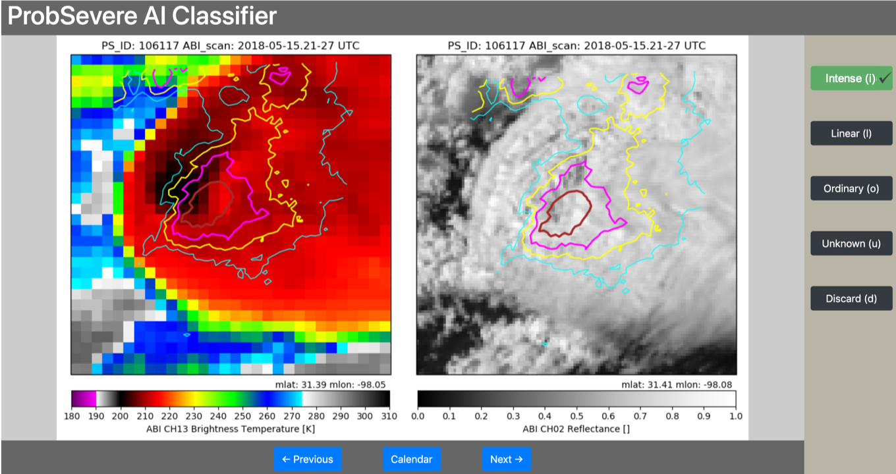
Detection of severe weather from GOES ABI
John Cintineo
Developed web-based tool to quickly label “intense” convection:
Credit: Justin Sieglaff, Bill Bellon

Slide 3
Trained a neural network to identify “intense” convection (e.g., strong OTs, bubbling updrafts, cold-U/V thermal couplets)
Trained on ~220,000 images
Inputs:
ABI 10.35 µm BT
ABI 0.64 µm reflectance
GLM flash extent density
Output:
“Probability of intense convection”
Automatically identifies features that have proven difficult to do so algorithmically (i.e., no more feature engineering)
Reliably identifies intense convection without ground-based radar data
Funding sources: SSEC 2022; NOAA AI Initiative

Slide 4
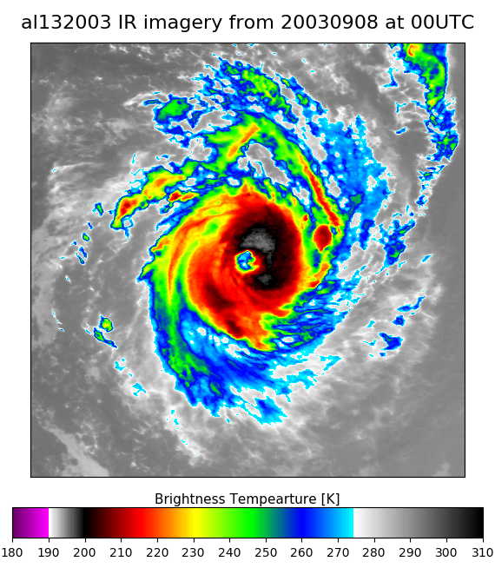
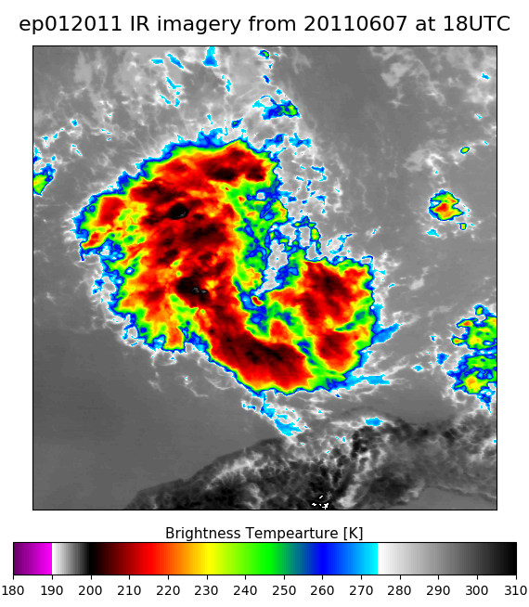
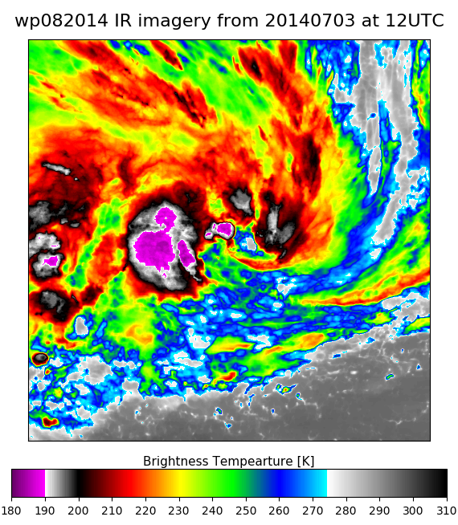
Tropical Cyclone Rapid Intensification Prediction with Deep Learning
Sarah Griffin
Models can be trained to recognize something the human eye recognizes, like a cat or tornado in a picture.
Can we train it to predict something humans cannot recognize, like a rapidly intensifying tropical cyclone based on satellite imagery?
Atlantic: Brier Skill Score ~ 0.02
Same as climatology. Not skillful.
East Pacific: Brier Skill Score ~ 0.05
Only slightly better than climatology.
West Pacific: Brier Skill Score ~ 0.10
Showing some predictability skill.
Will need to add some side channel information like sea surface temperature to enhance prediction.

Slide 5
Deep Learning for AMV Height Assignment
Tom Rink, Tony Wimmers, Andy Heidinger, Steve Wanzong
SSEC 2020, GOES-R AWG Derived Motion Winds
Height assignment to AMV winds is critical to NWP data assimilation, climate studies and aviation applications. Can Deep Learning be employed to improve or inform in situations that are currently difficult for the baseline algorithm ACHA?
Familiar approach:
New approach (for large datasets):
Observations
Physical or statistical model
Observations
Deep Learning
Expected Results
Expected Results
New Results “learned” from many examples
Example: Thin cirrus (low emissivity) over opaque mid, low-level cloud.
Spatial convolution of multi-spectral BTs over center target scene to identify cloud texture. Use ABI C04 to discriminate scenes with cirrus

Slide 6
Deep Learning for AMV Height Assignment
Implemented with Python TensorFlow 1.x utilizing Data Pipelining for remote or local data batch pre-fetching and processing, asynchronously with GPU training.
* Must develop workflows for large scale, un-localizable datasets.
NWP T, WV Profiles
AMV Scene ABI BT/Refls
Ancillary Data
1D CNN
2D CNN
Truth: Level of matching wind level in nearest RAOB
Concatenation
Minimize loss (MSE)
Dense Neural Network
AMV Pressure Prediction
Output Layer

Slide 7
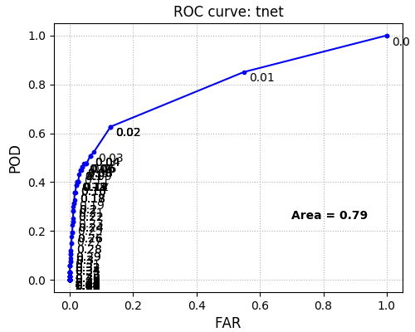
Detection of aviation turbulence with AI
Tony Wimmers
Precise estimation of turbulent regions confirmed by observations (orange: spill-your-coffee/sickness-bag turbulence)
Detects ~45% of turbulence at cruising altitude with very low false alarm rate
Funding sources: SSEC 2022; GOES-R Risk Reduction

