Slide 1
GSI Review Committee
NESDIS
R. Bradley Pierce
Jim Jung
17 July 2014

Slide 2
List of NESDIS GSI Related Projects
Kevin Garrett :
ATMS Impact Assessment (On hold until next GSI upgrade)
  MiRS 1DVAR preprocessor implementation
James Jung:
AIRS/IASI/CrIS Water vapor experiments
Daisuke Hotta, Eugenia Kalnay:
  Proactive QC based on EFSO
Erin Jones, Kevin Garrett
  AMSR2/GPM data assimilation
Dave Santek:
Polar Wind QC
Sharon Nebuda/J. Daniels
GOES-R AMV Assimilation
Qiang Zhao/Shobha Kondragunta
  GOES-R AOD Assimilation
Jun Li:
Satellite Data Assimilation for Tropical storm forecasts – SDAT
Tong Zhu:
  GSI Thinning Optimization
David Groff, Paul van Delst, Quanhua Liu
  New Microwave Cloud Optical Table
  Partial Cloud Fraction
Ming Chen and Fuzhong Weng
  Land Physical MW Emissivity Model Updates and Testing
GDAS/GFS
GOES-R
Regional GSI DA
CRTM
New Activity Since May GSI Review Committee meeting

Slide 3
List of NESDIS GSI Related Projects
Kevin Garrett :
ATMS Impact Assessment (On hold until next GSI upgrade)
  MiRS 1DVAR preprocessor implementation
James Jung:
AIRS/IASI/CrIS Water vapor experiments
Daisuke Hotta, Eugenia Kalnay:
  Proactive QC based on EFSO
Erin Jones, Kevin Garrett
  AMSR2/GPM data assimilation
Dave Santek:
Polar Wind QC
Sharon Nebuda/J. Daniels
GOES-R AMV Assimilation
Qiang Zhao/Shobha Kondragunta
  GOES-R AOD Assimilation
Jun Li:
Satellite Data Assimilation for Tropical storm forecasts – SDAT
Tong Zhu:
  GSI Thinning Optimization
David Groff, Paul van Delst, Quanhua Liu
  New Microwave Cloud Optical Table
  Partial Cloud Fraction
Ming Chen and Fuzhong Weng
  Land Physical MW Emissivity Model Updates and Testing
GDAS/GFS
GOES-R
Regional GSI DA
CRTM
New Activity Since May GSI Review Committee meeting
Focused discussion on modifications to GSI code

Slide 4
1DVAR Preprocessor Implementation plans for GSI
Kevin Garrett
MIIDAPS Overview
Multi-Instrument Inversion and Data Assimilation Preprocessing System
Providing a streamlined preprocessing algorithm for satellite radiance data
Consistent algorithm for all satellite data (1DVAR)
Provides quality control flags for various application (e.g. clear-sky DA)
Surface characterization through dynamic emissivity
  Over ocean, land, sea-ice and snow-cover
Atmospheric characterization (clear, cloudy, precipitating)
  Provide Cloud, Rain, Ice amount

Slide 5
Code Change Overview
Installation of the Microwave Integrated Retrieval System (MIRS) library
New module to run 1DVAR (and interface with MIRS library routines) in src/ directory
Code modification to interface GSI with new 1DVAR module and utilize outputs
Makefile, script changes
Targeted implementation in 2016 GSI update

Slide 6
Installation of MIRS Library
MiRS is an operational algorithm running in NESDIS STAR and OSPO daily for ~7 operational sensors
  Operational since June 2007
  Stable code following F90/95 standards and routinely checked for memory leaks
  Compiled with Intel or gfortran (simple configuration and top level makefile)
  Links to same CRTM library as GSI

Slide 7
New 1DVAR module in src/
New module called pp1dvar.f90
Contains subroutine pp1dvar_main which drives the 1DVAR minimization
  Make several calls to routines in MIRS and CRTM library
  Arguments contain satellite observation information, guess fields and 1DVAR output fields
  Reads a static namelist for each sensor and fix files which set parameters for 1DVAR minimization (state vector elements, use of guess fields, etc).
  The namelist could be generated by the exglobal_analysis script and put in the working directory but currently is located in the MIRS installation path. Fix files are also in the MIRS installation path, but could be moved to fix/
  Writes out 1DVAR parameters to binary file for each parallel call in setuprad for plotting and analysis. Output only written at first iteration of 1st loop and last of 2nd loop.

Slide 8
Code Modification to GSI
Disclaimer*
  All current code changes support proof of concept for 1DVAR preprocessor and are not final or necessarily optimized. Further guidance and coordination with EMC and others is required.
setuprad.f90
  Allocatable arrays to hold Tbs, geolocation and geometry information for 1DVAR, guess fields and returned 1DVAR parameters (nobs or nchanl x nobs).
  Call to new subroutine in crtm_interface.f90 (set_guess_profile) which does an interpolation of the guess fields to observation point. Essentially the same algorithm used in call_crtm subroutine. But 1DVAR is called before call_crtm, so it could not be utilized. Set_guess_profile could be moved to more relevant module and utilized by call_ctrm.
  Call to pp1dvar_main subroutine is made during 1st and 2nd outer loops.
    pp1dvar_main(mype,obstype,satId,nobs,obs41dvar(:,1:nobs),lat,lon,zangl,scanpos(1:nobs),day(1:nobs),month(1:nobs),year(1:nobs),tguess,qguess,pguess,sstguess,wspguess,pp1dvar_qc,pp1dvar_chisq,pp1dvar_clw,pp1dvar_rwp,pp1dvar_gwp,pp1dvar_emissivity,pp1dvar_tbf) blue: input, green: output
    Argument list could be cleaned up (data structure) but is not finalized.
  Call to call_crtm has additional arguments (for 1DVAR qc and surface emissivity)
  Optional call to new, generic QC subroutine. (i.e. rather than call qc_atms, qc_amsu, qc_ssmis, a single subroutine is called for all sensors “call qc_satobs”). Subroutine is added to qcmod.f90.
  Usual changes for USE statements, allocation/deallocation

Slide 9
Code Modification to GSI
crtm_interface.f90
  Make channelinfo structure public
  init_crtm
    Load_CloudCoeff=.true. Always
  call_crtm
    New arguments for 1DVAR surface emissivity (to use in place of physical model) and 1DVAR QC flags.
    Potential minor changes to options(1)%Use_Emissivity and options(1)%emissivity to utilize 1DVAR emissivity in crtm_k_matrix function call if desired
  New subroutine set_guess_profile to interpolate guess to observations for use in pp1dvar_main as the guess/background field
    This could be moved to separate module and utilized by call_crtm directly or indirectly

Slide 10
Code Modification to GSI
qcmod.f90
New “ifail” flag values for 1DVAR QC (qc, rain, cloud)
Addition of single subroutine qc_satdata (called from setuprad)
  Argument list not finalized.
  Testing currently on ATMS and SSMIS only.
  Only 1DVAR QC checked to determine if obs should be assimilated (set errf, varinv accordingly), rather than empirical factors sensor by sensor
    Gross error check is still used as well

Slide 11
Modifications to makefile/scripts
Addition of MIRS library to Makefile. This could be optimized with –lmirs but MIRS not built as static library yet.
Only current script change is to tar 1DVAR output binary files for each cycle.

Slide 12
Water Vapor Experiments
Jim Jung
Expected code modifications (in crtm_interface.f90)
if (prsi(k) < trop5) then
ifactq(m)=15
term = (prsi(k)-trop5)/(trop5-prsi(nsig))
jacobian(iqv+k,i) = exp(ifactq(m)*term)*jacobian(iqv+k,i)
endif

Slide 13
Water Vapor Experiments
Jim Jung
This code deflates the “q” jacobians above the tropopause.
It is:
  Scientifically incorrect (unable to adjust the q field where the radiance has sensitivity)
  A fix to larger problems
  Has itself, caused problems
Solutions should be:
  Better channel selection and bias correction
  Better stratospheric background error and correlation links
This code is being tested for removal in the GDAS.
  Am adding a namelist flag to use/reject this section of the code.

Slide 14
Water Vapor Experiments
Jim Jung
Potential Array removal (see first slide)
  ifactq(m) = 15
In the current GSI this array is initialized in radinfo, given a new value in crtm_interface.f90 and never changed.
This could be an integer, parameter, and scalar within crtm_interface.f90 and remove the array.
Has been re-defined as a parameter within crtm_interface.f90 in my branch of the GSI.
  Consulting with Mike Lueken about its removal.

Slide 15
Proactive QC based on EFSO
(Ensemble Forecast Sensitivity to Observations)
Daisuke Hotta, Eugenia Kalnay
Detect flawed observations 6 hours after the analysis using EFSO (Kalnay et. al 2012; Tellus A)
Reject the detected observations and repeat the analysis and forecast
Requirement: EnKF hybrid
GSI code modification: controlled use of each individual observation
Brief overview is to be featured in the next issue of JCSDA Quarterly Newsletter (No. 47)

Slide 16
Forecast Improvement by the rejection of the detected “flawed” observations
Net 6-hour EFSO Impact by obs. types measured with moist total energy norm
24-hour relative forecast Improvement
by the rejection of MODIS wind
The improvement locally reaches as much as 48%
Units: J kg⁻¹
MODIS→
6 hr
← Improve
Degrade →
Daisuke Hotta
Eugenia Kalnay

Slide 17
GSI-code modification
In our Proactive QC, the rejected observations has to be be specified individually.
Our implementation (there should be a better way):
  Prepare an ASCII file that lists the observations to be denied
  Insert code into each subroutine defined in setup*.f90 files that assigns QC flags to each of the observations specified in the ASCII file
Daisuke Hotta
Eugenia Kalnay

Slide 18
Future plan
Instead of redoing analysis, compute linear approximation of the refined analysis by using EFSO formulation.
→ Computationally much more efficient
→ Eliminates the necessity to modify the GSI code
Daisuke Hotta
Eugenia Kalnay

Slide 19
Addition of AMSR2 and GMI
Erin Jones
AMSR2 modifications in development:
  Addition of ‘amsr2’ observation type and amsr2bufr file type.
    amsr2 observation type refers to the first 14 channels of AMSR2, which have been put in a single bufr file to allow for only one function call to read_amsr2.
  Addition of read_amsr2.f90 source code.
  Modifications to source codes, to add the amsr2 observation type:
    read_obs.F90
      With one function call to read_amsr2
    radinfo.f90
    setuprad.f90
      Added to microwave sensors
  Modification of global_satinfo and global_satangbias fix files, as well as GSI driver script (exglobal_analysis).
  These changes are preliminary, and still being tested. Additional changes/modifications may be required.
Similar additions/modifications for DA of GMI 1B-R data (co-registered 1B data) expected, complimentary to current development efforts by GMAO for GMI 1B DA.

Slide 20
Atmospheric Motion Vectors
Sharon Nebuda, David Santek, Brett Hoover, James Jung, Jaime Daniels
Biweekly meetings with NOAA EMC to coordinate GSI
software changes.
Discussed: quality control, departure check, observation error settings and BUFR requirements
Shared: Modifications to the files read_satwnd.f90 and setupw.f90 via SVN to allow merging
with EMC efforts to include new data sources, increased data frequency, and the next generation
satellite wind BUFR format.
Current CIMSS efforts:
GOES-R ABI: James Jung, Sharon Nebuda, David Santek, Jaime Daniels (STAR)
Preparing for GOES-R ABI AMVs
MODIS/AVHRR : David Santek, Brett Hoover, Sharon Nebuda
Modification of quality control to use the Log Normal Vector Departure
Notes:
20

Slide 21
Additional Status Update Slides

Slide 22
Porting CMAQ Model and Aerosol Assimilation System to Support the Aerosol Forecasts for GOES-R Proving Ground Experiments
Qiang Zhao and Shobha Kondragunta
Stand-alone CMAQ model aerosol assimilation system on the S4 computer to improve the aerosol forecasts has been setup:
Ported the Cressman style Analysis-Forecast-Cycling data assimilation system to S4 and integrated it with the CMAQ model through shell scripts.
Modified CMAQ configuration to generate aerosol diagnostic data.
The Sparse Matrix Operator Kernel Emission (SMOKE) model was downloaded and installed on S4. The latest National Emissions Inventory (NEI) data were investigated.
Prepare for near-real-time air quality data assimilation/forecast experiment:
  Setup and streamlined automatic data flow from NOAA/Zeus to S4 for model input data files and from S4 to STAR local computers for model output.
  Developed a layer-collapsing package to reduce both the data size and computing time needed to run the CMAQ model.
Plans for next 6 months period:
  Setup real time experiments during DISCOVER-AQ field campaign
  Investigate CALIPSO aerosol data properties and availability and conduct experiments to assimilate CALIPSO aerosol extinction profile retrievals into CMAQ model.
  Continue the effort to build up emission processing system for the CMAQ model.

Slide 23
Transfer new/improved information into Bufr for better IR sounder assimilation with GSI
Satellite Data Assimilation for Tropical storm forecasts - SDAT
AIRS radiances with better cloud detection using MODIS (Done)
AIRS cloud-cleared (removed) radiances using MODIS (Done)
CrIS radiances with better cloud detection and cloud-removal (ongoing)

Slide 24
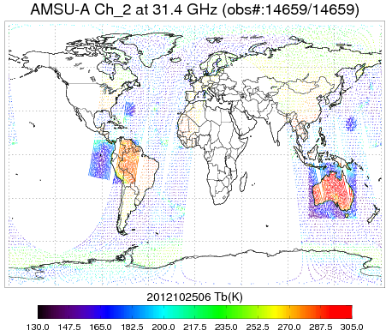
GSI Activities and Future Plan -Tong Zhu and Sid Boukabara (July 2014)
Community Satellite data Thinning and Representation Optimization Tool (CSTROT)
Summary for the development of CSTROT:
  A new thinning scheme is under development to optimize satellite data selection in GSI data assimilation procedure for global and regional modeling systems.
  The thinning strategy is based on the derived standard deviation (STD) of the satellite data that to be thinned. High density observations will be kept within data high variational regions, such as tropical cyclone and front systems. High density data can also be selected by giving the locations of the interested regions.
  Figure left illustrates the observation points kept after the thinning for NOAA-15 AMSU-A channel-2 brightness temperatures, with higher density observations selected in two target regions and two domains.
Future plan:
  We will keep working on the development of the new thinning scheme, and the implement of the scheme into GSI system.
  Perform impact studies of the assimilation of GOES and SEVIRI on GFS and HWRF forecasts with the new thinning scheme.
AMSU-A Ch-2 Tb on 0600 UTC 25 Oct. 2012 thinned with CSTROT scheme, with two target regions and two domain areas selected for higher density data.

Slide 25
CRTM updates
Quanhua Liu, Paul van Delst, Dave Groff
New Microwave Cloud Optical Table
  CRTM currently assumes spherical particles. There are studies showing the large difference of the MW cloud optical properties between spherical and non-spherical particles for snow, graupel, and hail.
  The microwave cloud optical table for non-spherical particles from Prof. Guosheng Liu at the Florida State University was tested. The results showed the large difference ( 5 ~ 10K) in brightness temperatures at high frequencies by using the tables for spherical and non-spherical particles.
  More assessments are needed before the release of the new table.
Partial Cloud Fraction
  The CRTM is being extended to have the capability for simulating satellite radiance over partial cloudy scenes. This can be useful toward cloud radiance assimilation because majority of microwave footprint is partially cloudy.
  According to user’s inputs of vertical distributed cloud fractions, we compute a “radiative” equivalent cloud fraction, so that the radiance is just a sum of clear-sky radiance and the cloudy radiance (a linear function of the effective cloud fraction).
Future Plans
    Use HWRF data to quantify the difference for microwave sensors by using spherical and non-spherical particles.
    Test CRTM simulations for partial cloudy cases; Applications in cloudy radiance assimilation and physical retrievals.

Slide 26
Community Surface Emissivity Model (CSEM) updates
Ming Chen Fuzhong Weng
Completed the initial design of the general CSEM framework. The design covered the following fundamental concepts:
  Mutual benefits for community users to use CRTM and for CRTM to incorporate external efforts. CSEM will be used to as a “pool” for selecting candidates for operational implementation, while providing general interface for users to hook up their new models with CRTM for research testing.
  Minimum modification requirement for the current CRTM software structure to keep backward compatibility with the earlier CRTM versions
  Flexible interfacing for O2R and R2O
  Easy maintenance and expansion
Reconstructed the current land microwave emissivity model structures following the general CSEM design concepts. The current land microwave emissivity model is a single module enclosing the physics of soil, canopy and snow. Following the CSEM design, independent modules for canopy, soil, snow have been built up. Extensive testing was performed to ensure the correct implementation of individual physical modules. A working version of the integrated land microwave CSEM has been completed, which will be used as a template for building up other CSEM subsystems, e.g., infrared land CSEM.

Slide 27
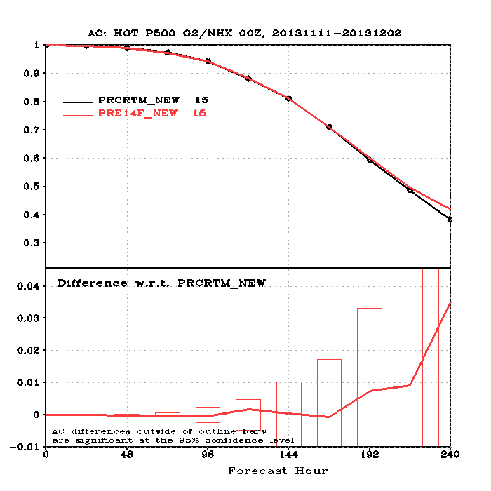
Community Surface Emissivity Model (CSEM) updates
Ming Chen Fuzhong Weng
Performed parallel GFS runs on Zeus to evaluate the potential impact of the land MW emissivity models on weather forecasting. Two GFS-GSI runs were successfully completed and analyzed. The configurations of the two GFS-GSI runs were the same except using different versions of the CRTM land MW emissivity models. It was found that the current improvement of the land MW emissivity model generally brings about positive impact on the GFS forecasting scores. More experiments will be performed.

