Slide 1
GSI Review Committee
NESDIS
R. Bradley Pierce
Jim Jung
9 August 2013

Slide 2
List of NESDIS GSI Related Projects
Kevin Garrett :
ATMS Impact Assessment
MiRS 1DVAR preprocessor implementation
James Jung:
AIRS/IASI/CrIS Water vapor experiments
Li Bi:
OSCAT Assimilation
Dave Santek:
Polar Wind QC
Sharon Nebuda/J. Daniels
GOES-R AMV Assimilation
Sean Casey:
Early morning orbit OSSE Analysis
GEO OSSE Development
Milija Zupanski:
Use of GSI in regional data assimilation
Jun Li:
Satellite Data Assimilation for Tropical storm forecasts - SDAT
Ming Chen/Fuzhong Weng
Microwave emissivity development
Quanhua Liu
CRTM extension for GSI cloud radiance assimilation
Improve radiative transfer solver for fast cloud radiance calculation
GDAS/GFS
GOES-R
OSSE
Regional GSI DA
CRTM

Slide 3
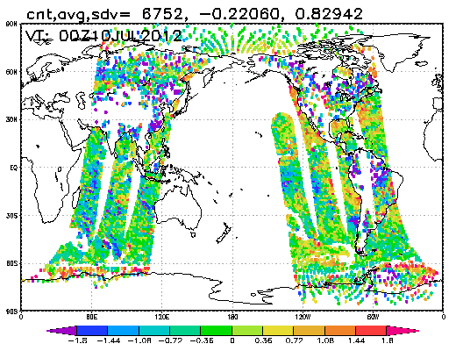
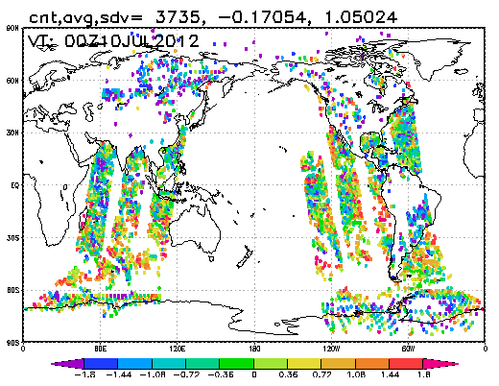
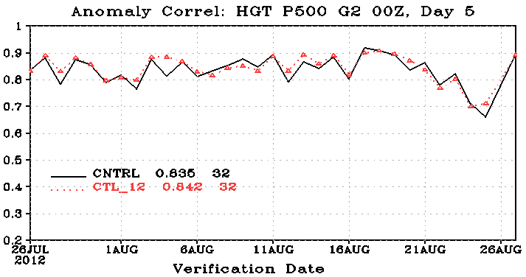
JPSS data gap Experiments
Kevin Garrett
Running new polar data denial experiments to assess impact of potential JPSS data gap, follow-up to GSI non-hybrid experiments run on JIBB last fall/winter 2012-2013.
  Ported code from EXP-ssmis branch (GSI and EnKF) and modified scripts to assimilate F16, F17, and F18 SSMI/S for early morning orbit.
  Began running 1st season control and 2polar experiments, where control run is current observing system, and 2polar removes redundancy from observing system as well as the POES/NPP afternoon orbit sensor data. 1st season is August 1-October 31, 2012.
Figure 2. Observation minus Simulation (O-B) after bias correction for F16 SSMI/S channel 1 – 50.3 GHz (top) and F17 SSMI/S (bottom) from data gap assessment experiments, 1 GDAS cycle.
Figure 1. 500 mb Global AC scores at Day 5 for new polar data denial control run with SSMI/S run on S4 (black) and benchmark control run from JIBB (no SSMI/S) (red) between July 26 and August 27, 2012. Agreement between the experiments partly confirms port of SSMI/S codes successful.

Slide 4
MiRS 1DVar GSI preprocessor
Kevin Garrett
Began implementation of a 1DVAR preprocessor to the GSI.
  Converted the MiRS 1DVAR program to a subroutine and linked along with MiRS library to the GSI.
  Implemented and tested 1DVAR call from read_atms.f90 program to preprocess ATMS observations. Processing takes many resources as the read_atms is not parallelized (although other reading codes are).
  Began implementing 1DVAR in the setuprad.f90 module to apply 1DVAR on thinned radiances for all passive microwave sensors as calling from the read_atms.f90 is inefficient.
  The best solution for practical application, calling the 1DVAR from a true “preprocessing” program before GSI is invoked, will be explored, e.g. at the BURFization or “dump” steps, so that the 1DVAR is applied to the full set of (non thinned) observations and does not increase the GSI run time.
Next 6 months
  Continue implementation of 1DVAR preprocessor to test QC and emissivity outputs applied in GSI. QC pre-processor is scheduled to be extended to all microwave and also IR sensors.
  Finalize JPSS data gap experiments and assess.
  Begin developing assimilation of SSMI/S imaging channels and/or AMSR2 data in GSI for both regional and global NWP.

Slide 5
Water Vapor Experiments
James Jung
T574 – hybrid, 2 season parallels
Proposed experiment steps
Current Status
Clip supersaturation at each outer loop
Add penalty for supersaturation during minimization (factqmax)
Review background error
Review gross error checks and assimilation weights
Add IASI and CrIS IR channels
Created a branch from NCEP trunk and benchmarking it on JIBB & S4.
Obtaining new data types used by latest GSI trunk (hourly GEO winds, OSCAT, SSMIS, etc.) to start new operational resolution parallels.
Coordinating with NCEP (Andrew Collard, Daryl Kleist, Mike Lueken, etc.)
  Are others interested?
Will be starting a new wiki page soon.
Notes:
T574 – hybrid, 2 season parallels will start after the new data are in place and am satisfied the GSI is working properly.

Slide 6
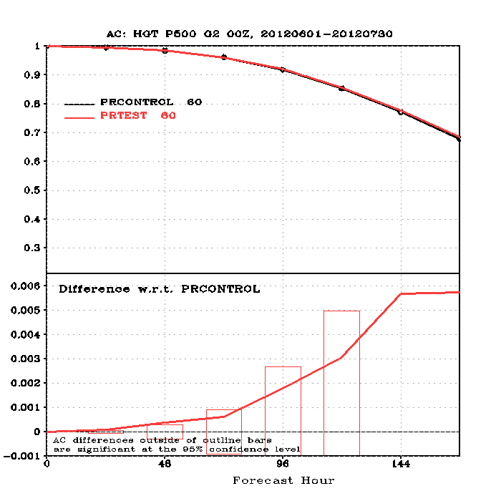
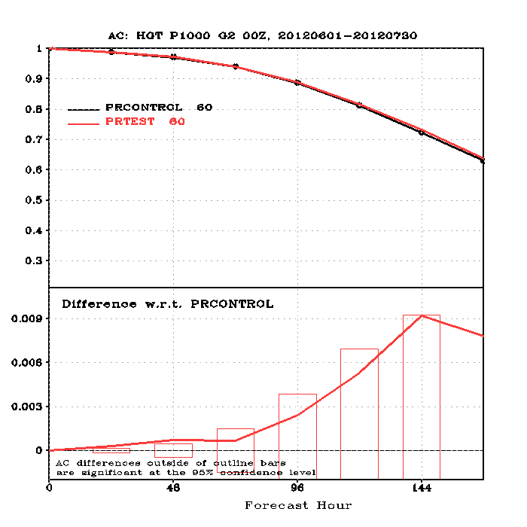
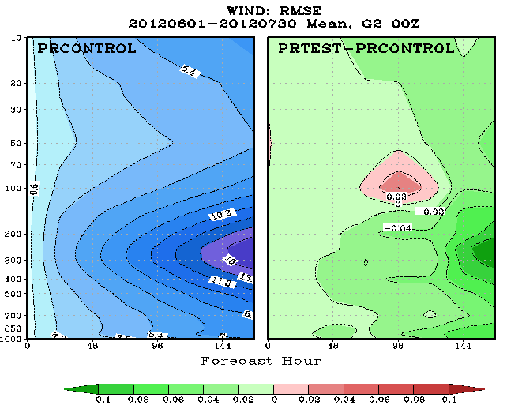
OSCAT assimilation in GSI
Li Bi
Optimizing the usage of OSCAT in GSI is high-priority item
Steps towards assimilating OSCAT in GSI
  Read KNMI OSCAT BUFR directly from GSI
    Added new subroutine read_sfcwnd.f90 to GSI, changes are committed to trunk.
    Modified setupw.f90 for OSCAT QC, changes are committed to trunk.
  Performed two-season KNMI OSCAT experiment, results are slightly positive.
  OSCAT code changes has been tested in regional NMMB.

Slide 7
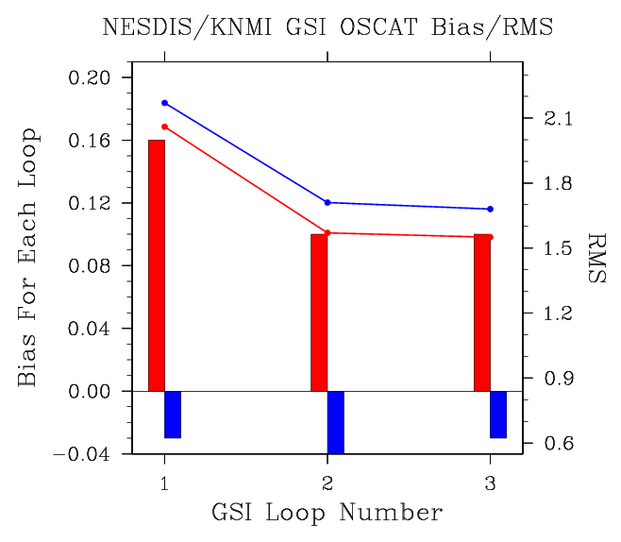
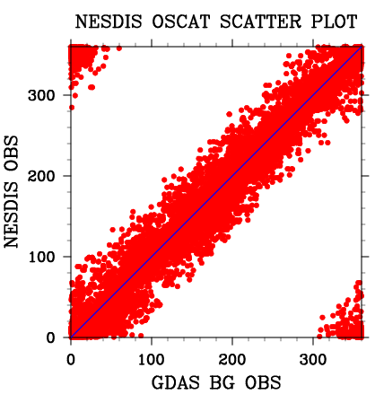
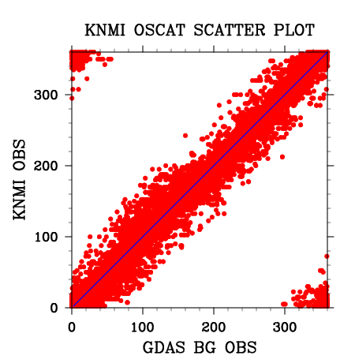
Work Plan
Start to assimilating NESDIS OSCAT products in GSI
  Investigate new QC techniques for NESDIS OSCAT BUFR
  Test 50km vs. 25km OSCAT data products
  Observation error impact
Start to look at OSCAT impact in HWRF
NESDIS/KNMI OSCAT Wind Direction
KNMI OSCAT RMS
NESDIS OSCAT RMS
KNMI OSCAT Bias
NESDIS OSCAT Bias

Slide 8
Polar Wind QC
David Santek, Brett Hoover, Sharon Nebuda
Using the hybrid GDAS/GFS.
Quality Control experiments with satellite-derived polar winds:
  Subversion branch SANTEK_POLAR_AMV
  Modified setupw.f90 and read_satwnd.f90 for assimilating AVHRR polar winds.
  Modified code to use Log Normal Vector Departure (LNVD, OMB_Vector_Departure/log(Wind_Speed)) for all polar winds; initial results looks promising and experiments are running now:
    Control
    MODIS using LNVD
    AVHRR using LNVD
    MODIS using LNVD without Water Vapor winds (this is a likely future scenario as Metop and JPSS do not have a WV imager channel)

Slide 9
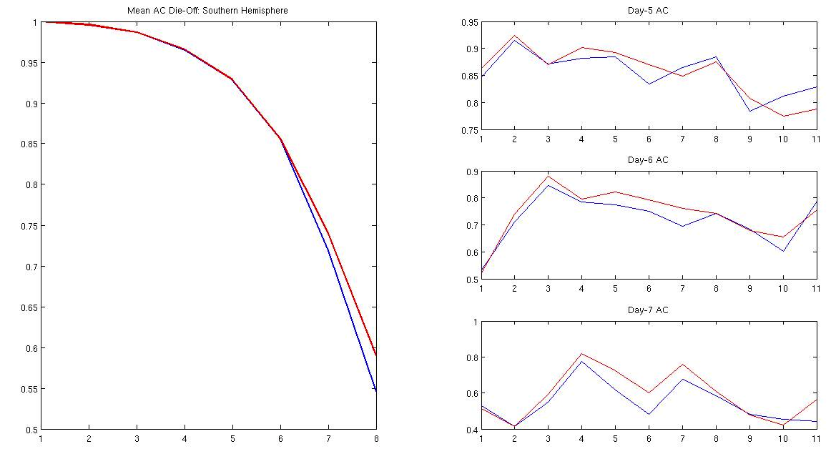
MODIS
Eleven days into the experiment, the die off curves for the MODIS winds using the LNVD are trending in the right direction for the Southern Hemisphere
Very preliminary results of the Anomaly Correlation (AC) scores for the first 11 days of the experiment 9-20 October 2012.
AC of the 500 hPa geopotential heights over the southern hemisphere (20°S-80°S) for the control and the experiment, using a LNVD threshold of 3.
AC averaged over the first 11 days
AC daily scores for Day-5, -6, and -7

Slide 10
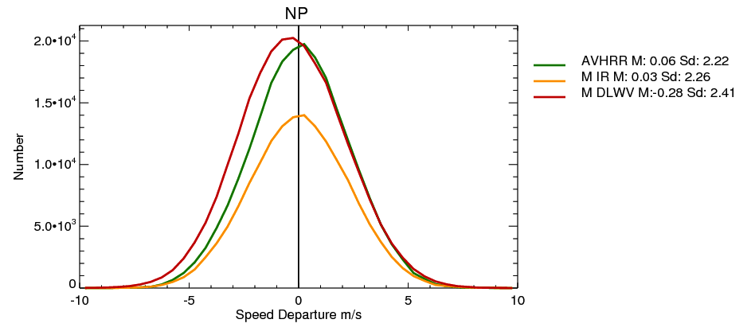
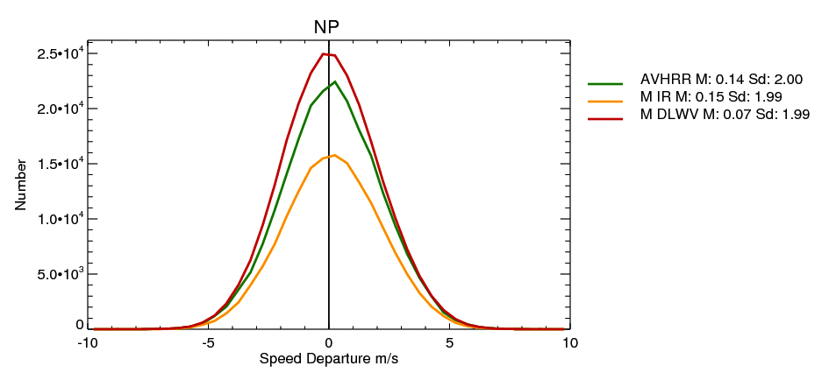
AVHRR
Eleven days into the experiment, the speed departure for the AVHRR winds has a very similar distribution to the MODIS winds for both background (left) and analysis (right)
AVHRR winds have a similar impact on the analysis as the MODIS winds: Both polar winds reduce the standard deviation from 2.22 (OMB) to 2.00 (OMA)
Speed OMB for AVHRR (green) and MODIS IR winds (yellow) for 9-20 October 2012.
Speed OMA for AVHRR (green) and MODIS winds (yellow) for 9-20 October 2012.

Slide 11
GOES-R AMV Assimilation
Sharon Nebuda
Developing Assimilation Techniques for Atmospheric Motion Vectors (AMV)
Derived via a New Nested Tracking Algorithm Derived for the GOES-R ABI
Progress May-July, 2013:
Identified 2 Nested Tracking Parameters for IR AMVs quality control
Begun seasonal assimilation and forecast experiments running on JIBB
Intended Project Outcomes:
Develop new AMV assimilation QC procedures
Evaluate data assimilation and forecast impact of the new AMVs
Assist in transitioning the newly-developed QC techniques into the
NCEP operational model
Notes:
11

Slide 12
GOES-R AMV Quality Control Parameters
For IR, NIR, VIS, and CTWV AMVs using the traditional metrics of:
QI no forecast component: Currently in NCEP GFS Operations
EE / Obs Speed: Under review for current GOES AMVs and effective for screening slower winds with predicted high error
For IR AMVs also investigating two Nested Tracking Parameters:
PCT1: Measure of the tracked clusters standard deviation divided by the distance the cluster moved between images
CPMX-CPMN: Measure of the range of cloud top pressures in the cluster group. Smallest values have larger departure bias for the AMV compared to the GFS in the extra-tropics.
In addition to these quality control parameters, modifying the wind departure check in the GSI to use a Log Normalized Vector Departure test. This threshold test is also under investigation to include for Polar AMVs in NCEP GFS Operations.

Slide 13
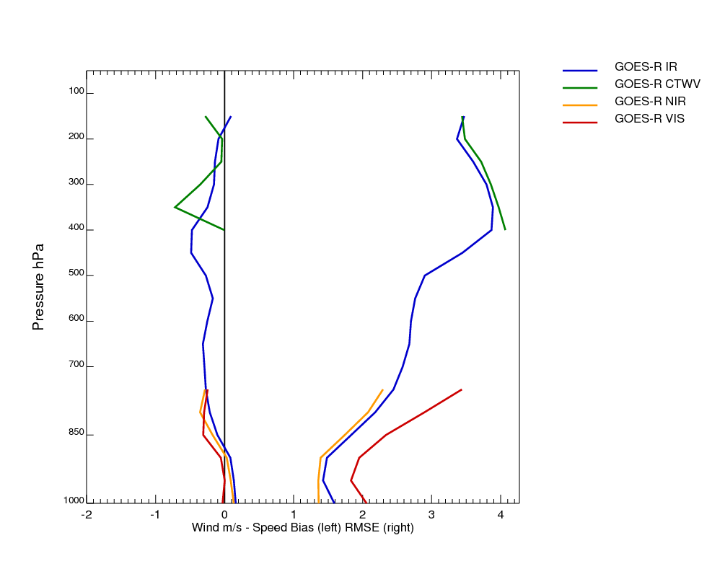
Assimilation Status
NCEP Global GFS control simulations are complete
for two seasons: May-July 2012 and Feb-March 2013
Experiment using GOES-R AMVs is under-way for the summer season.
1-30 June, 2012
GFS Assimilation-AMV wind speed bias and RMS vector difference for the SEVIRI proxy data region

Slide 14
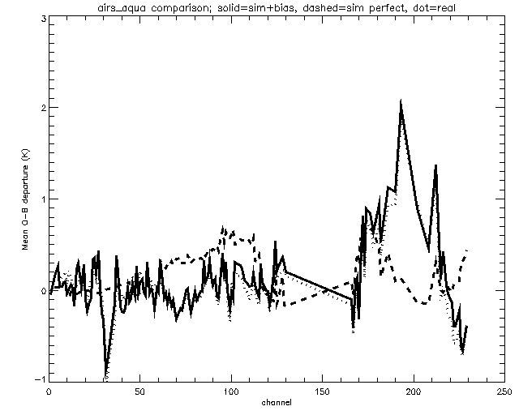
Recent OSSE developments
Early morning orbit OSSE Analysis
Sean Casey
New simulated data with added biases
  Radiance-by-channel patterns now more closely resemble real data (right)
  Still more precise than real data, leading to lower O-A stats for new simulated data; work ongoing
Altering read scripts, bias correction/qc, etc., to allow for assimilation of new test experiments:
  AIRS_GEO: An Atmospheric Infrared Sounder-type instrument in geostationary orbit
    In collaboration with AOML/SSEC
    Use same AIRS readers, but changing CRTM coefficient files, etc., to allow for a GOES-13-like location
  Planning work for future collaboration with ESRL, including:
    COSMIC II: A next generation GPSRO satellite constellation
    GIFTS: Geostationary Imaging Fourier Transform Spectrometer
Mean O-B for assimilated AIRS_AQUA channels
O-B for real obs (dotted ), simulated obs without biases (dashed), and with biases (solid)

Slide 15
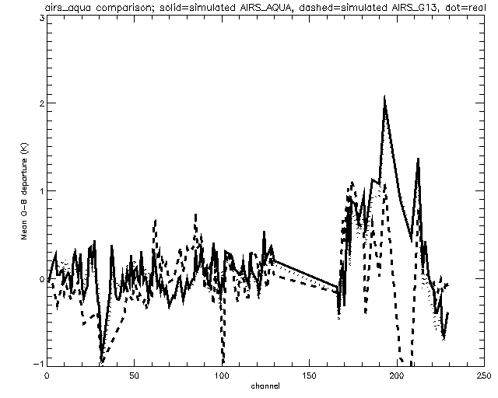
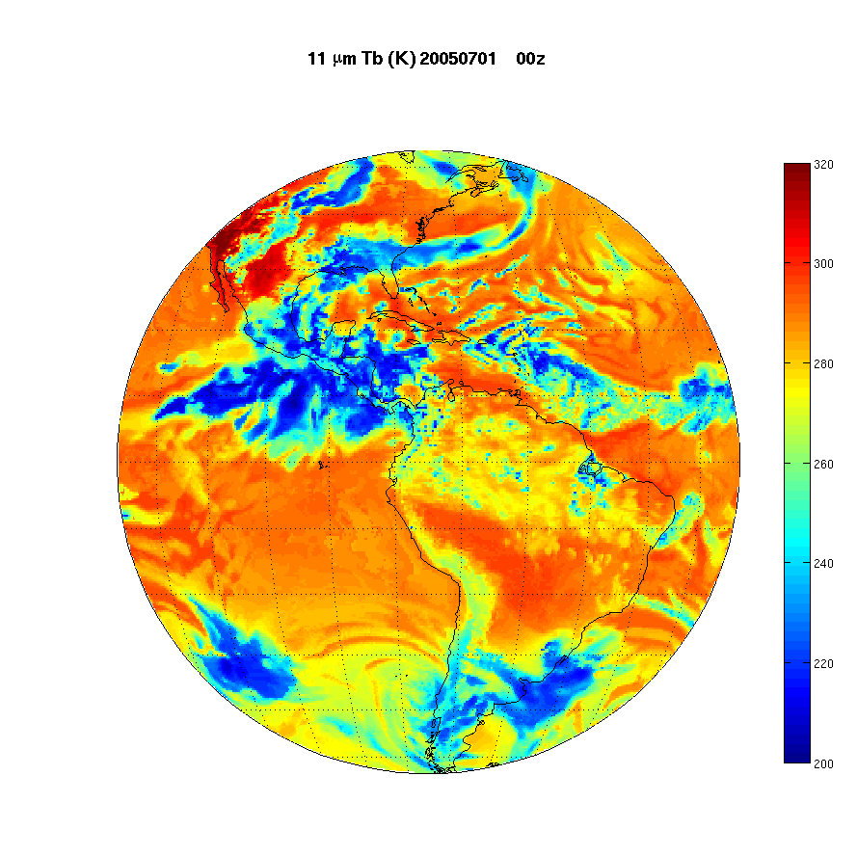
An Atmospheric Infrared Sounder-type instrument in geostationary orbit
Sean Casey/Zhenglong Li
SSEC providing synthetic Tb bufr files from ECMWF Nature run
SAID is set to 257 (GOES east, 75W)
max viewing angle is 53 degrees
both clear and cloudy pixels are included
Only the 281 AIRS NRT channels as distributed by NESDIS had been encoded;
Mean O-B for assimilated AIRS_AQUA and AIRS_GEO channels
O-B for real obs (dotted ), simulated AIRS GEO (dashed), and AIRS AQUA with biases (solid)

Slide 16

Use of GSI in regional data assimilation Milija Zupanski
Forward component of GSI used as observations operator with Maximum Likelihood Ensemble Filter (MLEF)
Benefits of using GSI as observation operator:
- access to NOAA observations
- observation errors
- quality control
- interpolation from WRF model grid to observation location
- transformation (e.g., Community Radiative Transfer Model - CRTM)
Applications:
- Tropical cyclones (NOAA hurricane WRF - HWRF)
- Severe weather (WRF-NMM)
- Coupled models (land-atmosphere, chemistry-atmosphere)
- Assimilation of all-sky infrared and microwave satellite radiances
Future use:
- Regional hybrid GSI with MLEF as ensemble component
Notes:
Outline slide

Slide 17
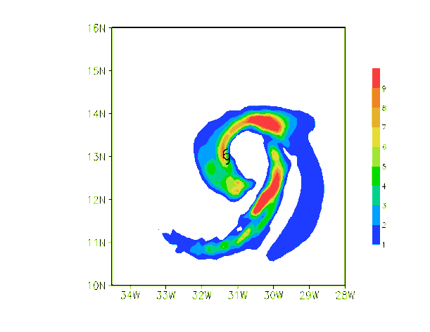
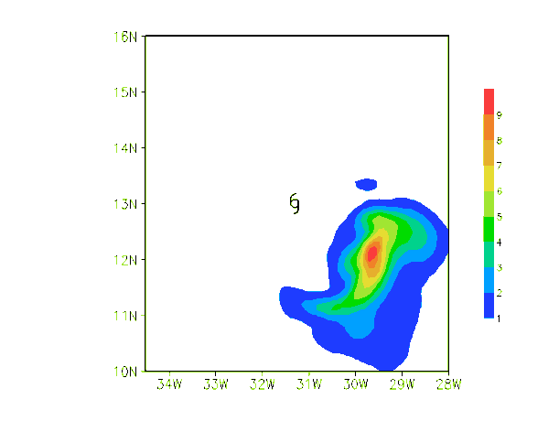
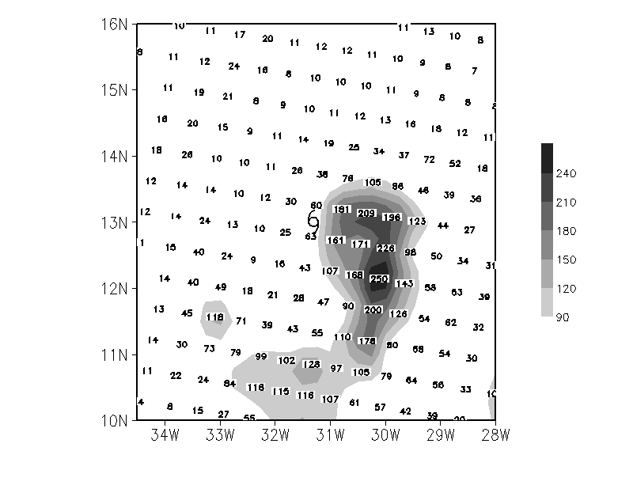
Hurricane data assimilation
Assimilation of SEVIRI all-sky infrared radiances for hurricane Fred (2009)
  NOAA hurricane WRF (inner nest at 9 km)
  1-hour assimilation interval
  Control experiment: no assimilation
  Data assimilation experiment: MLEF+GSI+CRTM
SEVIRI infrared all-sky radiance assimilation (proxy for GOES-R ABI instrument)
[Zhang et al. (2013)]
Cloud condensate:
Control experiment
Valid 0600 UTC 9 Sep 2009
Cloud condensate:
all-sky radiance assimilation
Valid 0600 UTC 9 Sep 2009
Verification: AMSU-A NOAA-16
retrieved cloud liquid water
Valid 0600 UTC 9 Sep 2009
Assimilation of all-sky infrared radiance is able to improve clouds in TC

Slide 18
Progress since May 2013
Satellite Data Assimilation for Tropical storm forecasts - SDAT
Jun Li
A real time system (satellite data assimilation for tropical storm forecasts - SDAT) based on WRF/GSI has been set up and tested, it is expected to be running in near real time at CIMSS in September 2013.
In order to enhance the application of moisture information from sounders, new forward operator and its Jacobian are developed inside GSI for layer PW at layer 300 – 700 hPa which has the best moisture information from IR sounders, therefore SDAT can assimilate both radiances and products (TPW, layer PW, soundings etc.);
SDAT has been tested with historical TCs (Ike 2008, Irene 2011, Sandy 2012) for life-cyclone forecast experiments which show:
  Sounders (AIRS, AMSU-A) improve TC forecasts:
  GFS has best track, but worst SLP and maximum wind most of time;
  HWRF has a very good analysis results;
  SDAT has best SLP and maximum wind most of time.

Slide 19
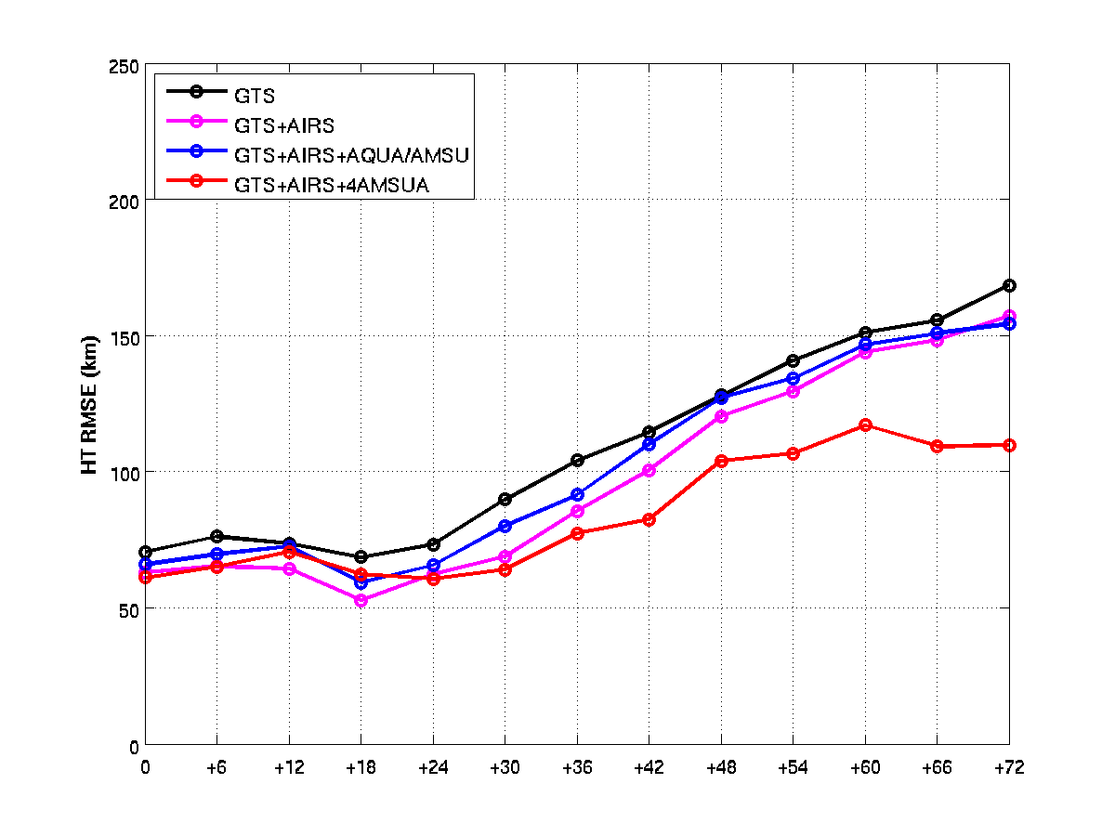
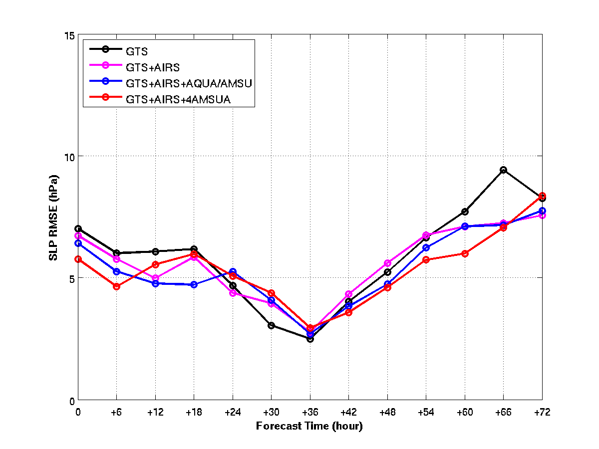
GTS: all conventional and other satellite/aircraft data from global telecommunication system;
AIRS: AIRS radiances;
AQUA/AMSU: AMSU-A radiances from Aqua satellite;
4AMSU: AMSU-A radiances from NOAA, Aqua and Metop satellites;
Model resolution 12 km (see below the domain,
Life-cyclone Irene (2011) forecast RMSE for track (upper) and SLP (lower) from SDAT

Slide 20
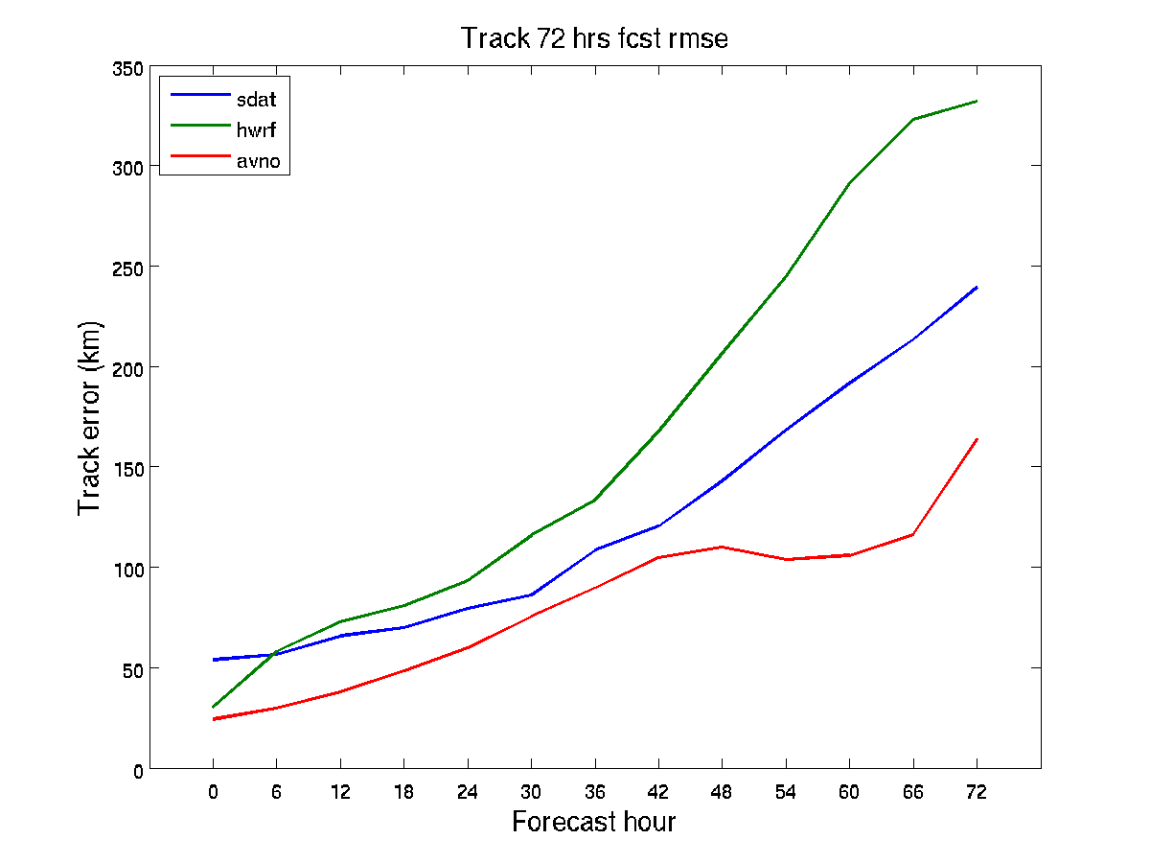
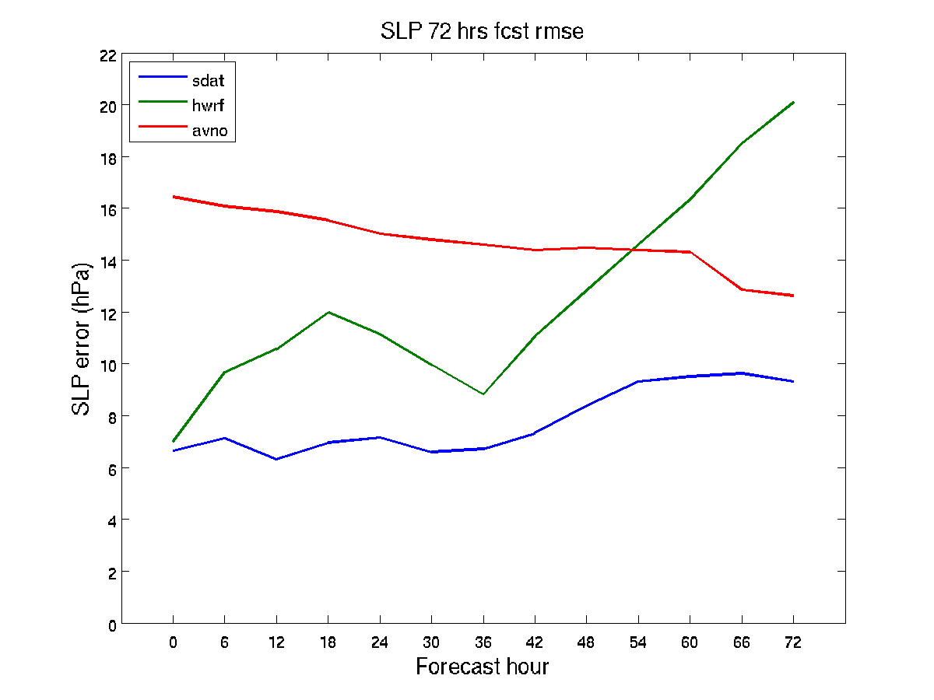
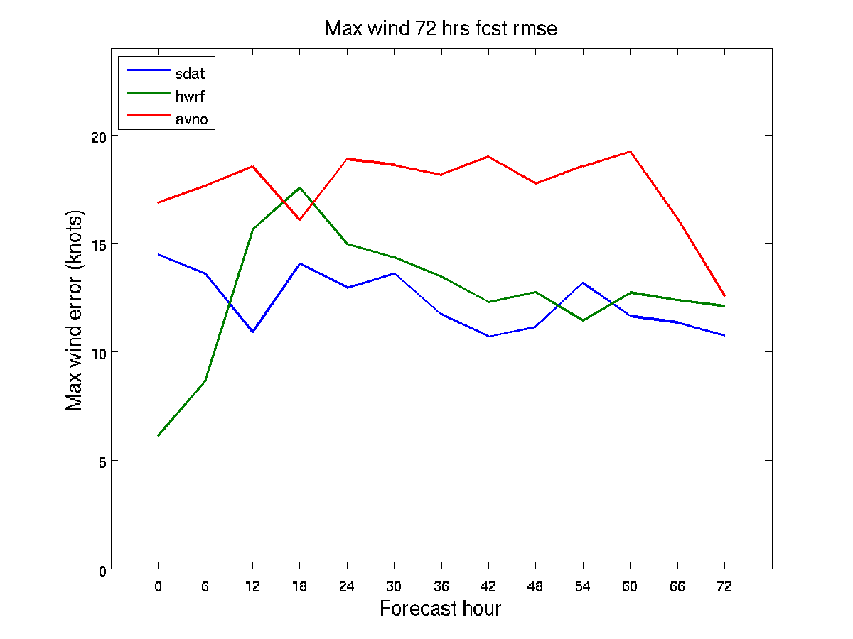
Life cyclone forecast experiments - Sandy 72 hours forecast
2012102218 - 2012102812
GFS has best track, but worst SLP and maximum wind most of time.
HWRF has a very good analysis results.
SDAT has best SLP and maximum wind most of time.

Slide 21
Future plans
Further test WRF/GSI on using moisture (radiances and LPW);
Prepare for real time SDAT experiments;
Update GSI using the latest version (Jinlong Li will attend the upcoming GSI tutoring) in August;
Experiments on moisture track winds from AIRS/CrIS pair soundings (a proposal to risk reduction is considered).

Slide 22
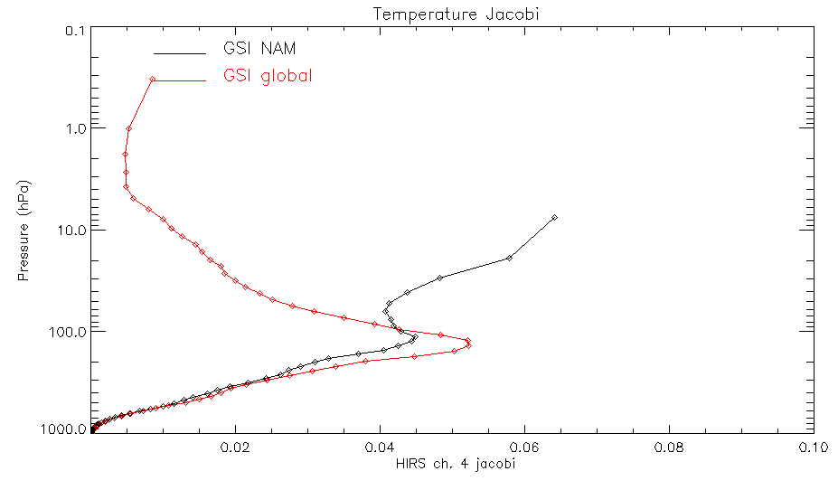
Sensitivity of CRTM Jacobian to Vertical Coordinates
Quanhua Liu, Paul van Delst, Dave Groff
CRTM team has worked to determine the validity of large model top temperature jacobians when NAM input vertical coordinates are applied. Specifically, the CRTM team has been concerned with scenarios in which the temperature jacobians generally exhibit two characteristics:
1) The largest temperature jacobians are at model top.
2) The largest temperature jacobians are significantly displaced above the weighting function.
NOAA-18 HIRS channel 4 jacobian values for a GSI global profile (red line) and a GSI NAM regional model profile (black line).

Slide 23
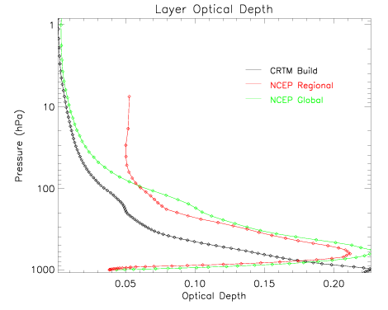
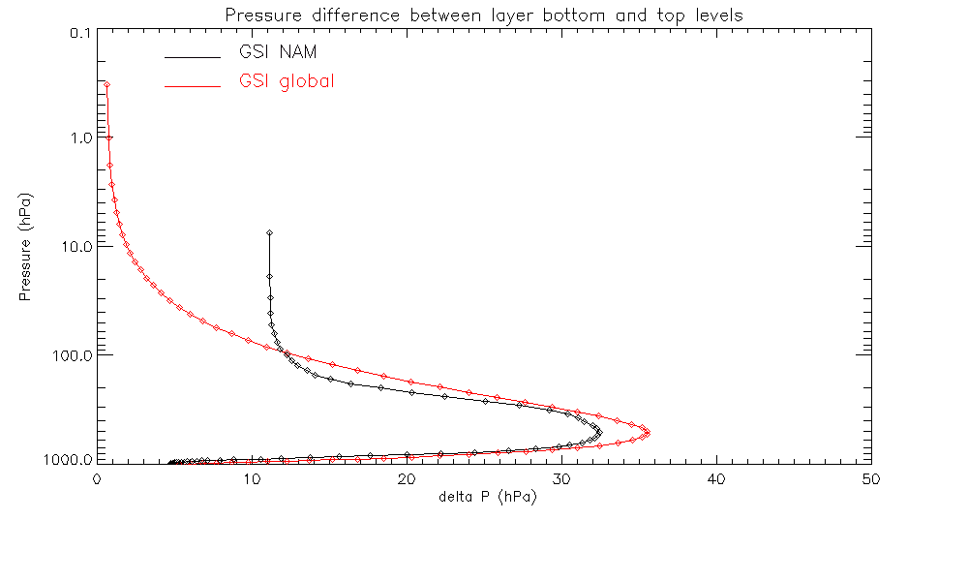
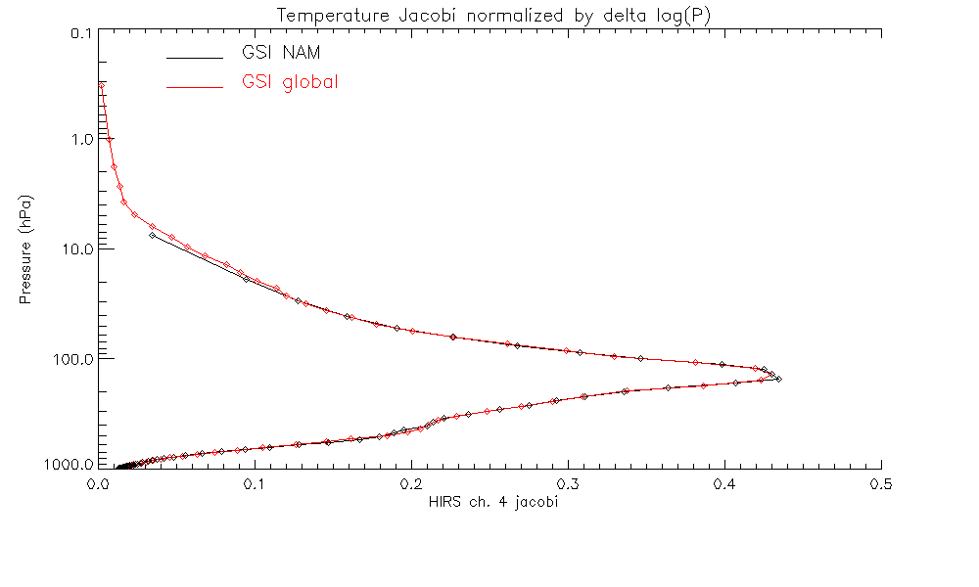
NOAA-18 HIRS channel 4 Layer optical depth for global profile (green line), regional profile (red line) and a CRTM profile (black line).
The layer optical depth is approximately proportional to the pressure difference of the layer.
The coarse vertical resolution of NAM above 100hPa caused large jacobian values for the channels which have significant absorption in the upper layers.
Important to consider for satellite radiance assimilation for regional model analysis.
Layer pressure difference for a GSI global profile (red line) and a GSI NAM regional model profile (black line).
Partial weighting function for atmospheric temperature for a GSI global profile (red line) and a GSI NAM regional model profile (black line).

Slide 24
Future Plan
  CRTM extension for cloud radiance assimilation
    Multi-layer cloud fraction
    Black cloud radiance profile for GSI cloud detection
    Cloud radiance jacobian values under clear-sky
  model conditions
  Improve cloud radiance computational efficiency

Slide 25
Improvement of CRTM Physical Land Emissivity Model with Non-isothermal Layers
Ming Chen/Fuzhong Weng
Canopy Physical RT Model (Weng et al , 2001)
Air
I₀
I(τ_{0,}μ) (1-R₂₁ )
Layer 1 ԑ₁
I₀R₁₂
Where,
τ₀
B_{c} (T_{c})
I₀(1-R₁₂ )
I(τ_{0,}μ) R₂₁
Layer 2 ԑ₂
I(τ_{1,-}μ)
I(τ_{1,-}μ) R₂₃
Vegetation
τ₁
I_{s} (T_{s ,i} , q_{s,i ,i})
Layer 3
Soil
Solution:
Soil Physical RT Model (Burke et al, 1979)
The equation system of Weng et al, 2001 was refined to take account the temperature difference between canopy and bare soil and the impact of soil temperature and moisture profiles and the canopy volume scattering scheme was improved with the introduction of a more general leaf inclination distribution model (Chen & Weng, 2013).
This multi-layered soil model consists of an incoherent soil RT scheme and a core profiling model which implemented 120 discrete vertical layers. Soil profiles were constructed from the 4-layer soil outputs of GFS.

Slide 26
Comparison of TB Obs - CRTM Sim
LandEM in REL-2.1 vs. Ongoing Improvement
23.8GHz
AMSU-A
50.3GHz
In comparison with the LandEM in CRTM REL-2.1, the ongoing improvements have significantly increased (~20% more) the data points that are possibly assimilated, especially over desert / bare soil regions. Both window-channel and surface sensible sounding channels are improved.
REL 2.1
REL 2.1
23.8GHz
AMSU-A
50.3GHz
Ongoing
Ongoing
(Chen & Weng, 2013)

Slide 27
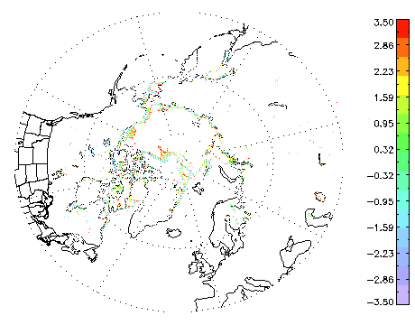
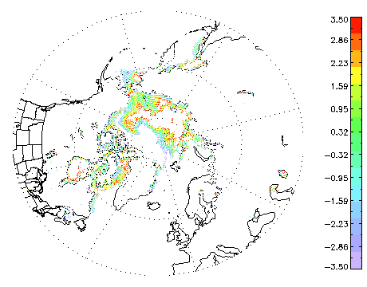
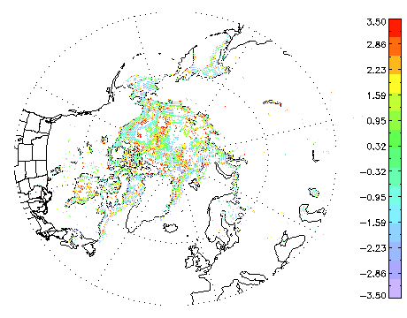
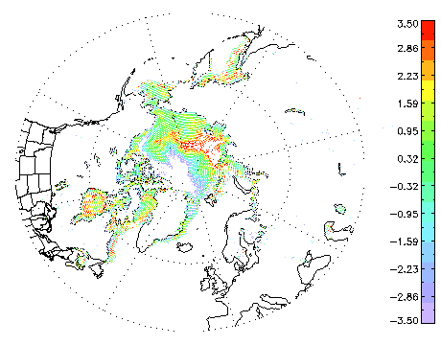
Development of ATMS Sea-ice Surface Emissivity Model
Ming Chen/Fuzhong Weng
TELSEM
Type-based sea-ice emissivity spectrum library is constructed and validated from well-controlled lab measurements and in-situ observations, which may provide more reliable spectral structure than other empirical method (e.g., TELSEM)
Semi-physical sea-ice typing
Typing algorithm based on first-order RT equation
Use the observations of few window channels to generate “real-time” typing and meanwhile avoid the looping of data usage for data assimilation system
Utilize the library spectral structure to keep the emissivity quality of the sounding channels.
23.8GHz
50.3GHz
23.8GHz
ATMS Sea-ice TB Obs-CRTM Sim
50.3GHz
MODEL
(Chen & Weng, 2013)

Slide 28
Future Plans
More heavily invest in cloudy radiance, AMVs, and geo-radiance assimilation.
Support AMDAR instrument quality control, software development and data assimilation.

