Slide 1
High Resolution Coupled RAQMS/WRF-Chem
Ozone and Aerosol Simulations
WRF/Chem
WRF/Chem – 40 layers, ptop~50mb (36km – 12km – 4km simulations)
Regional Atmospheric Chemistry Mechanism (RACM) with GOCART aerosols
3-4 days at 36km, 2 days at 12km, 30 hours at 4km resolution
Meteorological analyses updated every 24 hours at 00Z,
Thompson microphysics
RRTM LW scheme
Goddard SW scheme
Monin-Obukhov surface layer scheme
Unified Noah land-surface model
YSU boundary layer scheme
Day zero chemical initial conditions and chemical lateral boundary conditions from RAQMS
CRTM
WRF/Chem T, q, o3, GOCART aerosols (40 layers, ~50mb), land surface properties
RAQMS T, q, o3 – 35 layers on top of WRF domain
75 vertical layers
2 absorbers; ozone, water vapor
14 aerosols; sulfate, BC1, BC2, OC1, OC2, 5 dust bins, 4 seasalt bins
-Hygroscopic growth mechanism included in SEVIRI and Full Disk Simulations

Slide 2
Proxy Datasets
I. 4km CONUS (4km) 20-53N, 131 – 63W August 24th, 2006
WRF/Chem V3.0.1
Grell-Devenyi ensemble cumulus scheme
CRTM V1.1
NEI2003 4km emissions
Biomass burning emissions produced from WF-ABBA wildfire products
Number of clouds=2, water, ice
CRTM used a fixed satellite height and fixed aerosol effective radii and cloud effective radii
II. SEVIRI (4km) 25S – 40N, 26W -43E August 16th, 2006
WRF/Chem V3.0.1
Grell-Devenyi ensemble cumulus scheme
CRTM V2
NESDIS fire emissions
Number of clouds – 5; liquid, rain, snow, ice, graupel
-Calculated variable cloud effective radius (J. Otkin, CIMSS)
III. FULL_DISK (12km) 66S – 66N, 129E – 45W May 16th, 2010
WRF/Chem V3.2.1
used new Grell (G3) cumulus scheme
CRTM V2.0.2
WF ABBA fire detections
Number of clouds – 5; liquid, rain, snow, ice, graupel
-Calculated cloud variable effective radius (J. Otkin, CIMSS)

Slide 3
GOCART Aerosol Effective Radius(gotten from CRTMV2.0.2)
In CRTM there are 8 aerosol types.
Itype
1 dust
2 Sea salt SSAM
3 Sea salt SSCM1
4 Sea salt SSMC2
5 Sea salt SSCM3
6 Organic carbon
7 Black carbon
8 Sulfate
Calculation of aerosol effective radius
We are using a function from CRTMV2.0.2
FUNCTION GOCART_Aerosol_size(kk,ITYPE, & ! Input
t, & ! Input in K
q, & ! Input in g/kg
p) & ! Input in hPa
RESULT(R_eff ) ! in micrometer
Effective radius; R_eff(nradii, ntype); nradii=36, ntype=8
Number of RH levels used in hygroscopic calculation =36; rh(36)
Hydrophobic OC and BC get effective radii R_eff(1,ITYPE) and return to calling program
Hydophyllic OC, BC, sea salt and sulfate are run through hydroscopic growth mechanism
We set 5 dust bins effective radii in CRTM main program after function call (see below)

Slide 4
CRTM main program
Atmosphere(1)%n_Aerosols = 14
K=1,14 Itype
Atmosphere(1)%Aerosol(1)%Type = SULFATE_AEROSOL = 8
Atmosphere(1)%Aerosol(2)%Type = BLACK_CARBON_AEROSOL = 7 ! dry aerosol
Atmosphere(1)%Aerosol(3)%Type = BLACK_CARBON_AEROSOL = 7
Atmosphere(1)%Aerosol(4)%Type = ORGANIC_CARBON_AEROSOL = 6 ! dry aerosol
Atmosphere(1)%Aerosol(5)%Type = ORGANIC_CARBON_AEROSOL = 6
Atmosphere(1)%Aerosol(6)%Type = DUST_AEROSOL = 1
Atmosphere(1)%Aerosol(7)%Type = DUST_AEROSOL = 1
Atmosphere(1)%Aerosol(8)%Type = DUST_AEROSOL = 1
Atmosphere(1)%Aerosol(9)%Type = DUST_AEROSOL = 1
Atmosphere(1)%Aerosol(10)%Type = DUST_AEROSOL = 1
Atmosphere(1)%Aerosol(11)%Type = SEASALT_SSAM_AEROSOL = 2
Atmosphere(1)%Aerosol(12)%Type = SEASALT_SSCM1_AEROSOL = 3
Atmosphere(1)%Aerosol(13)%Type = SEASALT_SSCM2_AEROSOL = 4
Atmosphere(1)%Aerosol(14)%Type = SEASALT_SSCM3_AEROSOL = 5
!set 5 dust bins
Atmosphere(1)%Aerosol(6)%Effective_Radius(i) = 0.55_fp
Atmosphere(1)%Aerosol(7)%Effective_Radius(i) = 1.4_fp
Atmosphere(1)%Aerosol(8)%Effective_Radius(i) = 2.4_fp
Atmosphere(1)%Aerosol(9)%Effective_Radius(i) = 4.5_fp
Atmosphere(1)%Aerosol(10)%Effective_Radius(i) = 8.0_fp

Slide 5
From the CRTM the associated numbers for land use category /home/schaack/GOES-AWG/CRTM/REL-2.0.2.JCSDA_CRTM_intel/libsrc/CRTM_Surface_Define.f90 ! For land, the land types INTEGER, PARAMETER :: N_VALID_LAND_TYPES = 20 INTEGER, PARAMETER :: INVALID_LAND = 0 INTEGER, PARAMETER :: COMPACTED_SOIL = 1 INTEGER, PARAMETER :: TILLED_SOIL = 2 INTEGER, PARAMETER :: SAND = 3 INTEGER, PARAMETER :: ROCK = 4 INTEGER, PARAMETER :: IRRIGATED_LOW_VEGETATION = 5 INTEGER, PARAMETER :: MEADOW_GRASS = 6 INTEGER, PARAMETER :: SCRUB = 7 INTEGER, PARAMETER :: BROADLEAF_FOREST = 8 INTEGER, PARAMETER :: PINE_FOREST = 9 INTEGER, PARAMETER :: TUNDRA = 10 INTEGER, PARAMETER :: GRASS_SOIL = 11 INTEGER, PARAMETER :: BROADLEAF_PINE_FOREST = 12 INTEGER, PARAMETER :: GRASS_SCRUB = 13 INTEGER, PARAMETER :: SOIL_GRASS_SCRUB = 14 INTEGER, PARAMETER :: URBAN_CONCRETE = 15 INTEGER, PARAMETER :: PINE_BRUSH = 16 INTEGER, PARAMETER :: BROADLEAF_BRUSH = 17 INTEGER, PARAMETER :: WET_SOIL = 18 INTEGER, PARAMETER :: SCRUB_SOIL = 19 INTEGER, PARAMETER :: BROADLEAF70_PINE30 = 20

Slide 6
From GSI: use NMM to CRTM mapping of land surface type /home/schaack/GSI/NCEP_GSI/cmaq_gsi/src/main_to_ncep/crtm_interface.f90 ! Mapping land surface type of NMM to CRTM if (regional) then allocate(nmm_to_crtm(nvege_type) ) if(nvege_type==24)then ! Note: index 16 is water, and index 24 is ice. The two indices are not ! used and just assigned to COMPACTED_SOIL. nmm_to_crtm=(/URBAN_CONCRETE, & COMPACTED_SOIL, IRRIGATED_LOW_VEGETATION, GRASS_SOIL, MEADOW_GRASS, & MEADOW_GRASS, MEADOW_GRASS, SCRUB, GRASS_SCRUB, MEADOW_GRASS, & BROADLEAF_FOREST, PINE_FOREST, BROADLEAF_FOREST, PINE_FOREST, & BROADLEAF_PINE_FOREST, COMPACTED_SOIL, WET_SOIL, WET_SOIL, & IRRIGATED_LOW_VEGETATION, TUNDRA, TUNDRA, TUNDRA, TUNDRA, & COMPACTED_SOIL/) else if(nvege_type==20)then nmm_to_crtm=(/PINE_FOREST, & BROADLEAF_FOREST, PINE_FOREST, BROADLEAF_FOREST, & BROADLEAF_PINE_FOREST, SCRUB, SCRUB_SOIL, BROADLEAF_BRUSH, & BROADLEAF_BRUSH, SCRUB, BROADLEAF_BRUSH, TILLED_SOIL, URBAN_CONCRETE, & TILLED_SOIL, INVALID_LAND, COMPACTED_SOIL, INVALID_LAND, TUNDRA, & TUNDRA, TUNDRA/) Note: We use the 24 nvege_type version

Slide 7
From WRF User Guide 3.2 identify WRF surface types http://www.mmm.ucar.edu/wrf/users/docs/user_guide_V3/users_guide_chap3.htm#_Land_Use_and Table 1: USGS 24-category Land Use Categories Land Use Category Land Use Description 1 Urban and Built-up Land URBAN_CONCRETE 2 Dryland Cropland and Pasture COMPACTED_SOIL 3 Irrigated Cropland and Pasture IRRIGATED_LOW_VEGETATION 4 Mixed Dryland/Irrigated Cropland and Pasture GRASS_SOIL 5 Cropland/Grassland Mosaic MEADOW_GRASS 6 Cropland/Woodland Mosaic MEADOW_GRASS 7 Grassland MEADOW_GRASS 8 Shrubland SCRUB 9 Mixed Shrubland/Grassland GRASS_SCRUB 10 Savanna MEADOW_GRASS 11 Deciduous Broadleaf Forest BROADLEAF_FORES
12 Deciduous Needleleaf Forest PINE_FOREST 13 Evergreen Broadleaf BROADLEAF_FOREST 14 Evergreen Needleleaf PINE_FOREST 15 Mixed Forest BROADLEAF_PINE_FOREST 16 Water Bodies COMPACTED_SOIL* 17 Herbaceous Wetland WET_SOIL 18 Wooden Wetland WET_SOIL 19 Barren or Sparsely Vegetated IRRIGATED_LOW_VEGETATION 20 Herbaceous Tundra TUNDRA 21 Wooded Tundra TUNDRA 22 Mixed Tundra TUNDRA 23 Bare Ground Tundra TUNDRA 24 Snow or Ice COMPACTED_SOIL*

Slide 8
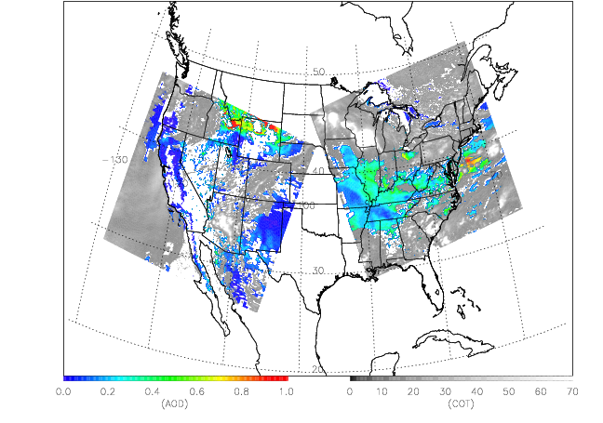
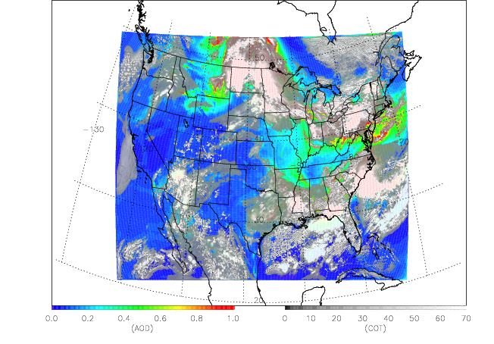
CONUS Simulated Cloud Optical Thickness (COT) and Aerosol Optical Depth (AOD)
Observed and simulated distributions of COT and AOD at 18:30Z on August 24th, 2006. Observed COT and AOD are from the MODIS instruments on the NASA Terra and Aqua satellites. Simulated COT is derived from the WRF cloud, rain, snow, ice and grapple distributions using a simple relationship between liquid water content and COT with fixed effective radii for ice (15 micron) and water (8 micron) drops [Stephens, 1978].
Simulated carbonaceous aerosols have been scaled by a factor of 4 to better represent the observed aerosol loading over Idaho and Montana.

Slide 9
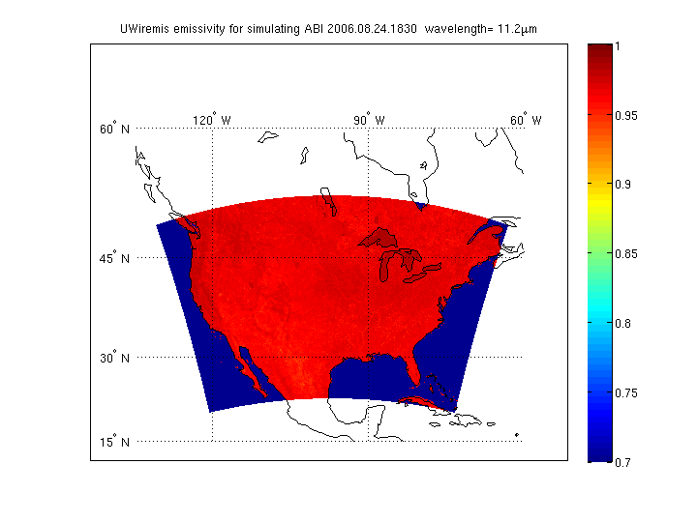
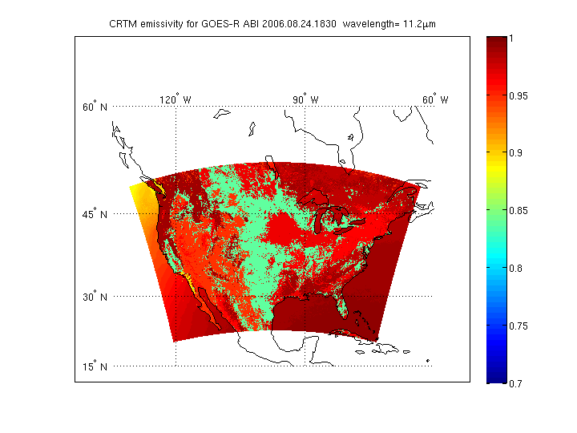
UW IR Emissivity provided by Eva E. Borbas, University of Wisconsin - Madison Space Science and Engineering Center (SSEC)

Slide 10
Large differences in 0.645 micron
Clear sky radiances over Nevada
Most likely associated with assumed surface reflectances

Slide 11
Valid at 2200 UTC 16 Aug 2006
“The large positive bias in the simulated BTD data over the western two-thirds of the Sahara is likely due to the lack of dust in the numerical model, which was important for this case since a significant dust storm was ongoing across this region (Liu et al. 2008). A greater sensitivity to dust with a corresponding reduction in the brightness temperatures at 10.8 mm causes the negative BTD (Ackerman 1997).”
Otkin et al. Validation of a Large-Scale Simulated Brightness Temperature Dataset Using SEVIRI Satellite Observations, JAMC, 2009, DOI: 10.1175/2009JAMC2142.1

Slide 12
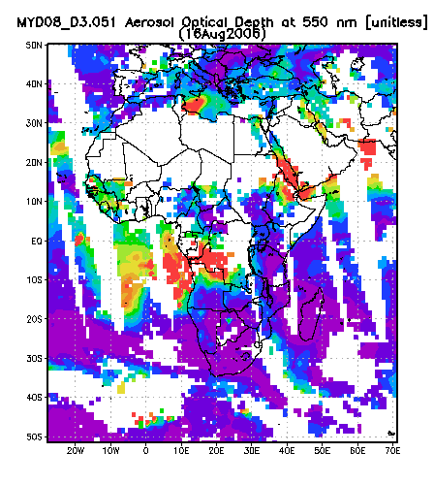
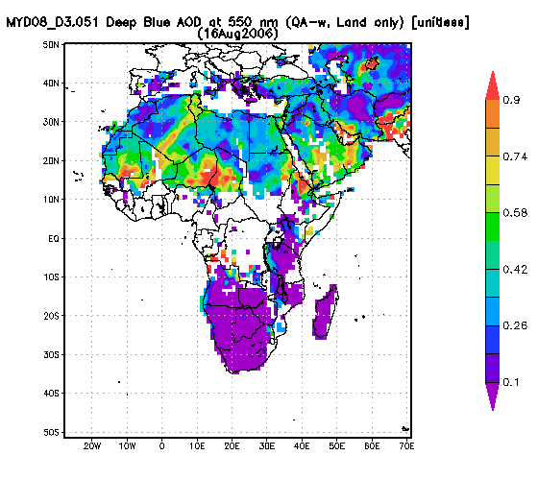
MODIS Aqua AOD August 16th, 2006
MODIS Aqua AOD Visualizations were produced with the Giovanni online data system, developed and maintained by the NASA GES DISC.

Slide 13
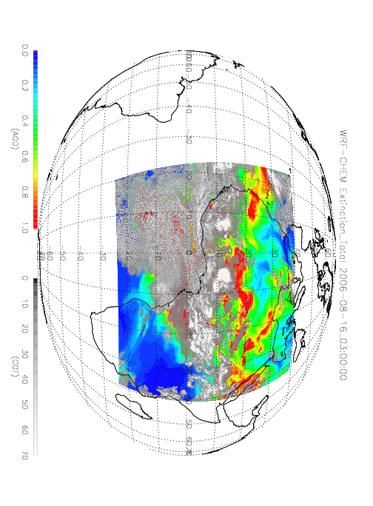

Slide 14
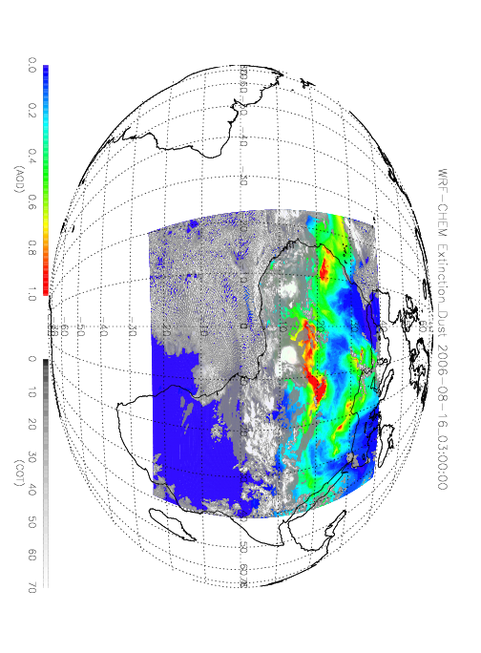

Slide 15
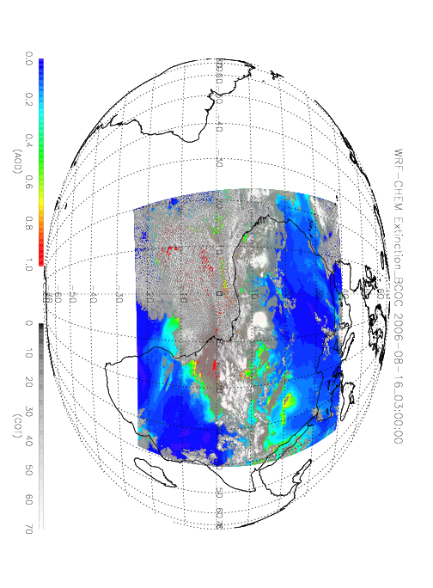

Slide 16
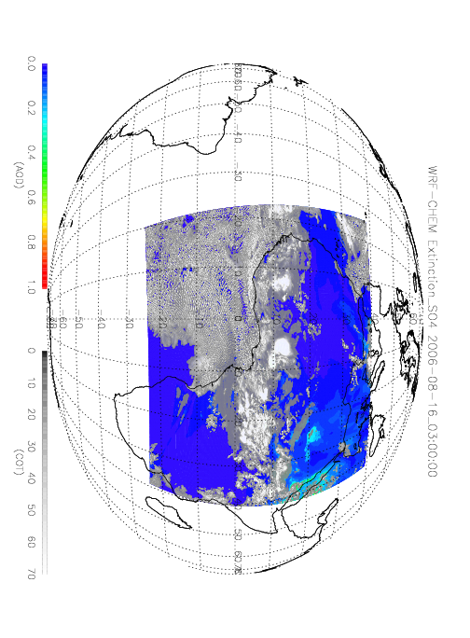

Slide 17
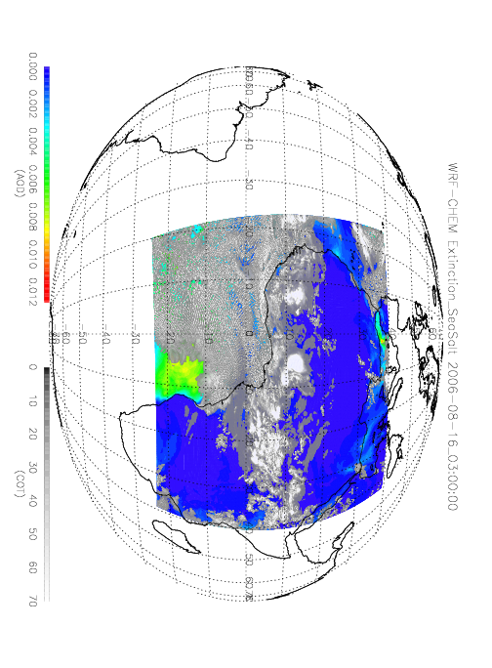

Slide 18
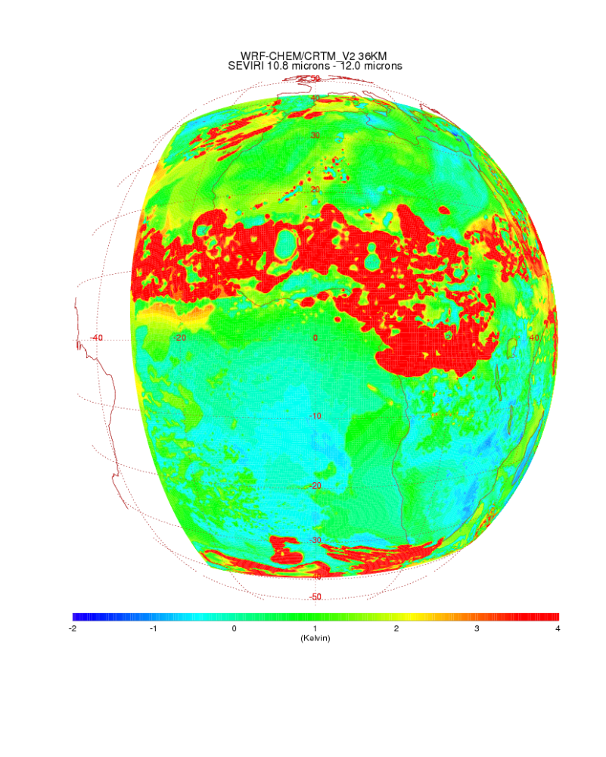
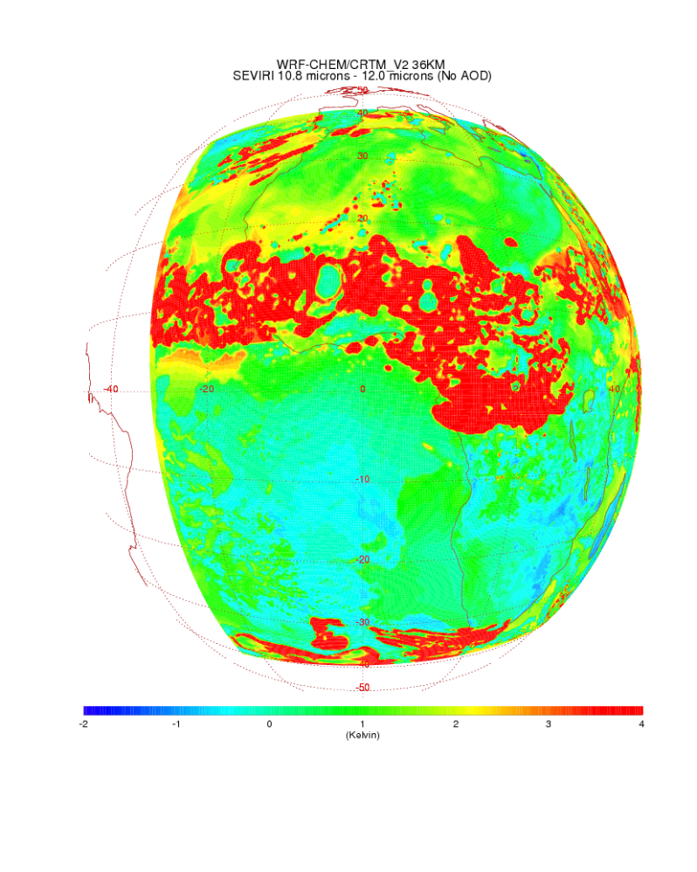
With Aerosol
NO Aerosol
10.8-12.0
10.8-12.0
36km WRF-CHEM/CRTM 10.8-12micron TB differences show impact of dust aerosol but show large differences wrt SEVIRI over Saharan Desert

Slide 19
Validation of Simulated ABI reflectivity and brightness temperatures over
Africa using SEVIRI measurements:
Impacts of surface emissivity/reflectance

Slide 20
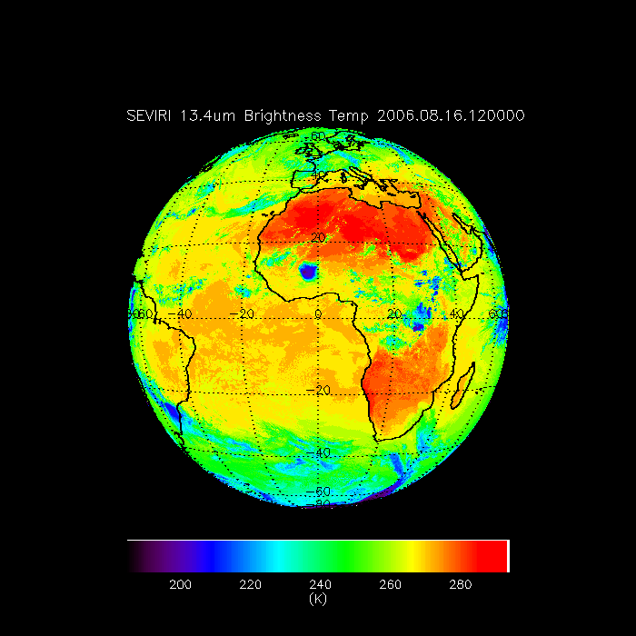
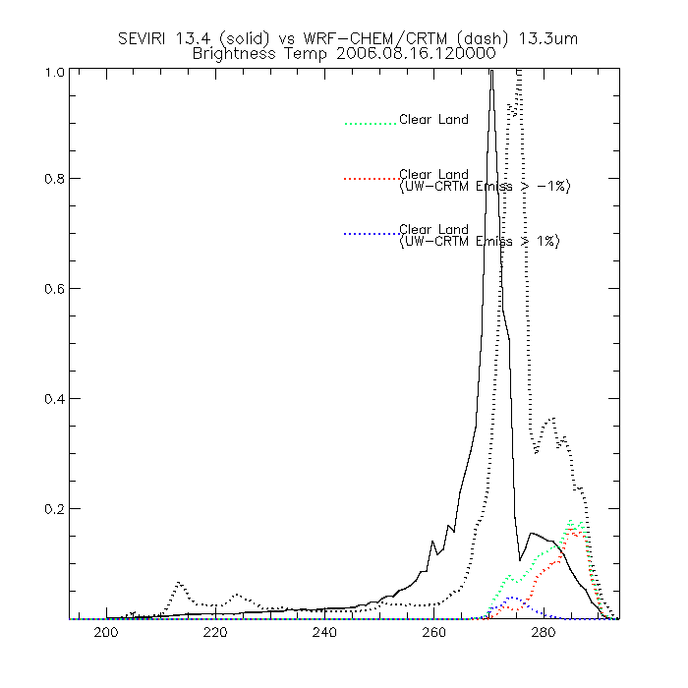
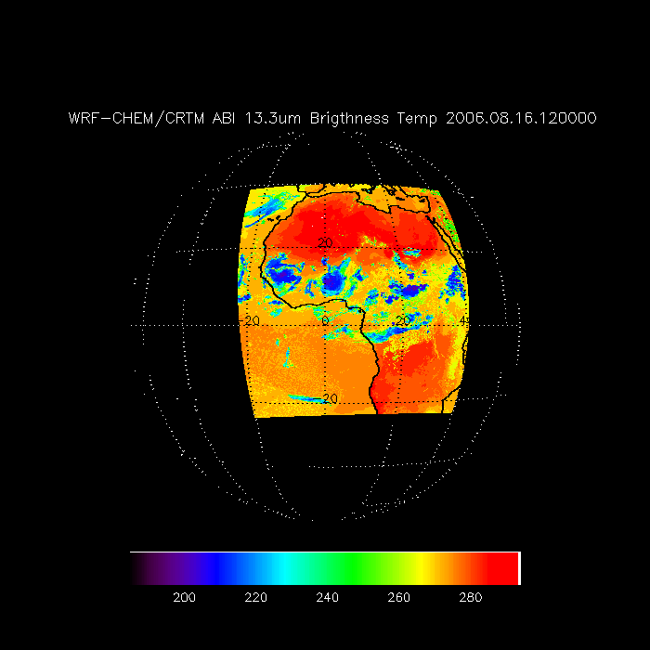
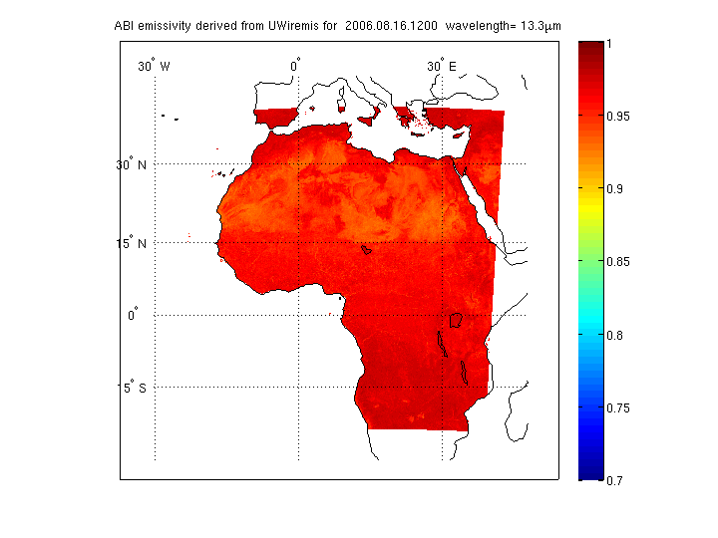
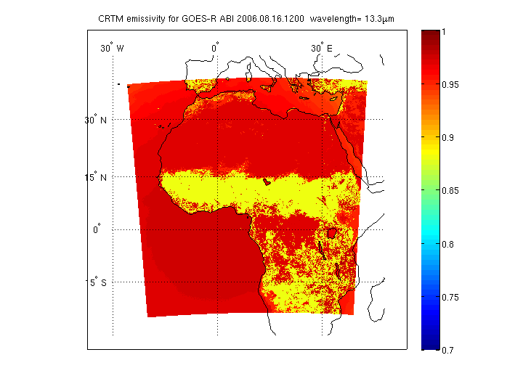
UW IR Emissivity provided by Eva E. Borbas,

Slide 21
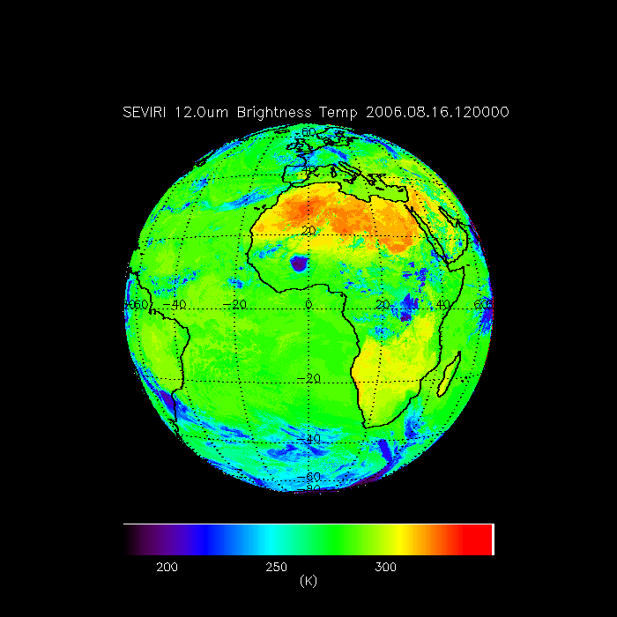
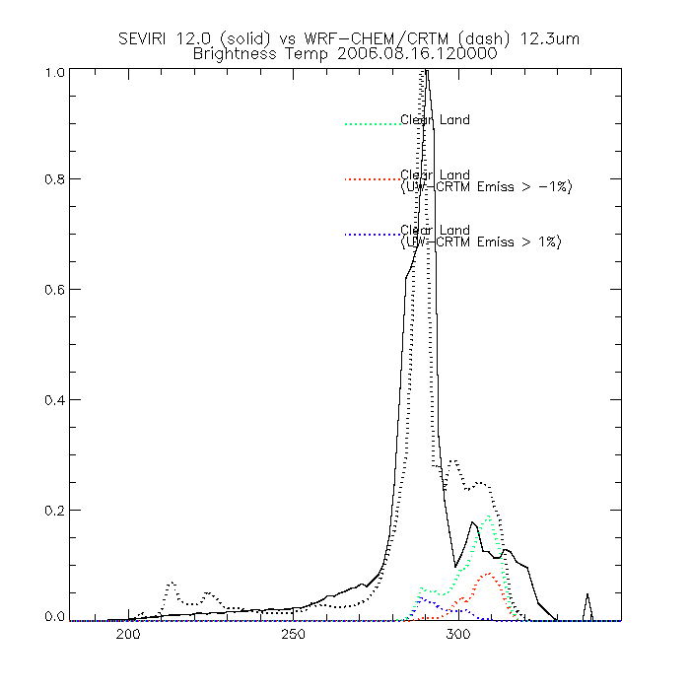
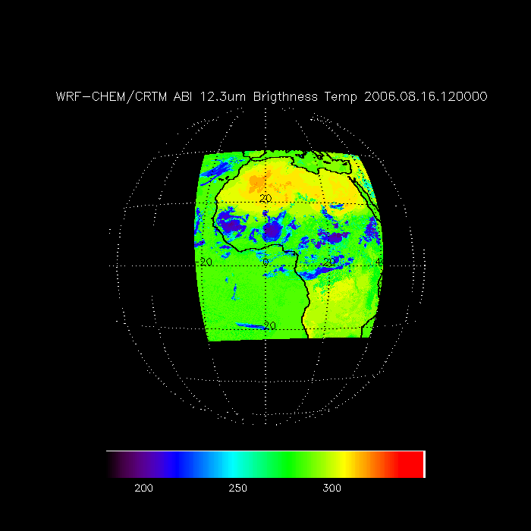
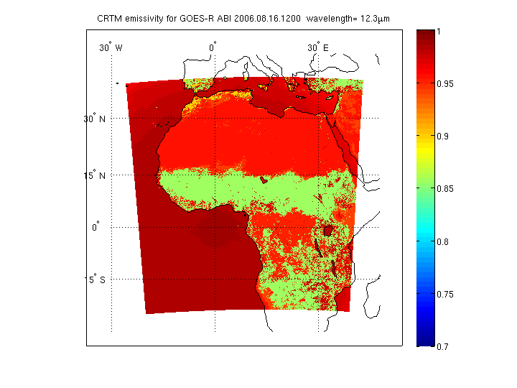

Slide 22
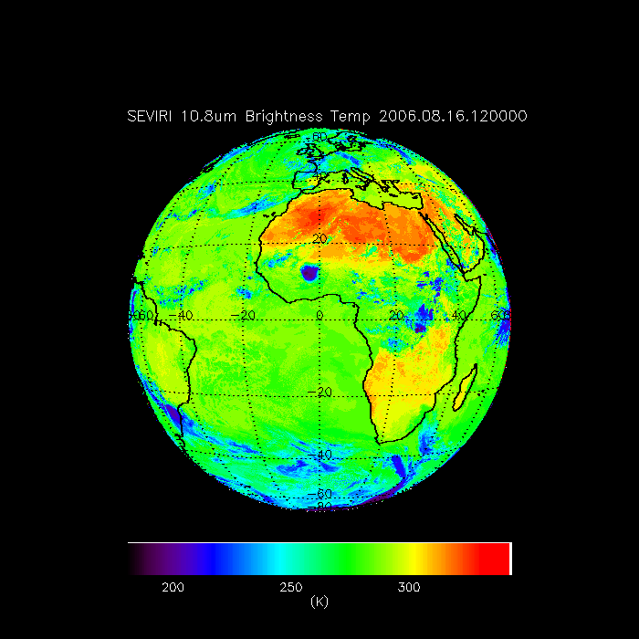
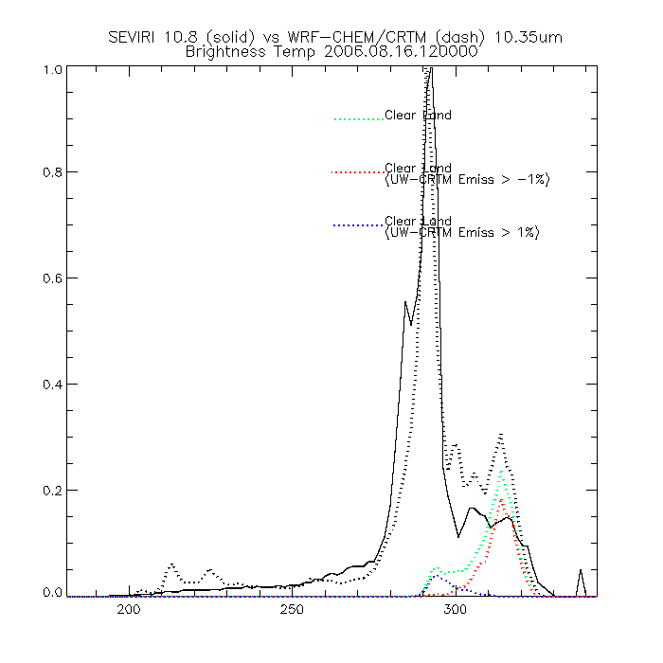
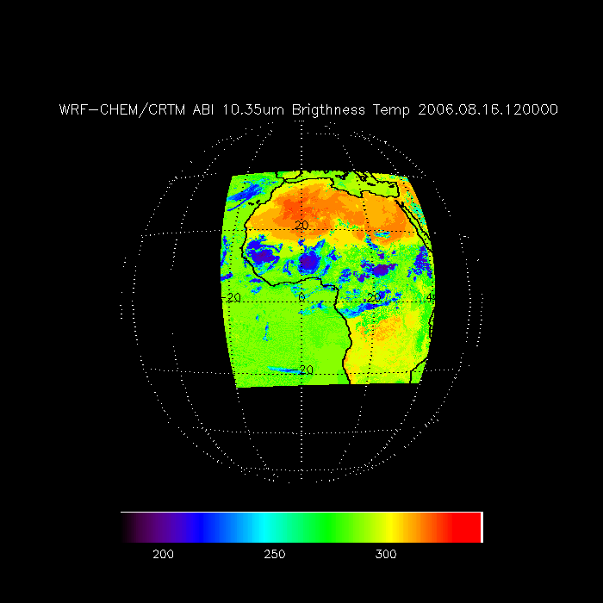
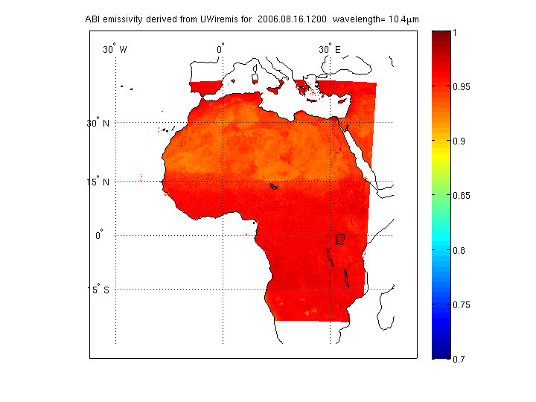
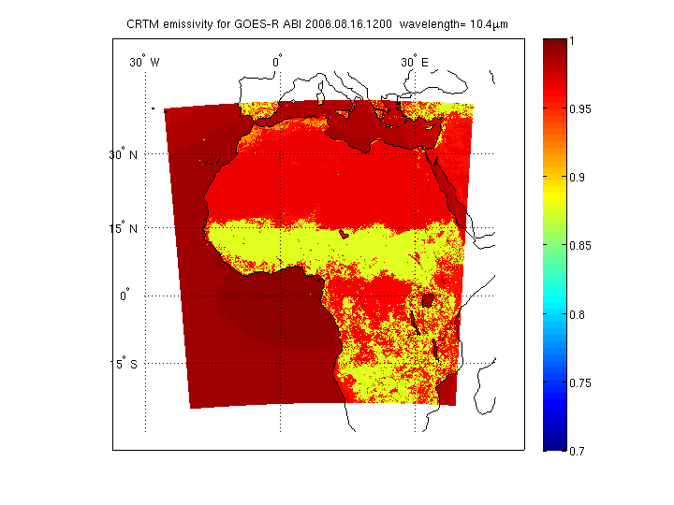

Slide 23
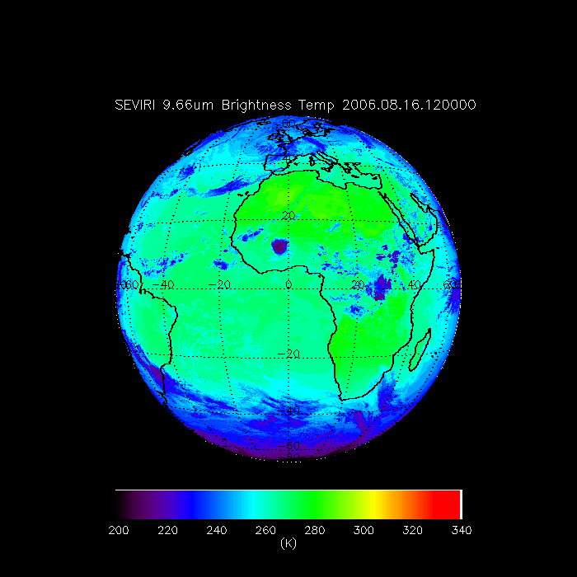
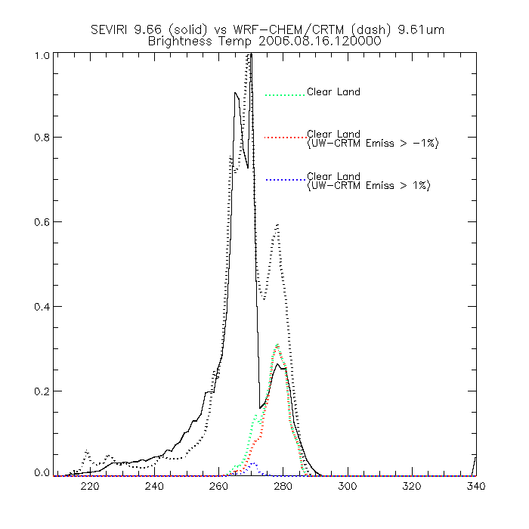
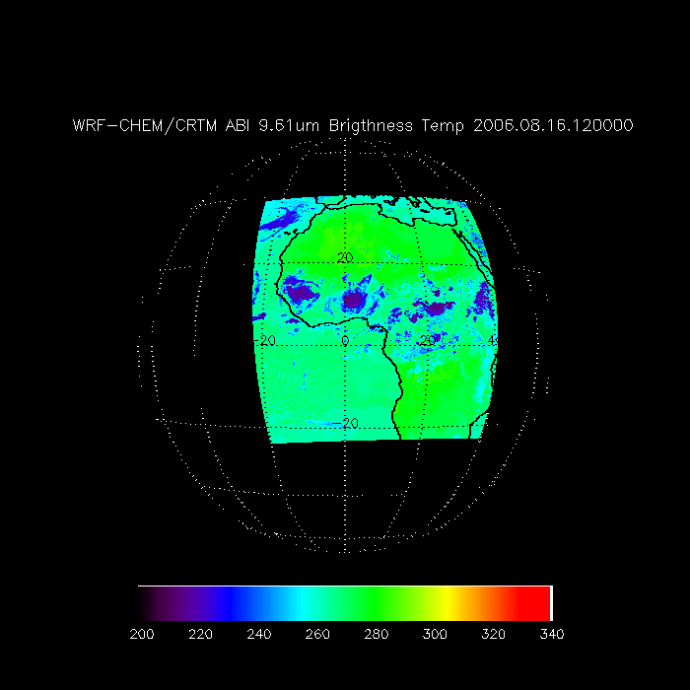
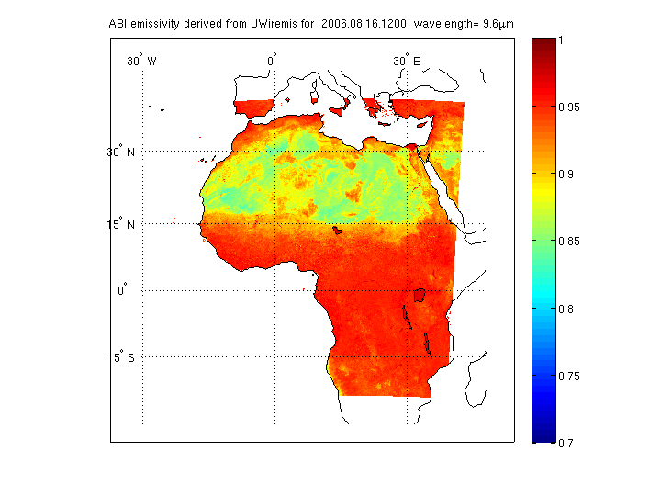
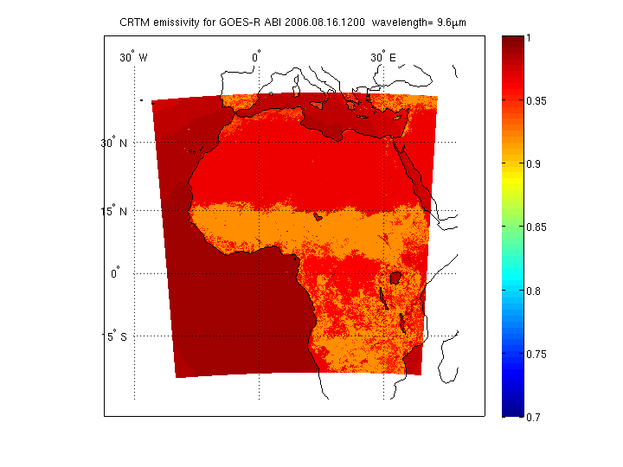

Slide 24
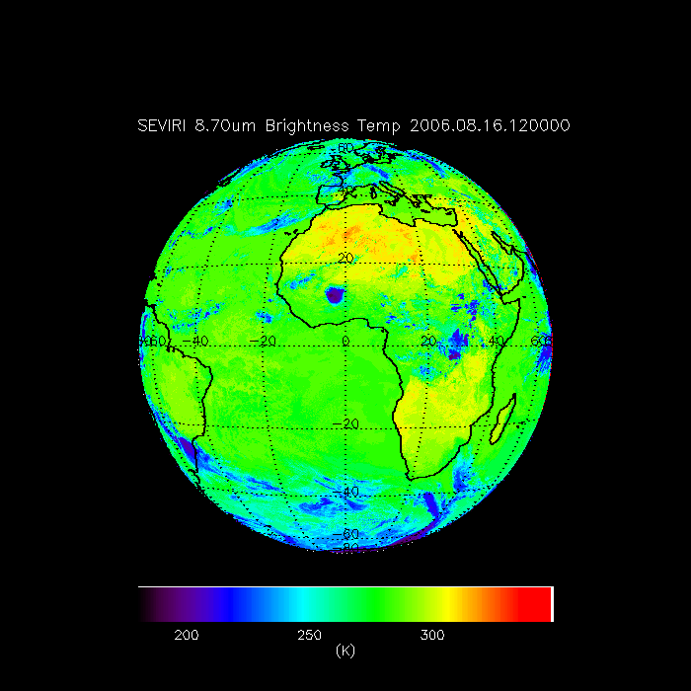
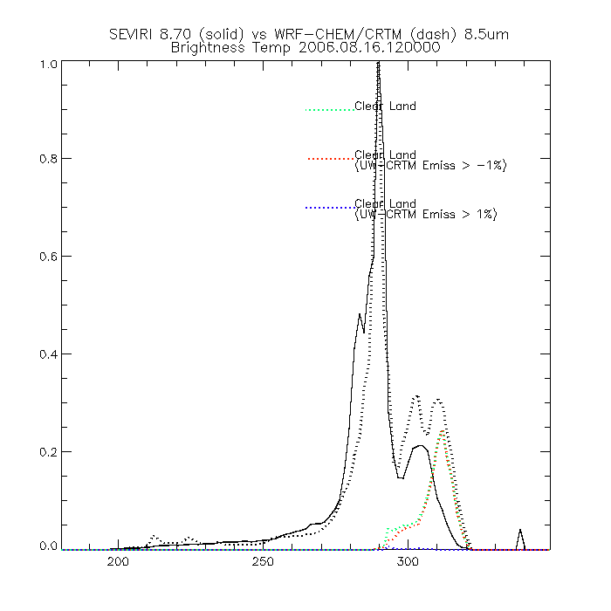
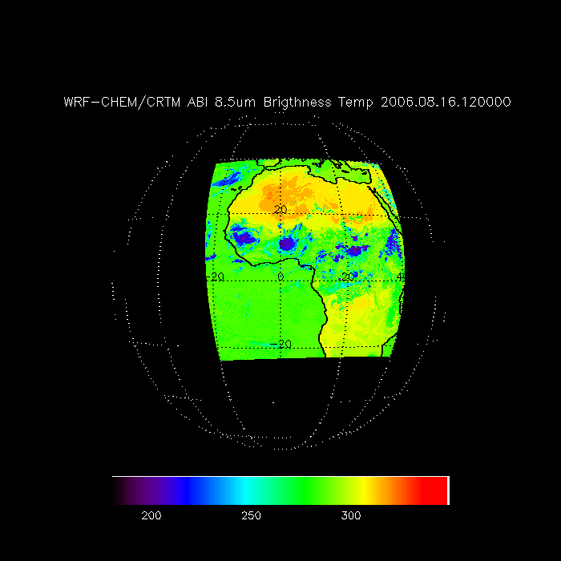
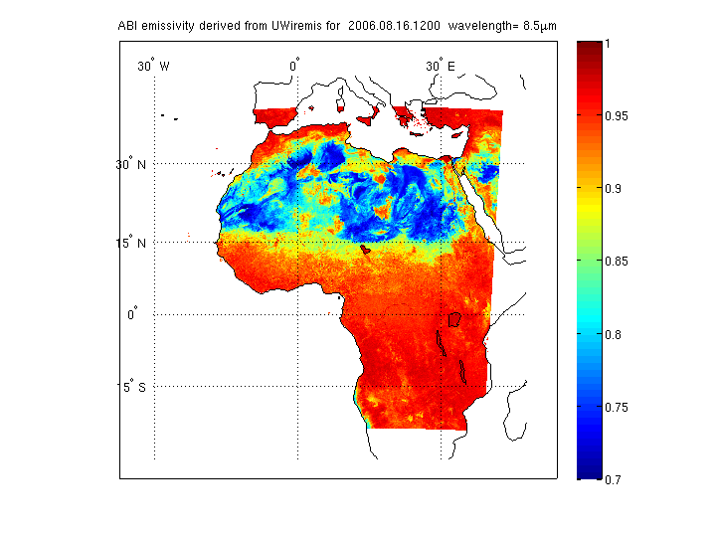
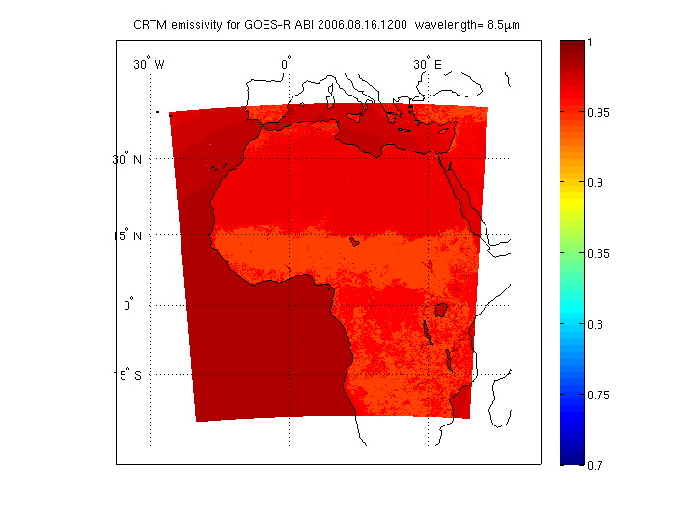

Slide 25
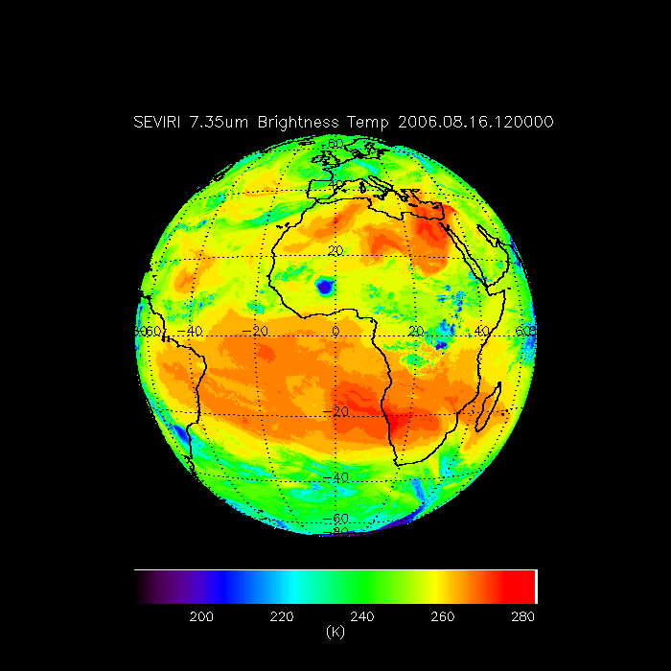
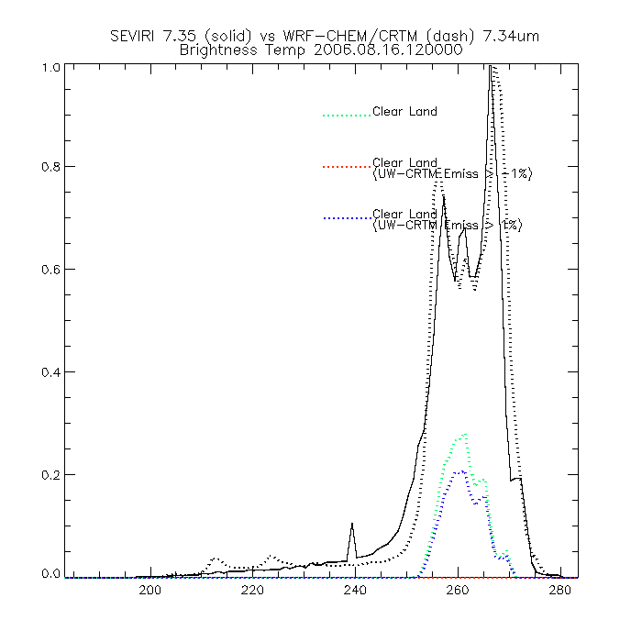
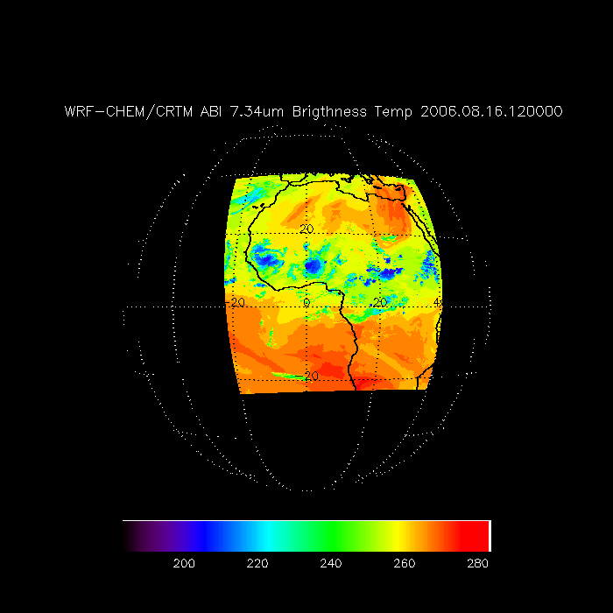
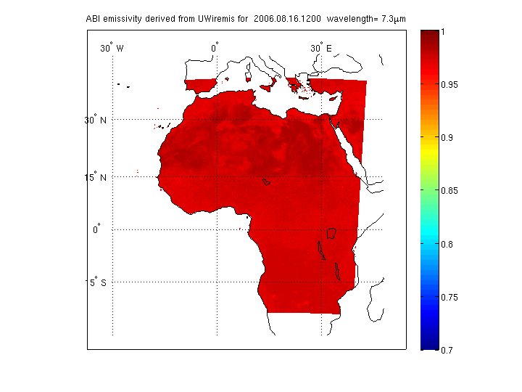
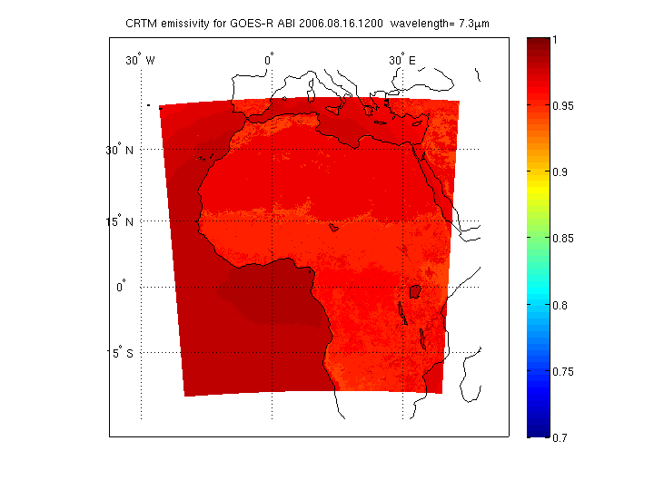

Slide 26
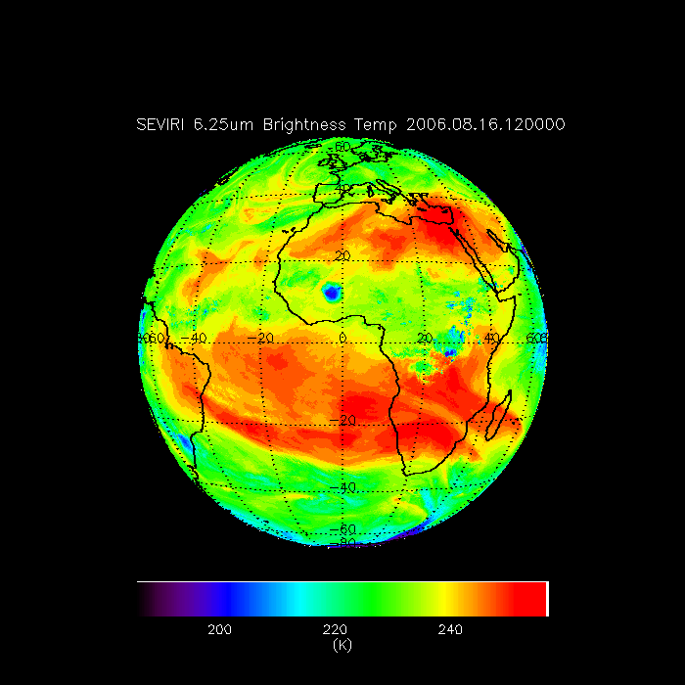
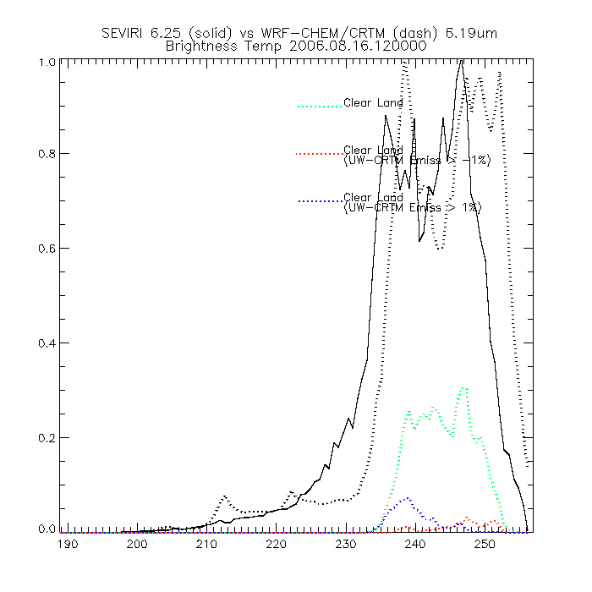
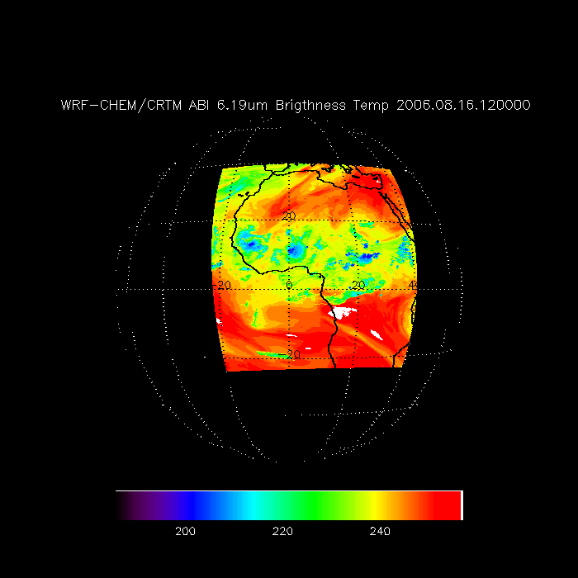

Slide 27
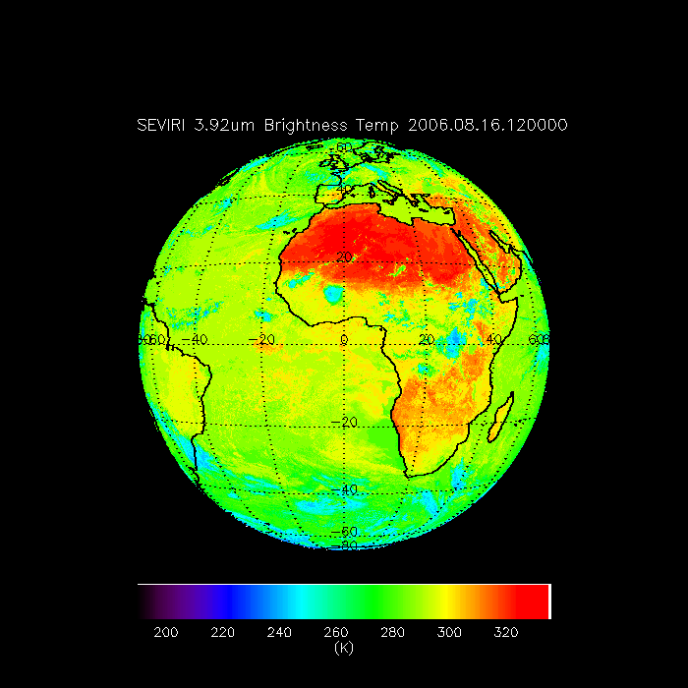
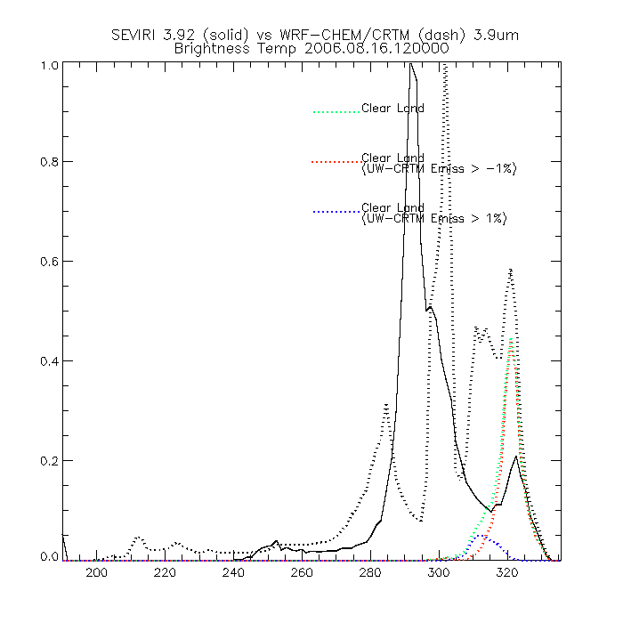
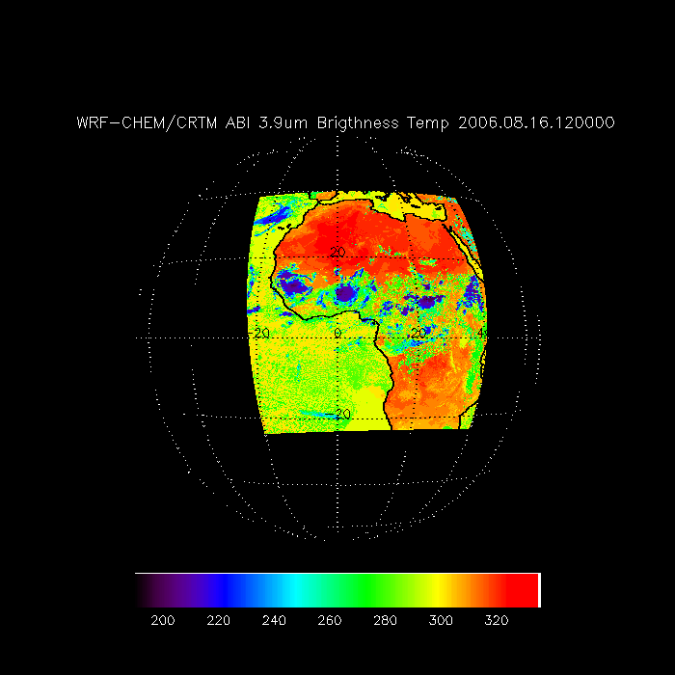
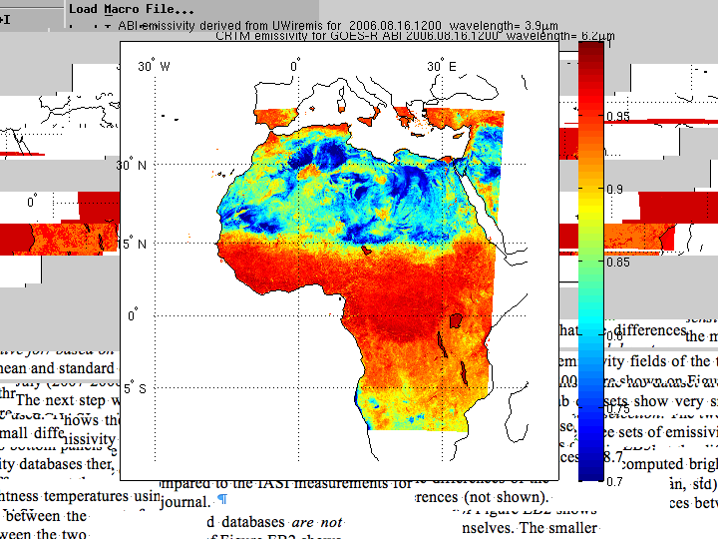
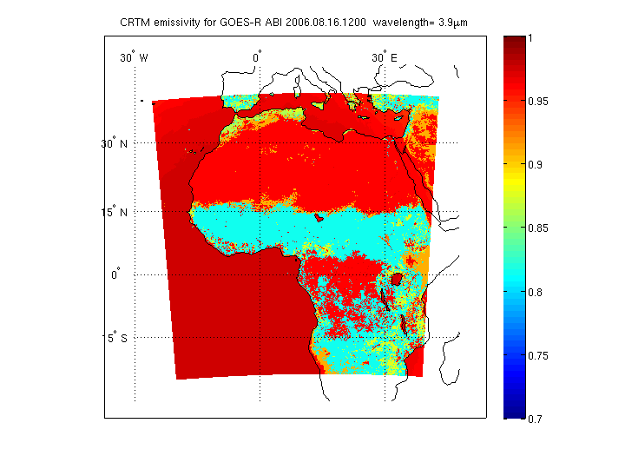

Slide 31
May 2011 Delivery:
12km Full disk simulation centered at 137E

