Slide 1
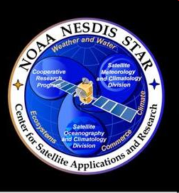
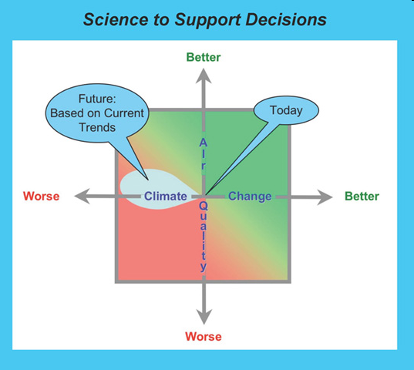
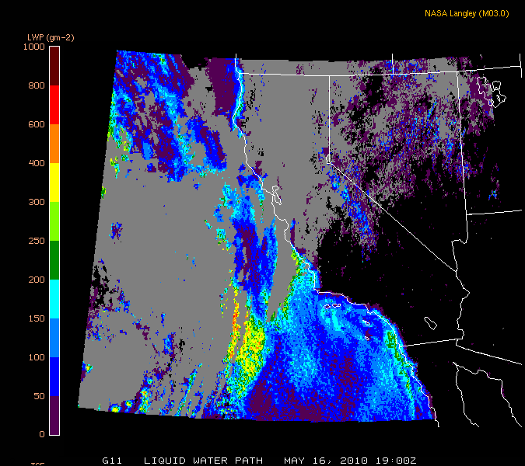
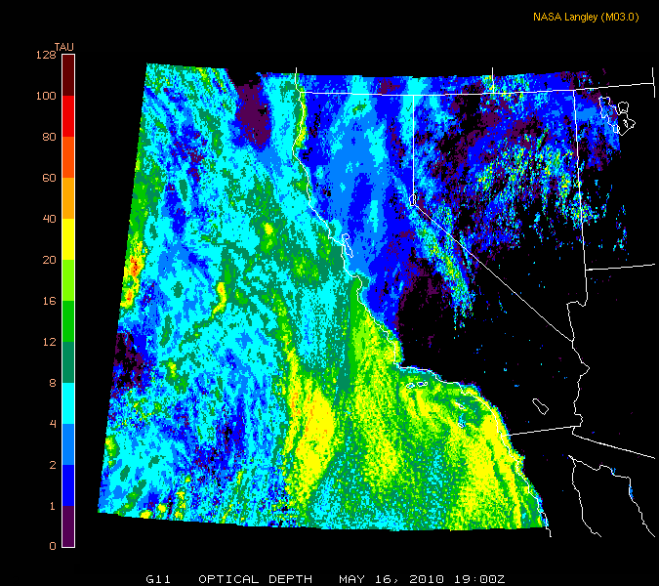
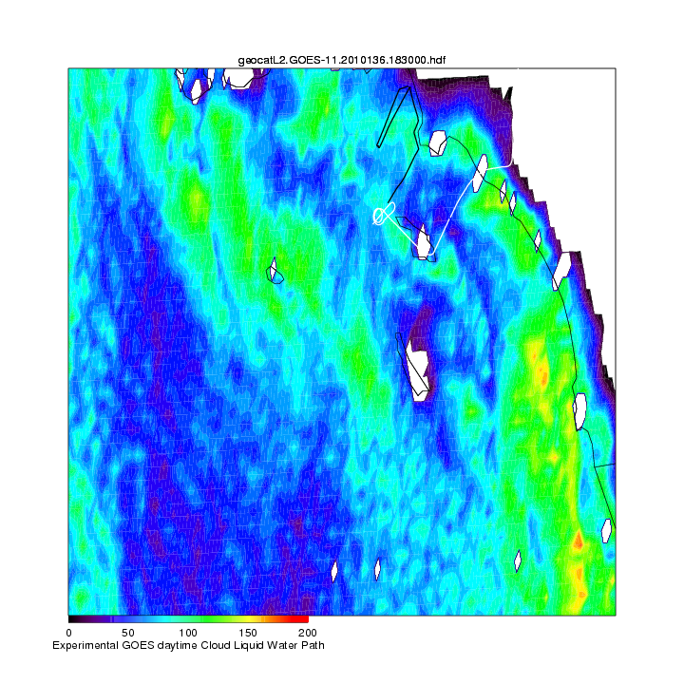
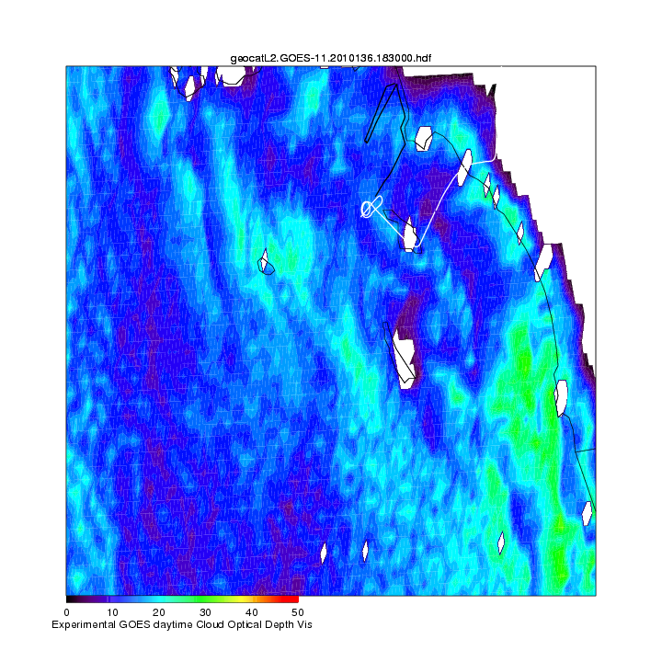
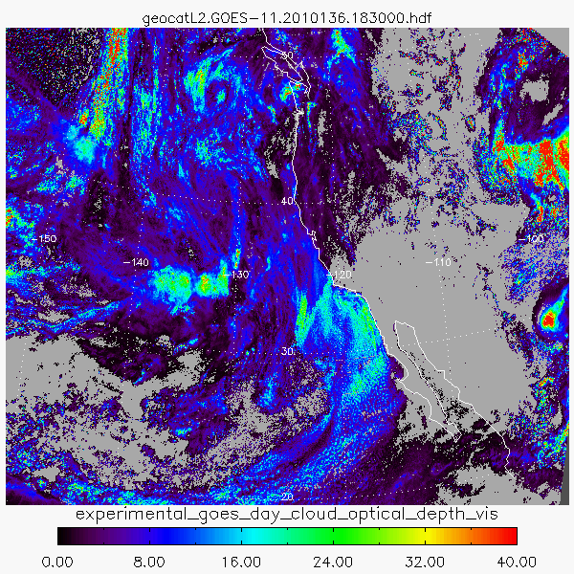
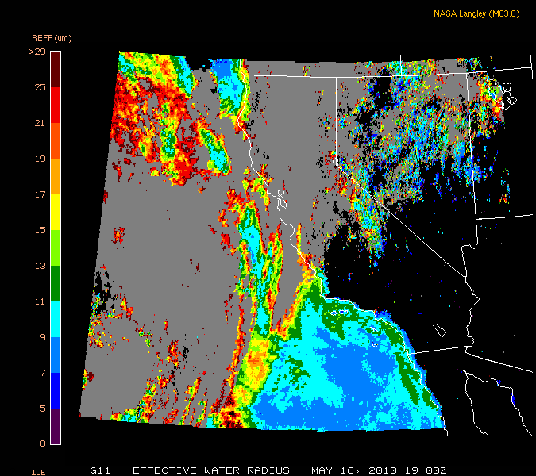
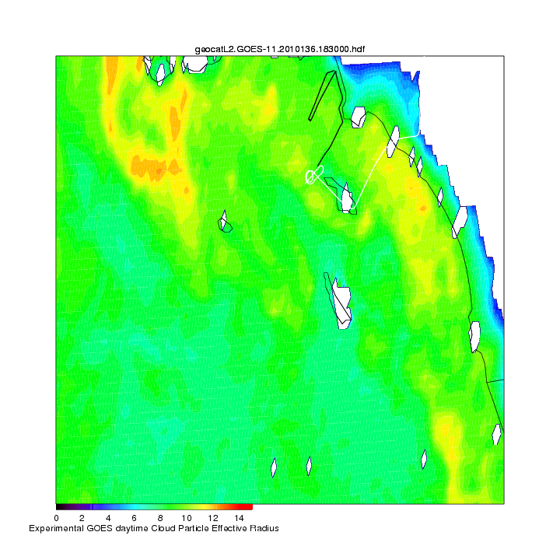
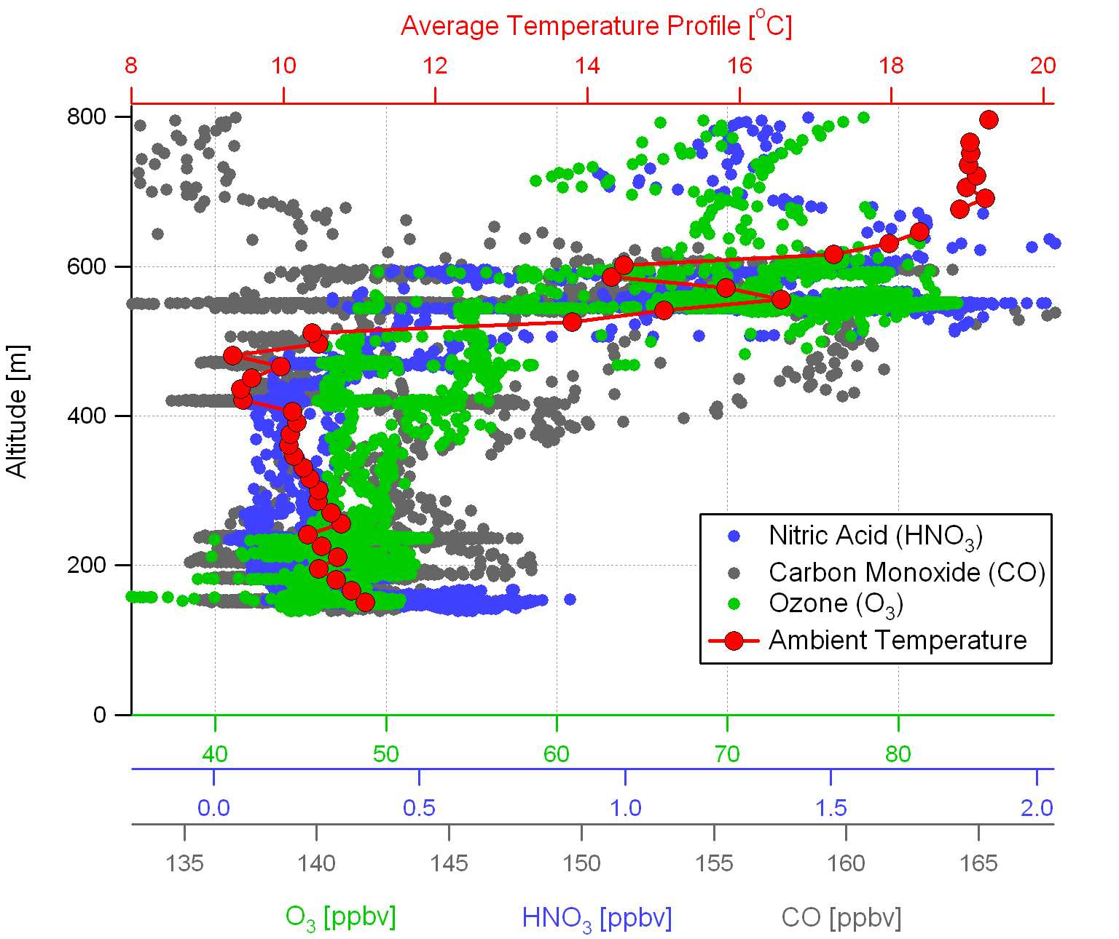
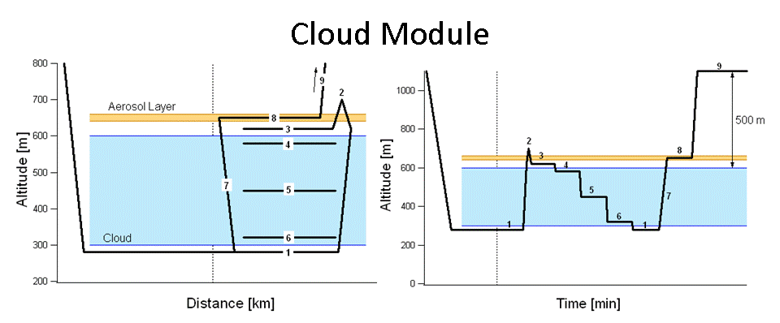
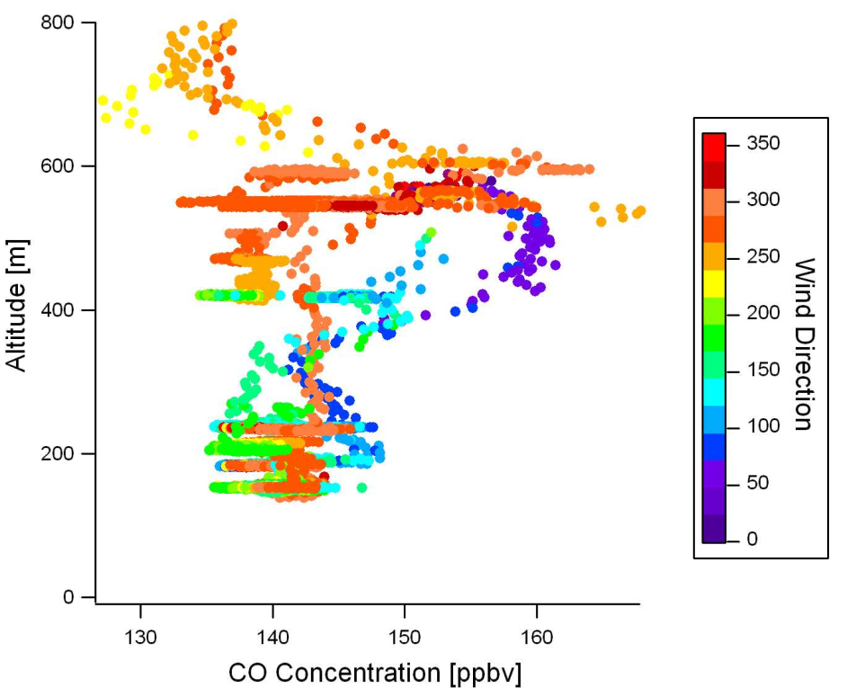
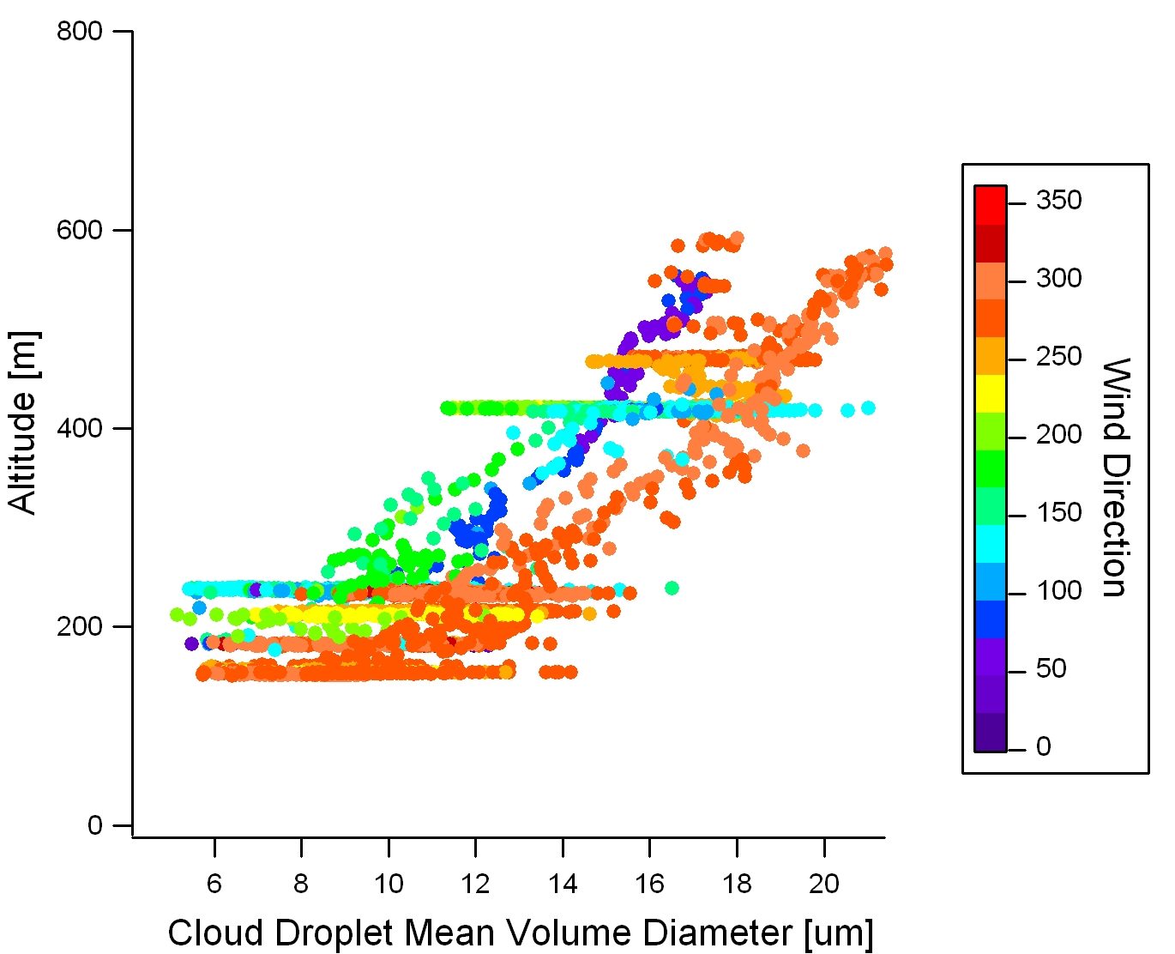
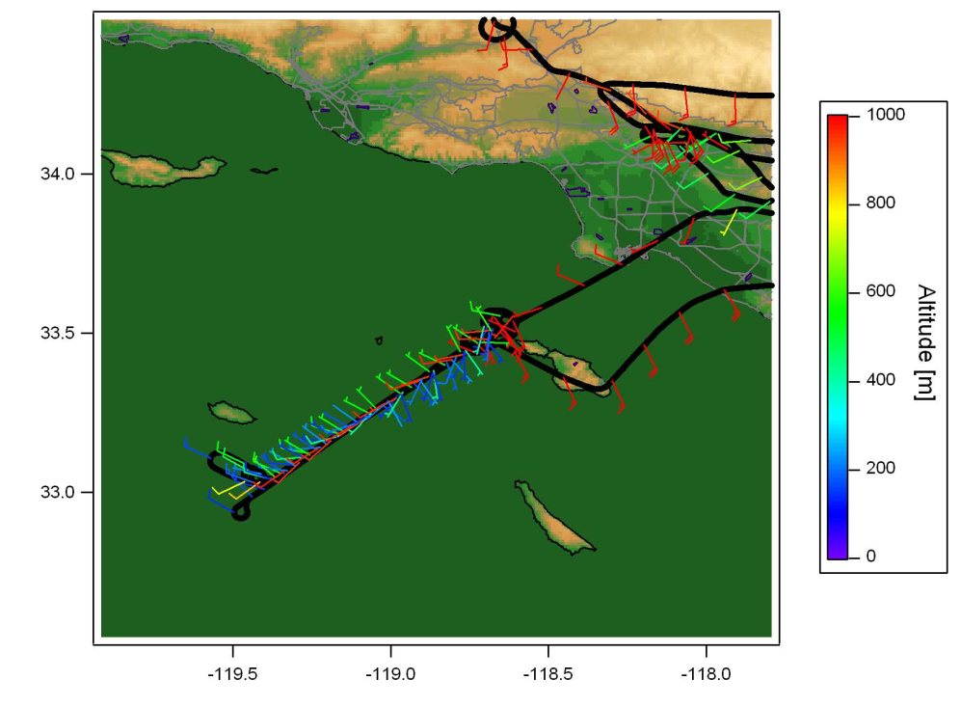
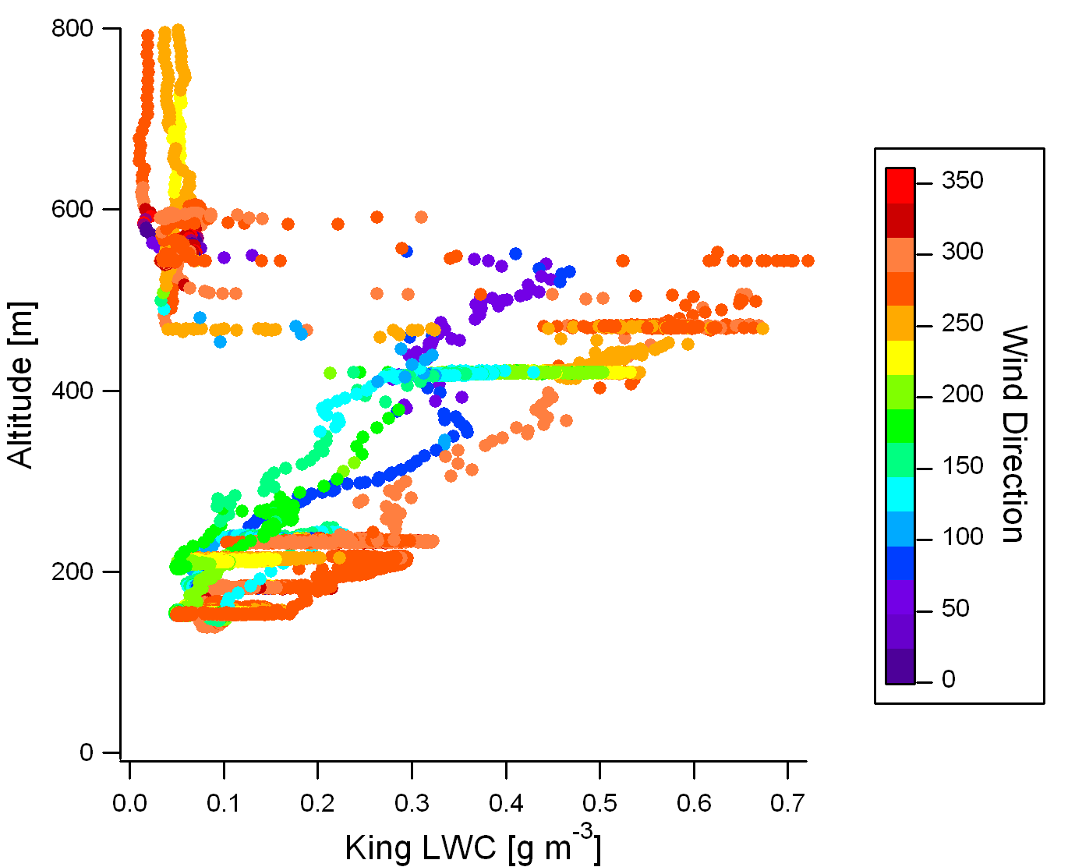
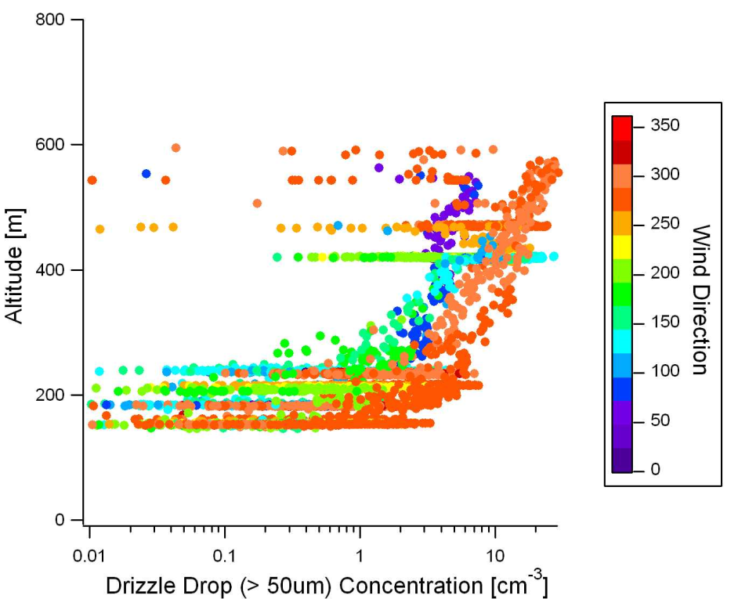
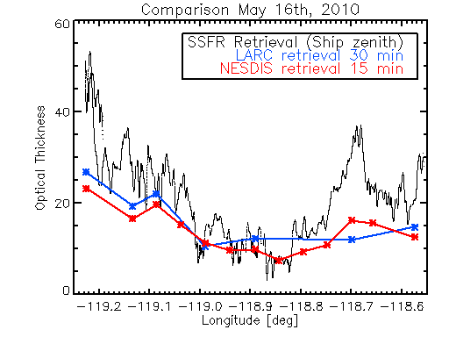
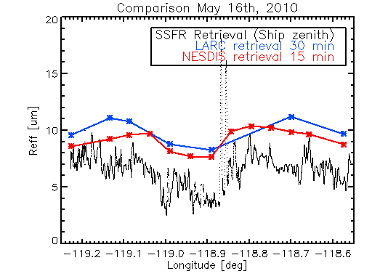
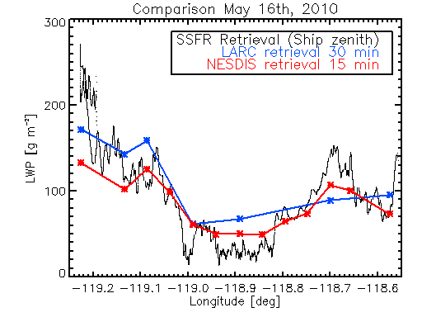
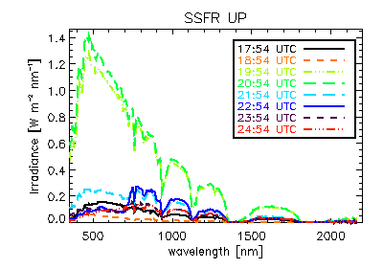
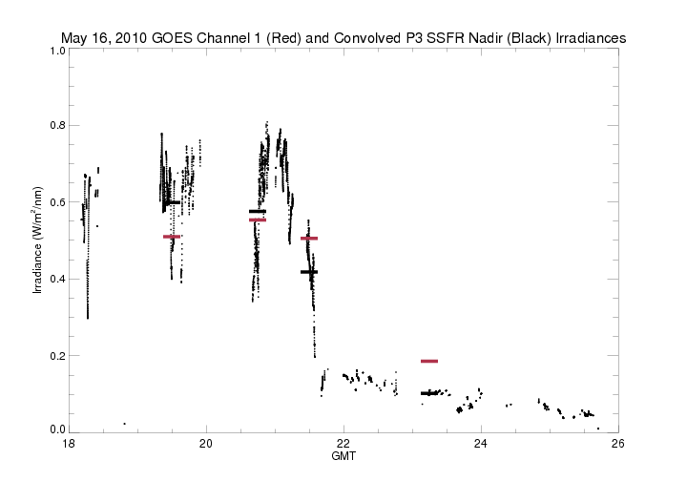
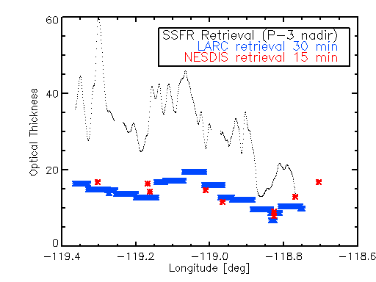
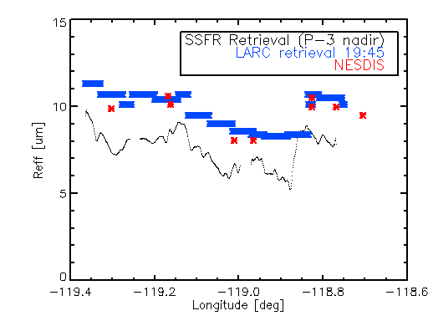
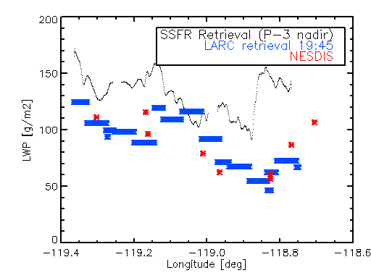
GOES-R Cal/Val Demonstration during the NOAA CalNex field Mission
R. Bradley Pierce¹, Sebastian Schmidt², Sara Lance³, Samuel Leblanc², Andrew Heidinger¹, Patrick Minnis⁴, John Holloway³, Thomas Ryerson³, Andy Neuman³,
Graham Feingold³, Peter Pilewskie², Michael Trainer³, Patricia Quinn⁵
¹NOAA/NESDIS/STAR, ²University of Colorado, ³NOAA/OAR/ESRL, ⁴NASA/LaRC, ⁵NOAA/OAR/PMEL
CalNex 2010 is a field project run by the NOAA Earth Systems Laboratory in partnership with the California Air Resources Board that is being conducted during May and June 2010 in Los Angeles, California. The goals of CalNex are to advance our understanding of air quality and climate change problems. The FY10 GOES-R Visiting Scientist Program supported Brad Pierce (NOAA/NESDIS/STAR) to collaborate with scientists from the California Air Resources Board (ARB) and NOAA/ESRL Chemical Sciences Division (CSD) on utilization and validation of real-time satellite retrievals during the field phase of the 2010 CalNex field mission. Joint OAR/NESDIS science and satellite validation activities during CalNex provide a basis for future field programs supporting GOES-R Level 1 radiance calibration and Level 2 retrieval validation. The detailed airborne and ship based measurements obtained during CalNex are proving useful in characterizing some of the GOES-R AWG cloud algorithms applied to data from NOAA's GOES-11 Imager. This poster illustrates the types of measurements collected at CalNex, provides some preliminary comparisons to GOES-R AWG products and CalNex insitu and remote measurements, and discusses how such measurements can be used for future GOES-R Calibration/Validation activities.
The daytime LaRC cloud retrieval algorithm uses the Visible (0.65 µm) Infrared (11 µm) Solar-Infrared (3.9 µm) Split-Window (12 µm) Technique (VISST). VISST is a 4-channel model-matching method that assumes plane parallel clouds. It matches observed radiances to theoretical radiances computed from parameterizations of radiative transfer calculations. Currently, the VISST is applied operationally in near-real time to data from 4 geostationary satellites and to MODIS, AVHRR, and, in the future, to NPP VIIRS data.
Two cloud retrieval algorithms (NESDIS DCOMP and NASA LaRC VISST) are considered
The GOES-R ABI Daytime Cloud Optical and Microphysical Properties (DCOMP) algorithm derives the cloud optical thickness, cloud effective particle size and cloud water path (liquid or ice). It uses state-of-the-art scattering calculations provided by Professor Ping Yang of Texas A&M for ice cloud retrievals and uses Mie Theory for water cloud retrievals. The algorithm accounts for molecular and aerosol scattering and absorption by atmospheric gases. The retrieval is conducted within an optimal estimation framework and provides error estimates of all retrieved parameters.
The GOES retrievals shown here were conducted using the 0.6 and 3.9 micron channels. Versions of this algorithm exist for MSG/SEVIRI (0.6 & 1.6 micron) and GOES-R ABI (0.6 & 2.2 micron). This algorithm also runs operationally within the NESDIS GOES Surface and Insolation Program (GSIP).
Cloud Liquid Water Path
Cloud Optical Depth
Satellite validation during May 16, 2010
NOAA P3 and Atlantis Cloud Module
Cloud Liquid Water Path
Cloud Optical Depth
Cloud Effective Radius
LARC
Cloud Effective Radius
NESDIS
Airborne insitu measurements provide information on the thermodynamic, microphysical, and chemical composition during the P3 cloud module
Insitu cloud microphysical measurements provide
information regarding the vertical distribution of
cloud droplet diameter and liquid water content.
These measurements will be used to validate the
satellite retrievals of cloud liquid water path and effective radius when integrated over the depth of the cloud. Lower cloud droplet diameters, drizzle drop concentrations, and liquid water content are associated with NE winds which are responsible for transport of the higher carbon monoxide near the top of the stratus deck. This case will provide an interesting opportunity to investigate the extent to which the smaller drops in the NE flow are being determined by entrainment of above cloud pollution or simply due to the lower LWC.
Temperature measurements during vertical profile legs show a strong inversion at the top of the marine boundary layer. Chemically aged upper tropospheric air (high ozone/Nitric Acid, low carbon monoxide) is found above the inversion. Chemically aged marine boundary layer air (low ozone/Nitric Acid, low carbon monoxide) is found below the inversion. A narrow pollution layer (higher carbon monoxide) is found just below the inversion and is most likely associated with transport of emissions offshore of CA.
P3 Wind Barbs
Spectrally-resolved UV/VIS/NIR measurements on the P3 and Atlantis provide information on cloud radiative properties
The Solar Spectral Flux Radiometer (SSFR) is deployed onboard the Woods Hole Oceanographic Institution research vessel "Atlantis" and NOAA WP-3D aircraft. It measures downwelling spectral radiance and irradiance from 350-1700 nm on the ship, and upwelling and downwelling irradiance from 350-2200 nm on the aircraft. Spectral resolution ranges from 8-12 nm. Optical thickness, effective radius, and liquid water path can be derived and compared with the satellite retrievals. Comparisons show that both retrievals capture the longitudinal variations in cloud properties but underestimate COT and overestimate R_{eff} relative to the SSFR retrievals. However, different
Integration of the SSFR nadir spectral
irradiance multiplied by the GOES
spectral response function allows
comparisons with estimated GOES
irradiances (π* radiance) during
periods when there are no clouds above
the P3. These comparisons provide a
“first cut” at characterizing GOES visible
channel calibration. The agreement between SSFR and the GOES-11 visible band is found to
be quite good in spite of the different sampling volumes and assumptions used in converting GOES radiance to irradiance. Future work will focus on retrieval of cloud properties from
NOAA P3 20100516 SSFR upwelling irradiance
GOES * π
Integrated SSFR
(GOES SRF applied)
SSFR and then using RTM to calculate (a) spectral radiance at TOA, and (b) spectral irradiance at aircraft altitude. If (b) is spectrally consistent with SSFR measurements, then (a) can be used to compare with satellite radiances.
Contact: brad.pierce@noaa.gov
sampling volumes from aircraft, ship, and satellite would need to be taken into account for true comparisons.

