Slide 1
Nested Global and Regional Scale Modeling of the Impacts of Intercontinental Pollution Transport and Continental US Recirculation during FRAPPE/DISCOVER-AQ
R. Bradley Pierce¹, Todd Schaack², Allen Lenzen², Andrew Wentland³, Georg Grell⁴, Steve Peckham⁴, Thomas McGee⁶, John Sullivan⁷
¹NOAA/NESDIS/STAR
²UW-Madison/SSEC
³UW-Madison/AOS (Now at ENVIRON)
⁴NOAA/ESRL
⁶NASA/GSFC
⁷UMBC/JCET
FRAPPE/DISCOVER-AQ March 03, 2016 webex

Slide 2
Nested RAQMS¹/WRF-CHEM² Configurations
1x1 degree RAQMS
Unified stratosphere/troposphere chemistry/GOCART aerosols
UW-Hybrid sigma-theta dynamical core
Constrained with Microwave Limb Sounder (MLS) stratospheric ozone profiles, Ozone Monitoring Instrument (OMI) cloud cleared Total Column Ozone and MODIS AOD
13km NOAA/ESRL RR-CHEM (North American Domain)
RADM2 chemical mechanism/MADE Aerosol parameterization
YSU PBL scheme (Yonsei University, Non-local-K scheme)
¹Realtime Air Quality Modeling System (RAQMS, http://raqms.ssec.wisc.edu/)
²Weather Research and Forecasting (WRF) model with chemistry (WRF-CHEM, http://ruc.noaa.gov/wrf/WG11/)

Slide 3
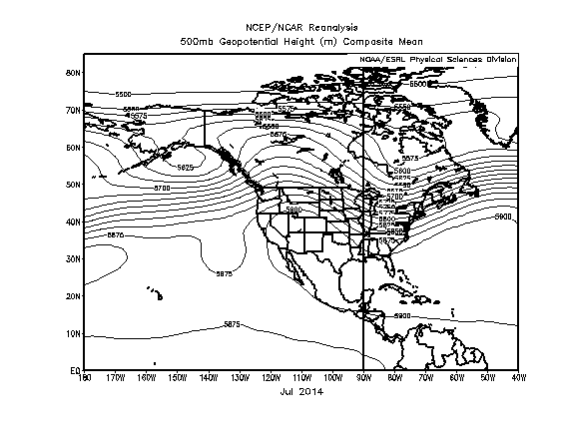
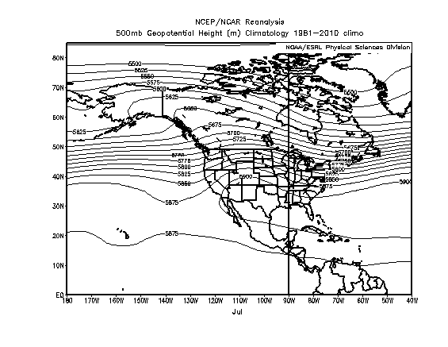
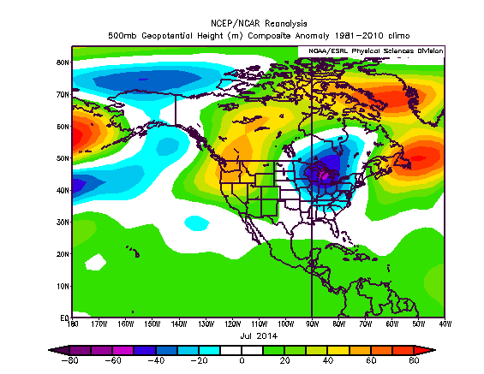
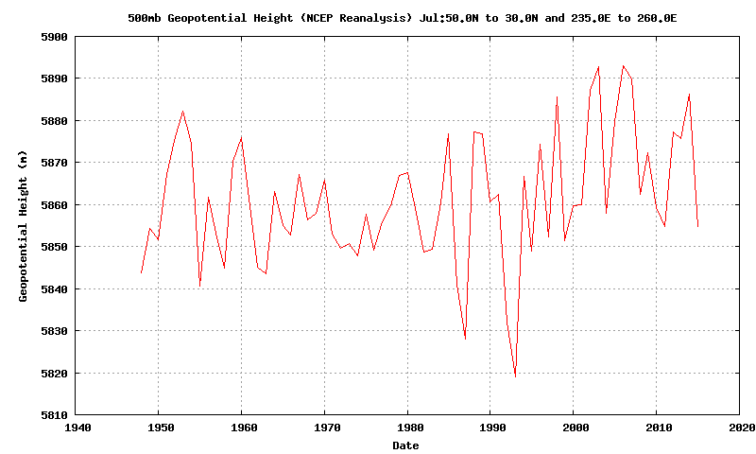
July 2014 500mb heights
July 2014 was dominated by a stronger than average ridge over the Pacific Northwest and stronger than average trough over the eastern US

Slide 4
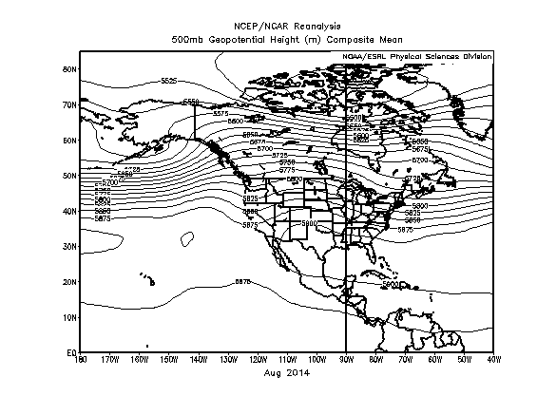
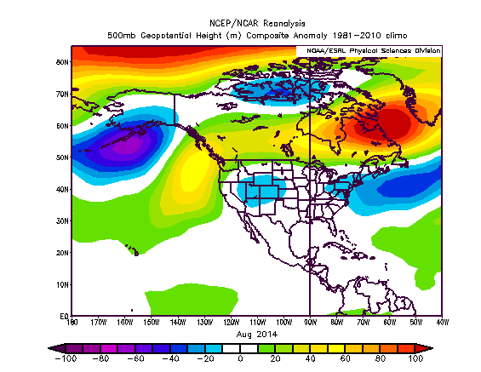
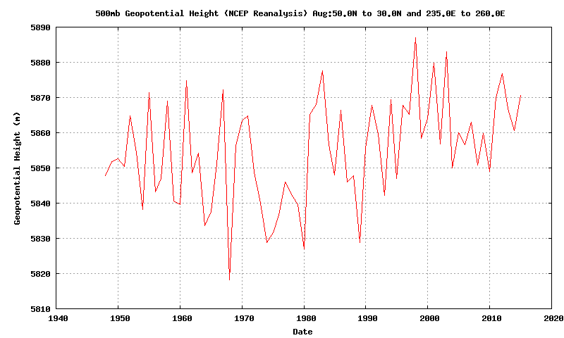
August 2014 500mb heights
August 2014 was dominated by a weaker than average ridge over the
4-Corners region

Slide 5
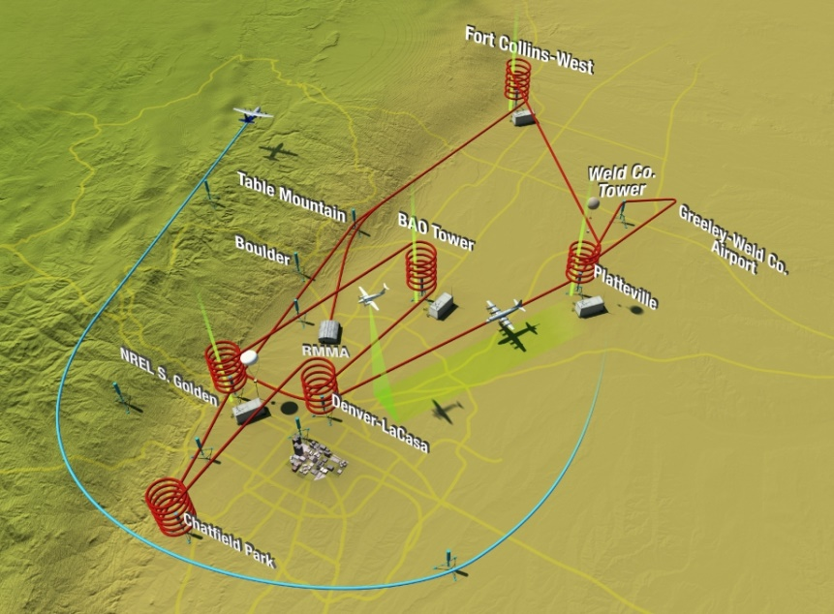
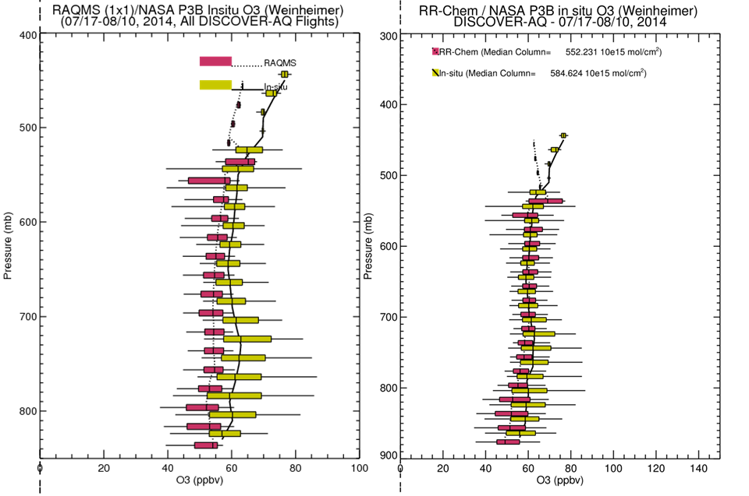
RAQMS/RR-Chem Real-time forecasts during the 2014 FRAPPE/DISCOVER-AQ mission
Nested RAQMS/RR-Chem forecasts show reduced biases and improved variability compared to airborne insitu measurements between 700-500mb.
However, biases are similar (15-20 ppbv) below 700mb and neither model captures the upper 90% of the observed ozone
Reduced bias

Slide 6
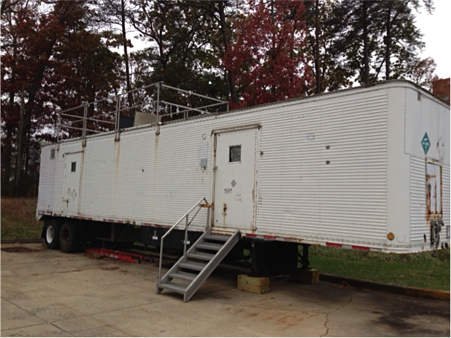
NASA Goddard Space Flight Center TROPospheric OZone DIfferential Absorption Lidar (GSFC TROPOZ DIAL)
(Thomas McGee and John Sullivan GSFC)

Slide 7
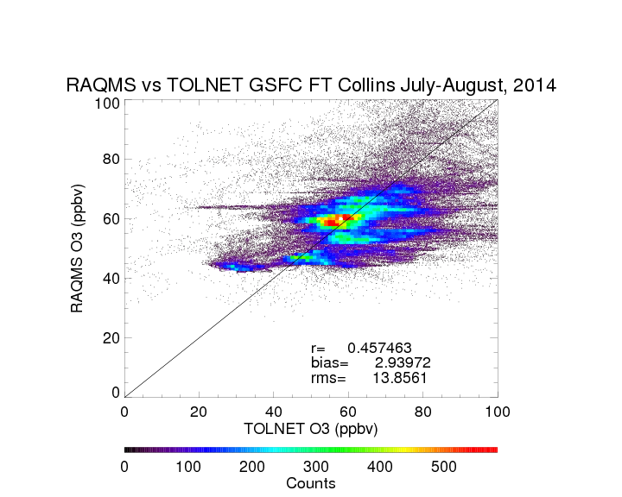

Slide 8
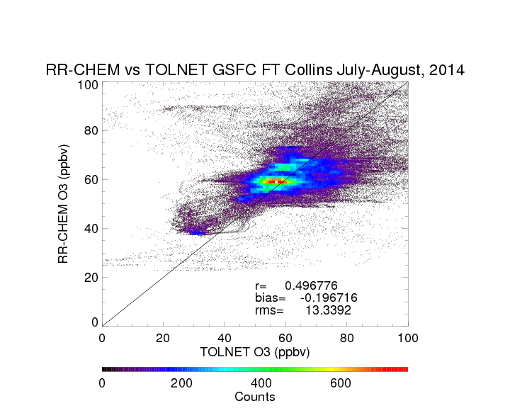
RR-CHEM shows improved correlation, reduced bias, and similar RMS errors compared to 1 degree RAQMS analysis

Slide 9
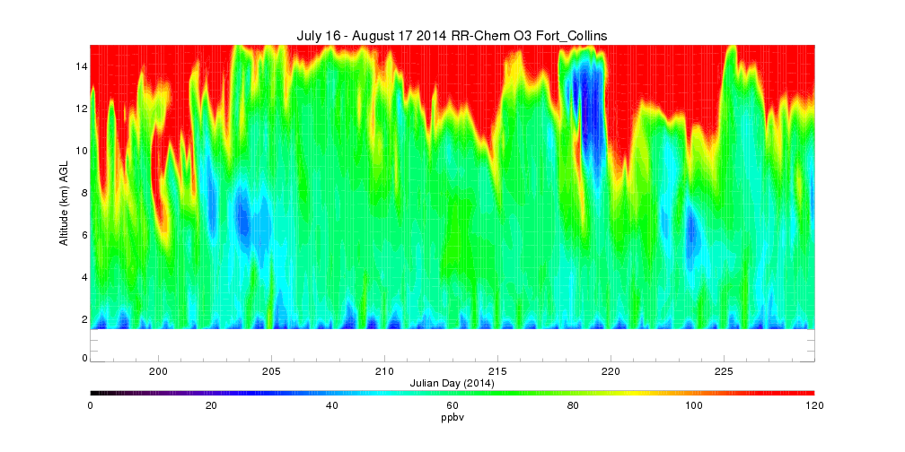
July 16 – August 17, 2014 RR-Chem Ozone timeseries
(Fort Collins, CO)

Slide 10
July 16 – August 17, 2014 RR-Chem Ozone timeseries
(Fort Collins, CO)
August 6: STE
Sullivan, J. T., et al (2015), Characterizing the lifetime and occurrence of stratospheric-tropospheric exchange events in the rocky mountain region using high-resolution ozone measurements, J. Geophys. Res. Atmos., 120, 12,410–12,424, doi:10.1002/2015JD023877.

Slide 11
July 16 – August 17, 2014 RR-Chem Ozone timeseries
(Fort Collins, CO)
August 9: CONUS PBL
August 6: STE

Slide 12
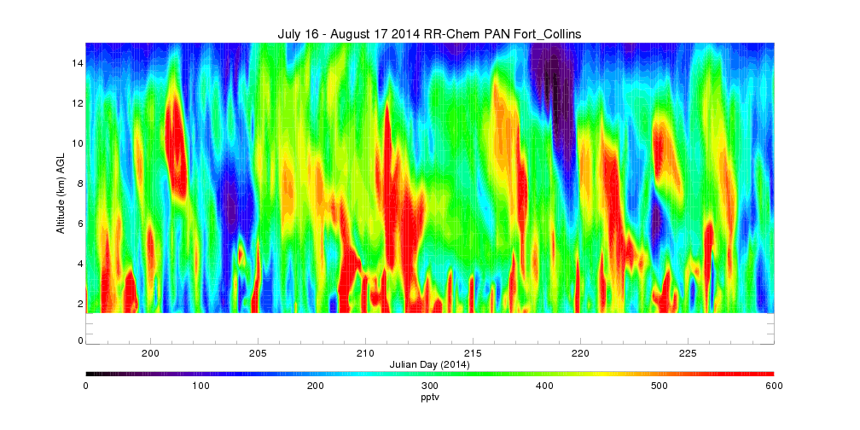
July 16 – August 17, 2014 RR-Chem PAN timeseries
(Fort Collins, CO)
August 9: CONUS PBL
August 6: STE

Slide 13
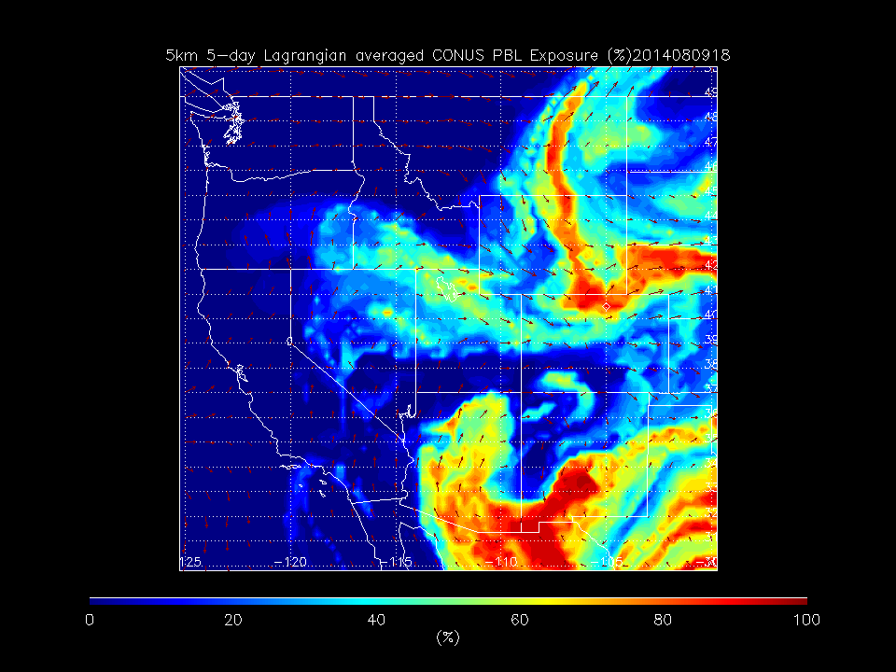
RAQMS Reverse Domain Filling (RDF) show that high PAN airmass over Fort Collins on 08/09 had it’s origins within the Continental US boundary layer

Slide 14
July 16 – August 17, 2014 RR-Chem PAN timeseries
(Fort Collins, CO)
August 11:East Asian Transport
August 9: CONUS PBL
August 6: STE

Slide 15
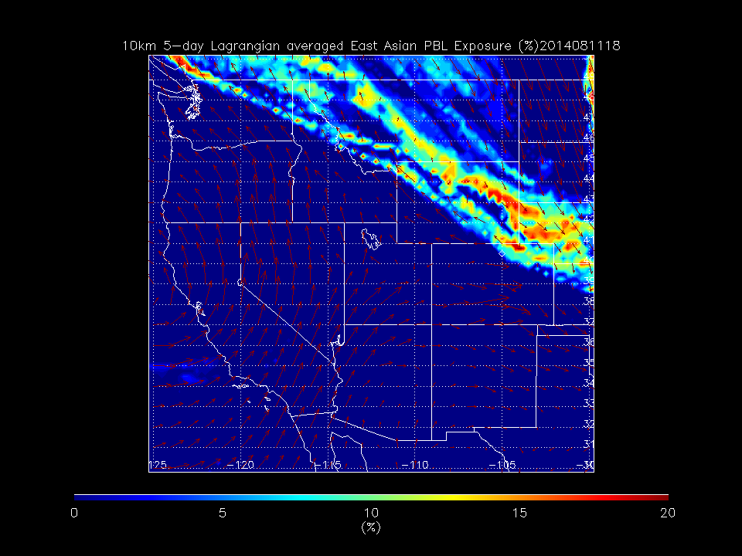
RAQMS RDF shows that high PAN air mass over Fort Collins on 08/11 had it’s origins within the East Asian boundary layer

Slide 16
July 16 – August 17, 2014 RR-Chem PAN timeseries
(Fort Collins, CO)
August 11:East Asian Transport
July 30: CONUS PBL
August 9: CONUS PBL
August 6: STE

Slide 17
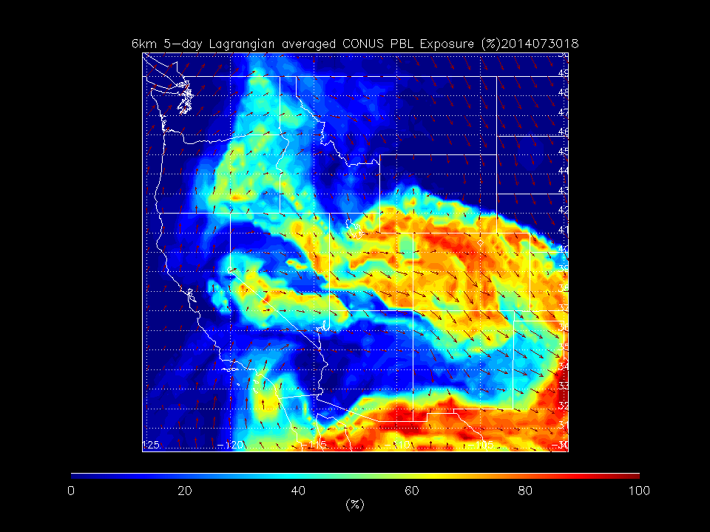
RAQMS Reverse Domain Filling (RDF) show that high PAN airmass over Fort Collins on 0730 had it’s origins within the Continental US boundary layer

Slide 18
July 16 – August 17, 2014 RR-Chem PAN timeseries
(Fort Collins, CO)
July 20: CONUS PBL
August 11:East Asian Transport
July 30: CONUS PBL
August 9: CONUS PBL
August 6: STE

Slide 19
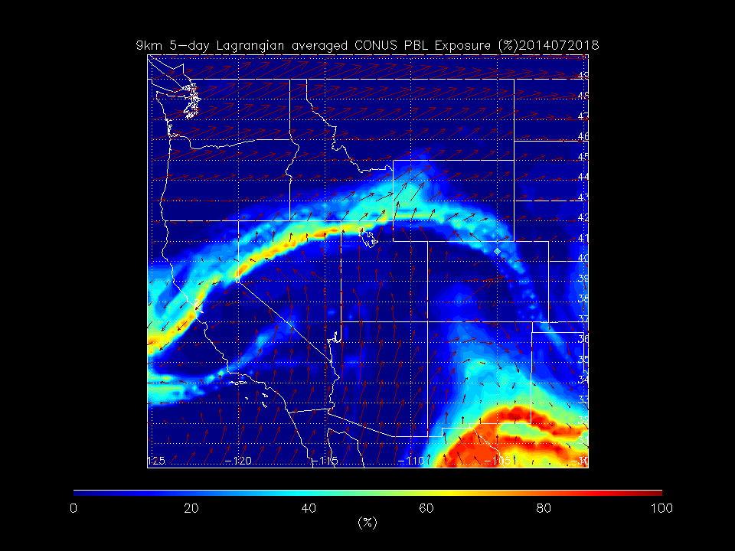
RAQMS Reverse Domain Filling (RDF) show that high PAN airmass over Fort Collins on 0720 had it’s origins within the Continental US boundary layer

Slide 20
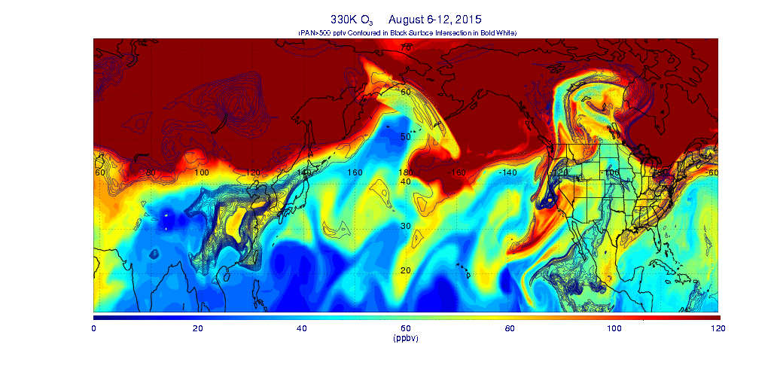
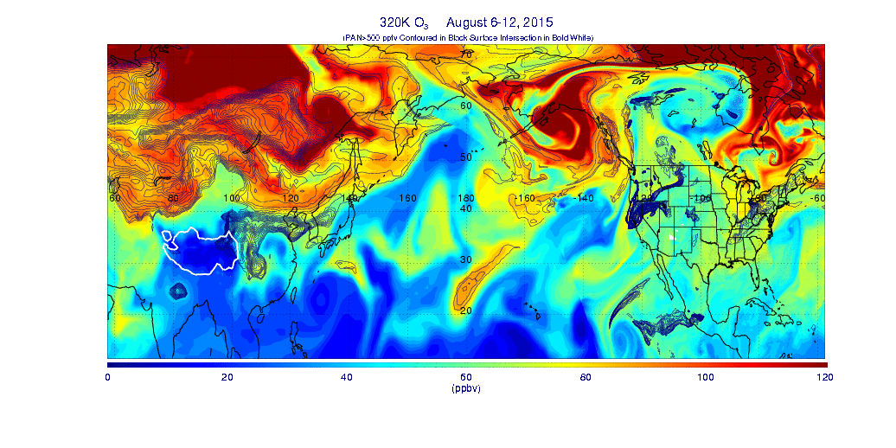
330K Nested
RAQMS/RR-CHEM
O3 (colored)
PAN (Black contours)
Surface intersection
(White)
320K Nested
RAQMS/RR-CHEM
O3 (colored)
PAN (Black contours)
Surface intersection
(White)
Discontinuity at LBC due to animation of RAQMS Analysis (forecast used in nesting)

Slide 21
Backup Slides

Slide 22
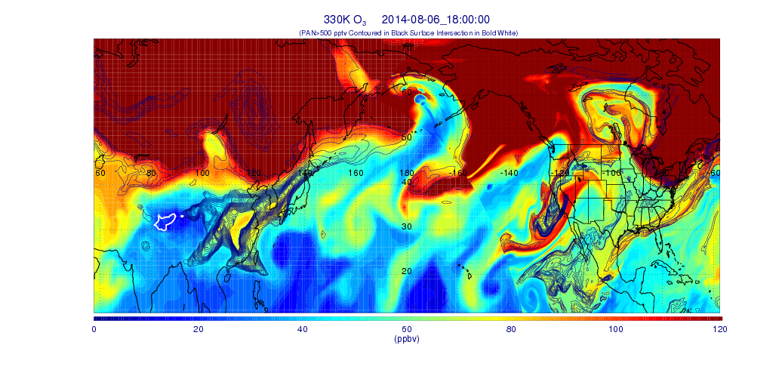
August 6: STE

Slide 23
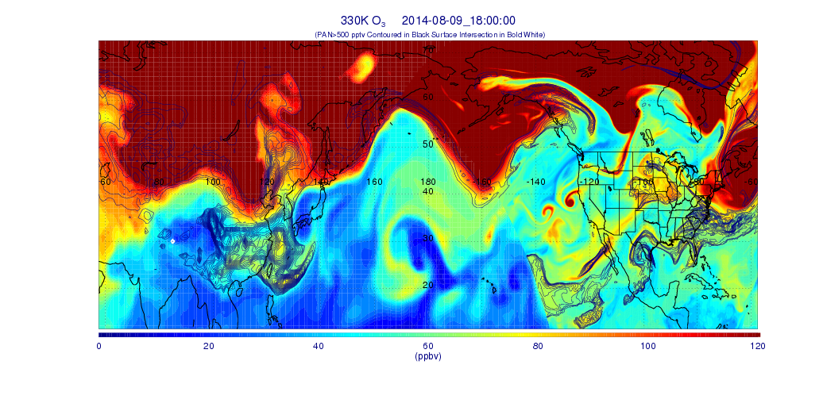
August 9: CONUS

Slide 24
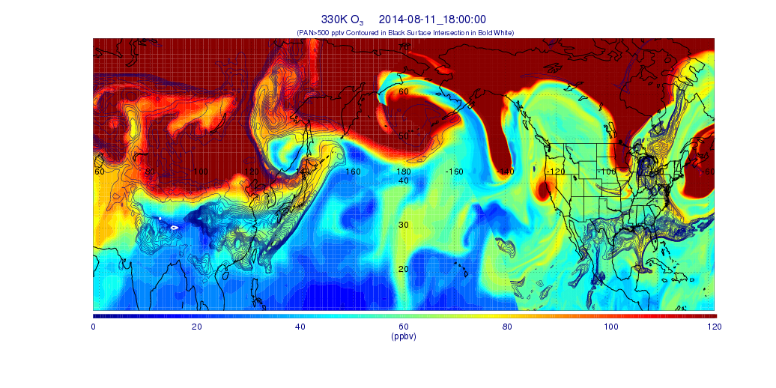
August 11: EASIA

