Slide 1
FIREX-AQ ER2/Satellite Telecon
June 28, 2019
Brad Pierce and Alexa Ross
UW-Madison SSEC
May 28-31 Canadian Wildfire event
VIIRS Highres AOD trajectories
NUCAPS CO trajectories
GOES-16/AirNow PM2.5 verification
June 24-25 VIIRS Highres “floater” domain demonstration

Slide 2
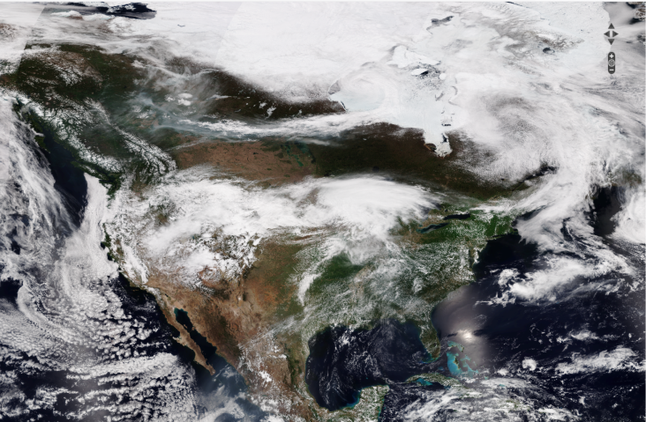
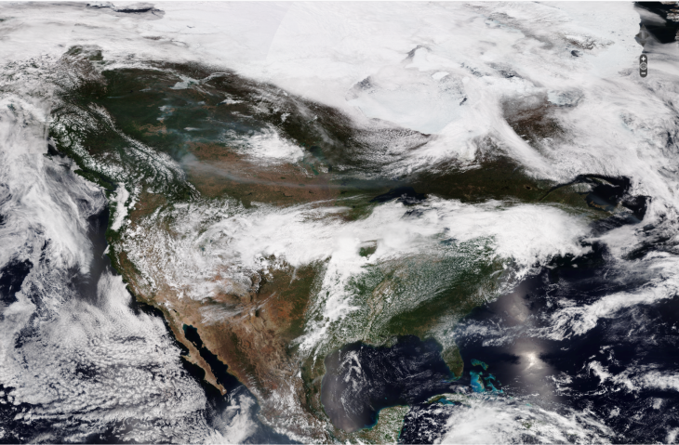
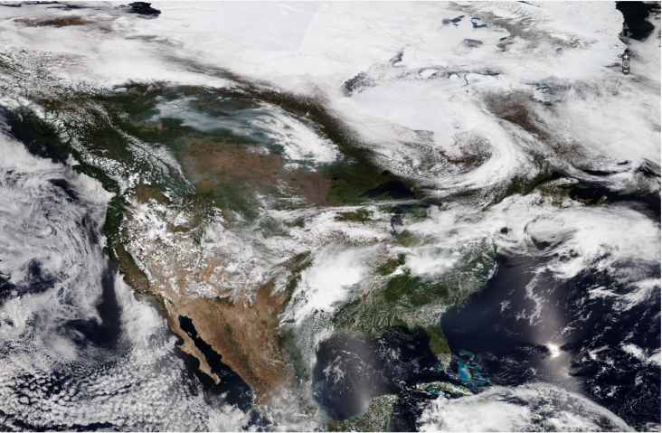
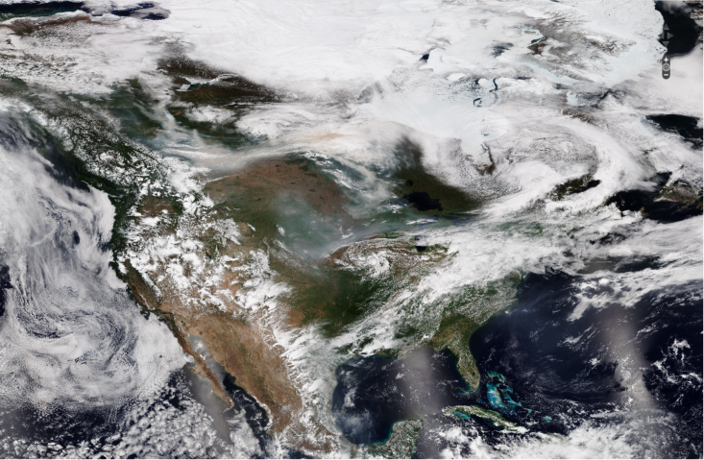
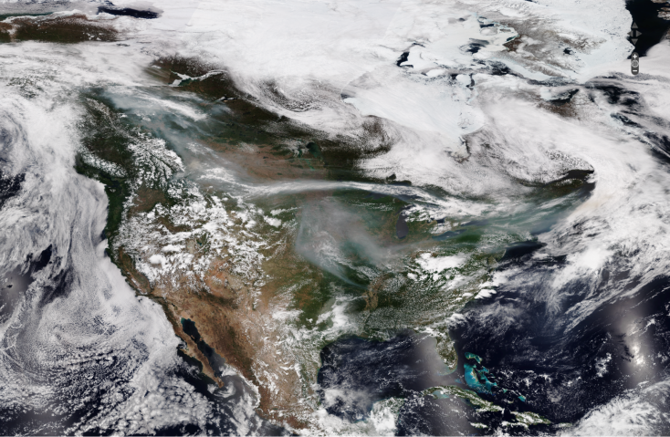
May 27, 2019
May 28, 2019
May 29, 2019
May 30, 2019
May 31, 2019
VIIRS True color image

Slide 3
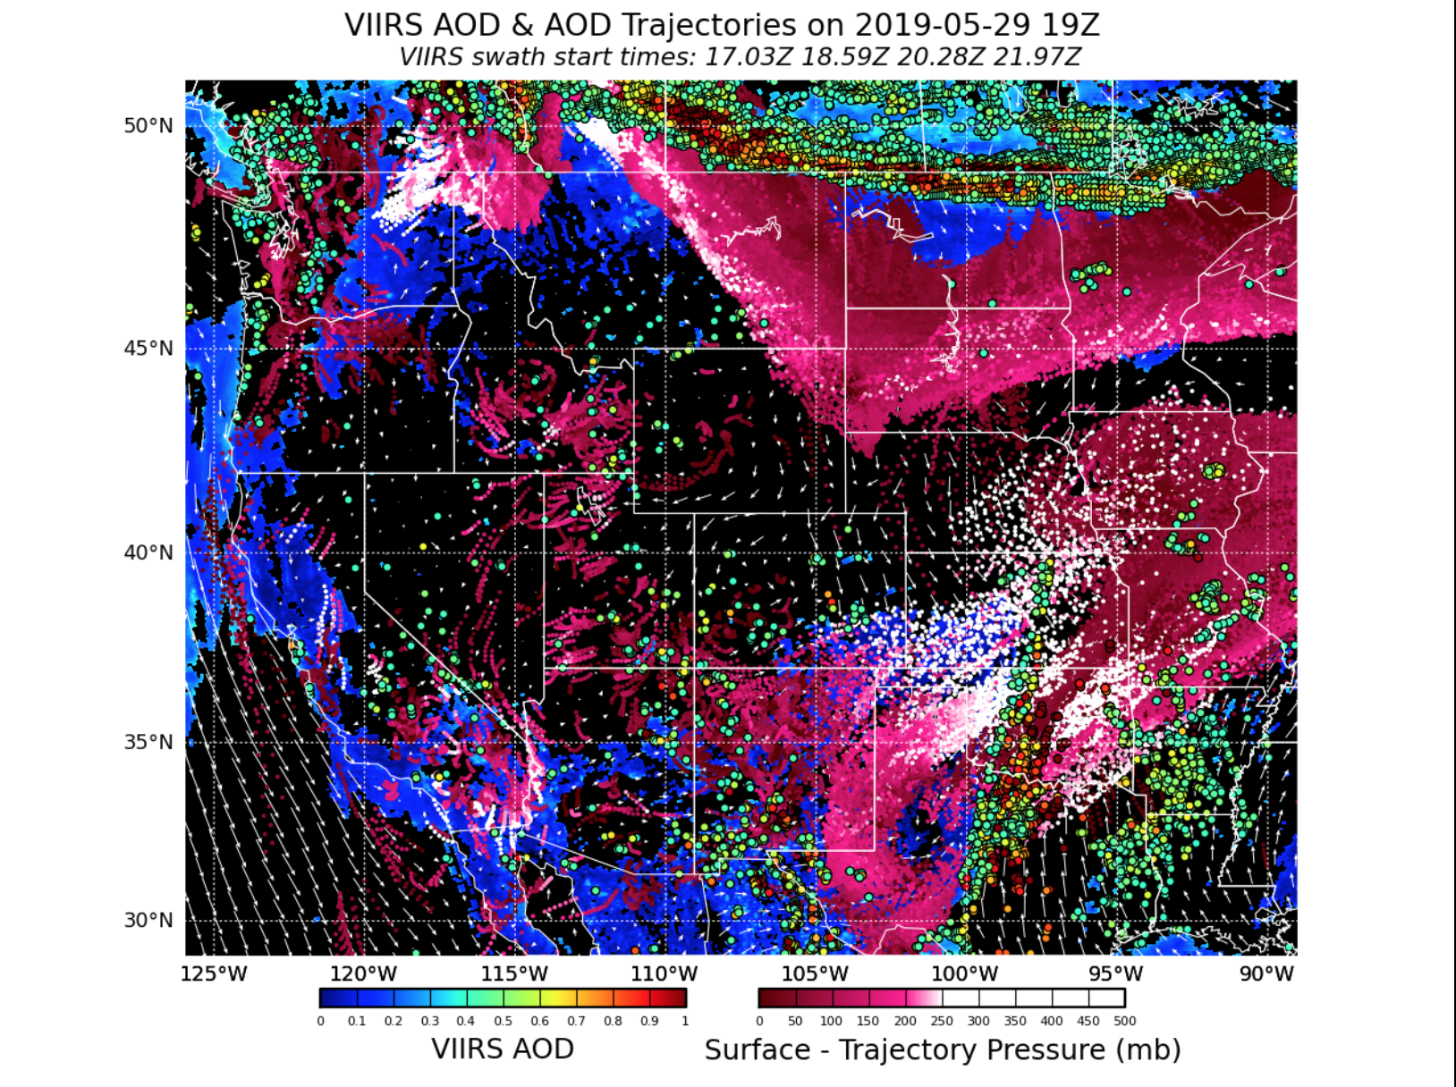
VIIRS AOD May 28, 2019
Large smoke events in southern Canada that will likely advect south into the Dakotas, and eastern Wyoming and Montana, as well as much of Minnesota
http://smoke.ssec.wisc.edu/idea-i-aerosolEntHR-live-test/
Notes:
24 and 48hr NUCAPS CO and 24hr VIIRS trajectory forecasts during last weeks smoke event
Add circle to smoke event forecast that I’m referencing. It’s assumed the aerosol is in the boundary layer. Because it’s “stretched” it’s likely getting pulled by the jet stream, indiciating it’s not actually in the boundary layer and is aloft.

Slide 4
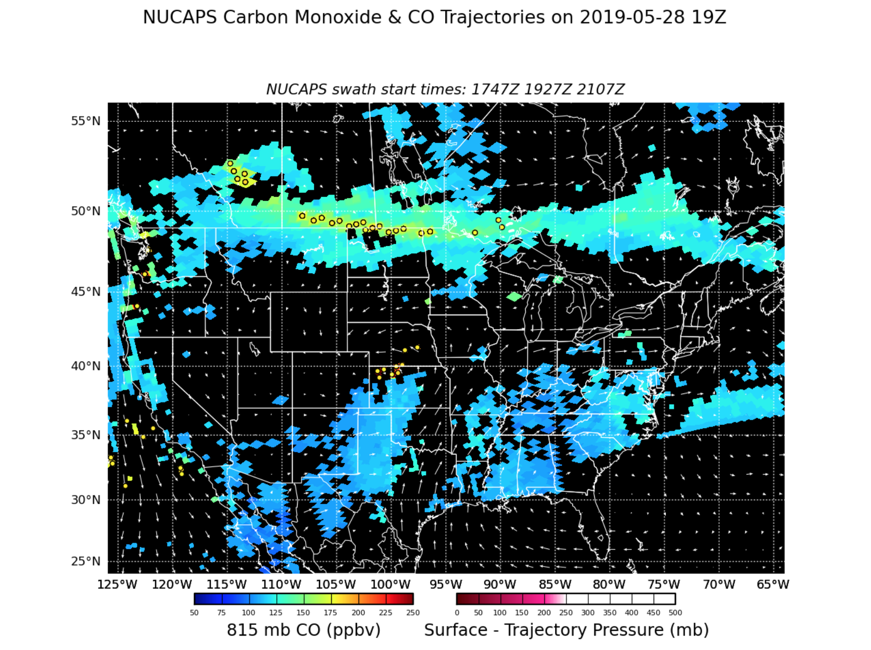
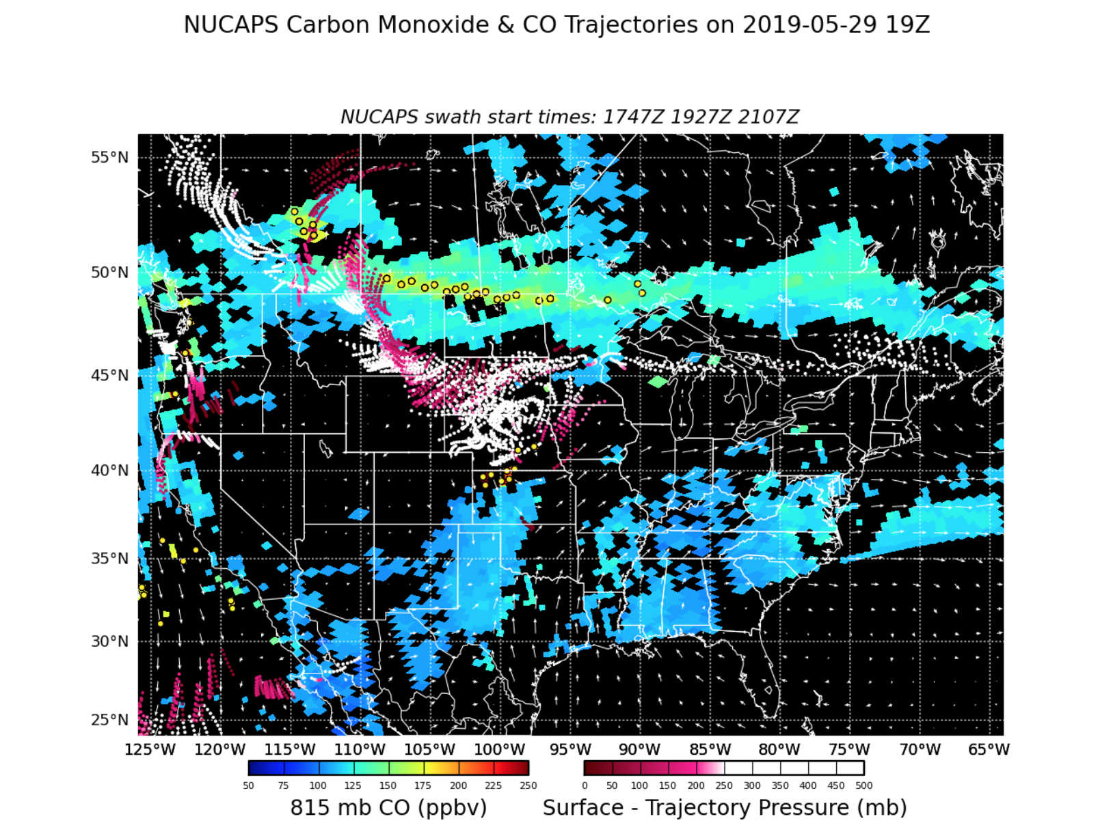
NUCAPS CO May 28, 2019
NUCAPS CO shows that Southern Canada CO plume is aloft and advecting westward and southward. Entrained into low pressure system causing spiral around South Dakota.
http://smoke.ssec.wisc.edu/idea-i-carbonmonoxide-live-test/
Notes:
Put NUCAPS after VIIRS forecast to see if they are consistent. The 24-hour forecast is too far south, looking at the data from the May 29 VIIRS.

Slide 5
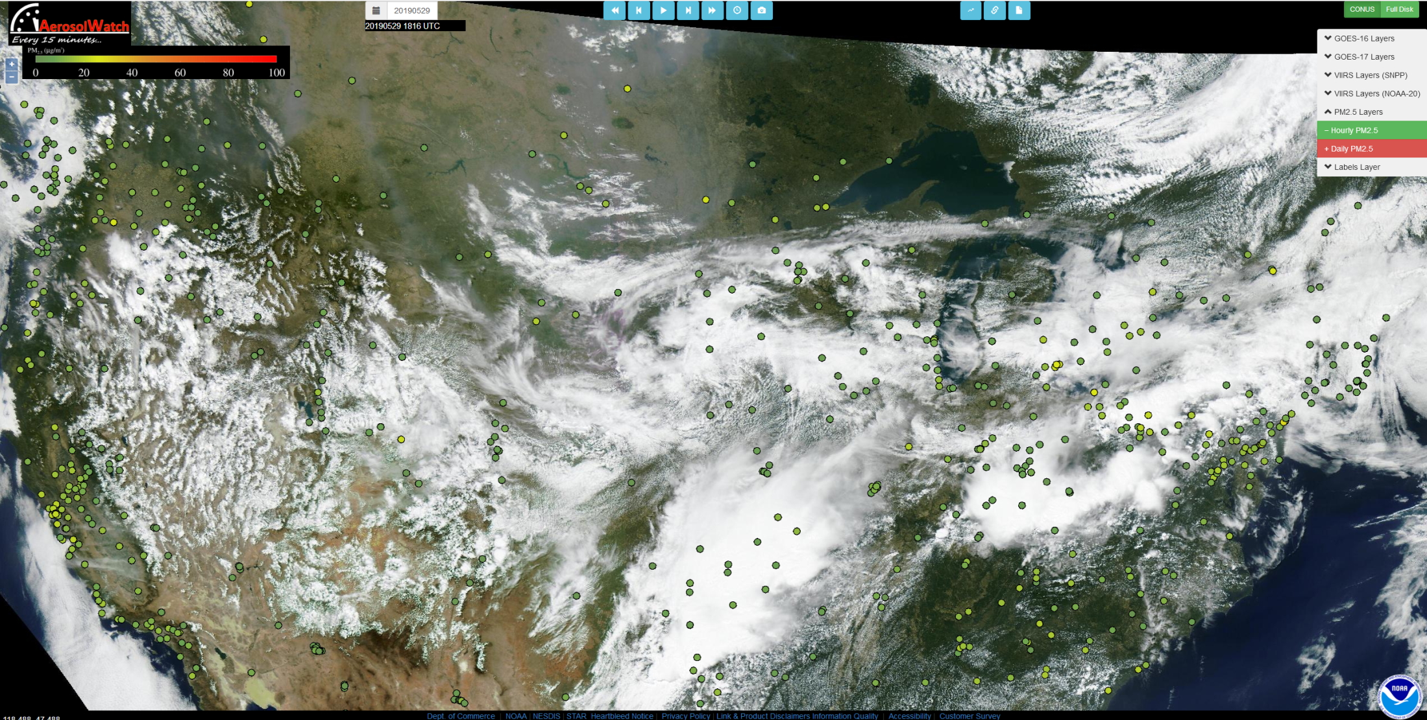
GOES-16 True Color Image with Surface PM2.5
18:16Z May 29, 2019
https://www.star.nesdis.noaa.gov/smcd/spb/aq/AerosolWatch/

Slide 6
GOES-16 True Color Image with Surface PM2.5
18:16Z May 29, 2019
https://www.star.nesdis.noaa.gov/smcd/spb/aq/AerosolWatch/

Slide 7
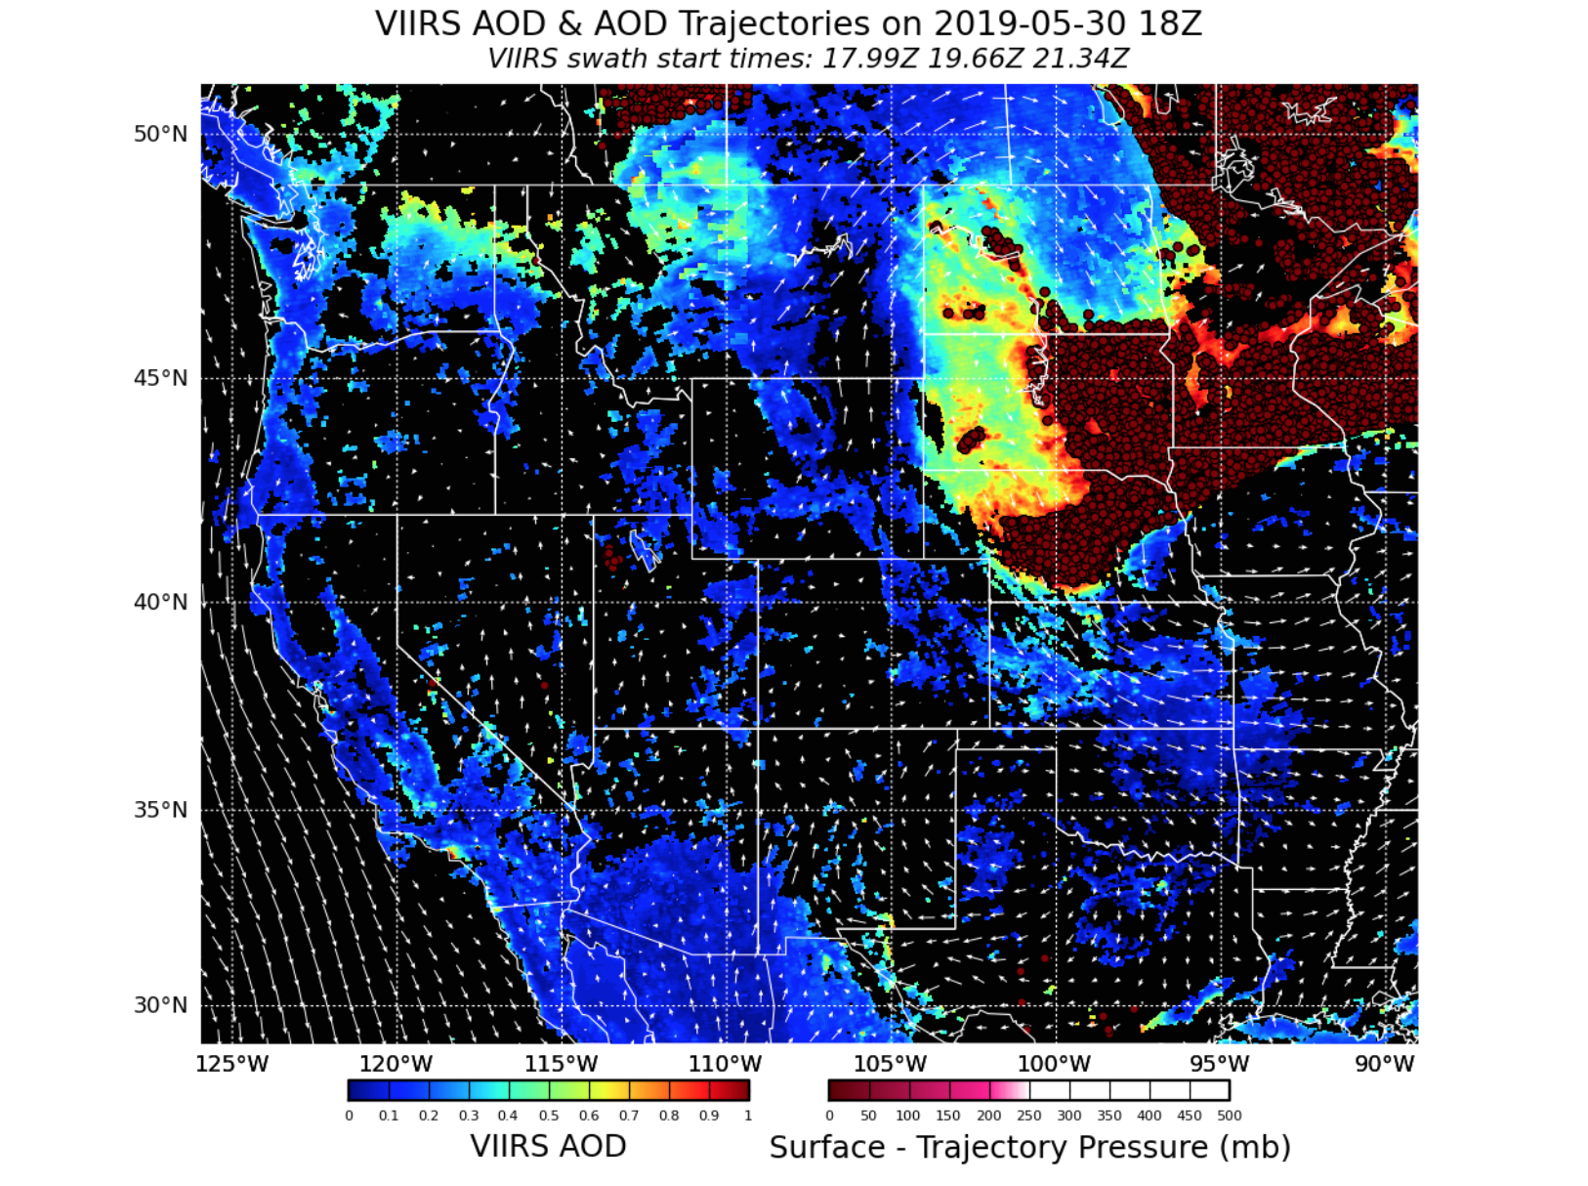
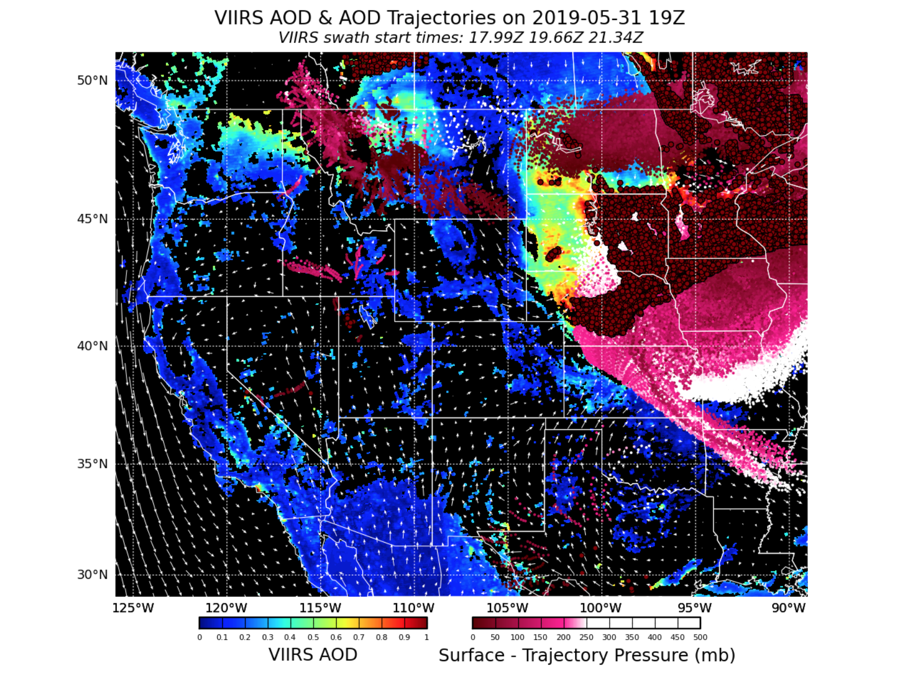
VIIRS AOD May 30, 2019
Extremely high AOD across the Midwest.

Slide 8
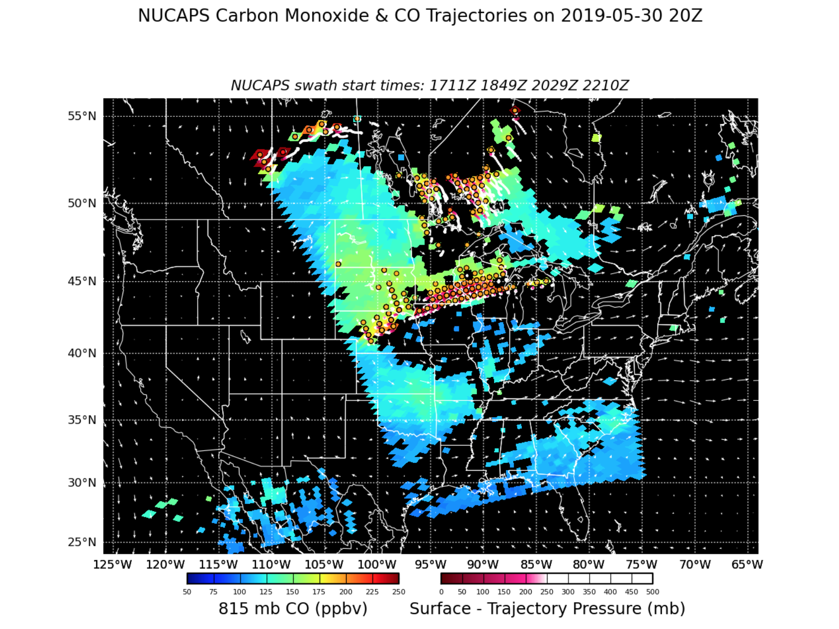
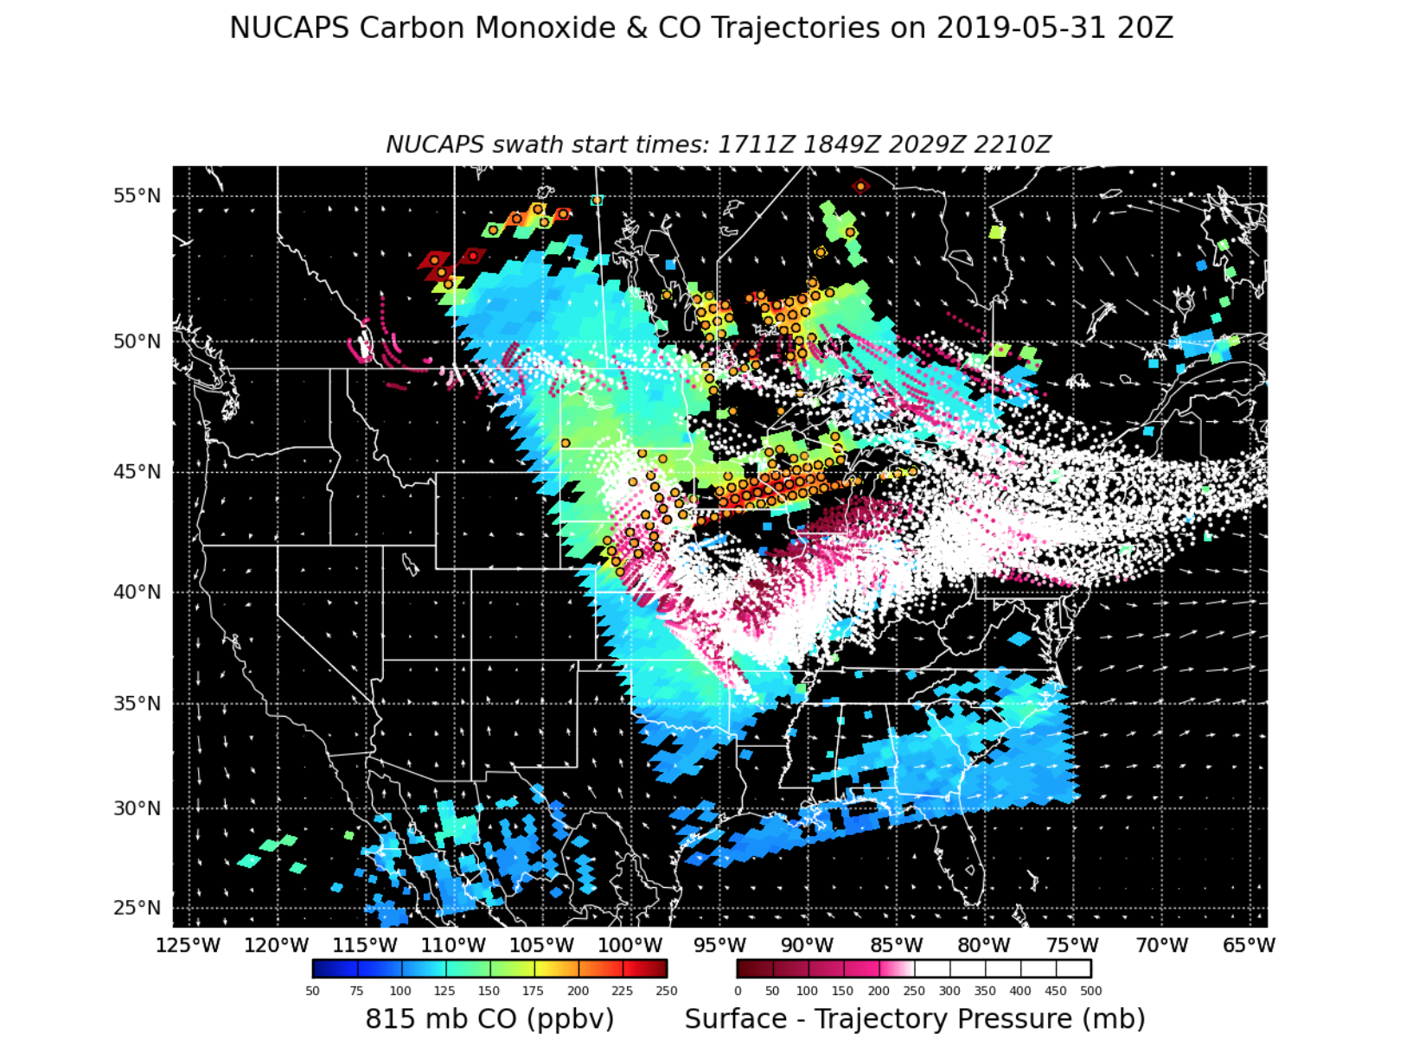
NUCAPS CO May 30, 2019
Very high near-surface CO in the Midwest; will advect southeastward.
Notes:
CO is mostly aloft

Slide 9
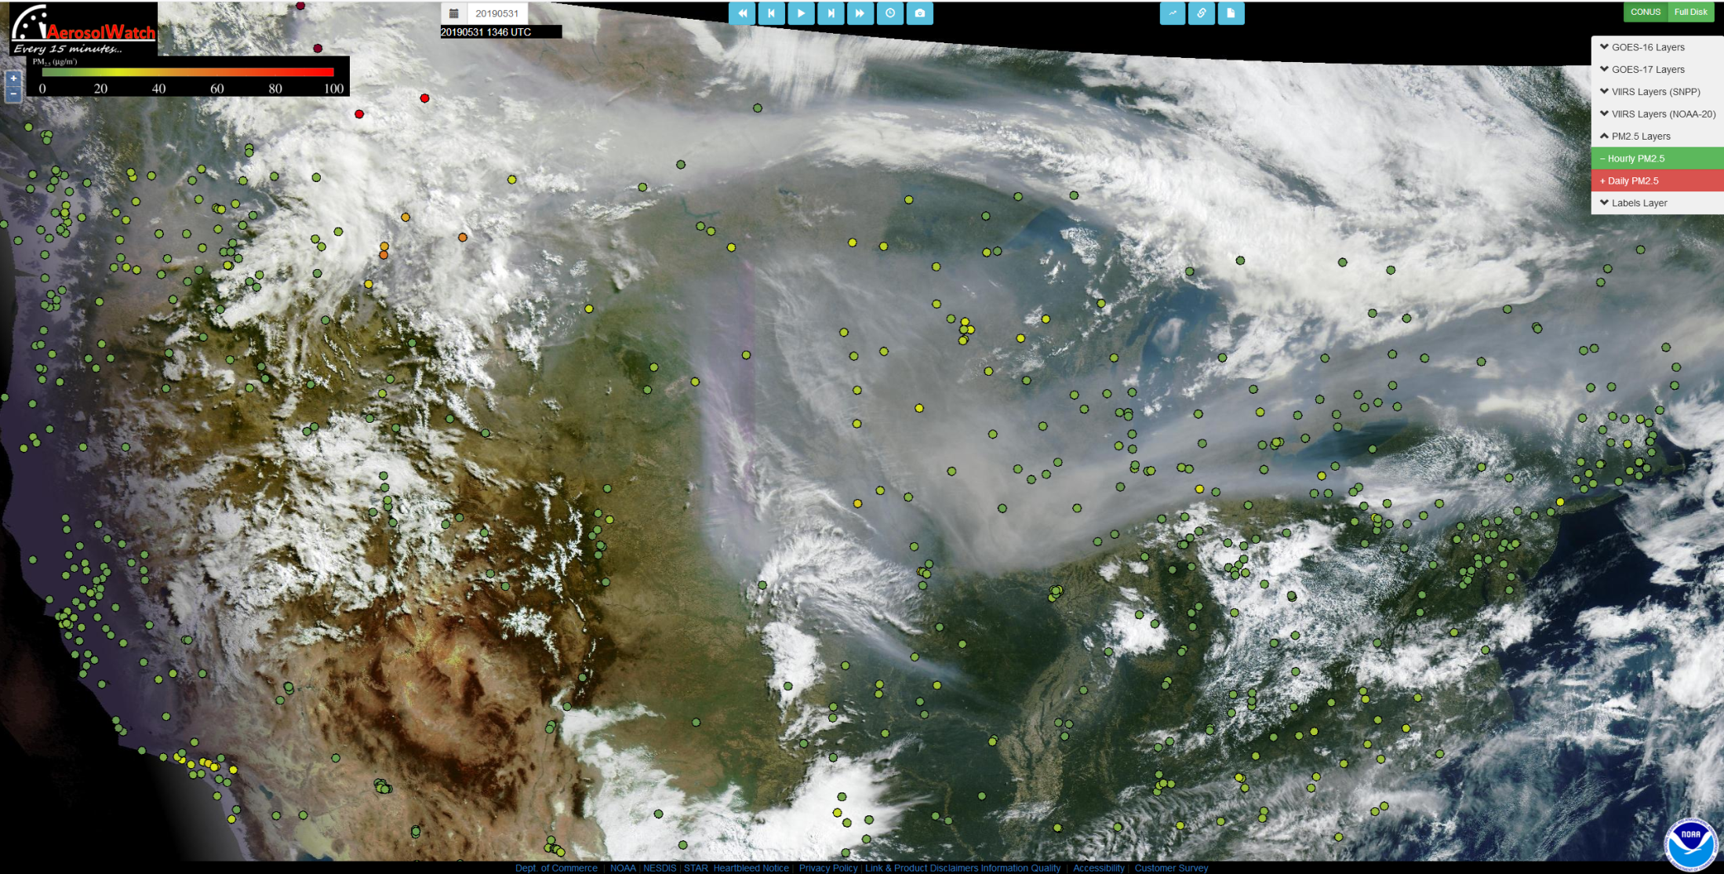
GOES-16 True Color Image with Surface PM2.5
13:46Z May 31, 2019

Slide 10
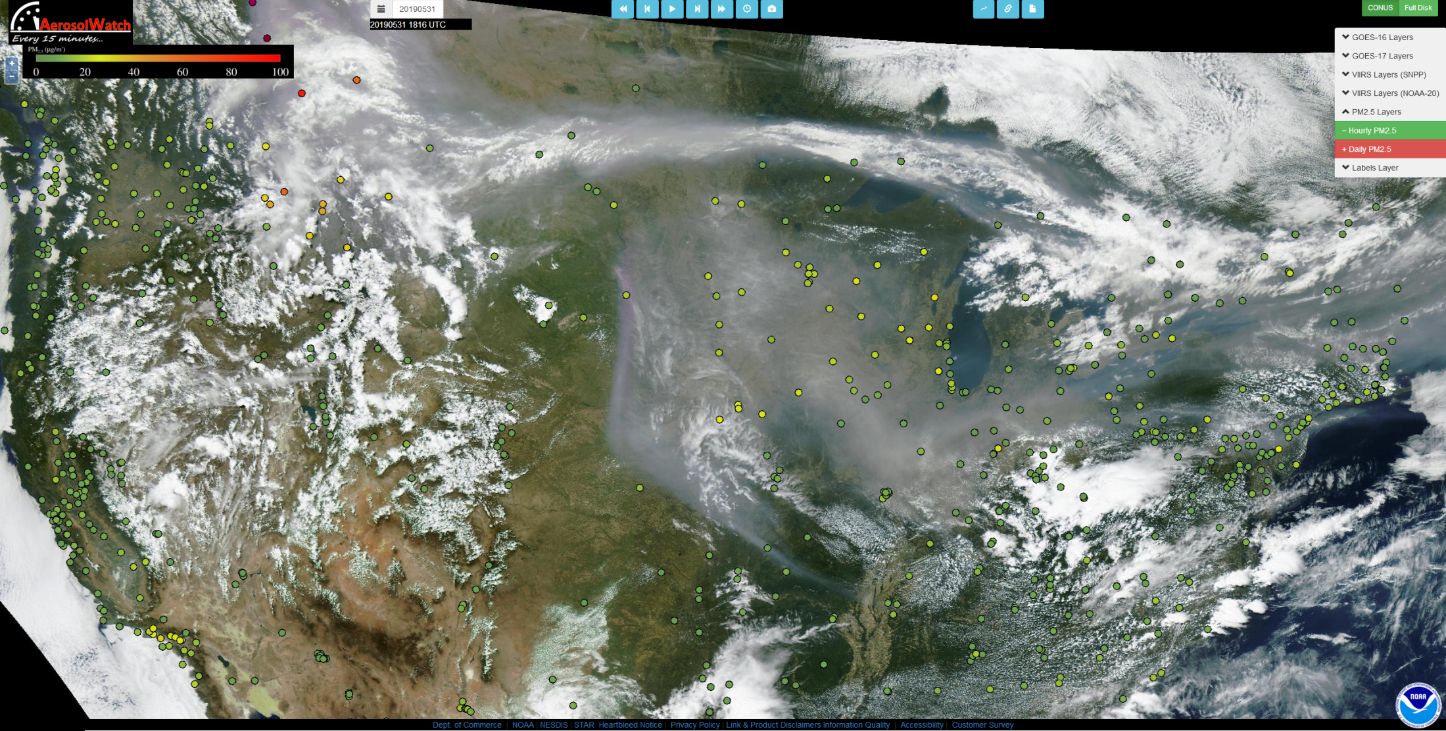
GOES-16 True Color Image with Surface PM2.5
18:16Z May 31, 2019

Slide 11
GOES-16 True Color Image with Surface PM2.5
18:16Z May 31, 2019

Slide 12
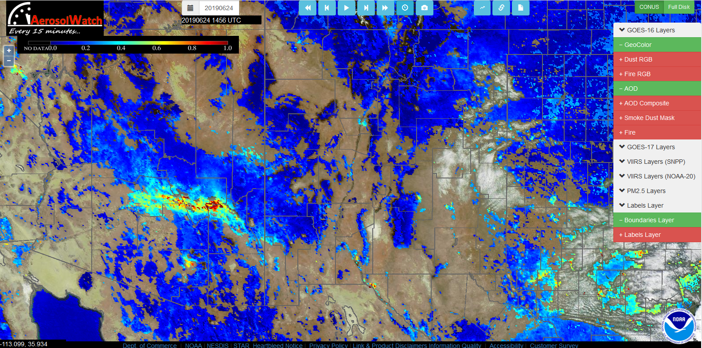
Using GOES-16 AerosolWatch AM AOD to determine VIIRS “floater” domain for 24hr high resolution trajectory forecasts

Slide 13
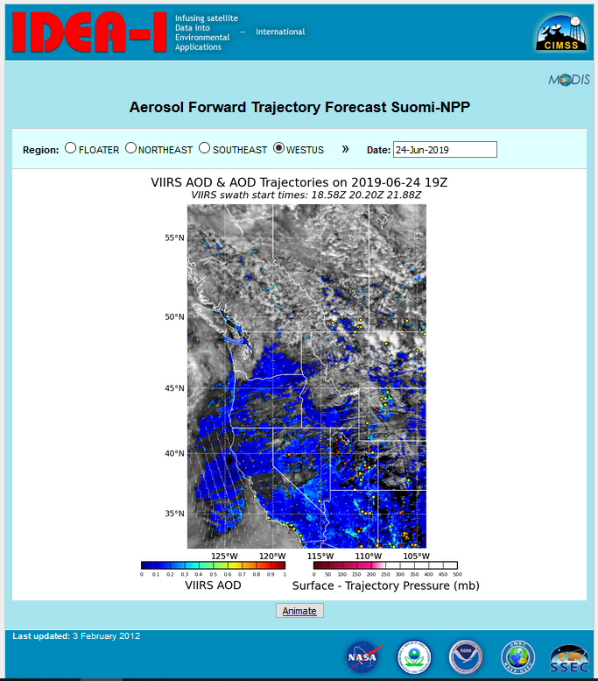

Slide 14
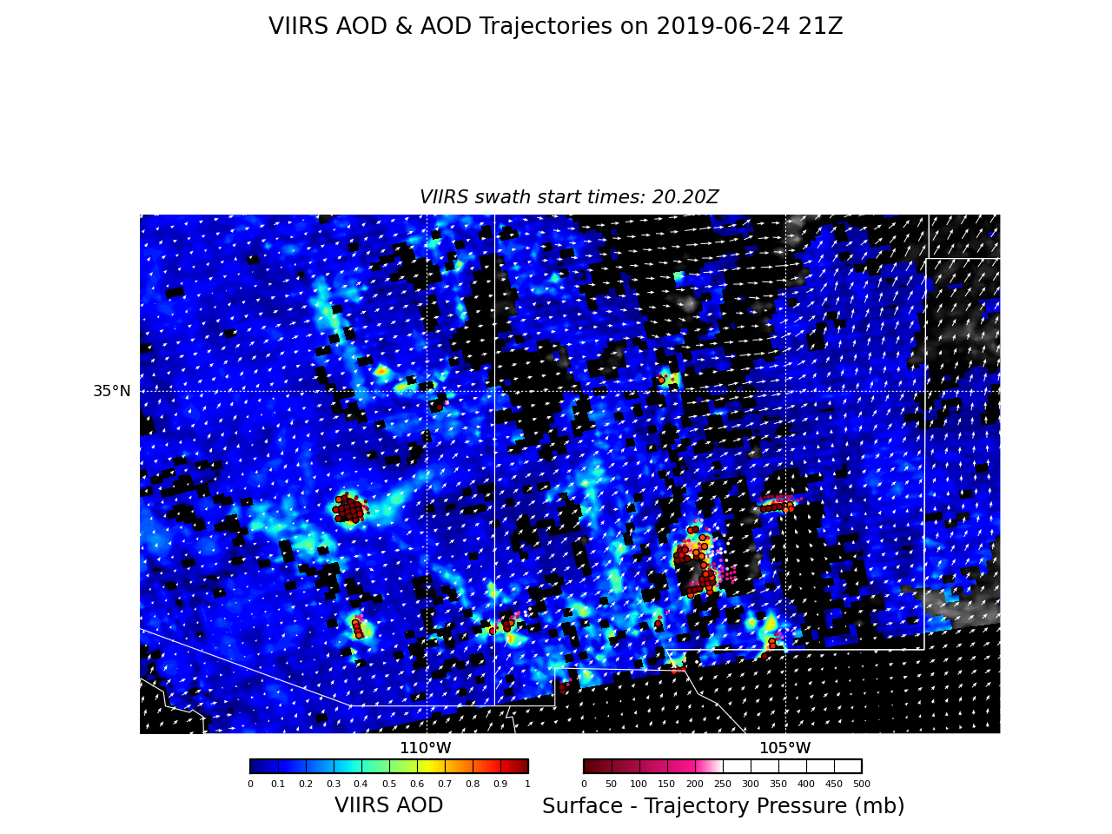

Slide 15
