Slide 1
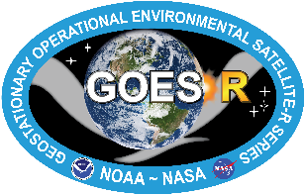
FIREX-AQ Science Objective for NESDIS Fire & Biomass Burning Emissions Team
Fire Detection and Fire Radiative Power
Smoke Detection Algorithm
VIIRS (SNPP & NOAA-20) and ABI (GOES-16 & GOES-17) detect smoke using spectral (visible and IR) brightness temperature differencing tests as well as aerosol indices calculated using 412 nm, 440 nm, and 2.25 µm for VIIRS.
MASTER observations can be used to evaluate the thresholds and their dependence on geometry used in the smoke detection algorithm.
F. Li, X. Zhang, S. Kondragunta, I. Csiszar, JGR, 2018
VIIRS detecting more fires than MODIS, especially as scan angle grows (a)
While total FRPs are similar (b), MODIS FRP is substantially larger than VIIRS as scan angle grows (c)
FIREX-AQ can help resolve this if fire detections, size, FRP are sampled in alignment to satellite overpass at nadir view and off-nadir view
Emissions Factors
NOAA xtended Global Biomass Burning Emissions Product (GBBEPx) algorithm uses emissions factors for different trace gases and PM2.5 based on literature
We will evaluate those values by comparing them to those derived based on measurements during FIREX-AQ

