Slide 1
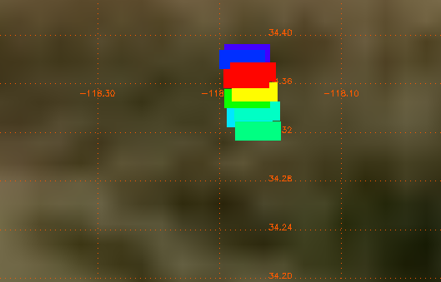
Present challenges with Satellite FRP observations
(Provided by Charles Ichoku and Luke Ellison)
Terra-MODIS: LocalTime=11:45 am, Scan Ang=1°, Npix=116, Total FRP=28879 MW
Example: MODIS observation of the 2009 Station Fire near JPL in Pasadena
What we need:
We need optimal instrumentation to better characterize and understand these fires at much higher resolutions than satellite measurements to get fire emissions right
Aqua-MODIS: LocalTime=1:25 pm, Scan Ang=51°, Npix=5, Total FRP=4814* MW
Analysis and Visualization by Luke Ellison
*This value is after removing duplicates

Slide 2
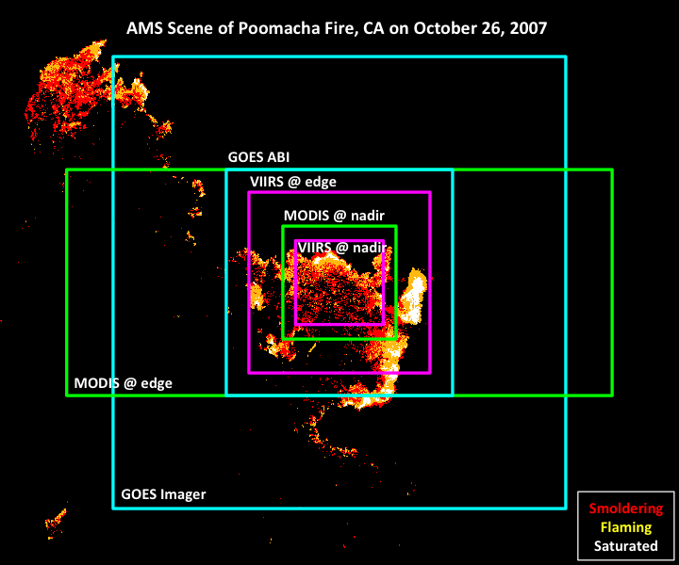
Different footprints
Satellite-Aircraft Synergy in Fire Energetics and Smoke Plume Observations
Provided by Charles Ichoku and Luke Ellison
Objectives
Detection of smaller fires that are missed by current fire-sensing systems and characterization of all fires to reduce scientific and operational uncertainties
Simultaneous determination of smoke plume heights to improve near real-time modeling of dispersion and impacts
Exaggerated Airborne pixel
Targeted Aircraft Instrumentation:
MASTER AirMSPI
eMAS
AVIRIS
HYTES
WASP

