Slide 1
Air Quality and Climate Change
Brad Pierce
(NOAA/NESDIS)
Forest County Potawatomi Community Climate Change Adaptation Workshop Crandon, WI June 28, 2016

Slide 2
Link Between Climate Change and Air Quality
Key Finding 1: Exacerbated Ozone Health Impacts
Climate change will make it harder for any given regulatory approach to reduce ground-level ozone pollution in the future as meteorological conditions become increasingly conducive to forming ozone over most of the United States [Likely, High Confidence].
Unless offset by additional emissions reductions, these climate-driven increases in ozone will cause premature deaths, hospital visits, lost school days, and acute respiratory symptoms [Likely, High Confidence].
Key Finding 2: Increased Health Impacts from Wildfires
Wildfires emit fine particles and ozone precursors that in turn increase the risk of premature death and adverse chronic and acute cardiovascular and respiratory health outcomes [Likely, High Confidence].
Climate change is projected to increase the number of naturally occurring wildfires in parts of the United States, increasing emissions of particulate matter and ozone precursors and resulting in additional adverse health outcomes [Likely, High Confidence]
Key Finding 3: Worsened Allergy and Asthma Conditions
Changes in climate, specifically rising temperatures, altered precipitation patterns, and increasing concentrations of atmospheric carbon dioxide, are expected to contribute to increasing levels of some airborne allergens and associated increases in asthma episodes and other allergic illnesses [High Confidence].
Fann, N., et al., 2016: Ch. 3: Air Quality Impacts. The Impacts of Climate Change on Human Health in the United States: A Scientific Assessment. U.S. Global Change Research Program, Washington, DC, 69–98. http://dx.doi.org/10.10.7930/J0GQ6VP6 (available on line at: https://health2016.globalchange.gov/air-quality-impacts )

Slide 3
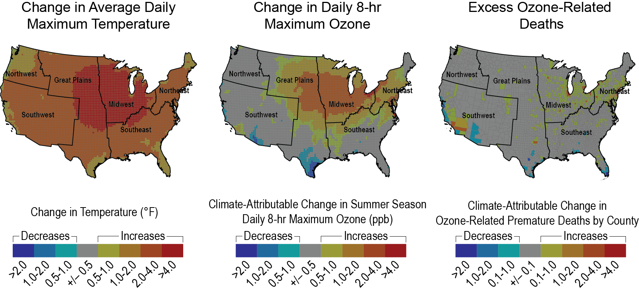
Key Finding 1: Exacerbated Ozone Health Impacts
Higher Emissions (RCP8.5, NCAR/DOE CESM)
Fann, N., et al., 2016: Ch. 3: Air Quality Impacts. The Impacts of Climate Change on Human Health in the United States: A Scientific Assessment. U.S. Global Change Research Program, Washington, DC, 69–98. http://dx.doi.org/10.10.7930/J0GQ6VP6 (available on line at: https://health2016.globalchange.gov/air-quality-impacts )

Slide 4
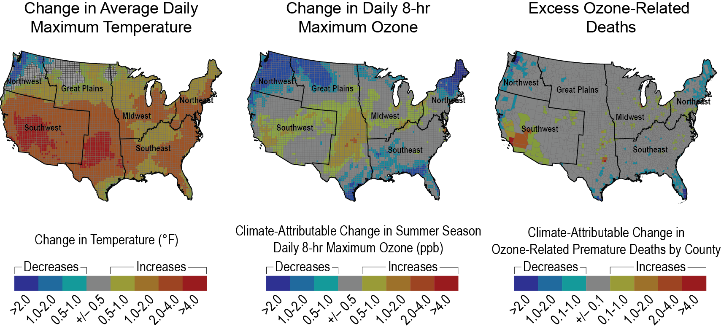
Key Finding 1: Exacerbated Ozone Health Impacts
Moderate Emissions (RCP6.0, NASA/GISS Modele2-R)
Fann, N., et al., 2016: Ch. 3: Air Quality Impacts. The Impacts of Climate Change on Human Health in the United States: A Scientific Assessment. U.S. Global Change Research Program, Washington, DC, 69–98. http://dx.doi.org/10.10.7930/J0GQ6VP6 (available on line at: https://health2016.globalchange.gov/air-quality-impacts )

Slide 5
American Lung Association “State of the Air”
Forest County Wisconsin 2016
Groups At Risk
Total Population: | 9,127
Pediatric Asthma: | 190
Adult Asthma: | 729
COPD: | 424
Cardiovascular Disease: | 650
Diabetes: | 754
Children Under 18: | 1,878
Adults 65 & Over: | 1,987
Poverty Estimate: | 1,519
The American Lung Association "State of the Air® 2016" (http://www.lung.org/our-initiatives/healthy-air/sota/)

Slide 6
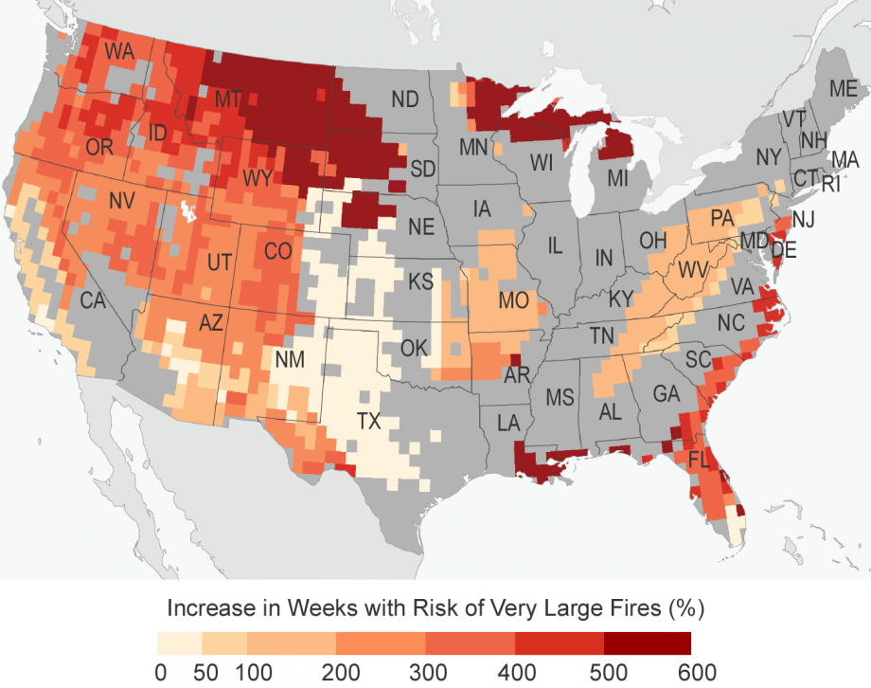
Key Finding 2: Increased Health Impacts from Wildfires
Very large fires (> 5000 ha)
Downscaled 1971-2000 vs 2014-2070 Representative Concentration Pathways 8.5 (RCP8.5) forcing experiments
Barbero, R. et al., Climate change presents increased potential for very large fires in the contiguous United States, International Journal of Wildland Fire 2015, 24, 892–899 http://dx.doi.org/10.1071/WF15083

Slide 7
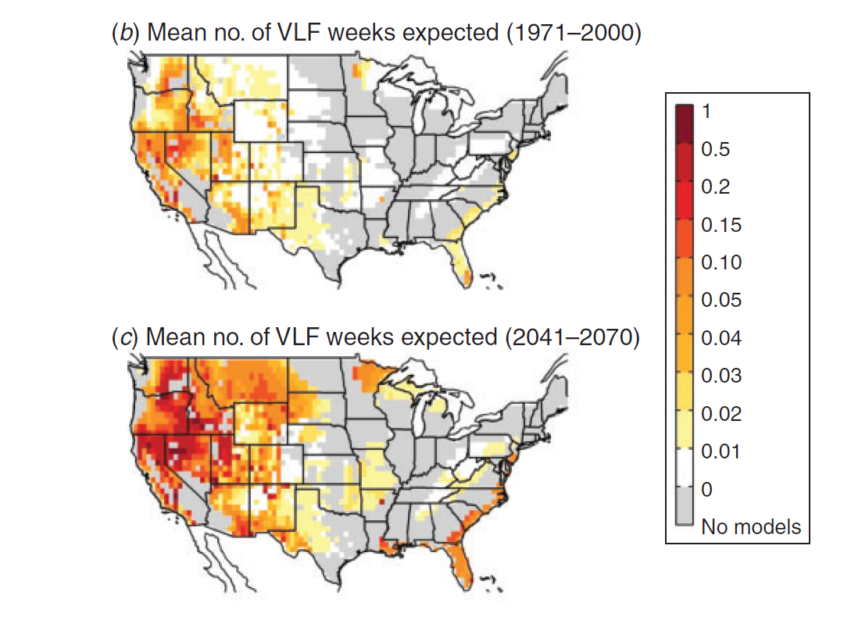
Key Finding 2: Increased Health Impacts from Wildfires
Very large fires (> 5000 ha)
Downscaled 1971-2000 vs 2014-2070 Representative Concentration Pathways 8.5 (RCP8.5) forcing experiments
Barbero, R. et al., Climate change presents increased potential for very large fires in the contiguous United States, International Journal of Wildland Fire 2015, 24, 892–899 http://dx.doi.org/10.1071/WF15083

Slide 8
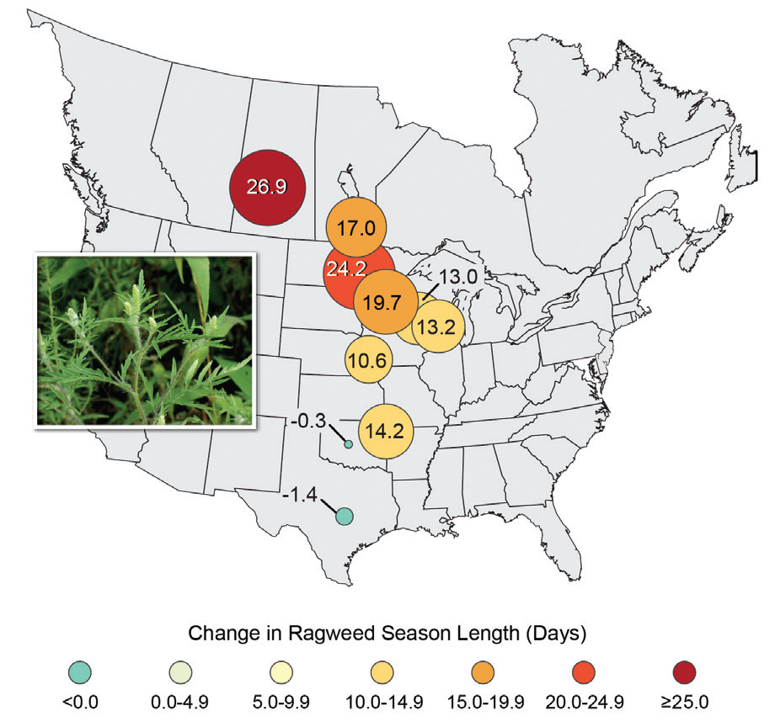
Key Finding 3: Worsened Allergy and Asthma Conditions
Ragweed pollen season length has increased in central North America between 1995 and 2011 by as much as 11 to 27 days in parts of the United States and Canada, in response to rising temperatures.
Melillo, J.M., T.C. Richmond, and G.W. Yohe, Eds., 2014: Climate Change Impacts in the United States: The Third National Climate Assessment. U.S. Global Change Research Program, Washington, D.C., 842 pp. http://dx.doi.org/10.7930/J0Z31WJ2

Slide 9
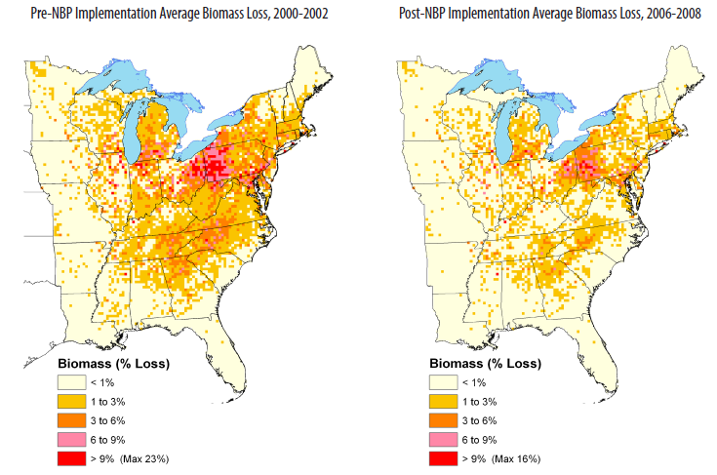
O3 impacts on forests
Ozone is considered the most important phytotoxic (directly toxic to plants) air pollutant affecting growth and health of forests and agricultural crops.
Negative O3 impacts on plants include chlorophyll damage, lowered stomatal conductance, premature senescence of foliage, and lower root mass
Estimated Black Cherry, Yellow Poplar, Sugar Maple, Eastern White Pine, Virginia Pine, Red Maple, and Quaking Aspen Biomass Loss for Pre (left) and Post (right) NOₓ Budget Trading Program (NBP) time periods (U.S. EPA, 2009b)
https://www3.epa.gov/ttnecas1/regdata/RIAs/s4-supplemental_analysis-secondary_standard11-5-09.pdf

Slide 10
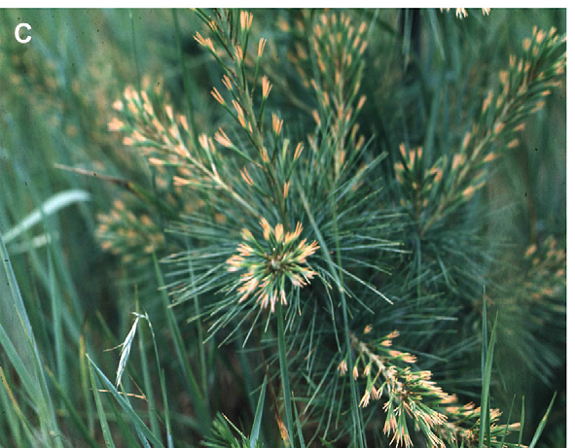
O3 Damage: Eastern White Pine
Tipburn symptoms of O3 exposure on eastern white pine from ambient air in southern Wisconsin
Karnosk, D. F., et al., 2007, Environmental Pollution 147 (2007) 489-506)

Slide 11
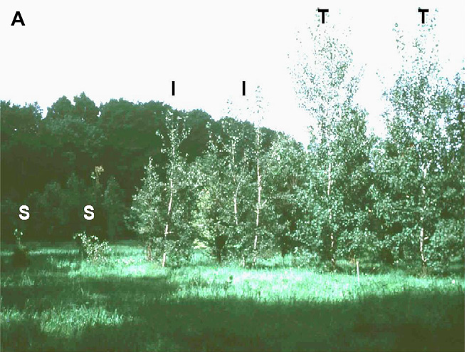
O3 Damage: Aspen
Effects of ambient O3 on aspen tree growth for three southern Wisconsin clones growing in southern New York where O3 levels are quite high. The two tree plots represent 10-year-old sensitive (left), intermediate (middle) and tolerant (right) genotypes that grew at similar rates under low O3 exposure in southern Wisconsin
Karnosk, D. F., et al., 2007, Environmental Pollution 147 (2007) 489-506)

Slide 12
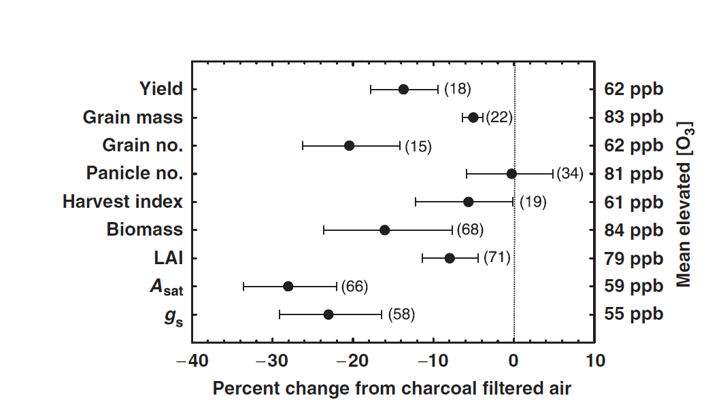
O3 Damage: Rice
Domestic rice responses to elevated ozone. Symbols represent the percent change at elevated CO2 and are surrounded by 95% confidence intervals. The mean treatment O3 concentrations for each variable are given on the right axis and degrees of freedom for each agronomic or physiological parameter are given in parentheses.
Ainsworth, E., 2008, Rice production in a changing climate: a meta-analysis of responses to elevated carbon dioxide and elevated
ozone concentration, Global Change Biology (2008) 14, 1642–1650, doi: 10.1111/j.1365-2486.2008.01594.

Slide 13
O3 Damage: Sugar Maple
Leaves exposed to high O3 showed symptoms of ozone toxicity including interveinal leaf bleaching and early leaf senescence.
The rate of CO2 assimilation of seedlings in the high-O3 treatment was lower than that of seedlings in the low-O3 treatment
Exposure to high ozone concentrations shifted the seasonal cycle so that cold acclimation of the stems occurred earlier in the fall and swelling of buds occurred earlier in the following spring.
  Early bud swelling in spring could increase bud sensitivity to late winter frost.
Ozone exposure during a single growing season did not lower the freezing tolerance of stems of maple seedlings during the critical periods of cold acclimation and de-acclimation.
  The reduced capacity to assimilate carbon as a result of an ozone induced decrease in photosynthetic rate could have a major impact on tree growth and freezing tolerance if the trees are subjected to chronic exposure to O3 for several years.
Bertrand, A. et al., 1999, Influence of ozone on cold acclimation in sugar maple seedlings, Tree Physiology 19, 527--534

Slide 14
Protect Yourself from Unhealthy Air
Check daily air pollution forecasts in your area. (https://www.airnow.gov/)
Avoid exercising outdoors when pollution levels are high. Limit the amount of time your child spends playing outdoors if the air quality is unhealthy.
Avoid exercising near high-traffic areas. Even when air quality forecasts are green, the vehicles on busy highways can create high pollution levels up to one-third mile away.
Use less energy in your home. Check U.S. Environmental Protection Agency's tips for conserving energy (https://www3.epa.gov/climatechange/wycd/home.html).
Reduce school bus emissions. Many school systems are using the U.S. EPA's Clean School Bus Campaign (https://www.epa.gov/cleandiesel/clean-school-bus)
Don't burn wood or trash. Burning firewood and trash are among the major sources of particle pollution (soot) in many parts of the country (https://www.epa.gov/residential-wood-heaters)
Use hand-powered or electric lawn care equipment rather than gasoline-powered. Don't allow anyone to smoke indoors and support measures to make all public places tobacco free.
The American Lung Association "State of the Air® 2016"

Slide 15

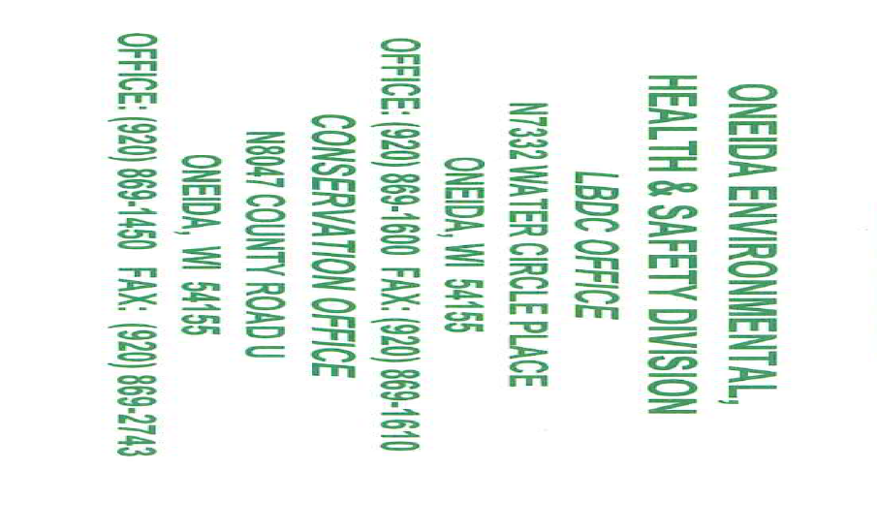
Oneida Nation Climate Change Focus
Strategically align the organization
  Every department will include climate change in budget requests and strategic planning.
  No cost – use existing staff
Balanced Scorecard model
This is not about prevention, we need to adapt
Not short term – fix and get back to normal
New normal – adaptation and mitigation
https://www.epa.gov/sites/production/files/2015-08/documents/9-jeff-mears-oneida-nation-ofwiscon.pdf (contact: Jeff Mears, Environmental Area Manager Oneida Nation)

Slide 16
Current Air Quality
2015 NAAQS
Wisconsin Department of Natural Resources, Wisconsin Air Quality Trends, December 2015 http://dnr.wi.gov/files/PDF/pubs/am/AM534.pdf

