Slide 1
All, Currently there's an upper level system affecting the western U.S. As this system slowly moves northeast, the potential for elevated ozone from at least one SI exists for the rest of today into tomorrow. As the upper low continues moving east, another SI will be possible Friday/Saturday of this week. Several monitors in Wyoming experienced elevated (1-hour values of 60's pbb) yesterday as a result of an SI filament moving over Wyoming. Attached are the 15UTC, 6/19 TCO and Band-12 GOES images. Just an fyi, Ryan
Ryan McCammon, Upper Green Data Analyst/Meteorologist State of Wyoming DEQ - Air Quality Division - Monitoring Section 122 West 25th St, Herschler Bldg 2 East Cheyenne, WY 82002

Slide 2
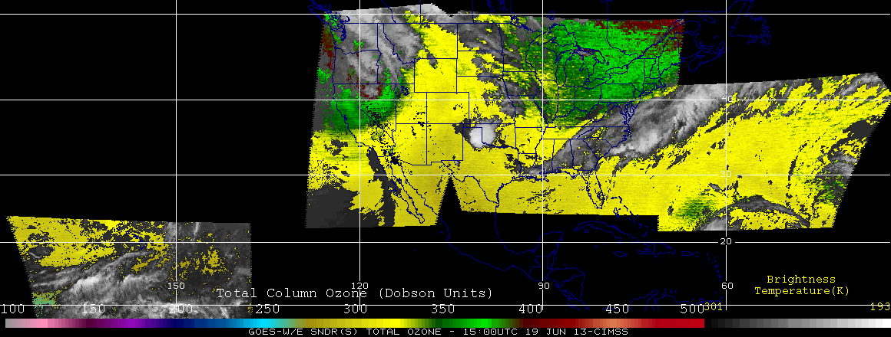

Slide 3
